Slide 1
UNIT 3 Topics 3.1-3.4
AMSCO Chpt. 8 pg. 260-292
Required Court Cases
Engel v. Vitale, pg. 268
Wisconsin v. Yoder, pg. 271
Tinker v. Des Moines, pg. 277
Schenck v. U.S., pg. 281
New York Times v. U.S. pg. 286
The Bill of Rights and the First Amendment

Slide 2
TOPIC 3.1 The Bill of Rights
Provisions of the U.S. Constitution’s Bill of Rights are continually being interpreted to balance the power of government and the civil liberties of individuals
Explain how the U.S. Constitution protects individual liberties and rights | The U.S. Constitution includes a Bill of Rights specifically designed to protect individual liberties and rights
Describe the rights protected in the Bill of Rights. | Civil liberties are constitutionally established guarantees and freedoms that protect citizens, opinions, and property against arbitrary government interference. The application of the Bill of Rights is continuously interpreted by the courts REQUIRED FOUNDATIONAL DOCUMENT - The Constitution of the United States The Bill of Rights consists of the first ten Amendments to the Constitution, which enumerate the liberties and rights of individuals

Slide 3
BILL OF RIGHTS AND THE STATES
BILL OF RIGHTS
Added to the original Constitution to appease states. Demanded by the Anti-Federalists
Rights of the individuals and states listed to protect them from the federal government
Bill of Rights only applied to the federal government and did not include protections against state governments (Barron v. Baltimore, 1833)
– Belief was that people could protect themselves against the state governments that were in their own backyards, but they needed additional protection against a new, powerful, and distant national gov’t. Each state had its own bill of rights to protect their citizenry from the state govt.

Slide 4
TOPIC 3.2 First Amendment: Freedom of Religion
Provisions of the U.S. Constitution’s Bill of Rights are continually being interpreted to balance the power of government and the civil liberties of individuals
Explain the extent to which the Supreme Court’s interpretation of the First and Second Amendments reflects a commitment to individual liberty | The interpretation and application of the First Amendment’s establishment and free exercise clauses reflect an ongoing tension between government power to make law and an individual’s right to religious freedom. Engel v. Vitale (1962), which declared school sponsorship of religious activities violates the establishment clause Wisconsin v. Yoder (1972), which held that compelling Amish students to attend school past the eighth grade violates the free exercise clause REQUIRED FOUNDATIONAL DOCUMENT The Constitution of the United States Engel v. Vitale (1962) Wisconsin v. Yoder (1972

Slide 5
TOPIC 3.2 First Amendment: Freedom of Religion
Provisions of the U.S. Constitution’s Bill of Rights are continually being interpreted to balance the power of government and the civil liberties of individuals
Explain the extent to which the Supreme Court’s interpretation of the First and Second Amendments reflects a commitment to individual liberty | The interpretation and application of the First Amendment’s establishment and free exercise clauses reflect an ongoing debate over balancing majoritarian religious practice and free exercise, as represented by such cases as: Engel v. Vitale (1962), which declared school sponsorship of religious activities violates the establishment clause Wisconsin v. Yoder (1972), which held that compelling Amish students to attend school past the eighth grade violates the free exercise clause REQUIRED FOUNDATIONAL DOCUMENT The Constitution of the United States REQUIRED SUPREME COURT CASES Engel v. Vitale (1962) § Wisconsin v. Yoder (1972

Slide 6
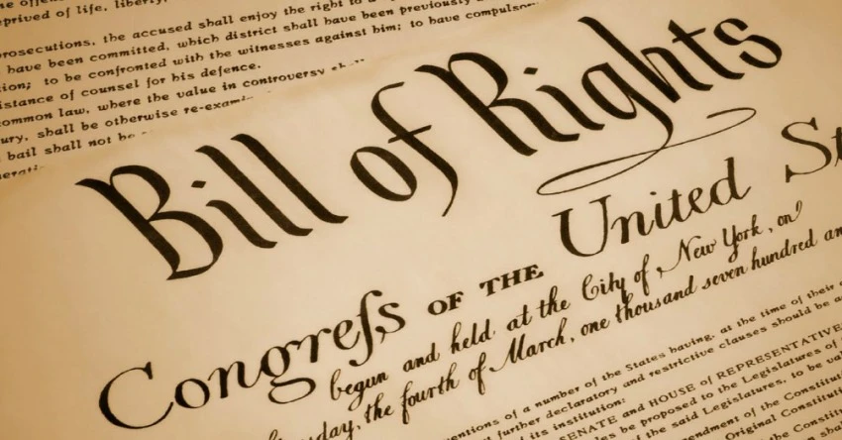
1st Amendment US Constitution Church & State
3.2 First Amendment Freedom of Religion
Religion
Assembly
Press
Petition
Speech
Congress shall make no law respecting an establishment of religion or prohibiting the free exercise thereof; or abridging the freedom of speech, or of the press; or the right of the people peaceably to assemble, and to petition the government for a redress of grievances.

Slide 7
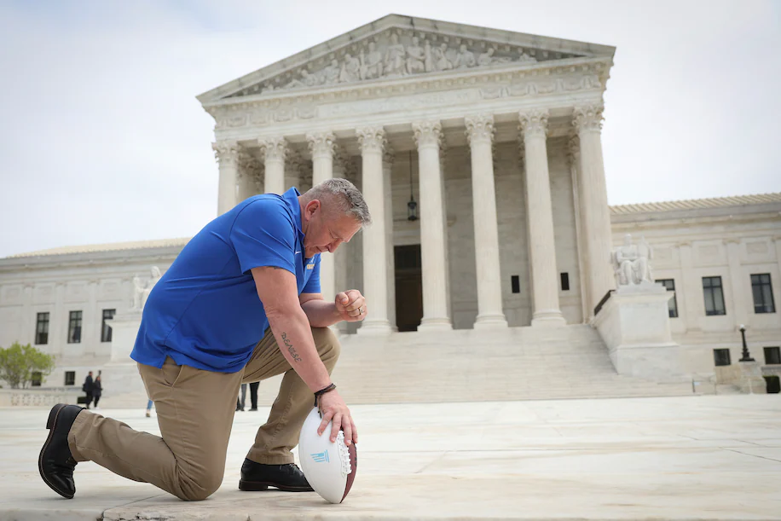
Is this legally allowed at public high school games?
What if the HS football coach prayed on the field after a game?
The Supreme Court ruled Monday that a school board in Washington state discriminated against a former football coach when it disciplined him for postgame prayers at midfield, the high court’s latest decision favoring the protection of religious faith over concerns about government endorsement of religion.
Published June 27, 2022 at 10:12 a.m. EDT
https://www.washingtonpost.com/politics/2022/06/27/supreme-court-praying-football-coach/

Slide 8
1st Amendment - Freedom of Religion
TWO CLAUSES THAT YOU MUST KNOW
The Establishment Clause
The Separation of Church and State
“Congress shall make no law respecting the establishment of religion…”
Engle v. Vitale, 1962
The Free Exercise Clause
Free to practice your religion
“… or prohibiting the free exercise thereof”
Wisconsin v. Yoder, 1972

Slide 9
FREEDOM OF RELIGION - THE ESTABLISHMENT CLAUSE
No Government “Establishment of Religion”
– A “wall of separation” - Separation of church and state (words of Jefferson; it is implied within 1st Amendment, but not stated – kind of like “fair trial”)
Lemon v. Kurtzman: Established a 3-part test (the Lemon test) to determine the constitutionality of a statute or practice:
Laws should have a secular (non-religious) purpose
Laws should be neutral toward religion (neither advance nor inhibit religion)
Laws should not be entangled with religion. If any is present, the statute or practice is unconstitutional. Avoid creating a relationship between religion and government that entangles either in the internal affairs of the other. EXCESSIVE ENTAGLEMENT
Basic meaning of establishment clause: government may not establish an official religion.
“Accomodationist View”: Government should bend a bit and allow a certain degree of church/state blending (allowing nativity scenes on city property, and allowing a non-denominational prayer in public school)
“Separationist View”: Government should allow virtually no blending of church and state. There should be a “wall of separation” between the two.
5

Slide 10
SCHOOLS AND RELIGION
ACTIVITIES NOT PERMITTED:
State-sponsored, recited prayer in public school is unconstitutional
Teacher-led prayer is unconstitutional
School-led prayer for any event is unconstitutional
Devotional Bible-reading in public school Graduation prayers is unconstitutional
Prohibiting the teaching of evolution in public school is unconstitutional
Posting of the 10 Commandments in public school is unconstitutional
Student-led prayer using PA system is unconstitutional
Requiring all students to say the pledge is unconstitutional
State money to pay for Bibles, chapels, field trips, etc. for private schools is unconstitutional

Slide 11
SCHOOLS AND RELIGION
ACTIVITIES PERMITTED:
Moment of silence in public school is constitutional (as long as the purpose is not stated as being for prayer).
Purchasing textbooks, lunches, bus transportation for private schools is constitutional
Allowing students to meet on campus for religious groups (such as Christian Club) is constitutional
Use of public school building by religious groups is constitutional
Voluntary after-school Bible study in public school is constitutional
Released time for students is constitutional
Public money to private schools as long as it does not violate the Lemon Test

Slide 12
FREEDOM OF RELIGION – FREE EXERCISE CLAUSE
Provides Freedom of Worship
Religious practices that have been restricted:
Polygamy (Reynolds v. U.S.)
Drug use (Oregon v. Smith)
Not vaccinating children of Christian Scientists before they enter school
Not paying Social Security taxes (Amish)
Wearing a Jewish skullcap
(Yarmulke) in the military
Religious practices that have been permitted:
Not saluting flag in public school (Jehovah’s Witnesses)
Not sending children to school past the 8th Grade for Amish (Wisconsin v. Yoder, 1972)
Animal Sacrifice (Santeria case)
Article 6 bans religious tests/oaths as qualifications to hold public office.
8

Slide 13
Engle v. Vitale (1962)
Issue: Does the recitation of a prayer in public schools violate the Establishment Clause of the First Amendment?
Majority: The Court ruled that the school-sponsored prayer was unconstitutional because it violated the Establishment Clause. The prayer was a religious activity composed by government officials (school administrators) and used as a part of a government program (school instruction) to advance religious beliefs. The Court rejected the claim that the prayer was nondenominational and voluntary. "There can, of course, be no doubt that New York's program of daily classroom invocation of God's blessings. . . in the Regents' prayer is a religious activity," Justice Black wrote. "We think that by using its public school system to encourage recitation of the Regents' Prayer, the State of New York has adopted a practice wholly inconsistent with the Establishment Clause."

Slide 14
Engle v. Vitale (1962)
Dissenting: Justice Potter Stewart wrote the lone dissent. He argued that the majority “misapplied a great constitutional principle” and denied public schoolchildren “the opportunity of sharing in the spiritual heritage of our Nation.” He noted that history and tradition showed many religious influences and elements in society, such as “In God We Trust” on the nation’s money, opening sessions of the Supreme Court with “God Save This Honorable Court,” the opening prayers in Congress, and the many acknowledgments of God by various presidents in public speeches.

Slide 15
Wisconsin v. Yoder (1972)
Issue: Under what conditions does the state’s interest in promoting compulsory education override parents’ First Amendment right to free exercise of religion?
Majority: The Supreme Court held that the Free Exercise Clause of the First Amendment, as incorporated by the 14th Amendment, prevented the state of Wisconsin from compelling the respondents to send their children to formal secondary school beyond the age of 14.
The Court ruled that the families’ religious beliefs and practices outweighed the state’s interests in making the children attend school beyond the eighth grade. The Court first satisfied itself that, according to expert testimony in the record, the requirement to send their children to school beyond the eighth grade would actually interfere with well-established and deeply held religious convictions.
The Court then rejected the state’s arguments for overriding the parents’ religious beliefs. The Court commented that an additional one or two years of high school (until the required age of 16) would not produce enough educational benefits for the Amish to constitute a “compelling government interest.”

Slide 16
Do you have to say the pledge of allegiance?
The Supreme Court held that a compulsory flag-salute law unconstitutional. The Court ruled:
“If there is any fixed star in our constitutional constellation, it is that no official, high or petty, can prescribe what shall be orthodox in politics, nationalism, religion, or any other matters of opinion or force citizens to confess by word or act their faith therein.”- West Virginia Board of Education v. Barnette, 1943
“To believe that patriotism will not flourish if patriotic ceremonies are voluntary and spontaneous, instead of a compulsory [forced] routine, is to make an un attering estimate of the appeal of our institutions to free minds.”- Justice Robert H. Jackson, West Virginia Board of Education v. Barnette, 1943
Why are we allowed to have a Christian Club on campus?

Slide 17
To what extent does the Supreme Court’s interpretation of freedom of religion reflect a commitment to individual liberty?
Explanation of the Free Exercise Clause | Explanation of the Establishment Clause
These cases examine whether or not the government has inhibited the free-exercise of religion. A related ruling came with the Wisconsin v. Yoder case when the Court ruled that a state requirement for Amish students to attend school past the eighth grade violate the free exercise clause. Freedom for Religion | The clause was created to prevent the federal government from establishing a national religion. More recently, the clause has come to mean that governing institutions—federal, state, and local—cannot sanction, recognize, favor, or disregard any religion. A related ruling came in the Engel v. Vitale case when the Court ruled school-sponsored prayer violates the establishment clause Freedom from Religion
AMSCO pg. 275

Slide 18
3.3 First Amendment: Freedom of Speech
Provisions of the U.S. Constitution’s Bill of Rights are continually being interpreted to balance the power of government and the civil liberties of individuals.
The Supreme Court has held that symbolic speech is protected by the First Amendment, demonstrated by Tinker v. Des Moines Independent Community School District (1969), in which the court ruled that public school students could wear black armbands in school to protest the Vietnam War
i. Time, place, and manner regulations that impose restrictions such as limits on the time of day an event can be held, limits on where an event can be held, and limits on the noise levels at an event
ii. Limitations on some obscene and offensive communication.
iii. Protections against defamation (language that harms the reputation of another) including libel (written communication) and slander (oral communication).
iv. Restrictions on speech that create a clear and present danger and subsequent
interpretations which have refined those restrictions.
REQUIRED FOUNDATIONAL DOCUMENT
The Constitution of the United States REQUIRED SUPREME COURT CASES
Tinker v. Des Moines Independent Community School District (1969) § Schenck v. United States (1919)
Explain the extent to which the Supreme Court’s interpretation of the First and Second Amendments reflects a commitment to individual liberty.

Slide 19
Is this legally allowed in public?
Should it be allowed if it is legal?

Slide 20
Is this what our Founders meant by giving individuals “freedom of speech” and “right to assemble” under the 1st Amendment?
Supporter of the Westboro Baptist Church picketing the funeral of a soldier who died in Iraq

Slide 21
Does freedom of speech include this?
Or this?
Or this?
Arm bands? Yes (Tinker v. Des Moines)
Flag burning? Yes (Texas v. Johnson) Bong hits? No (Morse v. Frederick)

Slide 22
IS ALL SPEECH FREE?
You are not free to publish obscene materials. You are not free to lie or slander others nor can you write falsely (libel). There are numerous court precedents that define when and where our free speech can and cannot be limited.
Schenck v. United States, 1919
Ruled that the First Amendment guarantees are not absolute and must be considered in the light of the setting in which supposed violations occur
Established the clear and present danger test; Created a precedent that 1st Amendment guarantees of free speech are not absolute and dangerous speech can be limited
“…Free speech would not protect a man in falsely shouting "fire in a theater”
Speech may be restricted when it incites violent action (imminent threat to society)
Brandenburg v. Ohio, 1969
SCOTUS limited the clear and present danger test
Ruled that the government could punish the advocacy of illegal action only if “such advocacy" is directed to inciting or producing imminent lawless action and is likely to incite or produce such action”

Slide 23
Schenck v. United States (1919)
Issue: Did Schenck’s conviction under the Espionage Act for criticizing the draft violate his First Amendment free speech rights?
Majority: Justice Oliver Wendell Holmes delivered the unanimous opinion for the Court in favor of the United States. Holmes accepted the possibility that the First Amendment did not only prevent Congress from exercising prior restraint (preemptively stopping speech, censorship). He said that the First Amendment could also be interpreted to prevent the punishment of speech after its expression.
Yet, according to Holmes, “the character of every act depends upon the circumstances in which
it is done.” In the context of the U.S. effort to mobilize for entry into World War I, the Espionage Act’s criminalization of speech that caused or attempted to cause a disruption of the operation of the military was not a violation of the First Amendment. According to Holmes, “when a nation is at war, many things that might be said in time of peace are such a hindrance to its effort that their utterance will not be endured so long as men fight and that no Court
could regard them as protected by any constitutional right.”
Holmes held that some speech does not merit constitutional protection. He said that statements that create a “clear and present danger” of producing a harm that Congress is authorized to prevent, fall in that category of unprotected speech. Just as “free speech would not protect a man in falsely shouting fire in a theatre and causing a panic,” the Constitution does not protect efforts to induce the criminal act of resisting the draft during a time of war.

Slide 24
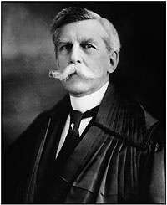
Free Expression
guarantees to each person the right of free expression in the spoken and written word and by other means of communication
guarantees all persons a full wide-ranging discussion of public affairs
You have the right to have your say and you have the right to hear what others have to say
“Hearing people say things you don’t like and saying things other people don’t like to hear, that's what living in a free society means”.
First the guarantees of free speech and press are intended to protect the expression of unpopular views clearly the opinions of the majority need little or no constitutional protection
“…if there is any principle of the Constitution that more imperatively calls for attachment than any other it is the principle of free thought—not free thought for those who agree with us but freedom for the thought that we hate.”
Second, some forms of expressions are not protected by the constitution as we shall see in the next section.
Justice Oliver Wendell Holmes

Slide 25
NON-PROTECTED SPEECH
F
Supreme Court holds that all speech is protected unless it falls into one of the four narrow categories:
Fighting words
Libel and slander (defamation)
Obscenity and pornography
Commercial speech
FLOC

Slide 26
NON-PROTECTED SPEECH
Libel and slander
Libel is a written defamation that falsely attacks a person’s good name and reputation
Slander is a spoken defamation that falsely attacks a person’s good name and reputation
Limits on student speech
Bethel v. Fraser (1986) – school can suspend a student from school for making a speech full of sexual double entendres or innuendos.
Obscenity (i.e. pornography)
Miller v. California (1973) gave constitutional definition of obscenity
Appeals to prurient interest in sex,
Patently offensive, and
Must lack serious literary/artistic/political/scientific value.
If not meeting all three criteria, then not obscene
– Sexually explicit materials about or aimed at minors are not protected by the First Amendment
17

Slide 27
NON-PROTECTED SPEECH
Commercial speech
Commercial speech (such as advertising) is more restricted than are expressions of opinion on religious, political, or other matters.
The Federal Trade Commission (FTC) decides what kinds of goods may be advertised on radio and television and regulates the content of such advertising.
Fighting words
– Governments may punish certain well-defined and narrowly limited classes of speech that by their very utterance inflict injury or tend to incite an immediate breach of peace
17

Slide 28
ESSENTIAL QUESTION CFU
What is a modern-day example of “clear and present danger”?
Should America limit speech (think about hate speech)?
18

Slide 29
PROTECTED SPEECH
Prior restraint /censorship
Blocking speech before it is given.
Such action is presumed by courts to be unconstitutional.
In the Pentagon Papers case (New York Times v. U.S.), the court refused to impose prior restraint: the revelations may have embarrassed the government, but they did not endanger national security.
Flag burning is constitutionally protected as symbolic speech. Do we have too many rights when it comes to freedom of speech?
Symbolic speech-Symbolic speech is limited compared to verbal speech.
– Tinker v. Des Moines (1969) – wearing black
armband at school at protest Vietnam War
– Texas v. Johnson (1989) – flag burning
19

Slide 30
Tinker v. Des Moines (1969)
Issue: Does a prohibition against the wearing of armbands in public school, as a form of symbolic speech, violate the students’ freedom of speech protections guaranteed by the First Amendment?
Majority: The justices said that students retain their constitutional right to freedom of speech while in public schools. They said that wearing the armbands was a form of speech, because they were intended to express the wearer’s views about the Vietnam War. The Court said, “First Amendment rights, applied in light of the special characteristics of the school environment, are available to teachers and students. It can hardly be argued that either students or teachers shed their constitutional rights to freedom of speech or expression at the schoolhouse gate....”
The Court stressed that this does not mean that schools can never limit students’ speech. If schools could make a reasonable prediction that the speech would cause a “material and substantial disruption” to the discipline and educational function of the school, then schools may limit the speech. In this case, though, there was not evidence that the armbands would substantially interfere with the educational process or with other students’ rights.
What about symbolic speech?

Slide 31
Explain the extent to which the Supreme Court’s interpretation of freedom of speech reflects a commitment to individual liberty? AMSCO Pg 283
How the Court Has Addressed Symbolic Speech | How the Court Has Balanced Free Speech and Order
The Court struck down both state and federal statutes meant to prevent desecrating or burning the U.S. flag in Texas v. Johnson (1989) and United States v. Eichman (1990), respectively. The Court found that these laws serve no purpose other than ensuring a government-imposed political idea— reverence for the flag. • In Tinker v. Des Moines Independent Community School District (1969) the Court ruled potential disorder by students wearing black armbands to protest the Vietnam War was a violation of First Amendment rights and protected. | • Using time, place, and manner regulations the Court ruled that burning a draft card was a danger and not protected in United States v. O’Brien (1968). In Cohen v. California (1971), a vulgar message against the Vietnam War on a citizen’s jacket was not a danger and was protected. This speech, political at its core, didn’t create any real danger. • A “clear and present danger” was created in the Schenck v. United States (1919) case and the Court ruled that anti-war literature was not protected because of the threat it posed to national security. • In Miller v. California (1973), the Court reaffirmed that obscene material was not constitutionally protected but stated local government can outlaw obscenity applying local community standards.

Slide 32
3.3 First Amendment: Freedom of the Press
Provisions of the U.S. Constitution’s Bill of Rights are continually being interpreted to balance the power of government and the civil liberties of individuals.
In New York Times Co. v. United States (1971), the Supreme Court bolstered the freedom of the press, establishing a “heavy presumption against prior restraint” even in cases involving national security.
REQUIRED FOUNDATIONAL DOCUMENT
The Constitution of the United States
REQUIRED SUPREME COURT CASE
New York Times Co. v. United States (1971)
Explain the extent to which the Supreme Court’s interpretation of the First and Second Amendments reflects a commitment to individual liberty.

Slide 33
3.4 FREEDOM OF THE PRESS - CONTROVERSIAL AREAS
Executive Privilege
Right of presidents to withhold
information from the courts.
U.S. v. Nixon (1974): A President generally does have executive privilege, but not in criminal cases. Even the President is not above the law.
Shield laws
Protect reporters from having to reveal
their sources.
The press claims that without them, their sources would “dry up,” and they would be unable to provide information to the public.
Courts have protected press's right to publish
The 1966 Freedom of Information Act
Liberalized access to non-classified
government records
Electronic Freedom of Information Act of 1996 requires most federal agencies to put their files online and to establish an index of their records - NASA a leader (UFO documents!)
Student Press
Hazelwood v. Kuhlmeier (1988)
High school newspaper can be regulated by the school if the school has a legitimate pedagogical concern in regulating the newspaper.
23

Slide 34
Hazelwood v. Kuhlmeier (1988) NOT a required case but you SHOULD know this case.
Students in the Journalism II class at Hazelwood East High School in St. Louis, Missouri wrote stories about their peers’ experiences with teen pregnancy and the impact of divorce. When they published the articles in the school-sponsored and funded newspaper The Spectrum, the principal deleted the pages that contained the stories prior to publication without telling the students.
Claiming that the school violated their First Amendment rights, the students took their case to the U.S. District Court for the Eastern District of Missouri in St. Louis. The trial court ruled that the school had the authority to remove articles that were written as part of a class.
The students appealed to the U.S. Court of Appeals for the Eighth Circuit, which reversed the lower court, finding that the paper was a "public forum" that extended beyond the walls of the school. It decided that school officials could censor the content only under extreme circumstances. The school appealed to the Supreme Court of the United States.
Decision and Reasoning
In a 5-3 ruling, the U.S. Supreme Court held that the principal's actions did not violate the students' free speech rights. The Court noted that the paper was sponsored by the school and, as such, the school had a legitimate interest in preventing the publication of articles that it deemed inappropriate and that might appear to have the imprimatur of the school.
Specifically, the Court noted that the paper was not intended as a public forum in which everyone could share views; rather, it was a limited forum for journalism students to write articles, subject to school editing, that met the requirements of their Journalism II class.

Slide 35
FREEDOM OF THE PRESS
Commercial speech on radio and television are regulated by the FCC. The broadcast media has less freedom than does print media, because airwaves are PUBLIC

Slide 36
EXAMPLE OF PRIOR RESTRAINT
In the famous case of New York Times v. United States (1971), the U.S. government sought a court order to keep the newspaper company, New York Times, from printing “The Pentagon Papers.” These documents entailed U.S. secret missions and involvement in the Vietnam War, which were stolen and leaked to the press.
The Nixon Administration, battling the Watergate Scandal at the same time, tried to prevent (prior restraint) the documents from being published.
The Burger Court found that the government couldn’t show the papers endangered national security enough to justify prior restraint.

Slide 37
New York Times v. U.S. (1971), pg. 286
Issue: Did the government’s efforts to prevent two newspapers from publishing classified information given to them by a government leaker violate the First Amendment protection of freedom of the press?
Majority: The Supreme Court ruled, 6-3, for the newspapers. The Court issued a short majority opinion not publicly attributed to any particular justice—called a per curiam (or “by the Court”) opinion—and each of the six justices in the majority (Justices Black, Douglas, Stewart, White, Brennan, and Marshall) wrote a separate concurring opinion. Chief Justice Burger and Justices Harlan and Blackmun each filed a dissenting opinion. It is one of the few modern cases in which each of the nine Justices wrote an opinion.
Per Curiam
The Court reaffirmed its longstanding rule that “[a]ny system of prior restraints of expression comes to this Court bearing a heavy presumption against its constitutional validity.” “The Government thus carries a heavy burden of showing justification for the imposition of such a restraint.” The per curiam opinion concluded, without analysis, that “the Government had not met that burden” in these cases.

Slide 38
FREEDOM OF ASSEMBLY
PUBLIC FORUMS AND TIME, PLACE, AND MANNER REGULATIONS
Governments may not specify what can or cannot be said, but they can make reasonable time, place, and manner regulations for the holdings of assemblies, protests, or gatherings
Police must have right to order groups to disperse (public order)
Problem of “heckler’s veto”: if govt. restricted assembly every time an opposing group claimed that there might be “violence or disorder” there would be very few assemblies. Courts are therefore reluctant to impose prior restraint (censorship).
The extent to which governments may limit access depends on the kind of forums involved:
Public forums (historically associated with free exercise such as streets, parks)
Limited public forums (public property such as city hall or schools after-hours)
Nonpublic forums (libraries, courthouses, government offices) - can not interfere with normal activities in order to stage a public protest
Civil disobedience is not a protected right
25

Slide 39
ESSENTIAL QUESTION
What is prior restraint? What was the majority opinion of
New York Times v. United States?
26

Slide 40
Free Press Supreme Court Cases | How the Ruling Affected Free Press
Near v. Minnesota (1931) | The Supreme Court ruled that a state law preventing the printing of radical propaganda violated freedom of the press.
New York Times Co. v. Sullivan (1964) | The Court ruled that in libel cases, the suing party must prove that the offending writer either knowingly lied or presented information with a reckless disregard for the truth. That the writer did so with malicious intent to defame and that actual damages were sustained. The Times argued that the First Amendment protected against slight mistakes made by the press and these errors should differ from an intentional defamation. The Supreme Court sided with the newspaper allowing for “breathing space” needed by the press.
New York Times Co. v. United States (1971) AMSCO pg. 288 | The right of the press to print information, that President Nixon claimed would compromise national security, was upheld. The broad term of “national security” did not allow Nixon (or the government) to exercise prior restraint.

