Slide 1
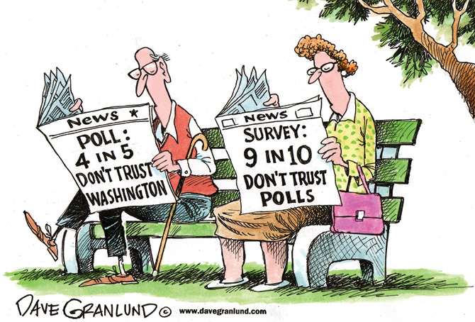
Chpt. 13 Topic 4.5-4.6
UNIT 4
Public Opinion
AMSCO pg. 424-443
https://upfront.scholastic.com/pages/promotion/030821/is-political-polling-dead.html#1200L
4.5 Measuring Public Opinion
4.6 Evaluating Public Opinion Data

Slide 2
TOPIC 4.5 Measuring Public Opinion
Public opinion is measured through scientific polling, and the results of public opinion polls influence public policies and institutions.
Describe the elements of a scientific poll.
Public opinion data that can impact elections and policy debates is affected by such scientific polling types and methods as:
Type of poll (opinion polls, benchmark or tracking polls, entrance and exit polls)
Sampling techniques, identification of respondents, mass survey or focus group, sampling error
Type and format of questions

Slide 3
TOPIC 4.5 Measuring Public Opinion
Public opinion is measured through scientific polling, and the results of public opinion polls influence public policies and institutions.
Describe the elements of a scientific poll.
Public opinion data that can affect elections and policy debates is influenced by different types of scientific polls such as:
i. Opinion polls (measuring public opinion on various issues)
ii. Benchmark polls (creating baseline views of a candidate)
iii. Tracking polls (following how views of a candidate change during a campaign)
iv. Exit polls (collecting data on why people voted the way they did)
Public opinion data that can affect elections and policy debates is influenced by polling methodology. Polling methodology is more precise when it includes:
i. Accurate sampling methods, including calculating a margin of error
ii. Neutral framing of questions (specific and unbiased wording of questions)
iii. Accurate reporting (clear reporting and conclusions that can be supported by the
data)

Slide 4
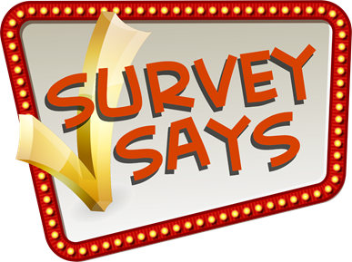
WHAT IS POLLING?
Polling is a means to assess public opinion on issues or a candidate. Leaders should have an appraisal of public opinion and consider it in reaching their decisions.
George Gallup is the Founding Father of modern-day polling = Gallup Polls

Slide 5
WHAT TYPES OF POLLS EXIST?
OPINION POLL
Interviews or surveys with samples of citizens that are used to estimate the feelings and beliefs of the entire population.
BENCHMARK POLL
Benchmark is generally the first poll taken (i.e. in a campaign). Can be used as the benchmark for a tracking poll.
15

Slide 6
WHAT TYPES OF POLLS EXIST?
TRACKING POLL
In a tracking poll, researchers ask people the same or similar questions over time to “track” the path of public opinion. It helps candidate measure the impact of their campaign. Is campaign getting msg across?
While the underlying goal of tracking polls is to identify information that can ultimately offer a campaign a strategic advantage, the polls themselves are not designed to sway undecided voters.
ENTRANCE/EXIT POLL
–outside of polling places on Election Day to predict the outcome of an election. Entrance polls are conducted before someone votes. Exit polls are conducted after someone votes
. The purpose of an exit poll is to predict the outcome of an election as soon after the polls close as possible.

Slide 7
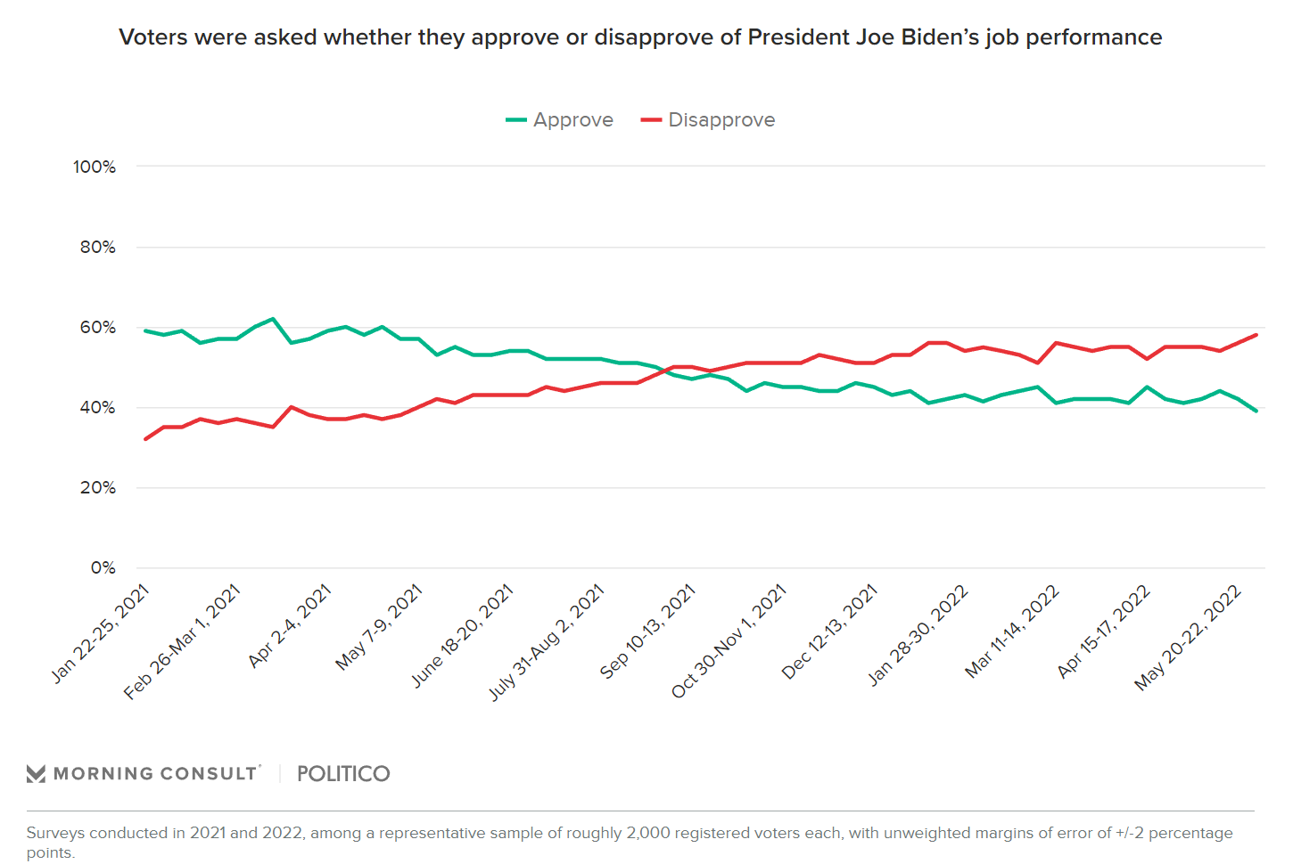
WHAT TYPES OF POLLS EXIST?
Presidential Approval
June 8, 2022
Approval ratings- gauged by pollsters asking whether the respondent approves, yes or no, of the president’s job performance.
This is a tracking poll

Slide 8
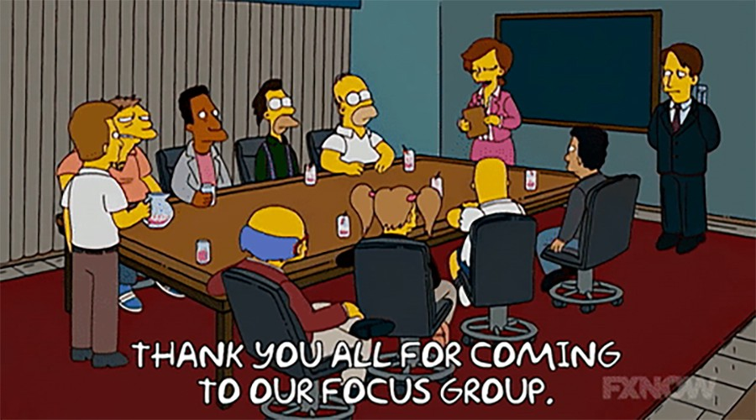
WHAT TYPES OF POLLS EXIST?
Focus Groups
A small group of citizens—10 to 40 people—who are gathered to hold conversations about issues or candidates less scientific
than many types of polls, focus groups allow for deeper insight into a topic. Pollsters can ask follow-up questions and examine body language and intensity
that would be missed in a simple automated questionnaire over the phone.
AMSCO pg. 427

Slide 9
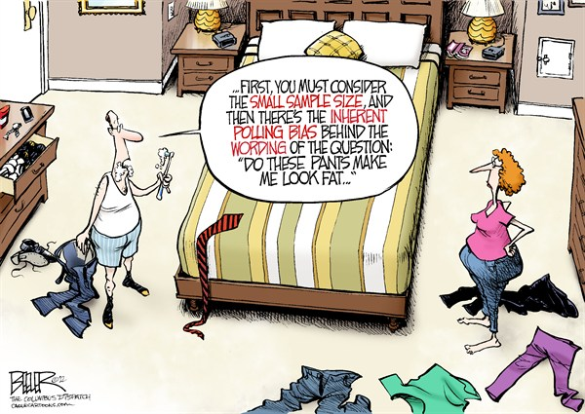
What Makes A Scientific Poll Scientific?
Randomness- a statistical technique that ensures that everyone has an equal opportunity to participate in the poll. A small random sample of 1,000-2,000 people can reflect the attitudes of millions.
Margin of Error- Every poll has a margin of error, which reflects the possible range of responses in randomly selected group. Margin of error decreases as the number of people who respond to a poll increases.
Questions- the way in which a question is worded can influence a response
UNSCIENTIFIC POLLS are used by special interests and biased questions to create the impression that their views are the most popular. https://classroom.synonym.com/

Slide 10
HOW IS A SCIENTIFIC POLL CREATED?
Creating an Accurate Poll
You must have:
Carefully Worded Questions
No bias and clearly differentiated alternatives
A poll that actually seeks the truth
Not “Advocacy” and “Push Polls” which try to influence the outcome
Push poll- an ostensible opinion poll in which the true objective is to sway voters using loaded or manipulative questions.
Used to influence voters by asking specific questions about an issue or a candidate. Under the guise of an objective opinion poll, loaded questions are posed to mislead or bias the listener against an opposing candidate or political party.
» "Would you be more likely or less likely to vote for John McCain for president if you knew he had fathered an illegitimate black child?”
» The allegation had no substance but planted the idea of undisclosed allegations in the minds of thousands of primary voters.
» McCain and his wife had in fact adopted a Bangladeshi girl.
Look for reliable pollsters - not party polls Remember…
Polls are just a snapshot and may be wrong!!!
https://ballotpedia.org/Push_polling

Slide 11
HOW IS A SCIENTIFIC POLL CREATED?
Define the “universe” (the population to be measured- through a random sample)
National polls typically require 1000-2000 respondents/ samples.
Sampling error: The margin of error is expressed in +/- terms.
Can reduce sampling error by adding more respondents
In other words…Take random samples WHERE everyone has an equal chance of being included
The way a question is asked.

Slide 12
MEASUREMENT OF PUBLIC OPINION
By elections: deceiving – does not tell us WHY people voted as they did (and only voters participate)
By straw polls – no use of sampling makes them NOT accurate
By Scientific polls
Most accurate
Through random means: where each person in universe has an equal chance of being selected (most important for getting an accurate measure of public opinion)
National polls typically require ~1,500-2,000 respondents
Margin of error: expressed in +/- terms
Can reduce margin of error by adding more respondents, but at some point, diminishing returns set in
Questions must avoid a bias

Slide 13
MEASUREMENT OF PUBLIC OPINION
Random Sampling
What went wrong?
In the fall of 1936, The Literary Digest mailed 10 million poll surveys but only 2.4 (24% or about ¼ of what was originally intended) million Americans responded on whether they planned to vote for President Franklin Roosevelt or his Republican challenger, Governor Alf Landon of Kansas. The magazine predicted an overwhelming Landon victory:
Landon would get 57% of the vote against Roosevelt's 43%
Cliff Notes AP Gov Review, pg. 99

Slide 14
MEASUREMENT OF PUBLIC OPINION
Random Sampling
What went wrong? A badly chosen sample
The people included in the poll were drawn from automobile registration lists and telephone directories. Those who owned cars and had phones in the midst of the Depression were the more affluent, and they were much more likely to vote Republican than the population as a whole.
Also, nonresponse bias. Out of 10 million people whose names were on the original mailing list, only about 2.4 million responded to the survey. People who respond to surveys are different from people who don’t.
https://www.math.upenn.edu/~deturck/m170/wk4/lecture/case1.html
Cliff Notes AP Gov Review, pg. 99

Slide 15
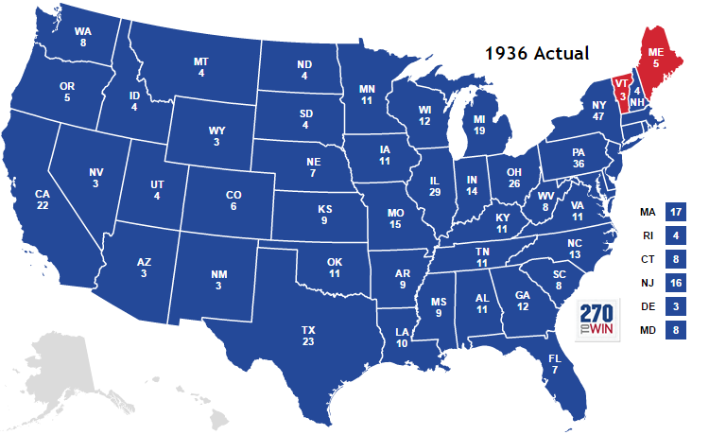
1936 Presidential Election
Presidential Candidate | Popular Vote, Electoral vote | Literary Digest Poll
F.D. Roosevelt | 60.8%, 523 | 43%
A. Landon | 36.54 %, 8 | 57%

Slide 16
MEASUREMENT OF PUBLIC OPINION
What is a Straw poll?- are not randomized, not accurate.
A television station flashes a question on the screen and gives viewers two toll-free numbers to call: one if you agree with the statement and the other if you disagree. A Web site asks, “Do you think the president is doing a good job handling the economy?”, and asks you to click Yes or No. These are attempts to gauge public opinion by polls. But these two examples tell us very little about what the people who called in or clicked online think. They are straw polls and are highly unreliable because they emphasize quantity (the more people who respond, the better) rather than the quality of the sample. Also, keep in mind that in phone-in or Internet polls, people who feel strongly about an issue can call in or log on as many times as they like.
Cliff Notes AP Gov Review, pg. 99

Slide 17
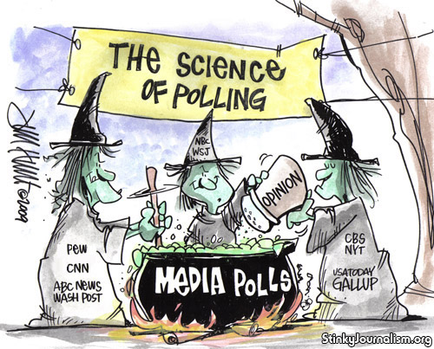
Polls are just a snapshot and may be wrong!!!

Slide 18
HAVE POLLS BEEN WRONG?
1948 Election “Dewey Defeats Truman”

Slide 19
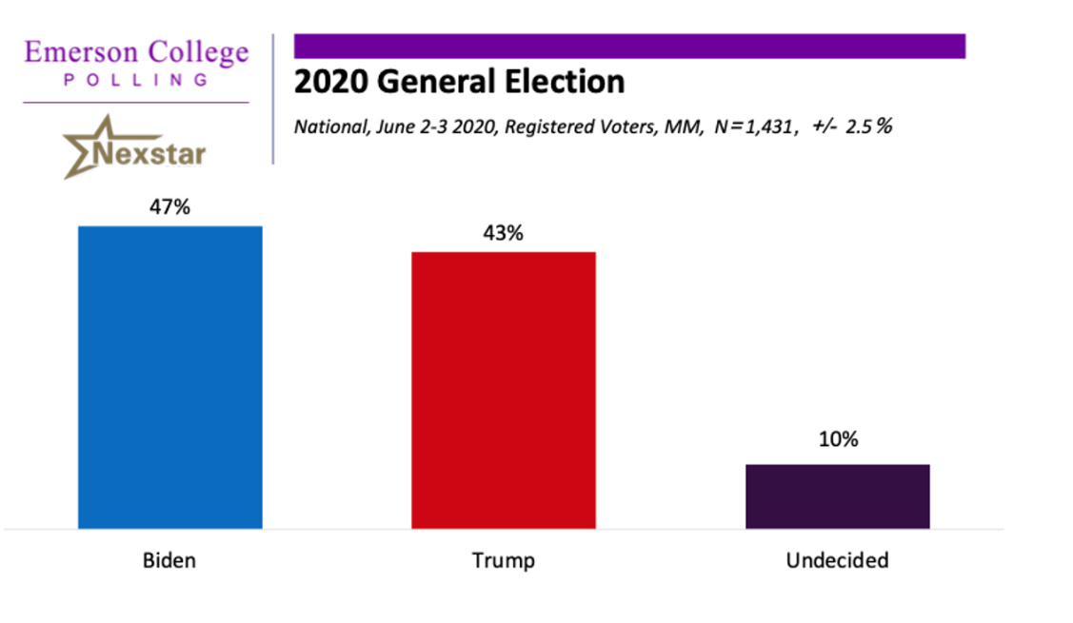
Margin of Error + / -
A margin of error of plus or minus 3 percentage points is common. If a presidential preference poll shows candidate A getting 53 percent of the vote and candidate B getting 47 percent, the difference might actually be as great as 12 percentage points (56 percent to 44 percent) or the election might be too close to call (50 percent to 50 percent).

Slide 20
THE WAY YOU ASK THE QUESTION MATTERS
The way questions are asked can skew results. For example, “Do you believe that convicted serial killers should be put to death?” will get a much different answer than “Do you believe in capital punishment?”
Pollsters need to avoid loaded questions or phrases that might prompt a particular response and skew the results.
Questions must be neutral/unbiased (objective), not emotionally charged, can’t lead the respondents towards a certain answer.
AMSCO pg. 428

Slide 21
THE WAY YOU ASK THE QUESTION MATTERS
Agree-Disagree v. Forced Choice Questions
Agree-Disagree
The best way to ensure peace is through military strength. (55% agree, 42% disagree)
Forced Choice
The best way to ensure peace is through military strength (33%)
OR
Diplomacy is the best way to ensure peace (55%)
Source: Pew Research Center, 1999.
Why is there a big difference between the polls? The way the question is formatted makes a big difference. Question format influences responses. When you use agree/disagree format, respondents tend to agree. It will skew the results.
Question format influences responses. For example, the first poll used the “agree-disagree” format, which increases the number of respondents who agree.

Slide 22
THE WAY YOU ASK THE QUESTION MATTERS
The way you ask a polling question can make a lot of difference in the way people answer it. In 2012, President Barack Obama stated that he believed same-sex couples should be allowed to marry. Following the controversial statement, several sources collected information on public opinion of gay marriage and President Obama’s statement. However, different sources asked slightly different questions, which led to different interpretations of public opinion of gay marriage.
13

Slide 23
THE WAY YOU ASK THE QUESTION MATTERS
Consider the following questions about gay marriage, each of which was asked between March and May, 2012. Read each question and consider how you would have responded if asked by an interviewer.

Slide 24
THE WAY YOU ASK THE QUESTION MATTERS
Which question(s) are loaded, prejudice, misleading?
Serial position effect- The tendency to recall earlier words is called the primacy effect; the tendency to recall the later words is called the recency effect.
Length of the question
The use of the word legal and illegal– implies criminal “MARRIAGE”. Improper use of word illegal, legal.

Slide 25
ESSENTIAL QUESTION CFU
What are three criteria to a scientific poll?
14

Slide 26
EXIT POLLS
Poll taken immediately after voters have exited the polling stations. An exit poll asks whom the voters actually voted for.

Slide 27
WHAT TYPES OF POLLS EXIST?
Approval Ratings
are gauged by pollsters asking whether the respondent approves, yes or no, of the president’s job performance.
Benchmark polls
Used to measure support for a candidate and to gather information about the issues that people care about.

Slide 28
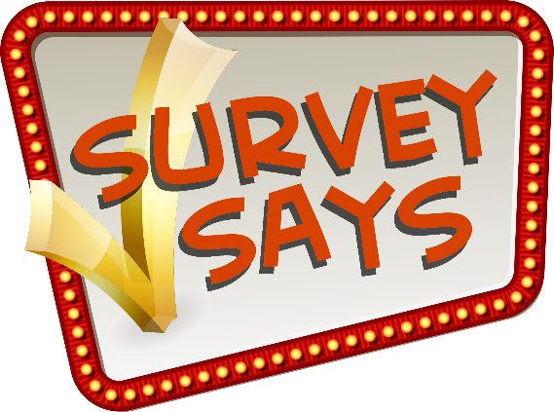
USES AND ABUSES OF POLLS
Uses of polls (remember - polls are a snapshot of opinion a point in time)
Informing the public
Informing candidates
Informing office-holders
Making election night projections through the use of exit polls
An attempt to change voters minds?
17

Slide 29
USES AND ABUSES OF POLLS
CNN boasted on Monday, April 3 about its poll showing that a majority of Americans approve of the indictment of former President Donald Trump.
The day after Manhattan District Attorney Alvin Bragg confirmed that a grand jury indicted Trump, CNN conducted a poll and found that 60% of Americans purportedly "approve" of the indictment while 40% do not.
But there is a significant problem with the poll and its result indicating widespread support for the indictment: It was conducted before the indictment was unsealed.
How, then, can anyone form a reasonable opinion about the indictment and whether or not they support it? The charges against Trump — reportedly 34 counts of a Class E felony for allegedly falsifying business records — will not be made public until the former president is arraigned, which is expected to take place on Tuesday.
Even more bewildering, only 51% of respondents said they've heard "a lot" about the case. Setting aside the fact that no one yet even knows the exact charges against Trump, the figure raises another question: How can you "support" something you're only vaguely aware of?
https://www.theblaze.com/news/cnn-poll-trump-indictment-approval

Slide 30
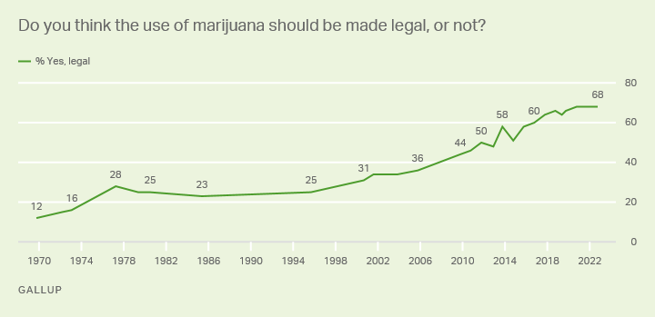
USES AND ABUSES OF POLLS
Do Polls Form Public Opinion?
An attempt can be made to use polls to influence rather than to reflect public opinion. Polls can be manipulated to give a false picture of public opinion. Moreover, there is evidence that since polls are believed to be reliable and useful, the public could be misled by unreliable surveys.
https://www.historians.org/about-aha-and-membership/aha-history-and-archives/gi-roundtable-series/pamphlets/em-4-are-opinion-polls-useful-(1946)/do-polls-form-public-opinion

Slide 31
ESSENTIAL QUESTION CFU
Identify and explain the following polls:
Tracking poll
Benchmark poll
Entrance poll
Exit poll
18

Slide 32
TOPIC 4.6 Evaluating Public Opinion Data
Public opinion is measured through scientific polling, and the results of public opinion polls influence public policies and institutions.
Explain the quality and credibility of claims based on public opinion data
The relationship between scientific polling and
elections and policy debates is affected by the:
Importance of public opinion as a source of political influence in a given election or policy debate
Reliability and veracity of public opinion dataPublic

Slide 33
Criticism of Polls During Elections
One of the criticisms of polls during either a primary or general election campaign is that they emphasize how much support each candidate has. Instead of highlighting the issues voters are concerned with, polls turn the election into a horse race. There may be a serious downside to this type of poll: Political scientists have noted the “bandwagon effect”—the candidate who is ahead in the polls stays ahead because voters want to go with a winner.
People want to hop on the bandwagon. Ever heard of that cliché?
Cliff Notes AP Gov, pg. 92

Slide 34
Criticism of Polls During Elections- Horse Race Journalism
People do not follow the candidate’s stance on policy issues and only pay attention to who is ahead in the race.

Slide 35
Criticism of Polls During Elections
Early projections from exit polls may discourage voter turnout, esp. in West
“Why should I go and vote if the other guy is already winning?”

Slide 36
ARE PUBLIC OPINIONS POLLS POSITIVE FOR SOCIETY?
Yes
Contributes to the democratic process by providing a way for the public to express its views.
Enables political leaders to understand and implement public preferences on key issues.

Slide 37
ARE PUBLIC OPINIONS POLLS POSITIVE FOR SOCIETY?
No
AMSCO pg. 435-36
Polls can also be used to manipulate public opinion.
Just because something is popular doesn’t make it right.
Social-Desirability Bias: Example: INFLATES VOTER TURN OUT
the tendency for respondents and declared voters to tell pollsters what they think the pollsters want to hear.
affects the predictions of voter turnout. Respondents may give the interviewer the impression that they will indeed vote, because they do not want to be seen as shirking a responsibility, but often on Election Day they do not vote. Voter turn out in USA is very low.
When asked their likelihood of voting on a scale of 1 to 9, U. S. citizens tended to say 8 or 9, yet only about 60 percent of eligible voters cast ballots. Those polled want to please the pollsters.
Bradley Effect: Voters intend to vote for a white candidate would nonetheless tell pollsters they are undecided or likely to vote for the non-white candidate.
Voters do not want to be perceived negatively, so they may give the interviewers a socially acceptable response, or what they perceive as the acceptable response, and yet act or vote in a different way.
The Bradley Effect is named after Tom Bradley, who lost his bid to become America’s first black governor (1982 in California), despite being ahead in the polls.

Slide 38
POSSIBLE PROBLEMS WITH DATA
Problems with this graph:
This graph needs a consistent scale. The truncated y- axis exaggerates small differences.
This graph compares one institution to all other institutions combined. This does not allow for an accurate comparison between the two sets of data presented.
Khan Academy. Good stuff. Use the site!

Slide 39
POSSIBLE PROBLEMS WITH DATA
Why it's better: The y-axis has a consistent scale that starts at zero. This allows the viewer to see that 40% more giraffes escaped from Porous Zoo in 2017 than in each of the previous years, rather than implying that 400% more giraffes escaped. This graph also compares one zoo (Porous Zoo) to one other zoo (Adamant Zoo, which we will assume is a zoo of comparable size and resources).
Khan Academy. Good stuff. Use the site!

Slide 40
ESSENTIAL QUESTION CFU
Are public opinion polls still reliable?
21

Slide 41
DO WE REALLY WANT TO HEAR THE PUBLIC’S OPINION?
In Federalist #63, Madison promoted the indirect election of senators “as a defense to the people against their own temporary errors and delusions.”
Electoral College indirect
Do average citizens today lack the time, energy, and interest to make educated decisions about elections and public policy?

Slide 42
HOW MIGHT POLITICIANS USE POLLING DATA?
Collecting information on how to conduct their campaign
Collecting information to shape policy
Promoting themselves to the public (platform formation)
Conducting opposition research
Collecting information to inform votes on bills/actions
Gaining support from donors

Slide 43
WHEN DO POLITICIANS IGNORE PUBLIC OPINION?
Think of themselves as trustees, not delegates
Loyalty to particular interest groups (e.g., large donors)
Not worried about reelection
Principle (stop laughing)
Believe that public opinion will change

Slide 44
WHAT IS PUBLIC OPINION?
Definitions
Public opinion is the distribution of individual preferences for or evaluations of a given issue, candidate, or institution within a specific population
Distribution means the proportion of the population that holds one opinion or viewpoint as compared to those with opposing opinions or those with no opinion at all
Individual preference means that when we measure public opinion, we are asking individuals about their opinions
Understanding public opinion
“The opinions held by private persons which government feels it prudent to heed”
Most of the American public shows little awareness and/or interest in politics.
Surveys show substantial lack of political knowledge on part of public:
Identifying political figures
Identifying key issues
6

Slide 45
WHO ARE THE “PUBLIC” IN PUBLIC OPINION POLLS??
VARYING LEVELS OF INTEREST IN POLITICS
1) ELITES
Those w/disproportionate amounts of political resources; Raise issues and help set national agenda; Influence the resolution of issues
2) ATTENTIVE PUBLIC
Those with an active interest in gov’t and politics - 25 percent of the American public (better educated)
3) MASSES
Those with little interest in gov’t and politics; Nonvoters - 35 percent of the American public (subset "political know-nothings")
7

Slide 46
WHO ARE THE “PUBLIC” IN PUBLIC OPINION POLLS??
TYPE OF OPINIONS
Stable
Change very little (e.g., death penalty)
Fluid
Change frequently (e.g., presidential popularity) Latent
Dormant, but may be aroused (e.g., military draft)
Salient
Have some personal importance to individuals (e.g., Brady and gun control)
Consensus
Shared by 75% of the people or more (e.g., having a balanced budget)
Polarized
Shared by less than 75% (e.g., gun control, ERA)
7

Slide 47
AWARENESS AND INTEREST
Political efficacy - belief that one can make a difference in politics by expressing an opinion and acting politically
Internal efficacy - the belief that one can understand politics and therefore participate in politics (such as voting)
External efficacy - the belief that one is effective in making a difference when participating in politics, for example that the government will respond to one's demands
When people believe that their vote will not make a difference, or effectuate political change, voter turn out decreases and voter apathy increases.

Slide 48
HOW DOES PUBLIC OPINION BECOME POLICY?
How is information gathered?
Who is in charge of creating policy?
Are there politics involved?
To whom should the “government” listen to?

Slide 49
MAKING SURVEY QUESTIONS GREAT AGAIN
Purpose of this poll?

Slide 50
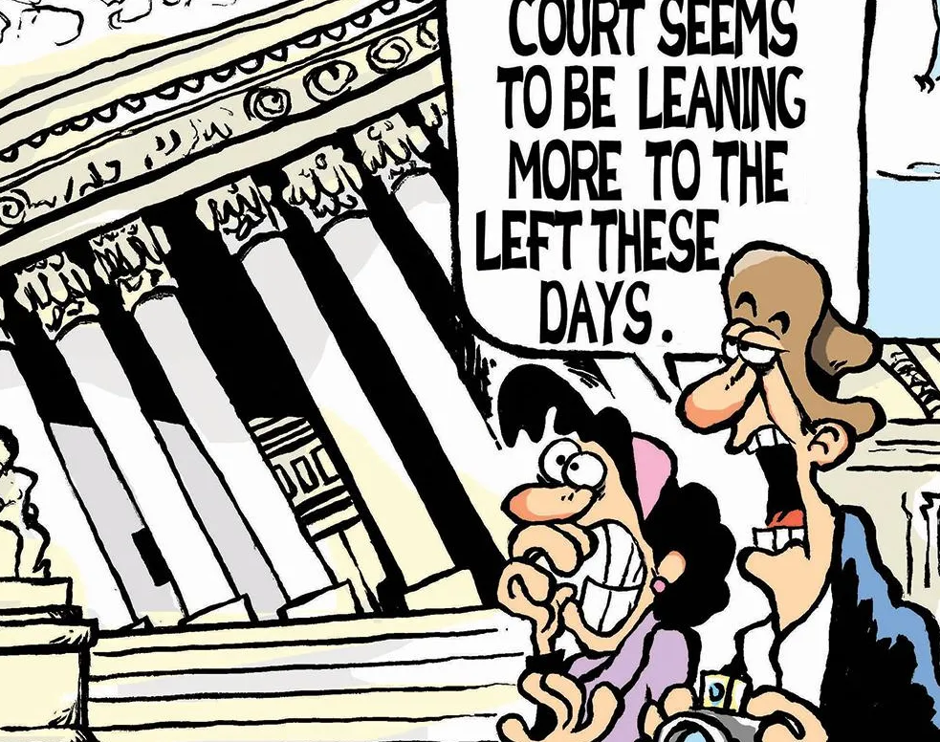
The Judicial Branch and Public Opinion
Although federal judges are appointed for life and are not at the mercy of the ballot box, they tend to listen to public opinion polls because the judicial branch depends on the executive branch to execute (enforce) the law.
The President is a political animal that depends on popular support to carry out his agenda and if the judicial branch issues a decision that is not popular, the President may just ignore to enforce it .

Slide 51
ESSENTIAL QUESTION CFU
Public opinion polls are commonly used by politicians and the media.
Identify two characteristics of a reliable scientific public opinion poll.
Describe two ways polling results are used by politicians.
Explain how frequent public opinion polls impact media coverage of political campaigns.
27

