Slide 1
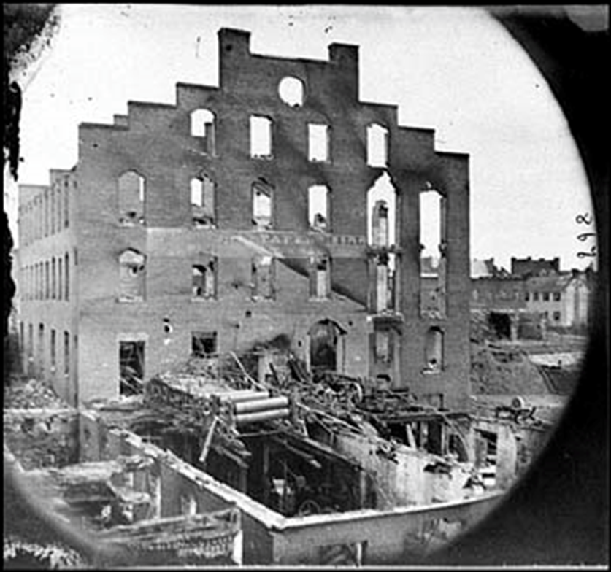
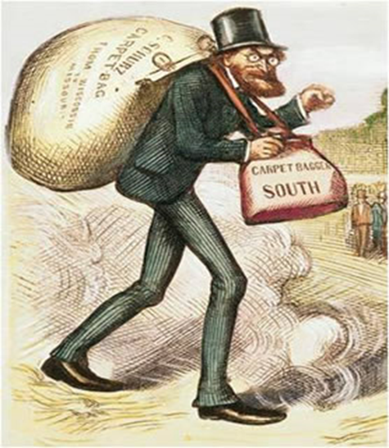
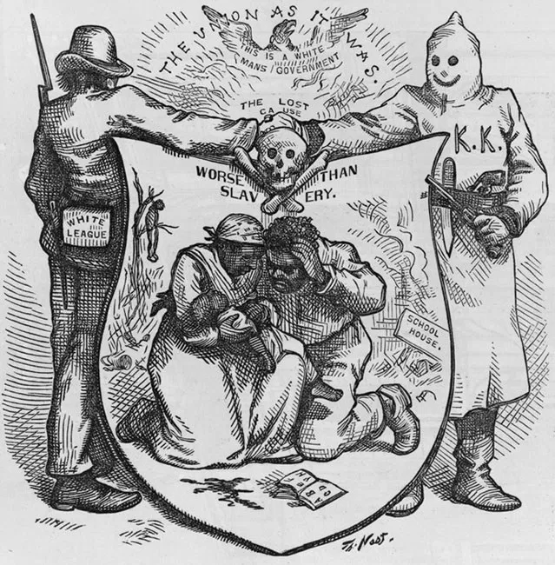
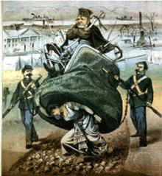

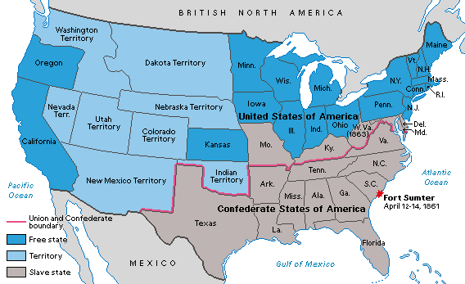
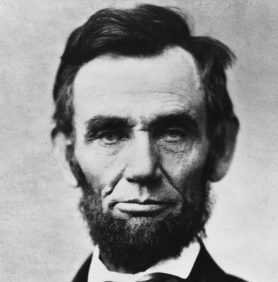
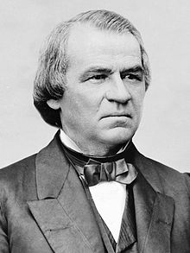
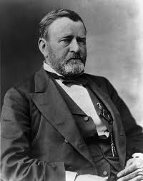
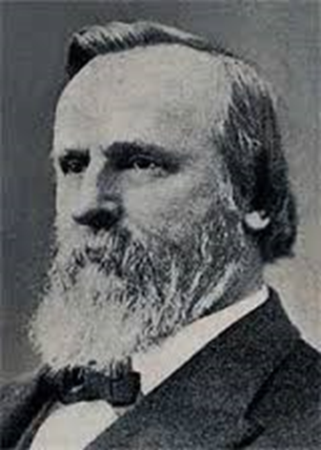
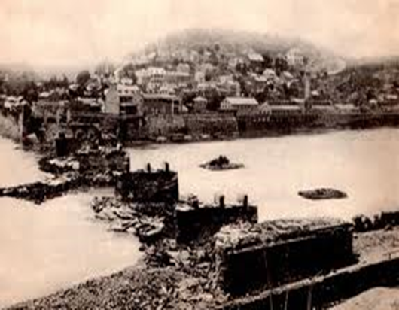
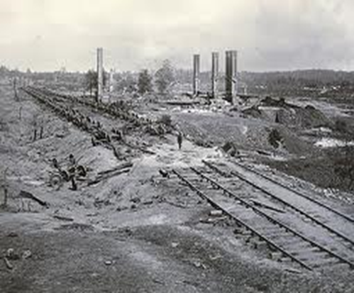
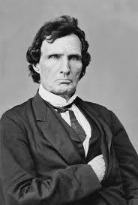
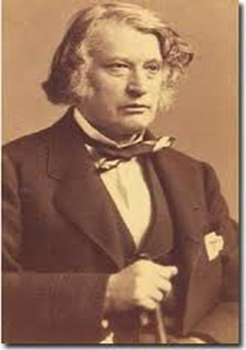
Reconstruction
America’s Unfinished Revolution
Chpt. 2

Slide 2
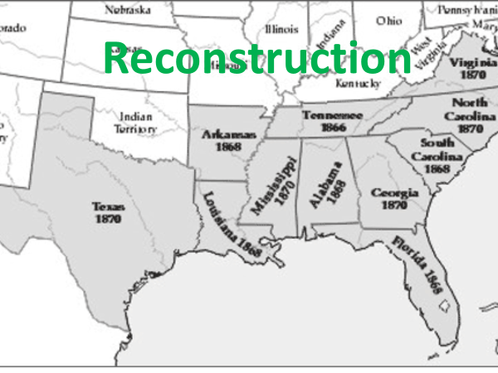
1865-1877
https://www.history.com/topics/american-civil-war/reconstruction

Slide 3
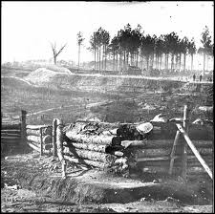
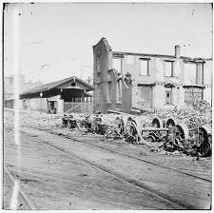
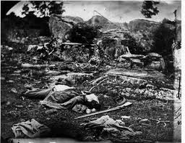
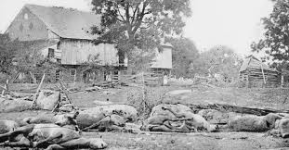

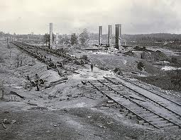
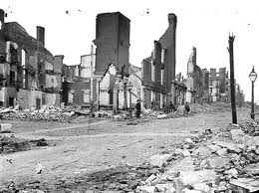
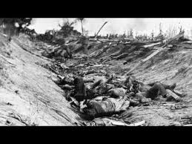
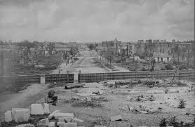
Reconstruction
1865-1877
The plan to reintegrate/rebuild the South back into the Union after the Civil War

Slide 4
“With malice [hatred] toward none, with charity for all, with firmness in the right as God gives us to see the right, let us finish the work we are in, to bind up the nation's wounds, to care for him who shall have borne the battle, and for his widow and for his orphans, to do all which may achieve and cherish a just and a lasting peace among ourselves and with all nations”.
Lincoln’s Second Inaugural Address
On March 4, 1865, President Lincoln laid out his approach to Reconstruction in his second inaugural address.
He hoped to reunite the nation and it’s people.

Slide 5
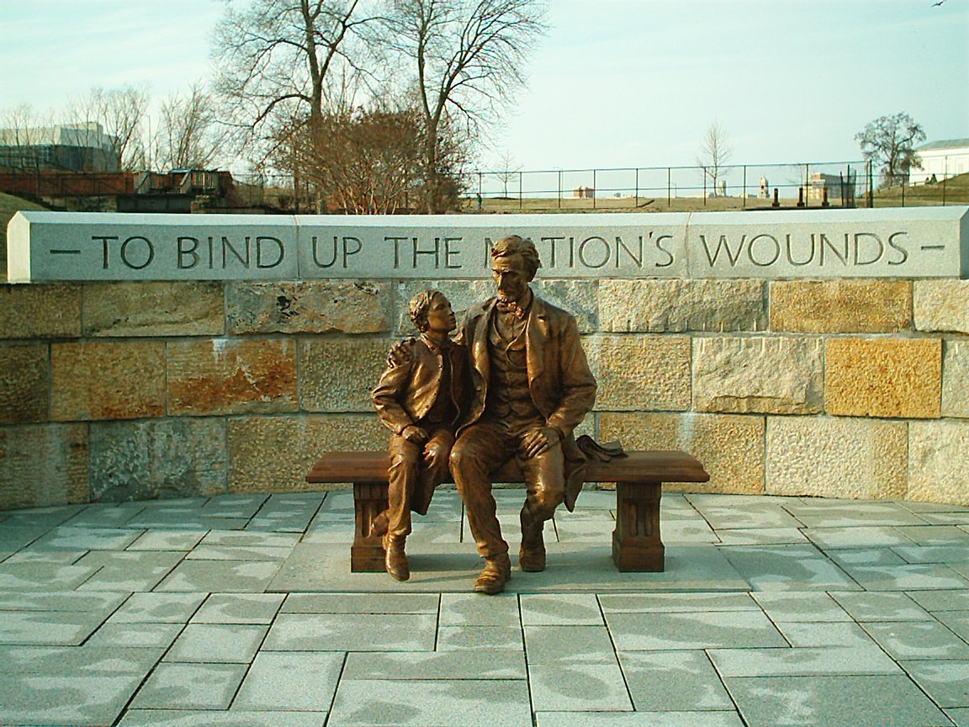
Lincoln Statue
Richmond, VA
Dedicated 2003
New York Times Article

Slide 6
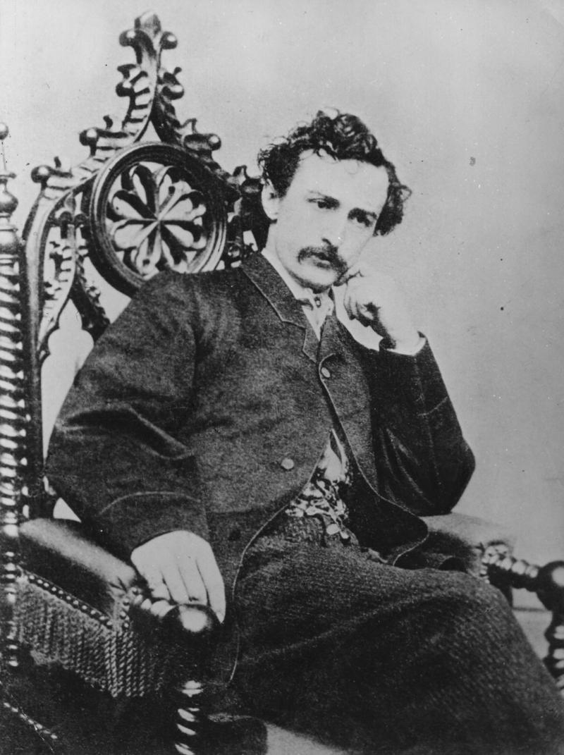
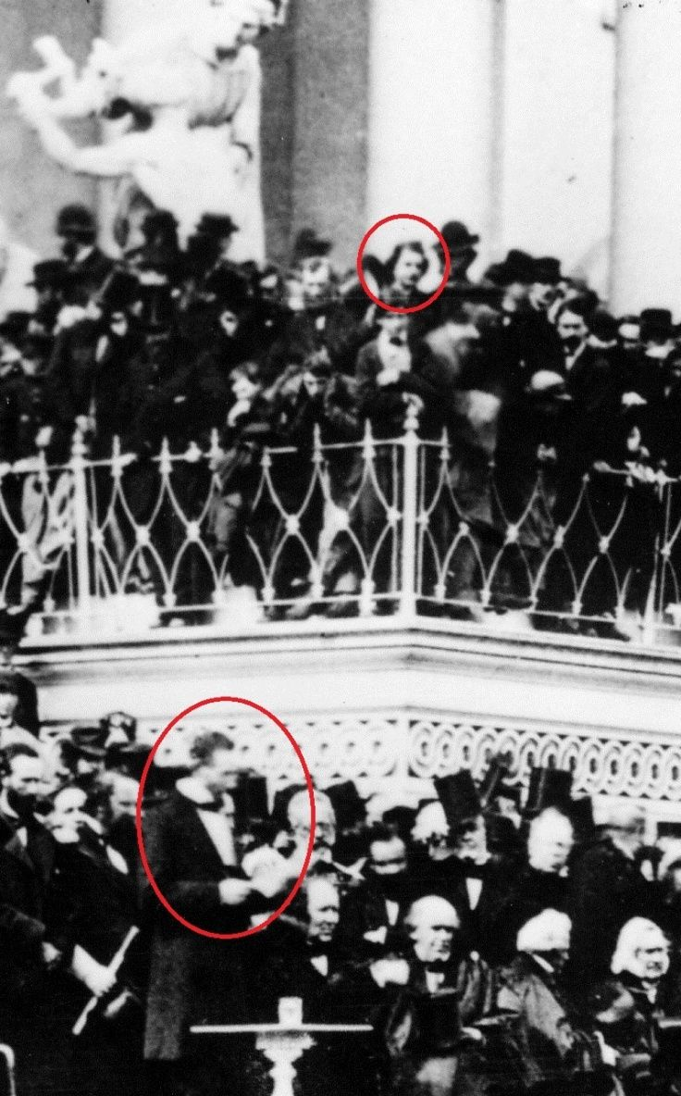
Lincoln’s Second Inaugural Address
In March 1865, Booth had witnessed Lincoln’s Inauguration Speech and was standing so close to the President that he felt he could have touched him. He wrote in his diary:
“I had an excellent chance to kill the President, if I had wished.”
Booth fulfilled his pledge to murder on April 15, 1865.

Slide 7
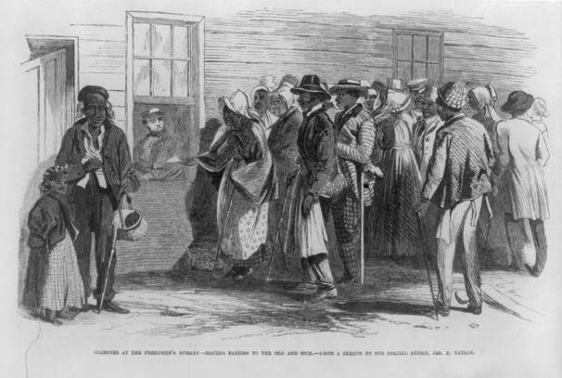
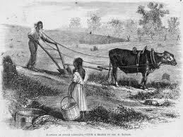
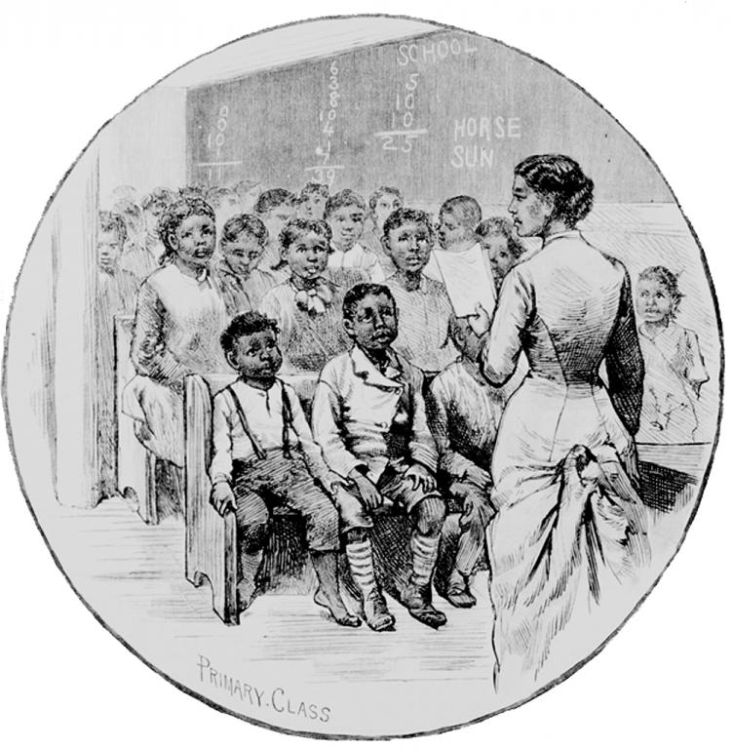
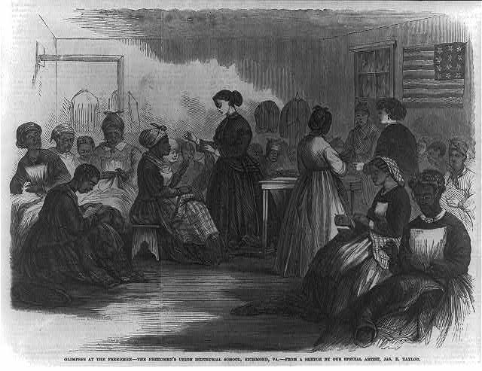
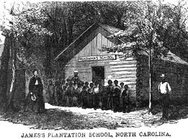
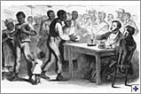
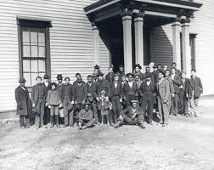
The Freedmen’s Bureau
Government agency designed to help African Americans
Provided basic education, jobs, clothing, shelter
Food Lines
Labor & Land Contracts
Aid Organization
Provide Food
Provide Clothes
Provide Money
Legal Services
Labor Contracts
Create Schools
Medical Care
For Whites/Blacks
Public Schools
Make Clothes
Provide Money / Legal Adv.
Howard University

Slide 8

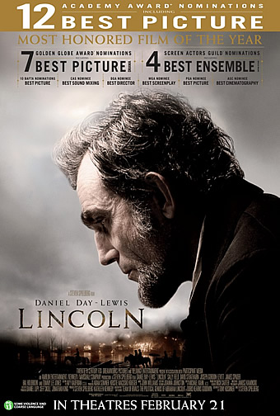
Presidential Reconstruction –Abraham Lincoln
Lincoln’s beliefs:
Southern states had never seceded, since no state could legally do so.
The Rebellion was primarily the work of specific individual Southerners (secessionists)
Reconstruction was the task of the president because only the president has the Constitutional power to pardon acts against the government. Reconstruction should be lenient
The Plan
* All southerners (except high Confederate military and government leaders) be pardoned upon taking an oath of allegiance (loyalty) to the Union
When 10% had taken the oath of allegiance, the state was permitted to form a legal state government (10% Plan)
The House of Representatives rejects Lincolns 10% Plan. They want to punish the ex-Confederates.
13th Amendment is passed- permanently prohibiting (outlawing) slavery throughout USA, December 1865. Lincoln believed that without an amendment to prohibit slavery, his Emancipation Proclamation might be overturned by the federal courts.
I (state your name) "faithfully support, protect and defend the Constitution of the United States, and the union of the States thereunder" Loyalty Oath

Slide 9
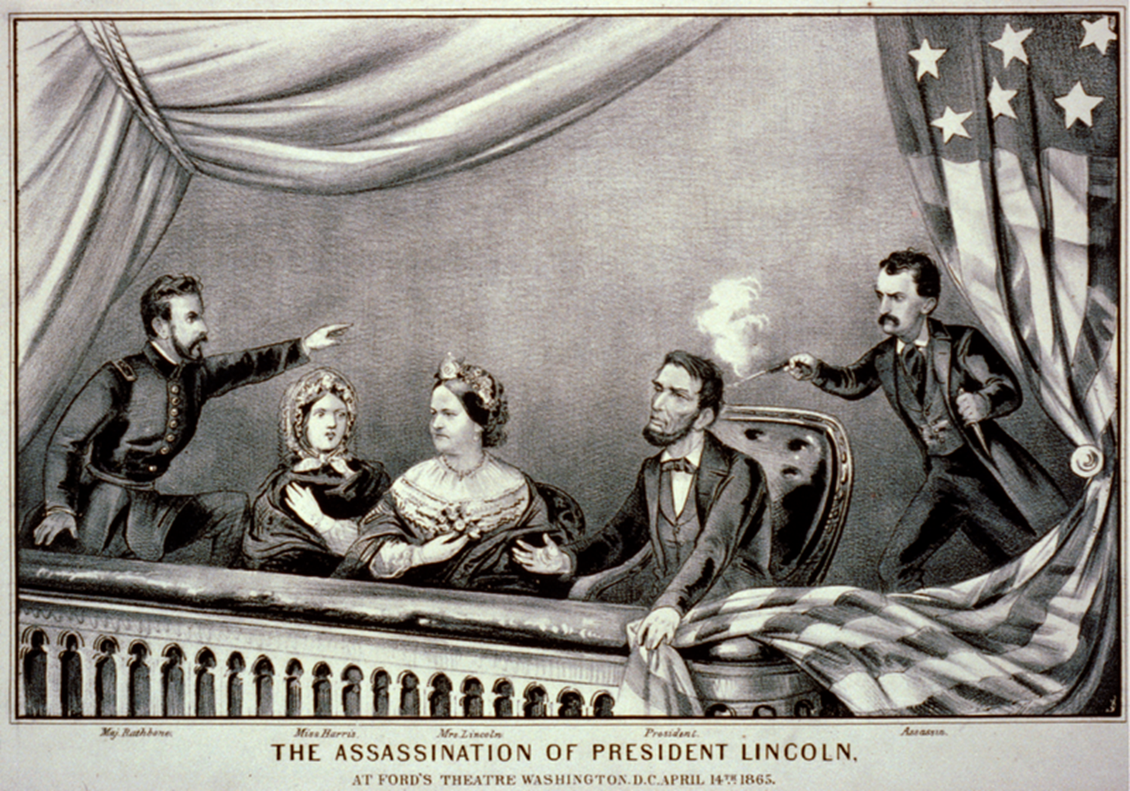
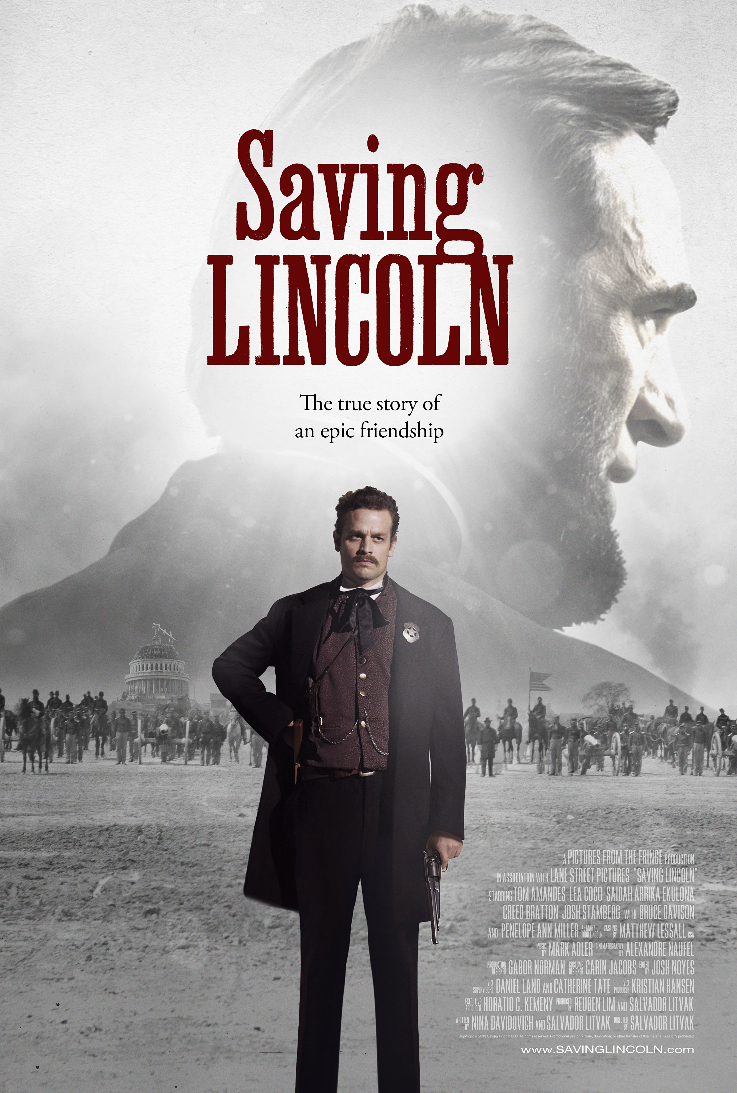
The Assassination of Abraham Lincoln
Sic Semper Tyrannis!

Slide 10
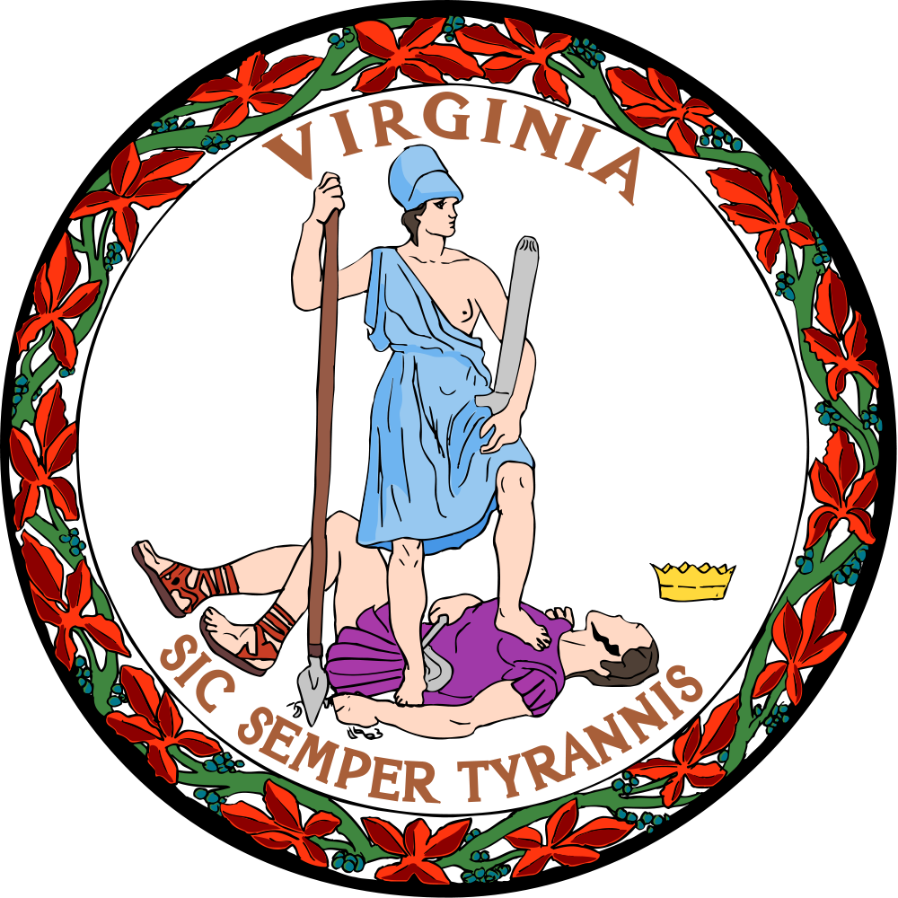
"Thus always I bring death to tyrants"

Slide 11
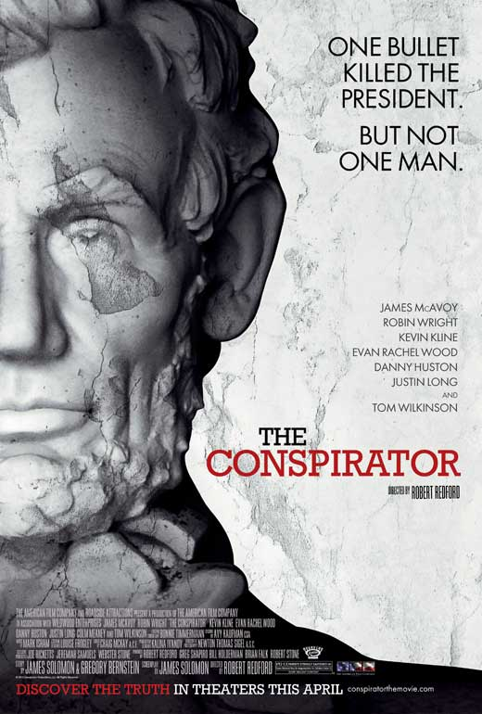
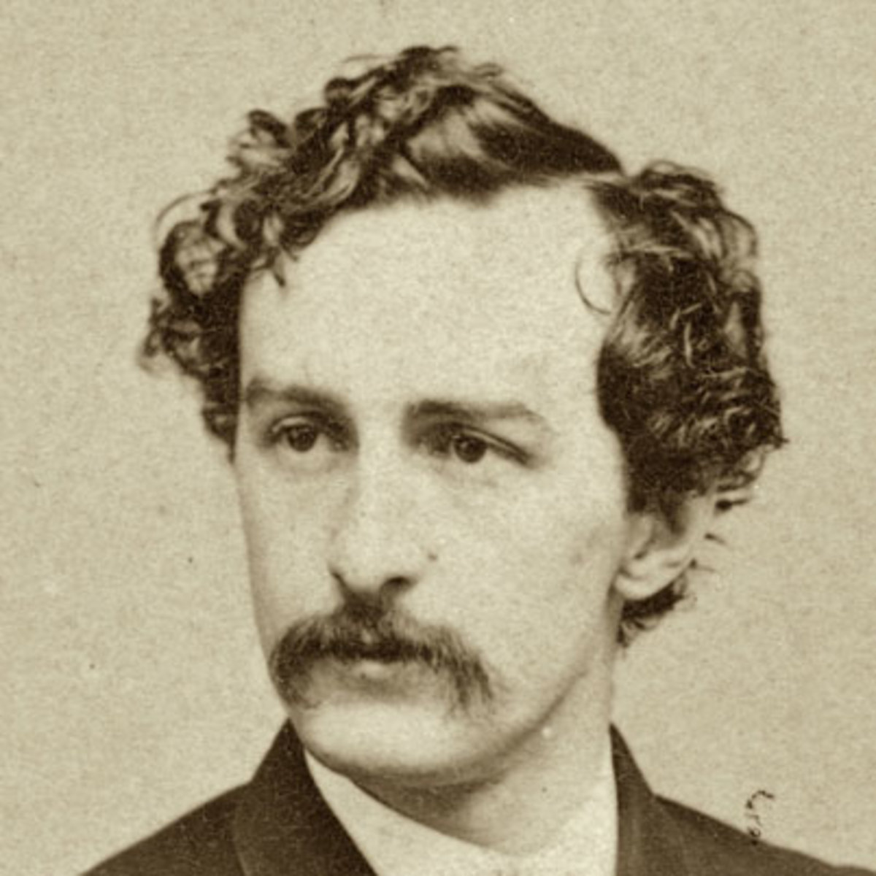
Lincoln is assassinated
Just six days after the war ended, on April 15, 1865, President Abraham Lincoln was assassinated while watching a play.
Lincoln was assassinated by John Wilkes Booth, a Southerner who was angry at Lincoln.
Northerner’s attitudes hardened against Southerners.
Vice-President Andrew Johnson became president.
The assassin John Wilkes Booth

Slide 12
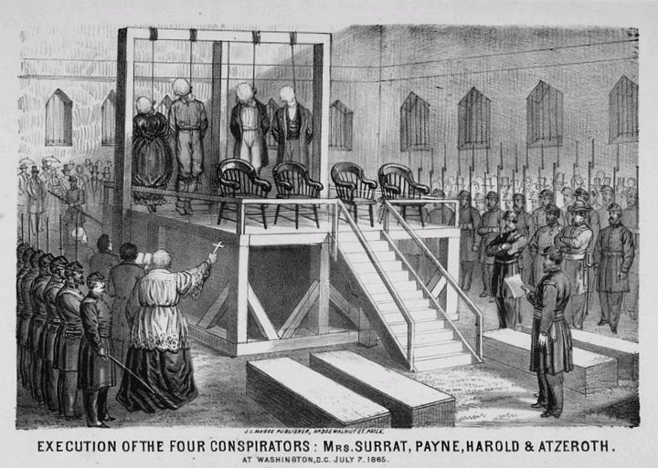
Mary Surratt
Mary Surratt was the first woman executed by the U.S. government.
Note the presence of the Catholic priest in the foreground (Nativism).

Slide 13
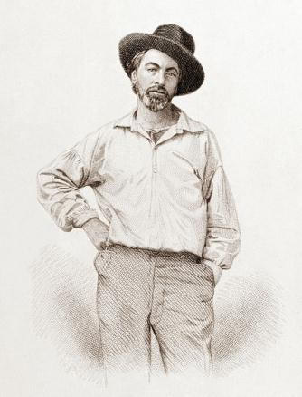
O Captain! My Captain!
By: Walt Whitman
O CAPTAIN! my Captain!
our fearful trip is done;
The ship has weather'd every rack,
the prize we sought is won;
The port is near, the bells I hear,
the people all exulting,
While follow eyes the steady keel,
the vessel grim and daring:
But O heart! heart! heart!
O the bleeding drops of red,
Where on the deck my Captain lies,
Fallen cold and dead.

Slide 14
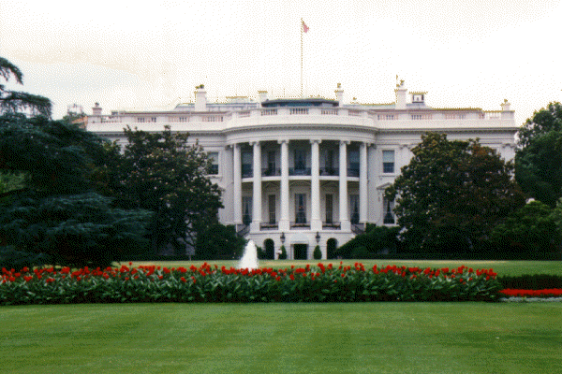
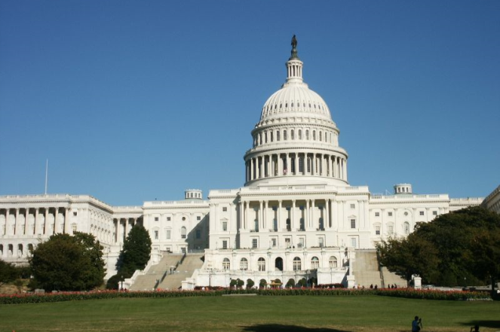
A Tale of
Two Reconstructions
Presidential
Congressional
(aka, Radical)

Slide 15

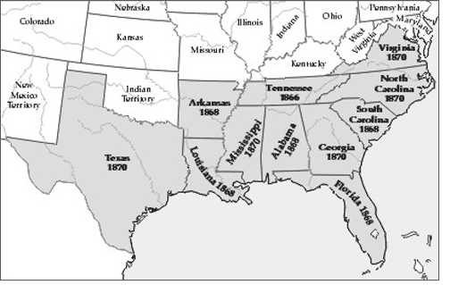
The Politics of Reconstruction
Confederate States of America
Lincoln’s successor was his Vice President- Andrew Johnson, a southerner from Tennessee and former slave holder.

Slide 16
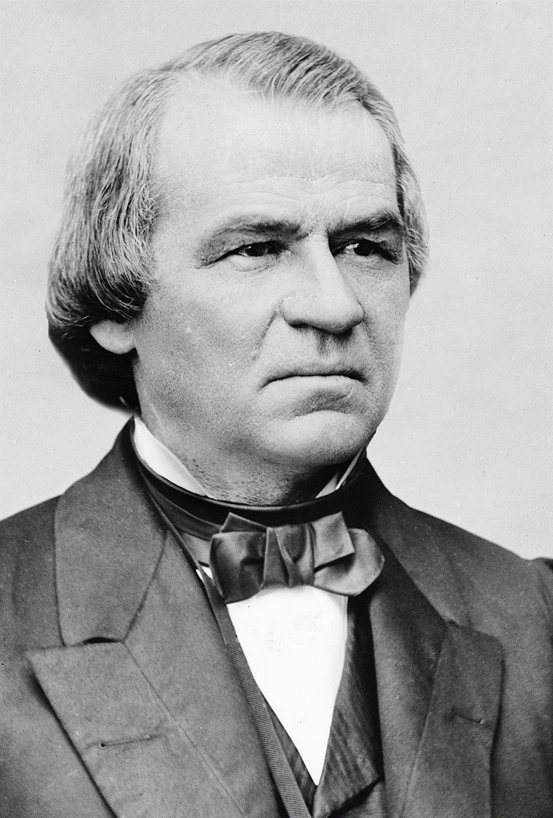
The Politics of Reconstruction
President Johnson continued with Lincoln’s Lenient Plan
Johnson was lenient on the ex CSA and issued thousands of pardons (to be forgiven, as if nothing had happened) to former Confederates.
Allowing them to regain their former properties, US citizenship and positions of power. Some got elected to Congress.
The president soon came under suspicion of many for being too sympathetic to the South.
Former Confederates became more daring.

Slide 17
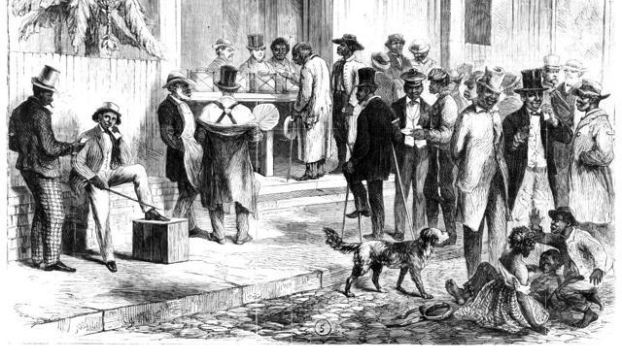
Protecting the Rights of the “NEW” Citizens of the Republic
Fearing that the former CSA would not respect, protect the rights of their former slaves, Radical Republicans in Congress began to pass legislation to protect their rights, especially the right to VOTE.

Slide 18

Radical Republicans
“If impartial suffrage is excluded in the rebel States then every one of them is sure to send a solid rebel representative delegation to Congress, and cast a solid rebel electoral vote. They, with their kindred Copperheads of the North, would always elect the President and control Congress”.-Thaddeus Stevens, (R)
Copperhead, also called Peace Democrat, during the American Civil War, pejoratively, any citizen in the North who opposed the war policy and advocated restoration of the Union through a negotiated settlement with the South.

Slide 19
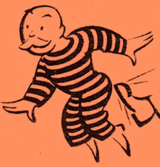
Congressional Reconstruction 1866-1873
Radical Republicans- wanted to punish the south and protect African Americans by making them FULL CITIZENS
Get out Confederates
In early 1866, Congressional Republicans, seized control of Reconstruction from President Johnson. Congress denied representatives from the former Confederate states their Congressional seats. Gave them the boot.
Passed the Civil Rights Act of 1866- all persons born in the United States were now citizens, without regard to race, color, or previous condition.
Forced the ex CSA to adopt the 14th Amendment to the Constitution, (1868) extending citizenship rights to African Americans and guaranteeing them equal protection under the laws. The 14th Amendment also reduced representation in Congress of any southern state that deprived African Americans of the vote.
15th Amendment (1870), gave voting rights to black men but no civil rights guarantees.

Slide 20
Congressional Reconstruction 1866-1873
Radical Republicans- wanted to punish the south
13th -Neither slavery nor involuntary servitude, except as a punishment for crime whereof the party shall have been duly convicted, shall exist within the United States, or any place subject to their jurisdiction.
14th- All persons born or naturalized in the United States and subject to the jurisdiction thereof, are citizens of the United States and of the State wherein they reside. No State shall make or enforce any law which shall abridge the privileges or immunities of citizens of the United States; nor shall any State deprive any person of life, liberty, or property, without due process of law; nor deny to any person within its jurisdiction the equal protection of the laws.
15^{th -} The right of citizens of the United States to vote shall not be denied or abridged by the United States or by any State on account of race, color, or previous condition of servitude. VOTE=SUFFRAGE=FRANCHISE
During Reconstruction African Americans gained achieved political equality with white Americans.
Many laws were passed by the Radical Republicans and amendments to the Constitution were added to protect African Americans especially in the south.
They included:
Civil Rights Act of 1866-define citizenship and affirm that all citizens are equally protected by the law.
Civil Rights Act of 1875-equality of all men before the law” and prohibited racial discrimination in public places and facilities such as restaurants and public transportation. The law also made it a crime for anyone to facilitate the denial of such accommodations or services on the basis of color, race, or “previous condition of servitude.”
Civil Rights Act of 1870-71- enforce the terms of the Fifteenth Amendment, which prohibited the states from denying anyone the right to vote based on race.

Slide 21
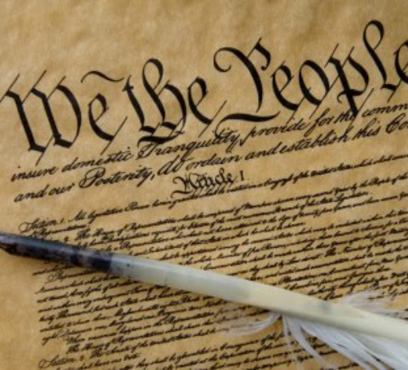
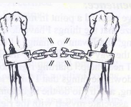


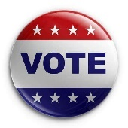
US Constitution THE SUPREME LAW OF THE LAND
13th Amendment
FREE
14th Amendment
Equal CITIZENS
15th Amendment
VOTE

Slide 22

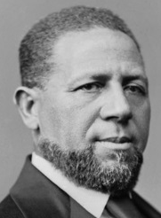




Congressional Reconstruction
Radical Republicans- wanted to punish the south
Hiram Rhodes Revels – he was the first black U.S. Senator elected in 1870 to serve the state of Mississippi.
To be readmitted to the Union, each Southern state was forced to ratify the 14th amendment, former CSA leaders were deprived of the right to hold elected office.
Shifted the balance of power in Southern governments to Republicans. As a result, many African Americans elected to public office-Senate, House, Governors, etc.
First “COLOREDS” elected to Congress and US Senate

Slide 23
The 14th and 15th Amendments Gains for the Freedmen
In 1867 and 1869 Congress passed the 14th and 15th Amendments, granting African American males citizenship, equality under the law and the right to vote.
In 1867 and 1868, voters in southern states chose delegates to draft new state constitutions. One quarter of the delegates elected were black.
The new state constitutions guaranteed civil rights, allowed poor people to hold political office, and set up a system of public schools and orphanages.
In 1870, southern black men voted in legislative elections for the first time. More than 600 African Americans were elected to state legislatures, Louisiana gained a black governor, and Hiram Revels of Mississippi became the first African American elected to the Senate.

Slide 24
The 14th and 15th Amendments Gains for the Freedmen
Freedom of movement: Enslaved people often walked away from plantations upon hearing that the Union army was near.
Exodusters: moved to Kansas and Texas
Freedom to own land: Proposals to give white-owned land to freed people got little support from the government. Unofficial land redistribution did take place, however.
Freedom to worship: African Americans formed their own churches and started mutual aid societies, debating clubs, drama societies, and trade associations.
Freedom to learn: Between 1865 and 1870, black educators founded 30 African American colleges.

Slide 25
Which statement is a valid generalization about the experience of African Americans during the early Reconstruction period (1865–1870)?
They gained economic equality.
Their participation in government decreased.
They achieved legal rights through constitutional amendments.
Their political equality was opposed by most Radical Republicans.

Slide 26







Reconstruction Amendments Review
1865-1870-To Secure the Rights of African Americans
13th -Neither slavery nor involuntary servitude, except as a punishment for crime whereof the party shall have been duly convicted, shall exist within the United States, or any place subject to their jurisdiction.
14th- All persons born or naturalized in the United States and subject to the jurisdiction thereof, are citizens of the United States and of the State wherein they reside. No State shall make or enforce any law which shall abridge the privileges or immunities of citizens of the United States; nor shall any State deprive any person of life, liberty, or property, without due process of law; nor deny to any person within its jurisdiction the equal protection of the laws.
15^{th -} The right of citizens of the United States to vote shall not be denied or abridged by the United States or by any State on account of race, color, or previous condition of servitude. VOTE=SUFFRAGE=FRANCHISE
IMPORTANT

Slide 27

Harper’s Weekly
Thomas Nast, Aug. 5, 1865
“And not this man”
Lady Liberty in a chamber bedecked with United States flags, pointing to an African American soldier who has lost a leg and is on crutches. Lady Liberty wonders why this impassive, disabled veteran in uniform—“This Man”—is not considered fit for American democracy. The cartoon reflects the empathetic view that the North had toward African Americans for a short time after the Civil War.
DOC INFO: Lady Liberty asks for equality for Black veterans.
Black soldiers sacrificed greatly for the war effort
INFERENCE:
Concerns Black suffrage
Black people, especially black troops, were not well treated after the war.
The South had not changed as much as the North had thought it had.

Slide 28



The First Vote
15th Amendment (1870)
What was the consequence of the change shown in this image?
Election of many Republicans to state & federal government offices.
Passage of the 14th amendment.
The founding of NAACP, Freedmen’s Bureau & ACLU.
The military occupation in the south came to an end.

Slide 29

Remember Dred Scott?
Dred Scott v. Sandford (1857) – Dred Scott, a slave, sued for his freedom. In arguably the worst decision ever, the Supreme Court ruled:
1)Slaves were not citizens
2)Slaves were property
3)Slaves could not sue
4)Slavery could not be prohibited in the territories
This ruling angered many northern abolitionists and further divided the nation.
Dred Scott Decision 1857
The Supreme Court’s decision in Dred Scott v. Sanford was nullified by the passage of the
Kansas-Nebraska Act
13th and 14th amendments
Compromise of 1850
Reconstruction Act

Slide 30





Impeachment of President Andrew Johnson 1868
Pres. Johnson opposed the terms of Congressional Reconstruction. Mid-term Congressional elections, supported the Radical Republicans.
Johnson had no friends in Congress.
The South (Democrats) was excluded from these mid term elections. Radical Republicans dominated Congress. They passed their own bills for Reconstruction and divided the South into 5 military districts
President Andrew Johnson (D) 1868
Thaddeus Stevens, House of Representatives
Charles Sumner, Senate

Slide 31




Slide 32



Slide 33

Conquered Provinces
  The Radicals proposed dividing the former Confederate states (minus Tennessee) into five military districts.

Slide 34
Conquered Provinces
The military districts shown on the map were created during Reconstruction to
(1) create economic and social equality in the South
(2) pay for the physical rebuilding of the South
(3) move Native American Indians to reservations
(4) govern the former Confederate states
  The Radicals proposed dividing the former Confederate states (minus Tennessee) into five military districts.

Slide 35

Impeachment
Photo Credit: Nancy Lehrer

Slide 36

Impeach- to be accused of a crime. The House of
Representatives holds vote to determine if a crime
has been committed-INDICTMENT
If the House votes yes, the trial is held in the Senate.
If the majority in the Senate votes yes, the President is removed from
office.

Slide 37



Congressional Reconstruction- Radical Republicans
Impeachment of President Johnson
Pres. Johnson opposed Congressional Reconstruction and vetoed all bills. Congress fed up.
Johnson had shown the willingness to veto bills passed by Congress. To avoid this, Congress passed the Command of the Army Act and the Tenure of Office Act.
The Command of the Army Act required all orders from the president to go through General Grant first.
Tenure of Office Act – required the Senate to approve the president’s removal of any govt. official that had been approved by the Senate.
Johnson retaliated by firing Secretary of War Stanton.
Within a week, the House of Representatives voted to impeach Johnson.
He was charged with “high crimes and misdemeanors”. He had broken the law when he refused to uphold the Tenure of Office Act.
Johnson’s impeachment vote was one short of removing him from office.
Radical
Republicans

Slide 38
Congressional Reconstruction- Radical Republicans
Thaddeus Stevens, in Congress, 1866
“Strip a proud nobility of their bloated estates, send them forth to labor and you will thus humble the proud traitors.”
Thaddeus Steven, in Congress, 1867
“I am for Negro suffrage in every rebel state. If it be just, it should not be denied: if it be necessary, it should be adopted: if it be a punishment of traitors, they deserve it.”
Radical
Republicans

Slide 39

Found not guilty in the Senate by one vote, President Johnson remained President until the end of his term. He did not run for re-election.

Slide 40


Reconstruction Governments in the South
“Carpetbaggers”
Northerners going south
Nickname applied by Southern whites to people who migrated South after the Civil War.
This was a term of abuse (an insult).
It meant that many of the new arrivals were poor whites able to fit all of their belongings in a few bags made of carpet who came to exploit the South.
Many northerners went south for:
Help the Freedmen
Business opportunities
Political office
Make money
Seen by many southerners as exploiting them for financial gain.
Carpetbaggers
Ex- Confederates and Southern whites, were excluded from the political process during Congressional Reconstruction. New political coalitions (groups) emerged: Carpetbaggers, Scalawags, Freedmen and Northern Republicans.

Slide 41


Reconstruction Governments in the South
“Scalawags”
Hiram Rhodes Revels – he was the first black U.S. Senator elected in 1870 to serve the state of Mississippi.
Ex- Confederates and Southern whites, were excluded from the political process during Congressional Reconstruction. New political coalitions (groups) emerged: Carpetbaggers, Scalawags, Freedmen and Northern Republicans.
As a result, many African Americans were elected to local, state and federal government offices-Senators, Representatives, Governors, Mayors, etc.
Southern whites who supported the Confederacy but now cooperated with the RADICAL REPUBLICANS and Reconstruction. It is a term of derision and means “rascal”.
First “COLOREDS” elected to Congress

Slide 42


The Republican Coalition
Reconstruction Governments in the South
in the South
“Carpetbaggers”
CSA General James Longstreet
“Scalawags”
Freedmen

Slide 43



Slide 44

Which of the following correctly describes the political cartoon above? a). Charles Schurz, who was a Northern Republican, is shown in a positive light as he heads to the South in enact Reconstruction policies. b). The southern citizens in the background are cheering his arrival due to the cooperation taking place between northern and southern politicians. c). The southern citizens in the background are actively attempting to prevent the arrival of the carpetbaggers they feared and hated with a passion. d). Charles Schurz is shown in a negative light since he is depicted as a grim and intense intruder with clenched fists.

Slide 45


The Strong Government

Slide 46

The Economics of Reconstruction: The “New South”
Sharecropping is a system of agriculture or agricultural production in which a landowner allows a tenant to use the land in return for a share of the crop produced on the land. Landlord will provide tools, seed, etc. Sharecropping helped ease the labor shortages in the South and provided a cheap labor supply.
A tenant farmer is one who resides on and farms land owned by a landlord. The farmer pays rent cash or with crops. Must provide his own tools.
Peonage, also called debt slavery or debt servitude, is a system where an employer compels a worker to pay off a debt with work. Legally, peonage was outlawed by Congress in 1867. Debt peonage.
DEBT became the NEW SLAVERY

Slide 47


The Economics of Reconstruction: The “New South”

Slide 48


The Economics of Reconstruction:
The “New South”
Some southerners saw the end of slavery as a good thing for the South.
Many southerners wanted a diversified economy in which the South could grow many types of crops and have it’s own manufacturing base.
They called this THE NEW SOUTH.
-Diversified crops-including many fruits and vegetables.
-Factories and the expansion of rail roads.

Slide 49

EOC Moment

Slide 50




Reconstruction Comes to an End
Legacy of Racism- Many whites refused to recognize blacks as their social and political equals.
Economic Dependence of African Americans- Southern blacks remained dependent on their former masters for their economic livelihood– sharecroppers, tenant farming
The Freedmen lacked Education and Political Experience
White Terrorism- KKK
Loss of Northern Interest in Southern Reconstruction- the economic depression of 1873 and the disputed election of 1876

Slide 51

Ulysses S. Grant 18th President 1869-1877
KKK waged an all out guerilla war to regain power in the South.
Congress passed a Force Act (an authorization of force against domestic terrorist)- Grant is given power to suspend the Constitutional rights of suspected terrorists and arrest them.
The KKK was crushed.
15th amendment was passed 1870
Amnesty Act 1872 allowed for former Confederates (except top leaders) to vote and thus elect conservative democrats to state governments. They will attempt to re-establish the “Old” South through Jim Crow & Black Codes
Civil Rights Act of 1875-guaranteed African Americans equal treatment in public transportation and public accommodations and service on juries.

Slide 52

Credit Mobilier Scandal 1872
The End of Reconstruction 1872-1877
A Union Pacific executive created a RR construction company to defraud the government.

Slide 53
GOV. SUBSIDIES
UNION PACIFIC
CREDIT MOBILIER
https://www.history.com/news/gilded-age-corruption-corporate-wealth

Slide 54

GOV. SUBSIDIES
The Union Pacific executive used
THE PEOPLE’S
money
to pay HIMSELF
UNION PACIFIC
CREDIT MOBILIER
More Info

Slide 55

The sham corporation, Credit Mobilier was granted $72 million in railroad building contracts when only $53 million was actually spent.
Where did the other $19 million
go?
https://www.history.com/news/gilded-age-corruption-corporate-wealth
Ames gave shares of Credit Mobilier stock to several members of Congress.

Slide 56


In my
POCKET!
Where did the other $19 million go?
Rep. Oakes Ames (R-MA)

Slide 57


WHERE IS CONGRESS?

Slide 58

The Public Perception
The Bosses of the Senate, Joseph Keppler, published in the January 23, 1889, issue of Puck magazine.
In their pocket. The monopolist bought of Congress.
The public lost trust in the government and this marked the beginning of the end for Reconstruction
https://www.history.com/news/gilded-age-corruption-corporate-wealth

Slide 59

The Way We Become Senator Nowadays
PUCK Magazine, Jan 22, 1890
The Constitution states that senators will be elected by the state legislatures. The senate would represent the interests of the states. This cartoons message is that the “fat cats” are buying of the state legislatures to get “elected” to the Senate.
This will change with the passage of the 17th amendment in 1913 in which senators would be elected directly by popular vote- the people

Slide 60

Whiskey Ring Scandal, 1875
The Whiskey Ring scandal in which federal agents and whiskey distillers underreported sales to cheat the government out of excise tax revenue and pocket the cash ensnared Grant’s personal secretary, Orville Babcock.
Wall Street financier and railroad magnate Jay Gould bribed Abel Rathbone Corbin, who had married Grant’s sister, to use his influence to steer the president toward policies that would favor the robber baron’s plan. “Grant is not a corrupt man as far as I can tell,” White says, “but he combines an incredible lack of attention to detail—astonishing given his army record—and a blind loyalty to friends.”
https://www.history.com/news/gilded-age-corruption-corporate-wealth

Slide 61

Panic Of 1873
https://www.pbs.org/wgbh/americanexperience/features/grant-panic/
Caused one of the worst economic depressions in US history. It was global in scope.
-89 of the 364 railroads went bankrupt
-18,000 business closed
-Unemployment was over 14%
Many American wanted the government to focus on fixing the economy and Reconstruction was largely ignored and brought to an end by 1877
Closing the door of the Stock Exchange
on its members

Slide 62

1874
Reconstruction Comes to an End 1874-1877
Northern public opinion turns against Radical Reconstruction.
Perception of
“Colored Rule”
and corruption in the South under Carpetbag state governments
http://blackhistory.harpweek.com/7illustrations/reconstruction/coloredrule.htm

Slide 63



Restoration of Southern “Home Rule” 1869-1877
1869
1870
1869
1874
1877
1876
1874
1871
1873
1877
1877

Slide 64

Congressional Election of 1874: Reconstruction Comes to an End
0
Democrats gain control of Congress
1874 Congressional Elections
Extend control into the state legislatures
Enforcing Reconstruction is becoming difficult
?
End of Reconstruction

Slide 65




Reconstruction Comes to an End: The Election of 1876
By 1876, South Carolina, Louisiana, and Florida were the only states that still had garrisons of federal troops supporting the Republican state governments through force of arms.
All three states had disputed election returns due to massive fraud by both parties.
An Electoral Commission, voting on party lines, certified the election for Hayes, who had been twenty votes shy of victory (while Tilden had been only one vote shy).
Democrats in Congress staged a filibuster in protest, but a compromise was reached in which the Democrats would accept the result in return for the removal of federal troops from the South and a promise from Hayes not to intervene in the Southern states’ internal politics (i.e., not enforcing the Fifteenth Amendment).
And the winner is?
Samuel Tilden (D-NY)
Rutherford B. Hayes (R-OH)

Slide 66


Slide 67




Compromise of 1877
Election of 1876
184
166
Rutherford B. Hayes
(R-OH)
Samuel Tilden
(D-NY)
DISPUTED ELECTION
185
“Rutherfraud”
Notes:
By 1876, South Carolina, Louisiana, and Florida were the only states that still had garrisons of federal troops supporting the Republican state governments through force of arms. All three states had disputed election returns due to massive fraud by both parties. An Electoral Commission, voting on party lines, certified the election for Hayes, who had been twenty votes shy of victory (while Tilden had been only one vote shy). Democrats in Congress staged a filibuster in protest, but a compromise was reached in which the Democrats would accept the result in return for the removal of federal troops from the South and a promise from Hayes not to intervene in the Southern states’ internal politics (i.e., not enforcing the Fifteenth Amendment).

Slide 68


Slide 69

Redemption for the South and Home Rule
The South now had home rule. Ex- confederates (democrats) now dominated Southern politics and the Democratic party was back in power. Many were elected to the US Congress as well.
Union troops were evacuated from the South and home rule restored. This was known as REDEMPTION. With this, all gains that were made in civil rights for African Americans were lost.

Slide 70
African Americans in the Southern States Lose the Right to Vote
Despite the 14th and 15th amendments, African Americans lost their rights.
Reconstruction Southern state governments fell under the control of former Confederates.
African Americans were stripped of the right to vote.
Southern blacks were dependent on white owners of land & business and were unlikely to challenge them politically.
Ku Klux Klan, White League, The Knights of the White Camelia openly threatened African Americans who tried to vote. African Americans tended to vote Republican & these terror organizations voted Democrat.
Lynching- public hangings carried out by vigilante groups.

Slide 71


Slide 72



African Americans in the Southern States Lose the Right to Vote
African Americans in the Southern States Lose the Right to Vote
1. Literacy Test
These test, like the one above from Louisiana were designed to prevent uneducated blacks from voting. If you did not pass the test, you could not vote. Black voter participation declined.

Slide 73
African Americans in the Southern States Lose the Right to Vote
African Americans in the Southern States Lose the Right to Vote
1. Poll Tax
Result: Fewer African Americans voted and African Americans voter participation went down.

Slide 74

African Americans in the Southern States Lose the Right to Vote
African Americans in the Southern States Lose the Right to Vote
1. Grandfather Clause
Allowed those who were able to vote before 1867 & those whose father or grandfather could vote before 1867 to skip the literacy tests & taxes.
As no blacks could vote before 1867, the year in which the Reconstruction Act ordered universal male suffrage, the grandfather clause excluded blacks
Declared unconstitutional by the Supreme Court in 1915
Result: Fewer African Americans voted and African Americans voter participation went down.

Slide 75


The (First) Ku Klux Klan
The name come from the Greek name "Kuklos" which means circle, and "Klan" was added. The members says it means "White Racial Brotherhood". The Klan was established in 1865 in Tennessee, after the civil war ended. The founder was Nathan Bedford Forrest, a soldier from the south. Mostly consisting of former Confederates (democrats), it grew to challenge Radical Republican reconstruction efforts and became America’s first terrorist organization.
1865-1874
Gen. Nathan Bedford Forrest, CSA
Vigilantism

Slide 76
“Worse than Slavery”
Political cartoonist Thomas Nast offered his commentary on and critique of contemporary events through his cartoons in Harper’s Weekly, a popular magazine that had a circulation of more than 100,000 readers. This Nast cartoon, “Worse Than Slavery,” appeared in the magazine on October 24, 1874. Carefully examine the individuals and items depicted in the cartoon. Note that the phrase near the top of the drawing, “This is a white man’s government,” is a quotation from the 1868 Democratic Party platform.
(America Past and Present, eight edition)
Image Analysis Questions:
1. According to the cartoon, what conditions or events are “worse than slavery”?
2. What view of the Reconstruction policy does the cartoonist appear to be expressing?

Slide 77

This well-known cartoon from Reconstruction shows two white men threatening an apprehensive African American holding a voting ticket. The caption reads, “OF COURSE HE WANTS TO VOTE THE DEMOCRATIC TICKET!” The second line says, “Democratic ‘Reformer.’ ‘You’re as free as air, ain’t you? Say you are, or I’ll blow yer black head off!” (Tennessee State Library and Archives)

Slide 78

Use the image above to answer parts a, b, and c.
a) Briefly explain the point of view expressed through the image about ONE of
the following.
Emancipation
Citizenship
Political participation
b) Briefly explain ONE outcome of the Civil War that led to the historical change depicted in the image.
c) Briefly explain ONE way in which the historical change you explained in part b
was challenged in the period between 1866 and 1896.

Slide 79

A. Points of view suggested by the image:
C. Examples of challenges to the point of view of the image
Emancipation resulted in positive outcomes, including freedom for slaves and citizenship for African Americans by allowing African Americans to vote, serve in the military, and participate in business and the economy.
Political participation, as illustrated in the image of the men voting, was a fundamental aspect of the freedom and rights of citizenship granted to former slaves and other African Americans.
Black Codes that restricted the rights of African Americans in the South
Grandfather clauses, poll taxes, literacy tests, and other ways of disenfranchising African Americans in the South despite the passage of the 15th Amendment
The formation of the Ku Klux Klan and other white-supremacist groups
Terror, lynching, and violence against African Americans and their supporters
Failure to enforce the Civil Rights Act of 1866
Failure to implement the Enforcement Act of 1870 (Civil Rights Act of 1870)
Passage of Jim Crow laws in Southern states
Supreme Ct. decisions- Plessy v. Ferguson-which allowed racial segregation despite the Fourteenth Amendment
Sharecropping (when linked to challenges to emancipation) that limited African Americans’ freedom and kept most Southern African Americans in poverty
B. Relevant outcomes of the Civil War
During Radical Reconstruction, the federal government attempted to protect African Americans’ rights in the South. The 13th Amendment, passed in 1865, abolished slavery; the Fourteenth Amendment, passed in 1868, guaranteed federal citizenship to African Americans and stated that rights cannot be abridged by the states; and the 15th Amendment, passed in 1870, stated that male voting rights could not be denied based on race, color, or previous condition of servitude.
The Emancipation Proclamation still affected post–Civil War culture even though it was issued during the Civil War.

Slide 80


African Americans in the Southern States Lose the Right to Vote
The Solid South
As a result of these measures, whites regained control of their state governments & representation in Congress. Even though a majority of citizens in Louisiana, Mississippi, & South Carolina were African Americans few could vote.
Resentful of Republican reconstruction for the next 100 years, white Southerners consistently voted for the Democratic Party.

Slide 81

Jim Crow
Black Codes
Segregation
and Voting Restrictions
These BLACK CODES, JIM CROW laws were passed throughout the South to LIMIT the effects of the Radical
Republicans. These laws were passed by democrats in the south.
“Jim Crow” Laws
Racial Segregation
Black Codes
Slave Codes
Literacy Tests
Poll Tax
Designed to keep Black citizens from voting
Grandfather Clause

Slide 82

The South is emboldened: The South Shall Rise Again
Black Codes or Jim Crow Laws
Black Codes – laws passed in southern states that were intended to limit the freedom of former slaves. Jim Crow Laws
These laws were slave codes of the past.
Black Codes were to preserve the structure of Southern society
with as little disruption as possible, despite the abolition of slavery

Slide 83



The System of Racial Segregation: the Reign of Jim Crow
Segregation Laws
Separated blacks from whites. By state law, whites and blacks attended different schools, rode separate rail way cars, ate in different restaurants, etc.
The facilities given to African Americans were generally inferior.
Jim Crow made the 14th and 15th amendments ineffective.

Slide 84


Slide 85


Plessy v. Fergusson, 1896
US Supreme court case that made segregation legal in the United States
Established the principle of “separate but equal”
Hommer Plessy

Slide 86


Plessy v. Fergusson, 1896
Separate but equal meant that minorities were not allowed in the same places as whites.
Southern states passed laws that legalized segregation known as “Jim Crow” laws

Slide 87


Plessy v. Fergusson, 1896
All the gains made during Reconstruction were lost until the 1950s-60s Civil Rights Movement
For the next 60 years, Jim Crow laws dominated society in the south for black Americans
Segregation became the way of life for black Americans in the South

Slide 88



“Our Constitution is color-blind and neither knows nor tolerates classes among citizens. In respect of civil rights, all citizens are equal before the law. The humblest is the peer of the most powerful. The law regards man as man and takes no account of his surroundings or of his color when his civil rights as guaranteed by the supreme law of the land are involved....
The arbitrary separation of citizens, on the basis of race, while they are on a public highway, is a badge of servitude wholly inconsistent with the civil freedom and the equality before the law established by the Constitution. It cannot be justified upon any legal grounds”…. Justice John Marshal Harlan
Justice John Marshall Harlan, dissented with the majority opinion and sided with Homer Plessy.
De Jure Segregation- by law
Most common in the South
De Facto Segregation- segregation by custom. Mostly in the North

Slide 89

Reconstruction 1865-1877

