Slide 1
UNIT 2
Topic 2.3
AMSCO pg. 124-36
Wapples pg. 271-279
Required Court Cases
Baker v. Carr - 1962
Shaw v. Reno – 1993
Chpt. 4 Topic 2.3 Congressional Behavior

Slide 2
TOPIC 2.3 Congressional Behavior
The republican ideal in the U.S. is manifested in the structure and operation of the legislative branch.
Congressional behavior and governing effectiveness are influenced by ideological divisions between political parties. Partisan voting (when members of Congress vote based on their political party affiliation) and polarization (when political attitudes move toward ideological extremes) can lead to gridlock (a situation in which no congressional action on legislation can be taken due to a lack of consensus).
Gerrymandering, redistricting, and unequal representation of constituencies have been
partially addressed by Supreme Court cases that opened the door for equal protection
challenges to redistricting.
Elections that have led to a divided government (when one party controls the presidency and the other party controls at least one of the chambers of Congress) can lead to more
intense partisanship. This partisanship can result in members of Congress voting against
presidential initiatives and appointments, especially those of a lame duck president.
Explain how congressional behavior is influenced by election processes, partisanship, and divided government
REQUIRED SUPREME COURT CASES
Baker v. Carr (1962)
Shaw v. Reno (1993

Slide 3
TOPIC 2.3 Congressional Behavior
The republican ideal in the U.S. is manifested in the structure and operation of the legislative branch.
Accountability to constituents in each chamber is affected by how representatives perceive
their roles.
i. A representative who conceives of their role as a trustee will vote on issues based on their own knowledge and judgement.
ii. A representative acting as a delegate sees themselves as an agent of those who elected them and will vote on issues based on the interests of their constituents.
iii. A politico uses a combination of these role conceptions.
Explain how congressional behavior is influenced by election processes, partisanship, and divided government
REQUIRED SUPREME COURT CASES
Baker v. Carr (1962)
Shaw v. Reno (1993

Slide 4
TOPIC 2.3 Congressional Behavior
The republican ideal in the U.S. is manifested in the structure and operation of the legislative branch.
Congressional behavior and governing effectiveness are influenced by: § Ideological divisions within Congress that can lead to gridlock or create the need for negotiation and compromise
Gerrymandering, redistricting, and unequal representation of constituencies have been partially addressed by the Supreme Court decision in Baker v. Carr (1962), which opened the door to equal protection challenges to redistricting and started the “one person, one vote” doctrine, and the no-racial-gerrymandering decision in Shaw v. Reno (1993)
Elections that have led to a divided government, including partisan votes against presidential initiatives and congressional refusal to confirm appointments of “lame-duck” presidents of the opposite party
Different role conceptions of “trustee,” “delegate,” and “politico” as related to constituent accountability in each chamber
Explain how congressional behavior is influenced by election processes, partisanship, and divided government
REQUIRED SUPREME COURT CASES
Baker v. Carr (1962)
Shaw v. Reno (1993

Slide 5
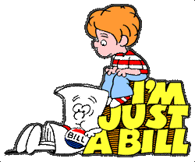
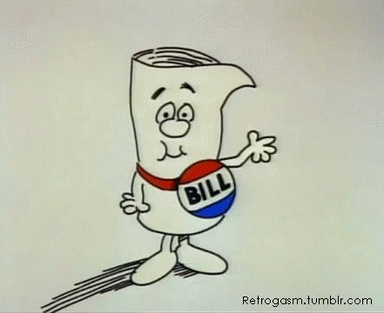
The Voting Model Different Role Conception
INFLUENCES ON CONGRESS on how they vote on a BILL
1. Trustee: Decisions made by elected official using their own personal views or decisions made by the elected official based on the public good and not on the basis of constituents’ views | 2. Delegate: Decisions made by the elected official mirror the constituents’ views, represent constituents’ views, or do what voters tell them to do.
3. Partisan: Lawmakers who owe their allegiance to their political party first vote along party lines. | 4. Politico: Legislators should follow their own judgment (that is, act like a trustee) until the public becomes vocal about a particular matter, at which point they should follow the dictates of constituents. It’s a combo
Senators and representatives are elected to represent people. As legislators, they have four voting options: trustee, delegate, partisan, and politico

Slide 6
INFLUENCES ON CONGRESS on how they vote on a Bill
OTHER MEMBERS OF CONGRESS
e.g., party leaders, committee leaders, state delegations, other members with a similar ideology, other members with similar districts. If a member votes according to these, he is said to engage in organizational voting.
Use of reciprocity among members (exchange of favors)
Use of logrolling among members (exchange of votes); “You scratch my back & I’ll scratch your back”
CONGRESSIONAL STAFF MEMBERS
As society has grown more complex, and Congress has taken on more responsibilities, Congress has needed to add staﬀ to deal with these realities. Staﬀ can:
Control information that members receive
Control access to members
Help to set committee agenda
Make recommendations on legislation
Help to write legislation
Discuss pros/cons of staﬀers representing an undemocratic aspect of Congress
11

Slide 7
INFLUENCES ON CONGRESS on how they vote on a BILL
INTEREST GROUPS/LOBBIES/PACS
Inﬂuence through:
campaign contributions through their PACs
"report cards"
targeting
providing information
testifying before Committees
CONGRESSIONAL CAUCUSES
e.g., black caucus, Hispanic caucus, blue collar caucus, women's caucus
THE PRESIDENT
Can reward or punish members, particularly those within his own party by:
Campaigning for or against members
Attending or not attending members' fund raisers
Speaking out for or against members
Using his "electronic throne" to gain leverage (“going public”), bully pulpit

Slide 8
INFLUENCES ON MEMBERS OF CONGRESS on how they vote on a BILL
CAMPAIGN CONTRIBUTORS
Again, the evidence here is mixed. Some studies show that contributions aﬀect voting behavior, but others have downplayed this, citing other inﬂuences such as party membership.
If contributions do aﬀect congressional voting, they probably have the greatest eﬀect on narrow issues that are not well known or publicized.
THE MEDIA
e.g., through its "watchdog" role
13

Slide 9
INFLUENCES ON MEMBERS OF CONGRESS on how they vote on a BILL
IRON TRIANGLES
Also known as subgovernments, issue networks, policy networks: a congressional committee, the related federal agency, and the impacted interest groups.
For example, on the issue of airline deregulation, an iron triangle might consist of:
Public Works and Transportation Committee
Federal Aviation Administration (FAA)
Numerous interest groups such as the Air Transport Assn., mechanics' unions, pilots' unions, etc.
PARTY MEMBERSHIP OF MEMBERS
This seems to be the best predictor of congressional voting – party unity scores are quite strong. Party aﬃliation is a particularly strong inﬂuence on economic and social welfare issues, and less of an inﬂuence on foreign policy and civil liberties issues.
14

Slide 10
INFLUENCES ON CONGRESS on how they vote on a BILL
CONSTITUENT CONVICTIONS
If a member votes according to these, he is said to act in the delegate role and engage in representational voting.
Of course, it is often diﬃcult to gauge constituent opinion on a given issue.
Most constituents are not even aware of the issues faced by Congress.
Another complication is the diversity of interests throughout districts and states.
MEMBERS' OWN CONVICTIONS
– If a member votes according to these, he is said to act in the trustee role and engage in altudinal voting.
15

Slide 11
AP FRQ Moment 2013 AMSCO pg. 95-96
Explain why a member of Congress might sometimes act as a trustee (attitudinal view) rather than a delegate (representational view).
A member of Congress might sometimes act as a trustee rather than a delegate, because
• Information access
• Reliance on expertise
• Divided constituency
• Salience of issue
• Vote his or her conscience (explaining why)
• Difficulty determining what voters want
Note: Must close loop to show contrast that the representative is voting regardless of what the constituents want.

Slide 12
Gerrymandering-Redistricting
If a state has a change in the number of seats OR if the population has signiﬁcantly changed within the state, its district boundaries must change.
This is known as REDISTRICTING and is usually carried out by the party in power of the state legislature.
A form of redistricting is gerrymandering: redrawing boundaries to favor the party in power of the state legislature.
Origin of the term
From 19th century Mass. governor Elbridge Gerry, who drew district lines himself.
Some of his districts had such strange shapes that they looked like salamanders, prompting one wag to instead refer to them as "gerrymanders."
10

Slide 13
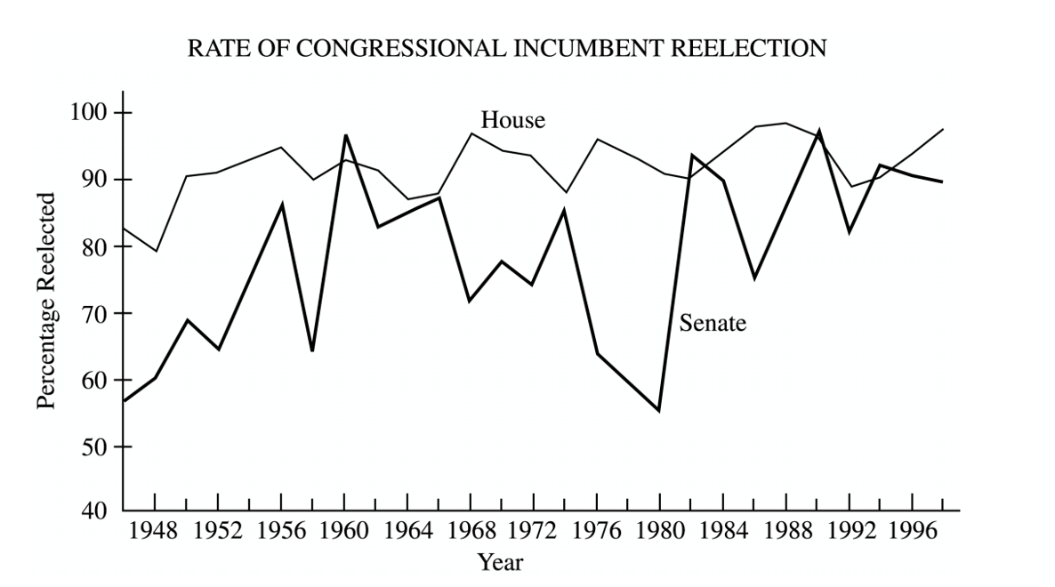
Question
The graph shows reelection rates for incumbents in the House and Senate. From this information and your knowledge of United States politics, perform the following tasks.
Identify two patterns displayed in the graph

Slide 14
The party in power can get a majority of seats in the House by: (gerrymandering is very PARTISAN)
"Packing:" drawing the district lines in such a way as to concentrate the opposing party in a few districts, thus preserving a majority of seats for itself.
"Cracking:" drawing the district lines in such a way as to disperse the opposing party throughout the state and thus dilutes that party's strength in order to preserve a majority of seats for the majority party.
Eﬀects
The party in power STAYS in power
"Safe" seats are created for incumbents, leading to further diﬃculties for challengers
Communities of interest may be broken up
Strangely shaped districts
"Majority-minority" districts created by racial gerrymandering
Cracking
Packing

Slide 15
The party in power can get a majority of seats in the House by:
"Packing:" drawing the district lines in such a way as to concentrate the opposing party in a few districts, thus preserving a majority of seats for itself.
"Cracking:" drawing the district lines in such a way as to disperse the opposing party throughout the state and thus dilute that party's strength in order to preserve a majority of seats for the majority party.
Eﬀects
The party in power STAYS in power
"Safe" seats are created for incumbents, leading to further diﬃculties for challengers
Communities of interest may be broken up
Strangely-shaped districts
"Majority-minority" districts created by racial gerrymandering
Cracking
Packing

Slide 16
What are the goals of gerrymandering?
Enhance party power
to protect incumbents and discourage challengers
increase minority representation /decrease minority representation
To reward friends and punish foes
All of this is done with cracking and packing techniques
THE PERSON IN POWER STAYS IN POWER
Incumbent- the person already in office, ie the incumbent President, Senator, Represenatative, etc.
Cracking
Packing

Slide 17
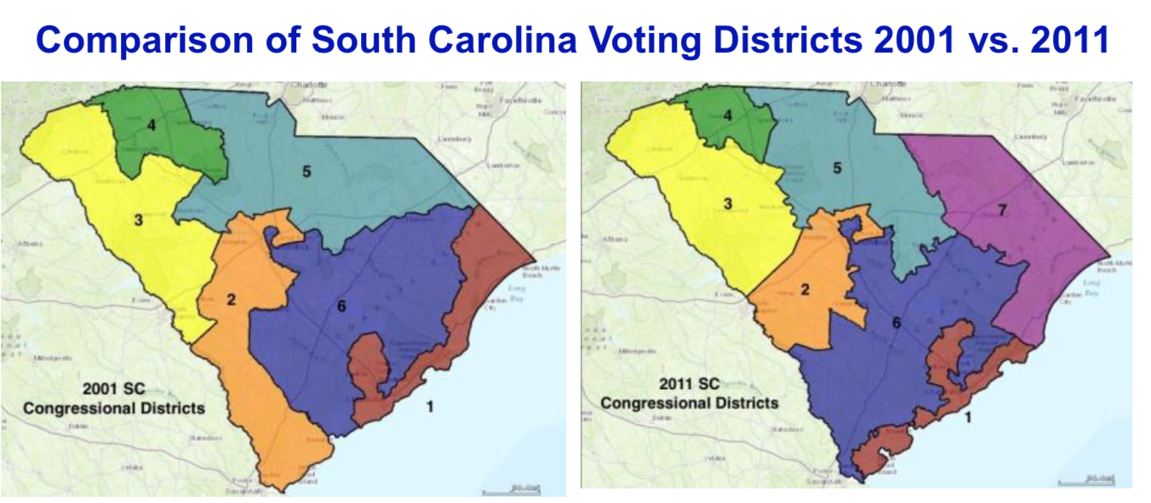

Slide 18
Can you spot the CRACKING and PACKING?

Slide 19
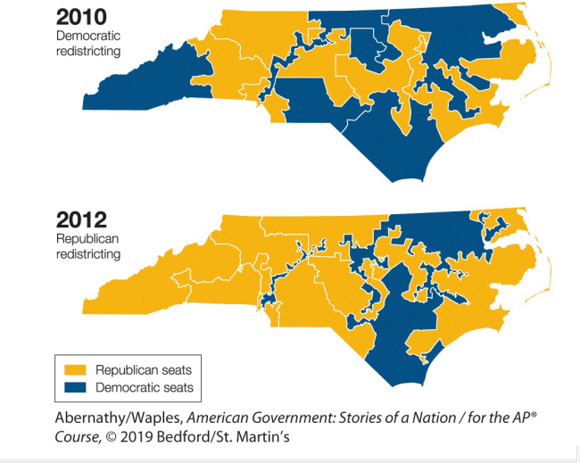
What do the maps illustrate?
A. partisan gerrymandering
B. demographic shifts within a congressional district
C. increase in electoral support for the Republican Party
D. the process of reapportionment

Slide 20
REDISTRICTING
REQUIREMENTS for Gerrymandering to be Legal
District lines must be contiguous
Racial gerrymandering is prohibited (Shaw v. Reno, 1993). Race may not be the primary factor in drawing district lines (but it can be a factor).
Cannot dilute racial minority voting strength
“Communities of interest” may be kept intact
SUPREME COURT REDISTRICTING REQUIREMENTS
Districts must be as near equal in population as possible.
Baker v. Carr, 1962: "one man, one vote" principle applied to state legislative districts to correct overrepresentation (malapportionment) of rural areas.
Wesberry v. Sanders, 1964: applied same principle to House districts.
Even if the number of rep’s to which a state is entitled does not change, it redistricts anyway because of geographic shifts in population that may have occurred within the previous ten years. This solves the problem of malapportionment.
12

Slide 21
Baker v. Carr (1962) – REQUIRED CASE
Issue: Do federal courts have the power to decide cases about the apportionment of population into state legislative districts?
Majority: The Supreme Court decided that the lower court’s decision that courts could not hear this case was incorrect. In a dramatic break with tradition and practice, the majority concluded that federal courts have the authority to enforce the requirement of equal protection of the law against state oﬃcials— including, ultimately, the state legislature itself—if the legislative districts that the state creates are so disproportionally weighted as to deny the residents of the overpopulated districts equivalent treatment with underpopulated districts. The majority concluded that there is no inherent reason why courts cannot determine whether state districts are irrationally drawn in ways that result in substantially diﬀering populations. Even though politics may enter into the drawing of districts, the constitutional guarantee of equal protection is judicially enforceable. A challenge to the diﬀering populations of legislative districts does not present a “political question” that courts are unable to decide.
The Court did not decide whether Tennessee’s districts actually were unconstitutional, however. Instead, the justices instructed the District Court to allow a hearing on the merits of Baker’s claim that the state’s legislative districts violated his 14th Amendment rights. That course established a precedent that dozens of federal courts later followed in allowing disgruntled residents to try to prove that legislative districts are unconstitutionally unbalanced.
Why it matters
1. States were required to apportion the representatives in a way that equally represented all the peoples so that no votes counted any more than others.
2. Fundamentally altered the nature of political representation across the USA. Many states had to re-draw their districts to be in compliance.
3. Got Supreme Court involved in political questions. This is an area mainly left to Congress and the President.

Slide 22
Shaw v. Reno (1993) SUPREME COURT CASES YOU MUST KNOW
Issue: Did the North Carolina residents’ claim that the 1990 redistricting plan discriminated on the basis of race raise a valid constitutional issue under the 14th Amendment’s Equal Protection Clause?
Majority: Yes. In a 5–4 decision, the U.S. Supreme Court decided in favor of Shaw, and sent the case back to the lower court to be reheard.
The case involved the redistricting of North Carolina after the 1990 census. North Carolina submitted to the Department of Justice a map with one majority-minority black district—that is, a district with a black majority. The DoJ believed that the state could have drawn another such majority-minority district in order to improve representation of black voters rather than including them all within one district. The state revised its map and submitted a new plan, this one with two majority-minority districts. Can districts be created solely on the basis of race?
NO, not even if it favors a minority group. Race can be a factor, but not the only factor.
Any redistricting plan that includes people in one district who are geographically disparate and share little in common with one another but their skin color, bears a strong resemblance to racial segregation.
They decided that if a redistricting plan cannot rationally be understood as anything other than an effort to divide voters based on their race, voters may challenge such a district under the Equal Protection Clause.
Bodies doing redistricting must be conscious of race to the extent that they must ensure compliance with the Voting Rights Act.
Supreme Court announced that states may take race into account, they may not make race the sole reason for drawing district lines
Can congressional districts be set up ONLY on the basis of race (even if it is designed to help minorities)? Explain.

Slide 23
Shaw v. Reno (1993) – REQUIRED CASE
Issue: Did the North Carolina residents’ claim that the 1990 redistricting plan discriminated on the basis of race raise a valid constitutional issue under the 14th Amendment’s Equal Protection Clause?
Majority: This case detailed the troublesome history of racial gerrymandering and explained how North Carolina District 12 was similar in many ways to past districts that had been held unconstitutional. The justices said that classiﬁcations of citizens predominantly on the basis of race are undesirable in a free society and conﬂict with the American political value of equality.
The majority said that any redistricting plan that includes people in one district who are geographically disparate and share little in common with one another but their skin color, bears a strong resemblance to racial segregation. They wrote that racial classiﬁcations of any sort promotes the belief that individuals should be judged by the color of their skin. They also said that drawing districts to advance the perceived interests of one racial group may lead elected oﬃcials to see their obligation as representing only members of that group, rather than their constituency as a whole. The justices concluded that racial gerrymandering, even for remedial purposes, may “balkanize us into competing racial factions; it threatens to carry us further from the goal of a political system in which race no longer matters.”

Slide 24
Shaw v. Reno (1993) – REQUIRED CASE
The Court was tasked with deciding the grounds on which voters could challenge voting districts as racial gerrymanders. They decided that if a redistricting plan cannot rationally be understood as anything other than an eﬀort to divide voters based on their race, voters may challenge such a district under the Equal Protection Clause. Therefore, the case was sent back to the lower court to determine if the North Carolina plan could be justiﬁed in terms other than race.
Why it matters?

Slide 25
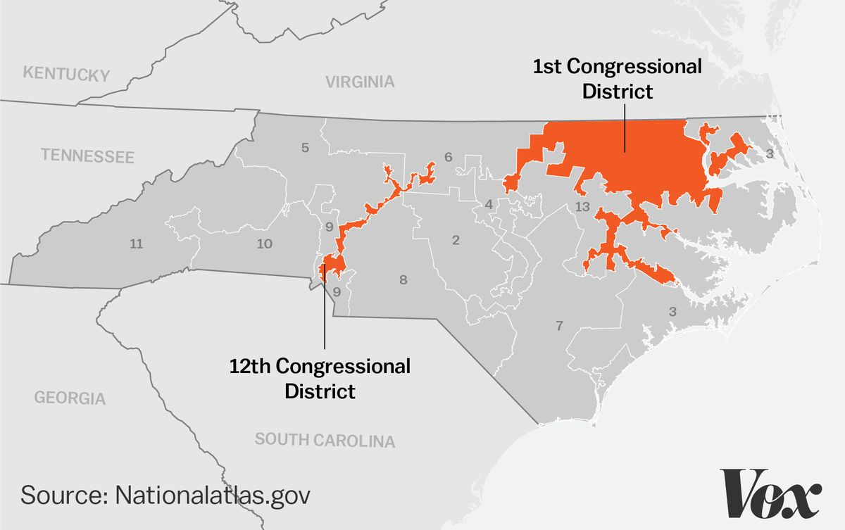

Slide 26
Shaw v. Reno (1993)
Issue: Did the North Carolina residents’ claim that the 1990 redistricting plan discriminated on the basis of race raise a valid constitutional issue under the 14th Amendment’s Equal Protection Clause? Majority: Yes. In a 5–4 decision, the U.S. Supreme Court decided in favor of Shaw, and sent the case back to the lower court to be reheard.

Slide 27
Shaw v. Reno (1993)
The case involved the redistricting of North Carolina after the 1990 census. North Carolina submitted to the Department of Justice a map with one majority-minority black district—that is, a district with a black majority. The DoJ believed that the state could have drawn another such majority-minority district in order to improve representation of black voters rather than including them all within one district. The state revised its map and submitted a new plan, this one with two majority-minority districts. Can districts be created solely on the basis of race?
NO, not even if it favors a minority group. Race can be a factor, but not the only factor.

Slide 28
Shaw v. Reno (1993)
Any redistricting plan that includes people in one district who are geographically disparate and share little in common with one another but their skin color, bears a strong resemblance to racial segregation.
They decided that if a redistricting plan cannot rationally be understood as anything other than an effort to divide voters based on their race, voters may challenge such a district under the Equal Protection Clause.
Bodies doing redistricting must be conscious of race to the extent that they must ensure compliance with the Voting Rights Act.
Supreme Court announced that states may take race into account,
they may not make race the sole reason for drawing district lines

Slide 29
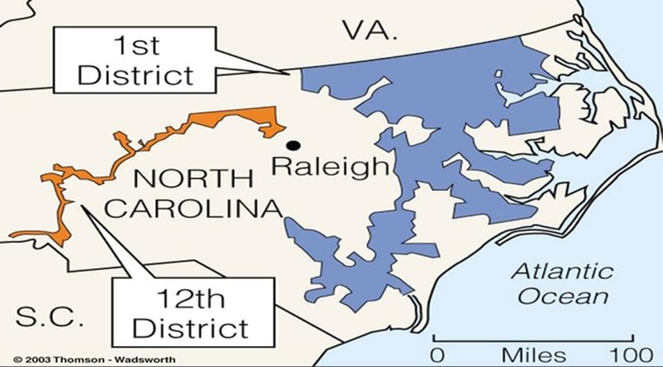
ESSENTIAL QUESTION CFU
Can congressional districts be set up ONLY on the basis of race (even if it is designed to help minorities)?

Slide 30
2008 AP Gov FRQ #1
Congressional reapportionment and redistricting are conducted every ten years. When redistricting is conducted, politicians often engage in gerrymandering.
Define congressional reapportionment and explain one reason why it is important to states.
Define congressional redistricting.
Explain two goals of politicians when they gerrymander during redistricting.
Describe two limits that the United States Supreme Court has placed on congressional redistricting.

Slide 31
RUBRIC 2008 #1
congressional reapportionment is the reallocation of the number of representatives each state has in the House of Representatives.
a. Reapportionment increases or decreases the number of seats a state has in the House/Congress (not the Senate).
• More representatives mean that a state has more influence.
• Reapportionment increases or decreases a state’s number of electoral votes.
The explanation point must be tied to an appropriate definition of reapportionment.
b. congressional redistricting The drawing/redrawing of House/congressional (not Senate) district lines.
C. Explanations of the goals of politicians when they gerrymander during redistricting:
• To enhance political party strength/to minimize the strength of the opposition party.
• To protect incumbents/to discourage challengers.
• To increase minority representation/to decrease minority representation.
• To punish foes/to reward friends.
NOTE: “Cracking” or “packing” must be tied to one of the above in order to earn the explanation point.

Slide 32
RUBRIC 2008 #1
Part (d): 2 points One point is earned for each of two descriptions of limits that the United States Supreme Court has placed on congressional redistricting.
Acceptable descriptions may include:
• Districts must be equally populated.
• Lines must be contiguous or connected.
• Redistricting cannot dilute minority voting strength.
• District lines cannot be drawn solely based upon race.
• Districts must be compact.
• Communities of interest must be protected.

Slide 33
The Trend Towards Party Polarization in Congress
Two parties more ideologically pure (Republicans more conservative, Dems more liberal)
Strict party-line voting the norm i.e. majority of Dems oppose majority of Reps/vice versa
Fewer moderates in either party (especially GOP)
Gerrymandered House districts major cause

Slide 34
Consequences of Party Polarization
Toxic atmosphere in Congress > lack of cooperation
Failure to compromise or build consensus
More extreme positions on issues by parties
Legislative gridlock > “nothing gets done”

Slide 35
“There are no moderates left in Congress”
“Gridlock”
Party polarization,
Partisanship, refusal to compromise, = GRIDLOCK
How can checks and
Balances facilitate
Gridlock?
How can checks and
Balances facilitate
Gridlock?

Slide 36
“There are no moderates left in Congress”
“Gridlock”
Party polarization,
Partisanship, refusal to compromise, = GRIDLOCK
How can checks and Balances facilitate
Gridlock?
Checks and balances limit the ability of one branch of government to carry out its responsibilities and thus facilitate gridlock.
The Mid-Term elections??

Slide 40
INCUMBENCY ADVANTAGE: GERRYMANDERING adds to gridlock. Better know how?
Number of Rep's per state is determined by population
Census conducted every 10 years
Census will show population changes in states
These changes must be reﬂected in state representation in House
If a state gains signiﬁcantly in population, it will probably gain some seats
If a state loses population or does not gain as much as other states, it will probably lose some seats
Congressional reapportionment - Reallocation of 435 seats in the House of Representatives based on changes in residency/population found in census
Total House seats set at 435 by the Reapportionment Act of 1929
Increase/decrease state’s electoral vote
Increase/decrease state’s inﬂuence in Congress
For every 710,767 people in a district = 1 Representative (2010 Census)

Slide 41
INCUMBENCY ADVANTAGE: GERRYMANDERING Key Terms Review
Apportionment- the distribution of the 435 seats in the HR among the 50 states based on each state’s population.
-Every state gets at least 1 seat; states with higher populations get additional seats
Reapportionment- the process by which congressional districts are redrawn and seats are redistributed among states in the house. Reapportionment occurs every ten years, when census data reports shifts in the population of districts.
Redistricting. The redrawing of congressional and other legislative district lines following the census, to accommodate population shifts and keep districts as equal as possible in population. Gerrymandering. The drawing of legislative district boundaries to benefit a party, group, or incumbent. This is done by states to benefit the party in power.
https://www.youtube.com/watch?v=N-dEYhcR2LY 1:35
9

Slide 42
Congress’s Public Image
Congress has a very low approval rating among voters. Seen as do nothing and uncaring. Multiple scandals did not help either.
Yet Congress receives 60% approval rating from their constituents.
“Not my Rep or Senator is bad, just yours”. Thus, the high incumbency rate.
Factors That Influence Congressional Behavior | Impact Of Congressional Behavior
Voting Models | Delegate model reflects the constituents will Trustee model has the representative voting in the way they feel is best for their constituency Political model blend of older models
Redistricting | Reshaping of a congressional district based on census data. The Supreme court will intervene in gerrymandering created an unfair situation for minorities (like in Baker v Carr and Shaw v Reno) or creates an advantage for one party.
Divided Government | Creates gridlock especially in the confirmation process for judicial nominations and in legislation or divisive issues

Slide 43
ESSENTIAL QUESTION CFU
Explain to your partner three of the advantages of the incumbent. Other partner, explain three different advantages of the incumbent. Younger student goes first.
16

Slide 44
JOB APPROACHES
Deﬁne direct democracy
Deﬁne republican form of government
Why did the founders choose a republic?
Ways a congressperson can do their job/vote
Trustee: based on own idea of what’s best
Delegate: based on constituent’s desires
Partisan: follow party lines
Politico: balance other approaches; depends on issues/circumstances
Why might candidate change between approaches at times?
How does a lame duck president inﬂuence the way a congress person votes?

Slide 45
Different Role Conception
Senators and representatives are elected to represent people. As legislators, they have four voting options:
Trustee: Decisions made by elected official using their own personal views or decisions made by the elected official based on the public good and not on the basis of constituents’ views | Delegate: Decisions made by the elected official mirror the constituents’ views, represent constituents’ views, or do what voters tell them to do.
Partisan Lawmakers who owe their allegiance to their political party first | Politico Legislators should follow their own judgment (that is, act like a trustee) until the public becomes vocal about a particular matter, at which point they should follow the dictates of constituents. It’s a combo

