Slide 1
Chpt. 11 Topics 3.10-3.13
UNIT 3
AMSCO pg. 341-391
Supreme Court Case
Brown v. Board of Education
Foundational Document
Letter from a Birmingham Jail
3.10 Social Movements and Equal Protection

Slide 2
3.10 The Fourteenth Amendment’s equal protection clause as well as other constitutional provisions have often been used to support the advancement of equality.
Civil rights protect individuals from discrimination based on characteristics such as race, national origin, religion, and sex; these rights are guaranteed to all persons under the due process and equal protection clauses of the U.S. Constitution, as well as acts of Congress.
The civil rights movement, the women’s rights movement, and advocacy for LGBTQ rights are evidence of how the equal protection clause can support and motivate social movements, as represented by:
i. Dr. Martin Luther King’s “Letter from a Birmingham Jail” and the civil rights movement of the 1960s
ii. The National Organization for Women and
the women’s rights movement
iii. The pro-life and pro-choice movements
Explain how constitutional
provisions have
supported and motivated
social movements.

Slide 3
3.10 The Fourteenth Amendment’s equal protection clause as well as other constitutional provisions have often been used to support the advancement of equality.
Explain how constitutional
provisions have
supported and motivated
social movements.
Civil rights protect individuals (applied to groups) from discrimination based on characteristics such as race, national origin, religion, and sex; these rights are guaranteed to all citizens under the due process and equal protection clauses of the U.S. Constitution, as well as acts of Congress
The leadership and events associated with civil, women’s, and LGBT rights are evidence of how the equal protection clause can support and motivate social movements, as represented by:
Dr. Martin Luther King’s “Letter from a Birmingham Jail” and the civil rights movements of the 1960s
The National Organization for Women and the women’s rights movement
The pro-life (anti-abortion) movement

Slide 4
3.11 Government Responses to Social Movements
Public policy promoting civil rights is influenced by citizen-state interactions and constitutional interpretation over time.
Explain how the government has responded to social movements.
The government can respond to social movements through court rulings and/or policies.
i. Supreme Court decisions which declared that race-based school segregation violates the Fourteenth Amendment’s equal protection clause.
ii. The Civil Rights Act of 1964 prohibits discrimination in public places, provides for the integration of schools and other public facilities, and makes employment discrimination illegal.
iii. Title IX of the Education Amendments Act of 1972 prohibits sex discrimination in any education program or activity receiving federal financial assistance.
iv. The Voting Rights Act of 1965 prohibits racial discrimination in voting.
REQUIRED FOUNDATIONAL DOCUMENT
The Constitution of the United States
REQUIRED SUPREME COURT CASE
Brown v. Board of Education (1954

Slide 5
3.11 Government Responses to Social Movements
Public policy promoting civil rights is influenced by citizen-state interactions and constitutional interpretation over time.
Explain how the government has responded to social movements.
The government can respond to social movements through court rulings and/ or policies.
Brown v. Board of Education (1954), which declared that race-based school segregation violates the Fourteenth Amendment’s equal protection clause
The Civil Rights Act of 1964
Title IX of the Education Amendments Act of 1972
The Voting Rights Act of 1965
REQUIRED FOUNDATIONAL DOCUMENT
The Constitution of the United States
REQUIRED SUPREME COURT CASE
Brown v. Board of Education (1954

Slide 6
3.12 Balancing Minority and Majority Rights
The Court’s interpretation of the U.S. Constitution is influenced by the composition of the Court and citizen-state interactions. At times, it has restricted minority rights and, at others, protected them
Decisions demonstrating that minority rights have been restricted at times and protected at other times include:
i. State laws and Supreme Court holdings based on the “separate but equal” doctrine restricting African American access to the same restaurants, hotels, schools, etc., as the majority white population
ii. Court decisions declaring that race-based school segregation violates the Fourteenth Amendment’s equal protection clause
iii. The Supreme Court upholding the rights of the majority in cases that limit and prohibit majority-minority districting
REQUIRED SUPREME COURT CASE
Brown v. Board of Education (1954)
Explain how the Court has at times allowed the restriction of the civil rights of minority groups and at other times has protected those rights.

Slide 7
3.12 Balancing Minority and Majority Rights
The Court’s interpretation of the U.S. Constitution is influenced by the composition of the Court and citizen-state interactions. At times, it has restricted minority rights and, at others, protected them
Decisions demonstrating that minority rights have been restricted at times and protected at other times include:
State laws and Supreme Court holdings restricting African-American access to the same restaurants, hotels, schools, etc., as the majority white population based on the “separate but equal” doctrine.
Brown v. Board of Education (1954), which declared that race-based school segregation violates the Fourteenth Amendment’s equal protection clause
The Supreme Court upholding the rights of the majority in cases that limit and prohibit majority-minority districting.
REQUIRED SUPREME COURT CASE
Brown v. Board of Education (1954)
Explain how the Court has at times allowed the restriction of the civil rights of minority groups and at other times has protected those rights.

Slide 8
Defining Civil Rights
Civil rights are the constitutional rights of all persons, not just citizens, to due process and the equal protection of the laws: the constitutional right not to be discriminated against by governments or individuals because of race, ethnic background, religion, or gender.
Civil Rights
14th Amendment issues
Action required of the government to ensure equality
Protects against discriminatory
treatment. Meant to protect GROUPS from unfair
treatment.
What Types of Discriminatory Treatment Have Groups Faced?
Racial Discrimination
Gender Discrimination
Discrimination based on age, disability, sexual orientation and other factors

Slide 9
What is the Difference between Civil Rights and Civil Liberties?
Civil liberties are the fundamental rights and freedoms of individuals that are protected from unreasonable government restriction.
Civil liberties are guaranteed in the Bill of Rights and protect individuals from the government
Civil rights refers to the governments protection of individuals from discrimination as members of particular group
The protection of civil liberties requires that a government does not infringe on the freedom of individuals
Civil rights require positive action by the government to protect individuals from discrimination in a particular group ie, race (ethnicity), gender, religion.

Slide 10
Slavery and Involuntary Servitude
The Emancipation Proclamation was an executive order that Pres. Lincoln issued. Lincoln feared that the Emancipation Proclamation would one day be overturned by a court or
Congress would pass a law making the Proclamation illegal and thus usher a return of slavery.

Slide 11
Slavery and Involuntary Servitude
The 13th Amendment made slavery illegal in the United States and it also protects against involuntary servitude. 13th amendment was done to codify the Emancipation Proclamation.

Slide 12
THE FOURTEENTH AMENDMENT
All persons born or naturalized in the United States and subject to the jurisdiction thereof, are citizens of the United States and of the State wherein they reside. No State shall make or enforce any law which shall abridge the privileges or immunities of citizens of the United States; nor shall any State deprive any person of life, liberty, or property, without due process of law; nor deny to any person within its jurisdiction the equal protection of the laws.
Does treating people equal mean treating people the same?

Slide 13
Jim Crow Era and Separate, but Equal
13th, 14th, and 15th Amendments were known as the Civil War Reconstruction) amendments and were designed to help African Americans.
When Reconstruction ended in 1877 and the North left the South, the South responded.
The Southern states would pass Jim Crow Laws, which were
laws aimed at separating minorities from the white population. They wanted to place black Americans in a system close to slavery as the law would permit.
Almost twenty years later, the Supreme Court under Melville Fuller would listen to the famous case of Plessy v. Ferguson (1896). They ruled 7-1 that separate facilities were NOT UNCONSTITUTIONAL provided they were equal.
This motto would be known as “Separate, but Equal.”
Chief Justice Fuller

Slide 14
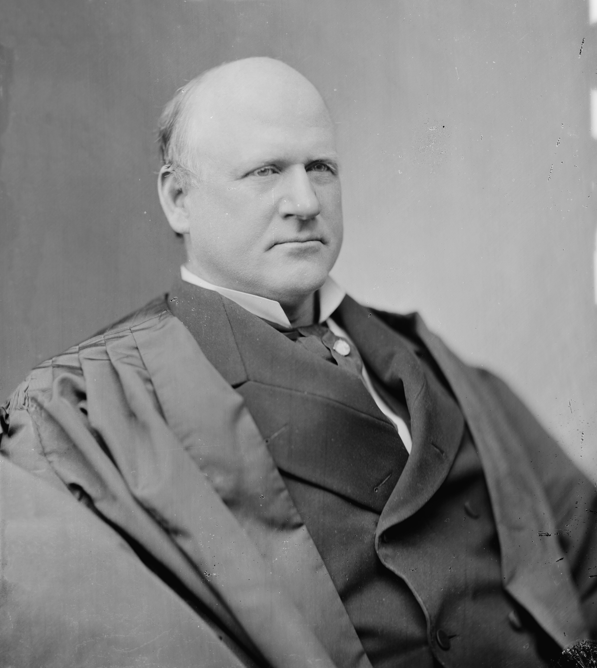
Justice John Marshall Harlan
The lone dissenter in the Plessy v. Ferguson case
“Our Constitution is color-blind and neither knows nor tolerates classes among citizens.”

Slide 15
Justice John Marshall Harlan: lone dissenter on Plessy
The white race deems itself to be the dominant race in this country. And so it is, in prestige, in achievements, in education, in wealth, and in power. So, I doubt not, it will continue to be for all time, if it remains true to its great heritage and holds fast to the principles of constitutional liberty. But in the view of the Constitution, in the eye of the law, there is in this country no superior, dominant, ruling class of citizens. There is no caste here. Our Constitution is color-blind and neither knows nor tolerates classes among citizens. In respect of civil rights, all citizens are equal before the law. The humblest is the peer of the most powerful. The law regards man as man and takes no account of his surroundings or of his color when his civil rights as guaranteed by the supreme law of the land are involved....
The arbitrary separation of citizens, on the basis of race, while they are on a public highway, is a badge of servitude wholly inconsistent with the civil freedom and the equality before the law established by the Constitution. It cannot be justified upon any legal grounds
http://chnm.gmu.edu/courses/nclc375/harlan.html

Slide 16
Educational segregation in the U.S. prior to Brown v.
Board

Slide 17
3.12 Balancing Minority and Majority Rights
The Court’s interpretation of the U.S. Constitution is influenced by the composition of the Court and citizen-state interactions. At times, it has restricted minority rights and, at others, protected them
Explain why a change in the composition of the United States Supreme Court could change the interpretation of the Constitution used in the Plessy and Brown case?
https://study.com/learn/lesson/strict-vs-loose-construction-outline-analysis.html

Slide 18
Brown v. Board of Education (1954)
Issue: Does segregation of public schools by race violate the Equal Protection Clause of the 14th Amendment?
Majority: Chief Justice Earl Warren delivered the unanimous opinion of the Court, ruling that segregation in public schools violates the 14th Amendment’s Equal Protection Clause.
The Court noted that public education was central to American life. Calling it “the very foundation of good citizenship,” they acknowledged that public education was not only necessary to prepare children for their future professions and to enable them to actively participate in the democratic process, but that it was also “a principal instrument in awakening the child to cultural values” present in their communities. The justices found it very unlikely that a child would be able to succeed in life without a good education. Access to such an education was thus “a right which must be made available to all on equal terms.”

Slide 19
Brown v. Board of Education (1954)
The justices then said that separating children solely on the basis of race created a feeling of inferiority in the “hearts and minds” of African-American children. Segregating children in public education created and perpetuated the idea that African-American children held a lower status in the community than white children, even if their separate educational facilities were substantially equal in “tangible” factors.
(1954) Brown case was the end of segregation

Slide 20
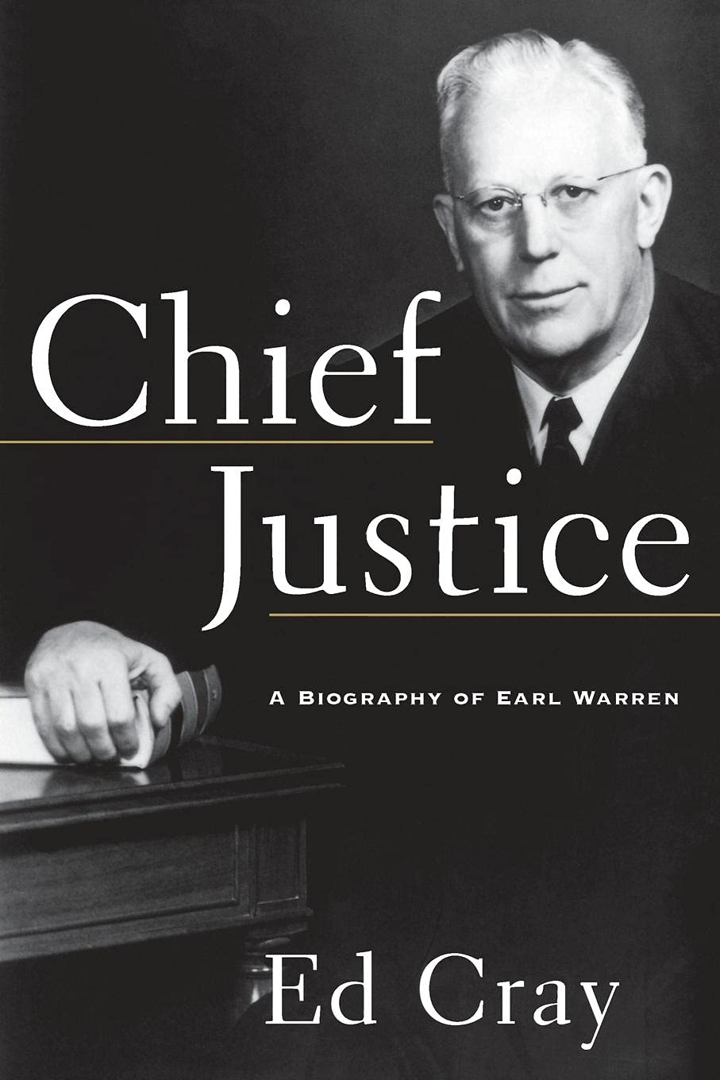
In writing the opinion for the Court, Chief Justice Warren said, “Does segregation of children in public schools solely on the basis of race, even though the physical facilities and other tangible factors may be equal, deprive the children of the minority group of equal educational opportunities? We believe that it does
. . . . To separate them from others of similar age and qualifications solely because of their race generates a feeling of inferiority as to their status in the community that may affect their hearts and minds in a way unlikely ever to be undone. . . . Separate educational facilities are inherently unequal.”
-Chief Justice Earl Warren

Slide 21
Brown v. Board of Education (1954)
FACTS: Black students in many states were denied admittance into public schools based on race (ethnicity). Resulting from Plessy v. Ferguson (1896)- Separate but equal doctrine.
Decision: Racial segregation in public schools permitted by sep but equal of Plessy v. Ferguson was found to be unconstitutional. | Constitutional Principle: Racially segregated schools was a violation of the 14th am equal protection clause.
Why it matters? It required the desegregation of public schools. It furthered the civil rights movements goals of integration in all aspects of society.

Slide 22
Brown v. Board of Education, 1954
Thurgood Marshall, NAACP- used the courts (litigation) to end segregation
Declared state laws establishing separate public schools for black and white students unconstitutional and ordered them to be integrated
Overturned the Plessy case
“Separate educational facilities are
inherently unequal"
The Supreme Court was the institution most responsible for advancing the African American Civil Rights Movement
Movie worth watching!

Slide 23
BROWN V. BOARD OF EDUCATION II (1955)
One year later, the Court addressed the implementation of its decision in a case known as Brown v. Board of Education II. Chief Justice Warren once again wrote an opinion for the unanimous court.
The Court acknowledged that desegregating public schools would take place in various ways, depending on the unique problems faced by individual school districts. After charging local school authorities with the responsibility for solving these problems, the Court instructed federal trial courts to oversee the process and determine whether local authorities were desegregating schools in good faith, mandating that desegregation take place with “with all deliberate speed.”
Title VI of the Civil Rights Act of 1964 stipulates that federal dollars under any grant or project be withdrawn from a school that discriminates (Civil Rights Act of 1964 essentially ends Jim Crow laws)
Brown II (1955) was the process of integration

Slide 24
When the Supreme Court overturned the Plessy decision with the Brown decision was this judicial activism or judicial restraint? Explain
Explain why a change in the composition of the United States Supreme Court could change the interpretation of the Constitution used in the Plessy and Brown case?
If there is an ideological shift and the Court went from being a majority liberal to a majority conservative
Strict constructionist v loose constructionist view
Judicial activism v. Judicial restraint
https://www.youtube.com/watch?v=nvHcWmC4_eM

Slide 25
Percentage of Black Students Attending School with any Whites in Southern States

Slide 26
FROM SEGREGATION TO DESEGREGATION
de jure segregation – segregation
imposed by law
Supreme Court sustained the right of judges to order busing to overcome de jure segregation
de jure segregation doesn’t exist in America today
de facto segregation – segregation resulting from economic or social conditions or personal choice/ tradition
The Court has refused to permit judges to order busing to overcome the effects of de facto segregation
de facto segregation still exists in America legally today (i.e. neighborhoods)
13

Slide 27
ESSENTIAL QUESTION CFU
What role did the 14th Amendment play in Brown v. Board of Education (1954)?
Which case was overturned as a result of Brown v. Board of Education?
3. How did Brown v. Board of Education strengthen minority rights?
14

Slide 28
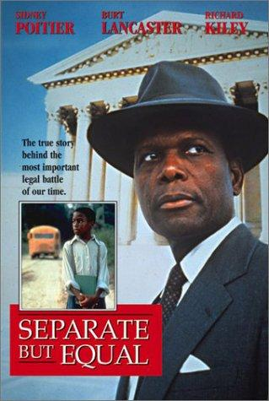
A dramatization of the American court case that destroyed the legal validity of racial segregation.

Slide 29
MLK and the Civil Rights Movement
Dr. Martin Luther King Jr.
Montgomery bus boycott
Birmingham March
March on Washington
Civil disobedience
Woolworth sit-ins
Freedom Summer
Voting Rights
Militant Movement
Malcolm X, Nation of Islam, separatist
Black Panthers

Slide 30
MLK and the Civil Rights Movement: The March on Washington, August 28, 1963
Why did MLK go to DC?
Since most African Americans were prevented form voting, many took to other forms of political participation-mainly demonstrations. Mass public demonstrations put pressure on politicians to act. They need the votes. Many protesters were white northerners. Public opinion was turning against segregation.
Because the CR Bill was stuck in Congress. The protest was meant to put pressure on Cong to get the bill to JFK. The march was broadcasted live around the world.
JFK was murdered Nov 1963. The bill remained in Congress. LBJ would push this bill and sign it into law as the CR Act of 1964.

Slide 31
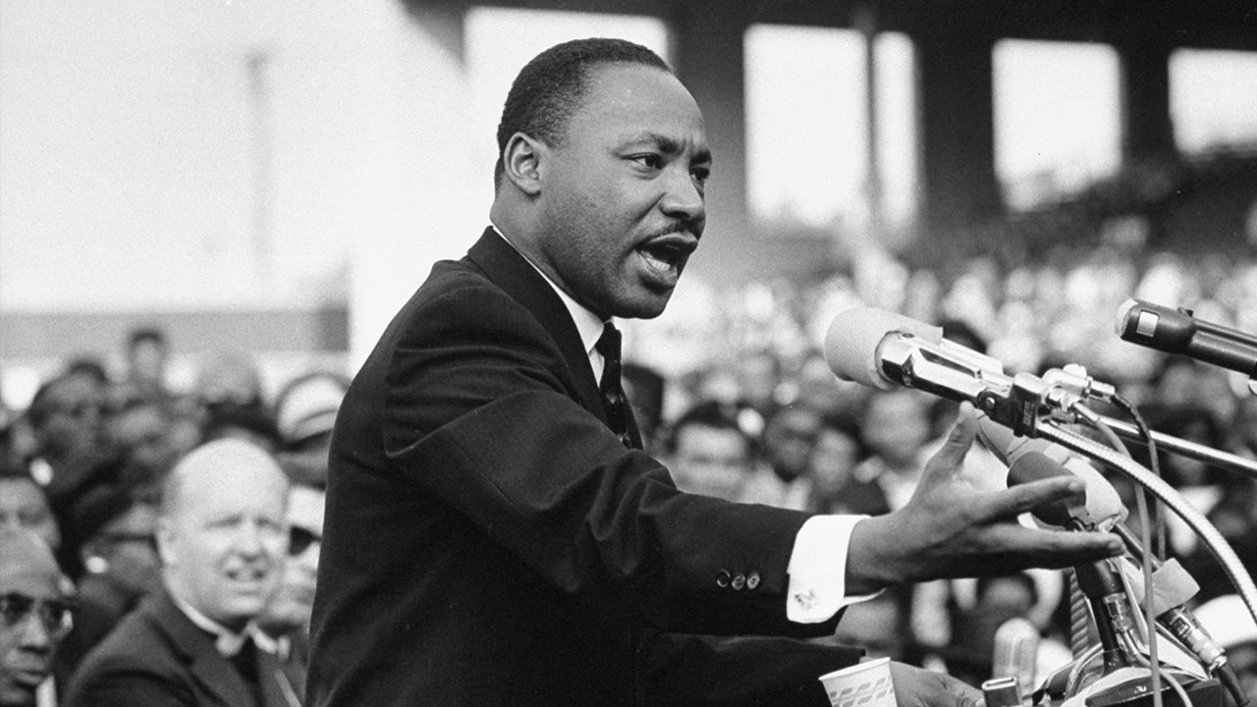
“In a sense, we have come to our nation's capital to cash a check. When the architects of our republic wrote the magnificent words of the Constitution and the Declaration of Independence, they were signing a promissory note to which every American was to fall heir.
This note was a promise that all men, yes, black men as well as white men, would be guaranteed the inalienable rights of life, liberty, and the pursuit of happiness.
It is obvious today that America has defaulted on this promissory note insofar as her citizens of color are concerned. Instead of honoring this sacred obligation, America has given the Negro people a bad check, a check which has come back marked "insufficient funds." But we refuse to believe that the bank of justice is bankrupt. We refuse to believe that there are insufficient funds in the great vaults of opportunity of this nation. So we have come to cash this check — a check that will give us upon demand the riches of freedom and the security of justice.”
MLK, 1963 March on Washington

Slide 32
In 1963, MLK organized a march to integrate Birmingham, Alabama
MLK’s strategy was to confront segregation through peaceful marches, rallies, & boycotts
Dr. King called Birmingham “the most segregated big city in the South”

Slide 33
During the march in Birmingham, MLK was arrested
MLK was arrested and jailed on April 16, 1963, during anti-segregation protests in Birmingham, Alabama. While in jail, MLK wrote an open letter called “Letter from a Birmingham Jail” in response to white leaders who believed King was pushing too fast towards civil rights.

Slide 34
YOU MUST READ King’s “Letter from a Birmingham Jail”

Slide 35
YOU MUST READ King’s “Letter from a Birmingham Jail”
Letter from Birmingham Jail
It is a thesis for a social movement for policy changes
freedom is never voluntarily given by the oppressor; it must be demanded by the oppressed.
Can be interpreted as demanding the fulfillment of the Declaration of Independence and the constitution’s 14th amendment equal protection clause
On the basis of these conditions, Negro leaders sought to negotiate with the city fathers. But the latter consistently refused to engage in good faith negotiation.
“… secure the Blessings of Liberty to ourselves and our Posterity, do ordain and establish this Constitution…” US Constitution
We have waited for more than 340 years for our constitutional and God-given rights.
“All men are created equal…” Dec. of Independence

Slide 36
CIVIL RIGHTS ACT OF 1964 March on Washington Pays off
Ended segregation in public places (i.e. hotels and restaurants) and banned employment discrimination on the basis of race, color, religion, sex or national origin >> ended Jim Crow Laws
Title II (of Civil Rights Act of 1964): Places of public accommodation
Makes it a federal offense to discriminate against any customer or patron in a place of public accommodation because of race, color, religion, or national origin
Heart of Atlanta Motel v. U.S. (1964) - Congress has a right to regulate individual businesses in the interest of promoting interstate travel/ commerce
Commerce Clause used to justify
Title VII (of Civil Rights Act of 1964): Employment
Makes it illegal for any employer in any industry affecting interstate commerce and employing 15 or more people to discriminate in employment practices against any person because of race, color, national origin, religion, or sex
14th Amendment equal protection clause used to justify

Slide 37
ESSENTIAL QUESTION
How did Dr. Martin Luther King’s “Letter from a Birmingham Jail” help the civil rights movement of the 1960s?
Why was the Civil Rights Act of 1964 so monumental? What did many Southern Democrats do as a result of the legislation?
After the death of President Kennedy in November 1963, it was the new president’s job, Lyndon Johnson, to continue Kennedy’s legacy.
During his term in office (63-69), Johnson signed two important legislative laws:
Civil Rights Act of 1964: Made discrimination by private business and state and local governments illegal.
Civil Rights Act of 1968: Prohibited racial discrimination in the sale and rental of housing.
21

Slide 38
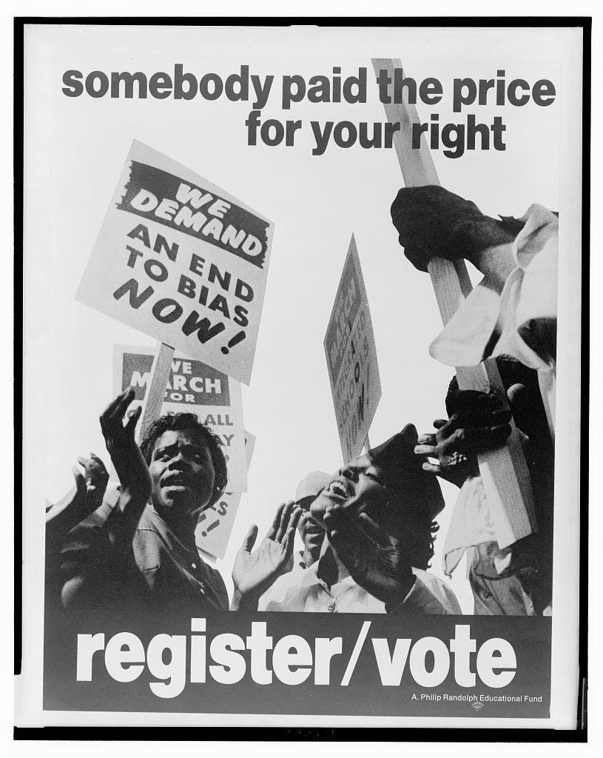
VOTING RIGHTS – PROTECTING VOTING RIGHTS
After federal troops withdrew from the South in 1877, southern Democrats used social pressure, violence, and terrorist activities to keep African-Americans from voting
Southern States created Jim Crow laws that made it difficult or impossible for African-Americans to vote; use of grandfather clause to keep white people voting

Slide 39
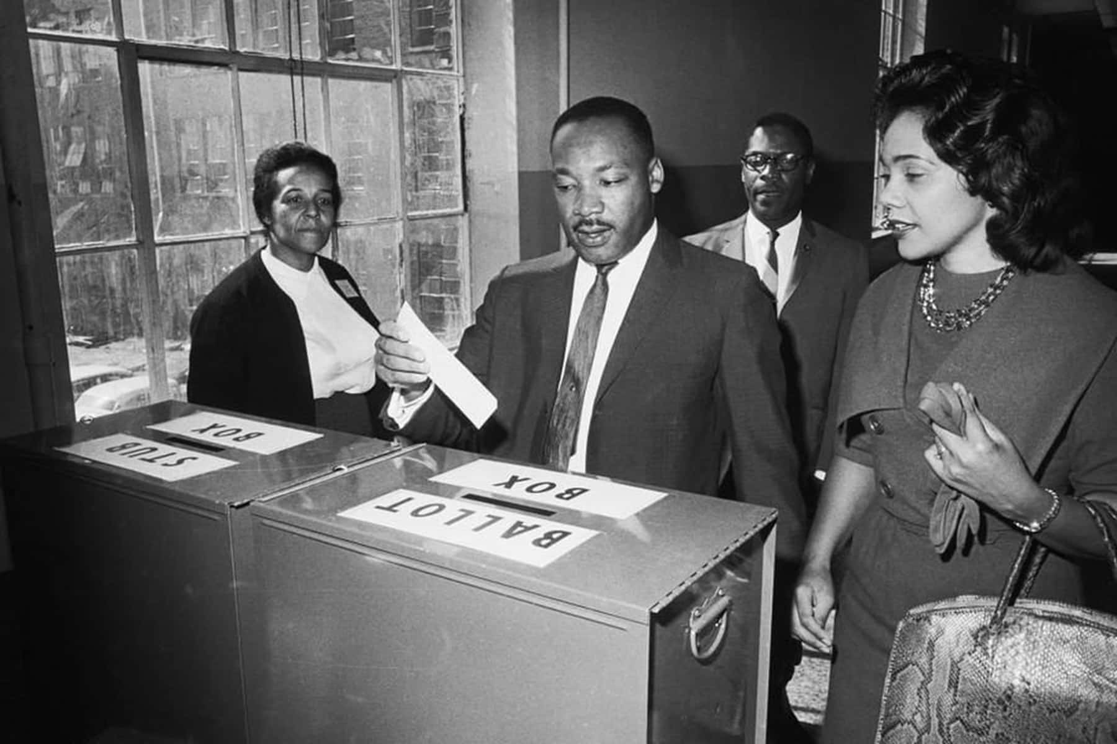
Give Us the Ballot…. MLK, 1957
“Give us the ballot, and we will no longer have to worry the federal government about our basic rights.
Give us the ballot (Yes), and we will no longer plead to the federal government for passage of an anti-lynching law; we will by the power of our vote write the law on the statute books of the South (All right) and bring an end to the dastardly acts of the hooded perpetrators of violence.
Give us the ballot (Give us the ballot), and we will transform the salient misdeeds of bloodthirsty mobs (Yeah) into the calculated good deeds of orderly citizens.
Give us the ballot (Give us the ballot), and we will fill our legislative halls with men of goodwill (All right now) and send to the sacred halls of Congress men who will not sign a “Southern Manifesto” because of their devotion to the manifesto of justice. ⁵(Tell ’em about it)
Give us the ballot (Yeah), and we will place judges on the benches of the South who will do justly and love mercy (Yeah), and we will place at the head of the southern states governors who will, who have felt not only the tang of the human, but the glow of the Divine.
Give us the ballot (Yes), and we will quietly and nonviolently, without rancor or bitterness, implement the Supreme Court’s decision of May seventeenth, 1954. (That’s right)”

Slide 40
VOTING RIGHTS – PROTECTING VOTING RIGHTS
Other devices used to keep African Americans from voting
White primary - were primary elections held in the Southern United States in which only white voters were permitted to participate. Primary operated by the Democratic party in southern states; ruled unconstitutional by Sup Court. https://www.tshaonline.org/handbook/entries/white-primary
Racial gerrymandering - the drawing of election districts to ensure that African Americans would be a minority in all districts – unconstitutional (15th Amendment)
Poll tax
Registration requirements
Literacy tests

Slide 41
24th Amendment – NO POLL TAXES
After the Fifteenth Amendment to the Constitution extended the vote to black men in 1870, many southern states instituted poll taxes to prevent blacks from voting.
Eligible voters were required to pay their poll tax before they could cast a ballot.
A “grandfather clause” excused some poor whites from payment if they had an ancestor who voted before the Civil War, but there were no exemptions for African Americans.
24th Amendment (1964) - Banned poll taxes
Modern-day question: Does having to show ID at a polling place constitute a “poll tax”?

Slide 42
VOTING RIGHTS ACT OF 1965
Provisions
Requires that states that had a history of denying African-Americans the right to vote must clear any changes in any voting practice or laws that might result in dilution of voting power with the Department of Justice (some has since been struck down)
Eliminated literacy tests
Empowered federal officials to register voters
Empowered federal officials to ensure that citizens could vote (w/ marshals)
Empowered federal officials to count ballots
Requires states to include ballots in languages other than English if a significant number of non-English speakers reside in an area
24

Slide 43
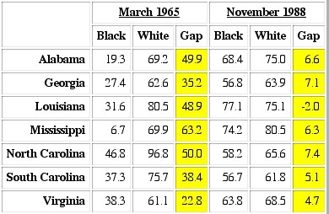
VOTING RIGHTS ACT OF 1965
Effects
Huge increase in black voter turnout
Large increase in number of black elected officials
Forced white elected officials to take into account the needs of blacks

Slide 44
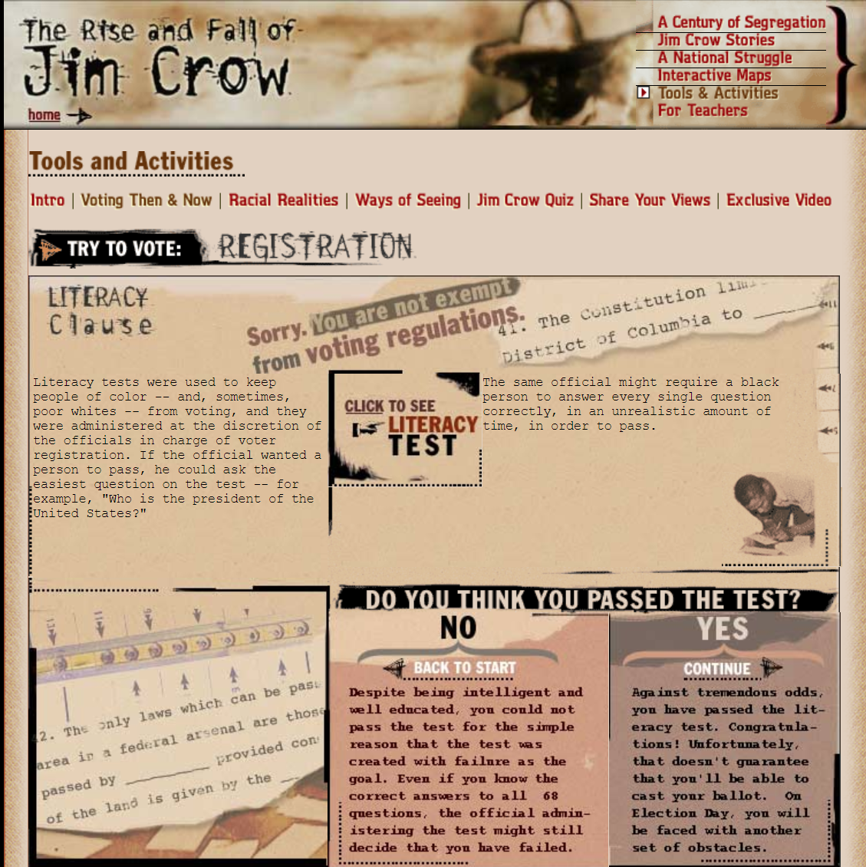
Play the Literacy Test Game
https://www.thirteen.org/wnet/jimcrow/voting_literacy.html

Slide 45
CIVIL RIGHTS ACT OF 1968 (FAIR HOUSING ACT)
Forbids owners to refuse to sell or rent to any person because of race, color, religion, national origin, sex (since 1978), handicap, or because a person has children (since 1988)
25

Slide 46
ESSENTIAL QUESTION CFU
What was the impact of the 24th Amendment and the Voting Rights Act of 1965?
26

Slide 47
Social Movements | Constitutional and Legal Provisions for Social Movements
• African American civil rights • Women’s rights • LGBTQ rights | The Fourteenth Amendment’s equal protection clause and the due process clause of the Fifth and Fourteenth Amendments are the foundation for all of the movement’s actions. • The Nineteenth Amendment (1920) granted women the right to vote. • The Equal Pay Act (1963) required employers to pay men and women the same wage for the same job. • The Civil Rights Act of 1964 guaranteed all citizens due process and equal protection clauses in the Constitution. • Title IX of the Education Amendments Act of 1972 guaranteed that women have the same educational opportunities as men in programs receiving federal government funding. • Lawrence v. Texas (2003) struck down a law that criminalized homosexual behavior. The equal protection clause voided this law because the statute specifically singled out gays and lesbians. • In Obergefell v. Hodges (2015) the Court ruled 5:4 that states preventing same-sex marriage violated the Constitution.

Slide 48
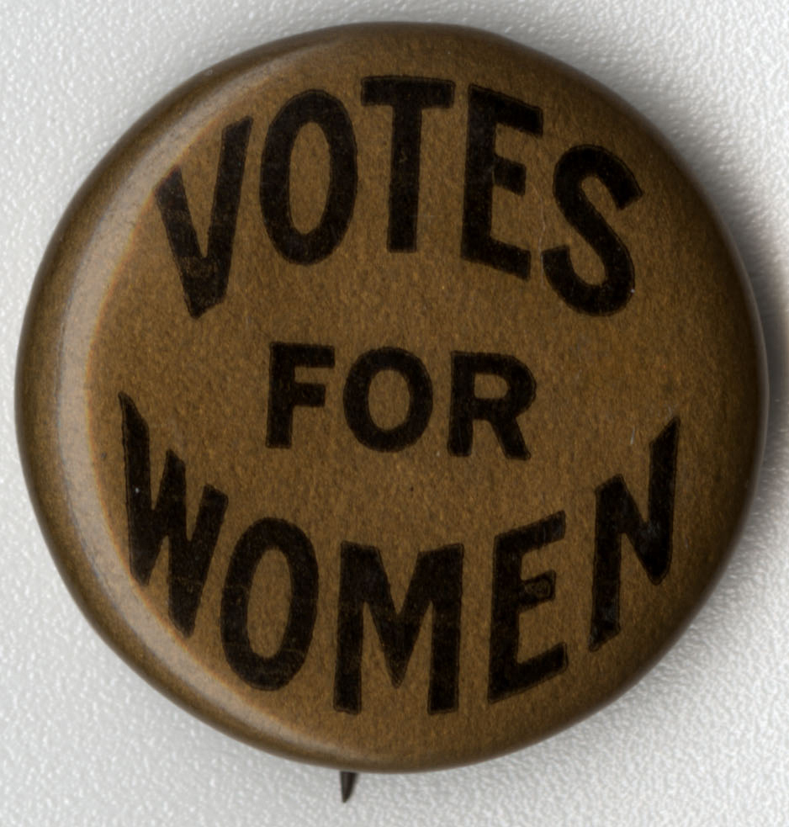
Topic 3.11-3.12
Women’s Civil Rights

Slide 49
WOMEN’S RIGHTS
First feminist wave
Struggle for suffrage – 19th Amendment, 1920
The right of citizens of the United States to vote shall not be denied or abridged by the United States or by any State on account of sex.
Congress shall have power to enforce this article by appropriate legislation.
5

Slide 50
WOMEN’S RIGHTS
Second feminist wave: 1960-present
National Organization for Women (NOW), 1966
– NOW’s purpose is to take action through intersectional grassroots activism to promote feminist ideals, lead societal change, eliminate discrimination, and achieve and protect the equal rights of all women and girls in all aspects of social, political, and economic life.
National Right to Life, 1968
National Right to Life carries out its lifesaving mission by promoting respect for the worth and dignity of every individual human being, born or unborn, including unborn children from their beginning; those newly born; persons with disabilities; older people; and other vulnerable people, especially those who cannot defend themselves. Our areas of concern include abortion, infanticide, euthanasia, assisted suicide, and the killing of unborn children for their stem cells.

Slide 51
WOMEN’S RIGHTS
Second feminist wave: 1960-present
Legislation
Equal Pay Act of 1963
The Equal Pay Act requires that men and women be given equal pay for equal work in the same establishment. The jobs need not be identical, but they must be substantially equal. It is job content, not job titles, that determines whether jobs are substantially equal. Specifically, the EPA provides that employers may not pay unequal wages to men and women who perform jobs that require substantially equal skill, effort and responsibility, and that are performed under similar working conditions within the same establishment.
Title VII of Civil Rights Act of 1964
It shall be an unlawful employment practice for an employer … to discriminate against any individual with respect to his compensation, terms, conditions, or privileges of employment, because of such individual’s race, color, religion, sex, or national origin.

Slide 52
WOMEN’S RIGHTS
Second feminist wave: 1960-present
Title IX of Education Act of 1972
Prohibited gender discrimination in federally subsidized education programs, including athletics
"No person in the United States shall, on the basis of sex, be excluded from participation in, be denied the benefits of, or be subjected to discrimination under any education program or activity receiving Federal financial assistance."
Did you see any mention of GRANTS?
7

Slide 53
Roe Revisited: Planned Parenthood v. Casey (1992)
The issue: Was the Pennsylvania Abortion Control Act of 1982 constitutional?
Law required that a woman seeking an abortion meet several conditions
Would Roe be overturned?
No… Justice O’Connor argued that stare decisis (precedent of the Court) required the Court to
not overturn Roe.
“A generation of women had come to depend on the right to an abortion.”
The Court held that states cannot prohibit abortion prior to viability (before the fetus could live independently outside of the mother’s womb).
HOWEVER, the Court allowed certain restrictions on abortions
States can regulate abortions before viability as long as the regulation does not place an “undue burden” (substantial obstacle) on the access to abortion.
After fetal viability, however, states have increased power to restrict the availability of abortions to
protect the health of the woman and the potential life of the fetus.
Thus, states can pass some laws that regulate abortion, but these laws cannot place a “substantial obstacle in the path of a woman seeking an abortion.”
But what is a “substantial obstacle?”
14

Slide 54
EQUAL RIGHTS AMENDMENT (ERA)
After the passage for the 19th
Amendment, the work for women’s right was not over.
The ERA was proposed to guarantee equal rights for all citizens regardless of sex; it seeks to end the legal distinctions between men and women in terms of divorce, property, employment, and other matters.
Sent to the states in 1972 for ratification by March 22, 1979. By
1977, 35 of 38 were ratified. Soon four states rescinded their approval, due to Phyllis Schlafly.

Slide 55
Topic 3.11 How has the government responded to social movements? AMSCO p. 365
Reconstruction Amendments : These three constitutional amendments were ratified to free the slaves (13TH am), to declare African Americans citizens assuring due process and equal protection (14th am), and to give them the vote (15th am). Free, Equal, Citizens, Vote.
Civil Rights of 1875: This act made it illegal for privately owned places of public accommodation—trains, hotels, and taverns—to make distinctions between black and white patrons. Also, it outlawed discrimination in jury selection, public schools, churches, cemeteries, and transportation.
Civil Rights Cases (1883): The Court overruled the Civil Rights Act of 1875 & enabled discrimination in commercial affairs.
Brown v. Board of Education: The Supreme Court ruled that the “separate but equal”
doctrine from the Plessy v. Ferguson (1896) case was inherently unequal, effectively striking down segregation in education.
24th Amendment (1964): This amendment outlawed the poll tax in any federal, primary, or general election.

Slide 56
Topic 3.11 How has the government responded to social movements? AMSCO p. 365
Civil Rights Act of 1964: This act prevented discrimination in employment, education, and in federal elections, and enabled federal enforcement of these guarantees.
Voting Rights Act of 1965: This law empowered Congress and the federal government to oversee state elections in southern states. It addressed states that used a “test or device” to determine voter qualifications or any state or voting district with less than 50 percent of its voting-age population registered to vote. The law effectively ended the literacy test.
Title IX of Education Amendments of 1972: This law guaranteed that women have the similar educational opportunities as men in programs receiving federal government funding.

Slide 57
The civil rights movement of the 1960s heralded the rights of African-Americans and Women. Subsequently it was extended to Latinos. Today such civil rights are being waged on behalf of the LGBT community.
Gay and Lesbian Rights
Court Cases and Laws for/against the Gay Community
Court Cases and Laws | Detail of Cases/laws
Bowers v. Hardwick (1986) | Supreme Court ruled that a Georgia criminalizing sexual behavior in private between consenting adults was constitutional.
“Don’t Ask, Don’t Tell” (1994) | Created during the Clinton Administration. 2011, Pentagon ended the policy and allowed gays to serve openly in the military.
Lawrence v. Texas (2003) | Overturned Bowers that laws regarding private sexual conduct violate the right to privacy and are unconstitutional.
Most effective way to secure rights has been through litigation in the courts to gain protections against discrimination.

Slide 58
Full Faith and Credit Clause
Under the Full Faith and Credit Clause of the Constitution (Article IV, Section 1), marriages recognized in one state are valid in all states.
In response to the issue of gay marriage, Congress passed the Defense of Marriage Act in 1996.
The legislation allows states to ignore same-sex marriages legal in other states and defines marriage in federal law as a legal union between one man and one woman.

Slide 59
Obergefell v. Hodges (2015)
The Court held that the Due Process Clause of the Fourteenth Amendment guarantees the right to marry as one of the fundamental liberties it protects, and that analysis applies to same-sex couples in the same manner as it does to opposite-sex couples.
Overturned Defense of Marriage Act (1996)
Court also held that the First Amendment protects the rights of religious organizations to adhere to their principles, but it does not allow states to deny same-sex couples the right to marry on the same terms as those of opposite- sex couples.
Groups of same-sex couples sued their relevant state agencies in Ohio, Michigan, Kentucky, and Tennessee to challenge the constitutionality of states’ bans on same-sex marriage or refusal to recognize legal same- sex marriages that occurred in jurisdictions that provided for such marriages.

Slide 60
3.13 AFFIRMATIVE ACTION
Policies designed to give special attention or compensatory treatment of members of some previously disadvantaged groups.

Slide 61
3.13 Affirmative Action
The Court’s interpretation of the U.S. Constitution is influenced by the composition of the Court and citizen-state interactions. At times, it has restricted minority rights and, at others, protected them
Describe Supreme Court
debates about affirmative
action policies.
Affirmative action refers to policies intended to address workplace and educational disparities related to race, ethnic origin, gender, disability,
and age. Supreme Court debate has focused on whether affirmative action is protected by the equal protection clause of the Fourteenth Amendment to the Constitution.

Slide 62
3.13 Affirmative Action
The Court’s interpretation of the U.S. Constitution is influenced by the composition of the Court and citizen-state interactions. At times, it has restricted minority rights and, at others, protected them
Explain how the Court has at times allowed the restriction of the civil rights of minority groups and at other times has protected those rights.
The debate on affirmative action includes justices who insist that the Constitution is colorblind and those who maintain that it forbids only racial classifications designed to harm minorities, not help them

Slide 63
THE AFFIRMATIVE ACTION CONTROVERSY
Affirmative action -policies requiring special efforts in employment, promotion, or school admissions on behalf of disadvantaged groups
The goal of affirmative action is to move beyond equal opportunity toward equal results.
Some groups have claimed that affirmative action programs constitute “reverse discrimination.”
Constitutionality of affirmative action programs
University of California Regents v. Bakke (1978)
Quotas cannot be used for admissions (cannot reserve seats for racial minorities)
Affirmative action programs are not necessarily unconstitutional
30

Slide 64
THE AFFIRMATIVE ACTION CONTROVERSY
Reaffirming the Importance of Diversity
–Gratzv. Bollinger (2003)–race cannot be used as a “bonus” point
–Grutterv. Bollinger (2003)–race can be one of the factors to be considered in admissions
30

Slide 65
Regents of the University of California v. Bakke (1978)
UC Davis Medical School desired to produce more minority doctors so they set aside 16 (out of 100) places in the entering class for members of disadvantaged groups
Alan Bakke, a white applicant, was repeatedly deferred even though his MCAT scores were substantially higher than most of the minority applicants who were accepted
Affirmative Action laws are not unconstitutional, but quotas in college admissions are unconstitutional. The Court said the university could use race as one element in admissions.

Slide 66
IS AFFIRMATIVE ACTION THE SAME THING AS QUOTAS?
Some, but not all, Affirmative Action programs use quotas
Quotas require that a certain number or percentage of a disadvantaged group get a job
For example, if it is proven that a police force actively discriminated against hiring minority officers, a quota may be used to correct past discrimination

Slide 67
ESSENTIAL QUESTION CFU
Think about the debate on affirmative action. Some say that the Constitution should be colorblind. Some say we should have policies that forbid only racial classifications designed to harm minorities, not help them. What say you?
33

