Slide 1
Chpt. 16 Topic 5.3-5.5
UNIT 5
AMSCO pg. 523-553
Political Parties

Slide 2
TOPIC 5.3 Political Parties
Political parties, interest groups, and social movements provide opportunities for participation and influence how people relate to government and policy-makers.
Describe linkage institutions.
Linkage institutions are channels that allow
individuals to communicate their preferences
to policy-makers:
Parties
Interest groups
Elections
Media.
Explain the function and impact of political parties on the electorate and government.
The functions and impact of political parties on the electorate and government are represented by:
Mobilization and education of voters
Party platforms
Candidate recruitment
Campaign management, including fundraising and media strategy
The committee and party leadership systems in legislatures

Slide 3
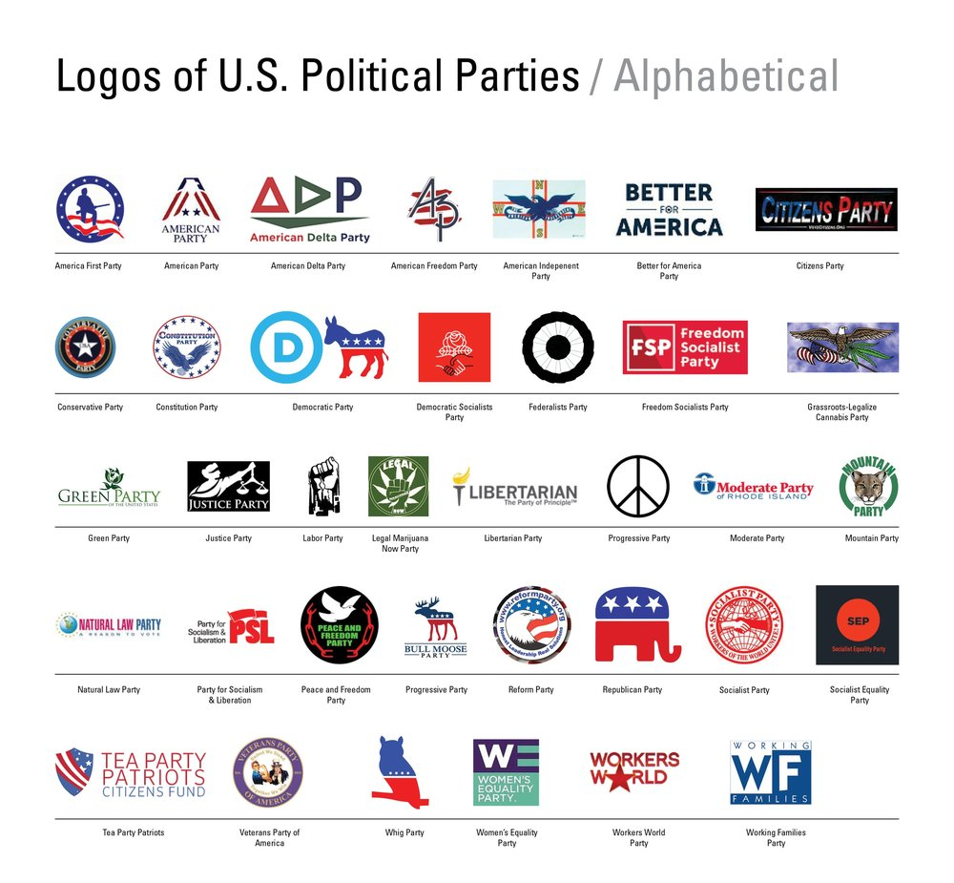

Slide 4
LINKAGE INSTITUTIONS
Linkage institutions are channels that allow individuals to communicate their preferences to policy-makers:
What are some examples of linkage institutions?
Elections
Interest Groups
Political Parties- A political party is an organized group of people who have the same ideology, or who otherwise have the same political positions, and who field candidates for elections, in an attempt to CONTROL THE GOVERNMENT so they can implement the party's agenda.
Mass Media
How do you let the government know about your opinions and beliefs?

Slide 5
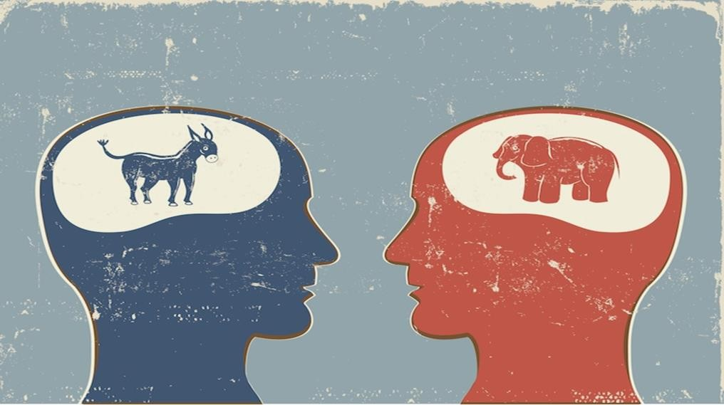
ESSENTIAL QUESTION CFU
Describe the linkage institutions
4

Slide 6
WHAT IS A POLITICAL PARTY?
Def: A political party is an organized group of people who have the same ideology, or who otherwise have the same political positions, and who field candidates for elections, in an attempt to get them elected and thereby implement the party's agenda.
THREE COMPONENTS OF PARTIES
Party-in-Government
Party leaders occupy positions in presidency, Congress, state governors, state legislatures, and local governments (though sometimes these are nonpartisan positions)
Party platform – a set of positions/policy objectives that members of political party agree to
Party in the Electorate
Party identification – the degree to which a voter is connected to and influenced by a particular political party
Parties as Organizations
Unites people with shared social, economic, ideological goals
Find and support candidates for
office and win elelctions
Educate and mobilize voters
Raise money, develop media strategy
National party organizations exist to create a streamlined voice (platform) for the party and get members elected
Outside groups have growing influence over candidates compared to parties
Parties influence voter choice
“R” or “D” is a cue on ballot
Voted on at the convention
When they win, they begin the process of governing based largely on the shared platform
Straight-ticket voting - Voting for all of the candidates on the ballot from one political party
Growing number of independents has led to less party-line voting and more split-ticket voting – voting for candidates from different parties in the same election
Party leadership chair is responsible for raising money and serves as spokesperson
Recruitment – the process through which political parties identify potential candidates
– Parties help handle the cost and burden of campaign- war chest-funds for elections
Maintain voter database to target in elections
5

Slide 7
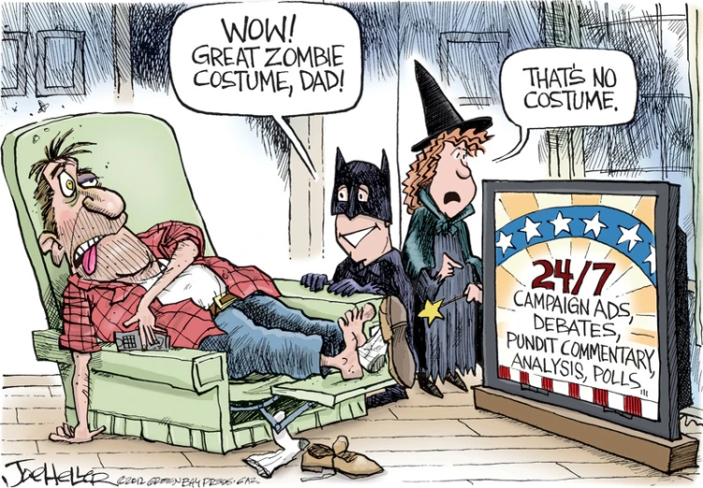
Presidential election ads seem to start sooner every election cycle. Recently, these ads have shown up a full 16 months before the election.

Slide 8
WHAT ARE THE MAJOR FUNCTIONS OF POLITICAL PARTIES?
Organize the competition by designating candidates to run under their label
A party's ability to organize the competition is influenced by how states organize their ballots or the type of elections they provide
The party column ballot makes it easier for voters to vote a straight ticket
The office block ballot makes it harder to cast a vote for all the candidates of a single party
Unify the electorate/ voters
Nominate candidates
Previously: caucuses >> nominating conventions
Now: primary elections
With advent of primaries, nominating function now seriously lessened.
Control over many of these functions has been declining
Provide “loyal opposition”

Slide 9
WHAT ARE THE MAJOR FUNCTIONS OF POLITICAL PARTIES?
Act as Moderating Influence on Government
To win elections, parties must usually nominate moderate candidates who appeal to the vast center of the American electorate. Fringe elements squeezed out.
Criticism: To appeal to such a wide variety of party members, parties must avoid taking strong stands
Inform public about political issues through party platforms
However, few people check platforms, which in any case are often broadly-worded, i.e., like train platforms: “something to get on rather than something to stand on.”
Political parties are organized at the local, state, and national levels. This doesn’t mean, however, that there is a strict hierarchy within the party; indeed, local and state party organizations often function quite independently from the national organization. Because of different state laws, parties operate differently from state to state.

Slide 10
WHAT ARE THE MAJOR FUNCTIONS OF POLITICAL PARTIES?
Agents of political socialization- process in which people develop their political values, beliefs, attitudes and ideology
Linking mechanism between people and government
Provide Patronage-term is used to describe political patronage, which is the use of state resources to reward individuals for their electoral support.
Register voters, mobilize voters, and get them to the polls
Raise and spend campaign funds
Declining importance w/advent of “candidate-centered” campaigns.
Simplify decisions for voters: provide “shorthand” through which busy and uninterested voters can base a voting decision, use of “party lens” by voters.
Inform public about political issues through party platforms
However, few people check platforms, which in any case are often broadly-worded

Slide 11
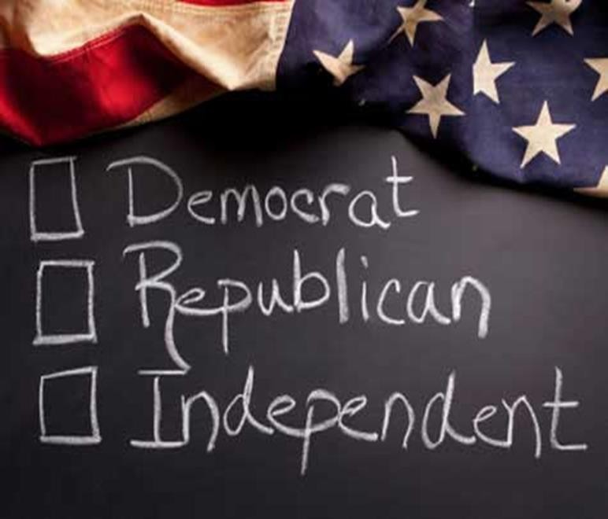
WHAT ARE THE MAJOR FUNCTIONS AND IMPACT OF POLITICAL PARTIES?
Recruit and nominate candidates
Organize the competition by designating candidates to run under their label
Unify the electorate
Inform public about political issues through party platforms
However, few people check platforms, which in any case are often broadly-worded
Provide “loyal opposition”
Agents of political socialization
Linking mechanism between people and government
Provide patronage-provide gov jobs for those party loyalist who helped candidate win, i.e. ambassadorships
Mobilize voters: register voters, educate voters,, and get them to the polls
Campaign management, including fundraising and media strategy
Declining importance w/advent of “candidate-centered” campaigns
Simplify decisions for voters: provide “shorthand” through which busy and
uninterested voters can base a voting decision, use of “party lens” by voters
The committee and party leadership systems in legislatures
5

Slide 12
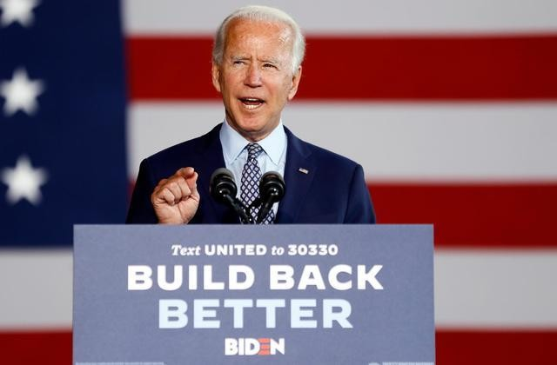
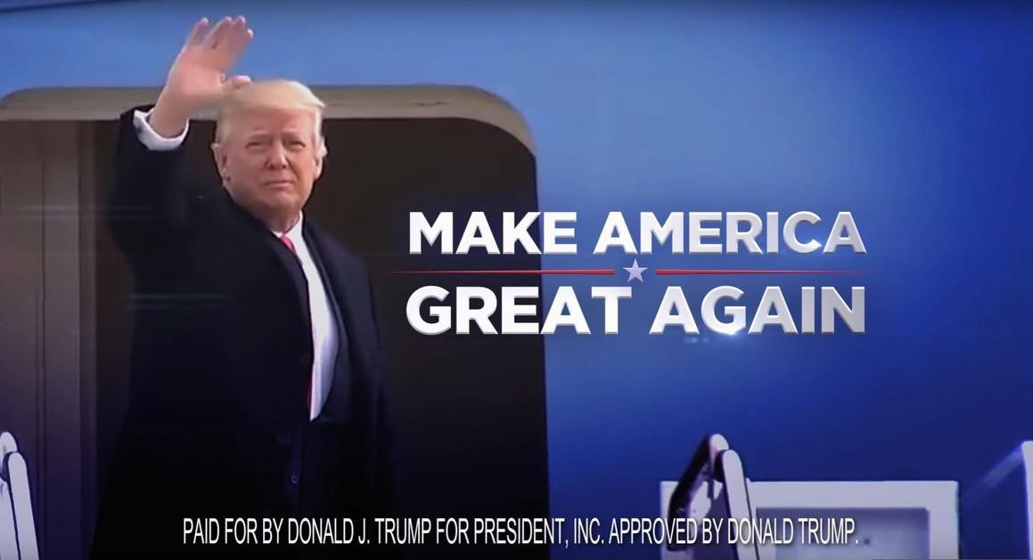
ESSENTIAL QUESTION CFU
Explain the function and impact of political parties on the electorate and government
How does the competition between political parties further representative democracy?
6

Slide 13
TOPIC 5.4 How & Why Political Parties Change & Adapt
Political parties, interest groups, and social movements provide opportunities for
participation and influence how people relate to government and policy-makers..
Parties have adapted to candidate-centered campaigns, and their role in nominating candidates has been weakened.
Explain why and how political parties change and adapt.
Parties modify their policies and messaging to appeal to various demographic coalitions
The structure of parties has been influenced by:
Critical elections and regional realignments
Campaign finance law
Changes in communication and data-management technology
Parties use communication technology and voter data management to disseminate, control, and clarify political messages and enhance outreach and mobilization efforts.

Slide 14
RISE OF POLITICAL PARTIES
OUR FIRST PARTIES
Dangers of factions mentioned by Madison in Federalist #10 and Washington’s warning about the “baneful effects of the spirit of party.”
Parties became necessary to get things done, e.g., Hamilton’s financial plan and support for Jefferson’s Louisiana Purchase.
Necessity of an institution that unifies government in order to overcome the systems of separation of powers and checks and balances that divide government.

Slide 15
RISE OF POLITICAL PARTIES
Historical development: the Six Party Systems in American history. Realignment occurs roughly every 36 years or so.
1796-1820: 1st party system
Federalists v. Jeffersonian Democratic-Republicans
1824-1856: 2nd party system
Jacksonian Democrats v. Whigs
1860-1892: 3rd party system
Republican dominance as the party against slavery and the party that put the Union back together.
1896-1928: 4th party system
Second period of Republican dominance with its coalition of big business and the working classes against the Democratic rural interests.
1932-1964: 5th party system
Democratic dominance begun under FDR and the New Deal. FDR’s grand coalition included urban dwellers, labor unions, Catholics, Jews, the poor, Southerners, Blacks, farmers.
9

Slide 16
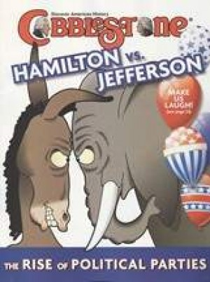
RISE OF POLITICAL PARTIES
Control of government has shifted back and forth between the parties in periods of realignment, which is a major shift in allegiance to the political parties that is often driven by changes in the issues that unite or divide voters. Periods of realignment may be ushered in by critical elections, a major national election that shifts the balance of power between the two parties. Periods when one party wins most national elections are called party eras. Political scientists debate the boundaries of major eras in party control and how decisive a particular election was in signaling a change in those boundaries.
10

Slide 17
RISE OF POLITICAL PARTIES
party coalition- groups of voters who support a political party over time.
Realignment when the groups (coalition) of people who support a political party shift their allegiance to a different political party.
Critical Election a major national election that signals a change in the balance of power between the two parties.
Dealignment- process whereby a large portion of the electorate abandons its previous partisan affiliation without developing a new one to replace it. Rise of independents
Party Era time period when one party wins most national elections.

Slide 18
RISE OF POLITICAL PARTIES
Historical development: the Six Party Systems in American history. Realignment occurs roughly every 36 years or so.
1968-present: 6th party system
Era of Divided Government and Dealignment
Much split ticket voting
Presidents of one party (typically Republican) with Congresses of the opposite party (typically Democratic).
An era of party dealignment, as voters are moving away from both parties and are increasingly
independent.
Nixon (“Southern strategy”) and Reagan built a coalition of disenchanted white suburban middle class, Southern white Protestants, big business
Clinton won twice in part because of his resurrection of FDR’s grand coalition, especially Southern
middle class moderates (“Reagan Democrats”). Women’s votes were also decisive.
Election of 2000 gave us a Republican president who won only a minority of popular votes, a 50-50 Senate (which became a 50-49-1 Democratic Senate after Jeffords defection), and a House w/a narrow Republican majority
10

Slide 19
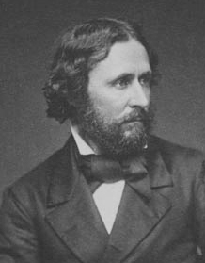
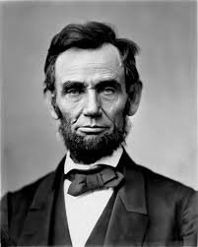
The Republican Party 1854
John C. Fremont
Republican Presidential Candidate, 1856
The Republican Party was formed by a coalition of Free-Soilers, Whigs, Know-Nothings and Northern Democrats in order to stop the spread of slavery in the western territories and in the south.
The Republican would control the Presidency from 1861-1932 with 2 exceptions. This is an example of REALIGNMENT.
Abraham Lincoln
Republican Presidential Candidate,
1860

Slide 20
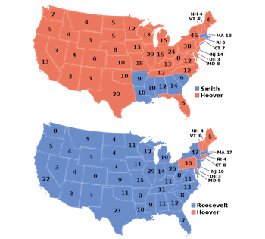
What Realignment Looks Like
Compare these maps of the presidential election of 1928 (top) and the election of 1932 (bottom). This is a clear example of realignment, as a huge number of voters switched their affiliation from Republican (red) to Democrat (blue)

Slide 21
DIVIDED GOVERNMENT
Creates GRIDLOCK and nothing gets done
Since 1953, we have had divided government twice as often as we have had one party in control of both legislative and executive branches
Republican President and a Democratic Congress (control of even one house) or Democratic President & Republican Congress (control of even one house)
Relative party strengths
National Government 2019-2021
President: Republican
House: 232 Democrats, 197 Republicans, 1
Independent, 5 vacancies (116th Congress)
Senate: 53 Republicans, 45 Democrats, 2 Independents (116th Congress)
11

Slide 22
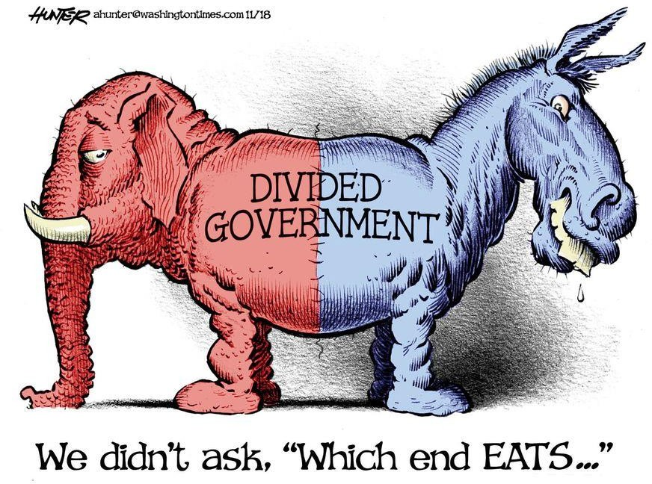
DIVIDED GOVERNMENT
Relative party strengths
National Government 2021-2023
President: Democrat
House: 221 Democrats, 211 Republicans,
3 vacancies (117th Congress)
Senate: 50 Republicans, 48 Democrats, 2 Independents (117th Congress)

Slide 23
REALIGNMENT AND CRITICAL ELECTIONS
Realignment
Sharp changes in issues, party leaders, the regional and demographic bases of power of the two parties, and structure or rules of the political system resulting in a new political power structure.
A "critical" election usually serves as the basis for realignment.
Characteristics
Intense electoral involvement by the voters
Disruptions of traditional voting patterns
Changes in the relations of power within the community
The formation of new and durable electoral groups
Four critical (or realigning) elections (each realignment lasts roughly 36 years)
1824: Andrew Jackson and the Democrats
1860: The Civil War and the rise of the Republicans (slavery issue fixed new loyalties in the popular mind)
1896: A Party in transition (economic issues shifted loyalties)
1932: Franklin Roosevelt and the New Deal alignment (economic depression triggered new coalition for Democrats)
– 1968: Nixon?
12

Slide 24
DEALIGNMENT
We are experiencing dealignment
Definition: Process whereby a large portion of the electorate abandons its previous partisan affiliation without developing a new one to replace it.
People have abandoned both parties to become Independents
However, most Independents are really partisans in their voting behavior and attitudes
Dealignment has led to ticket splitting in recent times
Other factors that have weakened the parties and contributed to
dealignment
It is contrasted with realignment.
Candidate-centered campaigns (especially after FECA)
Public disenchantment with parties and politics during the 60's
Growth of interest groups – have taken on some party functions
Development of mass media – candidates rely on media rather than party organization to get message across
Growth of political independents
Trend to “vote the man, not the party” and rise of ticket splitting (voting for candidates from both political parties)
Counter arguments to dealignment theory:
– Even though % of independents has increased, 2/3 of “independents” are actually “leaners.” They are, in effect, “closet Democrats” and “closet Republicans.”
13

Slide 25
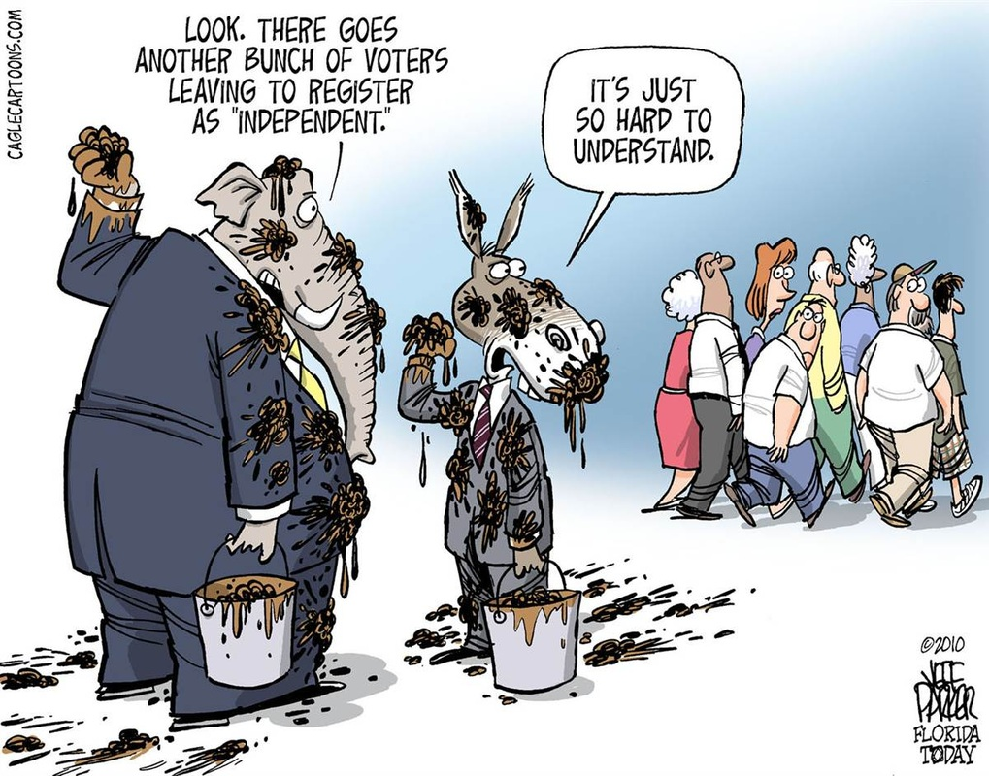
DEALIGNMENT
Definition: Process whereby a large portion of the electorate abandons its previous partisan affiliation without developing a new one to replace it.
We are experiencing dealignment
People have abandoned both parties to become Independents
However, most Independents are really partisans in their voting behavior and attitudes
It is contrasted with realignment.
13

Slide 26
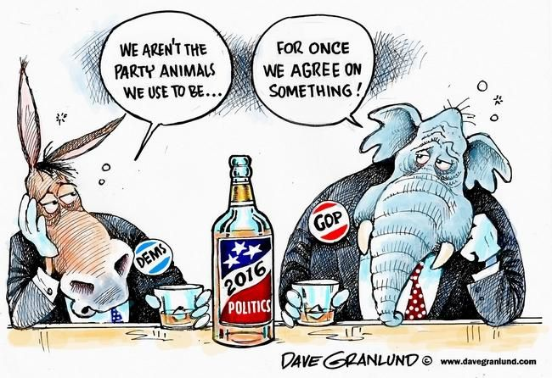
DEALIGNMENT
Definition: Process whereby a large portion of the electorate abandons its previous partisan affiliation without developing a new one to replace it.
We are experiencing dealignment
People have abandoned both parties to become Independents
However, most Independents are really partisans in their voting behavior and attitudes
It is contrasted with realignment.
13

Slide 27
Political parties have changed/adapted since they were first formed.
They have had to adapt to candidate- centered campaigns.
Candidates now increasingly create their own brand, relying less on party symbols and messaging.
Name recognition, handsome, glib...is well known and films well!

Slide 28
Political Parties Have Changed/Adapted Since They Were First Formed.
Polarization has made it difficult for the old methods of parties to remain successful
Voters now dislike other side more than they like showing support for their own side
Candidates in 2016 forced the party establishment to focus on new issues
Candidate-Centered Campaign
A trend in which candidates develop their own strategies and raise
money with less influence from the party elite
Party status for picking nominees not as powerful anymore

Slide 29
TOPIC 5.5 Third-Party Politics
Political parties, interest groups, and social movements provide opportunities for
participation and influence how people relate to government and policy-makers..
In comparison to proportional systems, winner-take-all voting districts serve as a structural barrier to third-party and independent candidate success.
Explain how structural barriers impact third-party and independent candidate success
The incorporation of third-party agendas into platforms of major political parties serves as a barrier to third-party and independent candidate success

Slide 30
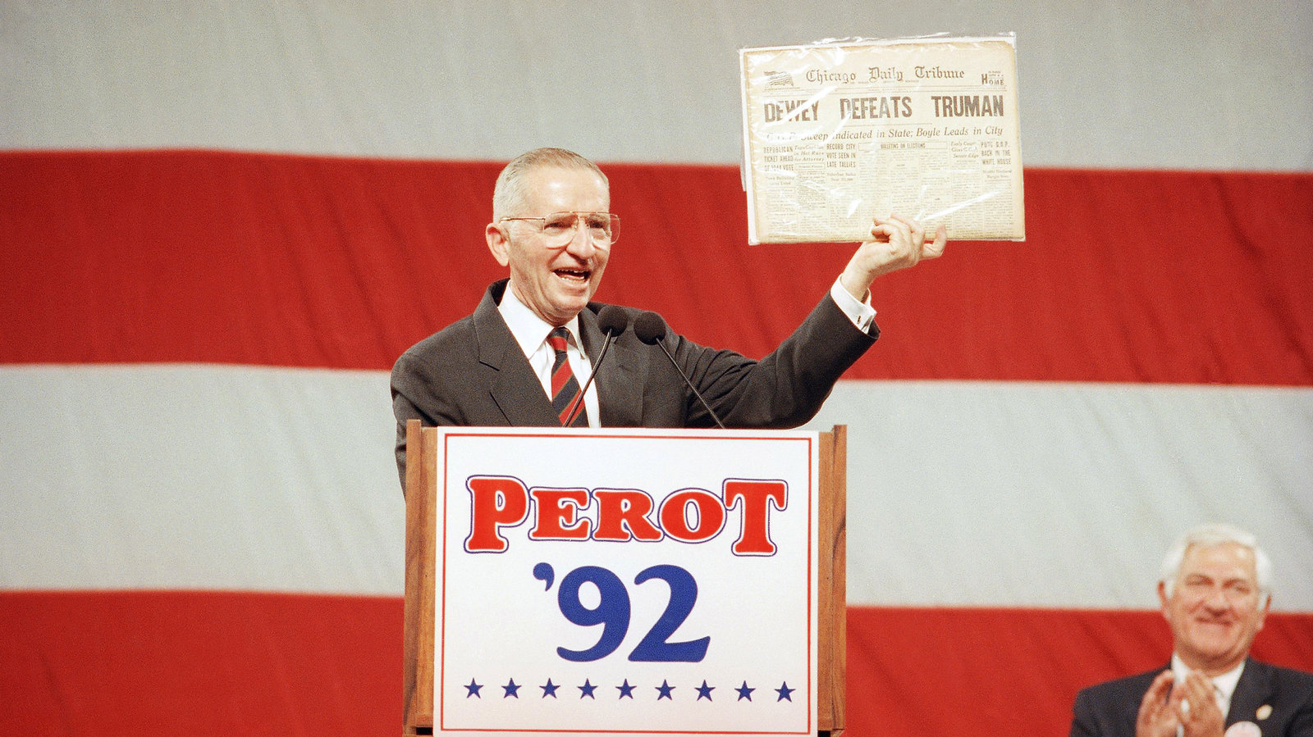
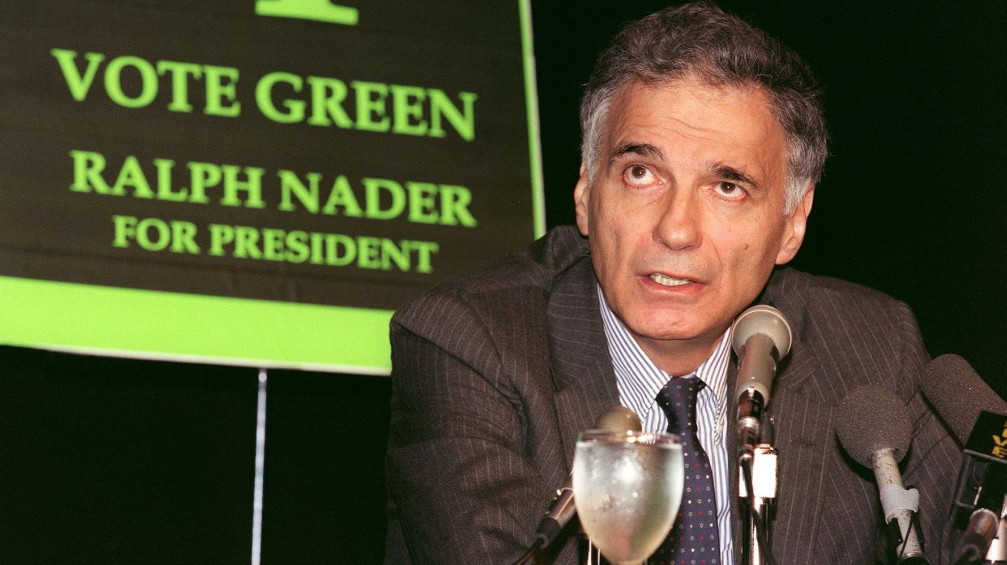
MINOR (THIRD) PARTIES
TYPES
Economic Protest Party- Populist Party
Ideological
Communist Party, Libertarian Party
Single issue
Free Soil opposed the spread of slavery
Right to Life opposes abortion
Know Nothings opposed Irish-Catholic immigration
Green Party
Parties centered around a strong personality (Splinter Party)
Teddy Roosevelt’s Bull Moose Party
George Wallace’s American Independent Party
Ross Perot's Reform Party

Slide 31
MINOR (THIRD) PARTIES

Slide 32
MINOR (THIRD) PARTIES
16

Slide 33
MINOR (THIRD) PARTIES
16

Slide 34
MINOR (THIRD) PARTIES
CONTRIBUTIONS OF THIRD PARTIES
Raise issues that other parties must address, and often incorporate into their own party platforms. “Champions not of lost causes, but of causes yet to be won” (e.g., Populist Party: direct election of senators, income tax, etc.)
Voice for the fringe elements in society
Safety valve for discontent in society
EFFECTS OF THIRD PARTIES
Rarely win elections
Influence the outcome of presidential elections (e.g., 1968, 1992, 2000): “spoiler role”- Third parties may take votes from the major two parties affecting the outcome of the election. SPOILER ROLE
17

Slide 35
MINOR (THIRD) PARTIES
OBSTACLES
Two-party tradition (because of single-member legislative districts)
In comparison to proportional systems, winner-take-all voting districts serve as a structural barrier to third-party and independent candidate success
Single-member, winner-take-all, plurality district system for congressional seats, as opposed to the multi-member, proportional system that is common in other countries
Electoral College’s Winner-Take-All system: Perot won 19% of the vote in 1992, but had zero electoral votes.
Getting candidates on the ballot
Democrat and Republican candidates are automatically placed on state ballots
Minor party candidates must persuade registered voters to sign petitions in order to have their names placed on the ballot
Money
Media coverage
Exclusion from TV debates
18

Slide 36
INCORPORATION OF THIRD PARTY AGENDAS
The two major parties frequently incorporate the platforms of third parties into their own platforms; voters who identified with a third-party issue will often vote for a major party candidate who has adopted that issue because major parties are more likely to succeed.
The incorporation of third-party agendas into platforms of major political parties serves as a barrier to third-party and independent candidate success

Slide 37
ESSENTIAL QUESTION CFU
Explain how structural barriers impact third-party and independent candidate success
20

Slide 38
20

Slide 39
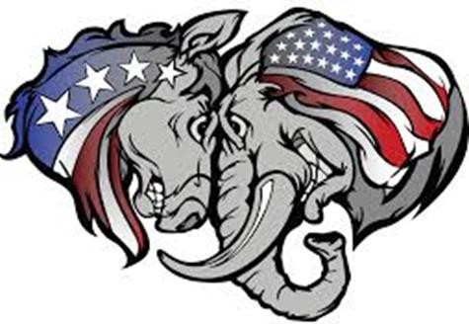
WHY ARE PARTIES LOSING POWER?
Parties lack strong rank-and-file membership/lack strong grass roots organization
Anyone can join merely by registration
No duties or dues
Most activities occur only at election time
Most Americans are mere spectators, rather than participants, in party activity
Small percentages of “Strong Democrats” and “Strong Republicans”
Increase in percentage of Independents (though most of these are “leaners”)
Parties have lost many of their traditional functions, or these functions have been weakened:
Nomination of candidates (now done by primary elections)
Funding of political campaigns (trend towards candidate-centered campaigns).
Unifying govt. (we often have divided government, and intra-party conflict can be strong).
Providing patronage (jobs now filled by Civil Service)

Slide 40
WHY ARE PARTIES LOSING POWER?
Weak party discipline
Split ticket voting (voting for some candidates from one party and candidates from another party). Voters feel less loyalty to parties.
Few penalties for politicians who stray from the party line. Since candidates are nominated by the people rather than by the party bosses, candidates feel less beholden to the party.
Candidates finance their campaigns on their own rather than rely upon the parties -> more willing to stray from the party line
Intra-party divisions
Between party regulars and candidate loyalists/issue advocates.
Between Democratic liberals and moderates (e.g. “Blue Dogs” in Congress).
Between Republican conservatives and moderates.

Slide 41
FACTORS THAT HAVE WEAKENED THE PARTIES
Candidate-centered campaigns (esp. after FECA).
Rise of campaign consultants to take over many of the
functions of parties.
Public disenchantment with parties and politics during
the 60s.
Growth of interest groups -- have taken on some party functions.
Development of mass media -- candidates rely on media rather than party organization to get message across. The internet, especially, has become important for candidate fund raising, candidate web sites, candidate Facebook profiles, candidate advertising on web sites. Candidates can do these themselves and do not need the parties for these things.
22

Slide 42
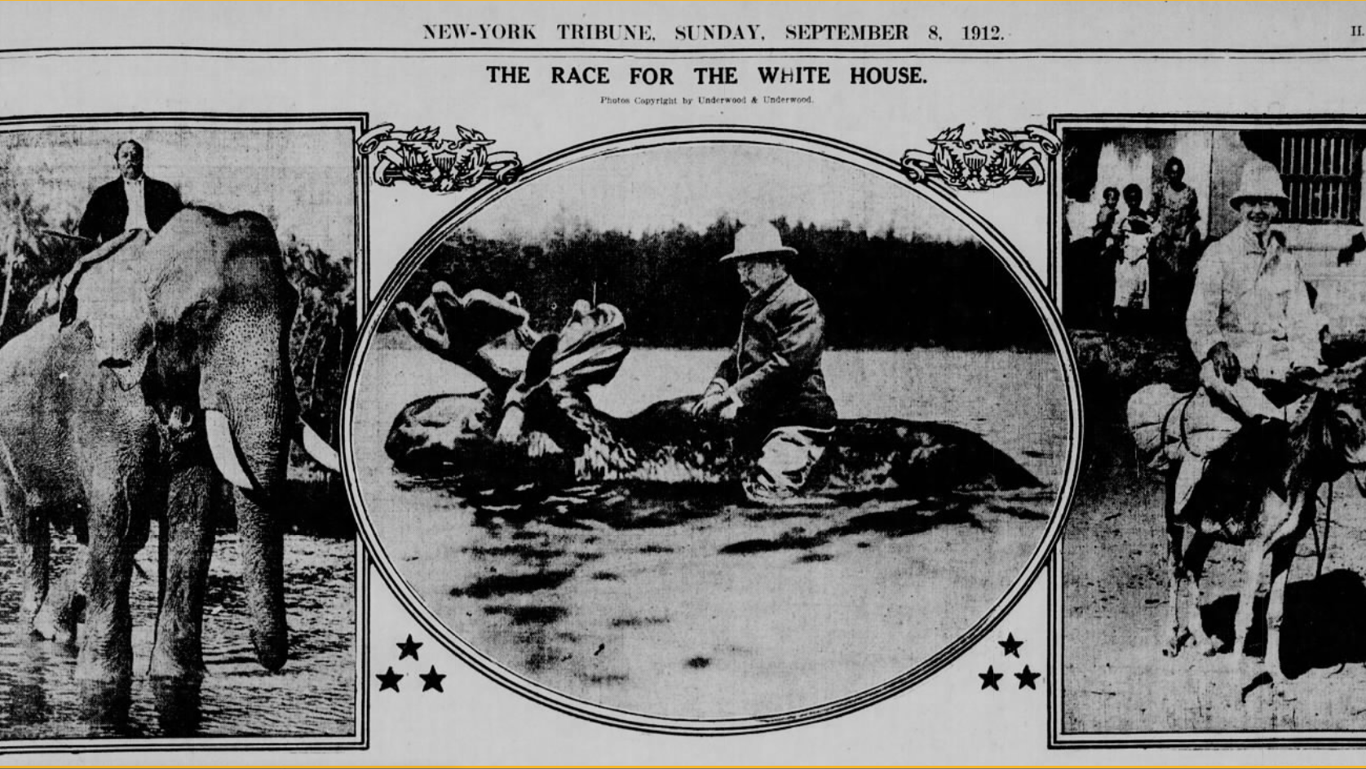

Slide 43
IMPACT OF PARTIES ON GOVERNMENT
CONGRESS
Majority party controls all committees.
Majority party has chairmen on all committees.
Majority party controls key leadership positions.
Staffers are partisan.
EXECUTIVE BRANCH
Nearly all appointments to White House staff are partisan. Many go to people from election campaigns.
Nearly all appointments to top positions in other parts of Executive branch are partisan.
Development of Civil Service System has greatly reduced party influence over the bureaucracy. Jobs now based on merit and not on party patronage.
JUDICIAL BRANCH
Nearly all appointments are partisan
23

Slide 44
INTO THE NEW CENTURY
A divided nation (Red States vs. Blue States) •
– Areas of party strength
Party platform - the official statement of party policy - is ambiguous by design
South: Republican strength (very conservative)
Great Plains: Republican strength
Rocky Mountains: Republican strength
West Coast: Democratic strength
New England: Democratic strength
Swing (Battleground) states
Party platform positions rarely help elect a presidential candidate, but can hurt a candidate
Differences at the national level between the two major parties were very sharp just before the Civil War and again during the New Deal
Democrats attracted Hispanics, African-Americans,
union members, etc.
Both major parties typically have been moderate, support a strong defense, a stable Social Security system, and economic growth
GOP did well with white males, religious conservatives, higher income voters
Differences over tax cuts, social issues, privatization
of Social Security

Slide 45
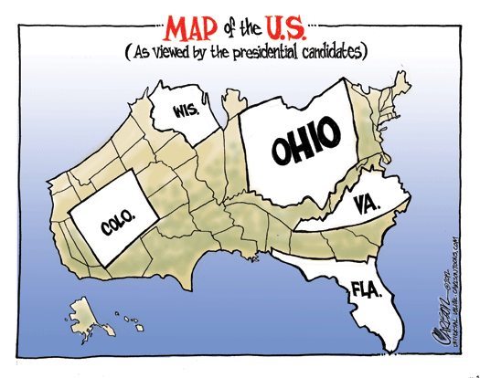
Swing States
US state where the two major political parties have similar levels of support among voters, viewed as important in determining the overall result of a presidential election.

Slide 46
PARTY SYSTEMS
United States' electoral two-party system versus multiparty systems
United States' winner-take-all system versus proportional representation in multiparty systems
United States' two-party system tends to create centrist parties versus influence of extremists in multiparty systems
Two-party systems lead to stable governments versus multiparty systems make governments unstable (coalitions form and collapse)
25

