Slide 1
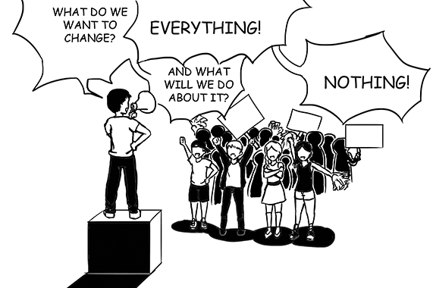
Unit 5 Chpt. 17 Topics 5.6-5.7 Pages 554-586 Required Document Federalist #10
Interest Groups Influencing Plicymaking

Slide 2
TOPIC 5.6 Interest Groups Influencing Policy Making
Political parties, interest groups, and social movements provide opportunities for
participation and influence how people relate to government and policy-makers..
Interest groups may represent very specific or more general interests, and can educate voters and office holders, conduct lobbying, draft legislation, and mobilize membership to apply pressure on and work with legislators and government agencies.
Explain the benefits and potential problems of interest-group influence on elections and policy making.
In addition to working within party coalitions, interest groups exert influence through long-standing relationships with bureaucratic agencies, congressional committees, and other interest groups; such relationships are described as “iron triangles” and “issue networks,” and they help interest groups exert influence across political party coalitions
Explain how variation in types and resources of interest groups affects their ability to influence elections and policy making.
The inequality of interest group resources affects the amount of influence they may have on the policymaking process.
i. Some interest groups, such as AARP, have large memberships, are able to mobilize those members, and possess access to large financial reserves.
ii. Some interest groups have more direct and more frequent access to important people in the policy process.

Slide 3
TOPIC 5.6 Interest Groups Influencing Policy Making
Political parties, interest groups, and social movements provide opportunities for
participation and influence how people relate to government and policy-makers..
Explain how variation in types and resources of interest groups affects their ability to influence elections and policy making.
iii. Free riders are individuals who benefit from the work of an interest group without providing financial support. Interest groups may deal with this issue by providing selective benefits, goods and services that are only available to members, to encourage more people to join.

Slide 4
TOPIC 5.6 Interest Groups Influencing Policy Making
Political parties, interest groups, and social movements provide opportunities for
participation and influence how people relate to government and policy-makers..
Interest groups may represent very specific or more general interests, and can educate voters and office holders, conduct lobbying, draft legislation, and mobilize membership to apply pressure on and work with legislators and government agencies.
Explain the benefits and potential problems of interest-group influence on elections and policy making.
In addition to working within party coalitions, interest groups exert influence through long-standing relationships with bureaucratic agencies, congressional committees, and other interest groups; such relationships are described as “iron triangles” and “issue networks,” and they help interest groups exert influence across political party coalitions
Explain how variation in types and resources of interest groups affects their ability to influence elections and policy making.
Interest group influence may be impacted by:
Inequality of political and economic resources
Unequal access to decision makers
“Free rider” problem

Slide 5
TOPIC 5.7 Groups Influencing Policy Outcomes
Political parties, interest groups, and social movements provide opportunities for
participation and influence how people relate to government and policy-makers..
Explain how various political actors influence public policy outcomes.
Single-issue groups, ideological/social movements, and protest movements form with the goal of impacting society and policy making.
Competing actors such as interest groups, professional organizations, social movements, the military, and bureaucratic agencies influence policy making, such as the federal budget process, at key stages and to varying degrees.
Elections and political parties are related to major policy shifts or initiatives, occasionally leading to political realignments of voting constituencies.

Slide 6
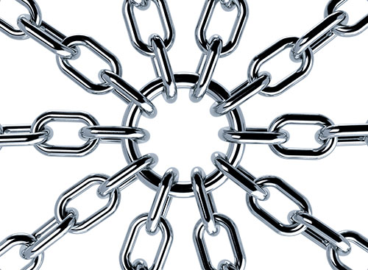
LINKAGE INSTITUTIONS
Linkage institutions are channels that allow individuals to communicate their preferences to policy-makers:
What are the four linkage institutions?
Elections
Political Parties
Interest Groups - Organization of people whose members share policy views on specific issues and attempt to INFLUENCE THE GOVERNMENT AND PUBLIC POLICY TO THEIR BENEFIT.
Mass Media
How do you let the government know about your opinions and beliefs?

Slide 7
LINKAGE INSTITUTIONS
Political Parties, interest groups, elections, media
Political parties, interest groups and social movements provide opportunities for participation and influence how people relate to government.
Political parties provide labels; issue platforms and most importantly choose candidates that represent our wishes.
Interest groups provide us a way to focus our political attention on single issues or policy priorities. There is strength in numbers. Interest groups are an important linkage institution to our democracy.
Elections give “we the people” the most direct way to influence our government and its decisions. When our candidates win elections, we feel that our interests will be represented. In this way we are connected to our government.
The role of the media is to inform us about our government. They are gatekeepers, scorekeepers and watchdogs. Media sets priorities and helps to become agenda setters when deciding what to cover. Media tells us who is winning and losing in the political process at any given time. But perhaps most importantly the media holds our government accountable. They police the government for us.

Slide 8
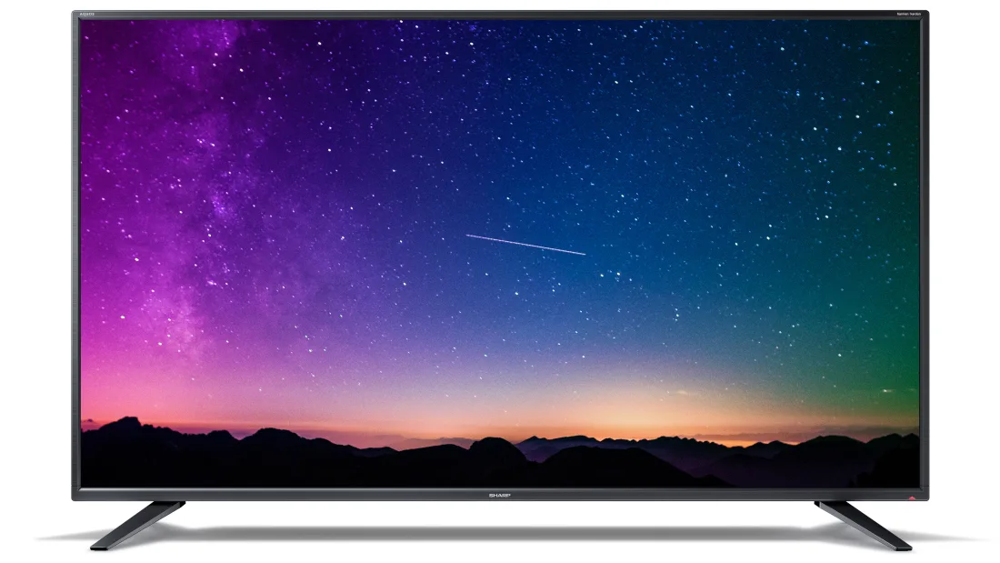

Slide 9
WHAT WERE INTEREST GROUPS ACCORDING TO JAMES MADISON?
Madison called interest groups “factions”
Madison’s dilemma: allowing people the liberty to form groups and express their views could destroy the hope for an orderly society.
Madison expressed the view that factions are undesirable but inevitable in a free society >> need to control their effects.
Madison addressed the problem of establishing a stable constitutional system that at the same time would respect liberty in The Federalist, No. 10 (freedom but limit factions)

Slide 10
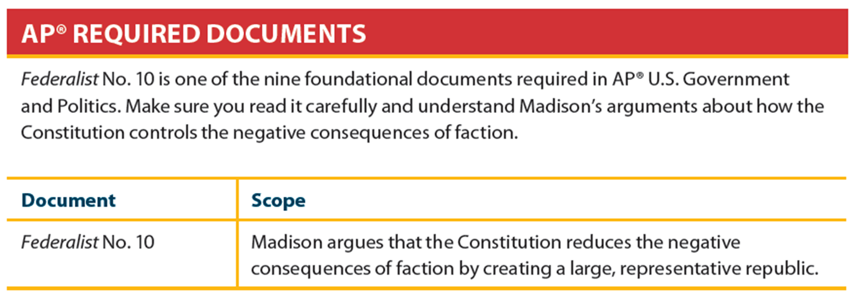
Interest Groups in American Representative Democracy
Exercising your right to form groups is, in essence, forming a faction
James Madison, Federalist No. 10
Factions are inevitable in a representative democracy and represent liberty
Lesson the dangers of faction by allowing them to compete
Interest groups compete over conflicting policy desires

Slide 11
WHAT ARE INTEREST GROUPS TODAY?
Interest group (AKA Special interests – term used in a negative way), Lobbyist or Lobby groups- mean the same thing.
Organization of people whose members share policy views on specific issues and attempt to influence public policy to their benefit
Interest groups are protected under the 1st Amendment of the Constitution (which means they have the freedom of speech and assembly)

Slide 12
PURPOSE OF INTEREST GROUPS
Educate voters and office holders/ raise awareness and interest in public affairs- issues & events that concern the people.
Make sure group members understand the group’s position on a specific issue
Make sure group members know who to vote for
Make sure elected/selected policymakers are sympathetic to your issues
Draft legislation
After you have gained access to sympathetic policymakers
Interest groups have policy specialists, while members of Congress are policy generalists
Mobilize membership
Apply pressure on and work with legislators and government agencies (to get laws created/changed in your favor)
Protesting and petitioning
Raise and spend money to gain access to policymakers
Interest groups may represent very specific or more general interests

Slide 13
HOW DO INTEREST GROUPS LINK CITIZENS TO GOVERNMENT?
Linkage institution (along with elections, political parties, and mass media) – link citizens to government
Express their members’ preferences to government policymakers
Convey government policy information to their members
Raise and spend money to gain access to policymakers
Interest groups may represent very specific or more general interests

Slide 14
WHAT IS THE DIFFERENCE BETWEEN INTEREST GROUPS AND POLITICAL PARTIES?
Interest groups seek to support public officials and influence government policies. (FUNDAMENTAL GOAL)
In contrast, political parties nominate candidates, contest elections, and seek to gain control over government- want to win elections. (FUNDAMENTAL GOAL)
Interest groups focus only on specific issues that directly affect their members. As a result, interest groups are able to articulate specific policy positions.
In contrast, political parties have positions on a wide range of public issues.
Interest groups are private organizations that are accountable to their members.
In contrast, political parties are public organizations that are accountable to the voters.

Slide 15
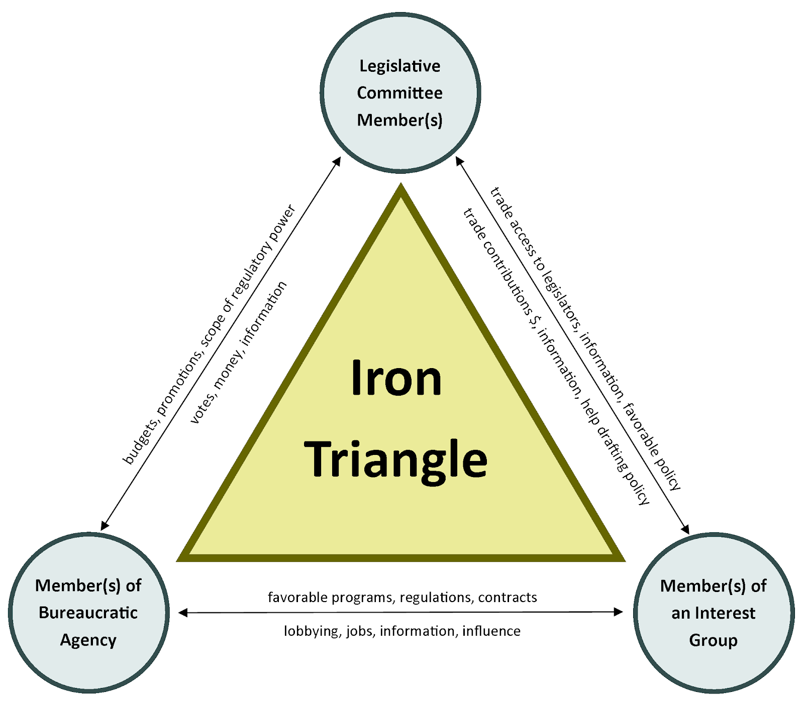
HOW DO INTEREST GROUPS EXERT INFLUENCE?
Interest groups exert influence through long-standing relationships with bureaucratic agencies, congressional committees, and other interest groups; such relationships are described as “iron triangles” and issue networks and they help interest groups exert influence across political party coalitions
Notes:
Issue network: a group of individuals, public officials, and interest groups that form around a particular issue, usually a proposed public policy that they wish to support or defeat.

Slide 16
IRON TRIANGLES
Definition: Alliances among bureaucrats, interest groups, and congressional subcommittee members and staff sometimes form to promote their common causes. Also known as sub-governments.
Example: An important issue that government has recently addressed is the effect of tobacco on health and the government's role in regulating it. The tobacco farmers and industry have numerous interest groups, a "tobacco lobby" that provide information to the tobacco division of the Department of Agriculture and to subcommittees of the House and Senate agricultural committees. They support the agency's budget requests and make contributions to the election campaigns of the subcommittee members. The subcommittees pass legislation affecting tobacco farmers and other members of the industry and approval higher budget requests from the agency. The agency gives the subcommittees information, help with constituents' complaints, and develop rules on tobacco production and prices. They all have a common interest - the promotion of tobacco farming and industry, and they can help one another achieve their goals. As a result, the president and Congress beyond the subcommittee have little decision-making power.

Slide 17
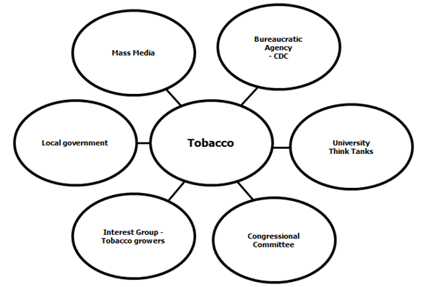
ISSUE NETWORKS
Definition: Network that consists of people in interest groups, on congressional staffs, in bureaucratic agencies, in universities, and in the mass media who regularly debate an issue.
The iron triangle may be criticized because interest groups today are so prolific that they are bound to create cross-demands on subcommittees and the bureaucracy. In the tobacco issue discussed above, interest groups have formed demanding that tobacco products be banned or heavily restricted by the federal government. With these counter-demands, the policymaking process would not run so smoothly and would broaden the number of people involved in the system. The issue is discussed on many levels, both inside and outside government. An agency, then, can be described as being embedded, not in an iron triangle, but in an issue network. The networks are contentious, with arguments and disagreements occurring along partisan, ideological, and economic lines. When a president appoints a new agency head, he will often choose someone from the issue network who agrees with his views.

Slide 18
ISSUE NETWORKS
Definition: Network that consists of people in interest groups, on congressional staffs, in bureaucratic agencies, in universities, and in the mass media who regularly debate an issue. They are not permanent
12

Slide 19
THE REVOLVING DOOR
Revolving door- the movement from the job of legislator to a job within an industry affected by the laws or regulations. Many officials leave their jobs on Capitol Hill or in the executive branch to lobby the government they departed. Some members of Congress take these positions after losing an election. Others do so because they can make more money by leaving government and working in the private sector. These former lawmakers already have influential relationships with members of Congress.
Almost half the members of Congress who left in 2017 became lobbyists.
This also applies to the bureaucracy, media. Many gov officials will move into media jobs to become news anchors on mainstream media outlets. Also, retired military personnel will find gainful employment in defense industry. For example, Lloyd Austin, is a retired general who upon retirement worked for a defense contractor-Raytheon. He is the current sect of defense.
https://www.opensecrets.org/revolving/rev_summary.php?id=82688

Slide 20
IRON TRIANGLE
(I didn’t produce this, but whoever did is a genius. I just made it better)
The Pentagon=Bureaucracy
The Pentagon is the U.S. Defense Department
Favorable rulings on defense contracts
Approval of budget requests
Information, help with Constituents’
complaints
Support for Agencies budget request
before Congress, expert information
Electoral Support-PAC$$, Expert information
Stark will influence Congress through Lobbyists (Int. Groups) & provide expert information & PAC $
Legislation affecting defense contracts budget

Slide 21
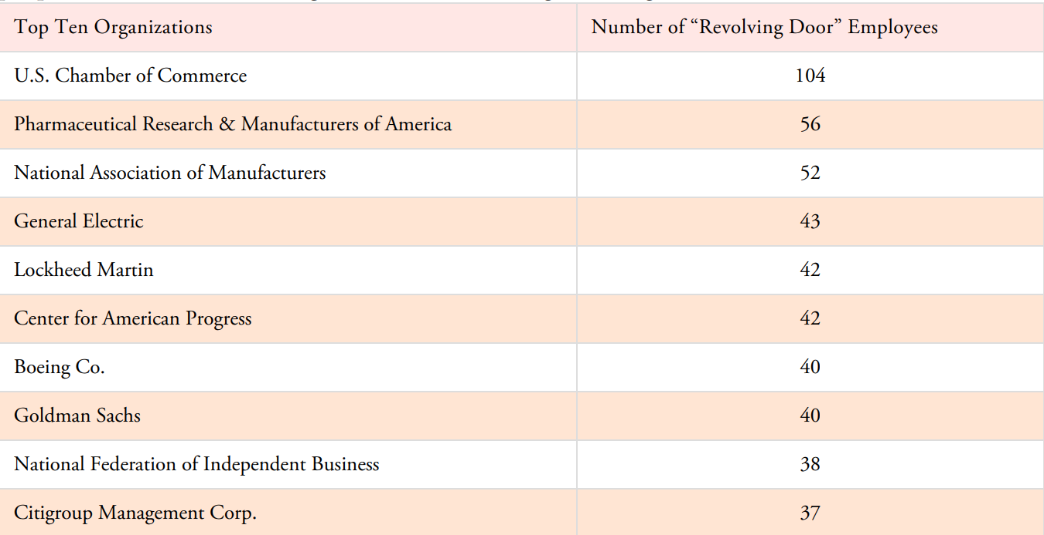
THE REVOLVING DOOR
Data from Center for Responsive Politics and OpenSecrets.org

Slide 22
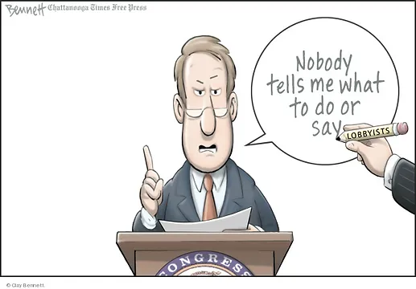
I love this political cartoon.

Slide 23
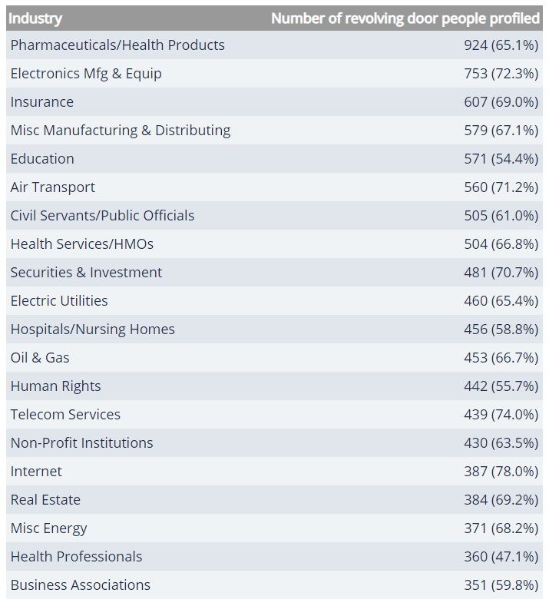
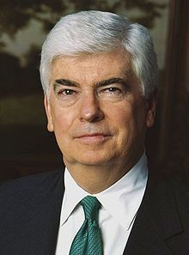
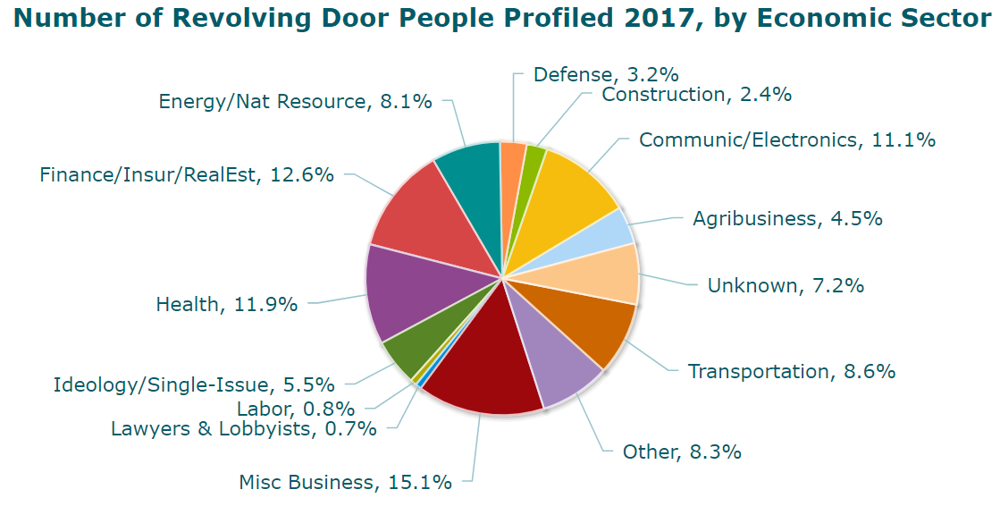
THE REVOLVING DOOR
Practically every industry and special interest area hires lobbyists to represent and defend their interests in Washington, D.C. But some industries frequently employ a special breed of lobbyist: those who previously worked for the federal government they're now tasked with lobbying.
Some of these "revolving door" lobbyists once toiled as low-level congressional staffers or entry-level bureaucrats. Plenty more, however, worked within government's upper ranks, serving as top agency officials, congressional chiefs of staff and even as members of the U.S. House and U.S. Senate.
Example: Chris Dodd
After serving 30 years in the US Senate as a Democrat representing Connecticut, Chris Dodd became the chairman and chief lobbyist for the Motion Picture Association of America (MPAA). He promoted the now-failed SOPA and PIPA, two anti-piracy bills that would have given the Federal Trade Commission broad powers to censor & shut down websites. Although the MPAA would not confirm with Dodd’s exact salary, media accounts point to $1.5 million, a slightly higher figure than the previous MPAA head, former Secretary of Agriculture Dan Glickman. Dodd received about a 762 percent raise after moving from public office to lobbying. Why are congressmen like Chris Dodd often hired as lobbyists?
Center for Responsive Politics http://www.opensecrets.org/revolving/top.php?display=I

Slide 24
THE REVOLVING DOOR
Example: Dr. Scott Gottlieb, M.D. Dr. Scott Gottlieb served as the 23rd Commissioner of Food and Drugs on May 11, 2017, to April 5, 2019. Dr. Gottlieb is a physician, medical policy expert, and public health advocate who previously served as the FDA's Deputy Commissioner for Medical and Scientific Affairs and before that, as a senior advisor to the FDA Commissioner.
FDA commissioner (2017–2019)
2019-to present Member of the Pfizer Board
Of Directors
https://www.fda.gov/about-fda/fda-leadership-1907-today/scott-gottlieb#:~:text=Scott%20Gottlieb%20M.D.&text=April%205%2C%202019.-,Dr.,advisor%20to%20the%20FDA%20Commissioner.
https://www.pfizer.com/about/people/board-members

Slide 25
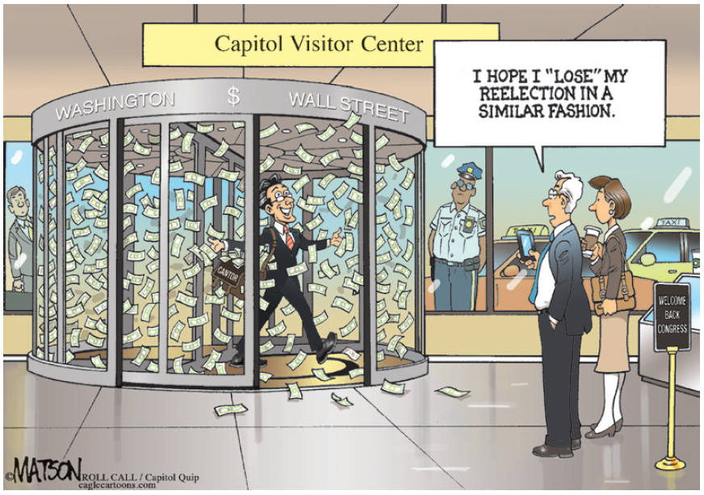
THE REVOLVING DOOR
Eric Cantor earned $193,400 a year as majority leader. His annual salary at Moelis is $400,000, and he received $1 million in stock (vested over five years) and a $400,000 signing bonus in cash in 2014, according to Securities and Exchange Commission filings. In 2015, he was slated to make another $1.2 million and $400,000 in stock. The $3.4 million payday drew accusations of selling out; at the very least, Cantor jumped into America’s other least-trusted institution: Wall Street.
Cantor was hired for his expertise in global markets and government regulation. He opened the bank’s Washington office in early 2015 but says he’s not a lobbyist: “I certainly know a lot of people, but I operate at the intersection of political risk, where public policy meets business-making decisions.”
Objectively, even Cantor could argue that he got out of Washington just in time: Now he enjoys a globe-hopping job, more money, the occasional TV interview, lunch or dinner with friends on the Hill.

Slide 26
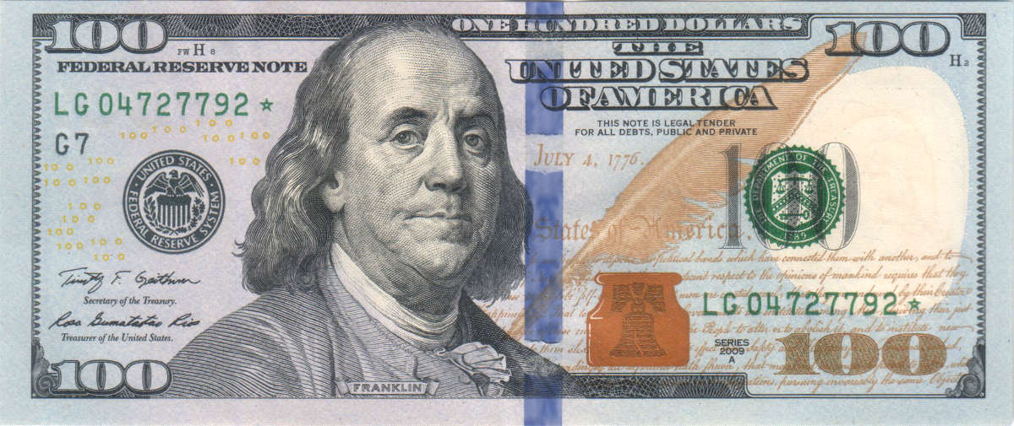
YOU SMELL WHAT I SMELL? MONEY!
Former Congressman Cal Dooley (D-CA) has made at least $4,719,093 as a lobbyist for food manufacturers and the chemical industry from 2005 to 2009.
Republic Report analyzed disclosures from the Grocery Manufacturers Association (GMA), an industry lobby — for companies like Kellogg — where Dooley worked following his retirement from Congress. We also added in Dooley’s salary from the American Chemistry Council, where Dooley now works as the president. The Chemistry Council represents Dow Chemical, DuPont, and other chemical interests. Dooley’s salary jumped 1357 percent between his last year in the House and his last reported salary for the Chemistry Council in 2009.
Former Congressman Billy Tauzin (R-LA) made $19,359,927 as a lobbyist for pharmaceutical companies between 2006 and 2010.
Tauzin retired from Congress in 2005, shortly after leading the passage of President Bush’s prescription drug expansion. He was recruited to lead PhRMA, a lobbying association for Pfizer, Bayer, and other top drug companies. During the health reform debate, the former congressman helped his association block a proposal to allow Medicare to negotiate for drug prices, a major concession that extended the policies enacted in Tauzin’s original Medicare drug-purchasing scheme. Tauzin left PhRMA in late 2010. He was paid over $11 million in his last year at the trade group. Comparing Tauzin’s salary during his last year as congressman and his last year as head of PhRMA, his salary went up 7110 percent.

Slide 27
ARE ALL INTEREST GROUPS CREATED EQUAL?
No!!
There are some factors that affect how influential an interest group can be:
Inequality of political and economic resources.
Unequal access to decision makers.
“Free rider” problem.

Slide 28
Free Rider
“Free rider” policy: a problem of group behavior that occurs when an individual can receive a public benefit without making a personal contribution of money or effort; for example, a person might listen to public radio but never contributes to the station, assuming that other donors will pay to keep it operating
The free-rider problem is the incentive to benefit from others’ work without contributing to the group.
Have you ever done a group project in which you did all the work? You have a “free-rider” problem.
There are many competing interest groups, and they can take a variety of forms, but all seek to influence public policy in favor of the needs of their constituents. Not all interest groups have an equal impact on policy, however, as some have more funds, greater access to decision makers, and more committed members.

Slide 29
WHAT FACTORS MAKE INTEREST GROUPS STRONG?
SIZE
More members = more money, more votes
More members also mean greater cross-pressure among members and possibly less focus
As size increases, free rider problem increases.
Free riders are people who benefit from the interest group without making any contribution.
i.e., an elderly person will benefit from the group’s lobbying efforts whether or not he joins AARP.
IG try to prevent this by giving incentives for people to join the group.
SPREAD
The extent to which membership is concentrated or dispersed ‑ is important
ORGANIZATIONAL STRUCTURE: CENTRALIZED OR DECENTRALIZED
An organization with separation of powers tends to be less cohesive than a centralized, disciplined group
LEADERSHIP
Leaders may either bring the various elements of a group together or sharpen their disunity
RESOURCES
Money
Expertise
Reputation
Connections
Volunteers

Slide 30
WHAT ARE EFFECTIVE TACTICS (TECHNIQUES) OF INTEREST GROUPS?
MASS MAILING (COMPUTERIZED AND TARGETED)
LITIGATION (USED BY NAACP, ACLU, NOW, ETC.)
If an interest group fails in one arena, the courts may be able to provide a remedy.
Interest groups can file amicus curiae briefs to influence a court’s decision.
amicus curiae: briefs submitted by a “friend of the court” to raise additional points of view and present information not contained in the briefs of the formal parties
Class Action lawsuits permit a small number of people to sue on behalf of all other people similar situated.
USE OF MASS MEDIA
Independent expenditures
Issue advocacy
BOYCOTTING
ELECTIONEERING
Funneling volunteers to campaigns
Encouraging members to vote
Campaign contributions
Endorsement of candidates
“Targeting” of unfriendly candidates
Issuing “report cards” to rate candidates
INITIATIVE, REFERENDUM AND RECALL AT STATE AND LOCAL LEVELS
LOBBYING= influence with expert information and or PAC $ for re-election campaign

Slide 31
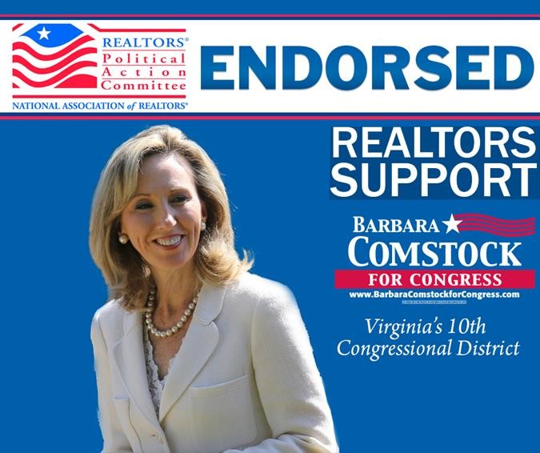
WHAT ARE PACS (POLITICAL ACTION COMMITTEES)?
Political Action Committees, commonly called "PACs," are organizations dedicated to raising and spending money to either elect or defeat political candidates.
PACs solicit contributions from employees or members and make contributions in the PACs name to candidates or political parties.
Most PACs are directly connected to specific corporations, labor groups, or
recognized political parties.
Non-connected or ideological PACs raise and spend money to elect candidates -- from any political party -- who support their ideals or agendas
Under federal election laws, PACs can legally contribute only $5,000 to a candidate committee per election (primary, general or special). They can also give up to $15,000 annually to any national party committee, and $5,000 annually to any other PAC.

Slide 32
INFLUENCES ON PUBLIC POLICY
Today it is common place for various political actors, in the form of interest groups, professional organizations, social movements, the military, and bureaucratic agencies, to influence the policy making process.
Does that make it right?

Slide 33
WHAT ARE EFFECTIVE TACTICS (TECHNIQUES) OF INTEREST GROUPS?
Outside lobbying, more accurately described as grass-roots lobbying, is an effort to mobilize public opinion and put pressure on public officials. It may involve organizing a letter-writing or e-mail campaign or taking out ads in the print and electronic media in support of an issue.
Organized labor’s attack against the North American Free Trade Agreement (NAFTA) is a good example of grass-roots lobbying. Labor’s ads on billboards and in newspapers, as well as its television/radio spots, emphasized that NAFTA would export U.S. jobs to other countries.
17

Slide 34
How do Interest Groups Participate Directly in the Electoral Process?
They openly endorse candidates who support their goals and encourage their members to vote for those candidates.
This approach is somewhat risky because, if an interest group’s candidate loses, the interest group will likely not have the same access to the winner.
The ratings that many public interest and ideological interest groups publish on members of Congress are either a form of endorsement or ammunition for a challenger in the race.
Interest groups can help out a campaign by providing mailing lists, by mobilizing volunteers to get out the vote or distribute literature, and, most important, by contributing money largely through political action committees (PACs).

Slide 35
WHY DO INTEREST GROUPS KEEP GROWING?
Economic developments.
Government policies, whenever govt. creates an agency, it creates an entry point for interest groups
more groups needed to form in order to protect their stakes in these agency activities.
Diversity of population – countless social, racial, economic and geographic cleavages- the division of voters into voting blocs.
Diffusion of power in government. Political power shared by many –> plenty of places in which a group can argue its case. The more places there are to influence policy, the more organizations there will be to exercise that influence.
Weakness of political parties.
Reforms of the 1970's opened up the lobbying process (FECA and the explosion of PACs).
Interest groups tend to beget interest groups ( when one is formed, another may be formed to counter it)
Technology, e.g., computerized mailing lists to solicit funds, use of communications media and Internet.

Slide 36
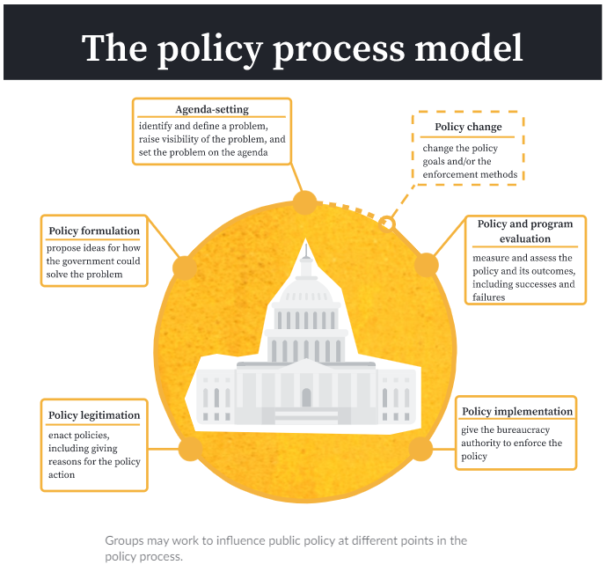
HOW DOES PUBLIC OPINION BECOME POLICY?
How is information gathered?
Who is in charge of creating policy?
Are there politics involved?
To whom should the “government” listen to?
GROUPS INFLUENCING POLICY OUTCOMES – FROM KHAN ACADEMY
1.
6.
2.
5.
4.
3.

Slide 37
HOW DOES PUBLIC OPINION BECOME POLICY?
1.
6.
2.
5.
3.
4.
GROUPS INFLUENCING POLICY OUTCOMES – FROM KHAN ACADEMY

Slide 38
Types of interest groups: Business Interest groups can be classified according to the groups that they represent. How do they try to impact society and policy making?
Most interest groups are founded on the basis of economic interests. Among those groups, are those representing business, labor, agriculture and certain professions
Trade Associations- created to protect business interests.
National Restaurant Association,
American Trucking Association,
National Cable Telecommunications Association,
Business Roundtable and some of the biggest hitters out there are part of the group. CEOs from Amazon, Apple, and General Motors are members. This gives the group a lot of clout in addition to power.

Slide 39
Types of interest groups: Labor Interest groups can be classified according to the groups that they represent. How do they try to impact society and policy making?
Most interest groups are founded on the basis of economic interests. Among those groups, are those representing business, labor, agriculture and certain professions
Samuel Gompers- founder of the American Federation of Labor- to protect worker’s rights. Later merged with Congress of Industrial Organizations- The AFL-CIO. At one point in time, the largest labor union in USA.
UAW- United Auto Workers
International Brotherhood of Teamsters

Slide 40
Types of interest groups: Agricultural groups Interest groups can be classified according to the groups that they represent. How do they try to impact society and policy making?
Most interest groups are founded on the basis of economic interests. Among those groups, are those representing business, labor, agriculture and certain professions
Oliver Hudson Kelley- The Grange. Formed to address farmers concerns, especially against the railroads.
The Farm Bureau
National Farmers Union

Slide 41
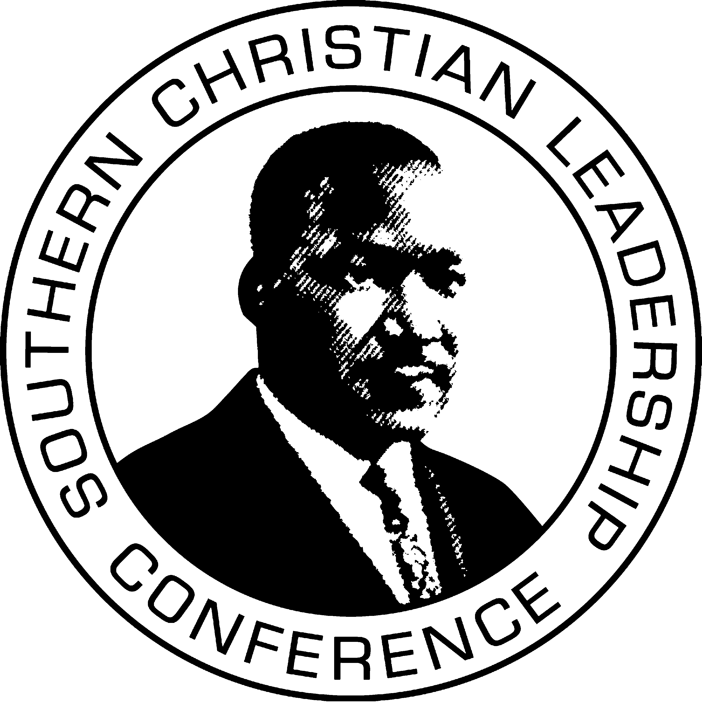
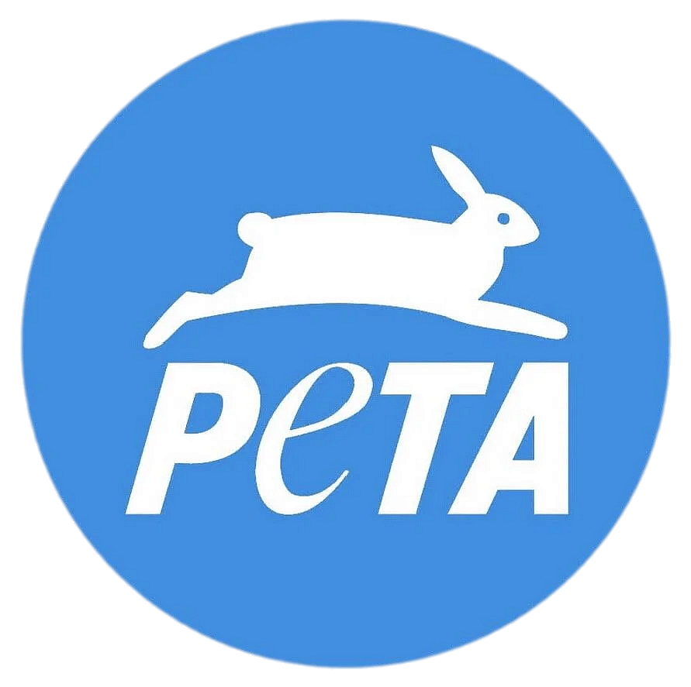
Types of interest groups Interest groups can be classified according to the groups that they represent. How do they try to impact society and policy making?
What is a single-issue interest group?
Groups that form to address a narrow area of concern or simply focus on one topic.
Goal is to get government action on one overriding issue.
Examples: EMILY’s List, NRA, AARP
What is an ideological interest group or social movement?
Groups that form around a particular political ideology.
Goal is to bring about change in society, such as the Civil Rights Movement or the Environmental Movement; these groups support policies and elected officials that align with their beliefs.
Examples: NOW, NAACP, ACLU
What is a protest movement?
Groups that form out of protest.
Goal is to bring attention to a social problem through public demonstrations or other forms of direct action.
Examples: BLM, Occupy Wall Street

Slide 42
Types of interest groups Social Movements Interests
Social Movements Interests From American History
The Progressive Era 1890-1920
Progressive Era Amendments:
16th Amendment- income tax
17th Amendment- direct election of senators
19th Amendment- granted women the right to vote
Environmental Movement
Congress passed the first Clean Water Act and Clean Air Act, respectively, in part through the efforts of the environmental groups.
Consumer Movement
Civil Rights – NAACP – used litigation to end separate but equal
Martin Luther King- Southern Christian Leadership Conference- used civil disobedience to garner national attention to the plight of African Americans in the south
Ralph Nader emerged as America’s chief consumer advocate. He published Unsafe at Any Speed, an exposé of the auto industry, especially General Motors’ (GM) sporty Corvair
AMSCO pg. 571

Slide 43
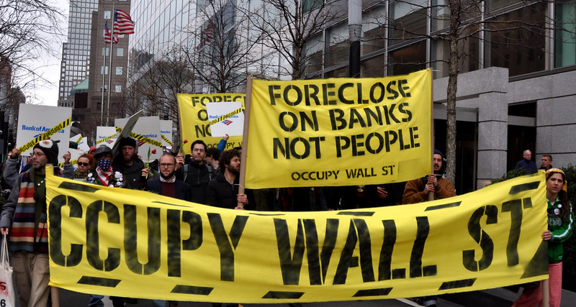
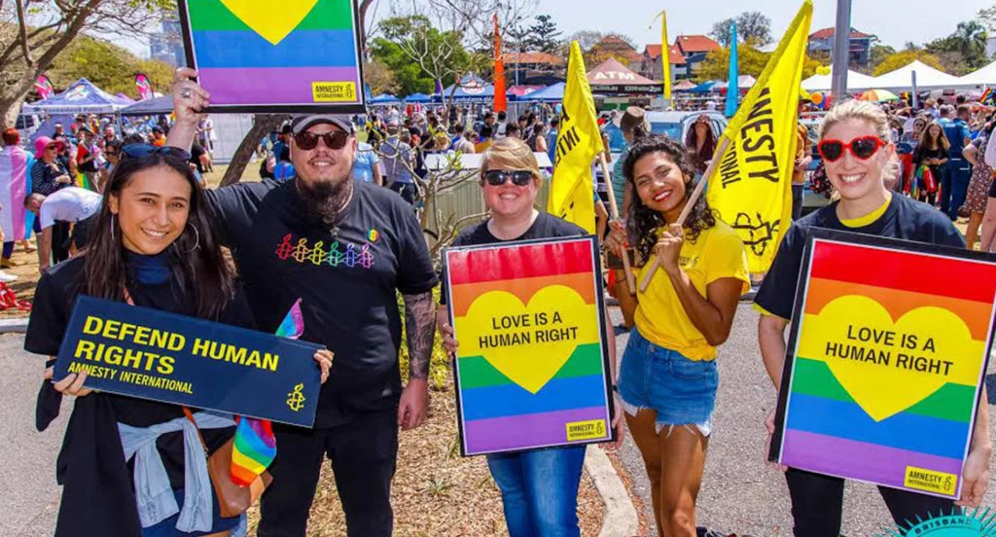
INTEREST GROUP VS. SOCIAL MOVEMENT
Interest groups – voluntary associations of people who come together with the goal of getting the policies that they favor enacted
Social movements – diffuse (spread out, not concentrated) groups that educate the public and put pressure on policymakers in an effort to bring about societal change

Slide 44
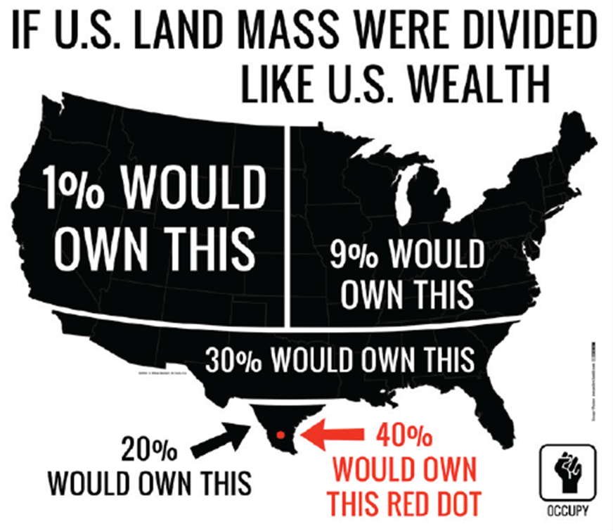
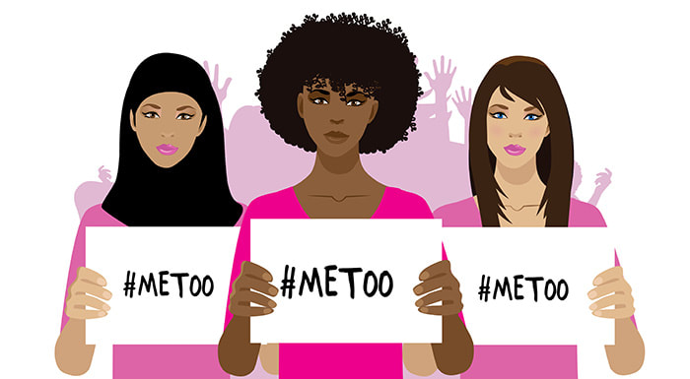
SUCCESSES AND FAILURES OF SOCIAL MOVEMENTS
Social movements are most successful when raising issues to national attention.
Depends upon the impact that protest has on the electoral system.
Elected officials either accommodate the demands of protestors or decide to ignore.
Social movements can get issues on the government’s radar by using protest tactics and the media. It can lead to the government setting issues on the policy agenda to solve in the coming year.
Occupy Wall Street struggled as a movement
Lacked clear message
Lost media coverage
#MeToo Movement
Viral campaign spreading message of sexual harassment successful at holding high profile individuals accountable for actions via public pressure

Slide 45
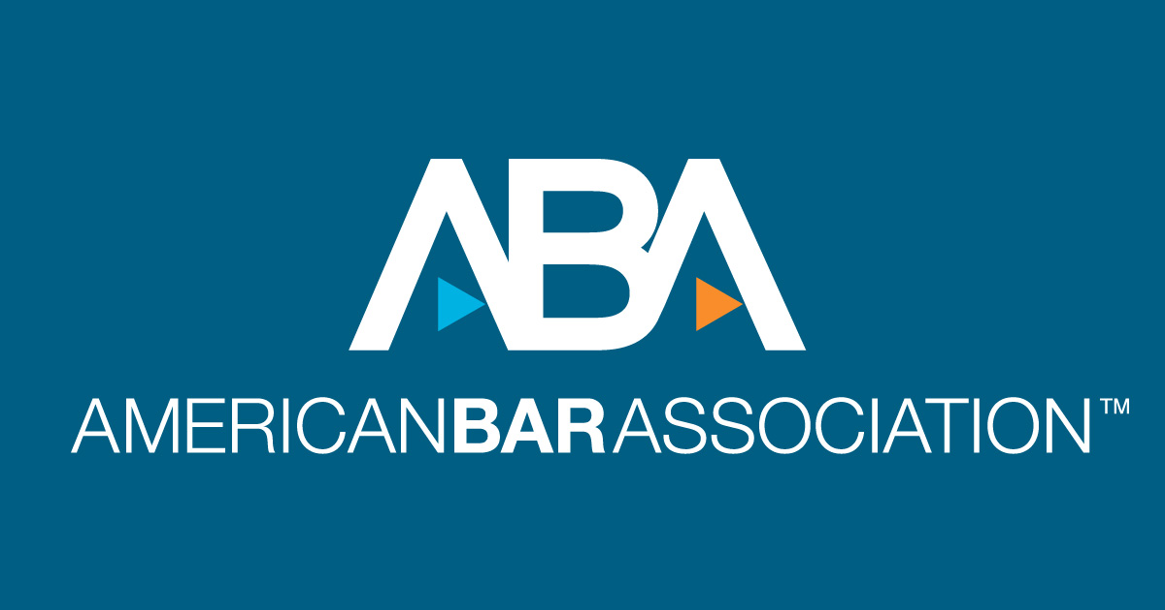
Types of interest groups Institutional Groups
Intergovernmental lobby are government institutions and their employees—police, firefighters, EMTs, sanitation workers, and others—who have a keen interest in government rules and regulations that affect their jobs and funding that impacts their salaries.
Professional associations are concerned with business success and the laws and practices that guide their trade.
Think tanks are research institutions, often with specific ideological goals in mind to influence policy.

Slide 46
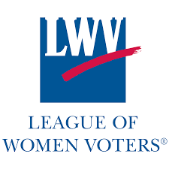
Types of interest groups Public Interests Groups
Public Interests Groups- is an organization that works for the best interests of the overall community, rather than the narrower interests o one segment. It seeks policies that benefit all or most people, whether or not they belong to or support the organization. Ex: child safety, consumer safety, automobile safety.
Common Cause- is an organization fighting for an accountable government, equal rights/opportunities/representation and empowering voices to be heard.
League of Women Voters- We empower voters and defend democracy through advocacy, education, and litigation, at the local, state, and national levels.
Public Citizen, Inc.-is a nonprofit consumer advocacy organization that champions the public interest – your interests – in the halls of power.

Slide 47
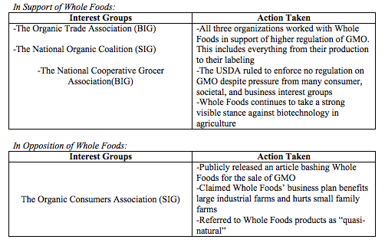

Slide 48
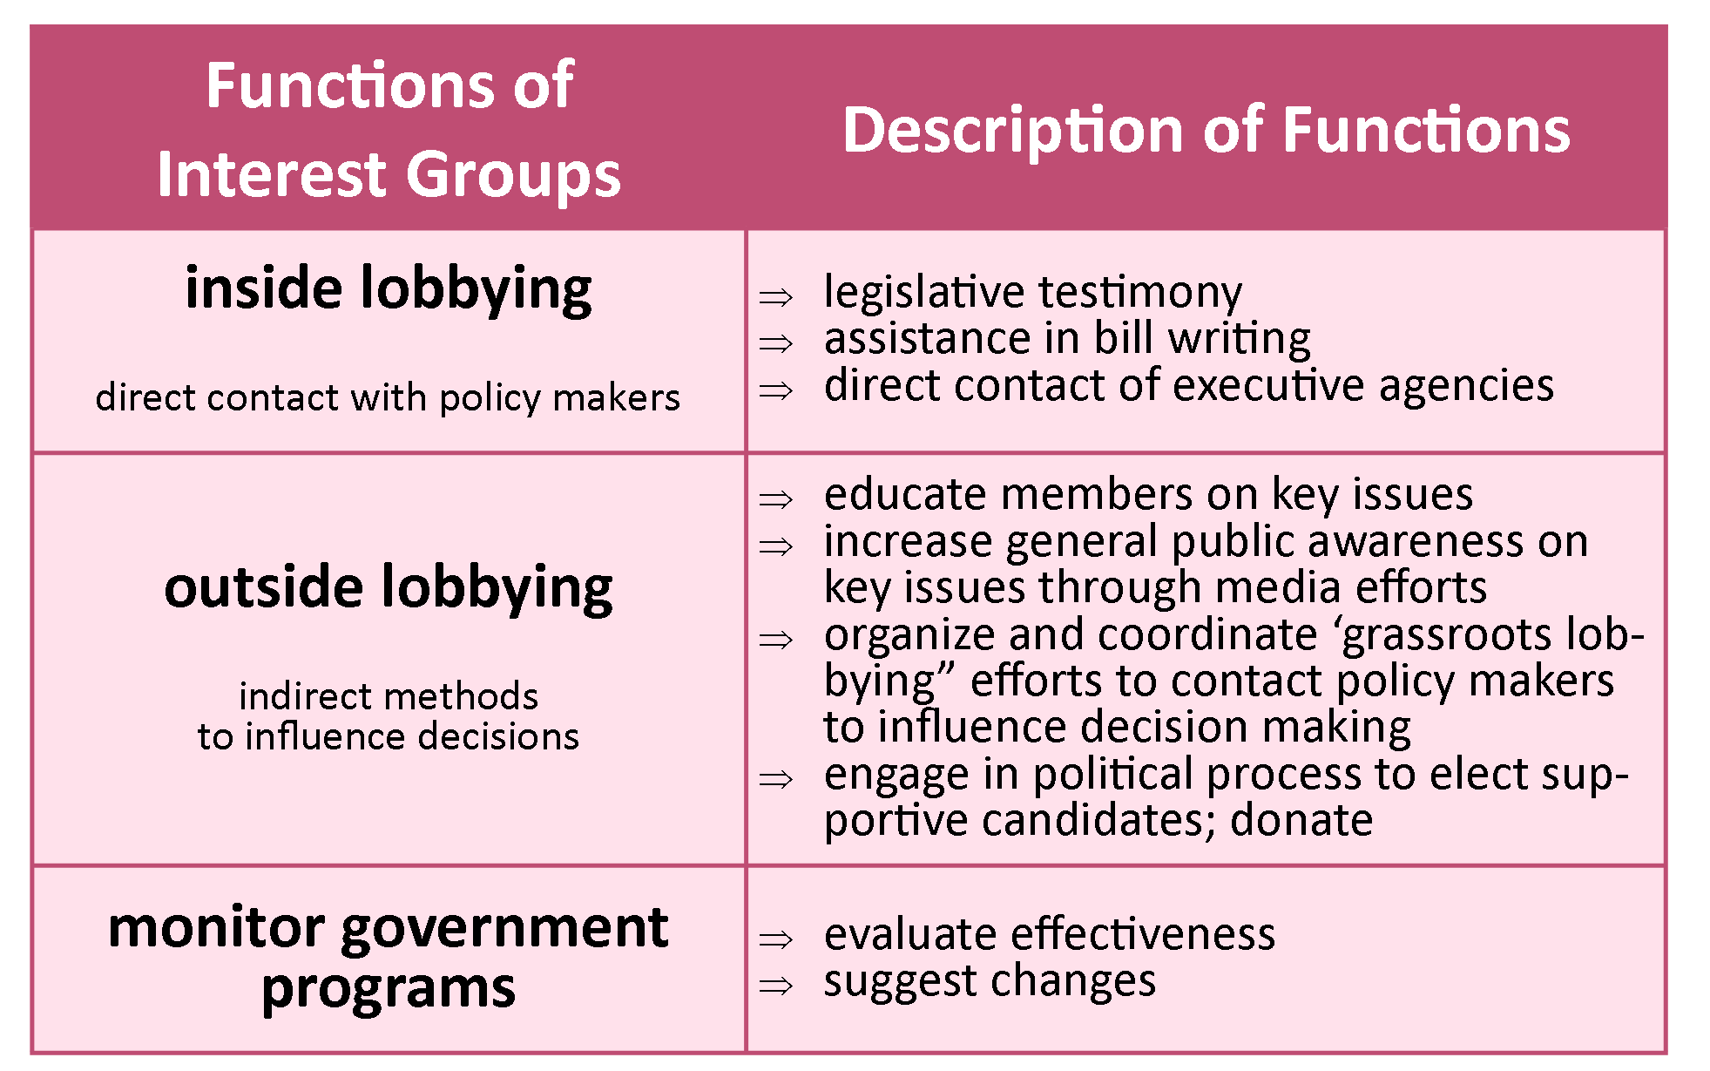

Slide 49
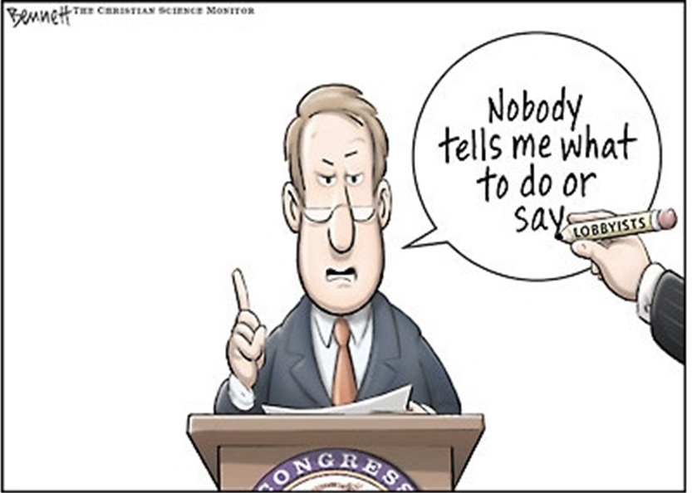
The influence of lobbyists
WHAT IS LOBBYING?
Attempting to influence the decisions of policymakers.
Interest group lobbying is generally most effective on narrow technical issues that are not well publicized (nobody has expertise on the issue except for the lobbyist)
WHO ARE LOBBYISTS AND WHAT DO THEY DO?
A person who is employed by and acts for an organized interest group or corporation to try to influence policy decisions and positions in the executive branch (bureaucratic agency) and legislative branch (congressional committee)
Influence governmental decisions, especially legislation
Provide information to government (Lobbyist = policy specialist, congressman = policy generalist)
Testify at hearings
Help write legislation
The revolving door is the employment cycle from government to interest group
Government employee to lobby the agency they came from is illegal –> conflict of interest
Congress to lobbyist is legal (with a “cooling off” period)

Slide 50
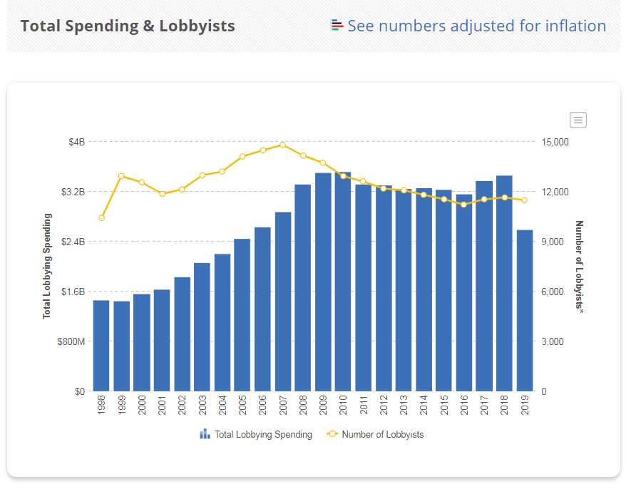

Slide 51
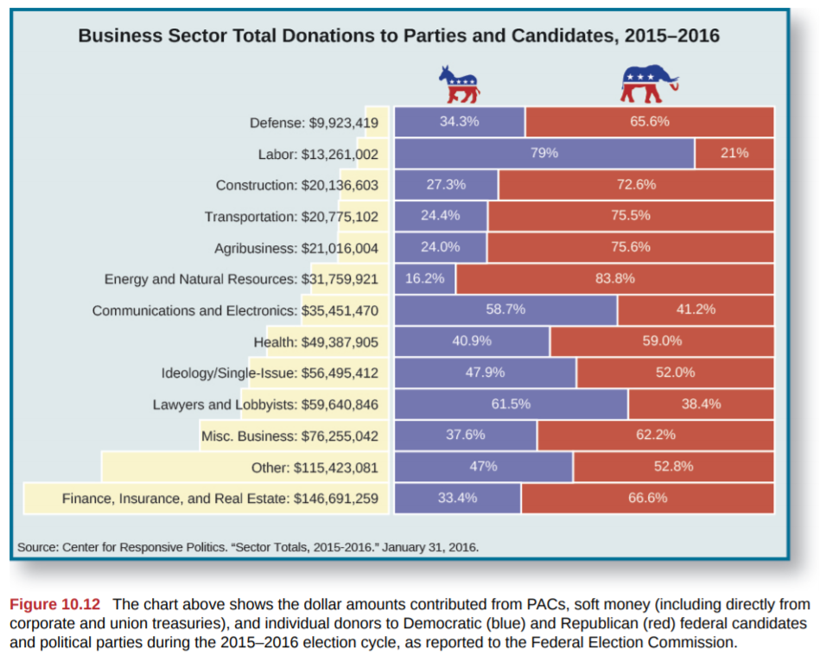

Slide 52
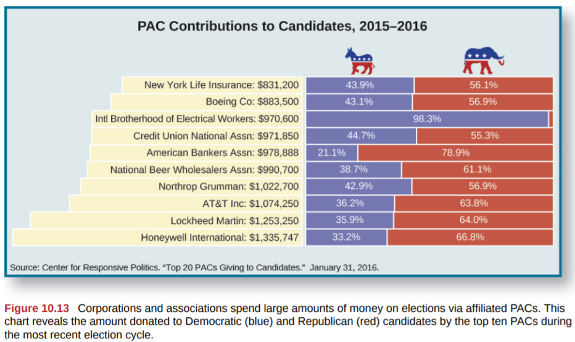

Slide 53
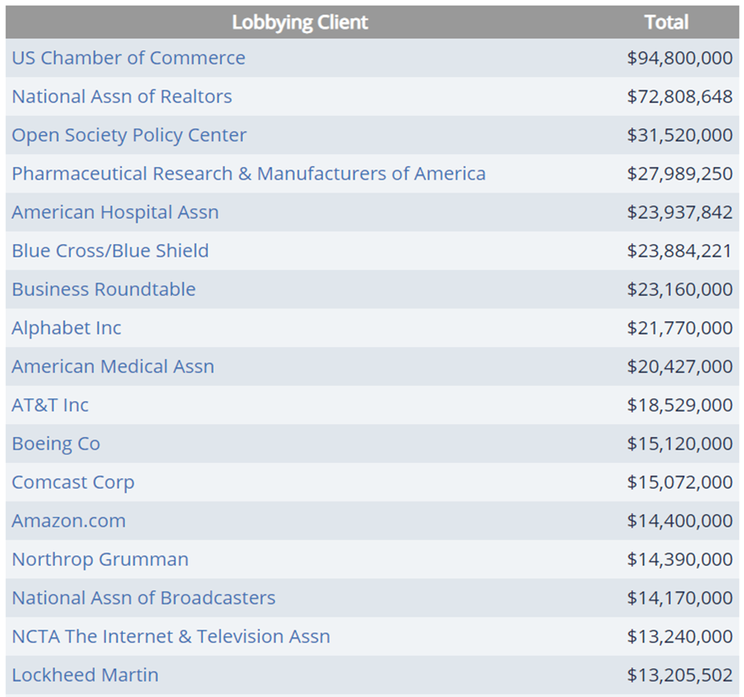
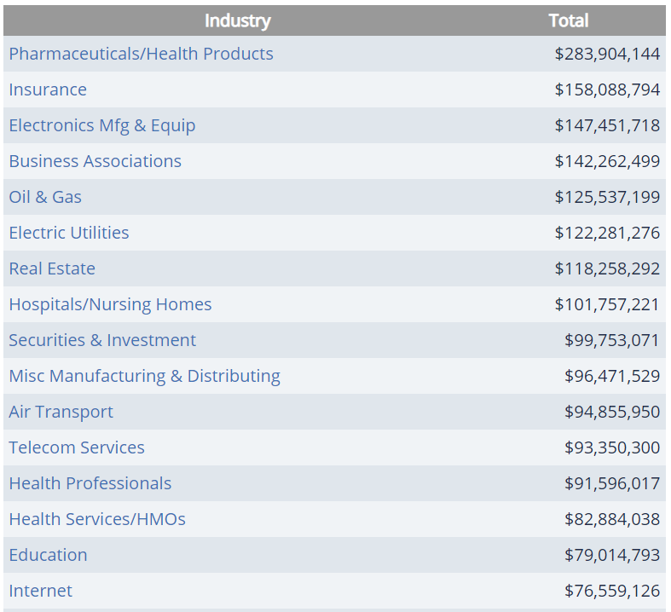
TOP INDUSTRIES - 2018
TOP SPENDERS - 2018

Slide 54
EXPLAIN WHY LOBBYISTS ARE GOOD FOR AMERICA?
EXPLAIN WHY LOBBYISTS ARE BAD FOR AMERICA?
They provide useful information to government
raise awareness and interest in public affairs
They provide a means of participation for people
They provide a means of representation on the basis of interest rather than geography. A “third house of Congress.”
1st Amendment protection
Lobbyists have always spent money. It’s more out in the open.
Provide information, more checks and balances
Vehicles for political participation- linkage
As Madison points out in Federalist #10, the “remedy” of curing the evils of factions by eliminating their causes is worse than the disease. Potential loss of liberty is worse than the abuses of lobbyists.
Rich and powerful interests are over represented.
Average and poor people are under represented.
By safeguarding liberty, equality is sacrificed.
Single-issue lobbies, especially, contribute to political polarization.
Lobbies contribute even further to diffusion of power, making it even more difficult for govt. to get things done.
Potential for bribery

Slide 55
LOBBYING BY INTEREST GROUPS
Interacting with government officials in order to advance a group’s public policy goals (done to all branches)
Legislative – influence legislation
Congress is a target for lobbyists
Strategies:
Contact members or their staff
Prepare research reports and briefs to bring more attention to issue
Draft bills and lobby to have them introduced
Provide useful and timely information
Executive – how laws are implemented
When establishing rules and procedures, bureaucratic agencies generate data and hire experts
Aide in the creation of regulation, just like policy
Judicial – how laws are interpreted
File lawsuits
Brown v. Board of Education
NAACP attempted to end legal segregation
When not party to a case, can file amicus curiae briefs (attempt to persuade the Court to agree with the arguments set forth in the brief)
Influence judicial appointments
Lobbyists provide useful knowledge and access to those in government
Lobbyists have greater access to policymakers than average citizens

Slide 56
ACTIVITIES OF LOBBYISTS TO EXERT INFLUENCE
Insider strategies: quietly persuading government decision makers through exclusive access
Outsider strategies: public efforts to influence policy with such things as lawsuits or get-out-the vote drives Client interaction: informing clients, discussing strategy
Legislative activity: providing information/researching bills/drafting bills
Social media: monitoring congressional activity, targeting outreach
Implementation: testifying on bills/filing amicus curiae briefs
Electoral activity: advertising, making PAC donations Other activity: meetings, business development/media commentary, etc
AMSCO pg. 561

Slide 57
THEORIES OF INTEREST GROUP FORMATION
Three main theories explain the impact of groups on the political process – all seek to control the policy agenda*:
Participatory democracy theory – the belief that citizens impact policymaking through their involvement in civil society
Groups outside the government that advocate for policy
Pluralist theory – political power is distributed among many competing groups, which means that no one group can grow too powerful
Elite theory – at theory that the wealthy elite class has a disproportionate amount of economic and political power
*policy agenda the set of issues to which government officials, voters, and the public are paying attention.
Notes:
policy agenda the set of issues to which government officials, voters, and the public are paying attention.

Slide 58
Groups Influencing Policy Outcomes END

