Slide 1
UNIT 2 Chpt. 7 Topic 2.12-2.15
AMSCO pg. 217-243
Topic 2.12-2.15 The Bureaucracy

Slide 2
2.12 The federal bureaucracy implements federal policies.
The federal bureaucracy is composed of departments, agencies, commissions, and government corporations that implement policy by:
i. Writing and enforcing regulations
ii. Issuing fines
iii. Testifying before Congress
iv. Forming iron triangles (alliances of congressional committees, bureaucratic agencies, and interest groups that are
prominent in specific policy areas) v. Creating issue networks (temporary coalitions that form to promote a common
issue or agenda)
The civil service primarily uses a merit system that prioritizes hiring and promotion based on professionalism, specialization, and neutrality, as opposed to political patronage, whereby bureaucratic jobs are politically appointed.
Explain how the bureaucracy carries out the responsibilities of the federal government.

Slide 3
THE MODERN BUREAUCRACY
A bureaucracy is a large, complex organization of appointed, not elected, oﬃcials.
LARGE: Three million civilian federal employees
Department of Defense is the largest department = about 50% (even without active military which is about 1.4 million)
Post Oﬃce has about 28%
<10% of top-level jobs are appointed (political appointees) by the president
>> PATRONAGE
>90% of federal employees are civil service workers >> MERIT SYSTEM
Tenure protection, diﬃcult to ﬁre (unless appointed by president)
Specialized units with expertise in a ﬁeld

Slide 4
Bureaucratic Myths & Realities
Americans dislike bureaucrats
Citizens and elected officials dislike “faceless” bureaucracies
– Too much “red tape”, ineffective, inefficient, delay
But majority of citizens report favorable interactions with various bureaucratic agencies
Bureaucracies are increasing
Federal bureaucracy is shrinking, but state and local bureaucracies have grown – Bureaucrats work in D.C.
Most work at the state or local level

Slide 5
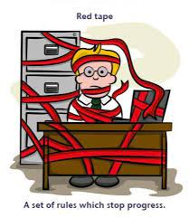
RED TAPE
Red Tape official routine or procedure marked by excessive complexity which results in delay or inaction. Seen as a waste of time; inefficient.

Slide 6
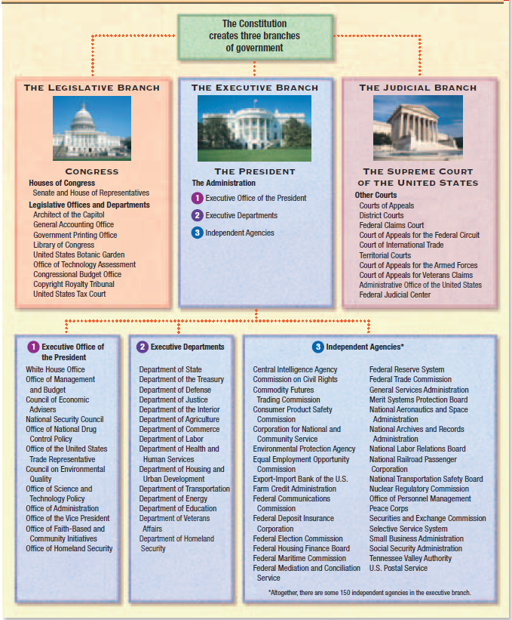
The Government
Of the
United States
Three Features of the Bureaucracy:
Hierarchical authority
Job specialization
Formalized rules

Slide 7
The Government Of the United States
Three Features of the Bureaucracy:
Hierarchical authority- The word hierarchical describes any organization structured as a pyramid, with a chain of command running rom the top of the pyramid on down to its base. The few officials and units at the top of the structure have authority over those officials and units at the larger middle level, who in turn direct the activities of the many at the bottom level.
Job specialization- Each bureaucrat, each person who works for the organization, has certain defined duties and responsibilities. There is, then, a precise division of labor within the organization.
Formalized rules- Formalized rules. The bureaucracy does its work according to a number of established regulations and procedures. Those rules are set out in written form and so can be known by all who are involved in that work
Magruder’s, Amer Gov 2009 pg. 426-27

Slide 9
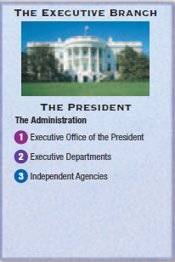
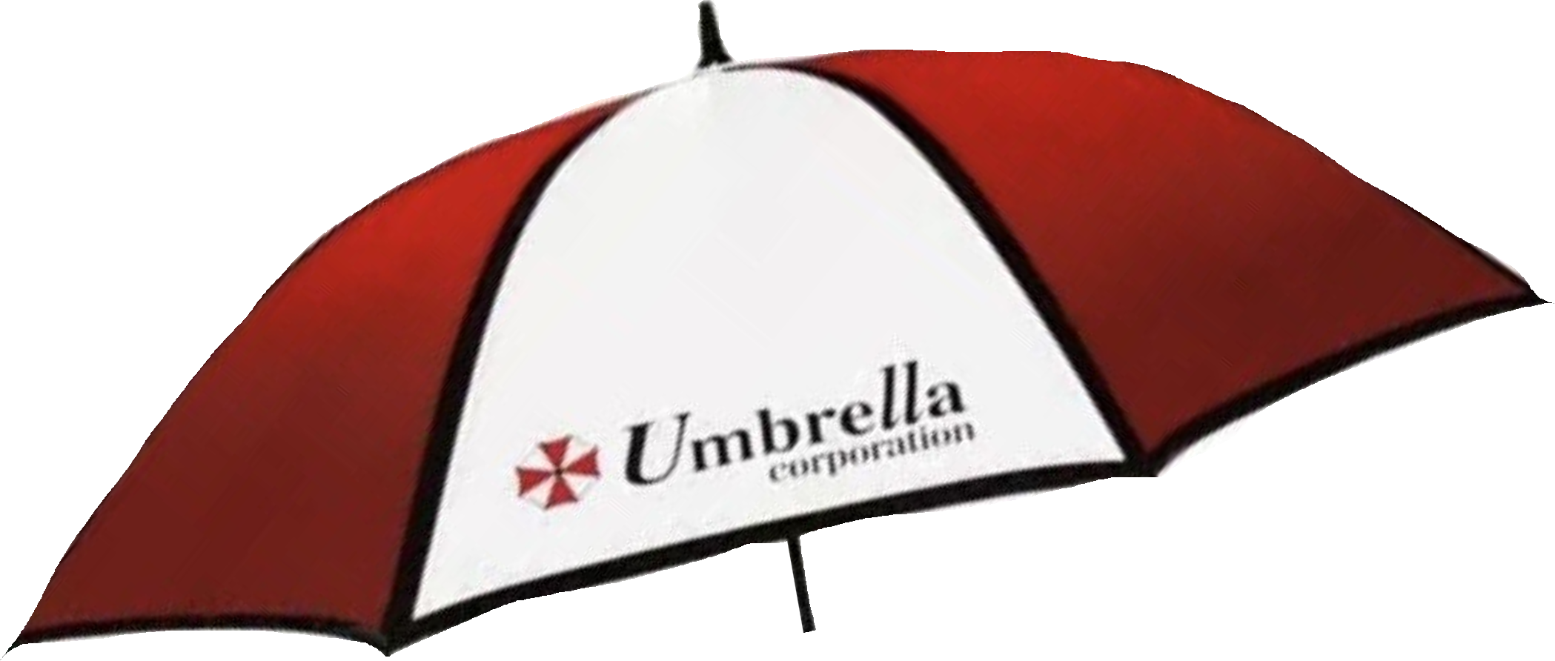
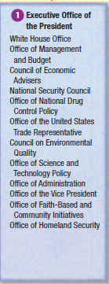
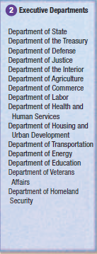
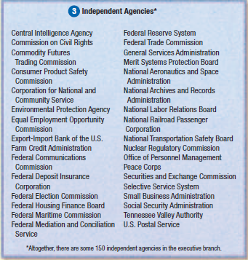

Slide 10
THE ORGANIZATION OF THE BUREAUCRACY
Agencies of the executive branch may be organized into four basic types:
Cabinet departments
Cabinet departments are heading by a secretary (except Dept of Justice) and manage a speciﬁc policy area with responsibility further divided among various agencies
Independent regulatory agencies or commissions
Regulatory agencies/commissions are created by Congress to regulate important parts of the economy
Government corporations
Government corporations are businesses run like corporations, but controlled by the government
Independent executive agencies
Independent agencies are agencies that do not fall into the ﬁrst three categories. They closely resemble Cabinet departments, but they are smaller and less complex.

Slide 11
The (Inner) Cabinet

Slide 12
THE CABINET DEPARTMENTS
Article 2, Section 2, Clause 1:
The President . . . may require the Opinion, in writing, of the principal Oﬃcer in each of the executive Departments, upon any Subject relating to the Duties of their respective Oﬃces
Each of the ﬁfteen cabinet departments is headed by a secretary, except for the Department of Justice, which is headed by the Attorney General
All of the heads are chosen (appointed) by the President and conﬁrmed by the Senate
Manage a speciﬁc policy area with responsibility further divided among various agencies
Secretaries often develop a strong loyalty to their departments. They become closer to the department than to the President.

Slide 13
THE CABINET DEPARTMENTS
The ﬁfteen cabinet departments, in order of creation, are:
State (1789) - advises the president on foreign policy, nego1ates trea1es, represents the United States in interna1onal organiza1ons
2) Treasury (1789) - collects federal revenues, pays federal bills, mints coins and prints paper money, enforces alcohol, tobacco and firearm laws
3) Defense (1789) - manages the armed forces, operates military bases
4) Interior (1849) - manages federal lands, refuges, and parks, operates hydroelectric facilities, manages Native American affairs
5) Justice (1870) - provides legal advice to the president, enforces federal laws, represents the United States in court, operates federal prisons. Led by the attorney general.
6) Agriculture (1889) - provides agricultural assistance to farmers and ranchers, inspects food, manages national forests, administers SNAP-food stamps,
7) Commerce (1903) - grants patents and trademarks, conducts the national census, pro-motes international trade
8) Labor (1913) - enforces federal labor laws (child labor, minimum wage, safe working conditions), administers unemployment and job training programs

Slide 14
THE CABINET DEPARTMENTS
The ﬁfteen cabinet departments, in order of creation, are:
9) Health and Human Services (1953) - administers Social Security and Medicare/Medic-aid programs, promotes health care research and runs the Food and Drug Administration
10) Housing and Urban Development (1965) - provides home financing and public housing programs, Section 8, enforces fair housing laws
11) Transportation (1967) - promotes mass transit programs and programs for highways, rail-roads, and air traffic, enforces maritime law
12) Energy (1977) - advances the energy security of the U.S. and takes care of the nation’s nuclear security
13) Education (1979) - administers federal aid programs to schools, engages in educa1onal research
14) Veterans Affairs (1989) - promotes the welfare of veterans of the armed forces
15) Homeland Security (2002) - prevents terrorist attacks within the United States, reduces America's suscep1bility to terrorism, minimizes damage and helps recovery from attacks that do occur

Slide 15
DEPARTMENT OF JUSTICE (1870)
Provides legal advice to the president, enforces federal laws, represents the United States in court, operates federal prisons

Slide 16
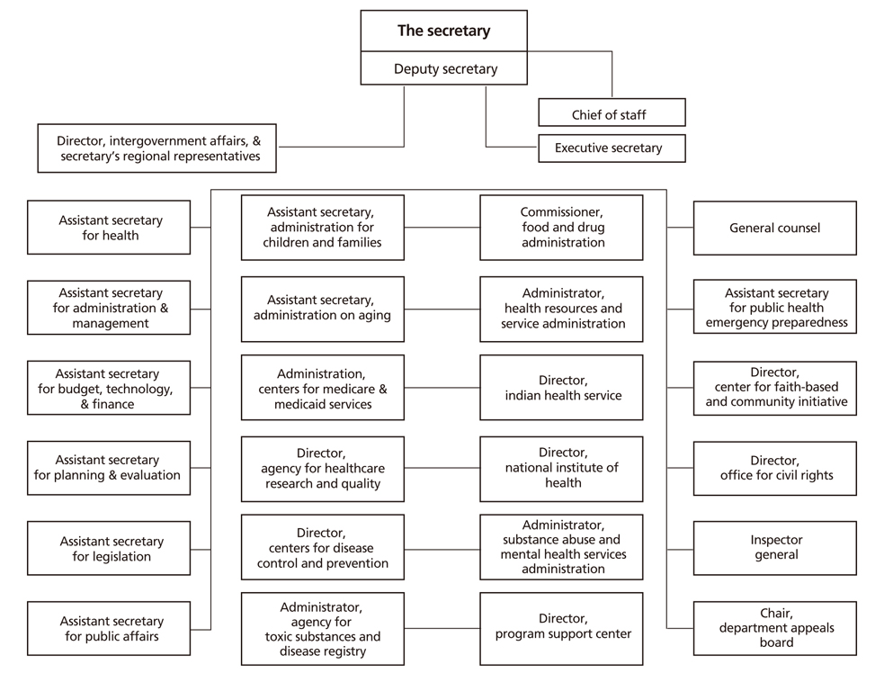
DEPARTMENT of Health and Human Services (1953) administers Social Security and Medicare/Medic-aid Programs, promotes health care research and runs the Food and Drug Administration

Slide 17
THE INDEPENDENT REGULATORY AGENCIES
Agencies (also known as independent regulatory commissions) are created by Congress
Regulate important parts of the economy
Make regulations (rules) for large industries and businesses that aﬀect the interests of the public
Since regulatory agencies are watchdogs that by their very nature need to operate independently, they are not part of a department
Small commissions govern the regulatory agencies
Five to ten members appointed by the president and conﬁrmed by the Senate
Commissioners are somewhat more "independent" than are the cabinet secretaries because they cannot be removed by the president during their terms of oﬃce
Commissioners serve rather long terms (5-14 years)
Terms of the commissioners are staggered
These factors help to insulate regulatory commissions from political pressure
Make sure you know how to explain how these factors insulate the regulatory commissions from political pressure.

Slide 18
THE INDEPENDENT REGULATORY AGENCIES
EXAMPLES:
Federal Communications Commission (FCC)
Regulates all communications by telegraph, cable, telephone, radio, and television.
The Federal Trade Commission (FTC)
Prevents businesses from engaging in unfair trade practices; stops the formation of monopolies in the business sector; protects consumer rights.
Federal Election Commission (FEC)
Administers and enforces the Federal Election Campaign Act (FECA); discloses campaign finance information and oversees the public funding of presidential elections.
The Securities and Exchange Commission (SEC)
Regulates the nation’s stock exchanges; requires full disclosure of the financial profiles of companies that wish to
sell stocks to the public.
The Federal Reserve Board (The Fed)
Establishes monetary policy >> refers to the money supply and interest rates. Monetary policy = controlling the money supply.
Sets bank interest rates; controls inflation; regulates the money supply; adjusts banks reserve requirements.
Fiscal policy = taxing and spending belongs to CONGRESS

Slide 19
WRITING/ENFORCING REGULATIONS
Tasks Performed by the Bureaucracy
Commissions have quasi-legislative powers because they have the authority to make rules and regulations that have the force of law
Commissions also have quasi-judicial powers because they can settle disputes in their fields (such as the FCC fining a TV or radio personality for objectionable material that was broadcast on his/her TV/radio program) – only for PUBLIC airwaves
Compliance monitoring- making sure the firms and companies that are subject to industry regulations are following those standards and provisions.
Issuing Fines
Bureaucrats testify before Congress and provide expert testimony/ information= A source of POWER
Can you spot checks and balances here?

Slide 20
THE INDEPENDENT REGULATORY AGENCIES
Agencies (also known as independent regulatory commissions) are created by Congress
Can the President fire the heads of these commissions and or agencies?
The Supreme Court did place limits on the president's removal power in 1935, in the Humphreys executor v. United States. President Hoover had appointed William Humphrey to a Seven-year term on the Federal Trade Commission in 1931. When Franklin Roosevelt entered office in 1933, he found Humphrey to be in sharp disagreement with many of his policies. He asked Humphry to resign, saying that “his administration would do better served with someone else on the FTC.” When Humphrey refused, Roosevelt removed him. Humphrey soon died but his heirs filed the suit for back salary.
The Supreme Court upheld their heirs claim. It based its decision on the act creating the FTC. The law provides that a member of the Commission may be removed only for “insufficiency, neglect of duty, or malfeasance in office.” The president had given none of these reasons when he removed Humphrey.
The court further held that Congress does have the power to set the conditions under which a member of the FTC and other such agencies might be removed by the president. It did so because those agencies, the independent regulatory commissions are not purely executive agencies.

Slide 22
THE GOVERNMENT CORPORATIONS
Blend of private corporations and government agency.
Created to allow more freedom and ﬂexibility than exists in regular government agencies.
Have more control over their budgets, and often have the right to decide how to use their own earnings.
Since the government still ultimately controls them, they do not operate like true private corporations.
EXAMPLES:
The U.S. Postal Service - The post oﬃce is a corporation that competes with private services.
National Railroad Passenger Corporation (AMTRAK) - Congress created Amtrak to provide railroad passenger service that is heavily subsidized by the federal government. Part of the motivation for its creation was the lack of private companies providing the service, and Amtrak has suﬀered some huge ﬁnancial losses. Recently, in an attempt to make the corporation more proﬁtable, Congress has allowed Amtrak to drop some of its less popular routes.
The Corporation for Public Broadcasting - This controversial government corporation still operates public radio and television stations. Although largely funded by private donations, the government still provides policies and money to support their programs.

Slide 23
THE GOVERNMENT CORPORATIONS
EXAMPLES:
The U.S. Postal Service - The post oﬃce is a corporation that competes with private services.
National Railroad Passenger Corporation (AMTRAK) - Congress created Amtrak to provide railroad passenger service that is heavily subsidized by the federal government. Part of the motivation for its creation was the lack of private companies providing the service, and Amtrak has suﬀered some huge ﬁnancial losses. Recently, in an attempt to make the corporation more proﬁtable, Congress has allowed Amtrak to drop some of its less popular routes.
The Corporation for Public Broadcasting - This controversial government corporation still operates public radio and television stations. Although largely funded by private donations, the government still provides policies and money to support their programs.

Slide 24
INDEPENDENT EXECUTIVE AGENCIES
Agencies that do not fall into the ﬁrst three categories.
Closely resemble Cabinet departments, but they are smaller and less complex.
Generally, they have narrower areas of responsibility than do cabinet departments.
Most are subject to presidential control and are independent only in the sense that they are not part of a department.
Their main function is not to regulate, but to fulﬁll a myriad of other administrative responsibilities.

Slide 25
INDEPENDENT EXECUTIVE AGENCIES
Examples:
Central Intelligence Agency - The CIA is responsible for providing national security intelligence to senior US policymakers.
Environmental Protection Agency - The EPA was established to consolidate in one agency a variety of federal research, monitoring, standard-setting and enforcement activities to ensure environmental protection.
The National Aeronautics and Space Administration - NASA administers the United States space program, ﬁnancing ventures into space since 1958.

Slide 26
EXECUTIVE OFFICE OF THE PRESIDENT

Slide 27
The EOP is an Umbrella Organization
An umbrella organization is an association of (often related, industry-specific) institutions who work together formally to coordinate activities and/or pool resources.

Slide 28
THE CONSTITUTION AND BUREAUCRACY
The Constitution made little mention of a bureaucracy
“All other oﬃcers of the United States whose appointments are not herein otherwise provided for, and which shall be established by law” (Article II, Section 3)
No provisions mentioned departments or bureaus, but Congress created the ﬁrst bureaucracy during George Washington’s presidency
Power of the Bureaucracy
Implementation and Discretionary authority
Carry out laws of Congress, executive orders of the president
Agencies have power to set speciﬁc guidelines and issue regulations when receiving a general mandate from Congress
– Congress gives them the bones, bureaucracy adds the meat
Regulation
Issue rules and regulations that impact the public and that the private sector must follow (EPA sets clean air standards); Labels on food, emissions of cars, etc.
Administrative Law
Rules and regulations created by an agency that have the eﬀect of law
Helping Congress draft legislation
Providing advice to the White House
Settling disputes
28

Slide 29
IRON TRIANGLES vs. ISSUE NETWORKS
Compare and contrast iron triangles and issue networks
IRON TRIANGLES
ISSUE NETWORKS
Deﬁnition: Alliances among bureaucrats, interest groups, and congressional subcommittee members and staﬀ sometimes form to promote their common causes. Also known as subgovernments.
Deﬁnition: Network that consists of people in interest groups, on congressional staﬀs, in bureaucratic agencies, in universities, and in the mass media who regularly debate an issue.

Slide 30
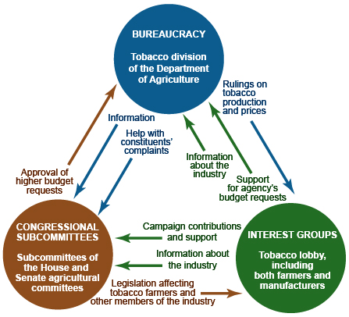
IRON TRIANGLES vs. ISSUE NETWORKS
IRON TRIANGLES
Definition: Alliances among bureaucrats, interest groups, and congressional subcommittee members and staff sometimes form to promote their common causes. Also known as sub governments.

Slide 31
IRON TRIANGLE
(I didn’t come up with this, but whoever did is a genius but I made it better)
The Pentagon=Bureaucracy
The Pentagon is the U.S. Defense Department
Favorable rulings on defense contracts
Approval of budget requests
Information, help with Constituents’
complaints
Support for Agencies budget request
before Congress, expert information
Electoral Support-PAC$$, Expert information
Stark will influence Congress through Lobbyists (Int. Groups) & provide expert information & PAC $
Legislation affecting defense contracts budget

Slide 32
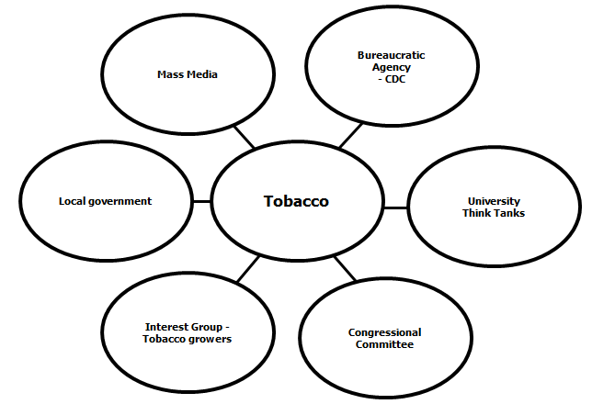
IRON TRIANGLES vs. ISSUE NETWORKS
ISSUE NETWORKS
Definition: Network that consists of people in interest groups, on congressional staffs, in bureaucratic agencies, in universities, and in the mass media who regularly debate an issue.

Slide 33
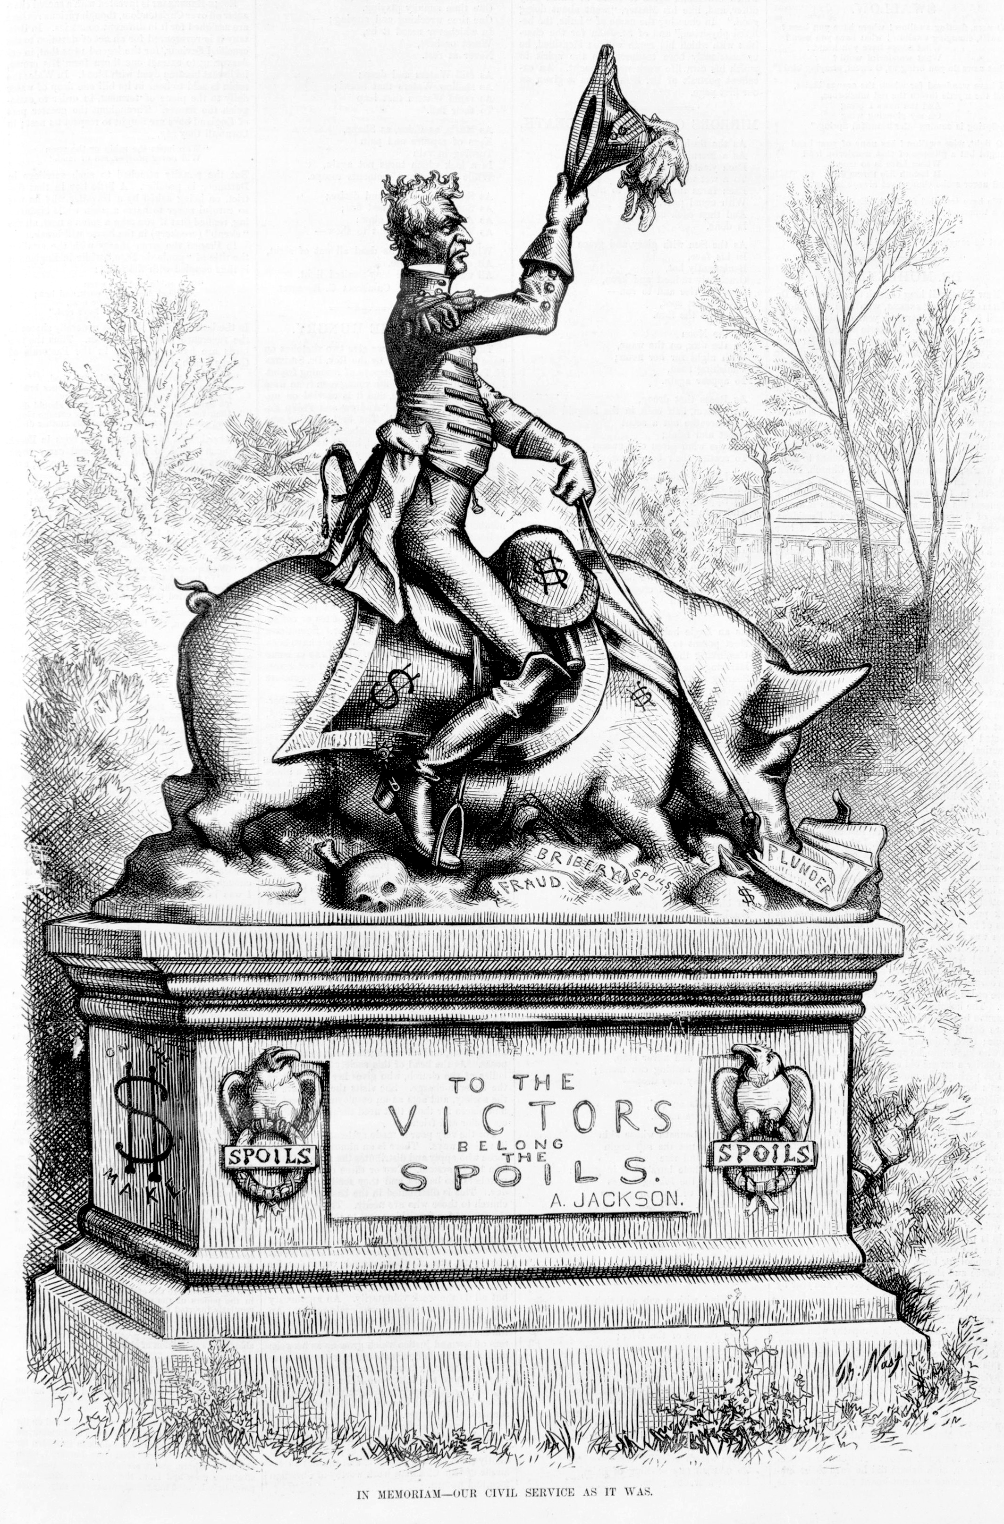
FROM PATRONAGE TO MERIT
Political patronage, civil service, and merit system reforms all impact the eﬀectiveness of the bureaucracy by promoting professionalism, specialization, and neutrality (non-partisan)
In memorial-our civil service as it was- was created by Thomas Nast and first appeared in Harper’s Weekly on April 28,1877 . The cartoons served to criticize Andrew Jackson's practice of granting government positions to friends and supporters. It was also a link to the corruption that plagued government in New York City during the 1800s.

Slide 34
FROM SPOILS TO MERIT
“To the victor belong the spoils” (1828)
The spoils system or patronage, started by Andrew Jackson, was used for ﬁlling federal jobs
President rewarding supporters with jobs based on service, not on merit
Garﬁeld’s assassination by a disappointed oﬃce-seeker (1881)
Creation of the Pendleton Act (1883)
Eliminated the spoils system (patronage); created merit system
An exam-based merit system would be used to ﬁll government jobs
Civil Service Commission was created to administer these exams
Hatch Act (1939)
Political activities of bureaucrats are limited
Civil Service Reform Act (1978)
Abolished the U.S. Civil Service Commission
Created the OPM (Oﬃce of Personnel Management)-runs the merit system and coordinates the federal application process for jobs and hiring, promoting the ideals of public service, finding the best people for federal jobs, and preserving merit system principles. AMSCO pg. 226

Slide 35
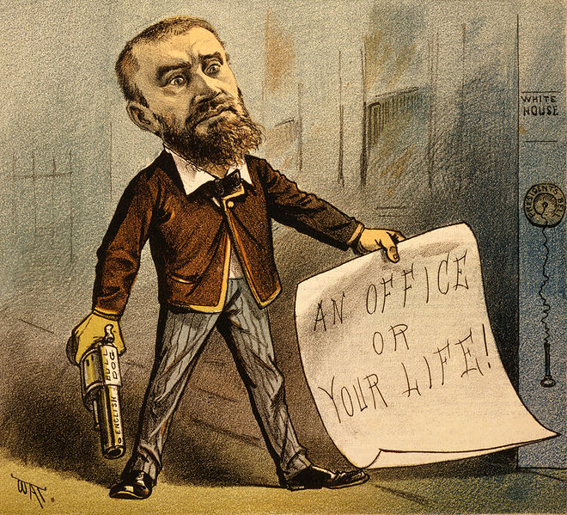
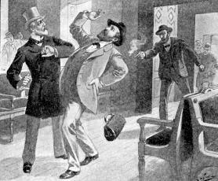
Civil Service Reform
Much of the corruption in government could be traced to the ‘spoils system’.
This gave government jobs as rewards to those who helped get a candidate elected.
These people were often not qualified for the job.
When Pres. Garfield was assassinated by an office-seeker, Congress decided it was time to act.
I’ve been shot !
Pres. Garfield gets shot.
September 19, 1881

Slide 36
Explain how the bureaucracy carry out the responsibilities of the federal government? Pg. 227
Bureaucratic Task | How Tasks are Completed
Writing and enforcing regulations | The legislation that creates and defines the departments and agencies often gives wide latitude as to how bureaucrats administer the law. All executive branch organizations have a degree of discretion in how they create and enforce regulations to carry out the law.
Enforcement and fines | Like a court, the regulatory agencies, commissions, and boards within the bureaucracy can impose fines or other punishments. the administrative adjudication targets industries or companies, not individual citizens.
Testifying before Congress | Cabinet secretaries and agency directors are often experts in their field. For this reason, they frequently appear before congressional committees to provide expert testimony (information) or to update Congress on their carrying out the law.
Actions of iron triangles and issue networks | An iron triangle is the relationship among three entities- an agency, a congressional committee, and an interest group- who joined forces to create policy. Issue networks include committee staffers (often the experts and real authors of legislation), academics, advocates, leaders of thinktanks, interest groups, and/ or the media that collaborate to create specific policy on one issue.

Slide 37
TOPIC 2.13 DISCRETIONARY AND RULE-MAKING AUTHORITY
Explain how the federal bureaucracy uses delegated discretionary authority for rule making and implementation?
The federal bureaucracy uses discretionary power as delegated by Congress to interpret and implement policies. Through their rulemaking authority, federal bureaucratic agencies utilize their discretion to create and enforce regulations. Bureaucratic agencies include:
i. Department of Homeland Security
ii. Department of Transportation
iii. Department of Veterans Affairs
iv. Department of Education
v. Environmental Protection Agency (EPA)
vi. Federal Elections Commission (FEC)
vii. Securities and Exchange Commission (SEC)

Slide 38
FROM SPOILS TO MERIT
Professionalism in the bureaucracy — The bureaucracy carries out the responsibilities of the federal government to regulate and enforce individual and commercial activities. Except for top-level political appointees, employees of the bureaucracy are specialists in their ﬁelds, who are hired and promoted based on merit rather than on their connections to politicians.
The transition from a patronage-based bureaucracy to a merit-based system has increased the bureaucracy's professionalism and expertise. The bureaucracy is nonpartisan and career civil servants tend to span many presidential administrations, allowing for continuity in the public sector.
7

Slide 39
2.13 EXPLAIN HOW THE FEDERAL BUREAUCRACY USES DELEGATED DISCRETIONARY AUTHORITY FOR RULE MAKING AND IMPLEMENTATION?
Powers of the federal bureaucracy to implement policy — After the president signs a bill into law or issues an executive order, the federal bureaucracy is responsible for implementing that policy. Laws may lack clear, concrete details on how they should be enacted, so the federal bureaucracy has discretionary authority to make decisions on what actions to take—or not take—when implementing laws, as well as rulemaking authority to create regulations about how government programs should operate and be enforced.
This authority enhances the power of the federal bureaucracy, giving it considerable jurisdiction (authority) over the implementation of government policies.
Policy directives from Congress are not always clear. Although the legislation may direct a federal agency to develop rules and regulations to implement the statute, bureaucrats have some flexibility in what these rules and regulations actually say. This flexibility is known as administrative discretion.

Slide 40
2.13 EXPLAIN HOW THE FEDERAL BUREAUCRACY USES DELEGATED DISCRETIONARY AUTHORITY FOR RULE MAKING AND IMPLEMENTATION?
Constitutionalism — Each branch of the government has diﬀerent powers, structures, and functions by design. Congress comprises the House of Representatives (designed to represent the population) and the Senate (designed to represent the states equally), each of which is aﬀected by chamber-speciﬁc rules and election processes. The power of the presidency has expanded over time, and the president uses both formal and informal powers to implement their policy agenda. The judicial branch exercises the power of judicial review to determine the constitutionality of the acts of the other branches and of state governments.
Competing policymaking interests — The interactions between the branches are complex by design. Congress, the executive branch (including the bureaucracy), and the judiciary must both compete and cooperate in order to enact policy. The implementation process is likewise diﬃcult, as each branch must struggle to maintain the accountability of a vast federal bureaucracy charged with putting policy into action.

Slide 41
EXAMPLES OF DISCRETIONARY AUTHORITY IN SELECT DEPARTMENTS AND AGENCIES AMSCO pg. 231,233
Name of the Department, Agency or Commission | Authority Delegated to the Body
Homeland Security | Allowing certain exemptions for immigrants
Transportation | Determining which highway projects get special grants
Veterans Affairs | Deciding how to administer a health program for veterans
Education | Cancelling or lowering student debt
Environmental Protection Agency | Intervening in state environmental issues
Federal Election Commission | Administering and enforcing federal campaign finance laws
Securities and Exchange Commission | Determining if financial firms should be disqualified from raising money because of illegal conduct

Slide 42
TOPIC 2.14 Holding the Bureaucracy Accountable
The federal bureaucracy implements federal policies
Oversight and methods used by Congress
to ensure that legislation is implemented as
intended are represented by:
Committee hearings
Power of the purse
Explain how Congress uses its oversight power in its relationship with the executive branch
As a means to curtail the use of presidential power, congressional oversight serves as a check of executive authorization and appropriation
Explain how the president ensures that executive branch agencies and departments carry out their responsibilities in concert with the goals
Presidential ideology, authority, and influence affect how executive branch agencies carry out the goals of the administration.
Compliance monitoring can pose a challenge
to policy implementation

Slide 43
TOPIC 2.14 Holding the Bureaucracy Accountable
The federal bureaucracy implements federal policies
Explain how Congress uses its oversight power in its relationship with the executive branch
Congressional oversight of the bureaucracy to ensure that legislation is implemented as
intended includes:
i. Review, monitoring, and supervision of bureaucratic agencies
ii. Investigation and committee hearings of bureaucratic activity
iii. Power of the purse (the ability of Congress to check the bureaucracy by appropriating or withholding funds)
As a means to curtail the use of presidential power, congressional oversight serves as a check of executive authorization and appropriation
Explain how the president ensures that executive branch agencies and departments carry out their responsibilities in concert with the goals
Presidential ideology, authority, and influence affect how executive branch agencies carry out the goals of the administration.
Compliance monitoring ensures that funds are being used properly and regulations are being followed. Compliance monitoring can pose a challenge to policy implementation.

Slide 44
Holding the Bureaucracy Accountable– CONGRESSIONAL INFLUENCE
Congress has a great amount of power over the bureaucracy because Congress can exercise LEGISLATIVE OVERSIGHT.- Is the process by which Congress through its committees, checks to see that the various agencies in the executive branch are working effectively and acting in line with the policies that Congress has set by law
What are the numerous ways in which Congress can exercise “oversight” of the bureaucracy?
Annual authorization legislation
No agency may spend money unless it has first been authorized by Congress
Authorization legislation originates in a congressional committee and states the maximum amount of money that an agency may spend on a given program
Even if funds have been authorized, Congress must also appropriate the money
Rewriting legislation
If they wish to restrict the power of an agency, Congress may rewrite
legislation or make it more detailed
The more detailed the instructions, the better able Congress is to restrict the agency's power
Creation of agencies
Constitutional power to create and abolish executive departments and independent agencies, or to transfer their functions
Advice and consent
Congress can influence the appointment of agency heads
The Senate has the power to confirm presidential appointments
Appropriations of agency budgets
Congress determines how much money each agency gets
Power of the PUR$E

Slide 45
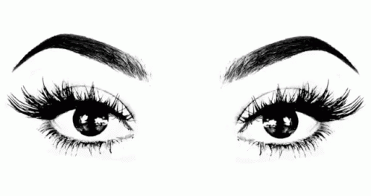
Holding the Bureaucracy Accountable– CONGRESSIONAL INFLUENCE
Congress has a great amount of power over the bureaucracy because Congress can exercise LEGISLATIVE OVERSIGHT.
What are the numerous ways in which Congress can exercise “oversight” of the bureaucracy?
Duplication
Giving any one job to more than one agency, keeping any single agency from becoming all powerful- FBI, DEA, ATF, DHSI
For example, drug trafficking is the task of the Customs Services, the FBI, the DEA, the Border Patrol, and the Department of Defense
Keeps any one agency from becoming all-powerful
Holding hearings and conducting investigations/oversight function
Congress can call bureaucrats to testify before committees to determine whether the agency is complying with congressional intent
Congress can investigate agencies- oversight function
Reorganization
By realigning or restructuring departments, agencies and their responsibilities, Congress can contain costs, reduce bureaucratic overlap and improve accountability
Sunset laws
Provides for the law to cease to have effect after a specific date, unless further legislative action is taken to extend the law
Sunset laws create a finite lifespan for a bureaucratic agency. In order to be reauthorized, these bureaucracies must prove their effectiveness and merit

Slide 46
Holding the Bureaucracy Accountable– CONGRESSIONAL INFLUENCE
What are the limits on congressional inﬂuence?
Congress may not really want to clamp down on the bureaucracy:
Members proﬁt politically from the existence of federal programs within their states or districts (e.g., military base closure)
Easier for Congress to simply pass broadly worded laws and have experts within the bureaucracy ﬁll in the holes
No electoral payoﬀ; Political ramiﬁcations-if Bur screws up, Cong blames the Pres
Oversight is labor intensive/hard work; Lack of technical expertise, time consuming
Congress creates opportunities for casework through red tape
Congress lacks expertise/agencies have expertise
Congress does not want to be blamed for bad policy
Time-consuming

Slide 47
Holding the Bureaucracy Accountable– CONGRESSIONAL INFLUENCE
LEGISLATIVE VETO
In the past: Congress passed a law, the relevant executive agency issued regulations to enforce the law, Congress could then analyze those regulations and veto them if it so desired.
The legislative veto was a way of forcing the bureaucracy to conform to congressional intent.
In the case of INS v. Chadha (1983), however, the Supreme Court declared the legislative veto to be an unconstitutional violation of separation of powers. Only the President has the veto power.

Slide 48
2.14 Holding the Bureaucracy Accountable– PRESIDENTIAL INFLUENCE
Appointments
Appointment of top-level bureaucrats (including Cabinet secretaries), confirmed by Senate.
Fire top-level bureaucrats (including Cabinet secretaries)
Executive Orders
An executive order is a directive, order, or regulation issued by the president
An executive order of the President must ﬁnd support in the Constitution, either in a clause granting the President speciﬁc power, or by a delegation of power by Congress to the President
Economic Powers
Proposes agency budgets (either an increase or a decrease in $) OMB
Other Powers
Propose the reorganization of the executive branch
Presidential power of inﬂuence over diﬀerent agencies direction
What are the limits on presidential inﬂuence?
Senate conﬁrmation needed for top personnel
President cannot ﬁre vast majority of bureaucrats
Reorganization must go through Congress
Agency budgets must go through Congress
23

Slide 49
2.14 CONTROLLING THE BUREAUCRACY – PRESIDENTIAL INFLUENCE
Office of Management and Budget (OMB): The OMB’s primary responsibility is to prepare the administration’s budget proposal. In addition, the OMB evaluates the operation of federal programs, reviews legislative proposals from the cabinet departments, and reviews the rules and regulations proposed by federal agencies.
OMB helps the President prepare the budget and submits the budget to Congress. The OMB reviews and modifies funding requests submitted by executive departments and federal agencies. The OMB modifies the requests, if necessary, to conform to the administration’s spending priorities.
In preparing the president’s budget, federal agencies are in regular contact with the OMB, which is responsible for keeping these spending requests within the parameters set by the president. Agencies may try to appeal to the president’s top aides regarding an OMB decision that calls for a cut in spending in some area. The Congressional Budget Office really is a check on the OMB and works closely with the House and Senate budget committees; in a divided government, the members of these committees may well be antagonistic to the administration.

Slide 50
2.14 CONTROLLING THE BUREAUCRACY – PRESIDENTIAL INFLUENCE
Beyond its budget chores, the OMB is a sort o presidential handy-man agency. It makes continuing studies of the organization and management of the executive branch and keeps the President up to date on the work of all its agencies. The OMB checks and clears agency stands on all legislative matters to make certain they agree with the President’s policy positions. It also helps prepare the hundreds of executive orders the President must issue each year and the veto messages the chief executive occasionally sends to Congress.
Magruder’s Amer Gov 2009, pg. 433

Slide 51
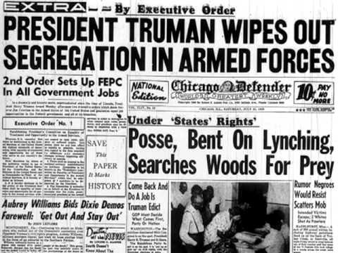
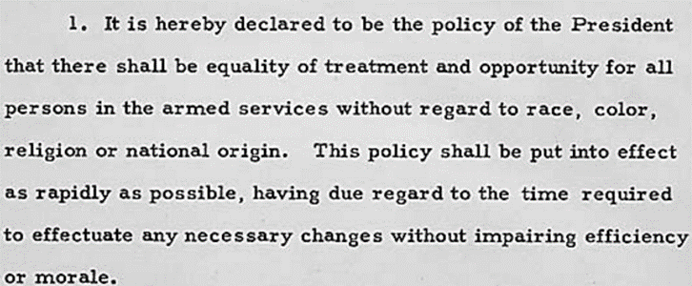
2.14 CONTROLLING THE BUREAUCRACY – PRESIDENTIAL INFLUENCE
Executive Orders- NOT in the Constitution but implied
An executive order is a directive, order, or regulation issued by the president
An executive order of the President must ﬁnd support in the Constitution, either in a clause granting the President speciﬁc power, or by a delegation of power by Congress to the President
https://www.flickr.com/photos/usnationalarchives/5842521656
In Executive Order 9981, what was the source of Constitutional authority?
Commander-n-Chief of Armed Forces
Executive Order 9981

Slide 52
Congressional Oversight of Executive Agencies | Presidential Oversight of Executive Agencies to Ensure Policy Goals
Committee hearings are held with some regularity where House and Senate committees hold congressional oversight hearings to address agency action, inaction, or their relationship with the agency. • Power of the purse gives Congress power to determines how much funding these organizations receive, asks top-level bureaucrats how they can improve their goals, and sometimes tries to constrain agencies. | The president exerts authority and influence to make sure their executive ideology is delivered in policy. Through the regulatory review process, administered through the Office of Information and Regulatory Affairs (OIRA), all regulations that have a significant effect on the economy, public health, and other major aspects of policy undergo close review. • Presidents have used both formal powers, such as the power to appoint officials, and informal powers, such as persuasion and leadership, to make the bureaucracy work for the executive agenda.
AMSCO pg. 238

Slide 53
Explain the extent to which governmental branches hold the bureaucracy accountable given the competing interests of congress, the president, and the federal courts?
2.15 Policy and the Branches of Government
The federal bureaucracy implements federal policies
Formal and informal powers of Congress, the
president, and the courts over the bureaucracy
are used to maintain its accountability
Explain how the distribution of powers among the three branches of government impacts policymaking.
The allocation of powers among the three branches of government creates multiple access points for stakeholders and institutions to influence public policy.
National policymaking is constrained by the sharing of powers between the three branches.

Slide 54
HOLDING THE BUREAUCRACY ACCOUNTABLE– THE COURTS
Powers
Court rulings that limit bureaucratic practices
Judicial review - can declare bureaucratic actions unconstitutional
Injunctions (a judicial order that restrains a person/group from beginning or continuing an action threatening or invading the legal right of another) against federal agencies
WHAT HAPPENED TO THIS CASE?
The Supreme Court also supported a ruling by the Federal Communications Commission
(FCC) in a 1969 case. In Red Lion Broadcasting v. FCC, the court upheld the constitutionality
of the commission's "fairness doctrine," which required broadcasters to present "fair and balanced" coverage of controversial issues.

Slide 55
HOLDING THE BUREAUCRACY ACCOUNTABLE– INTEREST GROUPS
POWER OF INTEREST GROUPS
Lobbying-influence Senate to confirm or not confirm heads-use media campaigns, information
“Revolving door” - Agencies are staﬀed by people who move back and forth between the public/private sector
Client groups
Some agency-interest group relations are so close that the interest group is said to be a client of the agency (e.g., dairy groups and Agriculture Dept)
Iron triangles: congressional committee, relevant agency, related interest groups
Issue networks: informal groups of people within both the public/private sectors who have common interests
Agency employees are recruited from the regulated industry (vice versa)
Agencies rely on support from regulated industries in making budget requests
Litigation: Take a bureaucratic agency to court

Slide 56
HOLDING THE BUREAUCRACY ACCOUNTABLE – INTEREST GROUPS
Who gets appointed by the President.
Very partisan. If pres is a dem, he appoints dems, if pres is a repub, he appoints repub
Interest groups input- ABA, AMA, NRA, NEA can voice their approval or disapproval for presidential appointments to the bureaucracy. They will use the media to sway public opinion and provide information in favor or against the nominee
Ethnic make up– to appeal to a vast demographic, women, men, etc.

Slide 57
Competing Interests of Congress and the Bureaucracy | Executive Branch Competition with the Bureaucracy | Judicial Checks of the Bureaucracy
Congress and regulatory agencies share a good deal of authority creating an unclear area of jurisdiction. One procedure that has developed to sort out any overlap is committee clearance, where congressional committees have the authority to review and approve certain agency actions in advance. Congress established the legislative veto in the 1930s to control executive agencies. The legislative veto is a requirement that certain agency decisions must wait for a defined period of either 30 or 90 days. The Court eventually ruled the legislative veto as unconstitutional. | The different beliefs or approaches of executive departments can create friction between them when the United States must state a position or make a decision. • The president’s policy goals may not take into account some of the practical constraints of the bureaucracy and as a result may be too difficult to achieve. • Federal employees sometimes see corruption or inefficiency in their offices but are tempted to keep quiet, so Congress passed the Whistleblower Protection Act in 1989, which prohibits a federal agency from retaliating or threatening an employee for disclosing acts believed to be illegal or dishonest. | Citizens and federal employees can sue the government over bureaucratic/ administrative action, decisions, or fines. • Firms and industry often appeal regulatory punishments in the U.S. circuit courts. • The U.S. Supreme Court has shaped how Congress can interact with agencies, generally giving the agencies wider latitude. • When Congress vaguely bestows power on an entity it creates, the Court recommends erring on the side of the bureaucracy.

Slide 58
The Food and Drug Administration (FDA) is the federal agency responsible for the approval, regulation, and control of prescription medications. All prescription medications must complete an extensive FDA approval process, which can take years. In an attempt to expedite this process, Congress passed the Biologics Price Competition and Innovation Act in 2009, which created a faster approval pathway for biologic products that are highly similar to existing FDA-approved medications. The law applies only to biologic products, those produced with living organisms, but not to chemically produced drugs. Insulin is a vital prescription medication used to treat diabetes. Over an eight-year period, beginning in 2009, the average price of insulin increased from $90 to $275 a vial. Since insulin was not regulated as a biologic, the time necessary to gain FDA approval prevented new companies from developing less expensive alternatives.
In 2017, public attention to the rising cost of insulin led the FDA to reclassify the drug as a biologic, thereby lessening the amount of time it took for new companies to get FDA approval. With more manufacturers competing in the marketplace, prices would likely drop.
a. Referencing the scenario, describe the executive branch authority used by the FDA in reclassifying insulin as a biologic and explain how this use of the FDA’s authority might affect the success of the Biologics Price Competition and Innovation Act.
b. Referencing the scenario, explain how Congress could have addressed the increasing cost of insulin prior to 2017.
c. Describe an informal power the president could use to influence the FDA’s decision to reclassify insulin as a biologic. Explain how the use of that informal power relates to the principle of separation of powers.

Slide 59
FREE RESPONSE QUESTION
The United States Congress and the President together have the power to enact federal law. Federal bureaucratic agencies have the responsibility to execute federal law. However, in the carrying out of these laws, federal agencies have policy-making discretion.
Explain two reasons why Congress gives federal agencies policy-making discretion in executing federal law.
Choose one of the bureaucratic agencies listed below. Identify the policy area over which it exercises policy-making discretion AND give one specific example of how it exercises that discretion.
Environmental Protection Agency (EPA)
Federal Communications Commission (FCC)
Federal Reserve Board
Describe two ways in which Congress ensures that federal agencies follow legislative intent.

Slide 60
FREE RESPONSE RUBRIC
PART (A): 2 POINTS
One point is earned for explaining each of two reasons why Congress gives federal agencies policy-making discretion in executing federal laws.
Congress lacks expertise/agencies have expertise.
Congress does not want to be blamed for bad policy.
Time-consuming.
Easier to come to agreement.
More efficient.
PART (B): 2 POINTS
One point is earned for correctly identifying the policy area identified with the agency. One point is earned for providing an example. The response must include a correct, specific example of how the agency exercises policy-making discretion in order to earn the point.
AGENCY
The Environmental Protection Agency (EPA)
POLICY AREA
Clean air and water
AGENCY
Federal Communications Commission (FCC)
POLICY AREA
TV, radio, satellite, telephone, etc.
AGENCY
Federal Reserve Board
POLICY AREA
Monetary policy
PART (C): 2 POINTS
One point is earned for each of two descriptions of ways Congress ensures that agencies follow legislative intent.
Acceptable descriptions may include:
Oversight.
Budget/appropriations.
Hearings.
Investigations.
Government Accountability Office (GAO).
Change law.
Legislative veto.
Casework.
Sunset laws/reauthorization/dissolve agencies/create new agencies.
Note: If one of the above is only mentioned as an example of oversight, the response gets only 1 point.

Slide 61
FREE RESPONSE QUESTION
Is Congress effective in exercising legislative oversight of the federal bureaucracy? Support you answer by doing ONE of the following:
Explain two specific methods Congress uses to exercise effective oversight of the federal bureaucracy.
OR
Give two specific explanations for the failure of Congress to exercise effective oversight of the federal bureaucracy.

Slide 62
FREE RESPONSE RUBRIC
1 point for taking explicit position: “Yes, Congress is effective,” or “No, Congress is not effective,” in providing oversight of the bureaucracy.
----------------------------------------------------------------------------------------------------
If the writer takes the affirmative (Congress exercises effective oversight):
2 points (maximum) for a complete explanation of first specific method Congress uses to exercise effective oversight.
Award 1 point for a statement showing general understanding of method of oversight.
Award 2 points for a specific explanation showing HOW/WHY the method is effective.
Methods of effective oversight may include
Budget control
Reauthorization/Jurisdiction of agencies
Setting guidelines for new agencies
Hearings, committee investigations
Power to organize/reorganize agency
“Sunset” legislation
Congressional support agencies - GAO, CBO
Iron triangles as a source of information
Casework as a source of information
Influence over selection of leadership
Program evaluation
2 points (maximum) for a complete explanation of a second specific method Congress uses to exercise effective oversight. Use the guidelines above for the first method in awarding one or two points for the explanation of the method.
----------------------------------------------------------------------------------------------------
If the writer takes the negative (Congress fails to exercise effective oversight):
2 points (maximum) for a complete explanation of the first reason for this failure.
Award 1 point for a statement showing general understanding of why failure occurs.
Award 2 points for a specific explanation of how/why the oversight method is not effective.
Reasons for the failure may include:
No electoral payoff/Political ramifications
Oversight is labor intensive/hard work
Lack of technical expertise
Logrolling
Lack of budget control
Enabling legislation is vague
Interest groups/PACs encourage members to overlook effective administration
Failure to “use” available powers or ineffective use of them
Iron triangles/cozy relationship with agencies
Bureaucratic pathologies (for example, Congress creates opportunities for casework through red tape; firing administrators is difficult)
2 points (maximum) for complete explanation of the second reason congressional oversight fails. Use the guidelines above for the first reason in awarding one or two points for the explanation of the reason.
Notes:
A general discussion of checks and balances is not acceptable and does not receive credit.
If the thesis contradicts the discussion or reasons or explanation, score for the answer that gives the student the most points.

Slide 63
FREE RESPONSE QUESTION
The federal bureaucracy as part of the executive branch exercises substantial independence in implementing governmental policies and programs. Most workers in the federal bureaucracy are civil-service employees who are organized under a merit system.
Describe one key characteristic of the merit system.
For each of the following, describe one factor that contributes to bureaucratic independence.
The structure of the federal bureaucracy
The complexity of public policy problems
For each of the following, explain one Constitutional provision that it can use to check the bureaucracy.
Congress
The courts
Interest groups

Slide 64
FREE RESPONSE RUBRIC
PART (A): 1 POINT
One point is earned for a description of a characteristic of the merit system. Answers may include:
Hiring or promotion based on merit/experience/qualifications
Hiring based on testing
PART (B): 2 POINTS
One point is earned for each of two descriptions of factors contributing to bureaucratic independence. Answers may include:
Structure of the bureaucracy
Large
Specialized units/expertise
Tenure protections/hard to fire
Based on merit
Independent agencies/independent regulatory commissions
Complexity of public policy problems
Specialized units/expertise
Delegated authority — because Congress and the president cannot handle everything, they delegate authority to the bureaucracy
Discretionary authority — because legislation lacks details, the bureaucracy can fill in the gaps
PART (C): 3 POINTS
One point is earned for each of three explanations of a constitutional provision that can check the bureaucracy. Answers may include:
Congress
Appropriations — can reward or punish agency
Legislation — can pass legislation affecting the bureaucracy
Rejection of presidential appointments to the bureaucracy
Impeachment of executive officials
Courts
Court rulings that limit bureaucratic practices
Judicial review — can declare bureaucratic actions unconstitutional
Injunctions against federal agencies
Interest groups
Use of the First Amendment
Lobbying
Protests
Media usage
Speech
Litigation

