Slide 1
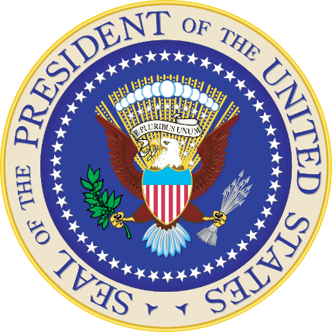
UNIT 2 Chpt. 5 The Presidency
AMSCO pg. 139-147
Wapples pg. 151-164159
Required Documents:
The Constitution
Topic 2.4 Roles & Power of the President
1

Slide 2
TOPIC 2.4 Roles and Powers of the President
The presidency has been enhanced beyond its expressed constitutional powers.
Explain how the president can implement a policy agenda.
Presidents use powers and perform functions of the office, with support from the Vice-
President, Cabinet, and Executive Office of the President, to accomplish a policy agenda.
The powers of the president include both formal and informal powers.
i. Vetoes and pocket vetoes are formal powers that enable the president to check
Congress, but vetoes can be overridden with a 2/3 vote while pocket vetoes cannot
be overridden with a 2/3 vote.
ii. Foreign policy powers that influence relations with foreign nations are both
formal (commander-in-chief and treaties) and informal (executive agreements).
iii. Bargaining and persuasion are informal powers that enable the president to secure
congressional action.
iv. Executive orders allow the president to manage the federal government and are
implied by the president’s vested executive power or by power delegated by Congress.
v. Signing statements are informal powers that inform Congress and the public of the
president’s interpretation of laws passed by Congress and signed by the president.
Required Documents:
The Constitution

Slide 3
TOPIC 2.4 Roles and Powers of the President
The presidency has been enhanced beyond its expressed constitutional powers.
Presidents use powers and perform functions of the office to accomplish a policy agenda.
Explain how the president can implement a policy agenda.
Formal and informal powers of the president include:
Vetoes and pocket vetoes—formal powers that enable the president to check Congress
Foreign policy—both formal (commander-in-chief and treaties) and informal (executive agreements) powers that influence relations with foreign nations
Bargaining and persuasion—informal power that enables the president to secure congressional action
Executive orders—implied from the president’s vested “executive power,” or from power delegated by Congress, executive orders allow the president to manage the federal government
Signing statements—informal power that informs Congress and the public of the president’s interpretation of laws passed by Congress and signed by the president

Slide 4
Framer’s Vision: DELIBERATIONS AT THE CONSTITUTIONAL CONVENTION
ALTERNATIVES
Some proposed a plural executive
Some wanted an executive council to have veto power over presidential actions
Some (e.g., Alexander Hamilton) wanted a president with a life term
Eventually, compromises brought about a single, elected president with a ﬁxed term of oﬃce
CONCERNS OF THE FOUNDERS
Fear of an excessively strong president
Fear that the presidency would be the "fetus of monarchy"
Concern over no term limits (no 22nd Amendment until 1951)
Fear of an excessively weak president who would become a "tool of the Senate" because of its ratiﬁcation and conﬁrmation powers.
The basic problem of creating a presidency:
Make him too weak: the legislature will usurp his powers.
Make him too strong: he will usurp the legislature.

Slide 5
Framer’s Vision: ELECTION OF THE PRESIDENT
Some wanted Congress to elect the President ---> fear of congressional dominance.
Some wanted direct election. Problems:
Inordinate weight to large states
Demagogues might have excessive appeal to the masses
Illiteracy was common
Communication was poor
THE COMPROMISE: THE ELECTORAL COLLEGE
The people had some input
Large states had a good amount of inﬂuence, but small states were protected by having a minimum of three electoral votes
Small states would also have a great deal of clout if the election were thrown into the House (and it was assumed that this would happen often since the two-party system was not anticipated). Under this scenario, a state has one vote and small states are therefore grossly overweighed.
5

Slide 6
Framer’s Vision: ELECTION OF THE PRESIDENT
TERM OF OFFICE
Four-year term
Fear of an unlimited number of terms of oﬃce were quieted when Washington chose not to run for a third term
Precedent was followed until 1940 (FDR) -> creation of 22nd Amendment limits President to two terms
FORMAL QUALIFICATIONS- Const requirements
Natural-born citizen
At least 35 years of age
Residency for at least 14 years
SELECTION
Elected in November in years divisible by 4
People >> Electors >> President
Electoral votes counted on January 6
President inaugurated on January 20 (established by the 20th Amendment)

Slide 7
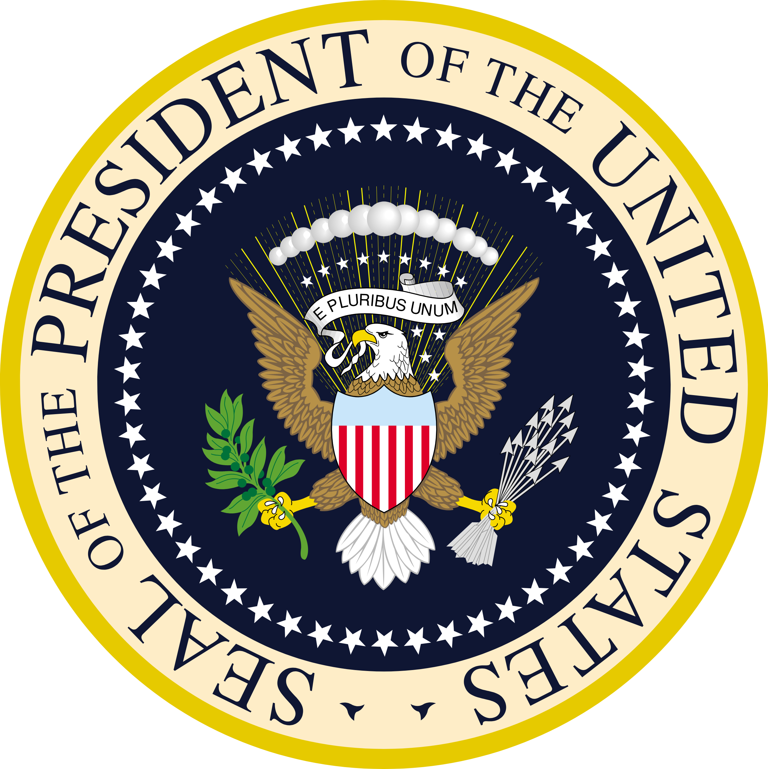
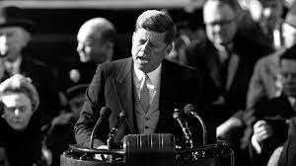
INAUGURATION
Inauguration- marking the beginning of an institution, activity, or period of office.
President inaugurated on January 20 (established by the 20th Amendment)
The president’s inaugural address is the first official action undertaken as president, and the speech often sets the tone and overall agenda for the administration. For example, President Kennedy, used it to rally Americans to his belief of how the Cold War should be fought and to encourage them to be more civic-minded.
"we shall pay any price, bear any burden, meet any hardship, support any friend, oppose any foe to assure the survival and success of liberty."
“ask not what your country can do
For you but what you can do for
Your country”

Slide 8
THE PRESIDENT
Informal “requirements”:
White (except one) - Obama
Male
Protestant (except one) – Kennedy
Married
Be able to raise money
Command media attention
All manner of professions, but mostly political ones (former state governors, for example)
Last president with no political experience before Trump was Eisenhower (1953-1961). He was a general.

Slide 9
Article II: Qualifications, Duties, and Limits of the Presidency
Must receive a majority of Electoral College votes to win the office
Shall hold office for a four-year term
Must be natural-born citizen, 35 years old, and U.S resident 14 years
Shall be the Commander in Chief of the Army and Navy
May require opinions of advisers and department heads
May pardon convicted persons for federal offenses
Shall appoint ambassadors, judges, and make treaties with Senate approval
May recommend measures to Congress
May convene or adjourn Congress
AMSCO pg. 140

Slide 10
Article II PRESIDENT CONSTITUTIONAL ROLES: CHIEF LEGISLATOR
Powers
Proposes legislation- “may recommend to Congress such measures as he shall judge necessary and expedient”
Vetoes legislation
Veto: Sending a bill back to Congress with the reasons for rejecting it. Can be overridden.
Pocket Veto: Letting a bill die by not signing it in 10 days when Congress is adjourned.
Lacks line-item veto struck down by Supreme Court because of conﬂict with separation of powers. The president must sign or veto all of a bill.
Calls special sessions of Congress.
Makes a State of the Union Address to Congress. President outlines his agenda to Congress and the nation
Checks
Congress need not pass suggested legislation
Congress can override veto with 2/3 majority in both houses
7

Slide 11
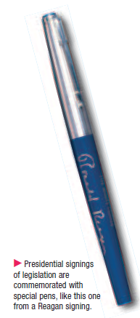
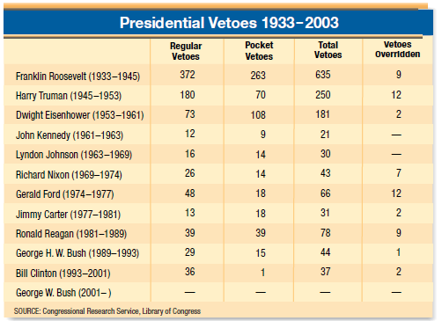
PRESIDENT CONSTITUTIONAL ROLES CHIEF LEGISLATOR
7

Slide 12
SIGNING STATEMENTS
A signing statement is a written message issued by the president upon signing a bill into law that states objectives to some of the provisions in the bill.
They are not provided for in the Constitution.
Why would a president issue a signing statement? Pg. 147AMSCO
What are some of the criticisms of the signing statements and how is this considered a violation of the separation of powers? AMSCO pg. 147

Slide 13
PRESIDENTIAL APPROVAL RATINGS
Presidential Approval
Product of many factors: war, the economy, the “honeymoon” period
Changes can highlight good/bad decisions
When is the best time for a president to negotiate with Congress? Why?

Slide 14
PRESIDENT CONSTITUTIONAL: ROLES CHIEF EXECUTIVE and ADMINISTRATOR
Powers
“Take care” clause of Article II requires that President enforces laws, treaties, and court decisions. This clause has also been used to justify:
Impoundment
Lincoln’s suspension of habeas corpus
Electronic eavesdropping by Bush 43 administration
Appoints oﬃcials to oﬃce and can ﬁre them.
Issues executive orders (have the force of law) to carry out laws. Do not need congressional approval. Can be challenged in court.
Checks
Congress passes the laws and has the "power of the purse“ and oversight
Senate can reject appointments and treaties.
Impeachment (by House) and removal (by Senate).
Supreme Court can strike down executive orders through judicial review
FDR issue an executive order to intern Japanese- Americans during WW II
LBJ's executive order #11246 that required aﬃrmative action programs for federal contractors.
Bush 43 created Homeland Security after 9/11 through an executive order. (Later made a Cabinet Dept. by Congress

Slide 15
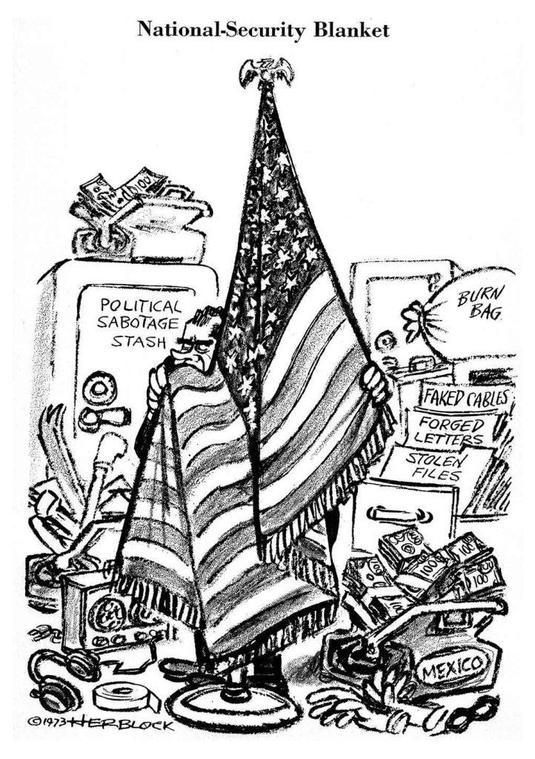
PRESIDENT CONSTITUTIONAL: ROLES CHIEF EXECUTIVE and ADMINISTRATOR
EXECUTIVE PRIVILEGE- NOT IN THE CONSTITUTION but implied in the separation of powers
Deﬁnition: The inherent power of the president to NOT divulge conversations between himself and his advisers.
Presidents claim that if such conversations were not “privileged,” advisers would be hesitant to give straight forward advice.
Critics claim that Presidents have abused this privilege by claiming it under the guise of “national security.”
In U.S. v. Nixon (1974), the Supreme Court stated that Presidents are in fact entitled to executive privilege most of the time, but not in criminal cases.
It would blur the lines of sep of pwrs, checks & bal

Slide 16
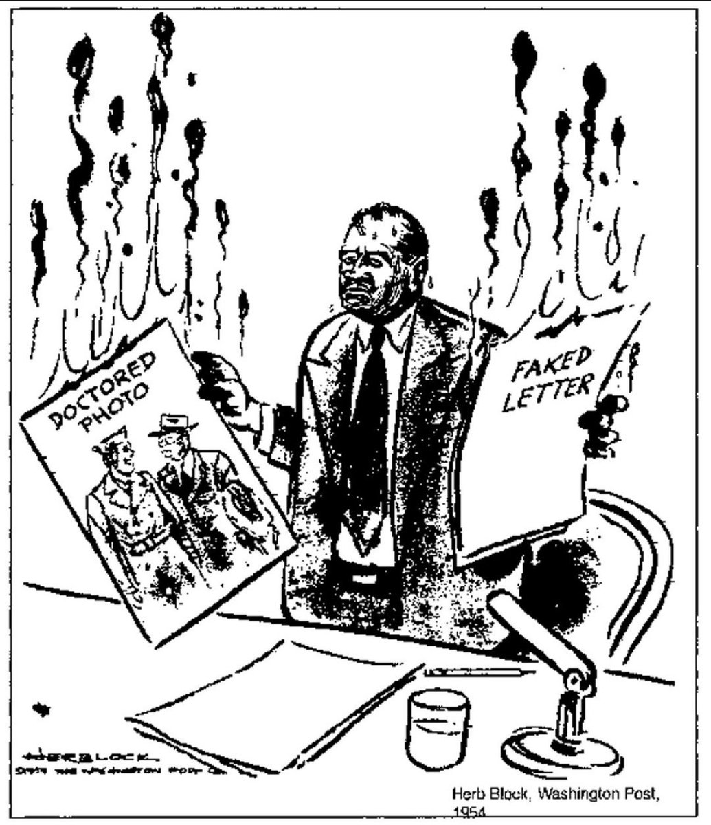
Myths and Misperceptions
EXECUTIVE PRIVILEGE
Contrary to popular belief, neither the term nor the concept of executive privilege appears anywhere in the Constitution. Legal historian Raoul Berger called it one of the greatest constitutional myths. Yet Presidents as far back as George Washington have claimed the right to withhold certain information from public scrutiny, even when served a subpoena. Dwight D. Eisenhower was the first President to use the term. Eisenhower asserted executive privilege more than 40 times in refusing to allow his aides to testify during the McCarthy hearings. Presidents contend that executive privilege is implied in the Constitution’s principle of separation of powers they need candid and confidential advice from their aides to do their jobs
Magruder’s American Government, 2009 pg. 408

Slide 17
PRESIDENT CONSTITUTIONAL ROLES: COMMANDER IN CHIEF
Power
Head of the armed forces (link w/civilian supremacy)
Checks
Congress appropriates funds for the military
Congress declares war
“Yesterday, December 7, 1941 – a date which will live in infamy”
President Roosevelt was asking Congress to declare war
War Powers Act of 1973
Federal law intended to check the president's power to commit the United States to an armed conﬂict without the consent of the U.S. Congress
Development of the Cold War placed the U.S. into a virtual non-stop crisis situation after 1945 -> assumption of great powers by the President to deal with various foreign crises. Like wise after 9/11

Slide 18
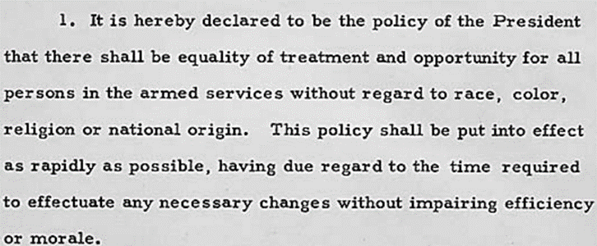
EXECUTIVE ORDERS
PRESIDENT
CONSTITUTIONAL ROLES: COMMANDER IN CHIEF
Executive Order 9981
As commander-in-chief of the military, President Harry S. Truman ended segregation in the military, in 1948 through an executive order

Slide 19
PRESIDENT CONSTITUTIONAL ROLES: CHIEF DIPLOMAT
Powers
Sets overall foreign policy.
Appoints and receives ambassadors.
Negotiates both treaties and executive agreements.
Gives diplomatic recognition to foreign governments.
Checks
Congress appropriates funds for foreign aﬀairs.
Senate can reject ambassadors and treaties.
Power of the Purse

Slide 20
PRESIDENT CONSTITUTIONAL: ROLES CHIEF OF STATE
The ceremonial head of our nation, e.g., tosses out the ﬁrst ball of the baseball season, bestows the medal of honor, visits areas struck by natural disaster.
Most nations separate the Chief Executive and Chief of State roles (e.g., Britain has a prime minister and a monarch, respectively), but the oﬃce of the presidency combines both roles.

Slide 21
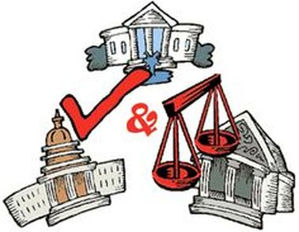
PRESIDENT CONSTITUTIONAL ROLES: CHIEF JURIST
Powers
Appoints federal judges.
Issues pardons (e.g., Ford pardoned Nixon for Watergate) and amnesty- is a group pardon.
The pardon power is an Executive check on the Judicial branch
Checks
Senate can reject judicial appointments.
Senators can place “holds” on appointments.
Senators can ﬁlibuster nominations or place a hold.
on the JUDICIAL BRANCH

Slide 22
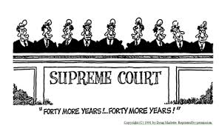
PRESIDENT CONSTITUTIONAL ROLES: CHIEF JURIST
The judge’s faces is of Pres. Ronald Reagan
Which of the following best illustrates the point being made in the cartoon above?
(A) The influence of presidents on the Supreme Court is limited because the Senate often rejects their nominees.
(B) The terms of the Supreme Court justices should be reduced from their current forty years.
(C) Presidents can have an influence on public policy far beyond their terms of office.
(D) The opinions of Supreme Court justices remain very similar over long periods of time.
(E) Supreme Court justice seldom issue dissenting opinions.

Slide 23
Informal Powers: NON-CONSTITUTIONAL SOURCES OF PRESIDENTIAL POWER
Development of the mass media casts the President into the public eye -> use of TV as the “electronic throne.”
Special addresses, press conferences, Saturday morning radio chats, photo opportunities, sound bites, staged events, “going public.”
Emergence of the U.S. as the great superpower after WWII.
Formal Powers are those powers listed (enumerated) in the Constitution, ie, Commander-in-chief
Informal Powers are those powers that are NOT listed in the Constitution such as THE PRESIDENT IS CHIEF OF THE
PARTY
Development of the Cold War placed the U.S. into a virtual non-stop crisis situation after 1945 -> assumption of great powers by the President to deal with various foreign crises.

Slide 24
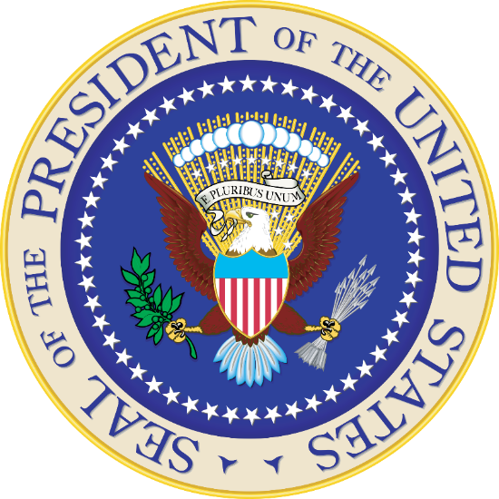
(INFORMAL Powers) NON-CONSTITUTIONAL SOURCES OF PRESIDENTIAL POWER
Unity of the oﬃce: the oﬃce is held by one man, as opposed to the 535-member Congress.
Presidential character and personality: Strong personalities such as the Roosevelt’s and LBJ can have great impact.
Growing complexity of society: With a highly industrial and technological society, people have demanded that the federal government play a larger role in areas of public concern, e.g., pollution, labor issues, air travel safety. The executive branch has thus grown to meet those public demands.
Congressional delegation of authority to the executive branch.
Congress often writes broadly worded legislation and lets executive agencies “ﬁll in the holes.”
Congress often bows to presidential demands in time of economic or foreign crisis.
Congress often bows to the President when he can proclaim a mandate from the people after a large electoral victory, e.g., Reagan insisting upon tax cuts and higher defense spending after the 1980 election.

Slide 25
PRESIDENT NON-CONSTITUTIONAL ROLES
HEAD OF POLITICAL PARTY
Selects the party's chairman of the national committee and VP nominee.
Political patronage.
CHIEF ECONOMIST
Responsible for the overall health of the economy.
Proposes the federal budget (though Congress can alter it).

Slide 26
How can a president implement Policy agenda?
Power Granted To The President | Example in Implementing Policy Agenda
Veto | President Bill Clinton rejected 37 bills during his two terms
Commander in Chief | president Barack Obama authorized US forces to kill Osama bin Laden
Executive Agreement | President John Kennedy made an agreement with the Soviet Union to remove missiles from Turkey if the Soviets removed missiles from Cuba
Executive Order | President Franklin Roosevelt issued the order to have people of Japanese ancestry placed into internment camps during World War Two
Executive Privilege | president Richard Nixon tested the power to withhold information of national security from Congress during Watergate. The Supreme Court stated he didn't have privilege in that case
AMSCO pg. 147

Slide 27
END

Slide 28
2.6 EXPLAIN HOW PRESIDENTS HAVE INTERPRETED AND JUSTIFIED THEIR USE OF FORMAL AND INFORMAL POWERS
a) Justiﬁcations for a single executive are set forth in Federalist No. 70

Slide 29
Federalist No. 70 (1788)
In this Federalist Paper, Alexander Hamilton argues for a strong executive leader, as provided for by the Constitution, as opposed to the weak executive under the Articles of Confederation. He asserts, “energy in the executive is the leading character in the deﬁnition of good government. It is essential to the protection of the community against foreign anacks…to the steady administration of the laws, to the protection of property… to justice; [and] to the security of liberty….”
Though some had called for an executive council, Hamilton defended a single executive as “far more safe” because “wherever two or more persons are engaged in any common… pursuit, there is always danger of diﬀerence of opinion…bitter dissensions are apt to spring. Whenever these happen, they lessen the respectability, weaken the authority.” Hamilton also argued that a single executive would be watched “more narrowly” and vigilantly by the people than a group of people would be.

Slide 30
Federalist No. 70 (1788)
1. What beneﬁts does a strong presidency provide to a representative democracy?
4. What, according to Hamilton, is the most necessary quality for a president?
A strong presidency provided unity, stability, and protection, a strong presidency not only protects the people from other countries, but also from themselves.
Hamilton considers energy the most necessary quality for a president. Energy is needed to protect the people's rights and liberties.
2. Why does a weak executive create a bad government?
5. What are characteristics of the legislative branch?
If the executive branch is weak, there is no one to protect the people's rights and liberties. This then causes distrust in the government, which shows the liabilities.
The legislative branch includes discussing/arguing/passing/settling laws and past disputes. They regularly exercise their powers through the Supreme Court and lower courts to show their agreements and the people's opinions as a whole.
3. What are four ingredient of an energetic executive?
Four ingredients of an energetic executive branch are unity, competent powers, adequate provision for its support, and duration. By showing so, the people begin to trust the government.

Slide 31
Federalist No. 70 (1788)
How do human weaknesses complicate decision-making, according to Hamilton?
Hamilton argued that human weaknesses will create unnecessary concerns in
decision making. Which led them to believe that the existence of Congress within the government will only become the hindrance for Government because it slowed down the decision-making process. But he did not consider who will watch over the government if congress does not exist.
8. Why is disagreement within the legislative branch beneﬁcial, while in the executive branch it is detrimental?
Disagreement within the legislative branch can usually lead to good things.
When the Congress is arguing about something, two sides want their side to win and they represent two sides of the population. When they manage to ﬁnd a solution or common ground on an issue, that means that it's usually a compromise so the issue in question moves forward a bit in such a way that it suits both sides a bit.
Disagreement in the executive branch however is not beneﬁcial because it
can cause delays in administering laws or signing them into law, or it can cause for people who did something bad to answer for it at a later time which gives them time to escape, or anything similar. Nothing good can come out of disagreement within the executive branch.
What problems might arise if the presidency were split between two people?
If the presidency were split between two people, they would disagree
because of the diﬀerences in their beliefs. Since they would not be able to agree on most things, action could not be taken, about certain events, until aWer everything had died down.

Slide 32
EXPLAIN HOW PRESIDENTS HAVE INTERPRETED AND JUSTIFIED THEIR USE OF FORMAL AND INFORMAL POWERS
b) Term-of-oﬃce and constitutional-power restrictions, including the passage of the Twenty-second Amendment, demonstrate changing presidential roles

Slide 33
2.5 EXPLAIN HOW THE PRESIDENT’S AGENDA CAN CREATE TENSION AND FREQUENT CONFRONTATIONS WITH CONGRESS
The potential for conﬂict with the Senate depends upon the type of executive branch appointments, including:
Cabinet members
Ambassadors
White House staﬀ
Senate conﬁrmation is an important check on appointment powers, but the president’s longest lasting inﬂuence lies in life-tenured judicial appointments
Policy initiatives and executive orders promoted by the president often lead to conﬂict with congressional agenda
33

Slide 34
TERM OF OFFICE
222
Four years
Maximum of two elected terms; Maximum of 10 years
Amendment 22 institutionalized Washington’s precedent.
Passage of 22nd Amendment (1951) was due to the Republican congress’ concern over future FDR’s.
Possible to serve just less than 10 years in oﬃce if a V.P. becomes President just after the midpoint of a President’s term of oﬃce.
If a V.P. serves less than half of a President’s term, he can be elected to the presidency twice.
If a V.P. serves more than half of a President’s term, he can be elected to the presidency only once.
Lyndon Johnson succeeded JFK in 1963 and was therefore eligible to be elected twice.
Gerald Ford succeeded Nixon in 1974 and was therefore eligible to be elected only once.

Slide 35
SUCCESSION
If oﬃce of presidency is vacant due to death, resignation, or impeachment and removal, the V.P. becomes President.
He in turn nominates, and Congress conﬁrms, a new VP.
If V.P. dies before his inauguration as President, the line of succession is as follows:
Speaker of the House
Senate President Pro Tempore
Sec. of State
Sec. of Treasury
Sec. of Defense
Other Cabinet secretaries in order of the creation of their oﬃces (Presidential Succession Act of 1947)
If the President is disabled, the 25th Amendment applies:
The President informs the Congress of disability and the V.P. becomes Acting President.
If the President is unable to inform Congress (e.g., coma), the V.P. and a majority of Cabinet secretaries can go to the Congress and receive approval for the V.P. to become Acting President.
In either case, the President regains powers by informing the Congress of his intent to return. In case of dispute, Congress has the power to decide who shall be President.

Slide 36
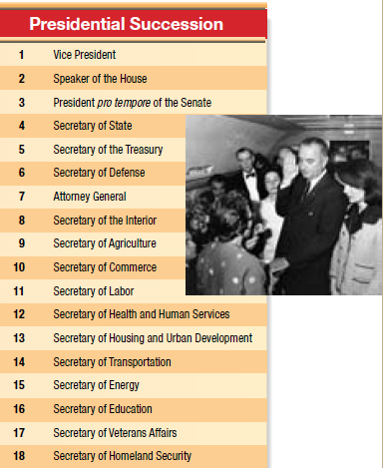
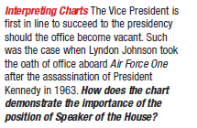

Slide 37
SUCCESSION
If the President is disabled, the 25th Amendment applies:
The President informs the Congress of disability and the V.P. becomes Acting President.
If the President is unable to inform Congress (e.g., coma), the V.P. and a majority of Cabinet secretaries can go to the Congress and receive approval for the V.P. to become Acting President.
In either case, the President regains powers by informing Congress of his intent to return. In case of dispute, Congress has the power to decide who shall be President

Slide 38
INCOMPLETE PRESIDENTIAL TERMS
What does superscript ‘b’ mean? How was this possible?

Slide 39
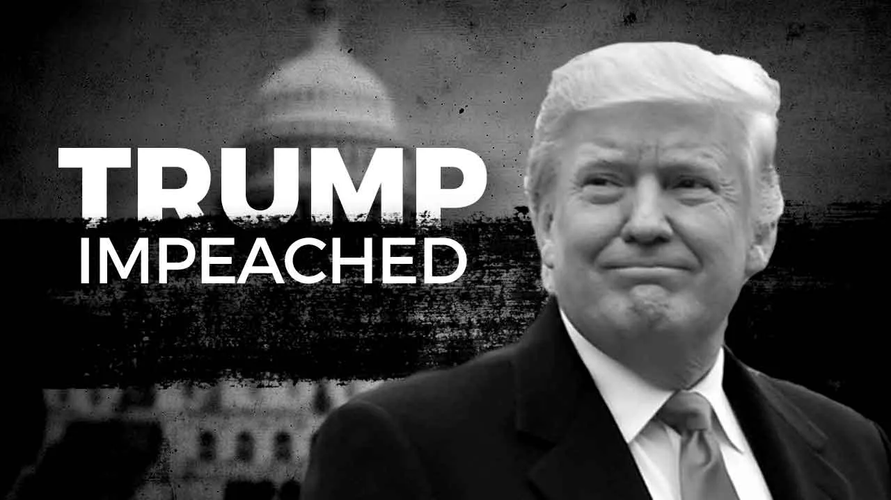
IMPEACHMENT
The vice president secedes if the president leaves oﬃce due to death or resignation or convicted of impeachment
Impeachment is investigated by the House, tried by the Senate with the Chief Justice presiding.
Only three presidents have been impeached: Andrew Johnson, Bill Clinton & Donald Trump (neither was convicted).

