Slide 1
UNIT 2 Topic 2.8-2.11
AMSCO pg. 177-210
Required Foundational Doc
Federalist #78, Art III of the Constitution
Required Supreme Court Case
Marbury v. Madison(1803)
Chpt. 6 Topic 2.8-2.11 The Judiciary

Slide 2
2.8 THE DESIGN OF THE JUDICIAL BRANCH PROTECTS THE SUPREME COURT’S INDEPENDENCE AS A BRANCH OF GOVERNMENT, AND THE EMERGENCE AND USE OF JUDICIAL REVIEW REMAINS A POWERFUL JUDICIAL PRACTICE
The foundation for powers of the judicial branch and how its independence checks the power of other institutions and state governments are set forth in:
Article III of the Constitution
Federalist No. 78
Marbury v. Madison (1803)
Explain the principle of judicial review and how it checks the power of other institutions and state governments
REQUIRED FOUNDATIONAL DOCUMENTS
The Constitution of the United States
Federalist No. 78
REQUIRED SUPREME COURT CASE
Marbury v. Madison (1803)
2

Slide 3
2.8 THE DESIGN OF THE JUDICIAL BRANCH PROTECTS THE SUPREME COURT’S INDEPENDENCE AS A BRANCH OF GOVERNMENT, AND THE EMERGENCE AND USE OF JUDICIAL REVIEW REMAINS A POWERFUL JUDICIAL PRACTICE
The foundation for powers of the judicial branch and the argument for how its independence checks the power of other branches are set forth in:
Article III of the Constitution
Federalist No. 78
Marbury v. Madison (1803)
Explain the principle of judicial review and how it checks the power of other institutions and state governments
REQUIRED FOUNDATIONAL DOCUMENTS
The Constitution of the United States
Federalist No. 78
REQUIRED SUPREME COURT CASE
Marbury v. Madison (1803)
3

Slide 4
2.8 INTRODUCTION TO THE FEDERAL COURTS
JUDICIAL POWER
Is passive
Courts cannot reach out and “take” cases >> Cases must come to them
There must be an actual case (“controversy”) for a court to make a ruling >> Courts cannot “create” cases
Can’t settle political issues/political questions between the president and Congress (must be a constitutional issue)
Only those with STANDING may challenge a law or government action
One who has sustained or is near sustaining an “injury” may bring a case to court
One cannot challenge a law simply because one does not happen to like it
JUDICIAL LAW-MAKING
Judges, contrary to what some may think, are not simply impartial referees who only carry out the law. Judges interpret the law, and in so doing in fact make law. It is necessary that they make law because:
Statutes are often broadly-worded, unclear, or contradictory
The Constitution is certainly broadly-worded, and requires interpretation
Thus, interpretation of statutes and the Constitution is, in eﬀect, making law. Evidence of judicial law making:
Courts have ruled >1,000 state laws as being unconstitutional
Courts have ruled >120 federal laws as being unconstitutional
The Supreme Court has reversed itself >140 times since 1810
4

Slide 5
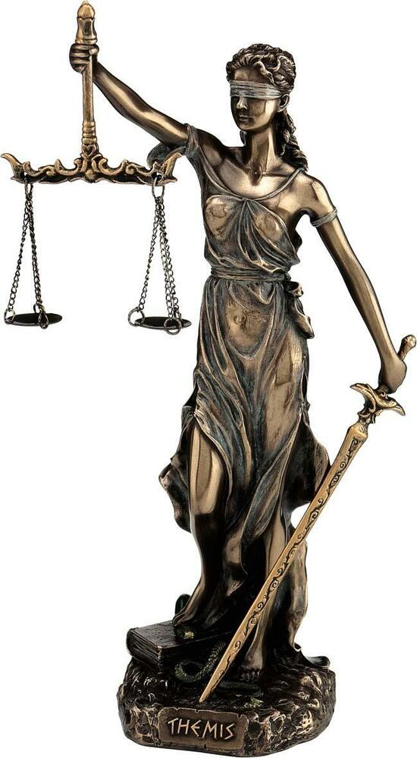
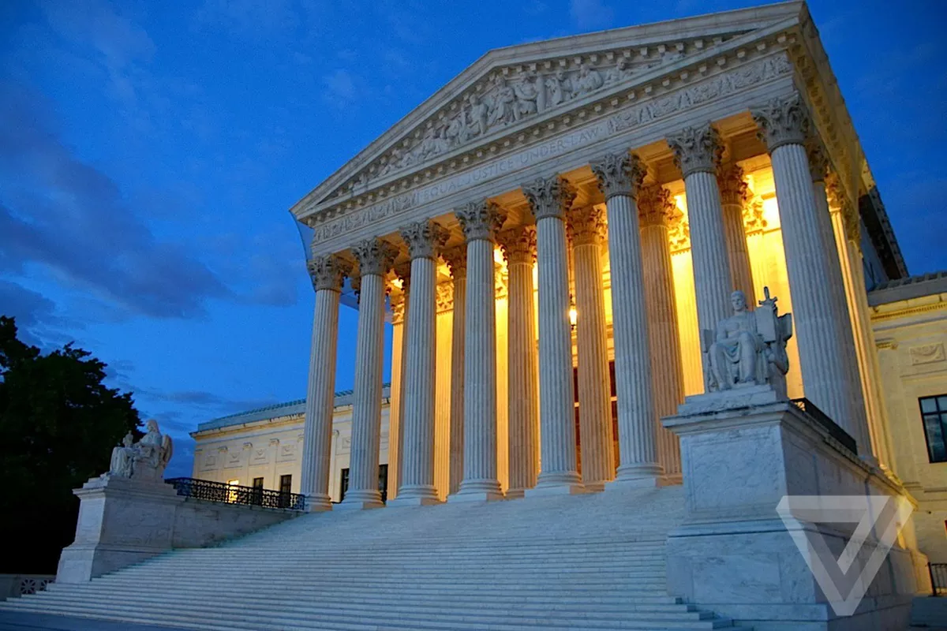
INTRODUCTION TO THE FEDERAL COURTS
AMERICA’S DUAL COURT SYSTEM
The U.S. has two separate court systems (STATE AND FEDERAL) because it is a federal system
Each state has its own court system (97% of all criminal cases are heard in state courts)
AP test will be only about the federal court system
THE SUPREME COURT OF THE UNITED STATES OF AMERICA
50 State Supreme Courts
State Appeals Courts
State Trial Courts
THE SUPREME COURT OF THE UNITED STATES OF AMERICA
13 Federal Appeals Courts
94 Federal District Courts

Slide 6
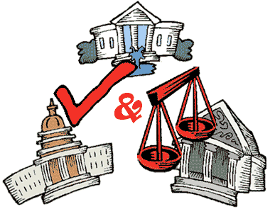
INTRODUCTION TO THE FEDERAL COURTS
For the AP exam you only must know the FEDERAL Courts
All lower courts are
created by Congress as
stated in the Constitution
All lower courts are
created by Congress as
stated in the Constitution
6

Slide 7
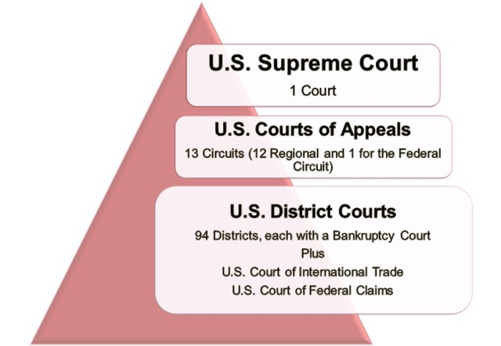
Federal Court System
REQUIRED for AP Exam
JURISDICTION — the authority to hear and decide cases
Appellate Jurisdiction
Limited Original Jurisdiction
All lower courts are
created by Congress as
stated in the Constitution
Appellate Jurisdiction
the authority of a court to hear and review decisions made by lower courts in that system.
Original Jurisdiction
the authority of a court to act as the first court to hear a case, which includes the finding of facts in the case.

Slide 8
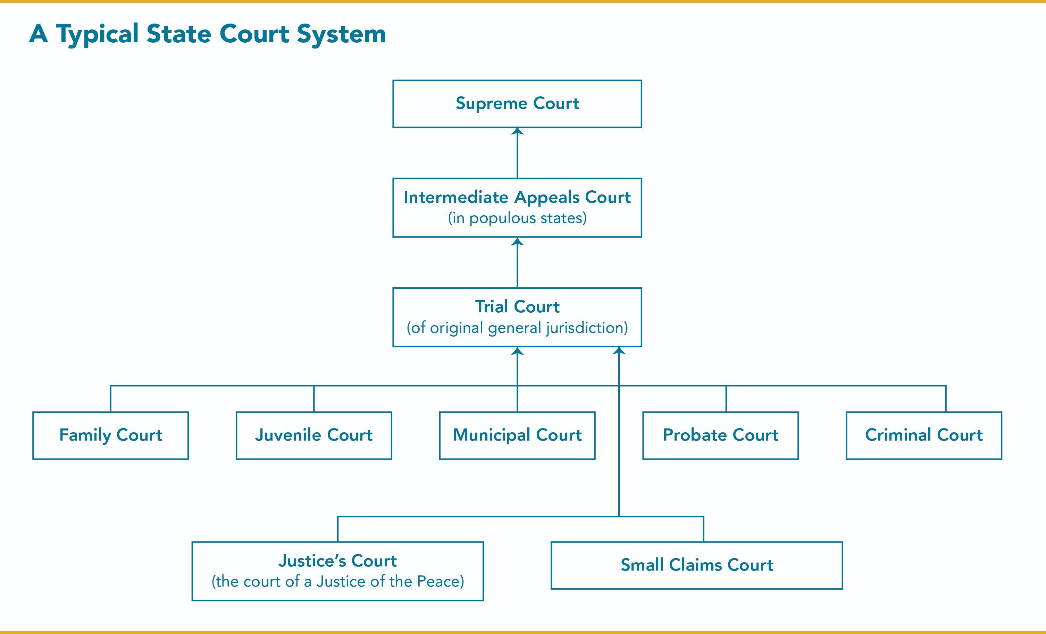
The federal court system was a copy of the system the states had already in place
Civil Court
8

Slide 9
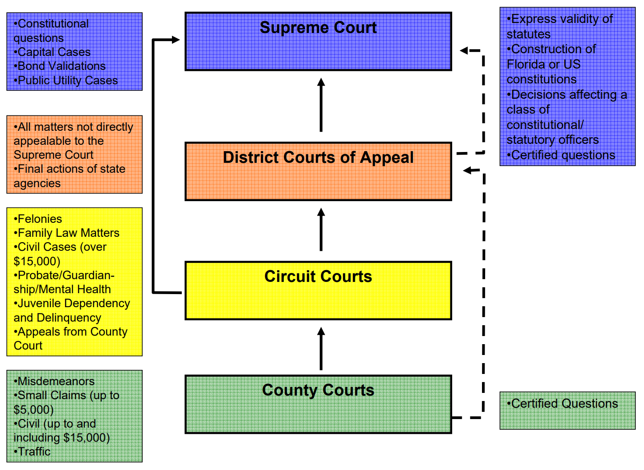
INTRODUCTION TO THE FEDERAL COURTS
State of Florida Court System
9

Slide 10
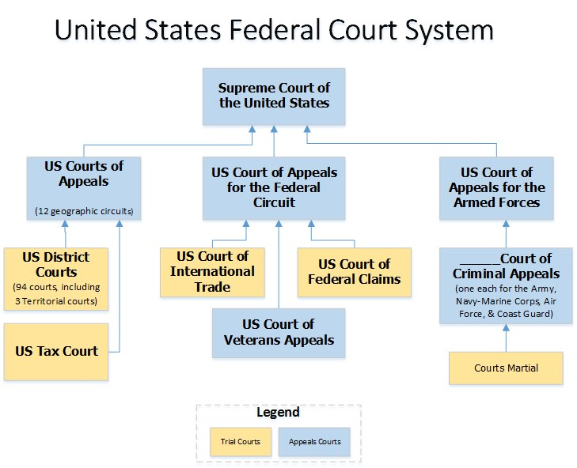
INTRODUCTION TO THE FEDERAL COURTS
Types of Federal Courts
10

Slide 11
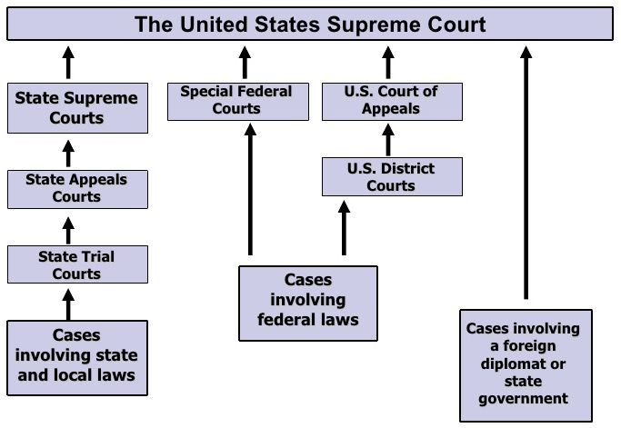
INTRODUCTION TO THE FEDERAL COURTS

Slide 12
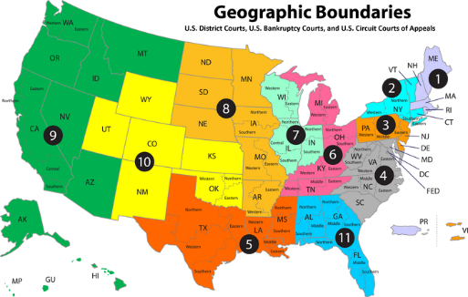

Slide 13
ARTICLE III (3) – JUDICIAL BRANCH
JURISDICTION — the authority to hear and decide cases —
The Supreme Court’s original jurisdiction is limited to: over all disputes between states and the national government, between two or more states, and between citizens of different states.
Combined with the supremacy clause in Article VI, Clause 2 of the Constitution, which declares that national treaties and laws “shall be the supreme law of the Land,” the federal courts emerged as superior to state courts and laws.
13

Slide 14
ARTICLE III (3) – JUDICIAL BRANCH
Section 1
The judicial Power of the United States, shall be vested in one supreme Court, and in such inferior Courts as the Congress may from time to time ordain and establish. The Judges, both of the supreme and inferior Courts, shall hold their Oﬃces during good Behavior, and shall, at stated Times, receive for their Services, a Compensation, which shall not be diminished during their Continuance in Oﬃce.
The SUPREME COURT has LIMITTED ORGINAL JURISDICTION
Section 2
Clause 1: The judicial Power shall extend to all Cases, in Law and Equity, arising under this Constitution, the Laws of the United States, and Treaties made, or which shall be made, under their Authority;--to all Cases aﬀecting Ambassadors, other public Ministers and Consuls;--to all Cases of admiralty and maritime Jurisdiction;--to Controversies to which the United States shall be a Party;--to Controversies between two or more States;--between a State and Citizens of another State; (This Clause has been aﬀected by Amendment XI.)--between Citizens of diﬀerent States,--between Citizens of the same State claiming Lands under Grants of diﬀerent States, and between a State, or the Citizens thereof, and foreign States, Citizens or Subjects.
Clause 2: In all Cases aﬀecting Ambassadors, other public Ministers and Consuls, and those in which a State shall be Party, the supreme Court shall have original Jurisdiction. In all the other Cases before mentioned, the supreme Court shall have appellate Jurisdiction, both as to Law and Fact, with such Exceptions, and under such Regulations as the Congress shall make.
Clause 3: The Trial of all Crimes, except in Cases of Impeachment, shall be by Jury; and such Trial shall be held in the State where the said Crimes shall have been committed; but when not committed within any State, the Trial shall be at such Place or Places as the Congress may by Law have directed.
Section 3
Clause 1: Treason against the United States, shall consist only in levying War against them, or in adhering to their Enemies, giving them Aid and Comfort. No Person shall be convicted of Treason unless on the Testimony of two Witnesses to the same overt Act, or on Confession in open Court.
Clause 2: The Congress shall have Power to declare the Punishment of Treason, but no Attainder of Treason shall work Corruption of Blood, or Forfeiture except during the Life of the Person attainted.
14

Slide 15
The Crime of Treason
“Treason against the United States shall consist only in levying war against them, or in adhering to their enemies, giving them aid and comfort.” The Founders went out of their way to define treason narrowly because they knew how it had been repeatedly abused in the past.
For much of the pre-revolutionary period in England, the accusation was a means of suppressing political dissent and punishing political opponents for crimes as trivial as contemplating a king’s future death (what was known as “compassing”), or speaking ill of the king (“lèse majesté”). King Henry VIII even had two of his six wives executed for alleged adultery on the ground that such infidelity was, of itself, “treason.” The English abuse of treason was anathema to a nascent republic dedicated to the rule of law and the right of peaceful dissent.
Sources
https://www.nbcnews.com/think/opinion/americans-have-forgotten-what-treason-actually-means-how-it-can-ncna848651
https://www.businessinsider.com/treason-only-crime-defined-constitution-richard-briffault-law-us-history-2017-3

Slide 16
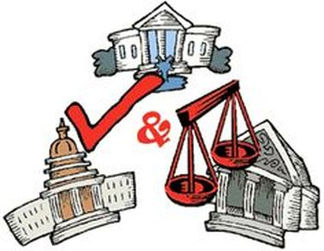
STRUCTURE OF THE FEDERAL COURT SYSTEM
ARTICLE III – THE FEDERAL (CONSTITUTIONAL) COURTS
The Supreme Court is the only court speciﬁcally mentioned in the Constitution
The President has the power to appoint all federal judges
Executive branch check on the judicial branch
The Senate has the power to conﬁrm all federal judges
Legislative branch check on the executive branch and judicial branch
Congress has the power to create all “inferior” (lower) federal courts
Legislative branch check on the judicial branch
Congress has the power to change appellate jurisdiction of federal courts
Legislative branch check on the judicial branch
Judges in these courts hold LIFE TERMS so that they are free from political pressure
Judicial branch check on the legislative branch and executive branch
Judicial Review
JUDICIARY ACT OF 1789
Established the basic three-tiered structure of federal courts that still exists
Congress set the size of the Supreme Court at six justices – later expanded to nine in 1869
Checks & Balances
16

Slide 17
STRUCTURE OF THE FEDERAL COURT SYSTEM
THREE LEVELS OF CONSTITUTIONAL (FEDERAL) COURTS
UNITED STATES SUPREME COURT (highest level)
COURT OF APPEALS (mid level)
DISTRICT COURTS (lowest level)
FEDERAL COURT JURISDICTION
Federal courts may try a case if it involves:
Disputes between two or more states
The Constitution, a federal law, or a treaty
The U.S. government as a party
Citizens of diﬀerent states
Ambassadors or diplomats

Slide 18
Jurisdiction of the Federal Courts
Jurisdiction = authority. There are three types of jurisdiction or authority to hear a case. Three types of jurisdiction:
(Exclusive-Those cases can be heard only in the federal courts )
Original- court in which a case is first heard
Concurrent- cases that may be tried in either a federal court or a state court
Appellate- A court that hears a case on appeal from a lower court
Federal courts may try a case if it involves:
Disputes between two or more states
The Constitution, a federal law, or a treaty
The U.S. government as a party
Citizens of diﬀerent states Ambassadors or diplomats

Slide 19
STRUCTURE OF THE FEDERAL COURT SYSTEM
THE THREE LEVELS OF CONSTITUTIONAL (FEDERAL) COURTS
DISTRICT COURTS COURTS OF APPEALS SUPREME COURT
94 courts w/ ~700 judges
Handle over 300,000 cases
Cases are tried by a judge and petit (trial) jury – jury decides outcome of case
Use grand juries to issue indictments
Orders that charge an individual with a crime
Does not mean that one is guilty; it means that one will be tried
Jurisdiction: original
Most cases end in a plea bargain
Decisions may be appealed to Courts of Appeals
13 “circuit” courts w/ ~160 judges
156 judges try >18,000 cases a year
Cases tried by a panel of three judges
– Do not hold trials or hear testimony – judges review district court decisions
Jurisdiction: appellate (hears appeals from District Courts and regulatory agencies)
Decisions may be appealed to the Supreme Court
Highest court in the land
~10,000 cases are petitioned for a writ of certiorari – only hear about 80 cases a year
Cases tried by entire court (currently nine judges - # of justices is established by Congress)
Jurisdiction: original and appellate
– Almost all cases are heard on appeal
Court of last resort
Supreme Court is the ﬁnal arbiter of the Constitution
Supreme Court decisions establish precedents that are binding on the entire nation

Slide 20
FEDERALIST #78 – THE JUDICIARY DEPARTMENT
Alexander Hamilton, 1788
To the People of the State of New York:
WE PROCEED now to an examination of the judiciary department of the proposed government.
In unfolding the defects of the existing Confederation, the utility and necessity of a federal judicature have been clearly pointed out. It is the less necessary to recapitulate the considerations there urged, as the propriety of the institution in the abstract is not disputed; the only questions which have been raised being relative to the manner of constituting it, and to its extent. To these points, therefore, our observations shall be conﬁned.
The manner of constituting it seems to embrace these several objects: 1st. The mode of appointing the judges. 2d. The tenure by which they are to hold their places. 3d. The partition of the judiciary authority between diﬀerent courts, and their relations to each other.
11

Slide 21
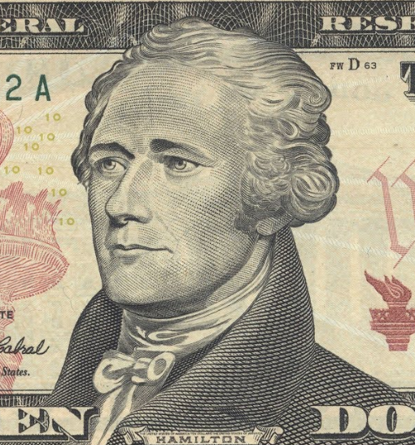
FEDERALIST #78
On what grounds does Hamilton argue that the judicial department of government is the least powerful branch of government?
It has the least capacity to annoy or injure the political rights of the Constitution. The executive makes appointments and holds the sword, and the legislature commands the purse and passes the laws. The judiciary has neither force, nor will. All it can do is exercise judgment and depend upon the executive to carry out its judgments.
Why do you suppose that Hamilton was so careful to point out the relative impotence of the judiciary?
To alleviate fears that this new department of government (there was no national judiciary under the Articles of Confederation) would be used to deny rights of the people.

Slide 22
FEDERALIST #78
3. Why does Hamilton consider the independence of the judiciary to be a vital component of constitutional government?
Because the courts are the bulwarks of a limited Constitution against the encroachments of the legislature. Without judicial independence, judges would be unable to eﬀectively check the legislature.
4. What arguments does Hamilton use to support life tenure for judges?
Life tenure frees judges from political pressure that might come from the legislature or executive if periodic appointments were made. Being freed from such pressure enables judges to guard against laws that are contrary to the Constitution.
Being a judge places great demands upon a person. Few men have the necessary abilities to be a judge, and few have the necessary ethical qualities, as well. Periodic appointments would discourage those few who are qualiﬁed, and would lead to less competent and less principled judges.

Slide 23
FEDERAL JUDGES
FEDERAL JUDGES:
Are appointed by President with “advice and consent” of Senate (majority vote needed for conﬁrmation)
Are given life tenure subject to good behavior
May be impeached and removed by Congress (very rare)
Advantages of life terms
Experience
Stability
Re-election not necessary
No fear of removal based on decision
Interest groups have little inﬂuence
Disadvantages of life terms
Judicial activism-
Precedent
Old court
Ideology; slow to change

Slide 24
EPLAIN THE PRINCIPLE OF JUDICIAL REVIEW AND HOW DOES IT CHECK THE POWER OF OTHER INSTITUTIONS AND STATE GOVERNMENTS?
The foundation for powers of the judicial branch and how its independence checks the power of other institutions and state governments are set forth in:
– Marbury v. Madison (1803)

Slide 25
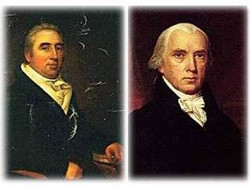
MARBURY v. MADISON (1803) – REQUIRED CASE
Crash Course Government and Politics
William Marbury
James Madison

Slide 26
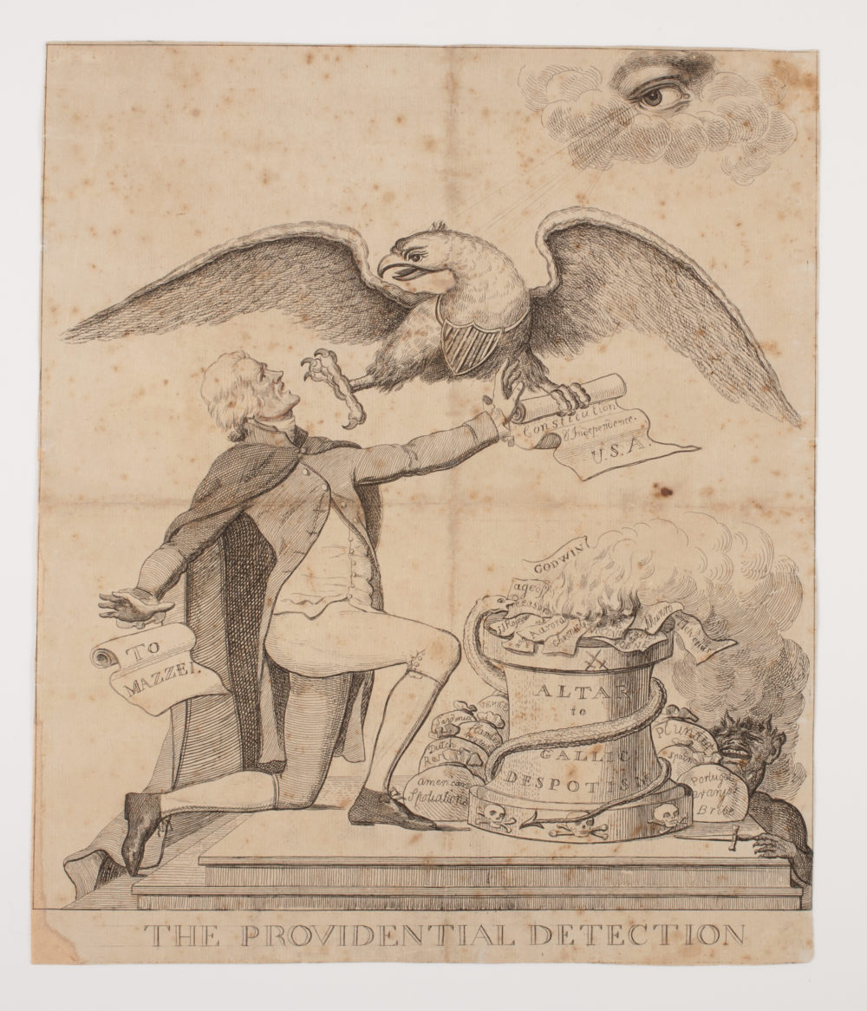
This cartoon, by an unknown artist, depicts Thomas Jefferson attempting to destroy the Constitution. It was well-known, at the time the Constitution was being drafted, that Jefferson was very worried about giving too much power to a central (federal) government.
In this cartoon, Thomas Jefferson kneels before the altar of Gallic despotism [a reference to the terrors of
the French Revolution] as God and an American eagle attempt to prevent him from destroying the United
States Constitution. He is depicted as about to fling a document labeled "Constitution & Independence U.S.A." into the fire fed by the flames of radical writings.
Jefferson's alleged attack on George Washington and John Adams in the form of a letter to Philip
Mazzei falls from Jefferson's pocket.
Jefferson is supported by Satan [depicted by a snake around the altar], the writings of Thomas Paine, and the French philosophers.
https://www.awesomestories.com/pdf/make/136388

Slide 27
MARBURY v. MADISON (1803) – REQUIRED CASE
Facts
William Marbury, who had been appointed a justice of the peace of the District of Columbia, was one of the appointees who did not receive his commission. Marbury sued James Madison and asked the Supreme Court to issue a writ of mandamus requiring Madison to deliver the commission.
Issues
Does Marbury have a right to his commission, and can he sue the federal government for it? Does the Supreme Court have the authority to order the delivery of the commission?
Decision
The decision in Marbury v. Madison ended up being much more signiﬁcant than the resolution of the dispute between Marbury and the new administration. The Supreme Court, in this decision, established a key power of the Supreme Court that continues to shape the institution today.
The Court unanimously decided not to require Madison to deliver the commission to Marbury. In the opinion, written by Chief Justice Marshall, the Court ruled that Marbury was entitled to his commission, but that according to the Constitution, the Court did not have the authority to require Madison to deliver the commission to Marbury in this case. They said that the Judiciary Act of 1789 conﬂicted with the Constitution because it gave the Supreme Court more authority than it was given in Article III. Thus the Judiciary Act of 1789 and the Constitution were in conﬂict with each other.
William Marbury
James Madison

Slide 28
MARBURY v. MADISON (1803) – REQUIRED CASE
Decision
Declaring the Constitution “superior, paramount law,” the Supreme Court ruled that when ordinary laws conﬂict with the Constitution, they must be struck down. Furthermore, the Court said, it is the job of judges, including the justices of the Supreme Court, to interpret laws and determine when they conﬂict with the Constitution. According to the Court, the Constitution gives the judicial branch the power to strike down laws passed by Congress (the legislative branch) and actions of the president and his executive branch oﬃcials and departments. This is the principle of judicial review. The opinion said that it is “emphatically the province and duty of the judicial department to say what the law is.”
This decision established the judicial branch as an equal partner with the executive and legislative branches within the government, with the power to rule actions of the other branches unconstitutional. The ruling said that the Constitution is the supreme law of the land and established the Supreme Court as the ﬁnal authority for interpreting it.
William Marbury
James Madison

Slide 29
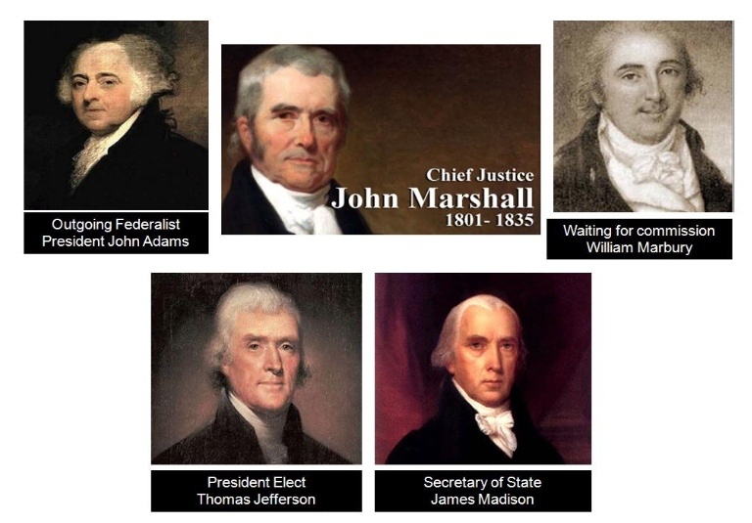
MARBURY v. MADISON (1803) – REQUIRED CASE
Outgoing President John Adams FEDERALIST
Outgoing Secretary of State John Marshall (becomes Chief Justice of Supreme Court) FEDERALIST
President elect Thomas Jefferson DEMOCRATIC -REPUBLICAN
Secretary of State James Madison DEMOCRATIC -REPUBLICAN
William Marbury FEDERALIST
Chief Justice John Marshall FEDERALIST

Slide 30
JUDICIAL REVIEW - MARBURY V. MADISON (1803)
Framers did not speciﬁcally provide for judicial review
Court could not enforce an unconstitutional law (Section 13 of Judiciary Act)
Chief Justice John Marshall reasoned that judges should interpret the Constitution, not the President or Congress
Judicial review became established due to this case
A single person may challenge an existing law through judicial hearings
Eﬀects
Litigation sometimes trumps legislation as a way to make public policy
Examples – Modern-day gun issues
District of Columbia v. Heller (2008) - Supreme Court held that a constitutional right to gun ownership - irrespective of service in a state militia - did exist.
McDonald v. Chicago (2010) - The Second Amendment right to keep and bear arms for self-defense in one's home is fully applicable to the states through the Fourteenth Amendment.

Slide 31
2.8 EXPLAIN THE PRINCIPLE OF JUDICIAL REVIEW AND HOW DOES IT CHECK THE POWER OF OTHER INSTITUTIONS AND STATE GOVERNMENTS?
The foundation for powers of the judicial branch and how its independence checks the power of other institutions and state governments are set forth in:
–Marbury v. Madison (1803)
Checks Over Other Branches and States | Judicial Review and Marbury v. Madison
The US district courts trying federal crimes, such as counterfeiting, mail fraud, and evading federal income taxes crimes defined under the enumerated powers in the constitution. Most violent crimes, and indeed most crimes overall are tried in state courts. Congress has outlawed some violent crimes Interstate actions, such as drug trafficking, bank robbery, terrorism, and acts of violence on federal property. | The judicial branch has the power of judicial review to examine acts of legislators and the executive branch to see if they abide by the constitution. This was established in the 1803 Supreme Court case of Marbury v. Madison
AMSCO pg. 187

Slide 32
THE SUPREME COURT
ORIGINAL JURISDICTION
The Court’s original jurisdiction only generates two to three cases a year
The Supreme Court exercises original jurisdiction in cases involving the following:
Two or more states
The United States and a state government
The United States and foreign ambassadors/diplomats
APPELLATE JURISDICTION
Most cases come under the Court’s appellate jurisdiction
Cases appealed from both state supreme courts and federal courts of appeals
Nearly all appellate cases now reach the SC by appeals. Small number by writ of certiorari
KEY POWERS
Power of judicial review (established by Marbury v. Madison, 1803)
Declare state laws, federal laws, and presidential actions unconstitutional
Power to interpret broadly worded laws of Congress
Power to determine the meaning and application of the Constitution
Power to overrule earlier Supreme Court decisions (e.g., Brown
overturning Plessy)

Slide 33
2.9-2.10 The Role of the Judicial Branch and The Court in Action
2.9 Explain the role of legal precedent in judicial decision making.
Stare decisis (the legal doctrine under which courts follow legal precedents when deciding cases with similar facts) plays an important role in judicial decision making.
Ideological changes in the composition of the Supreme Court due to presidential appointments have led to the Court’s establishing new or rejecting existing precedents.
2.10 Explain how life tenure can lead to debate about the Supreme Court’s power.
Life tenure for justices allows the court to function independent of the current political
climate. As a result of this independence, the Court can deliver controversial or unpopular
court decisions, which in turn can lead to debate about the court’s power.

Slide 34
2.9-2.10 THE DESIGN OF THE JUDICIAL BRANCH PROTECTS THE SUPREME COURT’S INDEPENDENCE AS A BRANCH OF GOVERNMENT, AND THE EMERGENCE AND USE OF JUDICIAL REVIEW REMAINS A POWERFUL JUDICIAL PRACTICE.
Explain how the exercise of judicial review in conjunction with life tenure can lead to debate about the legitimacy of the Supreme Court’s power
2.9 Precedents and stare decisis play and important role in judicial decision making
Ideological changes in the composition of the Supreme Court due to presidential appointments have led to the Court’s establishing new or rejecting existing precedents
2.10 Controversial or unpopular Supreme Court decisions can lead to challenges of the Court’s legitimacy and power which Congress and the president can address only through future appointments, legislation changing the Court’s jurisdiction, or refusing to implement decisions.

Slide 35
2.9 LEGITIMACY OF THE JUDICIAL BRANCH
Explain how the exercise of judicial review in conjunction with life tenure can lead to debate about the legitimacy of the Supreme Court’s power
2.9 Precedents and stare decisis play and important role in judicial decision making
Ideological changes in the composition of the Supreme Court due to presidential appointments have led to the Court’s establishing new or rejecting existing precedents
Plessy v. Ferguson (1896) was overturned by Brown v. Board of Ed (1954)

Slide 36
FACTORS THAT INFLUENCE SUPREME COURT DECISIONS- Precedent
PRECEDENT - a judicial decision that acts as a basis for deciding similar cases in the future. It sets an example for future cases with similar legal issues.
Stare Decisis
Stare decisis is a Latin phrase meaning “let the decision stand”
The vast majority of SC decisions are based on precedents established in earlier cases
Precedents help make SC decisions more uniform, predictable, and eﬃcient
Examples
In Marbury v. Madison, the Court established the principle (precedent) of judicial review as applied to Congress and the president
In another case, the Court extended the power of judicial review to overrule state courts
In Baker v. Carr, the SC established the principle of one person, one vote in state congressional districts
In Wesberry v. Sanders, the Court applied this principle to U.S. congressional districts
Exceptions
Although precedent is very important, the Court can overturn previous decisions
Plessy v. Ferguson permitted segregation if the facilities were “separate but equal”
The Court reversed this ruling in Brown v. Board of Education of Topeka, declaring that “segregation is a denial of the equal protection of the laws”- 14th amendment

Slide 37
The Supreme Court’s Decisions
How has the Supreme Court use of judicial review in conjunction with life tenure lead to debates about the legitimacy of the court?
Continuity or change in the Supreme Court | Effect on the legitimacy of the court
Lifetime tenure | As with the Anti-Federalist many Americans believe that with no power to hold the court accountable, the justices on the Supreme Court are two separated from the real sources of power- the people and the legislature- to be legitimate arbiters of democratic law. Brutus believed the Supreme Court justices would be placed in a situation altogether unprecedented in a free country totally independent
Shifting ideological makeup of the court | The composition of the court changes as seats become vacant, and the presidential appointments to fill them can lead to shifts in ideology of the court. These changes can result in overturning of some precedents, calling into question the reliability and therefore legitimacy of the Supreme Court
Amsco pg. 193

Slide 38
EXPLAIN HOW JUDICIAL REVIEW IN CONJUNCTION WITH LIFE TENURE LEAD TO DEBATE ABOUT THE LEGITIMACY OF THE SUPREME COURT’S POWER?
2.10 THE COURT IN ACTION
The design of the judicial branch protects the Supreme Court’s independence as a branch of government, and the emergence and use of judicial review remains a powerful judicial practice.
Controversial or unpopular Supreme Court decisions can lead to challenges of the Court’s legitimacy and power which Congress and the president can address only through future appointments, legislation changing the Court’s jurisdiction, or refusing to implement decisions
Political discussion about the Supreme Court’s power is illustrated by the ongoing debate over judicial activism versus judicial restraint

Slide 39
Views on the Interpretation of the Constitution
Strict constructionist interprets the Constitution in its original context. Judicial restraint Court.
Liberal constructionist interprets the Constitution as a living document and considers changes in social conditions since ratification. Judicial activist Court

Slide 40
The Warren Court (1953-1969)- Activist Court
Brown v. Board of Education (1954)
Overturned the 1896 Plessy v. Ferguson decision, stating the “separate but equal” standard violated the 14th Amendment’s equal protection clause. (See Topic 3.11.)
Mapp v. Ohio (1961) Ruled that evidence illegally obtained would be
inadmissible in court. (See Topic 3.8.)
Engle v. Vitale (1962) Upheld the establishment clause of the First Amendment.
Public school-sponsored prayer was unconstitutional. (See Topic 3.2.)
Gideon v. Wainwright (1963)
The court stated that all citizens must be provided a lawyer, even if they can’t afford (indigent) one. (See Topic 3.8.)
Miranda v. Arizona (1966) An arrest suspect had to be formally informed of his or
her rights—sometimes called Miranda rights. (See Topic 3.8.)
Tinker v. Des Moines Independent Community School District (1969)
Allowed for students to participate in non-disruptive symbolic speech in schools. (See Topic 3.3.)

Slide 41
HOW CASES REACHES THE SUPREME COURT
WRITS OF CERTIORARI- from the Latin “to be more informed”
• A writ of cert is an order by the Court directing a lower court to send up the record in a given case for its review
• The certiorari process enables the SC to control its own caseload
• Cases must involve a serious constitutional issue or the interpretation of a
federal statute, action, or treaty
• Denying a decision may mean any number of things:
– Case lacks a substantial federal issue
– Party lacks standing
– Court agrees with a lower court
THE RULE OF FOUR
• SC clerks screen the approximately 9,000 petition that come to the SC each term
• The justices conduct weekly conference meetings where they discuss
petitions prepared by their clerks
• For a case to be heard on appeal, at least four of the nine justices must
agree to hear the case (the Rule of Four)
41

Slide 42
THE SUPREME COURT
FILING BRIEFS
• Each party is required to file a brief, or detailed written statement, arguing one side of the case
• Briefs cite relevant facts, legal principles, and precedents that support their arguments
• Interested persons and groups that are not actual parties to the case may file amicus curiae (“friend of the court”) briefs
– Cases involving controversial issues such as affirmative action and abortion attract a large number of amicus curiae briefs
– Interest groups use amicus curiae briefs to lobby the Court. These briefs contain information to try to influence the court’s decision.
LISTENING TO ORAL ARGUMENTS
• Oral arguments are open to the public
• Attorneys are allowed exactly 30 minutes to present their case
DISCUSSION AND VOTING
• The justices discuss each case in a closed meeting held on Friday. Closed meetings is a check on Congress and President.
• The Chief Justice (John Roberts) presides over the meeting
https://www.uscourts.gov/about-federal-courts/educational-resources

Slide 43
OPINIONS and CASELOADS
WRITING OPINIONS
EVADING COURT DECISIONS
The Supreme Court is the highest court in the land, but it is possible to evade Court decisions:
Amending the Constitution; Court cannot strike down something as unconstitutional if it is written in the Constitution
When a decision is made, it is “remanded” to a lower court to carry out the SC’s decision
The lower court will have a certain amount of leeway in doing this
The executive branch may simply not carry out the decision
State and local governments may simply not carry it out, either (e.g., desegregation, school prayer)
After reaching a decision, the justices must write a formal opinion. Opinions present the issues, establish precedents, and set guidelines for lower courts.
Types of opinions
Majority opinion – oﬃcially known as “the opinion of the Court,” the majority opinion is the law of the land
Concurring opinion – supports the majority opinion but stresses diﬀerent constitutional or legal reasons for reaching the judgment
Minority or dissenting opinion – expresses a point of view that disagrees with the majority opinion. Dissenting opinions have no legal standing

Slide 44
2.11 Checks on the Judicial Branch
Political discussion about the Supreme Court’s power is illustrated by the ongoing debate over differing interpretations of judicial review.
i. Judicial activism asserts that judicial review allows the courts to overturn current Constitutional and case precedent or invalidate legislative or executive acts.
ii. Judicial restraint asserts that judicial review should be constrained to decisions that adhere to current Constitutional and case precedent.
Explain how the exercise of
judicial review can lead to
debate about the Supreme
Court’s power.
Restrictions on the Supreme Court are represented by:
i. Congressional legislation to modify the impact of prior Supreme Court decisions
ii. Ratification of a Constitutional amendment
iii. Judicial appointments and confirmations which may shift the ideological balance of the court
iv. The president and states delaying implementation of a Supreme Court decision
v. Enacting legislation to limit the cases the Supreme Court can hear on appeal by removing the court’s jurisdiction over a case
Explain how other branches
in the government can limit
the Supreme Court’s power.

Slide 45
2.11 EXPLAIN HOW OTHER BRANCHES IN THE GOVERNMENT LIMIT THE SUPREME COURT’S POWER?
Restrictions on the Supreme Court are represented by:
Legislation (Congress) impacting court jurisdiction
Congressional legislation to modify the impact of prior Supreme Court decisions
Constitutional amendments- 16th amendment- income tax
Judicial conﬁrmations (by the Senate)
The president and states evade, delay or ignoring Supreme Court decisions
Legislation impacting court jurisdiction- Congress created the tax courts.

Slide 46
2.11 EXPLAIN HOW OTHER BRANCHES IN THE GOVERNMENT LIMIT THE SUPREME COURT’S POWER?
Constitutional amendments- 16th amendment- income tax
In 1894, Congress passed the Wilson-Gorman tariff which established a tax rate of 2% for annual income over $4,000, but it was overturned by the Supreme Court in 1895. In the early 20th century, the income tax enjoyed renewed support and, in February of 1913, the Sixteenth Amendment to the Constitution was ratified, granting Congress the power to tax personal income.
https://www.efile.com/tax-history-and-the-tax-code/

Slide 47
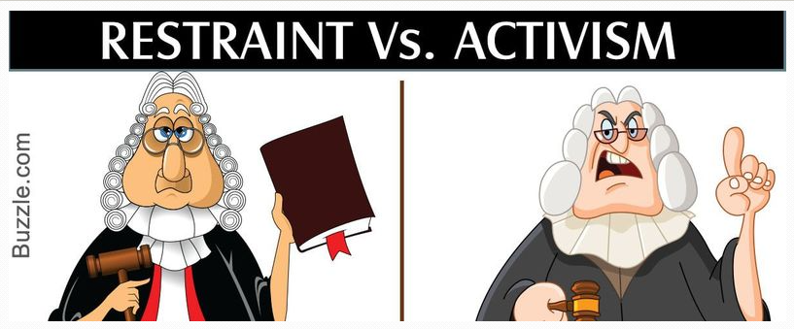
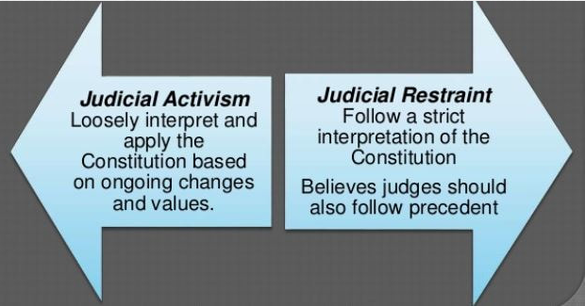
FACTORS THAT INFLUENCE SUPREME COURT DECISIONS
Judicial Philosophy
Once a supreme court makes a decision, it becomes a supreme law of the land
Judicial Restraint
Philosophy that the courts should allow the states and the other two branches (Leg and Exec) of the federal government to solve social, economic, and political problems
Courts should merely interpret the law rather than make law. That’s Congress’ job.
Federal judges must consider the original intent of the framers of the Constitution and exercise restraint in using their power to influence public policy.
https://newellta.weebly.com/judicial-philosophy.html
Notice the directions of the arrows. Activism goes to the left and Restraint goes to the right. When we think of politics, which groups are on the left and the right?

Slide 48
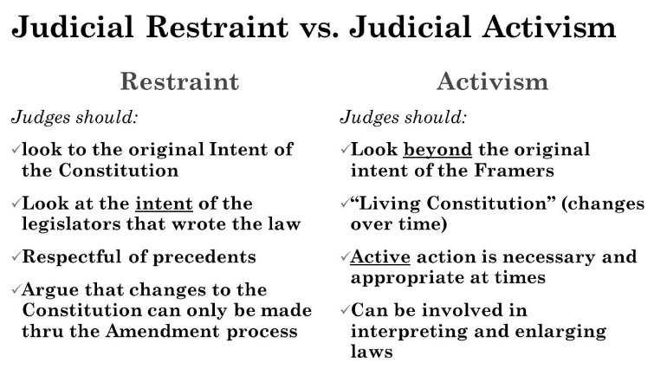
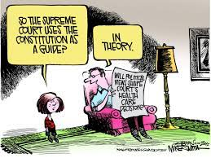
FACTORS THAT INFLUENCE SUPREME COURT DECISIONS
Judicial Philosophy
Judicial Activism- Since the Constitution is a living, breathing document, federal judges should make decisions applying a philosophy of judicial activism, interpreting laws based on the needs of the time. It is based on how they “feel” & not necessarily within the law.
Philosophy of judicial making whereby judges allow their personal views regarding a public policy instead of constitutionalism
Idea that judges ought to freely strike down laws that are inconsistent with their understanding of the Constitution
Courts should uphold the “guardian ethic” (guardian of people)
Examples of judicial activism:
Striking down Topeka School Board’s policy of segregation in Brown v. Board (1954)
Striking down a Texas law that banned ﬂag burning in Texas v. Johnson (1989)
Striking down the Gun Free School Zones Act in US v. Lopez (1995)
Striking down line-item veto in Clinton v. NY (1998)
Striking down a DC city ordinance banning handguns in DC v. Heller (2008)

Slide 49
Is interpreting law making law?
In the Supreme Court’s ability to interpret law, many would argue that they create law regardless because sometimes the law was not clearly written by the legislature. Let’s take the Plessy v Ferguson case 1896. It established the “separate but equal doctrine” and legitimized segregation throughout the nation. The Court went against the equal protection clause of the 14th amendment. They did what they “felt” was the need of the time. This is judicial activism because the 14th amendment clearly says that no state can, “…deny to any person within its jurisdiction the equal protection of the laws”. The writers of the 14th amendment never intended for separate equality. That is an oxymoron- like saying “pretty ugly”. If the authors of the 14th amendment intended separate equality, they would have stated it.
In 1954, Brown v. Board of Education, the SC reversed itself and ended segregation, declaring the separate facilities were not truly equal. This is judicial activism in the sense that it reversed a previous precedent. This separate but equal issue was sent before SC on several occasions prior to 1954 and the SC let the decision stand-stare decisis-judicial restraint. At that time, the SC figured that either Congress or the states would handle this issue. Neither did and segregation continued for nearly 60 years. In early 1950s, the Chief Justice of Supreme Court died and was replaced by a new Chief Justice, Earl Warren. The changing composition of the SC caused by vacancies and presidential appointments to the Court can alter the SC’s judicial philosophy for decades to come The Warren Court, as it became known, was the most liberal court of its time and very active.
If the 1896 Supreme Court had stayed within the confines of the 14th amendment, the Court would have ruled in favor of Plessy, but it did not and it created tremendous heartache in our country. In 1954, the Sup Ct. decision in reversing Plessy, was clearly within the original intent of the 14th amendment.

Slide 50
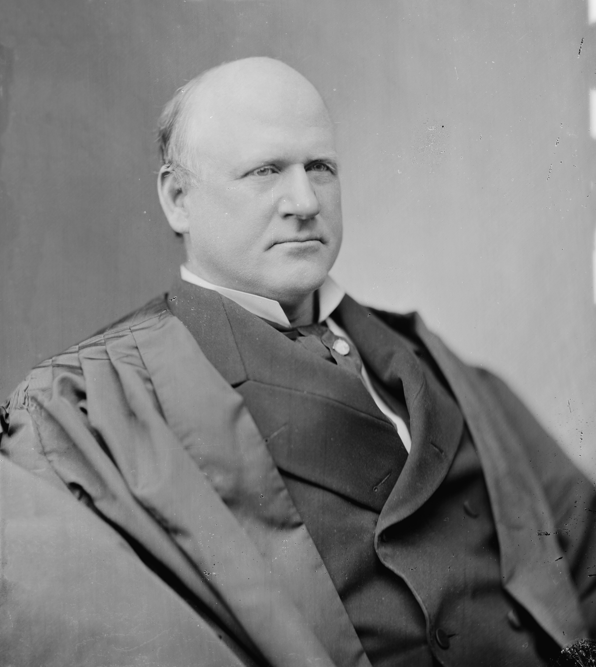
Justice John Marshall Harlan
The Lone Dissenter In The Plessy V. Ferguson Case
“Our Constitution is color-blind and neither knows nor tolerates classes among citizens.”

Slide 51
Justice John Marshall Harlan: lone dissenter on Plessy
The white race deems itself to be the dominant race in this country. And so it is, in prestige, in achievements, in education, in wealth, and in power. So, I doubt not, it will continue to be for all time, if it remains true to its great heritage and holds fast to the principles of constitutional liberty. But in the view of the Constitution, in the eye of the law, there is in this country no superior, dominant, ruling class of citizens. There is no caste here. Our Constitution is color-blind and neither knows nor tolerates classes among citizens. In respect of civil rights, all citizens are equal before the law. The humblest is the peer of the most powerful. The law regards man as man and takes no account of his surroundings or of his color when his civil rights as guaranteed by the supreme law of the land are involved....
The arbitrary separation of citizens, on the basis of race, while they are on a public highway, is a badge of servitude wholly inconsistent with the civil freedom and the equality before the law established by the Constitution. It cannot be justified upon any legal grounds
http://chnm.gmu.edu/courses/nclc375/harlan.html

Slide 52
Earl Warren's Supreme Court Decisions of Significance
Brown v. Board of Education of Topeka, 1954 separate but equal inherently unequal
Reynolds v. Sims, 1964 One man on vote
Mapp v. Ohio, 1961 states must use search warrants to search a home. Must have probable cause
Gideon v. Wainwright, 1963, under 6th amendment right to counsel the states must provide a lawyer for indigent defendants
Miranda v. Arizona, 1966 police must inform suspects of their rights: Miranda Rights
Engle v. Vitale, 1962 gov sponsored prayer illegal
Griswold v. Connecticut, 1965 established the implied right to privacy
Warren and judicial activism are often linked, especially by conservative critics of the Warren Court's decisions.
Warren believed the ultimate purpose of the judiciary should be to promote justice and, when necessary and appropriate, favor the expansion of rights and liberties in line with the ideals of the US Constitution. He, in essence, believed the Supreme Court should right wrongs that the states and federal government had failed to right on their own.
https://www.studysmarter.us/explanations/history/us-history/warren-court/

Slide 53
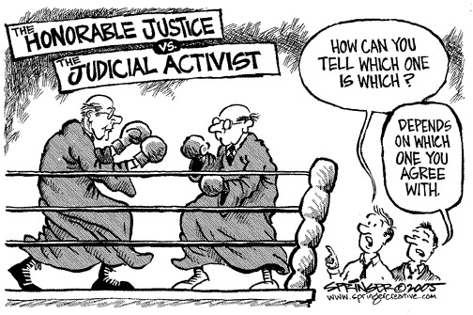

Slide 54
FACTORS THAT INFLUENCE SUPREME COURT DECISIONS
-- PUBLIC OPININON --
Public Opinion
The Constitution insulated SC justices from direct political pressures
Justices are appointed to serve life terms subject only to good behavior
The certiorari process enables the SC to set its own agenda
The public has limited access to Court proceedings. They meet behind closed doors to deliberate their decisions.
The Supreme Court is nonetheless aware of and sensitive to public opinion
The appointment and conﬁrmation processes keep the SC from deviating too far from public opinion
Congress and the state legislatures can amend the Constitution
Congress can change the SC’s appellate jurisdiction
Congress has the power to change the number of justices on the Court
Justices can be impeached
SC depends on the executive to carry out its decisions

Slide 55
LIMITING THE SUPREME COURT’S POWER - CONGRESS
Legislation impacting court jurisdiction
Article III of the Constitution left for the Congress to determine the distribution of federal jurisdiction within a system of federal courts and between the federal and state courts. Over the past two centuries, Congress has passed numerous statutes redeﬁning the jurisdiction of the federal courts within the limits set by the Constitution. Congress has gone so far as to eliminate a court’s jurisdiction to review a particular case during litigation.
Congressional legislation to modify the impact of prior Supreme Court decisions
Congress can show their dissatisfaction with Supreme Court interpretations of laws it passes by re-enacting the legislation to clarify its original intent and overrule a contrary Court decision. Congress will re-write the law to meet the SC criteria of legality.
Constitutional amendments
Congress can show their dissatisfaction with Supreme Court interpretations of laws it passes by proposing a constitutional amendment. Passing a constitutional amendment makes an issue “constitutional” and therefore overrule a contrary Court decision.
Judicial conﬁrmations
While the president nominates federal oﬃcials, the Senate has the ﬁnal say with conﬁrmation of those nominations. If the Senate is controlled by Republicans with a Democratic president, they would want the president to appoint judges who are closer to the middle.

Slide 56
FACTORS AFFECTING SELECTION OF FEDERAL JUDGES – CONGRESS POWER
Senatorial courtesy-applies to federal district courts
President will consult with the two Senators from the state in which they are to be appointed. The Senate will then show “courtesy” to those two senators by not conﬁrming judges to whom the two senators object (does not apply in the appointment of Supreme Court justices).
Senate Judiciary Committee- very important committee
Hold public hearings on each Supreme Court nominee, and sends a recommendation to Senate ﬂoor for approval or rejection
Senate
Simple majority vote needed for conﬁrmation

Slide 57
FACTORS AFFECTING SELECTION OF FEDERAL JUDGES – CONGRESS POWER
CONFIRMATION OF PRESIDENTIAL APPOINTEES- The Federal Courts
Senatorial courtesy a long-established practice: before President makes an appointment to a federal district court within a state, he will consult with the two senators of that state to get their approval of said nominee.
In general, senatorial courtesy only applies in cases where the appointee's job function and influence extend only over one particular state. So, if the president nominated a person to fill an open position in Ohio, and a U.S. Senator from Ohio was not in favor of that nomination, under senatorial courtesy, that nominee would not be approved by the rest of the Senate.
The philosophy behind senatorial courtesy is that the Senator from a particular state would have more extensive knowledge of the wishes of the people of his/her state and would be able to speak for them. There is no requirement that there must be a problem with the nominee; it is simply a courtesy to the senators from the impacted state that they may have a say in who is appointed to fill a position that directly impacts their constituents.
Although it is not in writing, as senatorial courtesy is strictly informal and customary, not a legally binding process, in practice, it is used only for appointments that impact one state rather than federal appointments. https://study.com/academy/lesson/what-is-senatorial-courtesy-definition-examples.html

Slide 58
2.11 Explain how other branches in the government can limit the Supreme Court’s power.
Restrictions on the Supreme Court are represented by:
The president and states delay, evade or ignore Supreme Court decisions
Judicial appointments

Slide 59
LIMITING THE SUPREME COURT’S POWER - PRESIDENT
The president and states evade delay or ignore Supreme Court decisions
The Supreme Courts majority opinion is oﬃcially known as “the opinion of the Court”. This means the majority opinion is the law of the land, but the Supreme Court has no ability to enforce this opinion. That responsibility falls on the president and the bureaucracy. If the president doesn’t take any action to enforce a law, then the opinion of the court is worthless.
In the Cherokee Indians case (1832), Andrew Jackson was infuriated by John Marshall and the Court’s ruling by insisting that Georgia laws that purported to seize Cherokee lands on which gold had been found violated federal treaties. Jackson is famous for having responded: "John Marshall has made his decision, now let him enforce it." Both Georgia and Jackson simply ignored the decision.

Slide 60
LIMITING THE SUPREME COURT’S POWER - PRESIDENT
Judicial appointments
The Constitution provides broad parameters for the judicial nomination process. It gives the responsibility for nominating federal judges and justices to the president. (It also requires nominations to be conﬁrmed by the Senate.)
More than 600 judges sit on district courts, almost 200 judges sit on courts of appeals, and 9 justices make up the Supreme Court. (Because all federal judges have life terms, no single president will make all of these appointments.)
Many vacancies do occur during a president's term of oﬃce.
The president is likely only to nominate justices who share his political ideology.
Pardon Pwr- President can nullify a federal court verdict by pardoning the defendant of all charges. Its as if no crime had been committed.

Slide 61
FACTORS AFFECTING SELECTION OF FEDERAL JUDGES
Political parties Existence of a “paper trail”
Judges are generally from the same political party as the President
If a prospective judge has written extensively, his writings may be used against him during conﬁrmation hearings
Age
Since judges have lifetime appointments, judges live on long afer the Presidents who appoint them die (presidential inﬂuence continues afer they leave oﬃce)
Diversity
Race (mostly white) and gender (mostly male)
Ideology of prospective judges
Presidents generally try to appoint people of similar philosophy (and judges may try to retire when there is a president with a similar ideology)
Number of judges
Congress can increase or decrease the number of courts and judges
Interest Groups
Tactics include protest demonstrations, appearances on TV and radio talk shows, media advertisements, editorials, and e-mails to senators
American Bar Association
Evaluates nominees (Senate Judiciary Committee considers ABA ratings)

Slide 62
FEDERAL ATTORNEYS
ATTORNEY GENERAL
Appointed by President with Senate consent
Head of Department of Justice- chief federal law enforcement officer
SOLICITOR GENERAL
Appointed by President with Senate consent
Represents U.S. government in Supreme Court
Decides which cases the federal government will appeal to the Supreme Court
Decides the federal government’s position in these cases
Sometimes called the “10th Justice” of the Supreme Court because of his/her inﬂuence there
U.S. ATTORNEYS
At least one for each District Court, 94 in all
Prosecutes federal cases, though most cases are settled by plea-bargaining
Appointed by the President for 4-year terms (key patronage positions)
Senatorial courtesy applies in their appointments

Slide 63
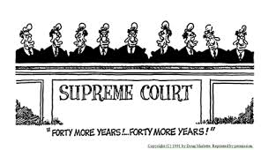
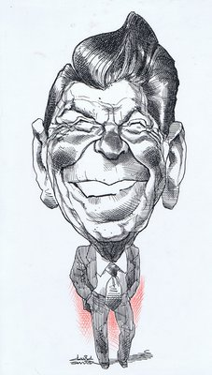
Which of the following best illustrates the point being made in the cartoon above?
(A) The influence of presidents on the Supreme Court is limited because the Senate often rejects their nominees.
(B) The terms of the Supreme Court justices should be reduced from their current forty years.
(C) Presidents can have an influence on public policy far beyond heir terms of office.
(D) The opinions of Supreme Court justices remain very similar over long periods of time.
(E) Supreme Court justice seldom issue dissenting opinions.

Slide 64
CHECKS ON THE JUDICIAL BRANCH
Executive checks on the Judicial Branch | Legislative Checks on the Judicial Branch
Presidential appointments for federal judgeships The manner in which a president or executive agency carries out judicial orders | The Senate Judiciary Committee reviews the president's judicial appointments. Sometimes nominees appear before the committee to answer senators questions about their experience or their views on the law. The practice of senatorial courtesy is often used with district Judge appointments, as districts are entirely within a given state. When vacancies occur, senators typically recommend judges to the White House. Federal judges who act criminally or perhaps unethically, can be impeached and removed . Impeachment has served as Congress check on judges life terms. Congress can write and pass new laws to clear up disputes or to better guide executive action.

Slide 65
FREE RESPONSE QUESTION Quantative Analysis
PRESIDENTIAL APPOINTMENTS TO THE FEDERAL JUDICIARY BY SELECTED DEMOGRAPHIC CHARACTERISTICS, 2000-2011 (IN PERCENT)
President | African American | Hispanic | Asian American | White | Women | Men
Barack Obama | 22% | 11% | 8% | 59% | 46% | 54%
George W. Bush | 7% | 9% | 1% | 82% | 22% | 78%
Presidents consider many factors when nominating candidates to the federal courts, and getting their nominees confirmed is often difficult.
Using the chart above, describe ONE similarity between President Barack Obama’s judicial appointments and those made by President George W. Bush.
Using the chart above, describe TWO differences between President Barack Obama’s judicial appointments and those made by President George W. Bush.
Explain why a president’s party affiliation accounts for differences in presidential appointments to the judiciary.
Describe one way a president can increase the chances of having judicial nominations to federal courts confirmed.

Slide 66
FREE RESPONSE RUBRIC
PART (A): 1 POINT
One point is earned for a correct description of a similarity between President Barack Obama’s judicial appointments and those made by President George W. Bush. Possible responses include:
In both cases more than half the appointees were white. President Obama’s appointees were 59 percent white, while President Bush’s appointees were 82 percent white.
In both cases the number of Hispanic nominees is roughly similar, within two percentage points.
In both cases Asian Americans were the lowest demographic nominated, both under 10 percent.
PART (B): 2 POINTS
One point is earned for each of two correct descriptions of a difference between President Barack Obama’s judicial appointments and those made by President George W. Bush. Possible responses include:
Obama appointed a significantly greater percentage of women than did Bush. President Obama’s appointees were 46 percent women, while President Bush’s appointees were 22 percent women.
Obama was more likely to appoint racial minority candidates than was Bush; for example, 22 percent of President Obama’s appointees were African American, as opposed to 7 percent of President Bush’s appointees.
Obama appointed more than Bush in any single minority category, appointing a higher percentage of African Americans, Hispanics, and Asian Americans.
PART (C): 1 POINT
One point is earned for a correct explanation of why a president’s party affiliation accounts for differences in presidential appointments to the judiciary. Possible responses include:
President chooses nominees with similar views who will rule in a manner consistent with the President’s policy preferences — party ID is a rough indicator.
President chooses nominees that cater to his party’s electoral coalition, which will help his party win future elections.
PART (D): 1 POINT
One point is earned for a correct description of a way that a president can increase the chances of having judicial nominations confirmed. Possible responses include:
Consulting with the Senate/using senatorial courtesy
Choosing a moderate
Properly vetting candidates/selecting qualified candidates

