Slide 1
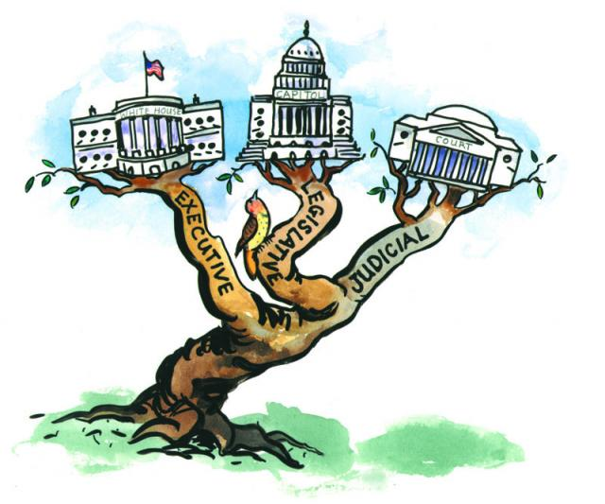
UNIT 2 Interactions Among Branches of Government
AMSCO Chpt. 4 pg. 100-07
Wapples pg. 190-219
Required Document:
The Constitution
Congress: Senate & House of Rep Topic 2.1

Slide 2
TOPIC 2.1 Congress: The Senate and the House of Representatives
The republican ideal in the U.S. is manifested in the structure and operation of the legislative branch.
Describe the different structures, powers, and functions of each house of Congress.
Republicanism, the democratic principle that the will of the people is reflected in government debates and decisions by their representatives, is shown in the bicameral structure of Congress. The Senate is designed to represent states equally, while the House is designed to represent the people.
Different membership sizes influence the formality of debate in each chamber. Debate
in the House, which has 435 members, is more formal than in the Senate, with 100 members.
Interactions in Congress are affected by the two-party system and term-length differences.
One-third of the Senate is elected every two years, creating a continuous legislative body.
All House members are elected every two years
The enumerated and implied powers in the Constitution allow Congress to participate in the public policy process by:
i. Passing a federal budget, raising revenue by laying and collecting taxes, borrowing money, and coining money
ii. Declaring war and providing the funds necessary to maintain the armed forces

Slide 3
TOPIC 2.1 Congress: The Senate and the House of Representatives
The republican ideal in the U.S. is manifested in the structure and operation of the legislative branch.
Describe the different structures, powers, and functions of each house of Congress.
Republicanism, the democratic principle that the will of the people is reflected in government debates and decisions by their representatives, is shown in the bicameral structure of Congress. The Senate is designed to represent states equally, while the House is designed to represent the people.
iii. Determining the process for naturalization by which people can become citizens of
the U.S.
iv. Regulating interstate commerce
v. Creating federal courts and their jurisdictions
vi. Enacting legislation under the authority of the necessary and proper clause
vii. Conducting oversight of the executive branch, including federal agencies in the bureaucracy
REQUIRED FOUNDATIONAL DOCUMENT
The Constitution of the United States

Slide 4
TOPIC 2.1 Congress: The Senate and the House of Representatives
The republican ideal in the U.S. is manifested in the structure and operation of the legislative branch.
The Senate is designed to represent states equally, while the House is designed to represent the population.
Describe the different structures, powers, and functions of each house of Congress.
Different chamber sizes and constituencies influence formality of debate
Coalitions in Congress are affected by term-length differences
The enumerated and implied powers in the Constitution allow the creation of public policy by Congress, which includes:
Passing a federal budget, raising revenue, and coining money
Declaring war and maintaining the armed forces
Enacting legislation that addresses a wide range of economic, environmental, and social issues based on the necessary and proper clause
Pork barrel legislation and logrolling affect the lawmaking in both chambers
REQUIRED FOUNDATIONAL DOCUMENT
The Constitution of the United States

Slide 5
2.1 Congress: The Senate and the House of Representatives
Describe the different structures, powers, and functions of each house of Congress.
Explain how republican ideal in the U.S. is manifested in the structure and operation of the legislative branch.

Slide 6
Fear of excessive power concentrated in single institution
Fear of mob rule by impassioned majority
Concern about manner of representation in Congress
Belief that Congress would be the dominant branch of government and its power had to be limited. But how?
Solution: bicameral legislature
Mob rule concern addressed by creation of "upper house" in which senators would be selected by state legislatures rather than the people, and which would check the passions of the people's representatives in the House.
Representation concern settled by a Senate w/equal representation and a House with representation based upon population.
4

Slide 7
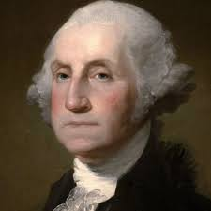
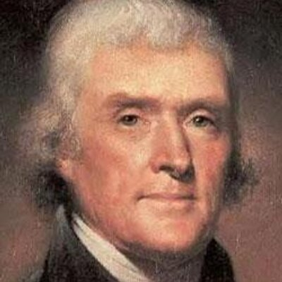
Structure of Congress: Bicameral Legislature
The story of the "senatorial saucer" is based on a supposed breakfast meeting between Thomas Jefferson and George Washington. In 1872, Moncure Daniel Conway told the story as follows:
There is a tradition that Jefferson coming home from France, called Washington to account at the breakfast-table for having agreed to a second, and, as Jefferson thought, unnecessary legislative Chamber.
"Why," asked Washington, "did you just now pour that coffee into your saucer, before drinking?"
"To cool it," answered Jefferson, "my throat is not made of brass."
"Even so," rejoined Washington, "we pour our legislation into the senatorial saucer to cool it."

Slide 8
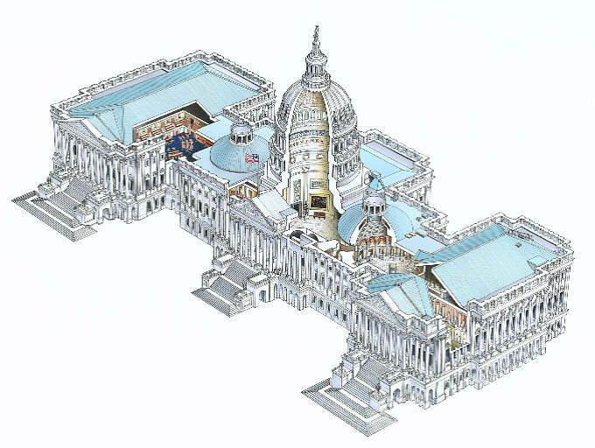
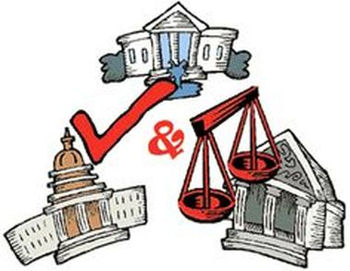
BICAMERALISM = TWO-HOUSE LEGISLATURE
The Congress: Bi-Cameral
Purpose of Bicameralism
To protect against an overly powerful legislature
House of Reps was expected to reflect popular will of average citizen
Senate was to provide more stability, continuity, and in-depth deliberation
Acts as a moderating effect on partisanship, and prevents government from steamrolling ahead and infringing on people’s rights
Part of the Connecticut (Great) Compromise at the Const. Convention
The Senate
The House of Representatives

Slide 9
Bicameral Legislature
The framers of the Constitution created the United States Senate to protect the rights of individual states and safeguard minority opinion in a system of government designed to give greater power to the national government. They modeled the Senate on governors' councils of the colonial era and on the state senates that had evolved since independence. The framers intended the Senate to be an independent body of responsible citizens who would share power with the president and the House of Representatives. James Madison, paraphrasing Edmund Randolph, explained in his notes that the Senate's role was "first to protect the people against their rulers [and] secondly to protect the people against the transient impressions into which they themselves might be led.“
They also built into the Constitution a series of cooling mechanisms intended to inhibit the formulation of passionate factions, to ensure that reasonable majorities would prevail.

Slide 10
House of Rep’s was designed to be closer to the people/ more responsive to the people:
Senate was designed to be more removed from the people:
Members elected directly by the people. Members are elected from smaller districts rather than on an at large basis, like the Senate
Members elected for only a two-year term
Entire body elected every two years
Revenue bills (tax bills) must originate in the House
Members originally were indirectly elected by state legislatures (until the 17th Amendment, 1913)
Members elected on an at-large basis by the entire state
Members elected for a six-year term
Only 1/3 of Senate is up for reelection every two years – more stability/continuity (staggered terms)
Consequences of a bicameral legislature
Gridlock – designed to be slowed down
Compromise between houses (especially if controlled by different parties-divided government) very difficult
Additional checks and balances
6

Slide 11
OVERVIEW OF CONGRESS: TERMS AND MEMBERSHIP
TERMS
Term of Congress lasts two years
Terms begin on Jan. 3 of every odd-numbered year and it is divided into two one year sessions.
Terms numbered consecutively (116th Congress from 2019-2021, 117th from 2021-2023)
Adjournment: End of a term; date must be agreed upon by both houses. Two regular sessions per term. Periodic recesses (not to be confused w/adjournment).
MEMBERSHIP
Over-representation of white, male, Protestant, upper-middle class lawyers in their 50's ---> charges of conservative/status quo bias.
Rebuttals:
Many more women and minorities have been elected in recent years.
Perfectly possible for white, male, Protestant, upper-middle class lawyers in their 50's to represent the poor and afflicted.
In any case, the people themselves are the ones who elected members
CONGRESS

Slide 12
Constitutional /Formal Requirements for Membership
Differences between House and Senate

Slide 13
CONGRESSIONAL SIZE
HOUSE OF REPS
SENATE
Determined by Congress – 435 members since 1911. Can be changed by new congressional law.
Members elected by districts, not states.
Number of reps per state is determined by population.
Demographic trends show increase in Sun Belt state representation (e.g., 53 reps in CA, 36 in TX), decrease in Frost Belt representation.
100 members, chosen in statewide elections (“at large”). With a smaller size, the Senate has been a more informal body with less need than the House for as many strict procedures/rules.
Two members from every state – established in Constitution. ALL states are EQUAL in the Senate
13

Slide 14
CONGRESSIONAL TERMS OF OFFICE
SENATE
HOUSE OF REPS
Terms of office
– Six years. 1/3 up for reelection every two years.
Terms of office are fixed
Two years. Entire body up for reelection every two years -- A more "responsive" (and potentially "radical") body to be kept in check by the Senate.
Term limits passed by some states, but ruled unconstitutional by Supreme Court (US Term Limits v. Thornton, 1995).
Qualifications
25 years of age
Citizenship for 7 years
Residency in state
Staggering of terms ensures a more stable body
No term limits allowed here, either
Qualifications
30 years of age
Citizenship for 9 years
Only one-third of senators are elected every two years (two-thirds of the senators remain current members). Therefore, the Senate is a “continuous body.”
– Residency in state

Slide 15
CONGRESSIONAL RULES FOR DEBATE
CONGRESSIONAL RULES FOR DEBATE
HOUSE OF REPS
SENATE
SENATE
Speaker of the House exerts great control. The Speaker is in charge of the calendar (what bills are debated and when that occurs) and influences the House Rules Committee in deciding the legislation to be considered.
o Because of the vast power wielded by the Rules Committee, its ratio has traditionally been weighted in favor of the majority party
If each voting member spoke for 15 minutes, to be followed immediately by another speaker, nearly 109 hours of time would be required. That translates into eleven ten-hour days of non-stop speeches. Debate is important when considering contentious issues.
Nevertheless, given the reality of our large House, members often choose knowledgeable colleagues who represent a point of view supported by others to speak on their behalf.
With a smaller size, the Senate has been a more informal body with less need than the House for as many strict procedures.

Slide 16
How do term-length differences affect coalitions in Congress? Coalition: A group that works together temporarily in a partnership to achieve a common goal.
HOUSE OF REPS
SENATE
Two-year term
Represent a single district
Doesn’t stray too far from the people. Why? Because of the 2 year term. They want to be re-elected.
Six-year term
Represent entire state
Your election cycle determines how you might vote on an issue. Why?

Slide 17
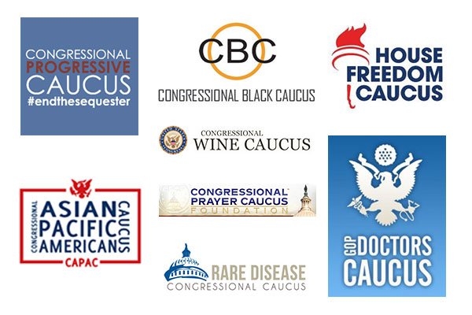
What are Caucuses?
Nongovernmental groups of like-minded people organized into
groups. These groups usually unite around a particular belief. Each party has a group in each house--the Democratic Caucus or the Republican Party Conference----which includes basically the entire party membership within that house. Meant to represent the underrepresented.
CONGRESSIONAL CAUCUSES
e.g., Black caucus, Hispanic caucus, blue collar caucus, women's caucus
https://blog.acton.org/archives/92839-explainer-what-you-should-know-about-congressional-caucuses.html

Slide 18
POWERS OF CONGRESS
EXPRESSED OR ENUMERATED POWERS - Spelled out in the Constitution
Levy taxes (revenue bills must begin in House)
Spend money for common defense and public welfare
Borrow money
Regulate foreign, INTERSTATE, Indian commerce. This clause has been tested frequently in the courts due to its broad interpretation by Congress.
Establish naturalization and bankruptcy laws
Coin money
Establish weights and measures
Punish counterfeiters
Establish post offices
Grant copyrights and patents
Create courts inferior to Supreme Court
Define and punish piracy
Declare war
Raise and support an army and navy
IMPLIED POWERS - Powers
suggested, but not expressed, in the Constitution
Based upon elastic clause (necessary and
proper clause)
Must come from expressed power
Examples: national bank, conscription, paper money, air force, CIA
Strict v. loose constructionist approaches

Slide 19
ENUMERATED POWERS/ Listed Powers
The enumerated powers [Article I section 8] and implied powers in the Constitution allow the creation of public policy by Congress. Be able to describe each of the following:
–Passing a federal budget
–Raising revenue
–Coining money
–Declaring war and maintaining armed forces
Enacting legislation that addresses a wide range of issues based on the necessary and proper clause.
–Economic
–Environmental
–Social

Slide 20
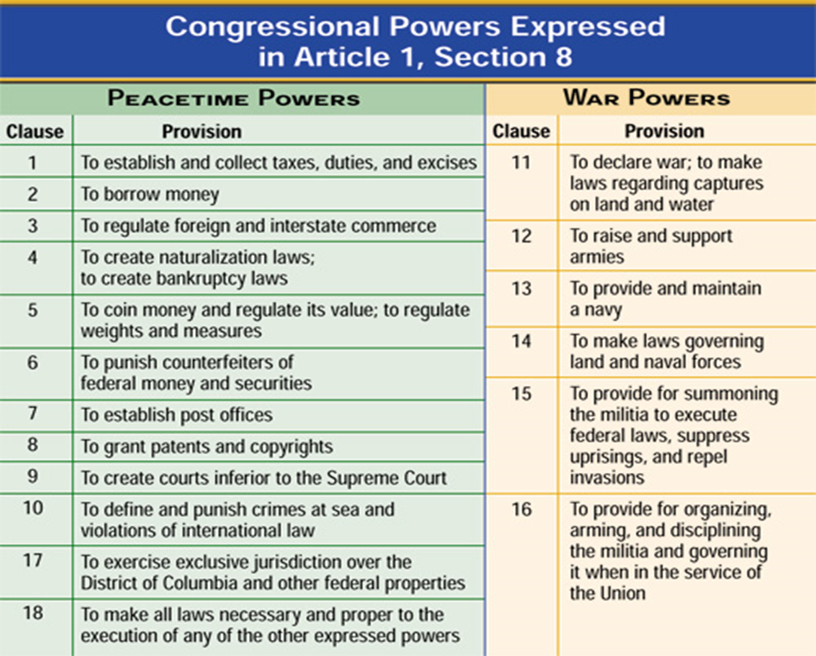
ENUMERATED or LISTED Powers of Congress
Sometimes referred to as the EXPRESSED POWERS

Slide 21
Powers of Congress ENUMERATED or LISTED
Sometimes referred to as the EXPRESSED POWERS
1. POWER OF THE PURSE
1.
2.
Article I also provides that no money can be drawn from the treasury without the approval of Congress. Congress appropriates, or allots, the public money it raises through taxes.

Slide 22
Powers of Congress ENUMERATED or LISTED
Regulating Commerce: Article 1, Section 8, Clause 3
2. COMMERCE CLAUSE
Congress also has the power "to regulate commerce among the states, with other nations, and with Indian tribes."
1824 Gibbons v. Ogden-solidified the power of Congress to regulate interstate commerce
1964 Civil Rights Congress's authority over commerce
1964 Heart of Atlanta Motel, Inc. v. United States
United States v. Lopez (1990)
Congress has written laws that apply to manufacturing and chemical plants to control the emissions these facilities might spew into the air.
Clean Air Act of 1970 (1970 CAA) resulted in a major shift in the federal government's role in air pollution control. This legislation authorized the development of comprehensive federal and state regulations to limit emissions from both stationary (industrial) sources and mobile sources.

Slide 23
Powers of Congress ENUMERATED or LISTED
Foreign and Military Powers
3. Foreign and Military Powers of Congress
power to declare war.
Funds (power of the purse) military, foreign endeavors, and foreign aid.
The Senate must approve appointed ambassadors and high-ranking military personnel.
The Senate must ratify treaties with other nations by a two-thirds vote.
Congress has oversight of the State and Defense Departments and relevant agencies.
Congress can institute a mandatory military draft (conscription) to staff the Armed Forces.
The President
The president is commander in chief of the Armed Forces.
The president appoints ambassadors and receives foreign ministers.
The president negotiates treaties with other nations.
The president issues executive orders that can impact foreign policy.
The president makes executive agreements with other heads of state.
The president commissions the military officers of the United States.
1973 War Powers Act

Slide 24
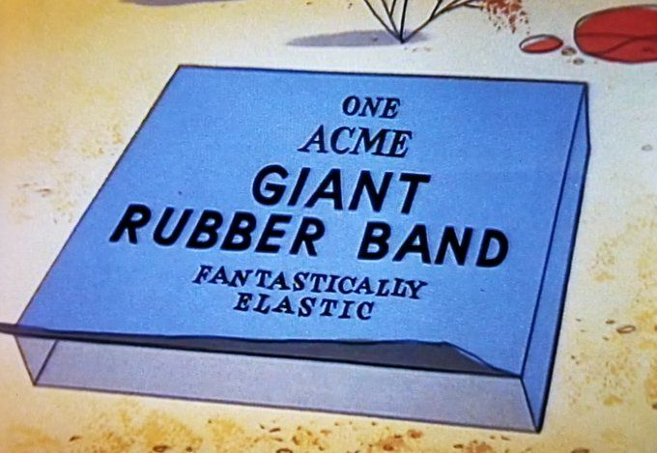
Powers of Congress: The Implied Powers
Necessary and Proper Clause
4. Implied Powers Elastic Clause
At the end of the list of enumerated powers in Article I is the necessary and proper clause. It gives Congress the power "to make all Laws which shall be necessary and proper for carrying into Execution the foregoing Powers.“ Also called the elastic clause, it implies that the national legislature can make additional laws intended to take care of the items in the enumerated list.
McCulloch v. Maryland in 1819 the Supreme Court ruled Congress could establish a bank. The Supreme Court ruled that the enumerated list implied that Congress could create a bank. Since then, the implied powers doctrine has given Congress authority to enact legislation addressing a wide range of issues-economic, social, and environmental.

Slide 25
NECESSARY AND PROPER CLAUSE
THE IMPLIED POWERS
Under Article I, Section 8 of the Constitution
–Congress has the power "to make all Laws which shall be necessary and proper for carrying into Execution the foregoing Powers, and all other Powers vested by this Constitution in the Government of the United States, or any Department or Officer thereof".

Slide 26
EXPRESSED
POWER
IMPLIED
POWER
To punish tax evaders
To collect taxes
To establish an IRS- tax collectors
The Necessary and Proper Clause allows the national government to stretch the meaning of the expressed powers to create laws that are necessary and proper for the good of America.

Slide 27
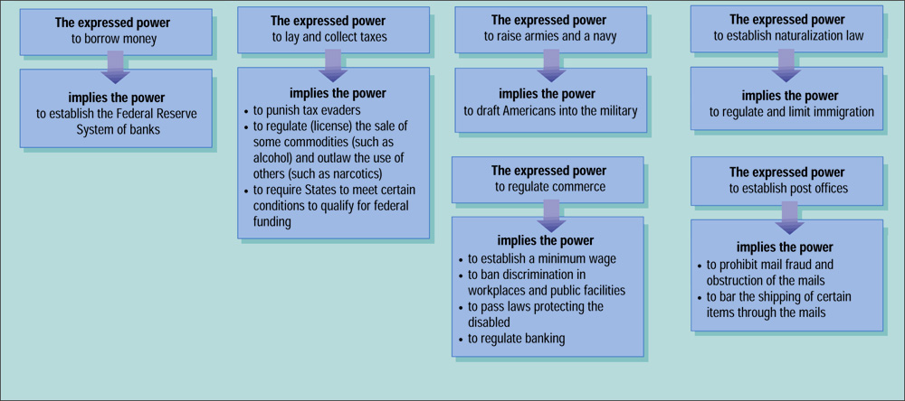
IMPLIED POWERS or NECESSARY AND PROPER
Implied powers are derived from the expressed powers

Slide 28
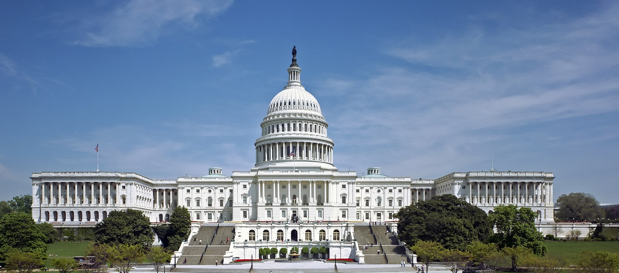
Differing Powers of the House and Senate
Describe the different structures, powers, and functions of each house of Congress AMSCO pg. 100-107.
Senate
House of Representatives
Introduce bills- proposed laws
Provides advice and consent on treaties and
Presidential appointments
The Senate holds the impeachment trial
Elects VP if no one wins 270 votes in elect. College
Introduce bills- proposed laws
Originates Revenue Bills
The House can impeach officials
Determines who will be President if no
one wins 270 votes in Electoral College
Differing Structures of the House and Senate
Senate
House of Representatives
Less centralized
Committees do not have as much authority
Looser debate (filibusters allowed but limited by cloture vote)
Leaders less powerful except for the powerful majority leader
Centralized and hierarchical
Rules committee (majority party controls agenda)
Limited debate time
Powerful speaker of the house
Focuses on revenue and spending (power of the purse)

Slide 29
POWERS DENIED TO CONGRESS
Passing ex post facto laws-A law that makes an action a crime even though it was legal when it was committed or increases the penalty for a crime after it has been committed. Under the Constitution, neither the states nor Congress can pass such a law.
Passing bills of attainder- A law that makes a person guilty of a crime without a trial. Neither Congress nor the states can enact such a law under the Constitution.
Suspending habeas corpus except in cases of rebellion or invasion
habeas corpus- A court order directing authorities to show cause for why a person under detention should not be released.
29

Slide 30
END

Slide 31
Pork barrel legislation and logrolling affect the lawmaking in both chambers
PORK BARREL
Metaphor for the appropriation of government spending for localized projects secured solely or primarily to bring money to a representative's district. AKA earmarks
LOGROLLING
Arrangement in which two or more members of Congress agree in advance to support each other's bills. AKA reciprocity

Slide 32
ESSENTIAL QUESTION CFU
Why is the Senate seen as a more informal body when it comes to debate? In other words, why does the House have more rules and formality when it comes to debate?

Slide 33
LEARNING OBJECTIVE
The enumerated and implied powers in the Constitution allow the
creation of public policy by Congress, which includes:
Passing a federal budget, raising revenue, and coining money
Declaring war and maintaining the armed forces
Enacting legislation that addresses a wide range of economic, environmental, and social issues based on the Necessary and Proper Clause

Slide 34
ESSENTIAL QUESTION CFU
How has the necessary and proper clause allowed the federal government to expand their powers?

Slide 35
LEARNING OBJECTIVE
5) Pork barrel legislation and logrolling affect the lawmaking in both chambers

Slide 36
Ready are you? What know you of ready? For eight hundred years have I trained Jedi. My own counsel will I keep on who is to be trained. A Jedi must have the deepest commitment, the most serious mind. This one a long time have I watched. All his life has he looked
away… to the future, to the horizon. Never his mind on where he was. Hmm? What he was doing. Hmph. Adventure. Heh. Excitement. Heh. A Jedi craves not these things. A Jedi craves to learn and pass the AP test. You are ready. What are the 3 most important ideas from this lesson?

