Slide 1
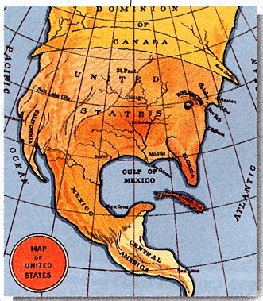
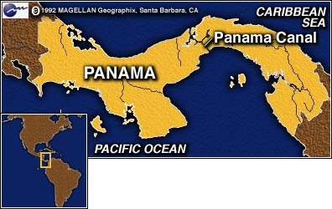
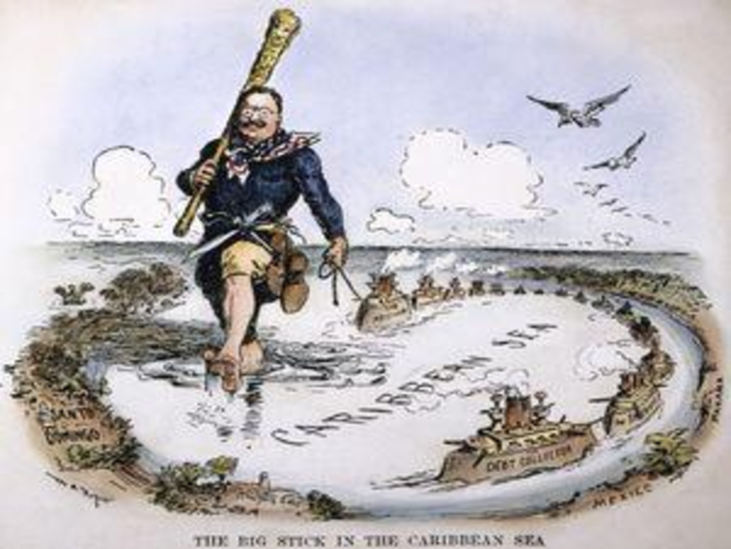
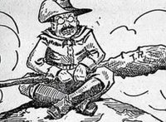
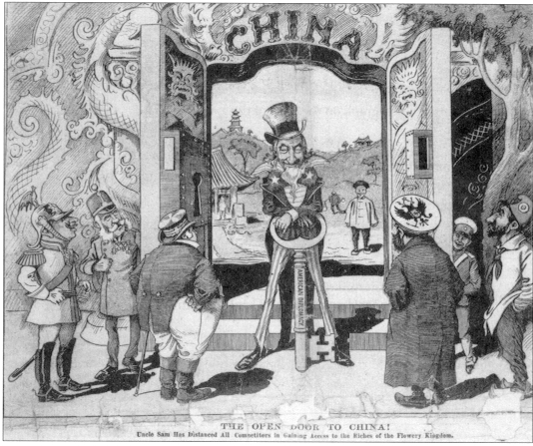

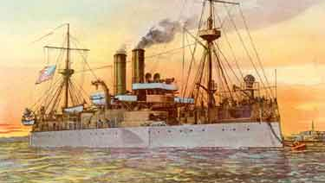
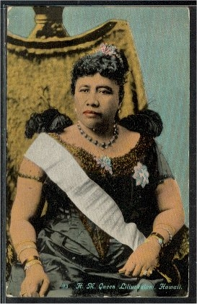
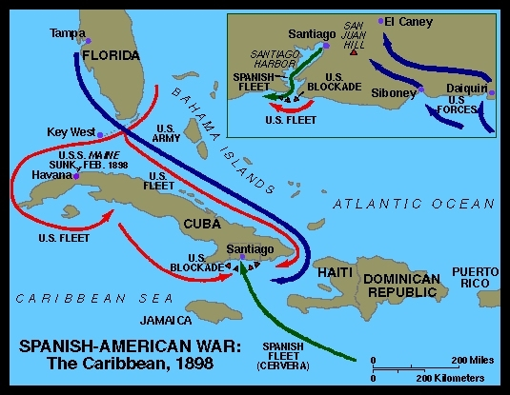
America Builds an Empire
Chpt. 8

Slide 2
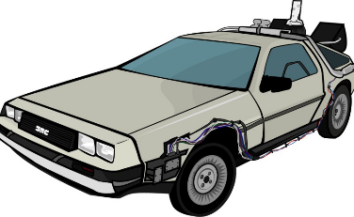
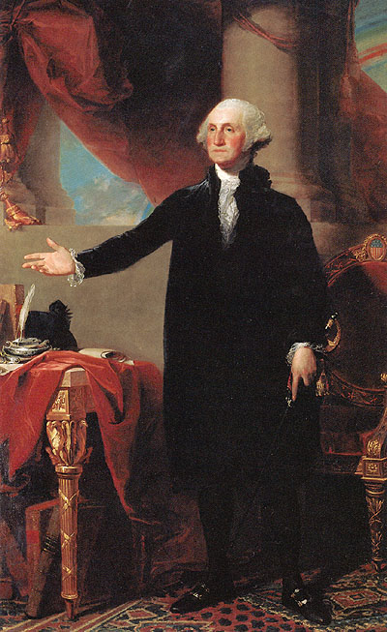

Isolationism vs. Interventionism
George Washington & America’s Early Isolationism
Proclamation of Neutrality
    Established U.S. neutrality in European affairs
  Farewell Address
    Final advice to the nation to maintain commercial, but not political ties to other nations (Europe)
    No military alliances

Slide 3
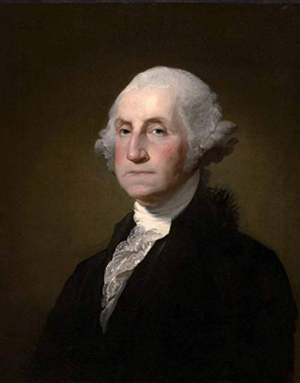
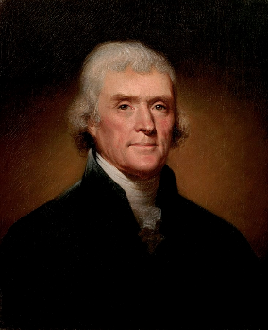
Some Famous Things They Didn’t Say!
“Entangling alliances”
A phrase often incorrectly said to come from George Washington’s Farewell Address. Washington warned not against “entangling” alliances but against both “passionate attachments” and “inveterate antipathies” to particular foreign countries.
It was Thomas Jefferson who said, in his first Inaugural, “peace, commerce, and honest friendship with all nations, entangling alliances with none.”

Slide 4
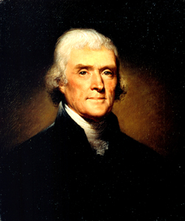
Thomas Jefferson
Louisiana Purchase
Jefferson bought the Louisiana Territory from France in 1803 for $15 million. This doubled the size of the U.S. which now stretched from the East Coast to the Rocky Mountains.

Slide 5
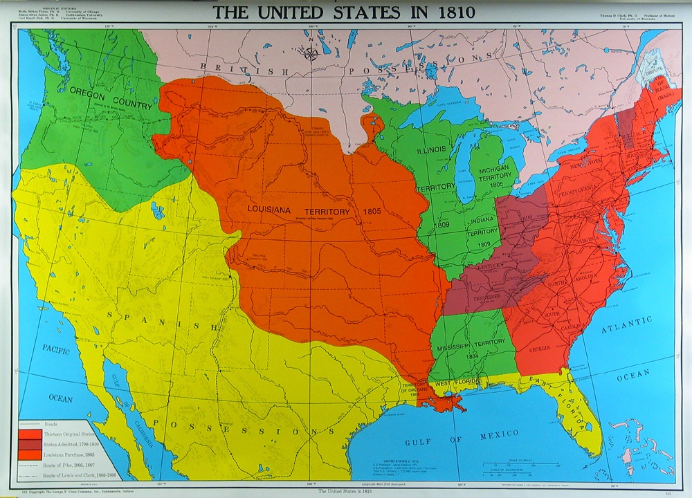
THE U.S. AFTER THE LOUISIANA PURCHASE
British Possessions
Oregon Country
Louisiana Territory
United States
Spanish Possessions

Slide 6
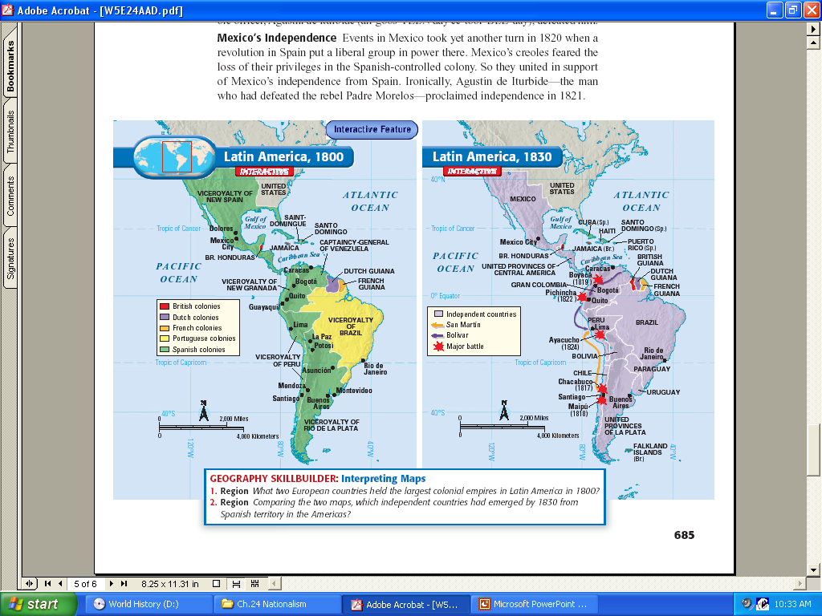
Latin American Revolutions

Slide 7
European influence in the Western Hemisphere

Slide 8
European influence in the Western Hemisphere removed to a large degree after the revolutions.
Latin America drew inspiration for their revolutions from the US revolution

Slide 9
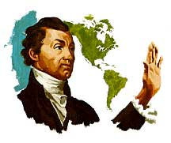
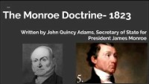
The Monroe Doctrine

Slide 10
James Monroe – 5th President (1817-1825)
Monroe Doctrine (1823)
Background > The European alliance of France, Russia, Prussia (Germany) and Austria was considering an attempt to reclaim as colonies Latin American states that recently gained their independence with a war with their former Mother Country: Spain.
With strong advice from Secretary of State John Quincy Adams, President Monroe addressed Congress with a statement of foreign policy that came to be known as the Monroe Doctrine
Declarations of the Monroe Doctrine:
UK agreed to the Monroe Doctrine
1) The American continent was no longer open to colonization by European nations.
2) The United States would not interfere in European affairs.
3) An act of intervention by a European power in the affairs of a country in the Western Hemisphere would be considered an act against the United States

Slide 11
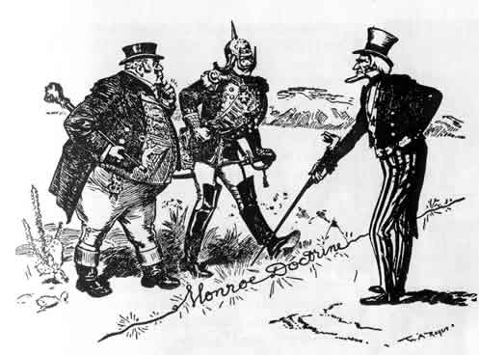

Slide 12
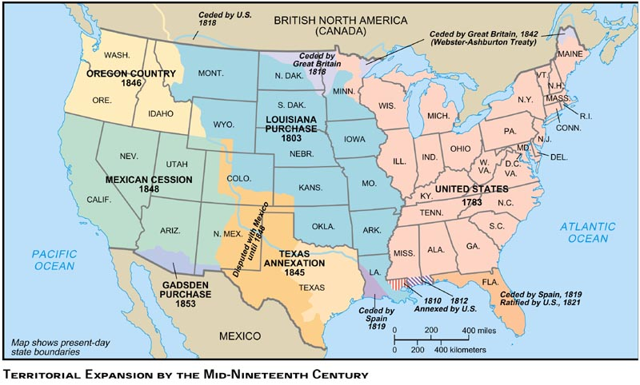
Manifest Destiny

Slide 13
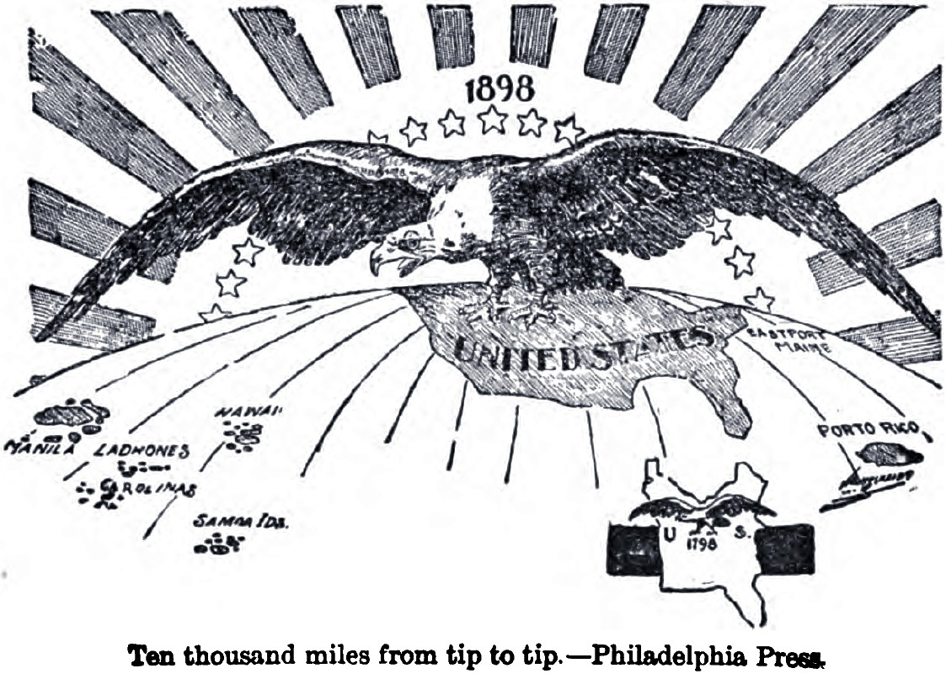
Forms of Imperialism
IMPERIALISM - economic and political domination of a strong nation over weaker ones
Leads to COLONILISM-the policy or practice of acquiring full or partial political control over another country, occupying it with settlers, and exploiting it economically for its natural resources
Protectorate-a country that is technically independent but is actually under the control of another country

Slide 14
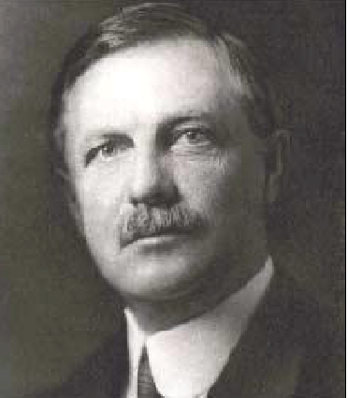
The Frontier Thesis (1893)
Frederick Jackson Turner: The Significance of the Frontier in American History, 1893
By the middle of the 1890's the American western frontier was viewed by many as being "closed”.
America’s unique development rooted in the frontier past vast expanse of “free” land reaching the Pacific meant looking overseas for the new “frontier”.
This was seen as the fulfillment of the westward expansions started under the banner of "manifest destiny".

Slide 15
“[W]e have in [United States history] a recurrence of the process of evolution in each western area reached in the process of expansion. Thus American development has exhibited not merely advance along a single line, but a return to primitive conditions on a continually advancing frontier line, and a new development for that area. American social development has been continually beginning over again on the frontier. This perennial rebirth, this fluidity of American life, this expansion westward with its new opportunities, its continuous touch with the simplicity of primitive society, furnish the forces dominating American character. The true point of view in the history of this nation is not the Atlantic coast, it is the Great West. . . . In this advance, the frontier is the outer edge of the wave—the meeting point between savagery and civilization.”
-Frederick Jackson Turner, historian, “The Significance of the Frontier in American History,” 1893

Slide 16
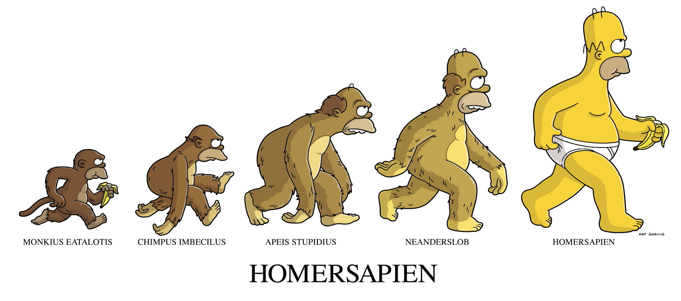
Manifest Destiny to Social Darwinism
The public perception of the "closing of the west", along with the philosophy of Social Darwinism, contributed to a desire for continued expansion of American lands and the spreading of American culture.
The result was a shift in US foreign policy at the end of the 19th century from a reserved, homeland concerned republic to an active imperial power.

Slide 17
The closing of the frontier by 1900 (manifest destiny) and the growth of industry in the late 1800s are two factors often associated with the rise of United States imperialism
A Diversity of Experience
The settlement of the West was a multicultural affair. You had English speaking Americans,
Germans, Scandinavians, African American Freedmen, Spanish Speaking Mexicans, Chinese, Japanese, Irish. It was the most diverse population of the USA.
Closing of the Frontier
The Growth of Industry
Rise Of U.S. Imperialism

Slide 18
Imperialism
Colonialism
Under the control of a superior power
"American imperialism" is a term that refers to the economic, military, and cultural influence of the United States internationally.

Slide 19
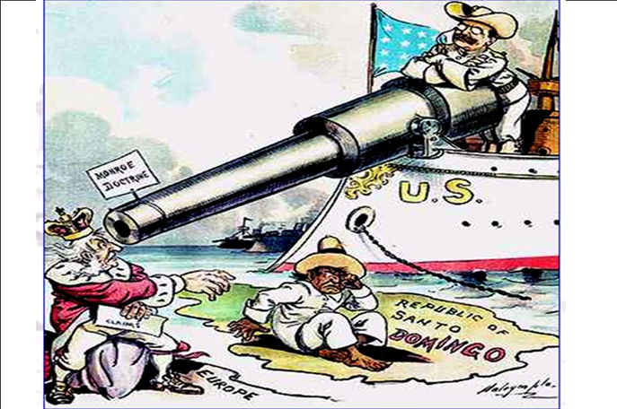
Forms of Imperialism
Sphere of Influence- a country or area in which another country has power to affect developments although it has no formal authority.
Territory- an area of land under the jurisdiction of a ruler or state (country).
Associate State- a nation with limited sovereignty, especially a former colony that now assumes responsibility for domestic affairs but continues to depend on the colonial ruler for defense and foreign policy. Ex. USA and Puerto Rico
Annexation-is the political transition of land from the control of one entity to another. A take over of territory
Hegemony- political, economic, and military predominance of one state over other states.
Protectorate-a country that is technically independent but is actually under the control of another country
Territory- an area of land under the jurisdiction of a ruler or state (country).
Notes:
This is another option for an Overview slides using transitions.

Slide 20
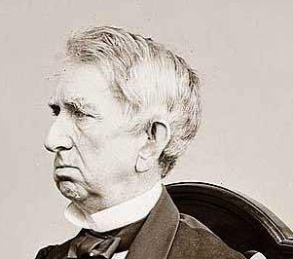

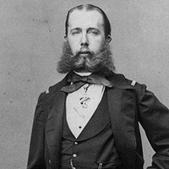
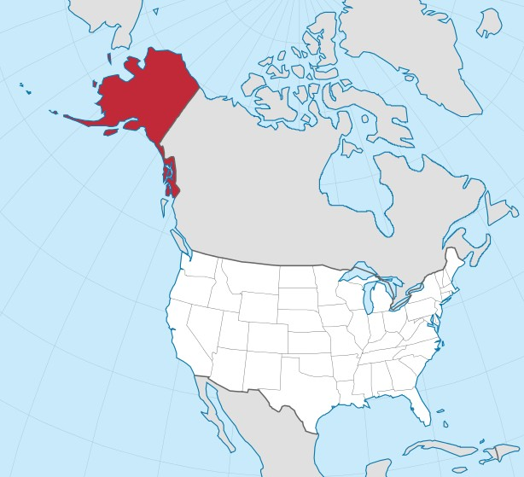
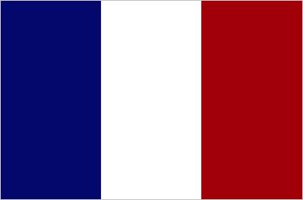
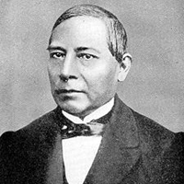
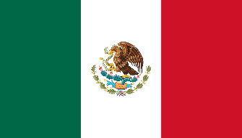
Seward, Alaska and The French in Mexico
Secretary of State Seward
Maximilian of Habsburg, Archduke of Austria, Emperor of Mexico
President of Mexico
Benito Juárez
Notes:
March 30, 1867

Slide 21
Alaska
Sect. of State William Seward arranged for the US to buy Alaska from the Russians for $7.2 million in 1867
Critics called it Seward’s Folly or Seward’s ice box.
When gold was discovered in Alaska in
the Klondike in 1896 the critics fell silent.
Later, diamonds and oil would be
discovered. Today Alaskan oil fuels the
western USA. Alaska became the 49th state in 1959.
Secretary of State Seward
Notes:
March 30, 1867
Alaska, originally knows as “Seward's folly” became a state in 1959, and later proved to be a land rich in timber, minerals and also oil.

Slide 22
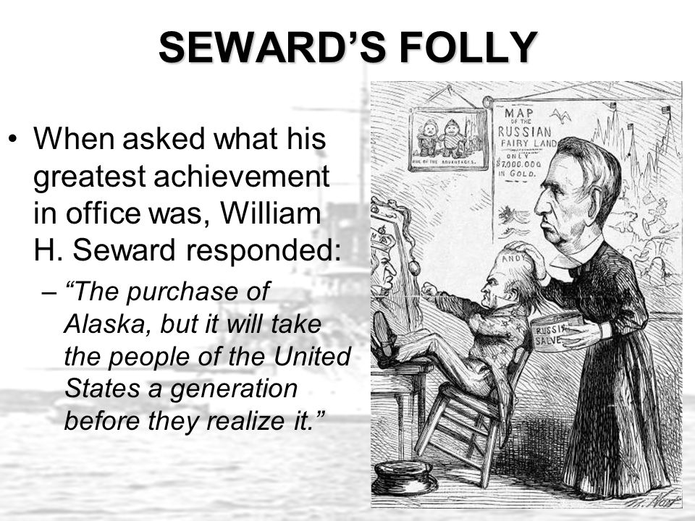

Slide 23
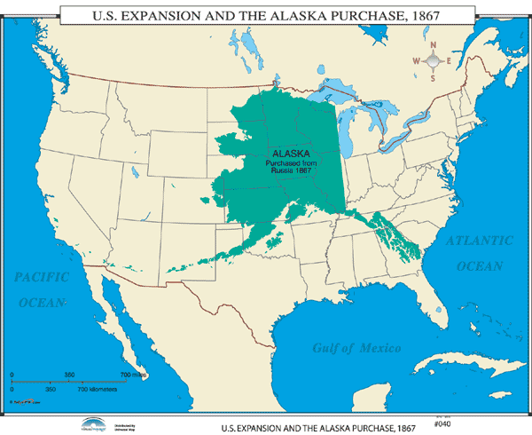

Slide 24
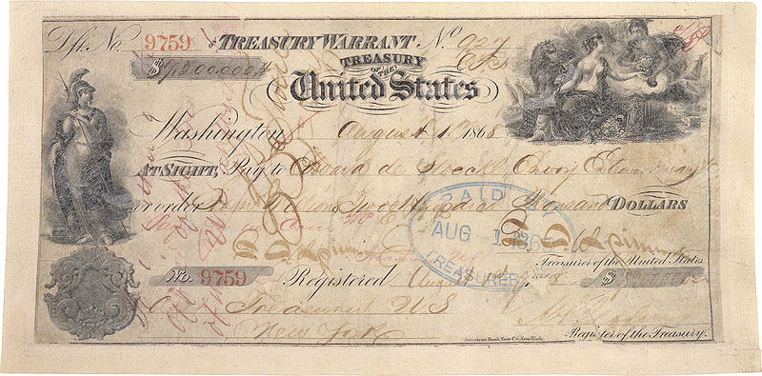
The original check used to pay for Alaska, worth $7.2 million

Slide 25
The French in Mexico
Napoleon III (nephew of the famous emperor Napoleon Bonaparte) had taken advantage of U.S. involvement in the Civil War by sending French troops to occupy Mexico. As soon as the Civil War ended in 1865, Seward invoked the Monroe Doctrine and threatened U.S. military action unless the French withdrew. Napoleon III backed down, and the French troops left Mexico in 1867.
Maximilian of Habsburg, Archduke of Austria, Emperor of Mexico
Cinco de Mayo, or the fifth of May, is a holiday that celebrates the date of the Mexican army’s 1862 victory over France at the Battle of Puebla during the Franco-Mexican War. The French left Mexico in 1867.
Benito Juárez

Slide 26
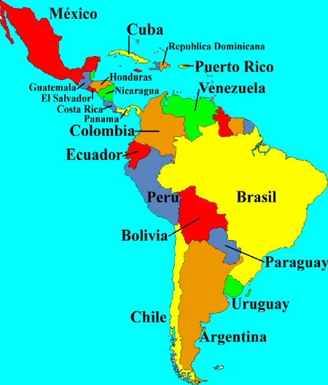
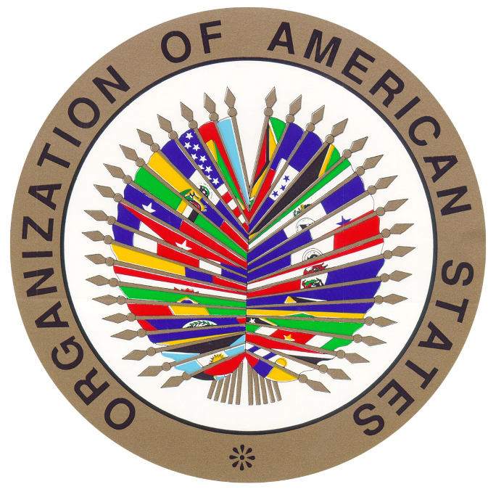
Latin America BIG SISTER DIPLOMACY James G. Blaine, Sect of State
Beginning with the Monroe Doctrine in the 1820s, the United States had taken a special interest in problems of the Western Hemisphere and had assumed the role of protector of Latin America from European ambitions. Benjamin Harrison's Secretary of State James G. Blaine of Maine played a principal role in extending this tradition
Blaine and the Pan-American Conference (1889) Blaine's repeated efforts to establish closer ties between the United States and its southern neighbors bore fruit in 1889 with the meeting of the first Pan-American Conference in Washington. Representatives from various nations of the Western Hemisphere decided to create a permanent organization for international cooperation on trade and other issues. Blaine had hoped to bring about reductions in tariff rates. Although this goal was not achieved, the foundation was established for the larger goal of hemispheric cooperation on both economic and political issues. The Pan-American Union continues today as part of the Organization of American States, which was established in 1948.

Slide 27
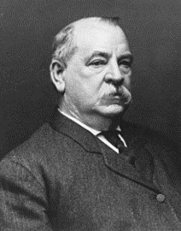
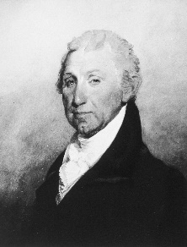
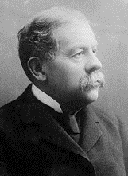
Cleveland, Olney, and the Monroe Doctrine
One of the most important uses of the Monroe Doctrine in the 19th century concerned a boundary dispute between Venezuela and its neighbor—the British colony of Guiana.
In 1895 and 1896, President Cleveland and Secretary of State Richard Olney insisted that Great Britain agree to arbitrate the dispute. The British initially said the matter was not the business of the United States. However, the United States argued that the Monroe Doctrine applied to the situation.
If the British did not arbitrate, the United States would back up its argument with military force. Deciding that U.S. friendship was more important to its long-term interests than a boundary dispute in South America, the British agreed to U.S. demands.
As it turned out, the arbitrators ruled mainly in favor of Britain, not Venezuela.
Even so, Latin American nations appreciated U.S. efforts to protect them from European domination. Most important, the Venezuela boundary dispute marked a turning point in U.S.—British relations.
From 1895 on, the two countries cultivated a friendship rather than continuing their former rivalry. The friendship would prove vital for both nations in the 20th century.

Slide 28
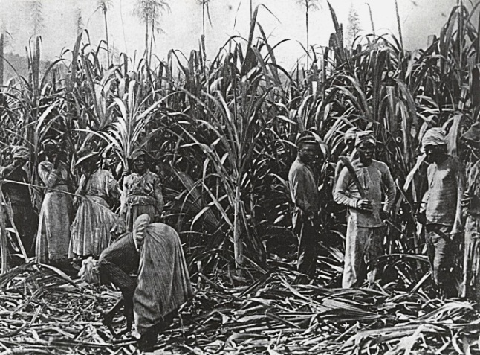
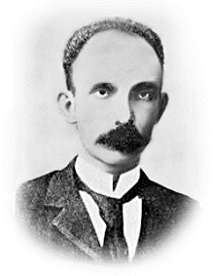
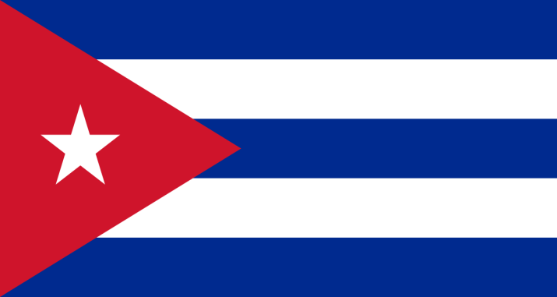
Origins of the Spanish-American War 1898
Spain was once the world greatest empire, but by 1890 it only controlled Cuba, the Philippines, and Guam.
Most Cubans were poor laborers who worked on sugar or tobacco plantations.
Cubans began to want their independence from Spain.
Jose Marti organized a rebellion while in exile in US. He announced his plans in Ybor City in Tampa and declared Cuban independence in April 1895. The Spanish sent an army to crush the rebels. Marti was killed a month later but the rebellion continued.
Let my people be free!
Jose Marti

Slide 29
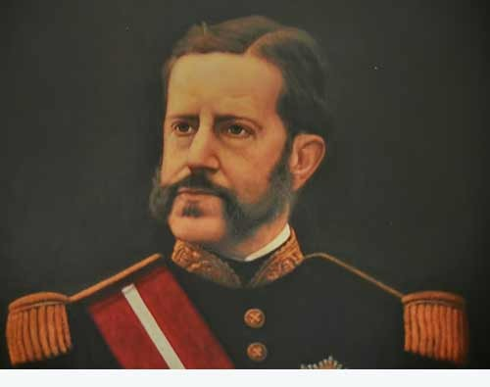
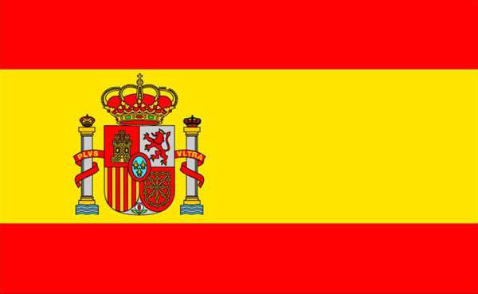
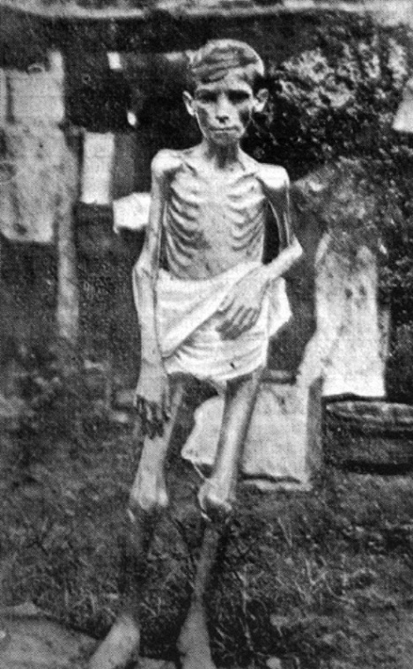
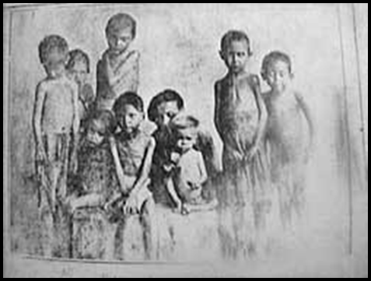
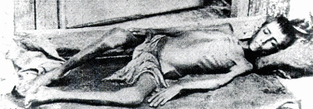
Origins of the Spanish-American War
Spain sent General Valeriano Weyler to end the rebellion.
He forced Cubans into concentration camps a policy known as re-concentration. This denied the rebels the food and support to carry out a war. Many died of disease or starvation.
General Valeriano Weyler

Slide 30
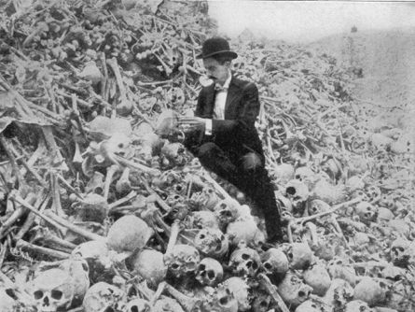
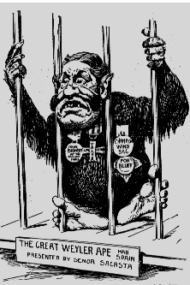
Origins of the Spanish-American War
Humanitarian Concerns:
225,000 Cuban civilians died in 18 months 1896-97 in these camps.
Many Americans felt US had a moral obligation to intervene and stop the mass killings.
US newspapers reported on the atrocities and Americans were enraged

Slide 31
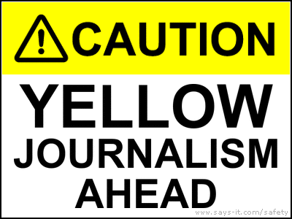
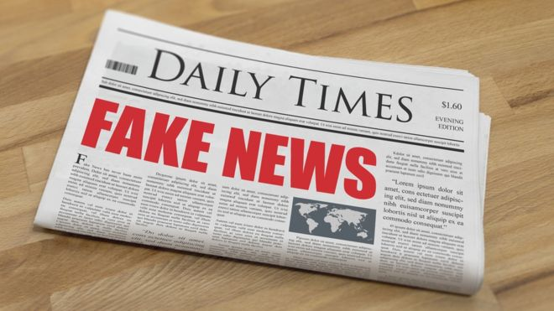

Slide 32
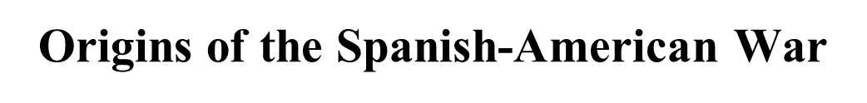


Yellow Journalism
The mistreatment of the Cubans by the Spanish caused alarm in the United States.
These events were reported on by U.S. newspapers like Joseph Pulitzer’s New York World and William Randolph Hearst’s New York Journal.
These newspapers deliberately sensationalized the news, showing the Spanish as murderous brutes in order to sell more newspapers.

Slide 33




Yellow Journalism/ The Press
When Hearst Artist Frederic Remington, cabled from Cuba in 1897 that "there will be no war," William Randolph Hearst cabled back: "You furnish the pictures and I'll furnish the war."
Joseph Pulitzer
New York World
versus
William Randolph Hearst
New York Journal
Yellow Journalism- journalism that is based upon sensationalism and crude exaggeration.

Slide 34



Yellow Journalism
This technique of exaggerated reporting became known as Yellow Journalism.
It gave the American public a distorted view of events in Cuba.
This misinformation caused Americans to worry about U.S. investments and citizens living in Cuba at the time.
Soon it would escalate to war.
The Yellow Press pushed for war.

Slide 35


Slide 36
1. Which of the following is the message of this political cartoon?
A. That the U.S. should remain neutral in the Cuban fight for independence.
B. That many Cubans are being murdered by the Spanish
C. That the naval officers aboard the USS Maine were murdered by the Spanish
D. That Spain should allow Cubans their independence

Slide 37

The Trouble in Cuba
A satirical map reflecting American sentiment towards Cuba, three years before the beginning of the Spanish-American War. "Uncle Sam" has his eye on Cuba, portrayed as a small fish, and announces: "I've had my eye on that morsel for a long time|guess I'll have to take it in!"
The "Trouble in Cuba" refers to the landings in February 1895 by armed forces under Jose Marti. In the spring, Marti's forces adopted a scorched earth policy intended to cripple the vital sugar industry by destroying cane fields, sugar mills and railroads. In June, the Cleveland administration officially proclaimed its neutrality in the dispute, effectively recognizing the insurgency (Trask 1996, 1-3, 11|Brewer 2009, 18). By the fall, the parties had settled into a guerrilla war that would continue until the American intervention.
During this period of time, Judge Magazine published at least five cartoon maps supporting and encouraging U.S. expansionism.

Slide 38

1. One important conclusion that can be drawn as a result of the Spanish American War is that
A. Only the President should decide issues of war and peace
B. The media are a powerful influence in shaping American public opinion toward war
C. The public has little confidence in the ability of the American military
D. International organizations play a decisive role in determining the outcome of war

Slide 39



Economic Interests
US govt and business leaders were concerned to protect US investments in Cuba which exceeded $50 million
Imperial Interests
US had interest in buying Cuba in 1854. Spain declined.
Ostend Manifesto was a document written in 1854 that described the rationale for the United States to purchase Cuba from Spain while implying that the U.S. should declare war if Spain refused.

Slide 40

William McKinley was president during the Spanish-American War.
Who is waiting?
2. Why should we wait
for the “facts”?
3. Why might the United
States want to go to war?
4. What positive effects
or outcomes could
come from a war with
Spain?
William McKinley
In order not to jump to conclusions
New Markets, territories
New Markets, territories and
USA now member of the Global
Imperialist community a-la Europe.

Slide 41



Triggering Events: The De Lome Letter and the Explosion of the Maine
The American President is weak
In 1898, a letter by the Spanish Ambassador De Lome was published in American newspapers.
This De Lome letter called the American Pres. McKinley ‘weak’ and it angered Americans.
Soon an American battleship, the U.S.S. Maine was sent to investigate in Cuba.
While moored in a Havana Harbor, it was sunk by a mysterious explosion killing 258 U.S. sailors.
America was outraged and cried for war!
“Remember the Maine”

Slide 42

This cartoon followed the explosion of the battleship Maine in Havana harbor on February 15, 1898. King Alphonso XIII playing with toy boats in Cuba, is about to suffer "Retribution."

Slide 43

William McKinley, Jr. (1843-1901) • 25th President
• Wanted to avoid war in Cuba
• Yellow journalism and public supported war
• In April 1898, President McKinley abandoned his failed diplomatic efforts and asked Congress for permission to intervene in Cuba.

Slide 44



The Course and Consequence of the War 1898
The Spanish-American War would be fought on two fronts:
  The Philippines in the Pacific
  Cuba in the Caribbean Sea
The Spanish were quickly defeated in the Battle of Manila Bay in the Philippines by Commodore George Dewey
The U.S.A. took control of the Philippines, even though the Filipino people had expected their freedom would be given to them by the United States.

Slide 45


Theodore Roosevelt: Assistant Secretary of the Navy
Resigned and joined the army to fight in Cuba.
“I should welcome
almost any war, for I
think this country
needs one”
• First Volunteer Cavalry, nicknamed the "Rough Riders.“
Stop, drop, that’s how rough riders roll…..(DMX)

Slide 46


The Course and Consequence of the War
US Army departed from Tampa, Florida and invaded Cuba
Teddy Roosevelt raised a volunteer force called the “Rough Riders”.
The Rough Riders won the Battle of San Juan Hill in Cuba.
Spanish navy was destroyed in Cuba.
The U.S. also took control of Guantanamo Bay (We still have it). It is a US naval base and prison camp.

Slide 47



Commodore George Dewey
May 1, 1899— Commodore Dewey and his Asiatic Squadron defeated the Spanish fleet in Manila Bay • During and after the war, George Dewey became one of the war's most celebrated heroes

Slide 48
According to this map which country is the US planning to invade?

Slide 49


Spanish-American War Results
The U.S.A. took control of Cuba just as it had the Philippines.
Some American soldiers had to be removed from Cuba because of yellow fever spread by the mosquito.
The Treaty of Paris was signed ending the Spanish American War gave the U.S.A. control of colonies formerly controlled by Spain.
These lands included:
  Cuba (under US control) & Puerto Rico (annexed) in the Caribbean Sea,
  The Philippines & Guam in the Pacific
  The US paid Spain $20million for the Philippines
GUAM

Slide 50
Controversy Over the Treaty of Paris
Far more controversial than the war itself were the terms of the treaty of peace signed in Paris on December 10, 1898. It provided for
(1) recognition of Cuban independence,
(2) U.S. acquisition of two Spanish islands Puerto Rico in the Caribbean and Guam in the Pacific, and
(3) U.S. acquisition of the Philippines in return for payment to Spain of $20 million. Since the avowed purpose of the U.S. war effort was to liberate Cuba, Americans accepted this provision of the treaty.
However, many were not prepared for taking over a large Pacific island nation, the Philippines, as a colony.

Slide 51


Spanish-American War Results
The Spanish-American War marked the end of Spain’s colonial empire and the beginning of the U.S.A. as a imperial/ world power!
But, it also brought the problem of what would the U.S.A. do with these new possessions? Keep ‘em or Free ‘em?
Should we become an imperial power?
Many Americans believed we should annex (make them a part of the U.S.), these people were called imperialists.
Imperialists felt the U.S. should expand and grab colonies while it could before the opportunity to do so was gone.

Slide 52

Recognition of U.S. Power
One consequence of the Spanish-American War was its effect on the way both Americans and Europeans thought about U.S. power.
The decisive U.S. victory in the war filled Americans with national pride.
Southerners shared in this pride and became more attached to the Union after their bitter experience in the 1860s.
At the same time, France, Great Britain, and other European nations recognized that the United States was a first-class power with a strong navy and a new willingness to take an active role in international affairs.

Slide 53

Columbia’s Easter Bonnet, 1901 Puck Magazine, 1901
Illustration shows Columbia adjusting her bonnet, which is a battleship labeled "World Power" with two guns labeled "Army" and "Navy"; it is spewing thick black smoke labeled "Expansion." She is inserting a tiny sword as a hatpin to hold it in place.
This represents the United States becoming more involved in overseas imperialism.

Slide 54


The Debate Over Imperial Expansion
IMPERIALISM - economic and political control of a strong nation over weaker ones
Many Americans were opposed to imperialism. The rule of one country over another seemed to be a violation of the democratic principals upon which the USA was founded
In 1898, Congress passed the Teller Amendment- an addition by Congress to its declaration of war against Spain, promising that the US would NOT annex Cuba even if it won the war.
3 categories justifying imperialism- POLITICAL, ECONOMIC, SOCIAL
Despite all this, the USA became an imperial power and those in favor pointed to the following to justify IMPERIALISM
The need for raw materials and markets for American industry ECONMIC$
New Technological Capabilities
Importance of Naval Power
Competition with European powers
A Golden Opportunity
The New Manifest Destiny
The “White Man’s Burden”- spread of Christianity
Social Darwinists

Slide 55





Arguments for Imperialism
1. The Need for Raw Materials and Markets for American Industry
Raw material
Finished Good
Because of high protective tariffs limited trade among the industrialized nations, colonies would provide guaranteed market for US goods.
2. New technologies made it possible to colonize many new areas especially the tropics. Telephone, steamship, rifle, machine gun, telegraph, medicines.

Slide 56
APUSH TOPIC 6.6
KC-6.1.I.E.i
Businesses increasingly looked outside U.S.
borders in an effort to gain greater influence
and control over markets and natural resources
in the Pacific Rim, Asia, and Latin America.

Slide 57


The Debate Over Imperial Expansion
Importance of Naval Power- Alfred Thayer Mahan, published The Influence of Sea Power Upon History in 1890.
Mahan recommended that the USA build a two ocean navy, Atlantic Fleet and Pacific Fleet, build a canal through Panama, annex colonies in the Caribbean and Pacific to serve as naval bases and supply stations and expand trade with East Asia

Slide 58

US Trade Routes

Slide 59


The Debate Over Imperial Expansion
Competition with European powers
In the 1880s-1890s European powers were carving up Africa, Asia, and the Pacific into colonies and spheres of influence. Many American imperialist urged the USA to grab some territories of its own before nothing was left.
We better hurry…..

Slide 60




Slide 61



Slide 62



5. A Golden Opportunity
This 1898 political cartoon from the Minneapolis Tribune depicts President McKinley with a “savage child,” labeled as The Philippines. McKinley is trying to decide whether to keep the child or give it back to Spain, which the cartoon indicates is akin to throwing it off a cliff. An anthropomorphized world looks on, indignantly.
The little savage child representing The Philippines depicts the typical image many Americans had for groups deemed to be racially inferior. The author made the native a child, referencing the child-like tendencies those classified as inferior were supposed to possess. It also is a nod to the United State’s attitude at the time towards countries they were annexing: that these countries (such as Hawaii, Guam, Puerto Rico etc) needed to be taught how to be civilized.
Denotation
the explicit or direct meaning
of a word. “What you see”
Connotation
an idea or feeling that a word invokes in addition to its literal or primary meaning
The eyes of the world are upon him

Slide 63

The cartoon is a question many Americans had as to what the government would do with the nation: Take it under its wing and bestow up them the gifts of civilization and democracy or throw them into the bottomless Catholic pit of Spain? This is where the man-earth figure in the image comes into play. The Minneapolis Tribune’s cartoonist uses this figure with his inquiring look to indicate that the correct action would be to save the savage child from the ‘Pit’ of Spain.

Slide 64

The Debate Over Imperial Expansion
The New Manifest Destiny
By this time the US had already expanded from the Atlantic coast to the Pacific coast. The next logical step would be to go beyond- to the Pacific and Asia.
This idea was closely tied to feelings of Anglo-Saxon superiority.

Slide 65


7. The “White Man’s Burden”
In February 1899, British novelist and poet Rudyard Kipling wrote a poem entitled “The White Man's Burden: The United States and The Philippine Islands.” In this poem, Kipling urged the U.S. to take up the “burden” of empire, as had Britain and other European nations and help “civilize” (the world) the brown man.
In his poem he was specifically addressing the US acquisition of the Philippines.

Slide 66



The “New” Imperialism
7. Also, many Americans had a humanitarian impulse behind these beliefs. Such humanitarians thought that by spreading Protestant
Christianity (Missionaries) and American institutions-democracy, freedom, elections, etc. they were doing native peoples around the world a great favor. Reverend Josiah Strong – Congregational Minister 1885 book – Our Country Claimed that Americans were a special, God favored Anglo-Saxon race who served as the representatives of “the purest Christianity, the highest civilization.” Americans had an “instinct or genius for colonizing” and should follow their destiny to “lift up” other societies.
Our Country: Its Possible Future and Present Crisis (1885)

Slide 67
The “White Man’s Burden”
It is the white man’s burden to lift (civilize) the people’s of the world. In this cartoon you see both US and UK (British) carrying (lifting) the non-white people to civilization atop of the mountain

Slide 68



The Debate Over Imperial Expansion
8. Social Darwinism
From the ideas of Charles Darwin’s theory of evolution.
'survival of the fittest' concept to mean that only the best adapted (those already well off) survive the 'natural conflict' between social groups and thereby enhance the survival capacity of the remaining society.
Also, many Americans had a humanitarian impulse behind these beliefs. Such humanitarians thought that by spreading Protestant Christianity and American institutions-democracy, freedom, elections, etc. they were doing native peoples around the world a great favor.

Slide 69
Naval Bases
Political
Competition with European Powers
Roots of U.S. Imperialism
Raw Materials & New Markets
Social Darwinists
Economic
Cultural
A Golden Opportunity
New Manifest Destiny

Slide 70


"Coasting"
-criticizes American foreign policy
-abandons "Monroe Doctrine" b/c "horse is too slow"
-riding the bike resembles controlling the world/easier to ride bike vs. horse
-bike can't move w/o Uncle Sam controlling it

Slide 71

Source: The Boston Globe, May 28, 1898.
The Debate Over Imperialism

Slide 72
Justification FOR/ AGAINST Imperialism (slide 54)
HIPP (Evidence): POV
critical of America’s policy of imperialism, seeing it as a sign of America’s ego in its superiority and greed
Analysis- the reason(s) your HIPP (Evidence) supports your Topic sentence
In writing your paragraph in a DBQ or
LEQ use the TEA method

Slide 73
This Puck cartoon endorses the expansionist foreign policy of President William McKinley as “enlightened” and “rational.” The annexation of Hawaii and Puerto Rico (respectively, during and after the Spanish-American War of 1898) are shown as natural increases in the size of the United States, a process that began with the Louisiana Purchase (1803) and continued with the acquisitions of Florida (1821), Texas (1845), California (1848), and Alaska (1867). Note that the Philippines are not mentioned. Uncle Sam rejects the tonic of “Anti-Expansion Policy” offered by three anti-imperialists (left-right): Oswald Ottendorfer, publisher and editor of the New Yorker Staats-Zeitung; Carl Schurz, a vice president of the Anti-Imperialist League and former U.S. senator (1869-1874) from Missouri, secretary of the interior (1877-1881), and editor of Harper’s Weekly (1892-1898); and, Joseph Pulitzer, publisher of the New York World.

Slide 74


Slide 75


The blackboard contains the lessons learned from Great Britain on how to govern a colony and bring them into the civilized world, stating, “... By not waiting for their consent she has greatly advanced the world's civilization. — The U.S. must govern its new territories with or without their consent until they can govern themselves.”
Veneration of Britain’s treatment of colonies as a positive model attests to the significant shift in the American world view given U.S. origins in relation to the mother country.
Even the Civil War is referenced, in a wall plaque: “The Confederate States refused their consent to be governed; but the Union was preserved without their
consent.” Refuting the right of indigenous rule was based on demonstrating a population’s lack of preparation for self-governance.
On his desk, Uncle Sam has a book on US First Lesson in Self- Government

Slide 76

School Begins School Begins” was published January 25, 1899
This cartoon was inspired by two events occurring the previous year: the Spanish-American War and the U.S. annexation of Hawaii. Puck addressed what to do with the new territories America gained by likening them to new, disobedient or uncivilized students with Uncle Sam, Puck‘s personification of the United States, serving as the schoolmaster.

Slide 77
This political cartoon should first be addressed for its portrayal of the new territories, namely Cuba, Porto (sic.) Rico, Hawaii, and the Philippines, as dark-skinned school children who are seen pouting as Uncle Sam lectures to them that “you’ve got to learn these lessons whether you want to or not! But just take a look at the class ahead of you and remember that in a little while, you will feel as glad to be here as they are!” The other children that Uncle Sam is referring to are well-dressed and attentively reading from their books. These other children represent states and territories that the U.S. has had for a while now, such as Texas (1845), California (1850), New Mexico Territory, Arizona Territory, and Alaska Territory. The presumption is then, that eventually these four new territories will eventually become civilized and become part of the Union.

Slide 78
AND, AFTER ALL, THE PHILIPPINES ARE ONLY THE STEPPING-STONE TO CHINA
E. Flohri
Judge, March 21, 1900
Uncle Sam, carrying a book entitled Education and Religion, brings railroads and modern industrial goods to China which awaits him with open arms. The cartoon justifies the U.S. occupation of the Philippines as a stepping stone in this trade. But as a matter of fact, the U.S.’s principal trans-Pacific trading partner was Japan, not China.
Denotation
the explicit or direct meaning
of a word. “What you see”
Connotation
an idea or feeling that a word invokes in addition to its literal or primary meaning

Slide 79

Chopping Down the Flag
Part of the original caption for this cartoon read, "Take your choice. Do you want a man who, having raised the stars and stripes on our new possessions . . .or a man who will cut down 'Old Glory' . . .?" The caption sets the tone for the cartoon. At the time, Bryan was running against McKinley for the presidency of the U.S. Which candidate do you think the artist supports?

Slide 80
Chopping Down the Flag
Uncle Sam has his arm across the shoulders of a man wearing the clothing of a prosperous businessman. This is a friendly gesture. Uncle Sam is extending his arm to show the man the other places that are now U.S. possessions. The cartoon artist is using these gestures to show that American imperialism is something that will benefit U.S. businesses.
Denotation
the explicit or direct meaning
of a word. “What you see”
Connotation
an idea or feeling that a word invokes in addition to its literal or primary meaning

Slide 81



Imperialism: America Becomes A World Power
REGION/EVENT | YEAR | DESCRIPTION
The Philippines & The Philippine-American War | 1898 – 1902
1) Anti-imperialist League argued annexation violated self-determination
2) Imperialists argued annexation would bring commercial & strategic advantages ($ + keeping Japan & Germany from moving in); they won
3) Philippine-American War
a) Rebellion led by Emilio Aguinaldo
b) Larger war & more casualties than the Spanish-American War
c) U.S. crushed the revolt & imposed its will:
1. English the official language
2. Public works introduced
3. Sedition Acts & persecution silenced opposition
4) Philippines gains independence in 1946.
IA - 5 America in the Philippines, Puerto Rico & Cuba (5:32)
Philippines 1900 (7:29)

Slide 82
The American Anti-Imperialist
League
Founded in 1899.
Mark Twain, Andrew
Carnegie, William
James, and William
Jennings Bryan among
the leaders.
Campaigned against the annexation of the
Philippines and other
acts of imperialism.

Slide 83



Anti-Imperialist Argument
Many Americans were opposed to imperialism. The rule of one country over another seemed to be a violation of the democratic principals upon which the USA was based on.
Anti-imperialist League argued annexation violated self-determination
2) Imperialists argued annexation would bring commercial & strategic advantages ($ + keeping Japan & Germany from moving in); they won
“Is it possible that the American republic is to be the suppressor of Filipino independence?” Andrew Carnegie

Slide 84

Anti-Imperialist Argument
Anti-imperialist felt that imperialism-the rule of one people by another- was immoral and went against the most basic values of American democracy. They formed that Anti-Imperialist League (1899). The most famous member was Mark Twain and he said:
According to Mark Twain, why was he opposed to US imperialism in the Philippines?
USA intends to rule the Philippines
as conquerors and not free them.
"I have read carefully the treaty of Paris, and I have seen that we do not intend to free, but to subjugate the people of the Philippines. We have gone there to conquer, not to redeem. It should, it seems to me, be our pleasure and duty to make those people free and let them deal with their own domestic questions in their own way. And so I am an anti-imperialist. I am opposed to having the eagle put its talons on any other land."

Slide 85
Anti-Imperialist Argument
INFORMATION WANTED
Grant Hamilton
Judge, June 11, 1898
A startled Uncle Sam holds a crying black orphan wearing a tag from Admiral Dewey. American
cartoonists consistently, and
erroneously, depicted Filipinos as
African savages and as crying
children. The caption “Information Wanted” is more truthful than the cartoonist probably intended for it
is true that the United States knew almost nothing about the diverse peoples it had suddenly adopted.

Slide 86


Other Results of the War
Imperialism remained a major issue in the United States even after ratification of the Treaty of Paris. An Anti-Imperialist League, led by William Jennings Bryan, rallied opposition to further acts of expansion in the Pacific.
Insular Cases. One question concerned the constitutional rights of the Philippine people: Did the Constitution follow the flag?
In other words, did the provisions of the U.S. Constitution apply to whatever territories fell under
U.S. control, including the Philippines and Puerto Rico? Bryan and other antiimperialists argued in the affirmative, while leading imperialists argued in the negative. The issue was resolved in favor of the imperialists in a series of Supreme Court cases (1901-1903) known as the insular (island) cases. The Court ruled that constitutional rights were not automatically extended to territorial possessions and that the power to decide whether or not to grant such rights belonged to Congress.

Slide 87





Slide 88

United States
Japan
Southeast Asia

Slide 89

The Philippine-American War (1899 – 1902)

Slide 90

The American Colonial Empire
Possessions in the Pacific
The Philippines:
The Filipino-American War 1899-1902
Spain
Filipinos had been fighting Spain
Long before the Spanish- American
War broke out. Bitterly disappointed when Pres. McKinely
annexed the Philippines instead of granting independence (they had an agreement), Filipinos rebelled and waged war against the US.
Led by Emilio Aguinaldo, the rebels used guerilla warfare tactics. It is a Spanish word meaning small war.
$20M
Philippines

Slide 91

The American Colonial Empire
Possessions in the Pacific
The Philippines:
The Filipino-American War 1899-1902
Faced with overwhelming odds, the Filipinos finally surrendered to the US in 1902 but sporatic fighting continued for the next decade.
The US built roads, hospitals, schools and the Jones Act gave Filipinos the right to elect both houses of their own legislature in 1916
The US granted the Philippines its independence on July 4, 1946.
Emilio Aguinaldo

Slide 92

1901
Columbia’s Easter Bonnet
Which of the following most directly led to the circumstances illustrated by the image?
A. The United States victory in the Spanish-American War
B. The Supreme Court ruling in Plessy v. Ferguson
C. The United States contributions to the Allied victory in the First World War
D. The ratification of the Nineteenth Amendment to the Constitution

Slide 93
1901
Columbia’s Easter Bonnet
The developments referenced by the image most directly contributed to United States involvement in
A. competition with Russia in opening trade with Japan
B. the suppression of an independence movement in the Philippines
C. acquisition of territory from Mexico through the Treaty of Guadalupe Hidalgo
D. an international monetary system that supported free trade between nations

Slide 94
1901
Columbia’s Easter Bonnet
The ideas expressed through the image reveal that in 1901, which of the following was most true of the United States?
A. Theories of survival of the fittest had been widely rejected by the public.
B. Efforts to spread democracy overseas had been largely peaceful.
C. Interventionism had become a more prevalent feature of foreign policy.
D. Women were encouraged to join the armed forces.

Slide 95


Slide 96

The Filipino First Bath
McKinley- “Oh, you dirty boy.”
Denotation
Connotation

Slide 97

THE FILIPINO’S FIRST BATH
Grant Hamilton
Judge, New York, June 10, 1899
Here President William McKinley scrubs a Filipino savage with a brush labeled “Education” in the cleansing waters of “Civilization”. A freshly scrubbed Cuba and Puerto Rico in the background are donning new clothes decorated with the
U.S. stars and stripes.

Slide 98


Slide 99


Slide 100

The American Colonial Empire
Possessions in the Pacific
Hawaii
Hawaii is an archipelago (a chain of islands) in the Pacific Ocean. It provided a coaling station on trips
From USA to East Asia.
1820s American traders came to Hawaii to exploit the islands’ sandalwood, which was much valued in China at the time.
1830s, the sugar industry was introduced to Hawaii and by the 1850s it had become well established.
American missionaries and planters brought about great changes in Hawaiian political, cultural, economic, and religious life, and in
1840 a constitutional monarchy was established, stripping the Hawaiian monarch of much of his authority.
Four years later, Sanford B. Dole was born in Honolulu, Hawaii, to American parents.

Slide 101

The American Colonial Empire
Possessions in the Pacific
Hawaii
Hawaii entered into a number of political and economic treaties with the United States
1887 a U.S. naval base was established at Pearl Harbor. Sugar exports to the United States expanded
U.S. investors and American sugar planters on the islands broadened their domination over Hawaiian affairs.
1891 Liliuokalani, the sister of the late King Kalakaua, ascended to the throne, refusing to recognize the constitution of 1887 and replacing it with a constitution increasing her personal authority.
In January 1893, a revolutionary “Committee of Safety,” organized by Sanford B. Dole, staged a coup against Queen Liliuokalani with the tacit support of the United States.
February 1, Minister John Stevens recognized Dole’s new government on his own authority and proclaimed Hawaii a U.S. protectorate.
Dole submitted a treaty of annexation to the U.S. Senate, but most Democrats opposed it, especially after it was revealed that most Hawaiians did not want annexation.

Slide 102




The American Colonial Empire
Possessions in the Pacific
Hawaii
President Grover Cleveland sent a new U.S. minister to Hawaii to restore Queen Liliuokalani to the throne under the 1887 constitution
Dole refused to step aside and instead proclaimed the independent Republic of Hawaii.
Cleveland was unwilling to overthrow the government by force, and his successor, President William McKinley, negotiated a treaty with the Republic of Hawaii in 1897.
In 1898, the Spanish-American War broke out, and the strategic use of the naval base at Pearl Harbor during the war convinced Congress to approve formal annexation. Two years later, Hawaii was organized into a formal U.S. territory and in 1959 entered the United States as the 50th state.
Cousins
Queen Liliuokalani

Slide 103

Another Shotgun Wedding
Shotgun wedding between Uncle Sam and a young woman labeled "Hawaii"; a former Confederate general labeled "Sen. Morgan" with a "Jingo" feather in his hat, stands behind them, holding a shotgun labeled "Bluster", as a minister labeled "McKinley" reads from the "Annexation Policy."
Shotgun says bluster. If you say that someone is blustering, you mean that they are speaking aggressively but without authority, often because they are angry or offended.
Jingo(ism)-extreme patriotism, especially in the form of aggressive or warlike foreign policy.

Slide 104


The American Colonial Empire
Other Possessions in the Pacific
Guam, Samoa, and Midway
These islands provided valuable coaling stations for US ships sailing to Asia where they could provide, fresh water, food and other supplies
Guam
Midway
Hawaii
American Samoa

Slide 105
An EOC Moment
In the late 1800s, the major goal of United States policy in both the annexation of Hawaii and the acquisition of the Philippines was to
obtain coaling stations and seaports for United States ships
expand United States fishing rights in international waters
limit the spread of Japanese influence
protect the area around the Panama Canal

Slide 106


USA and Puerto Rico
Puerto Rico is a small island nation in the Caribbean Sea.
The U.S. set up a government for Puerto Rico that was selected by the U.S. President and approved by our Congress.
Puerto Rico is considered a territory of the U.S. and its people have U.S. citizenship.
Puerto Ricans control their own internal affairs, but:
  Its citizens lack voting representation in the U.S. Congress, because it is not a state.
  Its citizens are not eligible to vote in national presidential elections. It is not a state and it has no electoral college votes.

Slide 107



America in the Caribbean
The Spanish-American War gave the U.S.A. direct control of Puerto Rico and indirect control of Cuba in the Caribbean Sea.
There were several reason why the U.S. was interested in maintaining an interest in the region:
  Hemispheric Security – U.S. wanted to keep European powers out of the region.
  Economic Interests – Caribbean was an important supplier of agricultural products, like Sugar, and was a market for American made products.
  Need for a Canal – The Spanish-American War had shown the need for a more direct route between the Atlantic and Pacific oceans.

Slide 108




USA and Cuba
Cuba is the largest island in the Caribbean Sea.
Even before the Spanish-American War the U.S. Congress had voted not to annex Cuba.
Cuba did become a protectorate under American control after the war.
U.S. Armed Forces remained in Cuba, and American businesses began to invest great sums of money in Cuba. (i.e. the Mafia)
The Platt Amendment gave the U.S. the right to intervene in Cuba’s business whenever it wanted to.
The Platt Amendment was repealed in 1930.
fever eradicated from Cuba.
Yellow

Slide 109



New Interests in the Caribbean
Virgin Islands, US Territories
The islands remained under Danish rule until 1917, when the United States purchased them for $25 million in gold in an effort to improve military positioning during critical times of World War I. St. Croix, St. Thomas and St. John became the US Virgin Islands.
United States Virgin Islands

Slide 110

US Trade Routes

Slide 111

Spain
Hawaii
Cuba
Puerto Rico
Philippines

Slide 112

American Foreign Policy, 1898-1914
Geography had placed the USA in a great place for trading with East Asia.
After 1898, the treaty ending the Spanish-American War gave new lands (Guam, Philippines, Samoa, Midway, Hawaii) to the USA, we now had a greater influence in the Pacific Ocean.
Gave USA an opportunity to trade with Japan, China and the Dutch East Indies (Indonesia).
Hawaii
Cuba & Puerto Rico
Philippines
Guam

Slide 113


America and China
By the 1850s, European nations already had ‘spheres of influence’ in China.
Spheres of Influence were areas where a nation enjoyed special privileges within another nation.
The USA didn’t have a sphere of influence in China and U.S. Secretary of State John Hay was worried that it might soon lose all ability to trade with China.
Sec. John Hay saw China as a great market for U.S. products.
The USA needs to continue trade with China

Slide 114

America and China
To keep China’s markets open to the USA, Sec. John Hay announced the “Open Door Policy” in 1899.
This policy would give an equal right to all nations to trade in China, not just those with a sphere of influence.

Slide 115


Slide 116

Open Door Policy USA China
Cartoon Open Door 1900 Cartoon depicting Uncle Sam propping The Open Door Policy with China with the brick of US army and navy prestige as the colonial powers of France and Russia look on China

Slide 117

An EOC Moment

Slide 118

America and China
In 1900, the Boxers, Chinese who opposed the influence of Western nations rebelled, and began killing foreigners living in China.
The Boxer Rebellion was crushed by the USA and other western nations who wished to keep China open for trade.
Sec. John Hay said the USA would oppose anyone attempting to use the Rebellion to break up China.

Slide 119




America and China
In 1900, the Boxers, Chinese who opposed the influence of Western nations rebelled, and began killing foreigners living in China.
The Boxer Rebellion was crushed by the USA and other western nations who wished to keep China open for trade.
Sec. John Hay said the USA would oppose anyone attempting to use the Rebellion to break up China.

Slide 120

The Real Trouble Will Come with the Wake, 1900 Puck
Japan, Russia, France, Germany, Austria-Hungary, Great Britain and Italy. The American eagle is observing the proceedings from his vantage point top left.

Slide 121



Opening of Japan
Japan had long been an isolationist nation and avoided Western influences.
In 1853, American Commodore Matthew Perry landed in Japan to open trade relations.
By 1890s, Japan had adopted many Western ways and became Asia’s 1st industrial power.
Japan soon became an imperialist nation after defeating both China (1894-95) and Russia (1904-1905) in war.
Pres. Teddy Roosevelt earned the Nobel Peace Prize for negotiating peace between these nations at the ‘Treaty of Portsmouth’. Russo-Japanese War 1904-1905

Slide 122

The USA and Latin America
The Panama Canal
During the Spanish-American War, U.S. warships had to sail 16,000 miles around the tip of South America to get from one ocean to the other.
Panama, is the narrowest point in Central America and the logical place to build a canal. (man made river)
At the time, Panama was a part of Columbia, which had refused to allow the U.S. to build the canal.

Slide 123


The USA and Latin America
The Panama Canal
At the time, Panama was a part of Columbia, which had refused to allow the U.S. to build the canal.
Pres. Roosevelt offered the Panamanians independence if they would allow the canal to pass through the Panama Canal Zone.
Panama agreed, Pres. Roosevelt sent warships to defend the rebels from Colombia and a deal was struck to start building the Panama Canal.

Slide 124


Colombia
Panama

Slide 125

The News Reaches Bogota, 1903 The New York Herald
Answer question 10 pg. 162

Slide 126


Slide 127

*The cartoon illustrates the actions of President Theodore Roosevelt in
(1) securing the land to build the Panama Canal
(2) leading troops in the Spanish-American War
(3) ending the war between Russia and Japan
(4) improving diplomatic relations with Latin American nations
* Critics of the actions shown in this cartoon claimed President Theodore Roosevelt was
causing environmental damage
following a policy of imperialism
(3) requiring massive tax increases
(4) producing major trade deficits with China

Slide 128

Building the Panama Canal

Slide 129


Slide 130





Challenges of Building the Panama Canal
Pres. Roosevelt immediately ordered construction of the canal to begin.
But there were obstacles:
  51 miles of jungle at varying land elevations
  Swamps
  Over 10 years to finish @ cost of $400 million
  Frequent rains caused mudslides
  Mosquitoes spread yellow fever, malaria
  Thousands of lives were lost
Dr. Walter Reed along with Cuban Dr. Carlos Finlay discovered mosquitoes caused the yellow fever.
Dr. Gorgas sprayed oil on all water to prevent more mosquitoes from breeding.

Slide 131

After Roosevelt’s visit to the Panama Canal Zone in 1906 the media portrayal of the work on the canal changed dramatically. Prior to the visit, the canal work was shown in a negative light, with emphasis put on the high death rate due to disease and the lack of progress being made. After the visit the canal work was pictured as heroic, manly work. Roosevelt was called “the man who can make the dirt fly”, which was the inspiration for this cartoon’s title.
This cartoon has Roosevelt shoveling those who slowed down the canal work’s progress and those who criticized the canal out of the way. He is drawn as a strong, manly figure who is getting work done. Early criticism of the canal had made a point of pointing out the slow progress that was being made on the canal. Roosevelt’s trip changed this perception, as he seemed to speed the work up and get everything working. Those who had earlier criticized the canal work were now seen as unpatriotic and as hindering progress. Their popularity greatly decreased, while that of the canal, the workers, and Roosevelt all increased.

Slide 132


The Caribbean as an American Lake
The Monroe Doctrine (1823) prevented European nations from establishing new colonies in the Western Hemisphere.
Pres. Roosevelt repeated this warning with his “Roosevelt Corollary” warning Europe to stay away.
The Roosevelt Corollary became known as the “Big Stick Policy”. This policy was deeply resented by Latin America.
Teddy Roosevelt often boasted he would “walk softly but carry a big stick”.
America would control the Caribbean area as Roosevelt sent U.S. troops to Central America to defend U.S. interests and keep Europe OUT.
The USA became the police for the Western Hemisphere

Slide 133

Roosevelt Corollary to the Monroe Doctrine
US was concerned about vulnerable Latin American and Caribbean countries becoming vulnerable to European intervention, TR declared that the Monroe Doctrine (1823) gave the US the right to intervene in domestic affairs of Latin American countries to maintain stability in the region and to protect the Western Hemisphere from European colonization.

Slide 134

The Caribbean as an American Lake
'The Big Stick in the Caribbean Sea.' President Theodore Roosevelt enforcing his concept of the Monroe Doctrine by having a U.S. naval flotilla steam from one Caribbean port to another. Cartoon, 1904, by W.A. Rogers.

Slide 135

The Worlds Constable
TR as the
Policeman, keeping
order in the
western hemisphere
On the one side
you have the
Europeans
Clamoring to
settle their
Claims with
the Latin Americans
TR is in the middle
making sure they do not
interfere in Latin
America. The US would
would settle the disputes.

Slide 136
ROOSEVELT CARTOON, 1904. 'The Big Stick in the Caribbean Sea.' President Theodore Roosevelt enforcing his concept of the Monroe Doctrine by having a U.S. naval flotilla steam from one Caribbean port to another. Cartoon, 1904, by W.A. Rogers.

Slide 137

Which United States foreign policy is the subject of this 1904 cartoon?
(1) imperialism (3) isolationism
(2) neutrality (4) containment
The cartoonist is expressing concerns about the ability of the United States to
(1) accept citizens from foreign countries
(2) control territories spread out over vast distances
(3) support human rights around the world
(4) maintain a trade surplus with new trading partners

Slide 138

The United States government justified most of the actions shown on the map by citing the
terms of the Roosevelt corollary to the Monroe Doctrine
(2) threats from Germany after World War I
(3) desire to stop illegal immigration from Latin America
(4) need to protect Latin America from the threat of communism
Which title would be the most accurate for this map?
Ending Colonization in Latin America
Promoting Trade with Latin America
(3) Humanitarian Aid in the Western Hemisphere
(4) United States Intervention in the Caribbean Area

Slide 139




William Howard Taft and Dollar Diplomacy
The use of US investments to promote US foreign policy objectives
Foreign policy created under President Taft that had the U.S. exchanging financial support ($) for the right to "help" countries make decisions about trade and other commercial ventures. Basically it was exchanging money for political influence in Latin America and the Caribbean.

Slide 140



Taft and Dollar Diplomacy
Instead of using “Big Stick Diplomacy” as Pres. Teddy Roosevelt had, Pres. Taft choose “Dollar Diplomacy”.
“Dollar Diplomacy” was using American investment to promote American foreign affairs. Instead of bullets use dollars. Lets get rich not get killed, ok? NO WAR, BUSINESS
U.S. banks loaned Latin American nations money, if they couldn’t repay the loans on time, the U.S. government would send troops to make sure it was repaid.
Example :
  U.S. bankers lent money to Nicaragua.
  Nicaragua had trouble repaying the loan.
  U.S. bankers wanted to take over Nicaragua’s railroad and national bank.
  Nicaragua’s government refused to allow this.
  So, Pres. Taft sent the Marines to collect the debt.

Slide 141


Wilson and Latin America: Moral Diplomacy

Slide 142


Wilson and Latin America Moral Diplomacy
Pres. Woodrow Wilson wanted his presidency to be seen less as a bully, but, Pres. Wilson was forced to send U.S. troops to several Central American nations to protect American interests.
Mexico had a revolution, but Pres. Wilson refused to recognize the new government, he called this his ‘watchful waiting’ policy to see what was going to happen. Also known as Missionary Diplomacy-the United States' moral responsibility to deny recognition to any Latin American government that was viewed as hostile to American interests.
Intervene to promote democratic governments and oppose non-democratic governments.
“Teach the Mexicans to elect good men.”
When Pancho Villa entered U.S. soil and murdered U.S. citizens, Pres. Wilson sent Gen. John J. Pershing to capture Villa.
Pancho escaped capture by the Americans.
American military entering Mexico in search of Pancho Villa.

Slide 143


Gen. John J. Pershing
US General John “Black Jack” Pershing.
Chased Pancho Villa back into Mexico but was unable to capture him. Later, he would command AEF (American Expeditionary Force) in France during World War I

Slide 144


Wilson’s Moral Diplomacy

Slide 145




Wilson & Latin America- Moral Diplomacy
Wilson’s Mexican policy damaged U.S. foreign relations. The British ridiculed the president’s attempt to “shoot” the Mexicans into self-government.
Latin Americans regarded his “moral imperialism” as no improvement over Theodore Roosevelt’s “big stick” diplomacy.
In fact, Wilson followed Roosevelt’s example in the Caribbean. In 1914 he negotiated exclusive rights for naval bases and a canal with Nicaragua.
In 1915 he sent marines into Haiti to put down a rebellion. The marines remained there until 1934.
In 1916 he sent troops into the Dominican Republic to preserve order and to set up a government he hoped would be more stable and democratic than the current regime.
Mexico
Nicaragua
Haiti
Dominican Republic

Slide 146
Old LEQ Prompt
Some historians have argued that United States foreign policy has more often been motivated by economic interests than by the desire to spread democratic and humanitarian ideals around the world. To what extent is this argument convincing with regard to United States foreign policy between 1890 and 1919?

Slide 147
End of Presentation

