Slide 1
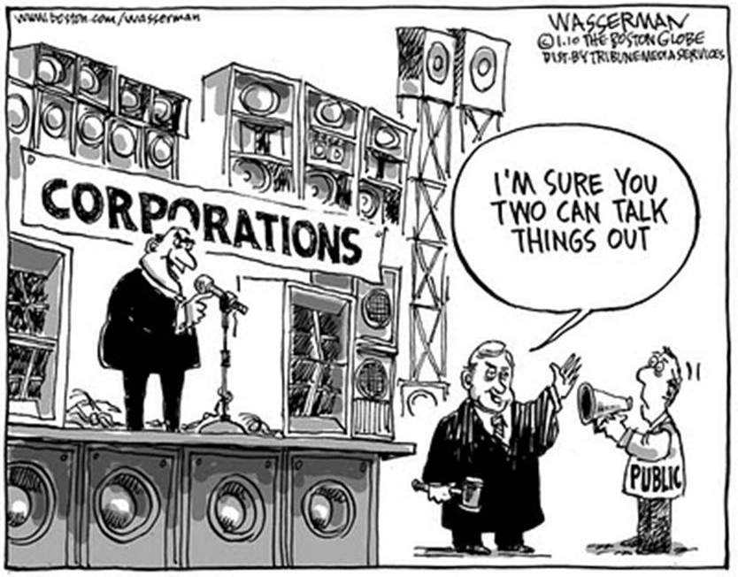
Topic 5.10-5.11 Chpt. 19
UNIT 5
Amsco pg. 605-627
Citizens United v. F.E.C., 2010
(Required Case)
5.10 Modern Campaigns & 5.11 Campaign Finance

Slide 2
TOPIC 5.10 Modern Campaigns
The impact of federal policies on campaigning and electoral rules continues to be contested by both sides of the political spectrum
Explain how campaign organizations and strategies affect the election process.
The benefits and drawbacks of modern campaigns are represented by:
Dependence on professional consultants
Rising campaign costs and intensive fundraising efforts
Duration of election cycles
Impact of and reliance on social media for campaign communication and fundraising

Slide 3
Political Fund-Raising Presidential Election Expenditures 1996-2020
1996 Clinton v. Dole | $87M
2004 Bush v. Kerry | 513M
2020 Trump v Biden | 14.4BILLION

Slide 4
Characteristics of a Modern Political Campaign
Why the increase costs?
Long election cycle- in some country's election cycles are 10 weeks or less. In USA 2 years out, Pres elections starts after midterms. The longer the cycle the more expensive campaigns become. Think Iowa and New Hampshire-caucus and primary start at beginning of the pres election year- Jan., Feb.
Complexity of campaigns- Require professional experts
- campaign manager
- public relations expert
- dedicated fundraisers
- social media consultants
3. Political Consultants- Professionals hired by a campaign to develop media strategy, fundraise, research and conduct polling.
No longer dependent on the political party for this support. Leading to a decline in the influence of political parties.
4. Paid employees and volunteers- make calls, visit residences to get the vote out for their candidate & raise money- canvassing
5. Increased reliance on social media for campaign communication and fundraising. “Viral" Marketing

Slide 5
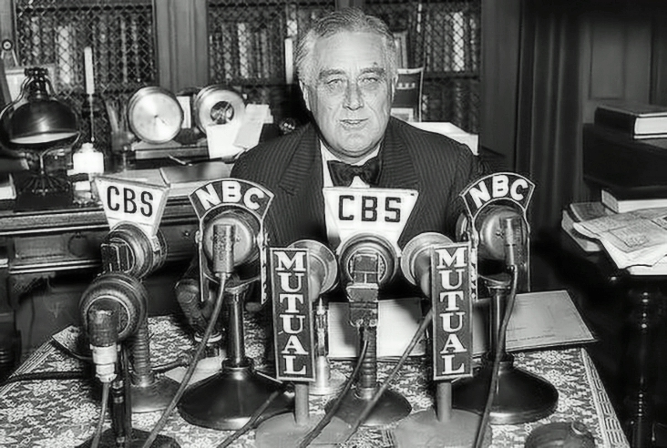
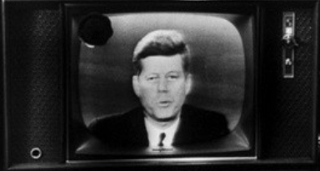
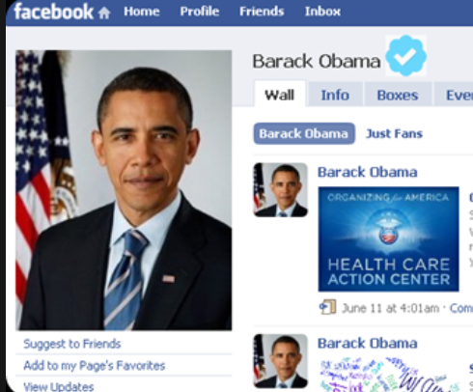
Social Media: Facebook
Facebook has dedicated staff that help political candidates reach voters by helping them use the platform to maximize its benefits. Because Facebook
knows everything about all if its users they know how to target political ads to people who will be receptive to them.
Presidential candidates have always exploited communication technologies to communicate with the masses. - Hiemler’s History
Obama- Facebook
FDR- Radio fireside chats
JFK- television

Slide 6
Social Media: Facebook
“Any candidate using Facebook can put a campaign message promising one thing in front of one group of voters while simultaneously running an ad with a completely opposite message in front of a different group of voters. The ads themselves are not posted anywhere for the general public to see (this is what’s known as ‘dark advertising’), and chances are, no one will ever be the wiser.
That undermines the very idea of a ‘marketplace of ideas,’ says Ann Ravel, a former member of the Federal Election Commission who has long advocated stricter regulations on digital campaigning. ‘The way to have a robust democracy is for people to hear all these ideas and make decisions and discuss,” Ravel said. ‘With microtargeting, that is not happening.’”
Julia Carrie Wong, "'It Might Work Too Well:' the Dark Art of Political Advertising Online," The Guardian, March 19, 2018.
Obama- Facebook
The effect of targeted campaign messages on different groups of voters, can directly affect voter mobilization efforts and voter turn out.
FDR- Radio fireside chats
JFK- television

Slide 7
What is all this money spent on?
Advertising- Presidential Campaign ads are very expensive

Slide 8
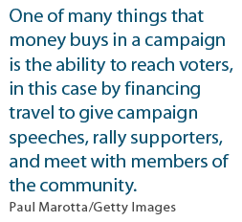
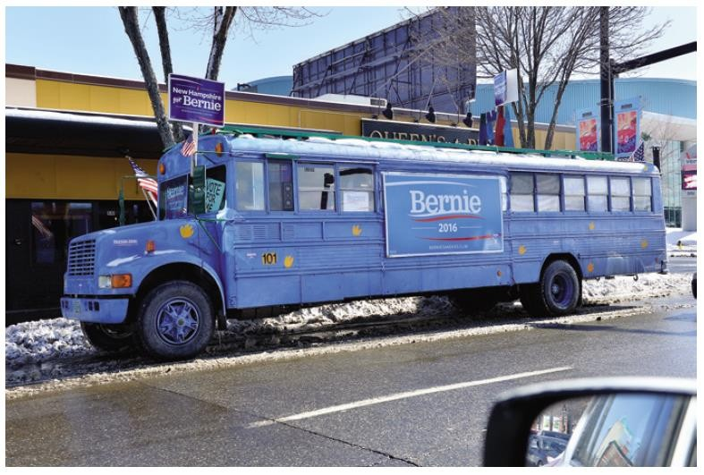
WHAT MONEY BUYS
The cost of a modern election has increased substantially in American campaigns
Buys media time – ads sway voters
Hire professional consultants
– Strategize campaign stops, manage message, arrange appearances, mobilize voters via GOTV efforts

Slide 9
What are the benefits and drawbacks of modern campaigns?
Dependence on professional consultants
How is this a positive and a negative?
Rising campaign costs and intensive fundraising efforts
How is this generally a negative?
Duration of election cycles
How is this generally a negative?
Impact of and reliance on social media for campaign communication and fundraising
How is this a positive and a negative?

Slide 10
https://www.youtube.com/watch?v=hT6EBFIe2Cc
TOPIC 5.11 Campaign Finance
The impact of federal policies on campaigning and electoral rules continues to be contested by both sides of the political spectrum
Federal legislation and case law pertaining to campaign finance demonstrate the ongoing debate over the role of money in political and free speech, as set forth in:
i. The Bipartisan Campaign Reform Actof 2002, which was an effort to ban soft
money and reduce attack ads with “Standby Your Ad” provision: “I’m [candidate’s name] and I approve this message”
ii. Supreme Court decisions that ruled political spending by corporations, associations, and labor unions is a form of protected speech under the First Amendment
Debates have increased over free speech and competitive and fair elections related to money and campaign funding (including contributions from individuals, political action committees [PACs], and political parties).
Different types of PACs influence elections and policy making through fundraising and spending.
REQUIRED SUPREME COURT CASE
Citizens United v. Federal Elections Commission (2010
Explain how the organization, finance, and strategies of national political campaigns affect the election process.

Slide 11
https://www.youtube.com/watch?v=hT6EBFIe2Cc
TOPIC 5.11 Campaign Finance
The impact of federal policies on campaigning and electoral rules continues to be contested by both sides of the political spectrum
Federal legislation and case law pertaining to campaign finance demonstrate the ongoing debate over the role of money in political and free speech, as set forth in:
Bipartisan Campaign Reform Act of 2002, which was an effort to ban soft money and reduce attack ads with “Stand by Your Ad” provision: “I’m [candidate’s name] and I approve this message”
Citizens United v. Federal Election Commission (2010), which ruled that political spending by corporations, associations, and labor unions is a form of protected speech under the First Amendment
Debates have increased over free speech and competitive and fair elections related to money and campaign funding (including contributions from individuals, political action committees [PACs], and political parties).
Different types of PACs influence elections and policy making through fundraising and spending.
REQUIRED SUPREME COURT CASE
Citizens United v. Federal Elections Commission (2010
Explain how the organization, finance, and strategies of national political campaigns affect the election process.

Slide 12
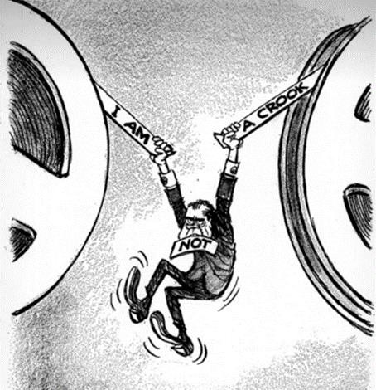
CAMPAIGN FINANCE REFORM
Limiting the role of money in political campaigns began with the Federal Election Campaign Act of 1971, 1974
You can thank Richard Nixon for this
Candidates must disclose funds and donors, there are limits on donations directly to candidates
Bipartisan Campaign Reform Act placed stricter limits on campaign contributions by individuals and PACs
Citizens United v. FEC struck down portions of the BCRA

Slide 13
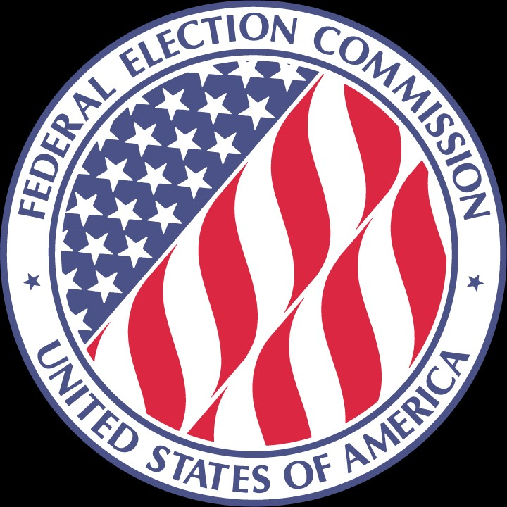
EFFORTS TO REFORM
Post-Watergate reforms – The Federal Election Campaign Act (FECA)
limited the amount that candidates for federal office can spend on media advertising
established a fund for public donations to PRESIDENTIAL campaigns (not done for congressional campaigns)
set up rules for the disclosure of all campaign financing and spending information
established limits on personal contributions to presidential and congressional candidates
established the Federal Election Commission to regulate campaign financing
Buckley v. Valeo (1976)
Supreme Court case that challenged most of the provisions in the Federal Election Campaign Act, as amended in 1974.
Supreme Court upheld the law's requirements that candidates, parties, PACs and groups engaging in express advocacy disclose their fund-raising and spending.
Supreme Court also affirmed voluntary public financing and limits on individual contributions.
Supreme Court struck down, as infringements on free speech, limits on campaign spending (unless the candidate accepts public financing), limits on contributions by candidates to their own campaigns (unless publicly financed) and limits on independent expenditures (election spending by outside interest groups not coordinated with candidates or their committees).

Slide 14
EFFORTS TO REFORM
Post‑Watergate reforms
1974 amendments to FECA established realistic limits on contributions and spending, tightened disclosure, and provided for public ﬁnancing of presidential campaigns; the amount of public subsidy rises with inﬂation
The law had to be amended after the 1976 Buckley v. Valeo decision, but the basic outline of the act remained unchanged
Buckley v. Valeo
SC case that challenged most of the provisions in the Federal Election Campaign Act, as amended in 1974.
SC upheld the law's requirements that candidates, parties, PACs and groups engaging in express advocacy disclose their fund-raising and spending.
SC also aﬃrmed voluntary public ﬁnancing and limits on individual contributions.
SC struck down, as infringements on free speech, limits on campaign spending (unless the candidate accepts public ﬁnancing), limits on contributions by candidates to their own campaigns (unless publicly ﬁnanced) and limits on independent expenditures (election spending by outside interest groups not coordinated with candidates or their committees).
14

Slide 15
Bipartisan Campaign Reform Act (BCRA)
Enacted in 2002, the Bipartisan Campaign Reform Act, commonly called the McCain-Feingold Act, is a major federal law regulating ﬁnancing for federal political candidates and campaigns. The law was designed to address two key campaign ﬁnance issues: soft money and issue advocacy.
According to the Congressional Research Service, soft money is "a term of art referring to funds generally perceived to inﬂuence elections but not regulated by campaign ﬁnance law." Prior to the enactment of McCain-Feingold, this included "large contributions from otherwise prohibited sources, [which] went to party committees for 'party-building' activities that indirectly supported elections." The law prohibited national political parties, federal candidates, and oﬃceholders from soliciting soft money contributions in federal elections.
In addition, McCain-Feingold barred corporations and unions from using their treasury funds to ﬁnance issue advertisements (sometimes called electioneering communications), which are deﬁned as "broadcast ads referring to clearly identiﬁed federal candidates within 60 days of a general election or 30 days of a primary election or caucus." In 2010, the United States Supreme Court ruled in Citizens United v. Federal Election Commission that this provision was unconstitutional.
15

Slide 16
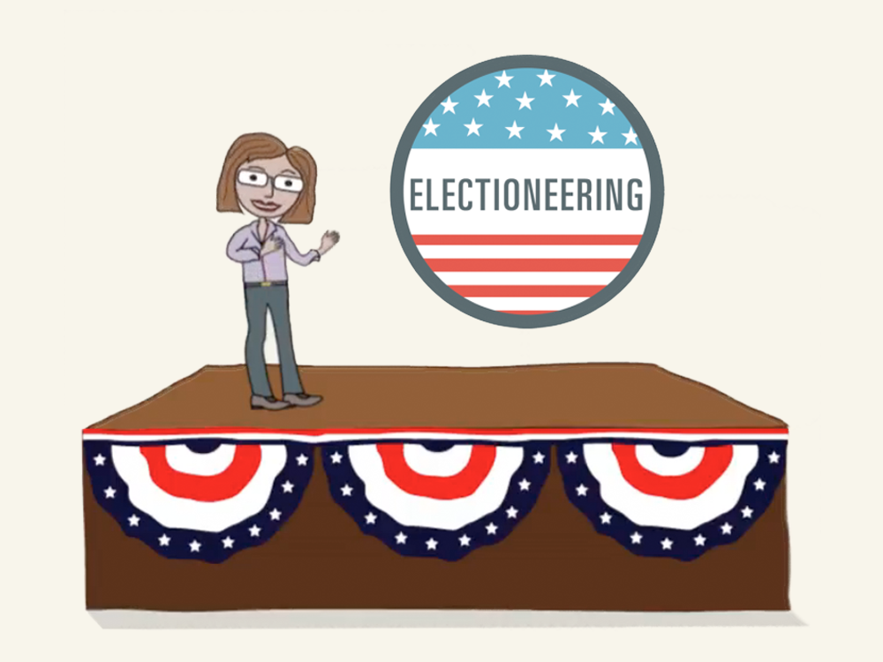
Electioneering
Electioneering is the activities that politicians and their supporters carry out in order to persuade people to vote for them or their political party in an election, for example making speeches and visiting voters.

Slide 17
Bipartisan Campaign Reform Act
According to the Federal Election Commission, the Bipartisan Campaign Reform Act "includes several provisions designed to end the use" of soft money in federal elections. Soft money is deﬁned as "money raised outside the limits and prohibitions of federal campaign ﬁnance law." Soft money is sometimes referred to as nonfederal money (meaning that the money is not subject to federal law). Speciﬁcally, the Bipartisan Campaign Reform Act does the following:
prohibits national political party committees from receiving or using soft money in federal elections
prohibits state, district and local political parties from receiving or using soft money for federal election activities; for speciﬁed activities, including voter registration drives and get-out-the- vote activities, these parties can use nonfederal funds
prohibits federal candidates and oﬃce holders from raising or using soft money for federal election activities
KNOW THIS
17

Slide 18
Bipartisan Campaign Reform Act
Issue advocacy refers to political advertising focused on "broad political issues rather than speciﬁc candidates." It does not attempt to persuade the public of particular electoral outcomes, but rather seeks to highlight broader political or social issues. Issue advocacy is distinguished from express advocacy, which expressly and clearly supports or opposes a particular electoral outcome. Express advocacy advertisements include "for" or "against" statements. Candidate-supported advertisements, for instance, which expressly state whether to vote for or against a candidate, are by deﬁnition express advocacy. Advertisements focused on broader issues, which do not use express statements of support or opposition, are by deﬁnition issue advocacy. Issue advertisements may make speciﬁc mention of a candidate or oﬃcial, but such advertisements not explicitly call for the election or defeat of that candidate or oﬃcial (instead, such ads may urge viewers to contact the named candidate or oﬃcial).
The Citizens United decision allows for unlimited spending on issue advocacy if it is not coordinated with the campaign.
The Bipartisan Campaign Reform Act deﬁned issue advertisements as electioneering communications. Electioneering communications are distributed within 30 days of a primary election or 60 days of a general election. The law prohibited corporations and labor unions from funding issue advertisements. This prohibition was struck down by the United States Supreme Court in 2010.

Slide 19
Citizens United v. F.E.C. (2010) – REQUIRED CASE
This case, however, is not about direct donations to candidates. Instead, this case is about how and when companies and other organizations can spend their own money to advocate the election or defeat of a candidate.
Facts
One of the federal laws that regulates how election money can be raised and spent is the Bipartisan Campaign Reform Act (BCRA), also known as the McCain- Feingold Act. Passed in 2002, one part of this law dealt with how corporations and unions could spend money to advocate the election or defeat of a candidate. The law said that corporations and unions could not spend their own money on campaigns. Instead, they could set up political action committees (PACs). Employees or members could donate to the PACs, which could then donate directly to candidates or spend money to support candidates. The law prohibited corporations and unions from directly paying for advertisements that supported or denounced a speciﬁc candidate within 30 days of a primary election or 60 days of a general election. It is this part of the BCRA that is at issue in Citizens United v. Federal Election Commission.
In 2008, Citizens United, a non-proﬁt organization funded partially by corporate donations, produced Hillary: The Movie, a ﬁlm created to persuade voters not to vote for Hillary Clinton as the 2008 Democratic presidential nominee. Citizens United wanted to make the movie available to cable subscribers through video- on-demand services and wanted to broadcast TV advertisements for the movie in advance. The Federal Election Commission said that Hillary: The Movie was intended to inﬂuence voters, and, therefore, the BCRA applied. That meant that the organization was not allowed to advertise the ﬁlm or pay to air it within 30 days of a primary election. Citizens United sued the FEC in federal court, asking to be allowed to show the ﬁlm. The district court heard the case and decided that even though it was a full length movie and not a traditional television ad, the ﬁlm was deﬁnitely an appeal to vote against Hillary Clinton. This meant that the bans in the BCRA applied: corporations and organizations could not pay to air this sort of direct appeal to voters so close to an election.
Because of a special provision in the BCRA, Citizens United was allowed to appeal the decision directly to the U.S. Supreme Court, which the organization did. Citizens United asked the Court to decide whether a feature-length ﬁlm really fell under the rules of the BCRA and whether the law violated the organization’s First Amendment rights to engage in political speech. The Supreme Court agreed to hear the case and heard oral argument in March 2009. Two months later the Supreme Court asked both parties to submit additional written responses to a further question: whether the Court should overrule its prior decisions about the constitutionality of the BCRA. The Court scheduled a second oral argument session for September 2009.
Issue
Does a law that limits the ability of corporations and labor unions to spend their own money to advocate the election or defeat of a candidate violate the First Amendment’s guarantee of free speech?
Majority Decision
The Court ruled, 5–4, that the First Amendment prohibits limits on corporate funding of independent broadcasts in candidate elections. The justices said that the government’s rationale for the limits on corporate spending—to prevent corruption—was not persuasive enough to restrict political speech. A desire to prevent corruption can justify limits on donations to candidates, but not on independent expenditures (spending that is not coordinated with a candidate’s campaign) to support or oppose candidates for elected oﬃce. Moreover, the Court said, corporations have free speech rights and their political speech cannot be restricted any more than that of individuals. The majority did not strike down parts of the BCRA that require that televised electioneering communications include disclosures about who is responsible for the ad and whether it was authorized by the candidate.

Slide 20
Citizens United v. F.E.C. (2010) – REQUIRED CASE
On January 21, 2010, the United States Supreme Court ruled that the First Amendment right to freedom of expression applies to corporations; thus, the government cannot limit political spending by corporations. Justice Anthony Kennedy penned the majority opinion, which was joined by Chief Justice John Roberts and Justices Clarence Thomas, Samuel Alito and Antonin Scalia.
“Although the First Amendment provides that “Congress shall make no law ... abridging the freedom of speech,”
441b’s prohibition on corporate independent expenditures is an outright ban on speech, backed by criminal sanctions. It is a ban not withstanding the fact that a PAC created by a corporation can still speak, for a PAC is a separate association from the corporation. Because speech is an essential mechanism of democracy
it is the means to hold oﬃcials accountable to the people—political speech must prevail against laws that would suppress it by design or inadvertence.”
—Justice Anthony Kennedy
The court upheld requirements for disclaimer and disclosure by the sponsors of political advertisements. The court also sustained the prohibition against direct contributions by corporations to candidates.
8

Slide 21
Citizens United v. Federal Election Commission (2010) REQUIERED CASE
Facts: BCRA prohibited corporations or non-profits to engage in electioneering communications for 60days before an election or 30 days before a primary. During 2008 primaries, Citizens United, a conservative non-profit org. was prevented by the FEC from showing anti-Hillary movie, Hillary: The Movie. The movie was meant to derail her attempt to win the presidency
Holding(s) 5-4 decision
Limitations put upon Corporations to run political advertisements and communications were not materially different from government censorship of speech towards individuals. That part of BCRA was struck down.
Corp, unions, int groups can raise & spend unlimited amounts of money.
Led to Super PACs=Expenditures Only Committee.
Constitutional Principle: First Amendment’s free speech clause, corporations have the right to engage in political speech. BCRA limited free speech & since corporations are associations of people, they to have free speech.
Why It matters: Since money equal speech in the political arena, is it fair for those with the most money to have the loudest voices? In this case, the SC said yes. As long as these organizations DO NOT collaborate directly with the candidate. Could this lead to quid pro quo? I helped you get elected and now you owe me? Hmmm…

Slide 22
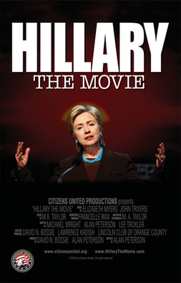
No Can’t Show!!!
Violated the BCRA. Wanted to show movie with in that 30-day window. Citizens United sued for violation of free speech.

Slide 23
Interest Groups / Lobbyist
What are interest groups/ lobbyist?
Give me some examples.

Slide 24
24

Slide 25
MONEY AND POLITICS
EXPLOSIVE GROWTH OF PACs-POLITICAL ACTION COMMITTEES
Interest groups use PACs to raise and spend money on election campaigns
A PAC is a registered organization that donates money to campaigns and causes
In 1974, only 600 PACs existed. Now: more than 4600.
Reason: Congressional legislation that had the intent of preventing a few wealthy campaign contributors from helping candidates “buy” elections. Instead, Cong. wanted to “open up” campaign contributions to the masses, as represented by PACs.
PACs even donate to candidates facing no opposition. Why?
Important to keep things in perspective: most congressional campaign money comes from individual contributions.

Slide 26
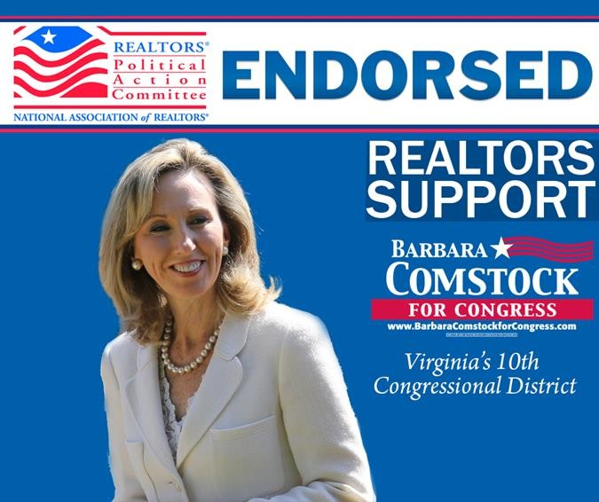
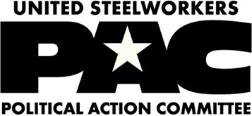
WHAT ARE PACS (POLITICAL ACTION COMMITTEES)?
Groups in American society form political action committees (PACs) so they can influence policy. PACs are formed to influence policy to help out their members.
Political Action Committees, commonly called "PACs," are organizations dedicated to raising and spending money to either elect or defeat political candidates.
PACs solicit contributions from employees or members and make contributions in the PACs name to candidates or political parties.
Most PACs are directly connected to specific corporations, labor groups, or recognized political parties.
Non-connected or ideological PACs raise and spend money to elect candidates -- from any political party -- who support their ideals or agendas
Under federal election laws, PACs can legally contribute only $5,000 to a candidate committee per election (primary, general or special). They can also give up to $15,000 annually to any national party committee, and $5,000 annually to any other PAC.

Slide 27
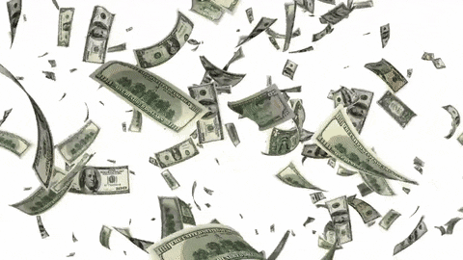
Political Action Committees
Under federal election laws, PACs can legally contribute only $5,000 to a candidate committee per election (primary, general or special). They can also give up to $15,000 annually to any national party committee, and $5,000 annually to any other PAC.

Slide 28
THE ROLE OF POLITICAL ACTION COMMITTEES (PACs)
PACs link two techniques of inﬂuence
Giving money and other political aid to politicians
Persuading oﬃceholders to act or vote "the right way" on issues

Slide 29
THE GROWTH OF PACs
The 1970s brought a near revolution in the role and inﬂuence of PACs, as the result of post Watergate reforms, increasing the number of PACs from 150 to more than 4,000 today
Corporations make up the majority of all PACs

Slide 30
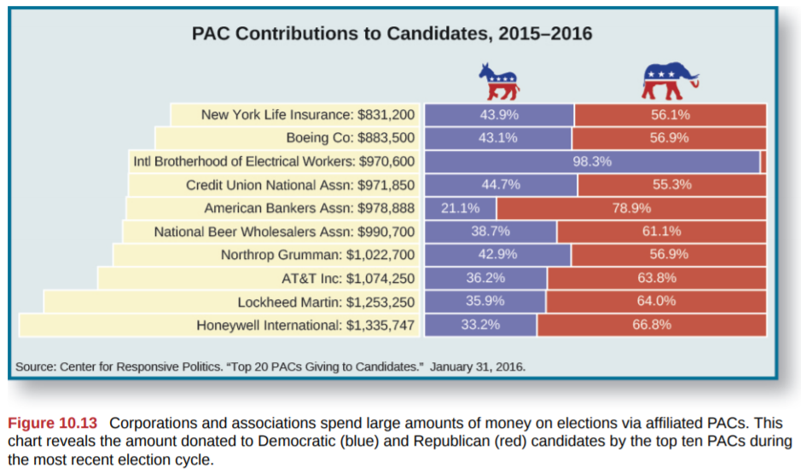
Political Action Committees

Slide 31
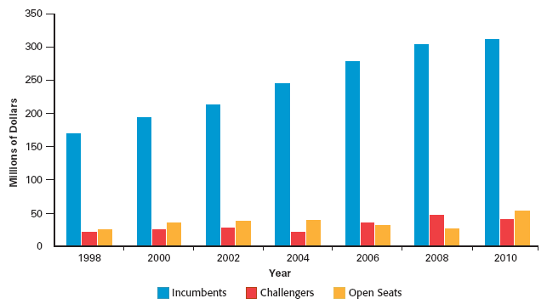
PAC CONTRIBUTIONS TO CONGRESSIONAL CANDIDATES, 1998-2010
10

Slide 32
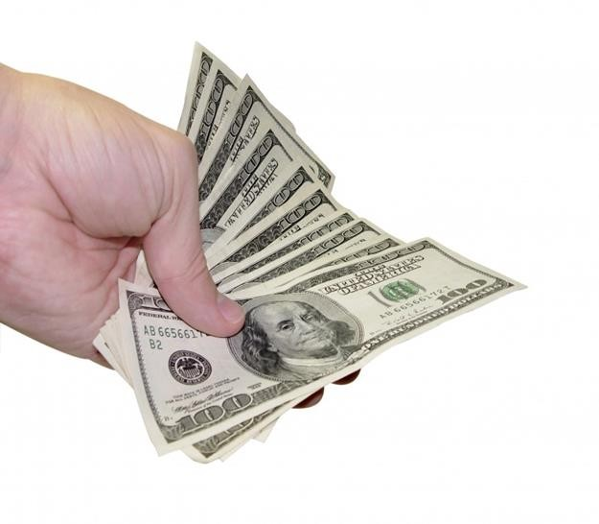
HOW PACs INVEST THEIR MONEY
Campaign Contributions – Factors influencing who gets PAC money:
Incumbents (Political party affiliation is of little importance.)
Incumbents win
Incumbents have shown to support the PAC’s positions
Incumbents hold committee seats = more power
Winners
Those who share a similar philosophy
Those who are likely to grant access
Tightness of a race, and the likelihood that the money will help make a difference in the outcome
Whether or not a candidate holds a committee seat of special importance to the PAC
PAC money makes up a higher % of congressional campaign funds than presidential campaign funds
Voter education projects (mailings, fliers, commercials)
Independent expenditures
Through "bundling" contributions, PACs increase their clout with elected officials

Slide 33
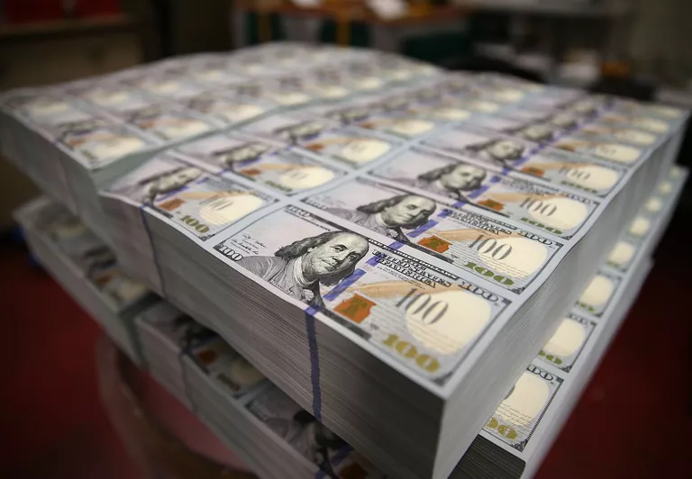
By Tom Murse, Oct. 21, 2019
Bundling campaign contributions is a common practice in American congressional and presidential elections.
The term bundling refers to a form of fundraising in which one person or small groups of people—lobbyists, business owners, special interest groups, or activists seeking legislative action—convince their wealthy friends, co-workers, and other like-minded donors to simultaneously write checks to their preferred candidate for public office
It is not uncommon for bundlers to raise hundreds of millions of dollars in a presidential-election year and receive special treatment in return for their work.
A bundler is a person or small group of people who pool or aggregate these contributions and then deliver them in one lump sum to a political campaign. In the 2000 presidential campaign, Republican nominee George W. Bush used the term "pioneers" to describe bundlers who raised at least $100,000 for his White House bid.
Bundlers are often rewarded by successful candidates with plum positions in an administration or other political favors. Four out of five of Democratic presidential nominee Barack Obama's largest fundraisers in the 2008 presidential campaign received key posts in his administration, according to the Washington, D.C.-based Center for Responsive Politics.
Bundling is a legal way for campaign supporters to circumvent individual contribution limits set forth in federal campaign finance laws.
https://www.thoughtco.com/bundling-political-contributions-legal-and-illegal-3367621

Slide 34
THE GOOD, THE BAD, AND THE ‘EH’ OF PACS
THE BAD- The Dangers
Ethical concerns: does a contribution “buy” anything?
Special access of PACs that the average person lacks
Drives up the cost of campaigning
Over representation of those wealthy enough to have PAC representation
Under representation of those who lack such representation
Further incumbency advantage in elections
THE GOOD- In Defense of PACs
PACs provide a means of participation and representation for the average person
Without PACs, only the wealthy could afford to run for office
1st Amendment’s right to petition the government
Contributions are nonpartisan
No conclusive evidence that PACs change congressional votes. Contributions likely to make a difference in arcane, obscure issues with little public awareness more than in issues of major importance with much public awareness.
PACs provide political education
PACs diversify political funding. W/over 4600 PACs, many interests are represented.
THE ‘EH’
It is what it is
At least we don’t have SuperPACs (or do we?)
11

Slide 35
THE EFFECTIVENESS OF PACs
Depends on the context in which money is given and received
Signiﬁcant relationship exists between PACs giving money and receiving favorable treatment in congressional committees; still debatable on impact of contributions upon election outcomes
PACs can help friendly incumbents with soft money contributions (unlimited contributions that presumably go for "party‑building" activities)

Slide 36
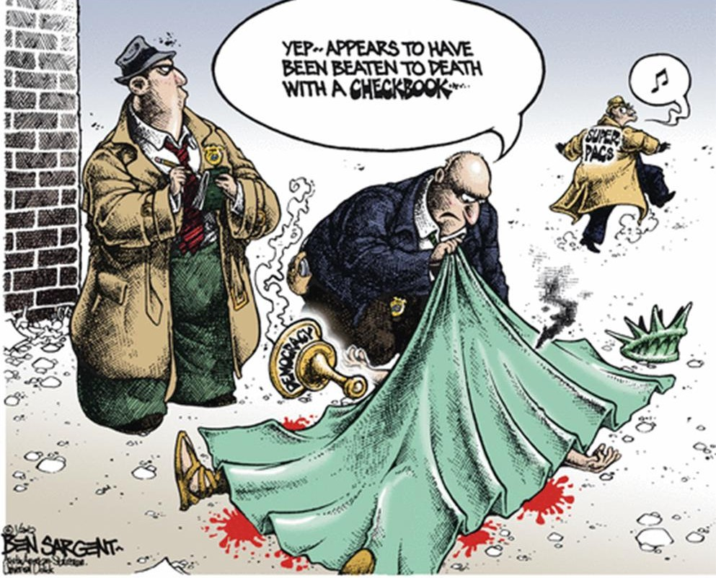
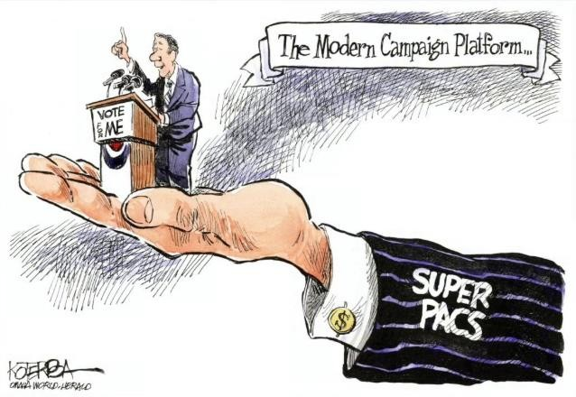
SUPER PACS
Officially known as "independent-expenditure only committees"
May not make contributions to candidate campaigns or parties, but may engage in unlimited political spending independently of the campaigns
Unlike traditional PACs, they can raise funds from corporations, unions and other groups, and from individuals, without legal limits
Citizens United v. FEC (2010)
501(c) group
Nonprofit, tax-exempt interest groups that can
engage in varying levels of political activity
Not subject to FEC disclosure rules
14

Slide 37
SUPER PACS

Slide 38
SUPER PACS

Slide 39
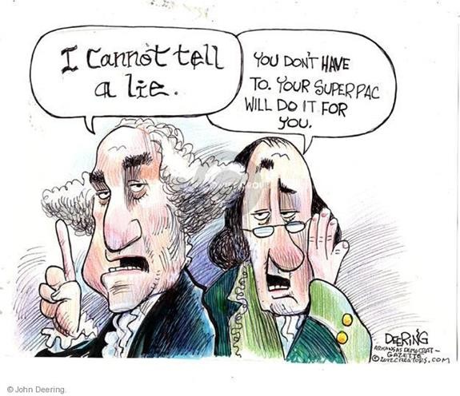
SUPER PACS
Super PACs came into existence in 2010 when federal court decisions found that limitations on both corporate and individual contributions is an unconstitutional violation of the 1st Amendment.
The most important difference between a PAC and a Super
PAC is in who can contribute and in how much they can give
Candidates can accept up to 5K per election from a PAC; they cannot accept money from corporations, unions and associations
For Super PACs there is no limit on who contributes or how much they can contribute but they cannot work in conjunction with the candidate they are supporting
Clinton Super PAC ad https://www.youtube.com/watch?v=C0l3L35FIWM&feature=youtu.be

Slide 40
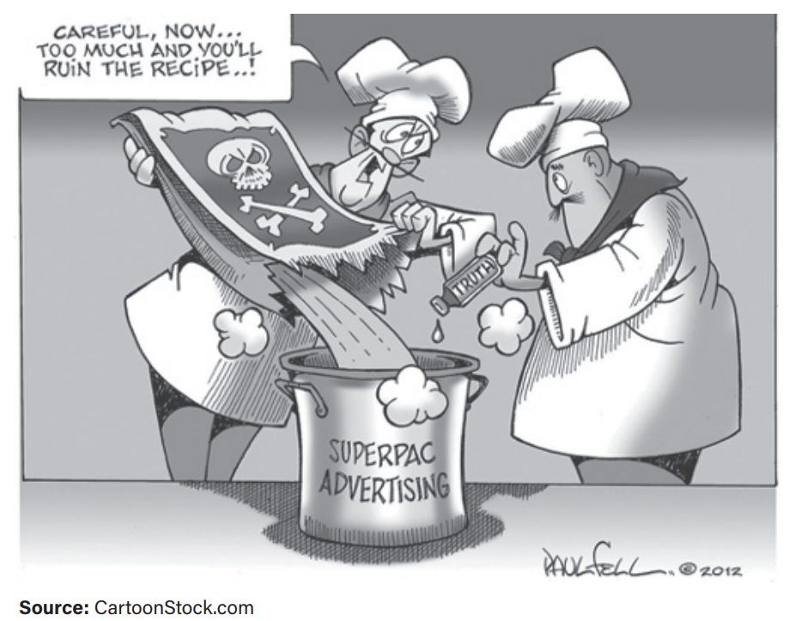
AMSCO pg. 658

Slide 42
RESISTING REFORM
Issue Advocacy
Deﬁnition – Promoting a particular position or an issue paid for by interest groups or individuals but not candidates
SC ruled that groups were free to run ads during the campaign season as long as the ads did not use words such as “vote for” or “vote against” a speciﬁc candidate, “defeat” or “elect”
Interest groups found ways to avoid disclosure or to communicate an electioneering message

Slide 43
RESISTING REFORM
Independent expenditures
Deﬁnition – Money spent by individuals or groups not associated with candidates to elect or defeat candidates for oﬃce
Current ﬁnance laws do not constrain independent expenditures by groups or individuals who are separate from political candidates due to free speech
Political parties have the same rights to make independent expenditures aﬀorded to groups and individuals

Slide 44
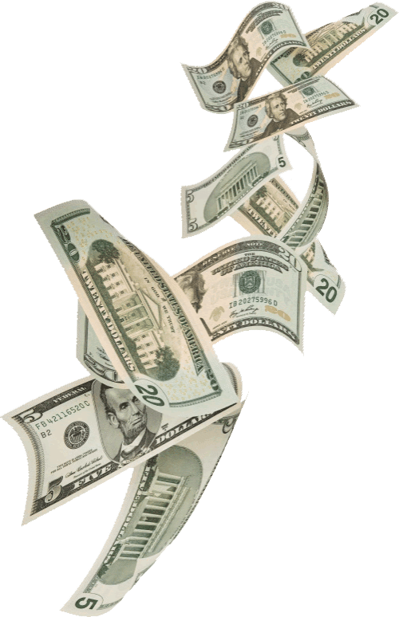
EFFORTS TO REFORM
Soft money
Deﬁnition – Funds given to state and local parties by political parties, individuals, or PACs for voter registration drives and party mailings
Federal law does not require disclosure of its source or use
Although soft money is supposed to beneﬁt only state and local parties, it inﬂuences federal elections
Mostly illegal now; Soft money >> purchased access to elected oﬃcials >> inﬂuence and the possibility or appearance of corruption

Slide 45
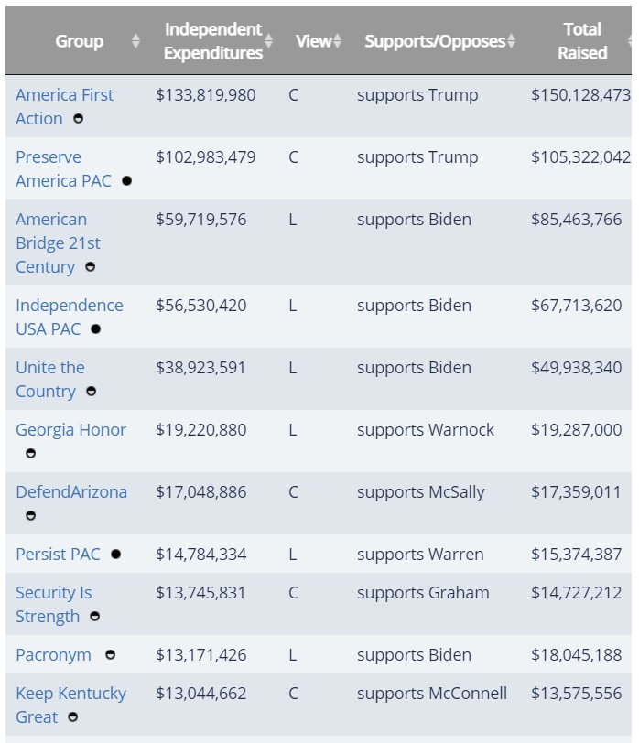
$uperPACs and Independent
Expenditures
(notice the background is the color of money)
16

Slide 46
2016 Outside Spending, by Single- Candidate Super PAC

Slide 48
CONTINUING PROBLEMS WITH CAMPAIGN FINANCE
Rising costs of campaigns
Since the FECA became law in 1972, total expenditures by candidates for the House have more than doubled after controlling for inflation, and they have risen even more in Senate elections
Declining competition
The high cost of campaigns dampens competition by discouraging individuals from running for office (challengers in both parties are underfunded)
Dependence on PACs for congressional incumbents
PACs do not want to offend politicians in power, and politicians in power want to stay in office
Politicians turn to individual donors who can contribute $500 or $1,000 to their campaigns
Donors want access and politicians to respond to their concerns and/or pass certain policies
PAC defenders argue there is no proven link between contributions and legislators’ votes
Candidates’ personal wealth
Growth in individual contributions and use of the internet to fund campaigns

Slide 49
WHAT MONEY BUYS
The cost of a modern election has increased substantially in American campaigns
Buys media time – ads sway voters
Hire professional consultants
– Strategize campaign stops, manage message, arrange appearances, mobilize voters via GOTV efforts

Slide 50
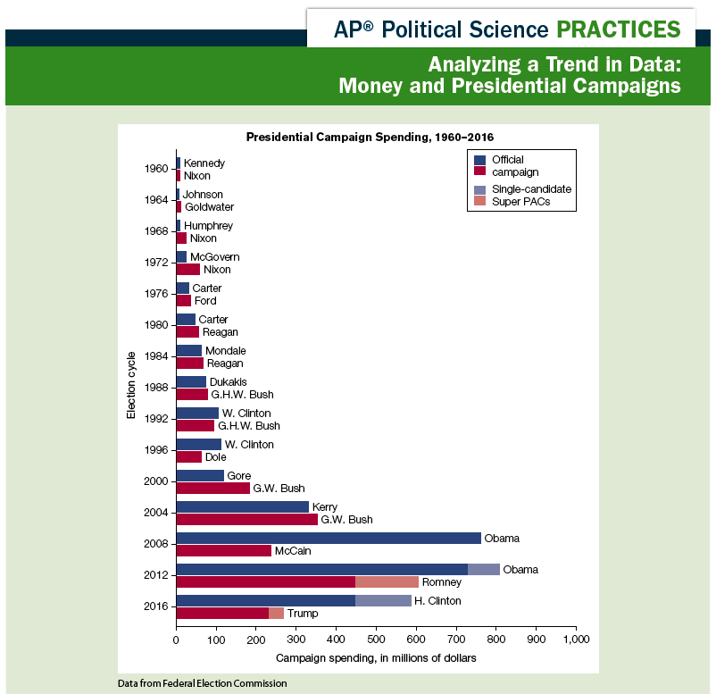

Slide 51
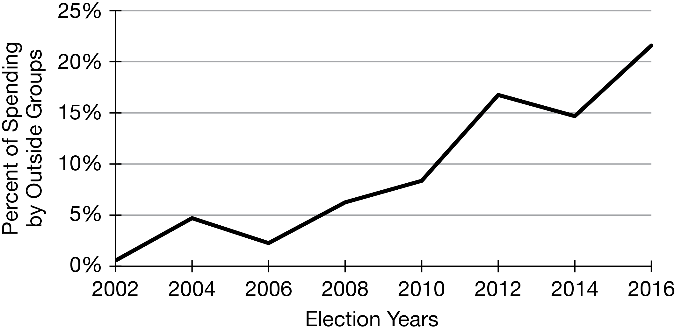
A. Identify a year from the line graph when there was a decline in the percentage of federal election spending by outside groups.
B. Describe an overall trend in the data after 2010.
C. Draw a conclusion as to why that overall trend occurred after 2010.
D. Explain how federal elections have changed based on the data presented in the line graph.

Slide 52
Identify a year from the line graph when there was a decline in the percentage of federal election spending by outside groups.
2006, 2014
B. Describe an overall trend in the data after 2010.
Overall, there has been an increase in the percentage of political spending by outside groups in federal elections.
C. Draw a conclusion as to why that overall trend occurred after 2010.
In 2010, the Supreme Court released the decision Citizens United v. The Federal Election Commission (FEC), which held that under the First Amendment, corporate funding of political information is free speech that cannot be limited. Since the ruling in 2010, more corporations and outside groups have made significant financial contributions to federal elections.
D. Explain how federal elections have changed based on the data presented in the line graph.
Federal elections have become more costly because outside interest groups are funneling more money into the election cycle. This means that outside groups may have a greater chance to influence the results of elections.
Outside groups are spending more money on elections. Because of Citizens United v. FEC, more outside groups are involved in the elections process than ever before. These groups can contribute large amounts of unregulated money without disclosing to the FEC who donated the money, making it impossible for citizens to cast a ballot that reflects full knowledge of which groups have an influence on the candidate’s policy positions.

