Slide 1
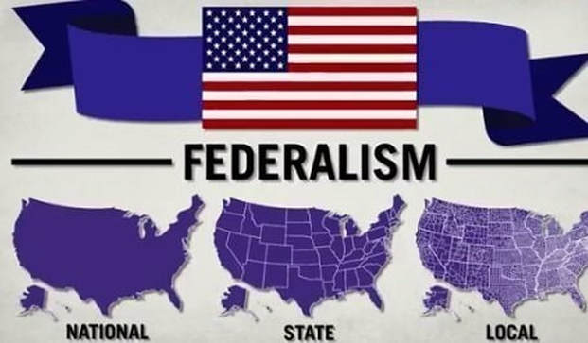
Federalism Topic 1.7
AMSCO Chpt. 3 Federalism
Pg. 57-65, Wapples pg. 148-214
Required Documents:
U.S. Constitution
Federalist No. 51
Supreme Ct Cases
McCulloch v. Maryland (1819)
United States v. Lopez (1995)
Chpt. 3 Topic 1.7-1.9
Relationship Between the States & the National Government

Slide 2
TOPIC 1.7 Relationship Between the States and Federal Government
Federalism reflects the dynamic distribution of power between national and state governments.
Explain how the
constitutional allocation of
power between the national
and state governments
affects society.
Federalism is the system of government in the United States in which power is shared between the national and state governments.
The exclusive and concurrent powers of the national and state governments help explain the ongoing debate over the balance of power between the two levels.
Exclusive power is held by only one level of government and includes enumerated powers that are written in the Constitution, and implied powers that are not specifically written in the Constitution but are inferred from the Necessary and Proper Clause.
Reserved powers are those not delegated or enumerated to the national government but are reserved to the states, as stated in the Tenth Amendment.

Slide 3
TOPIC 1.7 Relationship Between the States and Federal Government
Federalism reflects the dynamic distribution of power between national and state governments.
Concurrent powers are shared between both levels of government (fed and state govts) such as the power to collect taxes, the power to make and enforce laws and the power to build roads.
Explain how the
constitutional allocation of
power between the national
and state governments
affects society.
The distribution of power between national and state governments is demonstrated by:
i. Revenue sharing (national funding with almost no restrictions to the states on its use and is the least used form of funding)
ii. Block grants (national funding with minimal restrictions to the states on its use and is preferred by the states)
iii. Categorical grants (national funding that is restricted to specific categories of expenditures, is preferred by the national
government, and is the most commonly used form of funding)
iv. Mandates (requirements by the national government of the states)

Slide 4
TOPIC 1.7 Relationship Between the States and Federal Government
Federalism reflects the dynamic distribution of power between national and state governments.
Explain how the
constitutional allocation of
power between the national
and state governments
affects society.
The exclusive and concurrent powers of the national and state governments help explain the negotiations over the balance of power between the two levels.
The distribution of power between federal and state governments to meet the needs of society changes, as reflected by grants, incentives, and aid programs, including federal revenue sharing, mandates, categorical grants, and block grants

Slide 5
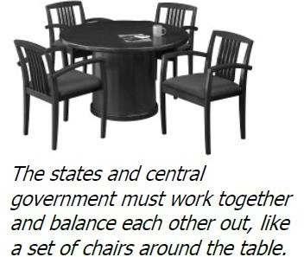
WHAT IS FEDERALISM?
DEFINITION - Constitutional division of powers between the national government and the states; both get their powers from Constitution, not each other
Constitution (federally based) replaced Articles (confederation based)
Federal system is NOT as efficient as a unitary system (which can be good)
Federalism debates depend upon issue at stake and rival philosophies of national action vs. decentralization (be able to explain what this means)
Since the New Deal in the 1930s to today, there has been a shift of power from the states to the national government; since 1994 elections there has been an attempt to return power to the states
Federalism issues are at the top of the political agenda along with the issue of devolution (what is devolution?)
FEDERALISM
5

Slide 6
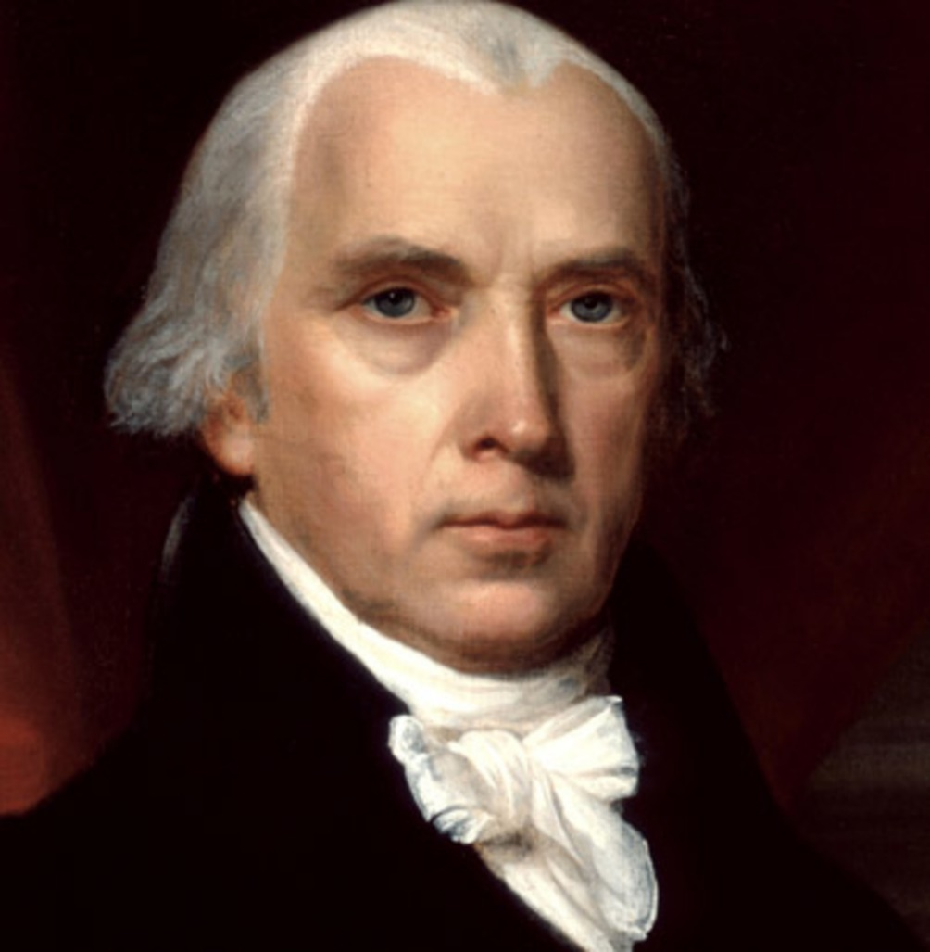
The powers delegated by the Constitution to the federal government are few and defined.
-James Madison

Slide 7
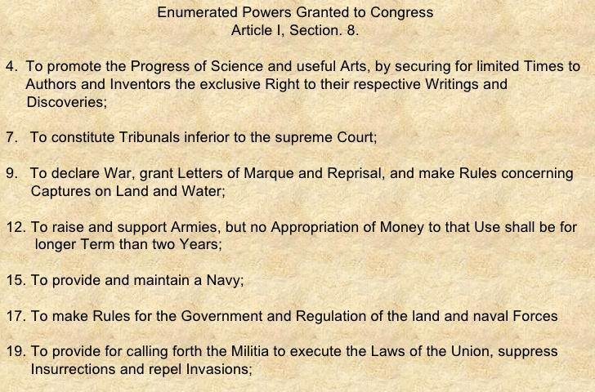

WHAT ARE POWERS GRANTED TO THE NATIONAL GOVERNMENT?
Powers granted ONLY to the national government are known as exclusive powers (Not all national powers are exclusive - such as tax)
Expressed (enumerated, delegated) powers
  Actually stated in the Constitution
  Many are listed (enumerated) in Article 1,
Section 8
Inherent powers
Not stated explicitly but held by the national government by virtue of its being a national government.
Some of these powers come from the Preamble (certain foreign policy powers such as immigration, diplomatic recognition, or acquiring territory).
7

Slide 8

WHAT ARE POWERS GRANTED TO THE NATIONAL GOVERNMENT?
Implied powers
  Not stated explicitly, but suggested implicitly
  Allow the national government to extend its powers beyond those expressed/enumerated in the Constitution
  Importance of necessary and proper clause (elastic clause)
    Hey! Isn’t this Article I, Section 8, Clause 18
    Example
      Power to Tax (Expressed – it’s in the Constitution)
      Power to throw you in jail for not paying taxes (Implied – not stated in Constitution, but can be implied from an express/enumerated power)
8

Slide 9
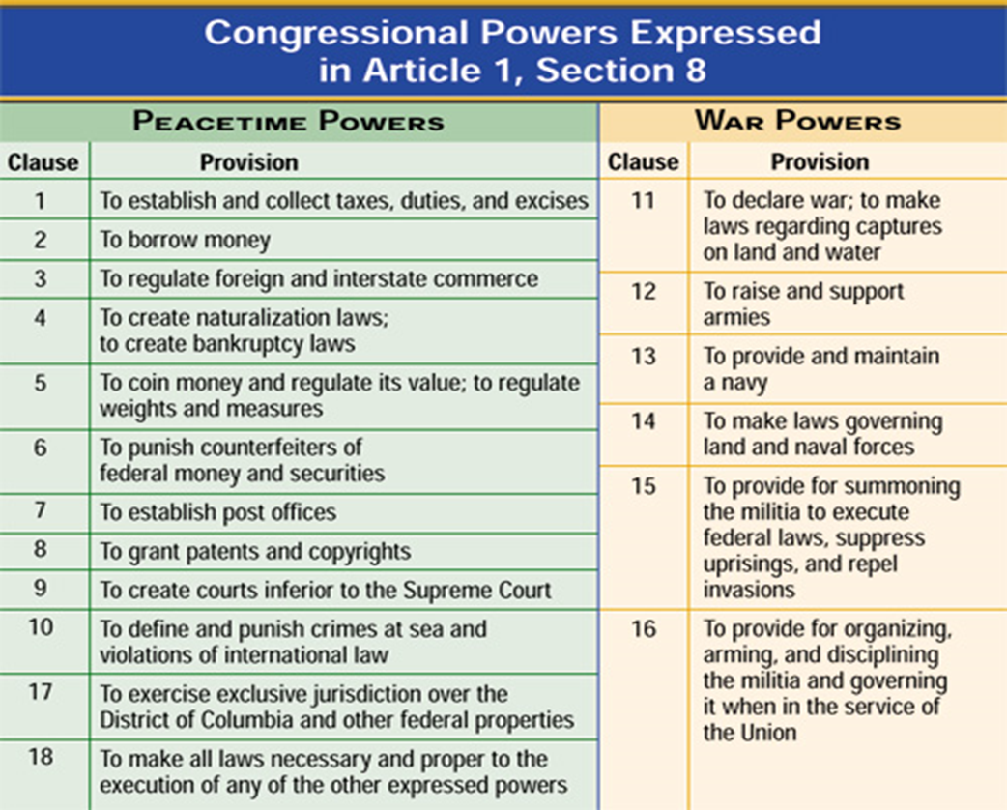
Enumerated Powers of Congress
EXCLUSIVE/ENUMERATED or LISTED Powers of Congress sometimes referred to as the EXPRESSED POWERS are delegated ONLY to Congress
National needs required consistency across state lines, such as having uniform weights and measures and a national currency

Slide 10
CONCURRENT POWERS or SHARED POWERS
Each state has concurrent powers with the national government
Granted to Congress, but not denied by Constitution or courts to the states
>> held by both national and state governments
Examples:
  Taxing- state gasoline tax, federal gasoline tax
  Borrowing
  Establishing court system
  Establishing law enforcement agencies
Questions of federal/state authority are decided by courts

Slide 11
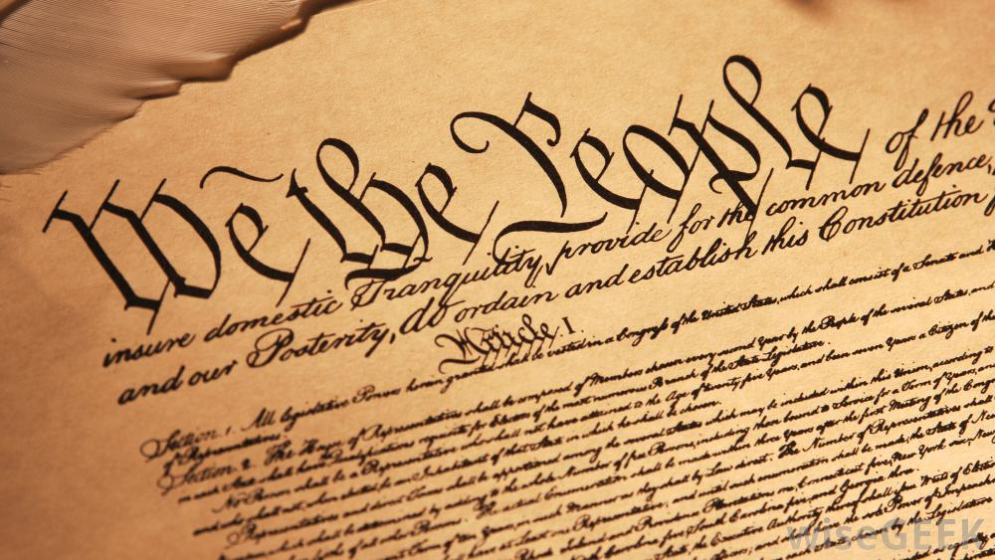


POWERS DENIED TO CONGRESS
Article I, Section 9
The founders also put limits on the powers of Congress
Passing ex post facto laws-A law that makes an action a crime even though it was legal when it was committed or increases the penalty for a crime after it has been committed. Under the Constitution, neither the states nor Congress can pass such a law.
Passing bills of attainder- A law that makes a person guilty of a crime without a trial. Neither Congress nor the states can enact such a law under the Constitution.
Suspending habeas corpus except in cases of rebellion or invasion
habeas corpus- A court order directing authorities to show cause for why a person under detention should not be released.
11

Slide 12
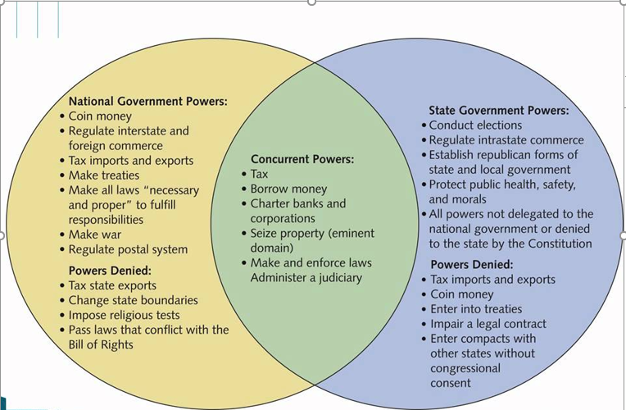
Federalism: A Sharing of Powers
Shared Powers

Slide 13
Provisions Defining Federalism, AMSCO pg. 58
The exclusive and concurrent powers of the national and state governments help explain the ongoing debate over the balance of power between the two levels.
CONSTITUTIONAL PROVISIONS THAT GUIDE FEDERALISM
Article 1, Section 8 | Enumerated/ Expressed powers of Congress, including the necessary and proper clause- Powers exclusive only to Congress
Article 1, Section 9 | Powers denied Congress; No regulating slave trade before 1808; states to be treated uniformly
Article 1, Section 10 | Powers denied to the states, such as treaties; impairing contracts
Article IV (4) | Full faith and credit; privileges and immunity; extradition
Article VI (6) | Supremacy clause
9th Amendment | rights not listed reserved by the people
10th Amendment | powers not delegated to the federal government reserved by the states

Slide 14
INTERSTATE RELATIONS
Full faith and credit (Article IV, Section 1)
  Clause requires each state court to accept civil judgments and public records of other state courts-MARRIAGE, CONTRACTS
Interstate privileges and immunities (Article IV, Section 2, Clause 1)
  States must extend to citizens of other states the privileges and immunities granted to their own citizens
  States may not impose unreasonable residency requirements
Extradition of fugitives (Article IV, Section 2, Clause 1)
  If a person is charged in any state with a crime and flees from justice, he must be returned to that state to face charges

Slide 15
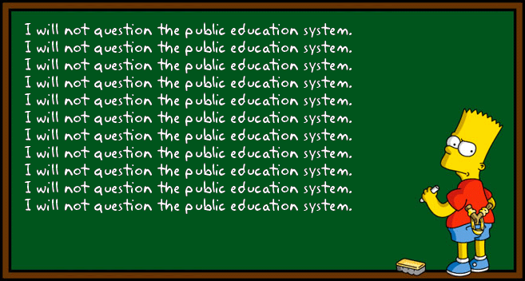
ESSENTIAL QUESTION
What is a concurrent power? Name five concurrent powers that are shared by the national government and state governments.
What is a reserved power? Name three powers that are reserved to the states. Be specific.
Here’s one hint! ➔ ➔ ➔
22

Slide 16
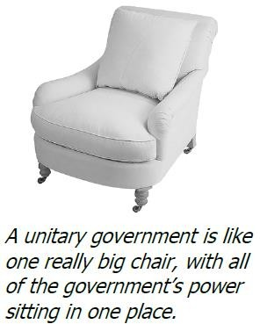
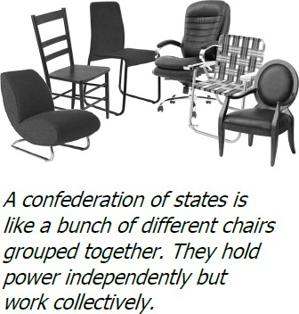
WHAT ARE ALTERNATIVES TO FEDERALISM?
UNITARY SYSTEM (REMEMBER THE SINGLE CHAIR)
  Places all governmental power in one, central, geographic area. In the United States, all states have unitary governments with bicameral legislatures (except Nebraska, which has a unicameral legislature). Ultimately, all local governments in a unitary state are subject to a central authority- the governor.
  More efficient than a federal system (which can be a bad thing)
  Why don’t we use it?
    Not used because too reminiscent of British rule (strong, distant government that becomes tyrannical)
CONFEDERATION (REMEMBER THE DIFFERENT CHAIRS)
  Sovereign states create a central government but carefully limit its power and do not give it direct authority over individuals
  States are supreme over central government
  Why don’t we use it?
    Not used because too reminiscent of Articles (tried and failed)

Slide 17
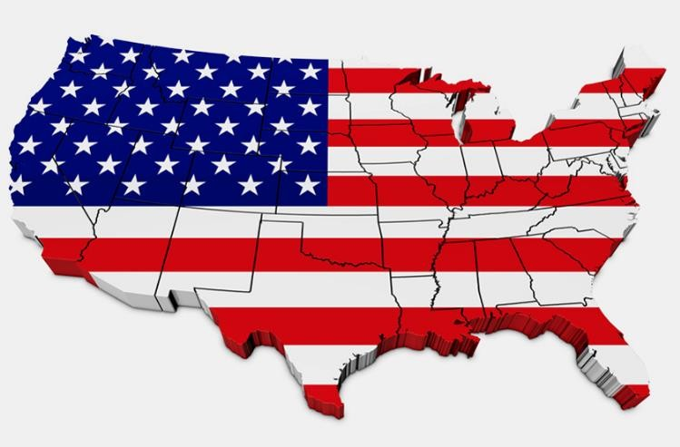
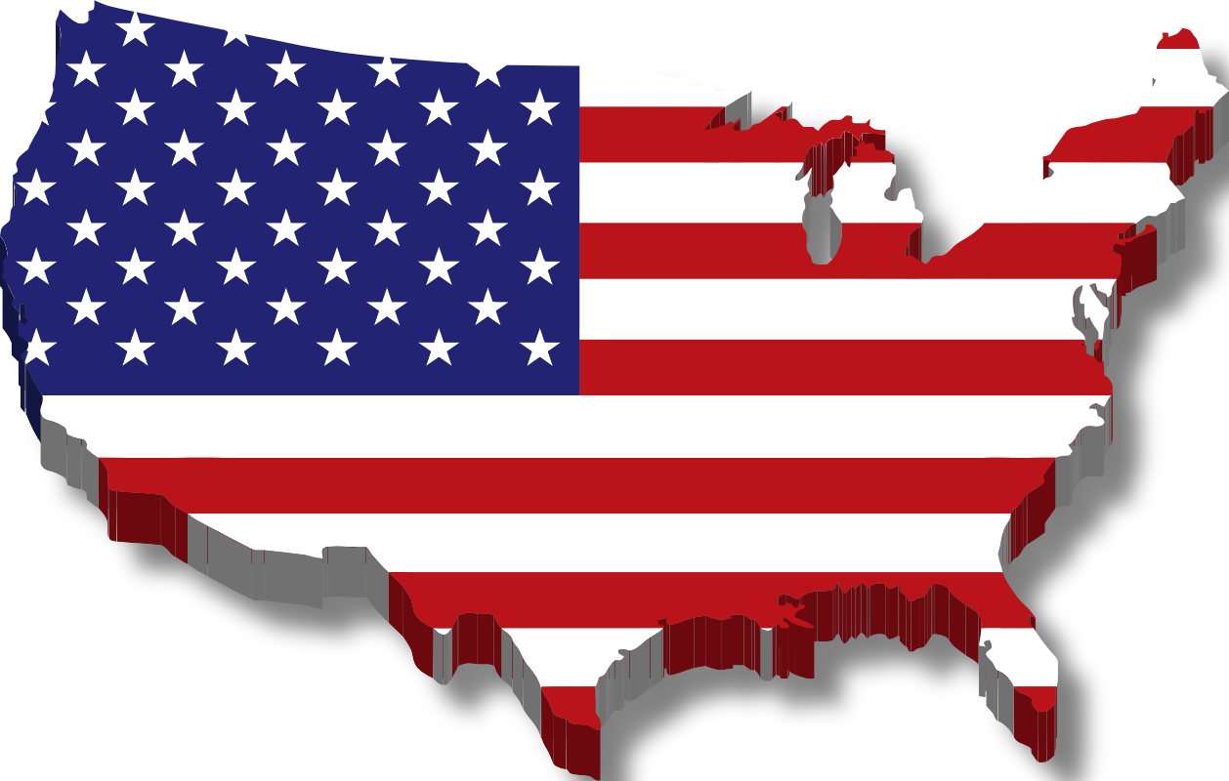
UNITARY SYSTEM – GOV’T MAKES LAWS AND THE WHOLE COUNTRY FOLLOWS THEM.
Federal Grant Program AMSCO pg 60-64
FEDERAL SYSTEM – NATIONAL GOVERNMENT IS LIMITED IN WHAT THEY CAN DO.
4

Slide 18
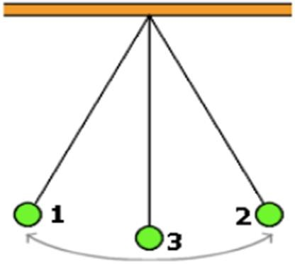
There are three ways of dividing power between the national government and the states
GOLDILOCKS OF GOVERNMENT
THINK OF THE PENDULUM SWING
TOO STRONG (KING)
TOO WEAK (ART OF CONF)
JUST RIGHT (FEDERAL GOV’T)

Slide 19
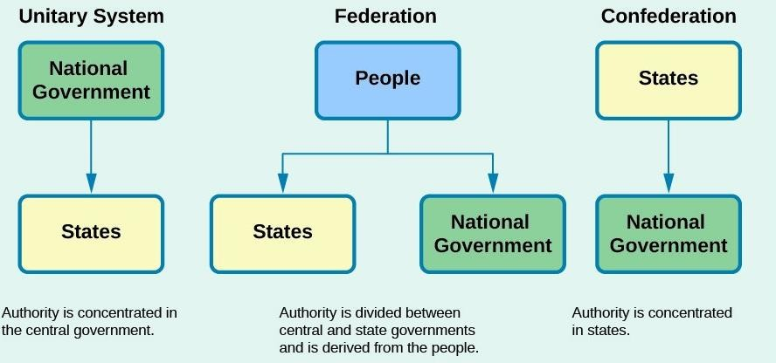
ESSENTIAL QUESTION
Explain how federalism differs in the amount of power that the national government has versus a confederation.
The people Source of Power
Popular Sovereignty

Slide 20
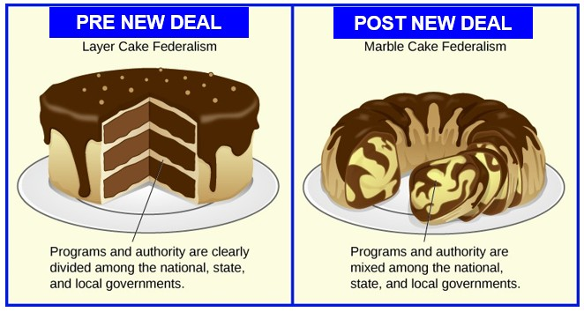
TWO TYPES OF DIVISION OF POWERS
IF YOU DON’T KNOW WHAT A LAYER CAKE OR MARBLE CAKE IS, PLEASE ASK. I DIDN’T KNOW. CAKE IS CAKE TO ME.

Slide 21
WHAT IS DUAL (“LAYER) CAKE”) FEDERALISM?
Prevalent through ~ 1937
State governments and national government each remained supreme within their own spheres.
Proper relationship between government and the states, portraying the states as powerful components of the federal government -- nearly equal to the national government.
Powers and policy assignments of the layers of government were distinct, as in a layer
cake.
Suggested that the powers of the national government should be interpreted narrowly (Constitution gives the federal government limited powers and the rest should be to the state's power).

Slide 22
DUAL (“LAYER CAKE”) FEDERALISM
Dual federalism
  Each government unit -- national and state -- is sovereign within its sphere.
  The relationship between national and states is best characterized by tension rather than cooperation.
  The national government has a limited set of constitutional purposes. All remaining powers belong to the states.
Of primary importance in dual federalism is states' rights, which reserve to the states all rights not speciﬁcally conferred on the national government by the Constitution. According to the theory of dual federalism, a rigid wall separates the national and the state governments.

Slide 23
WHAT IS COOPERATIVE (“MARBLE CAKE”) FEDERALISM?
Prevalent since ~ 1937
Mingling of responsibilities between the state and national government.
Sharing powers & policy assignments, like a marble cake.
Acknowledges a need for cooperation between state and federal governments.
Suggests that powers of the national government should be interpreted broadly.

Slide 24
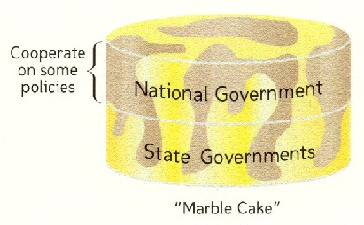
COOPERATIVE (“MARBLE CAKE”) FEDERALISM
Cooperative federalism rejects that state and national government must exist in separate spheres- NO layer cake. Only marble cake
  National and state agencies typically undertake government functions jointly rather than exclusively and routinely share power.
  Power is not concentrated at any government level or in any agency. The fragmentation of responsibilities gives people and groups access to many venues of inﬂuence.

Slide 25
DIFFERENCE BETWEEN DUAL AND COOPERATIVE
A critical diﬀerence between dual and cooperative federalism is how they interpret the elastic clause and Tenth Amendment.
These two sections of the Constitution deﬁne the relationship between state and national governments.
  Article 1, Section 8, lists the enumerated powers of Congress and ends with the elastic clause, which gives Congress the power "to make all Laws which shall be necessary and proper for carrying into Execution the foregoing Powers" meaning the enumerated powers.
  The 10th Amendment reserves for states or the people powers not assigned to the national government or denied to the states by the Constitution.
Dual federalism insists that powers not assigned to the national government are only for states and the people, and claims that the elastic clause is inﬂexible.
Cooperative federalism restricts the 10th Amendment and suggests supplements to the elastic clause.

Slide 26
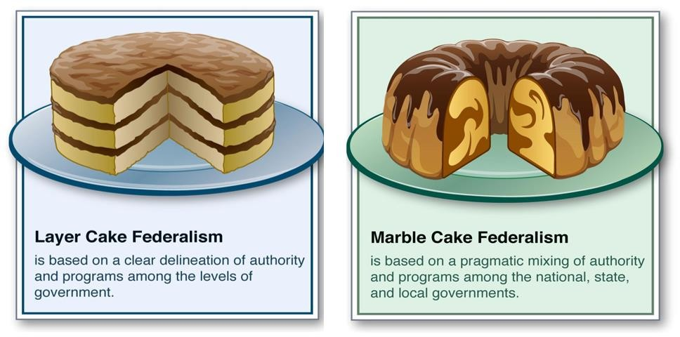
ESSENTIAL QUESTION CFU
Literally, which cake is better – layer or marble?
Explain why state governments would like dual federalism. How does the 10th Amendment play a role in this form of federalism?
Dual Federalism- 2 distinct separate power zones; not intruding upon each other
Cooperative Federalism- state & federal power overlap
14

Slide 27
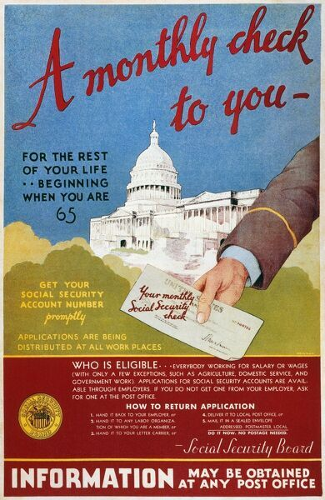
The New Deal & The Great Depression
The expansion of national power under Roosevelt’s New Deal—especially Congress’s authority to regulate interstate commerce—permanently altered the relationship between the states and the national government. Cooperative federalism, in which both levels of government are involved in setting policy, firmly replaced earlier models of dual federalism and made the national government at least a coequal in many areas of public policy traditionally handled by the states.
It established unemployment insurance for American workers. It set up old-age insurance and old-age assistance programs, later supplemented with disability insurance.
The Works Progress Administration (WPA) was the largest of the New Deal public works programs. It was created to provide jobs for the thousands of people who were unemployed during Great Depression. By 1943, the WPA had brought 8.5 million Americans into the workforce. The WPA projects-built infrastructure projects to benefit the public, such as bridges, airports, schools, parks, and utilities.
In addition, the program supported theater, music, and visual arts projects. Other programs funded research, historic preservation, and public libraries. The revolution in federalism was made possible by the severe economic crisis facing the nation and the inability of states to handle its fallout. States were desperate for help in handling the impact of the Great Depression, and the Roosevelt administration drastically increased the role of the federal government as a result. Wapples pg. 172-174

Slide 28
WHAT ARE FEDERAL GRANTS?
Federal revenue given to state and local governments to establish minimum national standards in important areas (air quality, water quality, transportation, education)
PURPOSE OF FEDERAL GRANTS
To equalize resources among the states (both rich and poor)
To attack national problems, yet minimize the growth of federal agencies (reduces growth of federal bureaucracy >> federal government simply provides money to states and has states run the programs - under federal guidelines, of course)3

Slide 29

The Feds want the States to do something, the Feds can either…
Addressing National Issues AMSCO pg. 61
GRANT the states money. States usually need more money so they accept the grants even if there are significant strings attached. Congress is able to use money to usurp state power because when the states voluntarily take the money they also sign on the dotted line to accept all the conditions of the grant.
or
MANDATE the states to do it. These mandates can either be fully funded, partially funded, or unfunded. Feds must have the constitutional authority to issue the mandate.

Slide 30
FISCAL AND REGULATORY FEDERALISM
“THE CARROT” AND “THE STICK”
To use a common metaphor, the national government uses the need for fiscal assistance as both a carrot and a stick.
The CARROT is the federal dollars needed by the state, which come in the form of grants-in-aid.
  As citizens’ needs expand, the states look to the national government to assist in meeting the financial aspects of
fulfilling those needs.
FISCAL FEDERALISM = THE CARROT
The STICK comes in the form of regulation and compliance with federal mandates to receive the money or to continue to obtain grants-in-aid.
  Regulations such as minimum wage, speed limits, and handicap accessibility are examples of “sticks,” or mandates, that states must comply with to receive the national funds.
REGULATORY FEDERALISM = THE STICK

Slide 31
TYPES OF FEDERAL GRANTS
BLOCK GRANTS
Granted to support a collection of general programs (e.g. transportation, urban development, education)
LESS STRINGS ATTACHED = States have more freedom to spend money how they see fit = fewer federal restrictions
Associate these with 104th and 105th Republican Congress and devolution of power back to states
CATEGORICAL GRANTS
Congress appropriates funds for specific purposes (e.g. low-emission bus, low- income housing, STEM education)
MORE STRINGS ATTACHED = States have less freedom to spend money how they see fit = more federal restrictions
States don’t have to accept these, but if they do they must comply with federal standards >> weakens the power of state governors and legislators
12

Slide 32
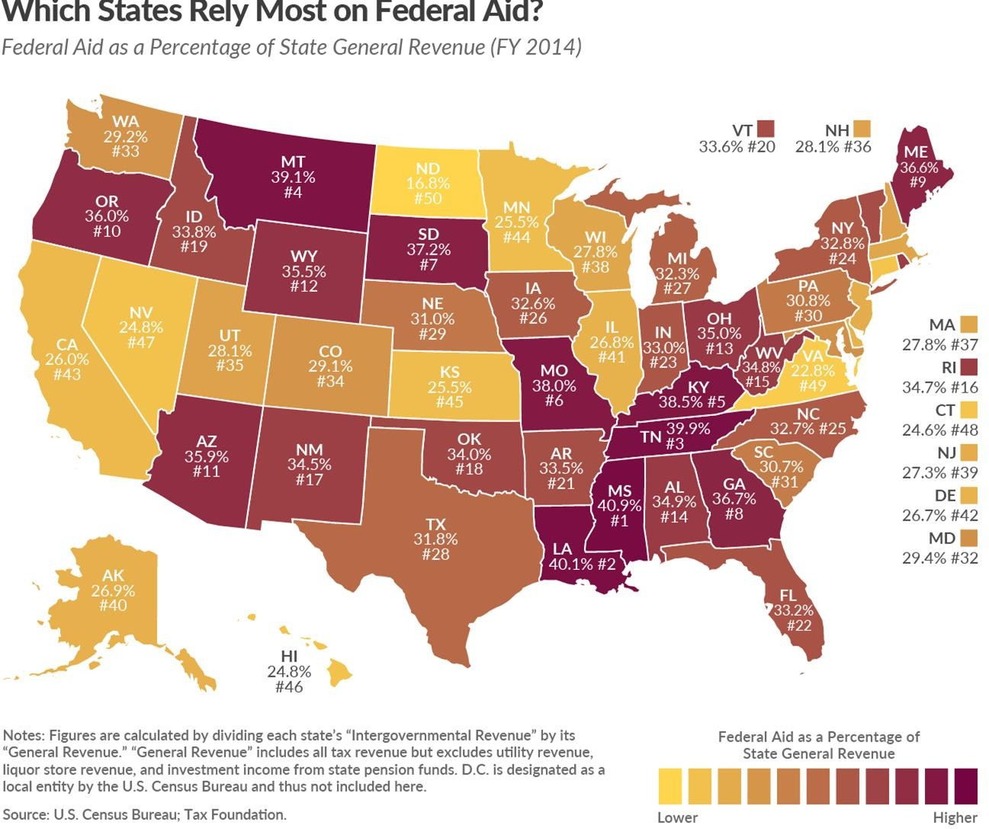
How can the federal government make the state governments do what they want?

Slide 33

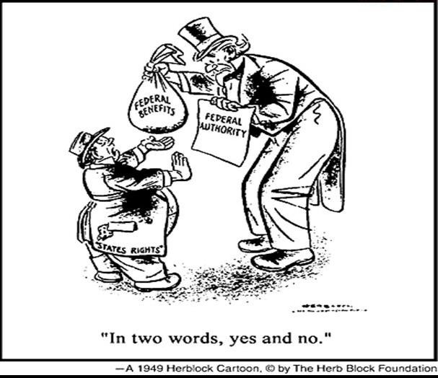











Why does every state have a drinking age of 21?
Same reason most of you will do as your parents wish when you are in college!
9

Slide 34
FISCAL FEDERALISM (“THE CARROT”)
Fiscal federalism is the model of spending, taxing, and providing grants in the federal government system.
The national government’s primary means of influencing state governments is giving money to states in the form of grants-in-aid (or grants).
Since World War II, states have come to rely heavily on federal money.
Likewise, the national government has also relied on the states to administer some federal policies, a practice called fiscal federalism.
The nation’s leaders originally designed them to help fund agriculture, land grant colleges, and farm-related education.
They grew to encompass many other types of funding such as public housing, urban development, and school lunch programs.

Slide 35
THE POLITICS OF FEDERAL GRANTS
DEMOCRATS have generally favored greater funding, but with more “strings” associated with categorical grants.
REPUBLICANS have generally favored less funding, but with fewer “strings” associated with block grants.
Welfare is an example of this.
  End of entitlement status of AFDC and federal guarantee of welfare checks with passage in 1996 of Personal Responsibility and Work Opportunity Reconciliation Act (Welfare Reform Act of 1996).
  Welfare block grants therefore replaced the welfare categorical grants.
  Even as a block grant, the Welfare Reform Act involved federal “strings.”
    No federal funds go to recipients who have not worked within 2 years.
    No federal funds go to recipients who have received federal money >5 years.
    States must spend at least 75% of what they had previously spent on welfare – this to avoid the “race to the bottom.”

Slide 36

DEVOLUTION REVOLUTION
Devolution was a movement to transfer responsibilities of government from the federal government to state and local governments.
Shifting of some authority from national government back to the states
Associated with Nixon, Reagan, and especially associated with 104th (1995-1997) and 105th (1997-1999) Republican Congress: “Devolution Revolution”
1980s (Reagan) started shifting the responsibilities and costs for many programs to state governments
Example: Use of block grants in Welfare Reform Bill of 1996 (ended welfare as federal entitlement program and gave more control to the States)
“…government is not the solution to our problems; government is the problem."- Ronald Reagan

Slide 37
DEVOLUTION REVOLUTION
Supreme Court actions consistent with devolution:
  Struck down Gun Free School Zones Act in 1995
    Congress overextended itself when it linked gun control laws to the interstate commerce clause of the Constitution. (U.S. v. Lopez)
  Struck down part of the Violence Against Women Act in 2000
    Rape victims could not sue their attackers in federal court because it was up to the states – not Congress – to give such help to women victimized by violence.
    Again, the Court said that the Congress overextended itself with the use of the interstate commerce
clause in passing the Act.
  Struck down Religious Freedom Restoration Act in 1993
    This act had restricted the power of the states to regulate religion >> this ruling gave states greater
authority to regulate religion.
  Struck down Brady Act in 1997
    Law required local law enforcement agencies to do background checks on gun buyers.

Slide 38
REGULATORY FEDERALISM (“THE STICK”)
One way for Congress to pass mandates is to impose regulations and standards on state and local governments.
DEFINITION: A federal mandate is a requirement or an order from the central government that all state and local government must comply with.
In the past, Congress has forced state governments to meet certain federal guidelines. This is known as regulatory federalism.

Slide 39
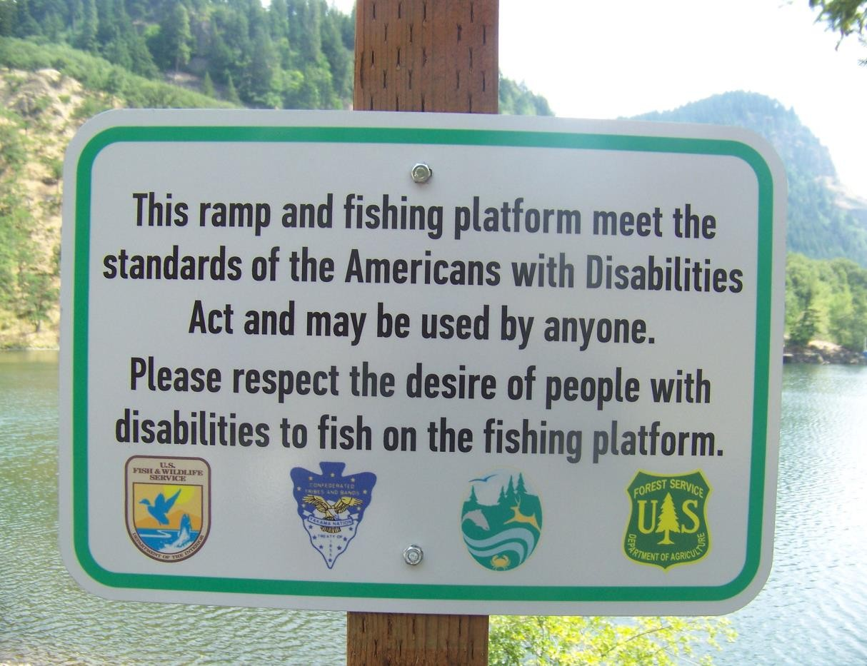
FEDERAL MANDATES
Mandate: a federal order imposed upon states. Examples:
  Americans with Disabilities Act (governors and mayors don’t like because of costs to remodel)
  Various environmental acts (e.g. Clean Air Act, Clean Water Act).
  Individuals with Disabilities Education Act.
Purposes: to meet a goal of the federal government.
Impact upon the states:
  Financial burdens, especially with unfunded mandates (e.g. ADA has imposed large costs upon states as they make “reasonable accommodations” for the disabled).
  State complaints about federal heavy-handedness (e.g. if a state does not devise a plan and pay for the requirements of the Clean Air Act of 1990, the federal government will impose its own plan upon the state).

Slide 40
NEW TECHNIQUES OF FEDERAL CONTROL
These four techniques fall under the category of unfunded mandates
DIRECT ORDERS
  State or local government must act under the threat of criminal or civil penalties
    Equal Employment Opportunity Act (1972) – bars job discrimination by state and local governments on the basis of race, color, religion, sex, and national origin.
  Pits the legal authority of Congress against the constitutional rights of the states.
CROSS-CUTTING REQUIREMENTS
  Conditions on one grant extended to all federally-supported activities
  Requirements imposed on virtually all grants to further various national social and economic policies.
    Title VI of the Civil Rights Act (1964) – no person in the U.S. shall, on the grounds of race, color, or national origin, be excluded from participation in, be denied the benefits of, or be subjected to discrimination under any program receiving federal assistance.
    Title IX of the Education Amendments (1972) – prohibited sex discrimination in educational institutions receiving federal aid.
  The federal government will force states to follow the law through the Civil Rights Act and if the state doesn’t, it risks losing money on all federally funded projects

Slide 41
NEW TECHNIQUES OF FEDERAL CONTROL
These four techniques fall under the category of unfunded mandates
CROSS-OVER SANCTIONS
  Permit the use of federal dollars in one program to influence state and local policy in another
  Failure to comply with the requirements of one program can result in reduced or terminated funds from another program that was separately authorized and separately begun.
    Federal highway aid and minimum drinking age of 21 AMSCO pg. 63 South Dakota v. Dole
4. PARTIAL PREEMPTION
  Federal law establishes basic policies but requires states to administer them usually without any federal funds
    Clean Air Act of 1990

Slide 42
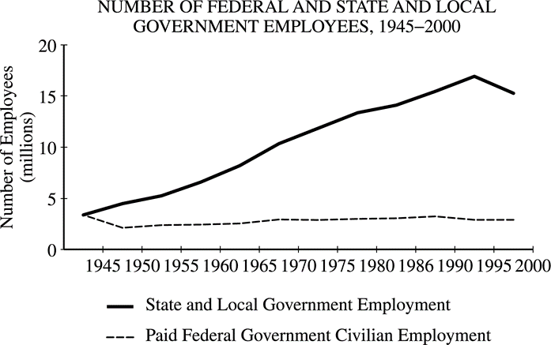
Using the data in the graph above and your knowledge of United States politics, perform the following tasks.
(a) Identify two trends shown in the graph.
Explain how each of the following contributes to the difference between the federal and the state and local lines in the graph.
Block grants
Federal mandates

Slide 43


ESSENTIAL QUESTION
How does the “devolution revolution” give states more power? Is this a good or bad idea?

Slide 44
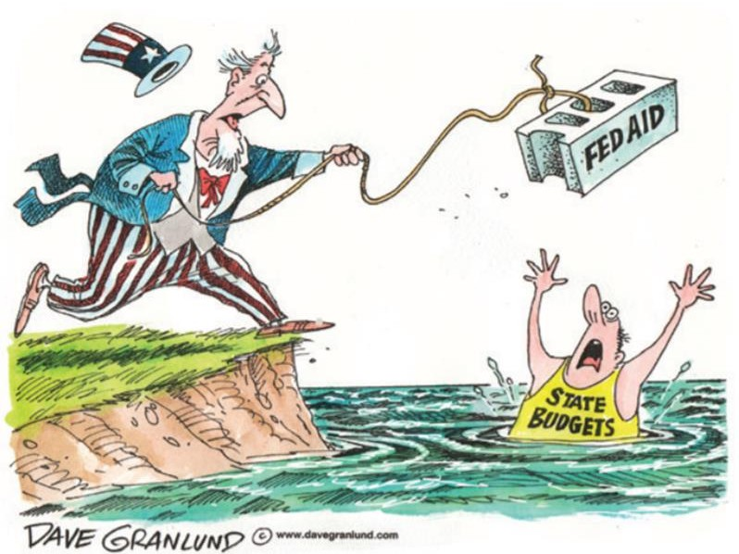
ESSENTIAL QUESTION
What are the positives and negatives of both block grants and categorical grants?

Slide 45


ESSENTIAL QUESTION
Why do unfunded mandates really hurt state budgets? Use the Americans with Disabilities Act as an example.

Slide 46
WHAT ARE THE ADVANTAGES OF FEDERALISM?
1. FEDERALISM CHECKS THE GROWTH OF TYRANNY
Inhibits formation of a single-interest majority
If tyranny occurred in a few states, federal government could prevent its spread to others (e.g. Shays’ Rebellion).
National government has only those powers granted to it - all others belong to states through Amendment 10.
2. FEDERALISM ALLOWS UNITY WITHOUT UNIFORMITY
No need for consensus on every divisive issue
More suitable for geographically large nation – allows for differences among states
More suitable for heterogeneous people – allows for differences
3. FEDERALISM ENCOURAGES EXPERIMENTATION
States are "laboratories" for public policy experimentation (gambling in NV, marijuana in CO)
States have been in the forefront on health care, voting, air pollution control programs
4. FEDERALISM PROVIDES TRAINING FOR FUTURE NATIONAL LEADERS
Training ground for state and local politicians to gain experience
20 of nation’s 45 presidents served as governor of a state = executive office experience
5. FEDERALISM KEEPS GOVERNMENT CLOSER TO THE PEOPLE
Provides numerous arenas for decision-making
Local and state politics involve citizens in large numbers (most Americans had a stronger allegiance to their state and state government)
Multiple points of access for citizens

Slide 47
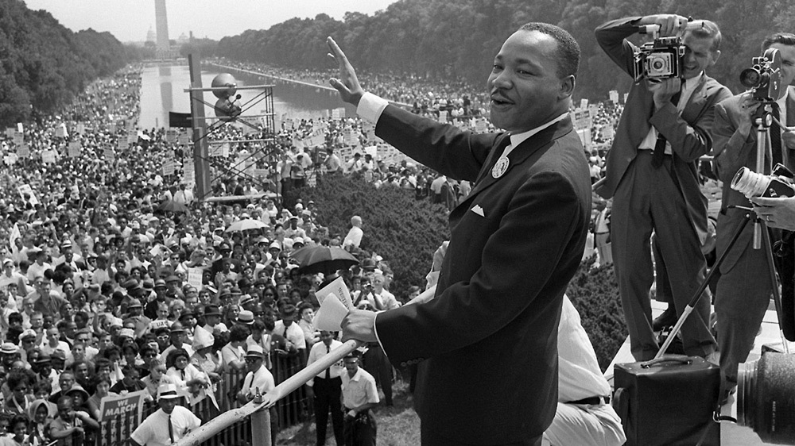
ADVANTAGES OF FEDERALISM
6. Allows the federal government to make unified policy when necessary or to protect minority rights when states may be violating them. (Think of civil rights legislation.) Also allows states to make policies specific to their needs and to serve as laboratories of democracy when there isn’t a national consensus on an issue
How do separation of powers and federalism protect the rights of the individuals?
Both ensure that no one person, branch, or level of government has too much power. Separation of powers does so by creating 3 branches of the federal government, each with their own powers: Legislative-make laws, Executive-enforce laws, and Judicial-interpret laws.
Federalism is the division of power between national, state, and local governments, leaving some policymaking powers to each level.

Slide 48
DISADVANTAGES OF FEDERALISM
Promotes inequality because of states diﬀer in the resources they can devote to providing services.
Enables local interests to delay or even thwart majority support for a policy.
Creates confusion because the diﬀerent levels of government make it diﬃcult for citizens to know what diﬀerent governments are doing.

Slide 49
TOPIC 1.8 Constitutional Interpretations of Federalism
Federalism reflects the dynamic distribution of power between national and state governments.
The Due Process and Equal Protection Clauses
of the Fourteenth Amendment give the national
government the power to enforce protections
for any person against the states, but Supreme
Court interpretations can influence the extent
of those protections.
The Commerce Clause gives the national government the power to regulate interstate commerce, but Supreme Court interpretations can influence the extent of this power.
The Necessary and Proper Clause gives Congress the power to make laws related to carrying out its enumerated powers, but Supreme Court interpretations can influence the extent of these powers.
The Supremacy Clause gives the national government and its laws general precedence over states’ laws, but Supreme Court interpretations may affect when specific actions exceed this constitutional power.
Explain how the balance
of power between national
and state governments has
changed over time based
on interpretations of the
Supreme Court of the United States.
REQUIRED FOUNDATIONAL DOCUMENT
The Constitution of the United States
REQUIRED SUPREME COURT CASES
McCulloch v. Maryland (1819)
United States v. Lopez (1995)

Slide 50
OLD CED: TOPIC 1.8 Constitutional Interpretations of Federalism
Federalism reflects the dynamic distribution of power between national and state governments.
The interpretation of the Tenth and Fourteenth Amendments, the commerce clause, the necessary and proper clause, and other enumerated and implied powers is at the heart of the debate over the balance of power between the national and state governments.
Explain how the balance of power between national and state governments has been interpreted differently over time
The balance of power between the national and state governments has changed over time based on U.S. Supreme Court interpretation of such cases as:
McCulloch v. Maryland (1819), which declared that Congress has implied powers necessary to implement its enumerated powers and established supremacy of the Constitution and federal laws over state laws
United States v. Lopez (1995), which ruled that Congress may not use the commerce clause to make possession of a gun in a school zone a federal crime, introducing anew phase of federalism that recognized the importance of state sovereignty and local control
REQUIRED FOUNDATIONAL DOCUMENT
The Constitution of the United States
REQUIRED SUPREME COURT CASES
McCulloch v. Maryland (1819)
United States v. Lopez (1995)

Slide 51
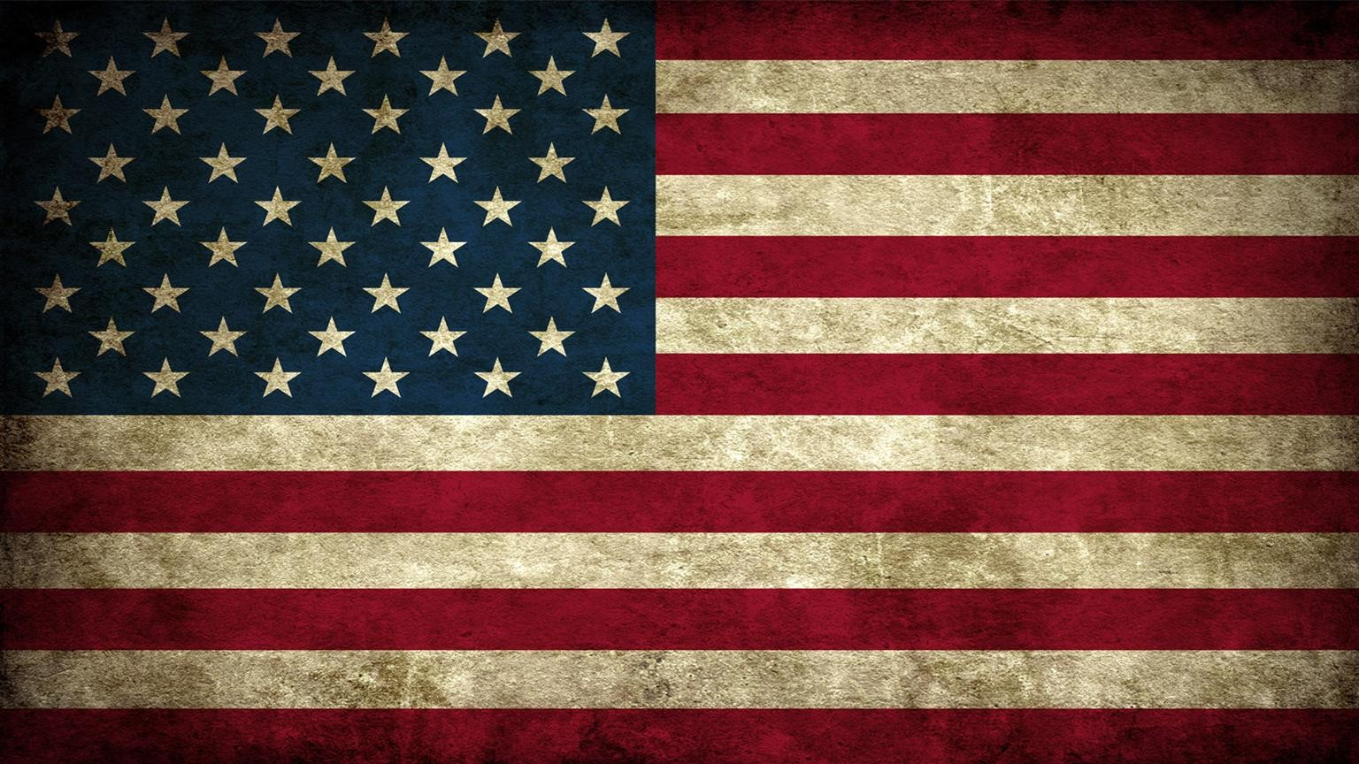

NECESSARY AND PROPER CLAUSE – AKA . . .
Topic 1.8 Constitutional Interpretations of Federalism, AMSCO pg. 66-74
IMPLIED POWERS
ELASTIC CLAUSE
ELASTIC CLAUSE
Imagine the elastic clause as a giant pair of
sweatpants.
National
Government
The elastic clause, or the necessary and proper clause, is a constitutional clause that gives Congress the power to make all laws “necessary and proper” for executing its powers.
In other words, it means that it is implied that Congress has the implied power, for instance, to set up a national banking system (we are stretching the meaning of the power to borrow and spend), even though it’s not expressed in the Constitution.

Slide 52

WHAT IS THE SUPREMACY CLAUSE?
(Good for the National Gov’t)
WHO ARE THE SUPREMES?
(Good for the Nation)
States may not override national policies; this restriction also applies to local units of government, since they are agents of the states (Constitution and national laws are the supreme laws)
The Supremacy Clause in the Constitution states that federal law takes precedence over state law when the laws conflict
Article VI (6), Paragraph 2 of the U.S. Constitution
11

Slide 53
10TH AMENDMENT VS. 14TH AMENDMENT
The arguments presented to the Supreme Court of the United States in Plessy v. Ferguson involve two competing amendments to the Constitution. The Fourteenth Amendment says states may not deny people equal protection of the law and the Tenth Amendment reserves broad, undefined powers (often referred to as police powers) for the states.
Federal Power
Fourteenth Amendment
Section 1. All persons born or naturalized in the United States and subject to the jurisdiction thereof, are citizens of the United States and of the State wherein they reside. No State shall make or enforce any law which shall abridge the privileges or immunities of citizens of the United States; nor shall any State deprive any person of life, liberty, or property, without due process of law; nor deny to any person within its jurisdiction the equal protection of the laws.
State Power
Tenth Amendment
The powers not delegated to the United States by the Constitution, nor prohibited by it to the states, are reserved to the states respectively, or to the people.
Plessy argued that by restricting him to a separate train car, the State of Louisiana violated his Fourteenth Amendment rights. However, the State of Louisiana countered that it had the power under the Tenth Amendment to create laws that preserve order and public peace. Louisiana claimed that by mixing black folks and white folks in areas of public accommodations, it would spark chaos and violence.

Slide 54
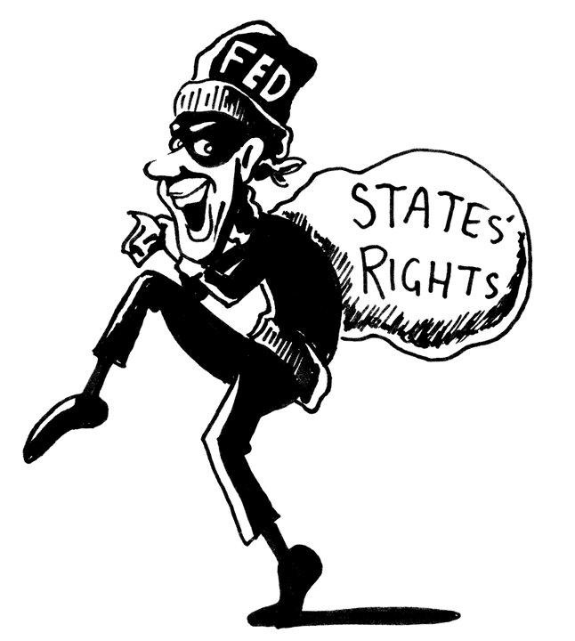
FEDERAL COURTS AND THE STATES
Supreme Court Shapes Federalism, AMSCO pg. 68
Actions by state and local officials can be challenged before a federal judge
Preemption - federal laws take precedence over state and local laws (civil rights, water quality)
Supreme Court has generally favored powers of federal government over the states

Slide 55

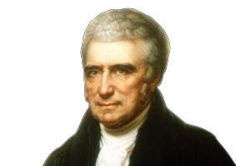
McCulloch v. Maryland (1819) – REQUIRED COURT CASE
In 1816, the Federal gov’t established the Second Bank of the United States in Baltimore, Maryland
In 1818, the State of Maryland passed an act to impose a tax on all banks in the State of Maryland not chartered by the legislature
With the bank refusing to pay such taxes, the case went all the way to the Supreme Court
Chief Justice John Marshall ruled in favor of the banks and gave his ruling on two important parts:
The establishment of national banking system, even though it isn’t stated in the Constitution, is constitutional under the “Necessary and Proper Clause.”
States do not have the right to tax a federal institution (“the power to tax is a power to destroy”) based on Supremacy Clause.

Slide 56
THE NATIONAL COURTS AND FEDERALISM – McCULLOCH v. MARYLAND (1819)
BACKGROUND:
Maryland attempted to close the Baltimore branch of the national bank by passing a law that forced all banks chartered outside of the state to pay a yearly tax. James McCulloch, the chief administrative officer of the Baltimore branch, refused to pay the tax. The state of Maryland sued McCulloch, saying that Maryland had the power to tax any business in its state and that the Constitution does not give Congress the power to
create a national bank. McCulloch’s attorneys argued that the establishment of a national bank was a “necessary and proper” function of Congress, one of many implied, but not explicitly stated, powers in the Constitution. The Maryland Court of Appeals ruled in favor of Maryland, and McCulloch appealed again. The case was heard by the Supreme Court of the United States.
ISSUE:
Did Congress have the authority under the Constitution to commission a national bank? If so, did the state of Maryland have the authority to tax a
branch of the national bank operating within its borders?
MAJORITY OPINION:
Key Claim(s):
  The Supreme Court determined that Congress did have the power under the Constitution to create a national bank. Even though the Constitution does not explicitly include that power, there is also nothing in the Constitution that restricts Congress’s powers to those specifically enumerated.
Reasoning used to justify the opinion:
  The Necessary and Proper Clause gives Congress the authority to make “all laws which shall be necessary and proper” for exercising the powers that are specifically enumerated, and the establishment of a national bank is “necessary and proper” to exercising other enumerated powers.
IMPLICATIONS:
The Marshall Court declared that “the Constitution and the laws made in pursuance thereof are supreme; that they control the constitution and laws of the respective states, and cannot be controlled by them.” Allowing a state to tax a branch of the national bank created by Congress would allow that state to interfere with the exercise of Congress’s constitutional powers.

Slide 57
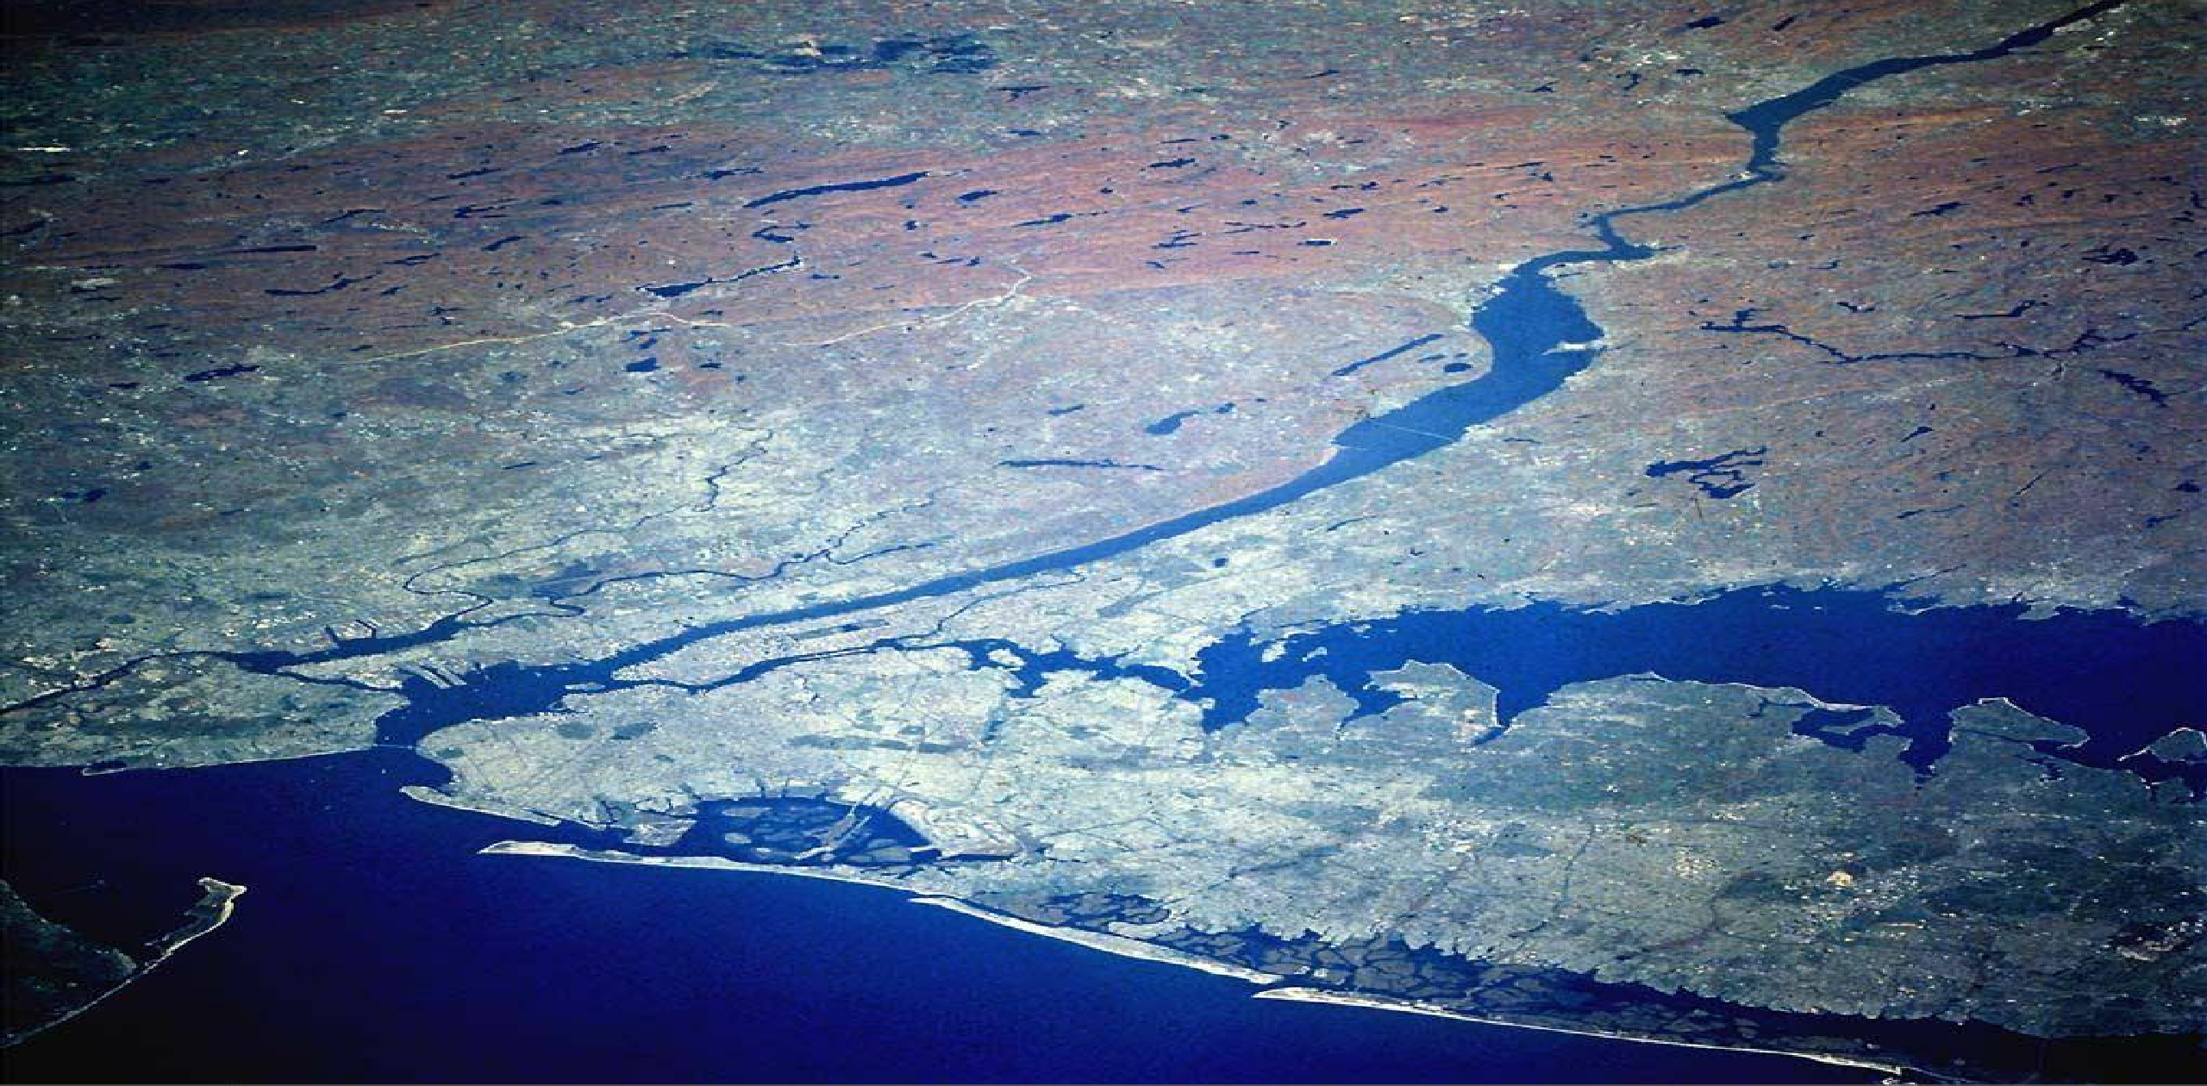
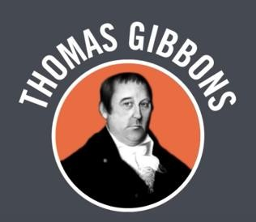
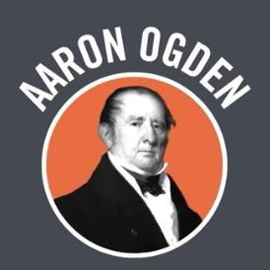
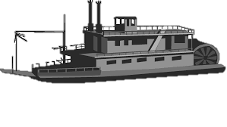
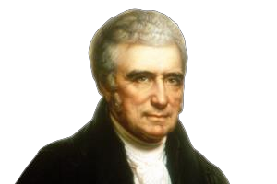
Gibbons v. Ogden (1824)
Hudson River
NY Legislature had passed a law giving a monopoly on steamship travel in NY state to a group of investors. Among the people who had permission to do business under this monopoly was Aaron Ogden.
Thomas Gibbons, another steamship trader, wanted to use the NY waterways for his business too. He had been given federal permission to so, but the State of NY courts issued an injunction against him. The case will make its way all the way to the U.S. Supreme Court.
Marshall Court ruled that the U.S. Constitution had a commerce clause that allowed the federal government to regulate commerce and believed that the U.S. government had the “necessary and proper” or
“elastic clause” to regulate interstate commerce.

Slide 58

ESSENTIAL QUESTION CFU
What two constitutional powers were cited in the ruling of McCulloch v. Maryland? Did this case expand the power of the state government or the national government?
Do you get the hint?

Slide 59
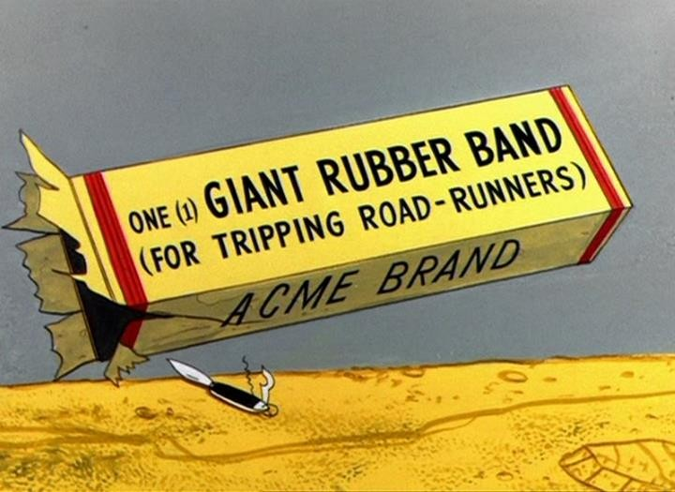
ESSENTIAL QUESTION CFU
How has Article 1, Section 8, Clause 18 (aka the Necessary and Proper Clause or Elastic Clause) greatly expanded the power of the national government? Give a modern-day example.
Obama Care
Gay Marriage
Education
Civil Rights
10
No Child Left Behind
Welfare

Slide 60
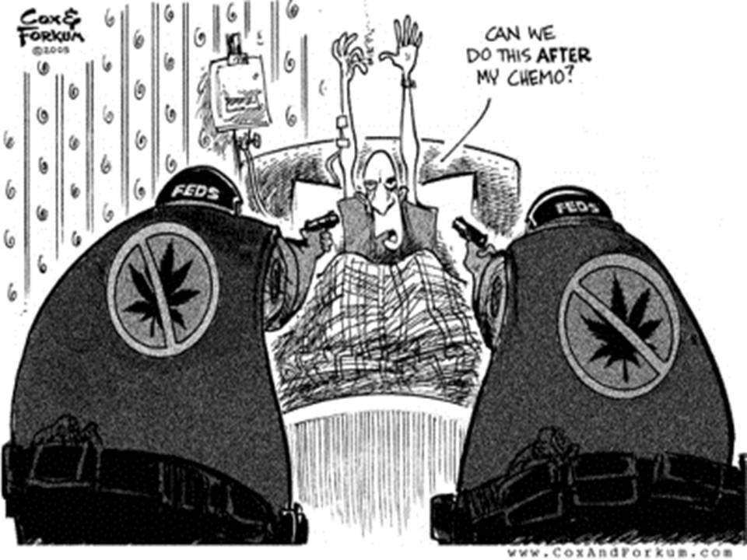
WHAT IS THE POWER TO REGULATE INTERSTATE & FOREIGN COMMERCE?
Through the commerce clause, Congress can regulate many activities and sustain other legislation as well
Gibbons v. Ogden (1824)
Only National government (Congress) may regulate interstate commerce
Power is not shared with the states
The federal government’s role has been greatly expanded through the interpretation of this clause
Heart of Atlanta Motel v. U.S. (1964)
Congress has a right to regulate individual, private businesses in the interest of promoting interstate travel
Civil Rights Act of 1964 applied to private businesses because customers come from out- of-state

Slide 61
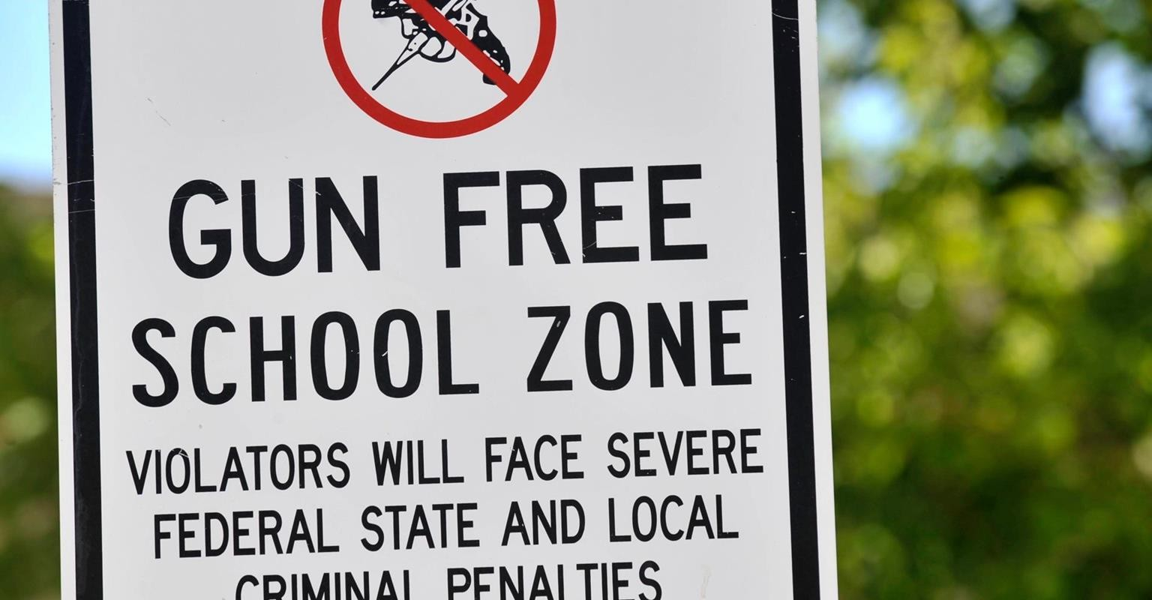

U.S. v. Lopez (1995) – REQUIRED COURT CASE
The Court ruled in favor of Lopez because regulating guns in local schools is not sufficiently related to Congress’ Commerce Clause power to pass constitutional muster.
The United States Congress passed the Gun-Free School Zones Act of 1990 which made it a federal offense “for an individual knowingly to possess a firearm at a place that the individual knows, or has reasonable cause to believe, is a school zone.”
Possession of a handgun near school is NOT an economic activity nor has a substantial effect on interstate commerce, and therefore CANNOT be regulated by Congress.

Slide 62
THE NATIONAL COURTS AND FEDERALISM – U.S. v. LOPEZ (1995)
BACKGROUND:
Lopez took a concealed weapon into school and was charged under Texas law for having a weapon on school grounds. Federal agents then charged Lopez with violating the Gun-Free School Zones Act of 1990. The state charges were dismissed. Lopez was found guilty. He appealed and the case was heard by the Supreme Court of the U.S.
ISSUE:
The question in the case related to the Commerce Clause and whether Congress had exceeded its authority under the clause.
MAJORITY OPINION:
Key Claim(s):
  The Gun-Free School Zone Act had nothing to do with interstate commerce or economic activity. Therefore, it was beyond the scope of Congress to regulate under the Commerce Clause.
Reasoning used to justify the opinion:
  The lawyers for the U.S. argued that since many guns have crossed state lines in the production and sale, then they should be considered interstate commerce. However, possessing a gun in a school zone is not, in itself, an economic activity that might affect interstate commerce.
IMPLICATIONS:
With their decision, the Court stopped what many people saw as federal encroachment into issues that fall within the states’ jurisdictions. The Court, following the idea of State Sovereignty Federalism, limited the federal government’s involvement in areas that were not specifically related to interstate commerce.

Slide 63
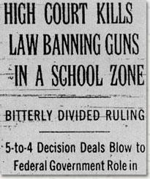
ESSENTIAL QUESTION CFU
What was the constitutional issue in U.S. v. Lopez? Did this case expand the power of the state government or the national government?
There are “Gun Free School Zone” laws today.
The Gun-Free Schools Act of 1994 requires each state receiving federal funds to have a state law in effect requiring local educational agencies to expel, for at least one year, any student who is determined to have brought a weapon to school.
The regulation of EDUCATION is a power RESERVED to States

Slide 64
TOPIC 1.9 Federalism in Action
Federalism reflects the dynamic distribution of power between national and state governments.
Explain how the distribution of powers among three federal branches and between national and state governments impacts policy making
The allocation of powers between national and
state governments creates multiple access
points for stakeholders and institutions to
influence public policy.
National policy making is constrained by the sharing of power between and among the three branches and state governments.

Slide 65
WHAT ARE POWERS GRANTED TO THE STATES?
States have RESERVED POWERS: the Constitution reserves for the states all powers not granted to the national government, subject only to the limitations of the Constitution
Amendment 10 states that any powers not granted to the national government are reserved for the states
Examples:
  Establishing voting requirements
  Running elections
  Establishing education
  Licensing professionals
  Protecting community health
  Establishing a vehicle code and state police

Slide 66
BALANCE OF POWER DEBATE
FEDERAL
Fourteenth Amendment:
Constitutional Amendment that grants citizenship, equal protection, and due process under the law to all people born in the United States.
Over the years, the Fourteenth Amendment has been used to require states to protect most of the same federal freedoms granted by the Bill of Rights.
Example: African American voting rights.
STATE
Tenth Amendment:
Constitutional Amendment that stipulates that all powers not given to the federal government are reserved to the States or the people.
This guarantee protects states’ reserved powers to regulate such things as marriage, divorce, and intrastate transportation and commerce, and to pass laws affecting education and public health and safety.

Slide 67
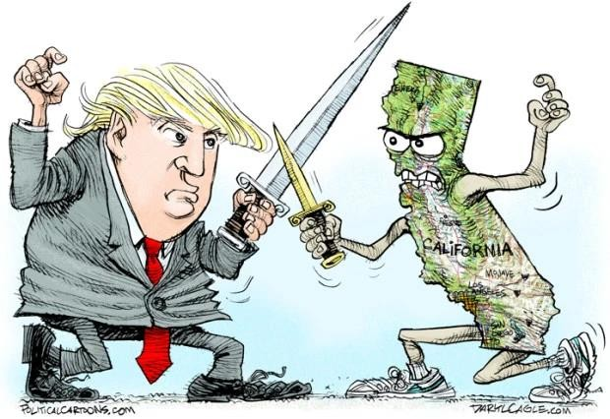
BALANCE OF POWER DEBATE
FEDERAL
Implied powers:
Powers of the federal government that are not explicitly named in the Constitution but are implied by the “necessary and proper clause” so that the federal government can carry out its enumerated powers.
STATE
Reserved powers:
Powers that only the state governments can carry out, such as setting up schools or running elections. The concept of reserved powers is defined in the 10th Amendment, which states, ''The powers not delegated to the United States by the Constitution, nor prohibited by it to the states, are reserved to the states respectively.'' In other words, if the Constitution does not give a certain power to the federal government and does not explicitly say that the states are not allowed to carry out that responsibility, then it is reserved for the state.

Slide 68
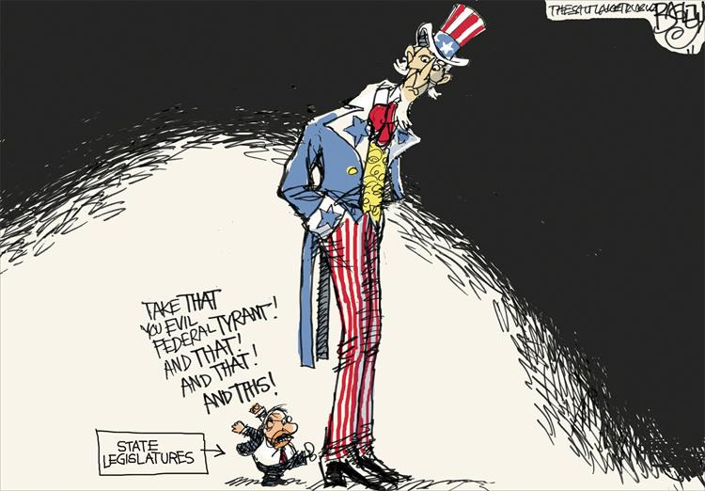
ESSENTIAL QUESTION
How is national policymaking constrained by the sharing of power between and among the three branches and the state governments?

Slide 69
EXPANSION OF CENTRAL GOVERNMENT FUNCTIONS
These constitutional powers expand the power of the federal government
  The Supremacy Clause
  The Power to Regulate Interstate and Foreign Commerce
  The War Power
  The Power to Tax and Spend

Slide 70
EXPANSION OF CENTRAL GOVERNMENT FUNCTIONS
The Supremacy Clause Article VI
  States may not override national policies; this restriction also applies to local units of government, since they are agents of the states (Constitution and national laws are the supreme laws)
  The supremacy clause in the Constitution states that federal law takes precedence over state law when the laws conﬂict

Slide 71
EXPANSION OF CENTRAL GOVERNMENT FUNCTIONS
The Power to Regulate Interstate and Foreign Commerce
  Through the commerce clause, Congress can regulate many activities and sustain other legislation as well
    Gibbons v. Ogden (1824)
    Only National government (Congress) may regulate interstate commerce
    Power is not shared with the states
  The federal government’s role has been greatly expanded through the interpretation of this clause
    Heart of Atlanta Motel v. U.S. (1964)
    Congress has a right to regulate individual, private businesses in the interest of promoting interstate travel
    Civil Rights Act of 1964 applied to private businesses because customers come from out-of-state

Slide 72
EXPANSION OF CENTRAL GOVERNMENT FUNCTIONS
The War Power
  The national government has the power to wage war
  The president can send troops because he is commander-in-chief of the military
The Power to Tax and Spend
  By attaching conditions to its grants of money, Congress may regulate what it cannot directly control by law
    Congress can’t technically legislate everything, but it can spend on virtually anything.
    States don’t have to accept federal money, but if they do, they must follow federal guidelines (e.g. federal highway funds can be denied if a state’s alcohol purchasing age is less than 21, federal education funds can be denied if states do not comply with No Child Leg Behind Act) – Federal “strings” afached to funding are ways in which the federal government can get its way on things.
    Recent example: Obamacare – Supreme Court ruled it was a tax and that the federal government could require people to have healthcare

Slide 73

POWERS OF THE NATIONAL GOVERNMENT
Inherent powers
  Not stated explicitly, but held by the national government by virtue of its being a national government.
  Some of these powers come from the Preamble (certain foreign policy powers such as immigration, diplomatic recognition, or acquiring territory).

Slide 74
POWERS OF THE STATES
States have RESERVED POWERS: the Constitution reserves for the states all powers not granted to the national government, subject only to the limitations of the Constitution
Amendment 10 states that any powers not granted to the national government are reserved for the states
Examples:
  Establishing voting requirements
  Running elections
  Establishing education
  Licensing professionals
  Protecting community health
  Establishing a vehicle code and state police

Slide 75
Constitutional Approach to Federalism | Federalism in Action
National environmental policymaking | The federal government began an era of environmental awareness with laws like the National Environmental Policy Act, Endangered Species Act, Clean Air Act, and Clean Water Act in the 1970s. The congressional and presidential disagreement over the Kyoto Protocol and the executive orders to join and leave the Paris Agreement show the struggle in federal action related to environmental concerns.
Federal and state action on marijuana policy | The federal policy set forth with the Controlled Substances Act of 1970 and the later relaxing of federal enforcement of the law by the Obama administration shows changes in direction regarding the drug over time. States have also disregarded the Controlled Substances Act by legalizing marijuana for medicinal or recreational purposes
Educational policy from federal and state government | The federal government became more involved in educational policy with the Elementary and Secondary Education Act. That involvement increased significantly with No Child Left Behind while weakening state control over education. Years later, educational control was somewhat returned to states with the Every Student Succeeds Act.

Slide 76
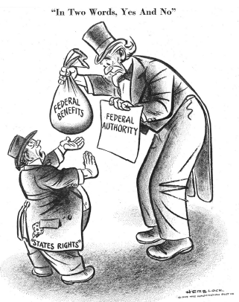
Which of the following is the most accurate
interpretation of the political cartoon?
(A) State governments have used the
Tenth Amendment to override the federal government’s mandates.
(B) State governments are unwilling to share their budgetary surpluses with other states.
(C) State governments prefer federal funding but do not want federal oversight over how the money is spent.
(D) The fiscal irresponsibility of state
governments has led to increased federal
regulation on their budgetary priorities.
Which of the following policies would the states
most likely prefer according to the political cartoon?
(A) Federal mandates
(B) Regulatory preemption
(C) Categorical grants
(D) Block grants

Slide 77
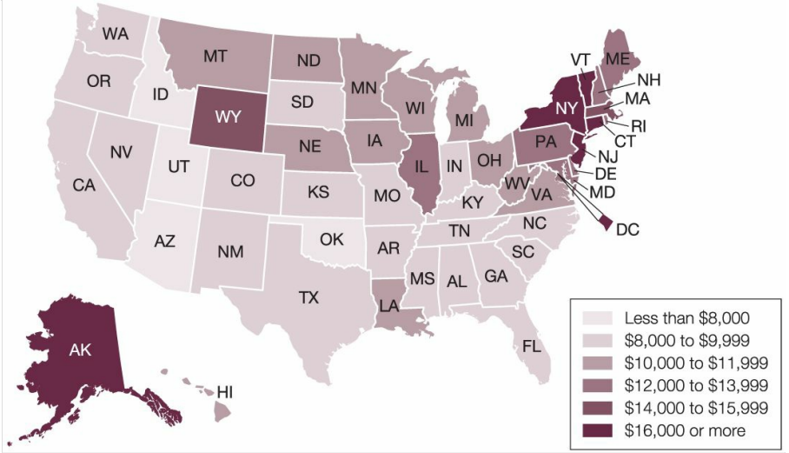
Per-Pupil Spending in Public Elementary-Secondary School Systems, by State: Fiscal Year 2013
Which of the following constitutional principles best explains why there is variation among states over per-pupil spending?
(A) Separation of powers
(B) Judicial review
(C) Checks and balances
(D) Federalism

