Slide 1
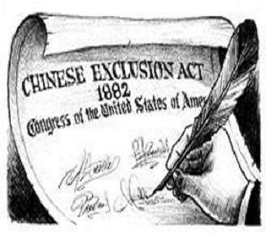
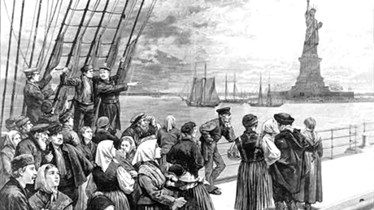
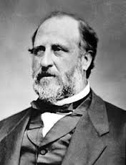
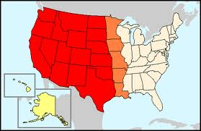
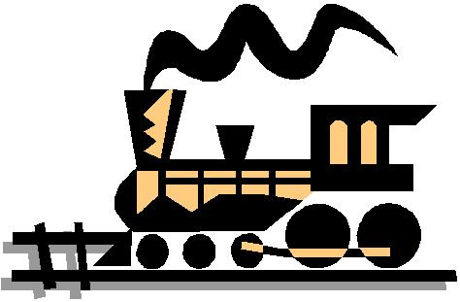
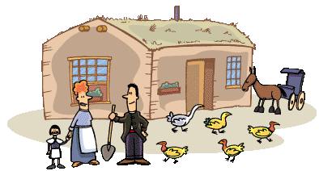
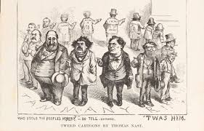
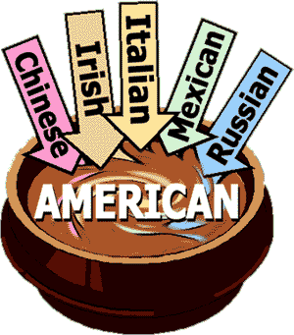
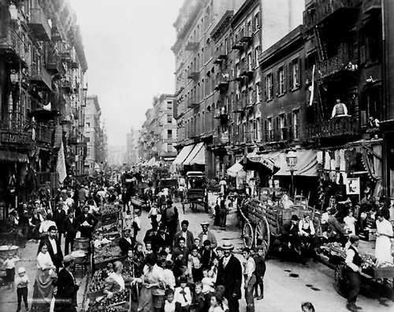
Cities, Immigration and Farmers During the Gilded Age
Chpt. 6

Slide 2
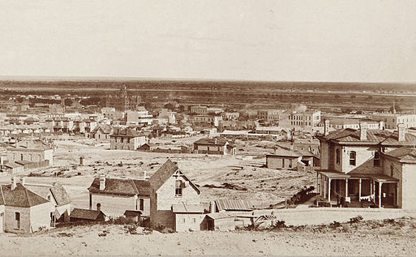
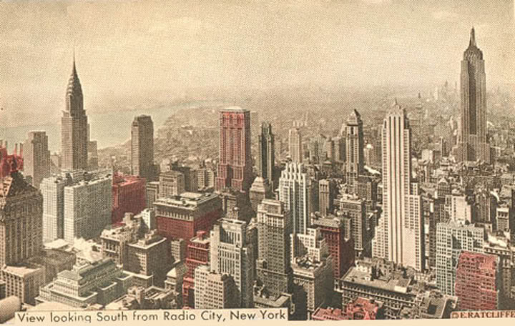
Urbanization-movement of people from country side into the city
An important result of industrialization was the rapid growth of cities.
In 1865, only two cities had a population over 500,000 – New York and Philadelphia.
By 1900, this number increased to six cities as Americans were moving to more urban areas.
By 1920 half of all Americans lived in cities.
There were several reason for this rapid urbanization.
To this….
From this….

Slide 3
Reasons for Urbanization
Railroads and improved roads
Cultural opportunities and variety of city life-music halls, museums, libraries, universities
The rise of factories and the needs of growing urban population create more jobs.
Farm workers were being replaced by machines and many unemployed farmers went to the cities to find jobs

Slide 4
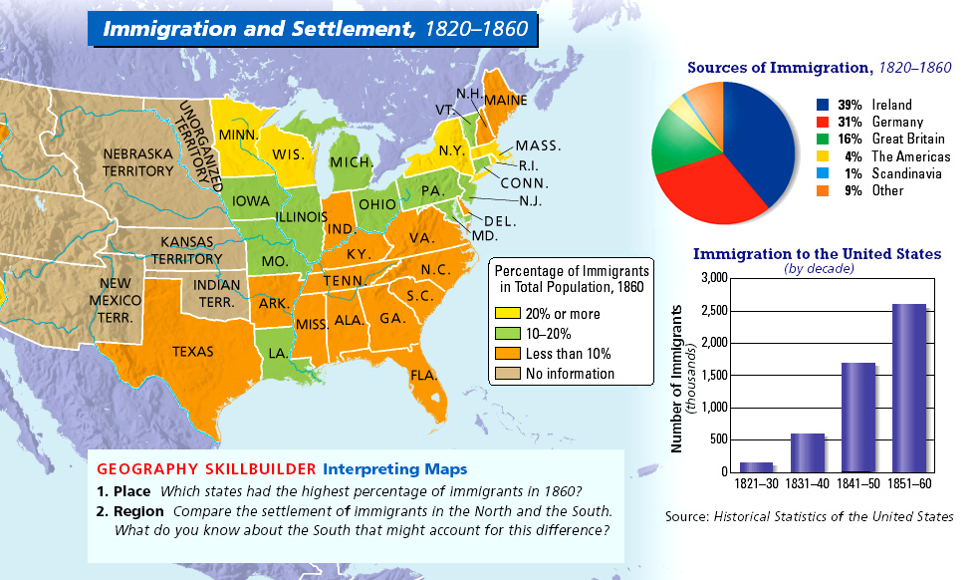
Causes of Urbanization
Increased immigration
Increased Immigration
Large numbers of immigrants were coming to America.
These immigrants were mostly coming from Europe and most had very little money.
They got off the ships and found jobs in the factories of the cities.
This steady supply of labor helped the factories grow as well as increased the size of cities.

Slide 5
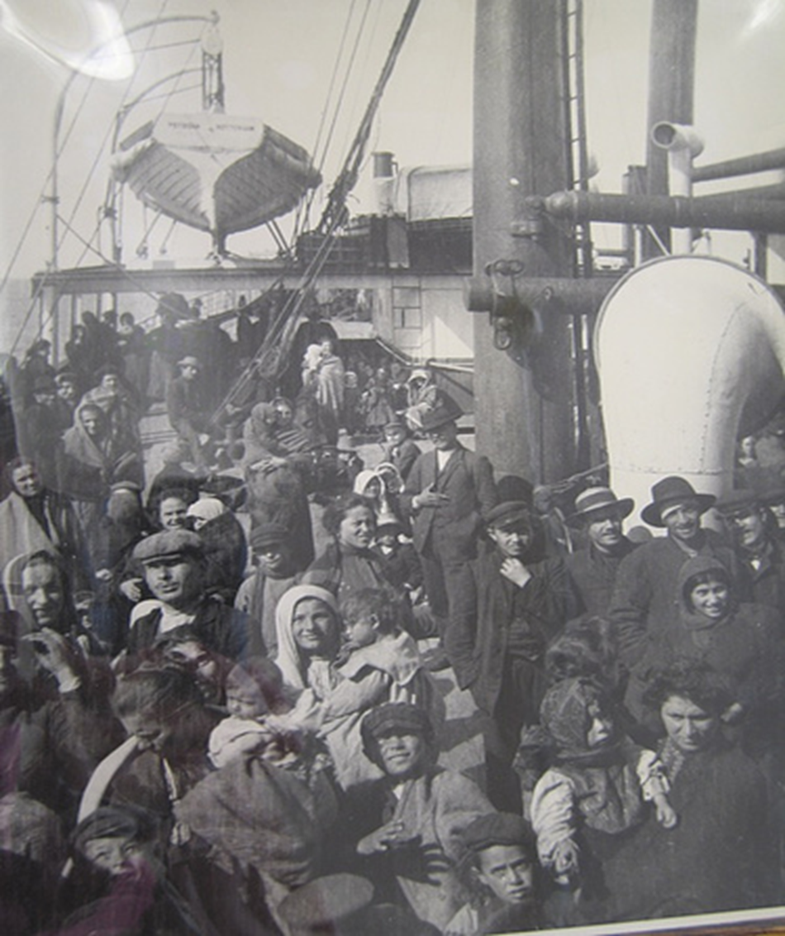
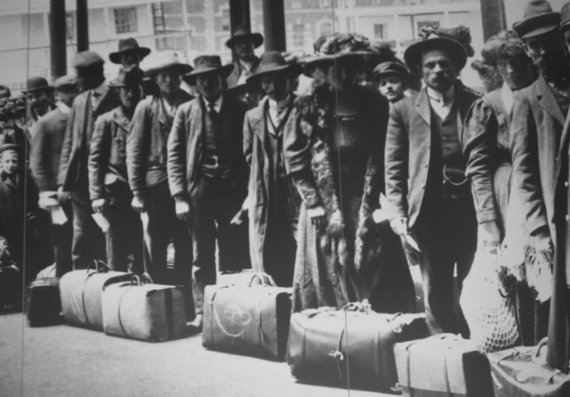
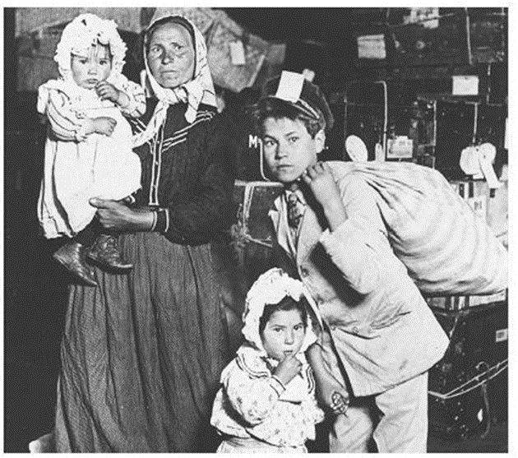

Slide 6
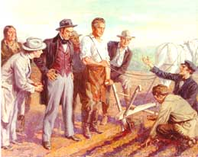
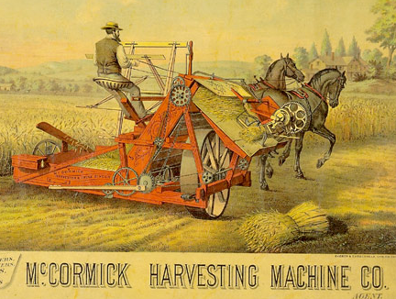
Causes of Urbanization
Improved farm equipment; Increased migration; Migration of African-Americans: Many African Americans moved north looking for better paying jobs
Improved farm equipment;
The Bessemer Process produced a better quality of steel making farm equipment more efficient and stronger.
John Deere’s steel plow allowed farmers to plant more crops.
Cyrus McCormick’s reaper reduced the number of people required to harvest the crops.
People left the farms to find jobs in the factories of the cities.

Slide 7
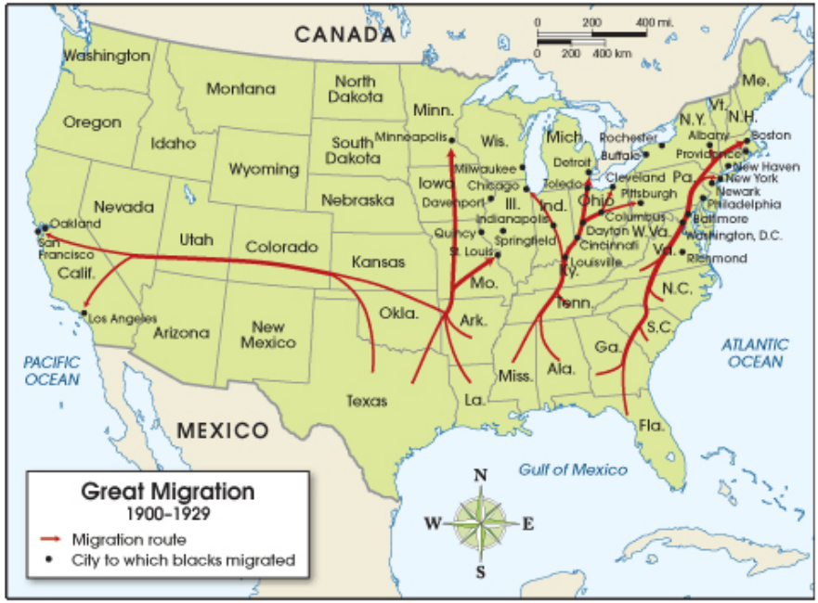
African Americans went north and west to seek better paying jobs.

Slide 8
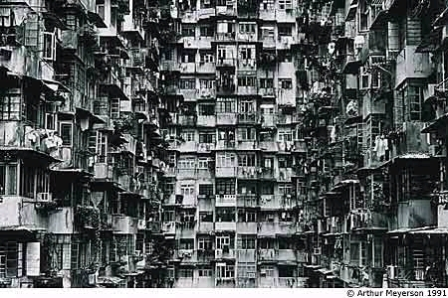
Growth of Cities Brings Problems
Did you hear Joe coughing all night?
Boy this water sure smells funny
Look out below !
The toilet doesn’t flush again !
Wish we could afford to move
Billy Bob you shouldn’t smoke in bed
If they don’t shut up I’m going to kick their &#@!
Thank goodness you have a factory job
Something sure stinks

Slide 9
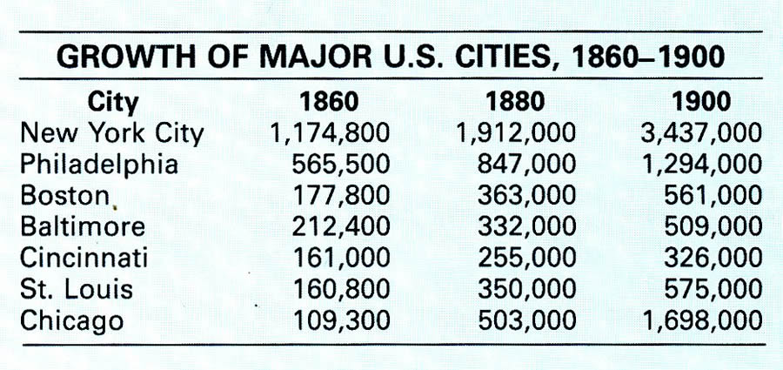
Urbanization
Looking for work, jobs led to the growth of cities
What factors caused that growth, and in what ways did Americans respond to the challenges posed by urbanization?

Slide 10
US Biggest Urban Centers 1870-1910

Slide 11
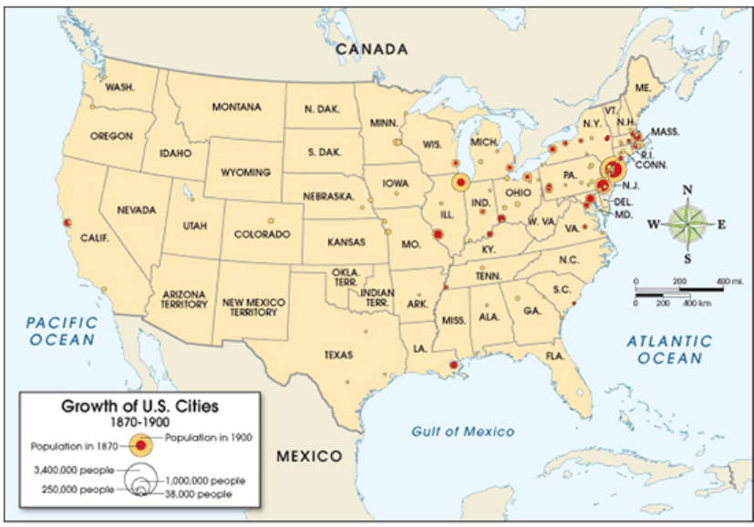
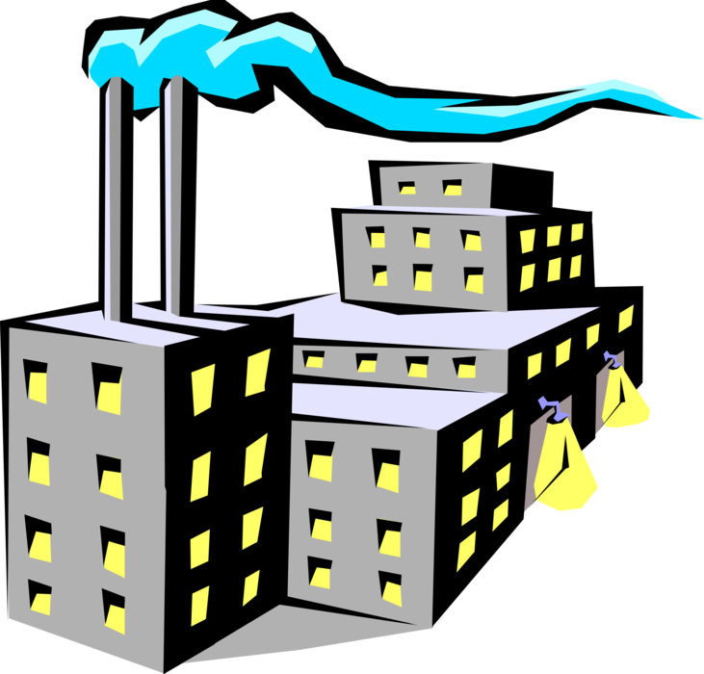
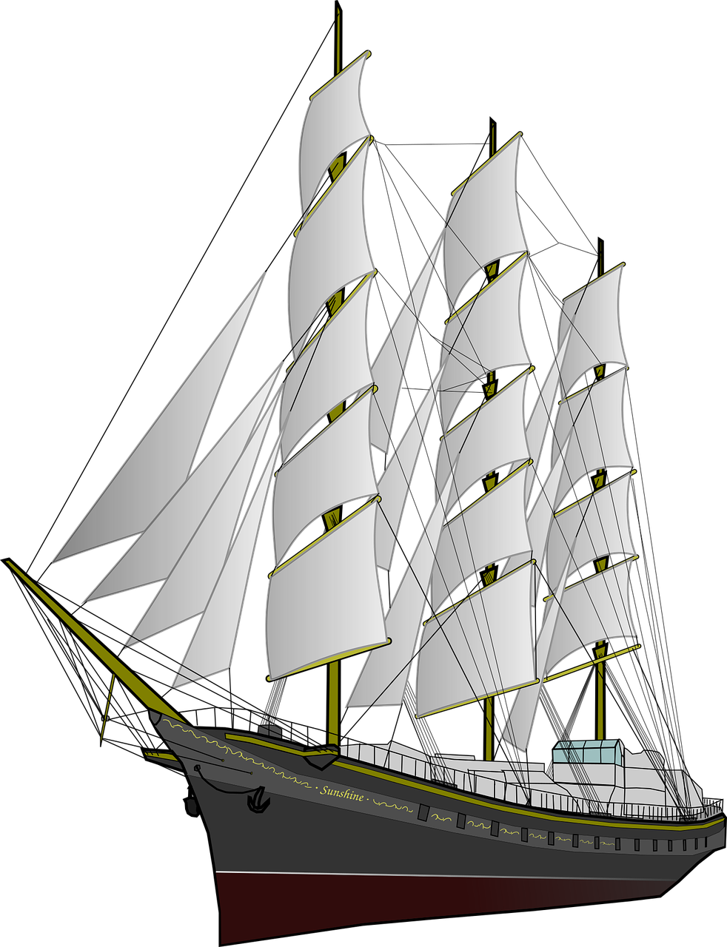
What caused city populations to grow, especially in the northeast and mid west (mid-
Atlantic states)?

Slide 12
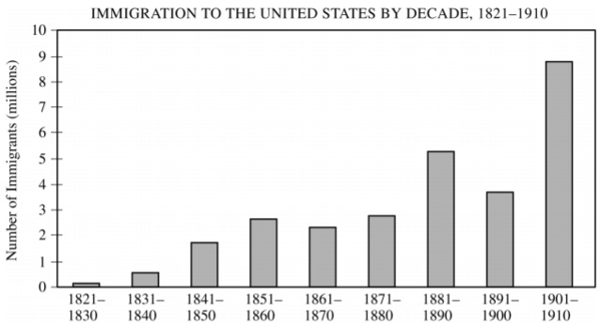
Which of the following most directly contributed to the overall trend depicted in the graph?
a. Global fluctuations in credit and stock markets
b. The transformation of the United States into an industrial society
c. Progressive Era reforms of social conditions in the United States
d. The outbreak of global war
The majority of immigrants who arrived in the United States between 1821 and 1880 settled in the
a. West and Midwest
b. South and Midwest
c. South and Northeast
d. Midwest and Northeast

Slide 13
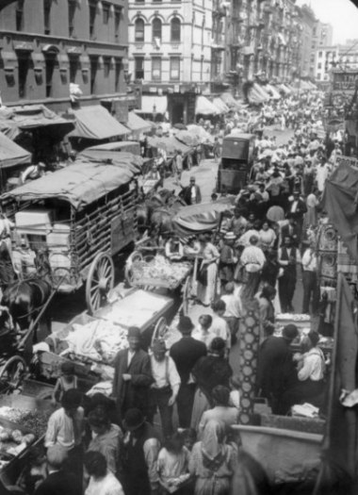
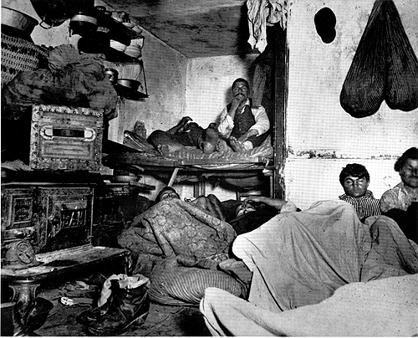
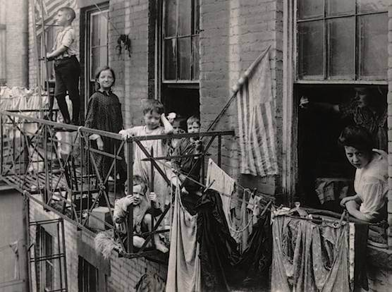
Problems Caused by Urbanization
This rapid urbanization of the cities led to many problems.
Overcrowding and congestion caused a lack of housing, transportation, and clean water.
Many families were forced to crowd into tenement housing- low-cost rental housing barely meeting minimal living standards
Lack of sanitation- lacking sewer systems and pollution from factories
NO or rarely any garbage collection
It also brought about an increase in the spread of diseases and crime.
Cities became overcrowded due to large influx of immigrants and farm workers from the west moving back to the cities.

Slide 14
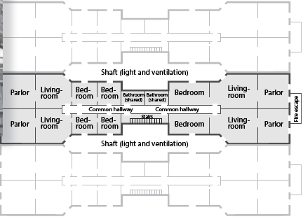
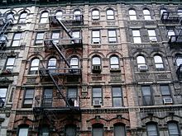
Floorplan of Tenement Row
No windows in some rooms
CALIENTE
Mom!! Where is the bathroom?
Outside in the hall. We share it with the neighbors

Slide 15
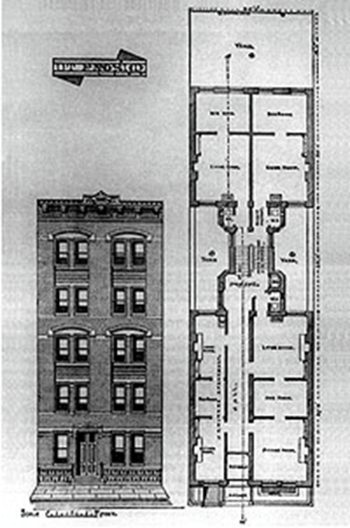
Tenement Row
FRQ
1. Briefly explain ONE specific problem that was caused by the rapid growth of cities during the period from 1865 to 1900.

Slide 16
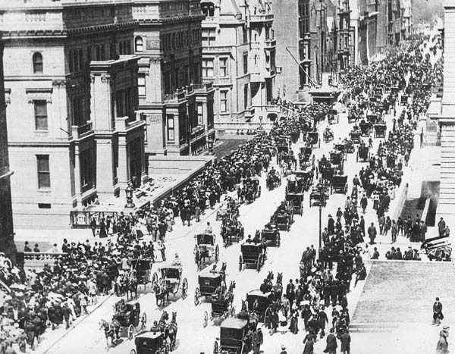
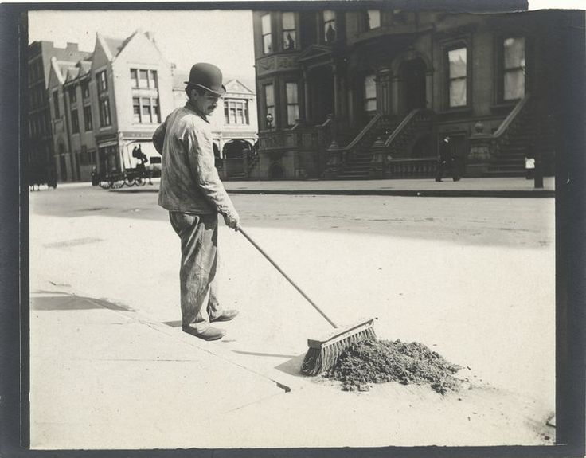

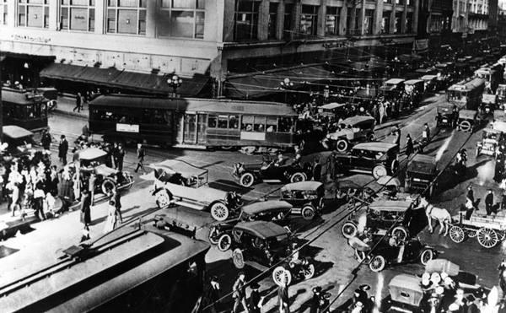
Problems Caused by Urbanization
Traffic congestion- horse drawn carriages, pedestrians, and cars. What a mess.

Slide 17
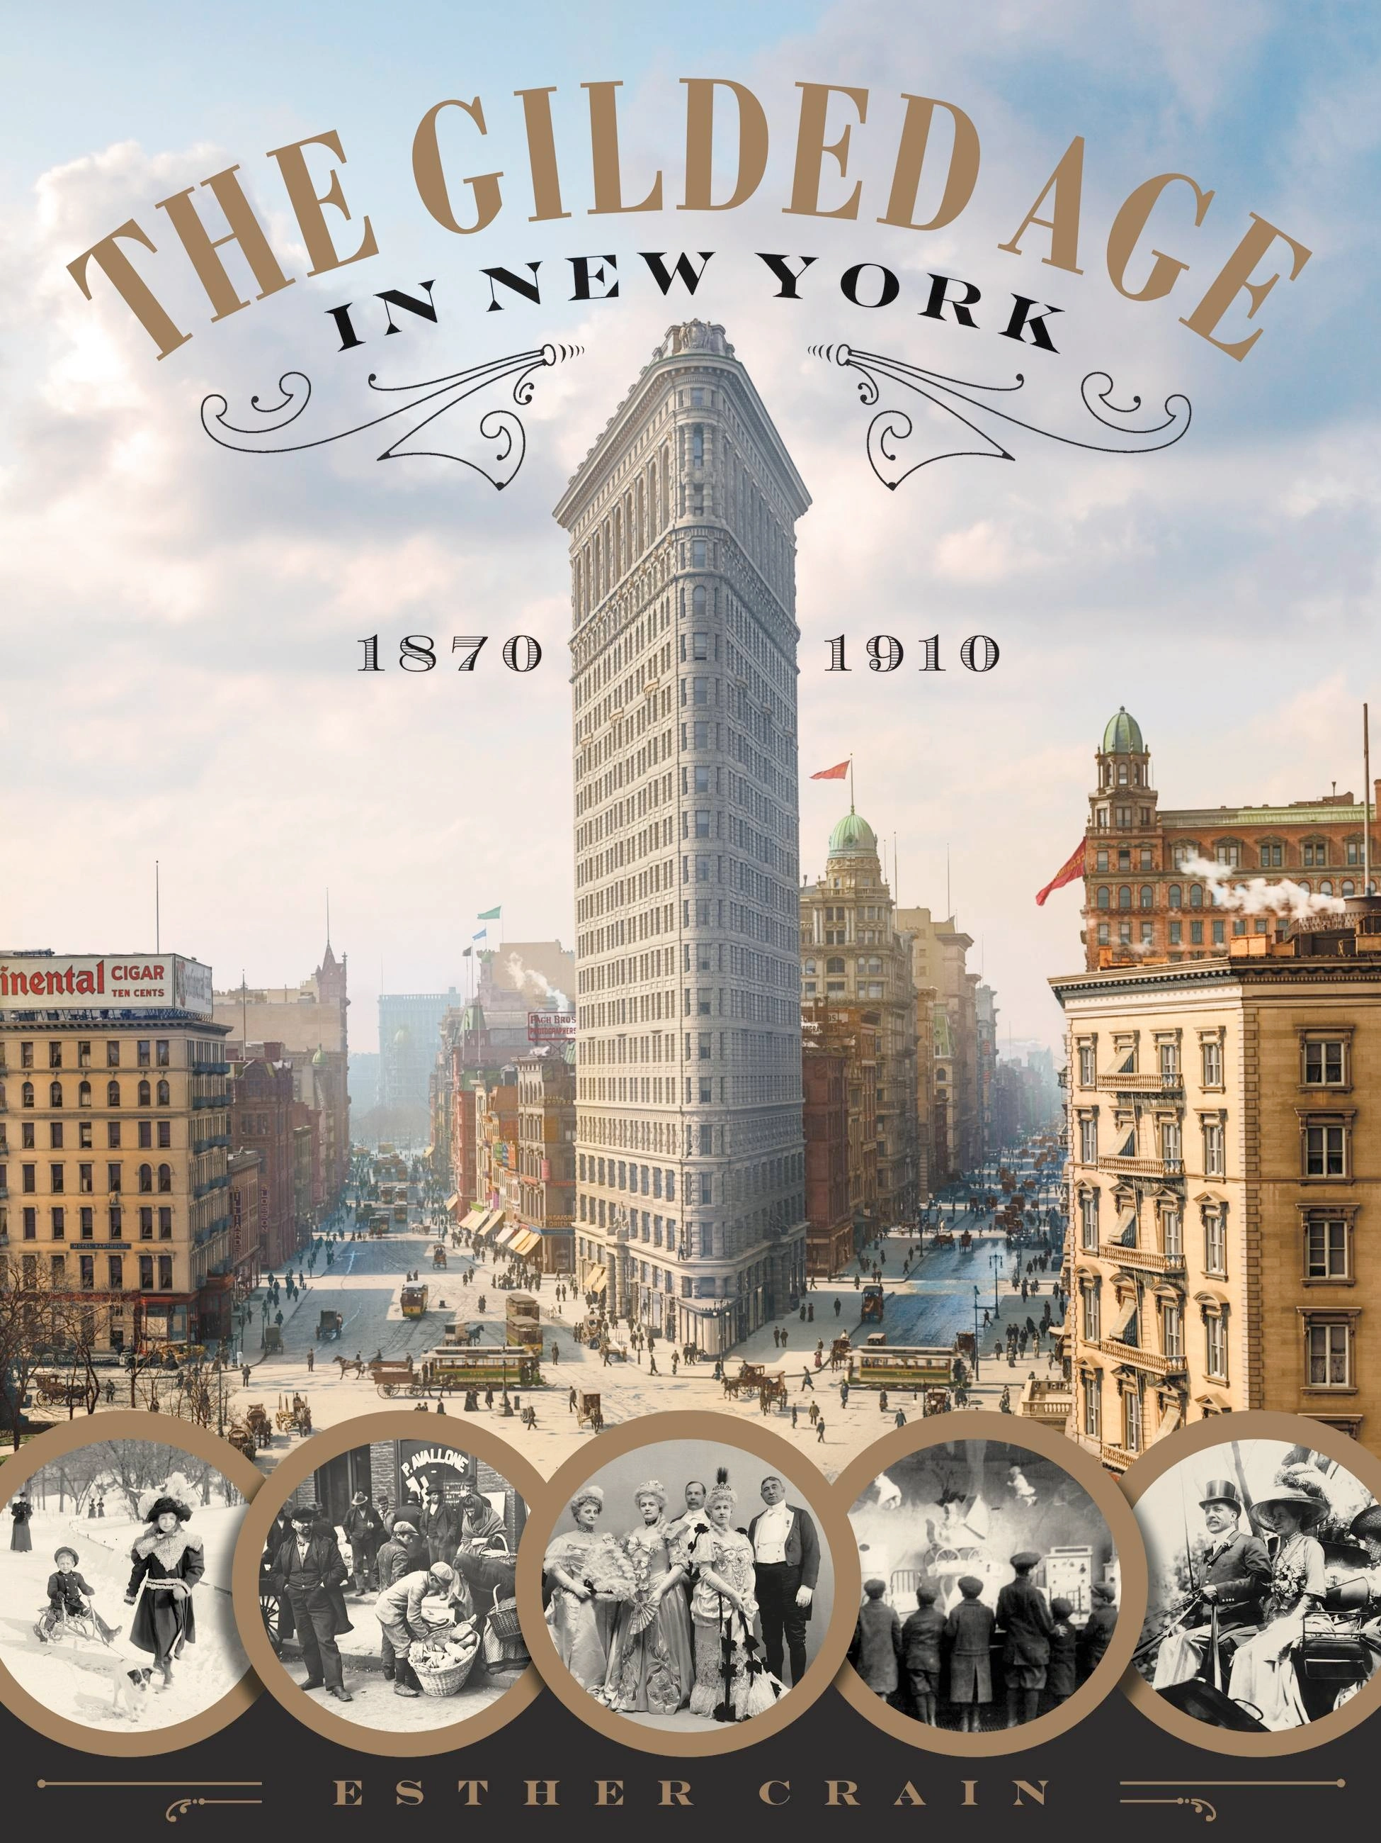
TOPIC 6.13 Politics in the Gilded Age
Politics and Power PCE
Debates fostered by social and political groups about the role of government in American social, political, and economic life shape government policy, institutions, political parties, and the rights of citizens.
Explain the similarities and differences between the political parties during the Gilded Age.
Economic instability inspired agrarian activists to create the People’s (Populist) Party, which called for a stronger governmental role in regulating the American economic system.
KC-6.3.II.A
The major political parties appealed to lingering divisions from the Civil War and contended over tariffs and currency issues, even as reformers argued that economic greed and self-interest had corrupted all levels of government.
KC-6.2.I.D
In an urban atmosphere where the access to power was unequally distributed, political machines thrived, in part by providing immigrants and the poor with social services.

Slide 18
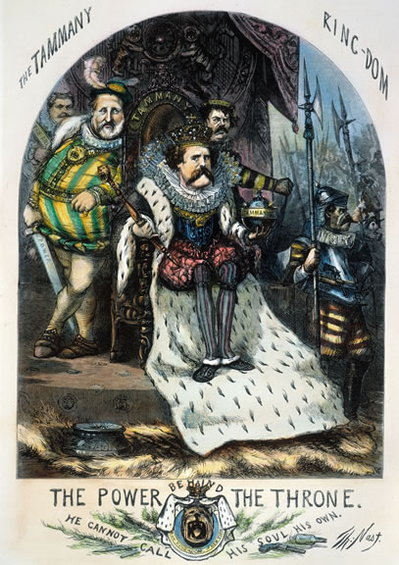
The Emergence of
Political Machines
Political Machine
Organized group that controls a city’s political party
• Give services to voters, businesses for political, financial support
• After Civil War, machines gain control of major cities
• Machine organization: precinct captains, ward bosses, city boss

Slide 19
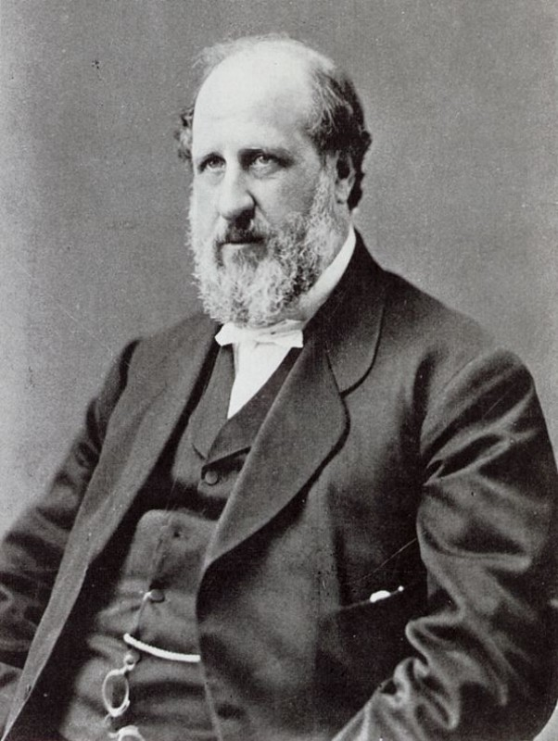
The Role of the Political Boss
May serve as mayor he:
  controls city jobs, business licenses
  influences courts, municipal agencies
  arranges building projects, community services
•Bosses paid by businesses, get voters’ loyalty, extend influence
Immigrants and the Machine
Many captains, bosses 1st or 2nd generation Americans
Machines help immigrants with naturalization, jobs, housing
Election Fraud and Graft
•Machines use electoral fraud to win elections
•Graft—illegal use of political influence for personal gain
•Machines take kickbacks, bribes to allow legal, illegal activities

Slide 20
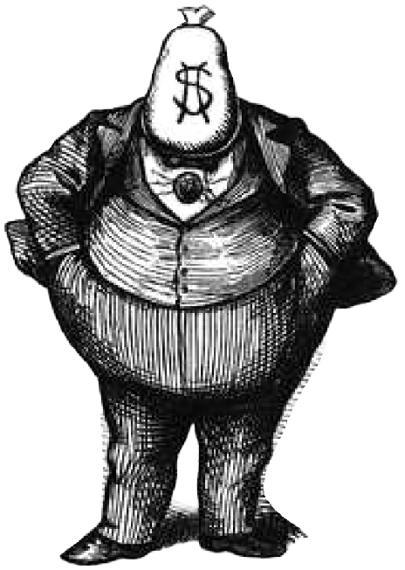
What is Graft?
Graft is the illegal use of political influence for personal gain
How do the bosses use graph for their own personal gain?
To win elections
To make themselves rich
To finance the operations of the political machine
What are kickbacks?
A kicked back is the illegal practice of getting contract workers hired by the bosses to overcharge the city for their services period then the overpayment will be split between the city boss and the contract worker.
The bosses would enrich themselves as well as the machine.

Slide 21
Problems Lead to Political Machines
Problem: Cities grow so fast their gov’t (municipal) could not keep up with needs of people
Solution: Political Machine steps in and provides services in exchange for votes and money
Goal of Pol. Mach: work to get their candidates elected
Transit, water & sewage systems, sanitation, protection- fire, police

Slide 22
Political Machines:
organized group that controlled things for a political party
All work together
to elect their
candidates &
ensure the success
of the machine
city boss
Ward and precinct bosses worked to make sure
there would be enough votes for their “man”
ward bosses
precinct captains
precinct workers

Slide 23
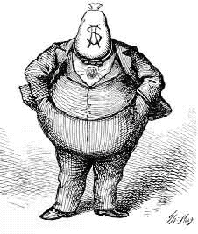
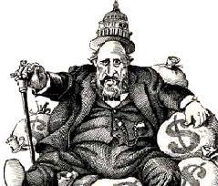
Political Corruption in the Cities & changing culture
Politicians also formed political machines.
These political machines were run by powerful politicians who did favors for people in return for bribes and votes.
These political machines were corrupt and took advantage of immigrants, if you wanted a job, you had to “pay” the ‘boss’. They wanted the immigrants vote when they became US citizens.
But at the same time they also helped them get things they wanted or needed- jobs, housing, food, etc. What we call today welfare, the machine provided.
One of the most famous political machines was Tammany Hall in New York City, it was run by Boss Tweed. (shown as a fat money grabber)
Boss Tweed made a vast fortune from kickbacks or bribe money. Graft or outright theft of city funds was also a way he made money.
https://www.history.com/news/thomas-nast-boss-tweed-cartoons

Slide 24
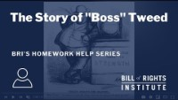

Slide 25
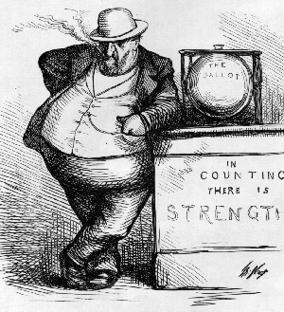
William Boss Tweed
Corrupt political leader put New York City in debt
  Political boss
1851 elected to city council
1852 served in Congress
Kept Democratic Party in power in NYC called Tammany Hall
Formed the Tweed Ring
Bought votes, encouraged corruption, controlled NYC politics

Slide 26
William Boss Tweed
Received large fees for interests (*kickbacks) from the Erie Railroad
Tweed Ring milked the city with false leases, padded bills, false vouchers, unnecessary repairs and over-priced goods
*Return of a portion of the money received in a sale or contract often illegal and corrupt in return for special favors.

Slide 27
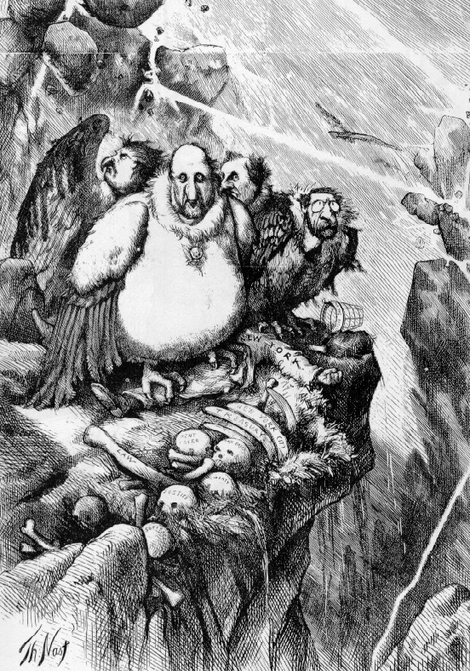
William Boss Tweed
Exposed for his corruption by cartoonist and editor, Thomas Nast
Tweed Ring fell and 1873 Tweed convicted of embezzlement
Later Tweed was arrested on a civil charge and jailed in NYC, later died there

Slide 28
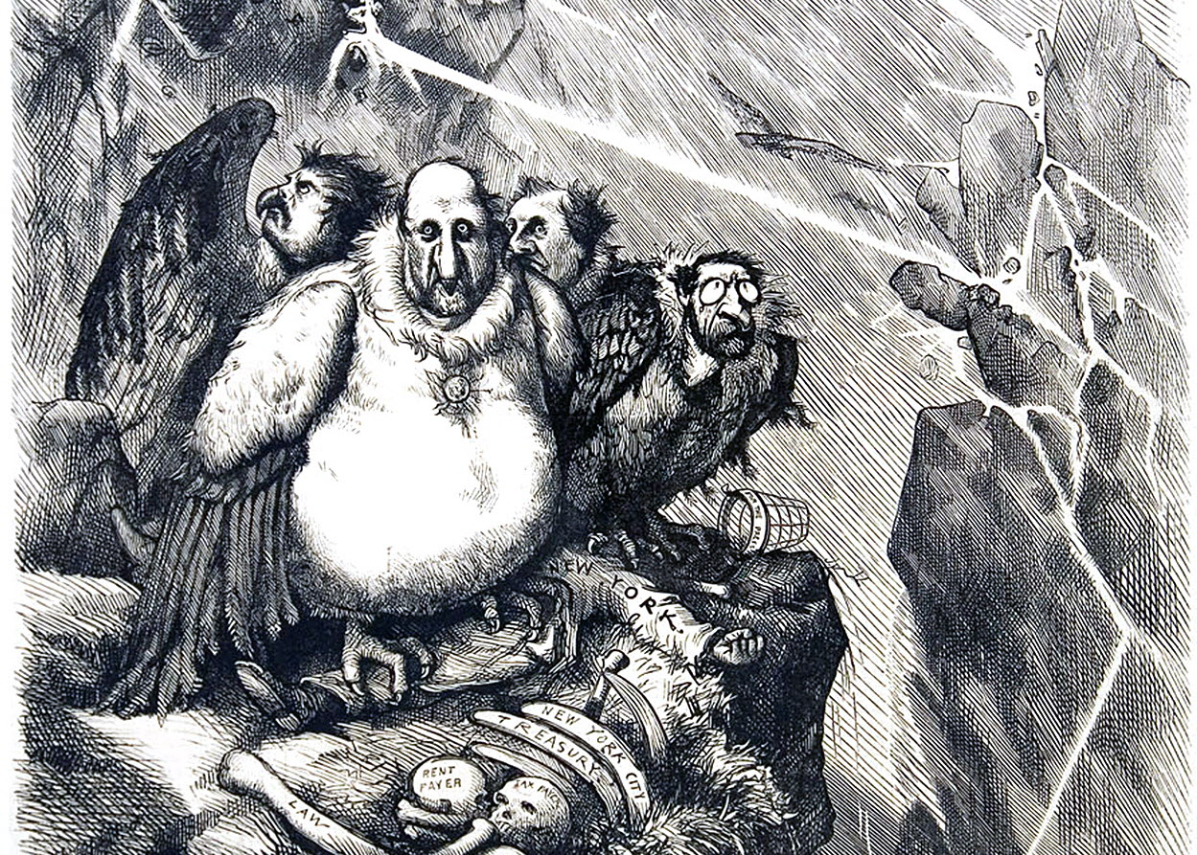

Slide 29
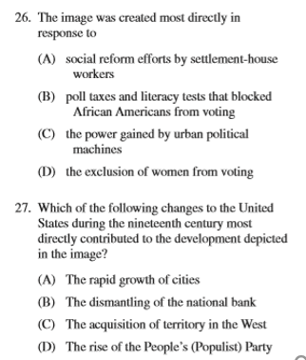
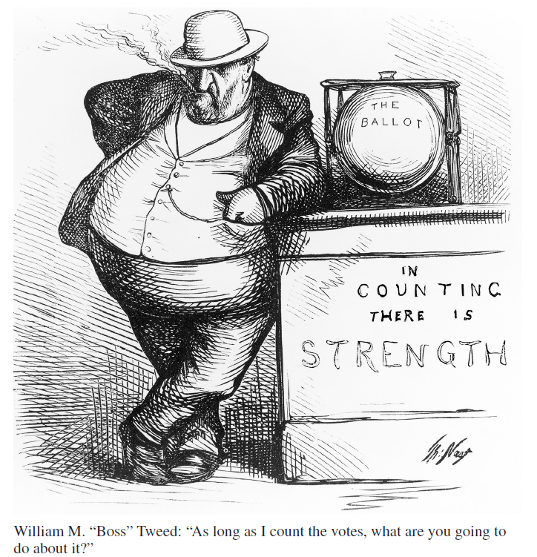
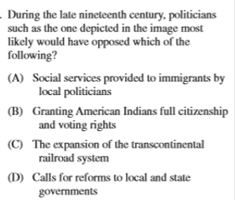

Slide 30
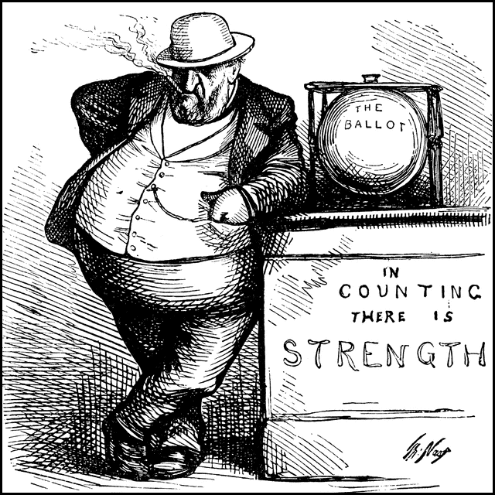
Nast depicts New York corruption with the abuses at the ballot box as the root of Tammany power. Boss Tweed: “As long as I count the votes, what are you going to do about it?” Illustration from the ClipArt ETC website.

Slide 31
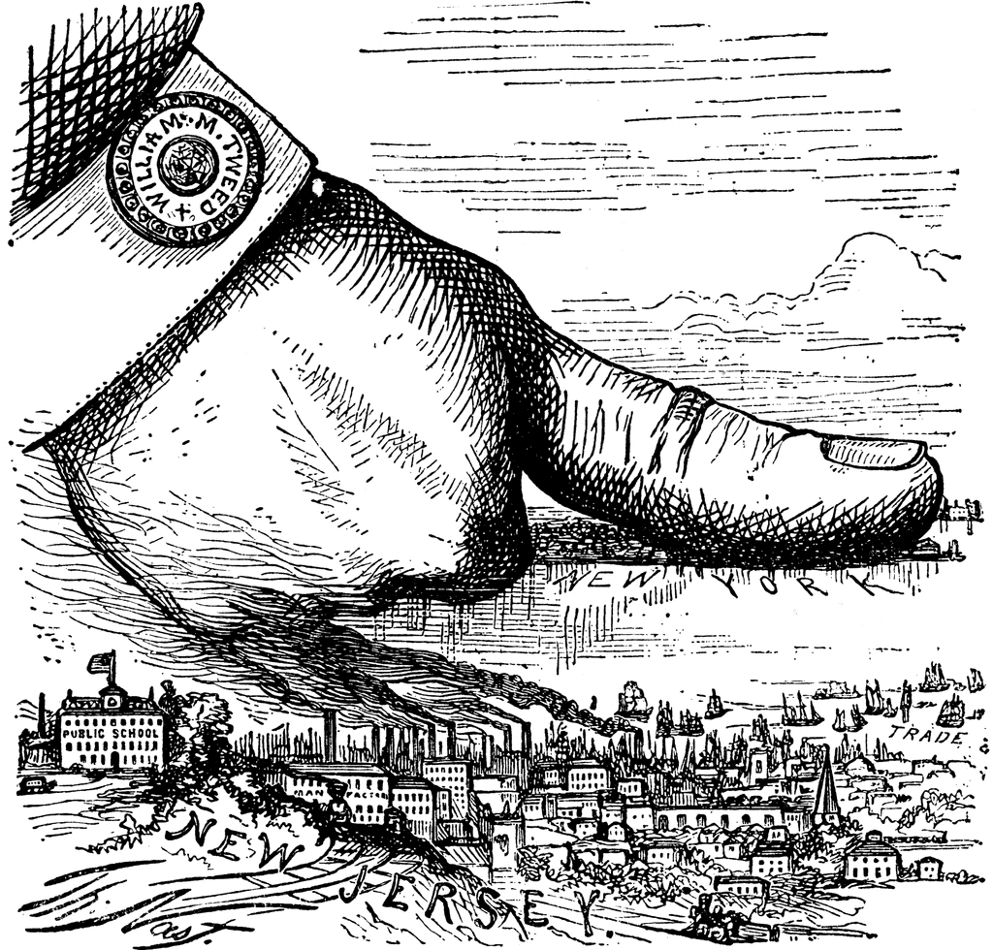

William Boss Tweed
Thomas Nast depicts New York corruption with New York under Tweed’s thumb. “The Boss - ‘well, what are you going to do about it?’”

Slide 32
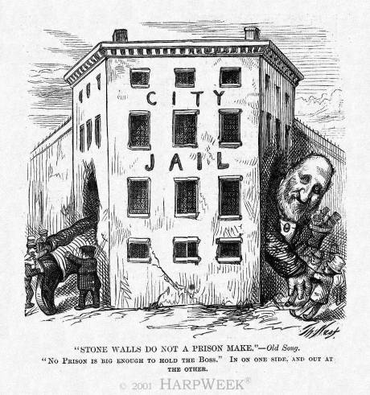
William Boss Tweed
Boss Tweed led a corrupt ring from 1869-1871 in New York City
Convicted of 120 counts of fraud and extortion, he was sentenced to 12 years in jail, but released after one period rearrested, he escaped to Spain

Slide 33
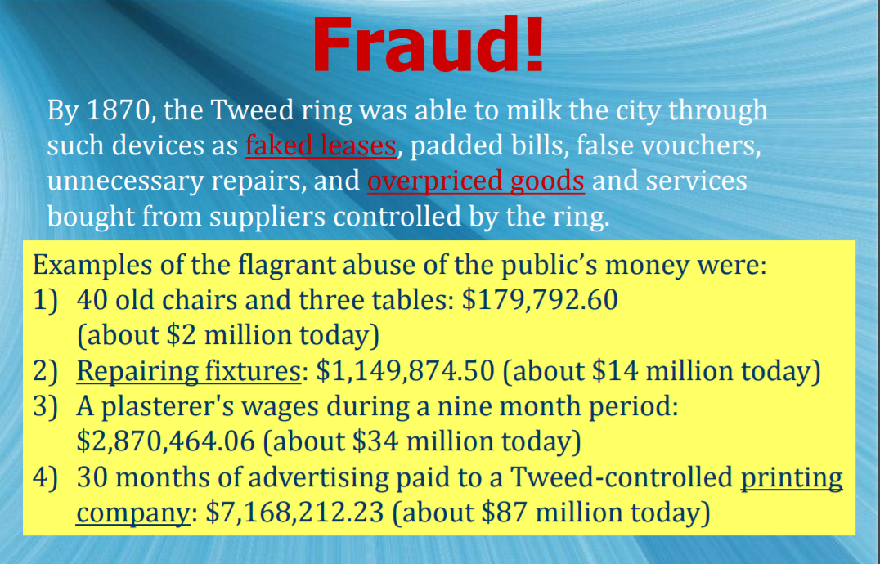

Slide 34


Boss Tweed did not take to kind to Thomas Nast’s cartoons
“Let’s stop them damn pictures. I don’t care so much what the papers write about—my constituents can’t read—but damn it, they can see pictures”. –Boss Tweed During the latter half of the 19th Century, William Marcy "Boss" Tweed was the poster boy for political corruption, and he is still considered one of the most notorious politicians in US history. He rose to power during a period when New York City was experiencing a huge influx of immigrants and needed to build many public works projects to cope with the increased demand for services. During the 1860s and early 1870s, Tweed and his cronies ran New York City and stole many millions of dollars of public money; by some estimates, as much as $200 million. Tweed was the richest, the most powerful and the most corrupt politician of his day.
Boss Tweed

Slide 35

  Thomas Nast
  Political Cartoonist who exposed the corruption of NYC’s Tammany Hall led by Boss Tweed. He exposed the corruption to the people and brought Tweed reign of corruption to an end.
Problem – governments had become corrupt with political machines.
Boss Tweed and other corrupt government officials went to jail for corruption.
Boss Tweed ran NYC’s most powerful political machine

Slide 36
  Thomas Nast
  Political Cartoonist who exposed the corruption of NYC’s Tammany Hall led by Boss Tweed. He exposed the corruption to the people and brought Tweed reign of corruption to an end.
As a political cartoonist, Thomas Nast wielded more influence than any other artist of the 19th century. He not only enthralled a vast audience with boldness and wit, but swayed it time and again to his personal position on the strength of his visual imagination. Both Lincoln and Grant acknowledged his effectiveness in their behalf, and as a crusading civil reformer he helped destroy the corrupt Tweed Ring that swindled New York City of millions of dollars. Indeed, his impact on American public life was formidable enough to profoundly affect the outcome of every presidential election during the period 1864 to 1884.” —Albert Boime
Boss Tweed ran NYC’s most powerful political machine

Slide 37


“Let’s stop them damn pictures. I don’t care so much what the papers write about—my constituents can’t read—but damn it, they can see pictures”. –Boss Tweed

Slide 38

The name given to the corrupt political boss and political machine located in New York during the late 1800's was __________________________________ .
Boss Tweed boss of Tammany Hall

Slide 39

What is the “Tammany Ring” referring to?
a. The current dance craze to hit the USA in the 1890s.
b. A new criminal organization plaguing Boston, Ma.
c. Tammany Hall political machine.
d. The Chicago syndicate known as the outfit.

Slide 40

“The Tammany Tiger Loose—‘What are you going to do about it?’”
Before being knocked to the ground by the tiger, the woman had been wearing a crown labeled “republic” and carrying a sword labeled “power”; she lies on top of a paper labeled “law” and a battered flag.
How does this cartoon demonstrate that Boss Tweed had an unfair grip over politics in New York?
Published by Harper's Weekly. November 11, 1871, by Thomas Nast

Slide 41
Cartoonists Thomas Nast chose the tiger as a symbol to represent which of the following?
A. The unlimited power of the robber barons
B. The impact of trust-busting on business in the US
C. The influx of immigrants and their impact on the US
D. The corrupt local government of New York City

Slide 42
How Political Machines helped??
Provided social services to those in need when the govt. role in resolving social problems was strictly limited
Political Machines lent money, provided jobs, emergency assistance for food and coal, or rent.
Helped immigrants apply for US citizenship
All of these services came with a price: LOYALTY to the Machine. They owned you and your family. This was not done out of the kindness of their heart. You turned against the machine, you quickly went jobless, homeless– think about it. Was it worth it? Many immigrants moved west.

Slide 43

“The Bosses in the Senate” 1889

Slide 44

The Way We Become Senator Nowadays
PUCK Magazine, Jan 22, 1890
The Constitution states that senators will be elected by the state legislatures. The senate would represent the interests of the states. This cartoon’s message is that the “fat cats” are buying of the state legislatures to get “elected” to the Senate.
This will change with the passage of the 17th amendment in 1913 in which senators would be elected directly by popular vote- the people

Slide 45

Political Corruption
Insider information in land speculation

Slide 46


Slide 47

6.8 Immigration and Migration in the Gilded Age
Push and pull factors shape immigration to and migration within America, and the demographic change as a result of these moves shapes the migrants, society, and the environment.
Explain how cultural &
economic factors affected
migration patterns over time.
KC-6.1.II.B.ii
The industrial workforce expanded and became more diverse through internal and international migration.
KC-6.2.I.A
As cities became areas of economic growth featuring new factories and businesses, they attracted immigrants from Asia and southern and eastern Europe, as well as African American migrants within and out of the South. Many migrants moved to escape poverty, religious persecution, and limited opportunities for social mobility in their home countries or regions.
KC-6.2.I.B
Urban neighborhoods based on ethnicities, races, and classes provided new cultural opportunities for city dwellers.

Slide 48

APUSH TOPIC 6.8 Immigration and Migration in the Gilded Age
As cities became areas of economic growth featuring new factories and businesses, they attracted immigrants from Asia and southern and eastern Europe, as well as African American migrants within and out of the South. Many migrants moved to escape poverty, religious persecution, and limited opportunities for social mobility in their home countries or regions.
LEQ or DBQ prompt
Evaluate the extent to which immigration affected United States culture in the period from 1840 to 1898.
Context: ask yourself, “how did we find ourselves in this situation?”
Why did they come to USA? What did we just finish talking about?
The industrialization of the United States because of the Civil War (1861-65)
Economic opportunity in the United States
Opportunities provided by Manifest Destiny

Slide 49
APUSH TOPIC 6.8 Immigration and Migration in the Gilded Age
Immigrants provided the cheap labor that helped the USA industrialization.
Once settled, immigrants looked for work. There were never enough jobs, and employers often took advantage of the immigrants. Men were generally paid less than other workers, and women less than men and children were paid the least (there were no anti-child labor laws). Social tensions were also part of the immigrant experience. Often stereotyped and discriminated against, many immigrants suffered verbal and physical abuse because they were "different." While large-scale immigration created many social tensions, it also produced a new vitality in the cities and states in which the immigrants settled. The newcomers helped transform American society and culture, demonstrating that diversity, as well as unity, is a source of national strength.
https://www.loc.gov/classroom-materials/united-states-history-primary-source-timeline/rise-of-industrial-america-1876-1900/immigration-to-united-states-1851-1900/

Slide 50
APUSH TOPIC 6.8 Immigration and Migration in the Gilded Age
As cities became areas of economic growth featuring new factories and businesses, they attracted immigrants from Asia and southern and eastern Europe, as well as African American migrants within and out of the South. Many migrants moved to escape poverty, religious persecution, and limited opportunities for social mobility in their home countries or regions.
LEQ or DBQ prompt
Evaluate the extent to which immigration affected United States culture in the period from 1840 to 1898.
Thesis: Immigration affected US culture in the period from 1840-1898 to a great extent because….. GIVE 3 REASONS, each reason is a body paragraph. Use TEA in each paragraph to complete your essay
In the next few slides, lets look at the evidence (images included) to determine what changes and to what extent did immigration affect US culture. We need to make 3 points in our essay body.

Slide 51


Slide 53





Immigration
This flood of immigrants coming into the USA, from Europe mostly came through Ellis Island, NY.
They came looking for the American Dream, to find a job, escape oppression and poverty,
or to reconnect with family.
Before 1890 most of these immigrants came from Western and Northern Europe, spoke English and were protestants. Old immigrants
After 1890 they mostly came from Eastern and Southern Europe, did not speak English, were mostly Catholic, Jewish, or Greek Orthodox
New Immigrants- came from Italy, Greece, Russia, Austria-Hungary. These countries had
no democratic traditions. Considered different.
Faced discrimination from old immigrants

Slide 54

Immigrants from Europe
Immigrants provided the labor force for industrial expansion of the US.
They also became the customers who in return bought the items produced.
Old New New New

Slide 55
Chart: Rise of Immigrants
IMMIGRATION
1,593,000
181,1880
2,753,00
926,000
1,110,000
1,847,000
1,069,000
5,780,000
540,000
2,928,000
Old = England and Germany
New = Southern Europe: Italy, Russia, Poland

Slide 56

An EOC Moment

Slide 57


An EOC Moment

Slide 58

Looking Backwards by Joseph Kepler Puck magazine Published on January 11th,1893 in New York City
The cartoon was created to show how old immigrants were hypocritical towards new immigrants in denying them the chance at the American dream. The old immigrants were now apart of American society, and some had become wealthy in America. They blamed the poor city conditions on the new immigrants.

Slide 60






The Immigrant Experience
After 1880 immigration changed, now they came from Southern and Eastern Europe, especially Poland, Italy, Greece, & Russia. NEW IMMIGRANTS
Immigrants settled in areas of the cities where others of the same nationality lived.
These ethnic neighborhoods were called ghettos- to be segregated or separated.
People felt more comfortable around those from the “Old Country” or those who spoke the same language and had similar customs.
But, these ethnic ghettos often isolated immigrants from mainstream American life, making it difficult for them to adapt to their new lives.

Slide 61

Push Pull Factors of Immigration
Fleeing crop failure
land and job shortages
rising taxes
famine

Slide 62

Why Immigrants Came to USA- Pull Push Review
Pull Factors – things that make a person want to move to another country
  Religious freedoms
  Job opportunities in factories, Transcontinental Railroad, gold mines, etc.
  Stable, democratic governments
  Hook up with family members already here
  Availability of cheap or free land
Push Factors – things that force people to leave their home country for another
  Wars in their homelands
  Famines (a severe lack of food)
  Lack of quality jobs
  Political unrest (bad leaders)
  Religious differences

Slide 63

Ellis Island Immigration Processing Center

Slide 64


Americanization
Some adult immigrants did attend night schools to learn English, but they were mostly too busy working.
It was the immigrant children that would become Americanized - learning to dress, speak, and act like other Americans.
These immigrant children would become assimilated – they became similar to other Americans.
America became a “melting pot” in which immigrants were melted down and reshaped.

Slide 65

Immigrants From Asia
Asians-primarily Chinese, arriving on the U.S. West Coast were processed at Angel Island immigration station in San Francisco Bay, California between 1910 and 1940.
1848-Pushed by warfare and economic hard times and Pulled by the lure of gold Chinese immigrants began arriving in California.
Hundreds of thousands of Chinese had migrated to California, Chinese workers had even helped build part of the Transcontinental Railroad.
After the RxR was completed many
Chinese moved to San Francisco
where they lived in “Chinatown”
Faced with discrimination, many left
their jobs and started their own
businesses- especially Chinese
laundries, restaurants, massage parlors.

Slide 66




Early Restrictions on Immigration
The Chinese Exclusion Act (1882) banned anyone from immigrating from China to the USA.
The first federal law to restrict immigration into the USA.
It also placed new restrictions of those Chinese already living here by restricting their travel.
Chinese children born in the USA were denied citizenship.
Many believed this violated their 14th Amendment rights.
Many saw these immigrants replacing American workers. Many were willing to work for lower wages

Slide 67


Early Restrictions on Immigration
For most of the 19th century there were no limits at all on immigration to the USA. Immigrants were needed a source of CHEAP LABOR for America’s growing industries.
Anyone who was healthy and could afford to get here was permitted.
Things were about to change, in 1882 the Chinese Exclusion Act (1882) was passed.
The first federal law to restrict immigration into the USA.
Hundreds of thousands of Chinese had migrated to California, Chinese workers had even helped build part of the Transcontinental Railroad.
Send us your …
But, No Chinese

Slide 68


a.
b.
c.
d.

Slide 69

Chinese Exclusion Act (1882)
First US Law to restrict immigration based on nationality or race
Remained on the books in various forms until 1943

Slide 70

No Soup For You!
"A Matter of Taste." (c. 1883). Thomas Nast. (John Chinaman refuses Soup in Kearney's Senatorial Restaurant--refers to legislation pertaining to Chinese Exclusion Act)
“How can Christians stomach such diet?”

Slide 71

Thomas Nast, cartoon - "The Comet of Chinese Labor" (1870)
http://www.csub.edu/~gsantos/img0049.html

Slide 72

"The Chinese Question." (February 18, 1871). Thomas Nast. (Columbia defends disconsolae John Chinaman from nativist Attacks)
http://www.csub.edu/~gsantos/img0050.html

Slide 73
An EOC Moment
One purpose of the Chinese Exclusion Act (1882) was to
a. speed construction of the westernrailroads
b. encourage settlement of the Pacific Coast
c. expand the civil rights of immigrants
d. protect the jobs of American workers

Slide 74

Melting Pot
Notes:
http://legalworldonline.com/OSCommerce/images/melting%20pot.jpg, http://regentsprep.org/regents/ushisgov/themes/immigration/melting_pot.gif, http://jackiemontgomery.files.wordpress.com/2009/05/meltingpot.jpg

Slide 75

Gentlemen’s Agreement
Now, Californians blamed the Asians for their economic problems.
In San Francisco the Board of Education in 1906 took all Asian school children and placed them special Asian Schools. As a result Anti-American riots broke out in Japan. In 1907-1908 an agreement was reached in which
Japan agreed to limit Japanese
emigration to the U.S. and in return
San Francisco withdrew its
segregation orders.

Slide 76




Gentleman’s Agreement (1907)
EXCLUSION BY LAW
EXCLUSION BY AGREEMENT
Japan agrees to control emigration if U.S. does not pass a law and treats existing Japanese immigrants fairly.

Slide 77



The Immigrant Experience
As more immigrants came to the USA, more Americans began to hate on these new immigrants.
These immigrant haters became known as Nativists, they thought they were here first and wanted the immigrants to go back where they came from. LIMIT immigration. Led to a rise in legislation to limit immigration.
Nativists hated on immigrants because they felt immigrants:
  Increased the crime rate
  Brought diseases to this country
  Took jobs from real Americans and brought down wages
  Competed for limited resources
  Basically they were just different!
  Afraid NEW IMMIGRANTS would not ASSIMILATE

Slide 78


An EOC moment
a.
b.
c.
d.

Slide 79


Slide 80

“Where the Blame Lies” by Grant E .Hamilton “Judge” magazine on April 4th 1891 in New York

Slide 81
VOCABULARY
dem·o·graph·ics
/ˌdeməˈɡrafiks/
noun
statistical data relating to the population and particular groups within it.
"the demographics of book buyers"

Slide 82

An EOC moment
  The graph to the left shows the rapid urbanization of the USA from 1860- 1930.
  Which factor contributed to the shift in population on the graph.
  Not enough families took advantage of the Homestead Act.
  Great Plains Indians left their reservation to buy new farmland.
  Houses in the cities were less expensive than those in the countryside.
  Better jobs in industry attracted farmers and farm laborers to cities

Slide 83
An EOC Moment
The economic development of the United States between 1870 and 1950 helped produce the results shown in the above graph. The trend shown in the graph is associated with
Increased urbanization
Decreased immigration
Advances in communication
Reduced population growth

Slide 84
An EOC Moment
Which demographic change resulted from the economic developments of the late 1800s?
a. an increase in African American migration from the North to the South
b. an increase in the number of people living in urban areas
c. a decrease in the number of immigrants coming to the United States
d. a decrease in the number of factory workers in the Northeast

Slide 85

EOC Moment
Use the image to answer the question.
The horizon of money, jobs, food and housing represents which of the following:
Push Factors
Pull Factors
ANSWER
Letter B
They are Pull Factors, they give people a reason to come to USA

Slide 86
An EOC moment
• Chinese Exclusion Act (1882)
• Gentlemen’s Agreement (1907)
• Emergency Quota Act (1921)
These federal actions demonstrate that Americans have
(1) supported the principle of open immigration
(2) provided immigrants equal access to jobs and social programs
(3) forced immigrants to settle in designated areas
(4) favored limiting immigration at different times in the nation’s history

Slide 87
APUSH TOPIC 6.8 Immigration and Migration in the Gilded Age
As cities became areas of economic growth featuring new factories and businesses, they attracted immigrants from Asia and southern and eastern Europe, as well as African American migrants within and out of the South. Many migrants moved to escape poverty, religious persecution, and limited opportunities for social mobility in their home countries or regions.
LEQ or DBQ prompt
Evaluate the extent to which immigration affected United States culture in the period from 1840 to 1898.
Thesis: Immigration affected US culture in the period from 1840-1898 to a great extent because….. GIVE 3 REASONS, each reason is a body paragraph. Use TEA in each paragraph to complete your essay
ESSAY points behind this wall
Point 1: Chinese Exclusion Act 1882
Point 2: Urban political machines and bosses
Point 3: Ethnic enclaves- Little Italy, Germantown (ghetto)
One more for good measure- the rise of Nativism
Complexity and reasoning: Comparison-contrast, causation-effect, continuity and change over time

Slide 88


The Farmers
During the late 1800s, the majority of Americans lived on farms, today less than 2% still live on a farm.
In the 1870s farmers moved onto the Great Plains, they introduced improved machinery and fertilizers to produce more than ever before.
Improved technology led to an abundance of crops which then led to a decrease in the price (deflation) received by the farmers.
But farming expenses remained, high, the farmers were going broke!
Many farmers moved back to the cities. This added to the URBANIZATION of the USA.

Slide 89

What factors caused that growth, and in what ways did Americans respond to the challenges posed by urbanization?

Slide 90


Slide 91





Improved technology
AS a result, farms needed less farm workers. Many left to the cities to find work. Led to a rapid increase of urbanization along with newly arriving immigrants. Cities grew rapidly. FACTORY JOBS.
The McCormick mechanical reaper replaced the manual cutting of the crop with scythes and sickles. This new invention allowed wheat to be harvested quicker and with less labor force.
Cyrus McCormick

Slide 92

Mechanized Farming

Slide 93

Mechanical Threshing Machine

Slide 94

The McCormick Reaper

Slide 95

The Tariff Cow. – The Farmer Feeds Her – The Monopolist Gets the Milk.

Slide 96

A Peculiar Case of Protracted Infancy.

Slide 97

Division of Labor.

Slide 98


Slide 99

Technology & Economic Growth
Better Technology = Increased Production
Agricultural Production

Slide 100

Overproduction and its Consequences
Agricultural Production
Trade
(Distribution)
Domestic Consumption

Slide 101

SURPLUS
Some rights reserved by quinet

Slide 102

LOW PRICES
Some rights reserved by quinet

Slide 103

Its tough being a farmer
Some rights reserved by UnitedSoybeanBoard

Slide 104


The American Labor Force
Puck Magazine, 1888

Slide 105
COMBINATIONS
MONOPOLISTS
[Trusts]
Government Policy
FARMERS?
Although the farmers still made up the plurality of the work force in the late 19th century, they were the last to organize as an interest group.
LABORERS
[UNIONS]

Slide 106
The Agrarian Movement
The Problems of Farmers: 1870 - 1900
Overproduction of crops - due to improved machinery, fertilizers, and new lands in the Great Plains caused an increase in food production this led to a drop prices (deflation) and a drop in farmers income.
International Competition- RxR & steamship transportation created an international market for food crops. Wheat growers faced foreign competition from Canada, Argentina, etc, further dropped food prices.
Scarcity of money- Govt stopped minting silver dollars. But population of US grew, value of its goods and services grew. There was not enough money supply and price dropped.
Profits of Middlemen- Farmers did not sell crops directly to consumers. They used middlemen (brokers) who connected them with urban markets for a fee. Farmers believed that brokers took advantage of them who bought grain when prices were low at harvest and re-sold at much higher prices. Also, some brokers were grain elevator owners, and charged high storage rates on their grain.
Transportation Costs – western farmers had to ship their crops to the Eastern markets, railroads took advantage of limited or no competition to charged high rates. RxR were a monopoly and charged high shipping rates.

Slide 107


The Great American Cow

Slide 108
The Agrarian Movement
The Problems of Farmers: 1870 - 1900
High Cost of Manufactured Products- expensive to buy farm equipment, high tariffs kept cheap imports out, and trusts did not help
Indebtedness – farmers were in debt from borrowing money to buy new machinery or make improvements. They used their farm land as collateral. If farmers did not pay the loans, banks would seize the land (foreclosure)
Because farmers had high debts, they favored cheap money- inflated money. If prices rose, the real value of a farmer’s payments to a bank would be less. But the economy was experiencing deflation.
Natural Disasters – droughts, floods, hailstorms, insects might wipe out a entire year’s crop.
Rural Isolation- farm families were miles from their nearest neighbor and towns. NO telephone, radio or car. Social isolation was a problem.
Farmers were price takers NOT price setters. Had no control over the price of the crops they produced. At the mercy of the market.

Slide 109
An EOC Moment
• They are suffering because they have little control over the prices for what they produce.
• They have worldwide competition.
• They have difficulty organizing to protect themselves.
• They pay high prices for capital goods.
Which group’s economic situation in the 1920s is most accurately described in these statements?
a. farmers
b. manufacturers
c. railroad companies
d. factory workers

Slide 110

As crop production increased the price farmers received went down. But, their production costs remained high or even increased causing farmers to go broke!
Law of Supply

Slide 111
An EOC Moment
Which trend is shown in these graphs?
When production increases, prices decrease.
When production increases, prices increase.
When production remains unchanged, prices decrease.
Prices and production are usually unrelated.
As a result of the trends shown in the graphs, the Populist Party wanted the federal government to
increase the money supply to
(1) raise the prices of crops
(2) limit the exportation of corn
(3) discourage the consumption of corn
(4) increase agricultural imports

Slide 112

The Agrarian Movement
In 1867, the Grange Movement was founded by Oliver Hudson Kelley
Its original purpose was to serve as a social club for farmers.
Its aim was to overcome the isolation of the rural farmer and to spread information about new farming techniques.
Soon the Grange had over a million members who now supported economic and political reforms.
Formed cooperatives (co-ops)- these co-ops bought machinery, fertilizes, and manufactured goods in bulk at a discount and passed the savings to the farmers.

Slide 113

Photo Credit: Billy Hathorn

Slide 114




Todays Co-ops
Today’s co-ops buy items in large quantities and sell them to members at a discount. Your membership fee helps the co-op pay for overhead expenses like- electricity, salaries of managers, etc. Co-ops then are able to pass down the cost savings to you in the form of lower prices. Very similar to the Grange co-ops.
Ace Hardware is also a co-op for the hardware store owners. Similar to the Grange, they buy items in bulk for all Ace Hardware store owners and pass on the savings to them in the form of lower prices, in turn they can sell to the consumer at lower prices and be able to compete against Lowe’s and Home Depot.

Slide 115


The Agrarian Movement
The Impact of the Grange Movement
Farmers mainly blamed the railroads for their problems.
Farmers felt they were being overcharged by railroads and grain storage facilities and by banks interest charge on loans. As the Grange Movement declined it was replaced by:
The Farmers Alliance- group of farmers who came together to negotiate lower rates.
Farmers who belonged to the Grange elected congressmen who promised reforms. Especially against the railroads monopoly pricing.
Midwestern states passed laws regulating the rates railroads and grain storage facilities could charge.

Slide 116

'The Grange Awakening the Sleepers'
The railroad trains are labeled with words like ‘bribery’, extortion, and lack of competition’.
This was to show that the railroads took advantage of the average American, particularly the small farmers.
It shows a farmer trying to warn unconcerned citizens about the abuses of the railroads. ● How did this cartoonist view the dangers to farmers?

Slide 117


The Agrarian Movement
The Granger Laws
Munn v. Illinois (1877), the Supreme Court upheld the right of the states to regulate businesses that affected public interests within the state.
Wabash v. Illinois (1886) US Supreme Court ruled that states could not regulate RxRs running through several states since this was interstate commerce. Only Congress could regulate interstate commerce. The Wabash decision invalidated many Granger Laws.
Interstate Commerce Act (1887), prohibited railroads from charging more for short hauls than long hauls over the same route. RxR (monopolies) were hurting small business owners.
It also banned pooling (price fixing agreements-collusion) or charging more for short hauls along the same route. RxR had to publish their rates which had to be “fair and reasonable”
Interstate Commerce Commission was created to enforce the new law, it became the first federal government agency to regulate unfair business practices.

Slide 118


Slide 119
LEQ or DBQ Prompt
To what extent did technology, government policy, and economic conditions change American agriculture in the period 1865-1900.
Contextualization: ask yourself how did we get here? The answer becomes the basis for your
Context paragraph.
Thesis:
Technology, government policy, and economic conditions changed American agriculture in the period 1865-1900 to a great extent because….. List three points. Each point will be come a topic for your essay. Three points= three paragraphs at a minimum for the body of your essay.
In the next slide, how would you use Mary Elizabeth’s Lease quote?

Slide 120

Mary Elizabeth Lease 1855-1933
Populist leader and orator Mary Elizabeth Lease, who supposedly advised Kansas farmers to "raise less corn and more hell.”
“The great common people of this country are slaves, and monopoly is the master. . . . The politicians said we suffered from overproduction. Overproduction, when 10,000 little children, so statistics tell us, starve to death every year in the United States. . . . We will stand by our homes and stay by our fireside by force if necessary, and we will not pay our debts to the loan-shark companies until the government pays its debts to us”.
“Wall Street owns the country. It is no longer a government of the people, for the people and by the people, but a government for Wall Street, by Wall Street, and for Wall Street. The great common people of this country are slaves, and monopoly is the master…Let the bloodhounds of money who have dogged us thus far beware”.
Would Mary Lease favor a take over of certain big business? If so, which one(s) and why?

Slide 121
Mary Elizabeth Lease 1855-1933
Populist leader and orator Mary Elizabeth Lease, who supposedly advised Kansas farmers to "raise less corn and more hell.”
To what extent did technology, government policy, and economic conditions change American agriculture in the period 1865-1900.
“The great common people of this country are slaves, and monopoly is the master. . . . The politicians said we suffered from overproduction. Overproduction, when 10,000 little children, so statistics tell us, starve to death every year in the United States. . . . We will stand by our homes and stay by our fireside by force if necessary, and we will not pay our debts to the loan-shark companies until the government pays its debts to us”.
Document Information:
•Political parties and politicians lie to farmers.
•Political parties and politicians encourage farmers to raise big crops.
•Political parties and politicians said farmers suffered from overproduction.
•In the United States, 10,000 children starve each year.
•Farm prices are falling.
Document Inferences:
•Farm prices were falling because of overproduction.
•Farmers were dissatisfied with political parties and politicians.
•Farmers may wish to form their own political party.
•The government should remedy overproduction by making sure people do not starve.
•Farmers have fallen on economic hard times.
•Discontented farmers formed the Populist Party.

Slide 122

The People’s Party
AKA “POPULISTS”
Photo of People's Party convention at Columbus, Nebraska, 1890

Slide 123
WHO?
Southern and Western Farmers
Photo of People's Party convention at Columbus, Nebraska, 1890

Slide 124

“THIRD” Party
Photo of People's Party convention at Columbus, Nebraska, 1890

Slide 125
A Jeffersonian Movement?

Slide 126

The Populist Party: 1891-1896
Farmers (mainly Grange members) formed the Farmers Alliance in the NW and South. Mainly focused on local politics.
In 1891, a new political party arose from the Farmers Alliance and the Grange and gained support with the ‘common man’, it was the Populist Party. It focused on NATIONAL issues.
Populist Party means People’s Party
The farmers, workers, and miners battled against the rich, bankers and railroad owners (monopolies).
For the first time women also played an important role in politics.
Populists believed that the rich had a stranglehold on government and they wanted the government to end poverty, injustice, and unfair laws. Wanted a more active gov in the economy to protect the people from Big Business.
Populist believed that the Democratic and Republican Party both had sold out to the banking interests (Wall Street)
Populist believed that the bankers were using their control of govt. to restrict the money supply so that their own gold would increase in value.

Slide 127


Slide 128

Populist Party Balloon
This political cartoon shown above is titled “A Party of Patches.” It was shown in Judge Magazine on June 6, 1891. The cartoon is from the point of view of the Republican Party. It depicts familiar members of the Populist party, Sockless Jerry Simpson and William Peffer (the guy with the long beard), riding in a balloon made of patches from different organizations under the Populist Party. It takes a jab at the Populist Party because the balloon is filled with “hot air.” The balloon patches show different organizations such as the Knights of Labor Party, Farmer’s Alliance, Old Greenback Party and the Old Granger Party. It also has patches that say communist and socialist.

Slide 129





Slide 130
The Populist Platform
Political Reform Proposals | Economic Reform Proposals
Graduated [Progressive]
Income Tax
Unlimited Coinage
of Silver
Nationalization
of Railroads
Direct Election
of Senators
Ballot Initiatives
Secret Ballot

Slide 131
A Jeffersonian Movement?

Slide 132



The Parable of the Wizard of Oz
parable noun
par·a·ble | \ˈper-ə-bəl, ˈpa-rə-\
a usually short fictitious story that illustrates a moral attitude or a religious principle
al·le·go·ry noun
/ˈaləˌɡôrē/
allegory; plural noun: allegories
a story, poem, or picture that can be interpreted to reveal a hidden meaning, typically a moral or political one.
L. Frank Baum
The Scarecrow represented the farmers, the Tinman the factory workers, the Wizard was President Grover Cleveland or Republican presidential candidate William McKinley, the Cowardly Lion was Democratic presidential candidate William Jennings Bryan and the silver shoes were the silver standard, the yellow brick road the gold standard.

Slide 133
The Goals of the Populist Party
OMAHA PLATFORM 1892
Unlimited Coinage of Silver – instead of gold coins, make more silver coins, it would help raise farm prices and make loan repayments easier. INFLATION
Term Limits for President – only a single 4 years term.
Direct Election of Senators – elected by the people of a state not the state legislature. Gave more participation in government.
Secret Ballot – to stop intimidation of voters.
Government Ownership of Utilities – like railroads, telegraph, and telephone companies. (kinda Socialist sounding)
Immigration Restrictions – have quotas (limits) on how many people could come from each country.
Graduated Income Tax – taxes wealthy at a higher rate.
Shorter Work Day – just 8 hours.
Initiative- voters could directly introduce bills into state legislatures
Referendum-Procedure for submitting to popular vote measures passed by the legislature or proposed amendments to a state constitution.

Slide 134



Slide 135

THE MONEY SUPPLY
Some rights reserved by danielmoyle

Slide 136

The Gold Standard
SOUND MONEY
Store of Value
Inflation

Slide 137

Bimetallism
Some rights reserved by digitalmoneyworld

Slide 138
Forms of Currency
2
Some rights reserved by digitalmoneyworld

Slide 139

Bi-metalism
16:1
Some rights reserved by sirqitous

Slide 140

Chart by:
Paweł Zdziarski

Slide 141
The Populist Platform
Political Reform Proposals | Economic Reform Proposals
Graduated
Income Tax
Unlimited Coinage
of Silver
Nationalization
of Railroads
Direct Election
of Senators
Ballot Initiatives
Secret Ballot

Slide 142




The Goals of the Populist Party
TRANSPORTATION—Transportation being a means of exchange and a public necessity, the government should own and operate the railroads in the interest of the people. The telegraph, telephone, like the post-office system, being a necessity for the transmission of news, should be owned and operated by the government in the interest of the people……
The Populist favored NATIONALIZATION (govt. take over of the Railroads).
USPS is a govt. owned corporation.
In 1971, the govt took over Amtrak, USA’s only passenger rail service..

Slide 143


Populists and Election Campaigns
1892 Election – Populists were successful in electing Senators and their Presidential candidate did well in the election (but he didn’t win).
1896 Election – Populists supported William Jennings Bryan for President due to his “Cross of Gold” speech in which he supported the unlimited coinage of silver, instead of gold. The Democratic Party and the Populist Party both nominated Bryan to run for President for both political party. Awkward. Lost to the Republican William McKinley
Bimetallism. Free silver was a major policy issue in late 19th-century American politics. Its advocates were in favor of an inflationary monetary policy using the "free coinage of silver" as opposed to the deflationary gold standard. Its supporters were "Silverites".
Plains farmers supported bimetallism because expanding the money supply would create inflation, making it easier for them to pay their debts. Bimetallism describes a monetary standard that accepts both silver and gold. It establishes a fixed rate of exchange between the two metals. This would never work- Gresham’s Law
1900 Election – Populists again supported Bryan, but he again lost to William McKinley.

Slide 144
Evaluate the extent to which the Populist movement marked a turning point in the United States economy OR politics.
In the development of your argument, explain what changed and what stayed the same in the economy OR politics as a result of the Populist movement within the period 1865–1920. (Historical thinking skill: Periodization)
In your response you should do the following.
Thesis: Present a thesis that makes a historically defensible claim and responds to all parts of the question. The thesis must consist of one or more sentences located in one place, either in the introduction or the conclusion.
Application of Historical Thinking Skills: Develop and support an argument that applies historical thinking skills as directed by the question.
Supporting the Argument with Evidence: Utilize specific examples of evidence to fully and effectively substantiate the stated thesis or a relevant argument.
Synthesis: Extend the argument by explaining the connections between the argument and one of the following.
A development in a different historical period, situation, era, or geographical area.
A course theme and/or approach to history that is not the focus of the essay (such as political, economic, social, cultural, or intellectual history).

Slide 145

Election of 1892
1892
1896
1900

Slide 146


Slide 147

An Easy Choice…

Slide 148

1896 Election – Populists supported William Jennings Bryan for President due to his “Cross of Gold” speech in which he supported the unlimited coinage of silver, instead of gold. The Democratic Party and the Populist Party both nominated Bryan to run for President for both political party. Awkward
The Democrats/ Populist lost the election of 1896 and 1900. With so many good ideas
how could they lose? They promised INFLATION if they won. That means higher prices for
food, energy, clothing, etc. The city folks did NOT want INFLATION and urban population was far greater than rural populations, urban out voted rural. By now, more Americans lived in cities than on farms by now.
Come on, VOTE FOR ME and I PROMISE YOU HIGHER PRICES. Really?

Slide 149

CROSS OF GOLD SPEECH
“They tell us that the great cities are in favor of the gold standard. We reply that our great cities rest upon our broad and great prairies”.

Slide 150
CROSS OF GOLD SPEECH
“Burn down your cities and leave our farms, and your cities will spring up again as if by magic; but destroy our farms, and the grass will grow in the streets of every city of the country”.

Slide 151
CROSS OF GOLD SPEECH
“You shall not press down upon the brow of labor this crown of thorns; you shall not crucify mankind upon a cross of gold”

Slide 152

William Jennings Bryan 1860-1925
Populist Leader who championed the cause of the farmer. Embraced by the Democratic Party.
To what extent did technology, government policy, and economic conditions change American agriculture in the period 1865-1900.
Source: Excerpts from a speech by William Jennings Bryan, July 1896
You come to us and tell us that the great cities are in favor of the fold standard. I tell you that the great cities rest upon these broad and fertile prairies. Burn down your cities and leave our farms, and your cities will spring up again as if by magic. But destroy our farms and the grass will grow in the streets of every city in the country.
If they dare to come out in the open field and defend the gold standard as a good thing, we shall fight them to the uttermost, having behind us the producing masses of the nation and the world. Having behind us the commercial interests and the laboring interests and all the toiling masses, we shall answer their demands for a gold standard by saying to them, you shall not press down upon the brow of labor this crown of thorns. you shall not crucify mankind upon a cross of gold.
Document Information:
Farms are necessary for the survival of cities.
•Cities favor the gold standard.
•The producing masses and the world are against the gold standard.
•The gold standard hurts commercial and laboring interests and the toiling masses.
Document Inferences:
Farmers favored the free and unlimited coinage of silver.
Although cities depend on farms, farms do not depend on cities.
There was conflict between urban and rural interests.
Democrats and Populists favored the free and unlimited coinage of silver.
Republicans favored the gold standard.
Farmers’ political response to hardships included the formation of the Populist Party.

Slide 153

William Jennings Bryan was the Democratic candidate for president in 1896 on a platform illustrated in the cartoon shown above. Bryan’s campaign positions on economic issues were very close to which of the following political groups of Bryan's period?
A. Republican Party
B. Populist Party
C. Progressive Party
D. Prohibitionist Party

Slide 154

Election of 1896
1892
1896
1900

Slide 155





The Legacy of Populism
The Populist party would soon fade away, but it was somewhat successful in its efforts, even though a Populist president was never elected.
The Populist Party did leave its mark on American history with the idea of Third parties.
Third parties provide an outlet for minorities to voice their grievances or to voice new ideas that the main stream (Democrat & Republican) don’t usually support.
Many Populist ideas were later adopted by the larger political parties, like a graduated income tax, direct election of senators,
eight hour work day, initiative, referendum and recall elections-is a procedure by which voters can remove an elected official from office through a direct vote before their term has ended. ONLY at the local and state elections
By 1902, the Populist Party faded but many of their ideas
were adopted by the Democrats and Republican Parties.
It changed the style of politics; closer to the people.

Slide 156

The Rematch
1892
1896
1900

Slide 157
An EOC Moment
In the United States, third parties have been influential because they have often
a. outspent their political opponents
b. provided the presidential candidate of the major parties
c. suggested reforms later adopted by the two major parties
d. elected majorities in both Congress and state legislatures

