Slide 1
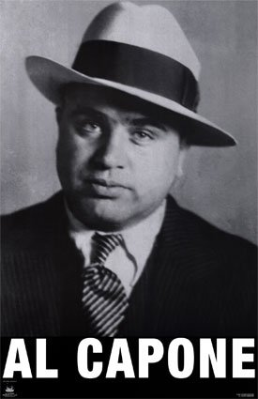
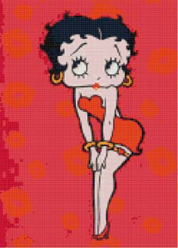
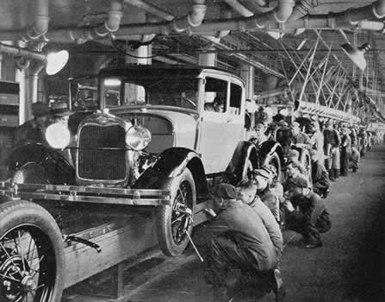
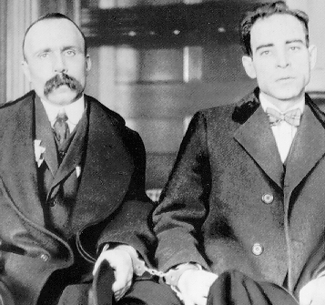
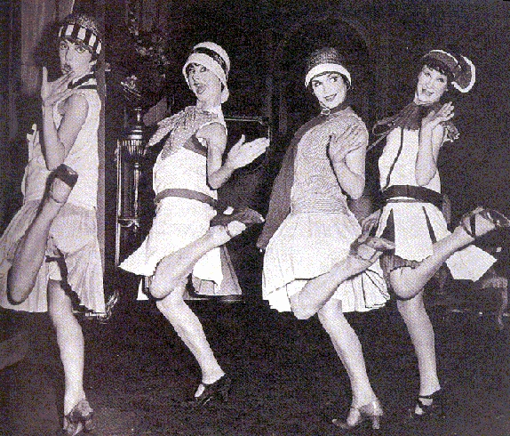
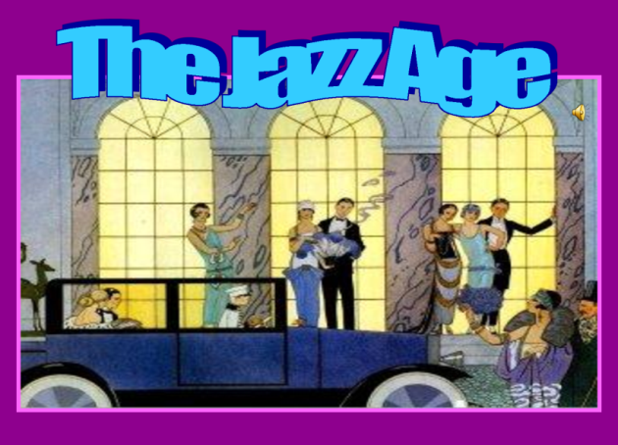


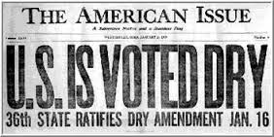
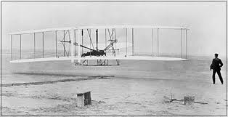

The Roaring Twenties
Chpt. 10

Slide 2

Learning Objectives
What difficulties did Americans have adjusting to peace after World War I?
What was the1920s Republican Presidents approach to a laissez-faire government?
What made the Roaring 20s roar?
How did cultural values change?
What impact did the “Harlem Renaissance” have on America?

Slide 3
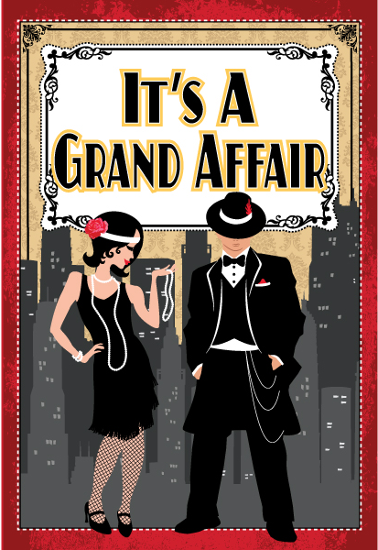
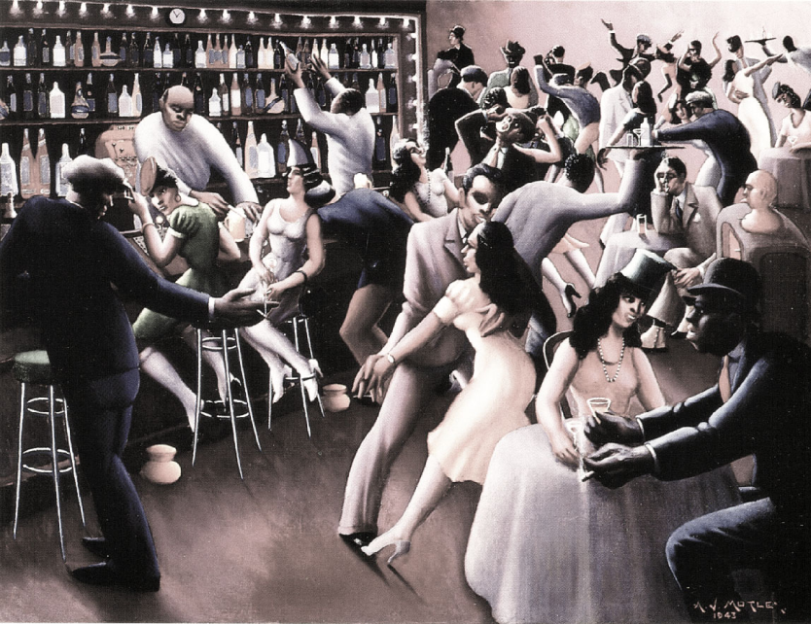
^{The} Twenties
After World War I, America would enter a new age of prosperity with automobiles, telephones, and electricity making life better.
American’s began focusing more on making money and enjoying themselves.
The 20s would be a period of economic prosperity and of new cultural values.
But, it didn’t start that way!

Slide 4
Learning Objective
What were some difficulties Americans faced adjusting to peace after World War I?
Things to look for ---
Government began to spend less money.
Recession in the US economy.
Jobs became harder to find.
Isolationism became the American theme.
Fear of the spread of Communism.

Slide 5
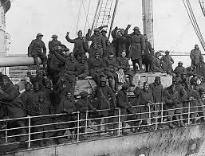
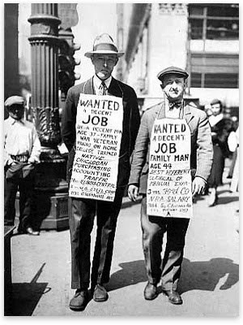

^{The} Post War Recession
US began to demobilize – the transition process during which a nation at war returns to a state of peace (opposite of mobilization)
After World War 1, America went into a period of isolationism, refusing to be drawn into Europe’s drama.
Government stopped spending money on the war effort.
Factories shut down to convert from making war materials to making civilian products. From Guns to Butter (military goods to civilian goods)
Soldiers returned home from war and had a hard time finding jobs because factories had shut down to change from military to civilian goods- RECESSION
Farmers lost money since their European market was now gone and US govt was not buying more food for the military. The farmers entered a long, drawn depression that would linger throughout the 1920s and 30s
US was hit by the Spanish Flu (Bird Flu) 500,000 to 650,000 Americans died from the flu

Slide 6


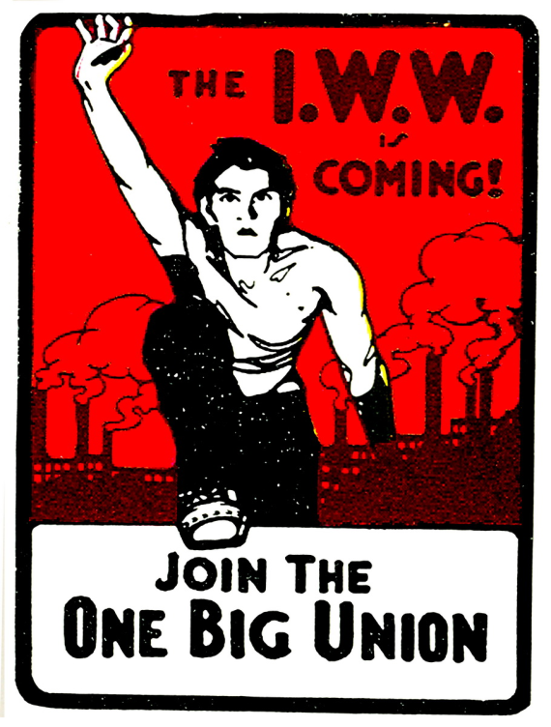
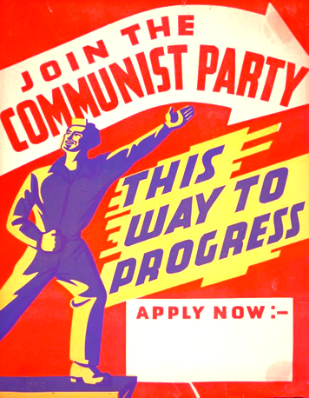
The Red Scare
The end of World War 1 brought new fears to Americans about Communists, anarchists, and immigrants.
In 1917, the Russians led by Lenin had a revolution, but instead of setting up a democracy, it became a communist or Bolshevik(s) nation.
Communists threatened to spread their revolution to other nations in Europe and take over.
When labor strikes hit the USA in 1919 many in the USA feared a communist revolution was happening in the U.S.

Slide 7
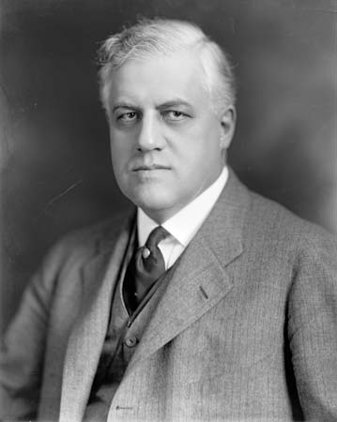
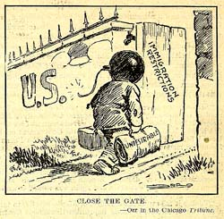
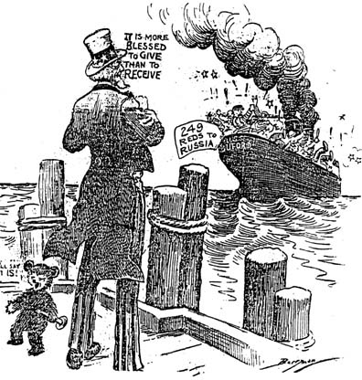
The Red Scare
This new fear of communism led the government to violate many individuals' civil rights.
The Palmer Raids1919-1920:
1919, Italian anarchists sets off a bomb at Attorney General Palmers’s house.
It was one of series of attacks across America on that day.
The nation demanded action be taken.
The US Attorney General rounded up suspected communists, without warrants, and had them jailed or deported, often without any evidence of wrongdoing.
A. Mitchell Palmer
Americans feared a Communist revolution in America just like in Russia

Slide 8
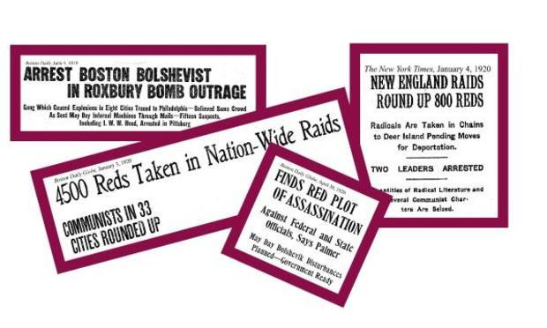
The Red Scare

Slide 9
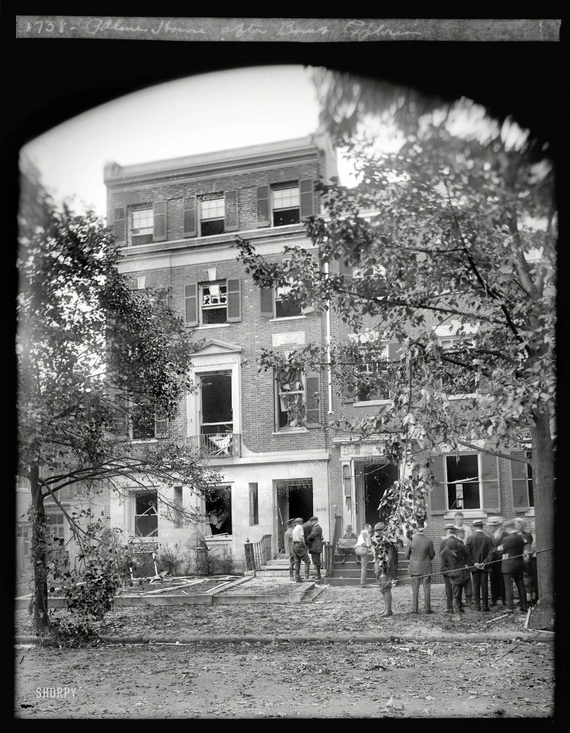
A. Mitchell Palmer’s House
The home was devastated when a bomb exploded at his front door on the night of June 2, 1919. If Palmer had been at his usual spot in the library, he likely would have been killed. Notice all the window blown out.
https://www.theyearthatwaspodcast.com/s1e15-redscare

Slide 10
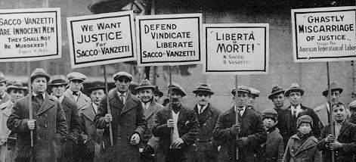
The Red Scare
This new fear of communism led the government to violate many individuals civil rights.
Sacco and Vanzetti: 1920
- Two Italian immigrants who admitted to being anarchist were tried, convicted, and executed (1927) of a robbery & murder on flimsy evidence.
- Many thought they were executed for being anarchists and foreign born
For countless observers throughout the world, Sacco and Vanzetti were convicted because of their political beliefs and ethnic background.

Slide 12
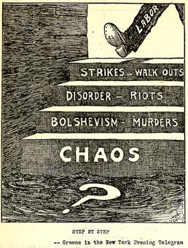
A Slippery Slope

Slide 13
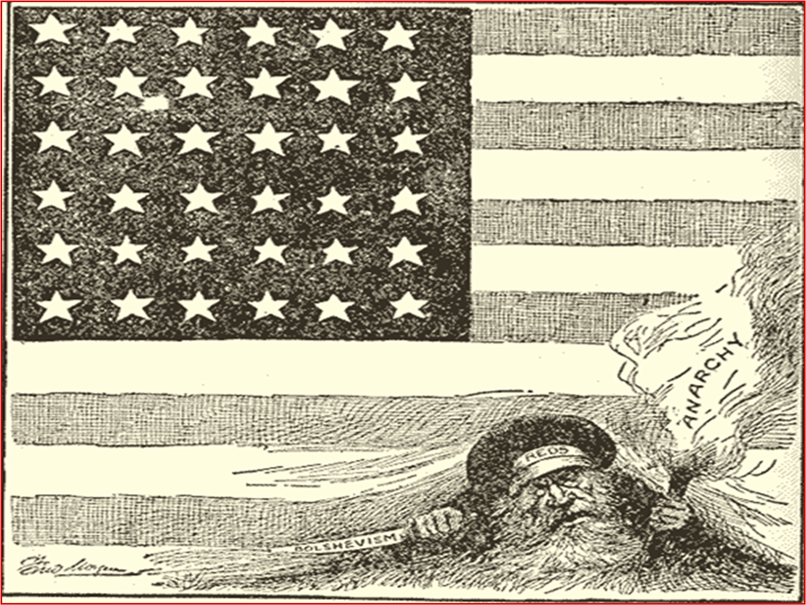
This cartoon reflects the fear that immigrants with radical ideas are infecting and endangering America
Cartoon from 1919: “Put them out and keep them out”

Slide 14
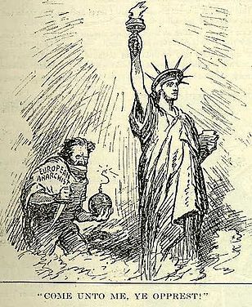
COME UNTO ME YE OPPRESSED
Published in 1919 in the Memphis Commercial Appeal.
Many Americans believed that immigrants were mostly or wholly responsible for radicalism in the United States. It seemed the easiest solution was that proposed by the 1918 Immigration Act: deport them all.
https://www.theyearthatwaspodcast.com/s1e15-redscare

Slide 15
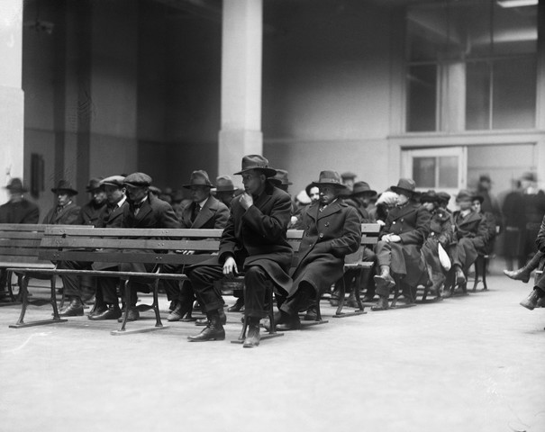
Suspected Radicals awaiting deportation hearings on Ellis Island

Slide 16
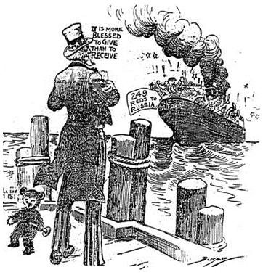
US Immigration Policy Changed

Slide 17
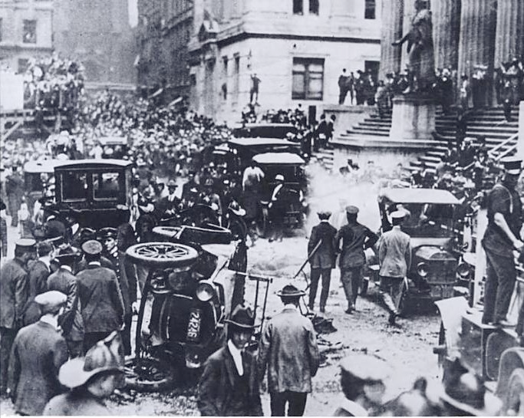

The Wall Street bombing occurred at 12:01 pm on September 16, 1920, in the Financial District of Manhattan, New York City. The blast killed 30 people immediately, and another eight died later of wounds sustained in the blast. There were 143 seriously injured, and the total number of injured was in the hundreds.
The bombing was never solved, although investigators and historians believe the Wall Street bombing was carried out by Galleanists (Italian anarchists), a group responsible for a series of bombings the previous year. The attack was related to postwar social unrest, labor struggles, and anti-capitalist agitation in the United States.

Slide 18
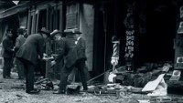
Wall Street Bombing, Sept. 16, 1920

Slide 19
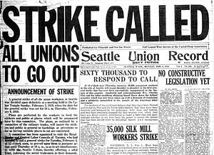
Labor Unrest, 1919
The year 1919 was one of the most explosive times in the history of American labor movement.
Some 4 million workers took part in over 3,000 strikes nationwide, and labor loss in nearly every case.
A few strikes in 1919 hold a place in labor history.
In Seattle, Washington, labor unrest at the shipyard spread across the city, igniting what became the nation's first general strike, or one in which all industries take part.
The conflict shut down the city yet failed
The strike discourage industry in Seattle for years.
In Boston, the police force went on strike to protest low wages and poor working conditions.
The city descended into chaos, and Governor Calvin Coolidge called in the militia to end the strike, making him a national hero. And eventually president
United Mine Workers had a no strike pledge during the war, but a strike in 1919 WON a large wage increase but no not better conditions.
The steel industry also struck in 1919

Slide 20
Would Americans Give up Civil Liberties in Exchange for Security?
Americans felt under attack in 1919 as a series of riots, strikes, disasters, and bombings hit the country. After radicals attempted to blow up the house of Attorney General Mitchell Palmer, he decided enough was enough. It was time to stop the Red Menace using any means possible. But would Americans tolerate the loss of their civil liberties in the pursuit of Bolsheviks?
https://www.theyearthatwaspodcast.com/s1e15-redscare

Slide 21
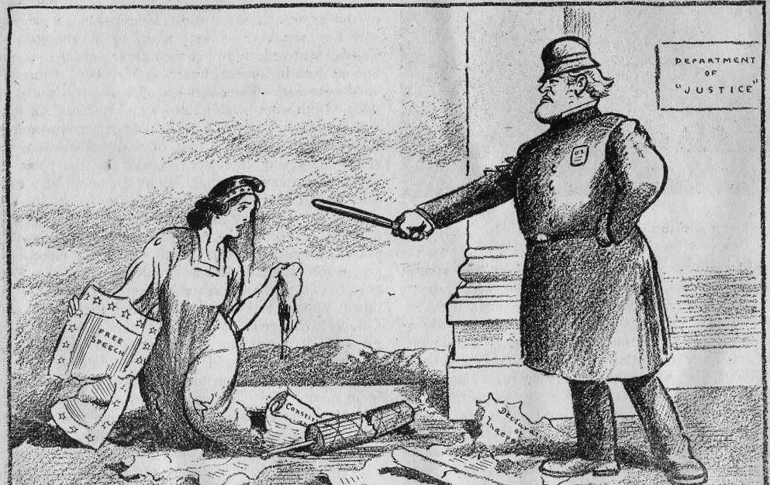
Political Cartoon

Slide 22
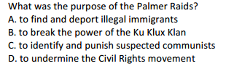
An EOC Moment

Slide 23
EOC Moment
Which conclusion can be drawn from the occurrence of the Red Scare?
A. Immigrants to the United States are consistently denied equal protection under the law.
B. A person’s best protection from persecution rests with the Supreme Court.
C. Civil rights are sometimes compromised by the public’s fear of radical political groups
D. Violent protests in the United States are usually met with a violent response from the government.

Slide 24
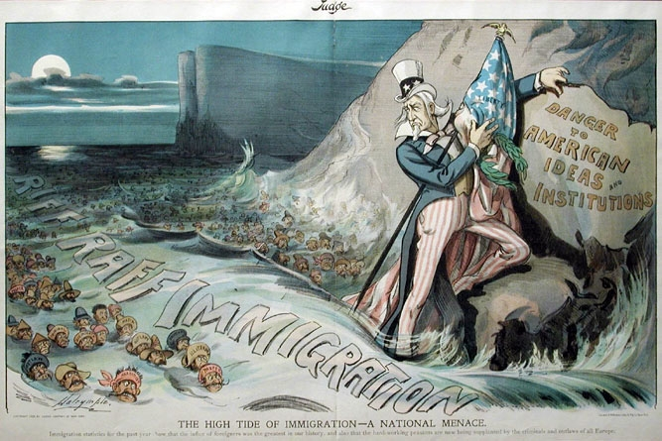
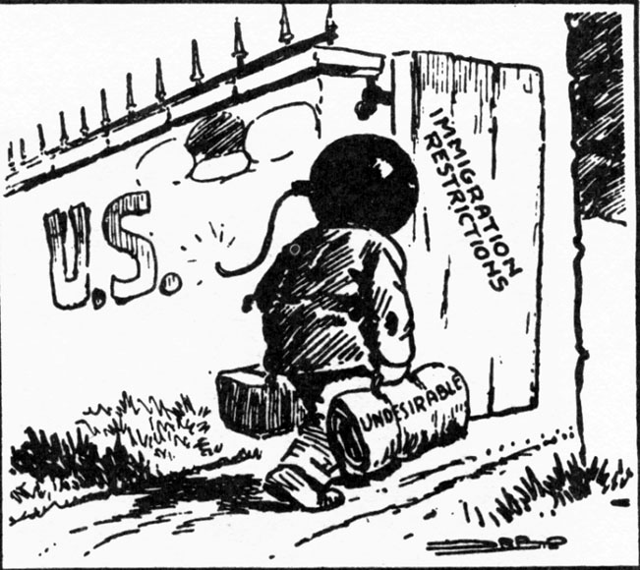
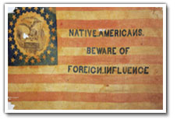
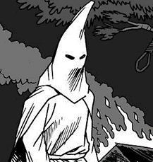
Rise of Nativism
The Red Scare, radical anarchist bombings, and the Sacco & Vanzetti trial led to a rise in nativism – the dislike of foreigners and xenophobia.
Nativists believed white Protestant (WASP) Americans were superior to others.
These nativist attitudes would bring restrictions on immigration.
KKK

Slide 25


Slide 26

The massive waves of immigration to American shores, particularly from southern and eastern Europe, between 1880s and 1920s met resistance from many quarters in US society who raised concerns over matters such as a glut on the already over-crowded labor market, introduction of criminal elements or social agitators, and so on.

Slide 27
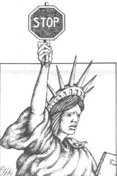
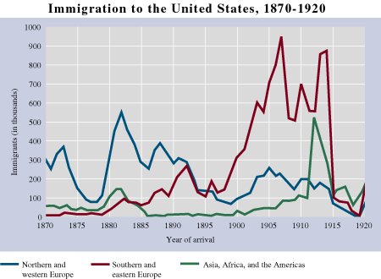
Rise of Nativism
In the early 1900s over 70% of immigrants to the USA were from Eastern & Southern Europe, they were the ‘New Immigrant’
EOC Moment
Why did immigration drop to almost nothing in 1914, and then remained at a low level until 1920?
World War I (1914-1917) stopped travel between Europe and the USA

Slide 28
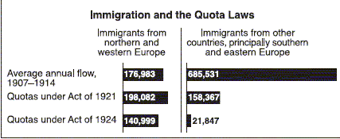
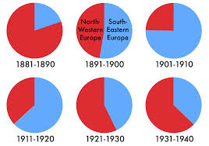
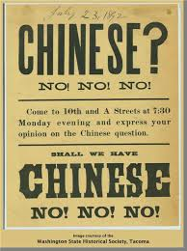
Rise of Nativism: Limits on Immigration
Immigration Acts
of 1921, 1924, and 1929
These were laws designed to keep immigrants from Eastern and Southern Europe out of America.
Emergency Quota Act (1921) Quotas were set allowing a certain number of immigrants from each nation to enter the USA.
Great Britain, Ireland, & Germany were allowed the most, while the ‘New Immigrant’ was limited, and Asians were totally stopped. Latin America had no restrictions.

Slide 29

U.S. Immigration
1880-1889
COMPARE
to 1880-1889

Slide 30
U.S. Immigration
1900-1909
COMPARE to 1890-1909

Slide 31
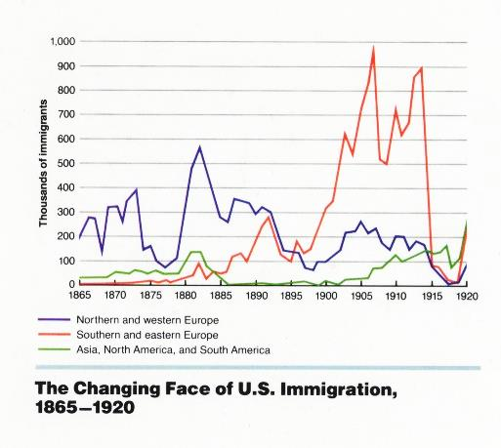

Slide 32
Immigrant Arrivals
 | 1921 | 1925 | 1928
Eastern Europe | 138,000 | 10,000 | 14,000
Southern Europe | 299,000 | 8,000 | 22,000
Asia | 25,000 | 4,000 | 4,000
Mexico | 31,000 | 33,000 | 40,000
TOTAL | 805,000 | 294,000 | 280,000
More Immigration Statistics

Slide 33
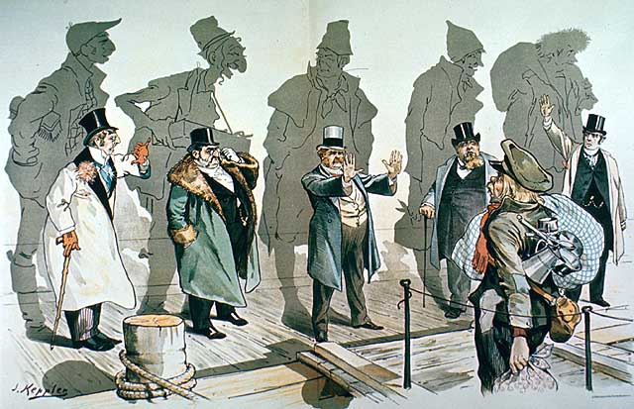
Rise of Nativism
The ‘New Immigrant’ without skills, education, or ability to speak English was seen as a threat to USA’s economic stability.
These ‘New Immigrants’ settled in the cities and added to the strain of providing public services.
EOC Practice
What do the shadows behind the well dressed men represent?
They show that even these wealthy men were once immigrants.

Slide 34
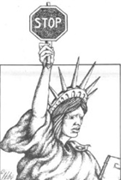
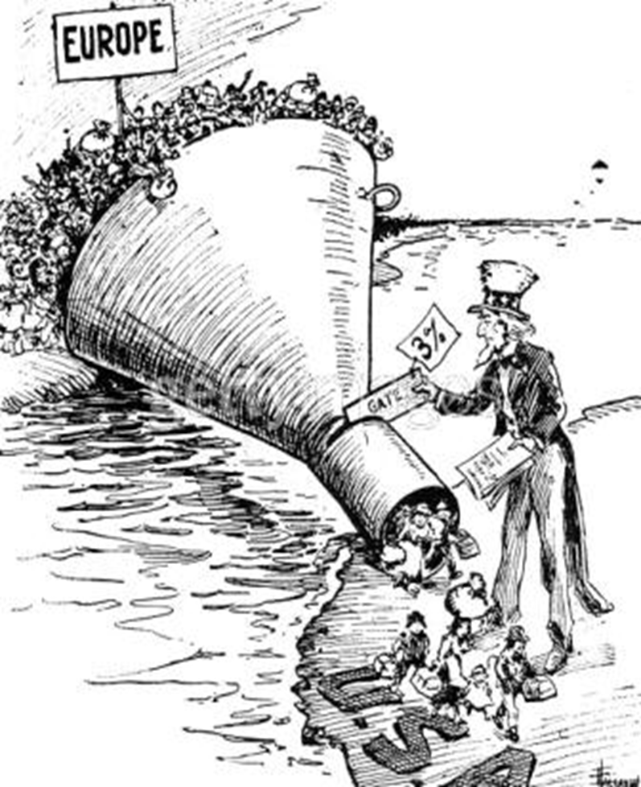

Pres. Warren G. Harding
Restrictions on Immigration
Fearing competition from
cheap foreign labor, Congress passed the Emergency Quota Act of 1921. A quota- a limited or fixed number or amount of people or things, in particular.
Xenophobia-fear of foreigners
It limited the total number of total immigrants into the US to 350,000 fewer than half of the number allowed in 1920.
The new quota system was meant to restrict immigration from SE Europe- the new immigrants

Slide 35
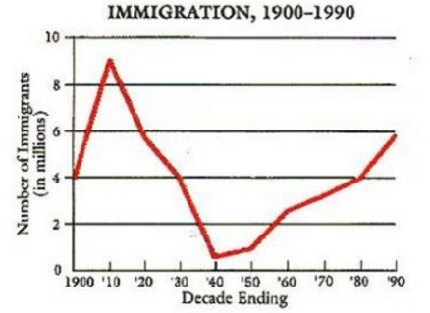
Use the graph above and your knowledge of U.S. History to choose which statement is true.
A. Immigration to the U.S. increased during the first decade of the 20th century due to World War I.
B. Immigration to the U.S. decreased during the first decade of the early 20th century due to an economic slump and agricultural drought.
C. Immigration to the U.S. increased during the early 20th century due to an economic surplus and technological increase.
D. Immigration hit its lowest point in the 20th century due to onset of the Great Depression.

Slide 36
EOC Moment
The convictions of Sacco and Vanzetti in the 1920s most closely reflected the
a. increase in nativist attitudes
b. federal government’s war on crime
c. corruption of political machines
d. rise in labor unrest

Slide 37
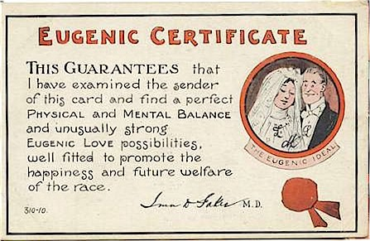

Eugenics
During the 1920s there was a belief in the superiority of the Anglo-Saxon ‘race’.
The theory of Eugenics was the belief that the human race could be improved by breeding.
Many held racist beliefs that light-skinned, blond-haired, blue-eyed people were superior.
Social Darwinism was the idea that the different races competed for survival just like plants and animals did, this explained that the rich were rich because they were superior or better adapted.

Slide 38
Learning Objective
What was the1920s Republican Presidents approach to a laissez-faire government?
Things to look for ---
Laissez-faire attitude that limited government interference in business.
Big supporters of Big business.

Slide 39

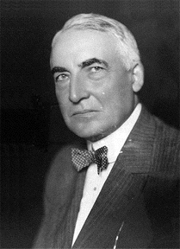
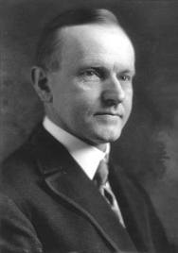
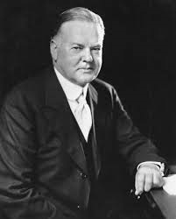
Three Republican Presidents:
Harding, Coolidge, & Hoover 1921-1933
During the 1920s, three Republicans would control the White House for twelve years.
They supported a laissez-faire policy of minimal government interference in business activities.
1921-1923
1923-1929
1929-1933
Warren Harding
Calvin Coolidge
Herbert Hoover

Slide 40

Three Republican Presidents:
Harding, Coolidge, & Hoover 1921-1933
During the 1920s, three Republicans would control the White House for twelve years.
All three Presidents favored lowering taxes, reducing regulations (laissez-faire) and raising tariffs on overseas goods
1921-1923
1923-1929
1929-1933
Warren Harding
Calvin Coolidge
Herbert Hoover

Slide 41
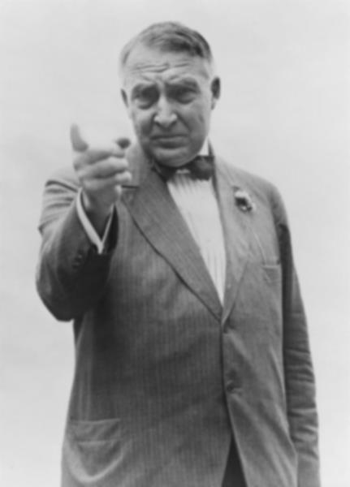

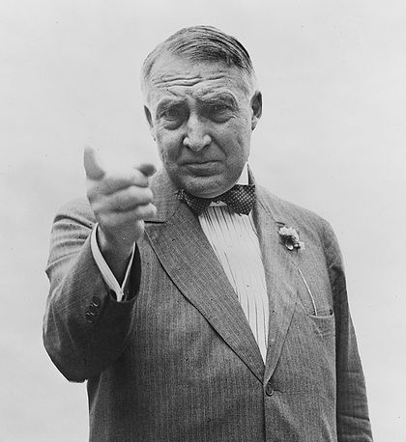
Return to Normalcy
Pres. Warren G. Harding

Slide 42



Pres. Warren G. Harding
In 1920, Warren Harding won the presidency in a landslide.
Pres. Harding captured the national spirit with his campaign slogan of ‘return to normalcy’.
Harding focused less on foreign policy and more on peace and prosperity at home. Isolationism from Europe
Under Harding the USA refused to join the League of Nations, it lowered taxes, and restricted immigration.

Slide 43

The negative effect that World War 1 had on our country in the economic, political, and social spheres caused people to abandon policies and ideals that led them into the war. Ideals like progressivism or an internationalist foreign policy were thus rejected in fear that they would lead our country down a similar path. "The nation appeared to be on the threshold of a wild era of rampant materialism that would demolish any lingering ideals of progressivism or internationalism." Therefore the abandonment of progressivism and internationalism helps to categorize the interwar period's foreign policy as isolationist.
Isolation from Europe

Slide 44
EOC Moment
President Warren Harding’s call for a “return to normalcy” meant the United States should
(1) limit the number of exports
(2) reduce its role in world affairs
(3) expand efforts to end racial discrimination
(4) support woman’s suffrage

Slide 45



Pres. Warren G. Harding
Policies Favoring Business – Laissez Faire
-A Higher Tariff- a tariff (customs duties) is a tax on imports making imports artificially more expensive.
A Tariff would keep out foreign products & protect US producers, farmers & their workers from cheap foreign competition.
-Fordney-McCumber Act- raised tariffs on import to an average of 38.5% of their value. Imports became VERY EXPENSIVE.
Other countries retaliated by raising tariffs on goods from USA, with a devastating impact on world trade.
Led to a trade war.
Trade is a major component of GDP.

Slide 46


Policies Favoring Business
Why the TARIFF?
EXPENSIVE

Slide 47


Pres. Warren G. Harding
Policies Favoring Business
-Lower Taxes for the Wealthy-
Andrew Mellon, Sect. of Treasury believed that wealthy Americans were more likely to invest in the economy than any other social classes.
Republican Congress passed
tax cuts on the rich, reducing
income and corporate taxes.
Laissez- Faire economics- minimal gov interference in the economy.
Andrew Mellon, Sect. of Treasury

Slide 48
EOC Moment
The US rejection of joining the League of Nations, higher tariffs, and new restrictions on immigration are all related to US
ability to protect its national interests
domestic policy for a better economy
return to isolationist foreign policy
frustration over Europe’s economic mess

Slide 49
EOC Moment
Which action best demonstrated the United States effort to isolate itself from European conflicts after World War I?
a. lowering tariff rates
b. attempting to improve relations with Asia
c. failing to sign international disarmament agreements
d. refusing to join the League of Nations

Slide 50

War Debt
Photo by Andres Rueda

Slide 51







Pres. Warren G. Harding
International Finance: Allied War Debt and German Reparation
Great Britain & France wanted
debt forgiveness. USA refused.
US demanded Allies pay back all loans. US taxpayers were paying interest to the bond holders who had raised large sums of cash for the war effort.
Allies were broke. England & France used the money they got from Germany reparations to pay back USA.
Germany broke. This created an unstable economy throughout Europe.
US came up with the Dawes Plan-
This was done to promote political and economic stability in Europe
The Dawes Plan
Private loans to
Germany
U.S. Investors
Wall Street Bankers
Reparations to
Great Britain and France
Allied war debt payments
U.S. Treasury
Charles G. Dawes

Slide 52




To Bring Economic & Political Stability to Europe
The Dawe’s Plan

Slide 53



THE ROARING 20s: FOREIGN POLICY
Dawes Plan
NOT
Dawes Act

Slide 54


To Bring Economic & Political Stability to Europe
This political cartoon shows Europe carefully walking on rock, after passing the Dawes Plan. This added to the idea of growing stability in Europe and the need to move forward.

Slide 55

How’s My Credit
What does this cartoon
Indicate about the US economy? And Europe’s economy?

Slide 56

MYTH
U.S. foreign policy was isolationist during the 1920s.

Slide 57
How did we get to an isolationist foreign policy? Context
World War 1 blood bath, G Washington’s farewell address
How does this compare to USA entry into the Spanish-Amer War 1898?
“Americans often preferred not to think about the terrible war in Europe [the First World War]. By 1917, however, US citizens realized that ignoring the war or pretending it had nothing to do with them imperiled their future.
“. . . They realized that they had run out of options. Between 1914 and 1917, Americans had variously hoped that their nation could serve as an arbiter (as it had during the Russo-Japanese War, earning Theodore Roosevelt the country’s first Nobel Peace Prize), the leader of a global peace movement, the center of international arbitration, and the advocate of worldwide disarmament. By early 1917, however, the majority had come to two conclusions. First, as Charles Fremont Taylor, the editor of a Philadelphia-based magazine, articulated, ‘no nation can be a hermit in these days of steamships, railroads, telegraphs, ocean cables, wireless, etc.’ They no longer believed, as they had in 1914, that the Atlantic Ocean provided the country with sufficient protection from Europe’s wars. Second, they believed that their leaders had tried every option short of war only to find the country in an even more perilous geopolitical position.”
Michael S. Neiberg, historian, The Path to War: How the First World War Created Modern America, 2016

Slide 58





US Foreign Policy 1920-1941
United States did not join the League of Nations but the US played an active role in promoting world peace through disarmament conferences through out the 1920s.
It did cooperate with international agencies throughout the 1920s and into the 1930s on such matters as trade, drug trafficking, arms reduction and in the pursuit of preventing future wars.
The United States also headed efforts to advance diplomatic talks on limited disarmament, to resolve the tangled questions of war debts and reparations, and to maintain international peace, all while remaining deeply involved in Western Hemisphere affairs, particularly in Central America.
American foreign policy was far from isolationist in the '20s.
In this lesson we will focus on:
Washington Naval Conference
The Four- Power Treaty
3. Dawes Plan
4. U$A as a CREDITOR nation
5. Kellogg-Briand Pact

Slide 59

Better Keep to the Old Channel
Literary Digest, 8/2/19. Originally from the New York American (McCay).
What are the dangers (challenges) facing US foreign policy during the 1920s?
What is the main idea of the cartoon?
Travel on ocean-going ships was dangerous and should be banned.
(2) The United States should return to an isolationist foreign policy.
(3) The United States should take the lead in creating an international peacekeeping organization.
(4) The United States Navy should make efforts to improve its fleet.

Slide 60




Pres. Warren G. Harding
The Four- Power Treaty
USA, Great Britain, France, and Japan
agreed to respect each other’s territories
the Pacific and submit any disputes to a
a joint conference of all four powers.
Nine-Power Treaty (1922) -affirming the sovereignty and territorial integrity of China as per the Open Door Policy.
All this was done to limit the destructiveness of war and if possible prevent future wars
Harding’s Foreign Policy
Washington Naval Conference Nov. 1921. USA proposed the USA, Great Britain and Japan each stop building new battleships and even scrap some of those it already had. Disarmament- reducing the numbers of weapons (arms reduction). Reduce battleship tonnage.
Ratio for the battleships of the 3 maritime powers 5:5:3
What was the purpose of all these treaties?

Slide 61

Washington Naval Conference 1921
Why was Japan not happy with
this deal?
Why did Japan finally agree to this
Deal despite the fact that it left it
at a disadvantage?
Japan only accepted the terms of the deal after the USA promised not to fortify Guam or the Philippines, giving the Japanese superiority in their home waters

Slide 62

What was the primary objective of this limitation?
A ten-year agreement fixed the ratio of battleships at 5:5:3—that is 525,000 tons for the USA, 525,000 tons for Britain, and 315,000 tons for Japan. Smaller limits with a ratio of 1.67 applied to France and Italy. Battleships, the dominant weapons systems of the era, could be no larger than 35,000 tons. The major powers allowed themselves 135,000:135,000:81,000 tons for the newly developed aircraft carriers.

Slide 63

U.S.S. South Carolina
DISMANTLED (1924)

Slide 64

What are they so worried about?
According to this cartoon what other naval issue was not covered by this naval
agreement?

Slide 65
An EOC Moment
After World War I, what did the U.S. government hope to achieve by lending money to Germany?
A. technological and military assistance from Europe
B. political and economic stability in Europe
C. investments for United States industries
D. profits for United States banks

Slide 66



Pres. Warren G. Harding
Pres. Harding urged tolerance towards other races, supported greater rights for African Americans, like anti-lynching laws and tolerance of Jews.
Pres. Harding appointed friends – the Ohio Gang - to positions of power.
The Teapot Dome Scandal was one of the worst in history, as one of Harding’s Cabinet members leased government land to friends for bribes.
Additional scandals included Harding appointees stealing U.S.A.’s money from veteran hospitals.
These scandals undermined Harding’s Presidency
Undermined Harding’s Presidency
The Spoils System

Slide 67


Slide 68




Teapot Dome, Wyoming

Slide 69
Undermined Harding’s Presidency

Slide 70


Slide 71




Pres. Calvin Coolidge
Calvin Coolidge served as Pres. Harding’s Vice Pres., when Harding died, Coolidge became President.
Coolidge was re-elected again in 1924 on a pro-business policy and the slogan “Keep Cool With Coolidge”.
“Silent Cal’ had a motto of:
“the business of America is business.”
The U.S. economy boomed under Coolidge, in fact some say that his laissez-faire attitude towards the economy led to over speculation that resulted in the stock market crash.

Slide 72

“Silent Cal”
"Mr. Coolidge, I've made a bet against a fellow who said it was impossible to get more than two words out of you."

Slide 73
“You lose.”

Slide 74

Pres. Calvin Coolidge
Immigration Act of 1924 or the National Origins Act – Lowered immigration per year to 150,000 and limited immigration based on
national origin. It favored WASP-Northern and Western Europeans.
Before WW1, 200,000 Italians (southern Europeans) immigrated to the USA; Emergency Quota Act of 1921 reduced the number to 40,000; under the National Origins Act, 4,000 Italians could legally enter the USA

Slide 75
EOC Moment
Which events best support the image of the 1920’s as a decade of nativist sentiment?
a. the passage of the National Origins Act and the rise of the Ku Klux Klan
b. the Scopes trial and the passage of women’s suffrage
c. the Washington Naval Conference and the Kellogg-Briand Pact
d. the growth of the auto industry and the Teapot Dome Affair

Slide 76




1920s
Foreign Policy

Slide 77
MYTH
U.S. foreign policy was isolationist during the 1920s.

Slide 78






Coolidge’s Foreign Policy
The Geneva Disarmaments Conference 1927
Coolidge called for disarmaments conference. The worlds naval powers although limited battleship construction had begun a naval arms race in building cruisers and other small war ships.
Conference ended in failure.
Kellogg- Briand Pact (1927)- was a treaty meant to outlaw war. 15 countries signed on to the Pact. It failed, World War II would start in 1939. No means of enforcement and too few countries signed up.
US Sect of State Frank Kellogg
French Foreign Minister Aristide Briand
15 countries signed on to the Pact

Slide 79
Kellogg-Briand Pact
(1929)
Renounced war as an “instrument of national policy”

Slide 80
An EOC Moment
In the 1920s, which United States action furthered the goal of international peace?
A. signing a pact to outlaw armed conflict
B. advocating a policy to promote isolationism
C. holding a conference to renounce imperialism
D. joining a league to secure military cooperation
Although in self-imposed isolation, USA very active in foreign affairs at this time, especially in the area of world peace.

Slide 81
An EOC Moment
Why did the United States participate in the Washington Conference (1921) and the Kellogg-Briand Pact (1928)?
A. to reduce barriers to international trade
B. to work with other nations to prevent future wars
C. to form military alliances as a defense against aggression
D. to expand American influence over Asia and Latin America
Washington Naval Conference
Four-Power Treaty
Nine-Power Treaty
Nov. 1921
Dec. 1921
Feb. 1922

Slide 82




Pres. Herbert Hoover 1928-1932

Slide 83


Pres. Herbert Hoover
Herbert Hoover organized U.S. food production in WW 1 and predicted the end of poverty if elected president.
Hoover was impressed with the achievement of business in raising the standard of living in America.
Hoover said this ‘rugged individualism’ had happened because:
  Individuals were given equal opportunities,
  They had a free education,
  They had a will to succeed
Hoover felt too much government interference in business would ruin a good thing.

Slide 84




How the Boom of the Roaring Twenties
Altered the US Economy
More Efficient Production Techniques
Rise of the Automobile
Other New Industries
Laissez-faire Economics
Age of Mass Consumption

Slide 85




More Efficient Production Techniques
New manufacturing techniques, such as the assembly line, led to improved efficiency. Making consumer goods more readily available to Americans. It ushered in the age of consumerism
As efficiency increased consumers benefitted from lower prices for goods.
The standard of living increased rapidly from 1890-1920s.
Mass production increased the efficiency of manufacturers of electronic goods, homes, furniture, and clothing, making consumer goods more readily available to Americans.
An unintended consequences of this improved efficiency was that skilled/ craft workers were no longer needed leading to an increase in unemployment. Creative Destruction.

Slide 86
More Efficient Production Techniques
Mass production made the United States an increasingly urban and industrial society.
Mass production promoted industrial growth and made the USA a top industrial producer in the world.

Slide 87





Henry Ford
Greater Efficiency in Manufacturing
Henry Ford didn’t invent the car, but he did perfect a way to make them cheaper and faster so more people could afford a car.
Ford pioneered the use of the assembly line to mass produce cars.
By 1924 Ford was producing one car every 10 seconds at a price of $300 per car.
He increased workers wages to $5.00 per day so they could afford to buy a car and other goods being mass produced.
Welfare Capitalism- the practice of businesses providing welfare services(BENEFITS) to their employees, especially their skilled workers.
=

Slide 88


Henry Ford

Slide 89

Henry Ford’s Assembly Line

Slide 90




Slide 91

1910 – Ford Model T

Slide 92

1925 Ford "New Model" T Tudor Sedan

Slide 93


Model T
October 1, 1908 marks the anniversary of the first Model T built for sale.
The Model T was the first low-priced, mass-produced automobile with standard, interchangeable parts.
The Model T was equipped with a 20-horsepower, four-cylinder engine with a top speed of approximately 45 miles per hour, weighed 1,200 pounds, and achieved 13-21 miles per gallon.

Slide 94

Model T
The first Model Ts sold for $825 – an unexpected bargain compared to other cars and even more remarkable is that during its 19 years of production, Ford continued to steadily lower its price, thanks to manufacturing efficiencies.
The moving assembly line for the Model T revolutionized manufacturing in 1913.

Slide 95


1925 Ford Model T
$295

Slide 96


Model T
More than 15 Million Model Ts had been sold by May 26, 1927, when a ceremony marked the formal end of Model T production.
Henry Ford called the Model T "the universal car," a low-cost, reliable vehicle that could be maintained easily and could successfully travel the poor roads of the era.

Slide 97



Slide 98


Slide 99




The Rise of the Automobile
The single most important factor behind the prosperity of the 1920s was the expanded use of the automobile.
Cars greatly affected all aspects of American life, as ownership rose from 8 to 24 million owners.
By 1929 1 out of every 9 jobs was in an auto-related business.
It also stimulated other industries like oil, steel, glass, & rubber.
The mass production of the automobile increased personal mobility.

Slide 100


Slide 101


Slide 102


Slide 103



The Rise of the Automobile
Cars gave people mobility.
Families went on vacations or to visit relatives. ROAD TRIP!!!
People moved out of inner cities to the suburbs- more open living areas on the outskirts of cities
School buses allowed rural student to attend school regularly for the first time.
Rural people were no longer as isolated.
Rapid growth of the middle class

Slide 104


What did not change? 1890-1920s
The rise of the muckraking press and Progressive reform movements attested to the fact that many workers experienced poor conditions in industrial work on assembly lines.
De-skilling made employers less dependent on skilled workers and made mass layoffs easier, contributing to the misery of economic downturns such as the Great Depression
Conflicts between management and labor unions increased in response to declining wages, poor working conditions, and health and safety issues (e.g., the Triangle Shirtwaist factory fire) resulting from mass production.

Slide 105
Learning Objective
What made the Roaring 20s roar?
Things to look for ---
The automobile and other industries.
More efficient production techniques.
Advertising and mass consumption.
Stock market speculation.

Slide 106










Assembly Line Led to Expansion of Other New Industries
The 1920s saw new discoveries and inventions in almost every field, opening the way for many new businesses.
Inventions made improvements in transmitting electricity to homes, businesses, & factories.
New household appliances like vacuum cleaners, refrigerators, toasters, coffee makers, stoves, radios, and motion pictures made life easier and more fun. It also eroded regional cultural differences, further uniting the country.

Slide 107

A Woman Uses The First Siemens Vacuum Cleaner, 1906
Made by SIMENS. It was called a dedusting pump.

Slide 108


Glenwood Stove and Washing Machine

Slide 109

Expansion of Other New Industries
Guglielmo Marconi invented the first practical radio signaling system in 1895 and is therefore generally credited as being the inventor of the radio.
$150.00
The first broadcast was an election night broadcast made by KDKA from the Westinghouse Electric buildings in East Pittsburgh which began at 6 p.m. on Tuesday, Nov. 2, 1920. Leo Rosenberg, radio’s first announcer, relayed the news to about 1,000 listeners that Warren Harding had beaten James Cox in the race for the White House.
Sales of radio equipment skyrocketed from $12.2 million in 1921 to $842.5 million in 1929

Slide 110


RADIO
220 stations eighteen months after KDKA took the plunge.
$50 to $150 for first radios
3,000,000 homes had them by 1922.

Slide 111


RADIO
Radio sets, parts and accessories brought in $60 million in 1922…
$136 million in 1923
$852 million in 1929
Radio reached into every third home in its first decade.
Listening audience was 50,000,000 by 1925

Slide 112


Slide 113



Radio and Motion Pictures
The Jazz Singer (1927)
Synchronized Dialogue
75%
of Americans went to see a movie each week in the 1920s
Home Entertainment

Slide 114









Radio drew the nation together by breaking down provincialism. The radio programs brought news, music entertainment, and advertisements to millions of listeners. Important sporting events were broadcast live across the nation increasing the popularity of Sports in the 1920's.
Babe Ruth
Jessie Owens
Jack Dempsey
Andrew “Rube” Foster
Negro Leagues

Slide 115






New Marketing Practices in an Age of Consumerism
Mass Production- requires Mass Consumption- requires new ways to market (sell goods). How would millions of consumers know what to buy?
ADVERTISEMENTS and the Birth of Advertising Agencies (Madison Avenue, NYC)
Radio
Newspapers
Mail order Catalogues
Street Signs
Business sponsored radio shows-Soap Opera
Birth of the Department Store

Slide 116





The Age of Mass Consumption/ Consumer Culture
Production techniques changed and so did patterns of consumption.
Goods began to be mass marketed on a national level.
Advertising stimulated demand.
Workers were receiving higher wages and they had more money (disposable income) to spend and also more leisure time.
New advertising industry sought to cultivate new markets-WOMEN- (i.e., female drivers, independent women, flappers and young women).
The more money a person made the more things they wanted to buy. Middle class grew
Purpose of advertising is to create a new market to sell goods and service. Women became a mass market.

Slide 117


Advertising
and the Installment Plan
Buy Now Pay Later
What we call today credit
The combination of mass production and increasing mass marketing toward women expanded opportunities for consumption and economic decision making.
Availability of credit and peoples’ willingness to buy on the installment plan expanded access to consumer goods.

Slide 118

The Installment Plan
LINK

Slide 119




The Age of Mass Consumption
Consumers for the first time began buying on credit. Buy now Pay later!!!
VISA, MasterCard, and other credit cards were not yet around, but installment plans were easy for a person to pay a small down payment and take the item home and then pay a little each month. The economy grew. Buy Now Pay Later
Suddenly American consumers were in debt!

Slide 120

The Age of Mass Consumption
Buy Now, Pay Later
$125.00 on Sale for $85.00
$1.00 Down payment
$5.66 a month for 15 months
Buy Now, Cry Later
Avg annual income in 1925 was $1895.00

Slide 121





Speculation Boom
Speculation is the purchase of an item, not for personal use, but in the hope of selling it later at a higher price, to make a quick n’ easy profit! Buy low, sell high
1920s saw millions speculate in the stock market and in real estate (buying property). There was little to no govt regulations
The price of a share of a corporation skyrocketed as more and more people began to invest in the stock market.

Slide 122


Speculation Boom on Wall Street
To make matters worse, people were buying stocks on margin-to borrow money from your stock broker to buy stocks. Buy low and sell high, pay back broker and keep the difference-profit.
This would work if stock prices kept going up. They did not.

Slide 123
An EOC Moment
The economic boom and the financial speculation of the 1920’s were caused in part by
a. installment buying and an unregulated stock market
b. the expansion of civil rights to women and minorities
c. the mobilization of the economy for war
d. increased government restrictions on big business

Slide 124



Uneven Prosperity
An BOOMING ECONOMY!
The U.S. experienced unprecedented economic growth during the 1920s, but not everyone shared in the prosperity. There was a widening GAP between the “haves” and the “have nots.”
A small percentage of Americans had the largest percent of the wealth.
With new farm equipment, electricity & fertilizers farmers faced lower incomes due to overproduction of crops and lower demand for U.S. farm products in Europe
Workers in factories faced competition for jobs with immigrants. Unable to form unions due to red scare
Minority Groups faced discrimination.

Slide 125



Learning Objective
How did cultural values change?
Things to look for ---
Prohibition and the 18th Amendment.
Religion vs. Science.

Slide 126


Temperance Movement and Prohibition
Attempts to Preserve Traditional Values
During the Progressive Era the growth of Temperance Movement (those against the drinking of alcohol) led to the passage of 18th Amendment.
The Temperance Movement thought that drinking alcohol was sinful, led to crime, and domestic violence.
Frances Willard was an outspoken leader of Temperance Movement, women’s rights, women’s suffrage & better working conditions for labor.

Slide 127




Prohibition - 18th Amendment (1919)
In 1919, the U.S. Congress passed the 18th Amendment to the Constitution which banned the manufacture, sale, or distribution of alcohol.
Volstead Act-defined intoxicating
Liquors to include beer and wine.
The law provided penalties for
the manufacturer, sale and transportation of alcoholic beverages but not for their consumption
But instead of people obeying the law there was a growing disrespect for the law.
Speakeasies and bootlegging alcohol allowed the average consumer to obtain liquor without any problems.

Slide 128

How Do You Amend the US Constitution?
PROHIBITION 18th Amendment

Slide 129

PROHIBITION
http://video.pbs.org/video/2082716396 (13:20)

Slide 130

The Drunkard’s Progress

Slide 131

PROHIBITION
“From the First Glass to the Grave, 1848”

Slide 132


Slide 133


Slide 134


Speakeasies
Private Clubs Illegally Serving Alcohol
Mayflower Club
(Washington, DC)

Slide 135


“Bootleggers”
Illegal Alcohol Smugglers

Slide 136


Slide 137

Prohibition
Prohibition agents destroying
barrels of alcohol, c.1921.

Slide 138
Speakeasies

Slide 139

Prohibition - 18th Amendment
Many Americans believed that Prohibition tried to force one group’s morals on others.
Still others opposed Prohibition because it closed breweries, bars, and distilleries where thousands worked.
Many said that Prohibition led to an increase in organized crime, the gangsters which willingly supplied illegal booze to consumers became rich and famous.

Slide 140



Prohibition - 18th Amendment
By 1933, the American public saw that Prohibition was a ‘failed experiment’.
People had been unwilling to accept the law, Pres. Harding even served alcohol in the White House.
The 21st Amendment repealed or did away with Prohibition.
Prohibition proved that unpopular laws are often unenforceable.

Slide 141

REPEALED 1933
The 18th Amendment is the only constitutional amendment to be specifically repealed by another.

Slide 142


The Bible vs. Science
Traditional Values vs. Modernism
The Scopes Monkey Trial 1925
Fundamentalism vs. Modernism
In the 1920s many southern states passed laws making it illegal to teach
Darwin’s Theory of Evolution in schools.
John Scopes taught evolution in his Tennessee Biology class and was arrested and put on trial for it.
The Scopes Monkey Trial became the most sensational trial of the decade.
It reflected disagreement over the cultural values of the American people

Slide 143




The Scopes Monkey Trial
William Jennings Bryan prosecuted John Scopes and Clarence Darrow defended him.
The Scopes Trial was the first trial to be broadcast over radio, as it pitted older religious beliefs against newer scientific theories (like Evolution),
Darrow cross-examined Bryan about inconsistencies in the Bible and made him look old school and out of touch with the modern world.
The result of the trial was that Scopes was found guilty and fined $1.
Man did not come from a monkey
You haven’t seen my cousin

Slide 144


Slide 145


An EOC Moment
This photograph shows one side of the 1920s conflict between
union men and factory owners
science and religion
nativists and immigrants
censorship and free press

Slide 146

Protecting American Civil Liberties
The American Civil Liberties Union
Created in January 19, 1920,to ensure individual rights of citizens were protected from government abuse.
The Palmer Raids were considered abusive by many.

Slide 147
Learning Objective
How did new values encourage greater openness and self-expression?
Things to look for ---
Flappers and women’s changing role.
Different forms of Music blend together.
Those crazy kids!
The Harlem Renaissance

Slide 148
The Emergence of New Values
Traditional values (conservative, religion Christian values) that had existed in America before the 1920s were found to be old and outdated.
Instead the 1920s led to newer, more modern values (liberal; secular) which encouraged a greater openness and self-expression.
Led to a clash of values which still persists to this day
Changes in music, art, literature, and sexuality provided the opportunity for expression of these freedoms.

Slide 149

Womanhood
Circa 1920
Notes:
http://museumvictoria.com.au/collections/items/261171/iron-electric-hotpoint-1920s

Slide 150

Notes:
http://tothetwenties.blogspot.com/2009/11/i-dont-mind-housekeeping-bit.html

Slide 151


Slide 152

I approve this message!

Slide 153
Or do I?

Slide 154

Notes:
http://tothetwenties.blogspot.com/search/label/appliance

Slide 155
The New Woman
Bobbed Hair
&
Short Skirts
Notes:
http://www.fanpop.com/clubs/1920s/images/17379132/title/1920s-photographs-photo

Slide 156
Make me some waffles.

Slide 157
No.

Slide 158
Honey, I’m back!
Most women remain in the “cult of domesticity” sphere
Notes:
http://tothetwenties.blogspot.com/2009/11/i-dont-mind-housekeeping-bit.html

Slide 159



Changing Roles of Women
Women had demonstrated their abilities during World War I.
A booming economy created new jobs & more women began working outside the home.
Women wanted equality with men in all areas.
In 1920, the 19th Amendment gave women suffrage or the right to vote.
These women worked for women’s suffrage
Voting Rights, Women & the 19th Amendment

Slide 160



Slide 161


Why were women given the right to vote in western states before 1920
During the westward expansion, women made many sacrifices. Toiling on the Great Plains along side their husbands. As a result, state leaders saw the inherent equality among men and women in their sacrifices to build the west and many western states granted women suffrage way before 1920. States have the power to set voter qualifications under the 10th amendment.
In November 1916, four years before the Nineteenth Amendment guaranteed the right of women to vote, Jeannette Rankin of Montana became the first woman elected to the United States Congress.

Slide 162


Changing Roles of Women
A new independent attitude began to appear among young, urban women.
These new women came to be known as flappers.
These flappers took more risks, cut their hair short, wore short skirts, smoked and drank in public, danced, and even chewed gum.
Flappers came to symbolize the new freedoms that many women felt during the 1920s
Women of today owe a great deal to the flappers who helped women gain their independent spirit!

Slide 163


Slide 164


Flappers
Challenged social norms
  Jazz
  Short Skirts & Hair
  Premarital sex
    Double Standard
Discovery of adolescence
  Child Labor

Slide 165

flappers

Slide 166

Hey! Is that MY cigarette?

Slide 167

DANCE PARTY!!!

Slide 168


Slide 169
Flappers

Slide 170

Although some saw Flapper culture as a threat to traditional gender roles...
Notes:
Sheet music for the song "We Men Must Grow A Mustache." 1922 Inset photo of bandleader Abe Lyman.

Slide 171

Most women were content to stay home and play with their new toys.

Slide 172


New Marketing Practices in an Age of Consumerism
Flapper
Changing Role of Women reflected in an ad for tires
The advertising industry sought to cultivate new markets (i.e., female drivers, independent women,
flappers and young women).

Slide 173
a) Briefly describe ONE perspective about women’s roles during the 1920s expressed through the image.
b) Briefly explain ONE specific historical development or circumstance from 1900 to 1929 that led to changes in women’s roles during the 1920s such as that depicted in the image.
c) Briefly explain ONE specific historical development in business OR culture that led to the creation and use of images such as the one above during the 1920s.

Slide 174


This 1964 ad catered to men on reasons why they should buy a Volkswagen.
Because sooner or later your wife will wreck the car, might as well get a VW .
This ad will not do well today.
This ad might actually be more demeaning than the previous Drummond ad. It claims that eventually your wife will wreck your car, basically implying that women wreck way more than men do. This ad explains the safety features of the VW as a result of the assumed wreck your wife will cause.

Slide 175





Changing Roles of Women
Sex discrimination eliminated in voting; Nineteenth Amendment (1920)
Women had played an active, supportive role during the First World War and involvement in more public and political roles
continued Mass media influenced culture and women were as likely to become highlighted in advertising as were men
More economic opportunities for women; access to jobs in offices, sales, factories, and elsewhere
Rise of flappers and the activities associated with flappers in the 1920s Women played active roles in social reform movements of Progressive Era-temperance movement, prohibition, child labor laws.
Women were seen as a new market
in the mass media of advertisement

Slide 176

An EOC Moment
Compare the images to answer the question below.
Which image shows the changing roles of women as women began to experiment with new found freedoms during the 1920s?
Image A
Image B
Answer
Image B
Image A
Image B

Slide 177





Youth and the Lost Generation
A new group of writers, known as the “Lost Generation”, rejected the desire for material wealth.
These writers believed they did not fit the patterns of everyday life after the horrors of World War I.
The Lost Generation felt America had become overly materialistic and lacked spirituality. Many moved to Paris, France
Ernest Hemingway
Wrote about W.W. I experiences in ‘A Farewell to Arms’
Sinclair Lewis
Ridiculed the narrowness and hypocrisy of American life in ‘Main Street’
F. Scott Fitzgerald
About rich, but unhappy man in ‘Great Gatsby’

Slide 178
An EOC Moment
In the 1920s, authors such as F. Scott Fitzgerald, Ernest Hemingway, and Sinclair Lewis wrote primarily about
the intolerance of the Ku Klux Klan
post–World War I disillusionment and materialism
the failure of cultural pluralism
the lack of educational opportunities for younger Americans

Slide 179


Youth and the Lost Generation
During the 1920s, young adults were responsible for zany fads, like flagpole sitting and marathon dancing.
Dances like the Charleston became wildly popular.
New words came into use:
  Bootlegging – hiding booze in your boot or pant leg.
  Speakeasies – place to buy illegal booze.
  Flat Tire – dull, or boring person
  Gam – a girl’s leg
  Jake – okay
  Spifflicated - drunk
  White Cow – a vanilla milkshake

Slide 180


Slide 181
Fads and Fashions of the 20s

Slide 182

Fads of the 20s

Slide 183




Tin Pan Alley
Following the Civil War, thousands of pianos were sold, as a result the sale of sheet music exploded.
Around 1910, New York City became the music publishing capital.
Tin Pan Alley, a section of New York, was the center of this activity.
Song-writing and musical ideas mixed together to form American popular music.

Slide 184






Tin Pan Alley
Publisher found that average people bought sheet music for popular tunes, just so they could play this music at home.
Vaudeville became the most popular form of entertainment and its shows had a great need for music.
Musicians like, Scott Joplin, Irving Berlin, Cole Porter, and George Gershwin became famous.
Click Image

Slide 185



Tin Pan Alley
Vaudeville became the most popular form of entertainment, and its shows had a great need for music.

Slide 186

Tin Pan Alley
Vaudeville became the most popular form of entertainment. It included musicals and comedy.

Slide 187

The Charleston

Slide 188


Popular New Heroes
Fads of the 1920s
The 1920s saw people have more leisure time and a greater opportunity for entertainment.
The American public embraced spectator sports, the radio, movies, and magazines.
On the radio people tuned into hear drama, crime, or mystery stories.
It happened in the 1920s

Slide 189








Popular New Heroes
Charlie Chaplin was one of the early movie stars.
Top 5 Hollywood Studios
Charlie Chaplin
Greta Garbo
Rudolph Valentino
Gloria Swanson

Slide 190




Disney Bros. Studios, 1928
Steamboat Willy, 1928
Walt and Roy Disney,1928
Snow White, 1937

Slide 191






Popular New Heroes
Babe Ruth and Jack Dempsey
Sports figures became legendary heroes during the 1920s
Babe Ruth
Batting average .342
Hits 2,873
Home runs 714
Runs batted in 2,213
He struck out 1,330 but achieved a record
HR hits not broken until 1974 by Hank Aaron.
Click on Black Screen to see
Jack Dempsey

Slide 192



Slide 193




Charles Lindbergh
In the 1920s a $25,000 reward was offered to the 1st person to fly across the Atlantic Ocean to deliver the mail.
On May 20, 1927, Charles Lindbergh became the first person to fly solo across the Atlantic.
Lindbergh’s flight made him a national hero and he opened the way for commercial flights between America and Europe!
Spirit of St. Louis
33 hours, 30 minutes

Slide 194


Charles Lindbergh
May 20, 1927
1st man to fly across
the Atlantic Ocean

Slide 195


Slide 196



African American Experience and the Harlem Renaissance
Booker T. Washington
He argued that African Americans should gain equality by focusing on job training (industrial training), not by demanding immediate social equality or political equality.
Believed that racism could be overcome by demonstrating that African Americans were honest, skilled and industrious. Manual labor technical skills.

Slide 197



African American Experience and the Harlem Renaissance
W.E.B. DuBois
  Help found the NAACP (1909) to help African Americans gain civil rights through LITIGATION.
  First African American to earn a Ph.D. from Harvard.
  W.E.B. felt African Americans should achieve immediate racial equality and supported open protests. Political Rights- the vote was very important.
  W.E.B. DuBois insisted that intellectual training of the most "Talented Tenth“ of the African American population would provide the leadership for African American advancement.
  He often disagreed with another Civil Rights pioneer Booker T. Washington, but both agreed that education was important

Slide 198


Booker T. Washington & W.E.B. Dubois
While both advocated for African American civil rights and social improvement, Booker T. Washington asserted that African Americans could still achieve change while accommodating segregationist policies, while W. E. B. DuBois argued that an improved place in society could not be achieved until segregation was eliminated.

Slide 199



Back-to-Africa Movement
Marcus Garvey was a controversial political activist know for his fiery speeches and his fancy uniforms.
Garvey formed the ‘Universal Negro Improvement League’ with a goal of total liberation of African people around the world. He embraced black nationalism. Black is beautiful.
There was disillusionment with those who had ‘migrated’ to the North.
The frustration of coping with urban life and the racism that had followed many African Americans set the stage for his Back-to-Africa Movement.

Slide 200
An EOC Moment

Slide 201



The Great Migration
During the 1920s many African Americans began moving out of the South to the ‘Promised Land’ of the Northern cities.
This mass movement became known as the Great Migration.
They left in search of (PULL FACTORS) jobs in the industrial cities of the North, and to escape (poverty PUSH FACTORS) sharecropping, tenant farming, and the deep racism (segregation or caste) of the South—Jim Crow. It changed the culture of these northern cities, especially Harlem, a section of New York.

Slide 202

DESTINATION:
Northern Cities
CLICK for more paintings from Jacob Lawrence’s Migration Series

Slide 203

DESTINATION:
Northern Cities
CLICK for more paintings from Jacob Lawrence’s Migration Series

Slide 204

PULL Factors
Photo by ROSS HONG KONG

Slide 205

Employment Opportunities
CLICK for more paintings from Jacob Lawrence’s Migration Series

Slide 206

Better Food
CLICK for more paintings from Jacob Lawrence’s Migration Series

Slide 207

Educational Opportunities
CLICK for more paintings from Jacob Lawrence’s Migration Series

Slide 208

PUSH Factors
Photo by gentlepurespace

Slide 209

ESCAPE
Injustice
CLICK for more paintings from Jacob Lawrence’s Migration Series

Slide 210

ESCAPE
Lynching
CLICK for more paintings from Jacob Lawrence’s Migration Series

Slide 211

Number 1 Reason
ESCAPE
Poverty
CLICK for more paintings from Jacob Lawrence’s Migration Series

Slide 212

Black % of Population
1900
Black = 35.00+%
Brown = 20.00-34.99%
Red = 10.00-19.99%
Orange = 5.00-9.99%
Light orange = 1.00-4.99%
Gray = 0.99% or less

Slide 213

Black % of Population
1990
Black = 35.00+%
Brown = 20.00-34.99%
Red = 10.00-19.99%
Orange = 5.00-9.99%
Light orange = 1.00-4.99%
Gray = 0.99% or less

Slide 214

Race Riots
East St. Louis (1917)
Chicago (1919)
CLICK for more paintings from Jacob Lawrence’s Migration Series

Slide 215


Increased completion
for jobs, housing and other resources led to racial tensions. This spilled over into race riots.
"Mr. President, why not make America safe for democracy?"
Urban League was set up to
aid African Americans moving from the south into the urban centers of the north with housing, food, clothing, etc. To ease the transition from rural life into urban life.
The World must be made safe for DEMOCRACY

Slide 216


THE 20s: URBAN MIGRATION

Slide 217

Chicago Race Riot (1919)

Slide 218
An EOC Movement
The main reason for the increased migration of African Americans out of the rural South during and following World War I was the
a. availability of cheap farmland in the West
b. opportunity for factory jobs in the North
c. chance to escape racial segregation by joining the military
d. elimination of the Ku Klux Klan in the northern states

Slide 219






HARLEM RENAISSANCE
Duke Ellington
Beginning of the Jazz Age in New York City
Acceptance of African American culture
African American literature and music

Slide 220



The Harlem Renaissance
The 1920s is often called the Jazz Age, because of the importance of the new form of African American music.
This ‘rebirth’ in the interest of the African American culture became known as the “Harlem Renaissance”.
The Harlem Renaissance was more than just about the music, it included dance, visual arts, literature, and poetry. It included all the arts and cultural achievements of African Americans.
Cab Calloway at the Cotton Club

Slide 221
The Harlem Renaissance

Slide 222






The Harlem Renaissance
Langston Hughes – writer/poet who expressed his pride in his heritage as well as attacking racism.
Countee Cullen – won more major literary awards than any other African American writer.
Zora Neale Hurston – one of first successful African American women writers, her greatest novel “Their Eyes Watching God”

Slide 223

Langston Hughes, 1925
I, too, sing America.
I am the darker brother. They send me to eat in the kitchen When company comes, But I laugh, And eat well, And grow strong.
Tomorrow, I'll be at the table When company comes. Nobody'll dare Say to me, "Eat in the kitchen," Then.
Besides, They'll see how beautiful I am And be ashamed—
I, too, am America.
Langston Hughes, 1902 - 1967
Theme for English B

Slide 224

An EOC Moment
During the 1920s, which development was most closely associated with the poem I, too Sing America
growth of the motion-picture industry
emergence of an antiwar party
blossoming of African American culture
expansion of mass consumption
Langston Hughes, 1925
What is a poet? A poet is an artist who paints with words

Slide 225

Theme For English B
The instructor said,
Go home and write
a page tonight.
And let that page come out of you—
Then, it will be true.
I wonder if it’s that simple?
I am twenty-two, colored, born in Winston-Salem.
I went to school there, then Durham, then here
to this college on the hill above Harlem.
I am the only colored student in my class.
The steps from the hill lead down into Harlem,
through a park, then I cross St. Nicholas,
Eighth Avenue, Seventh, and I come to the Y,
the Harlem Branch Y, where I take the elevator
up to my room, sit down, and write this page:
It’s not easy to know what is true for you or me
at twenty-two, my age. But I guess I’m what
I feel and see and hear, Harlem, I hear you.
hear you, hear me—we two—you, me, talk on this page.
(I hear New York, too.) Me—who?
Well, I like to eat, sleep, drink, and be in love.
I like to work, read, learn, and understand life.
I like a pipe for a Christmas present,
or records—Bessie, bop, or Bach.
I guess being colored doesn’t make me not like
the same things other folks like who are other races.
So will my page be colored that I write?
Being me, it will not be white.
But it will be
a part of you, instructor.
You are white—
yet a part of me, as I am a part of you.
That’s American.
Sometimes perhaps you don’t want to be a part of me.
Nor do I often want to be a part of you.
But we are, that’s true!
As I learn from you,
I guess you learn from me—
although you’re older—and white—
and somewhat more free.
This is my page for English B.

Slide 226









Jazz
Cab Calloway
Louis Armstrong
Duke Ellington
Billie Holiday
Bessie Smith

Slide 227


We’re Back
Birth of a Nation (1915)
(Popular film promoted racial stereotypes and made the KKK appear heroic.)
Nativist
Disbanded after Reconstruction, the KKK returned to national prominence in the 1920s to direct its hatred against African Americans, Catholics, Jews, and immigrants.
Americas 1st Terrorist Group

Slide 228


The [Second] Ku Klux Klan (1915-1929) NATIVIST SENTIMENTS
Nativist sentiment and the success of the film, Birth of a Nation, laid the groundwork for a revival of the Ku Klux Klan. Members of the “Second” Ku Klux Klan cast themselves as the guardians of “One Hundred Percent Americanism”
“TRUE AMERICAN”
“UNAMERICAN”
Black (Negroes)
Foreign Born (immigrants)
Jews or Catholic
White
Native Born
Protestants
The Klan considered anyone “Un-American” who did not fit the “WASP” [White Anglo-Saxon Protestant] profile. Note that while the Klan was a white supremacist organization, it also targeted immigrants and religious minorities.
Klan members march on Washington in the 1920s.
The Klan’s membership exceeded four million in the 1920s, and the organization was stronger in the Mid-Atlantic states (Indiana, Ohio, etc.) than it was in the South. It was the 3rd largest political party in USA
MORAL WATCHDOG:The Klan also supported Prohibition, opposed bootlegging and gambling, and held its members of high moral standards. This function of the Klan was undermined by scandals involving its members in the late 1920s and early 1930s and soon thereafter the Klan faded away.

Slide 229


Political Power of the New KKK
The Second Klan was a nationwide phenomenon.

Slide 230

The Rise and Fall of the 1920s KKK
In 1925, the Indiana KKK was the largest state branch in the Klan's "Invisible Empire." The conviction in November of that year of D. C. Stephenson, the powerful grand dragon of the Indiana Klan, for the murder of Madge Oberholtzer led to a dramatic decline in the organization's membership and political influence.
What began as a vicious rape on a night train from Indianapolis to Chicago ended with arrests of Indiana's governor and other high state officials…..
http://www.famous-trials.com/stephenson/74-home

Slide 231


Rosewood
The Rosewood massacre was a racially motivated massacre of black people and destruction of a black town that took place during the first week of January 1923 in rural Levy County, Florida.
The town was entirely destroyed by the end of the violence, and the residents were driven out permanently. The story was mostly forgotten until the 1980s, when it was revived and brought to public attention.
The massacre was instigated by the rumor that a white woman, Fanny Taylor, had been sexually assaulted by a black man in her home in a nearby community. A group of white men, believing this rapist to be a recently escaped convict named Jesse Hunter who was hiding in Rosewood, assembled to capture this man.

Slide 232
Summary of the Roaring 20s
The 1920s started out slowly but grew into a period of great prosperity.
The Twenties was a time of great excitement and rapid changes that ended with a crash!
A fear of communism, immigrants, & alcohol helped create feelings of mistrust, hatred, and unlawfulness.
Women’s suffrage, flappers, Ford cars, the Harlem Renaissance, and new technologies made the 1920s an exciting time to live.
The 20s roared until the stock market crashed and brought on the Great Depression.

Slide 233
An EOC Moment
The 1920’s are sometimes called the "Roaring Twenties" because
a. foreign trade prospered after World War I
b. the United States assumed a leadership role in world affairs
c. political reforms made government more democratic
d. widespread social and economic change occurred

Slide 234

An EOC Moment

Slide 235



Slide 236
END

Slide 237



First Flights
Wright Brothers – in 1902 at Kitty Hawk, North Carolina became first to fly.
Glenn Curtiss – in 1908 designed a seaplane that could take off and land on water.
Curtiss eventually flew his hydroaeroplane and marked the birth of the U.S. Naval aviation.

