Slide 1
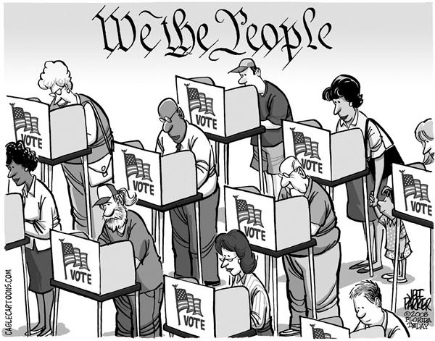
TOPIC 1.1-1.3 Ideals OF Democracy
Wapples Pg. 2-25
AMSCO Chpt. 1 Pg. 2-23
Required Document Declaration of Independence, Federalist 10, Brutus 1
Ideals Democracy

Slide 2
TOPIC 1.1 Ideals of Democracy
A balance between governmental power and individual rights has been a hallmark of American political development.
The U.S. government is based on the following democratic ideals:
i. Natural rights (all people have certain rights that cannot be taken away)
ii. A social contract (an implicit agreement among the people in a society to give up some freedoms to maintain social order)
iii. Popular sovereignty (all government power
comes from the consent of its people)
iv. Limited government (a government’s power cannot be absolute)
Explain how democratic ideals are reflected in the Declaration of Independence and the U.S. Constitution
The ideal of limited government is ensured by the interaction of these principles:
i. Separation of powers
ii. Checks and balances
iii. Federalism
iv. Republicanism- Representative Democracy

Slide 3
TOPIC 1.1 Ideals of Democracy
A balance between governmental power and individual rights has been a hallmark of American political development.
The Declaration of Independence, drafted by Thomas Jefferson (with help from Adams and Franklin), restates the philosophy of natural rights, and provides a foundation for popular sovereignty. The U.S. Constitution, drafted by James Madison at the Constitutional Convention in Philadelphia that was led
by George Washington (with important contributions from Hamilton and members of the “Grand Committee”), is an example of a social contract and establishes a system of limited government. The Constitution provides the blueprint for a unique form of democratic government in the United States.
Explain how democratic ideals are reflected in the Declaration of Independence and the U.S. Constitution
REQUIRED FOUNDATIONAL DOCUMENT
Declaration of Independence

Slide 4
LESSON 1.1 The Ideals of Democracy
Mayflower Compact 1620
When the pilgrims landed in Massachusetts in 1620, they knew their survival depended on working together and forming a civil body politic, so they drafted a governing document, the Mayflower Compact. This agreement was grounded in Christian morals in that God given right to self rule, even while the pilgrims remained British subjects. The Pilgrims and the strangers were pledging their loyalty to laws they would make themselves. This was the first experiment in consensual government in Western history between individuals with one another, and not with a monarch.
More than 150 years later the Declaration of Independence, applying the principles of enlightenment philosophy, provided a foundation for the government in which the people with protected rights not monarchs were the true source of governmental power. A decade later the United states constitution codified the ideals of self government, consent of the governed, and representation into guidelines for the new nation.
AMSCO pg. 3

Slide 5
Ideals of the American Government
1.1 Explain how democratic ideals are reflected in the Declaration of Independence and the U.S. Constitution.
The Framers decided to create a limited government based on ideas of natural rights, popular sovereignty, republicanism, and the social contract. We can see some of these ideas pop up in the foundational documents of the United States, including the Declaration of Independence and the Constitution. But what are these democratic ideas and why has the United States continued to hold onto them for more than 250 years?
Limited government
Natural rights
Popular sovereignty
Republicanism
Social contract

Slide 6
Philosophy on the Origins of Government: The Social Contract Theory and the State of Nature
How did man live before there was a government?
Who decided on what laws were needed for an orderly society?
The Philosophers:
Thomas Hobbes 1611-1677
John Locke (1632-1704)
Jean Jacques Rousseau (1712-1778)
Hobbes wrote that in earliest history humans lived in unbridled freedom in a state of nature, in which no government existed, and no person was subject to any superior power. That which people could take by force belong to them. However, all people were similarly free in this state of nature . No authority exists to protect one person from the aggressive actions of another person thus, individuals were only as free as their own physical strength and intelligence could make them. Life was “short, nasty and brutish”.
Magruder’s 2009 pg. 8

Slide 7
Thomas Hobbes 1611-1677 Wrote the book LEVIATHAN
Hobbes wrote that in earliest history humans lived in unbridled freedom in a state of nature, in which no government existed, and no person was subject to any superior power. That which people could take by force belong to them. However, all people were similarly free in this state of nature. No authority exists to protect one person from the aggressive actions of another period thus, individuals were only as free as their own physical strength and intelligence could make them. Life was “short, nasty and brutish”.
Human beings overcame their unpleasant condition, says the social contract theory, by agreeing with one another to create a state. By contract, people agreed to give up to the state as much power as was needed to promote the safety and well being of all. In the contract that is through a constitution, the members of the state created a government to exercise the powers they had voluntarily given to the state.
In short, the social contract theory argues that the state arose out of a voluntary act of free people. It holds that the state exists only to serve the will of the people that they are the sole source of political power and that they are free to give or to withhold that power as they choose. The theory may seem farfetched today. The great concept of this theory promote popular sovereignty, limited government and individual rights where immensely important to the shaping of the American government system.
Magruder’s 2009 pg. 9

Slide 8
Influence of Enlightenment Thought: NATURAL RIGHTS
Def: The idea that certain restrictions should be placed on government to protect the natural rights of citizens.
What is a limited government?
After the colonies decided to separate from the British monarchy, the Framers had to develop a system of government that would gain the support of all of the Patriots. They agreed on a system of limited government.
Limited government is a political system in which there are certain restrictions placed on the government to protect individual rights and liberties. This decision to create a limited government was a deliberate departure from the British monarchy, which the Framers felt violated their rights. They intentionally created a limited government that would have to abide by a set of rules designed by the people of the country.
Now that the Framers had a plan for the type of government they were going to have, they had to decide a few things:
What are the roles and responsibilities of this government?
How will the government respond to the will of the people?
To answer these questions, the Framers turned to political philosophers like Thomas Hobbes and John Locke, whose ideas about what makes a government successful inspired the current system of government in the United States today.

Slide 9
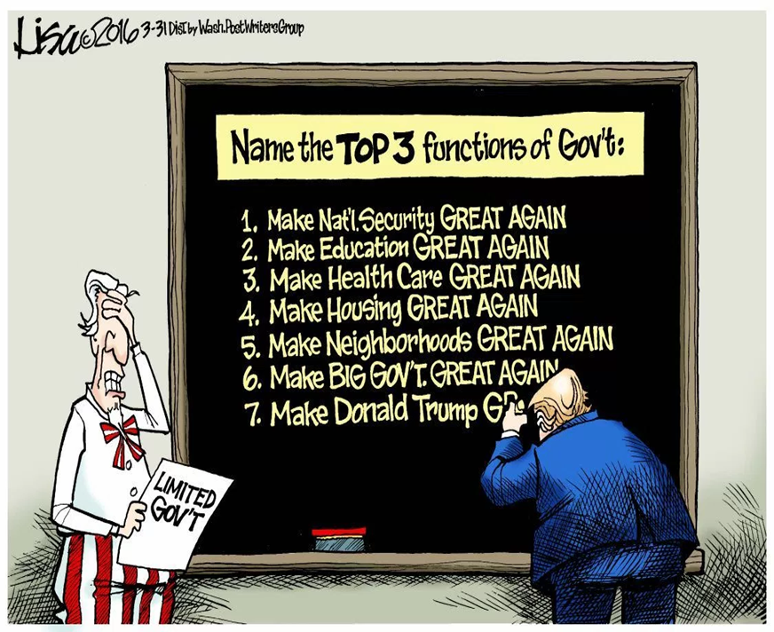
LIMITED GOVERNMENT
Def: The idea that certain restrictions should be placed on government to protect the natural rights of citizens.
What is limited government?
Watch here

Slide 10
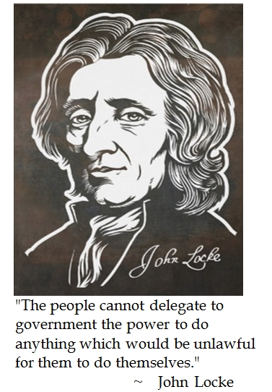
Influence of Enlightenment Thought: NATURAL RIGHTS
Def: The rights that people are born with and can never give up.
What are natural rights? GOD given rights
The main argument in the Declaration of Independence was that the British monarchy violated the natural rights of the American people. Natural rights, sometimes called unalienable rights, are rights the Framers believed all people are born with and can never give up. The Founders argued that the government’s central purpose should be to protect and uphold these rights.
Two Treatises of Government, 1689
Watch a video on Locke and Natural Rights (5:23)
John Locke, (1632-1704) an Enlightenment philosopher, wrote that all individuals are equal in the sense that they are born with certain "inalienable" natural rights. That is, rights that are God-given and can never be taken or even given away. Among these fundamental natural rights, Locke said, are "life, liberty, and property.“ His work inspired Thomas Jefferson, the main author of the Declaration of Independence, who described unalienable rights as “life, liberty, and the pursuit of happiness.” Having defined these natural rights, the Founders of the United States then had to answer the question: “How do we make sure society safeguards natural rights without giving the government too much power?”

Slide 11
Influence of Enlightenment Thought: NATURAL RIGHTS
Inalienable- unable to be taken away from or given away by the possessor.
The Bill of Rights are the people’s INALIENABLE rights.
Watch a video on Locke and Natural Rights (5:23)
We hold these truths to be self-evident, that all men are created equal, that they are endowed by their Creator with certain unalienable Rights, that among these are Life, Liberty and the pursuit of Happiness.
Declaration of Independence July 4, 1776

Slide 12
Influence of Enlightenment Thought: NATURAL RIGHTS
Philosopher | Hobbes (1588-1679) | Locke (1632-1704)
State of Nature | People are inherently selfish; “War of all against all.” | People are inherently good; born free and equal with inalienable rights
Social Contract Theory | People agree to give up some rights and power in exchange for protection. | People give up some freedoms, but only if the government agrees to protect everyone’s rights.
Purpose of Government | Provides security for the people; prevents war and chaos | Protects inalienable rights, laws are for the ”good of the people.”
Recourse of People | Rebellion only if the government does not protect the people. | People may overthrow governments when it attempts to take away freedoms/cannot protect inalienable rights.
Major Works | Leviathan | Second Treatise on Civil Government

Slide 13
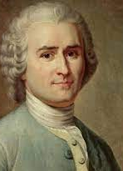
Influence of Enlightenment Thought: Popular Sovereignty
Jean-Jacques Rousseau and The Social Contract written in 1762
"Man was born free, and he is everywhere in chains.“ Rousseau asserts that modern states repress the physical freedom that is our birthright and do nothing to secure the civil freedom for the sake of which we enter into civil society.
Rousseau calls the collective grouping of all citizens the "sovereign," and claims that it should be considered in many ways to be like an individual person. While each individual has a particular will that aims for his own best interest, the sovereign expresses the general will that aims for the common good. The sovereign only has authority over matters that are of public concern, but in this domain its authority is absolute.
In the social contract Rousseau describes is the agreement of free and equal people to abandon certain rights
in order to find secure protections for society and to find freedom in a single body politic committed to the general good. He envisioned popular sovereignty----the people as the ultimate ruling authority--- and a government of officials to carry out the laws through the General Will.
https://www.sparknotes.com/philosophy/socialcontract/summary/

Slide 14
Baron de Montesquieu and the Spirit of the Laws 1748
French philosopher Montesquieu (1689-1755), recognized in the spirit of the Laws both the sovereign and the administrative actions of governmental powers. He saw a republican form of government as one having to defined and limited power, while granting political liberty to citizens. Montesquieu argued for the separation of powers in the administrative government, comprised of the executive, legislative and judicial branches.
James Harrington- wrote Oceana 1700
  Argued for government officials to be rotated in office to avoid abuse of power. Today we have term limits on Presidents, governors, mayors, etc.

Slide 15

POPULAR SOVEREIGNTY
Def: Government power comes from the will of the people or the consent of the governed.
What is popular sovereignty?
The Founders believed that the United States should be founded on the principle of popular sovereignty. Popular sovereignty is the idea that the government’s power comes from the will of the people or the “consent of the governed.” If the government started to violate the will of the people, Americans would have the right to change that.
This idea is the main argument within the Declaration of Independence, which claimed that the British monarchy had become too powerful and was not listening to the needs and desires of the colonists, who therefore had the right to rebel.
In the United States, we see popular sovereignty at a smaller level in most elections when the power of the government shifts from one political party to another. When control of the government shifts from one party to another, it shows that the will of the people has also changed.
Changes in leadership gives us insight into what the people want from their government. Political parties play a vital role in American politics, as they represent the opinions and needs of the people to the government.
Notes:
Assign: John Locke’s ideas in the Declaration of Independence. Worksheet
Watch: John Adams HBO Part 2 Video, Worksheet
In 1776, the Continental Congress had asked five men, including Roger Sherman and Robert Livingston, to draft an official statement about the colonists views.
Read the Declaration of Independence Activity: http://chnm.gmu.edu/lcpstah/lessons/lesson9/StudentHandoutsPacket.pdf
Although the Declaration served as an inspiration for American democracy, it did not outline an actual system of government.
Watch: https://www.youtube.com/watch?v=A_56cZGRMx4&index=8&list=RDKd7LK6hgsOE

Slide 16
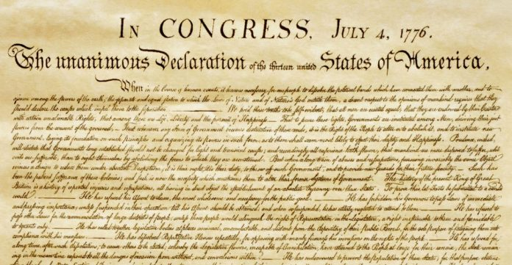
POPULAR SOVEREIGNTY can be found HERE
The Declaration of Independence
A document drafted by Thomas Jefferson, John Adams, and Benjamin Franklin. It provides a foundation for popular sovereignty.
“We hold these truths to be self-evident…”
At the most basic level, the Declaration of Independence is a list of grievances against the British Crown, seeking the sympathy of the international community for the cause of the colonies in revolting against their mother country. But at a higher level, the ideas expressed in the Declaration serve as the inspiration for American democratic values.
Notes:
Assign: John Locke’s ideas in the Declaration of Independence. Worksheet
Watch: John Adams HBO Part 2 Video, Worksheet
In 1776, the Continental Congress had asked five men, including Roger Sherman and Robert Livingston, to draft an official statement about the colonists views.
Read the Declaration of Independence Activity: http://chnm.gmu.edu/lcpstah/lessons/lesson9/StudentHandoutsPacket.pdf
Although the Declaration served as an inspiration for American democracy, it did not outline an actual system of government.
Watch: https://www.youtube.com/watch?v=A_56cZGRMx4&index=8&list=RDKd7LK6hgsOE

Slide 17
POPULAR SOVEREIGNTY can be found HERE
The Declaration of Independence
The Declaration of Independence justified its revolution through the social contract theory, arguing that King George III and his ministers had violated the contract. Thomas Jefferson called the document “pure Locke”
Notes:
Assign: John Locke’s ideas in the Declaration of Independence. Worksheet
Watch: John Adams HBO Part 2 Video, Worksheet
In 1776, the Continental Congress had asked five men, including Roger Sherman and Robert Livingston, to draft an official statement about the colonists views.
Read the Declaration of Independence Activity: http://chnm.gmu.edu/lcpstah/lessons/lesson9/StudentHandoutsPacket.pdf
Although the Declaration served as an inspiration for American democracy, it did not outline an actual system of government.
Watch: https://www.youtube.com/watch?v=A_56cZGRMx4&index=8&list=RDKd7LK6hgsOE

Slide 18


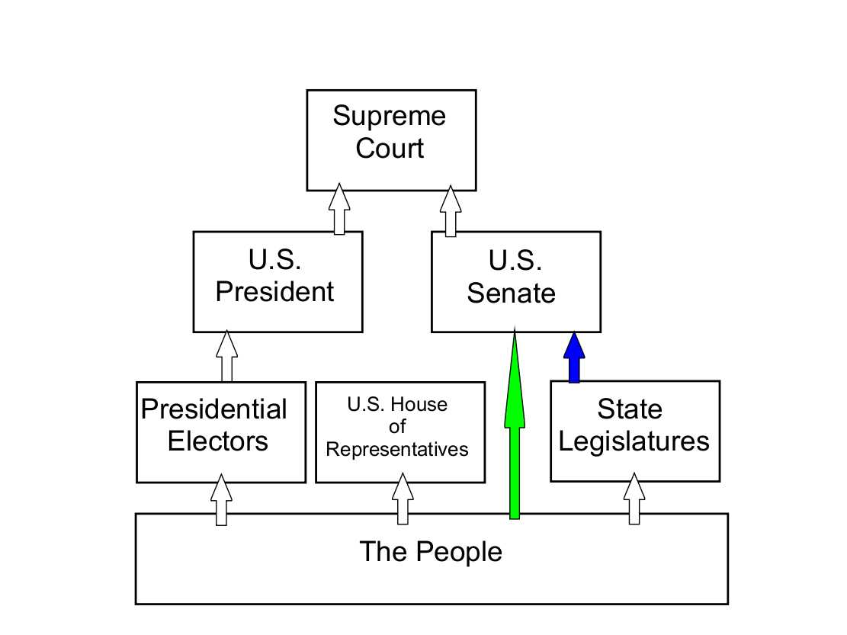
REPUBLICANISM
Def: Government in which elected leaders represent the interests of the people. REPRESENTATIVE DEMOCRACY
What is republicanism?
Leading up to the Revolutionary War, a famous phrase was “No taxation without representation!” To feel like their wants and needs were being heard by the government, the colonists wanted direct representation, but the British were unwilling to grant that to the colonies. Keeping that in mind, the Founders wanted to make sure that they were creating a political system that represented the people. But how do the people get the government to listen to their will?
The Framers believed that the best form of government is one in which elected leaders represent the interests of the people. This is known as republicanism.
The Framers wanted the will of the people to be reflected in the daily decisions of government and to prevent a tyrannical government from rising. By creating a system of government in which the people elected their leaders, the Framers believed that there was less of a chance of a government that would hold onto power and refuse to give it up.
Despite the Framers' desire to create a representative government, they extended the privilege of voting only to a small portion of US citizens: white, landowning men. It took nearly 200 years to extend voting rights to all people in the United States, meaning that not every person’s needs and wants were heard or represented in government for a lot of American history. But it was fixed. Try that in Cuba.

Slide 19

The History of Suffrage in the USA
1787- Only white male property owners could vote.
1828- Jacksonian Democracy- poor white males gained the right to vote. “The Common Man”
1868- 15th Amendment- right to vote for African American males.
1919- 19th Amendment proposed and passed in 1920, gave women the right to vote
1964- 24th amendment eliminated the poll tax
1971- 26th Amendment right to vote 18 year olds.

Slide 20
SOCIAL CONTRACT
Def: A social contract is an unofficial agreement shared by everyone in a society in which they give up some freedom for security.
What is a social contract?
For the government to protect the natural rights of American citizens, people would have to see the government as an authority they must respect. They would enter into a social contract with each other, meaning that American society as a whole would agree to give up some freedoms to be protected by the federal government. Thomas Hobbes, an English political philosopher, theorized that the social contract was the foundation of government.
If the people did not give up some freedoms, then the government would have no way to rule over them. For instance, you can’t just walk into someone’s house if the door is open and claim that the house is now yours. That is a freedom that you give up so the government can protect you from someone else doing the same thing to you. However, by ensuring that the government was limited, the Founders created a system that protected the freedoms granted to the people.
Still, the Founders were concerned about a strong central government turning into a tyrannical monarchy again. They faced yet another question: how do the people ensure that the government does not get too powerful and start restricting all of their freedoms?

Slide 21
SOCIAL CONTRACT
Def: A social contract is an unofficial agreement shared by everyone in a society in which they give up some freedom for security.
In short, the social contract theory argues that the state arose out of a voluntary act of free people. It holds that the state exists only to serve the will of the people, that they are the sole source of political power and that they are free to give or to withhold that power as they choose. The theory may seem farfetched today. The great concepts of this theory promoted popular sovereignty, limited government, and individual rights were immensely important to the shaping of the American governmental system.

Slide 22
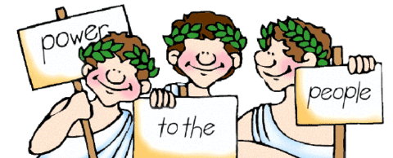
The Social Contract
The social contract theory argues that the state arose out of a voluntary act of free people.
It holds that the state exist only to serve the will of the people, that they are the sole source of political power, and that they are free to give or to withhold that power as they choose.

Slide 23
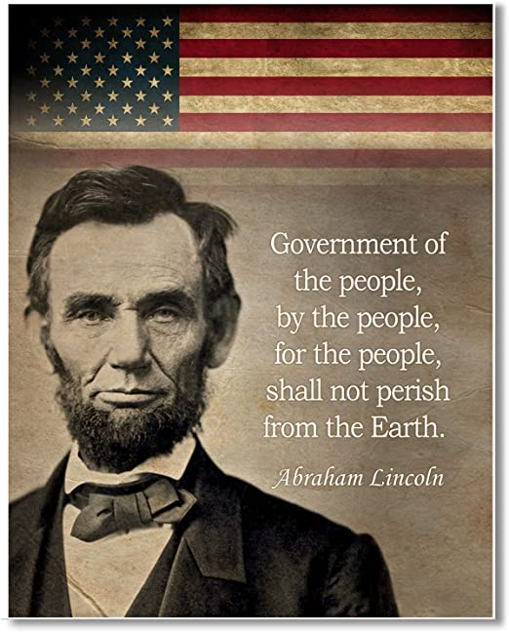



The Social Contract

Slide 24
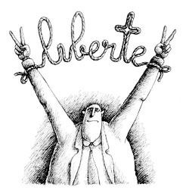
SOCIAL CONTRACT
“man is born free, but he is everywhere in chains"
The philosopher Jean-Jacques Rousseau popularized the idea of the social contract in the 1700s, but it's just as applicable today. As members of a society, we agree to the social contract — we cooperate with each other and obey society's laws. We also give up some freedoms, because we want the protection society can offer. The founders of the United States believed the social contract made citizens powerful, giving them a collective voice in their government.
The Enlightenment: Social Contract (3:20)

Slide 25
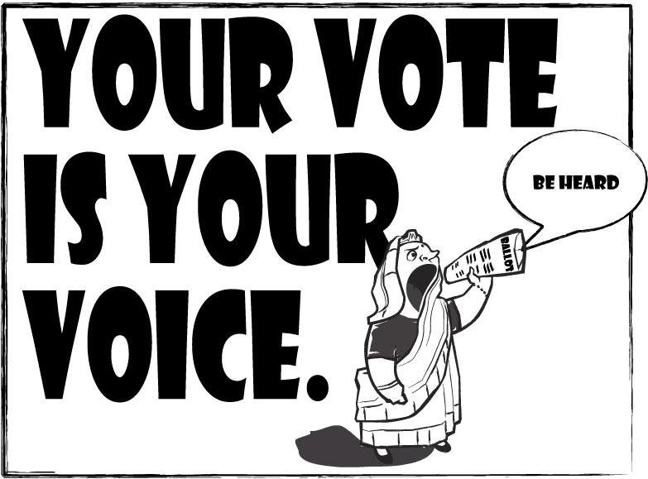
ESSENTIAL QUESTION CFU
How are the ideals of limited government, natural rights, popular sovereignty, republicanism, and a social contract embedded in the foundation of our government?
11

Slide 26
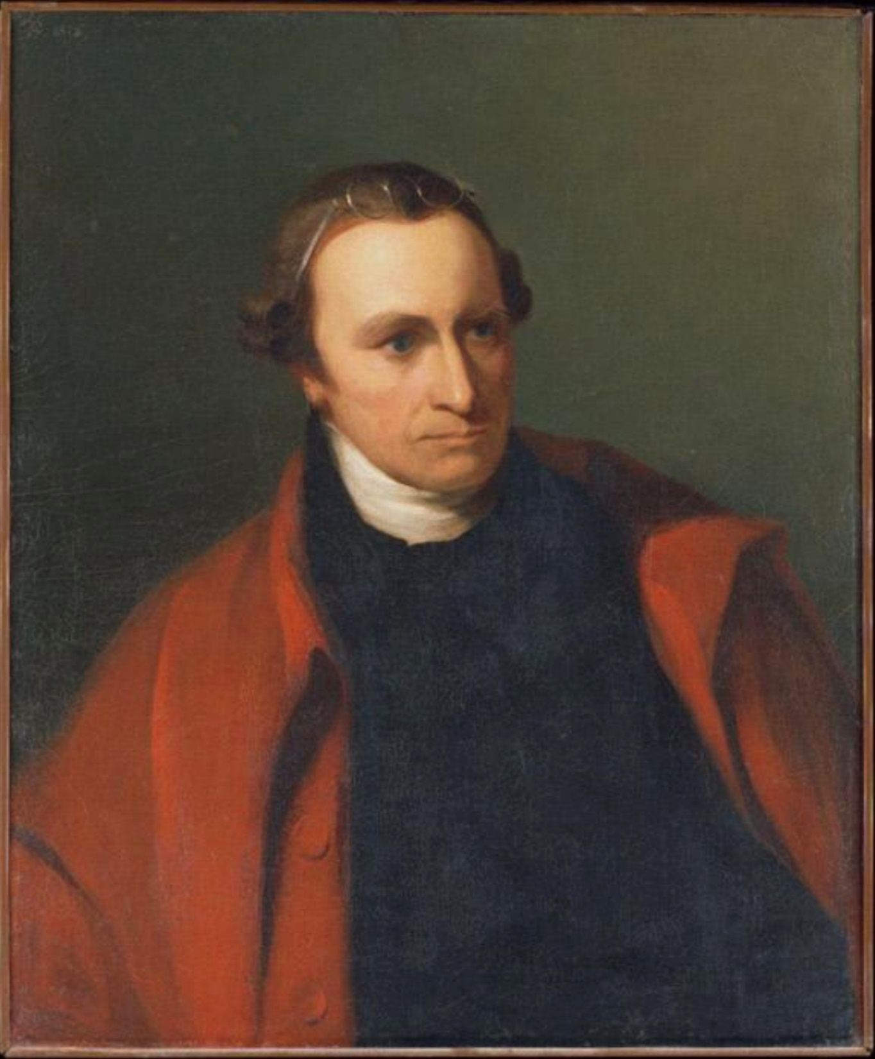
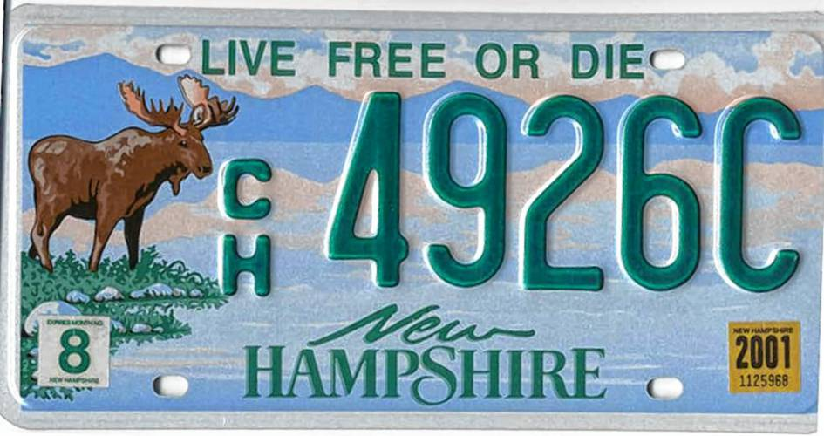

“Our brethren are already in the field! Why stand we here idle? What is it that gentlemen wish? What would they have? Is life so dear, or peace so sweet, as to be purchased at the price of chains and slavery? Forbid it, Almighty God! I know not what course others may take; but as for me, give me liberty or give me death!”
-Patrick Henry, July 1, 1776

Slide 27
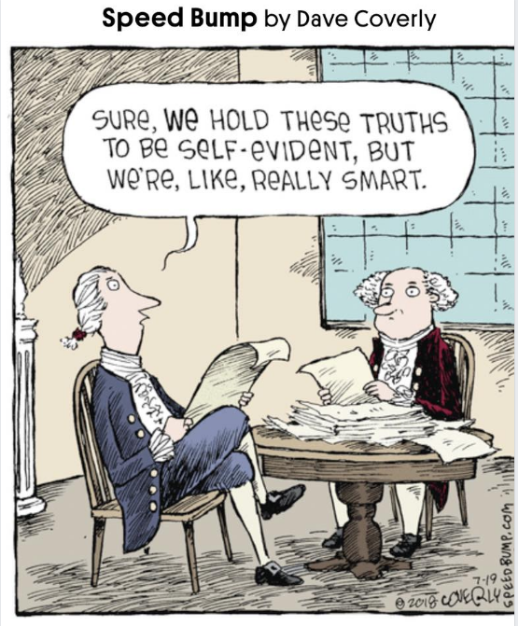
DECLARATION OF INDEPENDENCE
We hold these truths to be self-evident, that all men are created equal, that they are endowed by their Creator with certain unalienable Rights, that among these are Life, Liberty and the pursuit of Happiness.
That to secure these rights, Governments are instituted among Men, deriving their just powers from the consent of the governed. That whenever any Form of Government becomes destructive of these ends, it is the Right of the People to alter or to abolish it, and to institute new Government, laying its foundation on such principles and organizing its powers in such form, as to them shall seem most likely to effect their Safety and Happiness.

Slide 28
DECLARATION OF INDEPENDENCE
In essence, the Declaration of Independence is a LAWYER’S BRIEF (ARGUMENT) JUSTIFYIN A REVOLUTION for INDEPENDENCE
It states in no uncertain terms WHY the colonies ought to be free and independent states.
The History of the present King of Great-Britain is a History of repeated Injuries and Usurpations, all having in direct Object the Establishment of an absolute Tyranny over these States. To prove this, let Facts be submitted to a candid World.
He has refused …..
He has forbidden……
He has refused…..
He has called together Legislative Bodies….
He has dissolved Representative Houses …….
He has refused……
And the list goes on. Read the complaints against the king and know at least 2 reasons for independence.

Slide 29
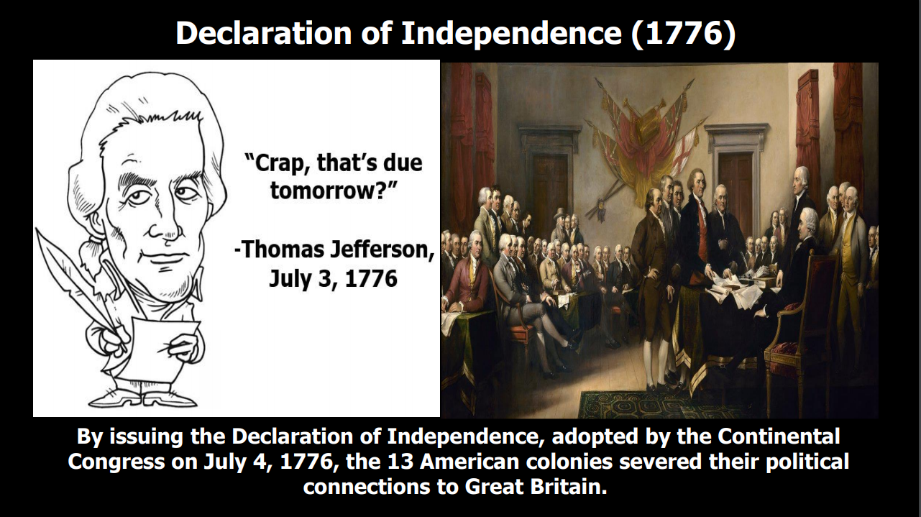

Slide 30
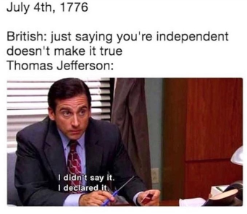
So how is the Declaration of Independence like a break-up letter?
Declaration of Independence
When in the Course of human events, it becomes necessary for one people to dissolve the political bands which have connected them with another, and to assume among the powers of the earth, the separate and equal station to which the Laws of Nature and of Nature's God entitle them, a decent respect to the opinions of mankind requires that they should declare the causes which impel them to the separation.
High school break-up letter
We have known each other for years now. Things used to be so great – it was like we were MFEO. I mean everyone said it was perfect. I really thought we would be together forever, but things just aren’t working for me.

Slide 31
Locke and Jefferson
 | John Locke Second Treatise of Government | Thomas Jefferson Declaration of independence
NATURAL RIGHTS | “The state of nature has a law to govern it” “Life, liberty, and property” | “Laws of Nature and Nature’s God” ”Life, liberty, and the pursuit of happiness.”
PURPOSE OF GOVERNMENT | “To preserve himself, his liberty, and property” | ”To secure these rights”
EQUALITY | “Men being by nature all free, equal, and independent.” | “All men are created equal.”
CONSENT OF THE GOVERNED | “For when any number of men have, by the consent of every individual, made a community, with a power to act as one body, which is only by the will and determination of the majority.” | “Governments are instituted among men, deriving their just powers from the consent of the governed.”
LIMITED GOVERNMENT | “Absolute arbitrary power, or governing without settled laws, cap neither of them consist with the ends of society and government. | “The history of the present King of Great Britain is a history of repeated injuries and usurpations.”
RIGHT TO REVOLT | “The people shall be the judge…Oppression raises ferments and makes men struggle to cast off an uneasy and tyrannical yoke.” | “Prudence, indeed, will dictate that Governments long established should not be changed for light and transient causes….But when a long train of abuses and usurpations, pursuing invariaably the same Object evinces a design to reduce them under absolute Depotism, it is their right, it is their duty, to throw off such government.

Slide 32
U.S. CONSTITUTION: A UNIQUE FORM OF DEMOCRACY
How does the Constitution provide the blueprint for a unique form of political democracy in the U.S.?
–Popular sovereignty and limited government, republicanism are prevalent in the Constitution
–Republicanism = representative democracy
–Compromises were made to appeal to a large number of groups

Slide 33
ESSENTIAL QUESTION CFU
How does the Declaration of Independence, drafted by Jefferson with help from Adams and Franklin, provide a foundation for popular sovereignty?
When in the Course of human events, it becomes necessary for one people to dissolve the political bands which have connected them with another, and to assume among the powers of the earth, the separate and equal station to which the Laws of Nature and of Nature's God entitle them, a decent respect to the opinions of mankind requires that they should declare the causes which impel them to the separation.
We hold these truths to be self-evident, that all men are created equal, that they are endowed by their Creator with certain unalienable Rights, that among these are Life, Liberty and the pursuit of Happiness. — That to secure these rights, Governments are instituted among Men, deriving their just powers from the consent of the governed, — That whenever any Form of Government becomes destructive of these ends, it is the Right of the People to alter or to abolish it, and to institute new Government, laying its foundation on such principles and organizing its powers in such form, as to them shall seem most likely to effect their Safety and Happiness.
16

Slide 34
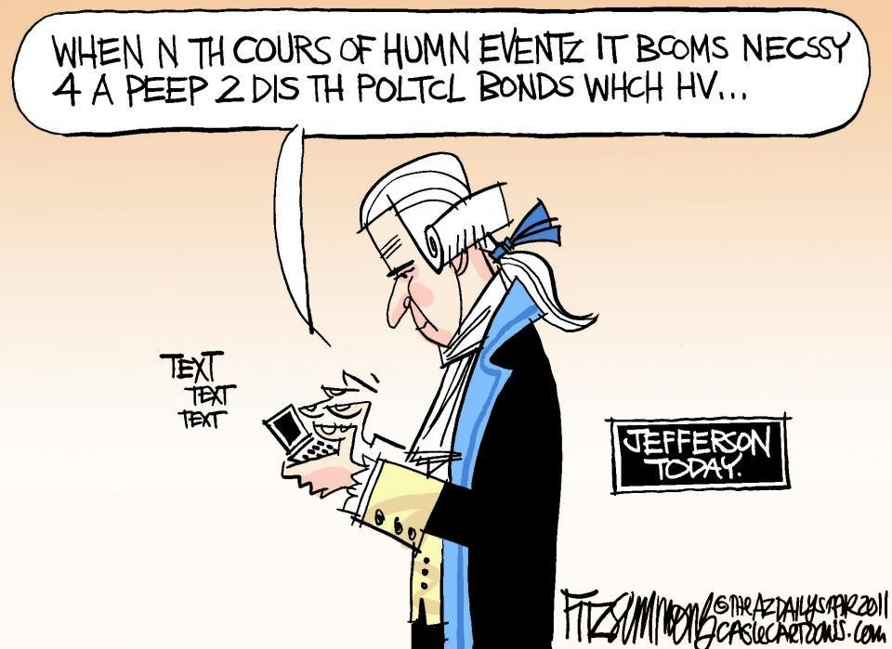

Slide 35
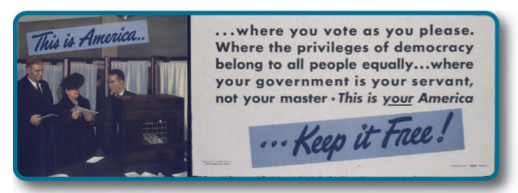
What kind of government does the United States of America have?
Notes:
When could a democracy be bad?

Slide 36
WHY WAS DEMOCRACY SEEN AS A BAD THING TO THE FOUNDING FATHERS?
Formerly a term of derision - Positive meaning only in last 100 years
Distinguishing feature of democracy is that government derives authority from its citizens
DIRECT DEMOCRACY (From the Greek Demos-Kratos or people power)
  Rule by the people and
    1) individual participation on legislation or policy or
    2) making decisions without delegating authority to elected representatives
  Only example in original Constitution is the election of House of Representatives
  Modern day examples of DIRECT DEMOCRACY in the USA
    Popular Election of United States Senators – 17th Amendment
    Direct primary - voters, rather than party leaders or other elected officials, select who may run for office
    Referendum - procedure for submitting to popular vote measures passed by the legislature or proposed amendment to a state constitution (can only be done at the state level)
    Initiative - procedure whereby a certain number of voters may, by petition, propose a law or constitutional amendment and have it submitted to the voters (can only be done at the state level)
    Recall - procedure for submitting to popular vote the removal of officials from office before the end of their term (can only be done at the state level)
  Founding Fathers feared direct democracy >> fear of MOB RULE or MOBOCRACY

Slide 37
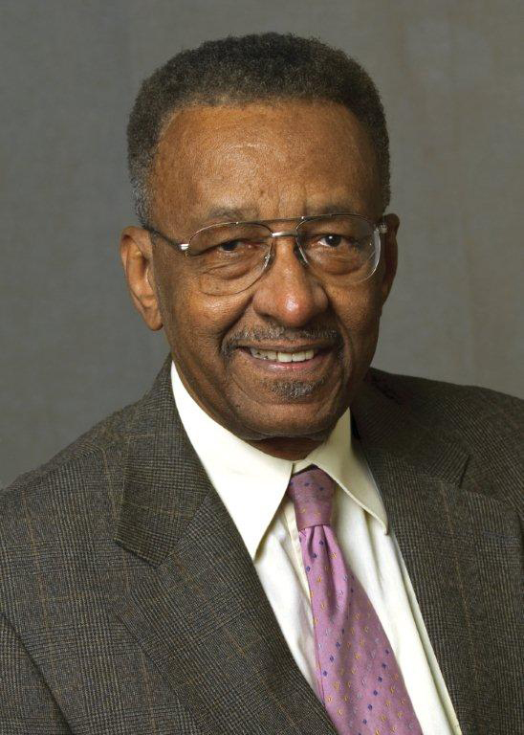
WHY WAS DEMOCRACY SEEN AS A BAD THING TO THE FOUNDING FATHERS?
Dr. Walter Williams:
America Isn't a Democracy. In Fact, the Founders Feared Democracy
By Walter E. Williams | January 28, 2020 | 11:12am EST
" When we die and if at our next destination, we see anything like a Bill of Rights, we know that we're in hell because a Bill of Rights in heaven would suggest that God couldn't be trusted.”
According to his quote, why do we have a Bill of Rights?
https://www.arodconnection.com/_files/ugd/b5c382_43e2cc1856904754bed8b3b2d664b5bd.pdf

Slide 38
A Check on the Majority AnnenbergClassroom.com
The essence of democracy is majority rule, the making of binding decisions by a vote of more than one-half of all persons who participate in an election. However, constitutional democracy in our time requires majority rule with minority rights.
Thomas Jefferson, third President of the United States, expressed this concept of democracy in 1801 in his First Inaugural Address. He said,
All . . . will bear in mind this sacred principle, that though the will of the majority is in all cases to prevail, that will to be rightful must be reasonable; that the minority possess their equal rights, which equal law must protect and to violate would be oppression.
In every genuine democracy today, majority rule is both endorsed and limited by the supreme law of the constitution, which protects the rights of individuals. Tyranny by minority over the majority is barred, but so is tyranny of the majority against the minority.
Minority here means the losing side. Side with the least votes.
Majority rule under the LAW- Constitution
Majority’s power is limited.
https://www.annenbergclassroom.org/glossary_term/majority-rule-and-minority-rights/

Slide 39


Is America Really a Democracy? (3:21)

Slide 40
TOPIC 1.2 Types of Democracy
A balance between governmental power and individual rights has been a hallmark of American political development.
Representative democracies can take several forms along this scale:
Participatory democracy, which emphasizes broad participation in politics and civil society
Pluralist democracy, which recognizes group-based activism by nongovernmental interests striving for impact on political decision making
Elite democracy, which emphasizes limited participation in politics and civil society
Explain how models of representative democracy are visible in major institutions, policies, events, or debates in the U.S
Different aspects of the U.S. Constitution as well as the debate between Federalist No. 10 and Brutus No. 1 reflect the tension
between the broad participatory model and the more filtered participation of the pluralist and elite models.
The three models of representative democracy continue to be reflected in contemporary institutions and political behavior.
REQUIRED FOUNDATIONAL DOCUMENTS
Federalist No. 10
Brutus No. 1

Slide 41
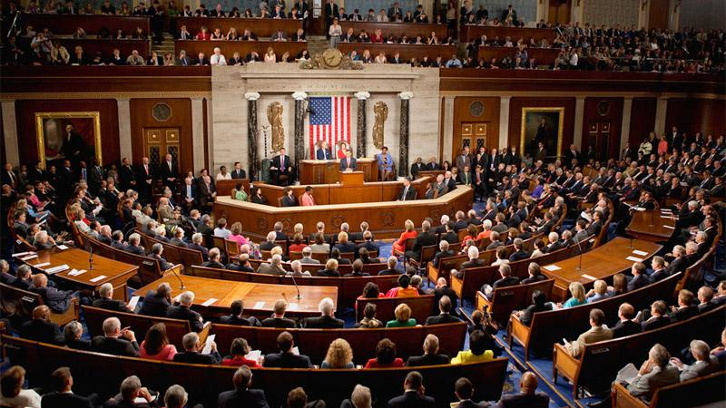
1.2 Types of Democracy
Explain how models of representative democracy are visible in major institutions, policies, events, or debates in the U.S.
Representative Democracy or a Republic
Small group of officials elected to represent the people=a Republic. The House of Representatives

Slide 42

HOW WAS A REPRESENTATIVE DEMOCRACY (REPUBLIC) BETTER?
REPRESENTATIVE DEMOCRACY- HOUSE OF REPRESENTATIVES
  Authority is delegated to elected representatives to make decision on behalf of citizens
  People vote >> Representatives >> make law (public policy)
  The idea that citizens directly elect members of the House of Representatives demonstrates that they have given their approval to the government- consent of the governed- popular sovereignty
  This is today’s meaning of democracy
  Representative democracy = republic
  Republic
    Same as indirect democracy
    Solves problems of direct democracy
    “Secures the advantages of direct democracy while curing its weaknesses”
Constitutional democracy refers to a government that enforces limits on those who govern and allows people to be heard through free and fair elections
Constitutionalism refers to how power is granted, dispersed, and limited
The House of Representatives is the most democratic institution of government that represents the framers’ commitment to a limited republic

Slide 43
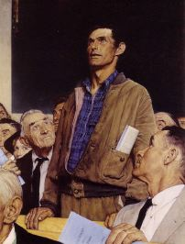
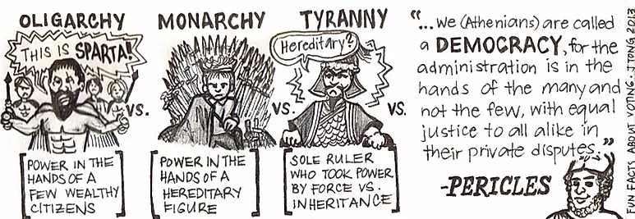
Direct Democracy= Participatory Dem
The size of the population in USA makes direct democracy impossible. Only works in small settings.
A form of democracy in which the people as a whole make direct decisions on laws and policies, rather than having those decisions made for them by elected representatives

Slide 44
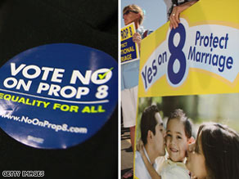
Example of Direct Democracy
Referendum or Initiative - Practice of submitting a law to a popular vote at election time. The law may be proposed by the legislature (referendum) or citizens (initiative). Only can done at the State level.

Slide 45


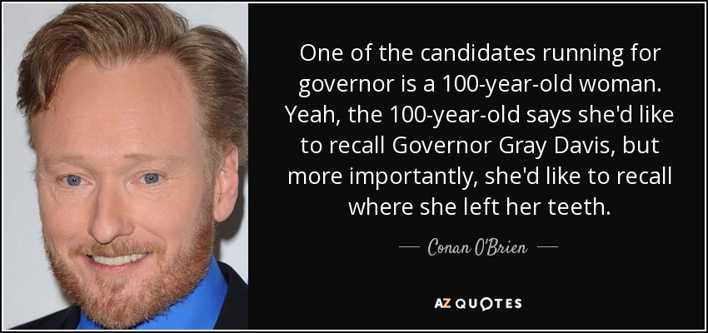

Slide 46







Slide 47
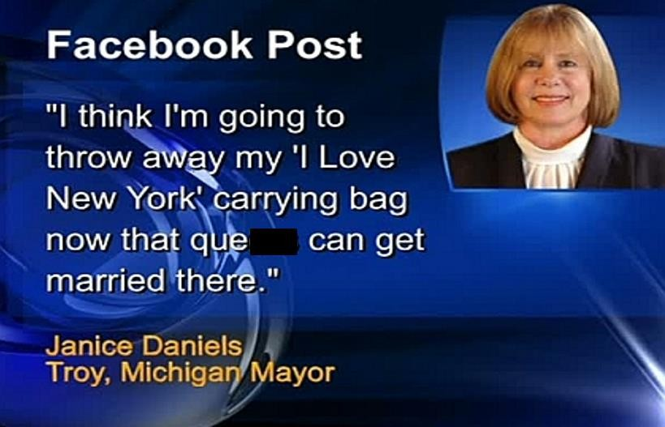





Slide 48

FEDERALISTS VS. ANTI-FEDERALISTS
Federalist No. 10 and Brutus No. 1 show how Federalists and Anti-Federalists had different opinions on how strong the federal government should be. (We will look at this in the next lesson in depth.)
Federalist No. 10:
an essay written by James Madison
argued that a strong central government will control the effects of factions (groups) because it is large and pluralist
argued that a large republic could control “mischiefs of faction” and distribute power between the federal government and the states evenly
Brutus No. 1:
an Anti-Federalist essay
argued against a strong central government, based on the belief that it would not be able to meet the needs of all US citizens
argued that a powerful, centralized government was too far removed from individual citizens to meet their needs

Slide 49
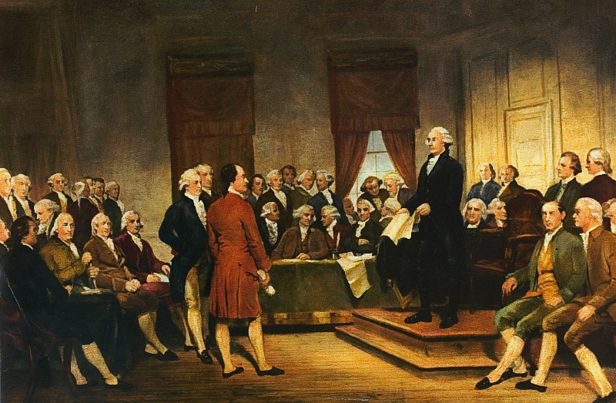
LEARNING OBJECTIVE 1.2
Explain how models of representative democracy are visible in major institutions, policies, events, or debates in the U.S.

Slide 50
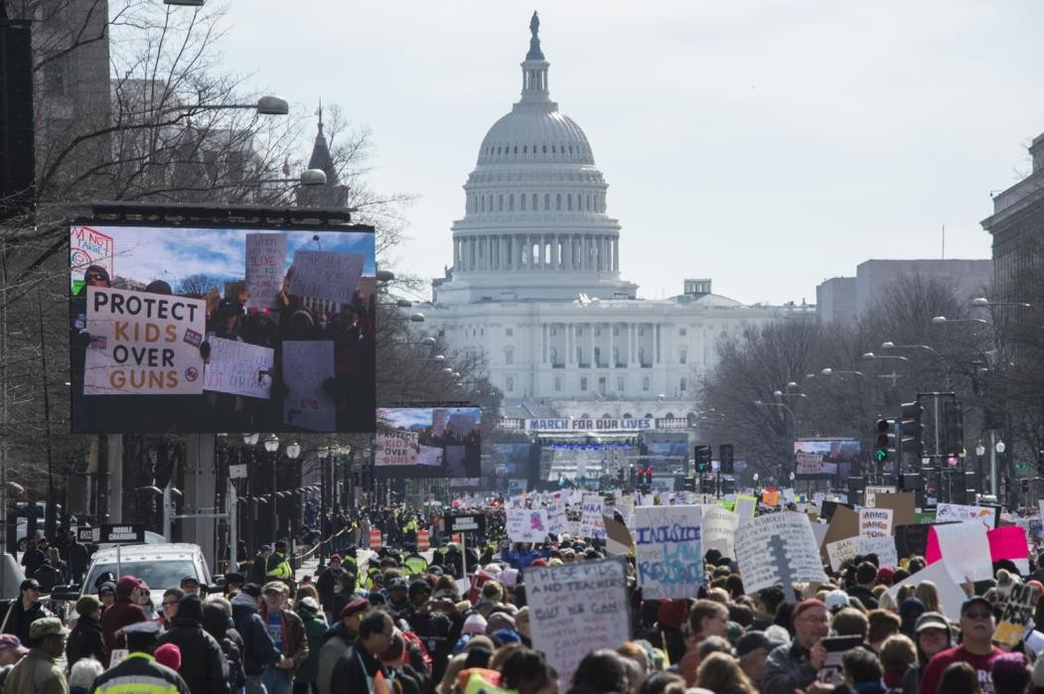

Participatory Democracy=Direct Dem
Emphasizes broad participation in politics and civil society
Citizens can influence policy decisions, but do not make them
Examples: voting in elections. Voting amendments 15, 17, 19, 26th amendments are all about PARTICIPATORY DEMOCRACY

Slide 51

Participatory Democracy
We can see participatory democracy in local and state forms of government, where citizens have multiple access points to influence policy-makers and the decisions they make.
Examples: town hall meetings, initiatives, referendums, ONLY at state level

Slide 52
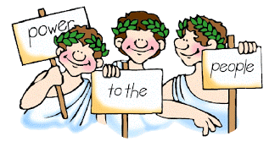
Participatory Democracy
Examples of participatory democracy include Ancient Greece. They practiced DIRECT DEMOCRACY which is a form of participatory democracy but only men voted in ancient Greece. 1st amendment right to petition gov for grievances

Slide 53
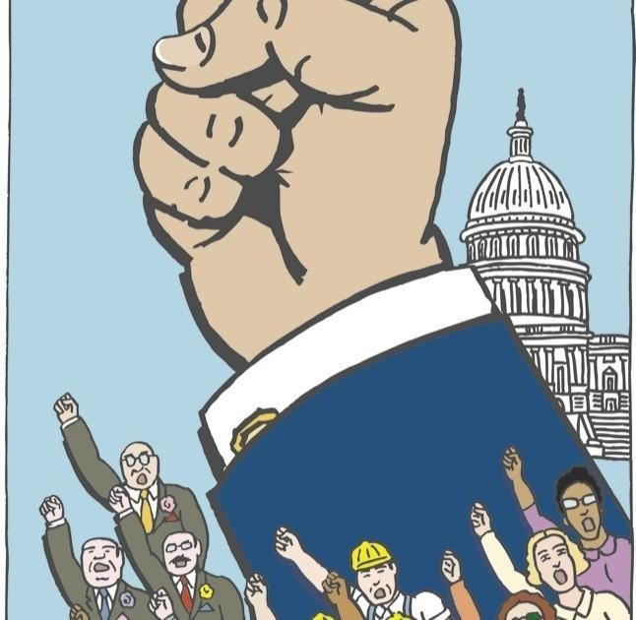
Pluralist Democracy
GROUPS
FACTIONS
Recognizes group-based activism by nongovernmental interests striving for impact on political decision making
No one group dominates politics and organized groups compete with each other to influence policy
Power is decentralized so that no one body or group has too much influence over policymaking.
Examples: Interest groups, trade unions

Slide 54
Pluralist Democracy
Hyper
Hyper-pluralism is pluralism gone sour.
Many groups are so strong that government is weakened.
b. There are too many groups with access to the different levels and branches of government: these groups have multiple ways to both prevent policies they disagree with and promote those they support.
c. When politicians try to placate every group, the result is confusing, contradictory, and muddled policy (or no policy at all).
Hyper-pluralism: argues that too many strong influential groups cripple the government’s ability to make coherent policy by dividing government and its authority.

Slide 55

Pluralist Democracy
Political Interest Groups= Lobbyists
As in a participatory democracy, anyone can participate in influencing political decisions, but in a pluralist democracy, individuals work through groups formed around common causes.
Examples: interest groups (age, race, occupation, region, income, hobbies, religion)

Slide 56
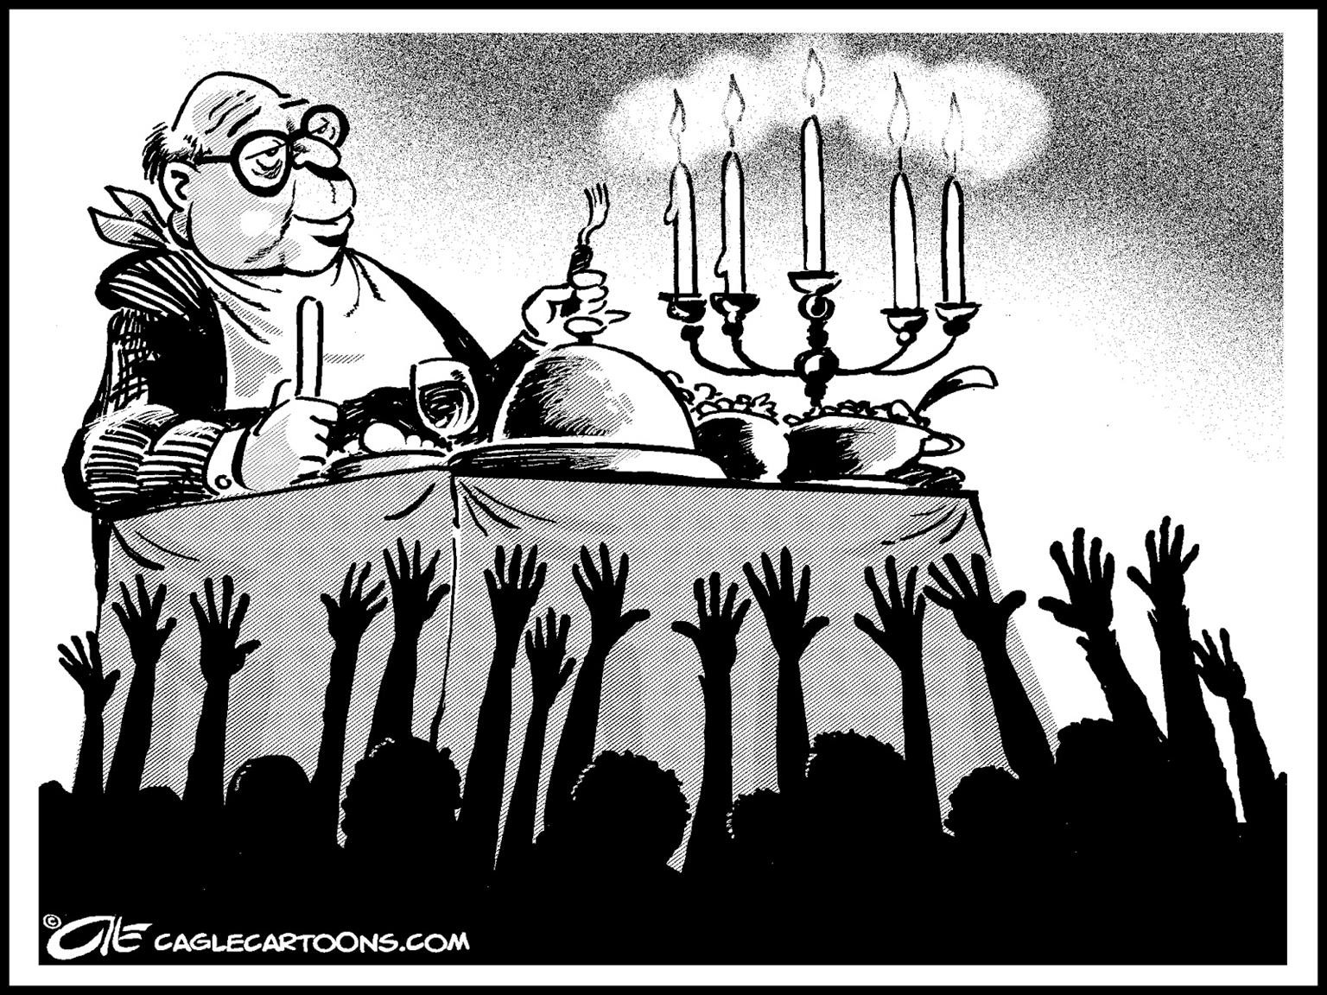
Elite Democracy
Emphasizes limited citizen participation in politics and civil society
A small number of people,
usually those who are wealthy and well-educated, influence political
decision-making
Examples: Electoral College, state legislatures chose U.S. Senators (original Constitution), unelected federal judges, Big Corporations
Under the 17th amendment (1913) US Senators would be elected by direct POPULAR ELECTIONS. More of a direct participatory democracy when it comes to US Senators.
Prior to the 17th amendment, Senators were appointed by state legislatures (Elite). It was the intention of the framers to insure the states had a voice in the federal government.

Slide 57
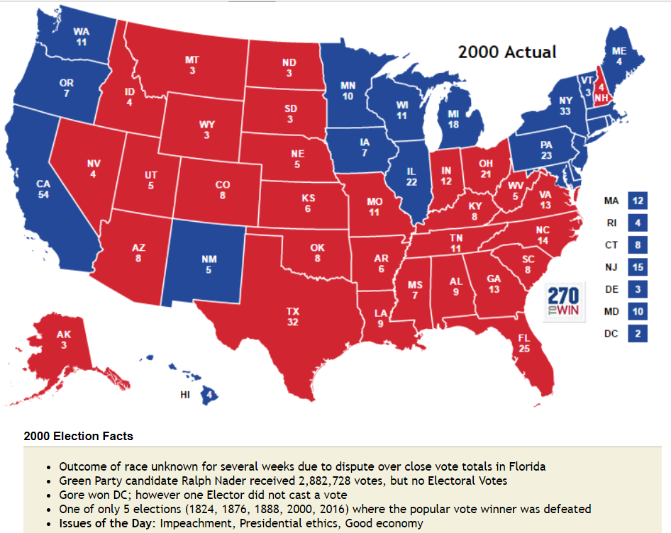
Elite Democracy
By having a small group of people make political decisions, the argument is that those few people will be highly informed and make the best decisions for all citizens.
Example: Electoral College
Notes:
Assign: Applying the Models
Practice 2018 FRQ

Slide 58

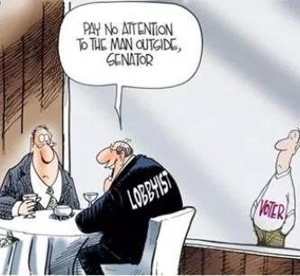
ESSENTIAL QUESTION CFU
Which model of representative democracy was most important to the Founding Fathers and which model is most reflected in contemporary institutions and political behavior?
Participatory democracy, which emphasizes broad participation in politics and civil society
Pluralist democracy, which recognizes group- based activism by nongovernmental interests striving for impact on political decision making
Elite democracy, which emphasizes limited participation in politics and civil society
32

Slide 59
NEW CED TOPIC 1.3 Government Power and Individual Rights
The Constitution emerged from the debate about the weaknesses in the Articles of Confederation as a blueprint for limited government.
Federalists supported ratification of the
Constitution and a strong central government. Madison’s arguments in Federalist No. 10 focused on the superiority of a large republic in controlling the “mischiefs of faction,” delegating authority to elected representatives and dispersing power between the states and national government.
Explain Federalist and Anti-
Federalist views on central
government and democracy.
Federalism
Anti-Federalists opposed the ratification of the Constitution and wanted more power reserved to state governments rather than a strong central government. Anti-Federalist writings, including Brutus No.1, adhered to popular democratic theory that emphasized the benefits of a small, decentralized republic while warning of the dangers to personal liberty from a large, centralized government.
REQUIRED FOUNDATIONAL DOCUMENTS
Federalist No. 10
Brutus No. 1

Slide 60
TOPIC 1.3 Government Power and Individual Rights
The Constitution emerged from the debate about the weaknesses in the Articles of Confederation as a blueprint for limited government.
Explain how Federalist and Anti-Federalist views on central government and democracy are reflected in U.S. foundational documents.
Madison’s arguments in Federalist No. 10
focused on the superiority of a large republic in controlling the “mischiefs of faction,” delegating authority to elected representatives and dispersing power between the states and national government.
Anti-Federalist writings, including Brutus No. 1, adhered to popular democratic theory that emphasized the benefits of a small, decentralized republic while warning of the dangers to personal liberty from a large, centralized government.
Federalism
REQUIRED FOUNDATIONAL DOCUMENTS
Federalist No. 10
Brutus No. 1

Slide 61
FEDERALISTS VS. ANTI-FEDERALISTS
Federalist No. 10 and Brutus No. 1 show how Federalists and Anti-Federalists had different opinions on how strong the federal government should be. (We will look at this in the next lesson in depth.)
Federalist No. 10:
an essay written by James Madison
argued that a strong central government will control the effects of factions (groups) because it is large and pluralist
argued that a large republic could control “mischiefs of faction” and distribute power between the federal government and the states evenly
Brutus No. 1:
an Anti-Federalist essay
argued against a strong central government, based on the belief that it would not be able to meet the needs of all US citizens
argued that a powerful, centralized government was too far removed from individual citizens to meet their needs

Slide 62
How are Federalist and Anti-Federalists views in central government and democracy reflected in America's foundational documents? AMSCO, pg 21
Examples Of Participatory | The Examples Of Pluralist | Examples Of Elite
Local governments often allow for town hall meetings or voting on local policies such as tax rates and public works construction. Initiatives and referendums are examples of participatory models. US House Of Representatives, since members are elected directly by the people from their district. | Interest groups unite citizens under common interest. Framers consider states to be interest. Early political groups such as the Federalists and Anti-Federalists, as well as current political parties or present different interest. | The Electoral College shows this model of democracy since a small group makes decisions for the public. Also, Congress members are elected officials representing a constituency. The Senate elections before 17th amendment, because they were elected/ appointed by the state legislatures.

Slide 63
Chpt. 1, Topic 1.3, pg. 21 AMSCO
Explain how are federalists and anti-federalist views on central government and democracy reflected in America's foundational documents?
OPPOSING VIEWS REGARDING GOVERNMENT AND DEMOCRACY
FEDERALIST Federalist No. 10 | Supported the strong national government created by the constitution Believed existing constitutional provisions will protect the rights of States and individuals believe qualified representatives were best suited to lead the nation believed unchecked factions would put the interests of a few above the interests of the nation Groups compete for power. It's natural for people to form groups, and in a large Republic there will be so many groups that no single group will dominate policymaking
ANTI-FEDERALIST Brutus No. 1 | Wanted states to have more power believed that Bill of Rights was needed to guarantee protection of the rights of States and individuals believe many should have a voice in government to prevent the elite from having too much power Power should be held by the people; local governments are more democratic and allow citizens to more directly influence public policy

Slide 64
Anti Federalist Opposition To The Constitution
Federalist Support For The Constitution
A strong national government and the diversity of America's large population will protect the rights of all citizens from the elite and will protect their units of states from the collective whole.
Because of this diversity no one group would ever emerge strong enough to dominate the others. A group for one thing would always have a group against it and balance each other out it at the end. Fed. 10
Feared a single executive might replicate a monarchy, potentially limiting state and individual rights.
Congresses’ power to tax, to control a standing army, and to do
The “necessary and proper” clause
Supremacy Clause

Slide 65
Federalist v. Anti-Federalist
 | View on Central Government | Examples from Foundational Documents
Federalists | Federalists wanted a federal government with more power and supported the structure of the government created in the Constitution. They believed the limited government created by the Constitution will prevent tyranny | Federalist No. 10 shows the beliefs of the Federalists in that the representative democracy created by the Constitution would consider the interests of all and not allow for a small, but powerful, group to dominate government.
Anti-Federalists | Anti-Federalists wanted more power in the hands of state governments. They feared an overreaching national government as seen from Britain in colonial times. They favored a bill of rights to clearly limit powers of the national government to prevent abuses. | The Anti-Federalists opinions are seen in Brutus No. 1 which stated the large nation will rarely have a chance to participate in government and the government will not be able to control factions or interests

Slide 66
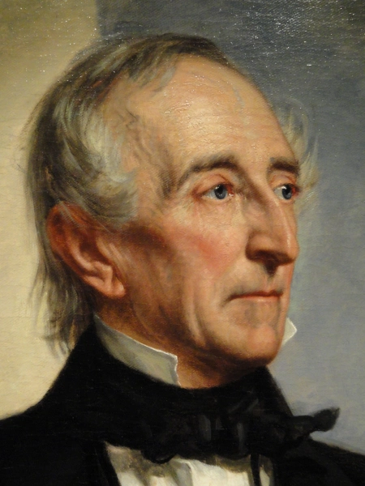
How will a democracy end?
“A democracy cannot exist as a permanent form of government. It can only exist until the voters discover that they can vote themselves largesse from the public treasury. From that moment on, the majority always votes for the candidates promising the most benefits from the public treasury with the result that a democracy always collapses over loose fiscal policy, always followed by a dictatorship. The average age of the world's greatest civilizations has been 200 years. These nations have progressed through this sequence: From bondage to spiritual faith; From spiritual faith to great courage; From courage to liberty; From liberty to abundance; From abundance to selfishness; From selfishness to apathy; From apathy to dependence; From dependence back into bondage.”
--Alexander Fraser Tyler, Lord Woodhouselee (1747 – 1813), a Scottish lawyer, writer and professor

Slide 67

How to write an Argumentative Essay

Slide 68




Argumentative Essay: Models of Democracy
Subject
Arguement
Develop an argument that explains which of the three models of representative democracy—participatory, pluralist, or elite—best achieves the founders’ intent for American democracy in terms of ensuring a stable government run by the people.
Use at least one piece of evidence from one of the following foundational documents:
Brutus 1
Federalist No. 10
U.S. Constitution
In your response, you should do the following:
Respond to the prompt with a defensible claim or thesis that establishes a line of reasoning.
Support your claim with at least TWO pieces of specific and relevant evidence
◆ One piece of evidence must come from one of the foundational documents listed above.
◆ A second piece of evidence can come from any other foundational document not used as your first piece of evidence, or it may be from your knowledge of course concepts
Use reasoning to explain why your evidence supports your claim or thesis.
Respond to an opposing or alternate perspective using refutation, concession, or rebuttal.
https://apcentral.collegeboard.org/media/pdf/ap-us-government-and-politics-2019-ced-scoring-guidelines.pdf

