Slide 1
UNIT 2 Interactions Among Branches of Government
AMSCO pg. 108-123
Required Document:
The Constitution
Topic 2.2 Congress: Structures, Powers, & Functions of Congress

Slide 2
TOPIC 2.2 Structures, Powers, and Functions of Congress
The republican ideal in the U.S. is manifested in the structure and operation of the legislative branch.
The structures and powers of the Senate and House are different by design. This difference directly affects the legislative process.
Both chambers refer bills to committees, which conduct hearings and debate and mark up bills with revisions and additions. Leadership in committees is determined by the majority political party.
Chamber-specific rules and procedures affect the legislative process.
i. In the House, the Speaker is elected by a majority of members and presides over the
legislative work in the House. All revenue bills must originate in the House. Rules for
debate in the House on a bill are established by the Rules Committee. The House can
form a Committee of the Whole in order to expedite debate on bills. An individual
representative in the House can file a discharge petition to have a bill brought to
the floor for debate, but it is rarely done.
ii. In the Senate, bills are typically brought to the floor by unanimous consent, but a Senator may request a hold on a bill to prevent it from getting to the floor for a vote. During debate, a Senator can use the filibuster (a tactic to prolong debate and delay or prevent a vote on a bill) or make a motion for cloture (a procedure to end a debate).
Explain how the structure, powers, and functions of both houses of Congress affect the policy-making process.

Slide 3
TOPIC 2.2 Structures, Powers, and Functions of Congress
The republican ideal in the U.S. is manifested in the structure and operation of the legislative branch.
iii. When a bill passed by both chambers on the same topic has variation in its wording, a conference committee meets to reconcile those differences.
Explain how the structure, powers, and functions of both houses of Congress affect the policy-making process.
Congress must generate a budget that addresses both mandatory and discretionary spending.
i. Mandatory spending is required by law for entitlement programs such as Social Security, Medicare, and Medicaid.
ii. Discretionary spending is approved on an annual basis for defense spending, education, and infrastructure. As entitlement costs grow, discretionary spending opportunities will decrease unless tax revenues increase, or the budget deficit increases.
Pork-barrel legislation (funding for a local project in a larger appropriation bill) and
logrolling (combining several pieces of legislation into one bill to secure enough votes
for passage) affect the legislative process in both chambers.

Slide 4
TOPIC 2.2 Structures, Powers, and Functions of Congress
The republican ideal in the U.S. is manifested in the structure and operation of the legislative branch.
By design, the different structures, powers, and functions of the Senate and the House of Representatives affect the policy-making process.
Explain how the structure, powers, and functions of both houses of Congress affect the policy-making process.
Though both chambers rely on committees to conduct hearings and debate bills under consideration, different constitutional responsibilities of the House and Senate affect the policy-making process
Chamber-specific procedures, rules, and roles that impact the policy-making process include:
Number of chamber and debate rules that set the bar high for building majority support
Roles of Speaker of the House, President of the Senate, party leadership, and committee leadership in both chambers
Filibuster and cloture
Holds and unanimous consent in the Senate
Role of Rules Committee, Committee of the Whole, and discharge petitions in the House
Treaty ratification and confirmation role of the U.S. Senate

Slide 5
TOPIC 2.2 Structures, Powers, and Functions of Congress
The republican ideal in the U.S. is manifested in the structure and operation of the legislative branch.
Congress must generate a budget that addresses both discretionary and mandatory spending, and as entitlement costs grow, discretionary spending opportunities will decrease unless tax revenues increase or the budget deficit increases
Explain how the structure, powers, and functions of both houses of Congress affect the policy-making process.
Pork-barrel legislation and logrolling affect lawmaking in both chambers.

Slide 6
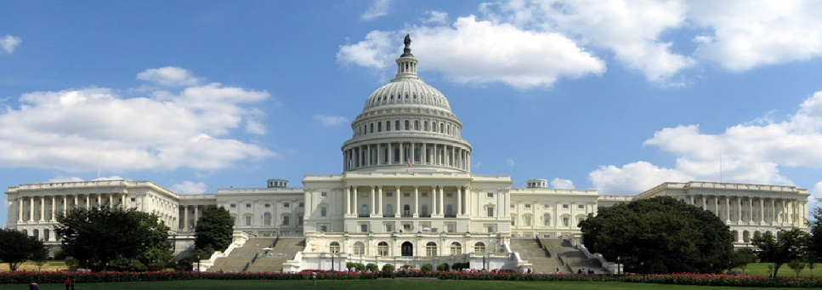
United States Congress

Slide 7
SPEAKER OF THE HOUSE
Presides over House (Most powerful member) – always elected from majority party in House
Appoints select and conference committees members
Appoints Rules Committee members and its chairman
Assigns bills to committees
Third in line for presidency after V.P.
Informal powers, e.g., access to media
Inﬂuences agenda of the House
MAJORITY LEADER/MINORITY LEADER
Partisan positions chosen by party members
Floor leaders and legislative strategists
MAJORITY WHIP/MINORITY WHIP
Assistant ﬂoor leaders
Inform party leaders on "mood" of House
Keep nose count on important votes
Persuade party members to vote with party
Liaison between party leadership and rank and ﬁle membership

Slide 8
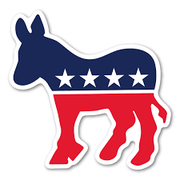
116th Congress - House Leadership Majority Party- Democrat
Democrats:
Speaker
Majority Leader
Majority Whip
Speaker Nancy Pelosi (D-CA)
Majority Leader Steny Hoyer (D-MD)
Majority Whip James Clyburn (D-SC)

Slide 9
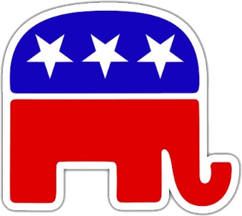
116th Congress - House Leadership Minority Party - Republican
Republicans:
Minority Leader
Minority Whip
Minority Leader Kevin McCarthy (R-CA)
Minority Whip Steve Scalise (R-LA)

Slide 10
SENATE August Body- marked by MAJESTIC DIGNITY OR GRANDEUR (upper house)
PRESIDENT OF THE SENATE
Vice President of the U.S.
Presides over Senate
Votes in case of ties
Ceremonial job (honorific)
PRESIDENT PRO TEMPORE
Ceremonial job/(honorific)
Presides in absence of V.P.
Fourth in line for presidency
MAJORITY LEADER
True leader in Senate
Recognized ﬁrst for all debates – w/power to ﬁlibuster, this gives Majority Leader strong inﬂuence on bills
True leader of majority party
Inﬂuences committee assignments of senators
Inﬂuences Senate agenda, along with Minority Leader
Informal powers, e.g., of using the media
MINORITY LEADER AND PARTY WHIPS
Same as House

Slide 11
116th Congress - Senate Leadership Majority Party - Republican
Republicans:
President of the Senate
(Vice President)
President Pro Temp
Majority Leader
Majority Whip
Majority Leader Mitch McConnell (R-KY)
President of the Senate Mike Pence (R-IN)
President Pro Tem
Chuck Grassely(R-IA)
Majority Whip John Thune(R-SD)

Slide 12
116th Congress – Senate Leadership Minority Party - Democrat
Democrats:
Minority Leader
Minority Whip
Minority Leader Chuck Schumer (D-NY)
Minority Whip Richard Durbin (D-IL)

Slide 13
DIFFERENCES IN OPERATION
HOUSE
More formal—stronger leadership from Speaker
Rules Committee
Power less evenly distributed
Members are highly specialized
Emphasize tax & revenue policy & budget
SENATE
Less formal—weaker leadership
Filibuster
Power more evenly distributed
Members are generalists
Emphasis on foreign policy
Longer terms—focus on bigger picture
10

Slide 14
THE COMMITTEE SYSTEM
• Real work of Cong. is done in committees and subcommittees, not on the floor of the House or Senate.
• Before a bill even reaches the floor, it must first pass through a committee, unless the committee has resisted "reporting out" the bill and the House votes to "discharge" it onto the floor for consideration on by the full body. (Senate committees lack the power to prevent bills from reaching the floor).
• Once in standing committee, usually passed to subcommittee where they can be amended, passed or killed
• Majority bills die in committee (pigeonholed v. discharge petition)
• Subcommittees
– Where majority of legislative work is done
– Where bills are mainly marked up
– Hold Congressional Hearings
• Committee functions:
1. Analyze legislation
2. Conduct investigations of executive branch on as-needed basis
3. Conduct oversight/investigations of executive branch agencies on an ongoing basis

Slide 15
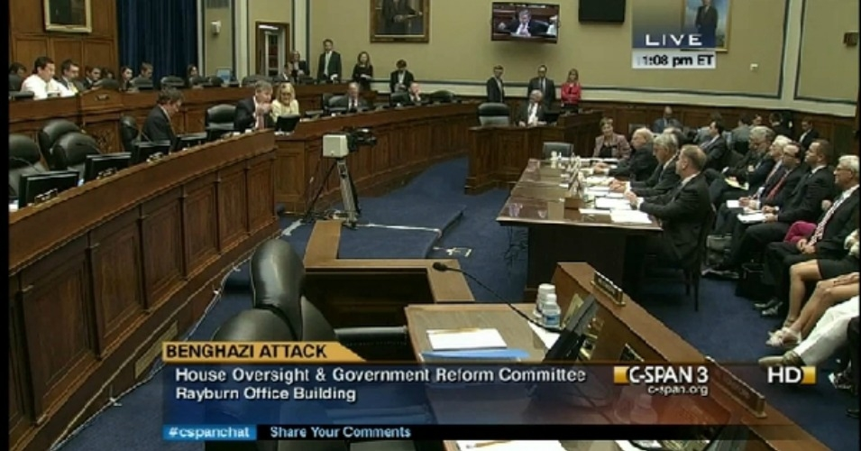
Congressional Oversight
oversight by the United States Congress on the Executive Branch, including the numerous U.S. federal agencies. Congressional oversight refers to the review, monitoring, and supervision of federal agencies, programs, activities, and policy implementation. Oversight is done through the committee system.

Slide 16
SELECTION OF COMMITTEE MEMBERS
Importance of getting on the right committee, i.e., one in which a member can best serve his constituents, and thus increase his/her chances of reelection.
Members are assigned to committees by either the Committee on Committees or the Steering the Policy Committee.
Whichever party has majority in the house will have a majority on each committee.
Committee chairman is of majority party; “ranking member” is most senior member of minority party on a committee

Slide 17
SELECTION OF COMMITTEE CHAIRMEN
Power of chairmen is substantial over:
Selecting committee agenda
Hiring staﬀ
Membership on subcommittees
Jurisdiction of subcommittees
Chairmen are selected by secret ballot in party caucuses or conferences (of party leaders) at the beginning of the term.
Generally, the seniority system is followed, i.e., the person of the majority party with the most seniority on THAT COMMITTEE is chosen chairman.
Advantages of seniority system:
Experience.
Stability.
Expertise.
Reduces inﬁghting among those who would be rivals for chairmen.
Disadvantages of seniority system: Increases inﬂuence of 1 party states, and decreases inﬂuence of competitive states.

Slide 18
COMMITTEE SYSTEM
Standing – Committees are the permanent committees of Congress.
Most important with 20 in House and 16 in Senate
Focus on legislation in a particular area (i.e. foreign policy, agriculture)
Develops expertise among its members
Select – Special panels, usually temporary… set to investigate/ research issues
Ex: Investigate Watergate
Joint – Members of House and Senate
Similar to Select Committees; ofTen focus public attention on major issues
Conference – Temporary comm. to iron out diﬀerences between versions of similar bills
Bills must pass House & Senate in exact same form

Slide 19
IMPORTANT STANDING COMMITTEES
Standing committees are the permanent committees of Congress.
HOUSE
Rules: Most powerful of all.
Sets legislative calendar and establish “rules” for debate and amendments; Set guidelines for ﬂoor debate; Limits time for debate
Controlled by Speaker; called “Traﬃc Cop”- controls the flow of legislation (bills)
Determines the type of amendments that will be allowed on a bill
– Closed rule v. Open Rule
Ways and Means: deals with tax bills.
Appropriations: deals with spending bills.
Authorization bill allows for money to be spent.
Appropriation bill provides the actual funding for the program.
“Earmarks:” special projects set aside by members to beneﬁt home districts or states. Dramatic rise of these in recent years.
Budget
Armed Services
Closed Rule: A rule issued by the House Committee on Rules, in which there is a strict time limit for debate and no amendments can be offered.
Open Rule: In the House of Representatives, a rule that allows any amendments to a bill, regardless of whether they’re relevant to the legislation.

Slide 20
IMPORTANT STANDING COMMITTEES
Standing committees are the permanent committees of Congress.
SENATE
Finance: deals with tax bills.
Appropriations: deals with spending bills. They control the “purse”
Budget.
Foreign Relations: Highly prestigious.
Senate has larger role in foreign aﬀairs than House because of treaty ratiﬁcation, ambassador conﬁrmation provisions in Constitution
Judiciary: Screens judicial nominees.
Careful scrutiny given because of the power of the modern judicial branch and the fact that federal judges have life terms. Presidents Clinton and Bush 43 both criticized the committee by holding up numerous judicial nominations. Some delays under Clinton lasted many months, and in some cases, years. The Judiciary committee approves pres nominations of fed. judges and refer to the Senate for approval or NOT!!
25

Slide 21
CONFERENCE COMMITTEES
Temporary committees comprised of members from both houses to iron out diﬀerences between versions of similar bills (b/c bills must pass House & Senate in exact same form)
Develop compromise language on a bill when House and Senate versions diﬀer (about 10% of the time).
After conference committee sends bill back to each house, no amendments are allowed, and the bill generally passes.
The power of these committees is such that they are often called the "third house of Congress."
26

Slide 22
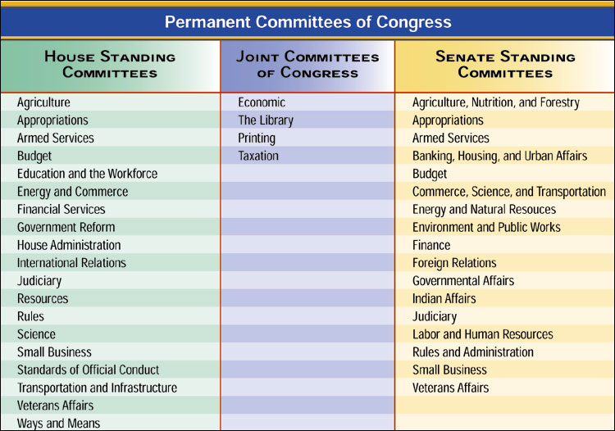
THE COMMITTEE SYSTEM

Slide 23
ESSENTIAL QUESTION CFU
What types of committees might a representative or senator from Florida want to sit on & why?
Committees often over-represent constituencies with the greatest stake in committee's business
– How does this contribute to the Iron Triangle?
27

Slide 24
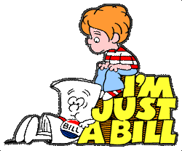
THE BILL PROCESS
Most important power of Congress- Write Laws
– Lengthy, deliberate, fragmented, characterized by negotiation and compromise
Anyone can write a bill…Only a member of Congress can introduce bill
A bill can be intro. in the House or the Senate, but all tax bills must originate in House of Rep.
Bill must pass both houses in the same form to move onto the President
29

Slide 25
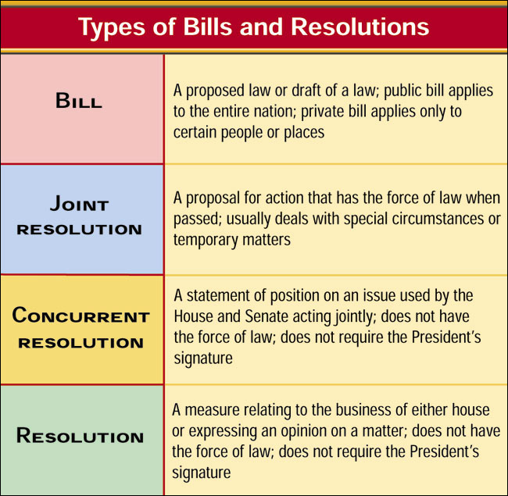
THE BILL PROCESS
29

Slide 26
The Bill Process: House of Representatives
Bill Introduced
Receives #/Reading…
Speaker of the House sends bill to appropriate Standing Committee (may set time limits on comm.)
Speaker may also decide not to refer bill to Committee at all, eﬀectively killing the bill
Standing Committees…Critical Step
Often report to subcommittee…hold hearings
Most bills die in committee… PIGEONHOLED
Discharge Petition…what is it?
Bills that receive consideration…
Bills approved by sub Committee then returned to full comm. where members can mark up or add items to bill
Standing Committee Options:
Report Favorably “Do Pass”
Pigeonhole/Table
Requires discharge petition
Amend and report in new form
Report w/ unfavorable recommendation

Slide 27
The Bill Process: House of Representatives
Rules Committee (HOUSE ONLY)
Once bill out of Standing Committee in the House…sent to the Rules Committee
Speaker of the House appoints 9/13 members
Functions of Rules Comm.
Comm. must grant a “rule” (set time for appearance/debate)…failure to do eﬀectively kills a bill
Restrict or loosen time limits for debate, even prohibit amendments (closed rule)
Only way to get around Rules Comm…discharge petition/vote to suspend rules

Slide 28
The Bill Process: House of Representatives
Rules on Bills:
OPEN RULE In the House of Representatives, a rule that allows any amendments to a bill, regardless of whether they’re relevant to the legislation.
CLOSED RULE A rule issued by the House Committee on Rules, in which there is a strict time limit for debate and no amendments can be offered.
There are variations of both rules.
Only germane amendments (amendments related to the substance of the bill) are allowed under the modified open rule.
The modified closed rule (also called the structured rule) may limit amendments to a particular section of the bill as established by the Committee on Rules.
There is no equivalent to the Committee on Rules in the Senate; a bill goes from the committee directly to the Senate floor for action.

Slide 29
THE BILL PROCESS: SENATE
Mirrors house, but more informal (no rules committee)
Referred to Committee by Senate Majority Leader
Senate Majority Leader may decide not to refer bill to Committee, eﬀectively killing it.
After committee, bills called to ﬂoor by majority leader (no rules Committee)
Unlimited debate…ends with unanimous consent
Filibuster, not in the Constitution. It is a Senate Rule ONLY
Delay or prevent action on a bill by using long speeches/unlimited debate to “talk a bill to death”, used by minority party to stop a bill. Minority does not have the votes to vote a bill out of existence.
So eﬀective, most bills now need 60 votes…why?
Cloture- Process to end a ﬁlibuster. It takes 16 senators to ask for a cloture vote
60 votes needed to end a ﬁlibuster= Cloture

Slide 30
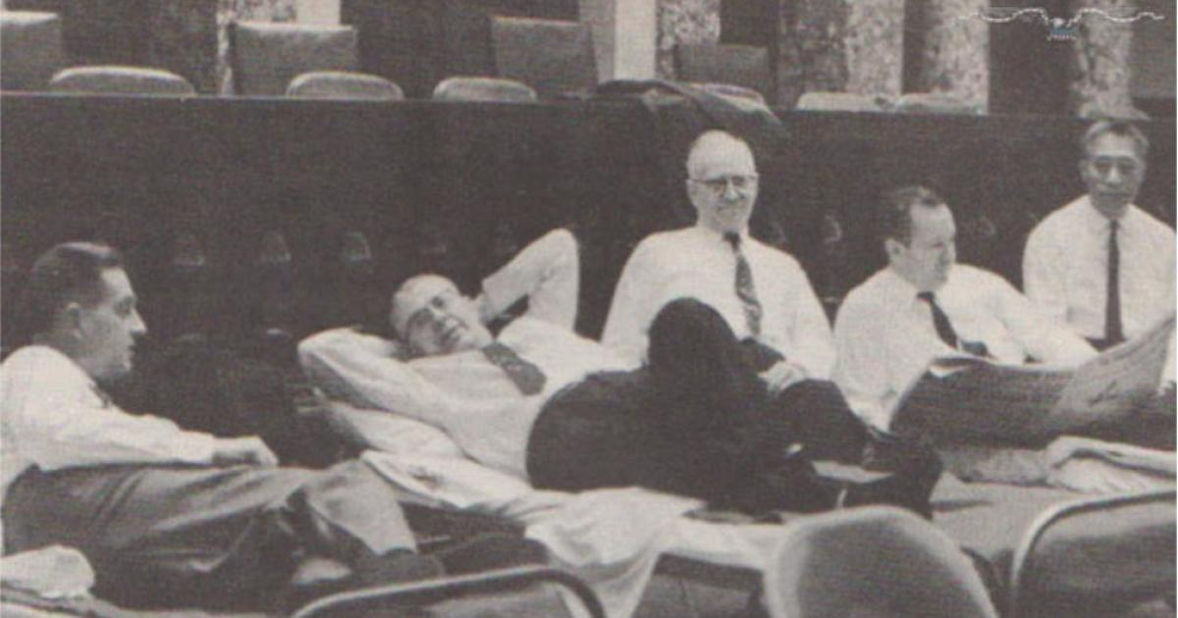
THE BILL PROCESS: SENATE
Filibuster, not in the Constitution. It is a Senate Rule ONLY
Delay or prevent action on a bill by using long speeches/unlimited debate to “talk a bill to death”, used by minority party to stop a bill. Minority does not have the votes to vote a bill out of existence.
So eﬀective, most bills now need 60 votes…why?
Cloture- Process to end a ﬁlibuster. It takes 16 senators to ask for a cloture vote
60 votes needed to end a ﬁlibuster
Senators rest on cots set up in the old Supreme Court chamber during the filibuster that attempted to prevent passage of the Civil Rights Act of 1957.
Why is a filibuster an effective way to kill legislation?

Slide 31
THE BILL PROCESS: SENATE Filibuster
Talking more talk is the filibusters major weapon. In addition, senators may use time killing motions, quorum calls, another parliamentary maneuvers. Indeed, anything to delay or obstruct is grist (to profit or gain from) for the minority's mill as it works to block a bill that will very likely pass if brought to a vote.
The Senate often tries to beat off a filibuster with lengthy, even day-and-night, sessions to wear down the participants. At times, some little-observed rules are strictly enforced. Among them are the requirements that senators stand not sit, lean on their desks, or walk about as they speak and that they not use unparliamentary language on the floor. These countermeasures seldom work.
Nearly all filibusters are team efforts, with a number of senators taking turns on the floor, relieving one another as they monopolize the Senates time.
Just the threat of a filibuster has resulted in the Senates failure to consider a number of bills and the amending of many others.
grist for/to one's mill, something employed to one's profit or advantage, especially something seemingly unpromising: Every delay was so much more grist for her mill.
Magruder’s American Gov 2009, pg. 352

Slide 32
THE BILL PROCESS: SENATE Filibuster
Record Filibusters
Senator Huey long spoke for more than 15 hours in 1935. He stalled by reading from the Washington telephone directory and giving his colleagues his recipe for pot-licker, corn bread and turnip greens.
Senator Strom Thurmond set the record filibuster he held the floor for 24 hours and 18 minutes in an unsuccessful, one person effort against what later became the Civil Rights Act of 1957
Senators rest on cots set up in the old Supreme Court chamber during the filibuster that attempted to prevent passage of the Civil Rights Act of 1957.
Why is a filibuster an effective way to kill legislation?
Magruder’s American Gov 2009, pg. 352

Slide 33
THE BILL PROCESS:
SENATE UNANIMOUS CONSENT AGREEMENT
Unanimous Consent Agreement - A unanimous consent request setting terms for the consideration of a speciﬁed bill or other measure. These agreements are usually proposed by the majority leader or ﬂoor manager of the measure, and reﬂect negotiations among senators interested in the measure. An agreement on the rules of debate for proposed legislation in the Senate that is approved by all the members
– Many are "time agreements," (filibuster) which limit the time available for debate and specify who will control that time. Many also permit only a list of speciﬁed amendments or require amendments to be to the measure. Many also contain other provisions, such as empowering the majority leader to call up the measure at will or specifying when consideration will begin or end.

Slide 34
THE BILL PROCESS: SENATE HOLD
DEF: An informal practice by which a senator informs his or her ﬂoor leader that he or she does not wish a particular bill or other measure to reach the ﬂoor for consideration. The majority leader need not follow the senator's wishes but is on notice that the opposing senator may ﬁlibuster any motion to proceed to consider the measure.
The Senate “hold” is an informal practice whereby Senators communicate to Senate leaders, often in the form of a letter, their policy views and scheduling preferences regarding measures and matters available for ﬂoor consideration. Unique to the upper chamber, holds can be understood as information-sharing devices predicated on the unanimous consent nature of Senate decision-making. Senators place holds to accomplish a variety of purposes—to receive notiﬁcation of upcoming legislative proceedings, for instance, or to express objections to a particular proposal or executive nomination—but ultimately the decision to honor a hold request, and for how long, rests with the majority leader. Scheduling Senate business is the fundamental prerogative of the majority leader, and this responsibility is typically carried out in consultation with the minority leader.

Slide 35
THE BILL PROCESS: SENATE HOLD
The inﬂuence that holds exert in chamber deliberations is based primarily upon the signiﬁcant parliamentary prerogatives individual Senators are aﬀorded in the rules, procedures, and precedents of the chamber. More often than not, Senate leaders honor a hold request because not doing so could trigger a range of parliamentary responses from the holding Senator(s), such as a ﬁlibuster, that could expend signiﬁcant amounts of scarce ﬂoor time. As such, eﬀorts to regulate holds are inextricably linked with the chamber’s use of unanimous consent agreements to structure the process of calling up measures and matters for ﬂoor debate and amendment.

Slide 36
MISCELLANEOUS FEATURES
Rider: is a provision not likely to pass on its own merit that is attached to an important measure certain to pass. Its sponsors hope that it will ride through the legislative process on the strength of the main measure
A bill with numerous riders is often called a Christmas tree bill
New laws added to a bill that may or may not be related to the subject matter of the bill…Why?
Usually controversial measures that can’t pass on their own or “gift” to interest group
Earmarks/Pork Barrel Spending
Appropriations bill that beneﬁts a speciﬁc constituency
How does this help w/ reelection?
“An earmark is money your Congressman wisely brings home to your district. Pork is money that some other Congressman wastefully brings home to his district.”

Slide 37
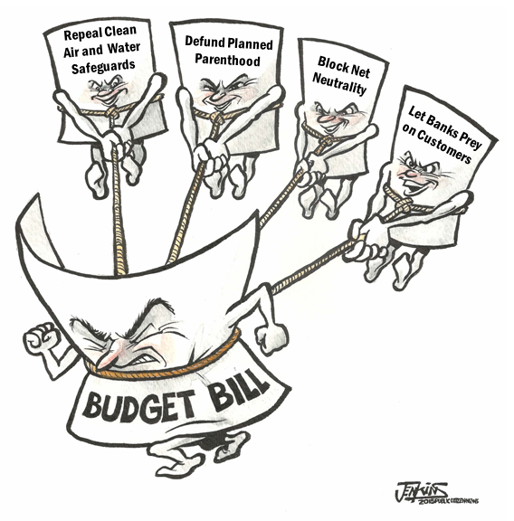
MISCELLANEOUS FEATURES
Rider: is a provision not likely to pass on its own merit that is attached to an important measure certain to pass. Its sponsors hope that it will ride through the legislative process on the strength of the main measure. Usually attached to appropriation bills.
A bill with numerous riders is often called a Christmas tree bill also called an omnibus bill
New laws added to a bill that may or may not be related to the subject matter of the bill…Why?
Usually, controversial measures that can’t passed on their own or “gift” to interest group

Slide 38
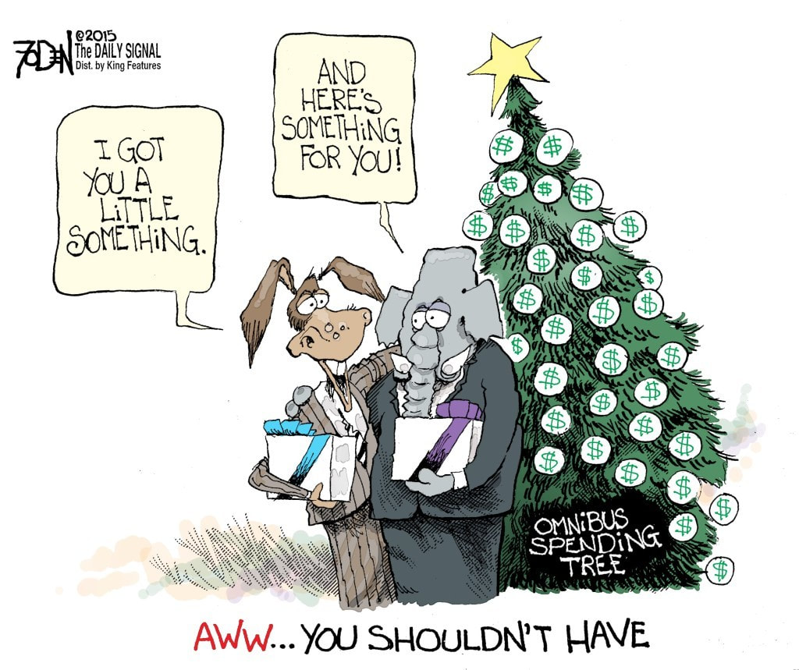
MISCELLANEOUS FEATURES

Slide 39
MISCELLANEOUS FEATURES

Slide 40
Pork barrel legislation and logrolling affect the lawmaking in both chambers
PORK BARREL
Metaphor for the appropriation of government spending for localized projects secured solely or primarily to bring money to a representative's district. AKA earmarks
LOGROLLING
Arrangement in which two or more members of Congress agree in advance to support each other's bills. AKA reciprocity

Slide 41
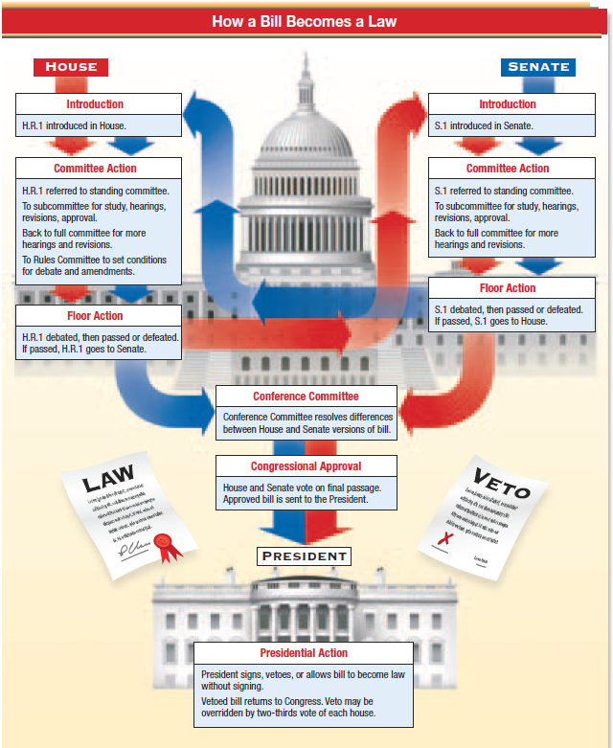

Slide 44
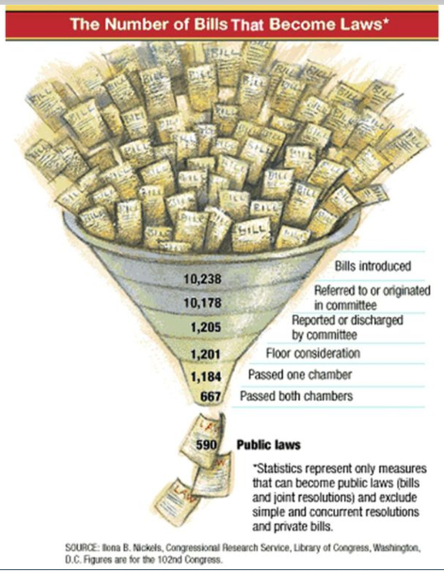
THE BILL PROCESS
This chart illustrates the many stages through which a bill must pass before it becomes law.
After which step do most bills die?
29

Slide 46
WHY DO SO MANY BILLS DIE?
For the AP exam, you must know the different ways a bill can die in HR and S.
Why do so many bills die?
Speaker and Senate Majority Leader can kill a bill by not referring it to a Committee
Most bills die in Committee (tabled or pigeon-holed)
Either the Committee never schedules it for a vote; or the vote fails to receive a majority in Committee
Bills could also be altered by Committees to make them more likely to fail on the ﬂoor (amendments)
Any Senator can block a vote with a ﬁlibuster
In the House, the Rules Committee can block a bill by never granting it a “rule” (scheduling it for debate) or setting restrictions on debate.
The president can kill a bill
Veto or Pocket Veto
Or the threat of a Presidential veto is enough to stop a bill in its tracks
A bill may fail to receive a simple majority vote on the ﬂoors

Slide 47
How do the structure, powers, and functions of Congress affect the policy making process?
 | Senate | House of Representatives
Committees and Policy Making | Finance Committee oversee spending and budget Foreign Relations Committee guides U S foreign policy | Ways and Means committee determines tax policy Rules Committee determines house proceedings committee of the whole allows for efficiency of procedures
Unique rules and procedures and policy making | Filibuster can let the debate time run out for a bill or blocking nomination Unanimous consent of senators shows a higher threshold for bills but can slow them down The hold can stall a bill | A discharge petition can bring a bill out of a reluctant committee Amendments offered to a bill must be germane

Slide 48
Generating a Budget
Congress must generate a budget that addresses both discretionary and mandatory spending, and as entitlement costs grow, discretionary spending opportunities will decrease unless tax revenues increase, or the budget deficit increases.
Congressional Budget Office- created by Congress to help in preparing the nations budget. Non-partisan accountants. Serves as a check on the President’s OMB- Office of Management and Budget, created by Congress to help the President prepare and present a budget to Congress.

Slide 49
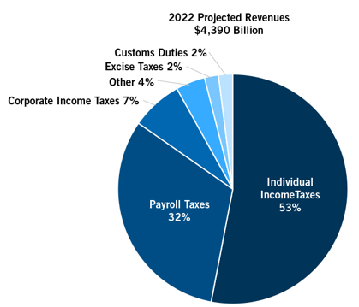
Sources of Government Revenues
For fiscal year 2019 the gov expected to
take in $2.3T. Gov revenue comes from 5 sources:
Individual Income taxes- taxes paid by workers
Corporate Income taxes- taxes paid by businesses on profits
Social insurance taxes- payroll taxes- taxes paid by employers and employees to fund Social Security (FICA Tax)
4. Tariffs and excise taxes- taxes (duties) paid on certain imports.
5. Other sources- estate taxes (inheritance tax)

Slide 50
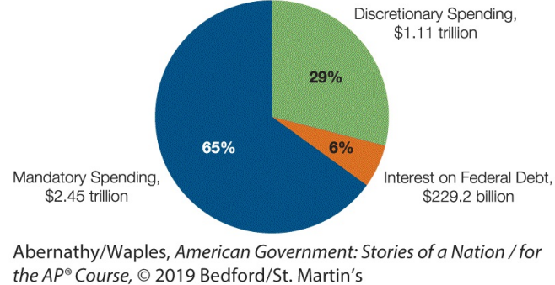
Mandatory Spending
Government spending the budget for fiscal year 20l9 called for spending $4.4 trillion. Each year spending falls into three categories: mandatory spending, interest on debt, and discretionary spending.

Slide 51
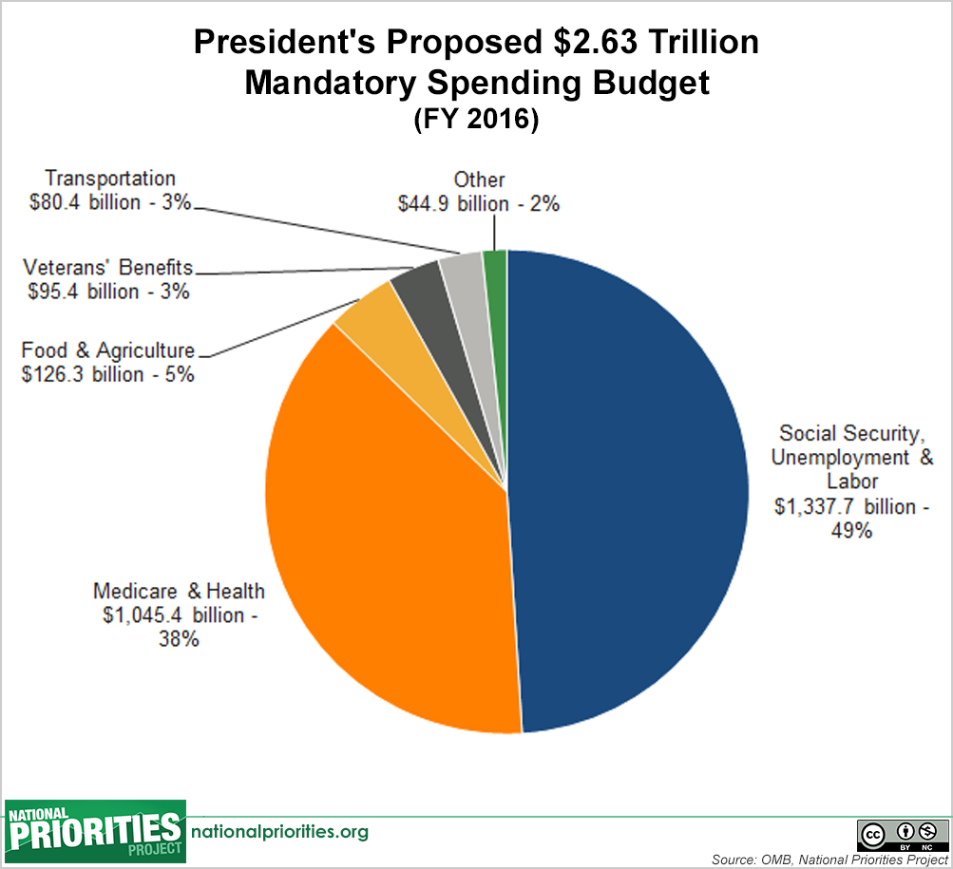
Mandatory Spending
Mandatory spending is payment required by law; mandated, for certain programs.
Social Security
Medicare/ Medicaid
Are the largest spending expense for the gov.
In 2016, US gov collected $3.3T in revenues but spent $3.99T running a deficit- gov spent more than it collected in taxes. Add up all the deficits and you get the national debt. The nation debt now stands at $29.9Trillion.

Slide 52
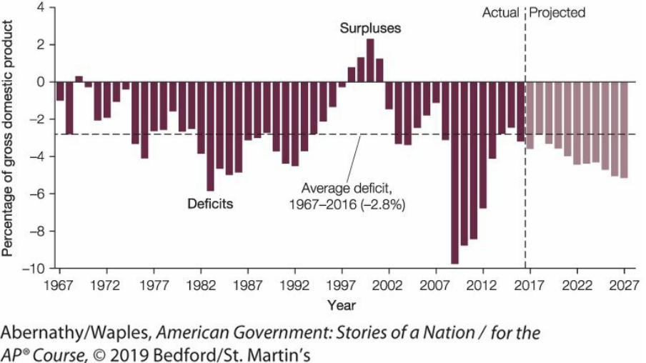
Federal Budget Deficits

Slide 53
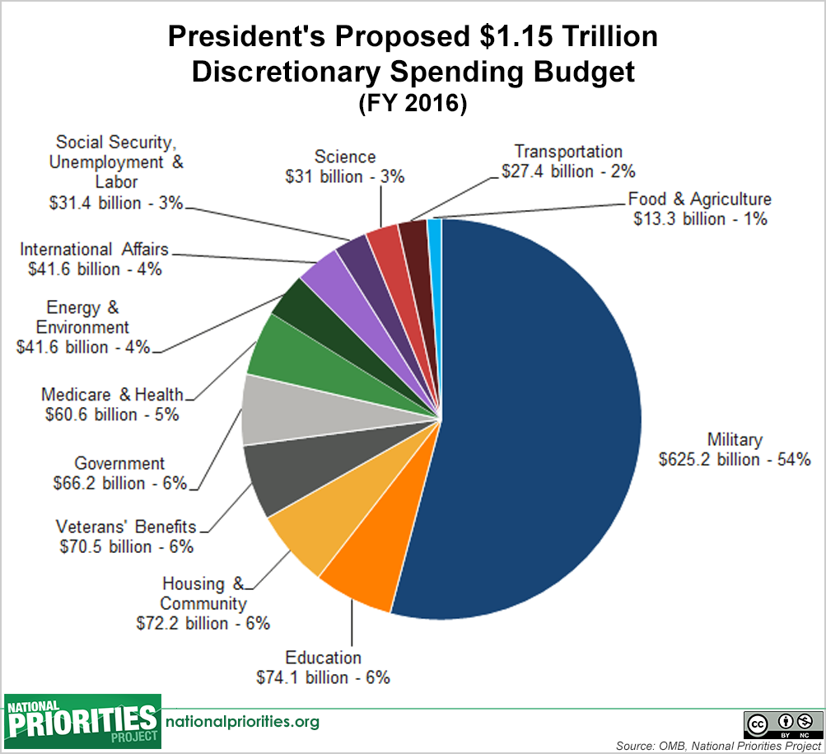
Discretionary Spending
Discretionary spending is money formally approved by the President and voted on by Congress during the appropriations process each year.
Largest discretionary budget item is national defense.

Slide 54
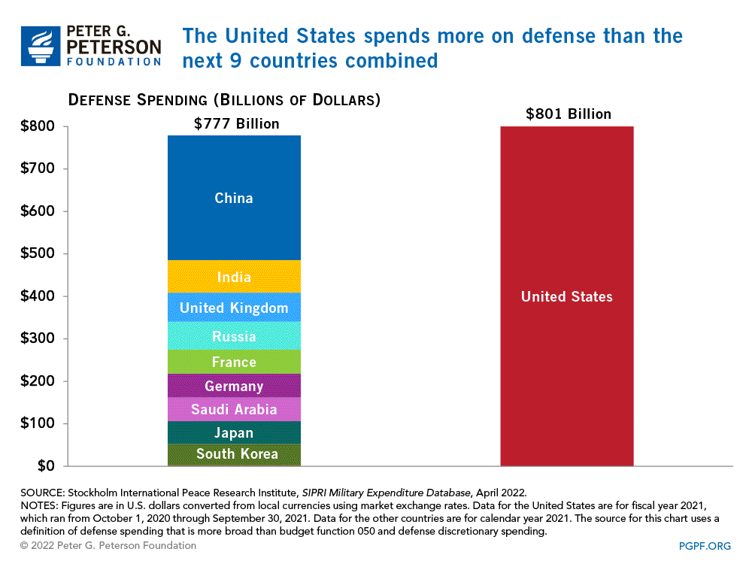

Slide 55
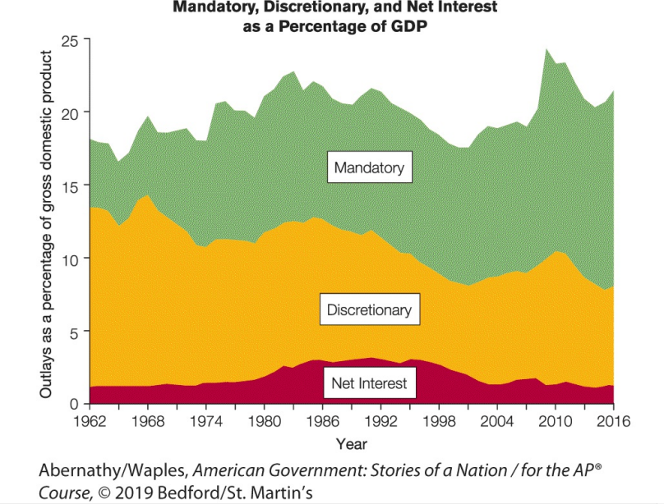

Slide 56
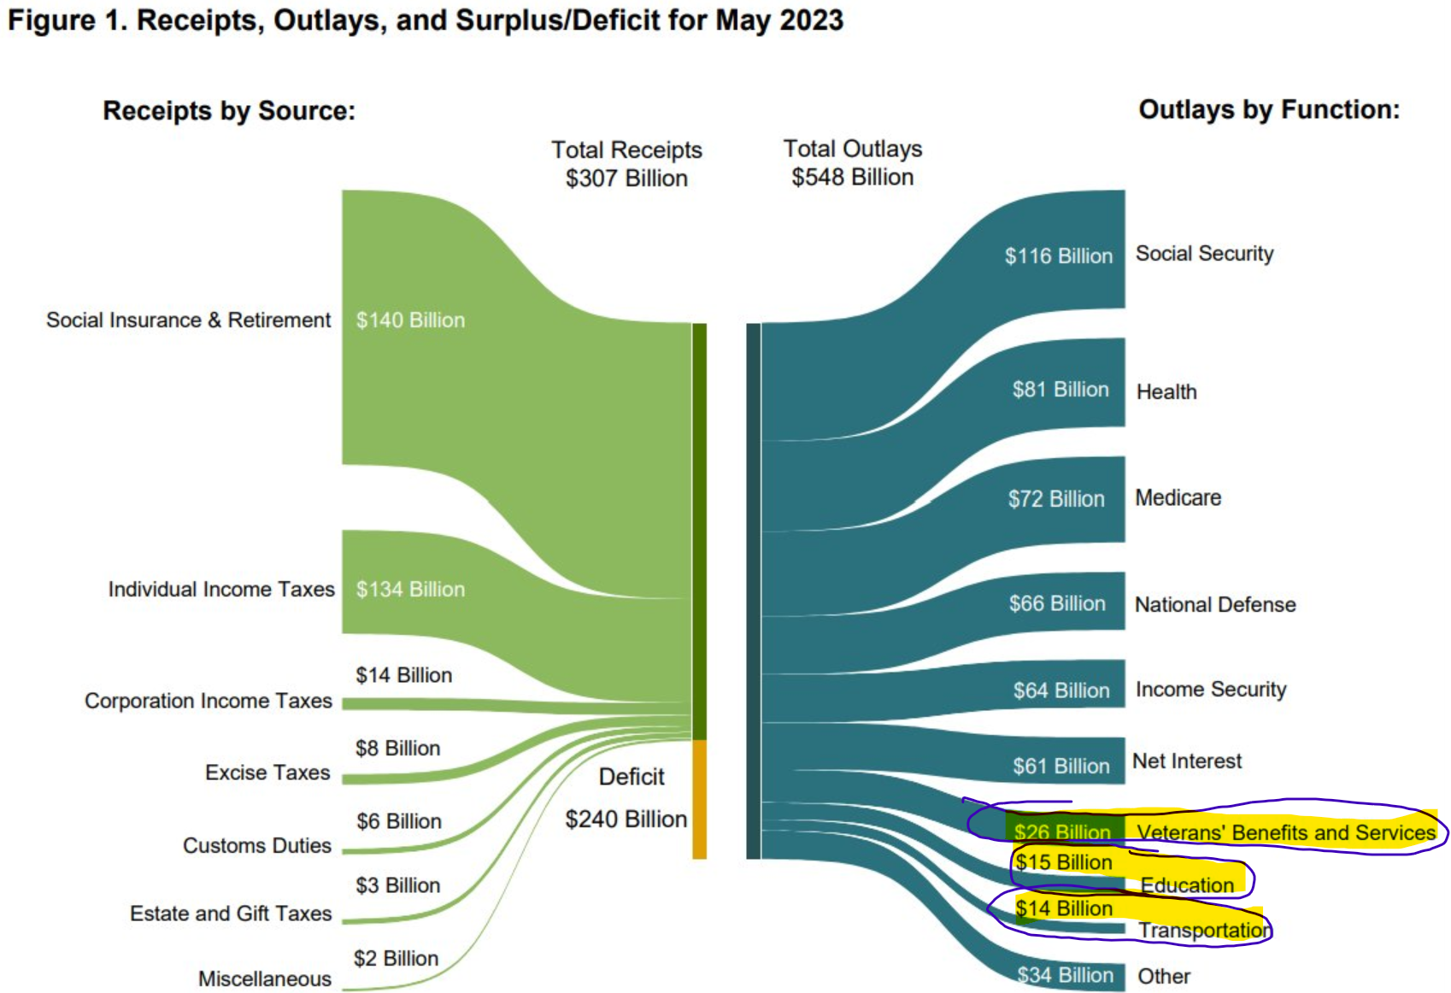
US Treasury data. unsustainable path: interest on the debt was a $61 billion in May, more than was spent on veterans benefits and services, education, and transportation COMBINED; interest costs were a quarter of the deficit last month

Slide 57
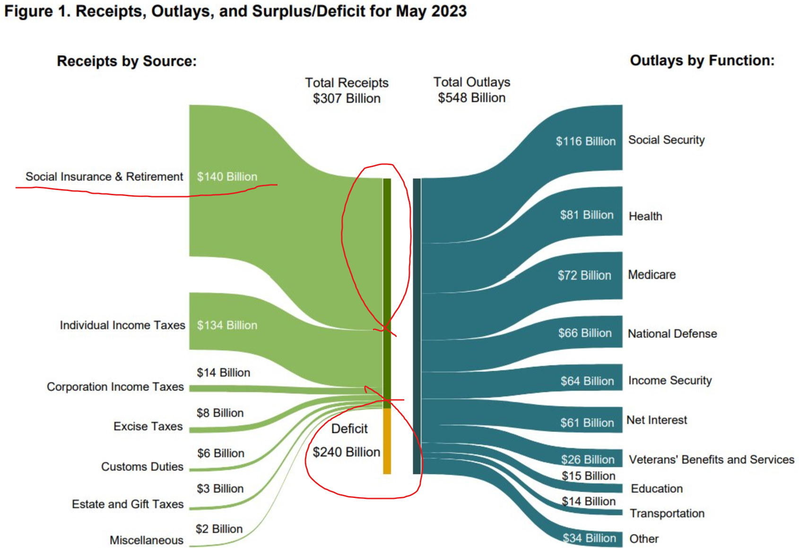
Treasuries graphic is deceptive, with no note that it isn't to scale deficit of $240 billion is numerically larger than social insurance and retirement receipts of 140 billion but deficit is 1/2 the size of the actual graphic

Slide 58
