Slide 1
UNIT 5
Topic 5.1-5.2
AMSCO pg. 492-522
5.1 Voting Rights & Models of Voter Behavior

Slide 2
TOPIC 5.1 Voting Rights and Models of Voting Behavior
Factors associated with political ideology, efficacy, structural barriers, and demographics influence the nature and degree of political participation.
Describe the voting rights protections in the Constitution and in legislation
Expansion of opportunities for political participation are found in the legal protections of the Amendments to the Constitution.
i. The 14th Amendment granted citizenship toall persons born or naturalized in the U.S., including formerly enslaved people.
ii. The 15th Amendment granted AfricanAmerican men the right to vote.
iii. The 17th Amendment changed the practice for electing Senators from a vote by state legislatures to a direct vote by the people.
iv. The 19th Amendment granted women the right to vote.
v. The 24th Amendment eliminated poll taxes, a structural barrier to voting.
vi. The 26th Amendment lowered the voting age to 18.

Slide 3
TOPIC 5.1 Voting Rights and Models of Voting Behavior
Factors associated with political ideology, efficacy, structural barriers, and demographics influence the nature and degree of political participation.
Describe different models of voting behavior
Various political models explain differences in voting behavior.
i. Rational choice voting refers to individuals who base their decisions on what is perceived to be in their best interest.
ii. Retrospective voting refers to individuals who decide whether the party or candidate in power should be reelected based on the
recent past.
iii. Prospective voting refers to individuals who vote based on predictions of how a party or candidate will perform in the future.
iv. Straight ticket voting refers to individuals who vote for all of the candidates from onepolitical party on a ballot.

Slide 4
TOPIC 5.1 Voting Rights and Models of Voting Behavior
Factors associated with political ideology, efficacy, structural barriers, and demographics influence the nature and degree of political participation.
Describe the voting rights protections in the Constitution and in legislation
Legal protections found in federal legislation and the Fifteenth, Seventeenth, Nineteenth, Twenty-Fourth, and Twenty-Sixth Amendments relate to the expansion of opportunities for political participation.
Examples of political models explaining voting behavior include:
Rational choice—Voting based on what is perceived to be in the citizen’s individual interest
Retrospective voting—Voting to decide whether the party or candidate in power should be reelected based on the recent past
Prospective voting—Voting based on predictions of how a party or candidate will perform in the future
Party-line voting—Supporting a party by voting for candidates from one political party for all public offices at the same level of government
Describe different models of voting behavior

Slide 5
LINKAGE INSTITUTIONS
Linkage institutions are channels that allow individuals to communicate their preferences to policy-makers:
What are the four linkage institutions?
Elections - Elections give “we the people” (POPULAR SOVEREIGNTY) the most direct way to influence our government and its decisions. When our candidates win elections we feel that our interests will be represented.
Political Parties
Interest Groups
Mass Media
How do you let the government know about your opinions and beliefs?

Slide 6
CURRENT QUALIFICATIONS
SUFFRAGE = RIGHT TO VOTE
VOTING
POLITICAL ACTIVITY MOST OFTEN ENGAGED IN BY AMERICANS (WHY?)
Originally the Constitution left the individual states free to determine the question of who could vote; eligibility standards for voting have been expanded by legislation and constitutional amendments
Religion (eliminated by state legislatures)
Property (eliminated by state legislatures)
Race (eliminated by 15th Amendment)
Gender (eliminated by 19th Amendment)
Income (eliminated by 24th Amendment banning poll tax)
Literacy (eliminated by Voting Rights Act of 1965)
Minimum of age 21 (eliminated by 26th Amendment)
IN ORDER TO VOTE, YOU MUST:
Have citizenship status
Be a resident of the state you are voting in
Meet the age requirement of your state-18 yrs old, 26th am.
Be registered in your voting area (in all states but North Dakota)
3

Slide 7
SUFFRAGE = RIGHT TO VOTE
VOTING
1957 Civil Rights Act: First such bill since Reconstruction, addressed discrimination in voter registration and established the U.S. Office of Civil Rights, an enforcement agency in the Justice Department.
• 1965 Voting Rights Act: The most effective bill to bring the black populace into the political process. This act outlawed literacy tests and put states with low voter turnout under the watchful eye of the Justice Department. The law gave the department jurisdiction over states that had any type of voting test and less than 50 percent turnout in the 1964 election.

Slide 8
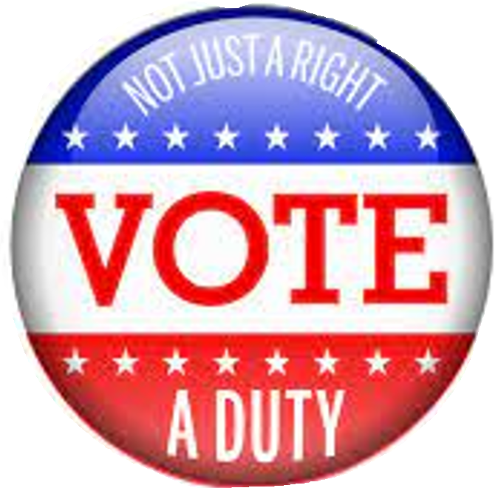
Expansion of the Right to Vote
1783-1827 Only white land/ property owners could vote
The Era of the Common Man- Pres. Andrew Jackson
The 1828 presidential election was the first in which non-property-holding white males could vote in most states. By the end of the 1820s, attitudes and state laws had shifted in favor of universal white male suffrage.
1865- 15th amendment granted black men the right to vote
1913- 17th amendment popular election of senators
1919- 19th amendment proposed and past in 1920 granting women the right to vote.
1962- 24th amendment outlawed poll taxes
Voting Rights Act of 1965-eliminated the literacy test
1971-26th amendment minimum voting age dropped to 18 years old
Read AMSCO pg. 496-500

Slide 9
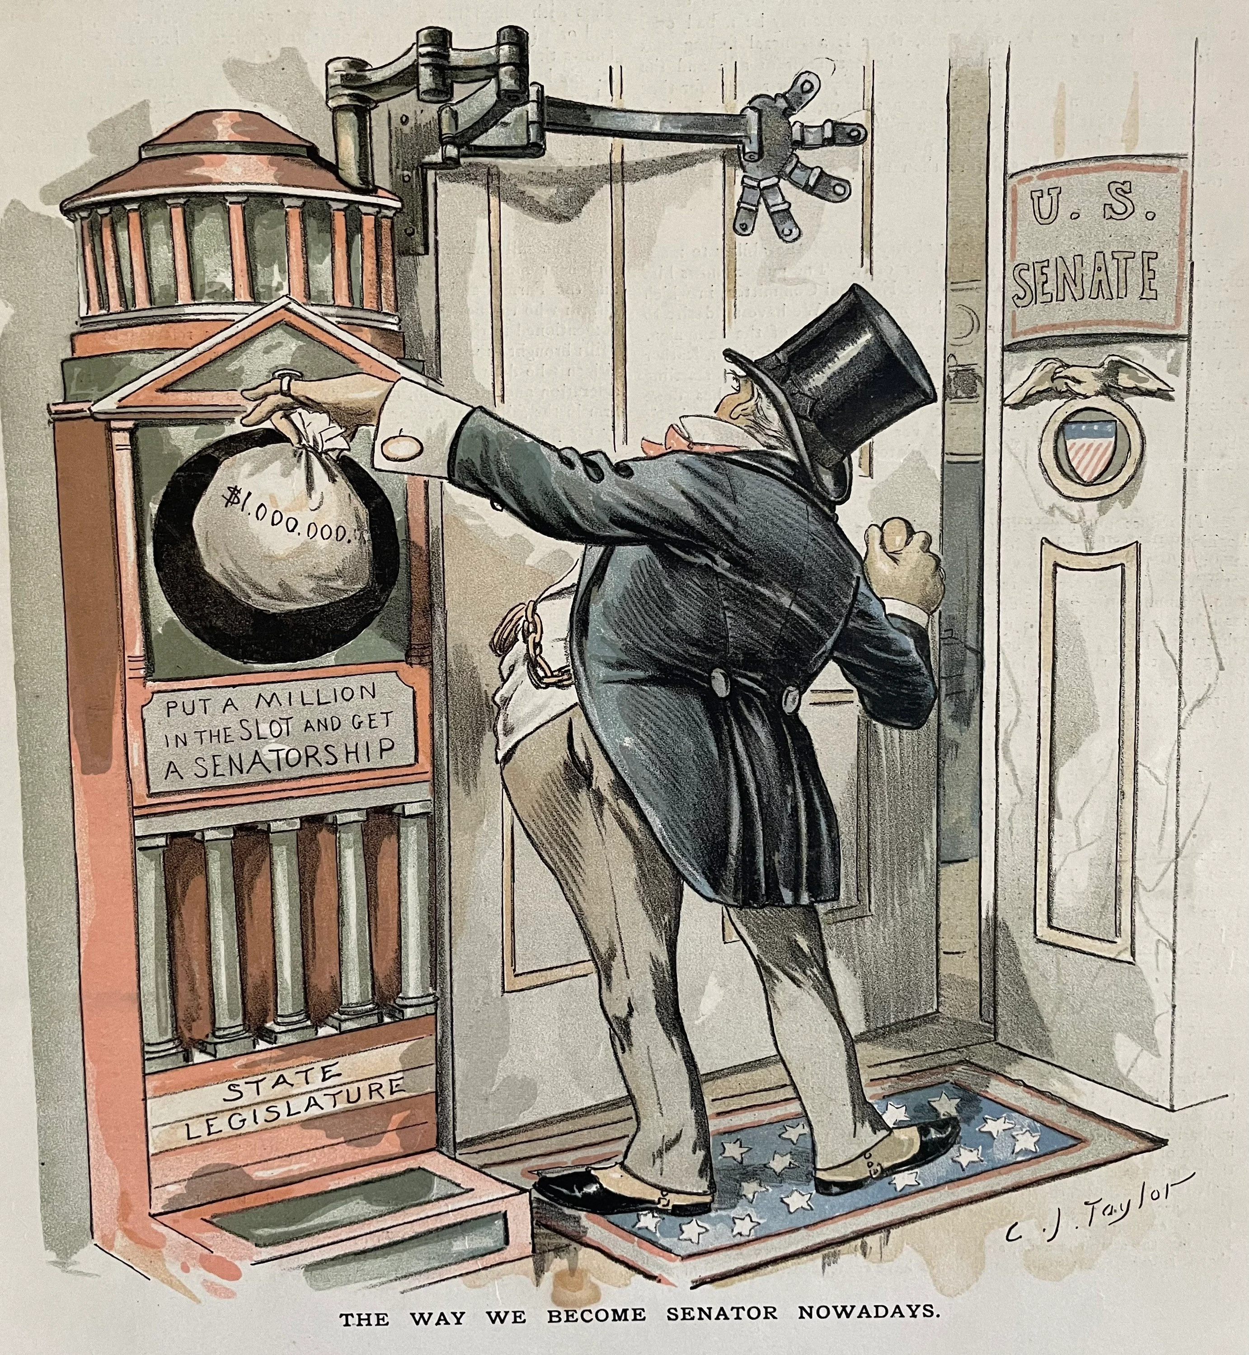
Progress Through Law The framers had also endorsed the elite model of democracy (see Topic 1.2) by calling for the election of senators by state legislatures. However, with the ratification of the 17th amendment 1913, popular elections for senators became the law of the land. With this change, the two federal senators from each state began to pay more attention to how citizen-voters in their state regarded them. AMSCO pg. 496
A cartoon from Puck magazine commented on Senate elections before the Seventeenth Amendment.
Source: Getty Images

Slide 10
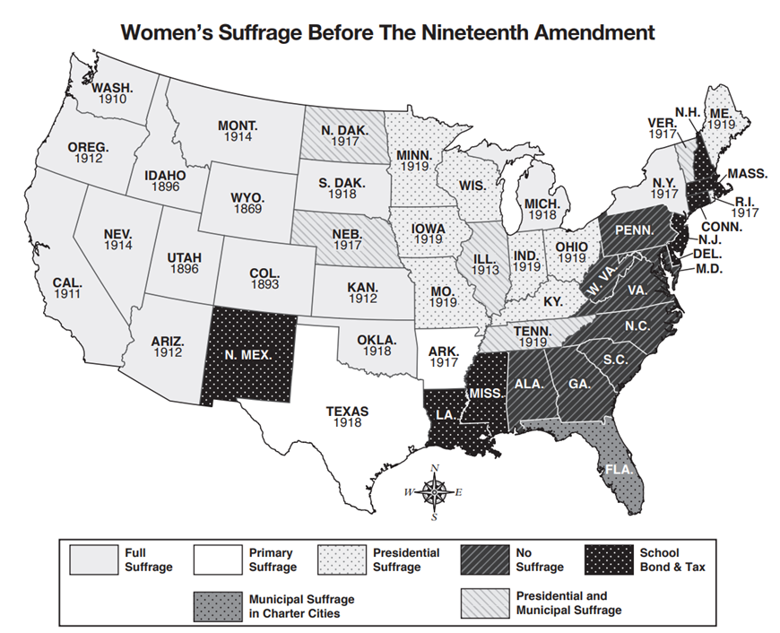

Slide 11
OTHER FORMS OF POLITICAL PARTICIPATION
(INVOLVEMENT OTHER THAN VOTING)
Petitions
Demonstrations/marches/rallies
Local party meetings
Making campaign contributions
Writing letters to the editor (or the internet equivalent)
Trying to persuade others
4

Slide 12
Political participation and awareness in the U.S.

Slide 13
TOPIC 5.2 Voter Turnout
Factors associated with political ideology, efficacy, structural barriers, and demographics influence the nature and degree of political participation.
Structural barriers (such as polling hours, availability of absentee ballots, etc.), political efficacy (the belief that an individual’s participation in the political process will make a difference), and demographics can influence differences in voter turnout in the U.S.
Explain the roles that individual choice and state laws play in voter turnout in elections
The following can influence voter turnout:
i. Differences in state-controlled elections (the hours polls are open, Voter ID laws,
variations in funding for polling places and workers, variations in types of voting
allowed, such as voting by mail, absentee voting, and early voting)
ii. Variations in voter registration laws and procedures (registering in-person, online,
or automatically)
iii. Election type (more turnout for presidential elections than midterm elections)
Demographic characteristics and political efficacy or engagement are used to predict the likelihood of whether an individual will vote.

Slide 14
TOPIC 5.2 Voter Turnout
Factors associated with political ideology, efficacy, structural barriers, and demographics influence the nature and degree of political participation.
Explain the roles that individual choice and state laws play in voter turnout in elections
Factors influencing voter choice include:
i. Party identification and ideological orientation
ii. Candidate characteristics
iii. Contemporary political issues
iv. Religious beliefs or affiliation, age, gender, race and ethnicity, and other demographic characteristics

Slide 15
TOPIC 5.2 Voter Turnout
Factors associated with political ideology, efficacy, structural barriers, and demographics influence the nature and degree of political participation.
Structural barriers, political efficacy, and demographics can predict differences in voter turnout in the U.S., and the following can influence voter turnout among democracies worldwide:
National versus state-controlled elections
Voter registration laws and procedures
Voting incentives or penalties or fines
Election type (midterm or presidential)
Explain the roles that individual choice and state laws play in voter turnout in elections
Demographic characteristics and political efficacy or engagement are used to predict the likelihood of whether an individual will vote.
Factors influencing voter choice include:
Party identification and ideological orientation
Candidate characteristics
Contemporary political issues
Religious beliefs or affiliation, gender, race and ethnicity, and other demographic characteristics

Slide 16
VOTER TURNOUT
voter turnout is the total number of votes cast for the highest
office on the ballot. When we say that voter turnout is low in the United States, it means that the number of people who actually vote is considerably less than the nation’s total voting age population (Note: The voter turnout number is not the same as the number of eligible voters because it includes noncitizens.)
Voter turnout is lower in midterm elections, when all the seats in the House of Representatives and a third of the Senate are contested, and lower still in many local and state races.

Slide 17
VOTER TURNOUT IN U.S. AS COMPARED TO FOREIGN NATIONS
One of the lowest of any industrialized nation
U.S.: In the 50% range in presidential elections; 30% - 40% range in midterm congressional
elections
Declining since 1960 (why?)
Deceiving because the U.S. doesn’t penalize for not voting
6

Slide 18
REASONS FOR LOW VOTER TURNOUT
Institutional barriers= Structural Barriers
Registration
Voter registration discourages voting
Registration laws vary by state, but is required in order to vote
The most important provision of voter registration is the closing date (no state can stop registration more than 30 days before election)
Effect of “motor voter” bill?
Allows people to register when applying for a renewal of driver's license
States can also use schools/libraries/city/county offices as registration sites
States can permit mail registration
Most registered claim to be Independents - thus
neither party helped
Does not appear to have increased voter turnout
7

Slide 19
REASONS FOR LOW VOTER TURNOUT
Institutional barriers- structural barriers
Registration
Explain how voter registration discourages voting.
Registration laws vary by state, but is required to vote
The most important provision of voter registration is the closing date (no state can stop registration more than 30 days before election)
Studies have shown that registration is the major hurdle to voter turnout. If you’ve moved from one state to another or from one county to another since the last election, you have to register again. This involves filling out an application and submitting it before the deadline, which varies from ten days to a month before the election. Only a handful of states allow you to register and vote on the same day.
7

Slide 20
REASONS FOR LOW VOTER TURNOUT
Institutional barriers
Long ballot
Weekday voting (Tuesdays)
Weakness of parties in mobilizing voters
Type of election
General election turnout > primary election turnout
Chief executive election turnout > legislative election turnout
Presidential elections have highest turnout
National election turnout > state election turnout
Difficulties in obtaining absentee ballots
Too many elections
Voting in 19th century was filled with fraud – turnout may have been overstated – Progressive reforms (registration, Australian((secret)) ballot) may have reduced fraud and therefore “turnout”

Slide 21
REASONS FOR LOW VOTER TURNOUT

Slide 22
REASONS FOR LOW VOTER TURNOUT

Slide 23
REASONS FOR LOW VOTER TURNOUT
Because the overwhelming majority of
those who register actually vote, the focus in improving turnout has been on making it easier to register. The National Voter Registration Act (Motor Voter Act), which Congress passed in 1993 and became effective in 1995:
■ Allowed eligible voters to register when they applied for or renewed their driver’s licenses (hence, the popular name, Motor Voter Act)
■ Directed the states to make registration services available at various government offices
■ Provided for registration by mail
■ Resulted in the creation of the National Mail Voter Registration Form, which allows a person to register from anywhere in the country.
7

Slide 24
REASONS FOR LOW VOTER TURNOUT
The National Voter Registration Act (Motor Voter Act) was believed by many would increase voter registration and thus voter turnout on election. It did the former and not the latter.
States like North Dakota, Minnesota and Wisconsin have no or very lenient registration requirements, and yet all have seen declines in voting turnout.
Why did voter turn out fail to increase?
Voters may just not care and most Americans are not politically engaged/educated on the issues.
7

Slide 25
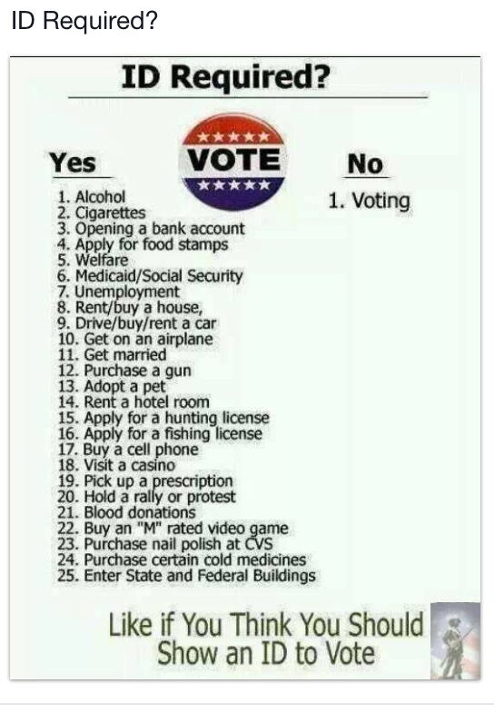
REASONS FOR LOW VOTER TURNOUT
34 states require some form of voter ID at the polls- generally put forth by Republican majorities.
Purpose:
-Prevent voter fraud and guarantee accuracy at the polls.
Liberals and Progressives see voter ID laws as barriers to those voters less likely to have an lD, most of whom tend to vote Democratic- minorities, workers, immigrants. They believe that these voters are less likely to have ID.
7

Slide 26
STRUCTURAL Barriers to Voting
NONSTRUCTURAL Barriers to Voting
Timing of elections | This barrier covers when the elections are held, including what day, what time polls are open, the length of time polls are open, early voting times, etc. | Accessibility | Voters need to be able to physically get to the polling place.
Losing the right to vote | In some states, people convicted of a felony lose their right to vote. | Political efficacy | The belief that your vote, and voting in general, matters.
Voter registration purges | Some states have adopted a policy of purging voter registrations for people who have not voted in a certain number of past elections. | Type of Election | The type of election, (presidential, midterm, state, local, etc.) usually affects voter turnout.
Voter ID laws | Most states require you to show some form of identification before you can vote. | Number of elections | In many states, there are several elections held at various times of the year, usually for local offices or ballot initiatives. Because of this, people may experience voting fatigue and/or lose interest.

Slide 27
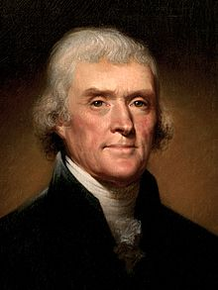
REASONS FOR LOW VOTER TURNOUT
“Educate and inform the whole mass of the people. They are the only sure reliance for the preservation of our liberty.”
“If a nation expects to be ignorant and free, in a state of civilization, it expects to what never was and never will be.”
-Thomas Jefferson
Read more at: https://yourstory.com/2017/04/quotes-by-thomas-jefferson
7

Slide 28
REASONS FOR LOW VOTER TURNOUT
Political reasons
Lack of Political efficacy
“Costs” of voting seem to outweigh benefits to many
Dissatisfaction with candidates, parties, and politics in general
Young people tend to have the lowest turnout. When the 26th Amendment was ratified,
turnout “naturally” declined

Slide 29
REASONS FOR LOW VOTER TURNOUT
Political efficacy is the belief that ordinary people can influence the government. Political efficacy effects voter turnout because if the people believe they can influence the government (high political efficacy) they are more likely to vote while low political efficacy would have less people that vote because they don't think their vote will do anything. This can lead to voter apathy.

Slide 30
WHY PEOPLE DON’T VOTE EVEN IF REGISTERED

Slide 31
ESSENTIAL QUESTION CFU
Why does registration pose such a big problem when it comes to voting?
What can we do to change that?
11

Slide 32
TURNOUT
Turnout is highest in presidential general elections
Turnout in general elections > turnout in primary elections
Turnout in presidential general elections > turnout in midterm general elections
Turnout in presidential primary elections > turnout in midterm primary elections
Turnout in elections in which candidates for federal office are on the ballot > turnout in state
elections in years when there are no federal contests
Local elections have lower turnout than state elections, and local primaries have even lower rates of participation
12

Slide 33
WHO VOTES?
Educational level
High levels of educational achievement are more likely to vote than those with low levels. Why?
Greatest predictor of voting that cuts
across other factors
Race
Whites vote at a higher rate than Blacks
Blacks vote at a higher rate than Hispanics
Gender
Women voters exceed that of men. Strong Democratic voting bloc
Income and career
Higher family incomes are more likely to vote than those with lower incomes
Higher-status careers are more likely to vote
than those with lower-status jobs
Age
Older people, unless they are very old and perhaps infirm, are more likely to vote than younger people
Persons 18 to 24 years of age have a poor voting record; so do persons over 70
13

Slide 34
Voter turnout in presidential and midterm elections, 1912–2018
Identify Trends

Slide 35
Turnout Increases with Age
70
60
50
40
30
20
10
0
18-20
21-24
25-34
35-44
45-54
55-64
65-74
75-84
85+
Why don’t politicians seem to care about young(er) people?

Slide 36
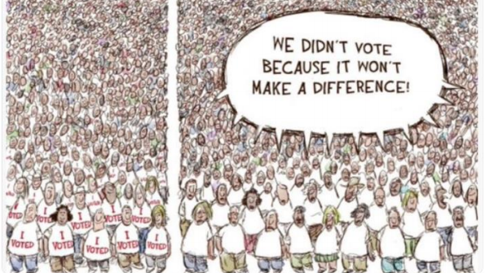
AWARENESS AND INTEREST
Political efficacy - belief that one can make a difference in politics by expressing an opinion and acting politically
• Internal efficacy - the belief that one can understand politics and therefore participate in politics (such as voting)
• External efficacy - the belief that one is effective in making a difference when participating in politics, for example that the government will respond to one's demands

Slide 37
ESSENTIAL QUESTION CFU
Why do politicians cater to certain demographics when it comes to running a campaign and making laws?
16

Slide 38
VOTING ON THE BASIS OF POLITICAL PARTY AFFILIATION
Party Identification – Our sense of identification or affiliation with a political party
Party-line voting – Supporting a party by voting for candidates from one political party for all public offices across the ballot
Traditionally the strongest predictor of how someone is going to vote
Geography (Red States & Blue States)
South: Republican (because of Civil Rights Acts in 60s)
Great Plains: Republican
Rocky Mountain Region: Republican (Colorado swinging Democratic)
New England: Democratic
West Coast: Democratic
Great Lakes Region: Swing
Metropolitan/Urban Centers: Democratic
Rural Areas: Republican
17

Slide 39
VOTING ON THE BASIS OF CANDIDATES
Candidate appeal – how voters feel about a candidate’s background, personality, leadership ability, and other personal qualities
More people now “vote the man, not the party” than in the past → increase in Independents
o In the past - Straight ticket voting o In the present - Split ticket voting
Voting for candidates from the same political party for every office on the ballot
Easier to do with party-column ballot
Decline in recent years (“vote the man, not the
party”)
Voting for candidates from two different political parties
Easier to do with office-column ballot
Increase in recent years (“vote the man, not the
party”)
18

Slide 40
VOTING ON THE BASIS OF ISSUES
Issues
i.e. economy - can be good or bad
War is traditionally a RALLY POINT (something we all rally around)
Rational-choice voting: Voting based on what is perceived to be in the citizen’s individual interest
Retrospective voting: Voting to decide whether the party or candidate in power should be re-elected based on the recent past
Prospective voting: Voting based on predictions of how a party or candidate will perform in the future
19

Slide 41
ESSENTIAL QUESTION CFU
Explain rational-choice voting, retrospective voting, and prospective voting with your group. Use relevant examples if possible.
It’s the summer of 2016. Would the picture below be an example of rational-choice voting, retrospective voting, or prospective voting?
It’s the summer of 2016. Would the picture below be an example of rational-choice voting, retrospective voting, or prospective voting?

Slide 42
VOTING BASED ON GENDER
Women are more likely to vote Democratic, especially if they are single
– More liberal on issues such as military action, capital punishment, gun control, social programs such as Social Security, education funding, and environmental initiatives
Men are more likely to vote Republican
Sex-sensitive issues (e.g., abortion, pornography, gun control, war) provoke different views among the sexes
GENDER GAP – Refers to the difference in the percentage of women and the percentage of men voting for a given candidate.
21

Slide 43
THE GENDER GAP
The Gender Gap is the difference in political views between men and women

Slide 44
VOTING BASED ON RACE (Ethnicity)
Whites: more conservative, greater support for Republicans
Blacks: more liberal, STRONGEST SUPPORTERS of Democratic Party (~90% Dem. in recent presidential elections)
Hispanics:
Mexican-Americans and Puerto Ricans more liberal and supportive of Democrats
Cubans more conservative and supportive of Republicans
Asians: supportive of Democrats
Who would Jim Halpert be more likely to vote for?
23

Slide 45
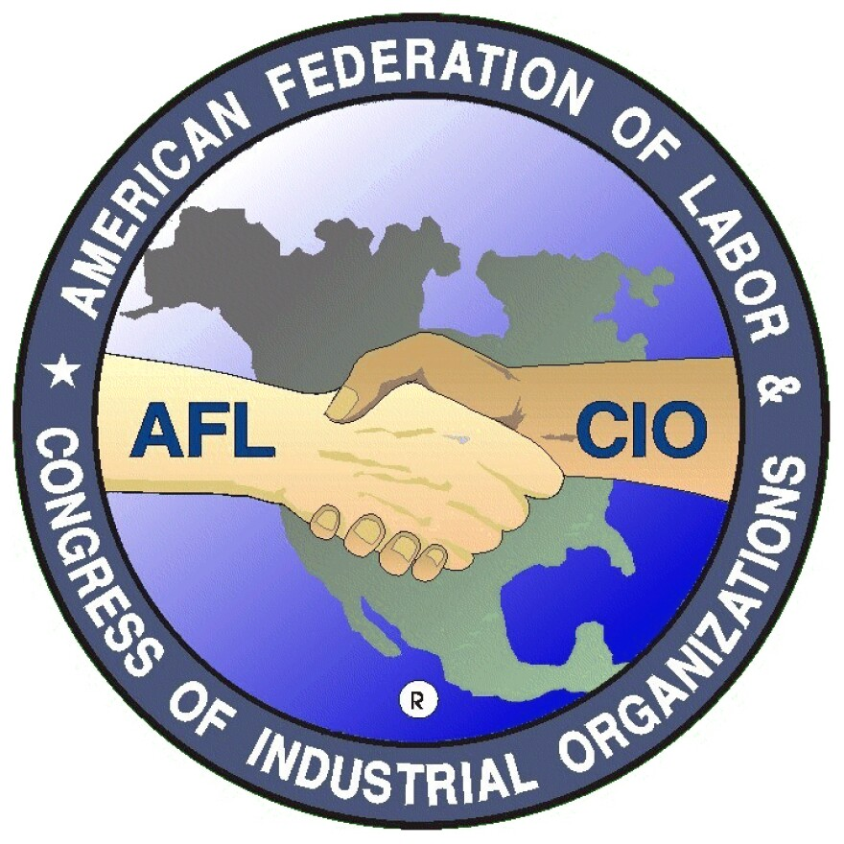
VOTING BASED ON OTHER FACTORS
Labor union members___ They have become less reliable Democratic voters; have decreased in number and thus there are fewer Democratic supporters; have become a smaller percentage of the Democratic voting bloc.
Social class
Lower: more likely than upper to vote Democratic (although changing)
Upper: more likely than lower to vote
Republican (although changing)
Religion
Protestant: more likely to vote Republican
Evangelicals, especially, are most conservative on social issues
Catholic: had been more likely to vote Democratic, but some slippage in recent years
White Catholics vote Rep in last pres election (60/27 R)
Non-white Catholics vote Dem in last pres election (67/26 D)
– Jewish: more likely to vote Democratic- swing vote

Slide 46
ESSENTIAL QUESTION CFU
How do different genders vote? How do different religions vote? How do different races votes?
25

Slide 47
25

