Slide 1
Chpt. 14 Topic 4.7-4.10
UNIT 4
AMSCO pg. 445-490
https://thejerryperezexperiment.weebly.com/
Political Ideologies and Public Policy

Slide 2
TOPIC 4.7 Ideologies of Political
Widely held political ideologies shape policy debates and choices in American Policies
Explain how ideologies of
the two major parties shape
Policy.
The Democratic Party (D or DEM) platforms generally align more closely to liberal ideological positions, and the Republican Party (R or GOP) platforms generally align more closely to conservative ideological positions.

Slide 3
POLITICAL IDEOLOGY
Definition: A cohesive set of beliefs about politics, public policy, and the role of government that shapes a person’s views.
A person who identifies themselves as a conservative or liberal varies according to age, race, gender, and socioeconomic status.

Slide 4
The meanings of liberal and conservative have changed over time. Nineteenth-century liberalism was associated with the principles of laissez faire—government should keep its hands-off business. Conservatives opposed change and put their trust in traditional institutions such as the monarchy and the church. In this regard our founders were very liberal. In the 21st century in the United States, liberals have called on the federal government, in particular, to regulate the economy in the public interest and help those who can’t help themselves; they strongly oppose any government attempt to restrict personal freedom. Conservatives, on the other hand, favor less intrusion from Washington, and want power to flow back to states and local governments; they believe that the government does have a role to play, however, in promoting certain types of social behavior (for example, programs that encourage abstinence). Libertarians, usually considered to be on the political right, believe in maximizing individual freedom and severely curtailing the power of the state; they reject both the liberal government as regulator and the conservative government as moral arbiter.
Cliff Notes AP Gov, pg. 88

Slide 5
LIBERAL IDEOLOGY - GENERALLY DEMOCRATS
CARDINAL ATTRIBUTES OF LIBERAL IDEOLOGY
Positive uses of government to bring about justice and equality of opportunity (larger government) such as social programs in the past the New Deal, LBJs Great Society -war on poverty
Emphasis on protection of individual rights and liberties
Emphasis on human rights in issues regarding foreign aid
Less emphasis on military spending
Higher taxes for the rich than for the poor
Larger government
Believe in possibility of progress, better future, equality of opportunity, minimum income level
Liberals charge that conservatives act in self-interest, concerned with rich; Liberals concerned government should take care of weak- emphasis on social safety net.
Liberal view holds all people equal; wish to lessen impact of great inequalities of wealth
Corporations seen as chief threat to liberty; Need for a strong central gov’t to “smooth out the rough edges of capitalism”
Set up programs to help criminals

Slide 6
LIBERAL IDEOLOGY - GENERALLY DEMOCRATS
CRITICISMS OF LIBERAL IDEOLOGY
Too much reliance on governmental solutions, higher
taxes, and bureaucrats
Forgets that government has to be limited
When government grows too big, it tends to start
dictating us
Too many governmental controls and too much taxation
undermine the self-help ethic
Welfare and regulatory state pushed by liberals will destroy true equality of economic opportunities
5

Slide 7
CONSERVATIVE IDEOLOGY (GENERALLY REPUBLICANS)
CARDINAL ATTRIBUTES OF CONSERVATE IDEOLOGY
Private property rights and belief in free enterprise (free market economy-laissez faire)
Keep government small except in the area of national defense
Government needs to ensure order; more pessimistic about human
nature
Preference for the status quo and desire change only in moderation
Taxes should be low for everyone
Prayers in public schools should not be banned
Abortion is the murder of a fetus- Pro Life
Strong defense budget
Don’t make America a welfare state
Lock up criminals for crimes
Human needs cared for by families/charities
Emphatically pro-business
Favor dispersing power broadly to avoid concentration of power at the national level
Subordinate economic and social equality to liberty and freedom
Government social activism has been expensive and counterproductive

Slide 8
CONSERVATIVE IDEOLOGY (GENERALLY REPUBLICANS)
CRITICISMS OF CONSERVATIVE IDEOLOGY
Hostility to government as counterproductive and
inconsistent
Conservatives have a selective opposition to government
Government deficits grew during the 1980s when conservatives were in control
Insensitivity to the social needs of the homeless and mentally ill
Too much faith in our market economy
Failure to acknowledge and endorse policies that deal with racism and sexism
7

Slide 9
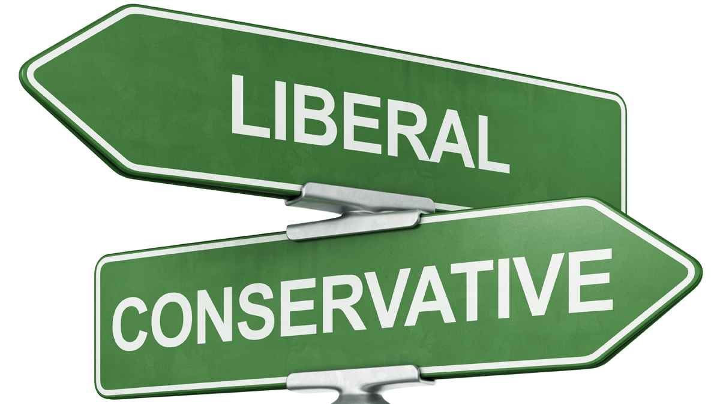
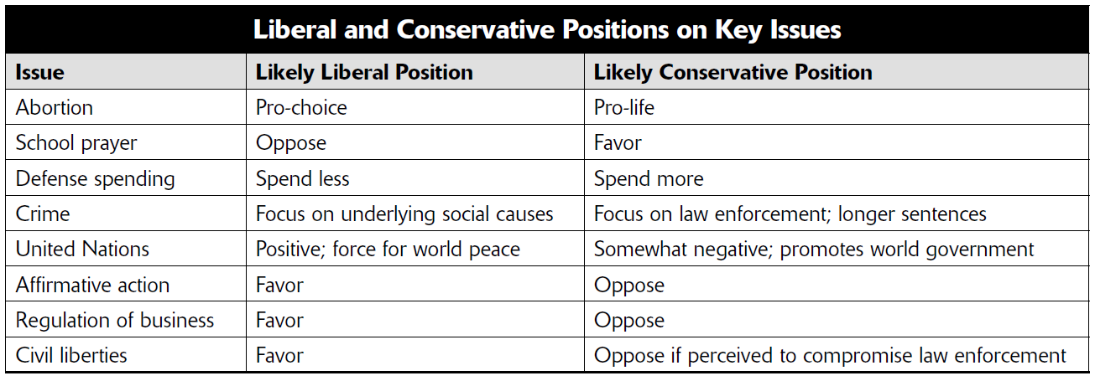

Slide 10
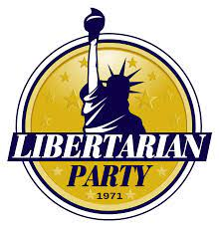
LIBERTARIANISM
An ideology that cherishes individual liberty and insists on a sharply limited government (Federal government should only be used for national defense, protection of private property, contract enforcement). They seek maximum freedom
Preaches opposition to government and just about all its programs
Opposes all government regulation. Gov should only protect property rights and contract law.
End government subsidies for businesses and farmers
No gun laws, no drug laws, no gambling laws

Slide 12
IDEOLOGICAL SPECTRUM
Liberal (left-wing)
– Political doctrine that takes protecting and
enhancing the freedom
of the individual to be the central problem of politics.
Moderate
– Is an individual who is not extreme, partisan or radical. More of a middle
of the road voter, who may have some beliefs on both ideologies.
Conservative (right-wing)
– Promotes retaining traditional social institutions.
Less government and taxes. A
person who follows the philosophies of conservatism is referred to as a traditionalist.
Left
Moderates- somewhere in between, and never fall fully into one camp or the other. May think conservatively on some issues and have liberal beliefs on others.
Right

Slide 13
The Liberal-Conservative Spectrum AMSCO pg. 446-50
Moderate
Liberal (left-wing)
Conservative (right-wing)
Most Americans are moderate, meaning somewhere in between, and never fall fully into one camp or the other. Many others may think conservatively on some issues and have liberal beliefs on others.
They see both parties as overly ideological and wish politicians would compromise more. A plurality are Democrats, but they see themselves as slightly right-of-center ideologically, and one-third say they vote equally for Democrats and Republicans.
https://www.theatlantic.com/politics/archive/2014/05/moderates-who-are-they-and-what-do-they-want/370904/

Slide 14
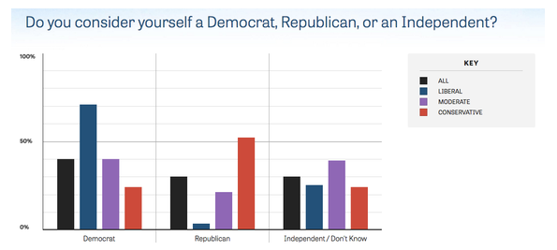
The Liberal-Conservative Spectrum AMSCO pg. 446-50
Moderate
Liberal (left-wing)
Conservative (right-wing)
Source: State of the Center, Third Way and the Benenson Strategy Group, 2014
https://www.theatlantic.com/politics/archive/2014/05/moderates-who-are-they-and-what-do-they-want/370904/

Slide 15
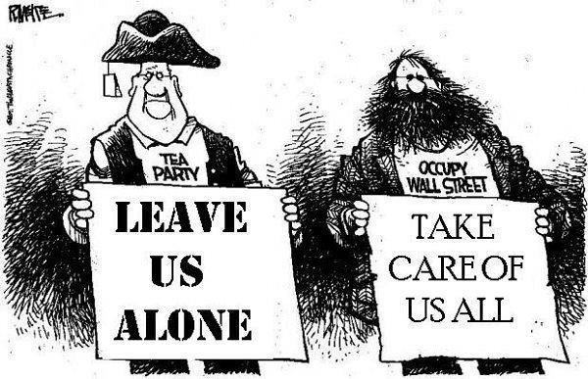
What is a Liberal? AMSCO pg. 446-48
The meanings of the terms liberal and conservative have changed through history. In the early United States, a “liberal” government was one that did little. Thomas Jefferson (strict constructionist) believed in a high degree of liberty, declaring that a government that governs best is one that governs least. With this statement, Jefferson described the government’s liberal approach toward the people, allowing citizen freedom, a free flow of ideas, free markets, fewer laws, and fewer restrictions at the federal level (small gov). The strict constructionist believed that states should hold as much power as they can, and this understanding of the word continued into the late nineteenth century.

Slide 16
What is a Liberal?
During the Progressive Era, (1890-1920) the fed.
Government’s role expanded going outside the confines of traditional gov. Laws were passed to curb monopolies, clean food and safe drugs, child labor laws, work safety laws. The 17th amendment was passed to bring gov closer to the people, etc. The list goes on.
During the 1930s Great Depression, FDR proposed a “liberal agenda” to fix the economy. The gov acted liberally with many ABC programs or relief, recovery, reform ( the New Deal). Gov expanded. Since the 1930s, the term liberal meant being open to allowing gov to act flexibly and expand beyond constraints.
In the 1960s, gov expanded even further with the Great Society.

Slide 17
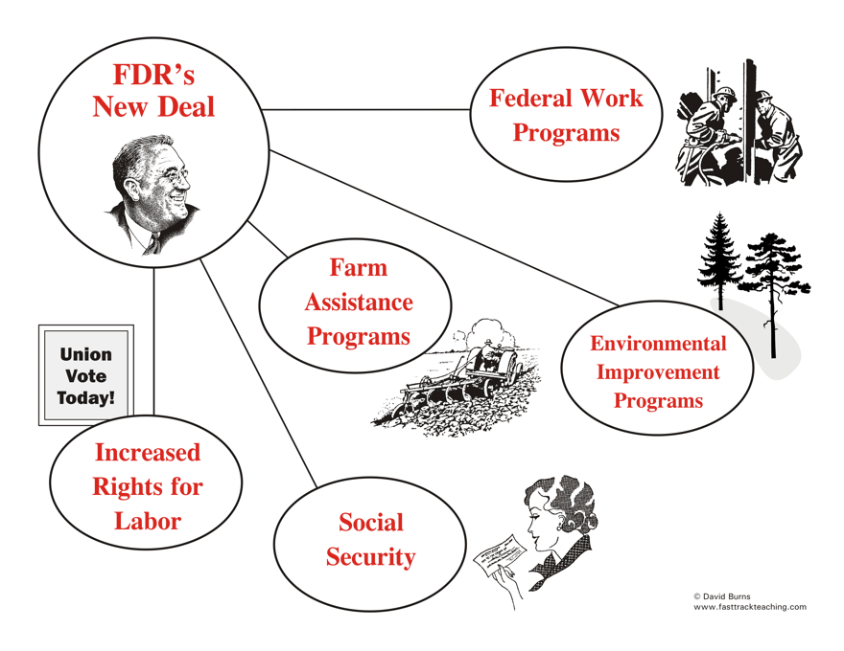
None of these programs existed prior to 1932

Slide 18
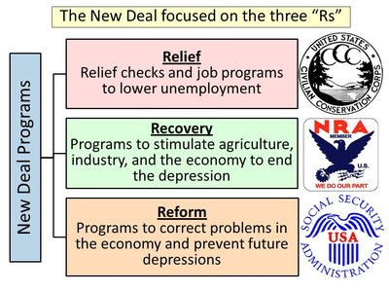

Slide 19
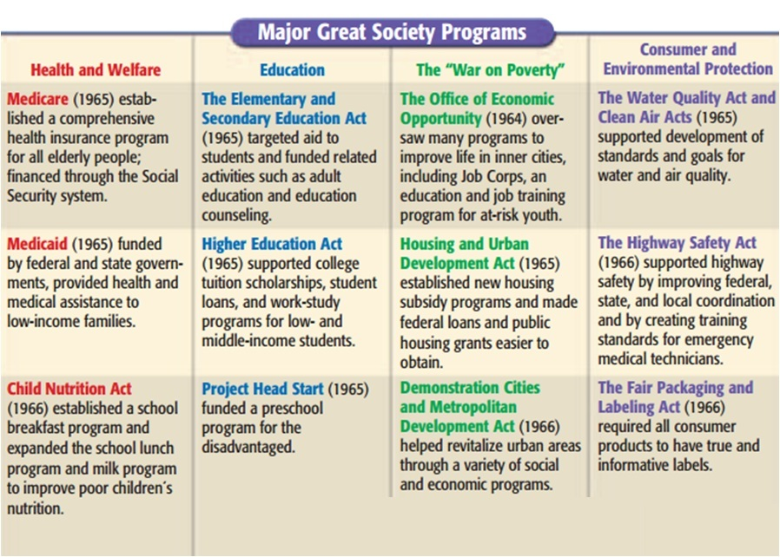

Slide 20
Liberal
Franklin Roosevelt
Lyndon B. Johnson
Great Depression
Great Society
Gov has expanded beyond its established boundaries. Gov should be used as a positive force to correct societies ills.
Size of
Government
Johnson’s Great Society
Size of
Government
FDR’s New Deal
Size of
Government

Slide 21
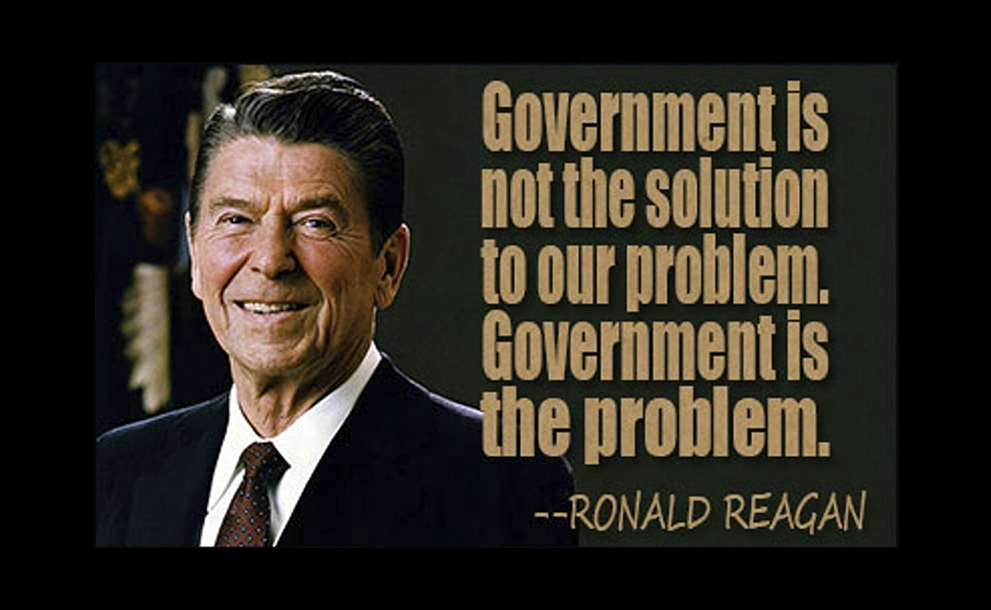
What is a Conservative
Conservatives tend to believe that government should be small, operating mainly at the state or local level. They favor minimal federal government interference in the economy and prefer private sector-based solutions to problems. They favor a strong free-market economy.
https://www.khanacademy.org/humanities/us-government-and-civics/us-gov-american-political-ideologies-and-beliefs/us-gov-ideologies-of-political-parties/a/lesson-summary-ideologies-of-political-parties

Slide 22
OTHER POLITICAL CHOICES
Independent
– An independent is variously
defined as a voter who votes for candidates and issues rather than on the basis of a political ideology to partisanship.
Libertarian
– Emphasizes freedom, liberty, and
voluntary association without coercion. Libertarians generally advocate a society with a small government compared to most present day societies.

Slide 23
Off the Line AMSCO pg. 447-448
Cleavages, or gaps (divisions in society), in public opinion make understanding where the public stands on issues even more difficult. Few people, even regular party members, agree with every conservative or every liberal idea. Many people simply do not fall on the linear continuum but rather align themselves with one of several other notable political philosophies:
Libertarian- a high regard; strict interpretation of the Bill of Rights; for civil liberties, conservative on economic issues, liberal on moral or social issues
Populist- of today favor small gov unlike their populists brethren of the past century. Favor gov regulations for job safety and farm subsidies.
Progressive- Modern progressives are aligned with labor unions. They believe in workers’ rights over corporate rights, and they believe the wealthier classes should pay a much larger percentage of taxes than they currently do.

Slide 24
Liberal and Conservative
Did you know that you could be a liberal and a conservative at the same time?
You could be a fiscal conservative and a social liberal? Or vice-versa
Explain how and give examples.

Slide 25
ESSENTIAL QUESTION CFU
List five tenants of a liberal ideology.
List five tenants of a conservative ideology.
11

Slide 26
TOPIC 4.8 Ideology and Policy Making
Explain how U.S. political culture (e.g., values, attitudes, and beliefs) influences the formation, goals, and implementation of public policy over time
Because the U.S. is a democracy with a diverse society, public policies generated at any given time reflect the attitudes and beliefs of citizens who choose to participate in politics at that time.
The balancing dynamic of individual liberty and government efforts to promote stability and order has been reflected in policy debates and their outcomes over time

Slide 27
TOPIC 4.9 Ideology and Economic Policy
Explain how different political ideologies affect the role of government in regulating the
marketplace.
Liberal ideologies favor more governmental regulation of the marketplace, conservative ideologies favor fewer regulations, and libertarian ideologies favor little or no regulation of the marketplace beyond the protection of property rights and voluntary trade.
Explain how fiscal and
monetary policy actions
influence economic
conditions.
Fiscal policy consists of actions taken by Congress and the president to influence economic conditions and includes Keynesian and supply-side positions.
Monetary policy consists of actions taken by the Federal Reserve (the Fed) to influence interest rates which affect broader economic conditions. The Fed is an independent agency which seeks to achieve maximum employment and price stability.

Slide 28
TOPIC 4.9 Ideology and Economic Policy
Describe different political ideologies on the role of government in regulating the marketplace.
Liberal ideologies favor more governmental regulation of the marketplace, conservative ideologies favor fewer regulations, and libertarian ideologies favor little or no regulation of the marketplace beyond the protection of property rights and voluntary trade.
Ideological differences on marketplace regulation are based on different theoretical support, including Keynesian and supply-side positions on monetary and fiscal policies promoted by the president, Congress, and the Federal Reserve.
Explain how political
ideologies vary on the
government’s role in
regulating the marketplace

Slide 29
WOULD A LIBERAL OR CONSERVATIVE FAVOR SPENDING ON . . .

Slide 30
FREE ENTERPRISE: 2016 ELECTION
Question: Should women receive equal pay to men?
Hillary Clinton:
Donald Trump:
She argued that employers should be required to pay men and women the same salary for the same job. With that stance, Clinton placed value on equality of opportunity over free enterprise, arguing that giving companies that discretion usually results in unequal pay on the basis of gender.
He argued that employers should not be required to pay men and women the same salary for the same job because there are a number of factors that go into determining salaries, like education level and prior experience. He placed value in free enterprise, giving companies the discretion and power to decide how much they pay their workers.

Slide 31
POWER TO MANAGE THE ECONOMY - PRESIDENT
No formal powers over taxation
and spending
Influence over the federal budget has expanded dramatically over time- OMB
Most important role is submission of the budget >> Outlines the president’s priorities and spending recommendations
14

Slide 32
POWER TO MANAGE THE ECONOMY - CONGRESS
Power to tax
Power to pay the debts of America
Power to “provide for the common defense and general welfare”
Power to borrow money and appropriate money
Congress is not bound by a balanced-budget requirement >> U.S.
government regularly runs large deficits
Congress must approve of the president’s budget
15

Slide 33
BUDGETARY POLITICS
Congressional committees and subcommittees
Congressional Budget Office
Government Accountability Office
Agencies
Office of Management and Budget
POTUS
Federal Budget
Congress

Slide 34
THE BUDGET PROCESS
Executive Branch
Agencies prepare their estimates of budget needs and present them to the Office of Management and Budget (OMB = charged with overseeing the budget process on behalf of the president).
Amount requested is typically based upon the amount granted in the previous year.
OMB reviews these requests and makes recommendations to the President.
President reviews OMB recommendations and then submits a budget to Congress.
The president's close control over both the preparation and execution of the budget is a major factor in his ability to command the huge executive branch
OMB monitors the spending that Congress appropriated.
What is the power of the OMB?
Presidential action
President signs or vetoes entire taxing and spending bills – no line item veto
Congress can override a veto with 2/3 vote in both houses
17

Slide 35
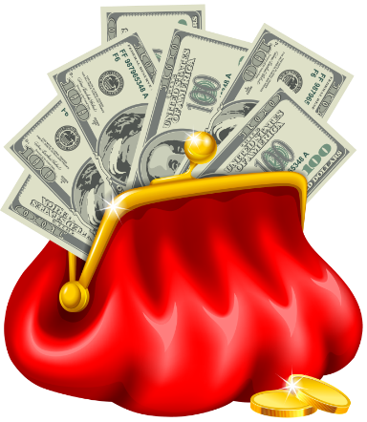
THE BUDGET PROCESS
Congress (Constitution grants Congress the “power of the purse”)
Congressional Budget Office (CBO) provides an independent analysis of the President's budget -- a check on OMB
Roles of Budget, Ways and Means, Finance, and Appropriations Committees
Input and lobbying from agencies
Majority vote needed in both houses
Government Accountability Office (GAO) is a congressional watchdog agency that ensures money is spent as prescribed by law
17

Slide 36
TOPIC 4.10 Ideology and Social Policy
Explain how political ideologies vary on the role of the government in addressing social issues.
Liberal ideologies generally favor more national government involvement to address some social issues such as education and public health, with less responsibility for these issues left to state governments.
Conservative ideologies generally favor less national government involvement to address some social issues such as education and public health, with more responsibility for these issues left to state governments.
Libertarian ideologies generally favor little national or state government involvement except when national or state government is protecting private property or individual liberty.
Explain how different ideologies impact policy on social issues.
Policy trends concerning the level of government involvement in social issues reflect the success of conservative or liberal perspectives in political parties.

Slide 37
TOPIC 4.10 Ideology and Social Policy
Explain how different ideologies impact policy on social issues.
Policy trends concerning the level of government involvement in social issues reflect the success of conservative or liberal perspectives in political parties.

Slide 38
TOPIC 4.10 Ideology and Social Policy
Explain how political ideologies vary on the role of the government in addressing social issues.
Liberal ideologies tend to think that personal privacy—areas of behavior where government should not intrude—extends further than conservative ideologies do (except in arenas involving religious and educational freedom); conservative ideologies favor less government involvement to ensure social and economic equality; and libertarian ideologies disfavor any governmental intervention beyond the protection of private property and individual liberty.
Explain how different ideologies impact policy on social issues.
The balancing dynamic of individual liberty and government efforts to promote stability and order has been reflected in policy debates and their outcomes over time.

Slide 39
THE BUDGET PROCESS
Political influences
Political party differences
Interest group/PAC influence
Iron triangles
Public opinion
18

Slide 40
TWO TYPES OF ECONOMIC POLICIES
Fiscal Policy
Refers to the taxing, spending, and borrowing activities of the national government
Conducted by the President and Congress
President proposes the budget and Congress passes it
Monetary Policy
Refers to the regulation of the money supply, controlling inflation, and adjusting interest rates
Controlled by the “Fed” or Federal Reserve Board

Slide 41
FISCAL POLICY
FISCAL POLICY – DEFINITION
Fiscal policy affects the economy by making changes in government’s methods of raising money and spending it
Policy that describes the impact of the federal budget (including taxes, spending,
and borrowing) on the economy
TOOLS AND IMPACT OF FISCAL POLICY
Governments try to stimulate the economy to prevent a recession/depression
Governments can lower taxes >> stimulates the economy by encouraging consumer spending or by encouraging investment
Government can increase its own spending, which offsets declines in consumer demand >> Keynesian economic policy
Economy is growing too quickly and economists fear inflation may increase >> government can attempt to cool the economy down by increasing taxes or by reducing its own spending
Inflation by definition it too much money in the economy and causes prices to increase

Slide 42
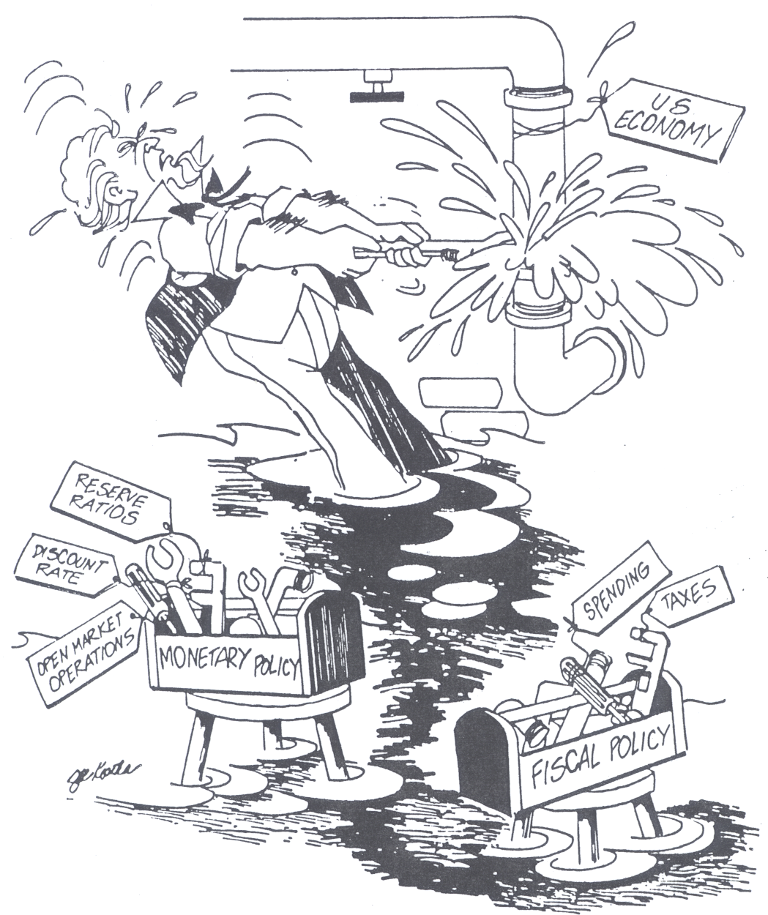
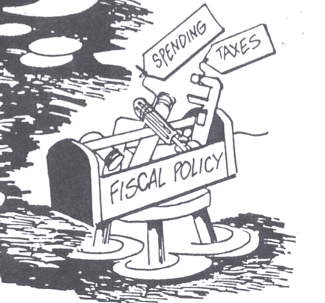
President and Congress

Slide 43
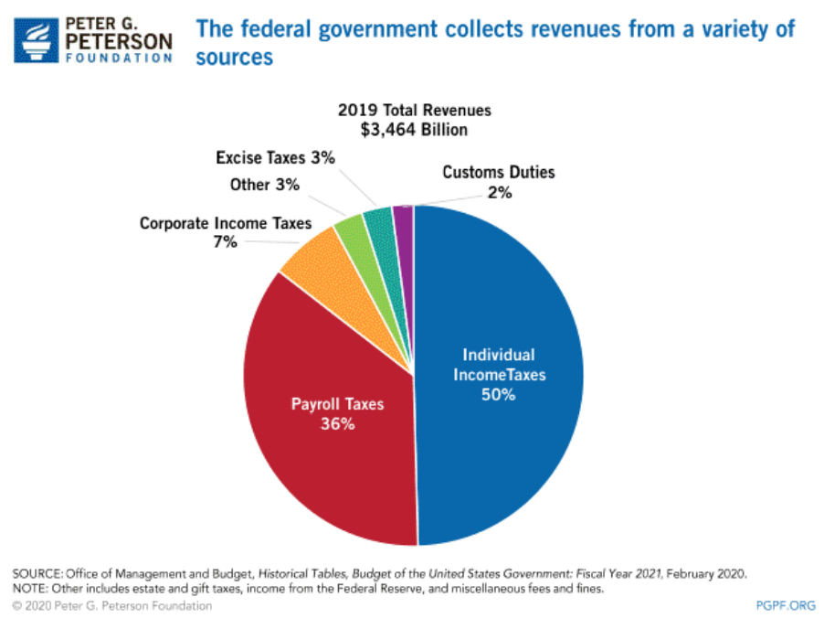
FISCAL POLICY
WHERE THE MONEY COMES FROM (SOURCES OF FEDERAL REVENUE)
Individual income taxes
The individual income tax is the federal government’s largest source of revenue
Payroll taxes
Tax that an employer withholds from an employee's salary and pays on behalf of his employees
Pay for social insurance (Social Security and Medicare)
Corporate income taxes
Tax on corporate profits
Excise taxes
Taxes on the consumption of liquor, tobacco, gasoline, telephones, air travel, and other so-called luxury items
Other
Estate and gift taxes
Tariffs - taxes on imports
Borrowing
Budget deficit - borrow money
Selling Treasury notes and savings bonds
Adds to national debt

Slide 44
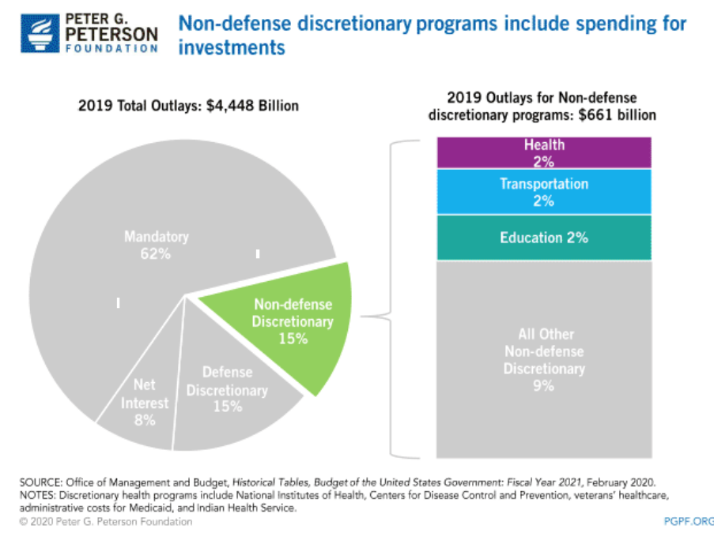
Types of Spending
Discretionary spending-spending for federal programs that must receive annual authorization
Mandatory Spending-(non-discretionary) federal spending authorized by law that continues without the need for annual approvals of Congress

Slide 45
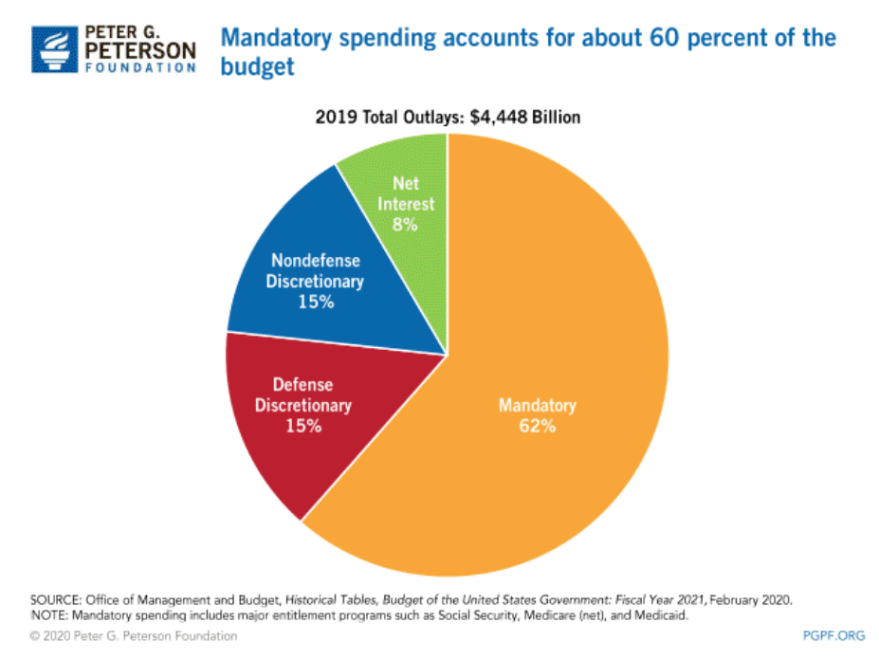
Types of Spending
Mandatory Spending includes:
Social Security
Medic Care
Medic Aid

Slide 46
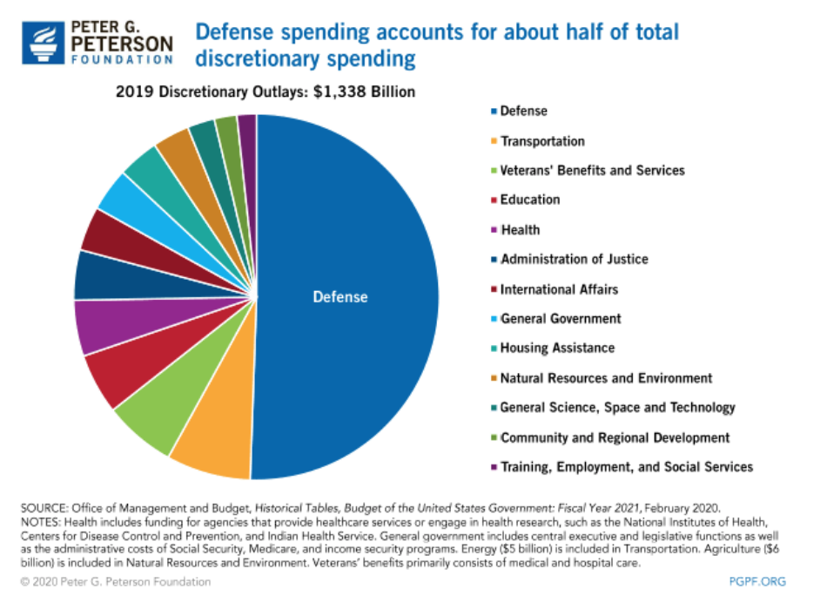
Types of Spending: Where the Money Goes
Discretionary Spending includes:
Defense 50% of budget

Slide 47
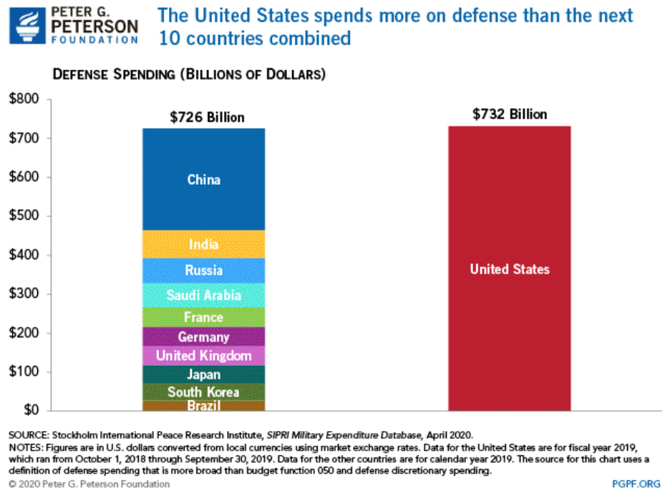
US Defense Spending Compared to Other Countries

Slide 48
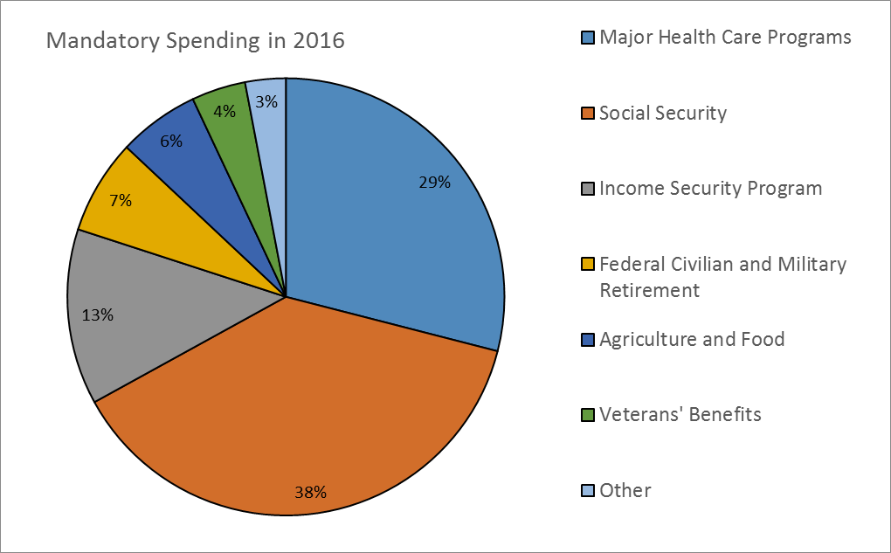
Types of Spending
Most mandatory spending consists of entitlement programs such as Social Security benefits, Medicare, and Medicaid. These programs are called "entitlements" because individuals satisfying given eligibility requirements set by past legislation are entitled to Federal government benefits or services.
Social Security and Medicare/ Medicaid
are 67% of the federal budget.

Slide 49
FISCAL POLICY
WHERE THE MONEY COMES FROM (SOURCES OF FEDERAL REVENUE)
21

Slide 50
FISCAL POLICY
WHERE THE MONEY GOES (SOURCES OF FEDERAL EXPENDITURES)
22

Slide 51
FISCAL POLICY - ENTITLEMENTS
Entitlements
Federal money that is provided to those who meet eligibility requirements and is automatically spent each year without congressional review
Also known as “uncontrollables”
Some have a built in COLA (cost of living adjustment), also without annual review. This in turn creates additional budget pressures.
Examples: Social Security, Medicare, federal pensions
These account for about 2/3 of the federal budget, which causes difficulties of balancing the budget.
Attempts to change/reduce/alter extremely difficult > many voters who support these programs (especially old people)- they vote the most.

Slide 52
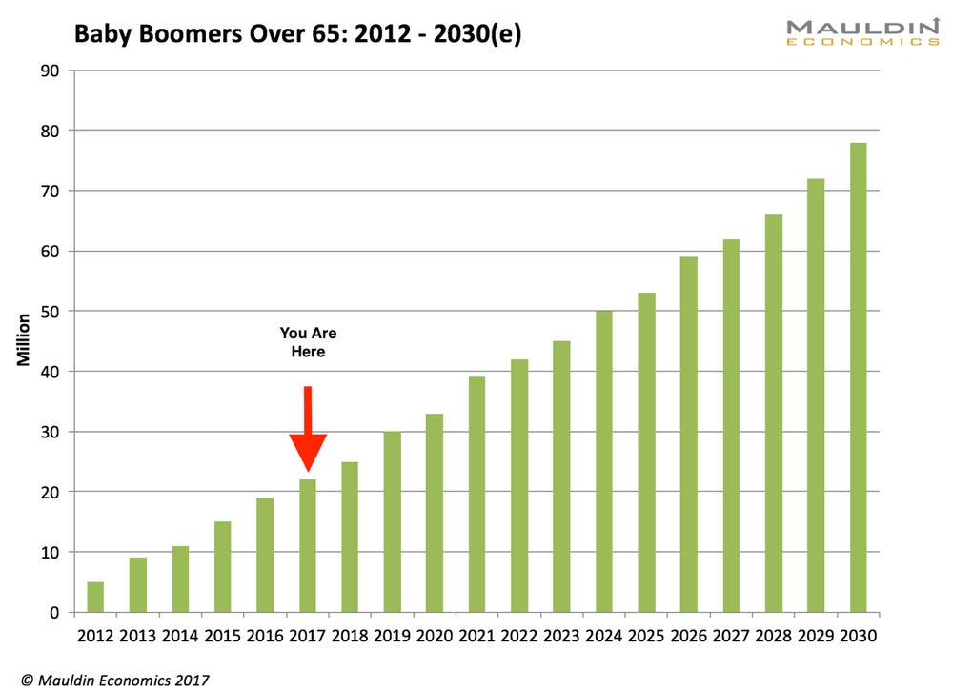
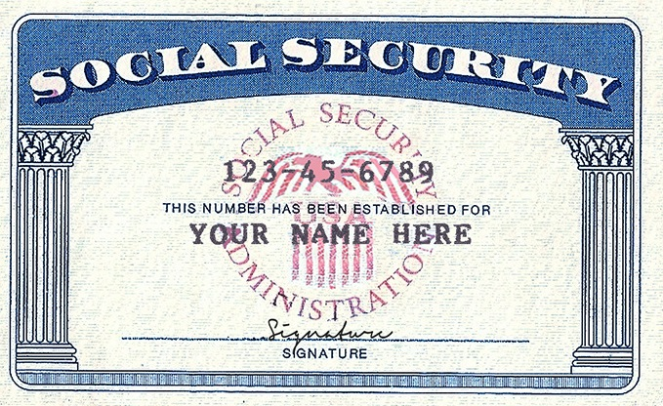
FISCAL POLICY - ENTITLEMENTS
As more Baby Boomers retire, the gov budget accounts for more social security and medicare. This is mandatory spending.

Slide 53
MONETARY POLICY
THE FED (THE FEDERAL RESERVE BOARD)
MONETARY POLICY – DEFINITION
Monetary policy is the government’s control of the money supply. The government can control how much or how little is in circulation.
The powerful arm of government that controls the money supply is the Federal Reserve System, which is headed by the Federal Reserve Board. The board is designed to operate with a great deal of independence from government control. One important way that the “Fed” controls the money supply is by adjusting interest rates - high rates discourage borrowing money, and low ones encourage it.
Members of the Fed can be known as either “hawks” or “doves.” Hawks are viewed as favoring tighter monetary policy with an emphasis on controlling inflation. In contrast, doves are viewed as favoring easier monetary policy with an emphasis on maintaining maximum employment.

Slide 54
MONETARY POLICY
THE FED (THE FEDERAL RESERVE BOARD)
The Federal Reserve Board’s seven members are appointed by the president and are approved by the Senate for 14-year, nonrenewable terms, and the president may not remove them from office before their terms are up. The chair is elected by the board for four years, and may be reelected. The Board heads the Federal Reserve System, which was created by Congress in 1913 to regulate the lending practices of banks. It consists of 12 regional banks, which in turn supervise a total of about 5,000 banks across the United States.

Slide 55
MONETARY POLICY
THE FED (THE FEDERAL RESERVE BOARD)
Established by Congress in 1913 to help govern the nation’s monetary policy through an independent and apolitical process
Overseen by a seven-member Board of Governors
Members of the board are appointed by the president and confirmed by the Senate to 14-year terms and cannot be removed
The length of their terms intended to insulate the Fed from political pressures from both the president and the Congress
The Fed’s primary role is to regulate the nation’s money supply. Priority is placed on limiting the rate of inflation and preventing recessions/ low unemployment 4-6%.

Slide 56
MONETARY POLICY
THE FED (THE FEDERAL RESERVE BOARD)
How does the Fed control monetary policy?
Open-market operations
Refers to the efforts by the central bank to buy or sell government bonds
This is the most common form of monetary policy and is generally used to try to control short-term interest rates
By selling bonds, the Fed effectively removes money from circulation, slowing the economy, int rates increase.
By purchasing bonds, the Fed effectively expands the money supply, encouraging economic activity, int rates drop.
Reserve ratios
The Federal Reserve establishes the minimum cash reserves any bank must hold.
By increasing the ratio, the Fed can effectively reduce the amount of money in circulation, slowing the economy down.
By contrast, reducing the requirement increases the amount of money in circulation, generally leading to an expansion of economic activity.
27

Slide 57
MONETARY POLICY
THE FED (THE FEDERAL RESERVE BOARD)
How does the Fed control monetary policy:
Federal funds rates- what banks charge each other on overnight loans. Set by Fed.
Interest rate at which banks trade reserve balances held at the Federal Reserve
This rate is an important benchmark, as many other interest rates, including credit card rates and home mortgage rates, are often based on the federal funds rate
Increasing the federal funds rate thus makes borrowing more expensive, slowing economic activity. This is done to slow down inflation
Lowering the federal funds rate makes borrowing cheaper, increasing economic activity. This is done to prevent a recession.
Discount rate- cost banks pay to borrow money from the Federal Reserve Bank
By reducing the discount rate, the Fed makes it more attractive for banks to borrow money, effectively increasing the amount
of money in circulation and encouraging economic activity
– By contrast, increasing the discount rate generally slows the economy down

Slide 58
DEVELOPMENTS IN ECONOMIC POLICY
Great Depression of 1930's led to even greater regulation of economy by Congress: Unemployment rate of 25%, bank failures, and deflation demanded aggressive actions.
Keynesian Economics
During Depression, New Deal was influenced by of British economist John Maynard Keynes= Demand Side Economics
Keynes suggested that government could manipulate the economic health of the economy through its level of spending.
In hard times, govt. should increase spending (even if it means running large deficits) to stimulate economic health.
In inflationary “boom” times, govt. should decrease spending to “cool down” the economy.
Difficulty posed by Keynesian Economics: Once govt. spending rises, it is politically difficult to cut it (consider the fights in recent years over entitlement reform). This helps to explain why we have such high budget deficits.

Slide 59
DEVELOPMENTS IN ECONOMIC POLICY
Great Depression of 1930's led to even greater regulation of economy by Congress: Unemployment rate of 25%, bank failures, and deflation demanded aggressive actions.
Supply-Side Economics
Definition: Cuts in taxes will produce business investment that will compensate for the loss of money due to the lower tax rates. Tax rates will be lower, but business will boom, unemployment will go down, incomes will go up, and more money will come into the Treasury in the form of income taxes.
Most associated with the Reagan Administration (1981-1989).
Unfortunately, the Reagan tax cuts were not accompanied by spending cuts, so the national debt tripled from $1trillion to $3 trillion.

Slide 60
DEVELOPMENTS IN ECONOMIC POLICY
The push for a Balanced Budget Amendment
High deficits have led some to believe that Congress needs to be “tied down” to a constitutional amendment that would require that spending not exceed income.
Supporters say that this is the only way to end the “spending bias” of Congress, and
that it is the only way to overcome the political difficulties of cutting spending.
Opponents say that such an amendment would be “tinkering” with the Constitution: It would decrease needed flexibility in times of crisis, and Congress would figure out a way of evading the amendment anyway.
This amendment was proposed in the Senate, but was voted down by the House in 1992.
The line-item veto could have precluded the need for such an amendment. Wasteful spending could be deleted with a “stroke of the pen.” Declared unconstitutional by the Supreme Court.

Slide 61
Keynes vs. Hayek

Slide 62
ESSENTIAL QUESTION CFU
What is the difference between monetary policy and fiscal policy? Who is in charge of controlling monetary policy? Fiscal policy?
What is the difference between Keynesian economics and supply-side economics? Which ideology generally favors each idea?
Explain the cartoon. Which economic
theory is portrayed?
30

