Slide 1
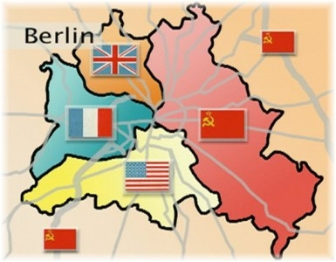
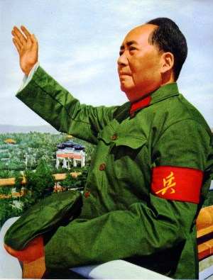
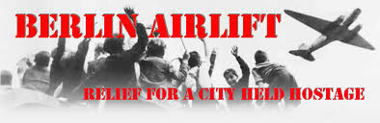
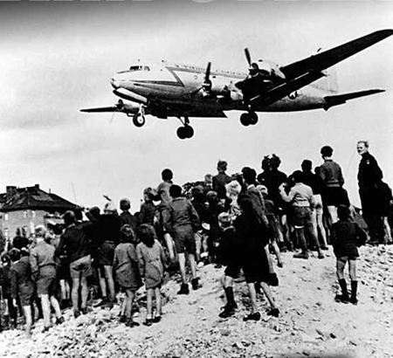
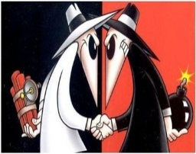

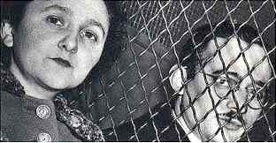
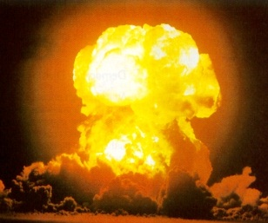
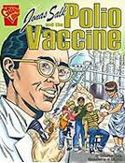
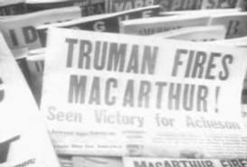
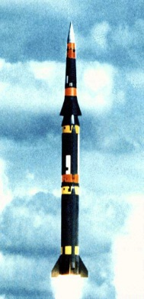
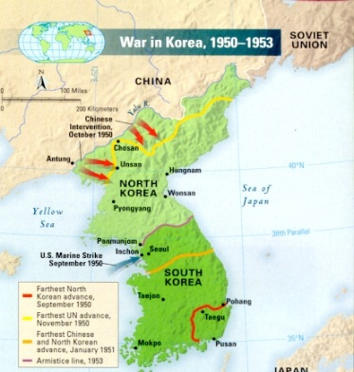
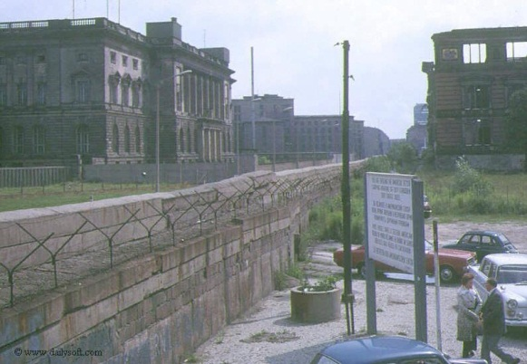

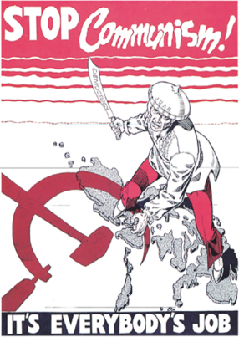
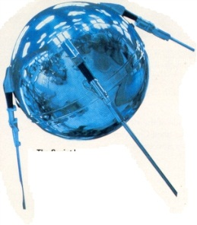
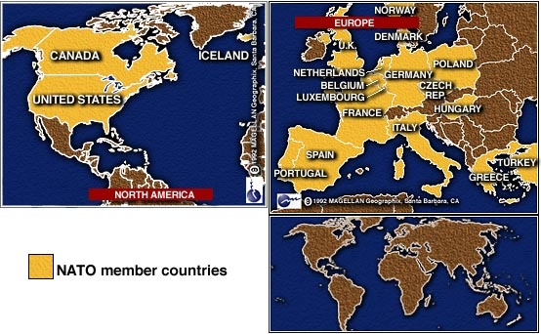
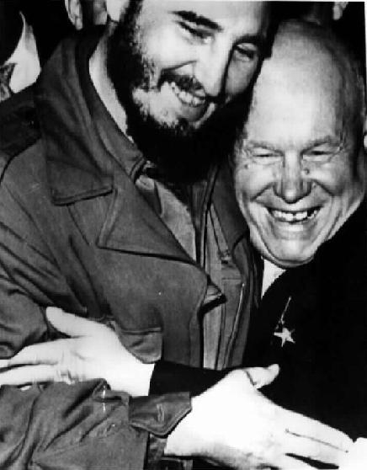
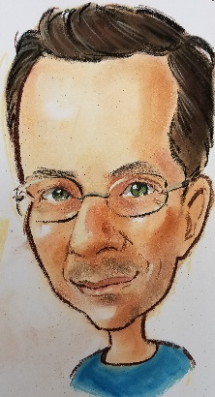
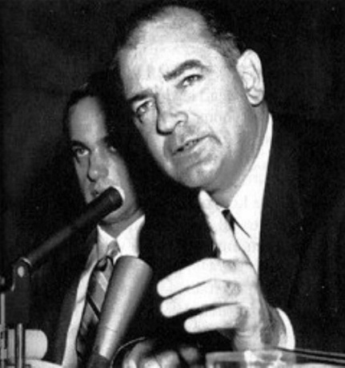

The Cold War
1945-1989
Chpt. 13

Slide 2
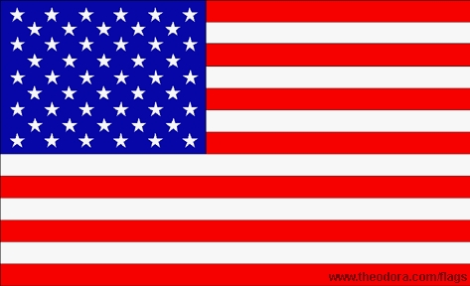
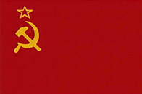
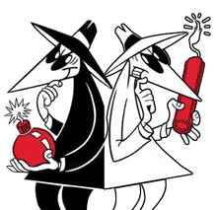
The Cold War
Although the U.S.A. and the Soviet Union were allies during World War II, these two Superpowers soon became rivals during the Cold War. They were called SUPERPOWERS because they possessed far greater military strength, economic power & political influence than any other country.
It was called a ‘Cold War’ because they never confronted each other directly in open warfare, that was because of the large number of nuclear weapons each side had pointed at the other.
Confrontation between USA & USSR took the form of: war of words, threats, spying, one-ups manship that led to frequent conflicts on every continent and proxy wars.
The purpose of the of USA during the Cold War was to stop
the spread of COMMUNISM.
A proxy war is a conflict instigated by opposing powers who do not fight against each other directly. Instead, they use third parties to do the fighting for them. ... However, a direct large-scale war between them would cause enormous damage to all belligerent powers.

Slide 3
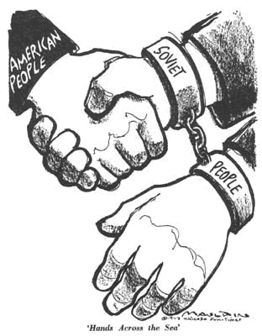
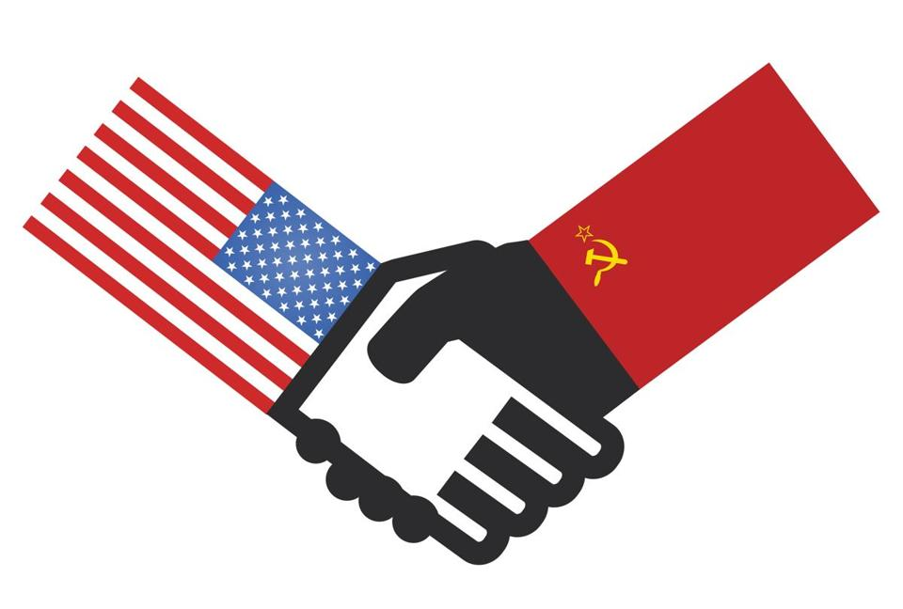
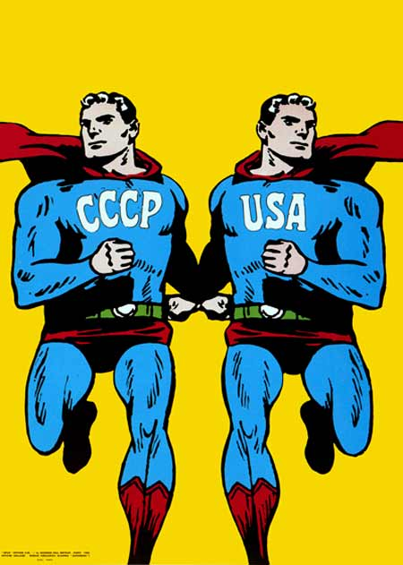
The Roots of the Cold War
The USA and the USSR were allies during WW II, but that would soon change.
Shortly after World War II, the cold war developed mainly as a result of the Soviet domination of Eastern Europe
The roots of the Cold War lay in the competing ideological systems between the U.S.A. and the Soviet Union.
The United States wanted to spread its system of Democracy (the people rule) and free enterprise.
The Soviet Union (USSR or Russia) wanted to see nations adopt Communism (the government rules).

Slide 4
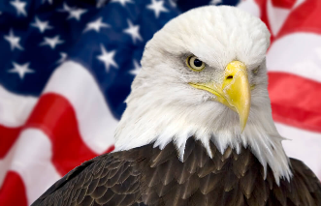


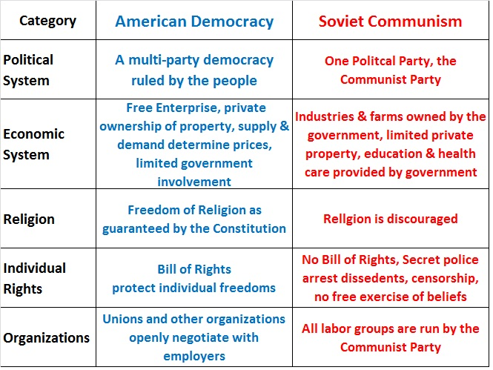
Democracy v. Communism

Slide 5
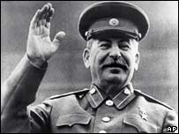
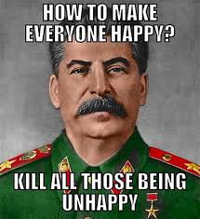
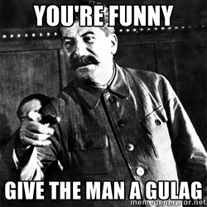
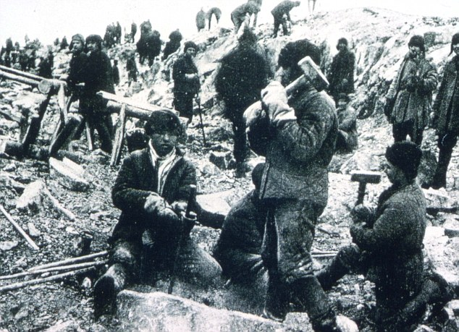
Joseph Stalin
Joseph Stalin, the leader of the Soviet Union, was supposed to create a classless society that helped all workers, instead he established a brutal dictatorship with him having absolute control.
Anyone Stalin considered to be against him, with or without evidence, could be executed, imprisoned or sent to a gulag (forced labor camp) in Siberia.

Slide 6
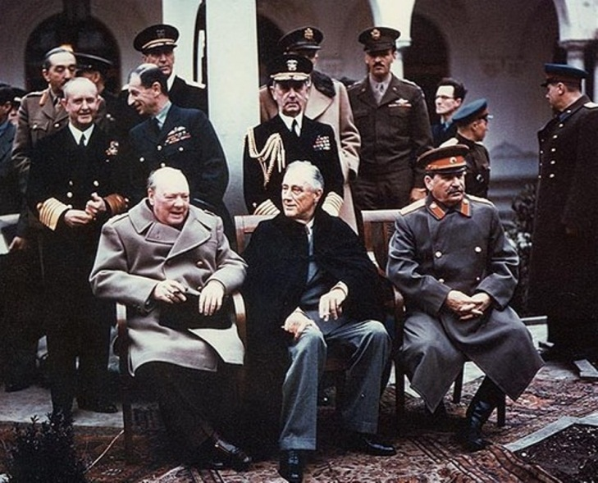
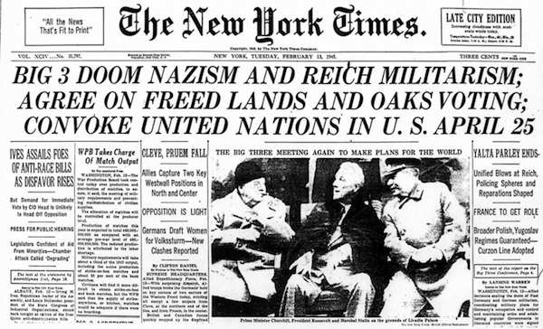
The Yalta & Potsdam Conferences
In February 1945 as the end of the war neared, the Big Three of Roosevelt, Churchill, and Stalin met in Yalta.
They agreed on:
  formation of the United Nations.
  a plan on how Germany would be divided up at the end of the war.
  the nations they had liberated would have free elections.
  Stalin even agreed to let Poland have free elections, ya right!
Later when they met at Potsdam the Big Three disagreed.

Slide 7
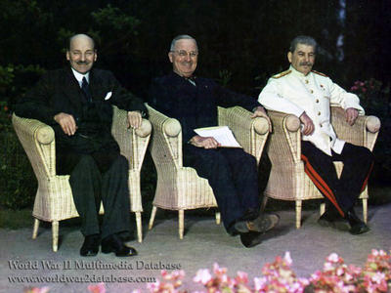
The Cold War Starts
Potsdam Conference-Potsdam, Germany. July- August 1945
Agenda:
1. Treatment of Germany
2. War against Japan
3. the future of Europe
It was here, that Stalin promised
open and free elections in Soviet occupied Europe, starting in Poland.
He lied. Thus the COLD WAR started, here at the Potsdam Conference. US and UK agreed that USSR could not be trusted.
Left to Right: United Kingdom Prime Minister Clement R. Atlee (January 3, 1883 - October 8, 1967) Harry S. Truman (May 8, 1884 – December 26, 1972) and Josef V. Stalin (December 18, 1878 – March 5, 1953)

Slide 8
Topic 8.2 The Cold War 1945-1980
America in the World Diplomatic, economic, cultural, and military interactions between empires, nations, and peoples shape the development of America and America’s increasingly important role in the world.
United States policymakers engaged in a cold war with the authoritarian Soviet Union, seeking to limit the growth of Communist military power and ideological influence, create a free-market global economy, and build an international security system.
As postwar tensions dissolved the wartime alliance between Western democracies and
the Soviet Union, the United States developed a foreign policy based on collective security, international aid, and economic institutions that bolstered non-Communist nations.
Concerned by expansionist Communist ideology and Soviet repression, the United States sought to contain communism through a variety of measures, including major military engagements in Korea.
The Cold War fluctuated between periods of direct and indirect military confrontation and periods of mutual coexistence (or détente).
Compare and contrast US foreign policy at the conclusion of WW1 with that of WW2.

Slide 9
Context: How did we get to an isolationist foreign policy?
World War 1 blood bath, G Washington’s farewell address
How does this compare to USA entry into the Spanish-Amer War 1898?
“Americans often preferred not to think about the terrible war in Europe [the First World War]. By 1917, however, US citizens realized that ignoring the war or pretending it had nothing to do with them imperiled their future.
“. . . They realized that they had run out of options. Between 1914 and 1917, Americans had variously hoped that their nation could serve as an arbiter (as it had during the Russo-Japanese War, earning Theodore Roosevelt the country’s first Nobel Peace Prize), the leader of a global peace movement, the center of international arbitration, and the advocate of worldwide disarmament. By early 1917, however, the majority had come to two conclusions. First, as Charles Fremont Taylor, the editor of a Philadelphia-based magazine, articulated, ‘no nation can be a hermit in these days of steamships, railroads, telegraphs, ocean cables, wireless, etc.’ They no longer believed, as they had in 1914, that the Atlantic Ocean provided the country with sufficient protection from Europe’s wars. Second, they believed that their leaders had tried every option short of war only to find the country in an even more perilous geopolitical position.”
Michael S. Neiberg, historian, The Path to War: How the First World War Created Modern America, 2016

Slide 10
APUSH Topic 8.2 The Cold War 1945-1980
Compare and contrast US foreign policy at the conclusion of WW1 with that of WW2.
USA now adopts a more active foreign policy to limit the spread of communism 1945 -1989
1917-1930s- US adopts isolationist foreign policy towards Europe- does not join the League of Nations
-High Tariffs
-Limits immigration
US seeks to maintain world peace throughout 1920s:
1. Washington Naval Conference
2. The Four- Power Treaty
3. Dawes Plan
4. U$A as a CREDITOR nation
5. Kellogg-Briand Pact
EVIDENCE

Slide 11
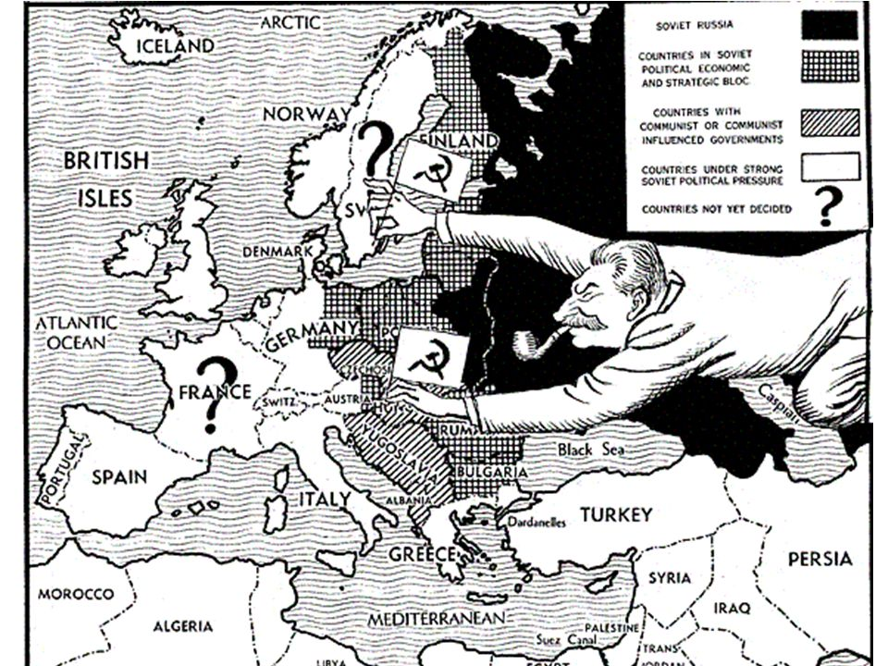

Slide 12
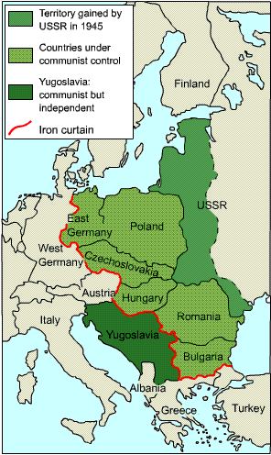
The Cold War Begins, 1945
After World War II, the Soviets saw a growing threat from the capitalist governments in the West.
To ensure a buffer zone between the West and the East, Stalin set up communist governments in these ‘satellite nations’(dependent states) he now controlled.
The Soviets occupied these nations and *prevented free elections, *seized industrial properties and *controlled all parts of the lives of the people of the USSR and eastern Europe nations.
Churchill said an ‘Iron Curtain’ has fallen over Eastern Europe, cutting it off from the freedoms of the West.

Slide 13
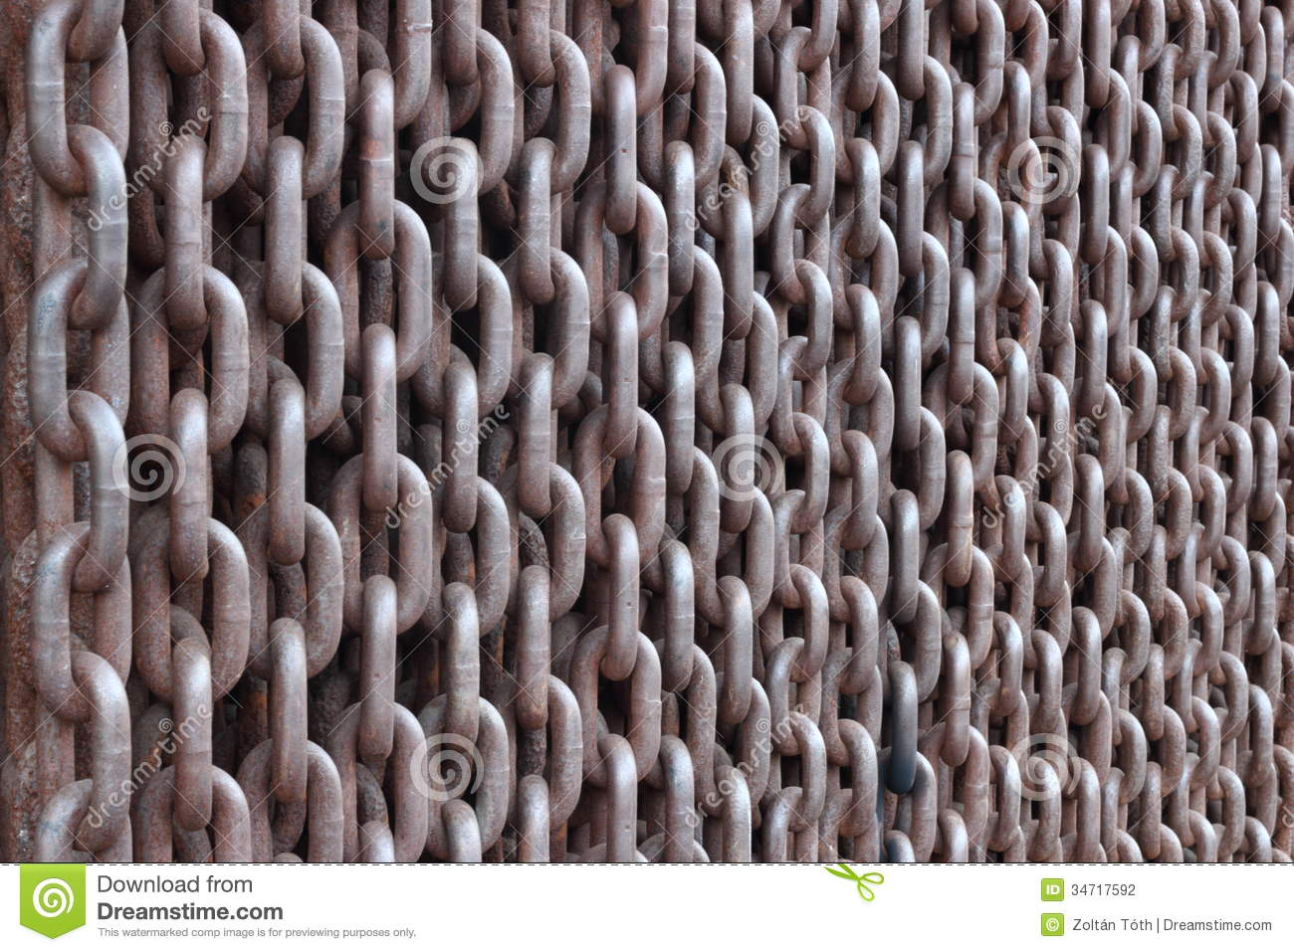
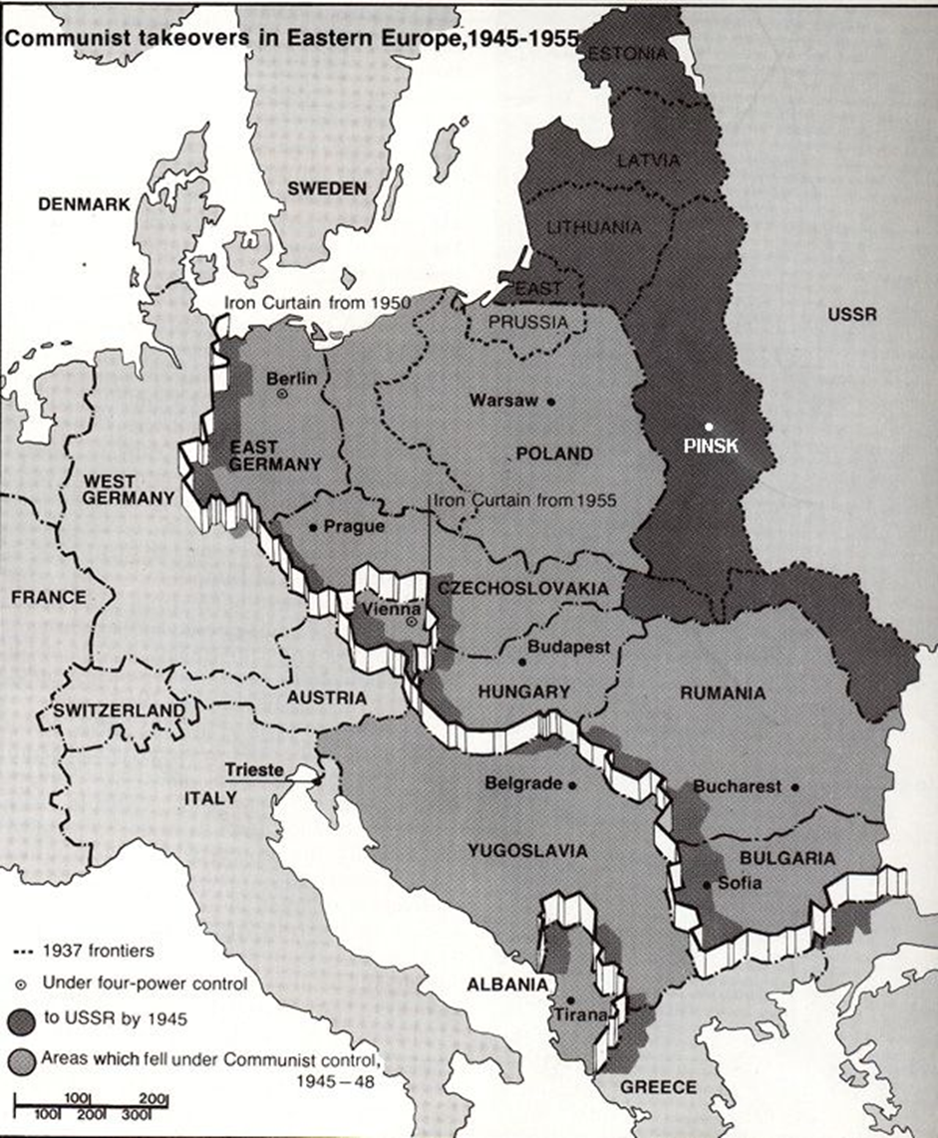
Iron Curtain
political and military barrier that isolated Soviet-controlled countries of Eastern Europe after WWII

Slide 14
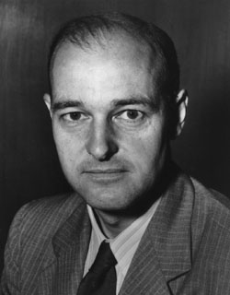
George Frost Kennan
His writings inspired the Truman Doctrine and the U.S. foreign policy of "containing" the Soviet Union. His "Long Telegram" from Moscow during 1946 and the subsequent 1947 article "The Sources of Soviet Conduct" argued that the Soviet regime was inherently expansionist and that its influence had to be "contained" in areas of vital strategic importance to the United States. These texts provided justification for the Truman administration's new anti-Soviet policy. Kennan played a major role in the development of definitive Cold War programs and institutions, notably the Marshall Plan.
George Frost Kennan

Slide 15
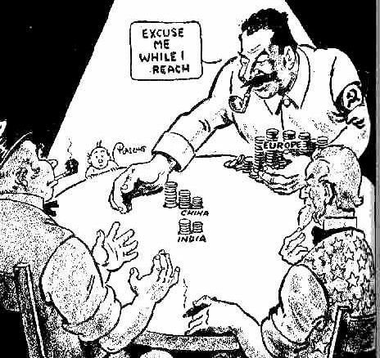

Slide 16
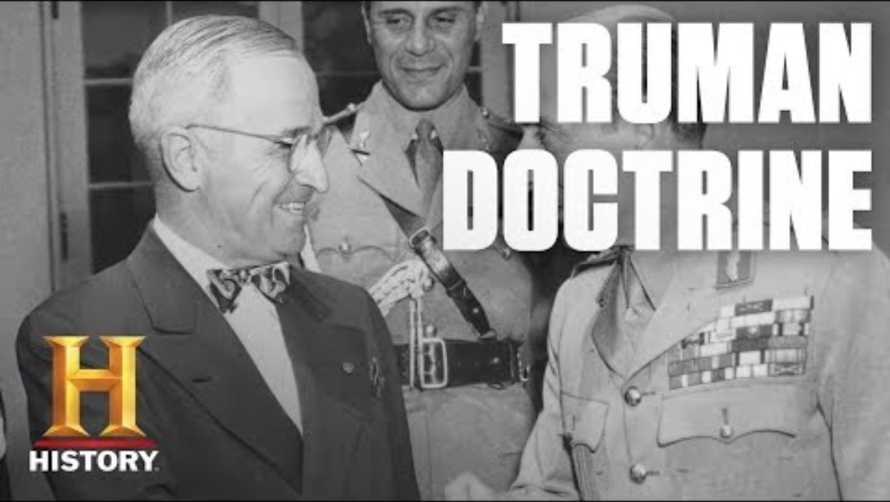

Slide 17
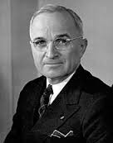
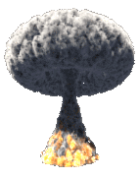
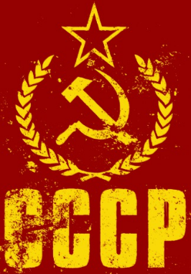
The Truman Doctrine 1947
Containment Policy- to stop (limit) the spread of communism.
Included: economic and military aid to any nation threatened by communist take over in Europe.
When Communist rebels threatened to take Greece and Stalin threatened Turkey, Pres. Truman decided to offer these two nations military aid.
Truman did not want to make the same mistake Britain and France made in trying to appease Hitler by giving into their demands.
Truman promised to support any country fighting Communism.
“I believe it must be the policy of the U.S. to support free peoples who are resisting attempts by armed minorities or by outside pressures.”

Slide 18
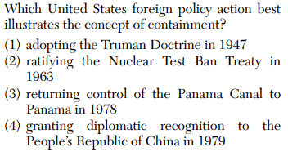
An EOC Moment

Slide 19
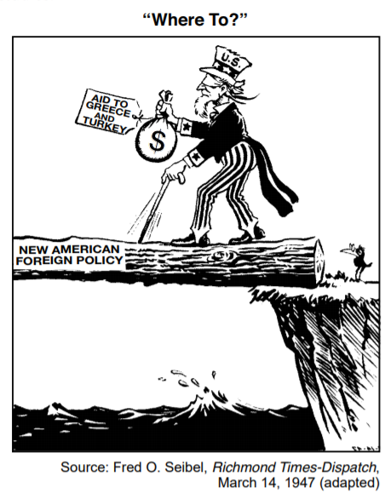
An EOC Moment
The point of view expressed by this cartoonist is that this “new” United States foreign policy is
(1) risky and may not succeed
(2) certain to lead to another war
(3) a violation of the United Nations Charter
(4) too expensive to support
Which United States foreign policy is being
referred to in this cartoon?
(1) Neutrality Act (3) Truman Doctrine
(2) Atlantic Charter (4) Manhattan Project

Slide 20
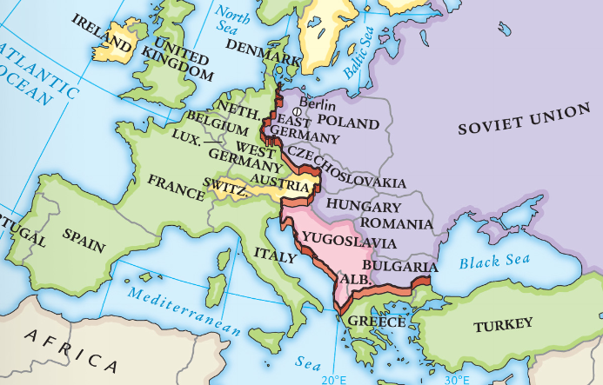
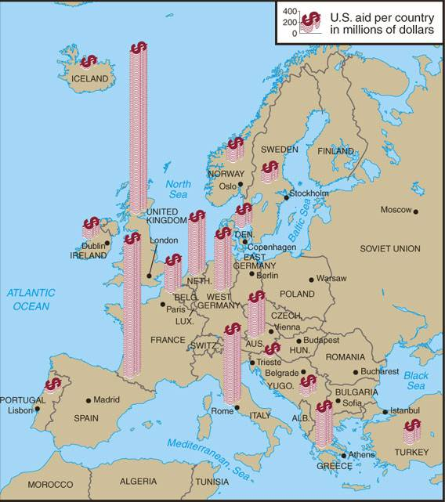
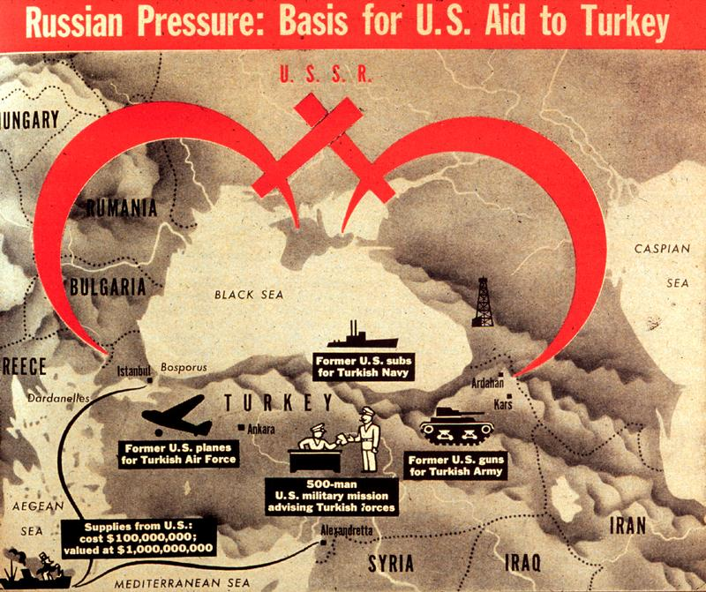
From 1945 to 1949, President Truman used containment to successfully stop the spread of communism in Europe
Marshall Plan
Berlin Airlift
Truman Doctrine

Slide 21
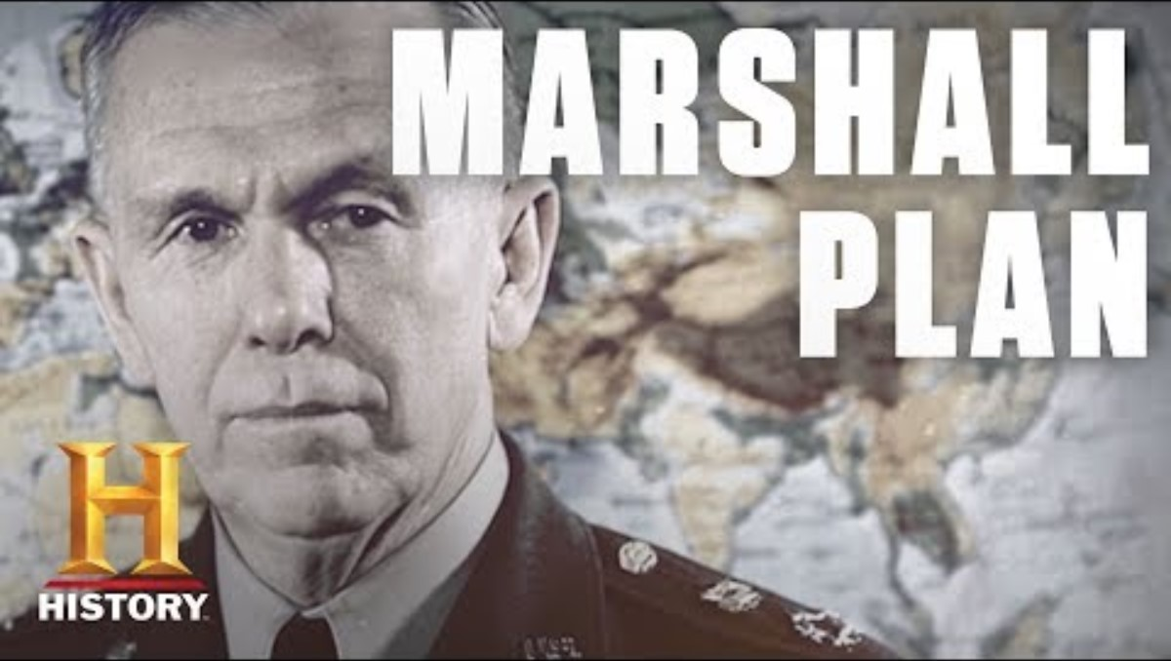

Slide 22
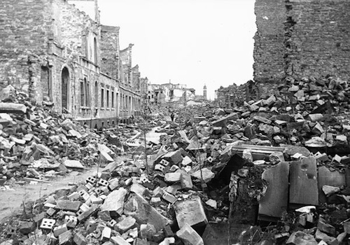

The Marshall Plan, 1948
After World War II, most of Europe was in shambles and many faced famine.
Entire cities were destroyed & farm production non-existent.
Pres. Truman believed people who were desperate might be attracted to Communism.
Secretary of State George Marshall proposed a plan to aid these war-torn nations of Europe.

Slide 23


The Marshall Plan, 1948
Sect. of State George Marshall believed that economic aid would create strong European allies and trading partners for the U.S.A. and prevent the spread of communism into Western Europe
Unlike WW I, where the enemy was treated severely, this plan also included helping to rebuild Germany and Italy.
The Marshall Plan was successful in rebuilding Europe and also in benefitting the American economy by raising US farms & factories production levels to new highs. Total cost $12.7 billion.
How did this plan benefit the USA?

Slide 24

The Marshall Plan, 1948

Slide 25


$12.7 billion total sent to Europe

Slide 26

The Marshall Plan, 1948

Slide 27

The Division of Germany
At the end of WW II, Germany was divided into an eastern bloc and a western bloc.
The Soviets controlled the eastern bloc, East Germany.
The USA, Britain, & France controlled the western bloc aka West Germany.
The city of Berlin was located entirely within the country of East Germany.
Berlin itself was divided into a West Berlin and an East Berlin
The ‘iron curtain’ separated east from west Communism from Democracy

Slide 28

Berlin: a Divided City
This map shows how Germany was divided as a country.
This map shows how Berlin was divided as a city.
This small white area shows that the city of Berlin is located inside of East Germany.

Slide 29


The Berlin Blockade & the Berlin Airlift
Berlin is located entirely within communist East Germany.
In 1948 the USA had created the Federal Republic of Germany (West Germany, capital city in Bonn). The USSR saw this as a threat
The USSR responded by limiting access to U.S. sector of the city.
The U.S. had been trucking in all needed supplies to West Berlin before this ‘Berlin Blockade’ by the Russians.
The U.S. responded to this blockade with the ‘Berlin Airlift’.
The U.S. flew tons of food, fuel, and other materials into West Berlin.

Slide 30

The Berlin Blockade & the Berlin Airlift

Slide 31



The Berlin Blockade & the Berlin Airlift
Uncle Wiggly Wings
https://www.pbs.org/wgbh/americanexperience/features/airlift-gail-halvorsen/

Slide 32

The Soviets are seen as taking over all of Berlin and closing off all roads to west Berlin. The Allies responded by the Berlin airlift. Between
June 24, 1948 – May 12, 1949 the US Airforce spent $224 million and delivered 2,323,738 tons of food, fuel, machinery, and other supplies. The end to the blockade was brought about because of countermeasures imposed by the Allies on East German communications and, above all, because of the Western embargo placed on all strategic exports from the Eastern bloc. As a result of the blockade and airlift, Berlin became a symbol of the Allies’ willingness to oppose further Soviet expansion in Europe.
https://www.britannica.com/event/Berlin-blockade

Slide 33




N.A.T.O. - North Atlantic Treaty Organization
In response to the Soviets blockade of Berlin, the U.S.A. and other non-communist nations that surrounded the North Atlantic Ocean, formed a military alliance called NATO in 1949.
NATO was based on the concept of collective security, where each NATO member pledged to defend other NATO nations from attack.
The Soviet Union responded by creating the Warsaw Pact with its eastern allies and satellite nations in 1955.

Slide 34

NATO was a pro democratic alliance system consisting of the U.S. as its strongest member. The Warsaw Pact was a conglomeration of Eastern European Pro- Soviet communist (Eastern Bloc) countries. These nations were united together in an all for one alliance. If one of them were attacked it would be like an attack against all of them this was called COLLECTIVE SECURITY.
Did the creation of NATO and Warsaw Pact make Europe Safer?
These nations had very different ideologies and saw each other as the enemy, each trying to advance its own political agenda.

Slide 35


Slide 36


Slide 37

NATO

Slide 38


Containment FAILED in Asia
America believed the policy of containment was working and stopping the spread of Communism in Europe.
Then in 1949, China the world’s most populous nation became communist.
Communist China led by Mao Zedong, and helped by the Soviets, overthrew the Nationalist government. Non-communist Chinese flee to Taiwan and establish a new government in exile.
Pres. Truman refused to recognize the Communist government in China.
The U.S. also prevented Red China from entering the United Nations.
Instead, U.S. puts Taiwan in the UN Security Council as a permanent member. USSR protests and walks out of UN. Costly Mistake on their part.

Slide 39


The Korean War aka Police Action, 1950-1953
The Korean War is referred to as a POLICE ACTION because Congress never declared war.
Korea, a former colony of Japan, was divided into two zones after World War II.
North Korea became a communist nation supported by China and the U.S.S.R..
South Korea became a democratic nation supported by the U.S.A..
The dividing line was the 38th Parallel line.
General Douglas MacArthur was Supreme Allied Military Commander in the Pacific and would soon lead the defense of South Korea.

Slide 40





The Korean War was a proxy war
A proxy war is a conflict instigated by opposing powers who do not fight against each other directly. Instead, they use third parties to do the fighting for them. ... However, a direct large-scale war between them would cause enormous damage to all belligerent powers.
Behind the scenes, the Soviets and the Chicoms were arming and financing North Korea to fight South Korea and the USA
1950, North Korea invaded the South.
These aggressive actions reminded Pres. Truman of the Nazi during WW II.
Pres. Truman sent U.S. troops into South Korea to resist the invasion.
The U.S. was able to pass a resolution in the United Nations to send U.N. troops (mostly Americans) to South Korea. First time USA fought as a member of United Nations forces.
USSR did not VETO the UN Security Council resolution to stop North Korea. USSR was boycotting UN Security Council in protest over its failure to sit communist China on the Council
Korean War became the first war to use an international peace keeping force (United Nations) to halt an aggression.
Cold War just turned HOT

Slide 41

The Korean War 1950-1953

Slide 42




Who are those guys?

Slide 43


Korean War 1950-53
International Intervention
The Korean War further split the world along ideological lines with some nations such as China and the Soviet Union supporting the North's communist regime while other countries such as the US and Australia supported the South's capitalist government. The ideological differences were most visible at the UN where the Chinese representative openly stated that the nation was willing to intervene in the conflict if the US got involved. The UN sent forces to the Korean War to aid the South Koreans. However, the UN forces were forced to retreat after the Chinese troops crossed the border and began playing a more active role in the war.
-Benjamin Elisha Sawe
WorldAtlas.com
The Korean War is referred to as a POLICE ACTION because Congress never declared war.
21 Countries under the UN umbrella and under US command fought in Korea.
The very thing, Senator Henry Cabot Lodge warned against in rejecting the Treaty of Versailles and the League of Nations

Slide 44


Korean War 1950-53
1) USA
2) Great Britain
3) Canada
4) Turkey
5) Australia
6) Philippines
7) Thailand
8) the Netherlands
9) Colombia
10) Greece
11) New Zealand
12) Ethiopia
13) Belgium
14) France
15) South Africa
16) Luxemburg
Medical units and aid were sent from these 5 countries:
17) Sweden
18) Denmark
19) India
20) Norway
21) Italy

Slide 45


Slide 46


Henry Cabot Lodge & George Washington had what in common when it came to US foreign policy?

Slide 47


Slide 48


The Truman-MacArthur Controversy
Pres. Truman sent General Douglas MacArthur to command U.S. forces.
MacArthur landed at Inchon, surprising the North and advancing northward to the Yalu River on China’s border with North Korea.
The Chinese became alarmed and sent large numbers of troops to aide the North.
MacArthur wanted to liberate China from Communist control by invading China, even if it took the A-bomb!

Slide 49


The Truman-MacArthur Controversy
Pres. Truman disagreed with MacArthur over the issue of invading China and the use of the bomb.
Gen. MacArthur made the mistake of criticizing Pres. Truman in a letter that went public.
Pres. Truman relieved MacArthur of his command believing it was necessary to keep civilian control over the military.

Slide 50





Rockets & Missiles were vogue & cars had fins, Rock n’ Roll was in
Greatest Hits 1950
1. "Goodnight Irene Gordon Jenkins & The Weavers
2. "Mona Lisa“ Nat King Cole
3. "Third Man Theme" Anton Karas
No. 1 TV Show 1950-56

Slide 51


In the Movies…..
December 21, 1949 Samson & Delilah was released to movie theatres. Top box office earner for Paramount Studios.

Slide 52


Dwight Eisenhower was elected president in 1953
& served until 1961
Eisenhower was a war hero who planned the D-Day invasion during World War II
His military experience gave Americans confidence that
he could face the threat of the USSR during the Cold War
Ike campaign commercial

Slide 53


End of the Korean War
1952, Dwight Eisenhower is elected President of U.S.A..
“Ike” was popular and won on the campaign promise of ending the war.
1953, the U.S. and North Korea signed an armistice ending hostilities.
The agreement called for a DMZ, (demilitarized zone) as a buffer between the two Koreas at 38th Parallel.—STALEMATE. The agreement was signed at Panmunjom, a village sitting on the DMZ
The result of the war was that the border between the two, remained the same as before the war began. Korea remains divided.
No official peace treaty has ever been signed with North Korea. Officially, a state of war still exist to this day.

Slide 54


Seesaw in Korea

Slide 55
Effects of Korean War
Confirmed domestic anxieties about the threat of communism and the Soviet Union and China
Led to a sustained period of Cold War tensions
Extended use of the Selective Service System (the draft) from 1950 through the 1960s and the service of millions in the Armed forces at home and abroad in this period

Slide 56

An EOC Moment

Slide 57


Korean war movies:
Porkchop Hill
Free on youtube
https://www.youtube.com/watch?v=hDhPE6bEy9o

Slide 58

Korean War Memorial, Washington D.C.

Slide 59


Slide 60
Nuclear Proliferation and the Arms Race
Nuclear Proliferation refers to the spread of nuclear weapons and technology.
This is dangerous for several reasons:
Tremendous destructive power of nuclear weapons
With the spread of this technology comes the increase likely hood that someday they could be used
Accidental explosion
Terrorists obtaining such weapons

Slide 61



Nuclear Proliferation and the Arms Race
In 1945 at the end of WW II, the U.S.A. was the sole atomic power in the world.
The U.S. refused to give up the secret of the bomb.
By 1949, the U.S.S.R. had developed their own A-bomb.
The nuclear ‘arms race’ had begun.
1952 the USA develops the hydrogen bomb. Much more powerful than any A-bomb. Less than a year later. USSR exploded their H-bomb.
During the 1950s, the U.S. leaders decided to rely more on nuclear weapons for defense, rather than building up a large military force.

Slide 62



In the 1950s, President Eisenhower escalated the Cold War by using brinkmanship: threatening to use nuclear weapons & willingness to go to the brink of war in order to force your opponent to back down.
If the USSR attacked a
NATO member,
the U.S. would use massive retaliation: attack every major Soviet city & military target
Arms Race
Arms Race
As a result,
the USA & USSR began stockpiling nuclear weapons & building up their militaries

Slide 63


In 1952, the USA tested the first hydrogen bomb which
is 1,000 times more powerful than the atomic bomb
The Soviet Union responded by detonating its own hydrogen bomb in 1953
Arms Race

Slide 64



With the USA & USSR in possession of large nuclear stockpiles, each side could destroy each other:
this was known as Mutually Assured Destruction (MAD)
Throughout the Cold War, the USA & USSR looked for ways to gain first strike capability

Slide 65



Massive Retaliation
The U.S. used its nuclear weapons as a deterrent to stop the U.S.S.R. from attacking.
The reason it worked was because we threatened to ‘nuke’ the Russians if they attacked us.
Massive retaliation was cheaper than a large military, but it doesn’t always work in every situation.
Soon we realized that such mass destruction could only be used if our nation’s survival was at stake.
MAD-Mutually Assured Destruction

Slide 66

How is this cartoon trying to explain that without the missiles there would be an actual war?
Since both sides are armed with the latest nuclear weapons, none dare use them because it would MUTUALLY ASSURE their DESTRUCTION

Slide 67





By 1959, both the USA & USSR developed rockets called intercontinental ballistic missiles (ICBMs) that could deliver nuclear warheads to distant targets
U.S. Polaris Submarine
Soviet Transporter Erector Launcher (TEL)
U.S. Titan ICMB from the 1960s
Soviet ICMBs from 1960-1975

Slide 68

Massive Retaliation
A nuclear triad refers to the nuclear weapons delivery of a strategic nuclear arsenal which consists of three components: land-based intercontinental ballistic missiles (ICBMs), strategic bombers, and submarine-launched ballistic missiles (SLBMs).

Slide 69

Americans Fear a Nuclear Attack

Slide 70








To combat American fears of a nuclear attack, the U.S. government responded in several ways
National and local governments prepared citizens for a Soviet nuclear attack on the United States
Citizens built fallout shelters in their backyards
Radioactive particles dispersed by a nuclear explosion.
Cities and schools practiced building evacuations and “duck & cover” drills

Slide 71

duck & cover

Slide 72



Massive Retaliation
US nuclear bomber deployments, 1945-1958
USSR
China
USSR

Slide 73







Fears of a nuclear attack and spread of communism led to a 2nd Red Scare in the late 1940s & 1950s
A Quick Overview
Americans grew worried about Communists
& Soviet spies living in America
The Loyalty Review Board was created to investigate & dismiss “disloyal” government employees
The House Un-American Activities Committee (HUAC) investigated suspected communists in the entertainment & other industries
From 1947-1951, 3.2 million gov’t employees were investigated & 212 were dismissed as security risks (2,900 resigned rather than face investigation)
Notes:
Appearing before HUAC committee: from left to right: Ronald Reagan, Jackie Robinson, Walt Disney, Ayn Rand

Slide 74
HUAC
House Un-American Activities Committee
Bomb the Communists
Are You Now, or Have You Ever Been a Member of the Communist Party?
I See Communists

Slide 75




The Cold War on the Home Front- The 2nd Red Scare
Following World War II, Americans feared a Communist takeover from within the U.S.A., another (2nd) Red Scare.
Pres. Truman ordered creation of Loyalty Review Boards to investigate un-American activities, like being in the Communist Party.
Many Americans were accused of ‘un-American’ activities, often with little evidence they were Commies.
These investigation often violated an individual's constitutional rights.

Slide 76





House Un-American Activities Committee
The “House Un-America Activities Committee” aka HUAC was created by Congress to identify current or former members of the Communist party.
HUAC investigated the “Hollywood Ten” made up of movie actors, directors, and writers about their possible Communist sympathies.
Those identified as commies were ‘blacklisted’,and lost their jobs.
Some like Alger Hiss were prosecuted, others were asked to inform on others.
Hollywood 10

Slide 77


Hollywood Ten
The “House Un-America Activities Committee” aka HUAC was created by Congress to identify current or former members of the Communist party.
HUAC investigated the “Hollywood Ten” made up of movie actors, directors, and writers about their possible Communist sympathies.
Hollywood 10

Slide 78


Slide 79



Red Scare fears in America were heightened by the discovery of spies working for the USSR:
State Department employee Alger Hiss
was convicted of
spying for the USSR
Julius & Ethel Rosenberg were executed for passing atomic bomb secrets to the USSR

Slide 80



Slide 81



The McCarthy Hearings
In the 1950s, Senator Joseph McCarthy led the hunt for Communists in America!
McCarthy used his power, unproven claims, and wild accusations as he ruined the lives of people he claimed were communists.
McCarthy claimed to have hundreds of names of communists and created an air of fear like the Red Scare of the 1920s, but he never provided any real proof.
Like the Red Scare of the 1920s, many Americans civil rights were violated.
If you dissented (disagreed with the government, you were considered disloyal and a RED).
The bullying tactic used to destroy a person’s reputation without evidence is called McCarthyism.

Slide 82



In 1950, Wisconsin Senator Joseph McCarthy emerged as the leader of the anti-communist Red Scare
He attacked Truman for allowing communists to infiltrate the government
He used public trials
to make unsupported accusations against suspected communists in the State Department & the U.S. military
“McCarthyism” did not result in a single confirmed communist or spy in the U.S. gov’t

Slide 83

The political cartoon “Red Smear” appeared in 1949, when government officials were prosecuting communists and others for subversive activities.
The cartoonist’s is depicting that the search for communists was indiscriminate and unfair and that anyone might be accused.
What is the cartoonist’s attitude toward the attempt to uncover communists?

Slide 84

Hysteria of Fear
Hysteria- exaggerated or uncontrollable emotion or excitement, especially among a group of people.
The mass hysteria created by the Red Scare, threatened the civil liberties of Americans.
Red Scare Psychosis- mental disorder in which thought, and emotions are so impaired that contact is lost with external reality.
Coping Mechanism
To calm these fears the US gov gave Americans remedies-
Duck and Cover
Fall out Shelters
Both of which were useless but like a baby’s security blanket, many American felt better.

Slide 85



At least we got a good book and a play out of the RED SCARE
THE CRUCIBLE, Jan 1953
https://www.pbs.org/wnet/americanmasters/arthur-miller-elia-kazan-and-the-blacklist-none-without-sin-why-arthur-miller-wrote-the-crucible/5911/#:~:text=During%20the%20tense%20era%20of,radical%20leftist%20activity%20in%20America.

Slide 86

An EOC Moment
Which factor is most closely associated with McCarthyism?
A. buildup of Soviet missiles in Cuba
B. fear of communist influence in the United States
C. rise of the Communist Party in China
D. creation of the Warsaw Pact by the Soviet Union

Slide 87



Eisenhower Doctrine
The Cold War Continues Under Eisenhower
Eisenhower sends aid to France, then fighting the communist in Vietnam
CIA trains rebels to overthrow communist govt in Guatemala
US pledges to defend Taiwan from Chicoms
USSR puts down rebellion in communist
Hungary (1956) USA does nothing. Why?
Because of a potential nuclear showdown
with the USSR in Europe.
Pres. Eisenhower gave control of foreign policy to John Foster Dulles, a devoted anti-Communist who wanted to stop the spread of Communism and prevent Soviets from gaining additional influence.
Under Dulles direction, Pres. Eisenhower announced he would send U.S. troops to any Middle East nation asking for help in fighting Communism.
This policy became known as the Eisenhower Doctrine.

Slide 88






U.S.-Soviet relations changed in 1953 when Stalin died after 30 years of absolute rule over the Soviet Union
Nikita Khrushchev
took over and began to aggressively challenge
U.S. influence in the world
In 1955, Khrushchev formed a communist alliance to rival NATO, called the Warsaw Pact
  In 1956, the Soviet Union threatened expansion into the Middle East
Eisenhower Doctrine was an extension of the Truman Doctrine (Containment) into the Middle East to protect the Suez Canal.
President Eisenhower responded with the
Eisenhower Doctrine (1957), pledging the USA to protect the Middle East from Communism

Slide 89

Soviet Union
China
Atlantic
Ocean
Africa
India
Pacific
Ocean
Brazil
Indian
Ocean
Australia

Slide 90

Quick Class Discussion:
Which part of the world did the U.S. promise to protect
in the (a) Monroe Doctrine, (b) Roosevelt Corollary,
(c) Truman Doctrine, and (d) Eisenhower Doctrine?

Slide 91




Spy Craft
CIA- USA Spy agency- Central Intelligence Agency
Kiss of Death
KGB- Komitet Gosudarstvennoy Bezopasnosti -Committee for State Security Soviet (Russian) Spy Agency and State Security Police

Slide 92



Spy Craft
CIA- USA Spy agency- Central Intelligence Agency
Minox camera
Microdot camera
The secret transfer of documents became very difficult during the Cold War. Agents relied on the microdot camera to photograph and reduce whole pages of information onto a single tiny piece of film. This piece of film could be embedded into the text of a letter as small as the period at the end of this sentence.
Microdots were also hidden in other things such as rings, hollow coins, or other mailed items. The recipient would read the microdot with the aid of a special viewer, often cleverly concealed as well.
https://www.cia.gov/legacy/museum/artifact/microdot-camera/

Slide 93



In 1957, the USSR used its first ICBM to launch Sputnik, the first satellite into space
Sputnik shocked Americans who feared the U.S. had fallen behind the USSR in science & technology
As a result of Sputnik, the Cold War escalated into a space race to show American & Soviet dominance

Slide 94
In 1957, the USSR used its first ICBM to launch Sputnik, the first satellite into space
Sputnik shocked Americans who feared the U.S. had fallen behind the USSR in science & technology
As a result, USA feared that the same rocket used to launch Sputnik, could also deliver a nuclear warhead any where in the world in minutes.

Slide 95



Slide 96


  The U.S. government reacted to Sputnik by
  passing the National Defense Education Act
  to promote math, science, and technology education and to fund university research

Slide 97

Trade Offs & Opportunity Costs
The cartoon shows one man (Eisenhower) saying to another Well, I Got That In, All Right as
they leave the budget building.
• It shows a missile (labeled Missile Programs jammed into the budget building.
• Cars labeled Civilian Services, Limited War Capabilities, Space Development, School
Construction, and Welfare Programs are falling off the cliff below the house.
Inferences:
• This suggests that the focus on missile programs is at the expense of most other social and
scientific programs.
• The cliff suggests a tie to brinkmanship.
• It can be tied to Document E to show the increasing concerns over the missile race.
• It can be contrasted with Document G which seems to show increasing expenditures on
education.
• It can also be tied to Document H showing the increasing amounts of money spent on defense.
• The impact of Sputnik could also be discussed

Slide 98


From 1945 to 1960, the United States experienced successes and failures in the Cold War with the USSR
Truman successfully contained communism
in Western Europe…
Eisenhower used the CIA & brinkmanship to limit Soviet global influence…
…but saw communism to spread in Asia & the USSR match America’s nuclear weaponry
…but the USSR was winning the space race & Americans were anxious about a nuclear war

Slide 99




In 1958, the USA created National Aeronautics & Space Administration (NASA) to catch up to the USSR
The USSR repeatedly beat the USA in space by launching the first man into orbit & orbiting the moon
NASA’s original seven Mercury astronauts
SPACE RACE

Slide 100




Slide 101


An EOC Moment
• October 4, 1957—Soviet Union launches Sputnik
• April 12, 1961—a Soviet cosmonaut is the first person to orbit Earth
• February 20, 1962—John Glenn is the first American to orbit Earth
• July 20, 1969—Neil Armstrong walks on the Moon
Which conclusion do these events directly support?
(1) The United States was the first to orbit Earth.
(2) The United States space program eventually surpassed the Soviet Union’s program.
(3) The Soviet Union and the United States both militarized space.
(4) Sputnik had little domestic influence on the United States.

Slide 102


The Spirit of Geneva
Eisenhower called for a
slowdown in the arms race and presented to the United Nations an atoms for peace plan. The Soviets also showed signs of wanting to reduce Cold War
They withdrew their troops from Austria and established peaceful relations with Greece and Turkey.
A summit meeting in Geneva, Switzerland, between Eisenhower
and the new Soviet premier, Nikolai Bulganin. At this conference, the U.S.
president proposed an "open skies" policy over each other's territory—open to aerial photography by the opposing nation—in order to eliminate the chance of a surprise nuclear attack. The Soviets rejected the proposal. Nevertheless, the "spirit of Geneva," as the press called it, produced the first thaw in the Cold War. Even more encouraging, from the U.S. point of view, was a speech by the
new Soviet leader Nikita Khrushchev in early 1956 in which he denounced the crimes of Joseph Stalin and supported "peaceful coexistence" with the West.

Slide 103

1960 - The U-2 Affair
On May 1, an American high-altitude U-2 spy plane is shot down on a mission over the Soviet Union.
After the Soviets announce the capture of pilot Francis Gary Powers, the United States recants earlier assertions that the plane was on a weather research mission.

Slide 104
The U-2 Affair
Suffering major embarrassment, Eisenhower was forced to admit the truth behind the mission and the U-2 program, although he refused to publicly apologize to Khrushchev.
This refusal caused the Paris Summit to collapse when Khrushchev stormed out of negotiations.
Powers was sentenced to ten years in prison, including seven years of hard labor, following an infamous show-trial.
He served less than two years, however, and was released in 1962 in exchange for Soviet spy Rudolf Abel.

Slide 105





Spy Craft
The FBI- Federal Bureau of Investigation
The FBI is the chief federal law enforcement agency. They are tasked not only enforcing federal law in all 50 states but also tasked with counterintelligence- tracking down foreign spies in the USA. During the Cold War they were very busy.
Rudolph Abel (left) was arrested by the FBI in 1957. He was later traded for American U2 spy plane pilot Francis Gary Powers (right) in 1962
Rudolph Abel used the hollowed nickel to transport microdot documents.
https://www.youtube.com/watch?v=fmKcqP_O53g
https://www.fbi.gov/history/famous-cases/hollow-nickel-rudolph-abel/

Slide 106

Spy Craft
Rudolph Abel (left) was arrested by the FBI in 1957. He was later traded for American U2 spy plane pilot Francis Gary Powers (right) in 1962
Rudolph Abel used the hollowed nickel to transport microdot documents.

Slide 107


Eisenhower's Legacy 1953-1961
After leaving the White House, Eisenhower claimed credit for checking Communist aggression and keeping the peace without the loss of American lives in combat. He also started the long process of relaxing tensions with the Soviet Union. In 1958, he initiated the first arms limitations by voluntarily suspending above-ground testing of nuclear weapons.
"Military-Industrial Complex" In his farewell address as president, Eisenhower spoke out against the negative impact of the Cold War on U.S. society. He warned the nation to "guard against the acquisition of unwarranted influence. . . by the military-industrial complex." If the outgoing president was right, the arms race was taking on a momentum and logic all its own. It seemed to some Americans in the 1960s that the United States was in danger of going down the path of ancient Rome by turning into a military, or imperial, state.
Today, the USA maintains nearly 800 military bases in more than 70 countries and territories abroad—from giant “Little Americas” to small radar facilities. Britain, France and Russia, by contrast, have about 30 foreign bases combined.
"In the councils of government, we must guard against the acquisition of unwarranted influence, whether sought or unsought, by the military-industrial complex. The potential for the disastrous rise of misplaced power exists and will exist."

Slide 108
An EOC Moment
What was one similarity between the Red Scare following World War I and the Cold War following World War II?
A. Fear of communism led to the suppression of the civil liberties of some Americans.
B. Large numbers of Russian revolutionaries settled in the United States.
C. Congressional investigations proved that the Federal Government was heavily infiltrated by Communist spies.
D. Renewed fighting between wartime enemies was a constant threat.

Slide 109
An EOC Moment
The successful launching of Sputnik by the Soviet Union in 1957 signaled the beginning of
A. American fears that the Soviets had achieved technological superiority
B. the Cold War with the United States
C. Soviet aggression in Afghanistan and China
D. disarmament discussions between the superpowers

Slide 110






Kennedy and the Space Race
“We will put a
man on
the moon”
To counter the Soviet space program (Sputnik 1957), JFK (1962) announced America would put a man on the moon before the end of the decade.
In 1962, John Glenn became the first American to orbit the earth.
The Space Race would set the U.S. on a road of exploration and discovery that would greatly improve American’s lives.
In 1969, Neil Armstrong and Buzz Aldrin would walk on the moon.
“One small step for man, one giant leap for mankind”

Slide 111

“We choose to go to the moon. . . and do the other things, not because they are easy, but because they are hard, . . . because that challenge is one that we are willing to accept . . . and one which we intend to win.”
President John F. Kennedy, speech given at Rice University, 1962

Slide 112



JFK, the Space Race, & Technology
Space exploration led to advances in technology that have improved the quality of our lives.
Satellites have improved TV and radio signals and communications with cellular telephones.
Satellites have allowed us to communicate faster, predict the weather and locate places with GPS (Global Positioning Satellite).
Technology can be great, but it can also led to bad consequences.

Slide 113


Eisenhower and John F. Kennedy’s Foreign Policy
JFK opposed communism, pledging to contain it as previous Presidents had.
JFK’s first challenge came from just 90 miles south of Florida, in Cuba.
Fidel Castro led an uprising that overthrew Cuba’s dictator General Fulgencio Batista in 1959.
Fearing a US intervention in Cuba, Castor soon aligned with the Soviet Union and became a communist in 1960.
Under JFK, the U.S.A. would break off relations with Communist Cuba that have lasted to this very day.
US cut off all trade with Cuba and issued a trade embargo.
General Flugencio Batista, President of Cuba before Castro

Slide 114



Slide 115


JFK and ‘The Bay of Pigs’ Invasion, 1961
In the 1950s, Pres. Eisenhower planned an overthrow of Cuba’s dictator Fidel Castro.
The plan included secretly training Cuban exiles on how to invade Cuba. It was to be a covert operation led by Cuban exiles.
Kennedy defeats Nixon (Eisenhower’s VP) in the 1960 election- and becomes President.
Pres. Kennedy continued with the plan, but he refused to provide air support for an invasion that might tie the U.S. to the plan.
The planned invasion site was called the Bay of Pigs.
Cuban exiles landed in Cuba and were defeated by the Cuban military.
The ‘Bay of Pigs’ turned out to be an embarrassing failure for JFK.

Slide 116


April 17-19, 1961 - Bay of Pigs
U.S.-organized invasion force of 1,400 Cuban exiles is defeated by Castro's government forces on Cuba's south coast at the Bay of Pigs.
Launched from Guatemala in ships and planes provided by the United States, the invaders surrender on April 20 after three days of fighting.
Kennedy took full responsibility for the disaster.
Captured Cuban exiles surrender to Castro’s army

Slide 117


What does the old cliché
“watch it blow up in your face”
mean?
of an action, project, or situation go drastically wrong with damaging effects to oneself
As a result of the failure at the Bay of Pigs, the Cold War is going to get worse with the Cuban Missile Crisis
Failure of the Bay of Pigs

Slide 118

Operation Mongoose Nov. 30,1961-?1962
JFK goes ahead with a plan called Operation Mongoose in which gov’t agents worked to disrupt the island’s trade and continued working with mobsters to assassinate Castro. It was a deliberate act of subversion.
Castro survives more than 600(?) assassination attempts created by the CIA
Examples: Exploding cigar, poisoned wetsuit, poisoned milkshake, exploding conch shell, etc.
a systematic attempt to overthrow a government
by using persons working secretly from within

Slide 119

Alliance for Progress
JFK’s pledge of support for Latin America
Considered a “Marshall Plan for brown people”
  $20 billion to support internal improvements
  Supported education and schools
  Built hospitals and promote health care
  Helped distribute land
Pros: helped some
Cons: much abuse and corruption

Slide 120

The Cuban Missile Crisis
In an attempt to counter any new American intervention and to improve the Soviet position in the nuclear arms race, Castro and Khrushchev devised a daring plan: installation of Soviet missiles and nuclear bombers in Cuba

Slide 121

Cuban Missile Crisis: 13 Days in October
The failure of the ‘Bay of ­­­­­­Pigs’ invasion had made the Cubans and the Soviets aware of the U.S.A.’s invasion attempt
The Soviets took steps to help protect Cuba from another invasion attempt by the U.S.
U.S. spy planes flying over Cuba discovered that Cuba was secretly preparing missile sites for nuclear weapons supplied by the Soviet Union
Soviet nukes were 90 miles away.

Slide 122
Cuban Missile Crisis: 13 Days in October
Oct. 14, 1962 – U-2 flights showed 65 sites for offensive medium-range ballistic missiles – could reach the U.S. in 3 minutes
When surveillance photos revealed nukes ready to launch in Cuba, JFK said the U.S. would respond to any attack from Cuba with an all-out nuclear retaliation against the Soviets
JFK ordered a naval quarantine of the island (used the word “quarantine” rather than “blockade” since blockade was an act of war)
Oct. 22 – JFK went on national television informing the Soviets of American policy and demanded their retreat
American forces around the globe went on alert
The world was on the brink of nuclear war

Slide 123

U2 Spy plane photo

Slide 124


Slide 125


Slide 126





Nuclear Chicken
JFK pushes for naval blockade- uses QUARANTINE term because blockades are considered acts of war
Goal:
  Seize any ships going into/out of Cuba
  Force the immediate removal of missiles
The Problem:
  A direct attack on Soviets would be an act of war
  The existence of the missiles were an act of war

Slide 127

Limit of Short range Soviet missiles

Slide 128

13 DAYS
For 13 days in October 1962 the world stood still as the threat of nuclear war gripped the planet
War seemed imminent
The first break in the crisis occurred when the Soviets ships turned back from the blockade

Slide 129



Slide 130

Cuban Missile Crisis
Eventually, the Presidents had worked out a secret agreement
Khrushchev said that he would remove the missiles if the U.S. agreed not to attack Cuba and remove its missiles from Turkey and Italy.
Kennedy publicly agreed to the 1st and privately to the second
For this reason, the USA has never attempted to invade Cuba.
Other historians have said the USA abandoned Cuba in exchange for Berlin.

Slide 131





The Fall Out
Russia blinks!
Russia removes missiles from Cuba
U.S. removes missiles from Turkey
Quarantine ends, but embargo begins
The Bad:
  Khrushchev forced from office
  Kremlin begins nuclear expansion
  The Good:
  U.S. and Russia agree to a test ban treaty. It banned all testing of nuclear weapons except underground. Cold war tensions seemed to easing.
  Establish direct communication link: the red phone- Hot Line
“We’re eyeball to eyeball, and I think the other fellow just blinked.” –Dean Rusk, Secretary of State

Slide 132


Slide 133
An EOC Moment
During the Cold War Era, the easing of tensions between the United States and the Soviet Union resulted in
A. the organization of the Warsaw Pact
B. the invasion of Hungary and Czechoslovakia
C. the Berlin Airlift
D. a treaty banning nuclear tests

Slide 134
An EOC Moment
. . . You have to take chances for peace, just as you must take chances in war. Some say that we were brought to the verge of war. Of course we were brought to the verge of war. The ability to get to the verge without getting into the war is the necessary art. If you cannot master it, you inevitably get into war. If you try to run away from it, if you are scared to go to the brink, you are lost. . . . — Secretary of State John Foster Dulles, Time, January 23, 1956 40 The policy described by Secretary
Dulles was most evident in the later actions of the United States during the
Cuban missile crisis
Nuclear Test Ban Treaty
energy crisis of 1973
Camp David talks between Egypt and Israel

Slide 135

Finger on the BUTTON
This cartoon was posted in October 1962, right after the Cuban Missile Crisis ended, much to the relief of people worldwide. This was created to show the tensions that still exist between the Soviet Union and the United States, and how fragile the relationship between the two world powers really was.

Slide 136

Vasili Arkhipov: The Quiet Hero of the Cuban Missile Crisis
On October 27th, 1961, while things were tense above the surface, they were also tense down below. A US Naval destroyer had spotted a USSR B-59 submarine in international waters around Cuba. In response, they started dropping charges to try and force it to emerge and identify itself.
Considering the very precarious situation on the surface it wasn’t the US’ best or smartest move.
Especially considering the USSR sub in question had no contact with the surface and no knowledge that this wasn’t an actual attack. Captain Savitsky was ready to start a nuclear war then and there, arguing they should deploy their weapon in response. The political officer aboard agreed.
Normally, that’s all that would be needed. They would have deployed the weapon and the consequences would have been catastrophic for the entire world.
But luckily this one time, on board this one sub, there was one other man whose permission was needed. Vasili Arkhipov was chief of the flotilla and his sign-off was required before they could launch the nuclear missiles.
Luckily, for all of us, Arkhipov refused. In doing so, he prevented the beginning of a nuclear war that could have decimated a huge portion of the planet. His refusal undoubtedly changed the course of world history.

Slide 137


From 1949 to 1960, the Cold War escalated as a result of a nuclear arms race, space race, & espionage

Slide 138

Timeline
April 17, 1961- Bay of Pigs Invasion
August 13, 1961- Berlin Wall goes up
October 16, 1962- Cuban Missile Crisis
November 22, 1963- Kennedy is murdered in Dallas
October 1964- Khrushchev is removed from power

Slide 139
Berlin: a Divided City
Although, in the beginning there was no actual wall separating the two sides, Berlin was a divided city.
In the democratic, western half the people lived good, had many choices, and enjoyed life.
In the communist eastern half, life was not as good, the choices in all parts of their lives was limited by the government.
As a result of the huge differences between the two halves of the city, the people living in East Berlin started moving to West Berlin.
The Russians became concerned that too many people were leaving the east for the west and they aimed to stop it!

Slide 140

The Berlin Wall
In August 1961, the Soviets starting building what would become known as the Berlin Wall.
The Berlin Wall was not designed to keep West Berliners out, but to keep the East Berliners in!
USSR was embarrassed by large number of East Berliners leaving to the West. After all communism was better than capitalism
Berlin Wall- a wall of concrete, barbed wire, guarded by machine gun towers
East Berlin
West Berlin
Those who tried to escape from the east to the west were put in prison or shot!
The Berlin Wall became a physical symbol of the iron curtain and the separation of democracy from communism.

Slide 141
Escape From East Berlin

Slide 142







Scenes of the Berlin Wall
An unsuccessful escape attempt
On the left – No Man’s Land on East Berlin side
On the right – West Berliners graffiti the wall
West Berliners look across the wall at the East German guards.
Memorials to East Germans killed attempting to escape to the West.
Even the East German guards want out!
West Berliners look across the wall to sneak a peek at relatives trapped in the east.
Sign warning you that you are leaving free West Germany to the communist East Germany

Slide 143



Friction Behind the Iron Curtain
Although America loudly condemned the Soviets aggressive behaviors after World War II, we never directly intervened behind the Iron Curtain.
The U.S. didn’t directly interfere when the Soviets:
  Suppressed an anti-communist revolution in Hungary (1956).
  Built the Berlin Wall (1961)
  Invaded Czechoslovakia (1968)

Slide 144



Slide 145



New Tools to Combat Communism
To better resist communism, JFK created the Green Beret-special forces army group that would be able to combat communism through guerilla warfare in Asia, Africa and Latin America
Kennedy also started the Peace Corp, in which young Americans provided economic and social assistance to developing countries. It was believed that poverty was the breeding ground for communism. Fight poverty, and communism will not grow.

Slide 146



Jacobo Arbenz, President of
Guatemala 1951-54
How the Cold War Impacted Florida
Florida
It was from Florida that
the CIA was able plan and train exiles to invade and overthrow the Arbenz government in Guatemala
It was from Florida that
the CIA was able plan and train exiles to invade Cuba. Exiles trained in the Everglades, the Keys and in Guatemala to overthrow the Castro govt. The invasion failed.

Slide 147






How the Cold War Impacted Florida
During the Cuban Missile Crisis, US troops flooded into South Florida. Afterwards, US troops used Florida’s tropical forest to train soldiers for Southeast Asia-Vietnam
Castro’s communist dictatorship led to a stream of refugees into the USA. 1959-1962 200,000 Cubans entered the USA. Most of them professionals or business owners. Most settled in Miami.
1965-1973 368,000 Cubans entered the USA. In 1980, Mariel boat lift 100,000 Cubans entered the USA when Castro declared that if any one wanted to leave could do so.

Slide 148


How the Cold War Impacted Florida
In order to counter Soviet gains in space the US looked for a space launching center and Florida’s Cape Canaveral was chosen.
Space Race. The US Air Force acquired Cape Canaveral in 1949. In 1950, it began testing missiles there. In 1958 NASA was formed and the USA entered the Space Race. All US rockets launched into space take off from Cape Canaveral.
Space Race. In 1963, NASA acquired 90,000 acres on nearby Merritt Island, Which became the Kennedy Space Center.

Slide 149

Florida’s Cape Canaveral

Slide 150






Slide 151
SAQ
a. Describes one specific historical difference between the United States reaction to international events following the First World War (1919–1930) and following the Second World War (1945–1960)
b. Describes one specific historical similarity between the United States reaction to international events following the First World War and following the Second World War
c. Explains one specific historical reason for a difference between the United States reaction to international events following the First World War and following the Second World War

Slide 152
SAQ
Describes one specific historical difference between the United States reaction to international events following the First World War (1919–1930) and following the Second World War (1945–1960)
NOTE: Credited responses for A, B, and C must explicitly address international events following both the First and Second World Wars. Some examples that would earn credit, with appropriate elaboration, include:
· The United States embraced isolationism following the First World War compared to after the Second World War when the United States embraced internationalism.
ELABORATE: embraced isolationism and internationalism- provide EVIDENCE, explain
· After the First World War, the United States reduced the size of the military compared to after the Second World War when the United States increased military spending. ELABORATE: why did USA increase miliary spending?
· The United States became more inward-looking (focused on domestic issues) after the First World War compared to after the Second World War when the United States attempted to expand its cultural influence abroad.

Slide 153
SAQ
NOTE: Credited responses for A, B, and C must explicitly address international events following both the First and Second World Wars. Some examples that would earn credit, with appropriate elaboration, include:
b. Describes one specific historical similarity between the United States reaction to international events following the First World War and following the Second World War
·The United States promoted international institutions such as the League of Nations, the UN, and NATO after both the First and Second World Wars.
· The United States pushed for formal international agreements after both the First and Second World Wars (e.g., the Washington Naval Treaty (may refer to Four, Five and/or Nine Power treaties instead) (1922), the North Atlantic Treaty (1949)), SEATO.
· The United States encouraged increased international trade after both the First and Second World Wars.
· American firms benefitted from international munitions sales in each war that bolstered the economy in the postwar.
· The United States engaged in efforts to rebuild postwar Europe (e.g., Dawes/Young plans, Marshall Plan).
· American suspicion of foreign influences (red scares against communism, anti-immigrant attitudes, and/or nativism) followed both the First and Second World Wars.
c. Explains one specific historical reason for a difference between the United States reaction to international events following the First World War and following the Second World War

Slide 154
NOTE: Credited responses for A, B, and C must explicitly address international events following both the First and Second World Wars. Some examples that would earn credit, with appropriate elaboration, include:
c. Explains one specific historical reason for a difference between the United States reaction to international events following the First World War and following the Second World War
· Because the United States was not attacked by a foreign country on domestic soil during First World War compared to the Second World War (i.e., Pearl Harbor), Americans became more disillusioned with the participation in the First World War compared to the Second World War.
· Because the United States was not attacked by a foreign country on domestic soil during First World War compared to the Second World War (i.e., Pearl Harbor), Americans became more engaged overseas in preventing future conflicts after the Second World War.
· Because of the onset of the Cold War at the conclusion of the Second World War, the United States committed to an internationalist stance unlike after the First World War, especially with regard to the containment of communism (e.g., Truman Doctrine, Korean War).
· Because of the onset of the Cold War at the conclusion of the Second World War, the United States (and later the Soviet Union’s) possession of nuclear weapons compelled the United States to assume international responsibilities to which the end of the First World War did not contribute.
· Because many Americans did not have long-term exposure to the horrors of the conflict of the First World War (e.g., trench warfare, industrial war) compared to the horrors exposed to the American public and United States soldiers (e.g., Holocaust, total war) during the Second World War, Americans were more willing to return to traditional isolationism from foreign entanglements.

Slide 155
· Because many Americans did not have long-term exposure to the horrors of the conflict of the First World War (e.g., trench warfare, industrial war) compared to the horrors exposed to the American public and United States soldiers (e.g., Holocaust, total war) during the Second World War, the United States was more committed to preventing the recurrence of warfare through international alliances after the Second World War.
· Because Americans blamed withdrawal from international affairs for the outbreak of the Second World War, the United States led the effort to form the United Nations after the Second World War, unlike the growth of isolationist sentiment after the First World War.
· Because Americans blamed withdrawal from international affairs for the outbreak of the Second World War, Americans were more accepting of joining international organizations after the Second World War compared to the First World War.

Slide 156
END

Slide 157



The Rosenberg Trials
Julius and Ethel Rosenberg were charged with selling national secrets to the Soviet Union (USSR) about how to make the atomic bomb.
In 1950, the Rosenberg's were found guilty and executed for spying.
Like Sacco and Vanzetti many Americans actually doubted the guilt of the Rosenberg's’.
In 1997, the U.S. government released the Venona Papers which proved they had been spying.

Slide 158



The Soviets Launch Sputnik, 1957
Sputnik was the world’s first artificial satellite to be sent into space.
The satellite was small and could do almost nothing, but it was a wake up call for America.
The USA realized we were behind the Russians in space technology.
The ‘Space Race’ had started!
America started placing a higher emphasize on science in schools.
JFK announced that America would soon put a man on the moon because of Sputnik

