Slide 1
ACE the SAQ
A Historical Writing Strategy
John Burkowski Jr.
Academy for Advanced Academics
Adapted and Revised PowerPoint Layout Created by Jessica Jenkins

Slide 2
A GENERAL WRITING APPROACH
In English Language Arts:
Claim
The argument to be proven.
Evidence
The facts and/or paraphrases and quotes used to support the claim.
Commentary
The explanation on how the evidence proves the claim.

Slide 3
How to ace the saq “ACE IT!”
Three sentences for each part of an SAQ question.
A = Answer. You directly answer the question by identifying your historical claim. - Use specific factual information, if applicable.
C = Cite. You briefly define/describe your claim. - Use specific factual information. - In stimulus-based questions, use a word or image component. (“snag a word/image”)
E = Expand. You explain the choice of your historical claim in response to the question and logically connect it to relevant historical developments. “How and why your claim best addresses the intent of the question.”

Slide 4
ACE – a (answer)
Depending on the prompt, this component requires you to directly answer the question by identifying a specific historical claim, general historical assertion, or historical interpretative analysis.
It is here where you confidently establish your historical argument.
It is similar to making a thesis/argument claim in an essay or topic/main idea sentence in a supporting paragraph.

Slide 5
ACE – a (answer)
In a situation of selecting provided options, identify the selected option. [SEE EXAMPLE PERIODIZATION]
In a situation of identifying a similarity or difference, be sure to directly address both components of comparison. [SEE EXAMPLE COMPARISON and EXAMPLE INTERPRETATION]

Slide 6
Ace – c (cite)
Depending on the prompt, this component requires you to directly answer the question by identifying a specific historical claim, general historical assertion, or historical interpretative analysis.
The definition/description should contain specific factual information/evidence directly relevant to the prompt and Answer.

Slide 7
Ace – c (cite)
In a situation where the Answer was identifying a specific historical claim, you should define or describe the claim [SEE EXAMPLE CAUSATION]
In a situation where the Answer was a general historical assertion, you should cite a specific historical event, situation, or event to prove the assertion. [SEE EXAMPLE CONTINUITY/CHANGE OVER TIME]
In a situation where the Answer was a historical interpretative analysis, you should “snag a word or phrase” to substantiate the interpretative analysis. [SEE EXAMPLE INTERPRETATION]
This does not mean to quote a word or phrase.
In a situation where the Answer was identifying a claim from a list of options, you should define/describe the selected option. [SEE EXAMPLE PERIODIZATION]

Slide 8
Ace – e (expand)
This last component requires you to explain how your Answer best addresses the prompt.
Like any writing prompt on the AP exam, there exists an intent and focus to assess historical understanding on a targeted historical learning objective, key concept, and/or historical thinking skill.
These questions are developed by historians and teachers of history. They are inherently designed to directly assess key concepts, but also assess broad historical phenomenon.
The explanation should connect or tie back the Answer to the prompt and fulfill its historical intent.
Why Expand? The explanation of the Answer should include a further connection to a direct or broad historical phenomenon relevant to the intent and focus of the question.

Slide 9
Example CAUSATION
Prompt (Part A): Briefly explain ONE important political response to the sectional conflict over slavery during the 1850’s.
ANSWER: The Kansas Nebraska Act in 1854 was another attempt to settle the sectional conflict over slavery during the 1850’s.
CITE: The act split the Nebraska Territory into two new territories, Nebraska and Kansas, and allowed each territory to determine free state or slave state through popular sovereignty.
EXPAND: Although the Kansas Nebraska Act attempted to settle the conflict over slavery through a more democratic means, it consequently allowed slavery to expand beyond the Missouri Compromise line of 36’30 and was considered a political victory for “slave power.”

Slide 10
Example COMPARISON
Prompt (i.e. Part A): Briefly explain ONE important difference between the Northern regional economy and the Southern regional economy in the period from 1800 to 1850.
ANSWER: The Northern regional economy developed a new industrial and manufacturing base while the Southern regional economy preserved its predominantly agrarian society.
CITE: The Lowell System pioneered manufacturing and mass production in the North while the South continued to expand cash crop plantations, such as cotton.
EXPAND: The increase in factories in the North developed a more fluid wage-earning free labor class whereas the Southern plantation economy preserved the rigid social hierarchy and slave labor.

Slide 11
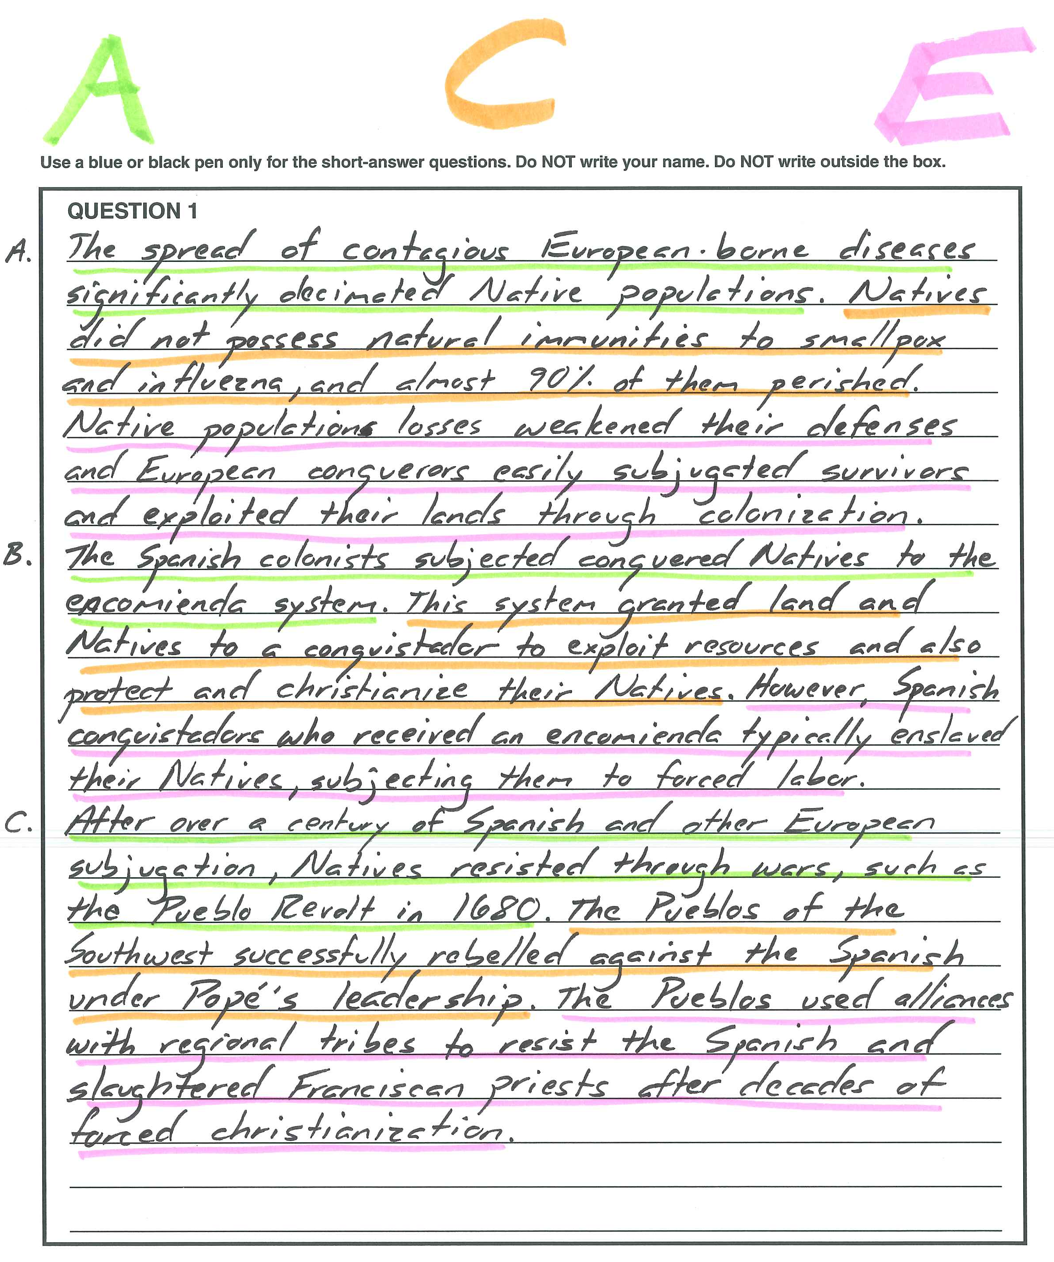
Example CONTINUITY/CHANGE OVER TIME

Slide 12
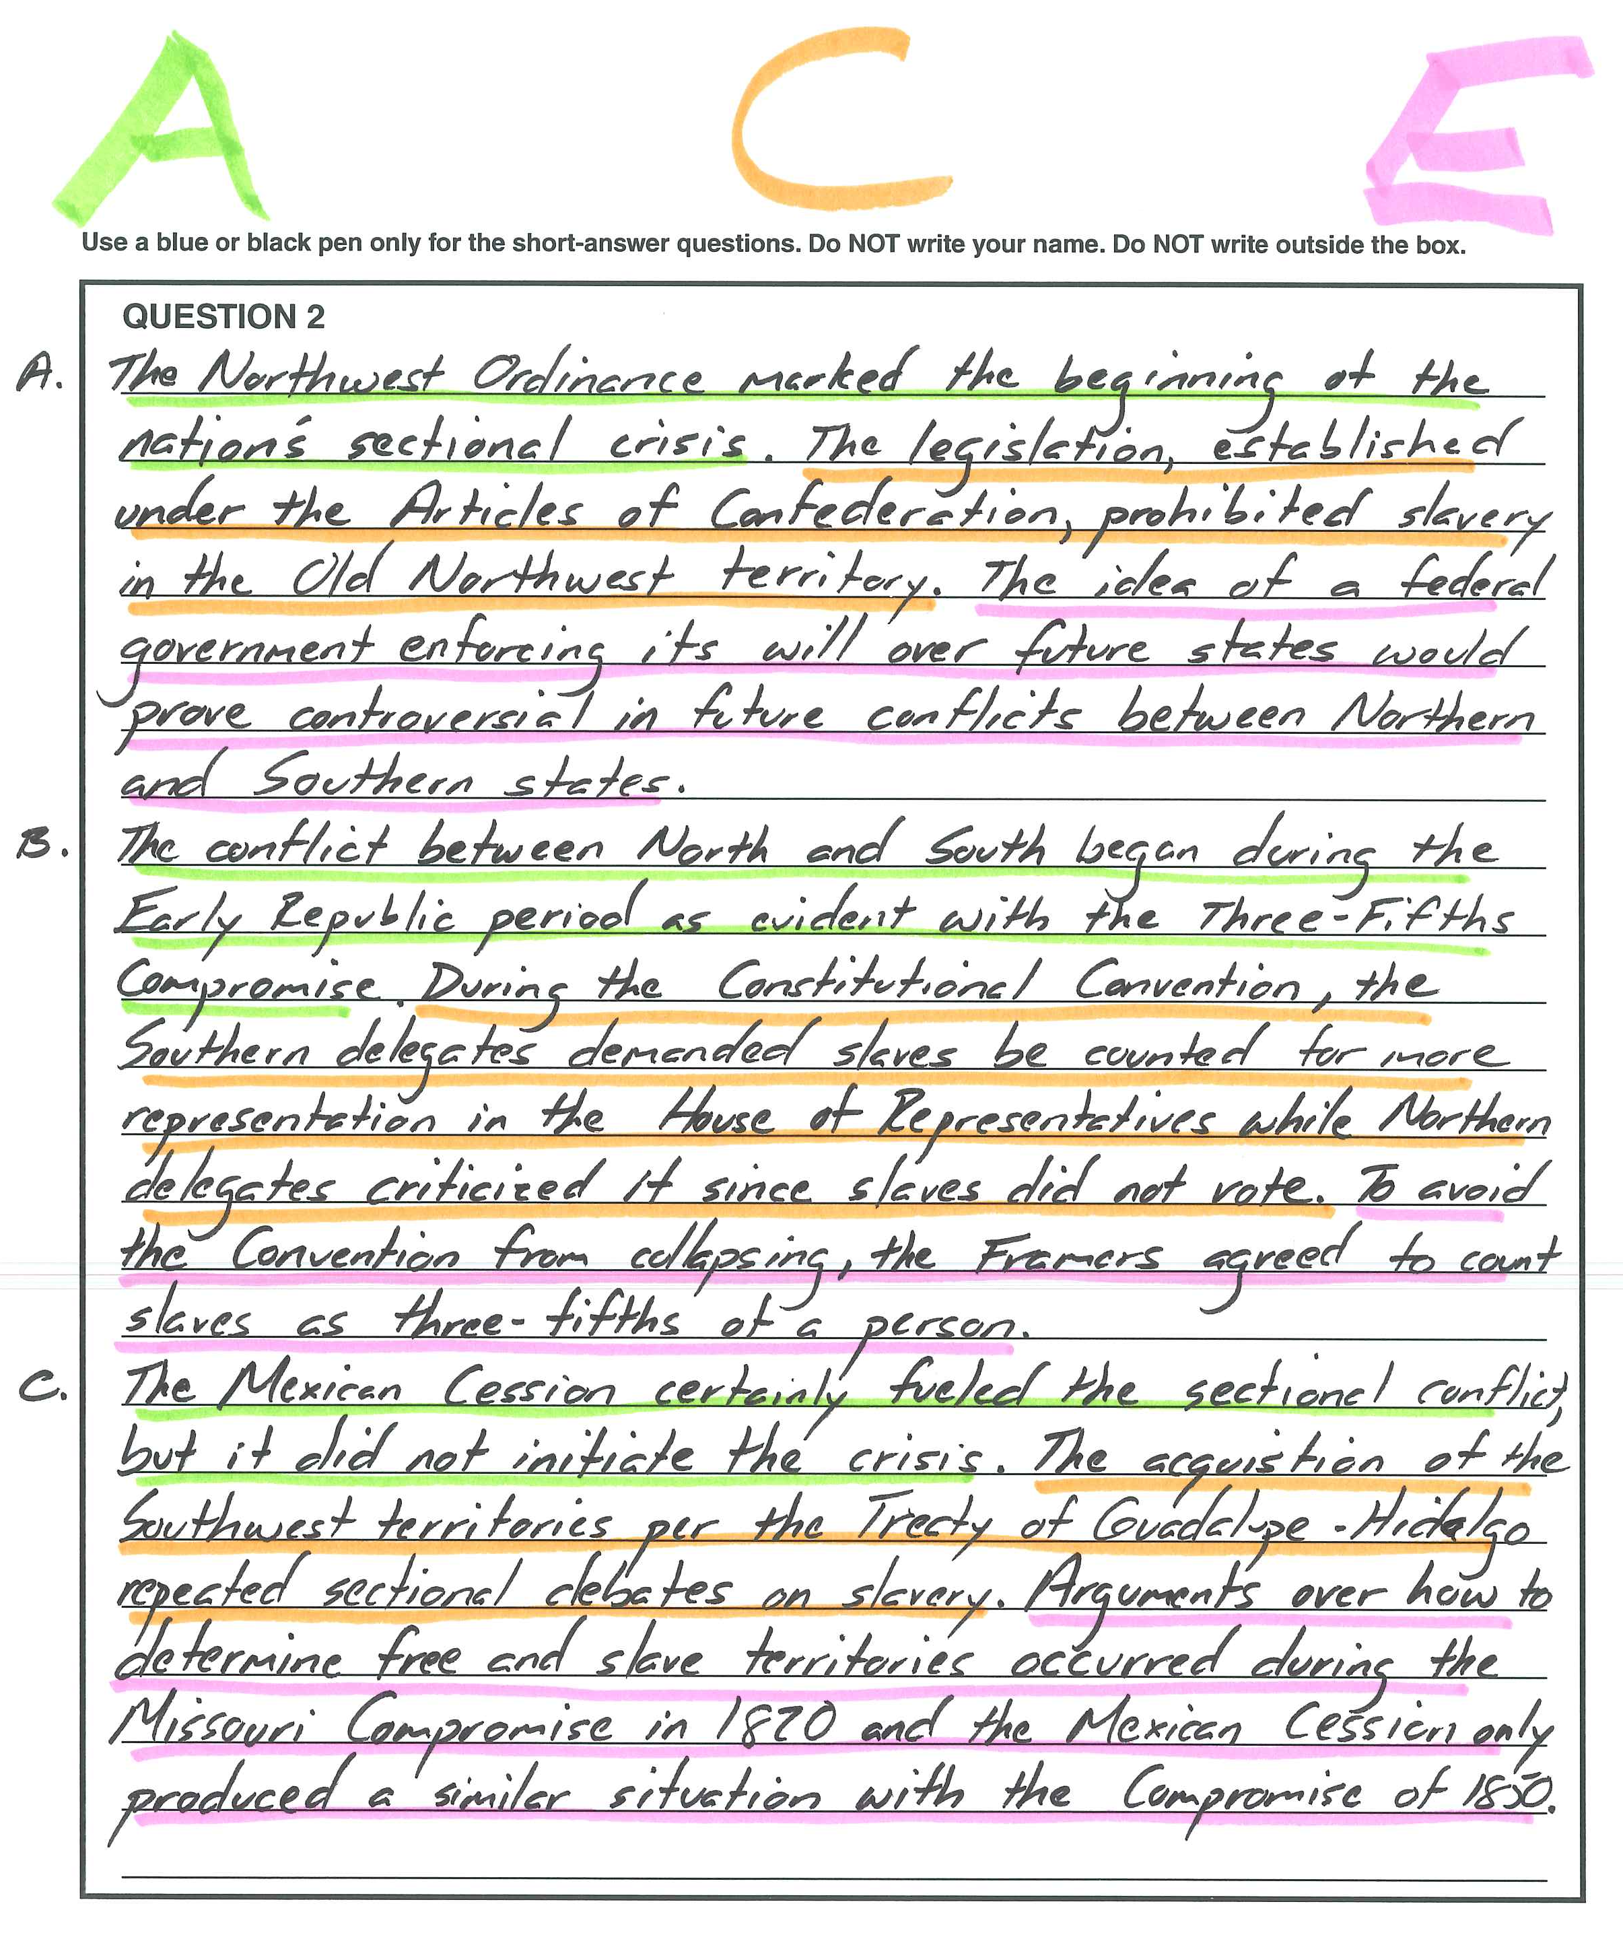
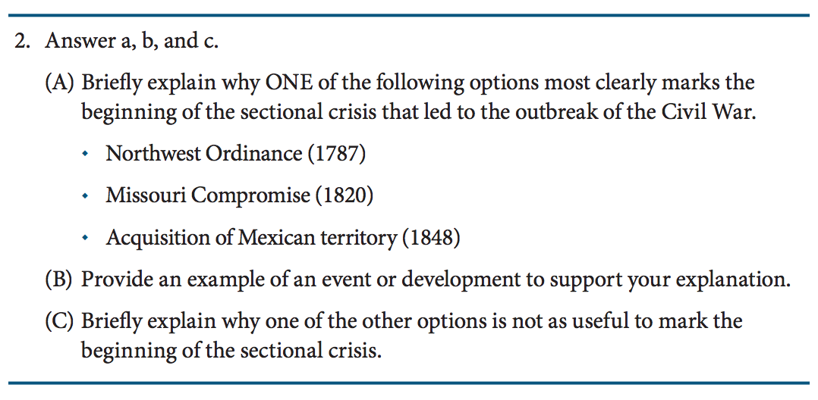
Example PERIODIZATION

Slide 13
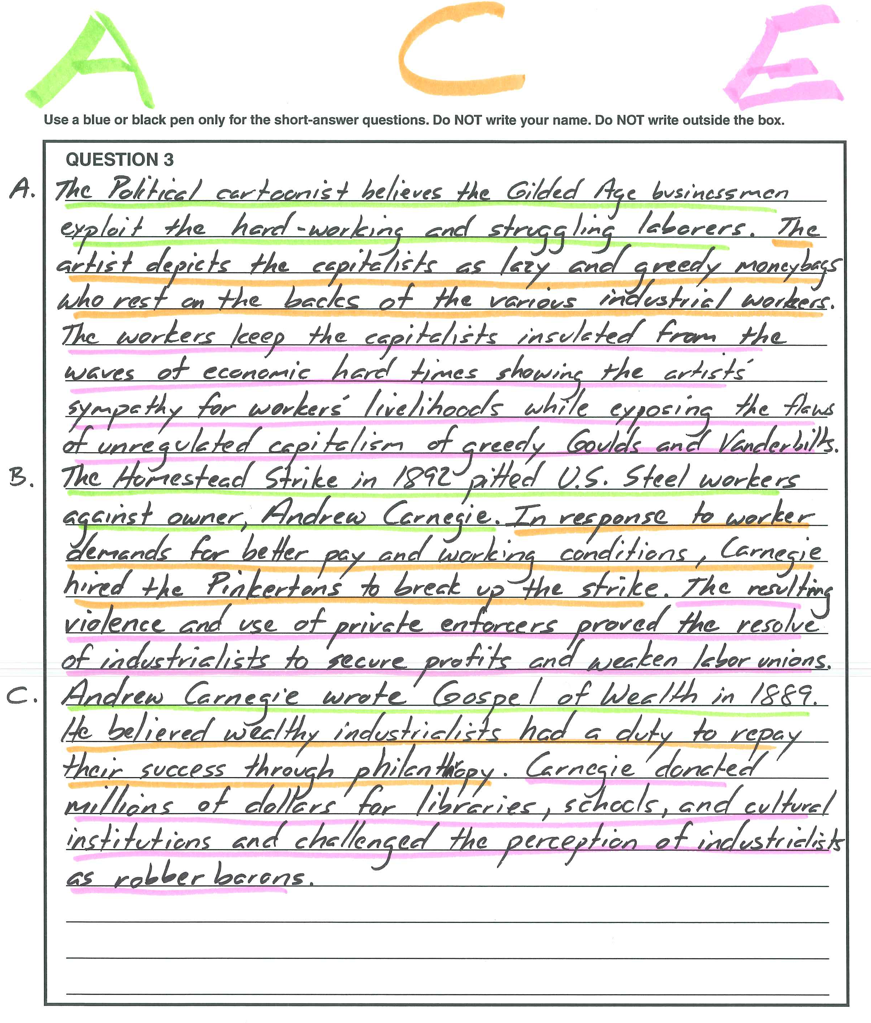
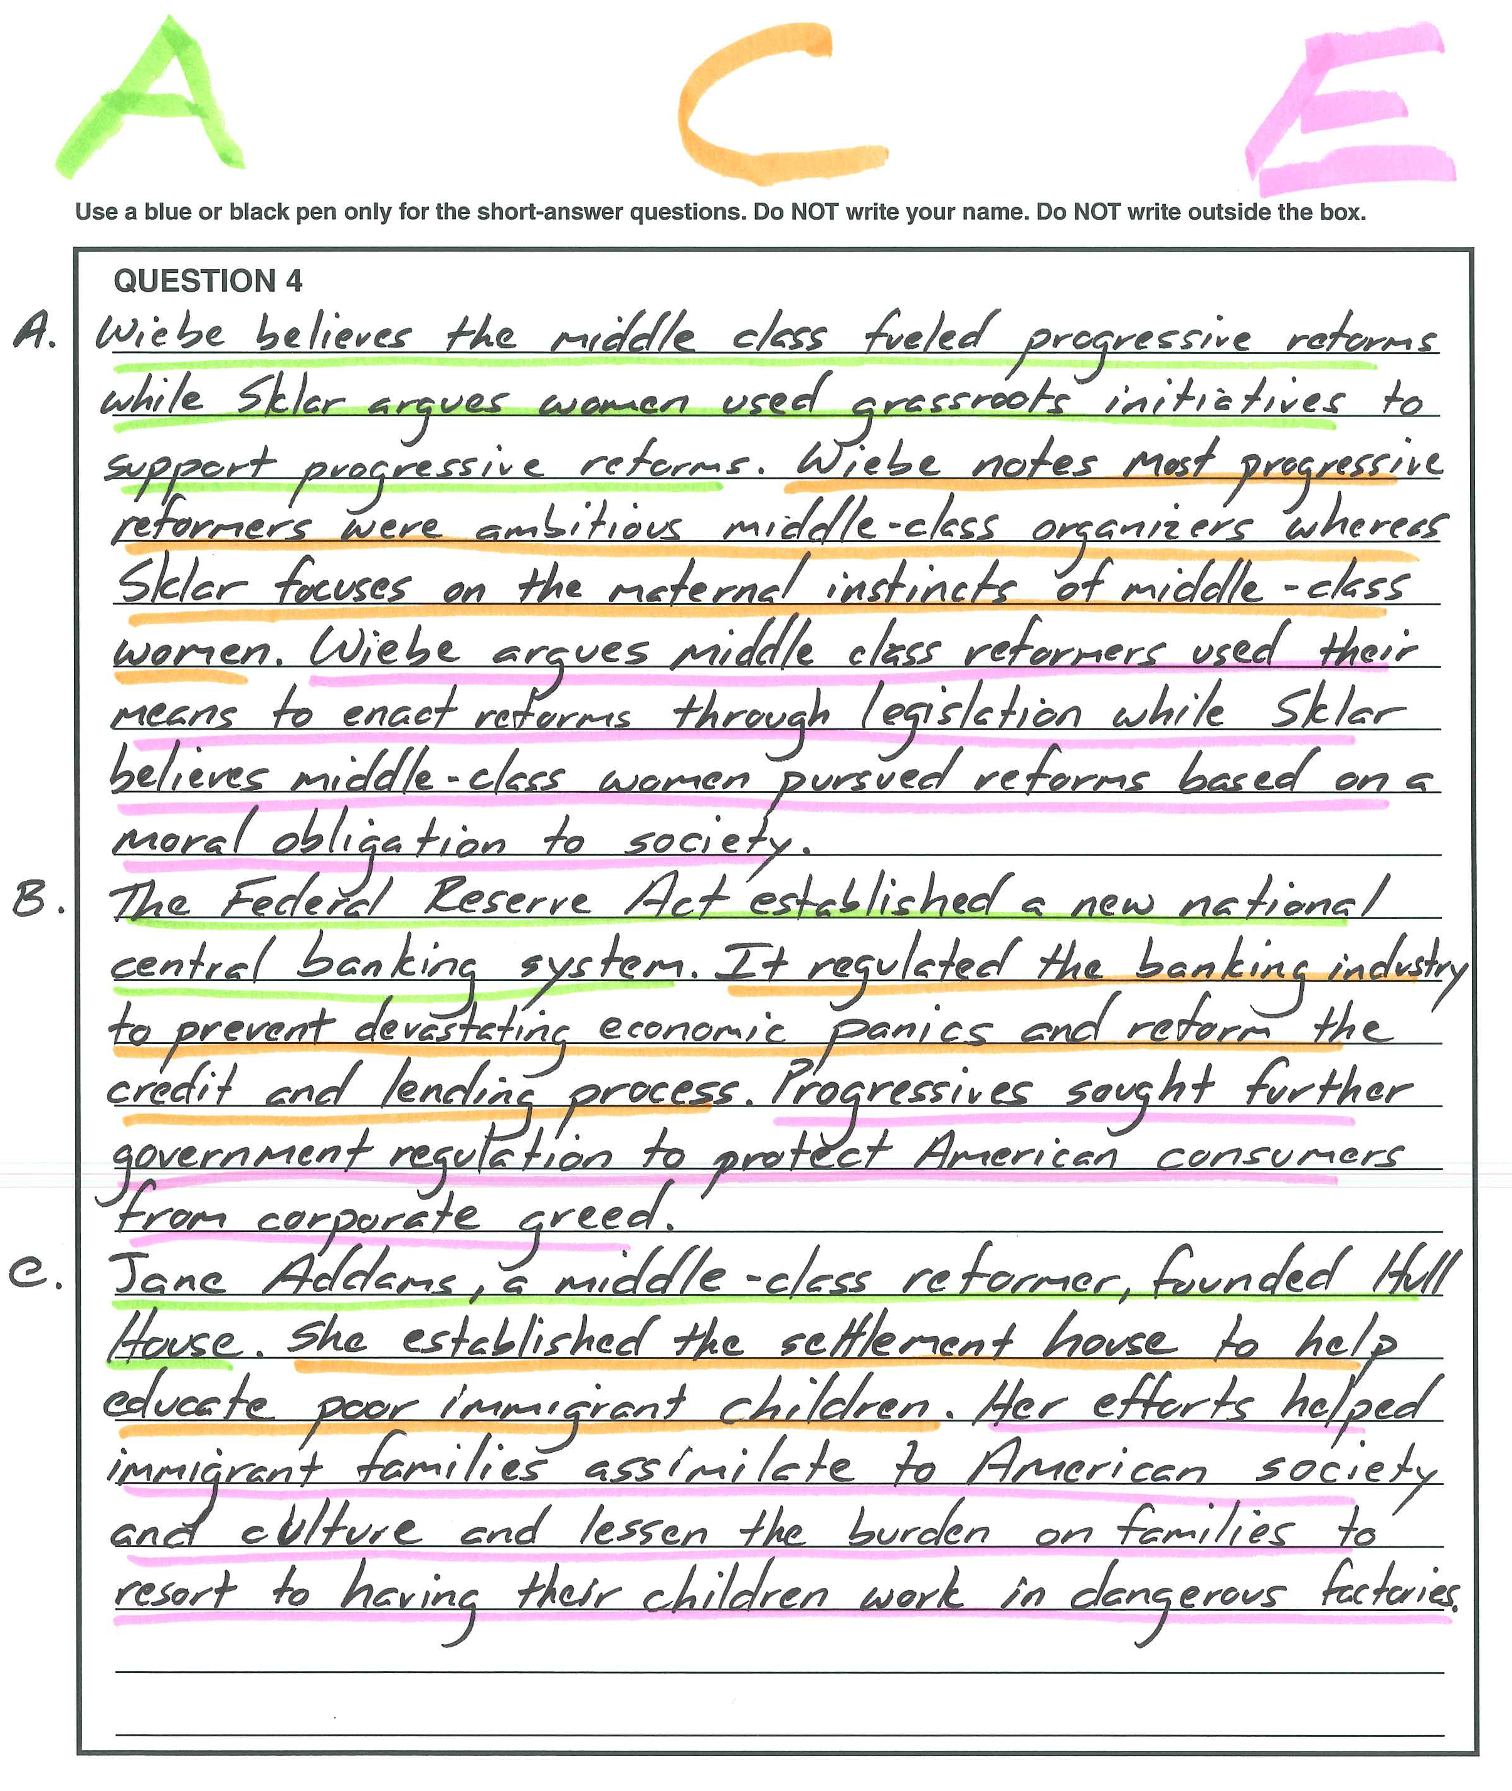
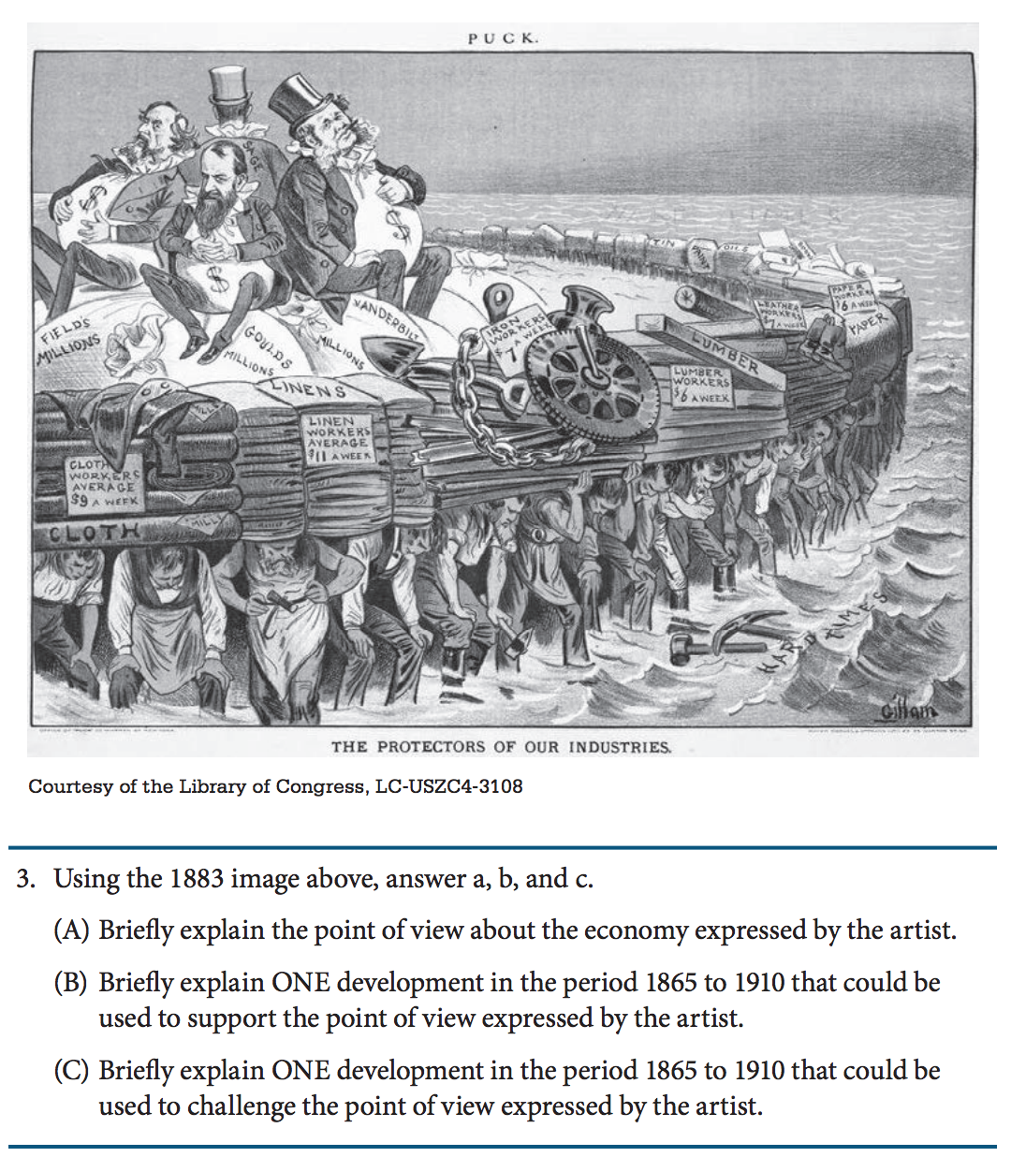
Example ANALYZING EVIDENCE (POLITICAL CARTOON/PAINTING/IMAGE)

Slide 14
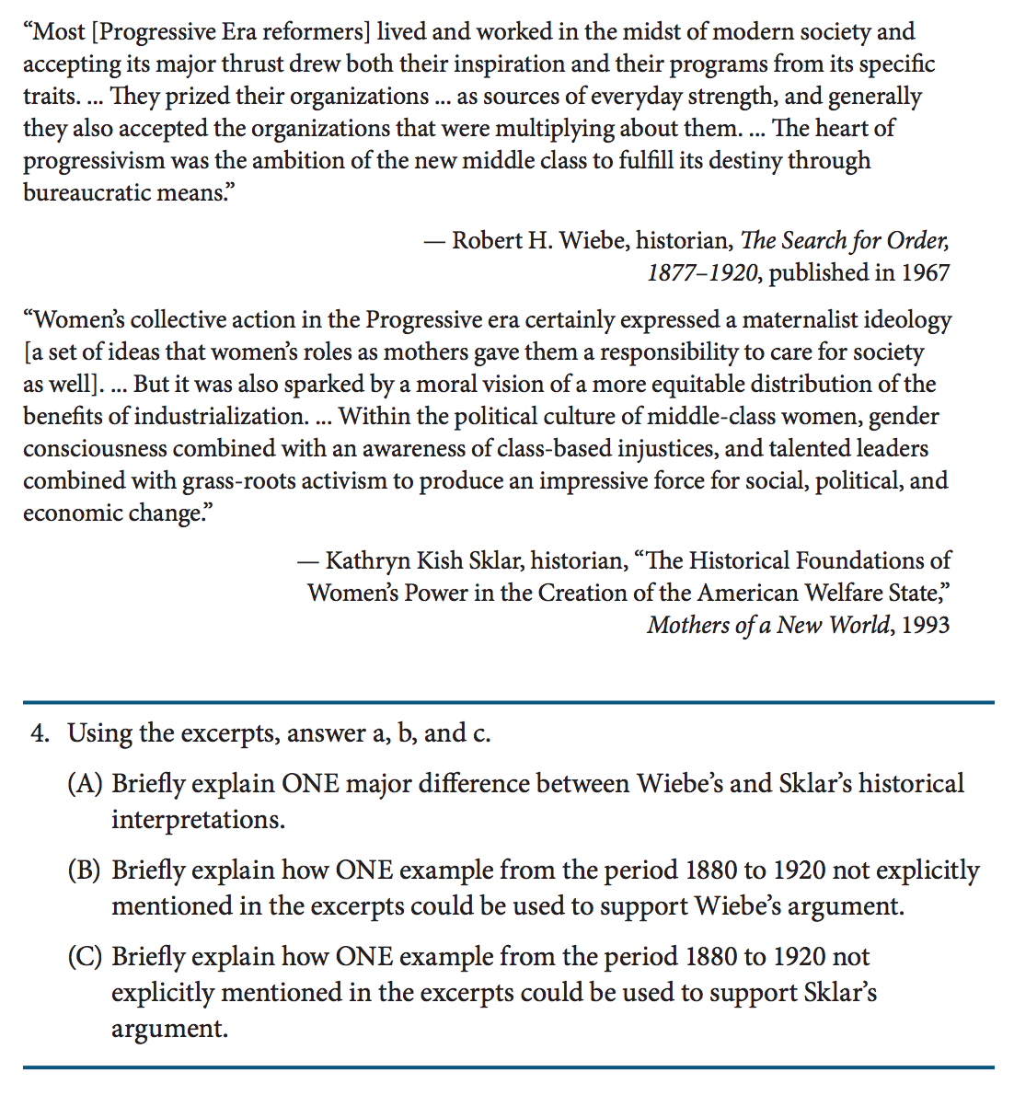
EXAMPLE interpretation

Slide 15
Saq to leq
2000 FRQ #2
Unofficial Revision 2000 LEQ #2

Slide 16
SAQ TO LEQ
2000 FRQ #3
Unofficial Revision 2000 LEQ #3

Slide 17
SAQ to DBQ
Original 2000 DBQ Prompt
Unofficial Revision 2000 DBQ Prompt

Slide 18
RECOMMENDED ACE APPLICATION
Not designed to be an immediate writing solution.
Strategy should be applied regularly and consistently throughout the course.
Applied to different types of SAQs to address Historical Thinking Skills.
Practice, practice, practice.
Ask an SAQ question part rather than an entire three-part SAQ.
Timing
Apply extended times in early development and application.
Administer questions in an exam-timed situation to assess mastery.
Allow students to adapt the strategy to their capabilities.
Adapt the strategy to your classroom, when preferred.

Slide 19
GENERAL WRITING GUIDELINES
Be explicit.
Always use specific factual and historical evidence and avoid answering only in generalizations.
Do not quote words or phrases from excerpts. [See Cite for further clarification.]
Unnecessary phrases to avoid: “According to the historian…,” “As seen in the excerpt/graph/image…,” “As written/mentioned by…”
Use active verbs and active voice.
Diction and syntax play an important role in establishing a confident historical claim and assertion in addition to developing concise responses.
GENERAL -> Europeans brought over diseases to the Americas and it had an impact on Native populations.
GO FOR THIS -> Contagious European diseases decimated Native populations.

Slide 20
STRATEGIC VALUE of ace
Keeps SAQ responses concise.
Increases likelihood of earning each point, particularly on interpretation prompts.
Develops ability to prove and substantiate claims and explanations.
Serves as a scaffolding technique for DBQ and LEQ essay responses.
Encourages sophisticated historical writing.
Should be constantly and consistently applied with SAQ assessments.
Common application with other AP disciplines using writing as part of their assessments.
AP European History
AP World History
AP U.S. Government
AP English Language and Composition

Slide 21
GENERAL SAQ GUIDELINES
Label each part in the left-side margins outside the box.
Do not skip lines or double-line.
Do not indent.
Do not write an introduction or conclusion. This is not an essay.
Write in complete sentences. No bullet points or sentence fragments.
Complete each task in order; A, B, C.
You may write any of the four SAQs in any order.
Recommended to answer in the order of most confidence first.

