Slide 1
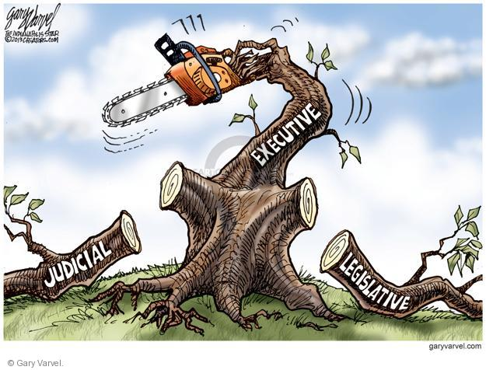
UNIT 2 Topic 2.5
Checks on the Presidency
AMSCO pg. 148-157
Topic 2.5 Checks on the Presidency

Slide 2
TOPIC 2.5 Checks on the Presidency
The presidency has been enhanced beyond its expressed constitutional powers.
Explain how the president’s agenda can create tension and frequent confrontations with Congress.
Senate confirmation is an important check on appointment powers but there can be a potential for conflict based on who is chosen by the president for appointments, including:
i. Cabinet members
ii. Ambassadors
iii. Some positions within the Executive Office of the President
iv. Supreme Court Justices, Court of Appeals judges, and District Court judges
Senate confirmation is an important check on appointment powers, but the president’s
longest lasting influence lies in life-tenured judicial appointments.
Policy conflicts with the congressional agenda (the formal list of policies Congress
is considering at any given time) can lead the president to use executive orders and
directives to the bureaucracy to address the president’s own agenda items.

Slide 3
TOPIC 2.5 Checks on the Presidency
The presidency has been enhanced beyond its expressed constitutional powers.
Explain how the president’s agenda can create tension and frequent confrontations with Congress.
The potential for conflict with the Senate depends upon the type of executive branch appointments, including:
Cabinet members
Ambassadors
White House staff
Senate confirmation is an important check on appointment powers, but the president’s longest lasting influence lies in life-tenured judicial appointments.
Policy initiatives and executive orders promoted by the president often lead to conflict with the congressional agenda.

Slide 4
The President’s Team: The Vice President
Only two constitutional duties:
Become President or Acting President if the oﬃce of President is vacant.
Preside over the Senate, voting only in case of a tie.
Traditionally, the V.P. is a dull, do-nothing job
The job of a V.P. is basically what the President says it is
Often involves unappealing work (e.g., attending funerals of foreign leaders)
V.P. is often selected not on basis of qualiﬁcations, but on basis of balancing the ticket with respect to geographical representation, connections to important blocs of voters, or experience.
After he has "done his job (i.e., helped win votes)," the V.P. is often "put out to pasture" for dull work.
Importance of the oﬃce:
9/44 Presidents have not ﬁnished their terms of oﬃce.
V.P. can become acting president if the president is disabled.
In recent years, Presidents (e.g., Carter, Reagan, Clinton) have made more eﬀective use of the V.P. This is especially true of Bush-Cheney.
Vice presidency can be a steppingstone to the presidency, e.g., Bush 41.

Slide 5
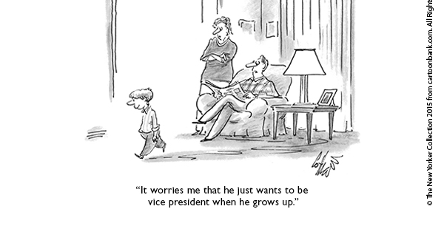

Slide 6
Incomplete Presidential Terms
What does superscript ‘b’ mean? How was this possible?

Slide 7
The Cabinet & the Bureaucracy
Cabinet oﬃcials are constitutionally banned from also being members of Congress.
Each Cabinet department is headed a by a secretary, i.e., Secretary of State runs the Department of State, appointed by the President with Senate confirmation. Often leads to conflict with the Senate. Checks and balances.
The Cabinet meets irregularly. Only at the call of the President.
They advise the President on a wide range of policy issues.
Cabinet secretaries are more interested in defending/enlarging their own departments than they are in meeting together to hammer out public policy. Many newly-elected Presidents speak of enlarging the Cabinet's role, but then think better of it as time goes on. Presidents rely less on their cabinet for advice.
A reason for this is the divided loyalties of Cabinet oﬃcials: Are the Secretaries most loyal to the President? To the Congress (which funds the departments)? To client groups (which depend upon the departments)? To the employees within the departments (with whom the Secretaries must deal daily)? Which one do you think he would be most loyal to?
Another reason is that the President’s goals often conﬂict with Cabinet Dept. goals, i.e., the President may want to cut spending, but Cabinet Secretaries generally want to see their departments grow rather than shrink.

Slide 8
CABINET
Deﬁnition
– The 15 Secretaries and 5 others who hold “Cabinet rank” (OMB Director, CIA Director, White House Counselor, UN Ambassador, US Trade Rep).
Each of these is appointed by the President w/Senate consent.
Inner Cabinet

Slide 9
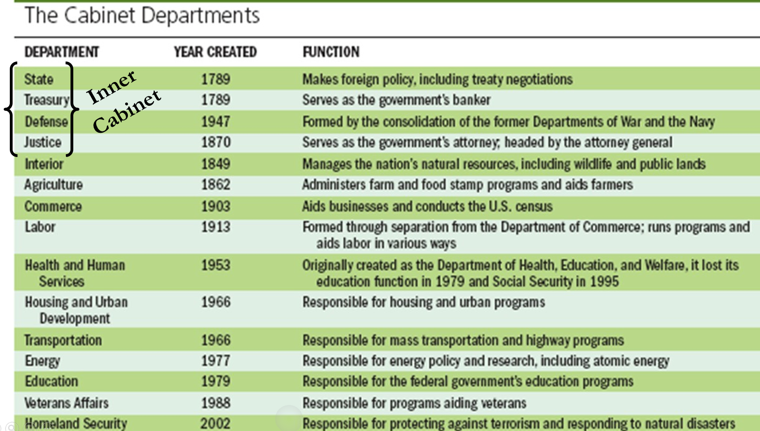
THE CABINET and Bureaucracy

Slide 10
FEDERAL APPOINTMENTS
Who gets appointed to federal positions?
As mentioned, the number of appointments is large, but the percentage of appointed positions in the federal government is small. (Less than 10%).
Presidents often do not know their appointees well -- They depend heavily on staﬀ recommendations.
Background of appointees:
Tend to come from private industry, universities, law ﬁrms, think tanks, Congress, state/ local government.
Most have had some federal experience.
Some have had some federal experience just prior to appointment.
Some are "in-and-outers," i.e., people who alternate between jobs in the public sector and private sector -- the "revolving door."

Slide 11
CABINET Secretaries
Factors aﬀecting selection of Cabinet secretaries:
Party aﬃliation
Interest group inﬂuence
Race
Gender
Geographical diversity
“Conﬁrmability” in the Senate
Presidential inﬂuence over the Cabinet is limited: This a check on Presidential power
Presidents can, of course, ﬁre the political appointees within a department.
However, Presidents have little control over the civil service employees of a department. These account for > 90% of all the people who work within the Cabinet departments, and it is exceedingly diﬃcult to ﬁre them from their positions.

Slide 12
CABINET Secretaries
Closest cabinet members to the president: Inner Cabinet
Sect of State
Sect of Treasury
Sect of Defense
Attorney General

Slide 13
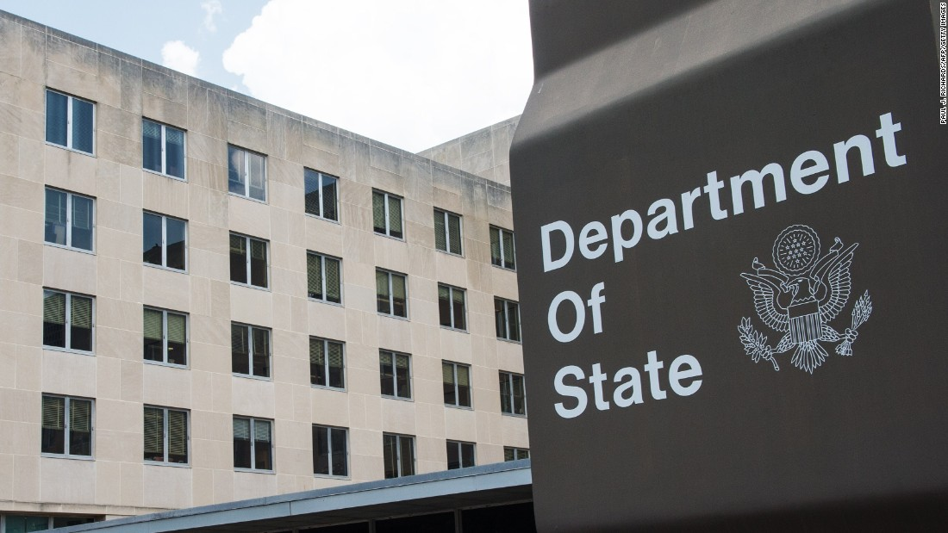
State Department
The U.S. Department of State, led by Sect of State
Helps President makes foreign policy, including treaty negotiations
The first department created by Congress headed by Thomas Jefferson.
Employs ambassadors in every country the US recognizes, organize and employ the diplomatic corps
US ambassadors are appointed by the president with Senate confirmation

Slide 14
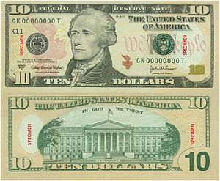
Treasury Department
The U.S. Treasury Department, led by Sect of the Treasury
Helps President with managing the economy, the nations finances
The second department created by Congress headed by Alexander Hamilton
Producing all currency and coinage of the U.S.;
Collecting taxes, duties and money paid to and due to the U.S.; IRS
Paying all bills of the U.S.;
Managing the federal finances;
Managing government accounts and the United States public debt;
Supervising national banks and thrift institutions;
Advising on domestic and international financial, monetary, economic, trade and tax policy (fiscal policy being the sum of these);
Enforcing federal finance and tax laws;
Investigating and prosecuting tax evaders;
Publishing statistical reports.

Slide 15
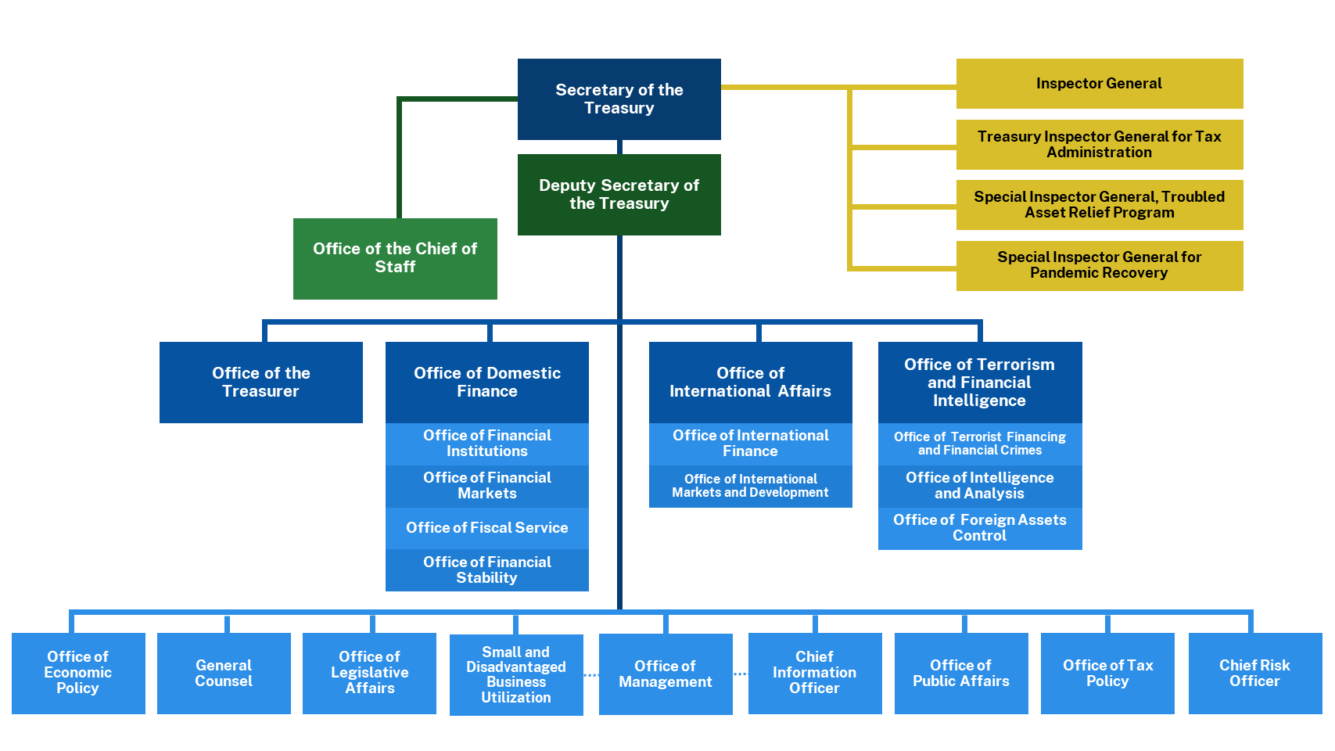

Slide 16
Defense Department
The Department of Defense, led by Sect of Defense
Headquartered at the Pentagon
Includes army, navy, air force, marines. Joint Chiefs of Staff- council of top military officials of each branch of the military advises the president on military matters.
Secretaries of defense are civilian officers who serve the president and have not served in the uniformed military service for at least seven years.
US military is under civilian control
Ultimately, the people run the military through their elected and constitutional civil officers, in contrast to many dictatorships where a strong military leader takes over the military first and the government second.
Single largest discretionary expense of the US budget $800billion annually
A check on Presidential Power

Slide 17
Department of Justice, estbl. 1870
The Department of Justice, led by the Attorney General
Enforces federal law and oversees all federal court case through out the US
Provides president with legal advice for the nation. The president depends on his White House staff for all of his personal legal advice.
Overall, the president engages with White House staff more frequently than with cabinet secretaries.

Slide 18
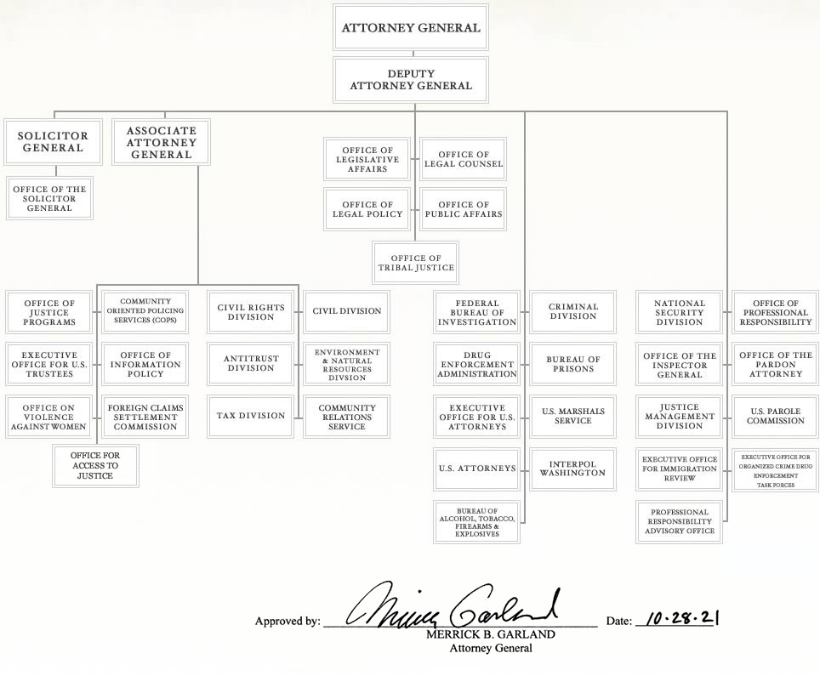

Slide 19
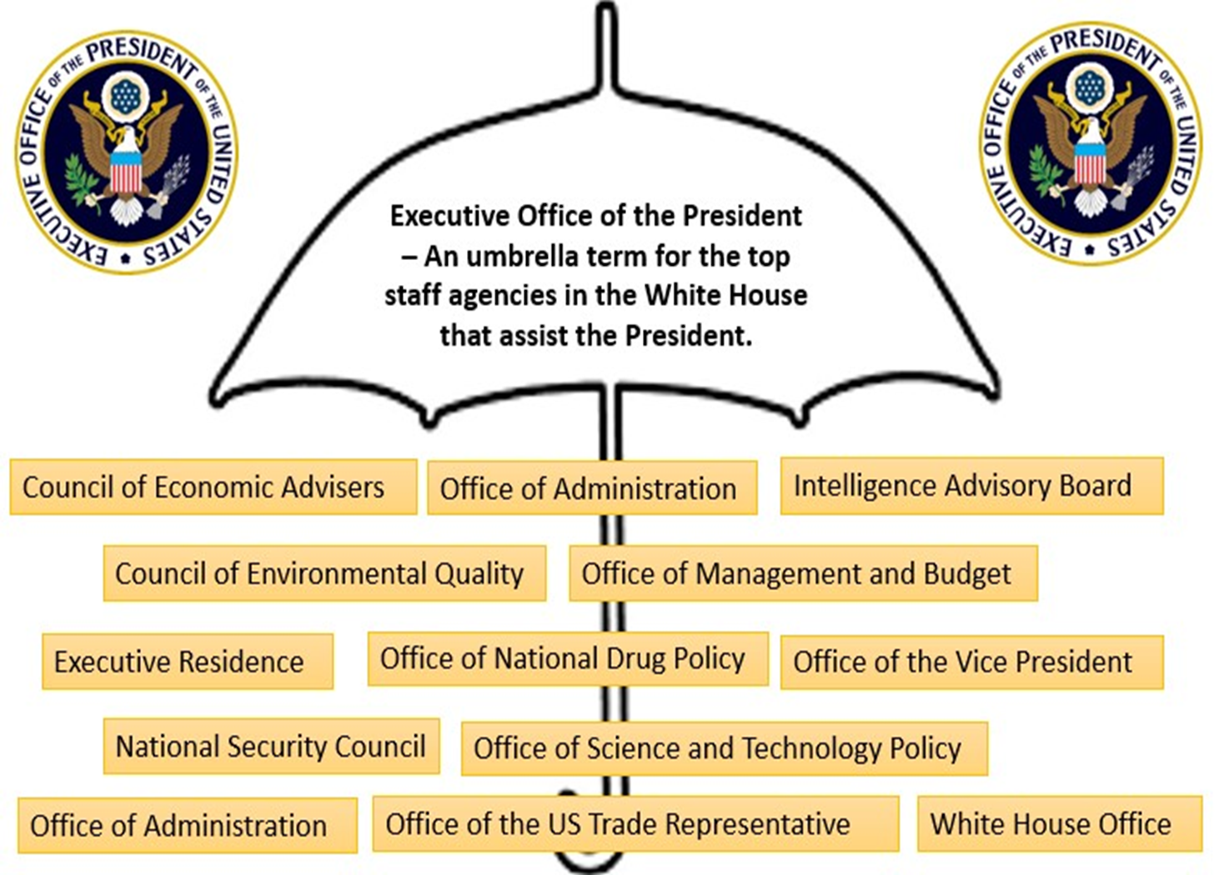
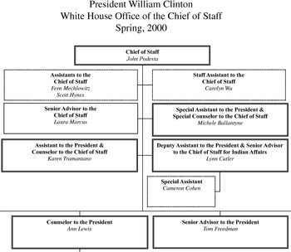
President’s Immediate Staff
The EOP
The White House Staff

Slide 20
EXECUTIVE OFFICE OF THE PRESIDENT

Slide 21
EXECUTIVE OFFICE OF THE PRESIDENT
White House Oﬃce or White House Staﬀ
Immediate staﬀ of President. Created in 1939 in the wake of the Great Depression
Oﬃce space in West Wing of White House –> proximity to President.
Rule of Propinquity: Power is wielded by people who are in the room where decisions are made.
Appointments to the White House Oﬃce
e.g., Chief of Staﬀ, generally do not require Senate consent. President’s gatekeeper
Oﬃcials are less subject to testifying before Congress since they have a greater degree of executive privilege protection.
Presidents typically seek people who will be loyal – less divided loyalties compared to cabinet positions.
OMB (Oﬃce of Management and Budget)
Prepares the annual budget and reviews federal programs
The OMB oversees the execution of the budget. The president's close control over both the preparation and execution of the budget is a major factor in his ability to command the huge executive bureaucracy.
NSC (National Security Council)
Coordinates foreign/military policy
Increasing importance of the National Security Adviser since the Nixon presidency
CEA (Council of Economic Advisers)
Three-person advisory group on economic policy

Slide 22
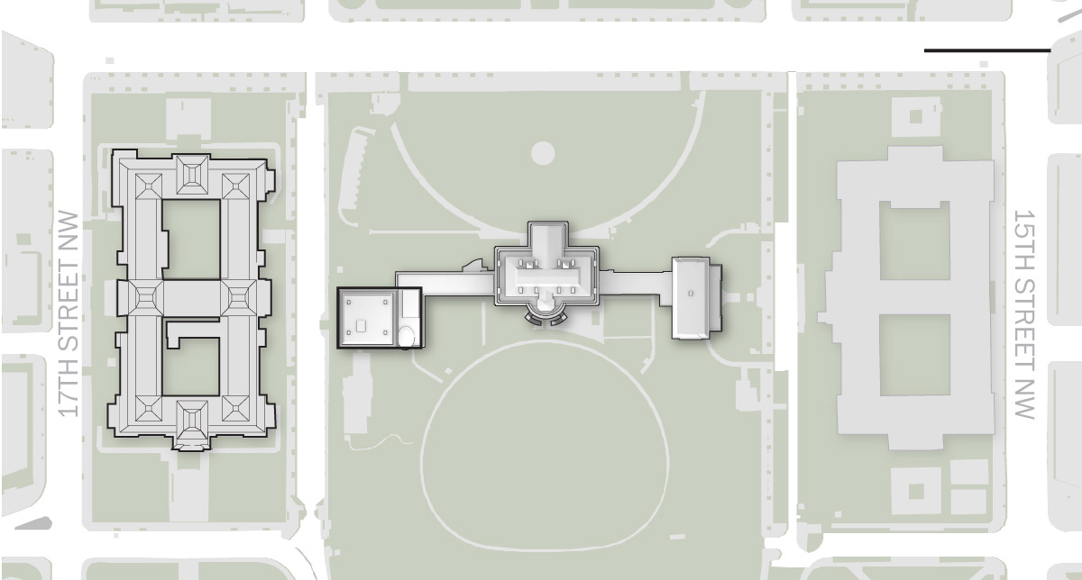
EXECUTIVE OFFICE OF THE PRESIDENT
The EOP
The White House
The West Wing

Slide 23
Overall, the president engages with White House staff more frequently than with cabinet secretaries.

Slide 24
Interactions with Other Branches
President's agenda is not always in line with Congress’s agenda intentions & conflict often arise between the branches.
The President's Inherent Powers
Inherent powers are powers that a president can assume to have as a necessary to the working ability of the government or office but not listed in the Constitution
Examples of President’s Inherent Powers:
the power to go public- bully pulpit- to command the media to gain popular support for his agenda in order to persuade Congress
power of persuasion
make executive agreements- similar to treaties but DOES NOT require Senate approval
executive orders
issue signing statements
use the bureaucracy
personality and leadership
make legislative proposals
The most common & controversial inherent powers are Emergency Powers, exercised only in times of great need. Therefore, Congress is hesitant in declaring war.
Can lead to TENSIONS & CONFRONTAITION with Congress

Slide 25
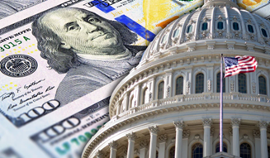
CHECKS on PRESIDENTIAL POWERS
Traditional, constitutional checks:
Congress- oversight/ investigations, power of the purse
Courts- judicial review
Informal checks:
Congressional leaders
Cabinet members
Bureaucrats- can slow down (delay) or “misplace” presidential action.
Political parties
Interest groups
Media: adversarial journalism, “gotcha” journalism
Senators’ use of “holds” and ﬁlibusters on presidential nominations
Divided government

Slide 26
U.S. Const., Art. 1, Sect. 9, Cl. 7 Power of the Purse

Slide 27
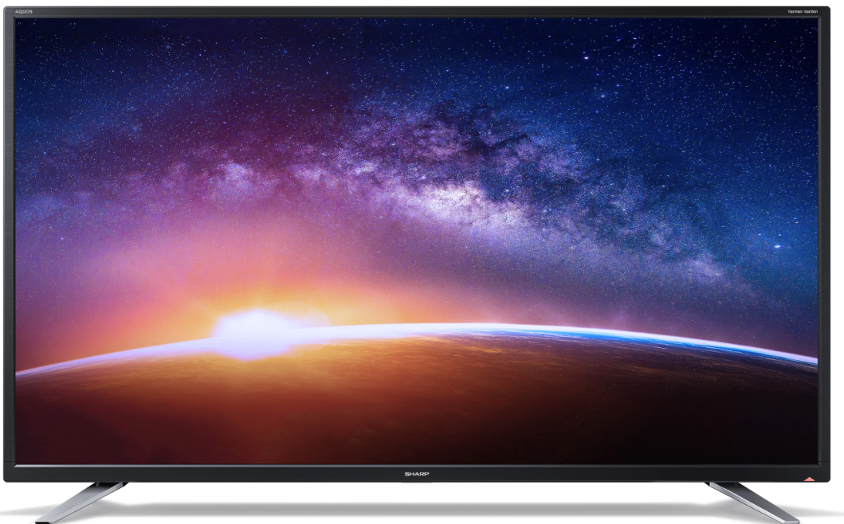
RECESS APPOINTMENTS
Because the founders did not anticipate that Congress would convene as frequently as it does in modern times, they provided for RECESS APPOINTMENTS. If the Senate is not in session when a vacancy arises, the president can appoint a replacement who will serve until the Senate reconvenes and votes on that official. This recess appointment is particularly necessary if the appointee is to handle urgent or sensitive work.

Slide 28
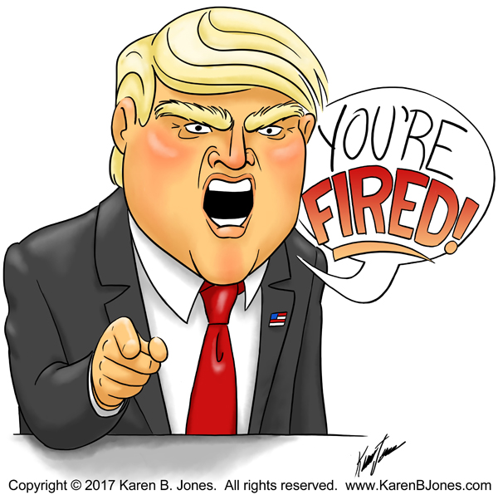
Removal
The President can remove all upper-level executive branch officials including all cabinet secretaries, ambassadors, federal district attorneys at will, except those that head the independent regulatory agencies. (More on this in Chpt7 Topic 2.12-2.15)

Slide 29
Judicial Interactions
As Chief Executive, the president enforces judicial orders/ decisions.
As Chief Executive President Eisenhower used his power as Commander-In-Chief, President Eisenhower had to enforce the Supreme Court decision in Brown v. Board of Education (1954).
He sent in the 101st Airborne US Army Paratroopers (1957) to enforce the Brown v. Brd of Edu, 1954 ending segregation in public schools.
In 1952 the Supreme Court overturned President Truman's nationalizing of the steel industry during the Korean War. Truman had taken that step to mobilize resources for the Korean War and to prevent a strike by steelworkers. The Court ruled, however, that the president lacked authority to seize private property. The power of judicial review checked the president’s executive power.
The federal government would either send Federal Marshalls or US Army troops to enforce civil rights

Slide 30
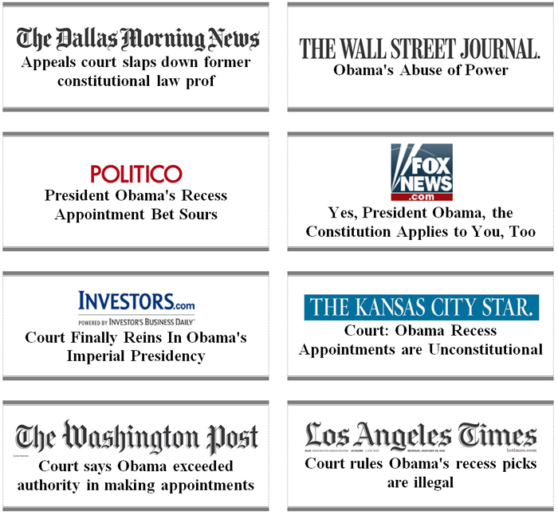
National Labor Relations Board v. Noel Canning, 2014
JANUARY 29, 2013
COURT REBUKES OBAMA “RECESS” APPOINTMENTS
Last January, President Obama flagrantly bypassed the Senate and appointed three members to the National Labor Relations Board, claiming the Senate was in recess even though it was meeting regularly in pro forma session. Last week, the U.S. Court of Appeals for the District of Columbia ruled unanimously that those unilateral appointments were unconstitutional.

Slide 32
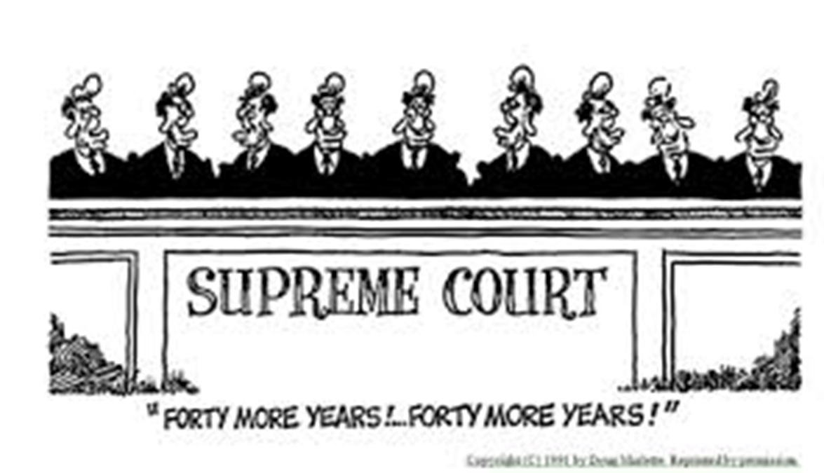
Judicial Appointments
Senate confirmation is an important check on appointment powers, but the president’s longest lasting influence lies in life-tenured judicial appointments.
The Justices faces in the Supreme Court are
of President Ronald Reagan. Reagan appointed
4 Justices, including elevating William Rehnquist to Chief Justice. Reagan appointed a total of 383 judicial appointments, the most by any president.
This allows a president’s influence on public policy long after he leaves office.

Slide 33
SOURCES OF CONFLICT BETWEEN THE PRESIDENT AND CONGRESS
SEPARATION OF POWERS AND CHECKS AND BALANCES
The Constitution is "an invitation to struggle between the President and Congress." There is supposed to be conﬂict.
EACH REPRESENTS DIFFERENT CONSTITUENCIES:
Members of Congress represent state and local interests ("All politics is local").
The President, however, represents the national interest.
DIFFERENT TIMES OF ELECTION
Diﬃcult for either to gain excessive power for any great length of time
Clinton was elected in '92 with a majority of Democrats in Congress, but just two years later the Republicans captured a majority of both houses. Mid- terms.
PARTISANSHIP
Since 1952, Presidents have often faced a Congress that has had a majority of the opposing party.
Even when the Congress has a majority of the same party as the President, intra-party struggles are common. With the weakening of political parties, the President does not have a strong "hold" on members of his own party in Congress. For example, some congressional Republicans wanted a stricter immigration policy than Bush 43.
“TWO PRESIDENCIES” THESIS
– Congress tends to be more cooperative with the President on foreign policy and national security issues (esp. in a crisis), but is less cooperative on domestic and economic issues.

Slide 34
SOURCES OF PRESIDENTIAL INFLUENCE ON CONGRESS
USE OF MEDIA
Media focuses more on a single person than on 535 members of Congrss
President can easily go directly to the people with his case.- BULLY PULPIT
"MANDATE FROM THE PEOPLE" after winning election by a large margin.
PATRONAGE
Enables a President to carry out policy his way.
Enables a President to cultivate members of Congress by seeking their input on appointments.
CHIEF OF PARTY ROLE
Convincing members of Congress to act in interests of "party unity."
PERSONAL LOBBYING OF MEMBERS OF CONGRESS
Use of both favors and punishment for cooperative or uncooperative members.
VETO, OR ITS THREAT
93% of vetoes are not overridden, so even the threat of a veto carries weight.
PRESENCE OF A NATIONAL EMERGENCY

Slide 35
How could the president's agenda cause confrontations with Congress?
Areas of Conflict Between the President and Congress | Examples of Conflict Between the President and Congress
Disagreements about inherent powers, especially when crisis arises | Lincoln suspended habeas corpus during their civil war and Chief Justice Roger Taney rebuked Lincoln saying only Congress had such power. Lincoln ignored the Court.
Senate standoff with presidential cabinet appointments or judicial appointments | Senate blocked Robert Bork’s appointment to the Supreme Court by Ronald Reagan.
Ambassador appointments can lead to conflict with the Senate | Half of Bidens ambassador nominations remain vacant, blocked in the Senate.

Slide 36
END of 2.5
END OF 2.5

Slide 37
TERM OF OFFICE
22,2
Four years
Maximum of two elected terms; Maximum of 10 years
Amendment 22 institutionalized Washington’s precedent.
Passage of 22nd Amendment (1951) was due to the Republican congress’ concern over future FDR’s.
Possible to serve just less than 10 years in oﬃce if a V.P. becomes President just after the midpoint of a President’s term of oﬃce.
If a V.P. serves less than half of a President’s term, he can be elected to the presidency twice.
If a V.P. serves more than half of a President’s term, he can be elected to the presidency only once.
Lyndon Johnson succeeded JFK in 1963 and was therefore eligible to be elected twice.
Gerald Ford succeeded Nixon in 1974 and was therefore eligible to be elected only once.

Slide 38
SUCCESSION
If oﬃce of presidency is vacant due to death, resignation, or impeachment and removal, the V.P. becomes President.
He in turn nominates, and Congress conﬁrms, a new VP.
If V.P. dies before his inauguration as President, the line of succession is as follows:
Speaker of the House
Senate President Pro Tempore
Sec. of State
Sec. of Treasury
Sec. of Defense
Other Cabinet secretaries in order of the creation of their oﬃces (Presidential Succession Act of 1947)
If the President is disabled, the 25th Amendment applies:
The President informs the Congress of disability and the V.P. becomes Acting President.
If the President is unable to inform Congress (e.g., coma), the V.P. and a majority of Cabinet secretaries can go to the Congress and receive approval for the V.P. to become Acting President.
In either case, the President regains powers by informing the Congress of his intent to return. In case of dispute, Congress has the power to decide who shall be President.

Slide 39
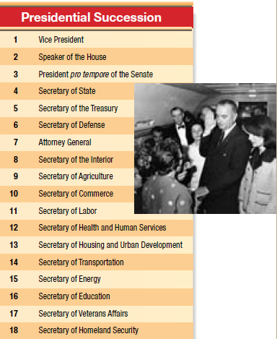
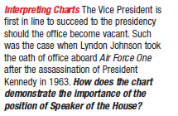

Slide 40
SUCCESSION
If the President is disabled, the 25th Amendment applies:
The President informs the Congress of disability and the V.P. becomes Acting President.
If the President is unable to inform Congress (e.g., coma), the V.P. and a majority of Cabinet secretaries can go to the Congress and receive approval for the V.P. to become Acting President.
In either case, the President regains powers by informing Congress of his intent to return. In case of dispute, Congress has the power to decide who shall be President

Slide 41
INCOMPLETE PRESIDENTIAL TERMS
What does superscript ‘b’ mean? How was this possible?

Slide 42
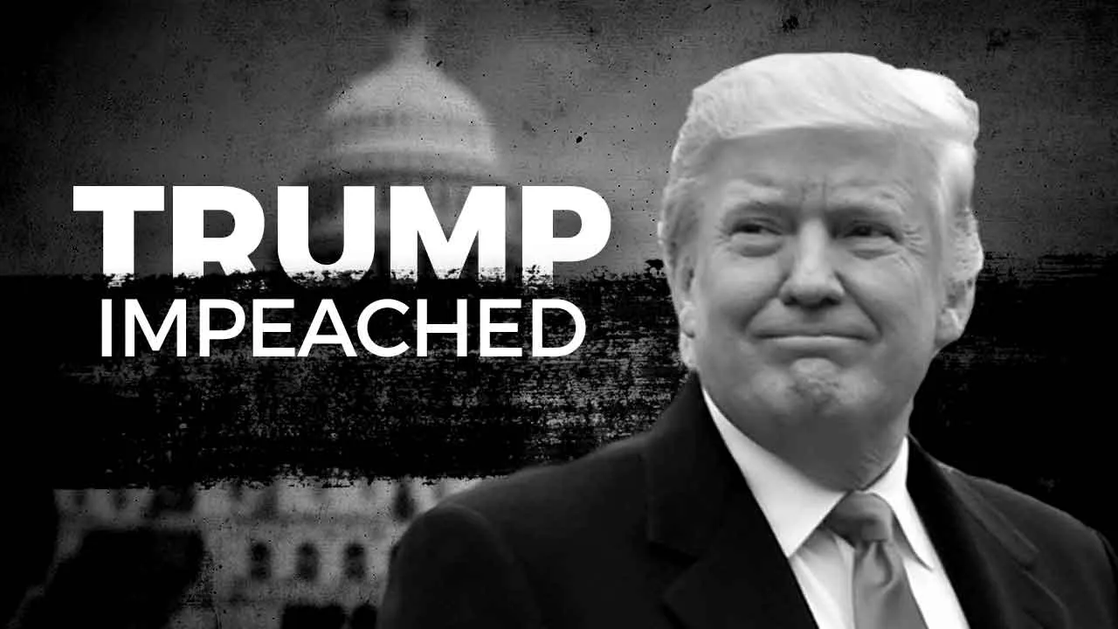
IMPEACHMENT
The vice president secedes if the president leaves oﬃce due to death or resignation or convicted of impeachment
Impeachment is investigated by the House, tried by the Senate with the Chief Justice presiding.
Only three presidents have been impeached: Andrew Johnson, Bill Clinton & Donald Trump (neither was convicted).

