Slide 1

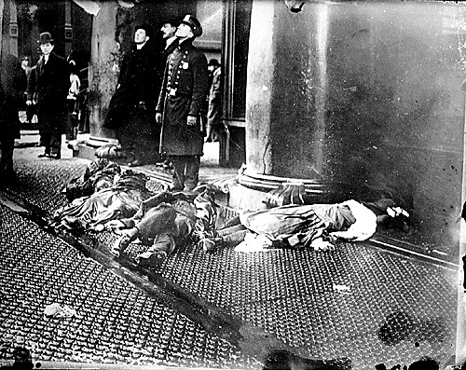
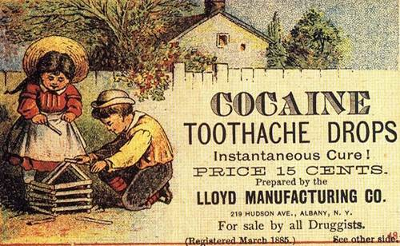

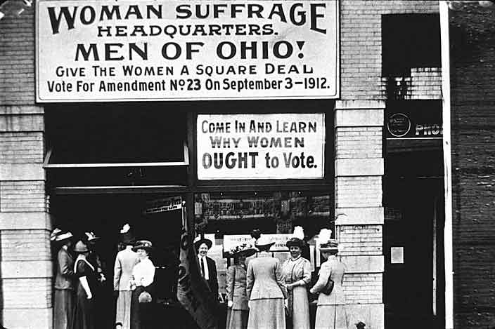
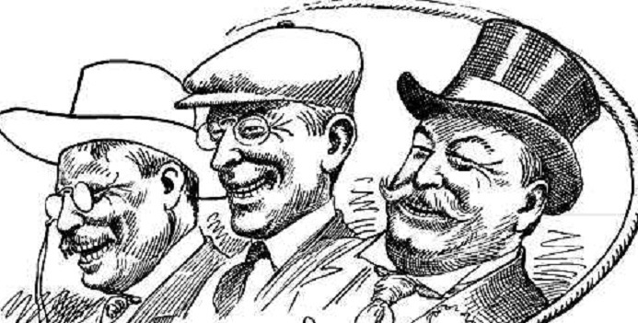
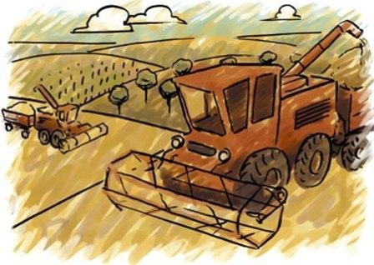
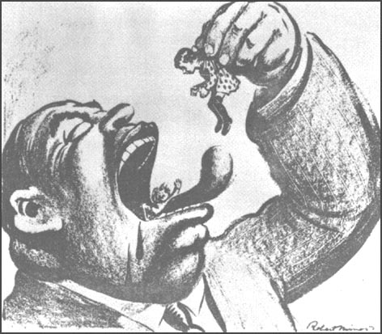
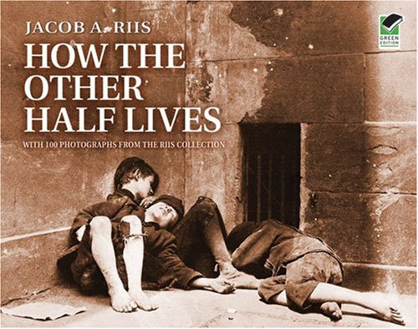

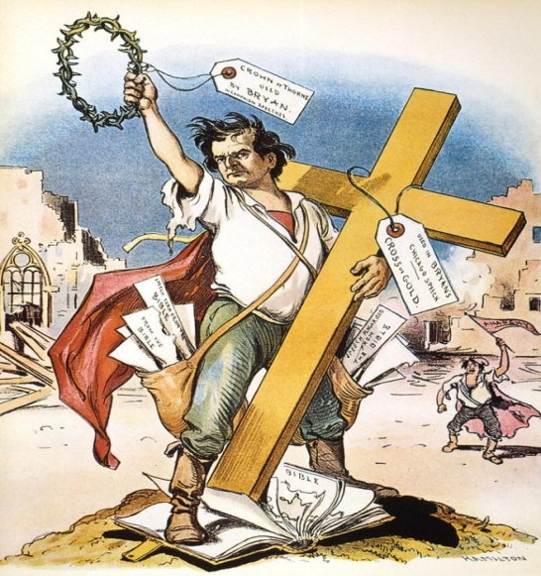

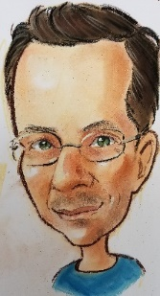
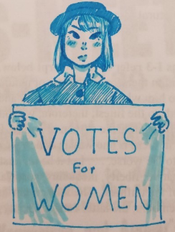
The Progressive
Era
Chpt. 7

Slide 2
The Progressive Era
In the late 1800s rapid industrialization and unrestricted growth of cities led to major problems.
Progressive reformers attempted to find a remedy for the social problems industrialization caused.
Progressive reforms were introduced at the national level by Presidents Teddy Roosevelt, William Howard Taft, and Woodrow Wilson.
In the following lesson you will find out what was done by these Presidents and others to help solve the problems during the Progressive Era of the early 1900s.

Slide 3
Roots of the Progressive Movement
Reform Tradition-starting with abolitionist
Legacy of Populism
Problems of Industrial Society
Influence of the Middle Class
Social Gospel Movement
New Forms of Journalism
Rising Consumer Confidence
Socialism, Anarchism, Communism
Support of Women and Workers

Slide 4
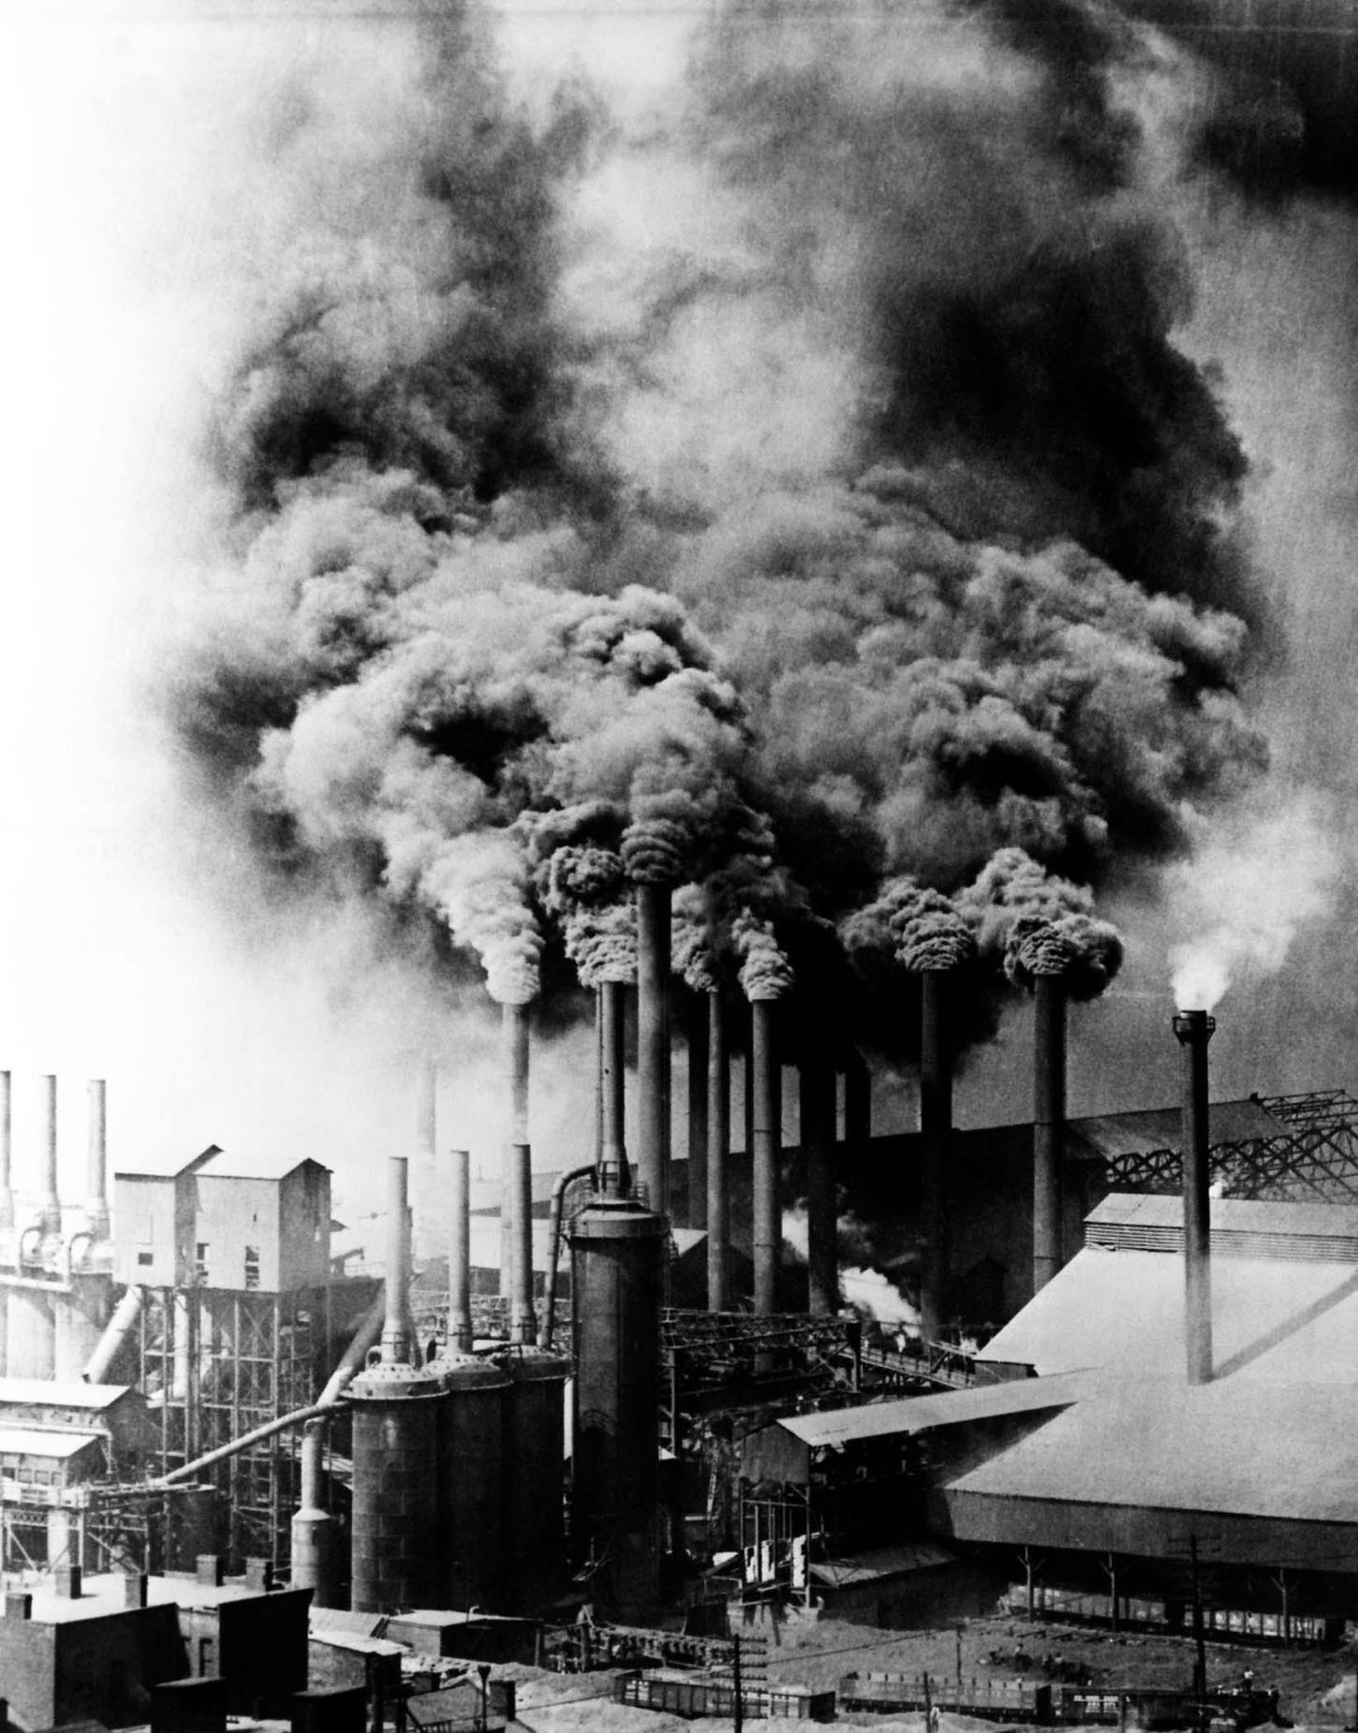




ROOTS OF PROGRESSIVES
How did we get here? The Context
Rapid growth of big business, coupled with social problems associated with overpopulation in urban environments led to political and social tensions
Immigration’s influence: 1900 76 million
Americans (1 in 7 foreign born) by 1914 another 13 million immigrants arrived on American soil.
Rejection of Social Darwinism - progressives believe that domination by the rich and powerful was a distortion of democracy.
As the middle class expanded, so to did supporters of the progressive movement. Technicians, managers, engineers and clerks, joined doctors, lawyers and teachers to form the progressive base.

Slide 5
The Populists: Goals
Improve conditions for farmers and workers
Curb the power of big business
Make government more accessible
The Social Gospel Movement:
1.Christianity 2.Social reform 3.Society must take
responsibility for the less fortunate
The Progressives: 1.Want to improve society 2.Use political action 3.Use the government to
solve problems
4.Regulation of Big Business

Slide 6

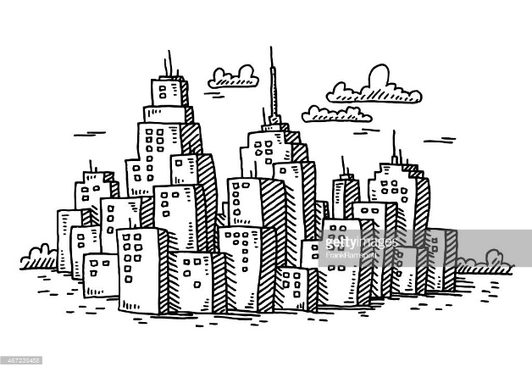
Populism to Progressivism
The Legacy of Populism
Many people believed we were making progress in improving society, but…
Industrialization and Urbanization had caused problems (poor schools, city slums, horrendous working conditions of the industrial laborers) in the American society.
People could improve society by relying on science and knowledge and show PROGRESS
Government should fix these problems.
But, Government had become corrupted by big business and political machines.
To achieve reform, the government itself had to be reformed.

Slide 7
The Progressive Movement 1890 - 1920
The Progressive Movement was at its greatest influence from 1900 to the start of World War I, 1917.
Progressives borrowed ideas from the Populists, but they were different in many ways.
Progressives were mainly middle-class city people, instead of the Populist farmers and factory workers.
Writers, lawyers, ministers, college professors, and even Presidents became the Progressive leaders.
Progressives were given their name for their belief in human “progress”
Progressives did not oppose industrialization but wanted govt to regulate it to correct its abuses, but first govt needed to be reformed (changed) because it had been corrupted by Big Business & political bosses

Slide 8
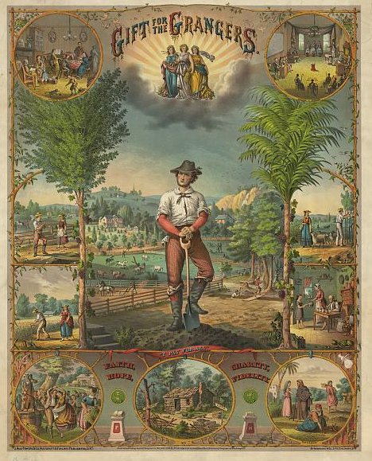
When did the Progesseive movement begin?
Farmers organize during the 1870’s
The Grange—1867---local level
Farmer’s Alliance---state level
Populist Party--national level People’s Party

Slide 9
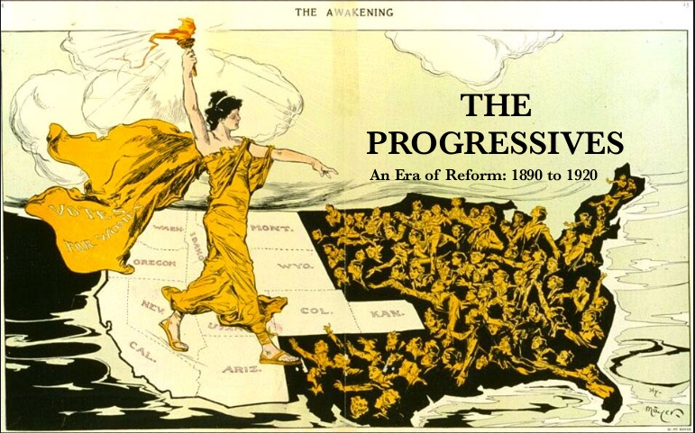

Slide 10

The Progressive Era with Mr. Green

Slide 11
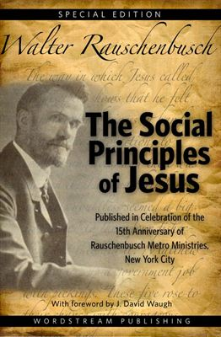
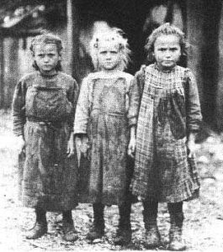


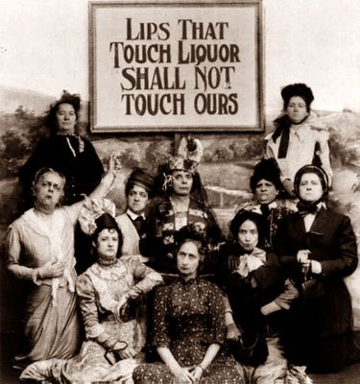
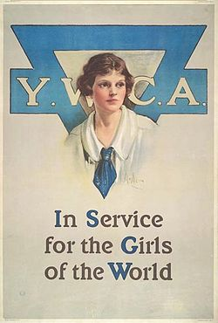
The Social Gospel Movement 1870-1910s

Slide 12
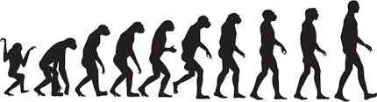
The Social Gospel Movement 1870-1910s
The Social Gospel Movement was a religious movement that arose during the second half of the nineteenth century. Ministers, especially ones belonging to the
Protestant branch of Christianity, began to tie salvation and good works together. They argued that people must emulate the life of Jesus Christ. To honor God, people must put aside their own earthly desires and help other people, especially the needy. The purpose of wealth was not to hoard it but to share it with other, less fortunate people. The ideas that originated from the Social Gospel would heavily influence the Progressive Movement. The Social Gospel Movement also attacked the concept of Social Darwinism.

Slide 13


The Social Gospel Movement 1870-1880s
The Social Gospel Movement started when Protestant ministers began calling for social reforms. Disgusted with poor schools, city slums, horrendous working conditions of the industrial laborers. It called for govts, churches, & private charities to work together to help people in need.
Followers of the Social Gospel movement believed that organized religion must place greater emphasis on reconstructing American society.
These reforms included the abolition of child labor and for safer working conditions.
These people emphasized the duty to help those less fortunate. They wanted to reconstruct American society.
Salvation Army emphasized the Christian duty to
help the less fortunate
Temperance Movement. The Social Gospel Movement also strongly supported banning alcoholic beverages. Alcohol was seen as a chief cause of many social problems. Many women groups were involved.
(Would lead to 18th Amendment-Prohibition)

Slide 14
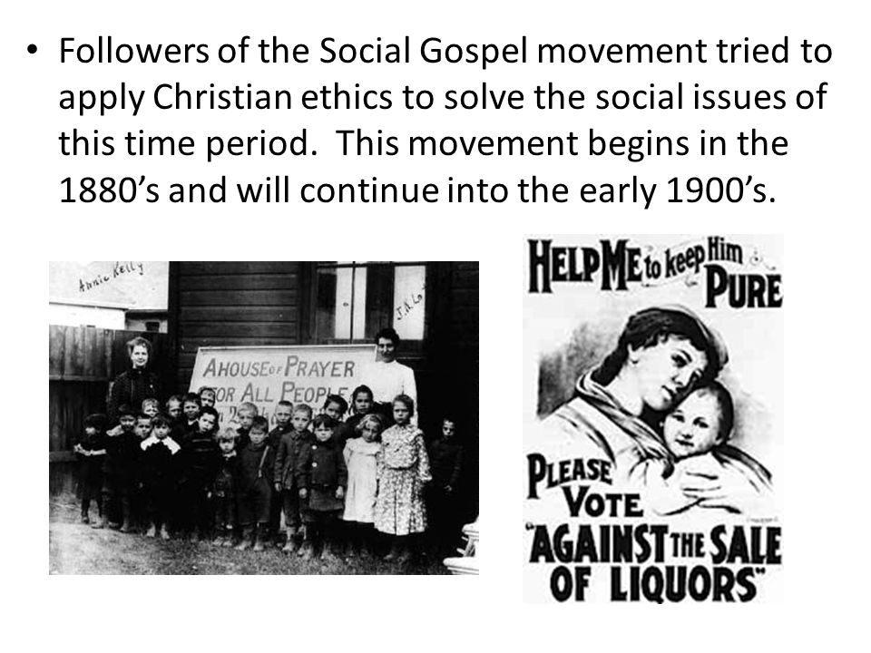

Slide 15
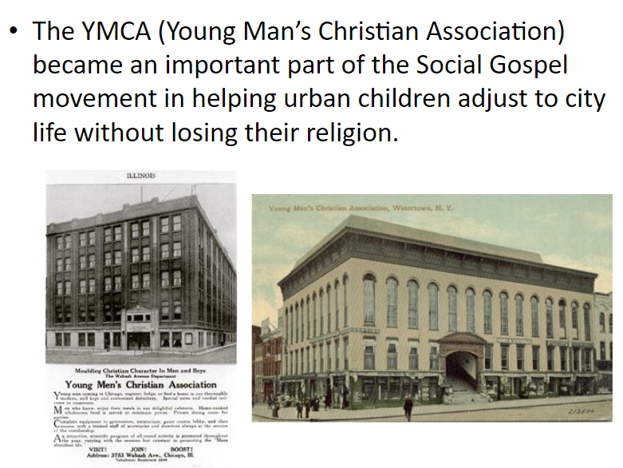



Slide 16
An EOC Moment

Slide 17
The Muckrakers
The muckrakers were reform-minded journalists, writers, and photographers in the Progressive Era in the United States who claimed to expose corruption and wrongdoing in established institutions, often through sensationalist publications.
APUSH- remember gender, ethnicity (race) and class. Especially in this section.

Slide 18
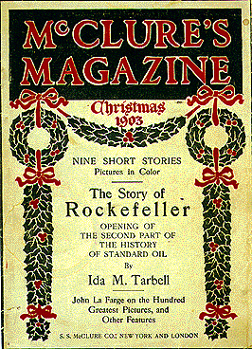
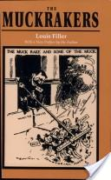

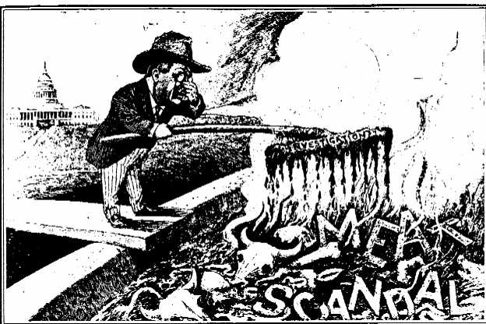
The Muckrakers- The Role & Purpose of Journalism
As the cities continued to expand the newspapers and magazines began to reach a larger audience.
Investigative reporters, writers, and social scientists exposed the industrial and governmental corruption.
These writers became known as Muckrakers, they raked up all the muck or the dirt of American life in both business and government.
Journalist now act as watchdogs
over govt. Expose problems, inform the public and stimulate debate in order to influence public opinion and the gov to address the problems exposed.

Slide 19

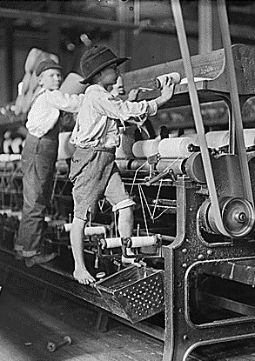
The Muckrakers
Muckrakers examined the rise of industry and the abuses that were often used in the effort to become rich. Wanted to expose the wrongs in society.
Muckrakers examined business practices and the negative effect they had on the consumers and the lives of the very poor.
Muckrakers are often considered to be the first Progressives.
Because of their books, many readers pressured govt to pass laws to address the ills of society and govt.
Progressive reformers and muckrakers utilized the expansion of the popular press to spread their views and to call on the public to exert pressure for social, cultural, political, and economic changes.

Slide 20
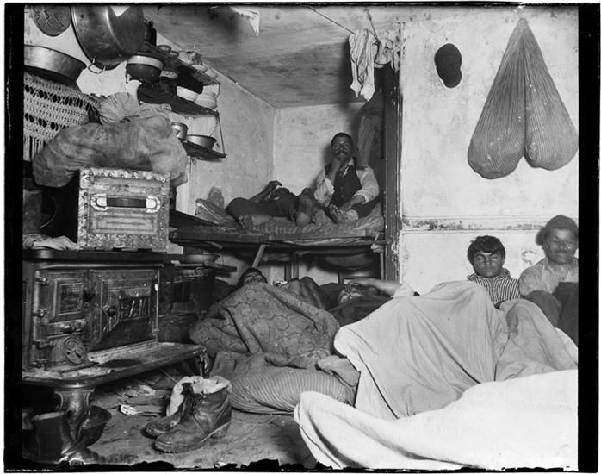
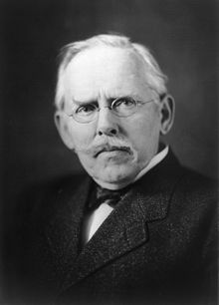
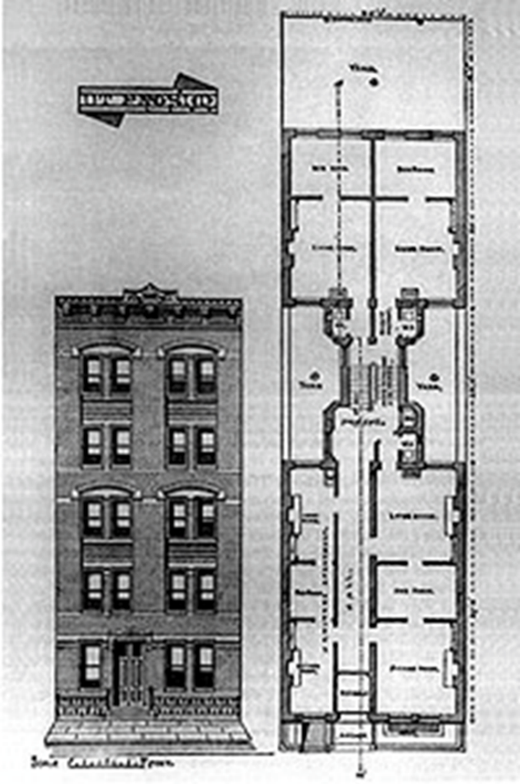
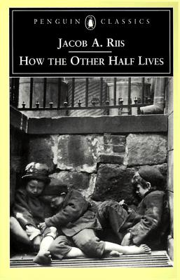
Muckrakers and Their Influences
  Jacob Riis
  He exposed the poverty, living conditions, and disease of the urban poor in his book “How the Other Half Lives” .
Problem – the horrible living conditions of the poor in the cities. Tenement Row
Led to New York City passing building codes to promote safety and health.

Slide 21
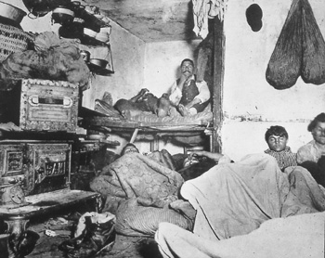
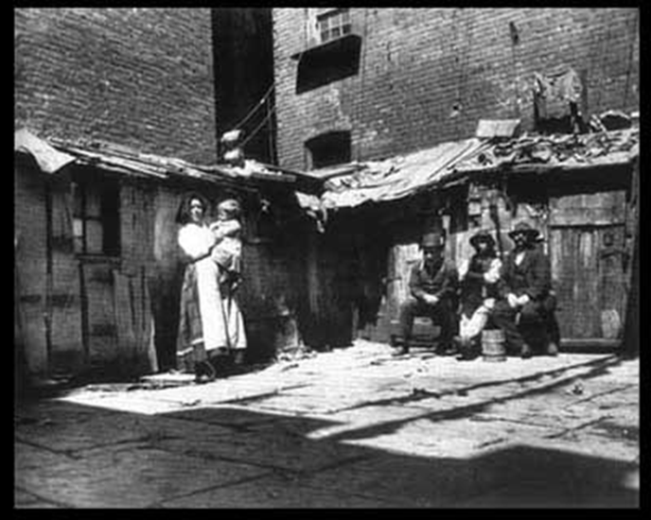
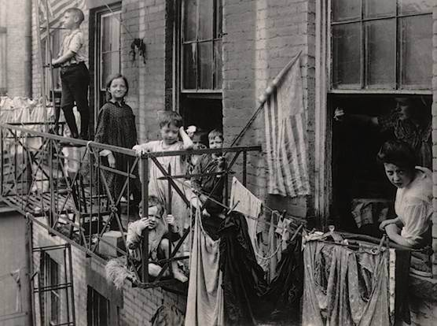
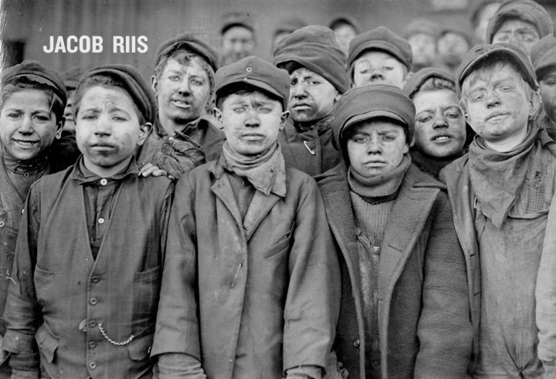

Slide 22
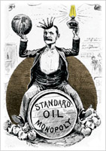

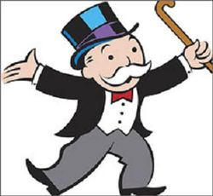
Laws Against Anti-Competitive Practices
Sherman Anti-Trust Act (1890)
Federal law aimed at stopping monopolies and trusts from engaging in unfair practices.
Attempted to prevent unfair competitive advantages.
Act marked a significant change in the attitude of government about the abuses of big business.
Standard Oil was the 1st monopoly the government attempted to stop.

Slide 23
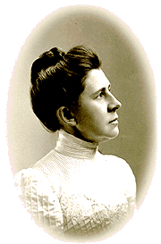
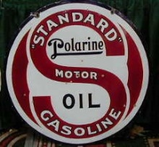
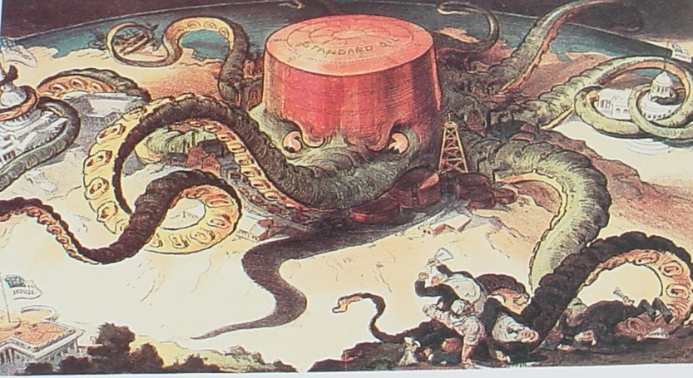
Muckrakers and Their Influences
  Ida Tarbell
  In her book, History of the Standard Oil Company (1904), she exposed Standard Oil’s ruthless business tactics of forcing others out of business and thereby creating a monopoly.
Problem – trusts and monopolies had an unfair advantage among businesses. They destroyed competition, stymied innovation and charged high prices
Government passed Sherman Anti-Trust Act outlawing monopolies.

Slide 24
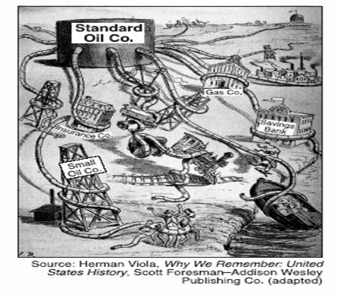

Slide 25
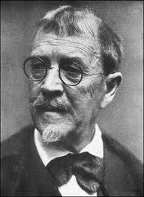
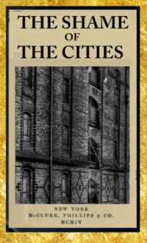
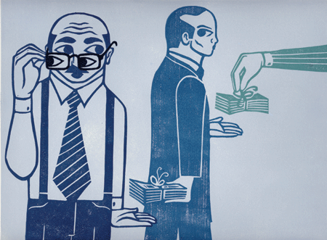
Muckrakers and Their Influences
  Lincoln Steffens
  Writer who exposed corruption in city and state governments in his book,
  “The Shame of the Cities”.
Problem – city and state leaders were often corrupt, took bribes or broke the law. The Political Machine, Bosses ran the city and sometimes the state.

Slide 26
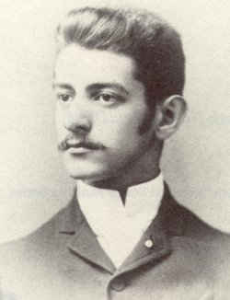
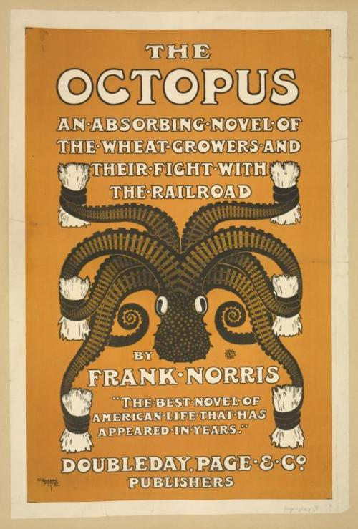
Muckrakers and Their Influences
Frank Norris
  Pointed out the stranglehold the railroads had on California farmers in his book “The Octopus” .
Problem – railroads were charging farmers more than their crops were often worth to ship them to market. RxR were a monopoly.

Slide 27


Muckrakers and Their Influences
Upton Sinclair
He exposed dangerous working conditions and unsanitary practices in meat packing industry in his book The Jungle. The Union Stock Yard & Transit Co., or The Yards, was the meatpacking district in Chicago
RESULT:
Government passed the
  “Meat Inspection Act” law that set standards of cleanliness and required federal inspection of meat plants.
  “Pure Food & Drug Act” law that required foods to be pure and accurately labeled.

Slide 28


Excerpt from “The Jungle”
Upton Sinclair’s book The Jungle portrayed the new industrial economy as inhumane, destructive, and uncaring.
“The meat would be shoveled into carts, and the man who did the shoveling would not trouble to lift out a rat even when he saw one – there were things that went into the sausage that in comparison with which a poisoned rat was a tidbit. There was no place for the men to wash their hands before they ate their dinner, and so they made a practice of washing them in the water that was ladled into the sausage.

Slide 29


Slide 30
An EOC Moment
One way in which Ida Tarbell, Upton Sinclair,
and Jacob Riis were similar is that each sought to
a. end racial discrimination
b. control illegal immigration
c. limit government regulations
d. expose economic and social abuses

Slide 31
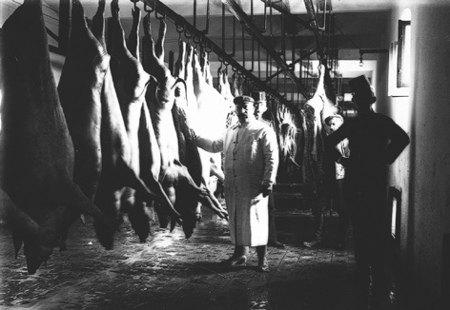
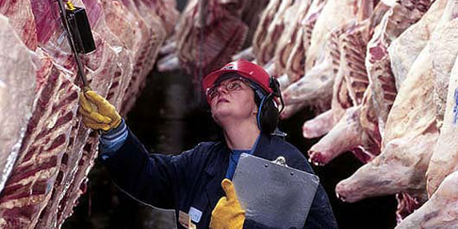
  Because of Upton Sinclair’s novel ‘The Jungle’ the government passed the ….
  “Meat Inspection Act” law that set standards of cleanliness and required federal inspection of meat plants.

Slide 32
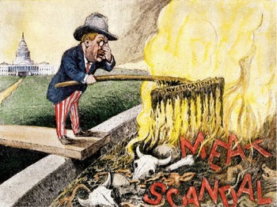
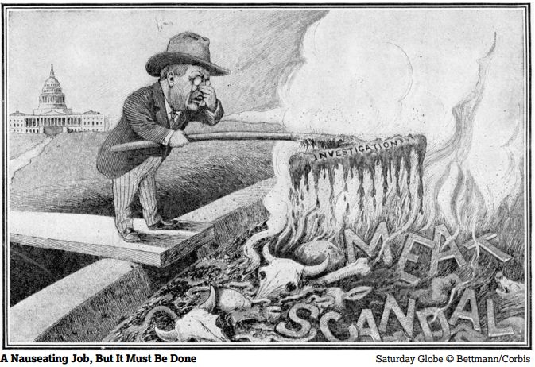
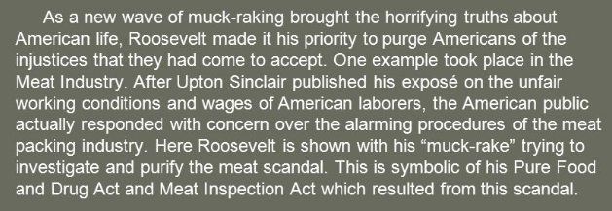

Slide 33
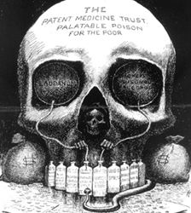
The Patent Medicine Trust Poison for the Poor
Why does it say poison for the poor?
Barrel says ‘Laudanum’ an opiate that was used by women instead of alcohol
Money bags, Grimm Reaper, and snake symbolize what?
  “Pure Food & Drug Act 1906” law that required foods and drugs to be pure and accurately labeled.

Slide 34




“Pure Food & Drug Act 1906” because of ads like these, this law required foods and drugs be pure and accurately labeled.

Slide 35

Pure Food & Drug Act of 1906
It also created the FDA- Food and Drug Administration
Oversees safety involving food, drugs, cosmetics, animal food, dietary supplements, medical devices, biological goods and blood products.

Slide 36
Overall, the “Muckrakers” exposed what was wrong with big business (monopolies) and led to more govt regulations of business, local gov and politics and societal changes.
Interstate Commerce Act
Sherman Anti-Trust Act
Clayton Anti-Trust Act
Pure Food & Drug Act of 1906
Meat Inspection Act
With all this new gov regulations on business, what was happening to laissez-faire?

Slide 37


Energy Drink
1918: RadiThor for $1.00
William J. A. Bailey dissolved radium in water to create an energy drink he named RadiThor, which was just one piece of the American frenzy over the newly discovered element. Industrialist Eben McBurney Byers was rumored to have consumed 1,400 bottles to ease back and joint pain; eventually, his teeth began falling out and his bone tissue started to disintegrate. It took another full decade for RadiThor to fizzle out; that's when, in 1931, the Federal Trade Commission filed a cease-and-desist order against Bailey Radium Laboratories.
https://montanatalks.com

Slide 38


Slide 39
Reformers
Progressives were so upset by the evils that had fallen on the American public thanks to the Industrial Revolution they began demanding reforms.
Reforms were based on the idea that Society can be made better.
Social Reformers attempted to help solve the problems that faced the American society.
Municipal Reformers focused their attention on solving problems at the city government level.
State Government Reformers to free states from corruption and influence of big business.

Slide 40



Social Reformers
Jane Addams
Part of the Social Gospel Movement
  Founded a settlement house called Hull House to help immigrants and needy find a place to live, jobs, or get an education. Provided social services to the poor- taught English to immigrants, childcare, nursing the sick, industrial arts, had dinning halls, gymnasiums. Government could not or would not provide this. Had hands off approach: laissez-faire
  Beginning of social services (welfare) like Youth Shelter, Food Bank, or Roxanne’s House

Slide 41
Social Reformers
Jane Addams
Part of the Social Gospel Movement
  Addams publicized Hull-House and the causes she believed in by lecturing and writing. In her autobiography, 20 Years at Hull-House (1910), she argued that society should both respect the values and traditions of immigrants and help the newcomers adjust to American institutions. She voice her opposition to the political corruption (The Machine) of her day.
  https://www.history.com/topics/womens-history/jane-addams

Slide 42

Jane Addams- Social Activist
Addams believed that many of the services provided to urban immigrant communities by political leaders represented corruption to be fought against and stopped by political reform movements.
Addams undermined the social service and political patronage system that immigrants relied upon by providing social services away from the political corruption of city politics
Addams sought to exercise social control by cleaning up urban
political machines and uplifting immigrants by Americanizing them

Slide 43
The Settlement [at Hull-House] . . . is an experimental effort to aid in the solution of the social and industrial problems which are engendered [created] by the modern conditions of life in a great city. . . .
It must be grounded in a philosophy whose foundation is on the solidarity of the human race, a philosophy which will not waver. . . .
The highest moralists have taught that without the advance and improvement of the whole, no man can hope for any lasting improvement in his own moral or material individual condition; and that the subjective necessity for Social Settlements is therefore identical with that necessity, which urges us on toward social and individual salvation.
Jane Addams, 1892 speech at the School of Applied Ethics in Massachusetts, reprinted in her 1910 memoir Twenty Years at Hull-House.
HIPP this document- describe the content of the document

Slide 44

The picture above shows Jane Adams with some of the children being served by Hull House in Chicago, Illinois. What goal of the Progressive Era is represented by this image and the existence of Hull House?
A. Fostering efficiency
B. Protecting social welfare
C. Creating economic reform
D. Promoting moral improvement

Slide 45



Social Reformers
Anti-Defamation League
Jewish organization opposed to religious prejudice.

Slide 46



Social Reformers
Ida Bell Wells-Barnett (July 16, 1862 – March 25, 1931) was an African-American journalist, newspaper editor, suffragist, sociologist and, with her husband, newspaper owner Ferdinand L. Barnett, an early leader in the civil rights movement. She documented lynching in the United States, showing how it was often a way to control or punish blacks who competed with whites, often under the guise of rape charges. She was active in women's rights and the women's suffrage movement, establishing several notable women's organizations. Wells was a skilled and persuasive rhetorician, and traveled internationally on lecture tours.

Slide 47
Social Reformers
Ida B. Wells- investigative journalist, author, educator, and an early leader in the civil rights movement.
Lynching (murder by hanging) was a common tactic used to intimidate African Americans, especially in the South.
After 3 of her friends were wrongfully lynched for crimes they didn’t commit, she started a national anti-lynching campaign.
https://www.biography.com/activist/ida-b-wells

Slide 48
Social Reformers
Ida B. Wells
“Eternal vigilance is the price of liberty, and it does seem to me that notwithstanding all these social agencies and activities there is not that vigilance which should be exercised in the preservation of our rights.”
“A Winchester rifle should have a place of honor in every black home, and it should be used for that protection which the law refuses to give.”

Slide 49



Slide 50


Slide 51




Municipal Reforms
Some Progressives focused on the abuses found at the Municipal, or city level of government.
Progressives wanted to limit the control of ‘political machines’ and get rid of corruption and inefficient government.
They wanted to replace the ‘bosses’ & ‘machines’ with real public servants such as mayors, city managers (usually appointed by the mayor with consent of the city council or commission, and city commissions or councils elected by the people.
Reformers wanted to expand city services to deal with overcrowding, fire hazards, and sanitation issues.

Slide 52

City Govt under the Political Machine

Slide 53


Slide 54


Slide 55


New Forms of City Govt Organization-GOAL TO BREAK POLITICAL MACHINE
How does the council-manager form of government reflect the goals of government reform during the Progressive era?

Slide 56



Reforming State Governments
At the state level, several Progressive governors took steps to limit corruption and the influence of big business.
Robert La Follette the Progressive governor of Wisconsin broke the power of local political bosses and the influence of the RxR.
Theodore Roosevelt of New York both took steps to limit the powers of big business within their states. Later would become President.

Slide 57

Robert LaFollete

Slide 58


Muckrakers and Their Influences
  Thomas Nast
  Political Cartoonist who exposed the corruption of NYC’s Tammany Hall led by Boss Tweed.
Problem – governments had become corrupt with political machines.
Boss Tweed and other corrupt government officials went to jail for corruption.
Boss Tweed ran NYC’s most powerful political machine

Slide 59

Political Reforms
To give people more power, a direct voice in the government, and make it more responsive to the people. Progressives passed several laws to increase voter participation in government.
Secret Ballot – to keep people from being intimidated or forced to vote a certain way.
Initiative – voters could introduce bills themselves. Procedure whereby a certain number of voters may, by petition, propose a law or constitutional amendment and have it submitted to the voters.
Referendum –Procedure for submitting to popular vote measures passed by the legislature or proposed amendments to a state constitution.
Recall – elected officials could be removed from office by voters in a special election before their term was up.
Direct Election of Senators – 17th Amendment (1913) Senators are elected by the people of a state.
Direct Primary-An election in which voters choose candidates to run on a party's ticket in a subsequent election for public office. Before this was done by the political machine.
Participatory
is a model of democracy in which citizens have the power to decide directly on policy and politicians are responsible for implementing those policy decisions.

Slide 60


The need for the 17th amendment.
Based on the message of the cartoon, why was direct popular elections of U.S. Senate needed?
“The Bosses of the Senate”
Corruption
Senate NOT responsive to the people but to BIG BUSINESS

Slide 61
Political Reforms
1790 to 1828
Caucus---small group of individuals who would choose a candidate
1828 to 1900
Convention---members from the political parties nominate a candidate
Current System Used
Direct Primary---allow registered voters to participate in choosing a candidate
Which of these nominating processes would be the most democratic way to nominate candidates and narrow the field of candidates for the general election?
electoral

Slide 62
An EOC Moment
The direct election of Senators by a state’s population was a main agenda of
A business owners, who found it difficult to influence Senators elected by state legislatures
B progressives, who wanted to reform a Senate that didn’t answer directly to citizens
C governors, who by and large sought to wrest power away from the state legislatures
D conservatives, who wanted to separate the interaction of federal and state governments
Why would a majority of poor people living in cities in the late 1890s and early 1900s be likely to support progressive leaders?
A Progressive leaders promised to get everyone a job and safe house by 1920.
B Almost all of the progressive leaders were poor, city dwellers with little education.
C Most progressives sought to resolve problems caused by industrialism and urbanization.
D Unlike politicians, progressives sought to resolve problems without using any government help.

Slide 63







Social Legislation
States also passed laws to overcome some of the worst effects of industrialization.
Abolishing the employment of young children and improving the working conditions in the factories.
Laws forcing employers to give compensation to workers injured on the job-workmen’s compensation
New regulations concerning the construction and safety of urban housing.
Laws regulating railroads, public utilities, laws conserving natural resources and laws prohibiting the sale of alcohol.

Slide 64


Social and Economic Reform
Triangle Shirtwaist Factory
In 1911, the Triangle Shirtwaist Factory caught fire and the public’s attention.
Immigrant women and girls worked on the upper floor in a sweatshop making clothing.
Fire spread rapidly and to make matters worse:
  the doors were bolted shut,
  the sprinkler system failed,
  the fire escape was faulty.

Slide 65





Progressive Era and Labor
Triangle Shirtwaist Factory
The fire department arrived but not in time to save the girls from either dying in the fire or jumping to their death on the street below.
In all 146 people died due to conditions in the factory.
Soon after the tragedy, Congress would pass laws sympathetic to union and called for safer conditions.

Slide 66






Triangle Shirtwaist Factory Fire 1911 New York City

Slide 67

Triangle Shirtwaist Factory Fire 1911 New York City

Slide 68





Slide 69


Effects of Triangle Fire
Department of Labor (1913) – Congress created a Cabinet post to study the problems of labor & to -
  “promote the welfare of working people and improve their working conditions”.
Clayton Anti-Trust Act (1914) – prevented courts from restricting activities of unions.
Child Labor Act (1916) – Prohibited sale
of goods made by child labor.
1971 OSHA-Occupational Safety and
Health Administration-to assure safe and healthful working conditions for working men
and women by setting and enforcing standards and by providing training, outreach, education
and assistance.

Slide 70




Progressive Era and Labor
During the Progressive Era, public attitude towards labor unions began to change.
The violence that had become associated with the labor unions caused a loss of public support for unions.
The government often had to use the military against the union protests.
All this would soon change!

Slide 71







PROGRESSVES: Four Women Reformers
19th Amendment
Susan B. Anthony
Florence Kelley
Carrie Chapman Catt

Slide 72






Susan B. Anthony
In 1872, Susan B. Anthony attempted to vote, exercising her 14th Amendment right (citizenship).
But, a judge refused to grant her the right to vote (suffrage).
In 1874, the Supreme Court ruled that women were citizens, but they couldn’t vote, because voting was not a ‘privilege’ of citizenship.
The Suffragettes were able to obtain suffrage for women living in the western states. Area in white

Slide 73

Political rights for women grew most rapidly on the western frontier primarily because
(1) the settlers were influenced by Native American Indian societies
(2) women greatly outnumbered men in the West
(3) pioneer life often required men and women to share responsibilities equally
(4) immigrants settling in the West brought ideals of gender equality from Europe

Slide 74




Florence Kelley(1859-1932)
She fought for a minimum wage, an 8-hour work day, and against child labor and improve working conditions.
She was appointed by the governor of Illinois as the state’s chief factory inspector.
Worked on the brief that persuaded the Supreme Ct. to limit women’s workday.
1909, she became one of the founders of the NAACP

Slide 75





Carrie Chapman Catt (1859-1947)
President of the National American Woman Suffrage Association (NAWSA)
Founder of the League of Women’s Voters.

Slide 76



Alice Paul (1885-1977)
Lead marches in Washington DC in1913
Picketed the White House and was arrested
Went on hunger strike while in prison and had to be forced fed
Her militant tactics convinced President Woodrow Wilson that the time had come for an amendment giving women the right to vote.
In 1923, she proposed the Equal Rights Amendment ERA

Slide 77

Women’s Suffrage Movement
In the early 19th century, the United States was a ‘patriarchal’ society – men held the positions of authority and women were considered inferior.
Women lacked the right to vote, to serve on juries, or to hold public office.
They were excluded from public life and were left in charge of the home and children.
In most states, once a woman married, she lost control of her property and wages to her husband.

Slide 78

Suffrage Parade, New York City, May 6, 1912
Many considered the Suffragettes “unfeminine”. These marchers knew this and are marching dressed in white “purity” of womanhood, in dresses (feminine) and with their children – we are mothers, wives.
The message is clear: WE ARE WOMEN, FEMENINE, MOTHERS PURE, HOME MAKERS, AND WIVES.
We can vote and our woman hood will not change.

Slide 79

Suffragettes March in New York City
October, 1917

Slide 80




Women’s Suffrage Movement
By the middle of the 19th century, some women began to organize to gain more rights.
In 1848, they held a convention at Seneca Falls, New York.
The convention passed a resolution that paraphrased the Declaration of Independence.
It proclaimed that women were equal to men and deserved the right to vote, or suffrage.

Slide 81

Women’s Suffrage Movement
Seneca Falls, 1848
Declaration of Sentiments
Elizabeth Cady Stanton wrote the Declaration of Sentiments to dramatize the denied citizenship claims of elite women during a period when the early republic’s founding documents privileged white propertied males. The document has long been recognized for the sharp critique she made of gender inequality in the U.S.
https://www.nps.gov/articles/declaration-of-sentiments.htm#:~:text=Elizabeth%20Cady%20Stanton%20wrote%20the,gender%20inequality%20in%20the%20U.S.

Slide 82

Seneca Falls, 1848

Slide 83

Women’s suffrage movement and the abolitionist movement were closely linked.
But because of the events that led up to the Civil War, the women’s suffrage movement was put on the back burner- given less priority. This will change by 1920.
Did you know that Fredrick Douglas was present at Seneca Falls Convention?

Slide 84


Women’s Suffrage Movement
But, Susan was unable to succeed in introducing a constitutional amendment requiring all states to give women suffrage.
By 1890 several women’s suffrage groups joined together to form the National American Women Suffrage Assn.
This group was led by reformers:
  Susan B. Anthony
  Elizabeth Cady Stanton
Look women will be able to vote !
But do I have to vote for a man ?

Slide 85



19th Amendment
During World War I, women had taken the place of the fighting man in the workplace, as women stepped up to meet the challenges of war, it became hard to deny them suffrage.
As a result of World War 1 and women’s involvement the U.S. Congress passed 19th Amendment in 1920 and the elections of 1920 saw an increase voter turn out---WOMEN
The 19th Amendment stated that no state could deny a citizen the right to vote based on their sex.

Slide 86




Impact of the 19th Amendment
The 19th Amendment was a step forward in making the USA a true democracy – a system of government by the people.
But, it did not lead to dramatic changes in our political system, as women did not sweep men out of public office.

Slide 87



Women’s Suffrage Prior to 1920
Map Credit: Lokal_Profil

Slide 88


Slide 89

Why were women given the right to vote in western states before 1920
During the westward expansion, women made many sacrifices. Toiling on the Great Plains along side their husbands. As a result, state leaders saw the inherent equality among men and women in their sacrifices to build the west and many western states granted women suffrage way before 1920. States have the power to set voter qualifications under the 10th amendment.
In November 1916, four years before the Nineteenth Amendment guaranteed the right of women to vote, Jeannette Rankin of Montana became the first woman elected to the United States Congress.

Slide 90
DBQ or LEQ Prompt
Evaluate the extent to which the ratification of the Nineteenth Amendment to the Constitution, which guaranteed women the right to vote, marked a turning point in United States women’s history.
CONTEXT: Women and African Americans
Seneca Falls Convention, 1848
The Civil War and the end of Reconstruction
· Westward expansion of the United States-women voted in the west
· The rise of Jim Crow segregation in the South and of other forms of racial discrimination throughout the United States
· The rise of large-scale industrialization-women labor
· Urbanization and the growth of cities
· Large-scale immigration from Europe
· Second Great Awakening and the Antebellum reform movements
CONTEXT: Ask yourself how did we get here? What events occurred before 50-100 years prior that led to these circumstances.
THESIS:
The ratification of the 19th amendment, which gave women the right to vote marked a turning point in US women’s history because….
COUNTER POINT: However, some would argue that little changed as a result of the passage of the 19th amendment because… CITE ONE REASON
Cite 3 reasons. Each reason becomes a body paragraph. Use the TEA method to build your paragraphs.
Topic Sentence
Evidence- would come from your documents in a DBQ-HIPP the document.
Analysis- would be the reason(s) why the document supports your thesis.

Slide 91





The Progressive Presidents
Between 1901 and 1919, three Presidents began a series of Progressive reforms.
Teddy Roosevelt
Woodrow Wilson
William Howard Taft

Slide 92



Theodore Roosevelt
1901 – 1909
Teddy Roosevelt came from a rich family but had grown up a sickly child.
Teddy overcame his illness by being actively involved in sports and hunting.
His accomplishments included:
  New York City Police Commissioner
  Rancher in the Dakotas
  Officer in the Spanish American War
  Governor of New York
As Vice-President, he became President with the assassination of Pres. William McKinley.

Slide 93




Theodore Roosevelt
1901 – 1909
TR believed that the President represented all Americans. He believed that the President was the steward or manager of the people’s interest.
His economic (domestic) agenda was called the Square Deal- fair play and equality of opportunity- especially conservation of natural resources, regulation of corporations and protection of consumers.
Under the Square Deal he launched new laws to protect the consumer’s health from false advertising:
  Meat Inspection Act (1906)
  Pure Food and Drug Act (1906)
  Increased powers of the I.C.C. to regulate railroads, telephones, and the telegraph.

Slide 94

Theodore Roosevelt 1901 – 1909
The Coal Miners Strike (1902) proved he was willing to use the power of the federal government to protect the public interests.
When the coal miners and the mine owners could not agree on a settlement, a strike looked near.
Roosevelt stepped in and threatened to used the military to keep the mines running for the good of the nation if an agreement was not reached
He forced mine owners and striking worker to arbitration-an independent person or body officially appointed to settle a dispute.
Problem solved!

Slide 95


Theodore Roosevelt
1901 – 1909
As President, Teddy believed in fair play and was suspicious of big business, particularly trusts or monopolies.
Roosevelt felt there were some ‘good’ trusts and some ‘bad’ trusts.
He used the Sherman Anti-trust Act against some ‘bad trusts’ he felt acted against the public interest.
Roosevelt became known as the ‘Trust-busting President’

Slide 96

TRUST BUSTING
Worked to curb the power of Trusts and to protect the Common Man
By 1900, Trusts – legal bodies created to hold stock in many companies – controlled 80% of U.S. industries
Six companies controlled 95% of railroads
1902 - TR filed suit against N. Securities Company
Roosevelt filed 44 antitrust suits under the Sherman Antitrust Act
Establishes Fed. Gov’t position in industry

Slide 97



Theodore Roosevelt
1901 – 1909
Roosevelt's motto was:
  “Speak softly, but carry a big stick”
Roosevelt, “The Trust Buster” felt that some trusts that served the public’s interest were ok, but those that didn’t needed to be stopped by regulation not by nationalization.
A trust that engaged in price-fixing (collusion) cutthroat competition had to be stopped. They were the BAD TRUSTS but NOT put under govt. control. Never to nationalized.

Slide 98


Theodore Roosevelt 1901 – 1909
1902 TR filed an anti trust lawsuit against Northern Securities Company a holding company controlled by JP Morgan to stop him from creating a monopoly railroad in the western US. TR won the case.
TR challenged Rockefeller’s Standard Oil which controlled 90% of all oil refining in the US.
TR believed that the federal govt should not take control of the monopolies but should regulate them.
Under TR, the federal govt shifted from unquestioned support of big business toward helping consumer.
J.P. Morgan

Slide 99

Standard Oil was broken up by Supreme Court in 1911
This promoted more competition-promotes lower prices, better quality
Not a government take over

Slide 100


Slide 101

On January 1 1984 AT&T became a long-distance company, while seven regional Bell Operating Companies (RBOCs) took control of the nation's local phone networks.
The break up of the telephone monopoly was a big event.
Not a government take over

Slide 102


How do these cartoons illustrate TR view on how monopolies (trusts) should be treated by the federal govt?

Slide 103


What does each "character" in the cartoon represent?
The man in the middle with a rifle represents Teddy Roosevelt. The bears represents trusts. The bear labeled "bad trust" represents the corrupt trusts whereas the bear labeled "good trusts" represents the trusts that are not as corrupt The bear that is not labeled on the right side is considered a hard-working, non-corrupt corporations.
What is the overall message of this cartoon?
The cartoon shows that Teddy Roosevelt believed there were "good trusts" and "bad trusts" and that he set out to STOP the "bad trusts". He cracked down on bad trusts by dissolving them. He had no wish to take down the "good trusts," but the trusts that were destroyed by Teddy Roosevelt became symbols, so that other trusts would reform themselves.

Slide 104

Roosevelt Versus the Trusts
What do the giants in the political cartoon represent?
What point does the cartoon make by picturing Roosevelt as tiny in relation to the giants?

Slide 105


Which statement best describes the cartoon
a. Monopolies must be destroyed even with violence.
Monopolies should be brought under direct control of the federal govt.
Monopolies should be broken up into smaller companies.
Monopolies that misbehave should be broken up into smaller companies.

Slide 106
In the cartoon above, President Theodore Roosevelt is depicted doing which of the following?
A. Standing guard to protect big business
B. Enforcing the Sherman Anti‐Trust Act
C. Leading a government take‐over of large industries
D. Putting an end to industries that might harm the environment

Slide 107
An EOC Moment
President Theodore Roosevelt earned a reputation as a trustbuster because he
a. favored the conservation of natural resources
b. used court actions to break up business monopolies
c. sided with labor unions against big business
d. opposed the efforts of consumer advocates

Slide 108

The Conservation Movement
Concerns over deforestation sparked the conservation movement, and the
breathtaking paintings and photographs of western landscapes helped to push Congress to preserve such western icons as Yosemite Valley as a California state park in 1864 (a national park in 1890), and to dedicate the Yellowstone area as the first National Park in 1872.
With the closing of the frontier era, Americans grew increasingly concerned about the loss of public lands and the natural treasures they contained.
The Forest Reserve Act of 1891 and the Forest Management Act of 1897 withdrew federal timberlands from development and regulated their use.
"CONSERVATIONISTS" believed in scientific management and regulated use of natural resources, "PRESERVATIONISTS," such as John Muir, a leading founder of the Sierra Club in 1892, went a step further, and aimed to preserve natural areas from human interference. The education efforts of the Arbor Day, Audubon Society, and the Sierra Club were another sign of a growing conservation movement by 1900.

Slide 109
Yosemite Valley, California 1890

Slide 110


Theodore Roosevelt
1901 – 1909
He was a big game hunter but, conservation of natural resources was important, and he stopped the government from selling off public lands and added millions of acres to the national parks and forests.
Appointed Gifford Pinchot, a conservationist, head of the National Forestry Service.

Slide 111

Gov Reforms at the Federal Level
The dawn of the 20th century brought the dawn of the Progressive Era that ended the corruption of the Gilded Age. Muckraking reporters who exposed political corruption paved the way for the enactment of reforms by President Theodore Roosevelt that included tax and election reform as well as limitations on corporate power.
Progressives believed that Government should fix these problems.
but Government had become corrupted by big business and political machines. To achieve reform, the government itself had to be reformed
Public officials (gov employees) were susceptible to corruption because many did not rely on salaries for income but on a cut of fees or taxes they collected, similar to sales commissions. “Taxes are kept down, but these offices are profit-garnering enterprises,” *White says of the Gilded Age’s fee-based governance.
Most postmasters, for instance, earned a percentage of stamps they sold, and public prosecutors received fees for each case they brought. White says this payment system easily morphed into bribery and fraud. For example, custom officials could collect half of the penalties paid on goods they said were undervalued for import—or be paid off to not report malfeasance.
*professor emeritus of history at Stanford University
https://www.history.com/news/gilded-age-corruption-corporate-wealth

Slide 112


Gov Reforms at the Federal Level
“This is a government of the people, by the people and for the people no longer,” former president Rutherford B. Hayes wrote in his diary in 1886. “It is a government by the corporations, of the corporations and for the corporations.” Politicians took spectacularly handsome bribes from corporations and demanded kickbacks as the helping hand, they extended often came with an open palm.
*professor emeritus of history at Stanford University
https://www.history.com/news/gilded-age-corruption-corporate-wealth

Slide 113


Civil Service Reform & the Creation of the Bureaucracy
Much of the corruption in government could be traced to the ‘spoils system’.
This gave government jobs as rewards to those who helped get a candidate elected.
These people were often not qualified for the job.
When Pres. Garfield was assassinated by an office-seeker, Congress decided it was time to act.
I’ve been shot !
Pres. Garfield
gets capped
September 19, 1881

Slide 114


Civil Service Reform & the Creation of the Bureaucracy
Pendleton Act (1883) passed by Congress created the Civil Service Commission.
This commission gave exams that selected government appointees based on merit, not on who they knew.
Helped to rid government of corruption and made it more efficient.
The creation of a government bureaucracy ended the Gilded Age’s political corruption.
Oversight laws were passed
Fee based moved to salary-based pays system for federal workers
“A series of laws providing oversight and a move away from fee-based governance to a salary resulted in a drop in corruption. The period between the Progressive Era and the 1960s and 1970s is among the least corrupt.

Slide 115


William Howard Taft
1909 - 1912
From Teddy to Taft
T
A
F
T
Roosevelt served two terms as President before he decided not to run for a third time. (no one had ever ran 3 times)
He supported his Vice-President William Howard Taft as the Republican nominee for President.
Taft won the election of 1908 and continued with Roosevelt’s Progressive policies, for a while.

Slide 117



William Howard Taft
1909 - 1912
Roosevelt supported Pres. Taft, until Taft began doing things not considered to be a part of the Progressive agenda.
Taft was nominated for President again in 1912, but Teddy decided to run against him.
Roosevelt started his own third party (The Progressive Party) nicknamed the Bull Moose Party.
But, Teddy’s 3rd Party split the votes and neither Taft nor Roosevelt would win in 1912.

Slide 118


Woodrow Wilson
1912 - 1916
The split between Roosevelt and Taft allowed the Democratic nominee Woodrow Wilson to win the 1912 Presidential election.
Wilson’s economic (domestic) agenda was called the “New Freedom”.
Pres. Wilson felt like Roosevelt:
  Big business needed to be tamed
  Trusts should be broken up- all trusts are bad. Break them all up
  Banking system needed fixed
  Tariffs only benefitted the rich
16th
Amendment

Slide 119


Woodrow Wilson’s
New Freedom Legislation
Underwood Tariff –
  A tariff is a tax on imports which benefits big business (manufacturers, trusts)
  Wilson felt tariffs benefitted the rich because it protected them from competition by making cheaper imports artificially more expensive and he lowered the tariffs.
  To make up for lost revenue ($) he introduced America’s first income tax.
Graduated or Progressive Income Tax
  Means that rich taxpayers are taxed at a higher rate-the more you earn, the income tax you pay. Meant to close the rich-poor gap. Resentment over the unequal distribution of wealth
  16th Amendment gave Congress power to tax a person’s income.

Slide 120



Woodrow Wilson’s
New Freedom Legislation
Federal Reserve Act –
  Reformed the banking industry.
  Federal Reserve Bank serves as a banker’s bank, where the banks borrow their money when no other bank had money. Its called the Central Bank of the United Sates
  It was meant to control inflation (control the money supply) and prevent economic downturns.
  Fed’s control interest rates and the amount of money a bank can loan. They control the money supply.
Federal Reserve Bank

Slide 121

Federal Reserve System Map

Slide 122
An EOC Moment
The Federal Reserve System was created in 1913 to
balance the budget
control the money supply
insure savings account deposits
regulate the stock market

Slide 123


Woodrow Wilson’s
New Freedom Legislation
Antitrust Legislation –
  Clayton Antitrust Act (1914) gave government more power to regulate unfair business practices. It prohibited the use of anti-trust laws against unions or farmer’s cooperatives with a few exemptions. It listed specific actions that business could not do.
  Federal Trade Commission protects consumers against unfair business practices by corporations. They have the power to issue regulations (rules with the force of law) to stop unfair trade practices until its fairness could be decided by a court.
As a result of all the Progressive Reforms the role and size of the Federal govt _________
GREW
The idea of laissez-faire as the solution to our growing economic problems was laid to rest.

Slide 124
During the Progressive Era, four amendments to the US Constitution were proposed by a 2/3 vote of Congress and ratified by 3/4 of the states.
Income Tax
Direct election of Senators
by the people (popular sovereignty)
Prohibition– NO BOOZE
Social Reform
21
1919, first
Voted for Pres
In 1920
Women gain the right to vote

Slide 125

A STRONGER CENTRAL GOVERNMENT
 | 16TH | 17TH | 18TH | 19TH
SCIENTIFIC PRINCIPLES | X |  | X
MORAL IMPROVEMENT |  |  | X | X
REGULATION OF BUSINESS | X |  | X
POLITICAL DEMOCRACY |  | X |  | X

Slide 126



Progressive Failures
No significant steps were taken at this time to challenge the South's Jim Crow system, solidly in place by 1900, which kept Blacks in second class citizen status until the 1960s.
  90% of American Blacks lived in the rural South during the Progressive Era.
  One out of seven farmers in the US in 1900 was Black.
b. Although Roosevelt invited Booker T. Washington to the White House for dinner, Southern anger, reacting with violent acts against Southern Blacks, caused Roosevelt to back away from further commitments after he lost Southern support.
c. The Southern-born Wilson had no enthusiastic support towards Black rights.

Slide 127


African Americans Respond
Niagara Movement - the first collective attempt by African- Americans to demand full citizen rights in the 20th century (without even indirect white support)
Led by W.E.B. Du Bois
Purpose: "organized determination and aggressive action on the part of men who believe in Negro freedom and growth" and opposition to "present methods of strangling honest criticism."
In a Declaration of Principles , they espoused black rights
including the unrestricted right to vote and the end of all segregation in public places
NAACP - 1909
Its primary purpose became to challenge racial discrimination and segregation in public places through the legal system.
Its publication Crisis was edited for 24 years by W.E.B Du Bois, whose participation in the organization was indispensable.

Slide 128
APUSH DBQ or LEQ Prompt
Evaluate the extent to which Progressive movement fostered political change in the US from 1890-1920.
Context:
Ask your self “how did we get here?” What events 50-100 years prior led to the rise of the Progressive and those events will become the basis for your context.
The expansion of industrialization- monopolies, labor conditions
The growth of cities- unsanitary conditions in cities, political machines, corruption
The development of large-scale immigration from southern and Eastern Europe
The consolidation of corporations into large trusts
The government's adherence to laissez-faire economics
Populists and the farmers
Thesis and counter argument: Try for the complexity!!
The Progressive Movement in the United States from 1890 to 1920 fostered political change to a great extent because they rooted out corruption in government, eliminated monopolies in business, and by advocating women’s voting rights. However, some would argue that the Progressive Movement did little to foster political change because they did not advocate civil rights for black Americans.
https://quizlet.com/569415684/apush-leq-on-evaluate-the-extent-to-which-progressive-movement-fostered-political-change-in-the-us-from-1890-1920-flash-cards/

Slide 129
An EOC Moment
• Pure Food and Drug Act passed
• Graduated income tax established
• Federal Reserve System created
These events occurred during which historic period?
Reconstruction (3) Roaring Twenties
Progressive Era (4) Farmer’s Alliance

Slide 130
An EOC Moment
Theodore Roosevelt’s Square Deal and Woodrow Wilson’s New Freedom shared the goal of
achieving equal rights for minority groups
protecting the interests of big business
strengthening federal regulatory power over large corporations
instituting laissez-faire policies

Slide 131
An EOC Moment
“Income Tax Amendment Passes”
“Congress Enacts Federal Reserve Act”
“Pure Food and Drug Act Passed by Congress”
Which reform movement supported the actions described by these headlines?
Progressive
labor
Prohibition
conservation

Slide 132

An EOC Moment

Slide 133
DBQ or LEQ Prompt
Evaluate the extent to which reform movements changed United States society in the period from 1877 to 1914.
CONTEXT: Ask yourself how did we get here? What events occurred before 50-100 years prior that led to this circumstances.
CONTEXT:
The Civil War and the end of Reconstruction
· Westward expansion of the United States
· The rise of Jim Crow segregation in the South and of other forms of racial discrimination throughout the United States
· The rise of large-scale industrialization
· Urbanization and the growth of cities
· Large-scale immigration from Europe
· Second Great Awakening and the Antebellum reform movements
THESIS:
The reform movements changed the United states society in the period 1877 through 1914 to a great extent because….
Cite 3 reasons. Each reason becomes a body paragraph. Use the TEA method to build your paragraphs.
Topic Sentence
Evidence- would come from your documents in a DBQ-HIPP the document.
Analysis- would be the reason(s) why the document supports your thesis.

Slide 134

American Literature and Art
The late 19th century was one of the most fertile period of American literature.
As industrialization increased the U.S. grew, so did the middle class.
As literacy rates rose so did an interest in reading.
Newspapers, magazines, and ‘dime’ novels created a market for literary works.

Slide 135
American Literature and Art
Improvements in transportation and communications made it easier to travel and to share experiences.
American writers were strongly influence by European novelists.
Realism – showing things the way they really were!
Showed the impact of industrialization and social change on people.
Realists described life with as much detail as they could.

Slide 136



Writers and Their Literature
Horatio Alger – famous for his ‘Ragged Dick’ novels about a poor boy who improves his life by hard work.
Mark Twain – Civil War era novels discuss slavery and society. Books like Tom Sawyer and Huckleberry Finn.
William Dean Howells – magazine editor who describes struggles of the ‘new’ rich to find acceptance in established society.

Slide 137



Writers and Their Literature
Jack London – ‘The Call of the Wild’, deals with conflict between civilization and nature.
Henry James – ‘The Portrait of a Lady’ about the wealthy upper class and difference between America and Europe.
Kate Chopin – scandalous book about love, passion, & suicide.

Slide 138



Art in 19th Century America
James McNeil Whistler – famous for paintings of his mother, ‘Whistler’s Mother’.
Winslow Homer – famous for scenes of the sea, boats, and coastlines.
Thomas Eakins – portraits of the arts, sciences, and medicine

Slide 139



Art in 19th Century America
Henry Ossawa Tanner – early African American painter focused on everyday scenes.
Frederick Remington – painted and sculpted cowboys, Indians, and romanticized views of the Western frontier.
Charles Russell - painted and sculpted cowboys, Indians, and romanticized views of the Western frontier.

Slide 140



Social Reformers
W.E.B. DuBois
  Help found the NAACP to help African Americans gain civil rights.
  First African American to earn a Ph.D. from Harvard.
  W.E.B. felt African Americans should achieve immediate racial equality and supported open protests. Political Rights- the vote very important but also believed that education was important. Talented 10th
  He often disagreed with another Civil Rights pioneer Booker T. Washington

Slide 141



Social Reformers
Booker T. Washington
Booker agreed with W.E.B. that African Americans should seek their civil rights, but he disagreed on how they should achieve those rights.
He argued that African Americans should gain equality by focusing on job training, education, not by demanding.
Both agreed that education was important

