Slide 1
UNIT 3 Chpt. 10 Topic 3.7-3.9
AMSCO pg. 311-333
Required Court Case
McDonald v. Chicago
3.7 Selective Incorporation

Slide 2
TOPIC 3.7 Selective Incorporation
Explain the implications of the doctrine of selective incorporation.
The doctrine of selective incorporation has imposed limitations on state regulation of civil liberties by extending select protections of the Bill of Rights to the states through the due process clause of the Fourteenth Amendment.

Slide 3
BILL OF RIGHTS AND THE STATES
BILL OF RIGHTS
Added to the original Constitution to appease states. Demanded by the Anti-Federalists
Rights of the individuals and states listed to protect them from the federal government
Bill of Rights only applied to the federal government and did not include protections against state governments (Barron v. Baltimore, 1833)
– Belief was that people could protect themselves against the state governments that were in their own backyards, but they needed additional protection against a new, powerful, and distant national gov’t. Each state had its own bill of rights to protect their citizenry from the state govt.
8

Slide 4
SELECTIVE INCORPORATION OF THE BILL OF RIGHTS
The BoR only apply to national government… NOT the states
– Barron v. Baltimore (1833)
1
14th Amendment: created the possibility that the B of R would apply to states
Gitlow v. New York (1925)
The first Supreme Court case to “selectively incorporate” a part of the BoR
Applies First Amendment protection of free speech to the states using the 14th Amendment's due process clause
2

Slide 5
SELECTIVE INCORPORATION OF THE BILL OF RIGHTS
The BoR only apply to national government… NOT the states
– Barron v. Baltimore (1833)
1
14th Amendment: created the possibility that the B of R would apply to states
Since Gitlow, the Supreme Court has gradually
incorporated other selected parts of the BoR to the states
Most of the rights have been “incorporated” (applied to the states)
Most recent, 2nd Amendment with gun ownership in Chicago
2

Slide 6
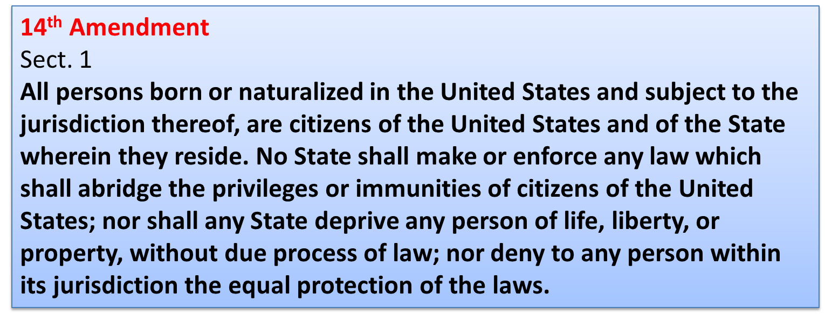
SELECTIVE INCORPORATION OF THE BILL OF RIGHTS and the 14th Amendment
2

Slide 7
SELECTIVE INCORPORATION OF THE BILL OF RIGHTS

Slide 8
SELECTIVE INCORPORATION OF THE BILL OF RIGHTS
DOCTRINE OF INCORPORATION constitutional doctrine through which the first ten amendments of the United States Constitution (known as the Bill of Rights) are made applicable to the states through the Due Process clause of the Fourteenth Amendment. Incorporation applies both substantively and procedurally.
11

Slide 9
SELECTIVE INCORPORATION
Modifying Effect of the 14th Amendment
The due process clause has been used to apply some of the provisions of the Bill of Rights to the states.
This clause bans states from denying life, liberty, or property without due process of law.
The “total incorporation” view would apply all of the provisions of the Bill of Rights to the states. It argues for nationalization (or federalization) of the Bill of Rights.
The “selective incorporation” view would apply only some of these provisions and would do so on a case- by-case basis.
10

Slide 10
A constitutional doctrine through which the Bill of Rights are made applicable to the states through the Due Process clause of the Fourteenth Amendment and so applied to state and local governments.
Utilizing the language of the Fourteenth Amendment, specifically that “no state…shall abridge…due process of law,” the national government now serves as protector of our inalienable right to “life, liberty and property.” Most of the time this has resulted in the national government imposing its will on state and local laws to the contrary.
The Fourteenth Amendment has weakened the states and strengthened the national government in our federal system of government.
Doctrine of Selective Incorporation
McDonald v. Chicago (2010): ruled the Second
Amendment’s right to keep and bear arms for self-defense in one’s home is applicable to the states through the Fourteenth Amendment.

Slide 11
SELECTIVE INCORPORATION
Modifying Effect of the 14th Amendment
Subsequent cases federalized parts of the Bill of Rights:
1st – Assembly, Petition, Religion, Speech, Press
2nd – Right to Bear Arms
4th – Search and Seizure protections
5th – Self-Incrimination, Double Jeopardy
6th – Right to Counsel, Right to Bring Witnesses, Right to Confront Witnesses
8th – Protection against Cruel and Unusual Punishment, Excessive Fines
All provisions of the Bill of Rights except Amendment 3, Amendment 7, and the Grand Jury requirement of the 5th Amendment have been federalized- applies to the states.
11

Slide 12
The 14th amendment was created to protect the rights of the newly freed people from the states. It bestowed upon them US citizenship and full guarantees of the Bill of Rights.
It was done to stop the Jim Crow/ black codes of the post civil war period.
14th am planted the seeds of the Civil Rights Movement

Slide 13
McDonald v. Chicago (2010)
Issue: Does the Second Amendment right to keep and bear arms apply to state and local governments through the 14th Amendment and thus limit Chicago’s ability to regulate guns?
Majority: 2nd Amendment right to keep and bear arms for the purpose of self-defense is fully applicable to the states under the 14th Amendment. The Court considered whether the right to keep guns “is fundamental to our scheme of
ordered liberty and system of justice.” The Court determined that both the Framers of and those who ratified the 14th Amendment considered the right to keep and bear arms among the fundamental rights “necessary to our system of ordered liberty.” Self-defense is a basic right, and that, under Heller, individual self-defense is the central component of the Second Amendment right to bear arms.

Slide 14
The debate over the Second Amendment involves concerns about public safety and whether or not the government regulation of firearms promotes or interferes with public safety and individual rights.
Supreme Court: “Undoubtedly some think that the Second Amendment is outmoded in a society where our standing army is the pride of our Nation, where well-trained police forces provide personal security, and where gun violence is a serious problem.
That is perhaps debatable, but what is not debatable is that it is not the role of this Court to pronounce the Second
Amendment extinct.”
-Justice Alito

Slide 15
Do government regulations of firearms promote or interfere with public safety and individual rights?

Slide 16
Do government regulations of firearms promote or interfere with public safety and individual rights?

Slide 17
What was the significance of the ruling in McDonald v. Chicago?
Have recent Supreme Court decisions on the Second Amendment leaned more toward individual liberty or public safety?
21

Slide 18
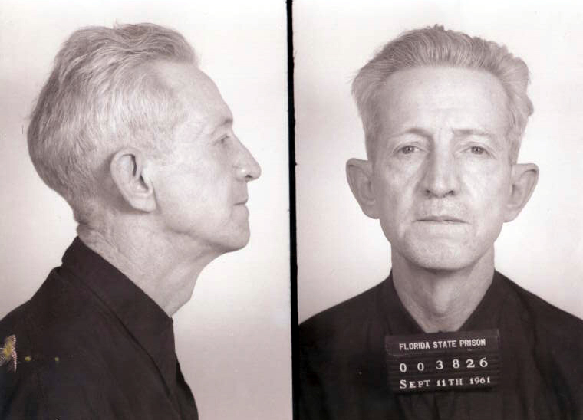
UNIT 3 Chpt. 10
Topic 3.8
AMSCO pg. 319-328
Required Court Case
Gideon v. Wainwright (1963)
3.8 Amendments:
Due Process and the Rights of the Accused

Slide 19
TOPIC 3.8 Amendments: Due Process & Rights of the Accused
Explain the extent to which the government is limited by procedural due process from infringing upon individual rights.
The Fifth and Fourteenth Amendments include clauses which state that the government may not infringe on a person’s right to life, liberty, or property without due process of law. The due process clause in the Fifth Amendment applies to the national government and the due process clause in the Fourteenth Amendment applies to states. Some government interests may justify the restriction of individual rights; for example, speech can be limited when it is shown to present a danger to public safety.
Procedural due process requires that government officials use methods that are not arbitrary when making and carrying out decisions affecting constitutionally protected rights. These procedural due process protections are reinforced by key protections enshrined in other provisions of the Bill of Rights and key legal doctrines established by the Supreme Court. For example, the Miranda rule requires accused persons to be informed of some procedural protections found in the Fifth and Sixth Amendments prior to interrogation. However, these procedural protections are not absolute. A public safety exception has been sanctioned by the Court that allows unwarned interrogation to stand as direct evidence in court.

Slide 20
TOPIC 3.8 Amendments: Due Process & Rights of the Accused
Explain the extent to which the government is limited by procedural due process from infringing upon individual rights.
Procedural rights of the accused and the prohibition of unreasonable searches and seizures are intended to ensure that individual liberties are not eclipsed by the need for social order and security, including:
i. The right to legal counsel, speedy and public trial, and an impartial jury
ii. Protection against warrantless searches of cell phone data under the Fourth Amendment
iii. Limitations placed on bulk collection of telecommunication metadata (Patriot and USA Freedom Acts)
Procedural due process also protects the rights of the accused during a trial. The Bill of Rights guarantees the right to an attorney and protection from unreasonable searches and seizures. The exclusionary rule, as decided by the Supreme Court, stipulates that evidence illegally seized by law enforcement officers in violation of the suspect’s Fourth Amendment rights (including the right to be free from
unreasonable searches and seizures) cannot be used against that suspect in criminal
prosecution.

Slide 21
TOPIC 3.8 Amendments: Due Process & Rights of the Accused
Protections of the Bill of Rights have been selectively incorporated by way of the Fourteenth Amendment’s due process clause to prevent state infringement of basic liberties
Explain the extent to which states are limited by the due process clause from infringing upon individual rights.
The Court has on occasion ruled in favor of states’ power to restrict individual liberty, as, for example, when speech can be shown to increase the danger to public safety
The Miranda rule involves the interpretation and application of accused persons’ due process rights as protected by the Fifth and Sixth Amendments, yet the Court has sanctioned a “public safety” exception that allows unwarned interrogation to stand as direct evidence in court
Pretrial rights of the accused and the prohibition of unreasonable searches and seizures are intended to ensure that citizen liberties are not eclipsed by the need for social order and security, including:
The right to legal counsel, speedy and public trial, and an impartial jury
Protection against warrantless searches of cell phone data under the Fourth Amendment
Limitations placed on bulk collection of telecommunication metadata (Patriot and USA Freedom Acts)

Slide 22
TOPIC 3.8 Amendments: Due Process & Rights of the Accused
The due process clause has been applied to guarantee the right to an attorney and protection from unreasonable searches and seizures, as represented by:
Gideon v. Wainwright (1963), which guaranteed the right to an attorney for the poor or indigent
The exclusionary rule, which stipulates evidence illegally seized by law enforcement officers in violation of the suspect’s Fourth Amendment right to be free from unreasonable searches and seizures cannot be used against that suspect in criminal prosecution.
REQUIRED SUPREME COURT CASE
Gideon v. Wainwright (1963)

Slide 23
FOURTH AMENDMENT RIGHTS
“The right of the people to be secure in their persons, houses, papers, and effects, against unreasonable searches and seizures, shall not be violated, and no Warrants shall issue, but upon probable cause, supported by oath or affirmation, and particularly describing the place to be searched, and the persons or things to be seized.” -4th amendment US Constitution
Probable cause- sufficient reason based upon known facts to believe a crime has been committed or that certain property is connected with a crime. Probable cause must exist for a law enforcement officer to make an arrest without a warrant, search without a warrant, or seize property in the belief the items were evidence of a crime.
https://www.law.cornell.edu/wex/probable_cause

Slide 24
FOURTH AMENDMENT RIGHTS
The Constitution forbids only "unreasonable"
searches and seizures
A police search without consent is constitutionally unreasonable unless it has been authorized by a valid search warrant.. There are exemptions as in exigent circumstances.
– Ex: police use of sobriety checkpoints in enforcing drunk driving laws
The constitutional requirements of a specific search warrant
Must describe what places are to be searched
Must describe what things are to be seized

Slide 25
FOURTH AMENDMENT RIGHTS
The Exclusionary Rule
Mapp v. Ohio (1961) - The Supreme Court ruled that evidence obtained unconstitutionally cannot be used in court against person from whom it was seized. EXCLUSIONARY RULE
Adopted mainly to prevent police misconduct
Not used if:
There would be “inevitable discovery” of
the evidence (Nix v. Williams)
Police operate “in good faith” that the warrant was valid (U.S. v. Leon)
In plain view
5

Slide 26
FOURTH AMENDMENT
“The right of the people to be secure in their persons, houses, papers, and effects, against unreasonable searches and seizures, shall not be violated, and no Warrants shall issue, but upon probable cause…”
Probable cause- sufficient reason based upon known facts to believe a crime has been committed or that certain property is connected with a crime. Probable cause must exist for a law enforcement officer to make an arrest without a warrant, search without a warrant, or seize property in the belief the items were evidence of a crime.
Versus REASONABLE SUSPICION
https://www.flexyourrights.org/

Slide 27
The Incorporation of the FOURTH AMENDMENT
Which case(s) really brought this amendment into public debate?
Weeks v. United States, 1914
Police officers in Kansas City, Missouri went to the house of Mr. Fremont Weeks and used his hidden key to enter and search his home. While there, they took papers, letters, books, and other items. They did not have a search warrant. These items were used in court to find Mr. Weeks guilty of sending lottery tickets through the U.S. mail.
Supreme Court Decision
The judgment of the district court was reversed. The evidence collected during the illegal search was in violation of the 4th Amendment and was thus inadmissible at the trial. In a criminal investigation, in order for a search to be legal, there must be probable cause. The probable cause must be used to gain a search warrant. If not, the search will be illegal and evidence collected as a result of the search can’t be used in court. The Weeks decision was the birth of a new legal doctrine – The Exclusionary Rule.
https://judiciallearningcenter.org/your-4th-amendment-rights/

Slide 28
Rochin v. California, 1952
Rochin was a suspected narcotics dealer. Acting on a tip 3 Los Angeles County deputy sheriffs went to his rooming house. They forced their way into Rochin’s room. There the deputies found him sitting on a bed and spotted two capsules on a nightstand. When one of the deputies asked, “who’s stuff is this?” Roachin popped the capsules into his mouth. Although all three officers jumped him, Roachin managed to have swallowed them.
Deputies took Roachin to a hospital, where his stomach was pumped. The capsules were recovered and found to contain morphine. The state then prosecuted and convicted Rochin for violating the state’s narcotics laws.

Slide 29
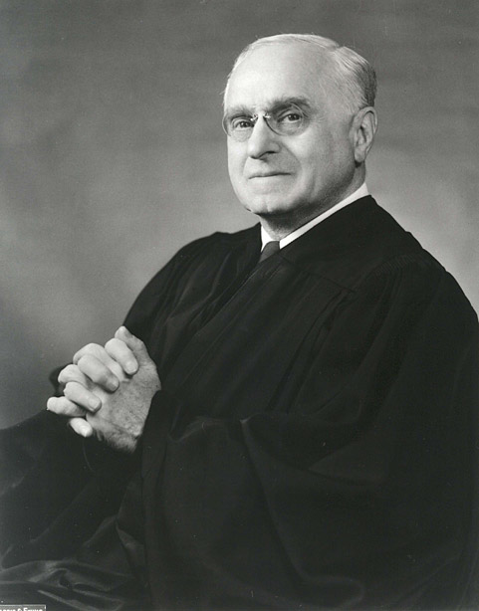
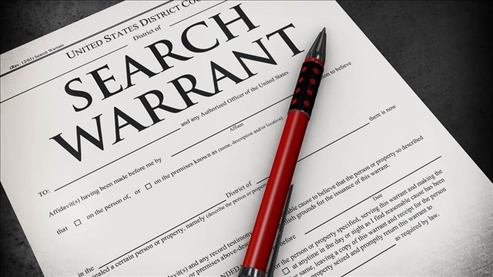
Rochin v. California, 1952
Did the police procedure forcing Rochin to vomit violate the Fifth Amendment privilege against self-incrimination and the Due Process Clause of the 14th Amendment? Explain
Where was the search warrant?
“This is conduct that shocks the conscience. Illegally breaking into the privacy of the petitioner, the struggle to open his mouth and remove what was there, the forcible extraction of his stomach's contents—this course of proceeding by agents of government to obtain evidence is bound to offend even hardened sensibilities. They are methods too close to the rack and the screw to permit of constitutional differentiation.”
Justice Felix Frankfurter

Slide 30
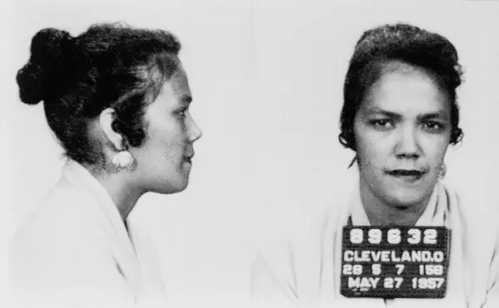
The Incorporation of the FOURTH AMENDMENT
Which case(s) really brought this amendment into public debate?
Mapp v. Ohio, 1961
Cleveland Police had gone to Dollree Mapp’s home to search for a fugitive. They entered her home forcibly, and without a warrant. Mapp and police got into a scuffle. Their very extensive search failed to turn up any fugitive evidence, but they did find some obscene books . Mapp was convicted of possession of obscene materials and sentenced to jail.
https://judiciallearningcenter.org/your-4th-amendment-rights/

Slide 31
4th Amendment The Fruit Of The Poisonous Tree Doctrine- The Exclusionary Rule
A doctrine that extends the exclusionary rule to make evidence inadmissible in court if it was derived from evidence that was illegally obtained. As the metaphor suggests, if the evidential "tree" is tainted, so is its "fruit."
The Exclusionary rule applies not only to evidence obtain indirectly as a result of improper police conduct but also to evidence obtained indirectly from the improper conduct.
Evidence derived initial improper conduct is usually called Fruit Of The Poisonous Tree

Slide 32
4th Amendment The Fruit Of The Poisonous Tree Doctrine- The Exclusionary Rule
Assume that a police officer searches the automobile of a person stopped for a minor traffic violation. This violation is the only reason the officer conducts the search; nothing indicates that the driver is impaired by drugs or alcohol, and no other circumstances would lead a reasonable officer to believe that the car contains evidence of a crime. This is an unreasonable search under the Fourth Amendment to the U.S. Constitution.
Assume further that the officer finds a small amount of marijuana in the vehicle. The driver is subsequently charged with possession of a controlled substance and chooses to go to trial. The marijuana evidence culled from this search is excluded from trial under the exclusionary rule, and the criminal charges are dropped for lack of evidence.
https://legal-dictionary.thefreedictionary.com/Fruit+of+the+Poisonous+Tree

Slide 33
14th Amendment to the US Constitution
All persons born or naturalized in the United States, and subject to the jurisdiction thereof, are citizens of the United States and of the state wherein they reside. No state shall make or enforce any law which shall abridge the privileges or immunities of citizens of the United States; nor shall any state deprive any person of life, liberty, or property, without due process of law; nor deny to any person within its jurisdiction the equal protection of the laws.
14th amendment was meant to protect citizens from the states. Passed in 1868 to protect the newly freed citizens of the Republic, the former slaves

Slide 34
Even today, some of the issues at the heart of the debates at the Constitutional Convention still exist.
GOVERNMENT SURVEILLANCE
USA PATRIOT ACT (Uniting and Strengthening America by Providing Appropriate Tools Required to Intercept and Obstruct Terrorism) 2001
The law covered intelligence gathering and sharing by executive branch agencies, points of criminal procedure, and border protection. It also widened authority on tapping suspects’ phones.
Soon, people began to question the law's constitutionality and its threat to civil liberties.
Some of the most controversial parts of the Patriot Act surround issues of privacy and government surveillance. The Fourth Amendment to the U.S. Constitution protects the "right of the people to be secure in their persons, houses, papers, and effects, against unreasonable searches and seizures . . . ." It requires law-enforcement officers to obtain warrants before making most searches.
Does the government have the right to collect phone and internet data from individuals?

Slide 35
GOVERNMENT SURVEILLANCE
Recent State Policy
Metadata is all the cell phone communication information minus the actual conversation; that is, who is calling whom, when, and for how long. The constitutional acceptance for such collection parallels an earlier Court ruling that allowed police to monitor calls made, though not the content of the conversation, if disclosed by a third party. The government’s motivation here is to determine who might be connected to terror suspects in the United States and abroad and to what degree.
Is metadata collection on the part of the gov allowed without a search warrant? Explain.
AMSCO pg. 305

Slide 36
Operation Sting-Ray
A device that the gov uses to track individual cell phones. It is called a cell site simulator. It tricks your cell phone into thinking that it is communicating with a cell phone tower but in reality, it is communicating with a gov data collection device called sting-ray. The cell phone then dumps all the data into the sting-ray and into the hands of the gov.
Sting-ray devices are used at state and local level through terrorism prevention grants (categorical grants).
https://www.youtube.com/watch?v=WjsTySwvelo

Slide 37
Operation Sting-Ray
Since you are transmitting your information over a 3rd party, you do not have a reasonable expectation of privacy. Therefore, the police can go through your trash can that you put out on the curb without a search warrant.
Like wise, when you are using your cell phone, you are sending your information into the public sphere through your cell phone plan. As result, the government argues that you do not have a reasonable expectation of privacy once that information is sent out.
-Smith v. Maryland, 1979
https://www.oyez.org/cases/1978/78-5374
The Supreme Court ruled a person waives their constitutional right to privacy when they tell the phone company which phone number They wish to be connected with. Mr. Smith should have expected the phone company to keep a record of his calls, he effectively waived his right to privacy.
https://youtu.be/WjsTySwvelo?t=536

Slide 38
Operation Sting-Ray
Gov argues that they are not collecting actual conversations or text messages but just metadata. But the latest version of the Sting-ray does have the ability to collect conversations and text messages.
In 2017, HR1061 was introduced in the House to regulate the use of sting-ray devices, but it got stuck in committee (pigeonholed).
2021, the Cell Site Simulator Warrant Act was introduced in both the House & Senate as a bi-partisan effort. Its purpose was to create a clear legal standard for the use of sting-ray by the gov and thus limit its use. It is stuck in committee- pigeonholed.
What do you think is this a violation of the 4th amendment?
https://youtu.be/WjsTySwvelo?t=536

Slide 39
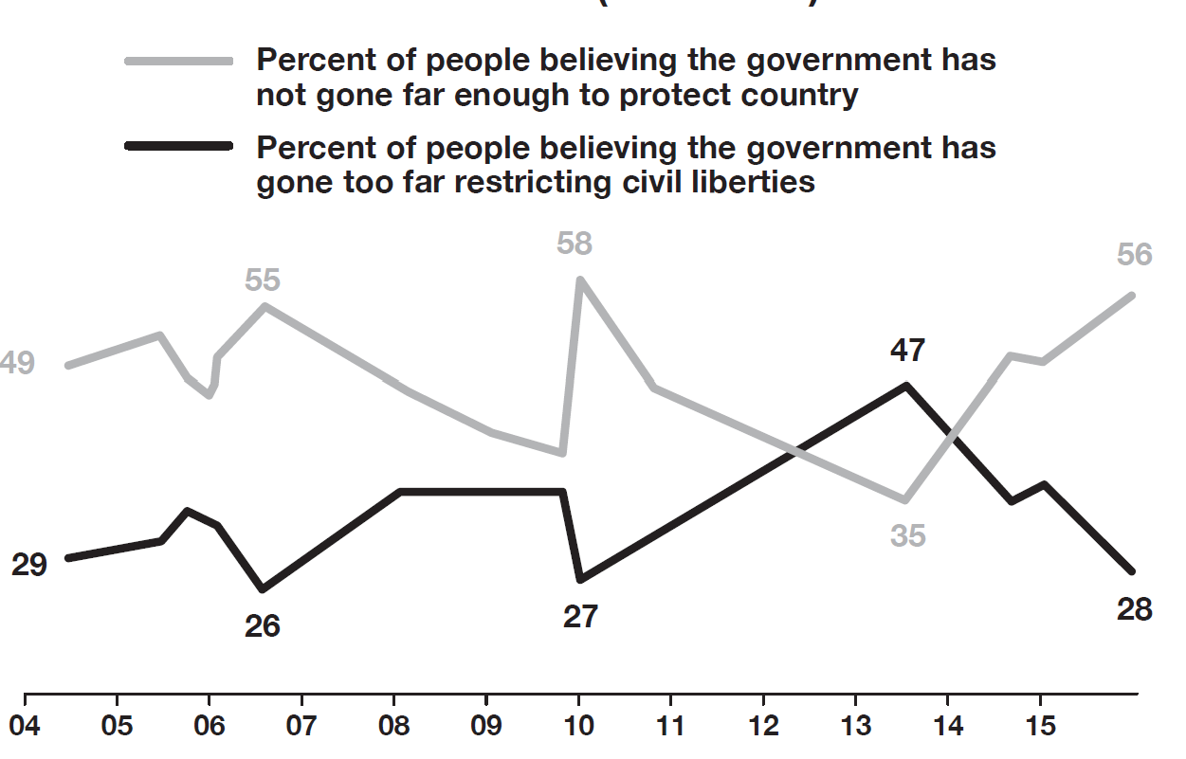
How much liberty are Americans willing to give up for a little extra security?
Public’s Shifting Concerns on Security and Civil Liberties (2004–2015) AMSCO pg. 310
Use the information graphic to answer the questions below.
Identify the lowest percent of people believing that government has gone too far restricting civil liberties.
(B) Describe a trend in the data in the graph.
(C) Draw a conclusion about the reason for the trend described in part B.
(D) Explain how the information graphic demonstrates citizen concern for protecting the country and restricting liberties.

Slide 40
College Board Scenario FRQ Assignment: CLOUD Act and Privacy Laws
Beginning in the 1960s, the Supreme Court issued a series of rulings which apply constitutional protections to places where a person might have a “reasonable expectation of privacy,” including areas outside the home. As the internet developed, questions emerged about where internet communication takes place and the level of privacy protection email users can expect.
In the case United States v. Microsoft (2018), the federal government issued Microsoft Corporation a warrant to hand over to authorities email communications between some of its users. Federal law enforcement alleged that one of Microsoft’s email users was operating an account to facilitate illegal drug trafficking. Microsoft refused to comply with the warrant, claiming that its servers were located in Ireland and thus not within the jurisdiction of the federal government.
Before the Supreme Court decided the case, Congress intervened by passing the CLOUD Act, which required internet-based companies to hand over communications requested in a warrant so long as both the federal government and the foreign government agreed. Microsoft and other internet companies accepted the new legislation, but the law raised concerns among many groups that civil liberties were being violated.
a. Referencing the scenario, describe the constitutional amendment that is most relevant to the Supreme Court case, and explain how the actions taken by the federal government prior to accessing emails illustrate the protection of a constitutional liberty.
b. Explain how passage of the CLOUD Act reflects a tension between balancing order and liberty in the American political system.
c. Describe the section of the Constitution that grants Congress the power to pass the CLOUD Act, and explain how this power reflects the principle of checks and balances reflected in the scenario.

Slide 41
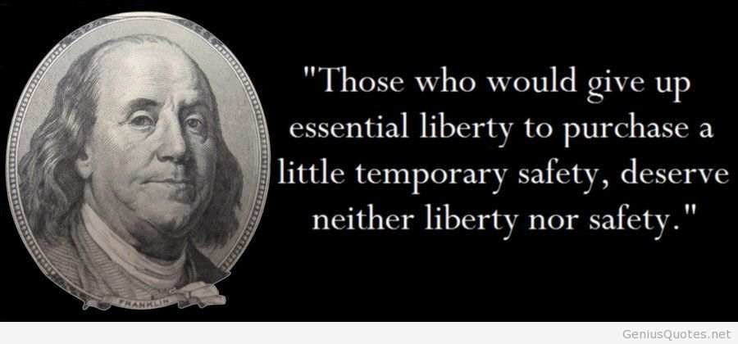

Slide 43
GOVERNMENT SURVEILLANCE
Even today, some of the issues at the heart of the debates at the Constitutional Convention still exist.
USA FREEDOM Act (Uniting and Strengthening America by Fulfilling Rights and Ending Eavesdropping, Dragnet-collection and Online Monitoring) – 2015
Restored in modified form several provisions of the Patriot Act
Imposes new limits on the bulk collection of telecommunication metadata on U.S. citizens by American intelligence agencies, including the National Security Agency.
Restores authorization for roving wiretaps and tracking lone wolf terrorists

Slide 44
ESSENTIAL QUESTION CFU
What is the 4th Amendment? Did the government violate the 4th Amendment with the Patriot Act?
8

Slide 45
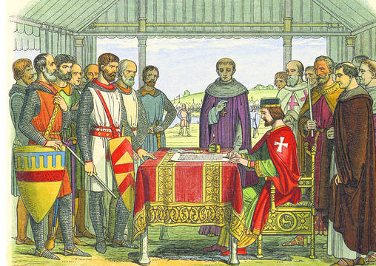
Amendments: Due Process and the Rights of the Accused
The right to due process dates back to England’s Magna Carta (1215), when nobles limited the king’s ability to ignore their liberties. Due process ensures fair procedures when the government burdens or deprives an individual. Due process also ensures accused persons a fair trial.
AMSCO pg. 319, 2021 ed.

Slide 46
5th Amendment to the US Constitution
"No person shall be held to answer for a capital, or otherwise infamous crime, unless on a presentment or indictment of a grand jury, except in cases arising in the land or naval forces, or in the militia, when in actual service in time of war or public danger; nor shall any person be subject for the same offense to be twice put in jeopardy of life or limb; nor shall be compelled in any criminal case to be a witness against himself, nor be deprived of life, liberty, or property, without due process of law; nor shall private property be taken for public use, without just compensation.“—eminent domain
eminent domain- The right of the government or its agent to expropriate private property for public use, with payment of compensation
The 5th amendment protects us from the federal government

Slide 47
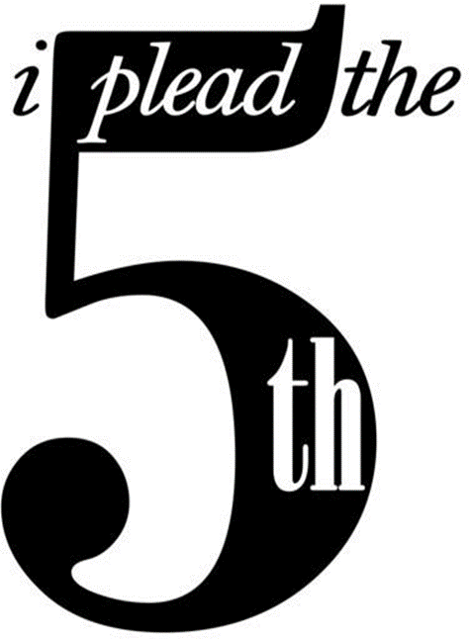
FIFTH AMENDMENT RIGHTS – DUE PROCESS RIGHTS
When govt. denies life, liberty or property, it must use fair procedures:
Observe Bill of Rights
Provide reasonable notice
Provide chance to be heard
Procedural due process refers to the methods, manners (process, the how) by which a law is enforced; pertains not to the law itself, but to the way in which the law is applied
Examples of violations of procedural due process:
Illegal Searches.
Unfair Court Procedures.
Substantive due process places limits on what a government may do; pertains to the content (substance, the policies, the what) of the law or fairness of the law.
Examples of violations of substantive due process:
Ban on all abortions within a state.
County ordinance banning all firearms.
Example of distinction between procedural and substantive: a law prohibits possession of narcotics (substantive) and police must generally obtain a warrant before conducting a search for narcotics in one’s home (procedural).
9

Slide 48
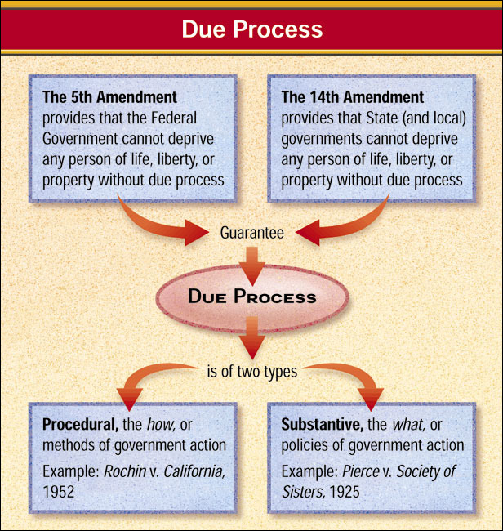
The Meaning of Due Process
…nor shall be compelled in any criminal case to be a witness against himself…

Slide 49
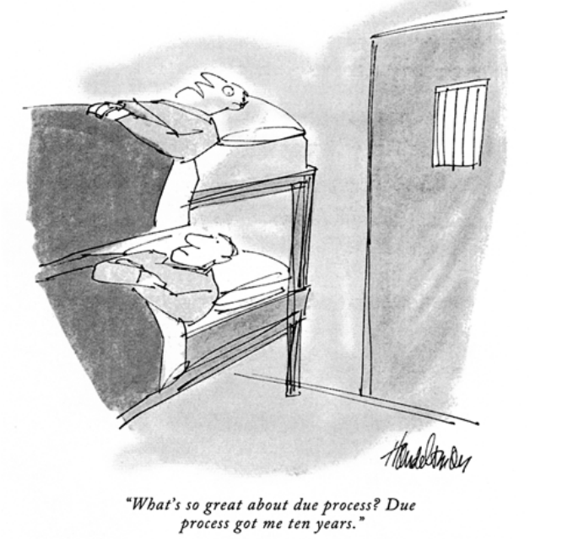
As long as due process has been followed, a convicted criminal can be deprived of his or her liberty.
Analyze Cartoons Is it possible that the prisoner's complaint is justified? Explain.
Magruders’s Amer Gov, 2004, pg. 566
What’s so great about due process? Due process got me ten years.

Slide 50
FIFTH AMENDMENT RIGHTS
No Self-incrimination - the right to remain silent
You have the right to remain silent
You do not have to testify against yourself; “I plead the 5th”
Designed so that the burden is on the government to prove guilt
Double jeopardy
Fifth amendment prevents individual from being tried again (if found innocent)
Still can be tried by both federal and state governments for the same offense (or by two states)
Double jeopardy does not forbid civil prosecution after acquittal in a criminal trial
Grand Jury Indictment
Grand jury indictment is necessary in order to require anyone to stand trial for a serious crime
Grand jurors are concerned with whether there is enough evidence to warrant a trial
Plea bargaining - pleading guilty to a lesser offense in return for not having to stand trial for a more serious charge (about 90% of cases end in a plea deal)
10

Slide 51
What does due process mean in the 5th Amendment? Why is this so important?
What is self-incrimination?
You can not be forced to testify against yourself
13

Slide 52
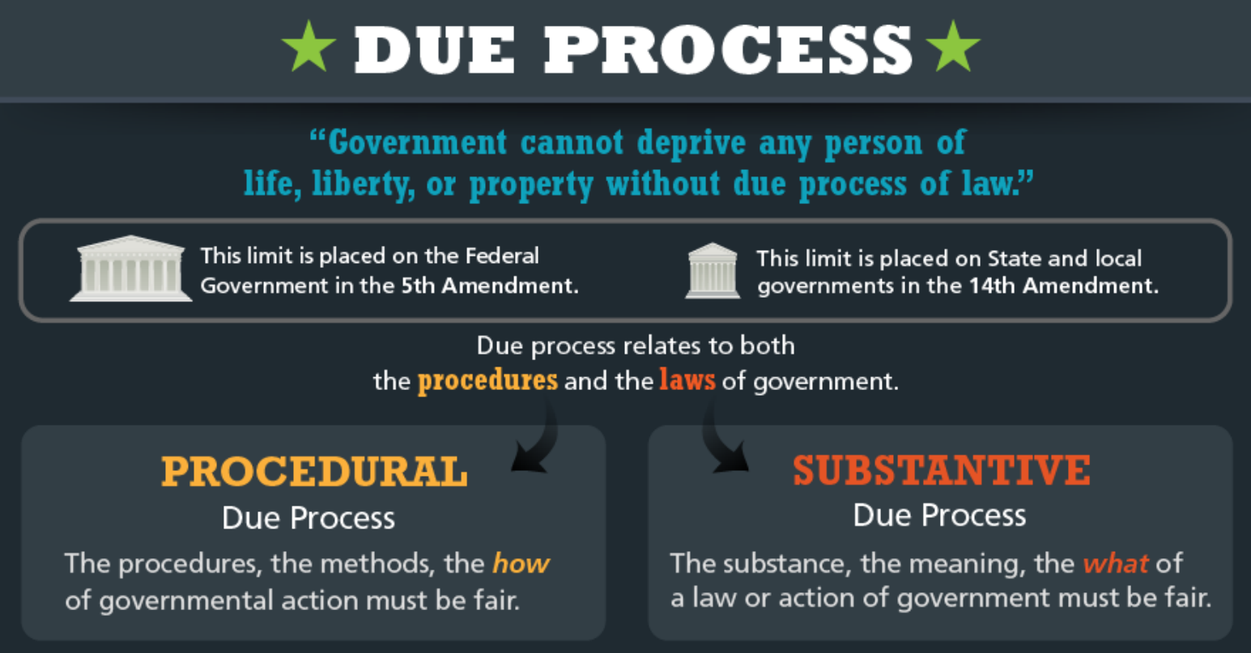

Slide 53
FIFTH AMENDMENT RIGHTS AND THE MIRANDA WARNING
Miranda v. Arizona (1966) - Supreme Court announced that no conviction could stand if evidence introduced at the trial had been obtained by the police during "custodial interrogation" unless suspects have been:
Notified that they are free to remain silent
Warned that what they say may be used against them in court
Told that they have a right to have attorney present during questioning
Informed that if they cannot afford to hire their own lawyer, attorneys will be provided for them
Permitted to terminate any stage of the police interrogation
11

Slide 54
6th Amendment
In all criminal prosecutions, the accused shall enjoy the right to a speedy and public trial, by an impartial jury of the State and district wherein the crime shall have been committed, which district shall have been previously ascertained by law, and to be informed of the nature and cause of the accusation; to be confronted with the witnesses against him; to have compulsory process for obtaining witnesses in his favor, and to have the assistance of counsel for his defense.

Slide 55
SIXTH AMENDMENT RIGHTS – “FAIR TRIAL” Procedural Due Process
Right to an attorney/counsel/lawyer
Government is obligated to give the defendant a speedy trial
Government is obligated to give the defendant a public trial
An impartial jury consists of persons who represent a fair cross-section of the community= jury of your peers
Defendant has the constitutional right to obtain witness in his/her favor
– Constitution gives accused persons the right to be confronted with the witnesses against them

Slide 56
SIXTH AMENDMENT RIGHTS – “FAIR TRIAL” Procedural Due Process
The Right to counsel
Judges have an obligation to ensure that all persons subject to any kind of custodial interrogation are represented by lawyers
Right to counsel extends to all hearings for all offenses for which an accused could be deprived of liberty
In Gideon v. Wainwright (1963), the United States Supreme Court ruled that the Sixth Amendment right-to-counsel provision applies to those accused of major crimes under state laws and applies to the indigent.

Slide 57
Gideon v. Wainwright (1963)
Issue: Does the Sixth Amendment’s right to counsel in criminal cases extend to defendants in state courts, even in cases in which the death penalty is not at issue?
Majority: The Supreme Court ruled unanimously for Gideon. The Supreme Court overturned part of Betts v. Brady, in which it had concluded that the Sixth Amendment's guarantee of counsel is not a fundamental right. Instead, the Court in Gideon said that the right to the assistance of counsel in felony criminal cases is a fundamental right essential to a fair trial.
Therefore, this protection from the Sixth Amendment applied to state courts as well as federal courts. State courts must appoint counsel to represent defendants who cannot afford to pay for their own lawyers if charged with a felony.
The Court said that the best proof that the right to counsel is fundamental and essential is that governments spend a lot of money to try to convict defendants and those defendants who can afford to almost always hire the best lawyer they can get. This indicates that both the government and defendants consider the aid of a lawyer in criminal cases absolutely necessary. In addition, the opinion noted that the Constitution places great emphasis on procedural safeguards designed to guarantee that defendants get fair trials.

Slide 58
Gideon v. Wainwright (1963)
HOW DO WE REMEMBER THIS CASE?
Gideon v. Wain-right to an attorney
Doesn’t this look like the face of every single villain in a Scooby Doo episode?
"And I would have gotten away with it too, if it weren't for you meddling kids!"

Slide 59
SIXTH AMENDMENT RIGHTS – “FAIR TRIAL”
An impartial jury consists of persons who represent a fair cross-section of the community
Defendant has the constitutional right to obtain witnesses in his/her favor
Government is obligated to give the defendant a public trial which means that ordinary people can watch the case
Right to adequate legal counsel (right to an attorney) will be provided to you
The defendant is guaranteed a “speedy” trial which means the trial for the alleged crimes will take place within a reasonable time after being arrested. Although most states have laws that set forth the time in which a trial must take place after charges are filed, often the issue of whether or not a trial is in fact “speedy” enough under the Sixth Amendment comes down to the circumstances of the case itself, and the reasons for any delays.
18

Slide 60
Incorporation Example - Gideon v. Wainwright
Gideon was not allowed an attorney after being arrested for a felony
A Florida STATE judge told Gideon that the 6th Amendment didn’t apply to him because he wasn’t being charged with a FEDERAL crime – therefore the state didn’t have to honor the right to an attorney.
From prison, Gideon petitioned the Supreme Court to use the Due Process Clause to “soak up” the 6th Amendment and get a new trial
– this time with an attorney
He applied for a writ of certiorari (orders the case to go immediately to the SCOTUS “to be made more certain”)

Slide 61
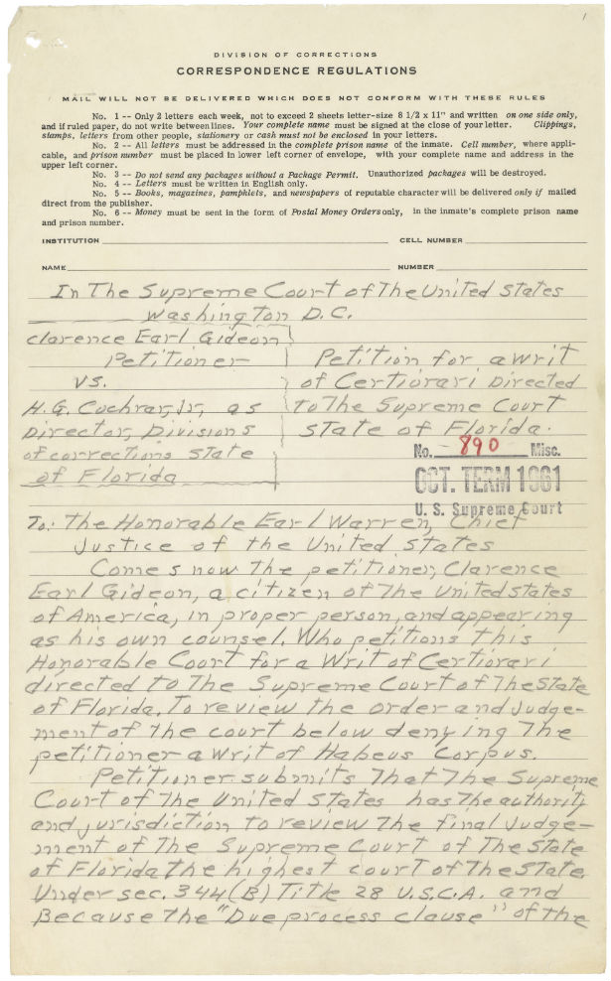

Slide 63
VIDEO: Gideon v. Wainwright (1963)
FACTS: Gideon was charged with a felony (petty larceny) & requested that the sate appoint him a lawyer. The court denied the request because according to Fl state law, attorneys could only be appointed for a capital crime.
Decision: states must appoint lawyers for defendants who can not afford one (indigent) | Constitutional Principle: 6TH amendment guarantees right to counsel to defendants in state courts by the doctrine of selective incorporation- 14th amendment.
Why it matters? 6th amendment was incorporated to the states through the doctrine of selective incorporation- constitutional doctrine through which the first ten amendments of the United States Constitution (known as the Bill of Rights) are made applicable to the states through the Due Process clause of the Fourteenth Amendment. Incorporation applies both substantively and procedurally. States were now required to fund and train public defense attorneys for indigent defendants. States set up the public defender's offices.

Slide 65
The Incorporation of the 6th Amendment into the State Court System
Powell v. Alabama (1933)- right to counsel in death penalty cases, capital offenses
https://www.history.com/topics/great-depression/scottsboro-boys
Betts v. Brady (1942)- indigent defendants need only be provided with a lawyer under special circumstances. Illiterate, mentally challenged.
Gideon v. Wainwright (1963)- overturned Betts and established the precedent that the indigent have a right to an attorney

Slide 66
Balancing Individual Freedoms with Public Order
The Fourth, Fifth, Sixth and Eighth Amendments provide constitutional
protection of the rights of the accused.
What are your rights according to those amendments?

Slide 67
ESSENTIAL QUESTION CFU
Why is the right to legal counsel such an important right?
21

Slide 68
ESSENTIAL QUESTION CFU
Has the government done a good job of balancing individual rights and public order?
28

Slide 69
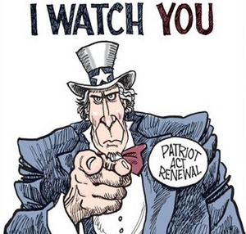
UNIT 3 Chpt. 10
Topic 3.9
AMSCO pg. 329-339
Required Court Case
Roe v. Wade (1974)
TOPIC 3.9 Amendments: Due Process and the Right to Privacy

Slide 70
TOPIC 3.9 Amendments: Due Process and the Right to Privacy
Explain the extent to which states are limited by the due process clause from infringing upon individual rights.
Over time, the Supreme Court has recognized constitutionally protected rights that are not explicitly listed in the Bill of Rights. These unenumerated rights include the right to privacy. Justices and scholars have drawn on several arguments to defend the existence of unenumerated rights. Some argue that an unenumerated right is implied by certain amendments that assume the existence of such rights. Others argue that the Ninth Amendment, which states that individuals have protected rights beyond those listed in the first eight amendments, provides support for the existence of unenumerated rights.
In a range of cases, the Supreme Court has used substantive due process to examine
whether government laws and actions are arbitrary infringements of individual rights.
While a right to privacy is not explicitly named in the Constitution, the Supreme Court, in Griswold v. Connecticut (1965), interpreted the due process clause to protect the right of privacy from government infringement. In Roe v. Wade (1973), the Supreme Court held that the application of substantive due process further extended the privacy right to abortion. The Supreme Court’s decision in Dobbs v. Jackson Women’s Health Organization (2022) overturned Roe v. Wade, holding that the Constitution does not confer a right to abortion, leaving decisions about the regulation of abortion to legislatures. The actions that are protected by the right to privacy and substantive due process continue to be debated.

Slide 71
TOPIC 3.9 Amendments: Due Process and the Right to Privacy
Explain the extent to which states are limited by the due process clause from infringing upon individual rights.
While a right to privacy is not explicitly named in the Constitution, the court has interpreted the due process clause to protect the right of privacy from state infringement. This
interpretation of the due process clause has been the subject of controversy, such as has resulted from:
Roe v. Wade (1973), which extended the right of privacy to a woman’s decision to have an abortion while recognizing compelling state interests in potential life and maternal health
NO LONGER REQUIRED SUPREME COURT CASE
Roe v. Wade (1973)

Slide 72
Is There a Right to Privacy in the Constitution?
Definition: The right to a private personal life free from the intrusion of
government
Not explicitly stated in the Constitution, but implied through the penumbras (implied rights) of the Bill of Rights
Supreme Court agrees that a right to privacy exist
Griswold v. Connecticut (1965)
Overturned an 1879 Connecticut law that made the contraceptives illegal to
married couples
Even though “privacy” doesn’t appear in the Constitution, specific guarantees in the 1st, 3rd, 4th, and 5th Amendments create a zone of privacy that is protected by the 9th Amendment

Slide 73
“Privacy” isn’t specifically mentioned in the Constitution but penumbras in the 1st, 3rd, 4th, and 5th Amendments create a zone of privacy that is protected by the 9th Amendment.
5
1
4
3
9

Slide 74
Is There a Right to Privacy in the Constitution?
The right to privacy or to be left alone is not mentioned in the constitution, it can be e can be inferred from the following amendments:
1st amendment: Freedom of speech or the privacy of your own thoughts or associations (assembly)
3rd amendment: protects your home from the once used government practice of housing soldiers during peacetime in your house.
4th amendment: protects against illegal searches, keeping your home or other areas private.
5th amendment: gives the accused the right to remain silent and thus keeping information private.
9th amendment: states that the people have rights not specifically listed, i.e. privacy.
AMSCO pg. 329

Slide 75
Video Roe v. Wade (1973)
FACTS: Texas state law prohibited abortions except to save the pregnant woman’s life and thus violated Roe’s right to privacy. Decisions about your body and abortions are private.
Decision: a woman has a right to an abortion based on the right to privacy. | Constitutional Principle: a woman’s right to privacy is within the right to privacy decided in Griswald v. Connecticut and incorporated through the 14th am
Why it matters? States had to re write their abortions laws to make it easier to obtain an abortion. Culture war soon ensued between pro-abortionists' liberals and anti-abortionists’ conservatives. Made political compromise difficult. This motivated conservatives to elected conservative president to get Roe decision overturned. Presidents appoint Justices to the Supreme Court.

Slide 76
Roe v. Wade (1973)
Issue: Does the U.S. Constitution protect the right of a woman to obtain an abortion?
Majority: In a 7–2 decision, the U.S. Supreme Court decided in Roe’s favor. Justice Blackmun wrote the opinion of the Court, which recognized that a woman’s choice whether to have an abortion is protected by the Constitution.
The majority rooted a woman’s right to decide whether to have an abortion in the Due Process Clause of the 14th Amendment, which prohibits states from “depriv[ing] any person of … liberty … without due process of law.” According to the majority, the “liberty” protected by the 14th Amendment includes a fundamental right to privacy. The majority began by surveying the history of abortion laws, and concluded that “the restrictive criminal abortion laws in effect in a majority of States today are of relatively recent vintage,” and “are not of
ancient or even of common-law origin.” The Court then held that “[t]his right of privacy, whether it be founded in the Fourteenth Amendment’s concept of personal liberty and restrictions upon state action, as we feel it is, or, as the District Court determined, in the Ninth Amendment’s reservation of rights to the people, is broad enough to encompass a woman’s decision whether or not to terminate her pregnancy.”
• 1st trimester abortions are allowed
• 2nd trimester abortions can be restricted, but not prohibited by the state
• 3 rd trimester abortions can be regulated or prohibit abortions except when medical judgment determines that an abortion is necessary to save a woman’s life

Slide 77
Roe v. Wade (1973)
The majority rooted a woman’s right to decide whether to have an abortion in the Due Process Clause of the 14th Amendment, which prohibits states from “depriv[ing] any person of … liberty … without due process of law.” According to the majority, the “liberty” protected by the 14th Amendment includes a fundamental right to privacy. The majority began by surveying the history of abortion laws, and concluded that “the restrictive criminal abortion laws in effect in a majority of States today are of relatively recent vintage,” and “are not of ancient or even of common-law origin.” The Court then held that “[t]his right of privacy, whether it be founded in the Fourteenth Amendment’s concept of personal liberty and restrictions upon state action, as we feel it is, or, as the District Court determined, in the Ninth Amendment’s reservation of rights to the people, is broad enough to encompass a woman’s decision whether or not to terminate her pregnancy.”
• 1st trimester abortions are allowed
• 2nd trimester abortions can be restricted, but not prohibited by the state
• 3rd trimester abortions can be regulated or prohibit abortions except when medical judgment determines that an abortion is necessary to save a woman’s life

Slide 78
A Woman’s right to privacy encompasses a woman’s decision whether or not to terminate her pregnancy
In the first trimester of pregnancy (about three months), a State must recognize a woman's right to an abortion; it cannot interfere with medical judgments in that matter during that period.
2. In the second trimester, a State, acting in the interest of women who undergo abortions, can make reasonable regulations about how, when, and where abortions can be peformed but cannot prohibit the procedure.
3. In the final trimester, a State, acting to protect the unborn child, can choose to prohibit all abortions except those necessary to preserve the li e or health o the mother
2009 Magruder’s pg. 581

Slide 79
Roe Revisited: Planned Parenthood v. Casey (1992)
The issue: Was the Pennsylvania Abortion Control Act of 1982 constitutional?
Law required that a woman seeking an abortion meet several conditions
Would Roe be overturned?
No… Justice O’Connor argued that stare decisis (precedent of the Court) required the Court to
not overturn Roe.
“A generation of women had come to depend on the right to an abortion.”
The Court held that states cannot prohibit abortion prior to viability (before the fetus could live independently outside of the mother’s womb).
HOWEVER, the Court allowed certain restrictions on abortions
States can regulate abortions before viability as long as the regulation does not place an “undue burden” (substantial obstacle) on the access to abortion.
After fetal viability, however, states have increased power to restrict the availability of abortions to
protect the health of the woman and the potential life of the fetus.
Thus, states can pass some laws that regulate abortion, but these laws cannot place a “substantial obstacle in the path of a woman seeking an abortion.”
But what is a “substantial obstacle?”
14

Slide 80
The Trump Presidency 2016-2020
Trump appointed and the Senate confirmed 3 Justices to the Court. This shifted the balance to a majority conservative court.
Dobbs v. Jackson Women's Health Organization (2021)
FACTS: in 2018, Mississippi passed a law called the “Gestational Age Act,” which prohibits all abortions, with few exceptions, after 15 weeks’ gestational age. Is Mississippi’s law banning nearly all abortions after 15 weeks’ gestational age unconstitutional?
DECISION: The Constitution does not mention abortion. The right is neither deeply rooted in the nation’s history nor an essential component of “ordered liberty.” The five factors that should be considered in deciding whether a precedent should be overruled support overruling Roe v. Wade and Planned Parenthood v. Casey:
they “short-circuited the democratic process,”
both lacked grounding in constitutional text, history, or precedent,
the tests they established were not “workable,”
they caused distortion of law in other areas, and
overruling them would not upend concrete reliance interests.
https://fivethirtyeight.com/features/the-supreme-courts-argument-for-overturning-roe-v-wade/
Abortion now reverts back to the states, where each state will have to write their own abortion laws.

Slide 81
Dobbs v. Jackson Women's Health Organization (2021)
Concepts of American Government
Judicial Activism or Judicial Restraint
Federalism
Checks and Balances

Slide 82
To what extent are states limited by the due process clause from infringing upon an individual's rights to due process and privacy
Right to Privacy Cases and Laws | How the Case/Laws Protects or Infringes upon Privacy Rights
Griswold v. Connecticut (1965) | The Court ruled an old anti-birth control state statute in violation of the Constitution. The overturned law had barred married couples from even receiving birth control literature, emphasizing an inherent .
Roe v. Wade (1973) | In addition to the right to privacy, the Court’s ruling relied largely on the Fourteenth Amendment’s due process clause, arguing that the state violated a woman’s broadly understood liberty by denying the abortion
Hyde Amendment (1976) | The law prevented federal funding that might contribute to an abortion.

Slide 83
Book Assignment
AMSCO pg. 337

