Slide 1
UNIT 5 Chpt. 18 Topic 5.9
AMSCO pg. 596-605
Congressional Elections

Slide 2
TOPIC 5.9 Congressional Elections
The impact of federal policies on campaigning and electoral rules continues to be contested by both sides of the political spectrum
Explain how the different processes work in U.S. Congressional election.
The process and outcomes in U.S. congressional elections are impacted by:
Incumbency advantage phenomenon
Open and closed primaries
Caucuses
General (presidential and midterm) elections

Slide 3
REGULARLY SCHEDULED ELECTIONS
Elections are held at fixed intervals that cannot be changed by the party in power.
National government establishes WHEN they will be held
States determine HOW the voting will occur
It does not make any difference if the nation is at war, as we were during the Civil War, or in the midst of a crisis, as in the Great Depression; when the calendar calls for an election, the election is held.

Slide 4
REGULARLY SCHEDULED ELECTIONS
Elections for members of Congress occur on the first Tuesday after the first Monday in November of even-numbered years.
Although there are some exceptions (for special elections or peculiar state provisions), participants know in advance just when the next election will be.
The predetermined timing of elections is one of the defining characteristics of democracy in the United States.
Regular chance to replace leaders (accountability)

Slide 5
FIXED, STAGGERED, AND SOMETIMES LIMITED TERMS
Electoral system is based on fixed terms, meaning that the length of a term in office is set, not indefinite
The term of office for the U.S. House of Representatives is two years (can be elected as many times as they want)- no term limit
The term of office for the Senate is six years (can be elected as many times as they want)
The term of presidency is four years (can only serve two full terms – 22nd amendment)
Our electoral system has staggered terms for some offices, meaning that not all offices are up for election at the same time
All 435 House members are up for election every two years
Only one-third of the senators are up for election at the same time
President is elected every four years

Slide 6
FIXED, STAGGERED, AND SOMETIMES LIMITED TERMS
Our electoral system has limits on the number of terms a person can hold a particular office
The Twenty-second Amendment limits presidents to two terms
Despite their popularity, proposals for term limits have repeatedly lost when they have come to a vote in Congress
If term limits are to be imposed on Congress, it will have to be done either by an amendment to the U.S. Constitution since the Supreme Court has ruled term limits for congressional offices (as set by the states) unconstitutional

Slide 7
WINNER‑TAKE‑ALL
The candidate with the most votes wins
Most American election districts are single‑member districts, meaning that in any district for any given election, the voters choose one representative or official (i.e. House of Reps districts)
When a single‑member district is combined with the winner‑takes‑all rule, there is a powerful push to sustain a two‑party system
In contrast to the winner‑takes‑all rule, proportional representation rewards minor parties and permits them to participate in government
In many other countries, political seats (offices) are awarded to parties that come in 2nd, 3rd, or 4th place that still win votes (not in the United States).
Example: If one state had 10 legislative seats in Congress, and a party wins 20% of the vote, that party would win 2 congressional seats in Congress. No proportional representation.
In the United States, the winner of the plurality (highest number of votes) wins.
No political seats awarded for 2nd place in the U.S.

Slide 8
WINNER-TAKE-ALL
In the U.S. House of Reps, the voters of each district choose one representative or official for that district
Candidate who receives the most votes (plurality) is the winner (difference between a plurality election and majority election)
Plurality Election
Majority NOT needed
Largest # of votes wins-PLURALITY
AKA: First-past-the-post
No Run-off election
Single-Member District
vs. “At-Large” Districts Ex. Senate elections or Wyoming
How does this support the 2-Party System?

Slide 9
SINGLE-MEMBER DISTRICTS & THE 2-PARTY SYSTEM
Washington = 10 Reps Single-Member Districts:
Individuals compete,
1 winner in each district → plurality vote
Minor parties get a small # in each → don’t win!!
At-Large Election/Proportional Representation
Parties compete statewide
% vote = % of seats
Minor parties → win a little
Example:
Democrats 41%
4 seats
4 seats
1 seat
1 seat
Republicans 39%
Greens 10%
Libertarians 10%

Slide 10
RUNNING FOR CONGRESS
PRIMARY ELECTIONS
Definition – elections in which the voters choose which candidate will represent their political party in the general election (Democrat vs. Democrat; Republican vs. Republican)
Closed
Used in most states
Only registered party members can vote for partisan offices, no crossing of party lines
Open
Independents may vote, voters get ballot of any one party they wish
Crossing of party lines allowed >>> danger of “raiding”
Blanket (“free love”)
Independents may vote, voters can “mix and match” their votes
i.e. vote for candidates of different parties for different offices
Unconstitutional
10

Slide 13
ESSENTIAL QUESTION CFU
Who establishes when we vote? Who establishes how we vote?
Why does our current voting system favor a two-party system?
How can we change this?
11

Slide 14
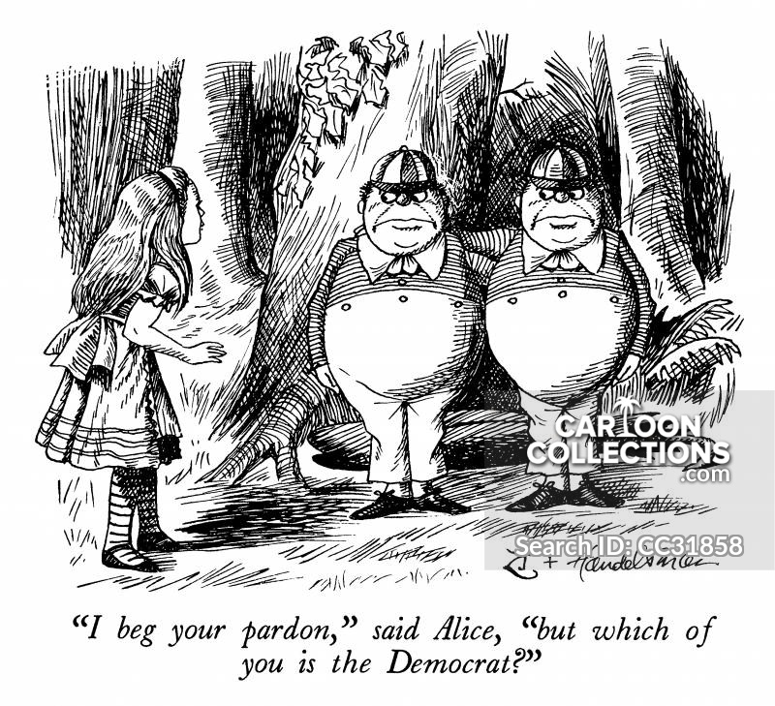

Slide 15
FACTORS AFFECTING OUTCOMES OF CONGRESSIONAL ELECTIONS
Incumbency: The Greatest Influence
Scope of incumbency advantage
• +90% of Congressmen who run are reelected, +80% of Senators
Lack of competitiveness >> charges of “permanent congress” and the call for congressional term limits (ruled unconstitutional by the Supreme Court)
Advantages of Incumbents
Franking Privilege
Staff already in place
Patronage
Casework done for constituents
Gerrymandered Districts (Safe Seats)
Name Recognition
Pork Barrel projects for the district
“War Chest” built up of financial support to discourage challengers from running
12

Slide 16
CONGRESS: THE INCUMBENCY ADVANTAGE
Franking privilege allows for members of Congress, and their staff, to send mail to their constituents, or supporters, without having to pay postage. This allows for Congress to be able to communicate more effectively with their supporters.
Staﬀers-who sole job is to assist the incumbent in all areas including re-election. AA= Administrative Assistant- office mgr, LA=Legislative Assistant- help member of Cong with legis. work
Patronage
One of the key inducements use by political machines. It is a job, promotion, or contract that is given for political reasons rather than for merit or competence alone.
Name recognition
Casework (constituency service)
Legislative work on behalf of individual constituents to solve their problems with government agencies and programs. Often time consuming and tedious
Money, esp. from PACs for re-election campaigns
GERRYMANDERING
Pork Barrel projects for the district
“War Chest” built up of financial support to discourage challengers from running
Incumbents are those already in office
Typically, 90% of Congress are incumbents; rarely lose an election. Why?

Slide 17
CONGRESS: THE INCUMBENCY ADVANTAGE
Incumbents are those already in office
Typically, 90% of Congress are incumbents; rarely lose an election. Why?
Casework (constituency service)
Legislative work on behalf of individual constituents to solve their problems with government agencies and programs
*Explain how case work may impact a members’ attention to legislation?
AP Gov Past FRQs 2012 #1c
Case work is often tedious and time consuming. Casework diverts resources and staff, thus reducing member’s ability to focus on legislation. As a result, case work takes away from the important work of legislation.

Slide 18
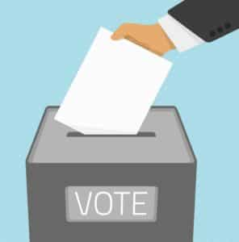
FACTORS AFFECTING OUTCOMES OF CONGRESSIONAL ELECTIONS
Coattail effect – The extent of presidential popularity affects both House and Senate elections
President’s party generally gains seats in the House and Senate in presidential election year
President’s party generally loses seats in the House and Senate in midterm election year.
Media, especially in Senate elections
Party affiliation – still a strong predictor of voting behavior
Issues – House seats lost relates to presidential popularity/economic conditions

Slide 19
INCUMBENCY ADVANTAGE: Consequences
continuity overtime-
less radical change and more incremental change
More experienced political leaders
more established relations with interest groups
discourages challengers
policy specialization
Fewer women and minorities
lack of responsiveness-abuse of power
Incumbency advantage is obviously good for the incumbents in office, but it may not always be good for the nation's political process. Incumbents in office may be more likely to abuse their power and start to get a false sense that they do not have to work as hard to get reelected. It is also harder for new candidates with new political ideas to get into the system so often older traditional ideas are just recirculated.
9

Slide 20
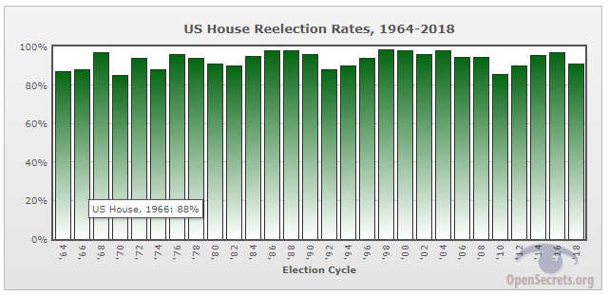
CONGRESS: THE INCUMBENCY ADVANTAGE
Incumbents are those already in office Typically 90% of Congress are incumbents; rarely lose and election. Why?

Slide 21
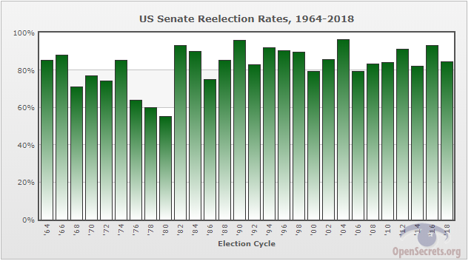
CONGRESS: THE INCUMBENCY ADVANTAGE
Incumbents are those already in office Typically 90% of Congress are incumbents; rarely lose and election. Why?

Slide 22
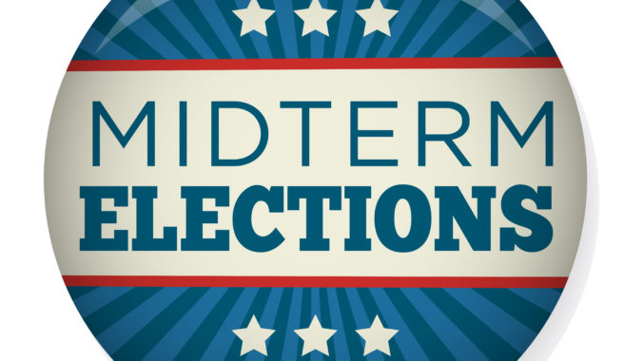
The midterms or midterm elections are general elections which are held at the midpoint of a presidency this is usually two years into a four year term period. All members of the house of representatives are up for reelection in the midterms in addition to approximately a third of the senate and the results can change the political landscape. Usually, the party that holds the presidency, loses seats.

Slide 23
ESSENTIAL QUESTION CFU
Explain to your partner three of the advantages of the incumbent. Other partner, explain three different advantages of the incumbent. Younger student goes first.
23

Slide 24
THE HOUSE
THE SENATE
Incumbent campaigns; In 2000, 98% of House incumbents were successful
Weak challenger campaigns (don't have perks such as franking privilege)
Strong challenger campaigns (due to incumbent vulnerability and challenger wealth)
Open seat campaigns (through death, retirement, redistricting‑promotes some turnover)
The six‑year term and the national exposure make a Senate seat competitive
The essential tactics of Senate races are much like those for the House
Incumbency is an advantage for senators, although not as much as for representatives, because senators run statewide, while reps have a gerrymandered district
Competitive elections increase in number when Senate only controlled by a few votes
24

Slide 25
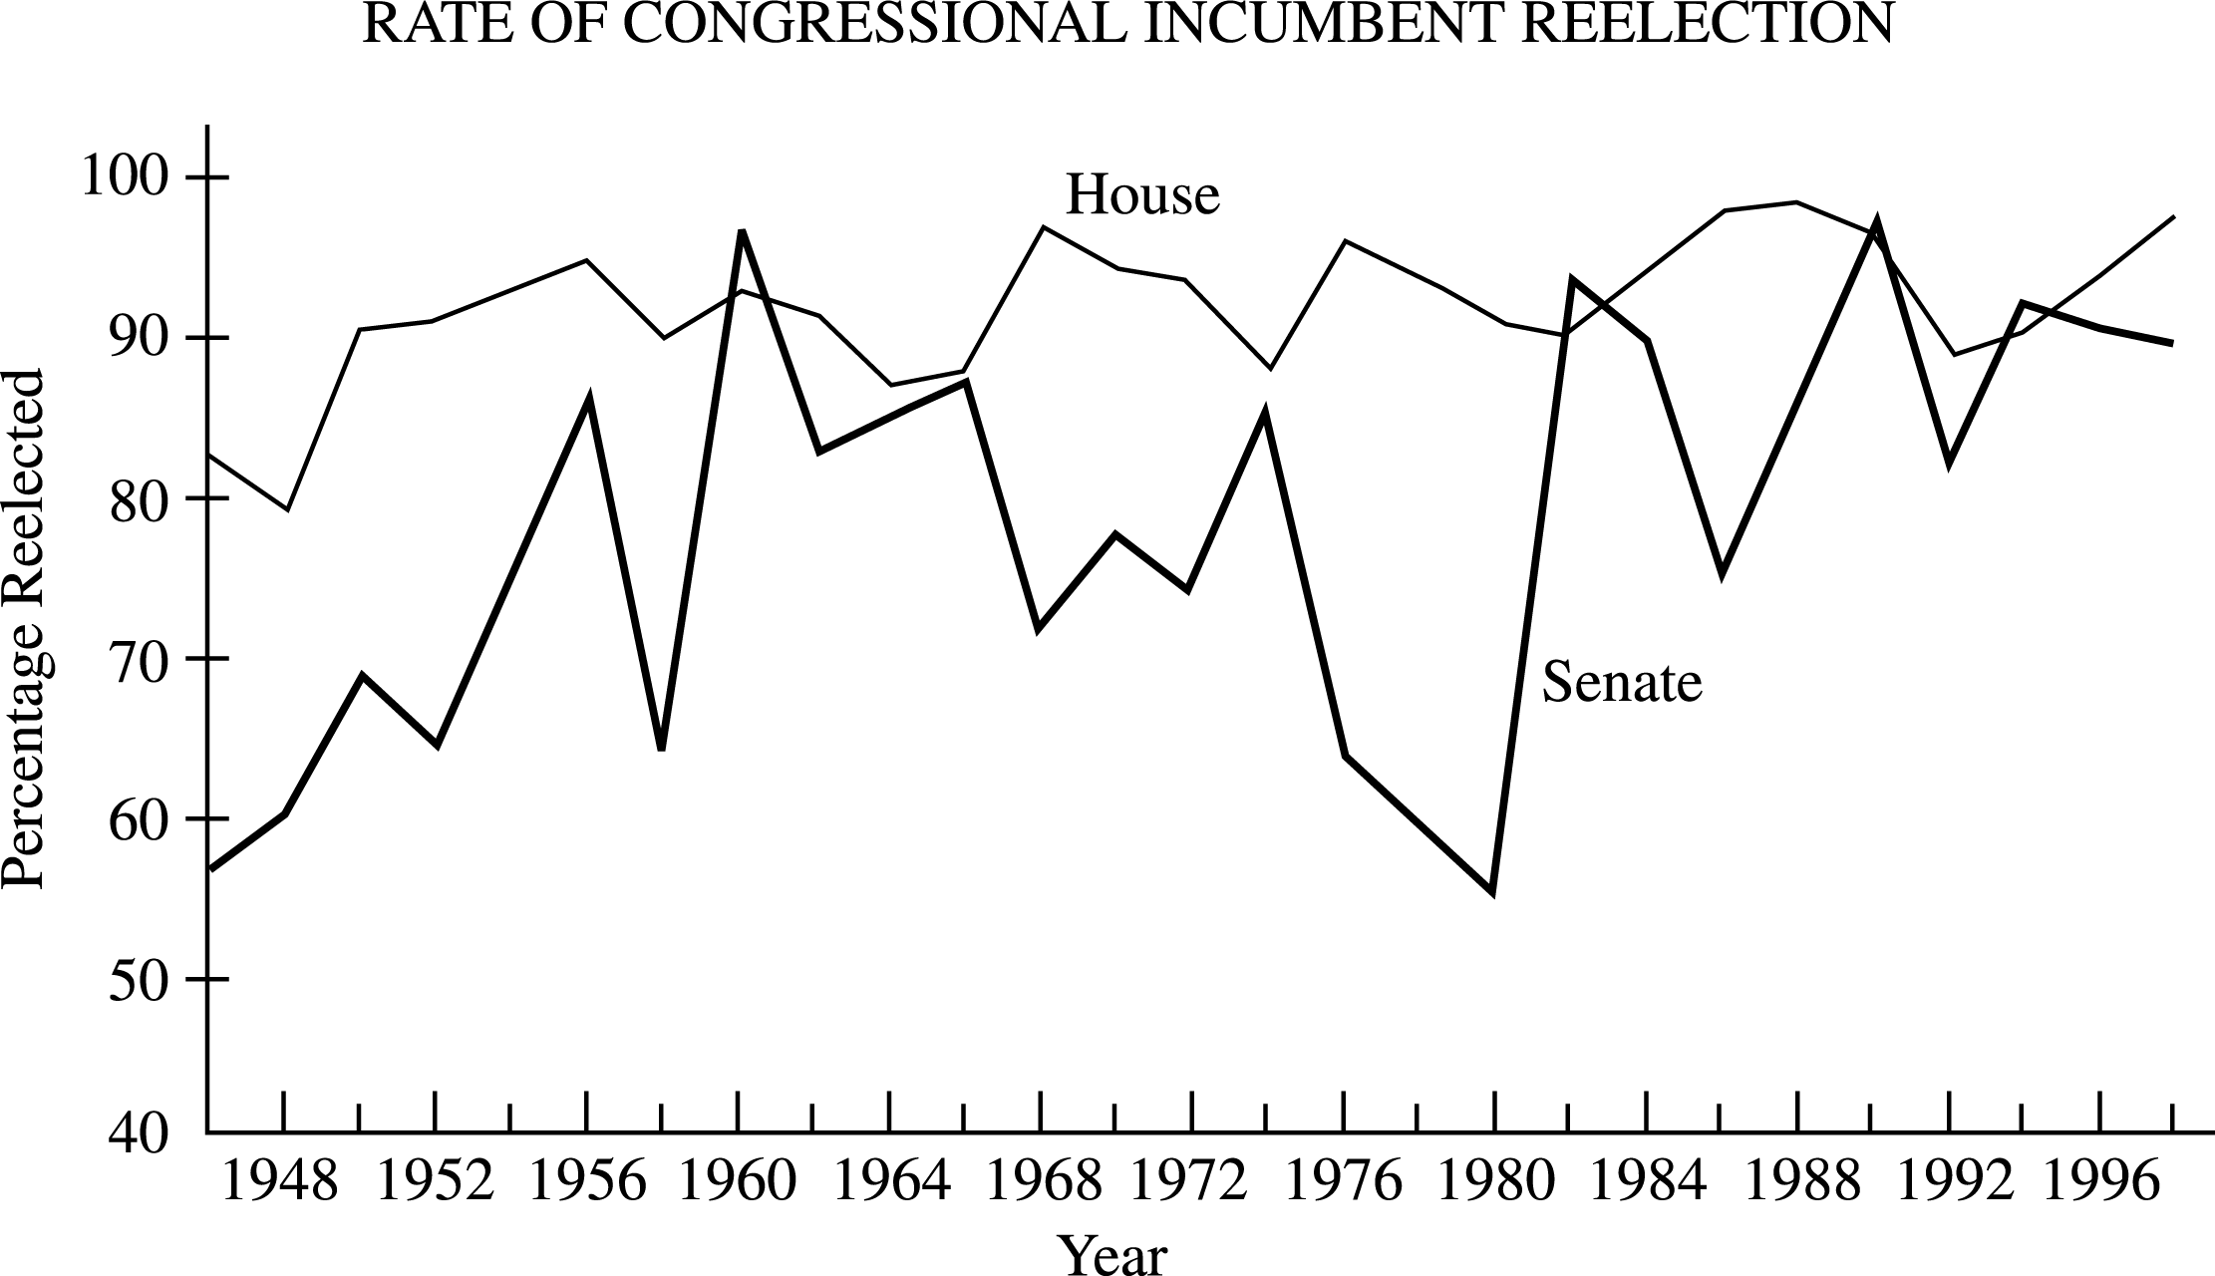
The graph above shows reelection rates for incumbents in the House and Senate. From this information and your knowledge of United States politics, perform the following tasks.
a. Identify two patterns displayed in the graph.
b. Identify two factors that contribute to incumbency advantage. Explain how each factor contributes to incumbency advantage.
c. Discuss one consequence of incumbency advantage for the United States political process.

