Slide 1
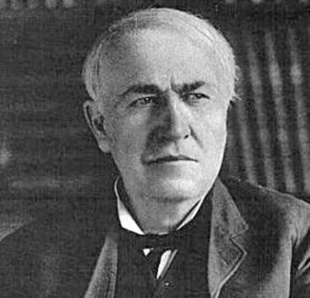
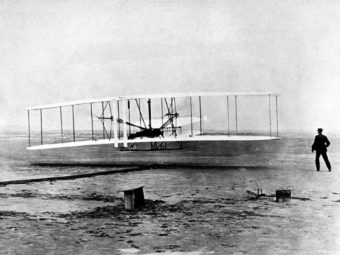

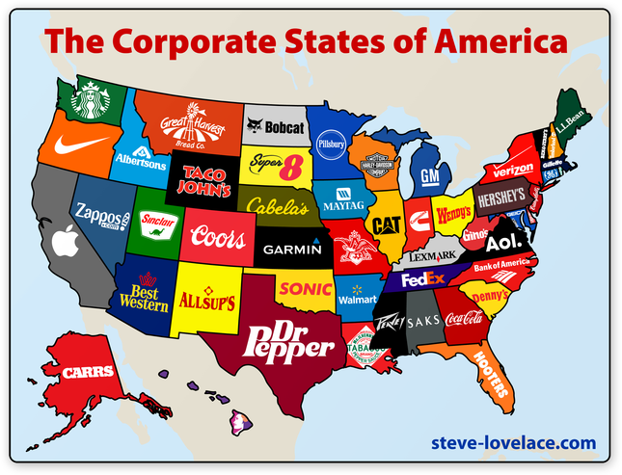
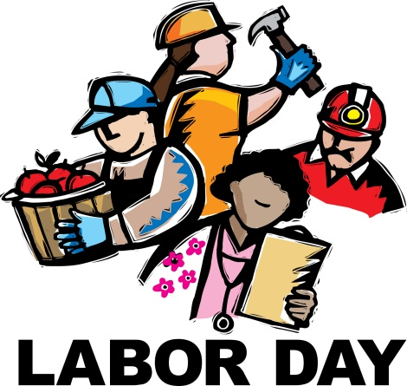

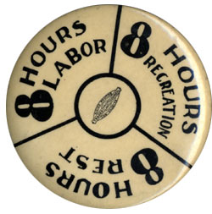
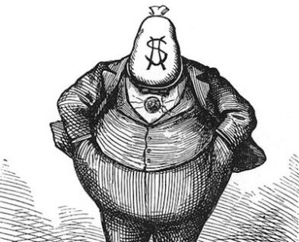
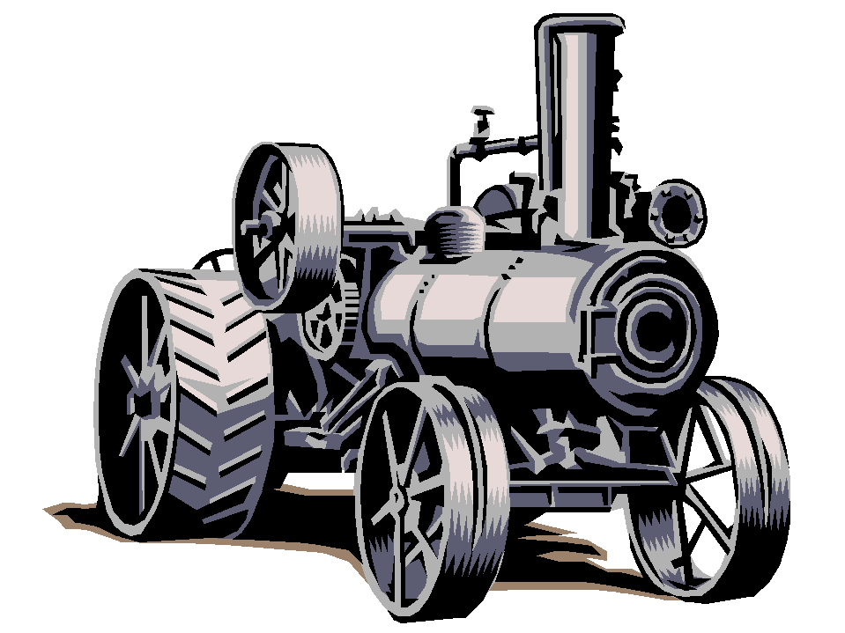
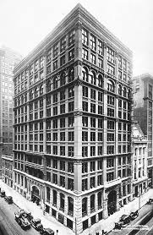
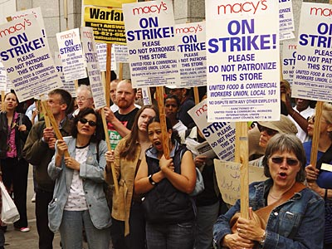
Industrialization
During the
“Gilded Age”
Chpt. 4

Slide 2
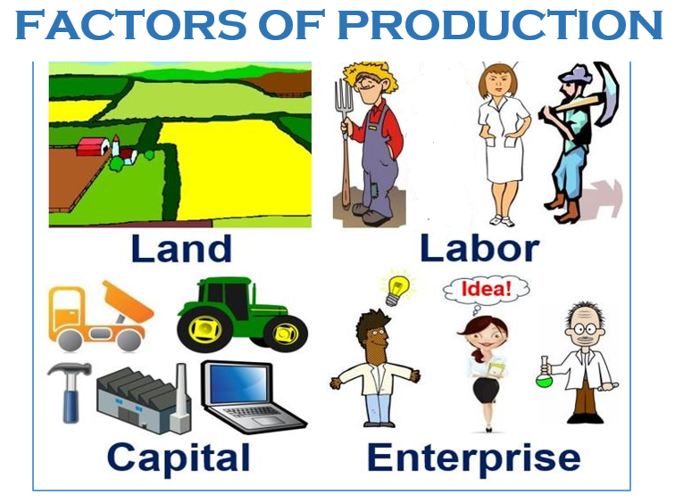
APUSH TOPIC 6.5 Technological Innovation
LEARNING OBJECTIVE
Explain the effects of technological advances in the development of the
United States over time.
Businesses made use of technological innovations and greater access to natural
resources to dramatically increase the production of goods.

Slide 3
Foundations for Economic Growth
1. Abundant natural resources
2. Free Enterprise or capitalist system(market economy)- factors of production-land, labor, capital-includes tool, machines, money are privately owned.
Markets-the interactions of buyers and sellers
Competition- lowers prices and produces higher quality goods
American culture emphasizes individualism and material success.

Slide 4
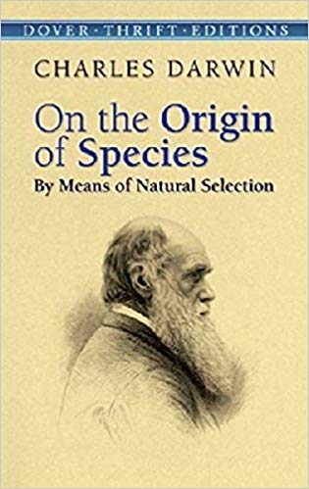
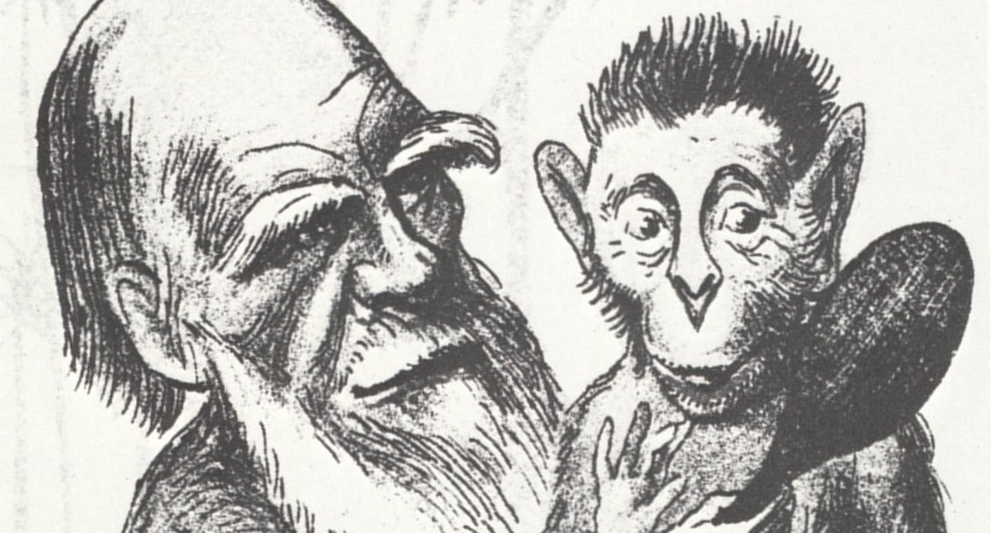
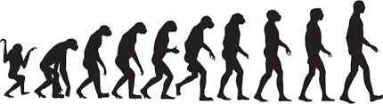
Social Darwinism-based on the evolutionary theory of Charles Darwin- survival of the fittest from his book On the Origins of Species
Social Darwinist believed that wealthy individuals were endowed with superior talent & viewed poverty as the fault of the poor themselves-inferior. Like in nature, survival of the fittest but in this case in the arena of economic competition.

Slide 5

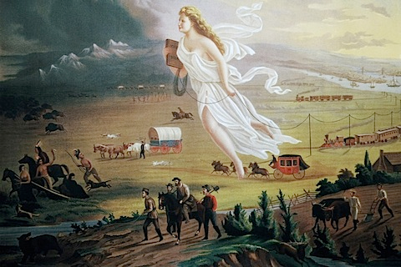
Foundations for Economic Growth
3. Role of Govt-laissez-faire- little govt interference in the economy.
Govt encouraged industrialization through:
Patent system- estbl. in US Constitution. Encourages inventiveness by guaranteeing an inventor exclusive rights to use his invention for 17 to 20 years.
Tariffs (a tax on imports)- protected US made goods from foreign competition. Thus making the imported good more expensive (import tax- duties).
Growth in railroads
Westward expansion- Manifest Destiny
4. Legacy of the First Industrial Revolution- steam power and the factory system
5. Civil War Stimulus- Northern manufacturing doubled between 1865-1875. Slavery ended- more labor
During the war laws were passed favoring North industry

Slide 6



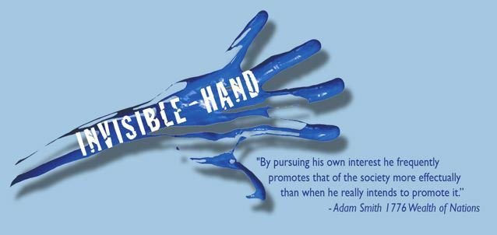
3. Free- Enterprise System: The Invisible Hand
Free- Enterprise System aka capitalism or the free market
Why does the baker bake bread?
To make money (self interest) and at the same time
feed the hungry.
Why does the baker bake really good bread?
To stay ahead of the competition and make more money.
The free market is regulated by the INVISBLE HAND, competition and self-interest

Slide 7
Free- Enterprise System: The Invisible Hand
Adam Smith described it this way in his book, The Wealth of Nations:
"It is not from the benevolence (kindness) of the butcher, the brewer, or the baker that we expect our dinner, but from their regard to their own interest."
So why does the baker choose to bake? The answer is self-interest. The baker wants to earn enough money to feed his family and buy the things he wants and the most effective way he has found to do that is to bake bread for you. In fact his bread has to be good enough and the service friendly enough that you are willing to give up your money freely in exchange for his bread. The baker while serving his self-interest has produced a good that is very valuable to you. The miracle of a market system is that self-interest produces behavior that benefits others.
Doesn't self-interest lead to price gouging, corruption and cheating? Sometimes it does, but most often it is held in check by competition. Because other self-interested people are competing in the marketplace, my self-interest is held in check. Competition is the regulator, a check on self-interest because it restrains my ability to take advantage of my customers.
https://www.stlouisfed.org/education/economic-lowdown-podcast-series/episode-3-the-role-of-self-interest-and-competition-in-a-market-economy

Slide 8
An EOC Moment
Which economic policy argues that government should limit, as much as possible, any interference in the economy?
socialism
laissez-faire
(3) mercantilism
(4) protectionism

Slide 9
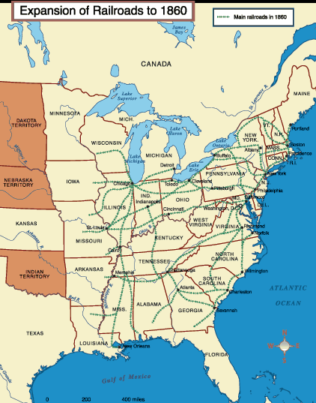
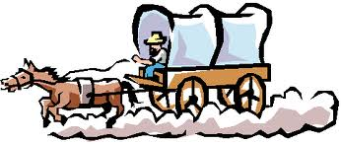
The Growth of Railroads
Before the Civil War, most of the railroad track in America had been built in the Eastern USA, especially in the Northeast.
Gold was discovered in the West and people slowly began migrating westward.
Travel was slow and difficult.
There was a desire to build a transcontinental railway that connected the East coast with the riches of California and the West.
But what route would it take?

Slide 10
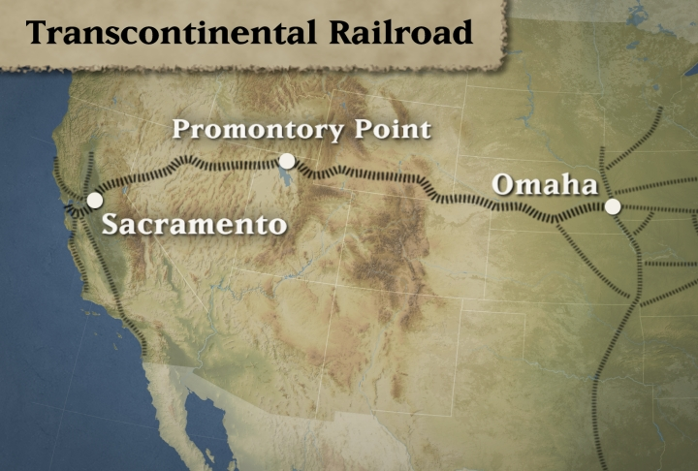
The Transcontinental Railroad
Railroads would have a significant impact on the economic, cultural, and social development of the Western United States
Opinions differed as to which route to take.
Should it go through the North or along a southern route?
The resulting Civil War caused the Transcontinental Railroad to be built along a northern route from Omaha, Nebraska to Sacramento, California.
Travel time would decrease from months to a few days.

Slide 11
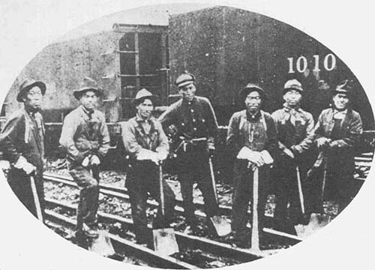
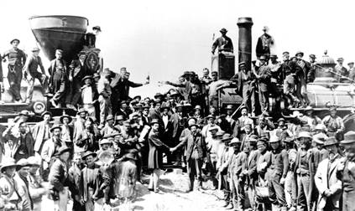
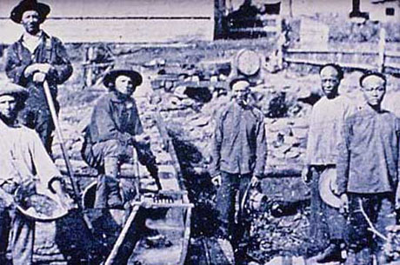
Building the Transcontinental Railroad
Civil War vets, Irish laborers, and free blacks started working westward from Omaha.
Chinese- (Coolies) workers started eastward from Sacramento.
They met at Promontory Point, Utah.

Slide 12
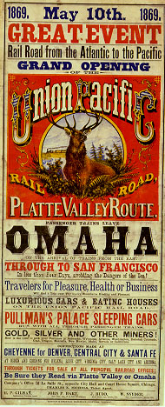
1st Transcontinental Railroad
May 10, 1869 at Promontory, Utah
“The Wedding of the Rails”
Central Pacific and Union Pacific

Slide 13
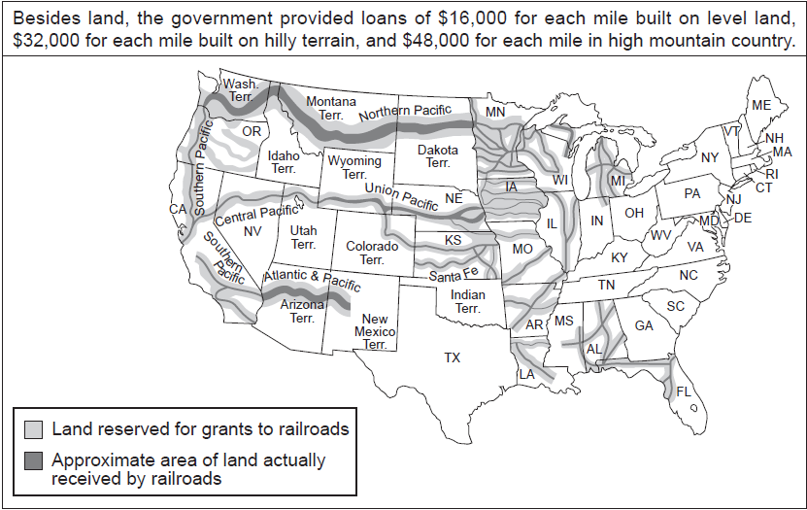

Slide 14
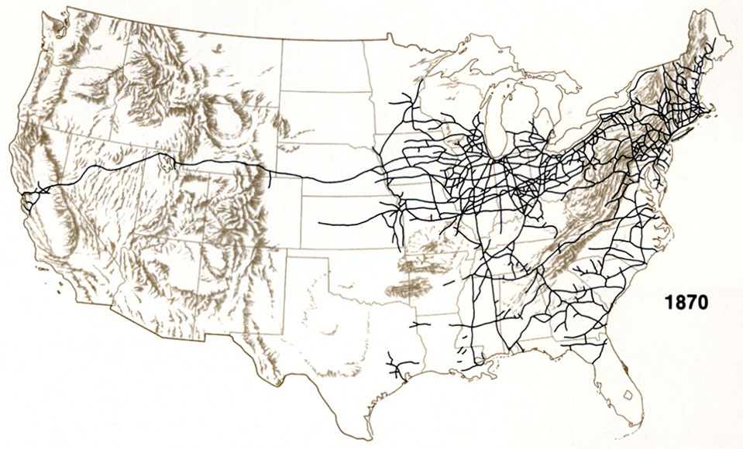
Transcontinental Railroad

Slide 15
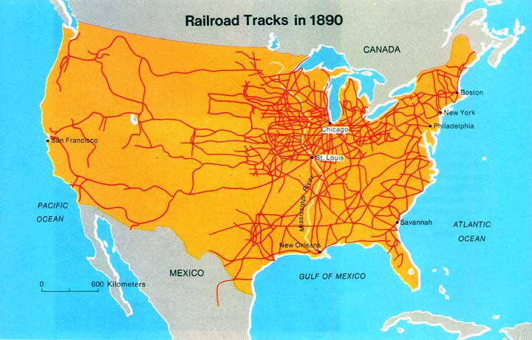
Transcontinental Railroad

Slide 16
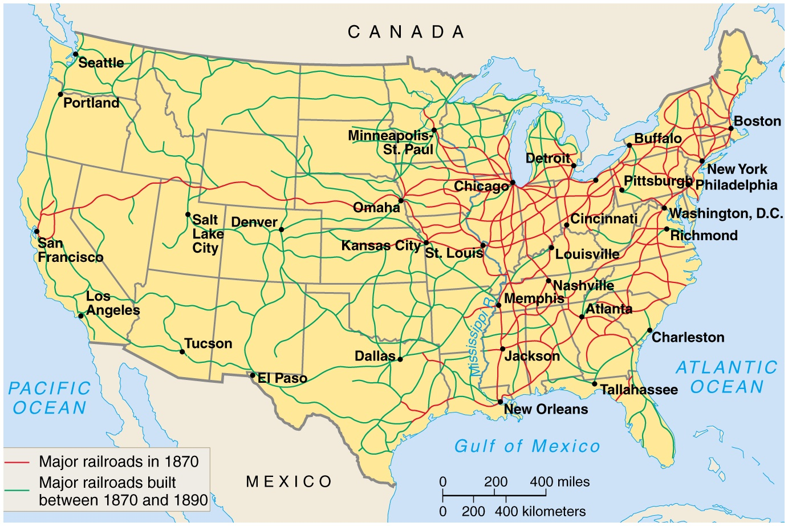
Promontory, Utah

Slide 17
America’s Second Industrial Revolution
After the Civil War, the USA was united by new railroad lines. The US went from local market economy to regional market economy to a national economy.
Manufacturer’s were able to produce more goods and sell them throughout the United States.
New business organizations were created to raise large sums of money to cover the enormous costs of production and distribution.
petroleum

Slide 18
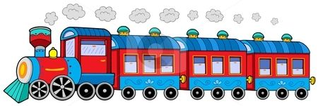
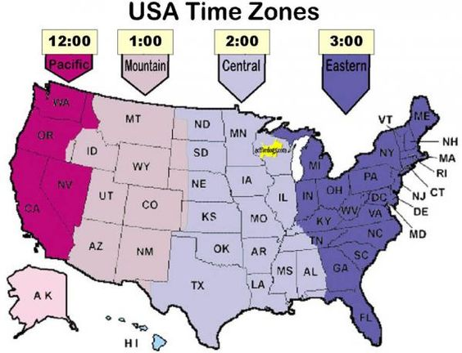
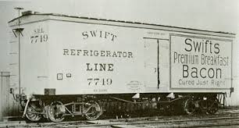
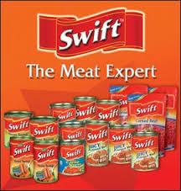
The Impact of the Railroads
George Pullman- invented the sleeping car
George Westinghouse- invented the air brake which stopped all train cars at the same time. Allowed for trains to carry more cargo and still stop safely.
RxR schedules created the need for uniform time zones across the country.
Gustavus Swift- developed first Refrigerated car. Meat was shipped
east. Chicago became the meat packing city of the USA
The railroad was the INTERNET of its day- carrying information and goods across the country

Slide 19
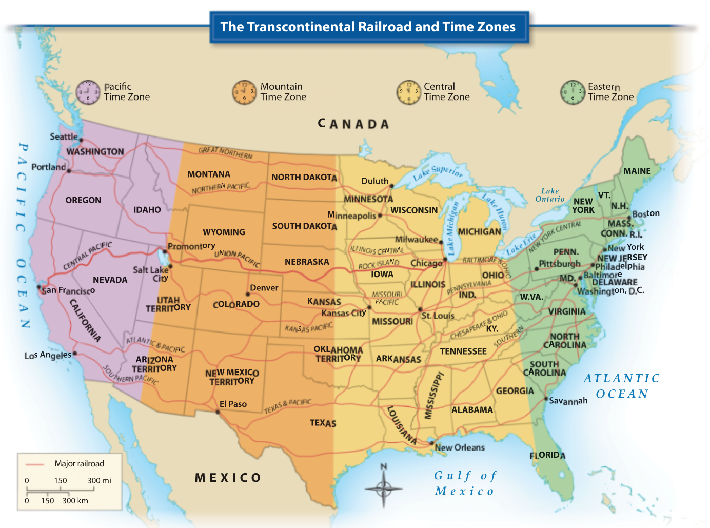

Slide 20
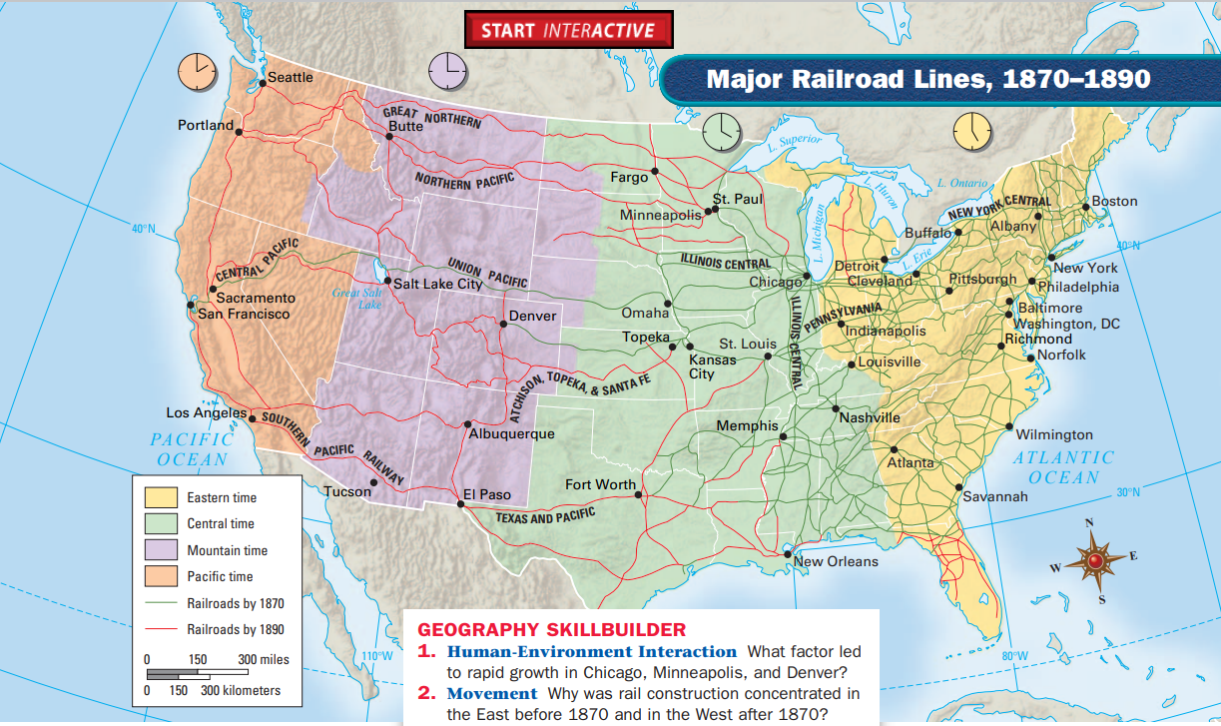
Time Zones Today
Pacific
Mountain
Central
Eastern

Slide 21
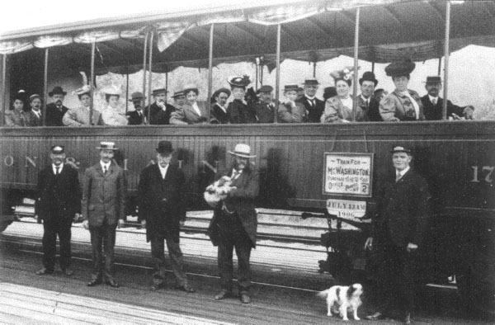
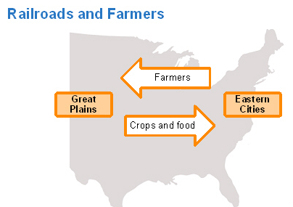
The Impact of the Railroads
The Transcontinental Railroad connected the different regions of the United States and Railroads became the lifeline to the West.
Trains brought the settlers and everything they needed to the West as towns sprang up.
Trains returned to the East with the products the West produced, beef, wheat, lumber, and gold.
Trains would also create a need for more natural resources, like coal, lumber and oil.

Slide 22
To what extent did transportation developments spark economic growth during the period from 1860 to 1900 in the United States?
Contextualization:
Thesis:
Transportation developments sparked economic growth during the period from 1860 to 1900 in the United States to a great extent because…….. List three points. Each point will be come a topic for your essay. Three points= three paragraphs at a minimum for the body of your essay.

Slide 23
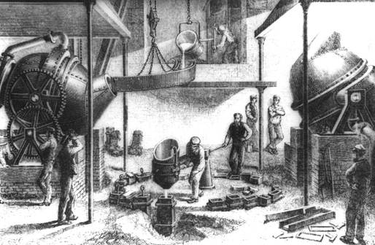
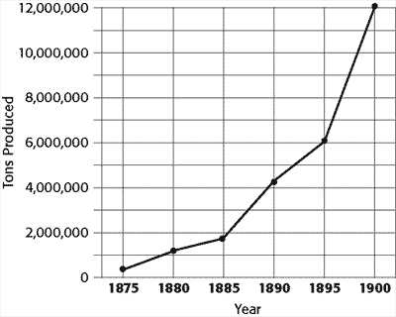
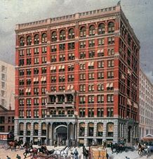

Technological Innovations
Bessemer Process – increased the amount and the quality of steel being produced at 80% less cost
This new steel was used to lay more miles of railroad track, to build the world’s 1st skyscrapers, and to make better machinery at lower costs.
World’s 1st built in 1885 it was 180 feet tall
World’s tallest built in 2010 it is 2,722 feet
Dubai

Slide 24
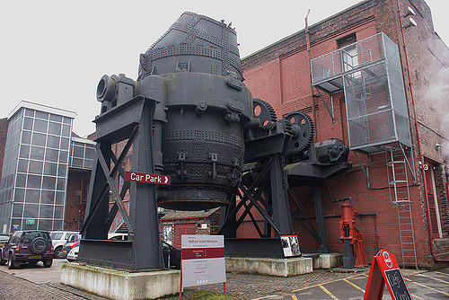
Bessemer- process invented by Sir Henry Bessemer
a steel-making process, now largely superseded, in which carbon, silicon, and other impurities are removed from molten pig iron by oxidation in a blast of air in a special tilting retort

Slide 25
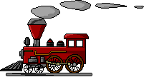
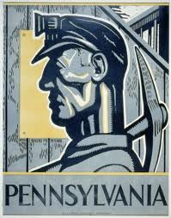
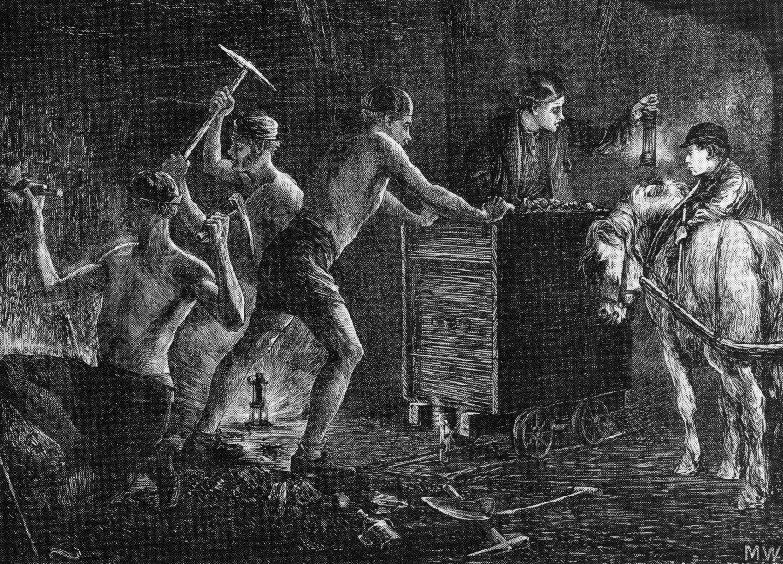
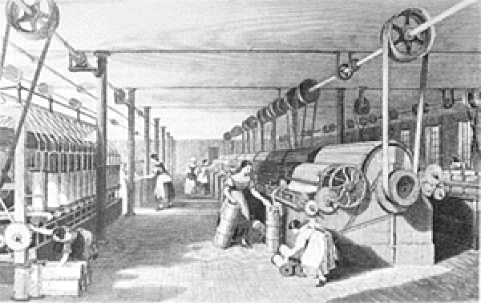
Technological Innovations
After the Civil War, human and animal strength were replaced by steam and electricity.
Steam engines, powered by burning coal to heat water, drove the textile mills, factories, and trains.
During the late 1800s the center of coal mining was in the Appalachian Mountains of western Pennsylvania.

Slide 26
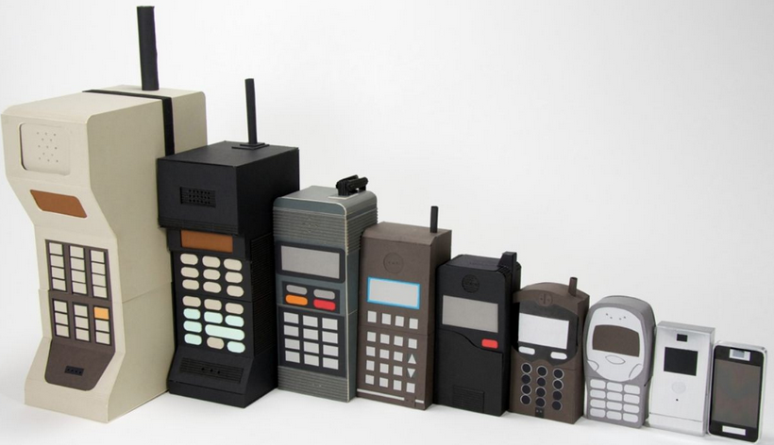
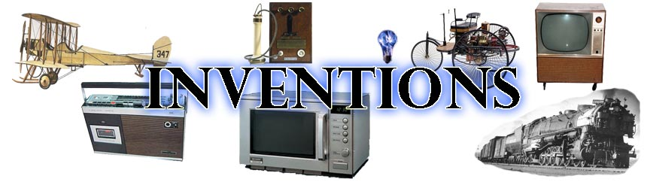
Innovation or Invention
Which is it? If it something that has been developed for the first time like machines or products then its….
Invention
Which is it? If it the process of putting these new inventions and methods into practice then it is…..
Innovation
An inventor might design and build the first refrigerator; an innovator is the first to build a factory that manufactures them

Slide 27
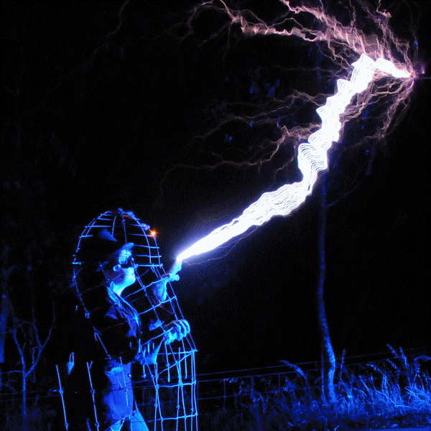
Demand for Electricity GREW

Slide 28
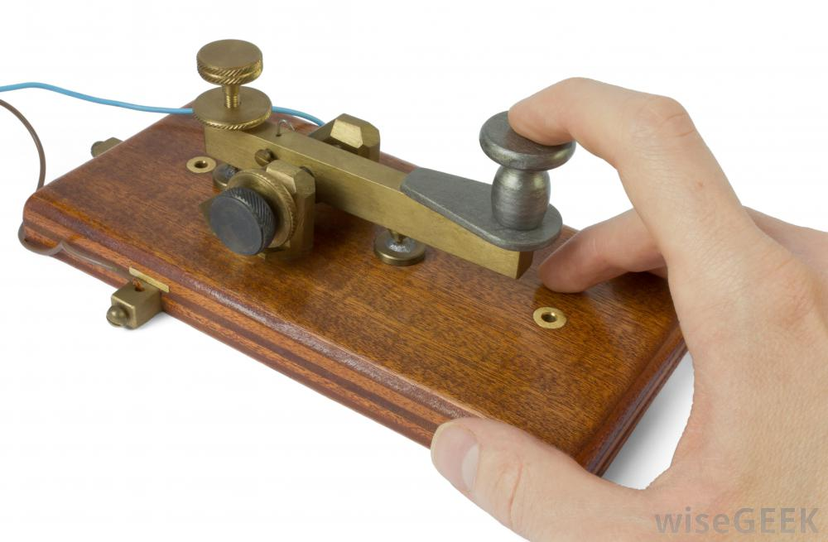

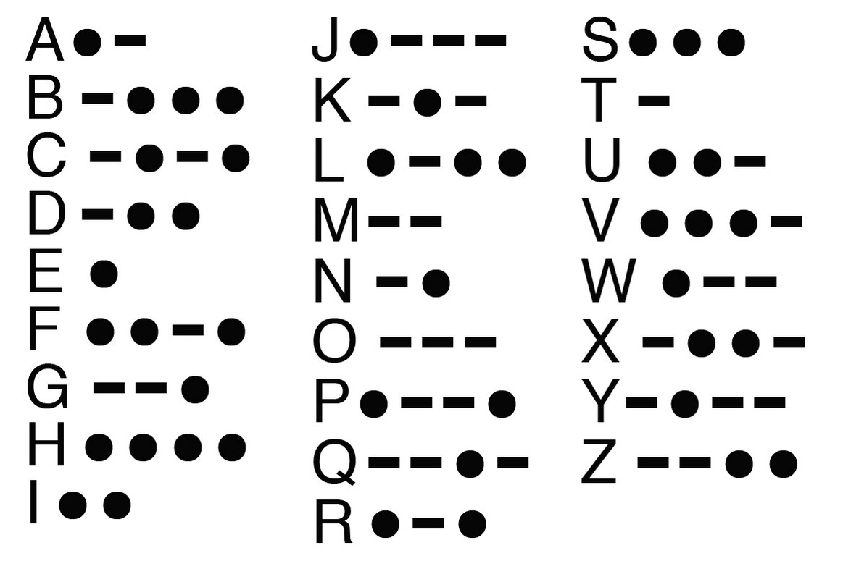
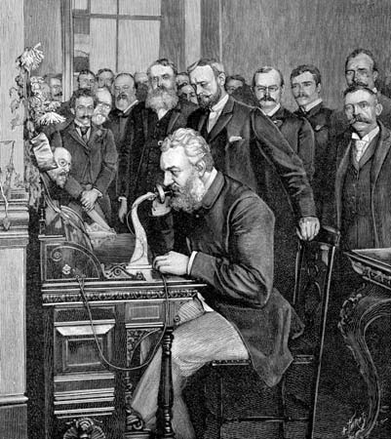
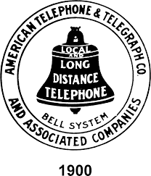
Communications
Samuel Morse (1791-1872)- developed the
telegraph using electromagnetism
- Invented a code (Morse code) a series of dots and dashes (long and short spaces) capable of transmitting the alphabet.
-Long distance and instant communications were now possible-
Cyrus Fields (1819-1892) formed a company and laid out the first transatlantic cable to carry telegraphic messages between America and Europe
Alexander Graham Bell (1847-1922)- invented the telephone and soon replaced the telegraph. He started AT&T a Bell Company

Slide 29


Slide 30

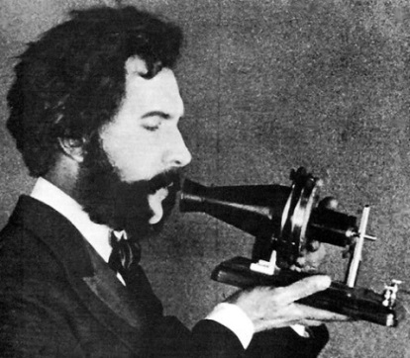



Electricity
The use of electricity was another of the era’s most significant developments.
Electricity was first used as a means of communication with the telegraph.
The telegraph dramatically changed the speed at which we communicated over great distances and made the Pony Express obsolete.
Alexander Graham Bell would later perfect the telephone in 1876, it hasn’t stopped ringing since then.
Communications haven’t been the same!

Slide 31





Business Communications
Christopher Sholes – typewriter, made businesses more productive and helped improve communications. Eventually led to computer keyboards. (1867)
The typewriter transformed business communications by replacing writing documents by hand with typing, thereby increasing the numbers of documents and communications that could be produced and creating entirely new occupations in large corporations, such as the typewriter/typist and the clerks needed to manage and organize the many documents and papers

Slide 32


The Cash Register
An early mechanical cash register was invented by James Ritty and John Birch following the American Civil War. James was the owner of a saloon in Dayton, Ohio, USA, and wanted to stop employees from pilfering his profits.
The Ritty Model I was invented in 1879 after seeing a tool that counted the revolutions of the propeller on a steamship. With the help of James' brother John Ritty, they patented it in 1883. It was called Ritty's Incorruptible Cashier and it was invented for the purpose to stop cashiers of pilfering and eliminating employee theft or embezzlement.

Slide 33





George Eastman
American entrepreneur who founded the Eastman Kodak Company and popularized the use of roll film, helping to bring photography to the mainstream.

Slide 34







Technological Innovations
Thomas Edison would also use electricity to produce amazing results. Created the Edison Electric Company. Later re-named General Electric.
Edison designed a way to get electricity into homes and businesses (DC), having electric appliances isn’t much good if you don’t have electricity.
He set up a LABORATORY in
Menlo Park, New Jersey just to invent.
Edison was able to create:
  Motion pictures, (entertainment)
  The light bulb, (world went 24/7)
  The phonograph, (which later gave way to other forms of recordings)
  Electric motors that would power factory machines and small appliances.

Slide 35






Technological Innovations
S
M
A
L
L
A
P
P
L
I
A
N
C
E
S

Slide 36


Edison v. Tesla over AC\DC
AC Current wins

Slide 37





Technological Innovations
Nicola Tesla-immigrated from Serbia to USA in 1884 and went to work with Edison
Developed AC current which we now use in our homes and businesses ------ just plug in.
Created the X-ray
Radio Remote Control
Fluorescent light bulb
the speedometer
The electric motor- replaced steam engines in factories and small appliances in our homes. Electric train motors in NY subways and trolley cars.

Slide 38

About the Edison, Tesla, and Westinghouse Feud

Slide 39






Technological Innovations
America’s first oil (petroleum) well was drilled in Titusville, Pennsylvania in 1859 by Edwin Drake.
At first, oil was just used as a lubricant, later it was refined into kerosene for lighting.
It wasn’t until the internal combustion engine and the development of the car, by the end of the 19th century that the demand for oil skyrocketed because of gasoline.
New sources of energy and transportation technologies have improved our mobility and our production capabilities.

Slide 40


Other Inventors & Innovations
This was a time period of many inventions that improved the lifestyle and standard of living (is a measure of how well of you are) of many Americans.
Internal combustion engine used a controlled explosions of gasoline
to move pistons in a cylinder.
Used by Henry Ford and others
and in airplanes
Wright Brothers – Orville & Wilbur first successful manned flight. Although their first flight lasted only seconds, it opened way for air travel at a dramatically increased speed and distance travelled. (1903)

Slide 41




First Flights
Wright Brothers – in 1902 at Kitty Hawk, North Carolina became first to fly.
Glenn Curtiss – in 1908 designed a seaplane that could take off and land on water.
Curtiss eventually flew his hydroaeroplane and marked the birth of the U.S. Naval aviation.

Slide 42




Other Inventors & Innovations
This was a time period of many inventions that improved the lifestyle and standard of living of many Americans.
Elias Howe – sewing machine, clothing could be made cheaper, faster, and now at home. (1846)
Improved by Isaac Singer when he added a foot pedal to power the sewing machine instead of a hand crank (see image). Eventually that was replaced by an electric motor.
Elisha Otis – passenger elevators, the new technique of making steel allowed for skyscrapers, this created a need for elevators to carry people between floors. (1852)
Allowed for taller buildings

Slide 43



Women & African American Inventors
Josephine Cochran- invented first automatic dishwasher in 1886 for commercial use only.
John Albert Burr- invented an improved rotor-blade lawn mower that would not allow lawn clippings to plug up the blades

Slide 44




Women & African American Inventors
Granville T. Woods (1856-1910)- invented system for trains
to send telegraph signal between stations and moving
trains
Elijah McCoy (1844-1929)- invented an automatic lube system for engines of locomotives and steamships.
"The real McCoy"
Sarah Goode-(1850)
invented the
fold-away bed

Slide 45



Women & African American Inventors
Madam C.J. Walker (1867-1919)- invented a cosmetic line for African American women at a time when cosmetic companies ignored the needs of black women. Invented a remedial shampoos based on sulfur to treat scalp diseases.
Lewis Howard Latimer(1848-1889)- patented an improved method for producing the carbon filament used in electric lightbulbs

Slide 46

Women & African American Inventors

Slide 47



Women & African American Inventors
Jan Ernst Matzliger (1852-1889) invented a machine to produce shoes faster and cheaper. From 50 soles per day to 150-700 soles per day.
Garrett Morgan (1877-1963) developed a safety hood and smoke protector for firefighter- a type of gas mask that used a wet sponge as a filter a and a long tube that dropped to the ground for the intake of air. He also invented the traffic light in the USA with a warning signal.

Slide 48


A Growing Population
The USA experienced a rapid population growth, as the population jumped from over 2 million to 76 million in just 50 years, cities were crowded .
A high birth rate and a constant stream of immigrants created a rising demand for goods and the growing population was a steady supply of cheap labor.
This population growth favored business expansion.

Slide 49





The Second Industrial Revolution

Slide 50
Making Connections-continuity and change
Which of the following best explains a connection between the economic productivity of the United States in the mid-1800s and in the late 1800s?
A. The application of new technologies expanded large-scale industrial manufacturing.
B. Labor unions sought to improve conditions in factories and wages for workers.
C. The use of sharecropping in the South expanded cotton agricultural production.
D. Corporations’ need for managers fostered the growth of a large middle class.

Slide 51
LEQ or DBQ Prompt
https://www.arodconnection.com/copy-of-ap-us-history-2
Evaluate the extent to which the Gilded Age economy fostered change in the United States in the period from 1870 to 1900.
Contextualization: Ask yourself what event(s) that occurred 50-100 years prior led to this current state of affairs? In other words, HOW DID WE GET HERE?
Market Revolution
the creation of trusts and holding companies
Civil War, Reconstruction
Thesis:
The Gilded Age economy fostered change in the United States in the period from 1870 to 1900 to a great extent because…. List three points. Each point will be come a topic for your essay. Three points= three paragraphs at a minimum for the body of your essay.
the growth of manufacturing, the large-scale production of goods, innovations in transportation and communication
Complexity: do a counter point:
However, some would argue that little change occurred because….. Most Americans
toiled on the farms and the USA remained largely a rural agrarian society.

Slide 52

How would this image support my thesis?
The Gilded Age economy fostered change in the United States in the period from 1870 to 1900 to a great extent because….

Slide 55
LAISSEZ FAIRE
An economic belief supported by the U.S. that opposes the government regulating business.
In the late 1800’s businesses operated without much government regulation. This is known as laissez-faire economics.
Laissez-faire means ‘allow to be’ or the government stays out of a person’s business in French.
Laissez faire supports our economic system of capitalism

Slide 56

New Types of Business Organization
Before the Civil War, most businesses were owned by individuals or by a groups of partners.
After the war, corporations became more common.
A corporation is a company chartered by the state and recognized as a separate ‘person’ from the owners
Bam! BIG Business was born.

Slide 57

Corporations
Corporations issue and sell ‘stock’ or shares of a company- Certificates of Ownership
A shareholder is a partial owner, and they receive a share of a corporation's profits based on the amount of stock they own. This profit sharing is called dividends.
Shareholders were responsible only for the shares they own, not for losses and are protected from lawsuits. Corporations reduce the financial risk for individual investors. The investor is only LIABLE for the amount he invested.
Corporations allowed for people to pool their money to raise the huge sums needed to build railroads, factories, steel mill, etc.
Corporations made modern industrial production possible

Slide 58




Structure of a Corporation
Elect a Board of Directors
Appoints General Managers
The board will also appoint a CEO
Chief Executive Officer:
aka The President
Who hire all Employees

Slide 59


Structure of a Corporation
Corporations’ need for managers and for male and female clerical workers, as well as increased access to educational institutions, fostered the growth of a distinctive middle class. A growing amount of leisure time also helped expand consumer culture.

Slide 60


APUSH TOPIC 6.10 Development of the Middle Class
Explain the causes of increased economic opportunity and its effects on society.
Corporations’ need for managers and for male and female clerical workers, as well as increased access to educational institutions, fostered the growth of a distinctive middle class. A growing amount of leisure time also helped expand consumer culture.

Slide 61
APUSH TOPIC 6.10 Development of the Middle Class
Corporations’ need for managers and for male and female clerical workers, as well as increased access to educational institutions, fostered the growth of a distinctive middle class. A growing amount of leisure time also helped expand consumer culture.
New industries
New inventions
New jobs that never existed before
All of this led to growth of the middle class-led to more leisure time, entertainment, culture
And new shopping experiences……

Slide 62












Development of a National Market
A new truly national market began to emerge as railroads, canals, the telegraph and telephone linked the country together.
National producers could ship their goods cheaper and would dominate sales in the West.
New methods of marketing and advertising gave manufacturers ability to expand across the nation.
Catalogs became “wish lists”
New type of retail stores emerged- THE DEPARTMENT STORE, CHAIN STORES, MAIL ORDER and SPECIALTY SHOPS.
and when a new catalog came the old one served another purpose…

Slide 63



Largest department store in the USA by 1900 was John Wanamaker’s Grand Depot in Philadelphia
Largest department store in the USA by 1900 was John Wanamaker’s Grand Depot in Philadelphia
Advertising became
BIG Business

Slide 64

New Stores
BETWEEN 1860 TO 1900
Specialty stores----sold single line of goods
Department stores---combined specialty stores
Chain stores---stores with branches in cities
Mail catalog stores
New ways to advertise
Montgomery Wards, J.C. Penney, Macy’s, Sears and Roebuck and Woolworths

Slide 65


Slide 66

The Free Enterprise System
The Success of America’s industrialization was based on its free enterprise system- LAISSEZ- FAIRE.
Free Enterprise System is when people have the freedom to make their own choices in what to buy, where to work, and what to make.
People are free to use their money and time to start a business in hopes of making a profit. (Entrepreneur/ Producers)
People are free to choose the type of product they wish to buy and how much they’ll pay. (Consumers)

Slide 67
The Free Enterprise System
People have unlimited wants but we have limited resources to satisfy these wants.
Businesses use their resources to compete with each other to satisfy these consumer desires.
Every society must answer three basic economic questions to determine how to use its resources to satisfy these wants.
What Should Be Produced ?
How Should It Be Produced ?
Who Should Get It ?

Slide 68


Entrepreneurs
An Entrepreneur is a person that invests their time, money, and skills on the chance of making a profit.
In the 1870s these entrepreneurs dominated America’s economic life.
Efficient large-scale production allowed them to sell goods at lower prices (economies of scale) and Competition forced them to continually improve the quality.
Many of these entrepreneurs created monopolies and made huge fortunes.

Slide 69
APUSH What changed in society?
New industries created- new occupations- business management, train engineer, telegraph operator, electrician (REMEMBER the light bulb), electrical engineer.
Ford Motor Company- new occupations- automobile mechanic and engineer.
How did the light bulb change the retail industry? Stores stayed open past sunset. Before the light bulb people worked form sunrise to sunset, now they can stay up later, stores open longer, factories if needed could operate 24/7
What continued to be the same?
Women
Black Americans

Slide 70




The Gilded Age 1870s-1900
The time when these Captains of Industry ruled America became known as the Gilded Age. Gilded means that its covered in gold but underneath there is something cheap like wood. Society looked gilded but underneath there was something very wrong. This term was coined by Mark Twain to express the poverty and corruption under all the glitter of gold.
They amassed fabulous wealth and lavishly spent it while the majority of Americans were poor.
These ‘robber barons’ were glorified and vilified.
Some became the richest men in the world.

Slide 71







A Portrait Gallery of the Great Entrepreneurs of the Gilded Age
The Captains of Industry or Robber Barons
Many of the more successful entrepreneurs became known as ‘Captains of Industry’.
Some called them ‘robber barons’ because of the ruthless tactics they used to destroy their competition and methods used to keep workers wages low.
Some of the best known were:

Slide 72


The Self-Made Men
The Men Who Built America
Novels by Horatio Alger Jr. Every Alger novel portrayed a young man of modest means who becomes wealthy through honesty, hard work, and a little luck. In reality, opportunities for upward mobility (movement into a higher economic bracket) did exist, but the rags-to-riches career of an Andrew Carnegie was unusual. Statistical studies demonstrate that the typical wealthy businessperson of the day was a White, Anglo-Saxon, Protestant male who came from an upper- or middle-class background and whose father was in business or banking. These novels were immensely popular.

Slide 73

The Self-Made Men
The Men Who Built America
So popular were his novels that a board game was created based on a on one of his novels, District Messenger Boy was a board game where players could achieve the ultimate goal of material success. Alger wrote hundreds of books on a common theme: A poor but hardworking boy can get ahead and make his fortune through a combination of “luck and pluck.”

Slide 74





Andrew Carnegie1835-1919
Carnegie started penniless, but he made his fortune in steel mills in the Pittsburgh, PA area.
He used vertical integration to undercut the competition. Predatory pricing- sell below cost to drive competition out of business
He bought his own iron ore fields, coal mines, production facilities and ships so he could control all phases of steel production.
He crushed attempts to form labor unions, paid low wages, and forced laborers to work 12-hour days.
The labor strike on Carnegie’s Homestead Steel Mill would be one of the eras most violent.

Slide 75


New Business Structures In USA 1870-1915
1. Businesses formed new conglomerates and holding companies (horizontal integration) in order to acquire control of multiple businesses within the same industry.
A conglomerate is a corporation made up of several different, independent businesses. In a conglomerate, one company owns a controlling stake in smaller companies that each conduct business operations separately.

Slide 76
Vertical Integration v. Horizontal Integration
Horizontal integration allowed for one big company to buy out the competition and dominate the market as the sole supplier of a good or service. This allowed them to charge high prices (monopoly)
Vertical integration occurs when companies buy their suppliers.
Instead of paying companies for coal, lime, and iron, Carnegie’s steel company bought coal mines, limestone quarries, and iron ore fields. Vertical integration saved money and enabled many companies to expand.

Slide 77





Slide 78


Slide 79


John D. Rockefeller
1839-1937
Rockefeller started out poor but made his fortune in oil in Ohio.
Kerosene, for lighting, made him millions, later the gasoline industry, would make him even richer.
Rockefeller used horizontal integration and ruthless tactics to drive his competition out of business, then he would buy them out and raise prices.
His Standard Oil Co. became a trust, with him owning most of the shares.
Later it would be a monopoly as he controlled 90% of all oil refined.

Slide 80

John D. Rockefeller
Which philosophy is expressed in the American Beauty Rose quote?
Social Darwinism
“The growth of a large business is merely a survival of the fittest...The American beauty rose can be produced in the splendor and fragrance which bring cheer to its beholder only by sacrificing the early buds which grow up around it.” John D. Rockefeller

Slide 81

Which feature of the United States economy in the late 1800s is symbolized by the rose in the cartoon?
a. technological improvements in agriculture
b. dependence on imported oil
c. creation of monopolies
d. governmental success in regulating business competition

Slide 82
A Portrait Gallery of the Great Entrepreneurs of the Gilded Age
The Captains of Industry or Robber Barons
Captains of Industry
Railroads - Vanderbilt
Oil Rockefeller
Steel Carnegie
Economics (J.P.Morgan)

Slide 83

Survival Of The Fittest

Slide 84

John D. Rockefeller
The cartoon features John Rockefeller, "on top of the world" sitting a barrel of standard oil. The cartoon is representing the enormous power Rockefeller and his Standard Oil Company held over smaller, weaker refineries and railroad industries. With the control of those businesses, Rockefeller obtained an enormous fortune and charged extremely high prices for his products, because there was no competition. As a result, the government stepped in to prohibit monopolies and trusts, and John Sherman and Congress wrote the Sherman Antitrust Act, which as we shall see in later chapters, was a weak law.

Slide 85


J.P. Morgan
1837-1913
1892 Morgan helped Edison start his company and promptly pushed him out over ACDC current debate. GE was born.
1895 formed JP Morgan & Company- a commercial & investment banking institution
1901 Morgan bought Carnegie Steel and joined them with other steel companies to form US Steel- largest steel maker in the world. First ever billion-dollar company in USA. Controlled 80% of steel production with 168,000 employees.
Morgan Bank today is known as Chase Bank

Slide 86
J.P. Morgan
1837-1913
Interlocking Directorates: The practice of having executives or directors from one company serve on the Board of Directors of another company. JP Morgan introduced this practice to eliminate banking competition in the 1890s.
Can control multiple businesses in the same industry was this legal? Clayton Antitrust Act prohibited this in the same industries

Slide 87






The Dominant Manufacturing Industries 1870-1914
Steel
Carnegie Steel
US Steel- JP Morgan
Petroleum
Standard Oil
Electrical Equipment
Edison Electric (General Electric)
Westinghouse
Automobiles

Slide 88



Ancillary Industries
Ancillary Industries
Distributions- Logistics
Jobbers (a business which buys goods and bulk products from importers, other wholesalers, or manufacturers, and then sells to retailers) replaced wholesale agents
Department Stores (Wanamaker, Marshall Fields
Mail Order (Sears & Roebuck, Montgomery Ward, JC Penney)
Railroad and free rural deliveries began in 1896
Investment Banking
Organize and Mobilize Credit
Investment Banking
Stock Markets
Speculation
House of Morgan
Railroads after 1893
US Steel 1901
Loan to US gov 1907

Slide 89
APUSH TOPIC 6.10 Development of the Middle Class
Explain the causes of increased economic opportunity and its effects on society.
Corporations’ need for managers and for male and female clerical workers, as well as increased access to educational institutions, fostered the growth of a distinctive middle class. A growing amount of leisure time also helped expand consumer culture.

Slide 90


6.10 Philanthropy
6.10 Some business leaders argued that the wealthy had a moral obligation to help the less fortunate and improve society, as articulated in the idea known as the Gospel of Wealth, and they made philanthropic contributions that enhanced educational opportunities and urban environments.

Slide 91


Philanthropy
Carnegie and Rockefeller both made millions at the expense of American public.
Carnegie wrote The Gospel of Wealth. He believed that a rich man should not die with his wealth but should give it away, especially to institutions that promoted self improvement. Ex. Libraries, Universities, hospitals
They paid low wages and demanded long hours of work.
As businessmen they didn’t believe in charity, their belief was;
‘help those who help themselves’
Later, both would lead the rich in philanthropy, they gave away millions of their dollars to the public-Charitable giving.
They built libraries', museums, colleges, and gave college scholarships.
Here’s
a dime

Slide 92
Andrew Carnegie’s “Gospel of Wealth" argued that the wealthy had a God-given responsibility to carry out
projects of civic philanthropy for the benefit of society. Practicing what he preached, Carnegie distributed more than $350 million of his fortune to support the building of libraries, universities, and various public institutions.

Slide 93

Philanthropy

Slide 94
“The purpose of this article is to present some of the best methods of performing this duty of administering surplus wealth for the good of the people. The first requisite for a really good use of wealth by the millionaire who has accepted the gospel [of wealth] . . . is to take care that the purpose for which he spends it shall not have a degrading, pauperizing tendency upon its recipients, and that his trust should be so administered as to stimulate the best and most aspiring poor of the community to further efforts for their own improvement. . . .
“The result of my own study of the question ‘What is the best gift which can be given to a community?’ is that a free library occupies the first place, provided the community will accept and maintain it as a public institution, as much a part of the city property as its public schools. . .
Andrew Carnegie, “The Best Fields for Philanthropy,” North American Review, 1889
The excerpt best serves as evidence for which of the following developments in the late 1800s?
a. The impact of the construction of transcontinental railroads on United States commerce
b. The growing support for labor unions among the owners of corporations
c. The emergence of arguments that wealthy people had a moral obligation to help society
d. The decline of urban centers as immigrant populations moved westward

Slide 95
An EOC Moment
When Andrew Carnegie stated, “The man who dies rich, dies disgraced,” he was supporting
consumer credit
Social Darwinism
charitable giving
antitrust legislation

Slide 96

Political Cartoons on Robber Barons
Robber Barons were accused of
  being just plain greedy
  unfair business practices,
  being above the law,
  abusing labor with low wages and long hours,
  having too much, influence on government,
  simply not caring about the American public,

Slide 97
An EOC Moment

Slide 98

Above the Law
Combinations & Restraint of Trade
For Congress

Slide 99

Abusing Labor With Low Wages And Long Hours

Slide 100

  Simply not caring about the American public,

Slide 101

  Having Too Much, Influence On Government

Slide 102

An EOC Moment
Based on your knowledge of the Second Industrial Revolution in the United States, what statement is this cartoon making?
A. The federal government is ruining the oil industry by placing too many restrictions and regulations on business owners.
B. The oil industry is thriving due to a healthy working relationship with the federal government.
C. The owner of Standard Oil has too much power and influence over the federal government.
D. Emissions from oil refineries are polluting the air and harming the environment.

Slide 103


being just plain greedy
An EOC Moment

Slide 104


An EOC Moment
What is being criticized in this cartoon?
environmental damage
business consolidation
oil exploration
federal tax laws

Slide 105

Gilded Age & Corruption
Railroads Were at the Forefront of Political Corruption
Railroads propelled the expansion of the American economy as tracks expanded nearly fourfold between 1871 and 1900. The federal government helped finance these huge infrastructure projects by granting more than 150 million acres of land to railroad companies, which sold them to raise revenue. “Railroads need monopoly franchises and subsidies, and to get them, they are more than willing to bribe public officials,” White says. The Central Pacific Railroad, for example, spent $500,000 annually in thinly disguised bribes between 1875 and 1885.
In the most notorious instance of corruption connected to the railroads, Union Pacific Railroad executives formed a sham construction company, Crédit Mobilier, that submitted bills for nearly double the construction cost of the eastern portion of the Transcontinental Railroad and pocketed the overcharges. To avert any investigation and ensure votes to benefit the company, railroad officials bribed approximately one dozen influential congressmen with Crédit Mobilier shares at below-market prices. Swept up in the Crédit Mobilier scandal was not just Ulysses S. Grant’s first vice president, but his second one as well.
https://www.history.com/news/gilded-age-corruption-corporate-wealth

Slide 106

Editorial cartoon on railroad influence depicting a man with a steam train head making business deals in Congress, by Thomas Nast, 1880s.
Kean Collection/Getty Images

Slide 107

“The Bosses in the Senate” 1889

Slide 108

The Way We Become Senator Nowadays
PUCK Magazine, Jan 22, 1890
The Constitution states that senators will be elected by the state legislatures. The senate would represent the interests of the states. This cartoons message is that the “fat cats” are buying of the state legislatures to get “elected” to the Senate.
This will change with the passage of the 17th amendment in 1913 in which senators would be elected directly by popular vote- the people

Slide 109
“The Bosses in the Senate” 1889
An EOC Moment
1. Why do you think the businessmen are drawn so large?
2. What are some of the trust that the “fat cats” represent in the political cartoon?
3. What legislative body is seated in this political cartoon?
4. Why would the Monopolists Trust have a larger open door to the Senate floor and the American public have a second floor door?

Slide 110

The cartoon above “The Bosses of the Senate” published in 1889
What is the viewpoint of the artist?
Trusts mainly compete against one another for profits.
Trusts have been subjected to unfair regulation by Congress.
Trusts have too much influence over the United Sates Senate.
Trusts play an essential role in promoting American economic growth.

Slide 111

Hard Times
What is the central message of this cartoon?
What does it say about the captains of industry?
Who are the folks at the bottom? What did they create to protect themselves? U_ _ _ _ _.
The wealthy are benefiting from the efforts of the working class.
nions

Slide 112


Slide 113


Slide 114

An EOC Moment

Slide 115
Which idea would Rockefeller, Carnegie, and Morgan most likely support?
(A) Socialism
(B) Laissez-faire
(C) Manifest Destiny
(D) Gospel of wealth

Slide 116

Rockefeller and The Trust
Trusts, are a larger company that controls similar smaller companies, to help him (Rockefeller) dominate the oil industry. He would raise oil prices once he controlled the market. Just one big monopoly. Trustees ran the companies as if they were one.
The dangers of a Monopoly- have no competition and can charge high prices. They dominate the market and have little incentive to improve their product. This leaves consumers with no choice but to pay up.

Slide 117


Slide 118
The Consolidation of Big Business and the Govt Response
Pooling Agreements- was informal agreement to fix prices or divide markets on a regional basis, often used by railroads. Referred to as collusion
Trusts- became popular because various states laws placed limits on companies operating in more than one state. To circumvent these restrictions, stockholders of existing companies gave their stock over to the board of directors of trust in exchange for trust certificates, entitling them to dividends on the profits of the entire trust. The trustees exercised control over the different companies in the trust and managed them as a single enterprise. It became an even bigger monopoly.
Holding Company- was a company that owned controlling number of shares in other companies

Slide 119
Business During the Gilded Age
Businesses formed new conglomerates and holding companies (horizontal integration) in order to acquire control of multiple businesses within the same industry.
During the Gilded Age businesses colluded in order to reduce competition in many industries.
Businesses developed vertical integration in order to control all stages of the production of a product, such as Andrew Carnegie and U.S. Steel.
By the late nineteenth century, businesses used horizontal and vertical integration to better compete with other corporations, sometimes monopolizing an entire industry.

Slide 120
How BIG Business Changed American Society During the Gilded Age
The development of corporate monopolies dominated the market for some products and services and resulted in higher prices.
Workers faced reduced negotiating power for wages and worsened working conditions due to business collusion and the power of corporations.
Consumers faced higher prices for products and services, such as high rates for rail transport, as a result of corporations and monopolies controlling prices.
Business leaders developed arguments in favor of laissez-faire economics and Social Darwinism in order to justify their increasing dominance over the economy.
The need for new sources of labor created by expanding businesses and corporations contributed to increased immigration to the United States to work in factories.
Increased production of goods by large businesses resulted in lower costs for many goods, which contributed to economic deflation and an increased standard of living for many.
As a result of these changes, the federal government began to actively support businesses in labor disputes.
Changes in business structures led to middle-class consumerism and leisure culture developing.
Organized labor arose in response to poor working conditions, long hours, and low wages imposed by the new business structures.

Slide 121
Explain how one specific historical development between 1870 and 1915 addressed the impact of new business structures.
Understand how society, government would react to monopolies from 1870-1915

Slide 122


An EOC Moment
Which issue is addressed in the cartoon?
The influence of labor unions
The excessive power of big business
The dangerous working conditions of factory labor
The corruption of political machines in American cities

Slide 123
Pros and Cons of Big Business
Large business is more efficient which leads to lower prices.
Hire large numbers of workers.
Produce goods in large quantities.
Have the resources for expensive research and to invent new items.
Unfair competitive advantage.
Often exploited workers.
Often unconcerned about pollution they may cause.
Have an unfair influence on government rules that affect them.

Slide 124
Laws Against Big Business
At first, the government did little to regulate big business.
Government and business leaders (monopolists) believed in laissez-faire
– the theory that government should not interfere in the operations of the free market.
Government did have some involvement in business, such as patent laws, enforcing contracts, laws protecting property, and tariffs to help American manufacturers.
Some of the anti-competitive practices of big business soon became so obvious that reformers started calling for government intervention to remedy the problems.

Slide 125

Supreme Court Cases Against Big Business
Munn v. Illinois (1877) US Supreme Court ruled that states could regulate business affecting the public interest such as RxR
Wabash v. Illinois (1886) US Supreme Court ruled that states could not regulate RxRs running through several states since this was interstate commerce. Only Congress could regulate interstate commerce.
Early Govt Regulation of Big Business-RxR
Interstate Commerce Act (1887)- In response to Wabash, Congress passed this law against unfair practices by RxR. RxR were prohibited from pooling agreements or giving rebates. All customers were required to pay the same rates, which were to be reasonable and just. A special regulatory commission was established to enforce the act.
Sherman Antitrust Act (1890)- forbids all trusts, combination and conspiracies that limit or restrict trade. Wording of the law was vague and it was used against labor unions instead of Big Business by the Supreme Court.
U.S. v. E.C. Knight Company (1895)- The Supreme Court ruled that the Sherman Antitrust Act could not be used to break up a monopoly controlling over 90% of US sugar refining. The Court held that this was a manufacturing monopoly and not interstate commerce. Sherman Act was weakened

Slide 126

Laws Against Anti-Competitive Practices
Interstate Commerce Act (1887)
Railroads often charged small farmers more to ship goods than they did large companies.
States passed laws to stop this, but the Supreme Court ruled these laws were unconstitutional because only Congress could regulate interstate commerce.
Congress finally passed the Interstate Commerce Act that prohibited unfair practices by the railroads.
The Interstate Commerce Commission was created to enforce these laws.
First time Congress had regulated big business.

Slide 127

The public may regard trusts or combinations with serene confidence- Andrew Carnegie
Reformers demanded that govt take measures to regulate Big Business. BB posed a greater danger to free markets than govt interference. The first anti-trust laws (laws against monopolies) were weakly enforced but it was a start as we shall see in the next chapter.

Slide 128
LEQ Prompt can also be a DBQ prompt if documents are provided
Evaluate the extent to which technology transformed the United States economy in the period from 1865 to 1898.
Context: How did we get here?
Thesis: Technology transformed the US economy to a great extent because…. 3 points (if docs are provided find the docs that support your thesis).
Or US economy was transformed by technology to a lesser extent because the US economy remained largely agrarian, the vast majority of people still lived in rural areas and ……

Slide 129
An EOC Moment
“A government’s primary role is to provide a favorable atmosphere for business, including a stable currency, hands-off regulation, and domestic order.” A supporter of this idea would most likely favor
establishing consumer protection laws
securing collective-bargaining rights
levying high taxes on business
following laissez-faire economics

Slide 130


Florida East Coast Railroad

Slide 131
Flagler merged several smaller railroads together to form the Florida East Coast Railroad. His railroad brought tourists to fill his hotels, but also made it possible for Floridians to export their agricultural products, including citrus fruits, vegetables, tobacco and ci-gars, cotton, beef, and cattle.
Helped improve the transportation system into Florida and increase tourism.

Slide 132

Flagler devoted much of his time and money to developing the Sunshine State. In 1887 and 1888, he built the Ponce de Leon Hotel (now Flagler College), a luxury resort in St. Augustine. He later built similar luxury hotels in Palm Beach and Miami, forming the basis for the tourism industry in Florida. Flagler’s enterprises also included railroads, real estate, and shipping. Flagler’s contributions to the growth of Miami were so important that he was given an unofficial title as the “Father of Miami”

