Slide 1
AP GOVERNMENT & Politics
https://visual.ly/community/infographic/politics/lobbyists-how-we-run-washington

Slide 2
I hear all this talk about lobbying and lobbyist…. what is all that?

Slide 3
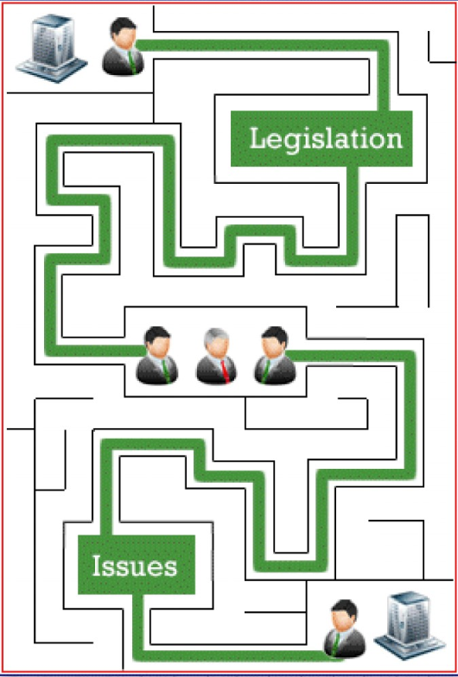
Well, why don’t organizations talk to politicians themselves

Slide 4
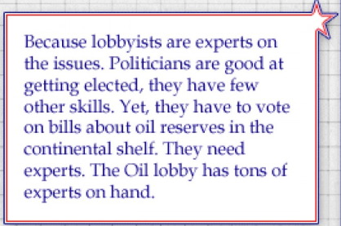
But, why would politicians listen to lobbyist? Obviously they have an agenda
Providing this expertise to Congress goes a long way. It is one way lobbyist can influence Congress- EXPERT INFORMATION

Slide 5
Wait, so if lobbyist are experts on how legislation is done, and experts on the issues, why don’t they just write laws themselves

Slide 7
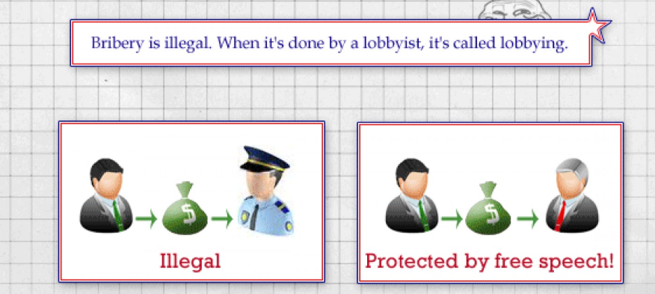
That just sounds like bribery
Ok, hold up. Those are some sneaky tactics. But why would Congress Critter let all this happen?

Slide 8
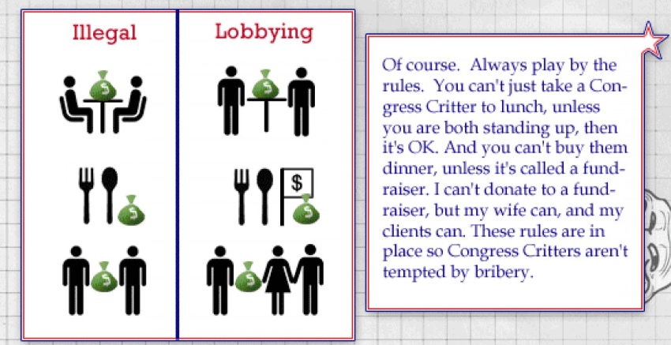
Surely, there are rules against these sort of things

Slide 9
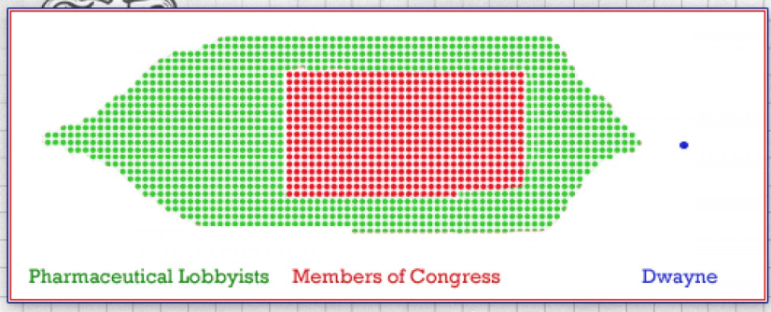
But isn’t there a lobbyist for the other side?
That is ridicules. Who wrote those laws?

Slide 10
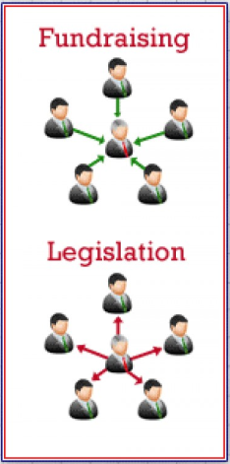
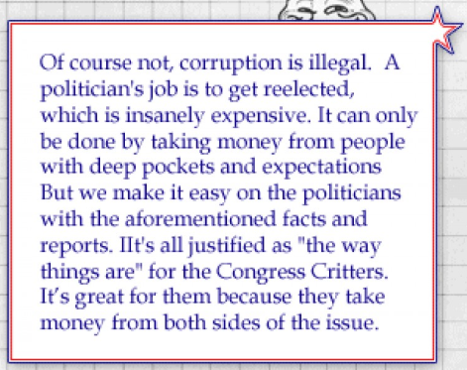
Well, what about all these Congress critters? Are they all just corrupt?
Holy cow, that must cost a fortune?

Slide 11
Wow, so what ever happened to that Pharma Bill?

Slide 12
Wait. Why are you telling me this?
The system is messed up. What can be done to fix it?

