Slide 1
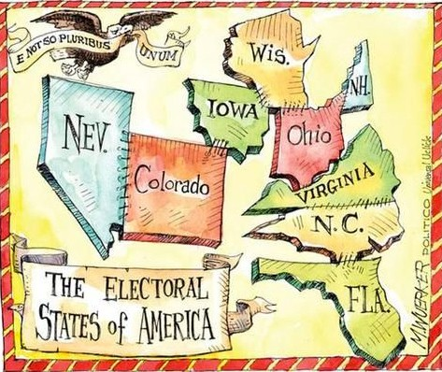
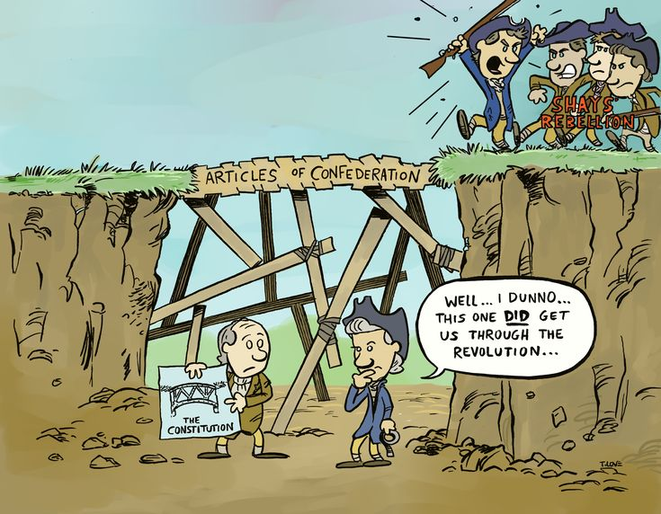
Chpt. 2
Wapples Pages 101-114
AMSCO Pg. 27-50
Required Docs:
Articles of Confederation
The Constitution
Federalist 51
Topic 1.4-1.6 Challenges of the Articles of Confederation

Slide 2
TOPIC 1.4 Challenges of the Articles of Confederation
The Constitution emerged from the debate about the weaknesses in the Articles of Confederation as a blueprint for limited government.
Explain the relationship between key provisions of the Articles of Confederation and the debate over granting the federal government greater power formerly reserved to the states.
Specific incidents and legal challenges that highlighted key weaknesses of the Articles of Confederation are represented by the:
i. Lack of centralized military power to address Shays’ Rebellion
ii. Lack of an executive branch to enforce laws, including taxation
iii. Lack of a national court system
iv. Lack of power to regulate interstate commerce
v. Lack of power to coin money
REQUIRED FOUNDATIONAL DOCUMENT
Articles of Confederation

Slide 3

So what does Goldilocks have to do with our government?

Slide 4
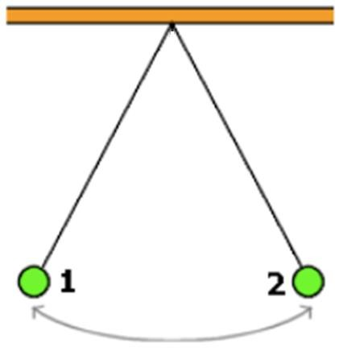

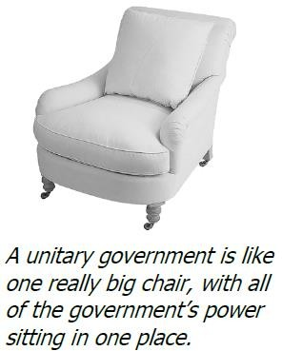
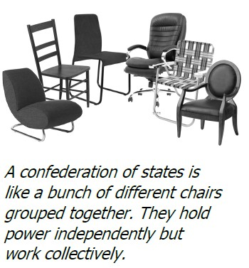
GOLDILOCKS OF GOVERNMENT
TOO STRONG
(KING)
DON’T EVEN GET ME STARTED ON THE FACT THAT GOLDILOCKS WAS A CRIMINAL!!!
4

Slide 5
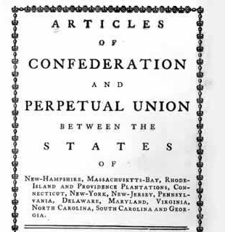
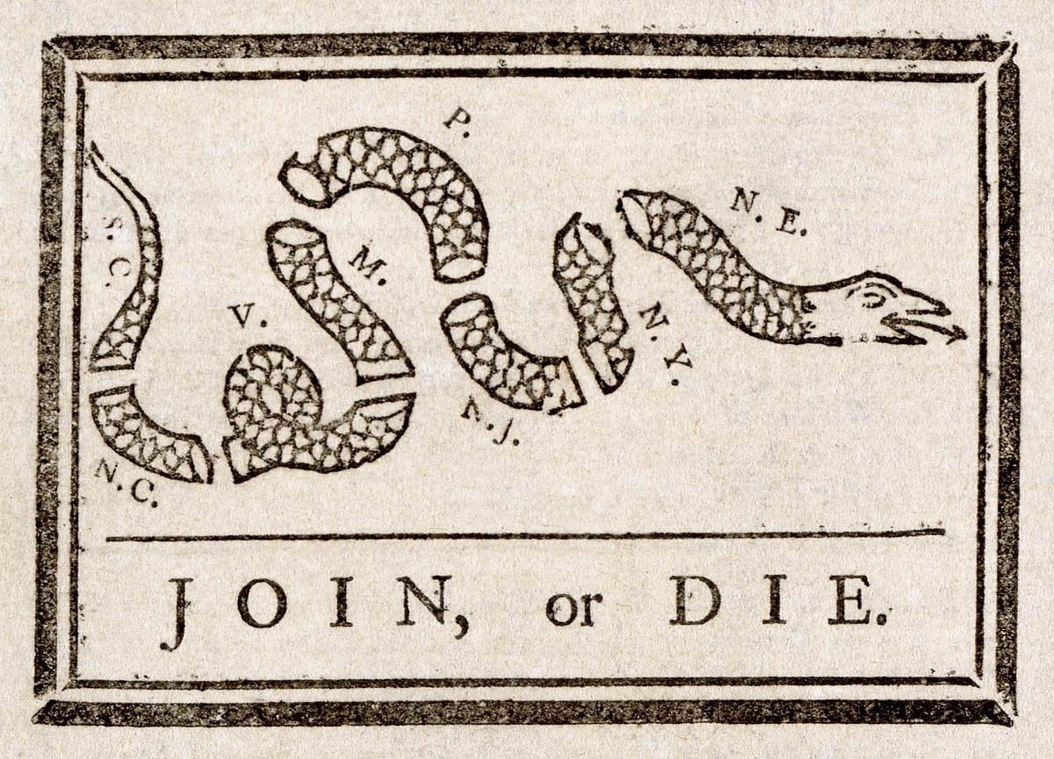
1.4 WHY DID WE COME UP WITH THE ARTICLES OF CONFEDERATION (AND A CONFEDERATION)? AMSCO pg. 27-31
After the Declaration of Independence was signed, the 2nd Continental Congress created the Articles of Confederation on November 15, 1777, but didn’t go into effect until March 1, 1781. It lasted until 1787 when it was replaced by the Constitution.
LOOK AT THE NAME OF OUR COUNTRY
Declaration of Independence >> Revolutionary War >> Articles of Confederation (1781) and its weak central government
U.S. began as a confederation (a “firm league of friendship”)

Slide 6
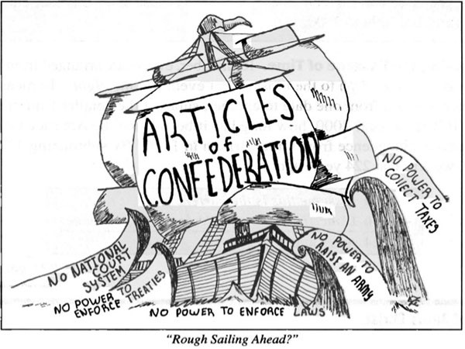
ARTICLES OF CONFEDERATION 1776-1787
“Each state retains its sovereignty, freedom, and independence, and every Power, jurisdiction, and right, which is not by this confederation expressly delegated to the United States, in Congress assembled.”
More power given to the states than the national government and that was a problem
Details of the Articles of Confederation
A very weak central government. With a one chamber legislature (unicameral), the states only had one vote.
National regulation of commerce didn’t exist. This means that the federal government didn’t have their own economic system.
Taxation was dealt with among the states, not the federal government.
Amendment of the Articles must require unanimous consent. Laws required passage by 9 of the 13 states.
No national executive or judicial branch.
Power over the states was nonexistent.
No national currency.

Slide 7
Problems with the Articles of Confederation

Slide 8
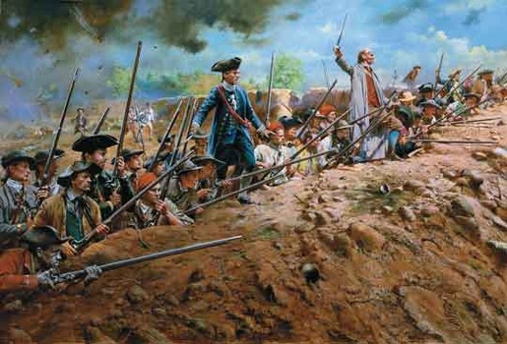
SHAYS' REBELLION August 1786
The national government under the Articles also lacked the power to raise an army or navy. Fears of a standing army in the employ of a tyrannical government had led the writers of the Articles of Confederation to leave defense largely to the states. Although the central government could declare war and agree to peace, it had to depend upon the states to provide soldiers. If state governors chose not to honor the national government’s request, the country would lack an adequate defense.
The weaknesses of the Articles of Confederation became apparent as a result of Shays’ Rebellion. In 1786, farmers in western Massachusetts were heavily in debt, facing imprisonment and the loss of their lands. Many of them were veterans, who owed taxes that had gone unpaid while they were away fighting the British during the Revolution. The Continental Congress had promised to pay them for their service, but the national government did not have sufficient money. Moreover, the farmers were unable to meet the onerous new tax burden Massachusetts imposed in order to pay its own debts from the Revolution.

Slide 9
SHAYS' REBELLION August, 1786
Led by Daniel Shays, the indebted farmers marched to a local courthouse demanding relief. Faced with the refusal of many Massachusetts militiamen to arrest the rebels, with whom they sympathized, the governor of Massachusetts called upon the national government for aid, but none was forthcoming. The uprising was finally brought to an end the following year by a privately funded militia.
Shays’ Rebellion brought home the weaknesses of the Articles of Confederation. The U.S. government had both failed to pay its veterans and failed to raise a militia in order to put down a rebellion. It had become clear the U.S. government’s inability to impose taxes, regulate commerce, or raise an army hindered its ability to defend the nation or pay its debts.
To find a solution, members of Congress called for a revision of the Articles of Confederation. In 1787, delegates from 12 of the 13 states met in Philadelphia to craft a new Constitution.

Slide 10
SHAYS' REBELLION August, 1786
The weak government response to Shay’s Rebellion shifted public opinion towards a stronger central government and a new constitution. Many delegates still hoped to revise the Articles of Confederation but soon realized that a new constitution was needed.

Slide 11

ECONOMIC PROBLEMS UNDER ARTICLES
One of the biggest problems was that the national government had no power to impose taxes. To avoid any perception of “taxation without representation,” the Articles of Confederation allowed ONLY STATE GOVERNMENTS TO LEVY TAXES.
To pay for its expenses, the national government had to request money from the states. The states, however, were often negligent in this duty, and so the national government was underfunded.
Without money, the US government could not pay debts owed from the Revolution or easily secure new funds. Foreign governments were reluctant to loan money to a nation that might never repay it. The fiscal problems of the central government meant that the currency it issued, called the Continental, was largely worthless.
The country’s economic woes were made worse by the fact that the central government also lacked the power to impose tariffs on foreign imports or regulate interstate commerce. Thus, it couldn’t protect American producers from foreign competitors. Compounding the problem, states often imposed tariffs on items produced by other states and otherwise interfered with their neighbors’ trade.
6

Slide 12

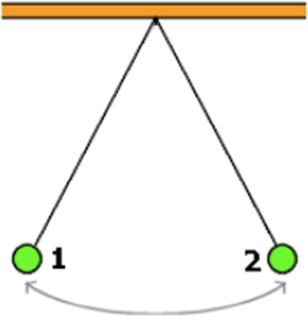
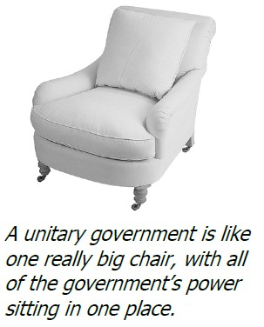
GOLDILOCKS OF GOVERNMENT
TOO STRONG (KING)
TOO WEAK
DON’T EVEN GET ME STARTED ON THE FACT THAT GOLDILOCKS WAS A CRIMINAL!!!
3

Slide 14
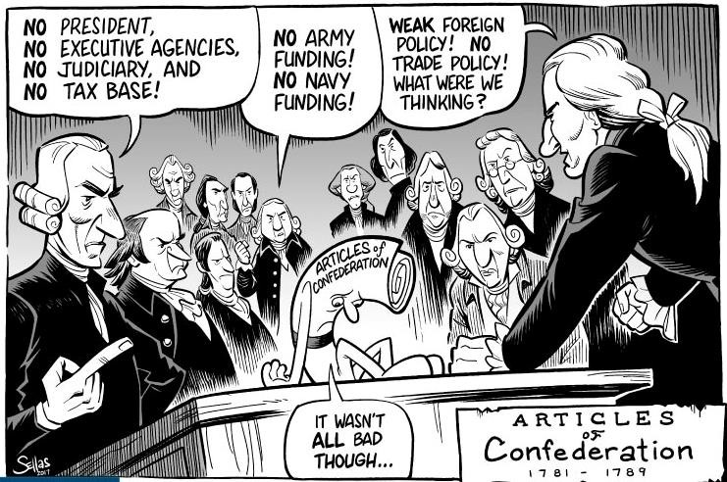
How did the lack of centralized military power (think Shays’ Rebellion) and the lack of tax-law enforcement power highlight key weaknesses of the Articles of Confederation?

Slide 15



So what does Star Wars
have to do with our American Government?
Think about this…
In Star Wars, the Republic was falling apart due to the Clone Wars and was soon reorganized into the Galactic Empire, for a safer and securer society.
With Shays’ Rebellion causing a major pain to the government, the American government soon reformed the Articles of Confederation into the United States Constitution for a safer and securer society.

Slide 16

CONSENSUS – WHAT WERE THE THINGS THAT THEY AGREED UPON AT THE START?
All delegates supported republican government (representative republic); scrap Articles
Common philosophy was a general framework of government favoring the protection of property
States would determine voting qualifications; suffrage for property owners only because they feared that the majority who had no property could out vote property owners and take away all of their property.
Provisions designed to increase the economic powers of the central government
Agreed on national government consisting of a supreme legislative, executive, and judiciary branch
Agreed on the need for a strong executive and an independent judiciary
Stronger national (central) government, but not tyrannical

Slide 17
1.4 The Constitution emerged from the debate about the weaknesses in the Articles of Confederation as a blueprint for limited government.
The Annapolis Convention- Maryland, September 1786
The Annapolis Convention was called in the fall of 1786 to address trade and navigation disputes among states.
Only five of the thirteen states sent representatives. Maryland did not send a rep, despite being the host of the convention.
Despite the poor attendance, delegates to the convention called for a convention in Philadelphia the following spring to discuss how to make the American government more effective in dealing with the challenges of the Articles of Confederations. By this time, many believed the Articles were due for a change, what they would get was the US Constitution. A totally different government.

Slide 18
How did the provisions of the articles of confederation lead to debates over granting powers formerly reserved for states of the federal government? AMSCOP pg. 31
Provisions from the articles of confederation | How the provisions proved to be a weakness
unanimous vote to amend the articles of confederation so all states had a | very difficult to get states with varying interest to agree in order to amend the government
states currency and only voluntary financial assistance from states for the government | lack of tax revenue resulted in financial problems with which states weren't to help
states provide for national defense with militia and no standing federal army | no federal military proved to be a problem when shays rebellion was difficult for the Massachusetts militia to quell

Slide 19
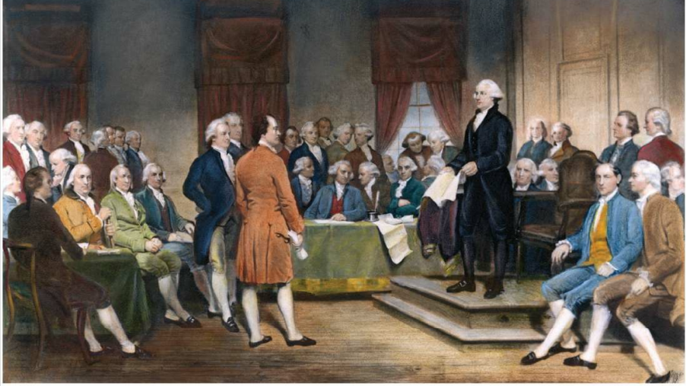
1.5 Ratification of the U.S. Constitution, AMSCO pg. 32-44

Slide 20
TOPIC 1.5 Ratification of the U.S. Constitution
The Constitution emerged from the debate about the weaknesses in the Articles of Confederation as a blueprint for limited government.
Compromises deemed necessary for adoption and ratification of the Constitution are represented by the:
Great (Connecticut) Compromise, which created a dual (bicameral) system of congressional representation with the House of Representatives based on each state’s population and the Senate representing each state equally
ii. Electoral College, which created a system for electing the president by electors from each state rather than by popular vote or by congressional vote
iii. Three-Fifths Compromise, which provided a formula for calculating a state’s enslaved population for purposes of representation in the House and for taxation
iv. Postponing until 1808 a decision whether to ban the importation of enslaved persons
v. Agreement to add a Bill of Rights to address concerns of the Anti-Federalist
Explain the impact of political negotiation & compromise at the Constitutional Convention on the development of the constitutional system.

Slide 21
TOPIC 1.5 Ratification of the U.S. Constitution
The Constitution emerged from the debate about the weaknesses in the Articles of Confederation as a blueprint for limited government.
Explain the impact of political negotiation & compromise at the Constitutional Convention on the development of the constitutional system.
Debates about self-government during the drafting of the Constitution necessitated the drafting of an amendment process in Article V that entailed either a two-thirds vote in both houses or a proposal from two-thirds of the state legislatures, with final ratification determined by three-fourths of the states.
The compromises necessary to secure ratification of the Constitution left some matters unresolved that continue to generate discussion and debate today.

Slide 22
TOPIC 1.5 Ratification of the U.S. Constitution
The Constitution emerged from the debate about the weaknesses in the Articles of Confederation as a blueprint for limited government.
Explain the ongoing impact of political negotiation and compromise at the Constitutional Convention on the development of the constitutional system.
The debate over the role of the central government, the powers of state governments, and the rights of individuals remains at the heart of present-day constitutional issues about democracy and governmental power, as represented by:
Debates about government surveillance resulting from the federal government’s response to the 9/11 attacks
The debate about the role of the federal government in public school education
REQUIRED FOUNDATIONAL DOCUMENT
The Constitution of the United States

Slide 23
Competing interest in early America, AMSCO pg. 33
Issue | Questions Answer | Groups Interested
Representation | Should a states representation be based on population or equal representation for a state regardless of size? | Large versus small states
Slavery | Should enslaved individuals count towards as state’s representation? | Southern states versus Northern states
office of the president | Should there be an executive and should the executive be chosen by a small elite or by a popular vote? | Privileged citizens versus citizens of lower social economic status
Federalism | What is a fair division of power among the levels of government? | Federal government versus state government

Slide 24
CONFLICT AND COMPROMISE – ON THE ISSUE OF REPRESENTATION
The Virginia Plan (favored by more populous states)
Representation in each house based on population and/or monetary contributions to the national government by the state and national legislature (Congress) would have had the power to veto state laws, three-branch system of government, national executive to administer the business of state, a judiciary, and a bicameral or two--house legislature. The people would elect a lower house that would then elect members of an upper house. the national government supreme over the states and offered the ideas for a multitier court system and the separation of powers, defining the distinct responsibilities and limits of each branch to keep any one branch from becoming too powerful.
The New Jersey Plan (favored by small states)
  Representation in house would be equal among the states
The Connecticut Compromise (Great Compromise)
  Created a bicameral congress – two legislative houses
    One house in which representation would be based on population – only form of direct democracy in original Constitution for elected officials (Virginia Plan = House of Representatives) and in which all bills for raising or appropriating money (aka revenue bills) would originate
    Second house in which each state would have an equal vote (New Jersey Plan = Senate)
12

Slide 25
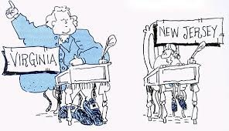
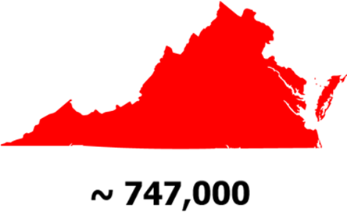

CONFLICT AND COMPROMISE – ON THE ISSUE OF REPRESENTATION
The Virginia Plan (favored by more populous states)
  Representation in each house based on population and/or monetary contributions to the national government by the state
The New Jersey Plan (favored by small states)
  Representation in house would be equal among the states
The Connecticut Compromise
  Created a bicameral congress – two legislative houses
    One house in which representation would be based on population – only form of direct democracy in original Constitution for elected officials (Virginia Plan = House of Reps) and in which all bills for raising or appropriating money (aka revenue bills) would originate
    Second house in which each state would have an equal vote (New Jersey Plan = Senate)
Virginia
Versus
New Jersey

Slide 26
THE GRAND COMMITTEE
Question facing the Convention:
How to apportion representatives in the national legislature?
Answer: Refer to a committee composed of one delegate from each of the eleven states that were present at that time at the Convention. The members of this Grand Committee, in its report to the Convention, offered a compromise.
– The large states had opposed the Connecticut Compromise, because they felt it gave too much power to the smaller states. The Grand Committee's proposal added the requirement that revenue bills originate in the lower house and not be subject to modification by the upper house (although this Origination Clause would later be modified so that revenue bills could be amended in the upper house, or Senate).
13

Slide 27
VIRGINIA PLAN VS. NEW JERSEY PLAN
(Large State Plan vs. Small State Plan)
Description | Virginia Plan | New Jersey Plan
Representation | Representation will be based on population (The bigger the population, the more representation) | Representation would be based on equality (meaning that all the states would have equal representation)
Legislative Branch | Two Houses House of Representative will be voted by the people The Upper House (Senate) will be voted by the House of Rep from nominations by State Legislatures | Continue the unicameral Congress of the Articles of the Confederation
Executive Branch | Chosen by the legislative branch | Chosen by Congress, but would have more than just one president. Have three presidents, one from each region of the U.S.
Judicial Branch | Chosen by the executive branch | Chosen by the executive branch
Would either of these plans work?

Slide 28
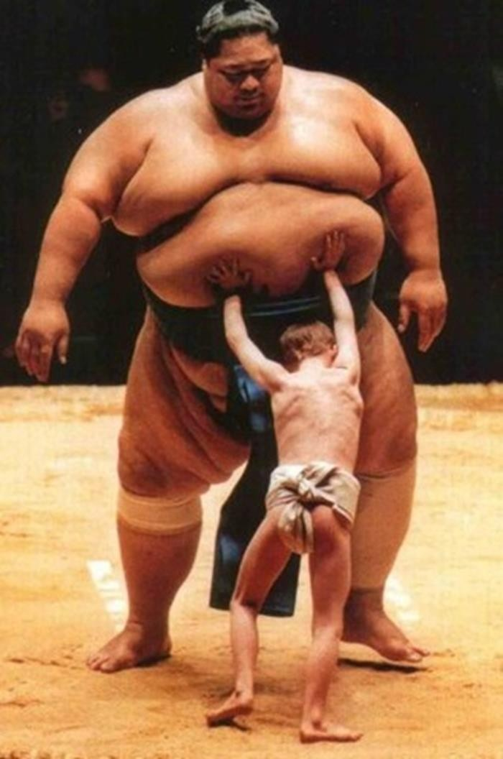




Virginia vs. New Jersey – Population in 1787
Virginia
Who’s going to win every time?
New Jersey

Slide 29
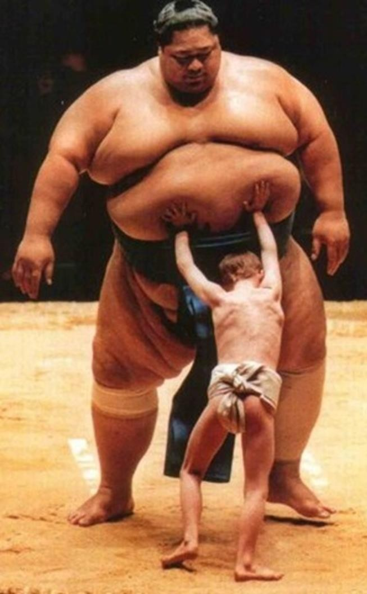

CONNECTICUT (GREAT) COMPROMISE BICAMERAL CONGRESS = TWO HOUSES
One house of Congress based on Virginia Plan – our House of Reps
One house of Congress based on New Jersey
Plan – our Senate
BASED ON POPULATION
BASED ON EQUAL REPRESENTATION

Slide 30

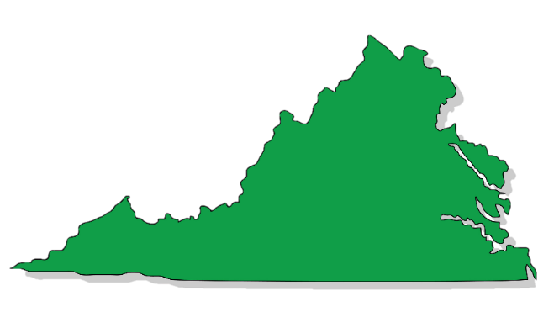

THE GREAT COMPROMISE
Representation will be different among the states. If a state has a large population, they get more representation. Smaller population, you get less representation.
Each state gets 2 senators each no matter how big the state population is.
Both sides couldn’t agree with either plan, until both ideas were combined together.
Connecticut Compromise or Great Compromise
New Jersey
Plan
Virginia Plan
Combing both plans together would create a two chamber (bicameral) house.
The House of Representatives would be based on the Virginia Plan, meaning representation is based on state population.
The Senate would be based on the New Jersey Plan and representation
would be equally divided among the states.

Slide 31
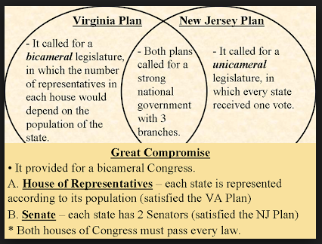
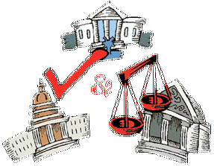

Slide 32
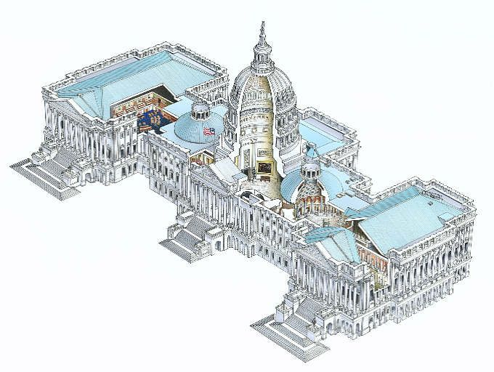
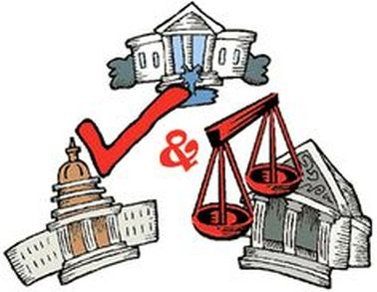
In republican government, the legislative authority necessarily predominates. The remedy for this inconveniency is to divide the legislature into different branches; and to render them, by different modes of election and different principles of action, as little connected with each other as the nature of their common functions and their common dependence on the society will admit … James Madison, Federalist No. 51
The Congress: Bi-Cameral
The House of Representatives
The Senate

Slide 33
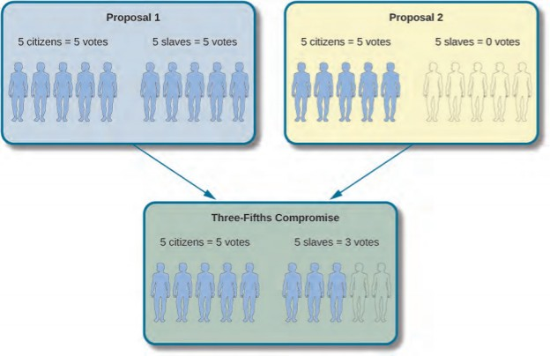
CONFLICT AND COMPROMISE –
NORTH-SOUTH COMPROMISES
Ratification of treaties
  Southern delegates insisted on a
two-thirds vote (supermajority) in the Senate before presidents could ratify treaties
Three-fifths Compromise
  Issue of counting slaves for representation in the House of Representatives
  For every five slaves, they would count as three people for representation in the House
  North happy because South has to pay more taxes
  South happy because they get more reps
Slave Trade Compromise
  Forbidding Congress the power to tax the export of goods from any State, and, for 20 years, the power to act on the slave trade.

Slide 34
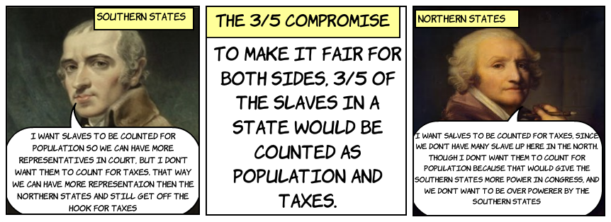
SLAVERY ISSUE
Slave Trade Compromise
An agreement during the Constitutional Convention of 1787 protecting the interests of slaveholders by forbidding Congress the power to act on the slave trade for 20 years.

Slide 35
The Three Fifths Compromise
Question how could the founding fathers who endorsed the idea that all men are created equal also endorse the idea that some men are not?
The 3/5 compromise was an example of difficult but necessary political bargaining. Without the 3/5 compromise north and southern states would have never agreed to form a single union.
3/5 compromise had nothing to do with the human worth of an individual instead it had to do with how many reps each state would have in the house representatives for that purpose southern states could only claim 3/5 of their slave population for representation in the House of Representatives.
Representatives and direct Taxes shall be apportioned among the several States which may be included within this Union, according to their respective Numbers, which shall be determined by adding to the whole Number of free Persons, including those bound to Service for a Term of Years, and excluding Indians not taxed, three fifths of all other Persons. (Slaves were referred to as persons, not slaves). Art I, Sect 2 US Constitution
The Three-Fifths Compromise was that three out of every five slaves would be counted. ... Delegates from states with a large population of slaves argued that slaves should be considered persons in determining representation, (they had no intention of giving slaves any benefit of said representation) but as property if the new government were to levy taxes on the states on the basis of population. The slave holding states wanted it both ways. The compromise gave the slave holding states some added numbers for representation but not the whole number and thus they had to pay less taxes but they also got less representation. It was compromise.
- Dr. Carol Swayne, Vanderbilt University

Slide 36
The 3/5 compromise was devised by those who oppose slavery. In other words, it wasn't the South who wanted to count slaves less than white population it was northern abolitionists.
The southerners wanted to count slaves to the fullest extent- to have more seats in the House of Representatives which means more votes which means more power especially in the Electoral College. To that end southerners wanted more representation but did not want to give the benefits of representation to their slaves as full persons.
Why is this important? In the 1790 census the middle states and New England states had a population of 1.8 million free whites.
Southern states are 1.1 million free whites and 633,000 slaves adding up North and South were nearly equal at 1.8 and 1.7 million respectively
By 1860 on the eve of the civil war the slavery population in the South was 4,000,000. Think about this. How powerful the southern states would have been in Congress (House of Rep) without the 3/5 compromise they would have had a powerful voting bloc plus immense influence on the Electoral College process. The South would have had more VOTES in the House if the slaves were to have been counted as full persons for representation. 3/5 compromise was done to limit the south’s influence in the House.
Why didn’t the north insist that the South not count slaves at all. Because the slave states would never have joined the union. Instead, we would have had two nation-states one free, one slave living side-by-side in constant conflict.
The 3/5 compromise was a solution to the most difficult challenge the framers face. How to create a single country out of a people so divided on such a fundamental issue.
Source: Dr. Carol Swain, professor of political science and professor of law at Vanderbilt University

Slide 37
CONFLICT AND COMPROMISE – THE PRESIDENT
Method of election:
  Some wanted election by Congress
  Some wanted election by state legislatures
  Some wanted direct election-POPULAR ELECTIONS
  Compromise: Electoral College system; created for two reasons
    First - Buffer between the people and the selection of a President
      The founding fathers were afraid of direct election of presidency
      Feared a tyrant could manipulate public opinion & come to power, vast majority of people were uneducated.
    Second - Structure of the government that gave extra power to the smaller states
      Small states had more power in selection of president
      Under the system of the Electoral College each state had the same number of electoral votes as they have representative in Congress, thus no state could have less then 3 >> disproportionate power to the smaller states. To avoid Tyranny of the majority. ELITE DEMOCRACY
18

Slide 38
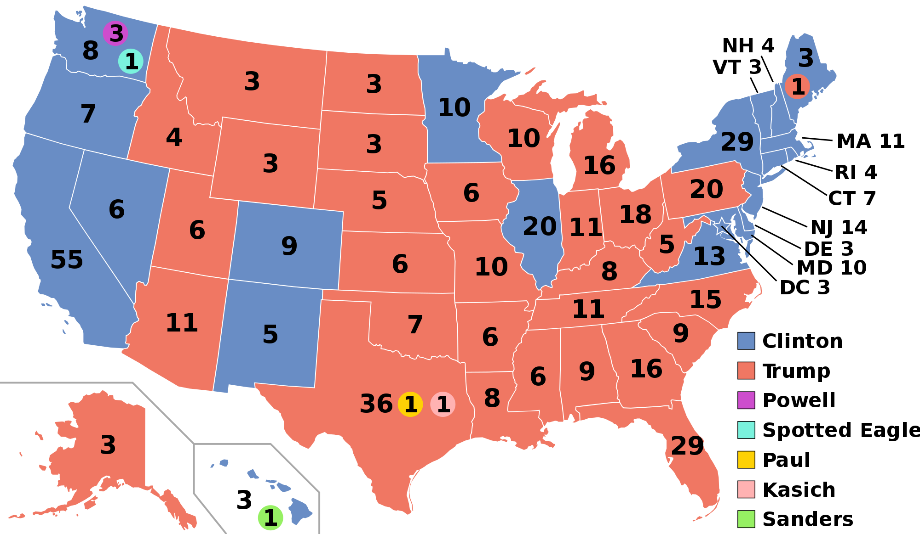
ELECTORAL COLLEGE
With Presidential Elections, the Founding Fathers believed that the average American was not well educated enough and couldn’t trust them to elect a president.
Founders created the Electoral College, which created electors in each state (# House Members + 2 Senators = Number Electoral vote) will cast votes.
Popular helps elect the electors, but many Americans believe that their vote doesn’t matter. Why?

Slide 39
What is a Typical Presidential Election Cycle?
The presidential election process follows a typical cycle:
Spring of the year before an election – Candidates announce their intentions to run.
Summer of the year before an election through spring of the election year primary and caucus debates take place.
January to June of election year – States and parties hold primaries and caucuses.
July to early September – Parties hold nominating conventions to choose their candidates.
September and October – Candidates participate in presidential debates.
Early November (8) – Election Day. Popular vote. The people are actually voting for electors.
December (26-28?) – Electors cast their votes in the Electoral College.
Early January (5, 6 or 7) of the next calendar year – Congress meets in joint session to count the electoral votes.
January 20 – Inauguration Day

Slide 40


If the Founding Fathers created a perfect Constitution, why did they allow us to change it?
An amendment is a change or addition to the Constitution.
When drafting the Constitution, the Framers detailed an amendment process in Article V that gave citizens avenues to change the Constitution.

Slide 41

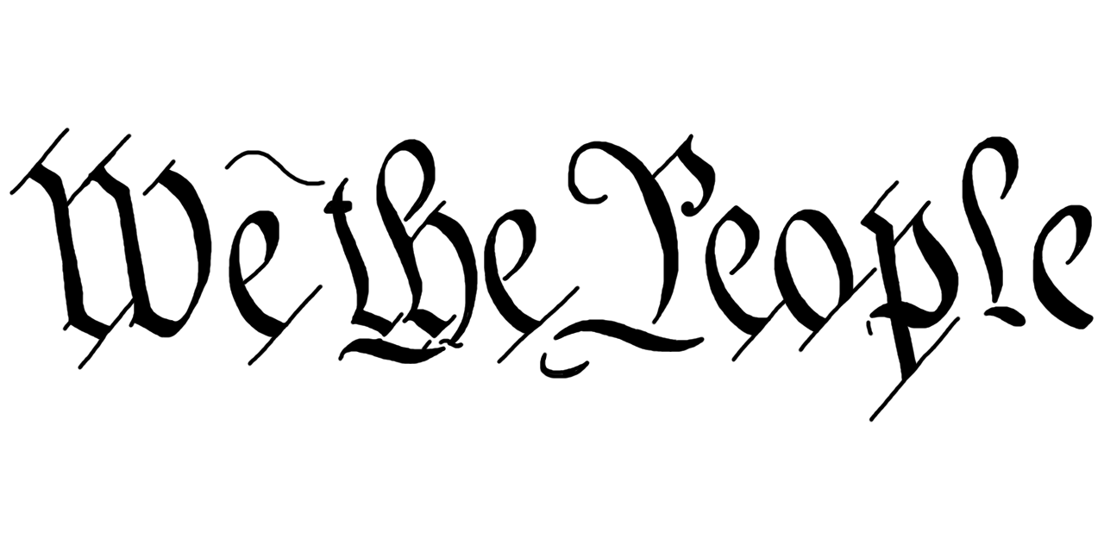
Popular Sovereignty
The framers attempted to legitimize the Constitution through an appeal to POPULAR SOVEREIGNTY.
Required Document
You must know each Article title

Slide 42
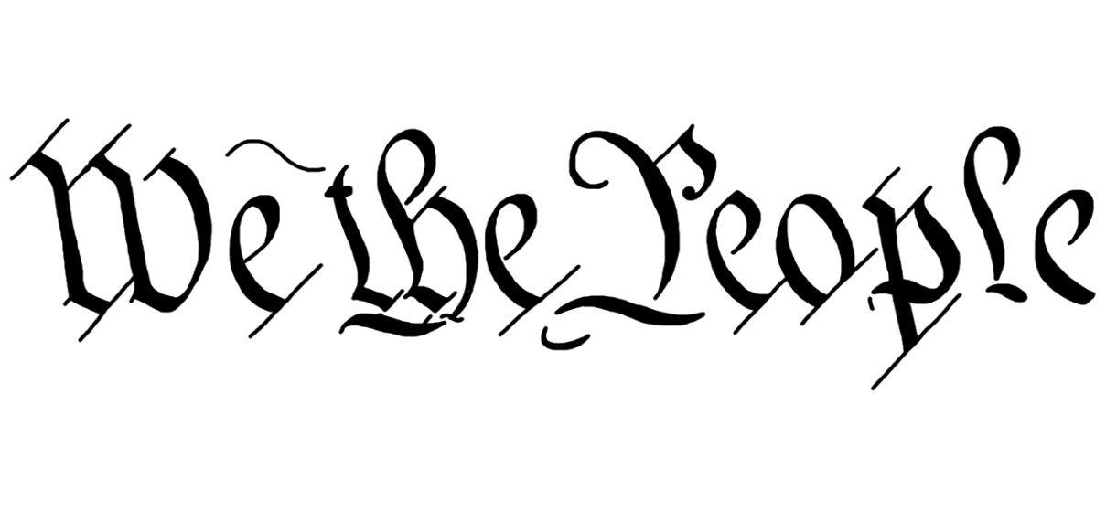
Popular Sovereignty
"We the People of the United States, in Order to form a more perfect Union, establish Justice, insure domestic tranquility, provide for the common defense, promote the general welfare, and secure the Blessings of Liberty to ourselves and our Posterity, do ordain and establish this Constitution for the United States of America."
in Order to form a
more perfect Union
establish Justice
insure domestic
tranquility
provide for the common defense
promote
the general welfare
and secure the Blessings of Liberty
to ourselves and our Posterity
What are the 5 objectives of the Constitution as outlined in the preamble?

Slide 43

MAKE EVERYONE HAPPY!!!
Bill of Rights
MUST know the Bill of Rights
Freedom of speech, religion, assembly, and press, petition
Right to bear arms
No quartering of troops
Right from illegal search and seizures
Due process, self-incrimination
Right to a fair trial
Civil suits
No cruel and unusual punishment
Individual rights
Power is reserved to the States
To make the Anti-Federalists
happy, the Federalists would create the Bill of Rights, which were a set of guaranteed liberties that the government could not take away from the American people, which didn’t go into eﬀect until 1791.

Slide 44
WHY DO WE NEED AN AMENDMENT PROCESS?
The Constitution of the United States was ratiﬁed in 1789, making it 229 years old, the oldest constitution in the modern world. It was created for our “posterity” (think Preamble).
The Framers could not have foreseen the changes the United States would experience.
  What can we do to update the Constitution to address these new issues?
  Solution: citizens could add changes to the Constitution.
Process for amending, or changing, the Constitution in Article V.
  Framers intended for the amendment process to be diﬃcult but not impossible.
  Although the federal government could propose amendments, three- fourths of states have to ratify every amendment (federalism).

Slide 45
CHANGING THE LETTER OF THE CONSTITUTION WHAT IS A FORMAL AMENDMENT?
Amendment - Written changes that are added to the Constitution. That means that we have 27 formal amendments.
Constitution should not change as an expression of basic and timeless personal liberties, but should adapt to changing conditions (amendment process)
Legacy of the Articles: Unanimous vote to amend >> impractical >> desire to make process easier, but not too easy
Process of amending reflects FEDERAL SYSTEM (Congress and the States are involved in this process)
First 10 formal amendments = Bill of Rights >> some rights are fundamental and should not be subject to majoritarian control
45

Slide 46
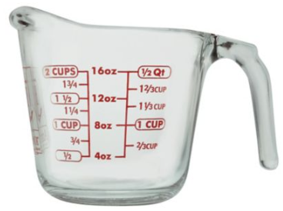
PROPOSING AND RATIFYING FORMAL AMENDMENTS, AMSCO Pg. 39-40
Proposed by 2/3 vote of each house of Congress
➔➔➔ Ratiﬁed by 3/4 of the state legislatures – used 26 times
Proposed by 2/3 vote of each house of Congress
➔➔➔ Ratiﬁed by special conventions in at least 3/4 of the states – used once (21st Amendment)
  A more directly democratic way. People elect delegates who state their positions on the proposed amendment. Citizens are in essence casting their votes on the amendment by voting for the appropriate delegates. Example, 21st Amendment, repeal of Prohibition, 18th amendment
2/3
FEDERALISM
3/4
7

Slide 47
The Congress, whenever two thirds of both houses shall deem it necessary, shall propose amendments to this Constitution, or, on the application of the legislatures of two thirds of the several states, shall call a convention for proposing amendments, which, in either case, shall be valid to all intents and purposes, as part of this Constitution, when ratified by the legislatures of three fourths of the several states, or by conventions in three
fourths thereof, as the one or the other mode of ratification may be proposed by the Congress; provided that no amendment which may be made prior to the year one thousand eight hundred and eight shall in any manner affect the first and fourth clauses in the ninth section of the first article; and that no state, without its consent, shall be deprived of its equal suffrage in the Senate.
—United States Constitution, Article V
Which of the following principles is reflected in Article V?
A. checks and balances
B. separation of powers
C. federalism
D. popular sovereignty

Slide 48
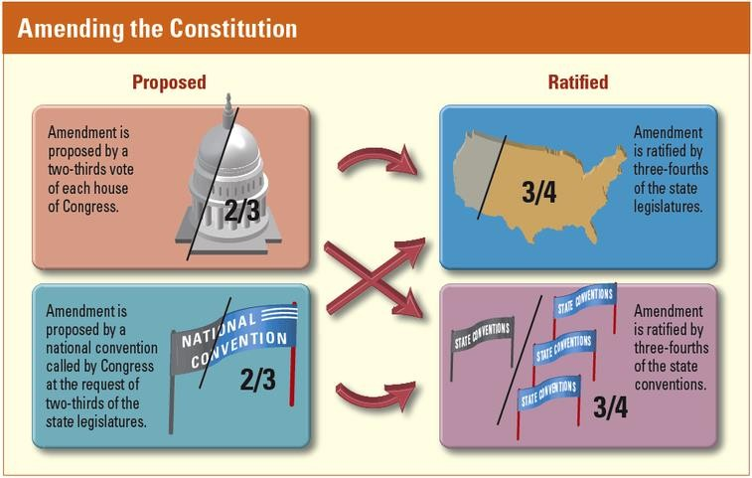
ESSENTIAL QUESTION
What process has been used to pass all but one of the amendments to the Constitution? How does this reflect federalism?

Slide 49
INFORMAL AMENDMENTS
What?
  DEFINITION - Changes to the Constitution that do not involve actually changing the wording of the Constitution
  Alters the meaning of the words already in the Constitution without amending it
  Ex. Judicial Review
Why?
  “Constitution belongs to the living, not the dead” (Jeﬀerson)
– gets new blood over time (laws, amendments)
  Jeﬀerson believed each generation might need new Constitution.
  This hasn’t occurred because of the informal changes that have allowed the Constitution to adapt to changing times(especially with Congress’ use of implied powers)
13

Slide 50
INFORMAL AMENDMENTS
CONGRESSIONAL ACTIONS
  Congress has passed laws that reinterpret and expand Constitutional provisions
    e.g., Commerce Clause allows Congress to regulate and promote interstate and international commerce
    Over time, Congress has passed many laws that deﬁne the Commerce Clause, including regulations on forms of commerce that didn’t exist in 1789, such as railroad lines, air routes, and internet traﬃc
14

Slide 51
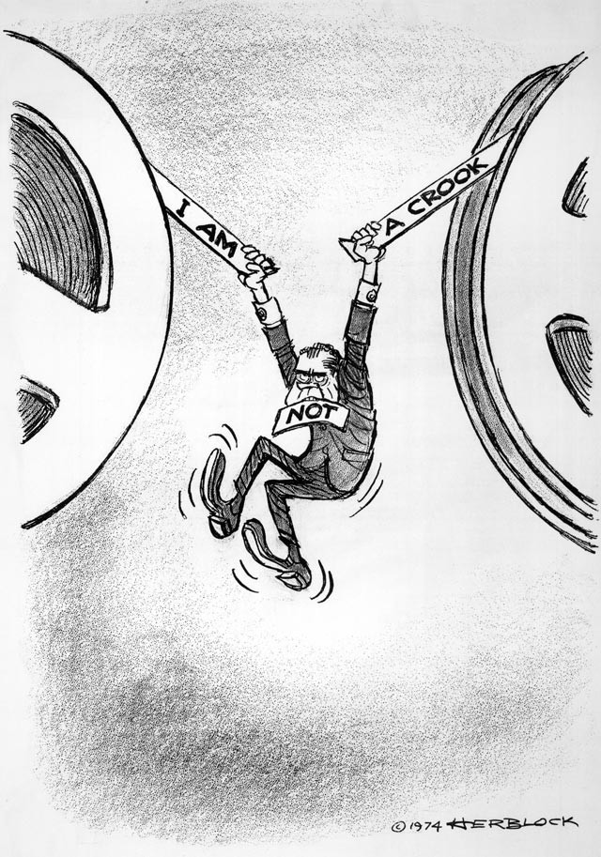
INFORMAL AMENDMENTS
PRESIDENTIAL ACTIONS
  Executive privilege/executive orders (latter has the force of law)
  Executive agreements with other countries
  Right to send armed forces into hostilities
  Right to propose legislation to Congress and work to secure its passage
15

Slide 52
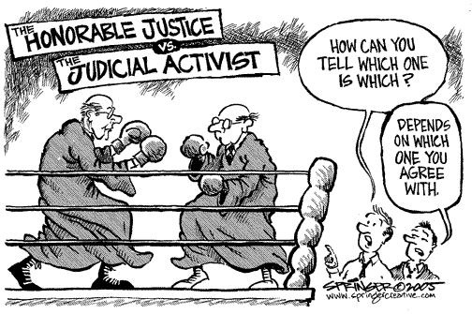
INFORMAL AMENDMENTS
JUDICIAL ACTIONS
  The judiciary has been the most inﬂuential in interpreting the Constitution
  Article III deﬁnes the power of the judiciary very broadly, but does not speciﬁcally mention judicial review
  Supreme Court has changed constitutional interpretations to reﬂect new social economic conditions (Brown v. Board, Texas v. Johnson)
16

Slide 53
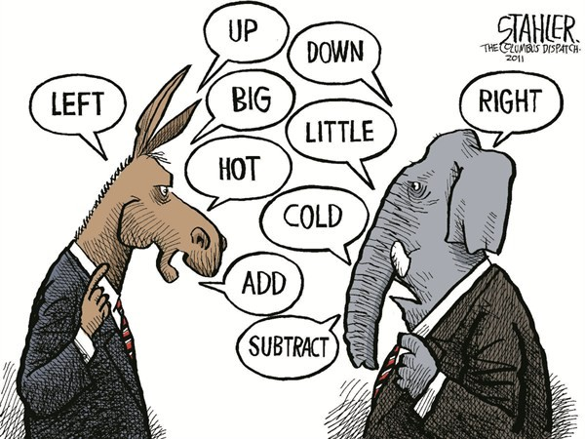
INFORMAL AMENDMENTS
CUSTOM AND USAGE
  Has democratized our Constitution (presidential and vice-presidential TV debates)
  Examples - Cabinet, political parties, committee system in Congress, senatorial courtesy, legislative veto, presidential nominating conventions
17

Slide 54


ESSENTIAL QUESTION CFU
How have informal amendments to the Constitution alleviated the need for a new constitution every generation?

Slide 55
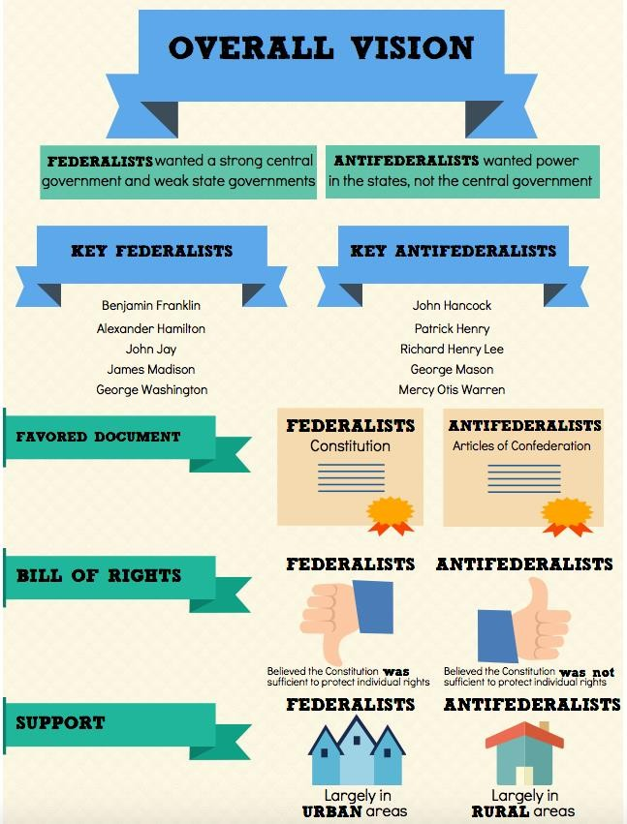

Slide 56
ESSENTIAL QUESTION CFU
Explain how the following compromises were deemed necessary for adoption and ratification of the Constitution.
Great (Connecticut) Compromise
Electoral College
Three-fifths Compromise
Compromise on the importation of slaves
Explain how these compromises necessary to secure ratification of the Constitution left some matters unresolved that continue to generate discussion and debate today (think Electoral College). Identify issues left unresolved by the original Constitution.
Slavery was allowed to continue, and the slave trade was allowed to continue for 20 years, after which it could be banned (it was).The proper balance between states and the federal government as well as the balance between individual rights and governmental power both continue to be debated today. Patriot Act, Fed gov involvement in public education-NCLB Act. From the ULTIMATEREVEIWPACKET.COM
22

Slide 57
TO ADOPT OR NOT TO ADOPT?
FEDERALISTS VS. ANTIFEDERALISTS
Main debate was primarily about the scope of power of the central government
  The Federalists wanted a stronger national government and weaker state governments (balanced relationship between federal and state governments)
  The Anti-federalists wanted a weaker national government and stronger state governments
Federalists:
  Views
    Elites most fit to govern
    Feared “excesses” of democracy; mobacracy
    Favored strong central government
Antifederalists:
  Views
    Feared concentration of power in hands of elites; Believed that government should be closer to the people
    Feared strong central government, favored stronger state governments
    Feared the lack of Bill of Rights (which would be added later to protect individual liberty) – their strongest argument
The Federalist essays (written by Alexander Hamilton, James Madison, and John Jay) helped the ratification process
The Anti-Federalist response was written in a series of essays by Brutus
20

Slide 58
RATIFICATION – THE GREAT DEBATE
Federalist versus Anti-Federalists (4:44)
BILL OF RIGHTS – THE FINAL COMPROMISE
At stake – individual rights and the role of the national government in economic development
One of the many points of contention between Federalists, who advocated a strong national government, and Anti-Federalists, who wanted power to remain with state and local governments, was the Constitution’s lack of a bill of rights that would place specific limits on government power. Federalists argued that the Constitution did not need a bill of rights, because the people and the states kept any powers not given to the federal government. Anti-Federalists held that a bill of rights was necessary to safeguard individual liberty from the newly created federal government.
Madison, then a member of the U.S. House of Representatives, altered the Constitution’s text where he thought appropriate. However, several representatives, led by Roger Sherman, objected, saying that Congress had no authority to change the wording of the Constitution. Therefore, Madison’s changes were presented as a list of amendments that would follow Article VII.
The House approved 17 amendments. Of these, the Senate approved 12, which were sent to the states for approval in August 1789. Ten amendments were approved (or ratified). Virginia’s legislature was the final state legislature to ratify the amendments, approving them on December 15, 1791.

Slide 59
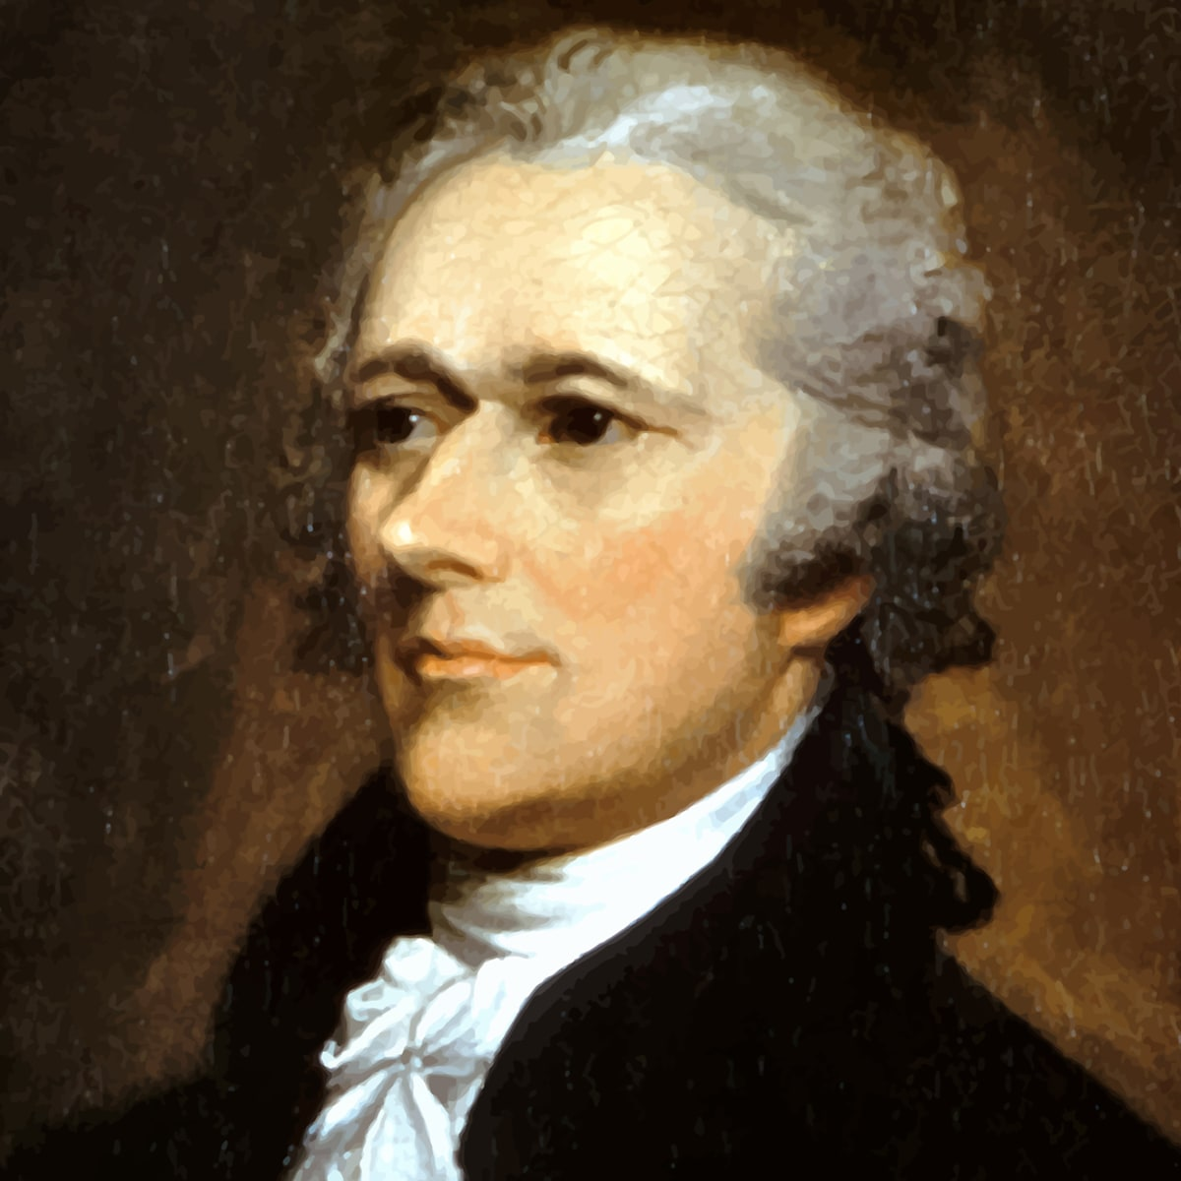
Alexander Hamilton- a Federalist
Why not a Bill of Rights?
I go further, and affirm that bills of rights, in the sense and in the extent in which they are contended for, are not only unnecessary in the proposed constitution, but would even be dangerous. They would contain various exceptions to powers which are not granted; and on this very account, would afford a colourable pretext to claim more than were granted. For why declare that things shall not be done which there is no power to do? Why for instance, should it be said, that the liberty of the press shall not be restrained, when no power is given by which restrictions may be imposed? I will not contend that such a provision would confer a regulating power; but it is evident that it would furnish, to men disposed to usurp, a plausible pretence for claiming that power.
—Alexander Hamilton, The Federalist paper number 84

Slide 60

FEDERALISTS VS. ANTI-FEDERALISTS
Federalist No. 10 and Brutus No. 1 show how Federalists and Anti-Federalists had different opinions on how strong the federal government should be. (We will look at this in the next lesson in depth.)
Federalist No. 10:
an essay written by James Madison
argued that a strong central government will control the effects of factions (groups) because it is large and pluralist
argued that a large republic could control “mischiefs of faction” and distribute power between the federal government and the states evenly
Brutus No. 1:
an Anti-Federalist essay
argued against a strong central government, based on the belief that it would not be able to meet the needs of all US citizens
argued that a powerful, centralized government was too far removed from individual citizens to meet their needs

Slide 61
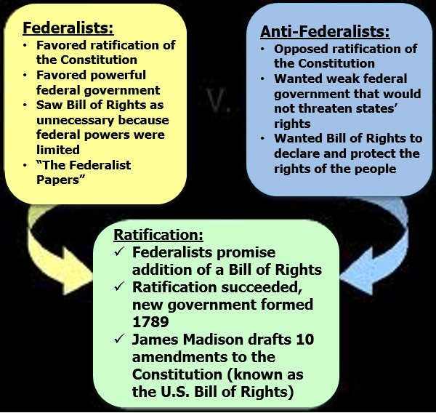
Federalist v. Anti- Federalist

Slide 62
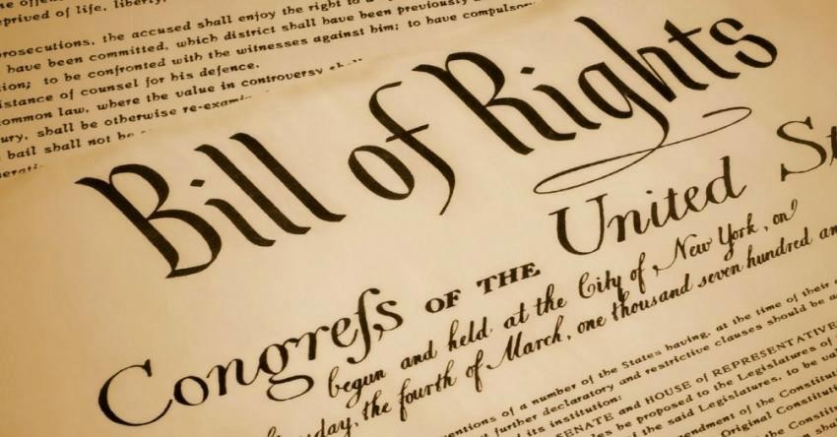
Conflict would be rectified by adding a bill of rights to the Constitution
The Bill of Rights was added to the Constitution in 1791
26

Slide 63
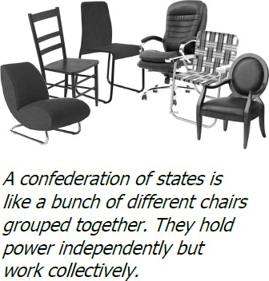
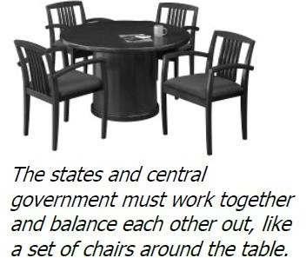
GOLDILOCKS
OF GOVERNMENT
TOO STRONG (KING)
TOO WEAK (ART OF CONF)
JUST RIGHT (CONSTITUTION)
27

Slide 64
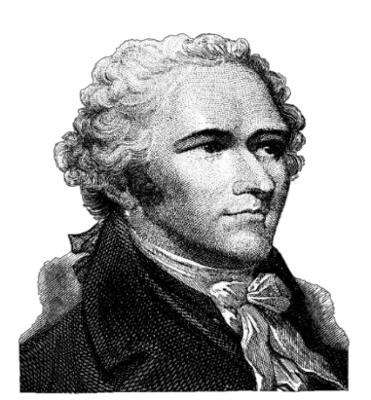
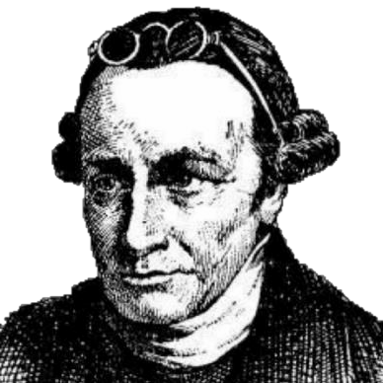
ESSENTIAL QUESTION CFU
Explain how the Federalists and Anti-Federalists each felt about ratification of the new constitution.
Alexander Hamilton Federalist
Patrick
Henry
Anti-Federalist
DESCRIPTION | FEDERALIST | ANTI-FEDERALIST
Leaders | James Madison, Alexander Hamilton, and John Jay | Patrick Henry, Richard Henry Lee and George Mason
Backgrounds | Large landowners, wealth merchants, and professionals | Smaller farmers, shopkeepers, and laborers
Government Preferred | Weaker state gov’t Strong national gov’t Indirect election of officials Longer terms Gov’t by the elite Expected few violations of individual liberties | Strong state gov’t Weak national gov’t Direct election of officials Shorter terms Rule by the common man Strengthened protections for individual liberties

Slide 65
Practice FRQ
The framers of the Constitution devised a federal system of government that affected the relationship between the national and state governments.
(a) Compare state sovereignty under the Articles of Confederation and under the Constitution.
PPT continues…..

Slide 66
Types of Governments- define each term
Dictatorship Oligarchy
Despot(ism) Anarchy
Tyrant Theocracy
Totalitarian
Autocracy (Autocratic)
Authoritarianism
Krytocracy
Plutocracy
Kleptocracy
Monarchy
Republic (Representative Democracy)
Democracy

Slide 67

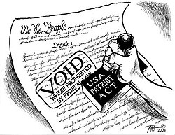
Even today, some of the issues at the heart of the debates at the Constitutional Convention still exist.
GOVERNMENT SURVEILLANCE
USA PATRIOT ACT (Uniting and Strengthening America by Providing Appropriate Tools Required to Intercept and Obstruct Terrorism) - 2001
The law covered intelligence gathering and sharing by executive branch agencies, points of criminal procedure, and border protection. It also widened authority on tapping suspects’ phones.
Soon, people began to question the law's constitutionality and its threat to civil liberties.
Some of the most controversial parts of the Patriot Act surround issues of privacy and government surveillance. The Fourth Amendment to the U.S. Constitution protects the "right of the people to be secure in their persons, houses, papers, and eﬀects, against unreasonable searches and seizures . . . ." It requires law- enforcement oﬃcers to obtain warrants before making most searches.
Does the government have the right to collect phone and internet data from individuals?

Slide 68
Constitutional Debates Today
The debate over the role of the central government, the powers of state governments, and the rights of individuals remains at the heart of present-day constitutional issues about democracy and governmental power, as represented by:
Debates about government surveillance resulting from the federal government’s response to the 9/11 attacks
The debate about the role of the federal government in public school education
PATRIOT ACT, 2001
Some argue that the fourth amendment, which says the government cannot conduct a search without obtaining a warrant and showing probable cause to believe that the person has committed or will commit a crime has been violated.
Also, violates the first amendment by effectively authorizing the FBI to launch investigations of American citizens in part for exercising their freedom of speech.
No Child Left Behind Act, 2002- The increasing role of the federal gov in education, a policy mostly left to the states
NCLB called for improvements in teaching methods, testing to measure progress, and sanctions for underperforming schools.
The Healthy, Hunger-Free Kids Act changed nutrition standards for the National School Lunch Program by requiring that schools serve more fruits, vegetables, whole grains and fat-free and/or low-fat milk more frequently and less starchy vegetables or foods high in sodium and trans fat (including vending machines). School districts faced loss of federal tax money (grants) for school lunches if they refused.
ESSA Act- Every Student Succeed Act- (replaced NCLB)- gave more power to the states over education.

Slide 69
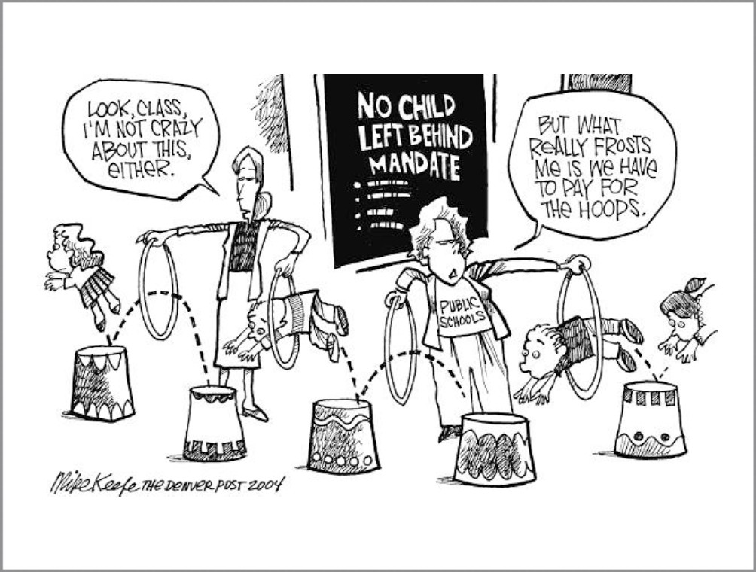
Even today, some of the issues at the heart of the debates at the Constitutional Convention still exist.
PUBLIC EDUCATION
No Child Lev Behind Act – 2001
An act to close the achievement gap with accountability, ﬂexibility, and choice, so that no child is lev behind.
States must adopt education accountability standards. States must annually test students. Sanctions against schools that fail to meet adequate yearly progress.
NCLB was criticized for growing the federal footprint in K-12 education.
Education advocates also claim the law has been underfunded.
Does the federal government have the right to play a role in education in America?

Slide 70
TOPIC 1.6 Principles of American Government, AMSCO pg. 45-50
The Constitution created a competitive policy-making process to ensure the people’s will is represented and that freedom is preserved
Explain the constitutional principles of separation of powers and “checks and balances.”
The specific and separate powers delegated to Congress, the president, and the courts allow each branch to check and balance the power of the other branches, ensuring no none branch becomes too powerful.
Federalist No. 51 explains how constitutional provisions of separation of powers and checks and balances control abuses by majorities.
Explain the effects of separation of powers and
checks and balances for the U.S. political system.
Separation of powers and checks and balances creates multiple access points for stakeholders and institutions to influence public policy.
Impeachment, removal, and other legal actions taken against public officials deemed to have abused their power reflect the purpose of checks and balances.
REQUIRED FOUNDATIONAL DOCUMENTS
Federalist No. 51
The Constitution of the United States

Slide 71
TOPIC 1.6 Principles of American Government, AMSCO pg. 45-50
The Constitution created a competitive policy-making process to ensure the people’s will is represented and that freedom is preserved
Explain the effects of separation of powers and
checks and balances for the U.S. political system.
Separation of powers and checks and balances creates multiple access points for stakeholders and institutions to influence public policy.
Checks and balances and separation of powers allow legal actions to be taken against public officials deemed to have abused their power. Those legal actions include the process of impeachment (the House formally charges an official with abuse of power or misconduct) and removal (if the official is convicted in a Senate impeachment trial).
REQUIRED FOUNDATIONAL DOCUMENTS
Federalist No. 51
The Constitution of the United States

Slide 72
TOPIC 1.6 Principles of American Government, AMSCO pg. 45-50
The Constitution created a competitive policy-making process to ensure the people’s will is represented and that freedom is preserved
The powers allocated to Congress, the president, and the courts demonstrate the separation of powers and checks and balances features of the Constitution.
Explain the constitutional principles of separation of powers and “checks and balances.”
Federalist No. 51 explains how constitutional provisions of separation of powers and checks and balances control abuses by majorities.
Multiple access points for stakeholders and institutions to influence public policy flows from the separation of powers and checks and balances
Impeachment, removal, and other legal actions taken against public officials deemed to have abused their power reflect the purpose of checks and balances.
REQUIRED FOUNDATIONAL DOCUMENTS
Federalist No. 51
The Constitution of the United States

Slide 73
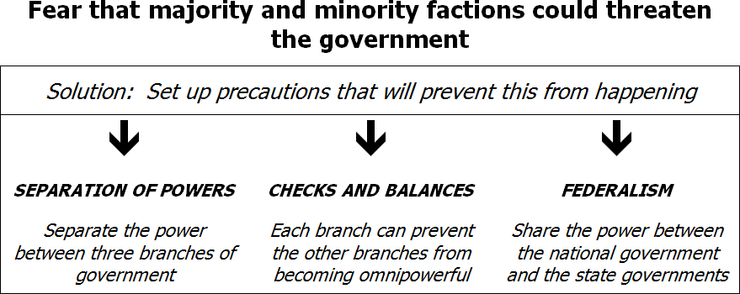
Madisonian’s 3 Part MODEL In Preventing Tyranny
9

Slide 74
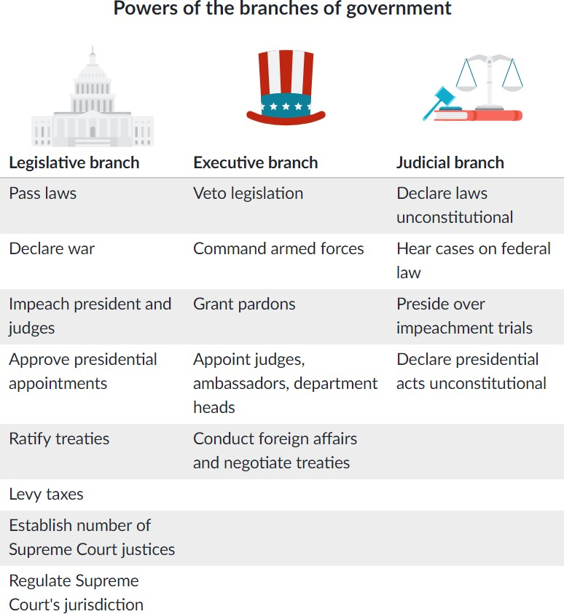
Separation of Powers
Three Branches of Government
Separation of Powers
Checks & Balances

Slide 75
In republican government, the legislative authority necessarily predominates. The remedy for this inconveniency is to divide the legislature into different branches; and to render them, by different modes of election and different principles of action, as little connected with each other as the nature of their common functions and their common dependence on the society will admit … James Madison, Federalist No. 51
The Congress: Bi-Cameral, Federalist 51
According to Madison the legislative Branch would be the strongest branch, making It bi-cameral would serve as a check within the the branch, leading to slower more deliberate legislative process
The Senate
The House of Representatives

Slide 76
SEPARATION OF POWERS
After the Revolutionary War, the writers of the Constitution knew that the best system of government would involve a separation of powers. They gave the new government three branches. The framers assigned the legislative, executive, and judicial branches distinct responsibilities to dilute power among the three branches. Each one would have its own jobs and responsibilities. The three branches of the U.S. government are the legislative, executive, and judicial. The Constitution describes the duties that each branch has and the titles of the people who carry out these duties.
The legislative branch makes laws for the nation. In the United States the legislative branch is called Congress. Congress is bicameral, it has two parts – the House of Representatives and the Senate.
The executive branch makes sure that the laws of the country are obeyed. The President is the head of the executive branch. He is also known as the Chief Executive of the country. The executive branch is very large because many people and groups are needed to help the President. The Vice President is the President’s main helper. Others who assist are the President’s Cabinet.
The judicial branch answers questions about the meaning of laws and whether or not they follow the constitution. The highest court in the judicial branch is called the Supreme Court. Nine judges, or justices, make decisions about laws and other court matters. The head of the Supreme Court is called the Chief Justice.

Slide 77
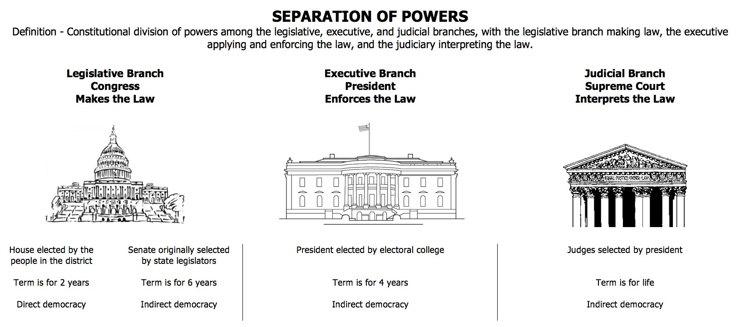
Federalist No. 51
11

Slide 78
WHAT WAS ONE OF MADISON'S THREE AUXILIARY PRECAUTIONS TO PREVENT TYRANNY?
CHECKS AND BALANCES- The ability of each branch to limit each other’s powers
Power struggles among three branches (especially Congress and the president)- interactions among the branches.
A majority of the voters can win control over only part of the government at one time. Staggering of terms within each branch, e.g. midterm congressional elections can serve as a check of the executive.
Independent national courts are provided
Political independence within each branch: no branch is dependent upon the other two for election (exception: judges are appointed by President and confirmed in the Senate) and continuance in oﬃce (life terms for judges ameliorate presidential inﬂuence)
The U S constitution establishes a system of checks and balances among branches of government and allocates power between federal and state governments. This system is based on the rule of law and the balance between majority rule and minority rights.
14

Slide 79
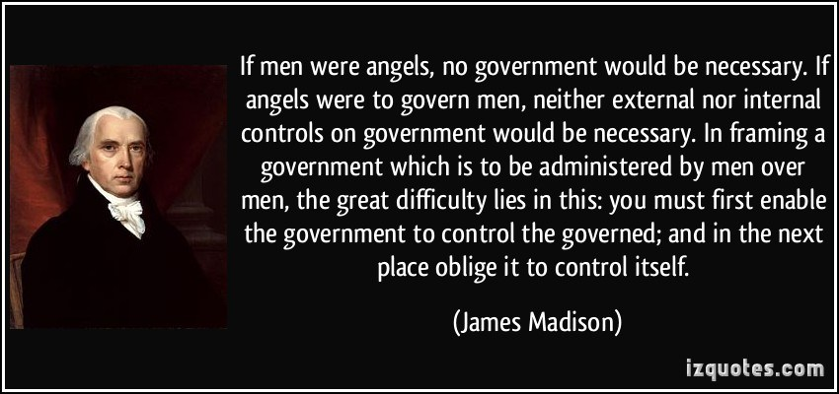
Federalist No. 51

Slide 80

Impeachment
CHECKS AND BALANCES
Photo Credit: Nancy Lehrer

Slide 81

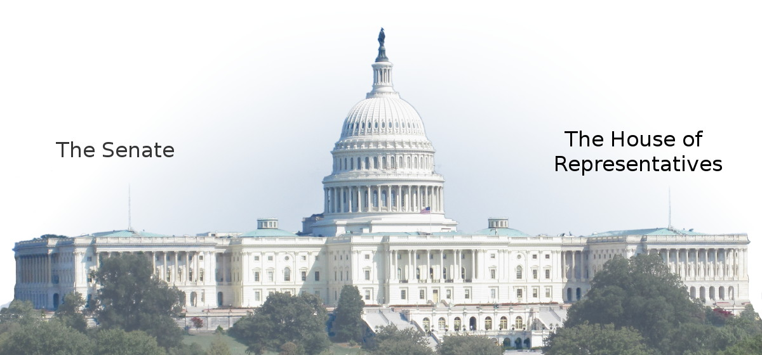
Impeach- to be accused of a crime. The House of
Representatives holds vote to determine if a crime
has been committed-INDICTMENT
If the House votes yes, the trial is held in the Senate with the Chief Justice presiding. Senators are the jury.
If the majority in the Senate votes yes, the President is removed from office.

Slide 82
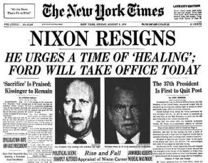
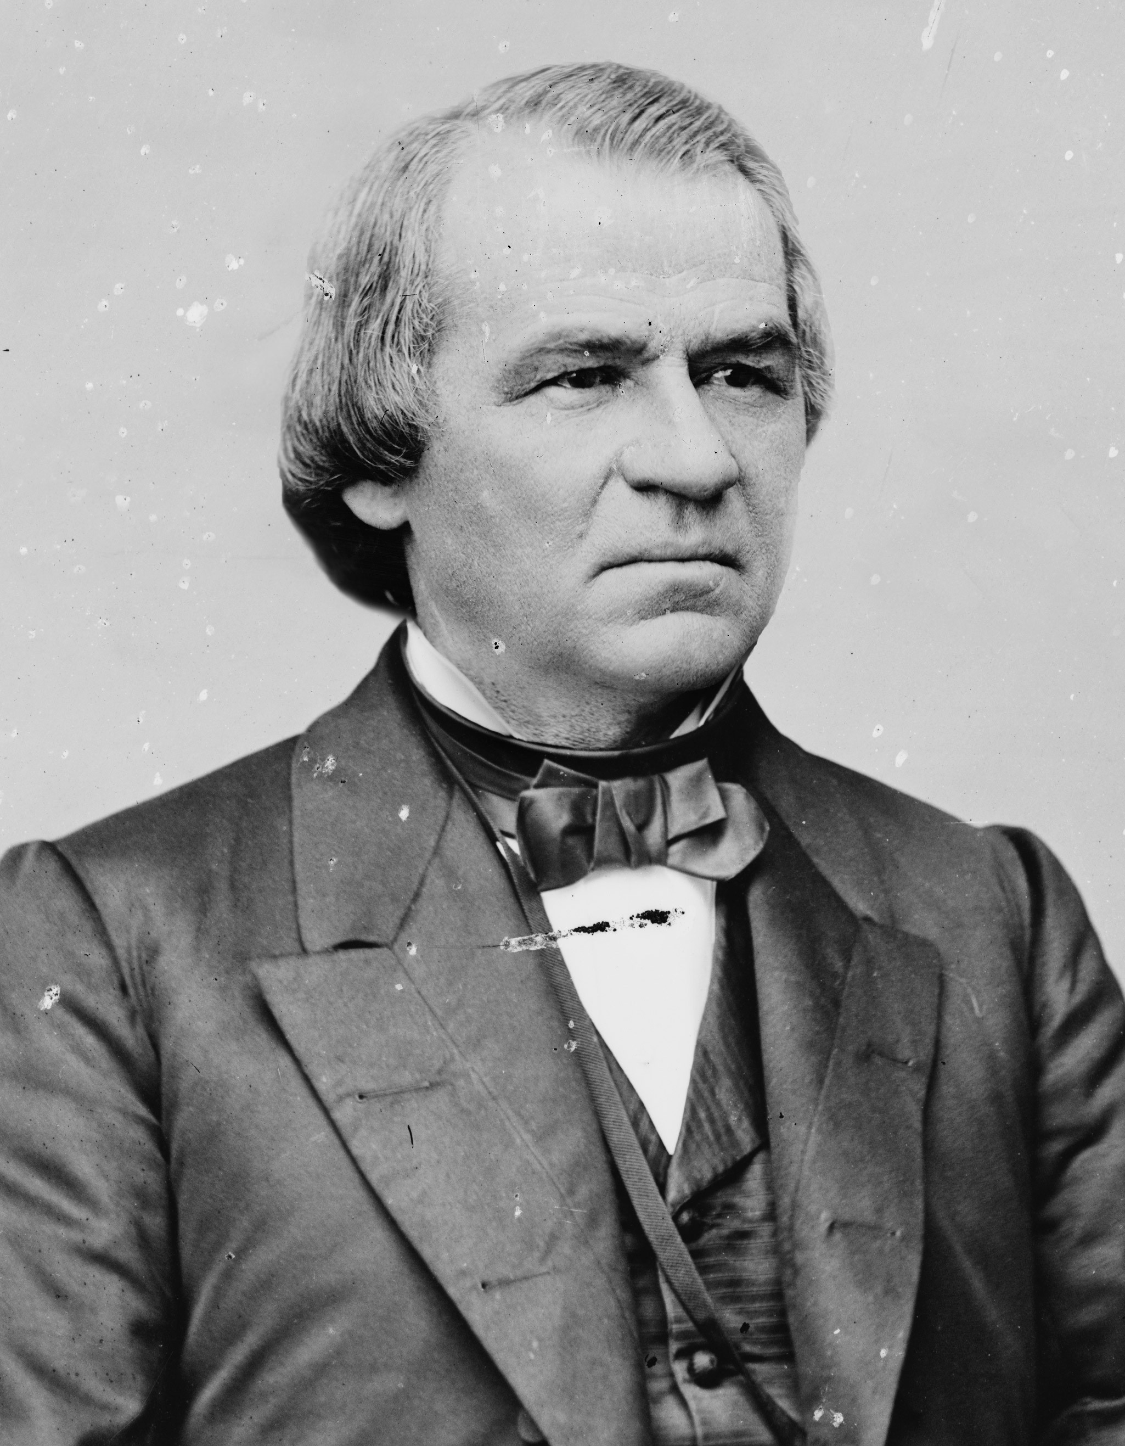
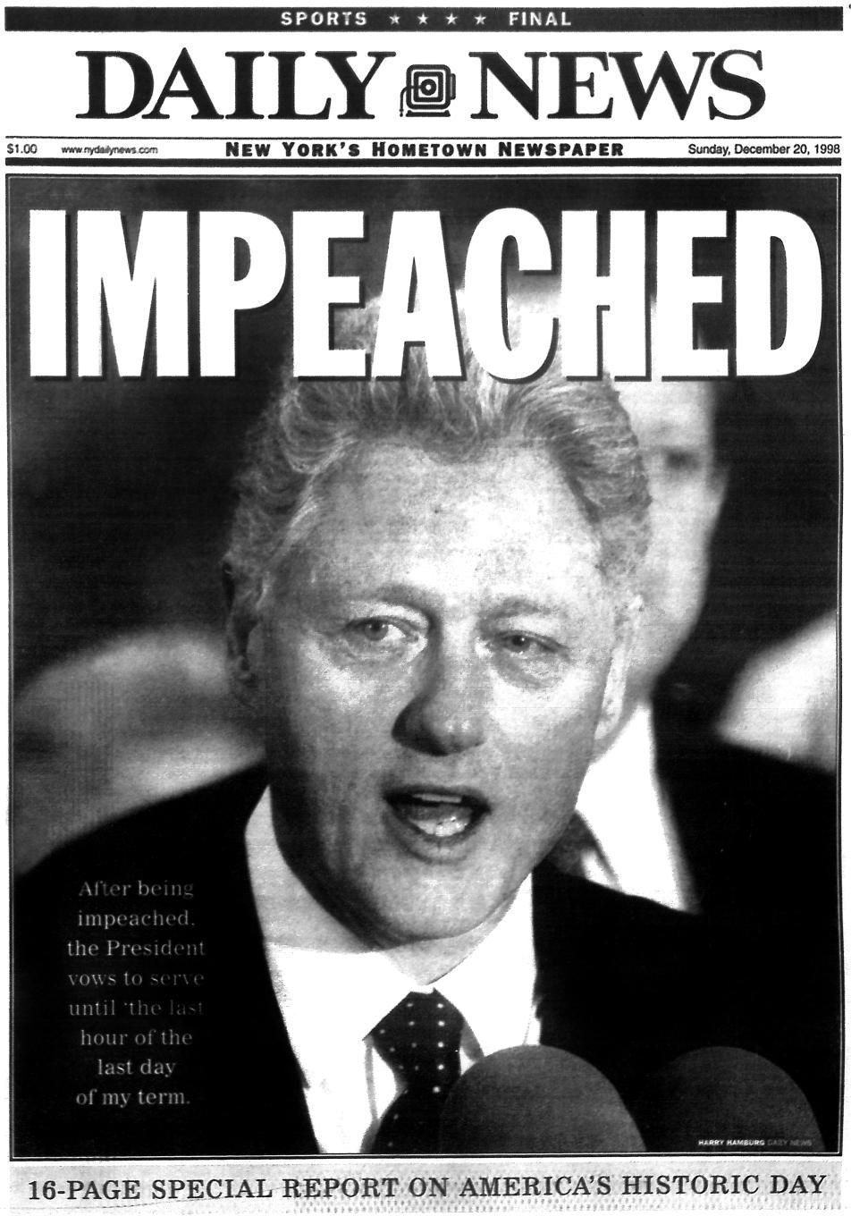


IMPEACHMENT
The vice president secedes if the president leaves oﬃce due to death or resignation or convicted of impeachment
  Impeachment is investigated by the House, tried by the Senate with the Chief Justice presiding.
  Only three presidents have been impeached: Andrew Johnson, Bill Clinton & Donald Trump (neither was convicted).

Slide 83
CHECKS AND BALANCES OF THE THREE BRANCHES
LEGISLATIVE OVER EXECUTIVE -Congress over President- (Top-Left)
refuse to confirm Pres. Appointments- the Senate refuse to ratify treaties declare war impeach and remove the Pres. and V.P. override a Pres. Veto

Slide 84
CHECKS AND BALANCES OF THE THREE BRANCHES
LEGISLATIVE OVER JUDICIAL -Congress over Supreme Court- (Top-Right)
propose amendments to overturn Court decisions impeach and remove federal judges refuse to confirm Supreme Court judges

Slide 85
CHECKS AND BALANCES OF THE THREE BRANCHES
EXECUTIVE OVER LEGISLATIVE -President over Congress- (Middle-Left)
veto acts of Congress suggest laws or policies send troops

Slide 86
CHECKS AND BALANCES OF THE THREE BRANCHES
EXECUTIVE OVER JUDICIAL -President over Supreme Court- (Middle-Right)
appoints federal judges pardon federal offenders can “refuse” to enforce judicial rulings

Slide 87
CHECKS AND BALANCES OF THE THREE BRANCHES
JUDICIAL OVER LEGISLATIVE -Supreme Court over Congress- (Bottom-Left)
appointed for life declare acts of Congress unconstitutional

Slide 88
CHECKS AND BALANCES OF THE THREE BRANCHES
JUDICIAL OVER EXECUTIVE -Supreme Court over President- (Bottom-Right)
appointed for life declare executive acts unconstitutional

Slide 89

ESSENTIAL QUESTION
Explain how Federalist No. 51 constitutional provisions of separation of powers and checks and balances would control abuses by majorities?
25

Slide 90

CHECKS AND BALANCES

Slide 91

SEPARATION OF POWERS and CHECKS AND BALANCES
Separation of Powers:
The separation of the powers of government among three branches— legislative, executive, and judicial—so that each branch has to cooperate with the others in order to accomplish policy making goals.
Checks and Balances:
The Framers gave each branch the power to check, or stop, the actions of the other two branches in meaningful ways.
How does the structure of U.S. government aﬀect citizens?

Slide 92
1.6 ESSENTIAL QUESTION CFU
How do the powers allocated to Congress, the president, and the courts demonstrate the separation of powers and checks and balances featured in the U.S. Constitution?
Explain the multiple access points for stakeholders and institutions to influence public policy as a result of separation of powers and checks and balances.
How have checks and balances been used in impeachment, removal, and other legal actions against public officials deemed to have abused their power?
You need to know the difference between checks and balances and separation of powers.
28

