Slide 1
UNIT 3 Topic 3.5-3.6
Balancing Liberty & Safety
AMSCO Chpt. 9 pg. 294-309
Required Court Case
McDonald v. Chicago
3.5 Second Amendment: Right to Bear Arms
3.6 Amendments: Balancing Individual Freedom with Public Safety

Slide 2
TOPIC 3.5 Second Amendment: Right to Bear Arms
Provisions of the U.S. Constitution’s Bill of Rights are continually being interpreted to balance the power of government and the civil liberties of individuals
Explain the extent to which the Supreme Court’s interpretation of the First and Second Amendments reflects a commitment to individual liberty
The Supreme Court’s decisions on the Second Amendment rest upon its constitutional interpretation of the right to bear arms.

Slide 4
The Second Amendment
“A well-regulated militia, being necessary to the security of a free State, the right of the people to keep and bear Arms, shall not be infringed.”

Slide 5
After D.C. v. Heller Ruling:
The Second Amendment
“A well-regulated militia, being necessary to the security of a free State, the right of the people to keep and bear Arms, shall not be infringed.”

Slide 6
District of Columbia v. Heller (2008)
Issue: Do the D.C. provisions violate the Second Amendment rights of individuals who are not affiliated with any state-regulated militia (like the National Guard), but who wish to keep handguns and other firearms for private use in their homes? Are you allowed to have a gun in your home for self-defense?
Ruling: In a 5-4 decision, the Court struck down the District of Columbia’s ban on handguns, holding that the Second Amendment guarantees an individual right to gun ownership.

Slide 7
Government Action Related to the Second Amendment | Effect on Gun Rights
National Firearms Act (1934) | Required registration of certain weapons, imposed a tax on the sale and manufacture of certain guns, and restricted the sale and ownership of high-risk weapons such as sawed-off shotguns and automatic machine guns
Gun Control Act (1968) | Ended mail-order sales of all firearms and ammunition and banned the sale of guns to felons, fugitives from justice, illegal drug users, people with mental illness, and those dishonorably discharged from the military (the law’s effect was to punish those who owned a gun or used it illegally more than prevent the purchase or possession of guns)
Brady Handgun Violence Prevention Act (1993) | Established a five-day waiting period for handgun purchases to allow for a background check
District of Columbia v. Heller (2008) | The Court ruled, in a five-to-four decision, that the Second Amendment recognizes an individual’s right to own a gun unrelated to militia service
McDonald v. Chicago (2010) | The Court applied the Second Amendment to the states (selective incorporation) via the Fourteenth Amendment’s due process clause, arguing that, based on Heller, the right to individual self-defense is at the heart of the Second Amendment

Slide 8
DIFFERENCE BETWEEN CIVIL LIBERTIES AND CIVIL RIGHTS?
CIVIL LIBERTIES
Definition – legal and constitutional rights that protect individuals from arbitrary acts of government. The BILL of Rights
Freedoms that are guaranteed -- either by law, constitution, or judicial interpretation
Involve basic freedoms (e.g. speech and religion)
The freedoms of conscience, religion, and expression, for example, which are secured by the First Amendment
The Bill of Rights, specifically amendments 1-8
4

Slide 9
DIFFERENCE BETWEEN CIVIL LIBERTIES AND CIVIL RIGHTS?
CIVIL RIGHTS, rights meant to protect groups
Definition – policies designed to protect people against arbitrary or discriminatory treatment by government officials or individuals
Include laws prohibiting racial, gender, physical, and religious discrimination- GROUPS. Those positive steps taken by gov to protect your rights. Ex. Any and all Civil Rights Laws
Protected by the due process and equal protection clauses of the Fifth and Fourteenth Amendments and by the civil rights laws of national and state governments

Slide 10
BASIS OF OUR CIVIL LIBERTIES – PROTECTED RIGHTS IN THE ORIGINAL CONSTITUTION
Writ of habeas corpus
Directs any official having a person in custody to produce the prisoner in court and to explain to the judge why the prisoner is being held; Can only be suspended during times of rebellion (Civil War)
Person has the right to know why he or she is being imprisoned
Ex post facto laws
Latin for “after the fact”
Punishes a person for something that was not a crime when he did it (retroactive punishment); May not be passed by Congress
Bills of attainder
An act that punishes a person without benefit of trial
May not be passed by Congress
6

Slide 11
ESSENTIAL QUESTION CFU
What are civil liberties? How does the Bill of Rights protect civil liberties?
7

Slide 12
BILL OF RIGHTS AND THE STATES
BILL OF RIGHTS
Added to the original Constitution to appease states. Demanded by the Anti-Federalists
Rights of the individuals and states listed to protect them from the federal government
Bill of Rights only applied to the federal government and did not include protections against state governments (Barron v. Baltimore, 1833)
– Belief was that people could protect themselves against the state governments that were in their own backyards, but they needed additional protection against a new, powerful, and distant national gov’t. Each state had its own bill of rights to protect their citizenry from the state govt.
8

Slide 13
SELECTIVE INCORPORATION OF THE BILL OF RIGHTS
The BoR only apply to national government… NOT the states
– Barron v. Baltimore (1833)
1
14th Amendment: created the possibility that the B of R would apply to states
Gitlow v. New York (1925)
The first Supreme Court case to “selectively incorporate” a part of the BoR
Applies First Amendment protection of free speech to the states using the 14th Amendment's due process clause
2
Since Gitlow, the Supreme Court has gradually
incorporated other selected parts of the BoR to the states
Most of the rights have been “incorporated” (applied to the states)
Most recent, 2nd Amendment with gun ownership in Chicago

Slide 14
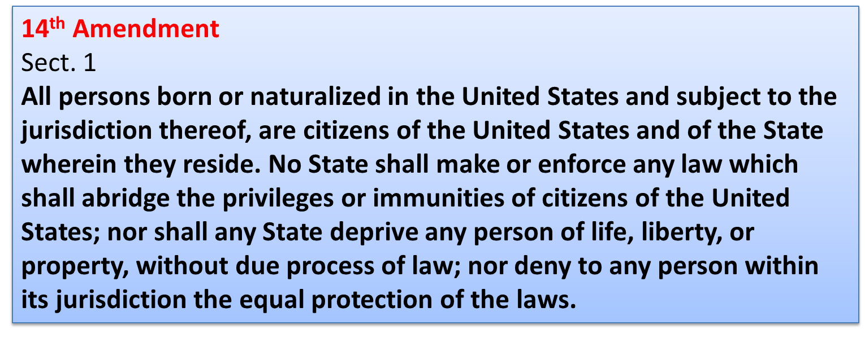
SELECTIVE INCORPORATION OF THE BILL OF RIGHTS Limits state authority
2

Slide 15
SELECTIVE INCORPORATION OF THE BILL OF RIGHTS

Slide 16
SELECTIVE INCORPORATION OF THE BILL OF RIGHTS
DOCTRINE OF INCORPORATION constitutional doctrine through which the first ten amendments of the United States Constitution (known as the Bill of Rights) are made applicable to the states through the Due Process clause of the Fourteenth Amendment. Incorporation applies both substantively and procedurally.
11

Slide 17
A constitutional doctrine through which the Bill of Rights are made applicable to the states through the Due Process clause of the Fourteenth Amendment and so applied to state and local governments.
Utilizing the language of the Fourteenth Amendment, specifically that “no state…shall abridge…due process of law,” the national government now serves as
protector of our inalienable right to “life, liberty and property.” Most of the time this has resulted in the national government imposing its will on state and local laws to the contrary.
The Fourteenth Amendment has weakened the states and strengthened the national government in our federal system of government.
Doctrine of Selective Incorporation
McDonald v. Chicago (2010): ruled the Second
Amendment’s right to keep and bear arms for self-defense in one’s home is applicable to the states through the Fourteenth Amendment.

Slide 18
A constitutional doctrine through which the Bill of Rights are made applicable to the states through the Due Process clause of the Fourteenth Amendment and so applied to state and local governments.
Doctrine of Selective Incorporation
Explain how has the 14th amendment impacted federalism?
Use TEA
Topic sentence- thesis
Evidence- use examples
Analysis-explain how/why your example backs up your thesis

Slide 19
Required Supreme Court Cases for AP Gov Exam
Marbury v. Madison (1803)
McCulloch v. Maryland (1819)
Schenck v. United States (1919)
Brown v. Board of Education (1954)
Baker v. Carr (1961)
Engel v. Vitale (1962)
Gideon v. Wainwright (1963)
Tinker v. Des Moines (1969)
New York Times Co. v. United States (1971)
Wisconsin v. Yoder (1972)
Roe v. Wade (1973)
Shaw v. Reno (1993)
United States v. Lopez (1995)
Citizens United v. Federal Election Commission (2010)
McDonald v. Chicago (2010)

Slide 20
Required Document Readings for AP Gov Exam
Required primary documents
1. The Declaration of Independence (full text, article, video)
2. The Articles of Confederation (full text, article, video)
3. The Constitution of the United States (full text, brief video, deep dive video)
4. Federalist No. 10 (full text, video part 1, video part 2)
5. Brutus No. 1 (full text, video)
6. Federalist No. 51 (full text, article, video)
7. Federalist No. 70 (full text, video(Opens in a new window)(Opens in a new window)(Opens in a new window))
8. Federalist No. 78 (full text, article)
9. Letter from a Birmingham Jail (full text, video)

Slide 21
SELECTIVE INCORPORATION
Modifying Effect of the 14th Amendment
The due process clause has been used to apply some of the provisions of the Bill of Rights to the states.
This clause bans states from denying life, liberty, or property without due process of law.
The “total incorporation” view would apply all of the provisions of the Bill of Rights to the states. It argues for nationalization (or federalization) of the Bill of Rights.
The “selective incorporation” view would apply only some of these provisions, and would do so on a case- by-case basis.
10

Slide 22
SELECTIVE INCORPORATION
Modifying Effect of the 14th Amendment
Subsequent cases federalized parts of the Bill of Rights:
1st – Assembly, Petition, Religion, Speech, Press
2nd – Right to Bear Arms
4th – Search and Seizure protections
5th – Self-Incrimination, Double Jeopardy
6th – Right to Counsel, Right to Bring Witnesses, Right to Confront Witnesses
8th – Protection against Cruel and Unusual Punishment, Excessive Fines
All provisions of the Bill of Rights except Amendment 3, Amendment 7, and the Grand Jury requirement of the 5th Amendment have been federalized-applies to the states.
11

Slide 23
Explain the doctrine of selective incorporation.
13

Slide 24
McDonald v. Chicago (2010)
Issue: Does the Second Amendment right to keep and bear arms apply to state and local governments through the 14th Amendment and thus limit Chicago’s ability to regulate guns?
Majority: 2nd Amendment right to keep and bear arms for the purpose of self-defense is fully applicable to the states under the 14th Amendment. The Court considered whether the right to keep guns “is fundamental to our scheme of
ordered liberty and system of justice.” The Court determined that both the Framers of and those who ratified the 14th Amendment considered the right to keep and bear arms among the fundamental rights “necessary to our system of ordered liberty.” Self-defense is a basic right, and that, under Heller, individual self-defense is the central component of the Second Amendment right to bear arms.

Slide 25
The debate over the Second Amendment involves concerns about public safety and whether or not the government regulation of firearms promotes or interferes with public safety and individual rights.
Supreme Court: “Undoubtedly some think that the Second Amendment is outmoded in a society where our standing army is the pride of our Nation, where well-trained police forces provide personal security, and where gun violence is a serious problem.
That is perhaps debatable, but what is not debatable is that it is not the role of this Court to pronounce the Second
Amendment extinct.”
-Justice Alito

Slide 26
Do government regulations of firearms promote or interfere with public safety and individual rights?

Slide 27
Do government regulations of firearms promote or interfere with public safety and individual rights?

Slide 28
ESSENTIAL QUESTION CFU
What was the significance of the ruling in McDonald v. Chicago?
Have recent Supreme Court decisions on the Second Amendment leaned more toward individual liberty or public safety?
21

Slide 29
END OF 3.5

Slide 30
Chpt. 9 Topic 3.6 AMSCO pg. 300-306
UNIT 3
Argumentative Essay Assignment
3.6 Balancing Individual Freedoms with Public Order and Safety

Slide 31
3.6 Provisions of the U.S. Constitution’s Bill of Rights are continually being interpreted to balance the power of government and the civil liberties of individuals
Court decisions defining cruel and unusual punishment involve interpretation of the Eighth Amendment and its application to state death penalty statutes over time
The debate about the Fourth Amendment involves concerns about public safety and whether or not the government collection of digital metadata promotes or interferes with public safety and individual rights
Explain how the Supreme Court has attempted to balance claims of individual freedom with laws and enforcement procedures that promote public order and safety
2

Slide 32
3.6 Provisions of the U.S. Constitution’s Bill of Rights are continually being interpreted to balance the power of government and the civil liberties of individuals
Court decisions defining cruel and unusual punishment involve interpretation of the Eighth Amendment and its application to state death penalty statutes over time
The debate about the Second and Fourth
Amendments involves concerns about public safety and whether or not the government regulation of firearms or collection of digital metadata promotes or interferes with public safety and individual rights.
Explain how the Supreme Court has attempted to balance claims of individual freedom with laws and enforcement procedures that promote public order and safety
2

Slide 33
EIGHTH AMENDMENT RIGHTS
Magruder’s American Government 2009, pg. 604
Cruel and unusual punishment; no excessive bail/ fines
The Death Penalty
Eighth Amendment forbids the inflicting of cruel and unusual punishments
The death penalty is not considered cruel and unusual punishment in America
Furman v. Georgia (1972) - Court struck down all of the then-existing State laws providing for the death penalty but not because that punishment is cruel and unusual. Rather, the Court voided those laws because they gave too much discretion to judges or juries in deciding whether to impose the ultimate penalty. The Court found that of all the people convicted of capital crimes, only a random few, most of them African American or poor, or both, were “capriciously selected for execution.
The case led to a de facto moratorium on capital punishment throughout the United States, which came to an end when Gregg v. Georgia was decided in 1976.
a two-stage process in capital cases: first, a trial to settle the question of guilt or innocence; then, for those convicted, a second proceeding to decide if the circumstances involved in the crime justify a sentence of death. DUE PROCESS. What amendments contain the dp statement(s)?
If, however, the death penalty is mandatory, such that there is no provision for mercy based on the characteristics of the offender, then it is unconstitutional.

Slide 34
EIGHTH AMENDMENT RIGHTS
Cruel and Unusual Punishment; no excessive bail/ fines
The Death Penalty
Eighth Amendment forbids the inflicting of cruel and unusual punishments
The death penalty is not considered cruel and unusual punishment in America
Furman v. Georgia (1972) - Court halted capital punishment until states could administer it in "consistent fashion" decision that ruled on the requirement for a degree of consistency in the application of the death penalty.
The case led to a de facto moratorium on capital punishment throughout the United States, which came to an end when Gregg v. Georgia was decided in 1976.
Gregg v. Georgia (1976) - The death penalty does not, automatically, violate the Eighth Amendment.
If the jury is furnished with standards to direct and limit the sentencing discretion, and the jury's decision is subjected to meaningful appellate review, the death sentence may be constitutional.
If, however, the death penalty is mandatory, such that there is no provision for mercy based on the characteristics of the offender, then it is unconstitutional.

Slide 35
EIGHTH AMENDMENT
In recent years, the Supreme Court has seen an increase in cases involving the death penalty, hinging on the question of whether certain uses of capital punishment violate the Eighth Amendment’s protection against cruel and unusual punishment.
In their rulings, which group(s) are not eligible for the death penalty?

Slide 36
EIGHTH AMENDMENT
Atkins v. Virginia (2002)
Ruled that it would be unconstitutional to execute someone with certain mental handicaps
Roper v. Simmons (2005)
Unconstitutional to execute someone who committed a capital offense under the age of eighteen

Slide 37
EIGHTH AMENDMENT
Which of the following statements best describes the information in the map?
a. Most states in the Northeast and West do not allow capital punishment.
b. Most states in the South and West allow capital punishment.
c. Capital punishment is not allowed in Oklahoma (OK) and New Mexico (NM).
d. Only three states do not allow capital punishment.

Slide 38
EIGHTH AMENDMENT
Explain how the death penalty laws shown demonstrates the principle of federalism?

Slide 39
DECLINE OF EXECUTIONS

Slide 40
DECLINE OF EXECUTIONS

Slide 41
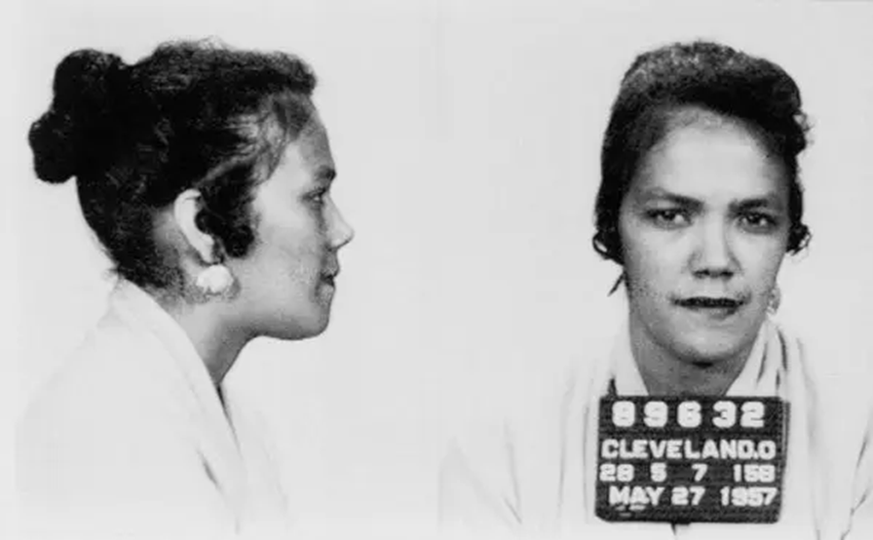
Fourth Amendment
The right of the people to be secure in their persons, houses, papers, and effects, against unreasonable searches and seizures, shall not be violated, and no Warrants shall issue, but upon probable cause, supported by Oath or affirmation, and particularly describing the place to be searched, and the persons or things to be seized.
Mapp v Ohio, 1961

Slide 42
FOURTH AMENDMENT
“The right of the people to be secure in their persons, houses, papers, and effects, against unreasonable searches and seizures, shall not be violated, and no Warrants shall issue, but upon probable cause…”
Probable cause- sufficient reason based upon known facts to believe a crime has been committed or that certain property is connected with a crime. Probable cause must exist for a law enforcement officer to make an arrest without a warrant, search without a warrant, or seize property in the belief the items were evidence of a crime.

Slide 43
FOURTH AMENDMENT
“The right of the people to be secure in their persons, houses, papers, and effects, against unreasonable searches and seizures, shall not be violated, and no Warrants shall issue, but upon probable cause…”
Probable cause- sufficient reason based upon known facts to believe a crime has been committed or that certain property is connected with a crime. Probable cause must exist for a law enforcement officer to make an arrest without a warrant, search without a warrant, or seize property in the belief the items were evidence of a crime.
Versus REASONABLE SUSPICION
https://www.flexyourrights.org/

Slide 44
FOURTH AMENDMENT RIGHTS
The Constitution forbids only "unreasonable" •The Exclusionary Rule searches and seizures
A police search without consent is constitutionally unreasonable unless it has been authorized by a valid search warrant
– Ex: police use of sobriety checkpoints in enforcing drunk driving laws
– Mapp v. Ohio (1961) - The Supreme Court ruled that evidence obtained unconstitutionally cannot be used in court against person from whom it was seized (it must be excluded from the trial)
– Adopted mainly to prevent police misconduct
The constitutional requirements of a specific search warrant
Not used if:
There would be “inevitable discovery” of the evidence (Nix v. Williams)
Police operate “in good faith” that the warrant was valid (U.S. v. Leon)
Plain View-
4
Must describe what places are to be searched
Must describe what things are to be seized

Slide 45
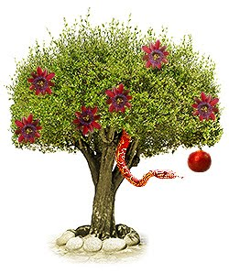
4th Amendment The Fruit Of The Poisonous Tree Doctrine- The Exclusionary Rule
A doctrine that extends the exclusionary rule to make evidence inadmissible in court if it was derived from evidence that was illegally obtained. As the metaphor suggests, if the evidential "tree" is tainted, so is its "fruit."
The Exclusionary rule applies not only to evidence obtain indirectly as a result of improper police conduct but also to evidence obtained indirectly from the improper conduct.
Evidence derived initial improper conduct is usually called Fruit Of The Poisonous Tree

Slide 46
4th Amendment The Fruit Of The Poisonous Tree Doctrine- The Exclusionary Rule
Assume that a police officer searches the automobile of a person stopped for a minor traffic violation. This violation is the only reason the officer conducts the search; nothing indicates that the driver is impaired by drugs or alcohol, and no other circumstances would lead a reasonable officer to believe that the car contains evidence of a crime. This is an unreasonable search under the Fourth Amendment to the U.S. Constitution.
Assume further that the officer finds a small amount of marijuana in the vehicle. The driver is subsequently charged with possession of a controlled substance and chooses to go to trial. The marijuana evidence culled from this search is excluded from trial under the exclusionary rule, and the criminal charges are dropped for lack of evidence.
https://legal-dictionary.thefreedictionary.com/Fruit+of+the+Poisonous+Tree

Slide 48
Even today, some of the issues at the heart of the debates at the Constitutional Convention still exist
GOVERNMENT SURVEILLANCE
USA PATRIOT ACT (Uniting and Strengthening America by Providing Appropriate Tools Required to Intercept and Obstruct Terrorism) 2001
The law covered intelligence gathering and sharing by executive branch agencies, points of criminal procedure, and border protection. It also widened authority on tapping suspects’ phones.
Soon, people began to question the law's constitutionality and its threat to civil liberties, especially due process.
Some of the most controversial parts of the Patriot Act surround issues of privacy and government surveillance. The Fourth Amendment to the U.S. Constitution protects the "right of the people to be secure in their persons, houses, papers, and effects, against unreasonable searches and seizures . . . ." It requires law-enforcement officers to obtain warrants before making most searches.
Does the government have the right to collect phone and internet data from individuals?

Slide 49
GOVERNMENT SURVEILLANCE
Recent State Policy
Metadata is all the cell phone communication information minus the actual conversation; that is, who is calling whom, when, and for how long. The constitutional acceptance for such collection parallels an earlier Court ruling that allowed police to monitor calls made, though not the content of the conversation, if disclosed by a third party. The government’s motivation here is to determine who might be connected to terror suspects in the United States and abroad and to what degree.
AMSCO pg. 303

Slide 50
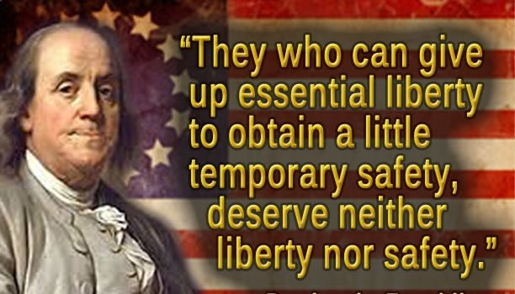

Slide 51
Government Action to Promote Public Order and Safety | Effect on Individual Freedom
Death penalty | The Eighth Amendment prevents cruel and unusual punishments and excessive bail. Debate continues about the death penalty as a deterrent for violent crime or violation of the Eighth Amendment.
Furman v. Georgia (1972) | The Court put the death penalty on hold nationally, yet only two justices called the death penalty itself a violation of the Constitution
Gregg v. Georgia (1976) | The Court began reinstating the death penalty as states restructured their sentencing guidelines. No state can make the death penalty mandatory by law. Rather, aggravating and mitigating circumstances must be taken into account in the penalty phase—the second phase of trial following a guilty verdict.
USA PATRIOT Act | Soon after the September 11 attacks an executive order by President George W. Bush secretly allowed the executive branch to connect with third parties—Verizon and other telecommunications companies—to acquire and examine cell phone data. This third-party relationship excused the government from obtaining warrants as long as the third party was willing to give up the information and allow this collection of metadata. Debate followed about the constitutionality of this order and Fourth Amendment protections against illegal search and seizures.
AMSCO pg. 306

Slide 52
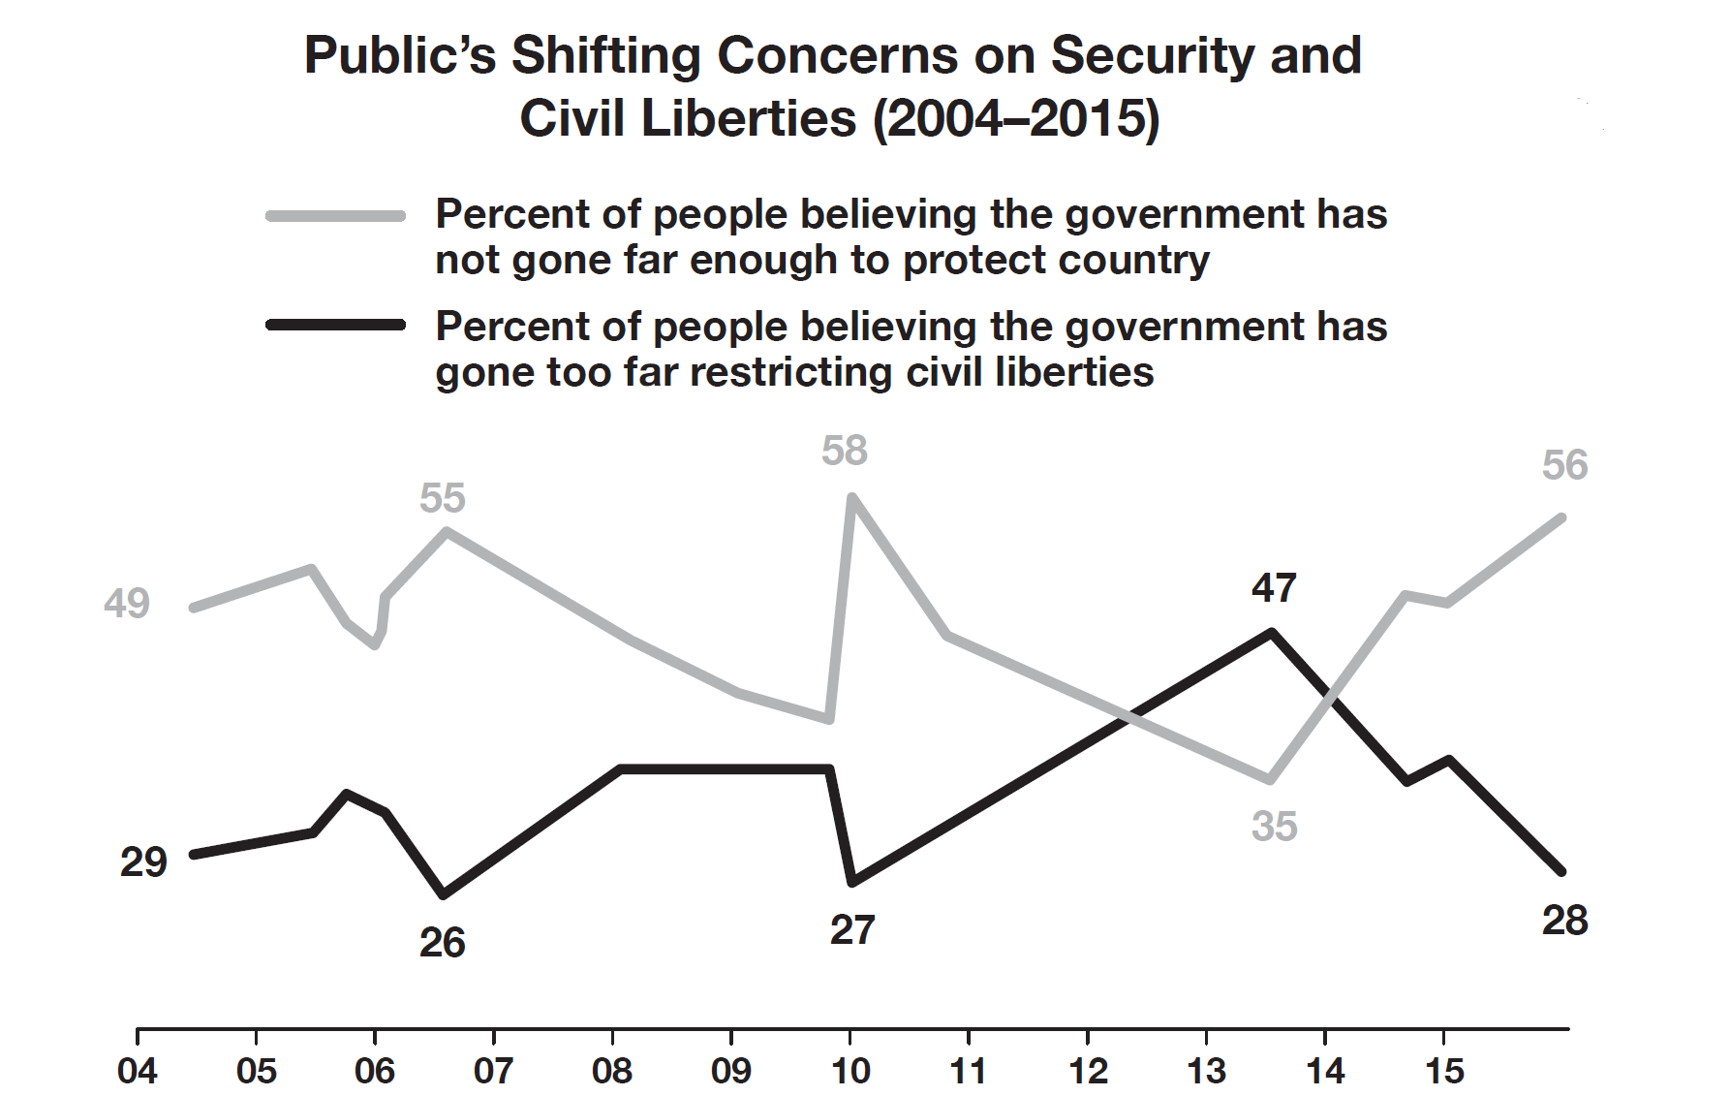
Book Assignment
AMSCO pg. 310
Use the information graphic to answer the questions below.
(A) Identify the lowest percent of people believing that government
has gone too far restricting civil liberties.
(B) Describe a trend in the data in the graph.
(C) Draw a conclusion about the reason for the trend described in
part B.
(D) Explain how the information graphic demonstrates citizen
concern for protecting the country and restricting liberties.

Slide 53
END of 3.6

