Slide 1
UNIT 2 Topic 2.6-2.7
AMSCO pg. 158-171
Required Document:
Federalist 70
The Constitution
2.6 Expansion of Presidential Power
2.7 Presidential Communication
1

Slide 2
TOPIC 2.6 Expansion of Presidential Power
The presidency has been enhanced beyond its expressed constitutional powers.
Explain how presidents have interpreted and justified their use of formal and informal powers.
Federalist No. 70 offers justification for a single executive by arguing a strong executive
is “essential to the protection of the country against foreign attacks, to the steady
administration of the laws, to the protection of property, and to the security of liberty.”
Passage of the Twenty-Second Amendment, which established presidential term limits,
demonstrates concern about the expansion of presidential power.
Different perspectives on the presidential role, ranging from a limited to a more expansive
interpretation and use of power, continue to be debated in the context of contemporary
events.
REQUIRED FOUNDATIONAL DOCUMENTS
The Constitution of the United States
Federalist No. 70

Slide 3
TOPIC 2.6 Expansion of Presidential Power
The presidency has been enhanced beyond its expressed constitutional powers.
Explain how presidents have interpreted and justified their use of formal and informal powers.
Justifications for a single executive are set forth in Federalist No. 70
Term-of-office and constitutional-power restrictions, including the passage of the Twenty-Second Amendment, demonstrate changing presidential roles.
Different perspectives on the presidential role, ranging from a limited to a more expansive interpretation and use of power, continue to be debated in the context of contemporary events.
REQUIRED FOUNDATIONAL DOCUMENTS
The Constitution of the United States
Federalist No. 70

Slide 4
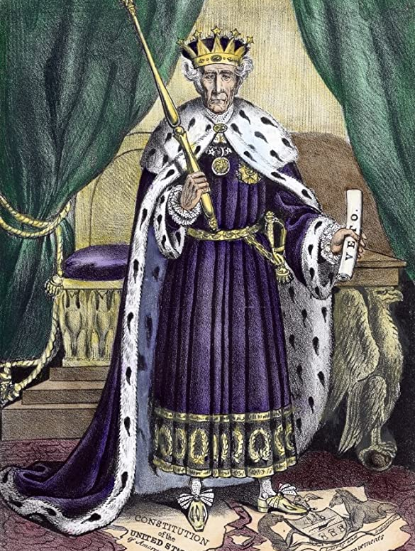
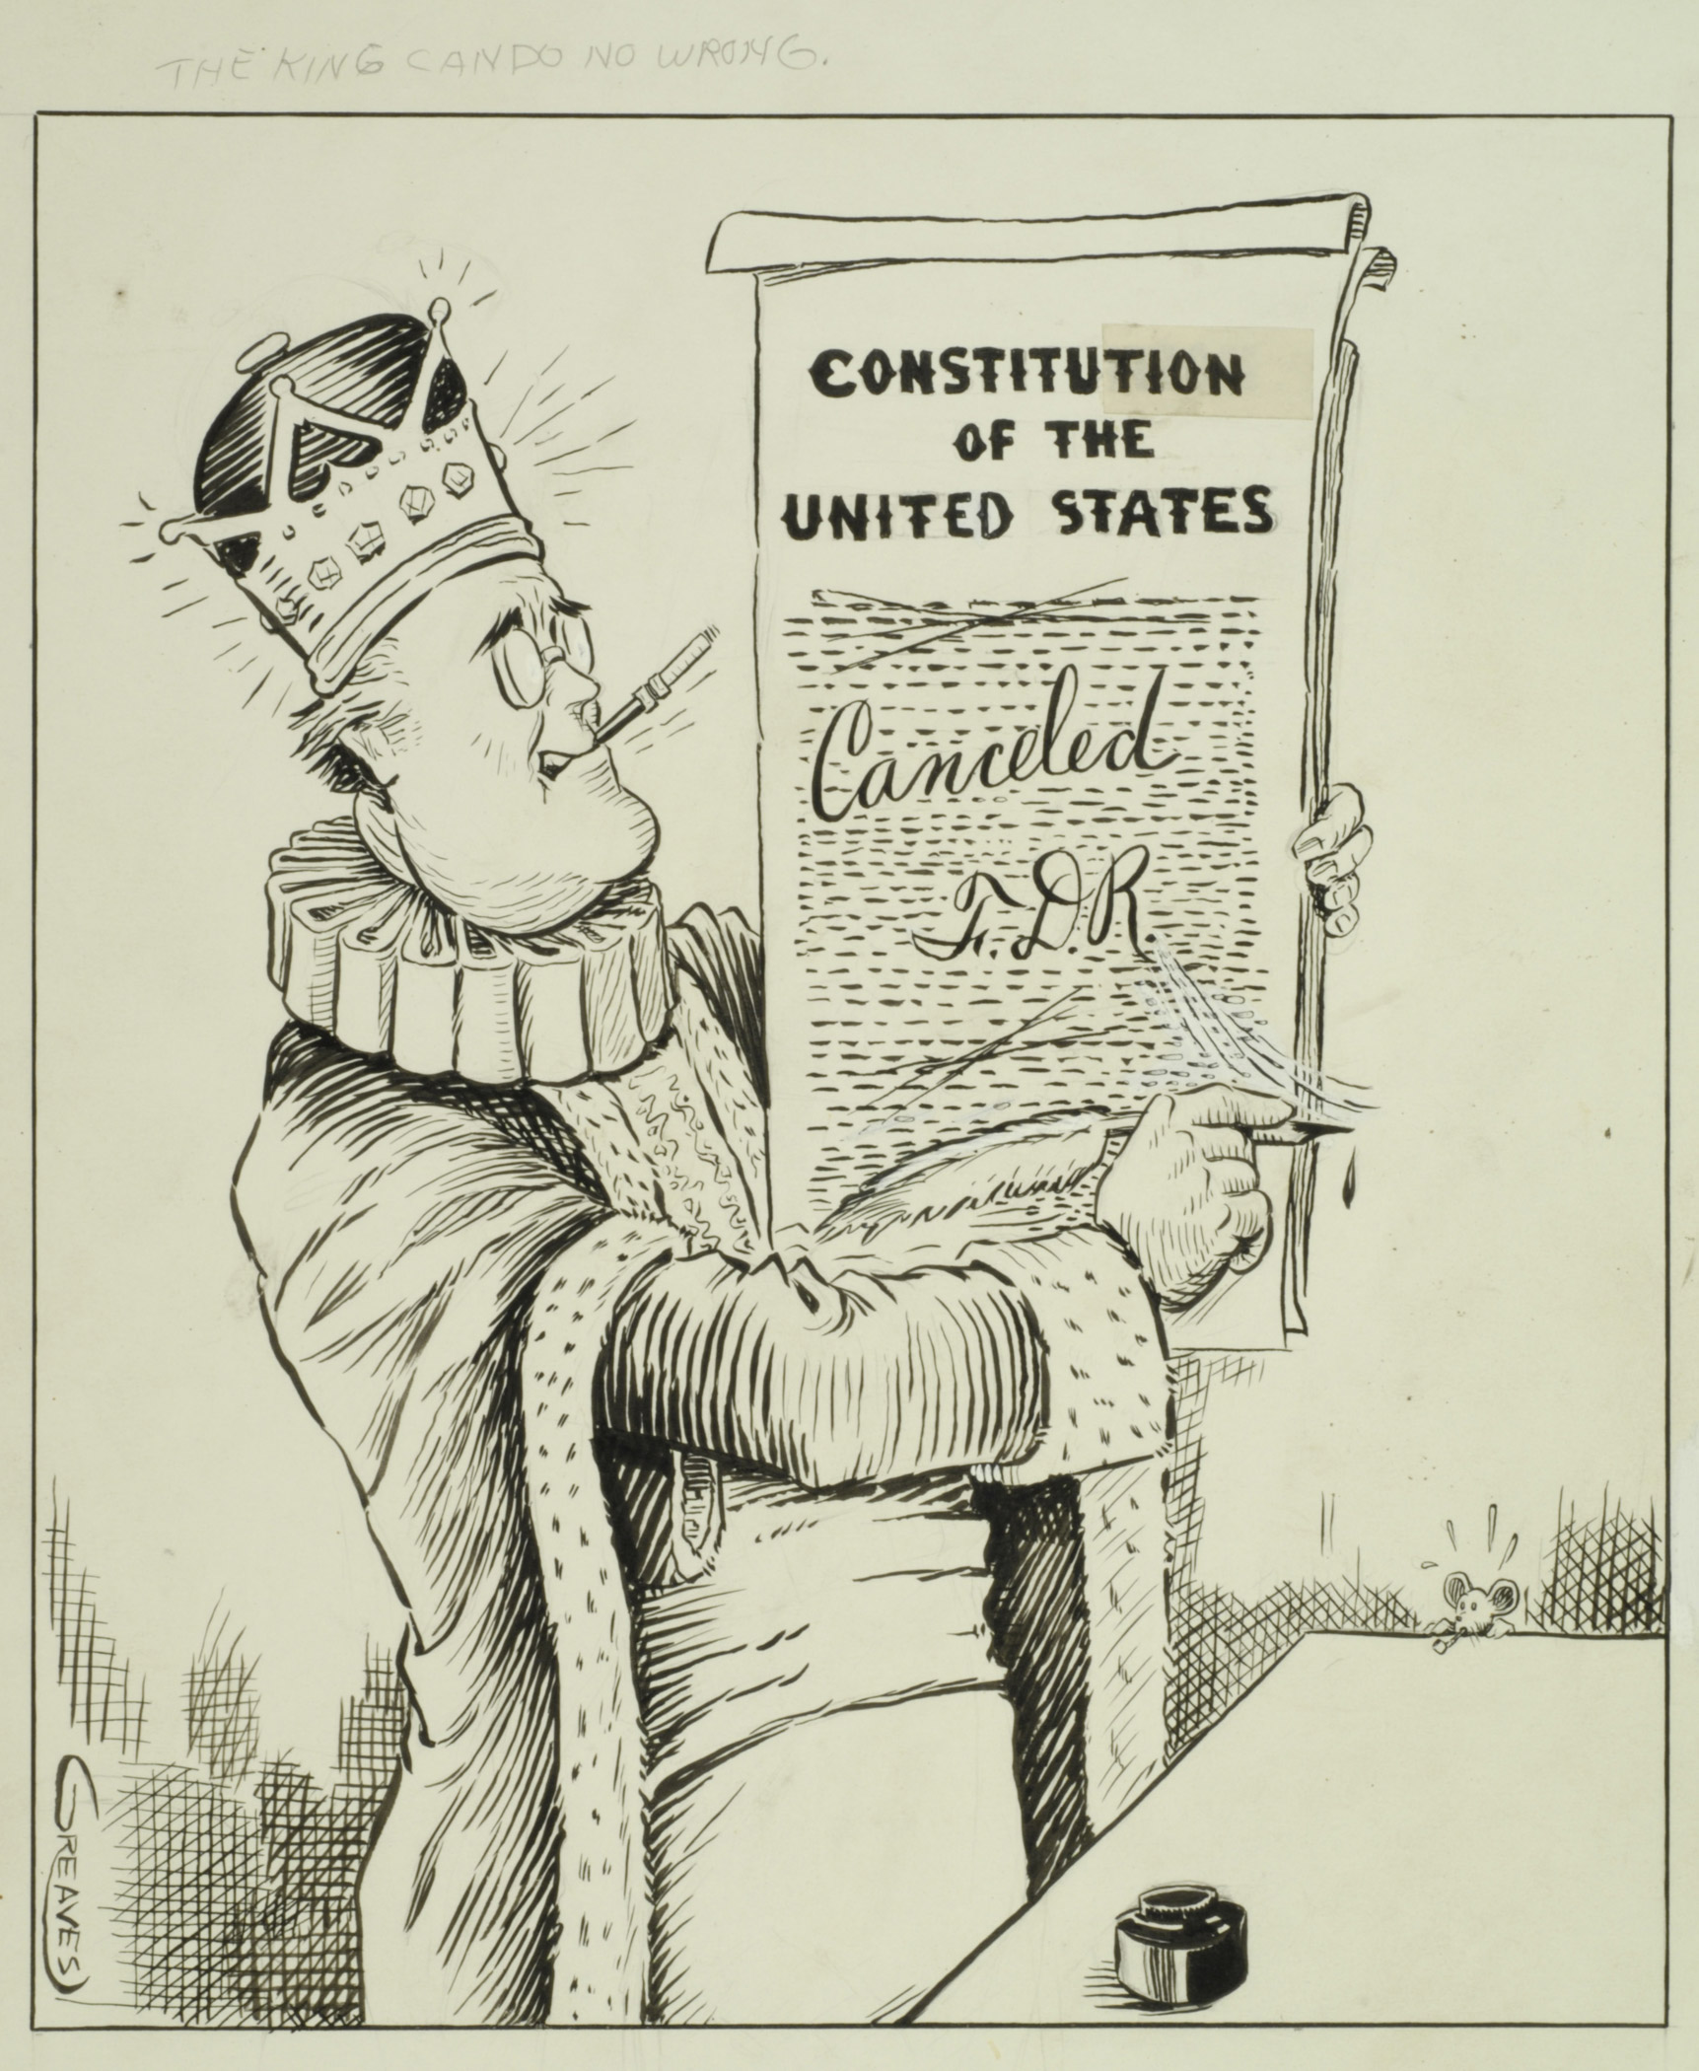
EXPLAIN HOW PRESIDENTS HAVE INTERPRETED AND JUSTIFIED THEIR USE OF FORMAL AND INFORMAL POWERS.
Diﬀerent perspectives on the presidential role, ranging from a limited to a more expansive interpretation and use of power, continue to be debated in the context of contemporary events

Slide 5
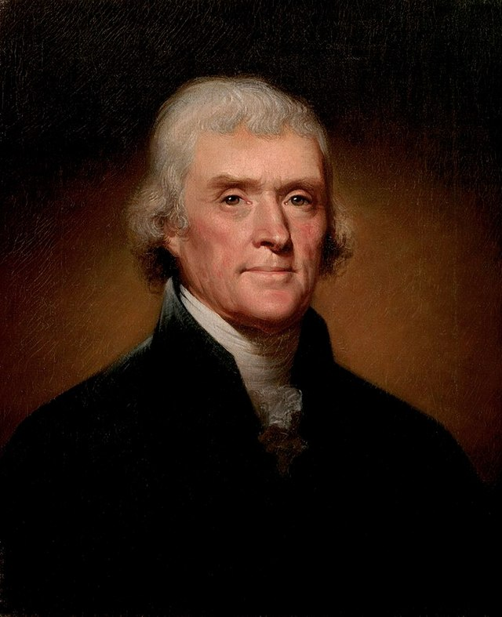
Explain how presidents have interpreted and justified their use of formal and informal powers.
Jefferson negotiated a deal to buy the Louisiana territory from France. He had been authorized by Congress to spend up to $10 million. France wanted $ 15 million, and Jefferson took the deal.
But did he have the authority to do this? The constitution makes no mention of the President having power to buy. Jefferson considered a constitutional amendment the only way to conclude the deal with France.
Jefferson wrote, “The General Government has no powers but such as the Constitution gives it. It has not given it power of holding foreign territory, and still less of incorporating it into the Union. An amendment of the Constitution seems necessary for this.”
Jefferson was assured by his Secretary of Treasury that any deal with France would be permissible and implied under the Constitution’s treaty making provisions.
https://constitutioncenter.org/blog/the-louisiana-purchase-jeffersons-constitutional-gamble

Slide 6
Federalist No. 70 (1788)
AP® REQUIRED DOCUMENTS
Federalist No. 70 is one of the nine foundational documents required in AP® U.S. Government and Politics. Make sure you read it carefully and understand why Hamilton argues in favor of a strong executive.
Document | Scope
Federalist No. 70 | Hamilton argues that an energetic single executive will protect against foreign attacks, provide for the administration of laws and protect liberty and property.
Wapples, pg. 301

Slide 7
Federalist No. 70 (1788)
In this Federalist Paper, Alexander Hamilton argues for a strong executive leader, as provided for by the Constitution, as opposed to the weak executive under the Articles of Confederation. He asserts, “energy in the executive is the leading character in the deﬁnition of good government. It is essential to the protection of the community against foreign anacks…to the steady administration of the laws, to the protection of property… to justice; [and] to the security of liberty….”
Though some had called for an executive council, Hamilton defended a single executive as “far more safe” because “wherever two or more persons are engaged in any common… pursuit, there is always danger of diﬀerence of opinion…bitter dissensions are apt to spring. Whenever these happen, they lessen the respectability, weaken the authority.” Hamilton also argued that a single executive would be watched “more narrowly” and vigilantly by the people than a group of people would be.

Slide 8
Federalist No. 70 (1788)
1. What beneﬁts does a strong presidency provide to a representative democracy?
4. What, according to Hamilton, is the most necessary quality for a president?
A strong presidency provided unity, stability, and protection, a strong presidency not only protects the people from other countries, but also from themselves.
Hamilton considers energy the most necessary quality for a president. Energy is needed to protect the people's rights and liberties.
2. Why does a weak executive create a bad government?
5. What are characteristics of the legislative branch?
If the executive branch is weak, there is no one to protect the people's rights and liberties. This then causes distrust in the government, which shows the liabilities.
The legislative branch includes discussing/arguing/passing/settling laws and past disputes. They regularly exercise their powers through the Supreme Court and lower courts to show their agreements and the people's opinions as a whole.
3. What are four ingredient of an energetic executive?
Four ingredients of an energetic executive branch are unity, competent powers, adequate provision for its support, and duration. By showing so, the people begin to trust the government.

Slide 9
Federalist No. 70 (1788)
How do human weaknesses complicate decision-making, according to Hamilton?
8. Why is disagreement within the legislative branch beneﬁcial, while in the executive branch it is detrimental?
Hamilton argued that human weaknesses will create unnecessary concerns in decision making. Which led them to believe that the existence of Congress within the government will only become the hindrance for Government because it slowed down the decision-making process. But he did not consider who will watch over the government if congress does not exist.
Disagreement within the legislative branch can usually lead to good things.
When the Congress is arguing about something, two sides want their side to win, and they represent two sides of the population. When they manage to ﬁnd a solution or common ground on an issue, that means that it's usually a compromise so the issue in question moves forward a bit in such a way that it suits both sides a bit.
Disagreement in the executive branch however is not beneﬁcial because it
can cause delays in administering laws or signing them into law, or it can cause for people who did something bad to answer for it at a later time which gives them time to escape, or anything similar. Nothing good can come out of disagreement within the executive branch.
What problems might arise if the presidency were split between two people?
If the presidency were split between two people, they would disagree because of the diﬀerences in their beliefs. Since they would not be able to agree on most things, action could not be taken, about certain events, until after everything had died down.

Slide 10
THE IMPERIAL PRESIDENCY
Throughout much of this century, the President has been the “great engine of democracy.”
The President was supposed to exercise great power to meet his goals.
In the wake of the Vietnam War and Watergate, however, Congress reasserted itself against what came to be seen as an “Imperial Presidency.”
The Imperial Presidency suggested that presidential power had grown excessive ("imperial").
Response:
Economic growth necessitated a strong executive branch
Congress itself delegated strong powers to the executive branch, esp. in area of foreign policy
10

Slide 11
THE IMPERIAL PRESIDENCY – AREAS OF ABUSE
WAR POWERS
Constitutional conﬂict of Congress' power to declare war vs. President's power as Commander-in-Chief.
In the 18th century, Congress had more time to deliberate war issues; in the modern era, however, Presidents have argued that they need more ﬂexibility to meet rapidly changing conditions.
Presidents have sent troops without a congressional declaration of war more than 125 times. This has happened very frequently since 1945.
Congress has in fact generally gone along with these operations, and has of course funded them, as well. When public opinion turns against the operations, however, Congress has often responded (e.g., Vietnam War).
One of the reasons Congress has gone along with these operations without a formal declaration of war is that such a declaration carries with it the transfer of great emergency powers to the President that the Congress may not want to grant him.
5

Slide 12
THE IMPERIAL PRESIDENCY – AREAS OF ABUSE
EMERGENCY POWERS
In time of war or emergency, the President assumes great powers.
Examples:
Suspension of habeas corpus
Control of communication and transportation
Declaration of martial law
Patriot Act
5

Slide 13
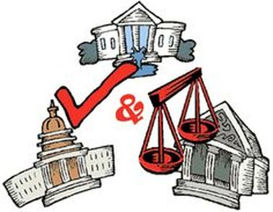
THE IMPERIAL PRESIDENCY – AREAS OF ABUSE
USE OF EXECUTIVE AGREEMENTS not in the Const. but implied (RATHER THAN TREATIES)
Deﬁnition: Deal between the President and the head of another nation (e.g., the destroyers-for-bases deal between FDR and Churchill in 1940).
Unlike a treaty, executive agreements DO NOT require SENATE ratiﬁcation.
Since WWII, the number of executive agreements has vastly outnumbered the number of treaties. Between 1980-1991, there were > 4100 executive agreements and less than 200 treaties.
The Constitution of the United States does not specifically give a president the power to conclude executive agreements. However, he may be authorized to do so by Congress, or he may do so on the basis of the power granted him to conduct foreign relations. Despite questions about the constitutionality of executive agreements, in 1937 the Supreme Court ruled that they had the same force as treaties. Because executive agreements are made on the authority of the incumbent president, they do not necessarily bind his successors. Britannica
6

Slide 14
THE IMPERIAL PRESIDENCY – AREAS OF ABUSE
What is particularly galling to Congress is that treaties are often on relatively trivial issues (e.g., archaeological artifacts in Mexico), but executive agreements are often on matters of great importance (e.g., military commitments to various nations). It was suppose to be for less trivial matters but that has changed. It is a way the President can circumvent the Senate treaty confirmation power.
Executive Agreements have the same status of a treaty. Treaties preempt state law through operation of the Supremacy Clause. Although it may be that executive agreements entered into pursuant to congressional authorization or treaty obligation also derive preemptive force from the Supremacy Clause, that textual basis for preemption is arguably lacking for executive agreements resting solely on the President’s constitutional powers. Justia
It is often said that the Senate ratifies a treaty. It does not. The Senate may give or withhold its “advice and consent” to a treaty made by the president. Once the Senate has “consented” to a treaty, the president ratifies it by exchanging instruments of ratification with other parties to the treaty.
6

Slide 15
THE IMPERIAL PRESIDENCY – AREAS OF ABUSE
EXECUTIVE PRIVILEGE- NOT IN THE CONSTITUTION but implied in the separation of powers
Deﬁnition: The right of president to NOT divulge conversations between himself and his advisers.
Presidents claim that if such conversations were not “privileged,” advisers would be hesitant to give straightforward advice.
Critics claim that Presidents have abused this privilege by claiming it under the guise of “national security.”
In U.S. v. Nixon (1974), the Supreme Court stated that Presidents are in fact entitled to executive privilege most of the time, but not in criminal cases.
6

Slide 16
THE IMPERIAL PRESIDENCY – AREAS OF ABUSE
EXECUTIVE PRIVILEGE- NOT IN THE CONSTITUTION but implied through the Constitutional Principle of checks and balances, separation of power.
The doctrine of executive privilege defines the authority of the President to withhold documents or information in his possession or in the possession of the executive branch from compulsory process of the legislative or judicial branch of the government. The Constitution does not expressly confer upon the Executive Branch any such privilege, but it has been claimed that the privilege derives from the constitutional principle of separation of powers and from a necessary and proper concept respecting the carrying out of the duties of the presidency imposed by the Constitution.
ArtII.S2.C3.2.3 Executive Privilege: Overview
Nixon and Executive Privilege
US v. Nixon https://www.youtube.com/watch?v=LvBmy7oqF_M
How does Federalist 70 support the concept of executive privilege?
COMPLETE FRQ Executive Privilege, Fed 70
6

Slide 17
THE IMPERIAL PRESIDENCY – AREAS OF ABUSE
IMPOUNDMENT
Deﬁnition: The refusal of the President to spend money that has been appropriated by Congress.
In the past, this was done when there was an obvious need, e.g., reducing defense spending after a war ended.
Nixon, however, impounded funds for policy objectives. Some members of Congress were livid that money was not spent when it had been lawfully appropriated by legislation. Such impoundment seemed unconstitutional.
Impoundment is unconstitutional.
6

Slide 18
TERM OF OFFICE
22,2
Four years
Maximum of two elected terms; Maximum of 10 years
Amendment 22 institutionalized Washington’s precedent.
Passage of 22nd Amendment (1951) was due to the Republican congress’ concern over future FDR’s.
Possible to serve just less than 10 years in oﬃce if a V.P. becomes President just after the midpoint of a President’s term of oﬃce.
If a V.P. serves less than half of a President’s term, he can be elected to the presidency twice.
If a V.P. serves more than half of a President’s term, he can be elected to the presidency only once.
Lyndon Johnson succeeded JFK in 1963 and was therefore eligible to be elected twice.
Gerald Ford succeeded Nixon in 1974 and was therefore eligible to be elected only once.

Slide 19
CONGRESS RESPONDS TO THE IMPERIAL PRESIDENCY
WAR POWERS ACT OF 1973
President can send troops overseas to an area where hostilities are imminent without a congressional war declaration only under these circumstances:
Must notify Congress within 48 hours
Must withdraw the troops after 60 days (can be extended another 30 days if the safety of the troops requires it)
Must consult w/Congress if troops are to engage in combat
Congress can pass a resolution, not subject to presidential veto, to have the troops withdrawn
Criticisms
Unconstitutional – an abridgement of the President’s authority as Commander in Chief
Ties the hands of the President – too inﬂexible
Makes it easy on the enemy – just wait 60-90 days
Presidents have claimed the act to be unconstitutional, some have disregarded it, but there has been no lawsuit to determine its constitutionality. A “political hot potato?”

Slide 20
CONGRESS RESPONDS TO THE IMPERIAL PRESIDENCY
EMERGENCY POWERS
Passage of National Emergencies Act of 1976
President must inform Congress in advance of powers to be used in emergencies.
State of emergency automatically ends after 6 months.
President can declare another 6 months of emergency, subject to congressional review.
IMPOUNDMENT
Budget and Impoundment Control Act of 1974-meant to prevent impoundment by president
If President impounds funds temporarily (deferral), either house can override.
If President impounds funds permanently (rescission), that act is automatically voided unless both houses of Congress approve within 45 days.
Establishment of Congressional Budget Oﬃce (CBO) as a check on OMB-Office of Management and Budget
Congress given three additional months to consider the President’s proposed budget.

Slide 21
CONGRESS RESPONDS TO THE IMPERIAL PRESIDENCY
CONFIRMATION OF PRESIDENTIAL APPOINTEES
Senatorial courtesy a long-established practice: before President makes an appointment to a federal district court within a state, he will consult with the two senators of that state to get their approval of said nominee.
In general, senatorial courtesy only applies in cases where the appointee's job function and influence extend only over one particular state. So, if the president nominated a person to fill an open position in Ohio, and a U.S. Senator from Ohio was not in favor of that nomination, under senatorial courtesy, that nominee would not be approved by the rest of the Senate.
The philosophy behind senatorial courtesy is that the Senator from a particular state would have more extensive knowledge of the wishes of the people of his/her state and would be able to speak for them. There is no requirement that there must be a problem with the nominee; it is simply a courtesy to the senators from the impacted state that they may have a say in who is appointed to fill a position that directly impacts their constituents.
Although it is not in writing, as senatorial courtesy is strictly informal and customary, not a legally binding process, in practice, it is used only for appointments that impact one state rather than federal appointments. https://study.com/academy/lesson/what-is-senatorial-courtesy-definition-examples.html

Slide 22
CONGRESS RESPONDS TO THE IMPERIAL PRESIDENCY
Much closer scrutiny given by Senate to recent appointments, e.g., rejection of Bork as Supreme Court Justice, emotion-charged hearings for Clarence Thomas.
"Rule of ﬁtness" seems to no longer be suﬃcient; now, a nominee's policy preferences are fair game for much more senatorial scrutiny than before.
Long conﬁrmation delays (through use of the “hold”) of years with some of Clinton’s judicial nominees due to the belief that the nominees were too liberal/out of the judicial mainstream. Democrats in Senate returned the favor in the Bush Administration by delaying conﬁrmations.

Slide 23
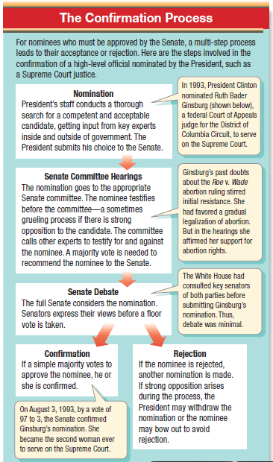
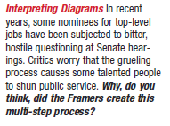
CONFIRMATION OF PRESIDENTIAL APPOINTEES

Slide 24
CONGRESS RESPONDS TO THE IMPERIAL PRESIDENCY
LEGISLATIVE VETO
In the past: Congress passed a law, the relevant executive agency issued regulations to enforce the law, Congress could then analyze those regulations and veto them if it so desired.
The legislative veto was a way of forcing the bureaucracy to conform to congressional intent.
In the case of INS v. Chadha (1983), however, the Supreme Court declared the legislative veto to be an unconstitutional violation of separation of powers.

Slide 25
CONGRESS RESPONDS TO THE IMPERIAL PRESIDENCY
FOREIGN AFFAIRS
Extensive debate over U.S. involvement in the Gulf War. Although Bush 41 did not use the War Powers Act, he did go to Congress to get its approval for U.S. action.
Congress gave strong support to Bush 43 and the war on terrorism.
Extensive debate over U.S. involvement in war against Iraq in 2003. Although Bush 43 did not use the War Powers Act, he did go to Congress to get its approval for U.S. action. Increasing criticism over war in Iraq.
Use of appropriations power to inﬂuence foreign policy. Congress tried to force Bush 43 into a deadline for withdrawing troops from Iraq by using funding as a lever.
Criticism of Patriot Act and secret domestic surveillance programs of NSA without going through Foreign Intelligence Surveillance Act court for prior approval.

Slide 26
SUCCESSION
If oﬃce of presidency is vacant due to death, resignation, or impeachment and removal, the V.P. becomes President.
He in turn nominates, and Congress conﬁrms, a new VP.
If V.P. dies before his inauguration as President, the line of succession is as follows:
Speaker of the House
Senate President Pro Tempore
Sec. of State
Sec. of Treasury
Sec. of Defense
Other Cabinet secretaries in order of the creation of their oﬃces (Presidential Succession Act of 1947)

Slide 27
SUCCESSION
If the President is disabled, the 25th Amendment applies:
The President informs the Congress of disability and the V.P. becomes Acting President.
If the President is unable to inform Congress (e.g., coma), the V.P. and a majority of Cabinet secretaries can go to the Congress and receive approval for the V.P. to become Acting President.
In either case, the President regains powers by informing Congress of his intent to return. In case of dispute, Congress has the power to decide who shall be President

Slide 28
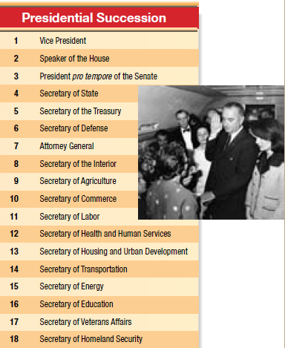
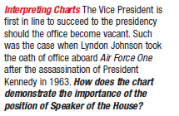

Slide 29
INCOMPLETE PRESIDENTIAL TERMS
What does superscript ‘b’ mean? How was this possible?

Slide 30
How have presidents interpreted and explained the use of formal and informal powers?
Presidential Expansion of Power | Response to Expansion of Presidential Power
In his “imperial presidency”, Andrew Jackson expanded voting rights. “The Age of the Common Man” | Jackson gained popularity among farmers and the common citizen. Presidential power expanded.
President Abraham Lincoln claimed inherent powers during the crisis of the civil war and suspended habeas corpus | The Supreme Court rebuked Lincoln saying only Congress had such power
President Theodore Roosevelt used a stewardship theory to the presidency in foreign relations to push US influence abroad | Populace reacted positively. T.R.’s actions expanded the US presence in the world, i.e., Panama Canal, Two ocean navy, big stick diplomacy-Roosevelt Corollary to the Monroe Doctrine, helped end Russo-Japanese war
President Franklin Roosevelt's new deal greatly expanded economic role for federal government in efforts to remedy the problems of the great depression. | Roosevelt was elected four times
Pres. Lyndon Johnson resolution to expand presidential power to conduct military actions during the Vietnam war | Congress passed the War Powers Act after the unpopular Vietnam war to limit the president’s war powers.

Slide 31
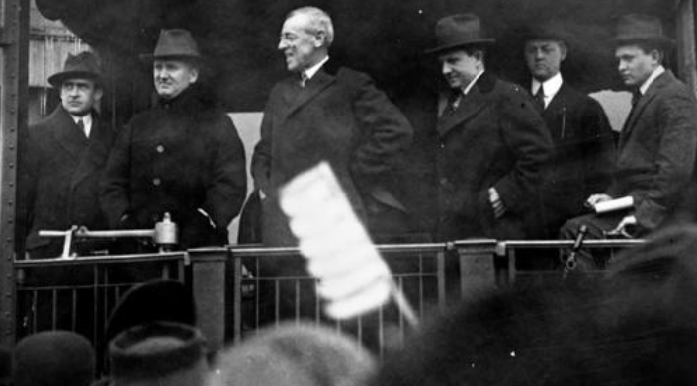
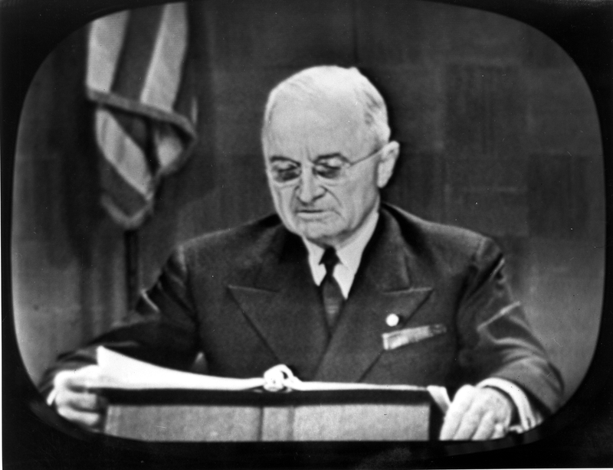
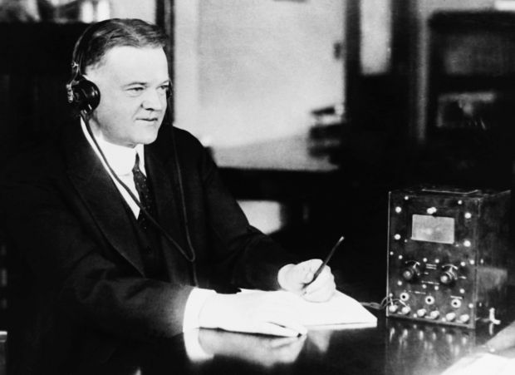
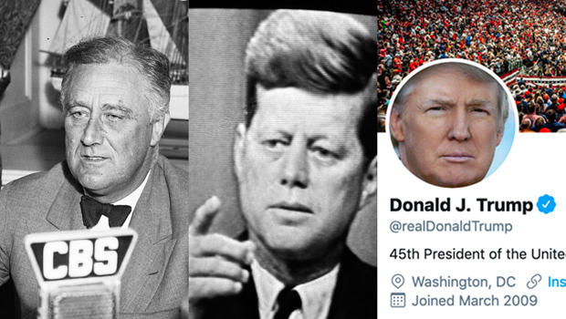
UNIT 2 Topic 2.7
AMSCO pg. 166-171
2.7 Presidential Communication
31

Slide 32
TOPIC 2.7 Presidential Communication
Explain how communication technology has changed the president’s relationship with the national constituency and the other branches.
The impact of presidential communication has increased with advances in communication technology.
i. Modern technology, such as social media, allows for rapid responses to political issues.
ii. Nationally broadcast State of the Union messages and the president’s bully pulpit are tools for agenda setting that use the media to influence public views about which policies are the most important.
The president uses the traditional media or digital medial to inform the public so that the public can then put pressure on members of congress to carry out the president’s agenda .

Slide 33
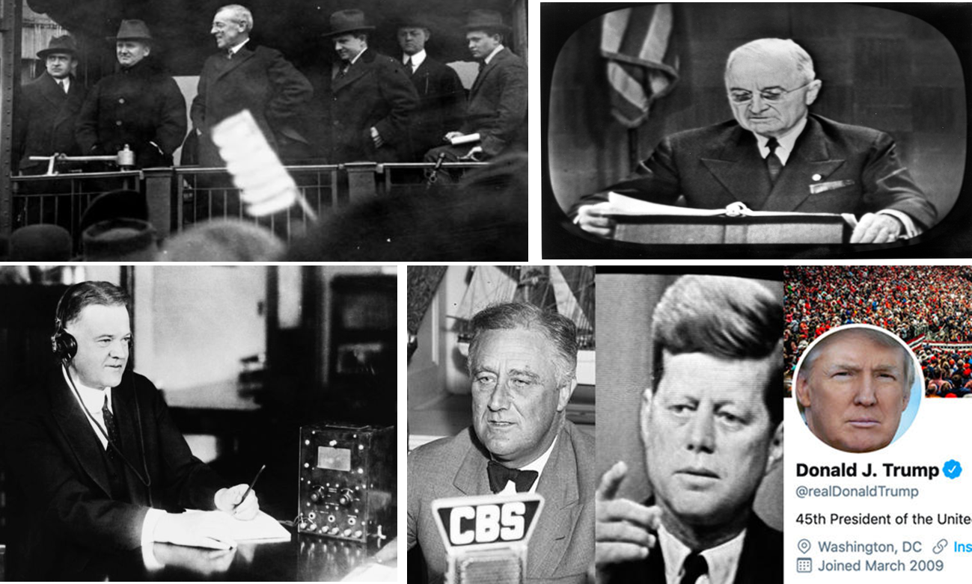
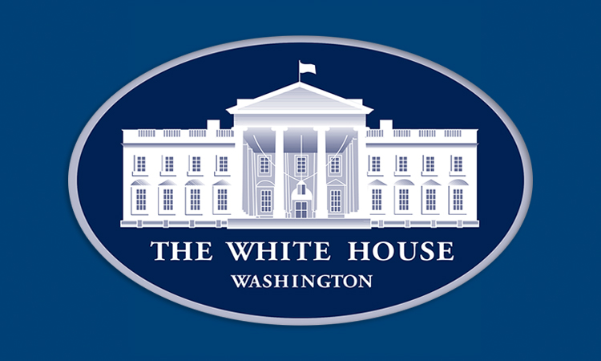
The President As Communicator-in-chief
The Constitution grants the president the power to “recommend to Congress such measures as he shall judge necessary and expedient”, meaning he can try to influence the legislative actions of Congress especially from the perspective of the manager who will carry out such policies. The President has many tools to influence Congress to pass his legislative agenda.
https://www.cbsnews.com/video/communicator-in-chief-how-presidents-use-the-media/

Slide 34
2.7 PRESIDENTIAL COMMUNICATION
How technology has changed presidential communication
How the president communicates to the national constituency and Congress
Presidents have leveraged changes in communication technology to enhance their power by appealing directly to the American public. For example, Franklin D. Roosevelt broadcast his fireside chats over the radio, keeping the public informed of his policy goals aimed at righting the economy after the Great Depression. In the twenty-ﬁrst century, presidents have used social media to reach large audiences of Americans and to respond rapidly to political issues.
When setting a policy agenda, presidents have taken advantage of contemporary technology and social media to inﬂuence the national constituency, promoting presidential policy goals via the president’s bully pulpit. The State of the Union is an opportunity for presidents to inform Congress and the American public of policy goals, and to signal which legislation he may veto. A check on Congress.
From Khan Academy website

Slide 35
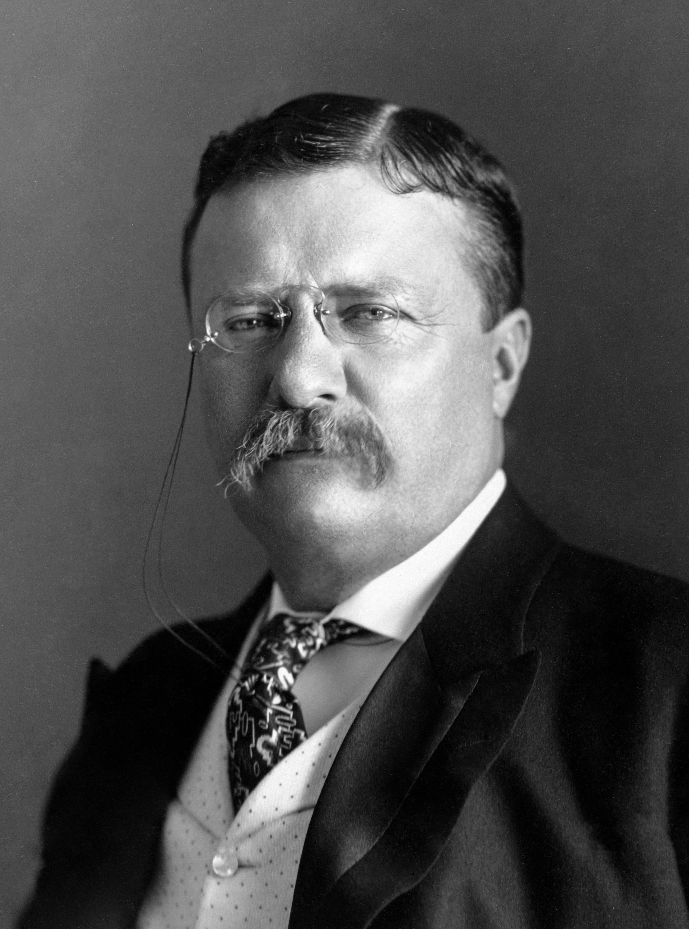
BULLY PULPIT
Merriam-Webster’s dictionary defines BULLY PULPIT as a prominent public position (such as a political office) that provides an opportunity for expounding one's views.
The term was first used by President Teddy Roosevelt as a reference to the White House meaning he could use the White House as a platform to promote his agenda; to communicate to the American people his agenda. Presidents figured if they could win over the American people to their agenda, the American people can then put pressure on Congress to pass his agenda.
Manage a crisis
Demonstrate leadership
Announce appointment of Cabinet members and Supreme Court Justices
Set and clarify the national agenda
Achieve a legislative agenda
Announce foreign policy initiatives
President Ronald Reagan – His nickname was the Great Communicator

Slide 36
The President As Communicator-in-chief
Relationship with the Press
Media’s role is to be a watchdog and hold politicians accountable
Presidents and media are often adversaries
Many people in the White House deal with the media, but the press secretary is the main contact person
Media is often more interested in the person, not the policies
News coverage has become more negative
Going Public
Public support is perhaps the greatest source of inﬂuence (power) a president has
Presidential appearances are staged to get the public’s attention
As head of state, presidents often perform many ceremonial functions which usually result in favorable press coverage

Slide 37
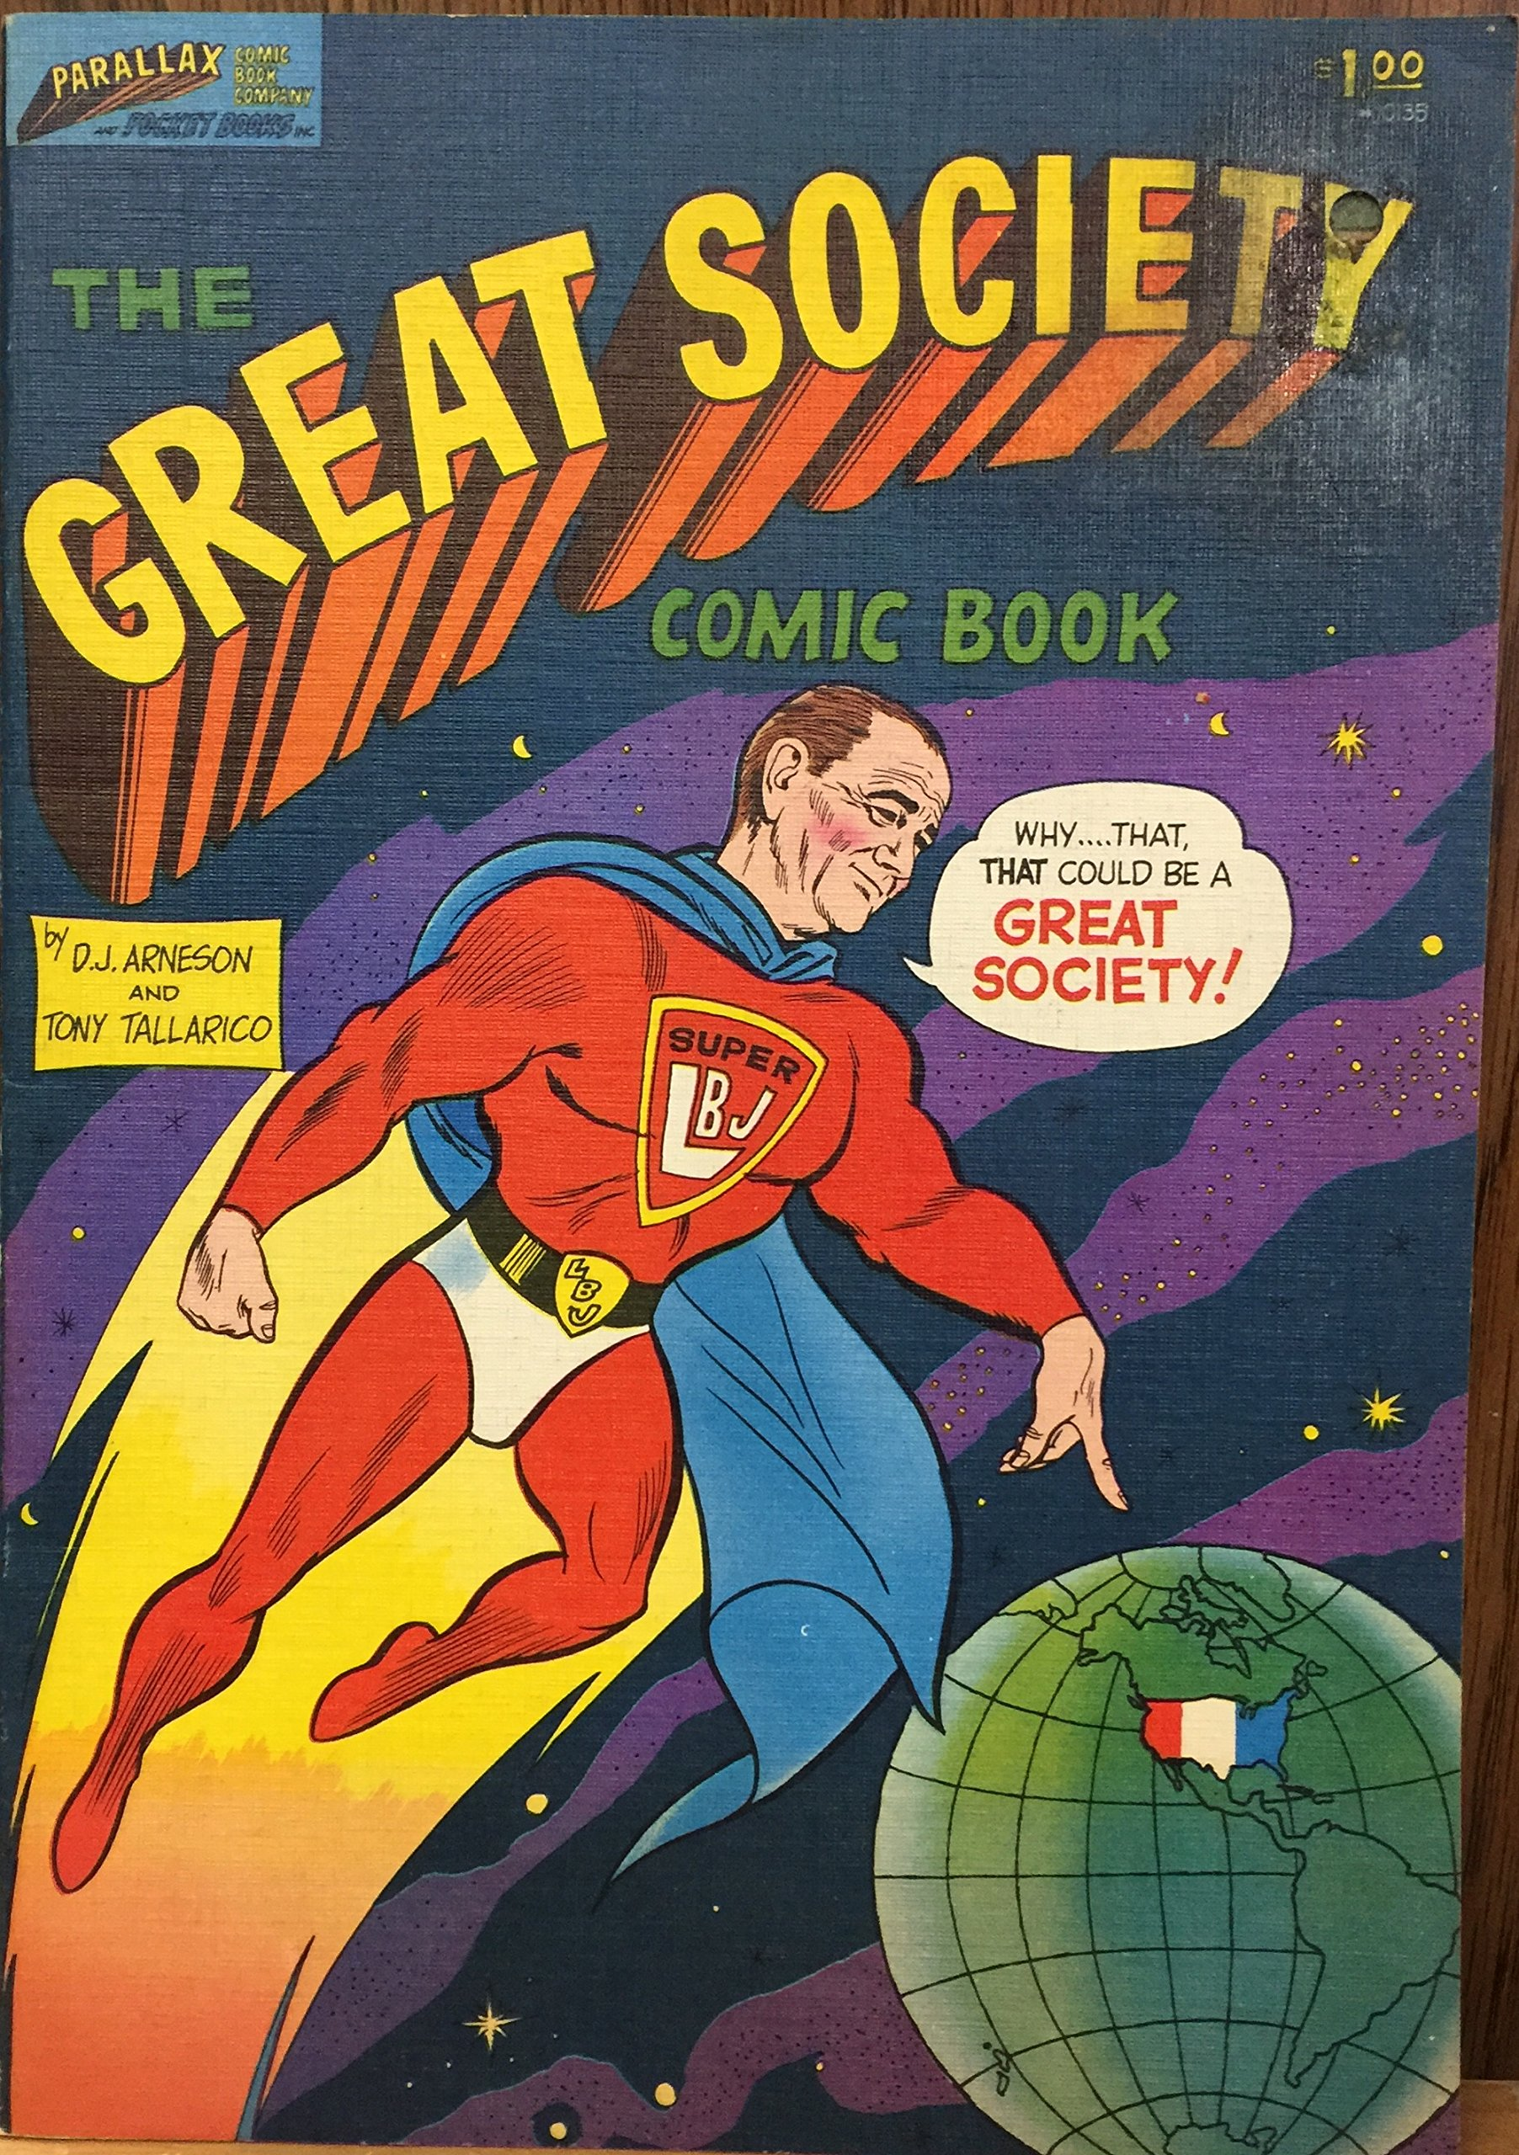
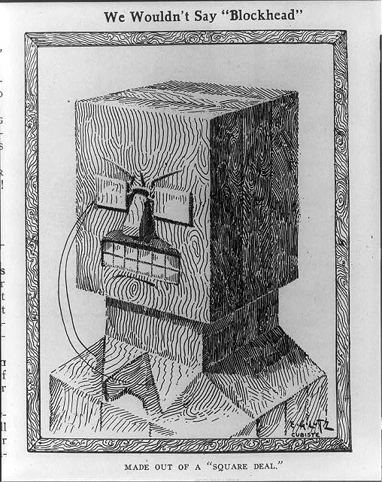
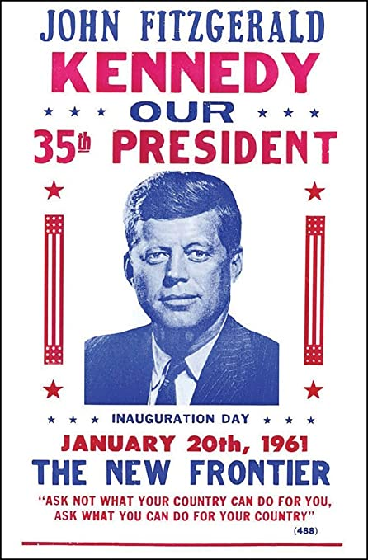
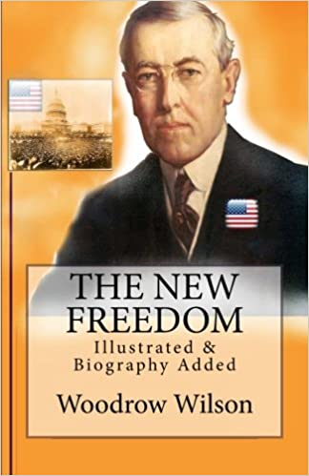
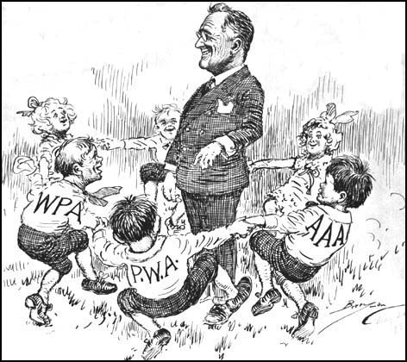
The State of the Union
The Constitution requires the president to keep Congress informed about “the state of the union.” This has become the annual State of the Union Address to a joint session of Congress, in which the president often outlines the administration’s legislative agenda.
The president outlines the administration’s legislative agenda in the State of the Union address. Some notable examples:
Teddy Roosevelt’s the Square Deal
Woodrow Wilsons’s New Freedom
Franklin Roosevelts the New Deal
John F. Kennedy the New Frontier
Lyndon Johnson’s Great Society

Slide 38
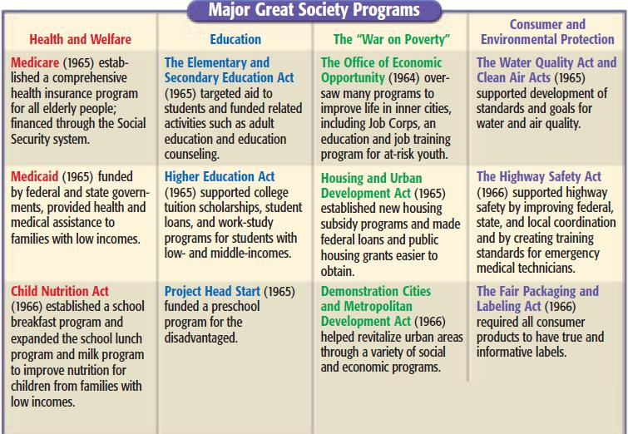

Slide 39
How has communication technology changed the president's relationship with the American people and other branches of government?
Communication or Technology Change | Presidential Use of Communication or Technology
Bully Pulpit | Coined by Theodore Roosevelt, gives the president an opportunity to use the power of persuasion with the people in order to influence Congress to carry out his policy agenda
State of the Union address | The Constitution requires the president to keep Congress informed about “the state of the union.” This has become the annual State of the Union Address to a joint session of Congress, in which the president often outlines the administration’s legislative agenda.
Fireside chat radio address | used by Franklin Roosevelt to speak plainly and in reassuring terms to the public during the Great Depression
Televised press conference | First used by Eisenhower (taped) & JFK (live) in the 1960s & by all presidents since
Social media | Obama embraced this media to share a wealth of information and images on several platforms. Trump used social media.

Slide 40
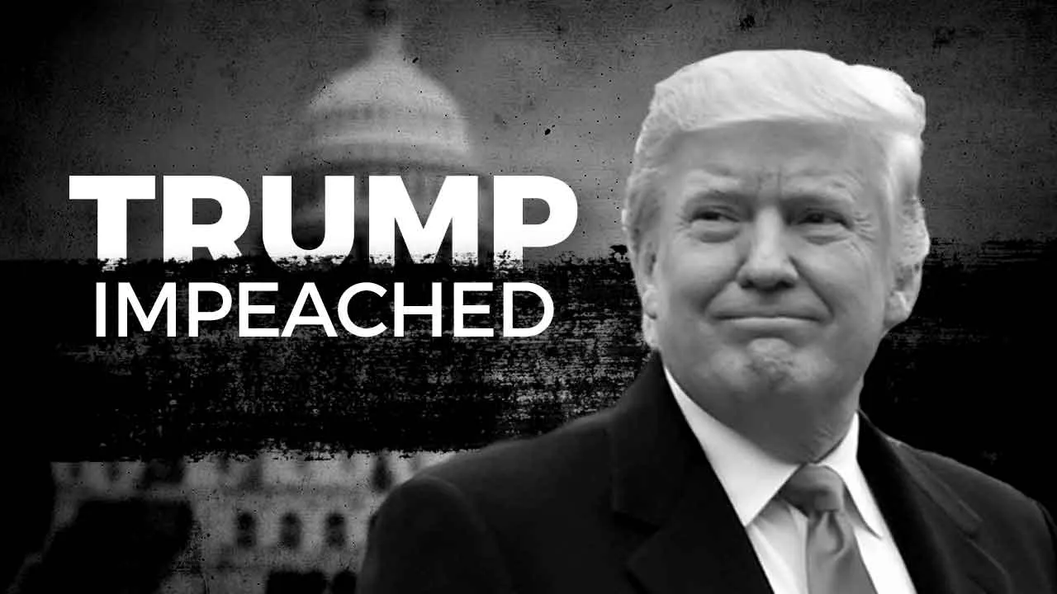
IMPEACHMENT
The vice president secedes if the president leaves oﬃce due to death or resignation or convicted of impeachment
Impeachment is investigated by the House, tried by the Senate with the Chief Justice presiding.
Only three presidents have been impeached: Andrew Johnson, Bill Clinton & Donald Trump (neither was convicted).

Slide 41
SOURCES OF CONFLICT BETWEEN THE PRESIDENT AND CONGRESS
SEPARATION OF POWERS AND CHECKS AND BALANCES
The Constitution is "an invitation to struggle between the President and Congress." There is supposed to be conﬂict.
EACH REPRESENTS DIFFERENT CONSTITUENCIES:
Members of Congress represent state and local interests ("All politics is local").
The President, however, represents the national interest.
DIFFERENT TIMES OF ELECTION
Diﬃcult for either to gain excessive power for any great length of time
Clinton was elected in '92 with a majority of Democrats in Congress, but just two years later the Republicans captured a majority of both houses.
PARTISANSHIP
Since 1952, Presidents have often faced a Congress that has had a majority of the opposing party.
Even when the Congress has a majority of the same party as the President, intra-party struggles are common. With the weakening of political parties, the President does not have a strong "hold" on members of his own party in Congress. For example, some congressional Republicans wanted a stricter immigration policy than Bush 43.
“TWO PRESIDENCIES” THESIS
– Congress tends to be more cooperative with the President on foreign policy and national security issues (esp. in a crisis), but is less cooperative on domestic and economic issues.

Slide 42
SOURCES OF PRESIDENTIAL INFLUENCE ON CONGRESS
CHIEF OF PARTY ROLE
Convincing members of Congress to act in interests of "party unity."
PERSONAL LOBBYING OF MEMBERS OF CONGRESS
Use of both favors and punishment for cooperative or uncooperative members.
VETO, OR ITS THREAT
93% of vetoes are not overridden, so even the threat of a veto carries weight.
PRESENCE OF A NATIONAL EMERGENCY
USE OF MEDIA
Media focuses more on a single person than on 535 people.
President can easily go directly to the people with his case.
"MANDATE FROM THE PEOPLE" after winning election by a large margin.
PATRONAGE
Enables a President to carry out policy his way.
Enables a President to cultivate members of Congress by seeking their input on appointments.

