Slide 1

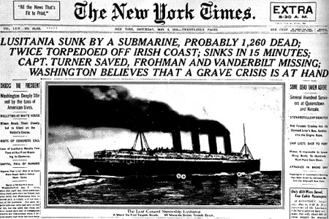

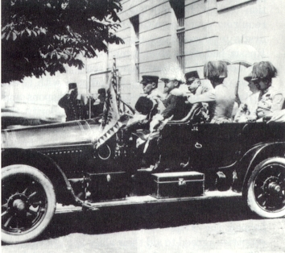
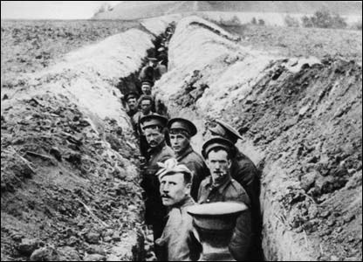
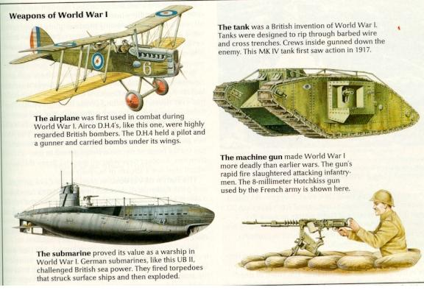
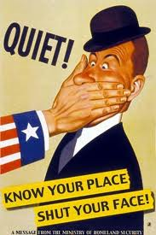
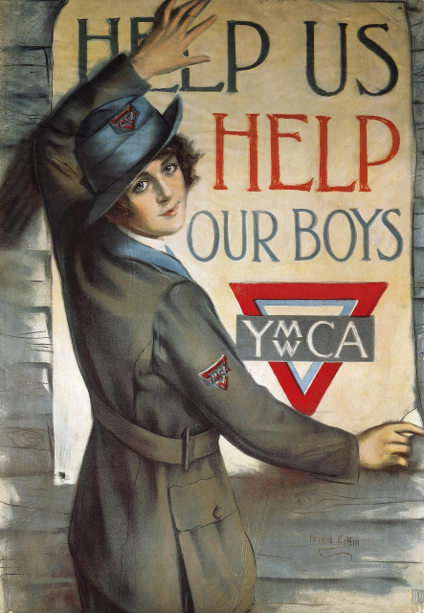
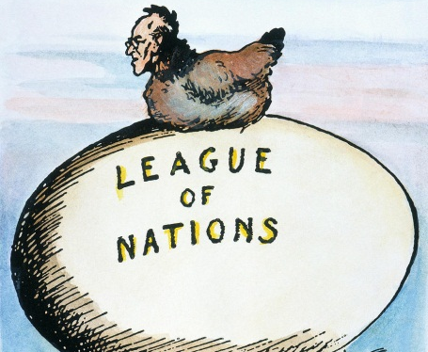
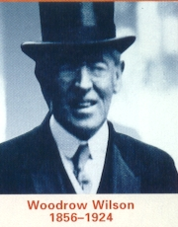
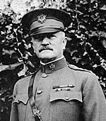

World War I
The Great War
1914-1918
R
R
Chpt. 9
HISTORY
HISTORY

Slide 2
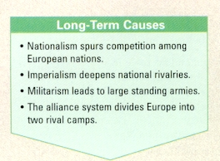
Causes of World War 1
R
HISTORY
World War 1 started in Europe in 1914, but the U.S.A. would not become involved until 1917.
There were 4 major causes of why the war happened:
  Militarism
  Alliance system
  Imperialism
  Nationalism

Slide 3
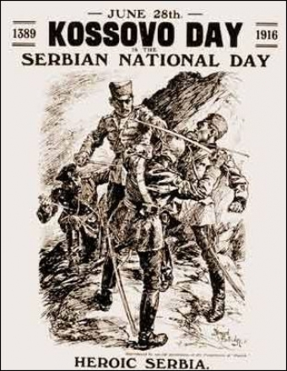
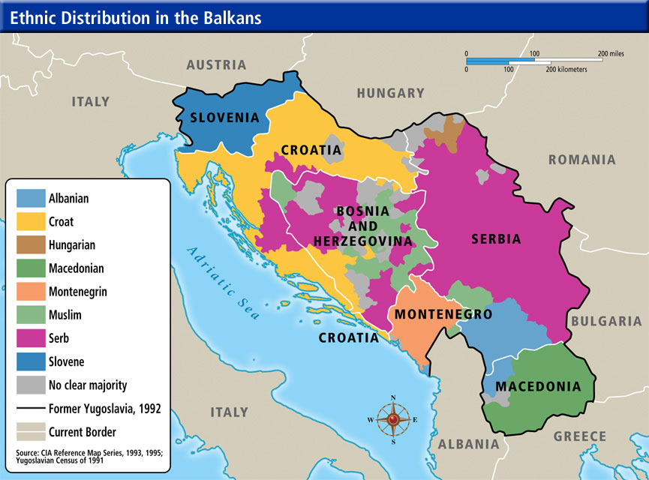
Causes of World War 1
Nationalism – a strong devotion to the interests and culture of one’s own nation, to the exclusion of other nations. The word nations comes from the Greek word “ethnos” the root word for ethnic.
This belief led to idea that a single nations interests are more important than cooperation among nations.
Several ethnic groups within other nations wanted to form their own countries. Such
Demands would lead to the dismemberment
of the Austrian-Hungarian Empire.
Nationalism led to fighting among nations!
Map of the Balkans region in Southeastern Europe

Slide 4
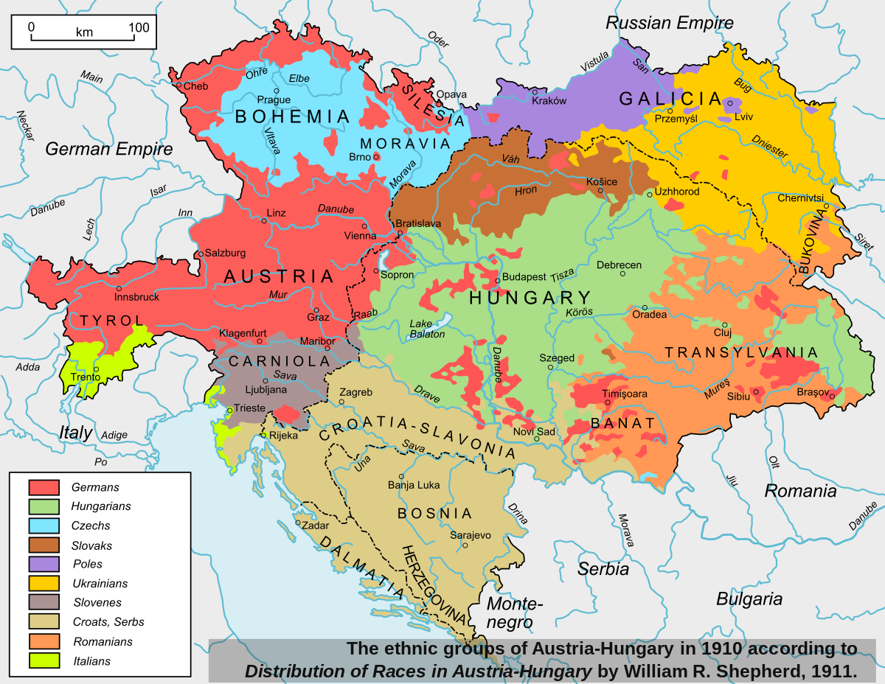
Austrian Hungarian Empire

Slide 5
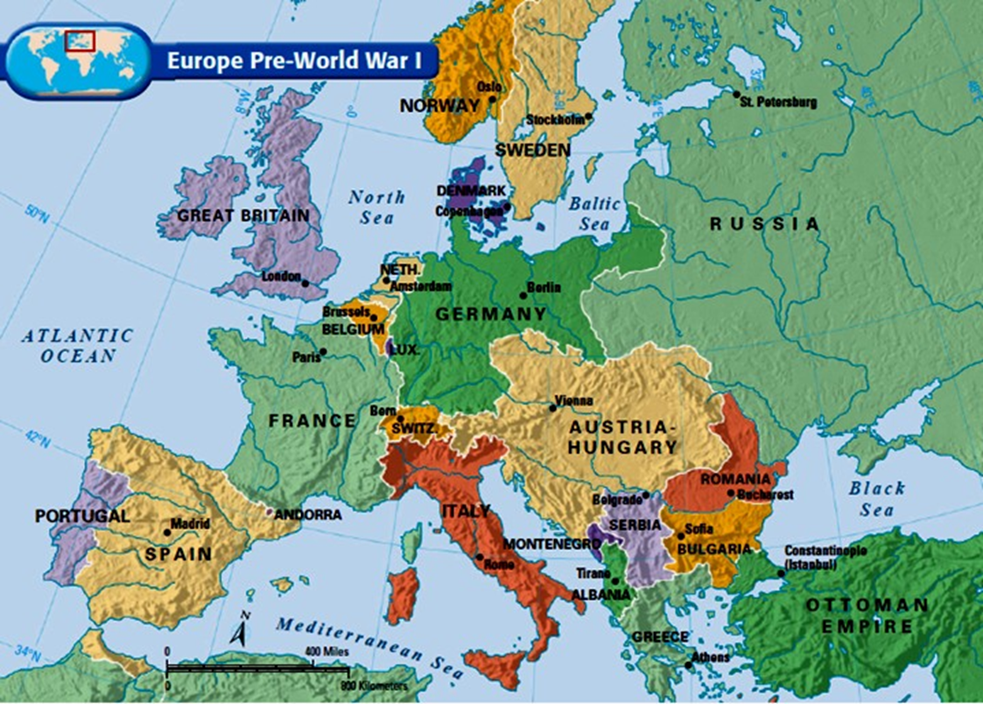
Serbians
Serbian Brotherhood with Russia
Nationalism was strong in the Balkans, where Serbia hoped to unite with Austrian Slavs

Slide 6
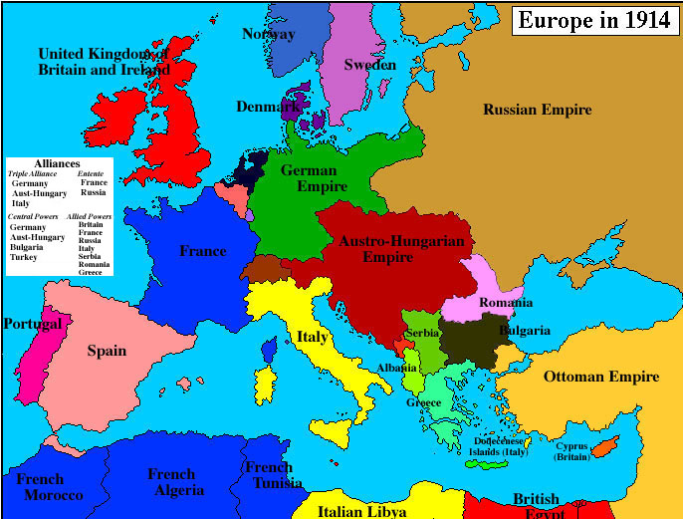








Slide 7
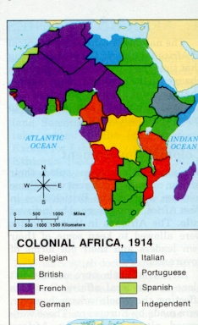
Causes of World War 1
Economic Rivalries & Imperialism – controlling a weaker nation as a source of raw materials and as a market for your products.
Many European nations controlled other nations of Africa and Southeast Asia, it was becoming more difficult to find and keep colonial empires.
As nations tried to increase their economic power and influence around the world it led to conflicts and war!
Ex. Russia wanted to extend its
Influence in the Balkans. This was seen as a threat by Turkey and Austria-Hungary creating tension
in the region
Do you think it is ok for a stronger nation to dominate a weaker nation for its resources and as a market for their products?

Slide 8
R
HISTORY

Slide 9
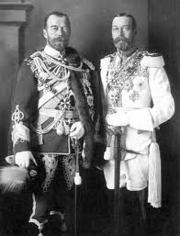
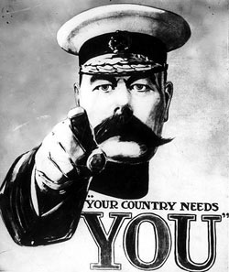
Causes of World War 1
Man I look good !
Militarism – build up of the military.
Arms Race- a competition between nations for superiority in the development and accumulation of weapons. Germany was a large land army and for the British a vast navy
Europeans were used to seeing people in uniform, even if you were not in the military.
It became a status symbol to wear military gear as military discipline and war became more admired.
Military leaders felt it was better to attack first rather than wait to be attacked, because of the time it took to mobilize troops.
Where did you get that coat ?
King George V (right) and his physically similar cousin Tsar Nicholas II of Russia in German military uniforms in Berlin before the war.

Slide 10
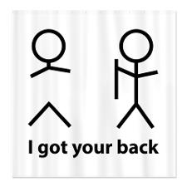
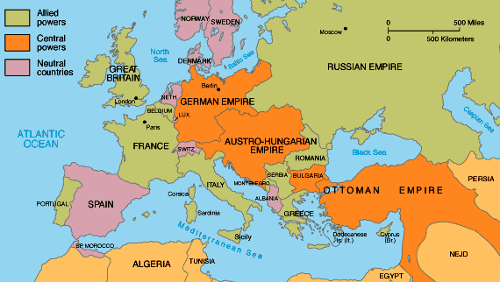
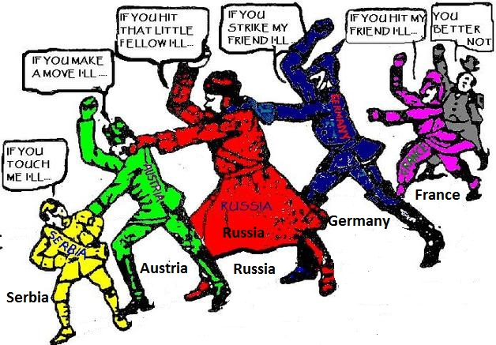
Causes of World War 1
Alliance System – agreements between nations to aid one another if they were attacked. Meant to keep a balance of power. National security is enhanced when military capability is distributed so that no one state is strong enough to dominate all others.
By 1890s, Europe was divided into two alliances,
  Central Powers (enemy) --- Allied Powers (friends).
One alliance had Germany Austria-Hungary, and the Ottoman Empire.
Other alliance was Great Britain, France, & Russia.
USA enters war on Allies side in 1917
bruh !!

Slide 11
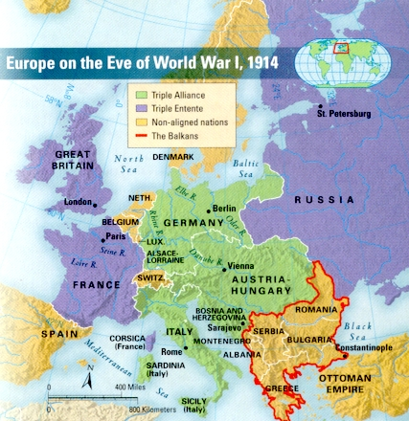
The Beginnings of War
In 1914 the country of Austria-Hungary used imperialism to control several smaller nations located in the Balkans region (outlined in red) of Europe.
Many nations of the Balkans were controlled by other stronger nations.
Serbia was 1 of these nations and didn’t like it.
The Balkans were called a “powder keg” and things were ready to explode!

Slide 12

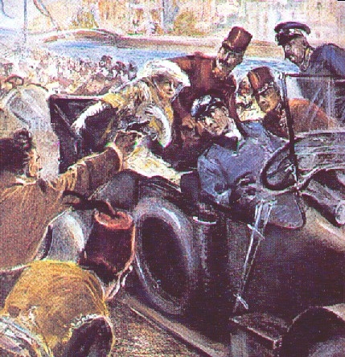
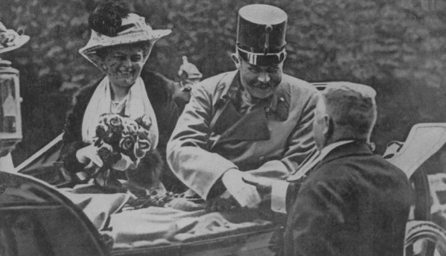
The Flashpoint of the War
The “powder keg” exploded in 1914.
Archduke Ferdinand of Austria-Hungary was touring several nations he exercised imperialism over.
A man from Serbia (country controlled by the Archduke) ran into the street and shot the Archduke and his wife.
Austrian govt sends Serbia an ultimatum-making demands that if not met would lead to war.
Serbia could not meet all the demands and Austria invaded Serbia
What should have been a regional conflict grew into a WORLD WAR
Take that you imperialist @#$%@
The Archduke gets capped

Slide 13
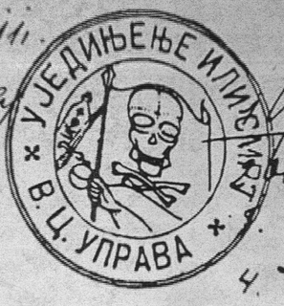
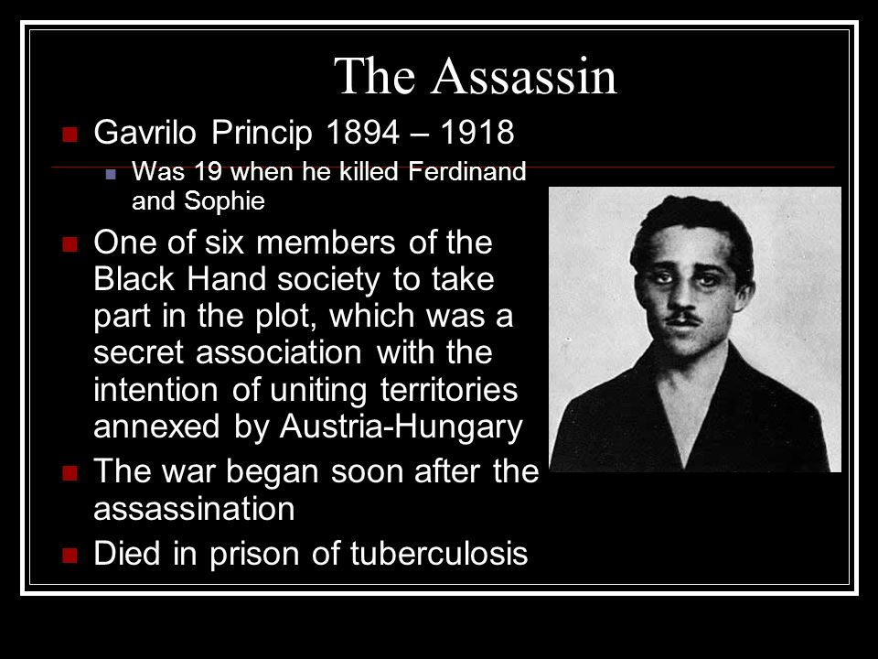
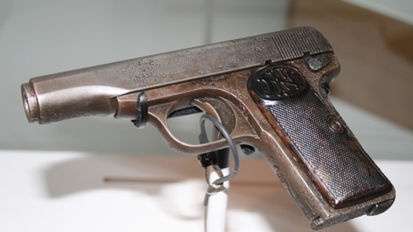
The Black Hand

Slide 14
Alliance System Takes Down Europe
The assassination of its leader caused Austria-Hungary to declare war on little Serbia.
But, Serbia had made a secret alliance with Russia.
Germany had an alliance with Austria-Hungary and Austria-Hungary attacked Serbia, the Russians came to their defense and declared war on Austria-Hungary.
Germany declared war on Russia
France had made an alliance with Russia, so the French declared war on Germany.
This brought Germany into the war, because they had an alliance to help Austria-Hungary.
The Germans invade neutral Belgium on their way into France, British declare war on Germany in order to protect Belgian neutrality.
And so on it went, as nation after nation was forced to join the war because of alliances they had made.
The war was on: August 1914- November 1918
Allies: Central Powers:
France Germany
United Kingdom of Great Britain Austria- Hungary
Russia Ottoman Empire
Italy (1915) Bulgaria
USA (1917)

Slide 15
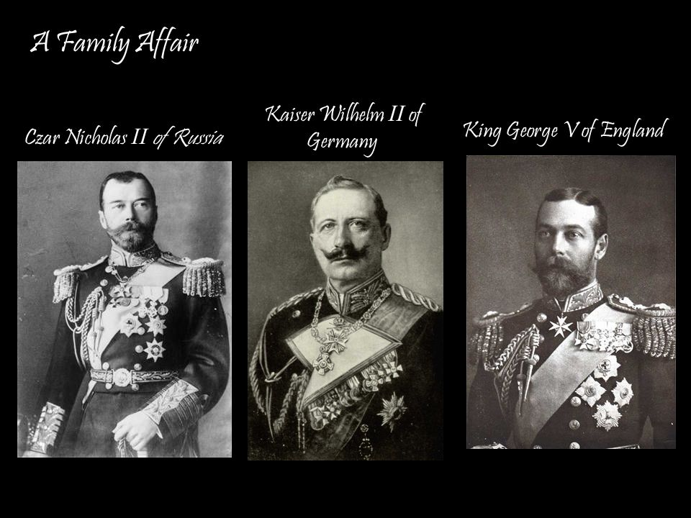



1st Cousins they all shared the same grandmother…….. Victoria- Queen of England

Slide 16
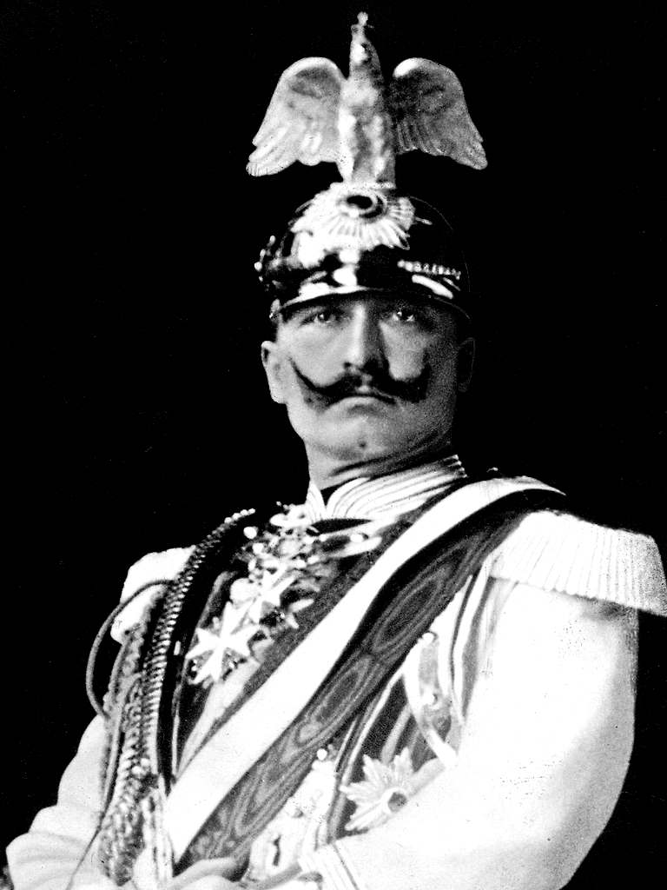
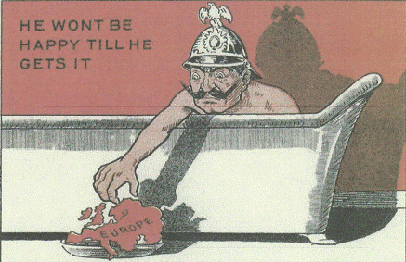
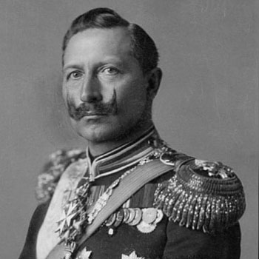
Cartoon Caricature
Cartoons tend to exaggerate a physical feature of the person. What physical feature does the Kaiser have that will be put into a caricature?

Slide 17
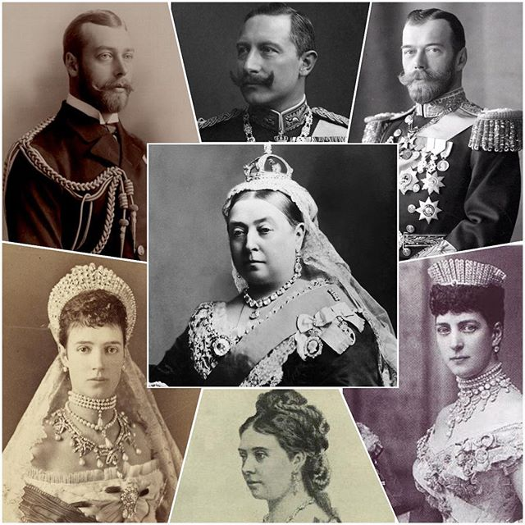







William
Wilhelm
George
Queen Victoria
Nicholas
Alexandra of Denmark,
Princess of Denmark
Maria Feodorovna, Dagmar of Denmark, sibling of Alexandra of Denmark
Victoria, Princess Royal
Daughter of Queen Victoria and Prince Albert of Great Britain

Slide 18
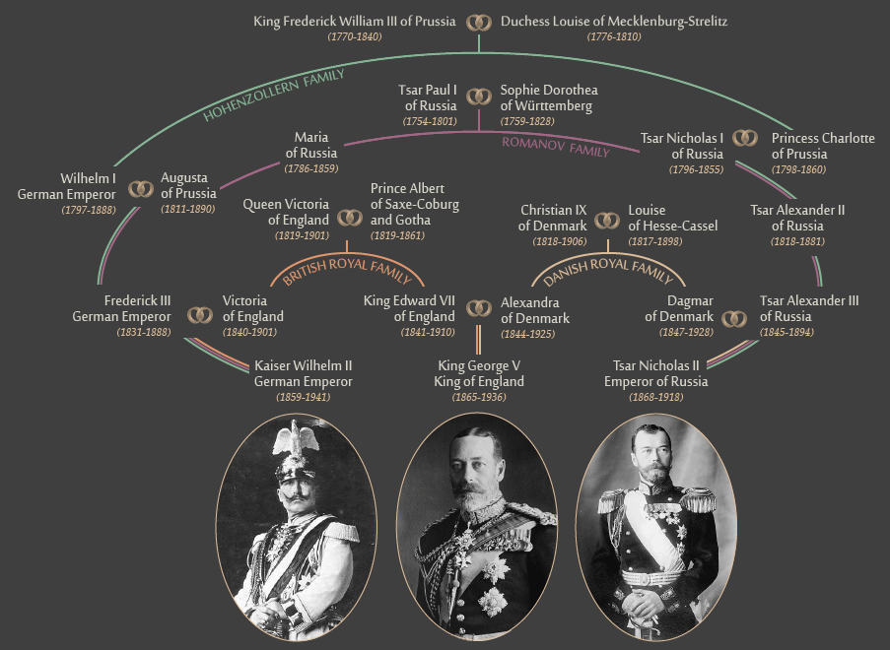

Slide 19
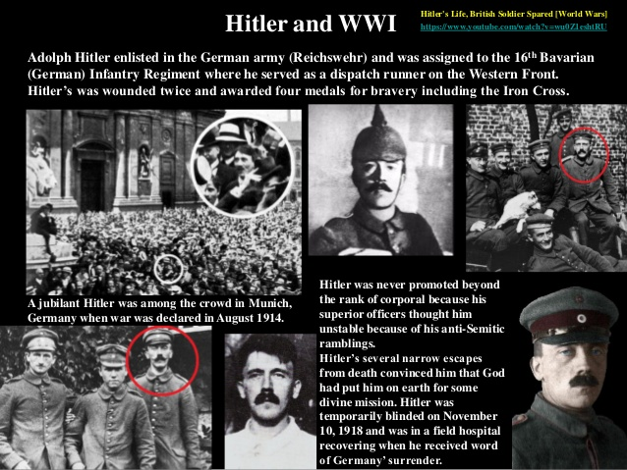

Slide 20
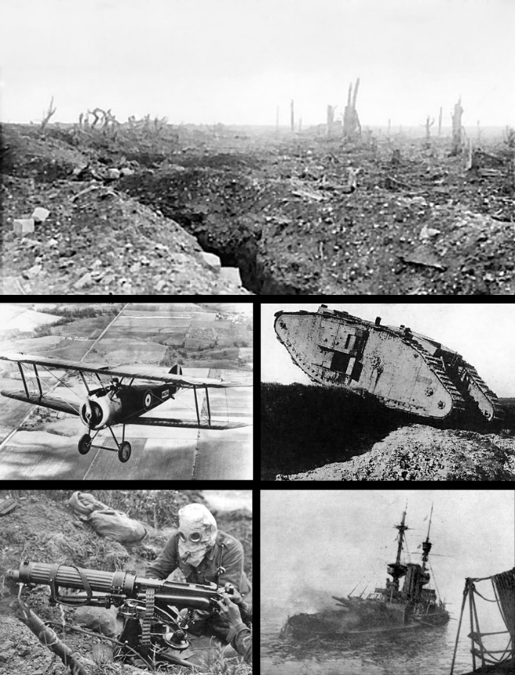
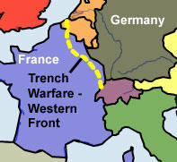
Fighting in Europe
Both sides predicted the war would be over soon, both would be wrong.
New weapons were introduced:
  machine guns, poison gas, submarines, airplanes, & tanks.
These weapons made it easier to defend a position rather than attack.
Trenches were dug along France’s eastern border with Germany, it was called the ‘Western Front’. The same happened on the Eastern Front with Russia and Austria-Hungary and Germany
The Western Front would become a very deadly area.

Slide 21
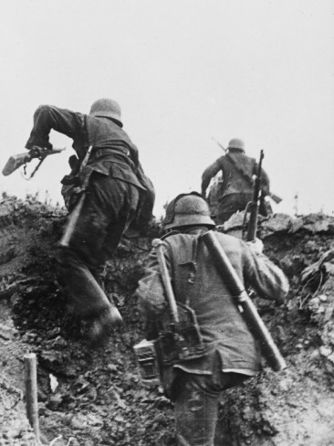
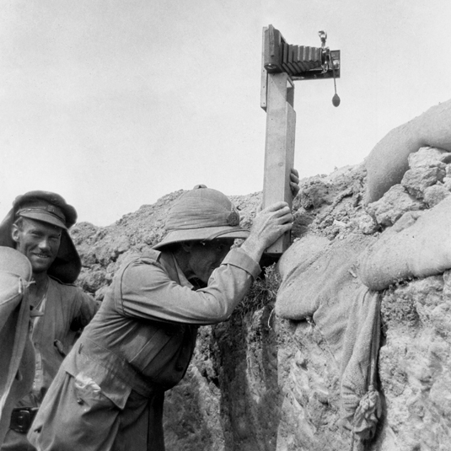
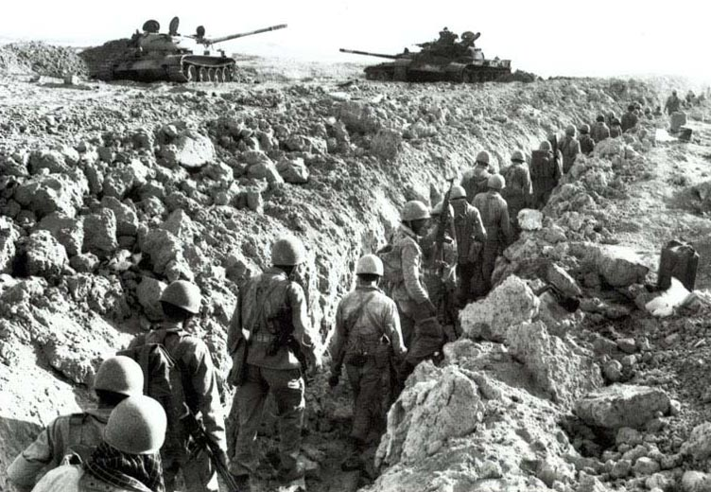
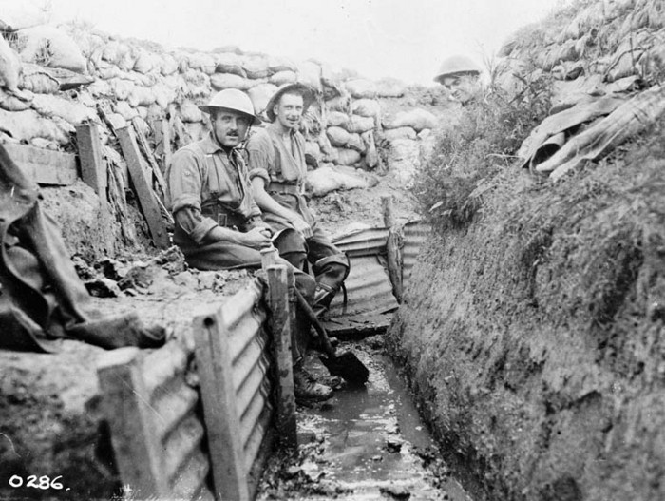
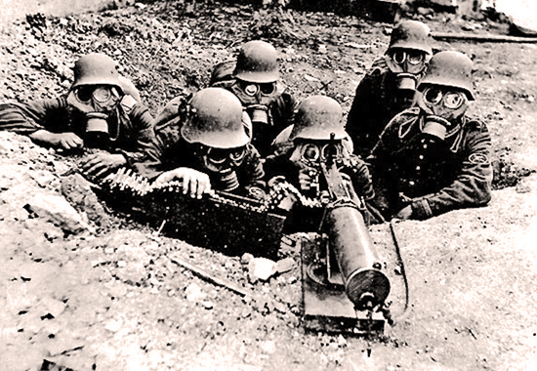
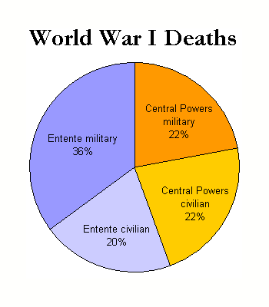
Trench Warfare
Fighting in Europe
Trench Warfare was a new and strange form of war no one had ever seen before.
Men dug trenches that were separated by barbed wire and land mines, and defended by machine guns. The area between them was called ‘no man’s land’ and was a killing zone.
Soldiers would spend years in the trenches because neither side could advance causing a stalemate (a situation in which no progress can be made or no advancement is possible) and drawing out the War. On the Western Front there were 1500 miles of trenches from Belgium to Alps near Italy. Same was happening on the Eastern Front with over 2000 miles of trenches.
The death toll would be horrendous.

Slide 22
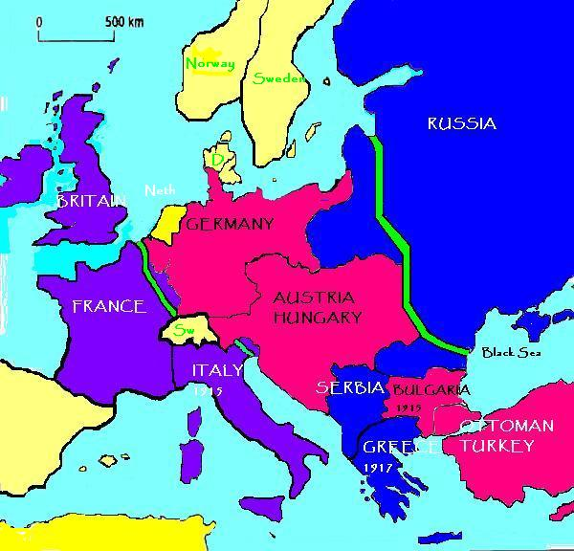
R
Fighting in Europe
HISTORY
Eastern Front Trench Line
Western Front Trench Line

Slide 23
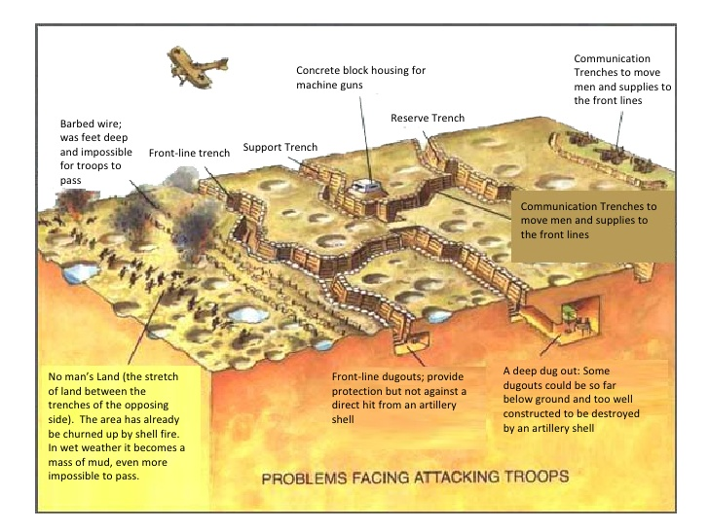
Fighting in Europe

Slide 24
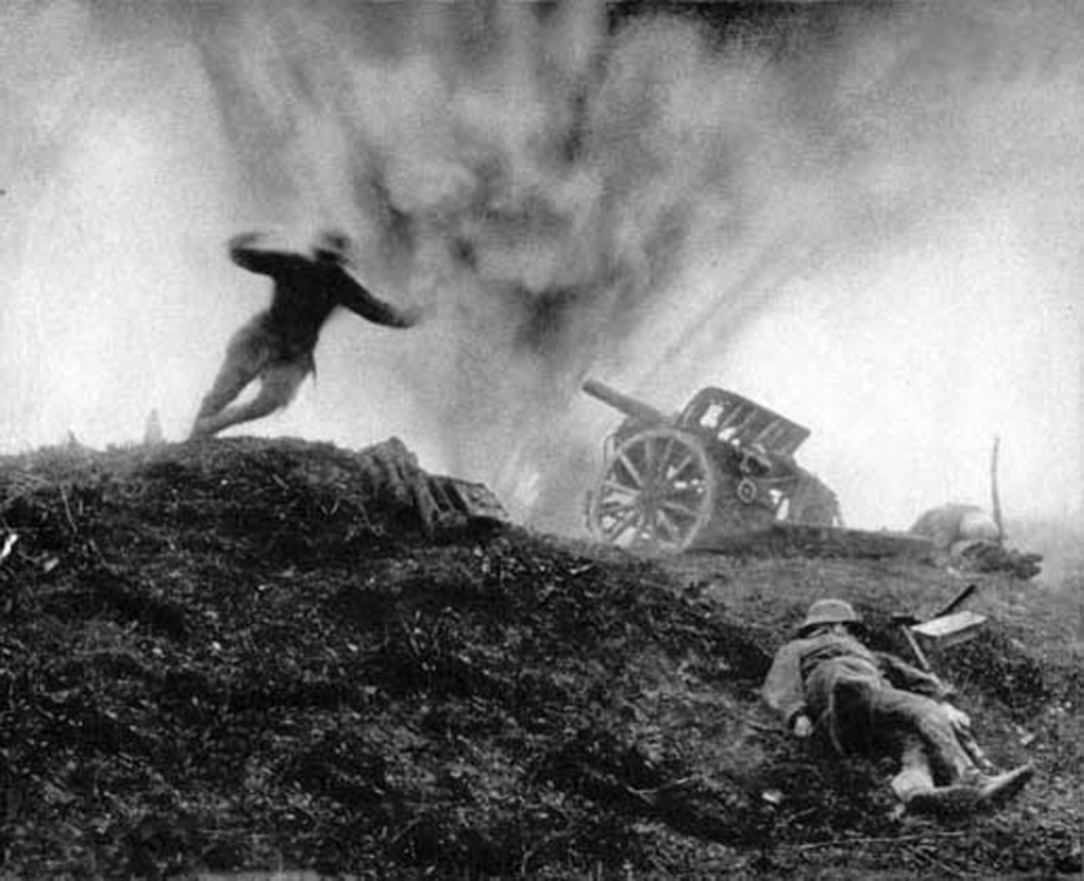
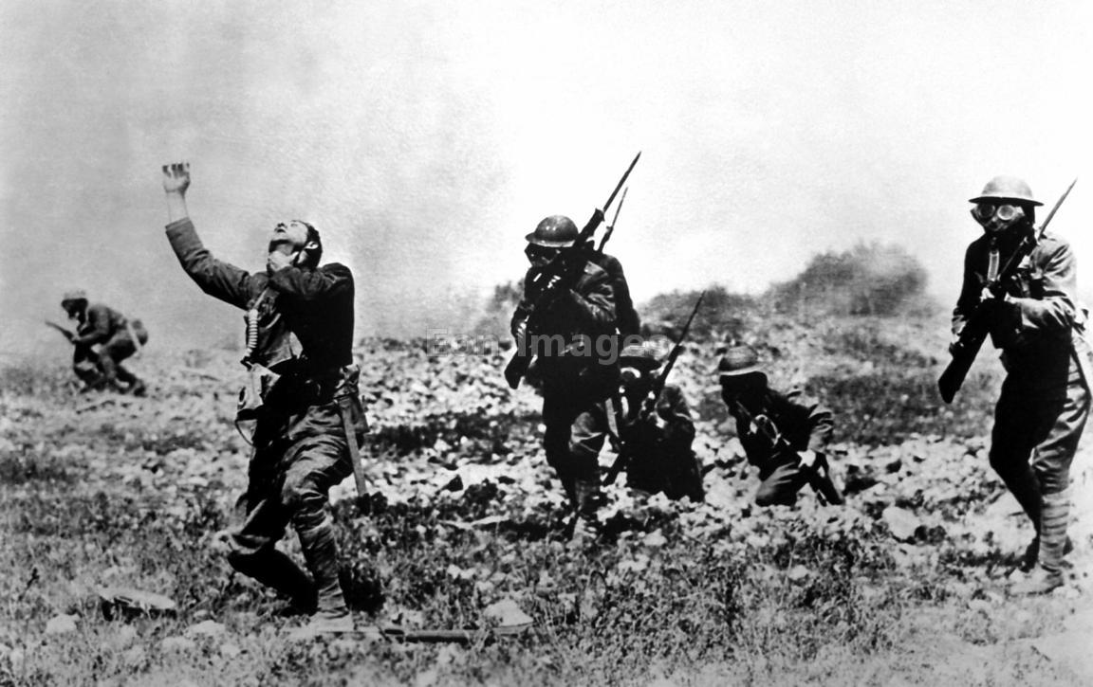
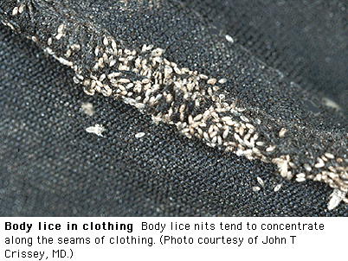
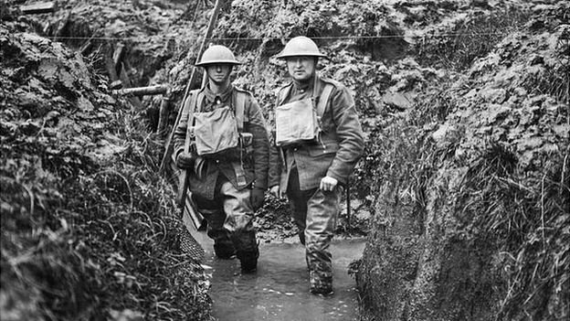
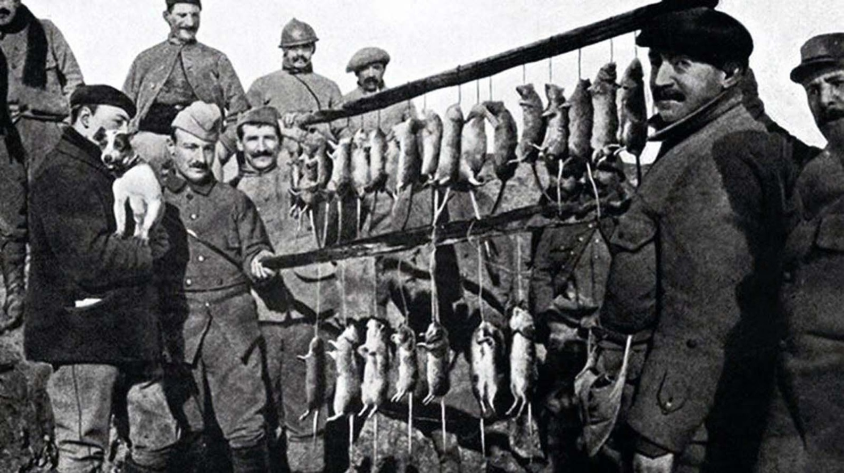
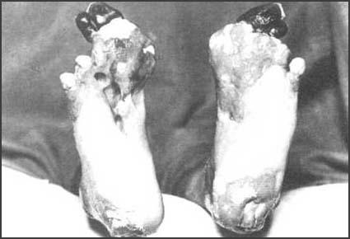
Trench Warfare
Fighting in Europe
Soldiers in trenches suffered from:
Loud shelling
Gas Attacks
Rats and lice
Dampness
Trench foot

Slide 25

Fighting in Europe
To breake through the trench lines, the British introduced the tank. The first use of tanks on the battlefield was the use of British Mark I tanks at the Battle of Flers-Courcelette (part of the Battle of the Somme) on 15 September 1916, with mixed results; many broke down, but nearly a third succeeded in breaking through the German trench line.

Slide 26


The Tank

Slide 27

A Window To The Past: Life in the Trenches
R

Slide 28

An aerial view of the Newfoundland Memorial Park in Beaumont Hamel, Northern France, with its shell craters and trenches
The entire Western Front trench network , when put together was 25,000 miles. That was a lot of digging.

Slide 29

Fighting in Europe
Naval Blockade. With a stalemate in Western Europe, Great Britain used its navy to starve Germany into surrender.

Slide 30


Slide 31


Fighting in Europe
Germany
USA
Airplanes- first used for reconnaissance- to see what is happening on the battlefield below. Pilots would soon engage in “dogfights”

Slide 32

Fighting in Europe

Slide 33





Aces of WW1
Fighting in Europe
A pilot who shoots down 5 enemy planes
earns the title of Ace
Eddie Rickenbacker, USA
26 Kills
Manfred von Richthofen, German Empire
The Red Baron
80 Kills

Slide 34





Slide 35




1917

Slide 36

America Goes to War
It’s 1914 and Europe is at war!
The U.S.A. remained neutral (didn’t become involved).
U.S. President Woodrow Wilson was elected as president on the campaign promise of “I’ll keep us out of war”.
Pres. Wilson kept his word until 1917 when a series of events caused America to want war.
Elect me and I will keep us out of Europe’s affairs

Slide 37

I

Slide 38


"It is our true policy to steer clear of permanent alliance with any portion of the foreign world"
"Peace, commerce, and honest friendship with all nations-entangling alliances with none."
R
HISTORY

Slide 39
Causes of USA’s Involvement in the War
When war broke out in Europe, America would attempt to remain neutral.
But the U.S.A. would eventually become involved.
Close ties with both Britain and France
Germany declares unrestricted submarine warfare.
Germany had promised not to sink neutral ships, but they were breaking that promise. The rights of neutral countries were violated.
Allied propaganda played the Germans as committing atrocities against civilians
The ‘Zimmerman Note’ offered Mexico a deal to join with Germany.

Slide 40









America Goes to War
-Close ties with both Britain and France. Most Americans favored the Allies in the war.
US shares a common language and history with Great Britain and France. Also shared common political system- democracy.
But many American could trace their ancestry back to Germany. Many German immigrants contributed the growth of the USA- Beer in Milwaukee, the hamburger from Hamburg, Germany, Kindergarten- the children’s garden, the Frankfurter (hot dog) from Frankfurt, Germany.
Many Americans detested German militarism and they had an emperor or Kaiser- dictatorship.
Kaiser

Slide 41







America Goes to War
German Atrocities and Allied Propaganda
By the time the USA joined the Allies in 1917, the Germans were portrayed as apes, hogs or monsters. This was done to dehumanize the Germans. After all, its easier to kill a monster than a human being.
USA was shocked at Germany’s invasion of Belgium. US public opinion turned against Germany.
The invasion was met with resistance. German soldiers, shot civilians, burned building, etc.
British propaganda- Information, especially of a biased or misleading nature, used to promote a political cause or point of view.
British needed USA to join war effort, so they exaggerated German atrocities to that end.
US press carried these propaganda stories as factual news. Even though theses stories were false, American public opinion was turning against Germany.

Slide 42








“Over There”
By George M. Cohan
https://www.youtube.com/watch?v=gsdSjN9ubSg
We are going Over There

Slide 43

America Goes to War
The British blockade cut off the Central Powers from the USA.
Americans grew more in favor of the Allies because they heard only their side of the story.
US trade with Germany dropped to almost nothing. While trade with the Allies quadrupled.

Slide 44

America Goes to War
The Blockade

Slide 45
Economic Moment
International trade is essential to a country’s economic health. The more exports (sales to other countries the better).
When exports are greater than imports (purchases from other countries), the country has a trade surplus.
When exports (sales to other countries) are less than imports (purchases from other countries), the country has a trade deficit.
Trade deficits are bad because there is an outflow of money leaving the importer country.
Trade surpluses are good because there is an inflow of money to the exporter. Trade surpluses make a country a creditor nation rather than a debtor nation.
Based on this information, answer the question on the next slide:

Slide 46

An EOC Moment
Data from this graph support the conclusion that World War I
caused the United States trade deficit to increase
cost the United States many billions of dollars
was a significant benefit to the American economy
created an unfavorable balance of trade

Slide 47





Fighting in Europe
Naval Blockade
The USA did not complain to Britain about blockade of Germany since this was a violation of international law.
German Counter Blockade
German fleet was unable to break the British blockade. They used U-Boats- submarines to sink ships with their torpedoes.
Germany threatened to sink all Allied shipping navigating in the blockaded areas.
Germany had no intention of attacking American ships but Americans travelling on Allied ships were taking a huge risk.

Slide 48

German U-boat

Slide 49
US ships travelled in groups, or convoys, escorted by battleships, destroyers and heavy cruisers
In crossing the Atlantic. This same tactic
would be used during WW2
Convoys made it difficult for U-boats to attack.

Slide 50




Economics of War
America Goes to War
Britain made huge war order to US factories and borrowed large sums of money from US banks to pay for it. By the spring of 1917 Britain owed the US $2.3 billion. By 1918 Britain owed the US $4.2 billion or about $100 billion adjusted for inflation in todays money. German trade with the US $27million.
British trade became more important to the US economy than trade with Germany.
USA had a stake in making sure the Allies won the war if the loans were to ever get repaid.
Germany was winning the war at this time.
Hey don’t laugh, you have to
pay it back. We will help you win.
Germany is winning

Slide 51



Sinking of the Lusitania
May 7, 1915
The image is a postcard that Germany printed to show its sinking of the Lusitania.
In early May 1915, several New York newspapers published a warning by the German Embassy in Washington, D.C., that Americans traveling on British or Allied ships in war zones did so at their own risk. The announcement was placed on the same page as an advertisement of the imminent sailing of the Lusitania liner from New York back to Liverpool.

Slide 52

Cruise ship: Sinking of the Lusitania
On the afternoon of May 7, 1915, the British ocean liner Lusitania is torpedoed without warning by a German submarine off the south coast of Ireland. Within 20 minutes, the vessel sank into the Celtic Sea. Of 1,959 passengers and crew, 1,198 people were drowned, including 128 Americans and 94 children were killed.
Unknown to most Americans, it was also was carrying tons of guns and ammunition for England.
This was the first time that Germany had actually killed American citizens.
American’s called for war!
The image is a postcard that Germany printed to show its sinking of the Lusitania.
159 Americans on board, 124 perished. 124 children on board, 94 perished, including 31 of 35 infants

Slide 53


Sinking of the Lusitania 1915
Here Lies The Facts
What is Uncle Sam complaining about?
To whom is Uncle Sam complaining to?
Gateway Book pg. 170
Sinking of the Lusitania, May 1915

Slide 54


Freedom of the Seas
Freedom of the Seas was one of the main reasons the U.S.A. finally entered the war.
Britain used a naval blockade against Germany, preventing them from getting food & supplies. Thousands of Germans were starving.
Germany continued to sink ships until America threatened to end relations with Germany and possibly enter the war on the side of the Allies
(1916) Germany then made the ‘Sussex Pledge’ not to sink merchant ships without warning or without helping passengers on board.

Slide 55
America to Germany
What is Uncle Sam complaining about?
Satirical cartoon showing the United States of America feebly remonstrating with Kaiser Wilhelm II, threatening him ineffectively about Germany's U-boat policy . America would finally enter World War 1 in 1917
America to Germany: “If you don’t darned stop this submarine business, and cease your murderous attacks on American citizens we’ll– er--er we’ll--hum—er well—we’ll jolly well send you another firm Note” The US would send 3 strongly worded notes.

Slide 56



Unrestricted Submarine Warfare
Germany was suffering from the British blockade and declared they would again start using Unrestricted Sub-marine Warfare to sink any ships they found.
They knew this might prompt USA to enter war but it was a risk they had to take to break the blockade. They felt they could defeat UK and France before USA could make a difference in the wars outcome.
This violated the principle of “freedom of the seas”, or the right of neutral nations like the USA to ship non-military goods to nations at war.
Swim with the fish
German U-Boat sinking an unarmed Allied ship
Notes:
.

Slide 57



The Zimmerman Note
Germany sent a telegram from its Ambassador Zimmerman to Mexico.
Germany offered Mexico lands in the southwestern USA if Mexico would attack the USA.
The telegram was intercepted and published in American newspapers.
America screamed for war!
Pres. Wilson asked Congress to declare war, and they did on April 2, 1917
Coded telegram proposing an alliance between Germany and Mexico
The Zimmerman Note decoded

Slide 58

The Zimmerman Note
Which countries are involved in this political cartoon?
What does the soldier promise the civilian?
What is the main idea of this
Cartoon?
R
HISTORY

Slide 59

The US in World War I
R
HISTORY

Slide 60






World War I Movies

Slide 61
An EOC Moment
Publication of this telegram in United States newspapers helped to
a. reelect Woodrow Wilson as president
b. convince the American public to support entrance into World War I
c. encourage Congress to pass neutrality legislation
d. grant statehood to Arizona and New Mexico
R
HISTORY

Slide 62

An EOC Moment
We intend to begin on the first of February unrestricted submarine warfare. We shall endeavor in spite of this to keep the United States of America neutral. In the event of this not succeeding, we make Mexico a proposal of alliance on the following basis: make war together, make peace together, generous financial support and an understanding on our part that Mexico is to reconquer the lost territory in Texas, New Mexico, and Arizona. The settlement in detail is left to you.…
— Telegram of January 19, 1917
This telegram was part of an effort to
a. form an alliance between Germany and the United States
b. convince several western states to secede from the United States
c. bring Mexico into World War I on the side of Great Britain and France
d. enlist Mexican support for Germany if the United States declared war
What were the two reasons why the USA declared war on Germany?

Slide 63


Wilson’s Speech in Asking Congress for War
“It is a fearful thing to lead this great peaceful people into war, into the most terrible and disastrous of all wars, civilization itself seeming to be in the balance. But the right is more precious than peace, and we shall fight for the things which we have always carried nearest our hearts -- for democracy, for the right of those who submit to authority to have a voice in their own governments, for the rights and liberties of small nations…..”
According to Wilson, what was America fighting for?
To make the world safe for DEMOCRACY
US Enters The Great War

Slide 64

EOC Moment Question

Slide 65
EOC Moment Question
Using the newspaper to answer the question
What event in American history does this newspaper headline refer to?
American Revolution
Civil War
Spanish American War
World War I
ANSWER: Letter D, the sinking of the Lusitania was a major cause of America entering into World War I

Slide 66

EOC Moment Question

Slide 67
EOC Moment
What was President Woodrow Wilson’s stated policy toward the warring nations of Europe prior to United States entry into World War I?
(a) neutrality (c) internationalism
(b) containment (d) dollar diplomacy
R
HISTORY

Slide 68
An EOC Moment
The United States tried to avoid involvement in World War I by following a policy of
a. neutrality
b. collective security
c. economic boycotts
d. military preparedness

Slide 69

An EOC Moment

Slide 70

America At War 1917-1918
R
HISTORY

Slide 71



The Home Front, 1917-1918
To fight the war, Pres. Wilson was given increased powers by Congress.
To solve the problem of a lack of military personnel the United States Congress passed the Selective Service Act. The Selective Service act required all males aged 21 to 30 to register for the draft or military conscription. You could potentially be SELECTED for military service. The draft put about 3million men into uniform. Later the age was changed to 18-45.
Some men refused to serve, because it violated their religious beliefs. They were called conscientious objectors.

Slide 72






Mobilization
To fight the war, US create AEF-American Expeditionary Force. One million strong Army unit to fight in France under US command of General John “Black Jack” Pershing.
USA not ready for war. USA had to mobilize-bring into use America’s vast resources. It would take USA over a year to get 1million soldiers into France- May 1918.
US soldiers were called “Doughboys”
because of the flour or pipe clay which the soldiers used to polish their white belts.
Because of Supreme Court ruling of ‘Plessey v. Ferguson, African Americans served in segregated units.
General John J. Pershing

Slide 73






The Home Front, 1917-1918
War-Time Economy
The war saw a vast expansion of the federal govt. Wilson was given sweeping power by Congress to regulate wartime production.
New Agencies of the Fed Govt.
1 Committee for Public Information
2 War Industries Board
3 Food Administration
4 Fuel Administration
5 Railroad Administration
6 Emergency Ship Corporation
7 War Labor Board

Slide 74


The Home Front, 1917-1918
1.

Slide 75




The Home Front, 1917-1918
CPI at Work
Led by George Creel the CPI sponsored:
Bond Rallies
Hollywood Movies
Posters
Paintings
Cartoons
All in an effort to sell the war to Americans. Support the war effort

Slide 76


The Home Front, 1917-1918
War-Time Economy
2. War Industries Board- Led by Bernard Baruch. WIB was to coordinate the purchase of war supplies. The organization encouraged companies to use mass-production techniques to increase efficiency and urged them to eliminate waste by standardizing products.
Bernard Baruch

Slide 77




The Home Front, 1917-1918
War-Time Economy
3. Food Administration Led by Herbert Hoover.
Oversaw the production and distribution of food.
Urged people to conserve food
Had meatless days and wheat less days
Urged Americans to plant Victory Gardens in school
Yards, open lots, people’s yards, etc.
Prevented hoarding of food by people
Herbert Hoover

Slide 78




The Home Front, 1917-1918
War-Time Economy
4. Fuel Administration Led by Harry A. Garfield.
Managed the countries coal and oil use.
Established daylight savings time to conserve energy in factories.
Encouraged Americans to take part in heatless Mondays
Harry A. Garfield
Herbert Hoover

Slide 79



The Home Front, 1917-1918
War-Time Economy
5. Railroad Administration Led by William Gibbs McAdoo. Fares were standardized, and the facilities of different railroad companies were shared
Provided higher wages for RxR workers and money for repairs.
William Gibbs McAdoo
Harry A. Garfield
Herbert Hoover

Slide 80




The Home Front, 1917-1918
War-Time Economy
6. Emergency Ship Corporation Led William Denman. Built a fleet of merchant ships to transport men and supplies to Europe. “A Bridge to France”
Harry A. Garfield
Herbert Hoover

Slide 81


The Home Front, 1917-1918
War-Time Economy
7. War Labor Board- meant to keep labor peace. Workers agreed not strike. Got higher wages

Slide 82

The Result:
All these new agencies gave Govt more power over the economy.
Civil Liberties
were curtailed.
There was a
sense of urgency
R
HISTORY

Slide 83








The Home Front, 1917-1918
Paying for the War
Almost 2 million men would serve in Europe.
The war cost about $30 billion, was paid for with increased taxes and the sale of war bonds. A bond is debt, the holder of the bond is lending money (creditor). The bond issuer owes the money plus interest (debtor)
US war bonds were called Liberty Bonds
As much as 1/3 of the money spent on the war was lent to the Allies. As a result the US went from a debtor nation to a creditor nation
All resources were mobilized turning the conflict into a ‘total war’.

Slide 84


The Home Front, 1917-1918
Civil Rights
During the war, civil liberties were violated to meet wartime needs.
Espionage Act- (1917) created procedures for detecting and imprisoning spies. It allowed the fed govt to censor and arrest anyone interfering with the draft.
Sedition Act (1918) made it a crime to criticize or use abusive language against the constitution, the govt, or the flag.
This violated American’s civil rights, like the 1st Amendment and freedom of speech/ expression
Over 6,000 Americans were arrested under these acts.

Slide 85


The Home Front, 1917-1918
Civil Rights
Eugene Debs (1918)- the former Socialist candidate for President- gave an anti-war speech in Ohio and was arrested.
Claimed 1st amendment right to free speech but was jailed all the same.
He was convicted under the Sedition Act of 1918 and sentenced to a term of 10 years. President Warren G. Harding commuted his sentence in December 1921.
Ran for President while in prison
He received 919,799 votes

Slide 86
Remember the John Adams
Alien and Sedition Acts 1798
Compare to Espionage and Sedition Act 1917

Slide 87


Schenk v. United States (1919)
Socialist Party member Charles Schenck opposed the war as well as the draft.
Schenck distributed leaflets urging recently drafted men to resist the draft.
He exhorted (encouraged) draftees to resist the draft because the Thirteenth Amendment prohibited “involuntary servitude” (slavery) in the United States.
He condemned the federal government, the war and the draft with very strong language, but he advocated only peaceful resistance.
He was a dissenter
Charles Schenck

Slide 88


Schenk v. United States (1919)
Schenck was charged with violating the Espionage Act of 1917, which made it a crime to, among other things, “obstruct the recruiting or enlistment service.”
Schenck challenged his conviction on First Amendment grounds (free speech).
Supreme Court ruled that in ordinary times his actions would be protected under 1st Amendment, but when a nation is at war many things that might be said in time of peace are a hindrance to its effort and can be limited. The Supreme Court introduced the “Clear and Present Danger Doctrine”. Simply stated, you can’t yell FIRE in a crowded theatre. Today you cant scream I have a BOMB at the airport. That would put people in DANGER.
1st amendment Freedom of Speech has limits
Charles Schenck

Slide 89
Schenk v. United States (1919)
The Pamphlet Mr. Schenk was distributing.

Slide 90
Wilson’s Strategy for Public Support of World War I
Propaganda
Muckraker George Creel led the Committee for Public Information, an agency charged with generating public support for the war
Espionage and Sedition Acts
In 1917 & 1918, legislatures passed laws that heavily fined & jailed people suspected of aiding the enemy, obstructing the war efforts or committing acts of disloyalty.
No-Strike Pledge
The AFL worked with industry leaders to create a labor force that was dedicated to American production. In return for agreements not to strike, workers received higher pay, 8-hour workday

Slide 91
EOC Moment
Which conclusion can be drawn from the occurrence of the decision of the Supreme Court in Schenck v. United States?
A. Immigrants to the United States are consistently denied equal protection under the law.
B. A person’s best protection from persecution rests with the Supreme Court.
C. Civil rights are sometimes compromised by the public’s fear of radical political groups
D. Violent protests in the United States are usually met with a violent response from the government.

Slide 92


Anti-German Sentiment
Prejudice against German-Americans became widespread. Up to 25% of US population could trace their ancestors back to Germany.
German language classes were dropped from public schools.
German language newspapers closed down.
Everything became ANTI GERMAN.
Salisbury steak
Hamburger
Became the
Liberty Sandwich
Frankfurter
Became the
Hot Dog
You could not display this

Slide 93






Experiences of Women and Minorities– at Home and Overseas
Women would play a vital role in the war as millions of men left their jobs to fight the war. Because of the labor shortage, many women took men’s factory jobs.
Army nurses served overseas for the first time.
African Americans were not allowed to fight in the AEF (American Expeditionary Force), but did serve under French leaders. Served in segregated units.
The efforts of women in the workplace helped them gain support for suffrage.
(19th Amendment)

Slide 94

An EOC Moment
R
HISTORY

Slide 95



Experiences of Women and Minorities– at Home and Overseas
Jewish Americans
Anti-Defamation League- (1913) was established to stop anti-Semitism and religious prejudice.
Leo Frank, whose lynching helped prompt the creation of the Anti-Defamation League.

Slide 96


American Indians
Indian Citizenship Act of 1919- gave those Indians who had served in the armed forces during the war the right to become US citizens.

Slide 97


Florida Connection
In 1914 which of the following Florida locations was chosen by the United States Navy as the sight of the first permanent naval air station because the climate allowed for year-round flying?
A. St. Augustine
B. Key West
C. Tampa Bay
D. Pensacola

Slide 98





Experiences of Women and Minorities– at Home and Overseas
African Americans- Harlem Hell Fighters- Some African American Units were assigned directly to the French Army and marched into Germany.
Henry Johnson and Needham Roberts both received French Croix de Guerre (War Cross) for heroism in combat.
Many believed if they fought for freedom and democracy abroad, they could help achieve it more rapidly at home for all African Americans at home.
Sgt. Henry Johnson
Croix de Guerre
Bolo Knife
Harlem Hell Fighters
Needham Roberts

Slide 99



Experiences of Women and Minorities– at Home and Overseas
Hispanic Americans- Because of labor shortages during the war, US officials made it easier for Mexican workers to enter the US. Mostly settled in SW USA- Texas, So. California, Arizona, New Mexico. Many became farm workers.
During the war, Congress gave citizenship to those Puerto Ricans who volunteered for military service.
Harlem Hell Fighters
Needham Roberts

Slide 100





Experiences of Women and Minorities– at Home and Overseas
Asian Americans
Asian Americans assigned to separate unit as “non-whites” and few saw combat.
Notable Exceptions:
Tomas Mateo Claudio
Sgt. Sing Kee
Distinguished Service Cross

Slide 101

Heroes of the War
Gen. John J. Pershing
Gen. Pershing was selected to lead the AEF which was the American Expeditionary Force.
Pershing was a decorated war veteran who refused to send American troops into battle until they were well trained.
This led to fewer deaths and the love and respect of his men.
Pershing won a huge victory at the Battle of the Argonne forest in northeastern France.

Slide 102


Heroes of the War
Alvin York
Alvin York represented the typical draftee in World War 1, he was underprivileged and uneducated.
In the Battle of Argonne Forest, Sgt. York singlehandedly was responsible for killing 25 Germans and capturing 132 prisoners of war.
He earned the Congressional Medal of Honor for his heroism.
The Medal of Honor has been given to over 3,499 soldiers.

Slide 103




The Labor Shortage and the Great Migration
When men left for combat training, this created a labor shortage back home.
Many African Americans in the south left to find work in northern factories-HIGHER PAY. Wanted to escape sharecropping, tenant farming and the crop lien system. Add to that Jim Crow laws (Black Codes) and rural poverty.
Known as the Great Migration the movement of 6 million African-Americans out of the rural south to the urban northeast and west began in 1910 and continued on and off until 1970.
National Urban League-founded to help African Americans with housing and jobs during the Great Migration
R
HISTORY
Click image for Video

Slide 104


Slide 105



Slide 106
An EOC Movement
The main reason for the increased migration of African Americans out of the rural South during and following World War I was the
a. availability of cheap farmland in the West
b. opportunity for factory jobs in the North
c. chance to escape racial segregation by joining the military
d. elimination of the Ku Klux Klan in the northern states

Slide 107



“Over There”- Allied Victory in Europe
US entered war April 1917
Germans launched aggressive submarine warfare
Needed a big push before US troop presence would make a difference
Russia drops out of war when Reds (communist) take over in October 1917 under Vladimir Lenin & re-name the country Union of Soviet Socialist Republics (USSR) or Soviet Union for short
Germany transfers 1000s of troops from the Eastern Front (Russian Front) to the Western Front (France) to make a final push (offensive) for Paris but they failed.
US troops began arriving in France June 1918 about 10,000 a day. About 2 million US troops arrived in France.
By November 1918, Germany surrendered.
Vladimir Lenin
Old Russian Flag
New Russian Flag

Slide 108

“Over There”- Allied Victory in Europe
November 11, 1918 at 11:00am Germany signed an armistice- ceasefire- an agreement to end the fighting and the war came to an end.
It is on this day Nov. 11 that we celebrate Veteran’s Day in remembrance to all US soldiers who never came home

Slide 109

November 11, 1918-November 11, 2018

Slide 110


Slide 111



troop buildup

Slide 112


Slide 113

An EOC Moment
Which of the following reasons best accounts for the percentage of U.S. deaths in relation to
other countries’ percentage.
A. The U.S. entered the war early and therefore experienced a great number of deaths on the
battlefield.
B. The U.S. experienced a large number of accidental deaths which contributed to a high
percentage of deaths.
C. The U.S. entered the war late and therefore experienced a low number of deaths on the
battlefield.
D. The U.S. had a large number of men volunteer to fight alongside Russia, which meant that
they were counted as part of Russia’s percentage of deaths.

Slide 114



Wilson’s Fourteen Points
Pres. Wilson broadened the war aims from a defense of ‘freedom of the seas’ to a crusade of making the world ‘safe for democracy’.
In January of 1918, Pres. Wilson made a speech to Congress called the “Fourteen Points”.
The speech outlined a plan for world peace.
Woodrow Wilson
US emerges as a creditor nation with a powerful industrial base

Slide 115
But, Wilson quickly learned that European leaders wanted to punish Germany and did not share his vision for a “Peace without Victory.”

Slide 116


Which is exactly what happened. 20 years later World War II would start.

Slide 117


Wilson’s Foreign Policy
Wilson was obsessed with establishing a new world order.
He believed the US should promote democracy around the world in order to insure peace.
Believed that all nations could work together to end war
AND, a country’s foreign policy decisions should be based on honesty and unselfishness…
Events around the world, however, kept him from ever realizing his dream.

Slide 118

Versailles Palace

Slide 119



The Treaty of Versailles
Germany, exhausted by the war, finally agreed to an armistice (peace agreement) on Nov. 11,1918 we now call this Veteran’s Day.
The USA met with the French, British, & the Italians to discuss peace terms.
The Russians, although they had fought on our winning side, were not invited to the peace talks. Russia had become communist!

Slide 120


Points 1-5: Create new rules that would
eliminate the causes of WW1
No more secret treaties
Reduction of militaries
Freedom of the Seas
International control over colonies
to end imperialism
Points 6-13: Divide the weak empires
Like Austria-Hungary & Ottoman Empire
into new nations based on
self-determination.
-New nations should have their own borders drawn with consideration to ethnic & national Identities.
-New nations should be free to choose
their own governments.
Point 14: To create a League of Nations to settle all future disputes among nations—TO PREVENT ALL FUTURE WARS

Slide 121


Terms of Treaty of Versailles
Although President Wilson exercised a leadership role at the Paris Peace Conference, he had to make concessions to the Allies, who insisted on a “war guilt” clause blaming Germany for the war and the payment of reparations from Germany to the Allies.
However, the Treaty of Versailles also included Wilson’s Fourteen Points, including re-drawing new national borders in Central Europe along ethnic lines, although it failed to accommodate every European ethnic group (What is a Yugoslavian?)

Slide 122

Other Terms of the Treaty of Versailles
Terms of the Treaty were very harsh, especially on Germany. Britain and France wanted to punish Germany.
Germany:
  Lost land they had conquered.
  Lost their overseas colonies.
  Demilitarization- reduce German military size.
  Accept blame for war in the- War Guilt Clause.
  Make reparations (payments for damages)
  $33 billion. It would equate to $402 billion in today's money adjusted for inflation.
These terms would lead to WW II.
Austria-Hungary & Turkey were also divided into several new nations-states.

Slide 123
Wilson’s Fourteen Points
The Fourteen Points
Major European nationalities would be given right of self-determination about their own country and governments.
Austria-Hungary and the Ottoman Empire would be divided into smaller nations.
Wilson called for a reduction in arms, removal of trade barriers, and an end to secret diplomacy.
Most important of all to Wilson was his plan called the “League of Nation”, an organization to mediate international disputes to avoid war.

Slide 124
Ottoman Empire was divided;
Britain & France acquire mandates in the Middle East
Europe and the Middle East Before and After World War I

Slide 125


Slide 126


Slide 127
An EOC Moment
A major purpose of President Woodrow Wilson’s Fourteen Points (1918) was to
a. ask Congress to enter World War I
b. set goals for achieving peace after World War I
c. provide an aid program for rebuilding war-torn nations
d. retaliate for the sinking of the Lusitania

Slide 128


The League of Nations
Pres. Wilson campaigned across America and with European leaders to gain support for his League of Nations plan.
But Americans were not interested in giving others the power to decide whether the USA would go to war or not.
European leaders argued with Wilson, because they wanted a harsher punishment on Germany than he did.
Wilson’s plan was in jeopardy.
The League of Nations
What about my plan ?
Germany must pay
I agree
Notes:
ree

Slide 129
USA Loans $ to Germany
US began a loan program to help Germany at the end of WW1. This was done to promote political and economic stability in Europe.
It was called the Dawe’s Plan. More about that in the next chapter.

Slide 130

The Dawe’s Plan

Slide 131


THE SHOWDOWN
WILSON vs LODGE
Graduate of Harvard
Republican
Believed League of Nations would take away Congress’s power to declare war
Made additions to the League of Nations, Wilson would not accept them
President of Princeton
Democrat
Believed in the League of Nations as the only way to end all war
Would only accept his ideas and not Congress’s

Slide 132



The Versailles Treaty Controversy
Although President Wilson played a leading role at the Paris Peace Conference, he had an even bigger task when he returned to the United States:
Pres. Wilson (D)
Senator Henry Cabot Lodge (R)

Slide 133


The Senators that did support the Treaty of Versailles were called INTERNATIONALISTS- is a political principle which transcends nationalism and advocates a greater political or economic cooperation among nations and people. Today they are referred to as GLOBALISTS.
I have been through that gate before, and I know what it means to stay out
Mostly Senate Democrats

Slide 134


Many Senators did not like the Treaty of Versailles because signing it meant to join the League of Nations- they were knows as the RESERVATION(IST)- a feeling of doubt because you do not agree completely with a plan, idea, or suggestion but would like to make changes to remove all doubt.
Mostly Republicans
The Reservationist
Believed that the League
of Nations would force the USA into “foreign entanglements” and take
the Congress’s power
to declare war in violation
of US sovereignty.

Slide 135

LEAGUE OF NATIONS
Without the assistance of the of the United States the League of Nations was doomed to failure.

Slide 136


Many Senators did not like the Treaty of Versailles because signing it meant to join the League of Nations- they were knows as the Irreconcilables-any of two or more ideas, facts, or statements that cannot be made compatible. In complete disagreement.
Mostly Republicans

Slide 137

Taking His Case to the American People
President Woodrow Wilson shown taking his case for ratifying the Treaty of Versailles to the public after it's rejection by Congress, political cartoon 1919.
Wilson(D) refused to negotiate with the Senate on any changes to the treaty. The Senate had a Republican majority and the treaty failed to pass, fear of losing US sovereignty over declaring war.

Slide 139


Rejection of League of Nations and the Treaty of Versailles
Opponents of the League of Nations argued that it would drag the USA into unwanted military commitments (wars or foreign entanglements).
Senator Henry Cabot Lodge (R)
strongly opposed the creation of the League, saying the USA would lose its freedom of action in declaring war.
For a treaty to be approved, 2/3 majority must vote YES in the Senate. The United States Senate refused to ratify (ok) the Treaty of Versailles and the USA never joined the League of Nations.
Senator Henry Cabot Lodge (R)
The League would handcuff the USA

Slide 140
League Of Nations
ARTICLE 10
The Members of the League undertake to respect and preserve as against external aggression the territorial integrity and existing political independence of all Members of the League. In case of any such aggression or in case of any threat or danger of such aggression, the Council shall advise upon the means by which this obligation shall be fulfilled.
Problems Senator Lodge Had With LoN
Power of Congress to declare war
Get US involved in a war with no self-interest
How would it effect the Monroe Doctrine Policy?
Will the LON guarantee a just and lasting peace?
Goes against our policy of no “foreign alliances”

Slide 141

The Lamb from the Slaughter

Slide 142

Article X of the League of Nations Covenant
The Members of the league shall undertake to respect and preserve against external aggression the territorial integrity and political independence of all Members of the League. In case of any such aggression or threat of aggression, the League shall have an obligation to advise how peace shall be maintained … Any war or threat of war affecting any member of the League is a concern to the whole League, the League shall take action to safe guard the peace of nations … if arbitration by the League in case of aggression is not successful, military intervention may be necessary under the control of the League Council.
This controversial section of the Treaty of Versailles illustrates the concept
of “collective security”. Why would Wilson support this concept? And why would the Isolationists in the Senate oppose it?

Slide 143

LEAGUE OF NATIONS
Was Wilson’s League of Nations and his belief in “ending all war” based on idealism or reality?
Could the world eliminate war?

Slide 144
EOC Moment
Henry Cabot Lodge and other senators opposed ratification of the Treaty of Versailles (1919) because they believed the treaty
a. failed to punish Germany for its involvement in World War I
b. excluded reparations for European allies
c. could draw the United States into future conflicts
d. placed blame for World War I on all the warring countries

Slide 145
EOC Moment
"We are to be an instrument in the hands of God to see that liberty is made secure for mankind."
-President Woodrow Wilson
President Wilson tried to carry out the idea expressed in this quotation by
A. protesting the sinking of the Lusitania
B. proposing a program of civil rights for minorities in American society
C. urging the Allies to adopt the Fourteen Points
D. taking control of territories conquered in World War I

Slide 146

After World War I, the opposition of some Members of Congress to the Versailles Treaty was based largely on the idea that the Treaty
A. did not punish the Central Powers harshly enough
B. did not give the United States an important role in world affairs
C. would require the United States to join the League of Nations and might result in a loss of United States sovereignty
D. would require the United States to assume the cost of rebuilding the war-torn European economies

Slide 147

Which statement best describes
the message of the cartoon?
The League of Nations and the US Constitution have much in common.
League of Nations was amended into the US Constitution.
The US Constitution and the League of Nations were both founding documents.
There is no room for the League of Nations in US foreign policy.

Slide 148
One goal for a lasting peace that President Woodrow Wilson included in his Fourteen Points was
A. establishing a League of Nations
B. maintaining a permanent military force in Europe
C. returning the United States to a policy of isolationism
D. blaming Germany for causing World War I

Slide 149

What was the main purpose of this poster?
A. To create public distrust of Germans
B. To encourage young men to enlist in the army
C. To demonstrate the reason for entering the war
D. To generate financial support for the war effort

Slide 150

This cartoon implies that without America the bridge would collapse.
The bridge represents the League of Nations, and Uncle Sam, the personification of America is reluctant to place the keystone in the bridge to complete it.
This is odd because in the Treaty of Versailles, it was Woodrow Wilson the president of the USA that suggested that the League of Nations as part of his fourteen points.
The missing keystone demonstrates how difficult it will be for the League to function without having the United States as a member.
It was a Republican majority in Congress that blocked the USA's entry into the League, not the President. It is now known that Wilson was very, very ill during vital periods at Versailles and afterwards and probably lacked the will to win Congress around.
Dec. 10, 1919

Slide 151

USA refused to join the League of Nations

Slide 152


America Retreats to Isolationism
By 1919, the American people had become disillusioned by world affairs.
Victory in WW 1 had come at a high price in lives and dollars.
Americans began to think George Washington was right with his advice of staying out of European entanglements.
America began to look at their well being at home.
America should stay out of Europe’s business

Slide 153
American Isolationism
America turned to a policy of isolationism –
  ‘separating themselves from other countries’ affairs’.
America turned its back on Europe by:
  Raising tariffs on imports to protect US businesses
  Restricting European immigration, especially from Eastern and Southern Europe. (The New Immigrant)
  Rejecting the Treaty of Versailles.
  Refusing to join the League of Nations.
These were all signs of America’s decision to isolate themselves from the rest of the world (Europe).
But America remained an active global player from 1920-1941 in the area of preventing future wars, as we shall see in the next chapter.

Slide 154

The negative effect that World War 1 had on our country in the economic, political, and social spheres caused people to abandon policies and ideals that led them into the war.
Ideals like progressivism or an internationalist foreign policy were thus rejected in fear that they would lead our country into another future war.
Therefore the abandonment of progressivism and internationalism helps to categorize the interwar period's foreign policy as isolationist. But the USA continued to play an active role in the arena for world peace; to prevent another world war.

Slide 155


Slide 156
POSTWAR ADJUSTMENTS
Return to a peacetime industry and economy
War boosted American economy and industry.
United States became a world power, largest creditor and wealthy nation.
Soldiers were hero’s but found that jobs were scarce.
African American soldiers, despite their service returned to find continued discrimination.
The Lost Generation of men who were killed in WWI.
US returned to neutrality and isolation.
Did not accept the responsibility of a world power that President Wilson believed the US should take on.

Slide 157



Involvement in the war led to changes for women & African Americans & an economic boom.
The USA played a major role in the peace process, but refusal to join the League weakened world leaders to stop World War II

Slide 158
LEQ
Evaluate the extent to which United States participation in the First World War (1917–1918) marked a turning point in the nation’s role in world affairs.
Context
Colonial empires grew in the late 1800s as Europeans scrambled to take over territory in Africa and Asia; some Americans, hoping to emulate the Europeans and gain international prestige, advocated for an increase in the United States role in the world.
Evidence
· Imperialism
· Spanish-American War (1898–1899)
· Philippines
· Teddy Roosevelt Big Stick policy- Roosevelt Corollary to the Monroe Doctrine
· William H. Taft
· Dollar Diplomacy
· Mexican Revolution
· Wilson’s watchful waiting

Slide 159
LEQ
Evaluate the extent to which United States participation in the First World War (1917–1918) marked a turning point in the nation’s role in world affairs.
Context
Colonial empires grew in the late 1800s as Europeans scrambled to take over territory in Africa and Asia; some Americans, hoping to emulate the Europeans and gain international prestige, advocated for an increase in the United States role in the world.
Thesis
United States participation in the First World War (1917–1918) marked a turning point in the nation’s role in world affairs to a great extent because of ……..
Evidence
· Imperialism
· Spanish-American War (1898–1899)
· Philippines
· Teddy Roosevelt Big Stick policy-
Roosevelt Corollary to the Monroe Doctrine
· William H. Taft- Dollar Diplomacy
· Mexican Revolution
· Wilson’s watchful waiting
· Washington Naval Conference
· Kellogg Briand Pact

Slide 160
APUSH discuss USA in Latin America at this time

Slide 161
“Americans often preferred not to think about the terrible war in Europe [the First World War]. By 1917, however, US citizens realized that ignoring the war or pretending it had nothing to do with them imperiled their future.
“. . . They realized that they had run out of options. Between 1914 and 1917, Americans had variously hoped that their nation could serve as an arbiter (as it had during the Russo-Japanese War, earning Theodore Roosevelt the country’s first Nobel Peace Prize), the leader of a global peace movement, the center of international arbitration, and the advocate of worldwide disarmament. By early 1917, however, the majority had come to two conclusions. First, as Charles Fremont Taylor, the editor of a Philadelphia-based magazine, articulated, ‘no nation can be a hermit in these days of steamships, railroads, telegraphs, ocean cables, wireless, etc.’ They no longer believed, as they had in 1914, that the Atlantic Ocean provided the country with sufficient protection from Europe’s wars. Second, they believed that their leaders had tried every option short of war only to find the country in an even more perilous geopolitical position.”
Michael S. Neiberg, historian, The Path to War: How the First World War Created Modern America, 2016
a. Briefly describe ONE piece of evidence used in the excerpt to support the argument made in the excerpt.
You must first identify the argument.

Slide 162
a. Briefly describe ONE piece of evidence used in the excerpt to support the argument made in the excerpt.
You must first identify the argument. Did you find it?
“Americans often preferred not to think about the terrible war in Europe [the First World War]. By 1917, however, US citizens realized that ignoring the war or pretending it had nothing to do with them imperiled their future.
“. . . They realized that they had run out of options. Between 1914 and 1917, Americans had variously hoped that their nation could serve as an arbiter (as it had during the Russo-Japanese War, earning Theodore Roosevelt the country’s first Nobel Peace Prize), the leader of a global peace movement, the center of international arbitration, and the advocate of worldwide disarmament. By early 1917, however, the majority had come to two conclusions. First, as Charles Fremont Taylor, the editor of a Philadelphia-based magazine, articulated, ‘no nation can be a hermit in these days of steamships, railroads, telegraphs, ocean cables, wireless, etc.’ They no longer believed, as they had in 1914, that the Atlantic Ocean provided the country with sufficient protection from Europe’s wars. Second, they believed that their leaders had tried every option short of war only to find the country in an even more perilous geopolitical position.”
Michael S. Neiberg, historian, The Path to War: How the First World War Created Modern America, 2016

Slide 163
The argument is:
“Americans often preferred not to think about the terrible war in Europe [the First World War]. By 1917, however, US citizens realized that ignoring the war or pretending it had nothing to do with them imperiled their future.
a. Briefly describe ONE piece of evidence used in the excerpt to support the argument made in the excerpt.
a. First, because of the country’s role in ending the Russo-Japanese War, Americans believed that the United States could play an important role as an arbiter of peace between warring nations. TR brought Russo Jap war to an end. USA leader in world peace.
Second, new communication and transportation technologies made it more difficult for the United States to avoid becoming involved in European conflicts.

Slide 164
a. Briefly describe ONE piece of evidence used in the excerpt to support the argument made in the excerpt.
You must first identify the argument. Did you find it yet?
“Americans often preferred not to think about the terrible war in Europe [the First World War]. By 1917, however, US citizens realized that ignoring the war or pretending it had nothing to do with them imperiled their future.
“. . . They realized that they had run out of options. Between 1914 and 1917, Americans had variously hoped that their nation could serve as an arbiter (as it had during the Russo-Japanese War, earning Theodore Roosevelt the country’s first Nobel Peace Prize), the leader of a global peace movement, the center of international arbitration, and the advocate of worldwide disarmament. By early 1917, however, the majority had come to two conclusions. First, as Charles Fremont Taylor, the editor of a Philadelphia-based magazine, articulated, ‘no nation can be a hermit in these days of steamships, railroads, telegraphs, ocean cables, wireless, etc.’ They no longer believed, as they had in 1914, that the Atlantic Ocean provided the country with sufficient protection from Europe’s wars. Second, they believed that their leaders had tried every option short of war only to find the country in an even more perilous geopolitical position.”
Michael S. Neiberg, historian, The Path to War: How the First World War Created Modern America, 2016

Slide 165
b. Briefly explain how ONE piece of evidence not mentioned in the excerpt could be used to support, modify, or refute the argument in the excerpt.
·Evidence that the resumption of submarine warfare by Germany and attacks against United States shipping that led many in the United States to call for a declaration of war could be used to support the argument in the excerpt.
· Evidence that, before the First World War, the United States had sought a greater global role in competing with international powers, such as engaging in imperialist ventures to acquire overseas colonies and intervening in Caribbean and Latin American countries. This could be used to modify the argument in the excerpt.
· Evidence that many groups, including Socialists and pacifists, vocally opposed declaring war against the Central Powers could be used to refute the argument in the excerpt. Socialist Eugene Debbs, anti-war protestor- Charles Schenk- encouraged men to avoid the draft.

Slide 166
c. Briefly explain how ONE process discussed in the excerpt compares with the earlier United States decision to participate in the Spanish-American War.
· As with the Spanish-American War, proponents of declaring war during the First World War won out over opponents supporting traditional isolationism.
· In both the Spanish-American War and the First World War, proponents of war used alleged attacks against United States interests (the explosion of the USS Maine and the attack on the RMS Lusitania) to gain support for their position.
· While Woodrow Wilson used the idea of allowing the people of Europe to use self-determination to choose their own governments as a reason for entering the conflict, the ideas of United States leaders during the Spanish-American War differed, as they argued that Spanish colonies needed to be liberated from Spanish control but were not ready for independent self-government.

